Slide 1
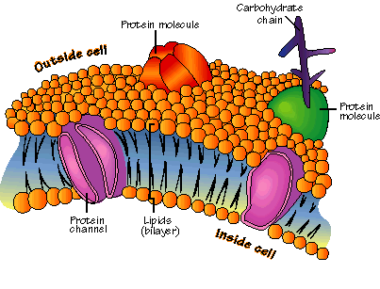
Bio.A.4:
Homeostasis and Transport
Chapter 7.2, 7.3 & 7.4
Pg 204-217

Slide 2
Bio.A.4.1 – Identify and describe the cell structures involved in transport of materials into, out of and throughout a cell
Bio.A.4.1.1 – Describe how the structure of the plasma membrane allows it to function as a regulatory structure and/or protective barrier for a cell
Bio.A.4.1.2- Compare the mechanisms that transport materials across the plasma membrane

Slide 3
Bio.A.4.2 – explain mechanisms that permit organisms to maintain biological balance between their internal and external environments
Bio.A.4.2.1 – Explain how organisms maintain homeostasis

Slide 4
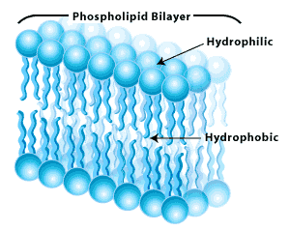
The Cell Membrane
ALL cells contain cell membranes
Cell membranes are made of a double-layered sheet called a lipid bilayer.
The lipid bilayer is flexible and forms a strong barrier between the cell and its environment
Purpose: to regulate what enters and leaves the cell as well as protect and support the cell

Slide 5
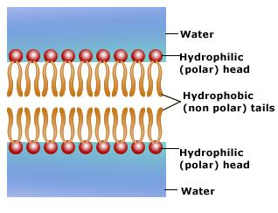
Properties of Lipids
Lipids are made of 2 parts
  A head and a tail
  The head is polar & hydrophilic (water-loving)
  The tail is non-polar & hydrophobic (water-hating)
When mixed with water, the tails cluster together and the heads are attracted to the water

Slide 6
Fluid Mosaic Model
The cell membrane is a fluid mosaic
  Fluid because it is not rigid, proteins embedded in the membrane can float around
  Mosaic because it is made of many different kinds of molecules
What are these different parts doing?
  Many are proteins used for transport or structure or carbohydrate molecules used for identification

Slide 7
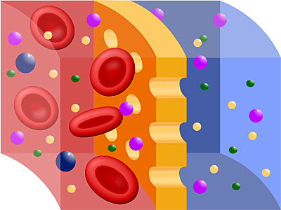
Permeability of the Membrane
Many substances can cross the cell membrane, but very large or strongly charged substances cannot cross
The cell membrane is selectively permeable or semipermeable
What role do proteins play in the permeability of the membrane?

Slide 8
Cell Transport
The membrane is important in keeping the cell’s internal environment constant (homeostasis)
The membrane regulates the movement of molecules from one side of the membrane to the other
Some of these processes occur naturally and others require energy from the cell

Slide 9
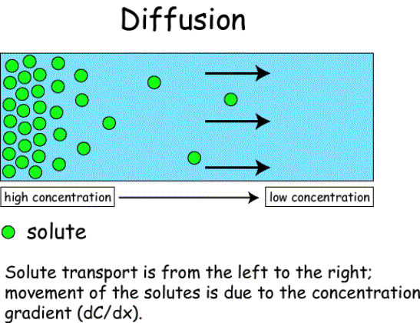
Diffusion
Diffusion is the movement of materials from an area of high concentration to an area of lower concentration
If the substance is able to cross the membrane, it will move freely across depending on the concentration
This process does NOT require energy and is an example of passive transport

Slide 10
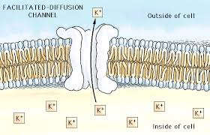
Facilitated Diffusion
Molecules that are large or charged can pass through the membrane – but how?
They use a protein channel! The proteins act as carriers for specific molecules to pass through, like cars pass through a tunnel –this process is called facilitated diffusion and requires NO energy

Slide 11
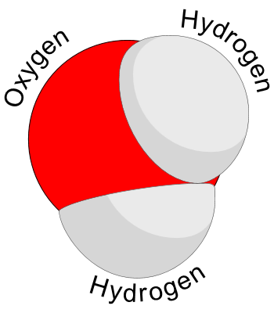
Osmosis
Osmosis is the diffusion of water across a semi-permeable membrane
The cell membrane has proteins called aquaporins that allow water to pass right through them, according to the laws of diffusion
Why would water need a special protein to cross the membrane?

Slide 12
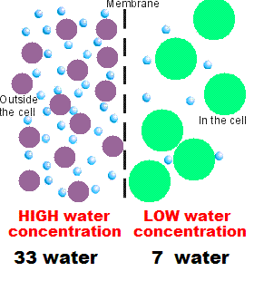
Osmosis
Which way will the water molecules move?
Why wouldn’t the green or purple molecules move?

Slide 13
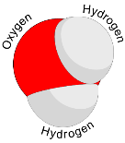


Osmosis
Water molecules can move in both directions across the membrane, which means it can enter or leave the cell – what determines which way the water will move?
The amount of solute (substance dissolved in the water) will determine the net direction of water movement
Eventually, equilibrium will be reached and both sides of the membrane will be isotonic

Slide 14
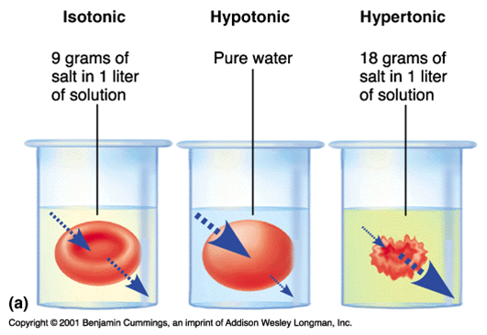
Hypertonic vs. Hypotonic
If the solute is more concentrated outside the cell, the solution is hypertonic
  Water will rush out of the cell trying to reach equilibrium and the cell will shrink (shrivel)
If the solute is less concentrated outside the cell, the solution is hypotonic
  Water will rush into the cell trying to reach equilibrium & the cell will swell (or burst!)

Slide 15
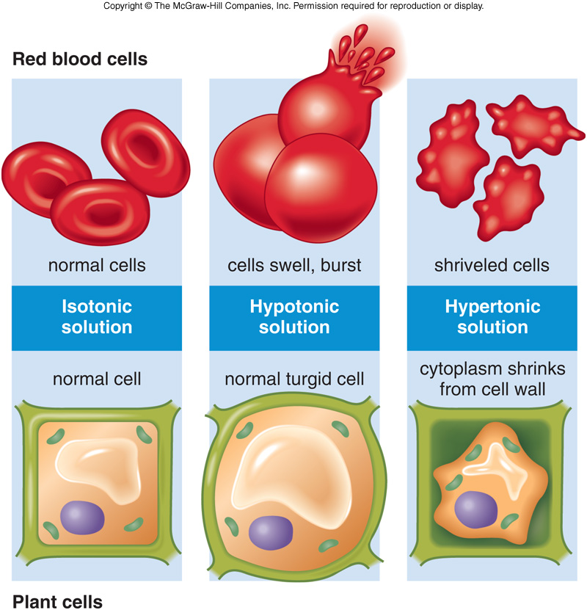
Why would plant cells be better off than animal cells?
What would happen to the cells of a freshwater fish if it was put into a saltwater tank?

Slide 16

Active Transport
So far we have seen processes that require no energy from the cell, but sometimes energy is required for what the cell wants to move across the membrane
Active Transport requires energy!
What molecule supplies the energy to cells?

Slide 17
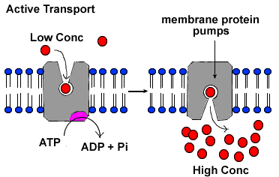
Protein Pumps
One way cells push molecules across the membrane is with protein pumps – these pumps will change shape (and use ATP) to move molecules across
Why does it require energy?
  The molecules are being moved from low concentration to HIGH concentration – the opposite of how they want to go!

Slide 18
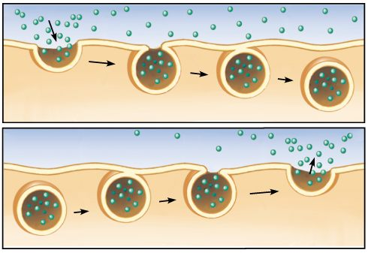
Bulk Transport
Very large molecules or food can be moved across the membrane without going through it
Endocytosis – large molecules are brought into the cell when the cell membrane itself moves around the substance and forms a vesicle
  Phagocytosis (eating)
  Pinocytosis (drinking)
Exocytosis – large molecules or wastes expelled out of the cell when a vesicle attaches to the membrane and fuses with it

Slide 19
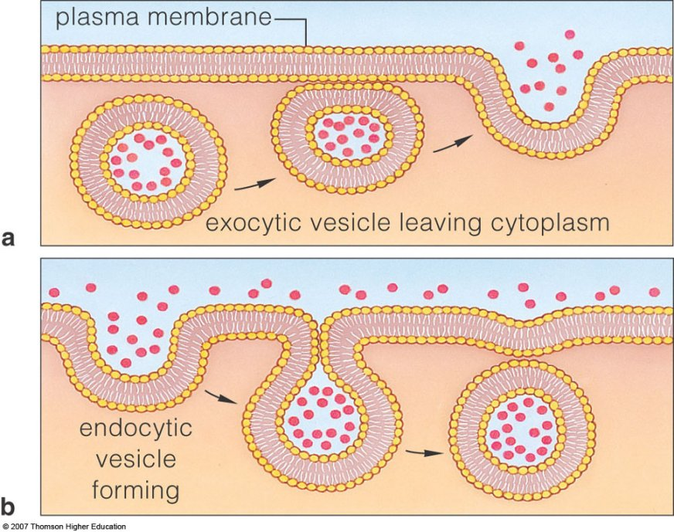
What cells in your body need to use endocytosis to “eat” other cells?

Slide 20
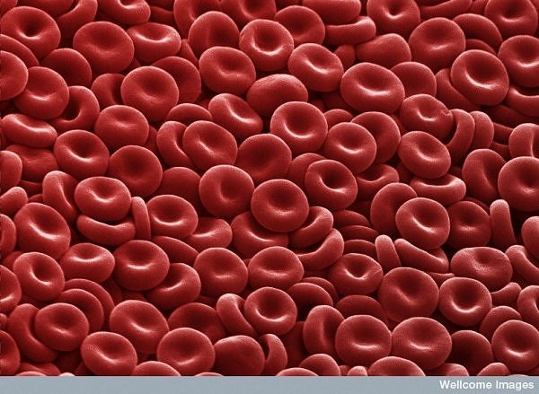
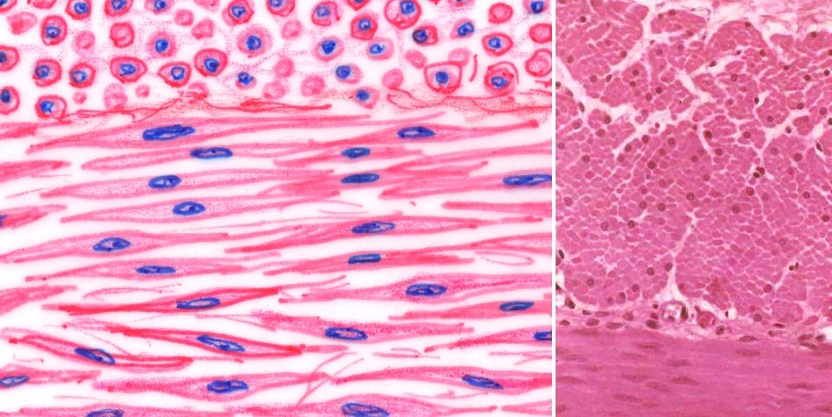
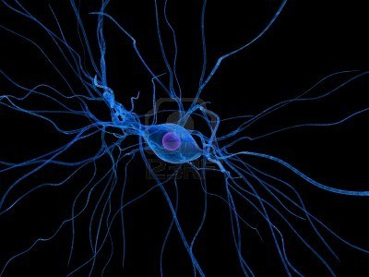
Homeostasis
Unicellular organisms (single-celled) must maintain homeostasis by growing, responding, reproducing and transforming energy
Multicellular organisms have specialized cells that each do a specific task and must communicate with each other to maintain homeostasis. They must work together like the members of a team!

Slide 21
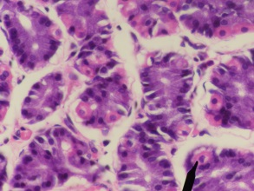
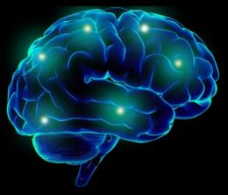
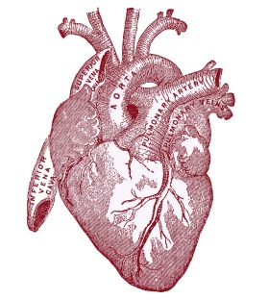
Levels of Organization
Specialized cells of multicellular organisms are organized into tissues (eg. muscle)
Tissues are organized into organs (eg. stomach)
Organs are organized into organ systems (eg. digestive system)
Specialization and interdependence allow the organism to maintain homeostasis
How are your brain cells different from your heart cells?
How are your brain cells dependent upon your heart cells?

