Slide 1

Immigration--Legal Issues

Slide 2
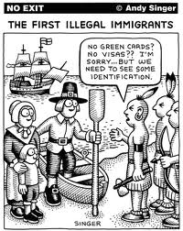

Slide 3
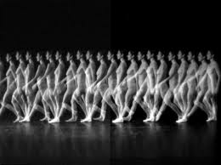
1 of 35 people are in motion in migration (UN 2010)
In the last 2 years 793,000 were deported
In IL, 78% of deported people are non-criminals (level 4)
40 million immigrants
  11 million undocumented
  Democrat vs. Republican

Slide 4
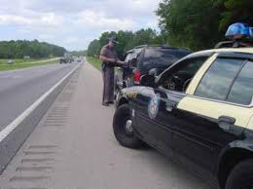

Legislative Action
DREAM Act (Federal & Illinois)
  Senator Cullerton
Smart Enforcement Act

Slide 5

DREAM Act
Educate HS teachers & counselors so students know their educational opportunities
Privately funded scholarship fund since undocumented students cannot receive any financial aid
Driver’s Certificates
Volunteer Commission to monitor and implement

Slide 6
DREAM Act
For 10 years, ppl have tried passing this in Congress
Roughly 95,000 youth in Illinois would benefit from DREAM
In the Federal Government, DREAM fell short by 2 votes in December 2010 (One of those votes Sen. Mark Kirk from IL)
The IL bill would not offer legal status, but take steps to make sure students have opportunity to learn

Slide 7
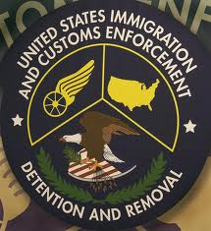
Smart Enforcement Act
“Secure Communities”
  Deportation Program designed to use local law enforcement to help ICE catch violent criminals
ICE, IL State Police agree this program isn’t working
Encourages racial profiling

Slide 8

Money for Who?
Provides incentives for local sheriffs who capture anyone who might be an immigrant
McHenry County--worse effects of program
Make 10.5-11.5 million a year for housing immigrant detainees ($100 a night per person)
Sheriff of McHenry County acknowledged some deputies were racial profiling and falsifying reports, however, he said the number of deputies was not great enough to investigate the issue any further

Slide 9
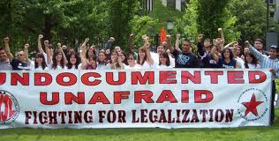
IL/Chicago is most progressive
Religious Workers Access Bill
  Only IL has this law where detainees can have Pastoral Care
DREAM Act – passed 2011
Immigrant Youth Justice League (founded in Chicago)
Arizona Laws

Slide 10
Chicago Statistics
Chicago has one of richest immigration histories--7th in the nation
  In 1870, 50% of population was made of immigrants
From 1880-1920, most immigrants were from Ireland and Germany, with Russian Jews, Slavs and Italians behind

Slide 11
In 2010 Cesus, 1/5 of population was forgein born
  25% from Asia
  23% Europe
  40% from Latin America
Top two countries of origin are
  Mexico
  Poland

Slide 12
Of the total immigrant population, the majority entered before 1990
Only 20% have entered since 2000

Slide 13
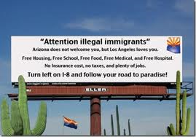

Slide 14
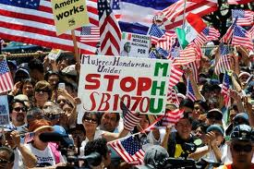
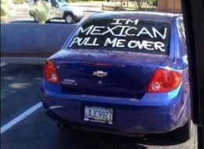

Slide 15
Why is reform necessary?
Could help crime (many undocumented refuse to file reports b/c they are scared of being deported)
Many examples of immigrants being poorly represented in court or no translators
But most importantly…

Slide 16

Dignity of All People

Slide 17
Deferred Action for
Childhood Arrivals
June 15, 2012 Pres. Obama announced “deferred action” for undocumented youth who entered the U.S. before the age of 16
  Receive deferred action for a period of two years and be eligible to apply for work authorization
  Must pass background check

Slide 18
  Temporarily eliminates possibility of deportation for youths who would qualify for relief under the Dream Act
  Homeland Security has deemed the person a low priority for immediate enforcement and the person will not be deported
  Can be employed in U.S.
USCCB supports DACA until Congress can pass a Federal Dream Act
  An unauthorized youth of good character should be provided a clear path to citizenship through education or military service

Slide 19
Immigration Reform?
2013: soon to be proposed in Senate
  No undocumented immigrant is eligible to apply for temporary status until the border security and fencing plan is in place.
  Temporary status for at least ten years, no currently undocumented immigrant can even attain permanent residence, much less citizenship, unless the border security, employment verification and exit system triggers have been achieved.

Slide 20
Immigration Reform?
2013: soon to be proposed in Senate
  No one gets amnesty.
  Once the first security triggers are achieved, undocumented immigrants will be able to come forward, must submit to and pass background checks, be fingerprinted, pay $2,000 in fines, pay taxes, prove gainful employment, prove they’ve had a physical presence in the U.S. since before 2012 and going to the back of the line, among other criteria. Criminals and those who don’t meet these criteria will be deported.

Slide 21
Immigration Reform?
2013: soon to be proposed in Senate
  Undocumented immigrants will not be eligible for federal benefits.

Slide 22
Immigration Reform?
2013: soon to be proposed in Senate
  Their status can be revoked if they commit a serious crime or if they fail to comply with the employment requirement, the public charge requirement (which goes hand in hand with the employment requirement), their tax obligations and their physical presence obligations.
For undocumented immigrants who avail themselves of the process outlined in this bill, they will face a longer, more costly and less certain way forward than if they had come legally in the first place.

Slide 23
Immigration Reform?
2013: soon to be proposed in Senate
  Not Punishing Children For Their Parents’ Mistakes: Young undocumented people whose parents brought them to the U.S. illegally or overstayed visas, will be eligible for permanent residence in five years and citizenship immediately thereafter, provided they meet all the prescribed criteria.
This proposal has not gained traction in congress. Dems and Repubs have opposite approaches to reform → stalemate

Slide 24
Immigration Reform?
2014: Congressional Hispanic Leadership Institute
  earned legalization process & special consideration for military and dreamers
  expedite the transition to permanent legal status of qualified foreign undergraduate and graduate students studying in the United States
  An expanded H-1B, L-1, and EB visa program for professionals and highly skilled workers, and H-2B temporary visas that support seasonal industries and small businesses, are critical to the U.S. economy

Slide 25
Immigration Reform?
  Improving the efficiency of the agricultural worker visa program (H-2A) will allow the U.S. to maintain a reliable agricultural workforce.
  Delays, backlogs, and disruptions in the immigration and border management systems that impede the movement of people and legitimate cargo across U.S. borders must be addressed, and increased enforcement targeting human trafficking, drug smuggling, terrorism, and counterfeit goods across U.S. borders, is key to maintaining U.S. security and prosperity
  Lincoln Diaz-Balart Congressional Hispanic Leadership Institute

