Slide 1

Sociological Reasons Not to Live Together
Cohabitation
What’s the big deal?
Church's teaching on cohabitation and living together before marriage.

Slide 2
Cohabitation?
Definition: living together before marriage.
  Living together.
  Getting to know one another.
  Preparing for marriage.
  However, cohabitation undermines American value-based understanding of marriage, and may be linked to damaging effects of women and children.

Slide 3
First…Some basics
Here’s what the numbers say.
http://www.youtube.com/watch?v=_uXXK6IQOfY

Slide 4
However…
Psychiatrists still believe that the institution of marriage promotes the longevity of relationships better than merely cohabiting.
Marriage 101: Skip the Trial Run
  According to some studies (Rutgers University), cohabiting may actually increase your risk of breaking up.
    Carries with it emotional, financial, and possibly even legal ramifications.

Slide 5
Cohabiting
Here’s the deal….
Cohabiting, just like sex, isn’t an issue of merely ‘going through the motions’; rather, the issue goes much deeper as the Church wants us to understand.
  The issue comes down to commitment.
  Insofar as….”Commitment means both commitment to a person and to the relationship” (Dr. Christine Whelan, Phd, Busted Halo).

Slide 6
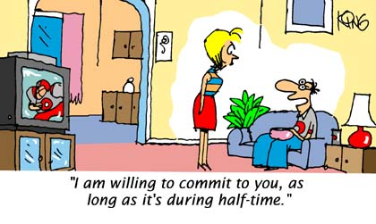
Cohabitation and Commitment

Slide 7
Sociological Reasons not to Live together before marriage
1. Least likely to marry each other.
    Drifting in search of the myth of the ‘one, true love.’
  2. Higher separation and divorce rates.
  3. Cohabiting and unhappier marriages.
4. Sexual activity may positively correlate to increased divorce rates.
5. Premarital sex; extramarital affairs (remember the video, ‘Hook up Culture’?

Slide 8

Sociological Reasons not to Live together before marriage.
6. Live together=more prone to fleeting romance.
7. “Trial marriages” don’t always guarantee better marriages.
  Compatibility must be built, not earned or tested.

Slide 9
Sociological Reasons not to live together before marriage
8. Living together=no legal or societal responsibilities.
9. Miss something in the maturing process.
10. Avoid joint decisions that married couples make.
11. Cohabitation= marriage of convenience and not commitment, per se.
12. Premarital sex may mask the reality that the person is not right for you.

Slide 10
Sociological Reasons not to live together before marriage
13. Those who live together may have superficial or significantly weaker relationships.
14. More difficulty resolving conflicts.
15. Can kill romance; loss of ‘starry-eyed’ beginnings.
16. May lay a distrustful foundation.
17. Those who live together do not experience the best sex.
18. Face parental disapproval.
19. Those who live together may hurt their children.

Slide 11
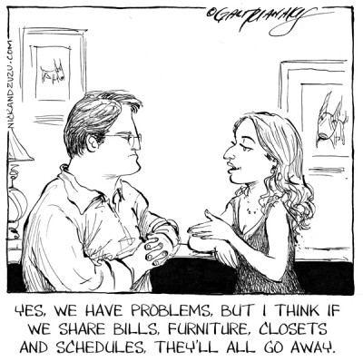
Sociological reasons not to live together before marriage
20. Those who live together often lack a common purpose.
21. May not have an egalitarian relationship.
22. No specialization of responsibilities.
23. Less benefits and support, socially and legally.

Slide 12
Numbers Cohabitating?
Catholic Update: Cohabitation before Marriage Joseph M. Champlin, 2003.; The State of our Unions, Marriage in America, 2011.

Slide 13
Top ten reasons you may not want to live together before marriage.(Mrs. King)
1. Living with someone is a big commitment and it isn’t easy. You are more likely to work harder at building a strong relationship when you are married.
2. You are likely to miss out on a really important time for self development that is gained from living on your own. This experience is something you will cherish forever and will serve you later in your married life.
3. Living together is a significant time commitment in what is typically the best time for you to find the person you want to marry. The dating world is scattered with people who lived with their significant other only to break up 5 years later and find themselves in a place they do not want to be – 30 and still single.

Slide 14
Top ten reasons you may not want to live together before marriage.
4. It cheapens the fun and excitement of getting married. People who live together come back from their wedding day and nothing much has changed – they still live together. When you wait until you get married it’s more exciting. It really feels like you are entering a new phase in your life and embarking on a new journey with the person you are going to spend the rest of your life with.
5. It will make your parents happy. Never underestimate, the value of making what in hindsight will be a small sacrifice to do something that will gain favor with the people responsible for you being alive.
6. Do you really want to end up breaking up with this person or getting dumped only to become the cautionary tale that everyone points to as to why you shouldn’t live together before marriage?

Slide 15
Top ten reasons you may not want to live together before marriage.
7. Your reason for absolutely having to live together before being married will likely not be a valid one when you look back on it in 10 years.
8. If your reasoning is based purely on financial reasons it is just as easy to get a roommate and wait until you are ready to be married.
9. If you breakup while living together and you are in the middle of a lease, you either have to move out and pay a stiff penalty or be left in the uncomfortable situation of living with your ex boy/girlfriend. Sometimes you may still be in residence after the new boy/girlfriend moves in.

Slide 16

Top ten reasons you may not want to live together before marriage.
10. It is against the wishes of the Catholic Church, which is not intended to make people’s lives more difficult, but rather is a recommendation provided to help people live a better, well thought out life.

