Slide 1
Avoiding Clichés and Slang
Skill 14

Slide 2
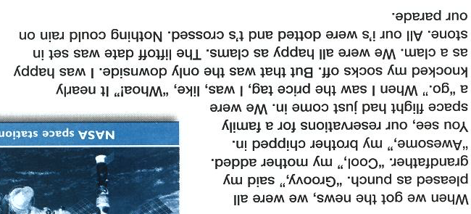
Read the following passage

Slide 3
You probably noted that this passage suffers from a lack of formal English. It might be acceptable in a letter to a friend, but not in formal writing.
Formal writing does not always need to be stiff and dry. Use informal, everyday words and phrases, but use they judiciously!

Slide 4
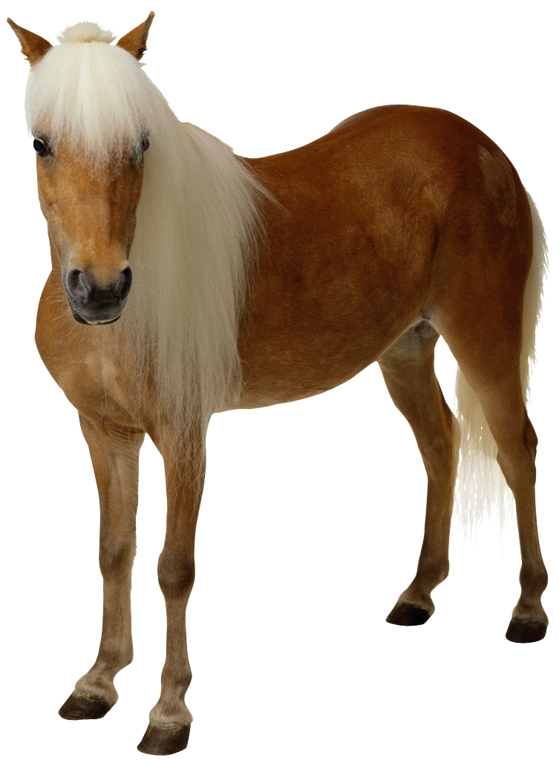
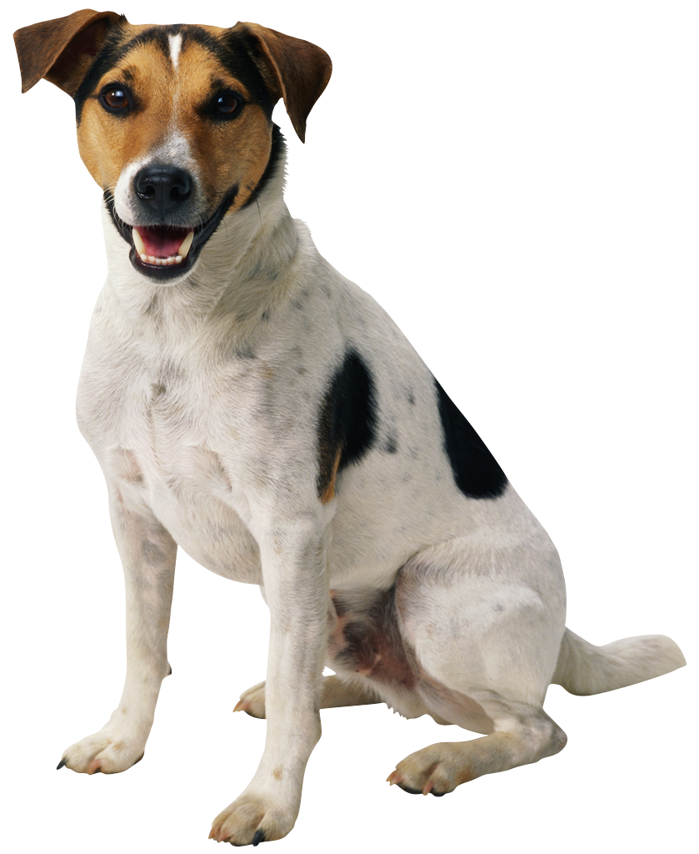
Clichés
Clichés are expressions or idioms that have become trite from overuse. Avoid them in your writing!
Works like a horse
Raining cats and dogs
Pretty as a picture

Slide 5
Slang
Slang is composed of newly made-up terms, or new meanings attached to existing terms.
Slang can add genuineness and immediacy to your writing.
Slang is always changing, so be careful! Use of slang limits your audience.

Slide 6
Practice
Identify and eliminate the Clichés and Slang from each sentence below:
1. When our father began poring over family space-trip packages like a hawk, we knew he had something up his sleeve.
2. We knew we would have to cough up an arm and a leg – nearly $20 million – for the trip.
3. Dudes across the country, who all think the idea of a family space vacation is way cool, are vying for tickets.

