Slide 1

Welcome to Open House! Mr. Wayman (C-2)
French Levels 1-6 (incl. honors)
French NHS Sponsor
Dept. Chair of World languages.
Note: All of the info from this presentation can be found on my class website:
http://www.quia.com/profiles/pwayman12 (Or Google “Wayman Quia.”)

Slide 2
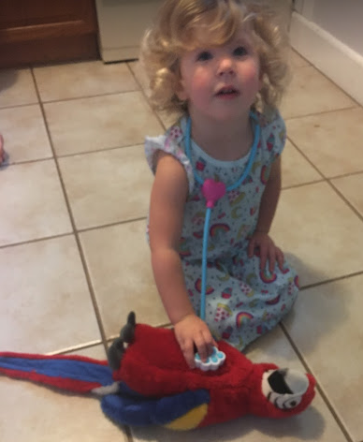
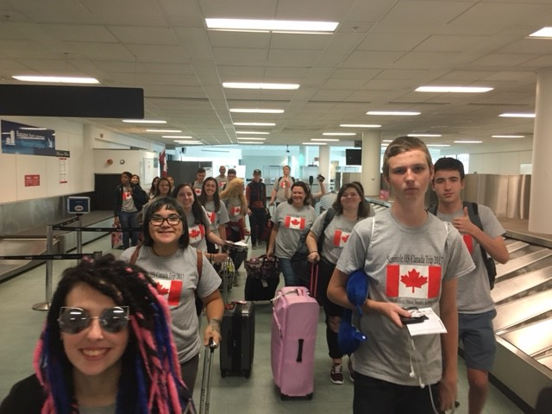
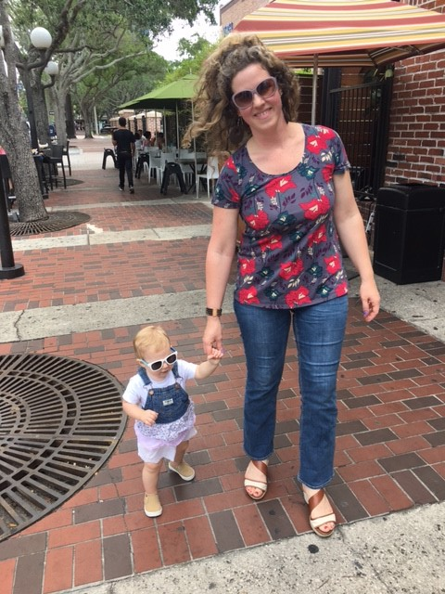
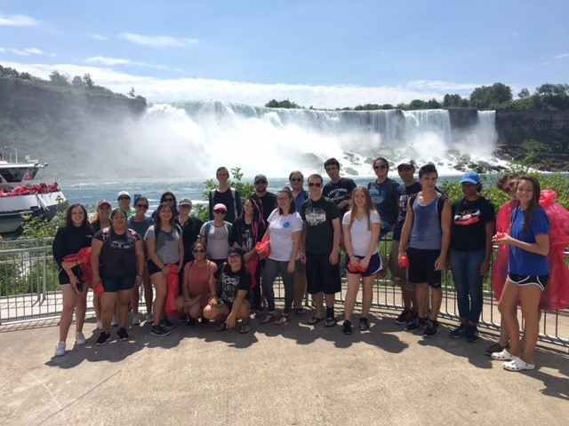
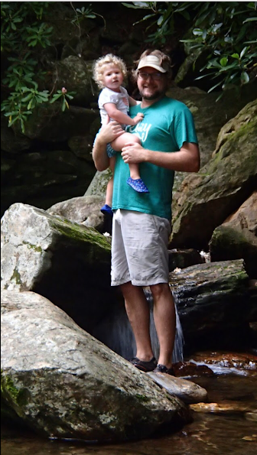
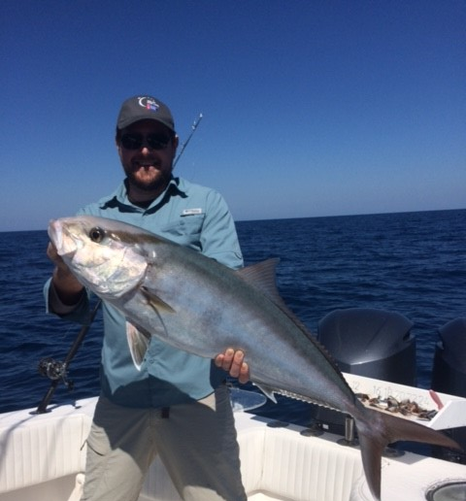
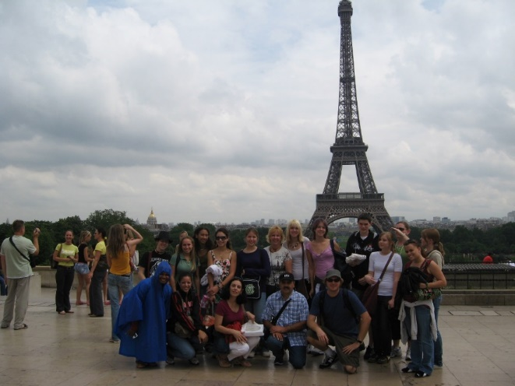
About M. Wayman…

Slide 3
Course Objective:
To further the students’ understanding of the French language, and the cultures of francophone peoples throughout the world--- and to increase proficiency through practice in reading, writing, speaking and comprehension of the target language.

Slide 4
Course Requirements:
Participation in class is essential every day! (When students are absent a lot (mentally or physically, it can be hard to get caught up—as a lot of what is learned in “absorbed” in class).
A positive attitude! ☺
Basic school supplies (no required book—and all vocab sheets or reference materials are posted on line.)
Internet access is very helpful—as daily agendas, assignments, videos, audio files, and activities are posted on the class Website (updated each day).
Although not required: apps such as Duo-Lingo and Babbel are very useful (and fun), for extra practice.

Slide 5
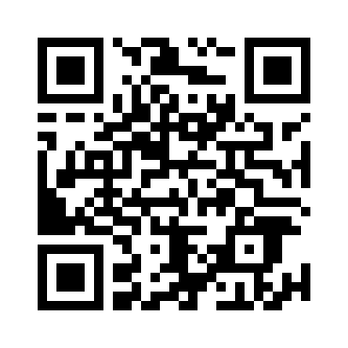
Communication:
The “go to” place (for students and parents) for class information is my class Website:
http://www.quia.com/profiles/pwayman12
Just Google: “Wayman Quia”
My contact info:
waymanp@pcsb.org (preferred)
547-7536 Ext: 1189

Slide 6
Grades:
It is expected that both students and parents check Focus regularly—to monitor student progress.
Grades are usually updated weekly.
I have 2 grading categories:
- Homework & Class work (Participation): 35% - All assessments (quizzes, tests, speaking assessments): 65% **Note: These are color-coded in Focus.

Slide 7
Technology in this class:
Language labs
Mobile lab
Smart projector
Innovation lab
Personal electronics allowed for class-related activities.

Slide 8
Tutoring:
FNHS / SNHS tutoring will be available at lunch. Additionally, school-wide tutoring will be available in French, Spanish, and many other subjects. Please see the school Website, or me, for more details.

Slide 9
Note about school-wide discipline focus:
Please talk to your kids about making sure they:
Are responsible for themselves (following procedures and policies, getting makeup work, etc.).
Follow the school dress code and electronics policies.
Are on time to class .

Slide 10
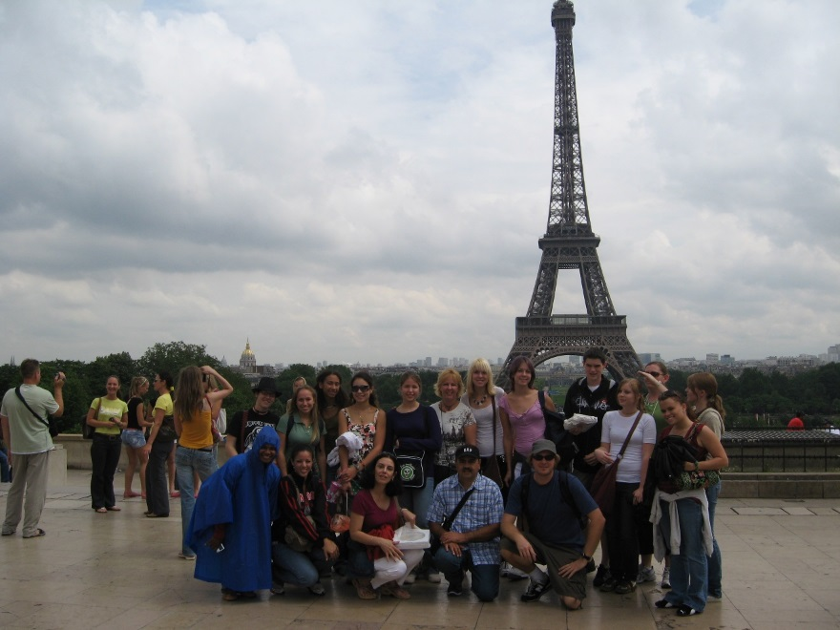
Student Travel
Getting outside of the classroom, delving into a Francophone, Hispanic, or any other culture is one of the best ways to enrich one's education. From time to time, I plan summer trips to foreign locals for the students. In the past, I have traveled with students to France (Paris, Normany, Bordeaux), Spain (Madrid, San Sebastian, Seville), England (London, Windsor), Italy (Florence, Rome, Naples, Sorrento, Pompeii, Isle of Capri), Germany (Aachen, Trier), Luxembourg, and Greece (Peloponnese Islands and Athens). Most recently, I lead a group of SHS students to Canada in the summer of 2017. We traveled to Montreal, Quebec City, Tadoussac on the Saguenay Fjord, Ottawa, Toronto, and Niagara Falls. This summer (2019) I am taking a group to Spain and France (Madrid, Segovia, Barcelona, Paris, Normandy, and Mont Saint Michel. Check out my Website for more info. And Stay tuned for info on the next adventure (summer 2021)! :)
Learn more or see a travel journal at: https://www.quia.com/pages/pwayman12/page16

Slide 11
Donations to the Class
… are gladly accepted, and appreciated. ☺
We can always use extra tissues, paper towels, hand sanitizer, Clorox wipes (for lab), low odor dry-erase markers, and air spray cans (for cleaning tech equipment).
Please send items with students if you would like to donate. ☺

Slide 12
Questions or comments?
Merci beaucoup! Looking forward to a great year in French!
Mr. Wayman
Note: Again, all of the info from this presentation can be found on my class website:
http://www.quia.com/profiles/pwayman12
Have a nice evening! Thanks for visiting. ☺

