Slide 1
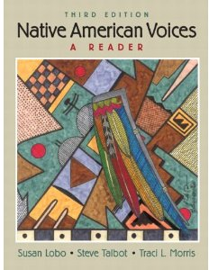
Welcome to Native American Studies – SOCI 1100 4A
Fall, 2012
Room 239
Fort Omaha Bldg. #10
September 5, 2012

Slide 2
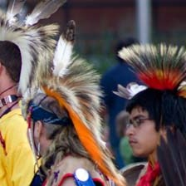
Agenda
Go over syllabus
Complete Survey
Roll call and discuss survey
Review Historic Peoples
Discuss MCC powwow and plans for Native American Days activities
Assignment

Slide 3
Native peoples of North America
Culture and life
Borrowed from
http://nativeamericans.mrdonn.org/powerpoints/overviews.html

Slide 4
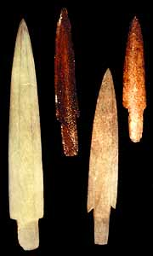
Arctic/Subarctic Peoples
Inuit living in the arctic region are the direct descendants of a prehistoric hunting society that spread across Canada from Alaska and centered on capturing massive bowhead whales.

Slide 5
This culture, called Thule by archaeologists, quickly adapted to the harsh conditions found in the arctic. Not only were whales, seals, fish and caribou abundant, but also large forests were found in coastal areas.

Slide 6
Wood was a rare resource in remote arctic areas and needed for making tools, boat frames and numerous other articles, as well as used as fuel for cooking.
People hunted game in all seasons of the year for food and material to craft articles needed for everyday life.

Slide 7
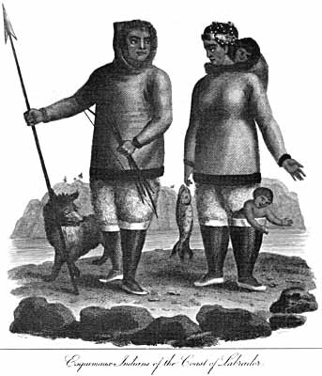
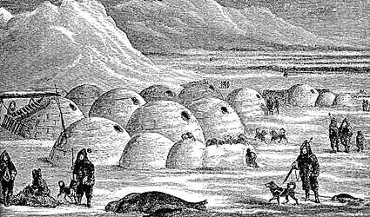
They travelled in one person kayaks and larger umiaks framed with wood and covered by seal skins; wore clothing made from the pelts of seals in summer and caribou in winter; lived in skin tents during mild seasons; and settled during winter either in earthen huts banked by sods with a roof supported by whale ribs and shoulder blades, or in snow houses called igloos, ingeniously shaped from blocks of hard snow.

Slide 8
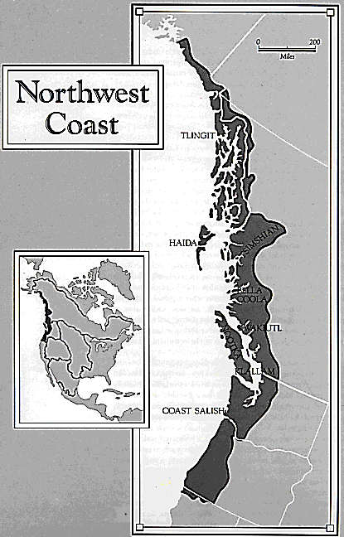
Northwest
The Northwest Coast area extended along the Pacific coast from S Alaska to N California.
Thickly wooded, with a temperate climate and heavy rainfall, the area had long supported a large Native American population.

Slide 9
Food sources are salmon, supplemented by sea mammals (seals and sea lions) and land mammals (deer, elk, and bears) as well as berries and other wild fruit. They used wood to build their houses and had cedar-planked canoes and carved dugouts.

Slide 10
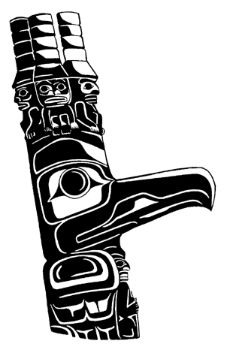
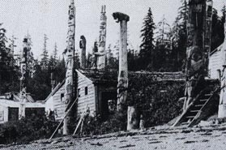

In their permanent winter villages some of the groups had totem poles which were elaborately carved and covered with symbolic animal decoration. They also made ceremonial items, such as rattles and masks; weaving; and basketry.

Slide 11
Their society included chiefs, nobles, commoners, and slaves. They had woven robes, furs, and basket hats as well as wooden armor and helmets for battle. Potlatches were social occasions given by a host to establish or uphold his status position in society. Often they were held to mark a significant event in his family, such as the birth of a child, a daughter's coming of age, or a son's marriage.

Slide 12
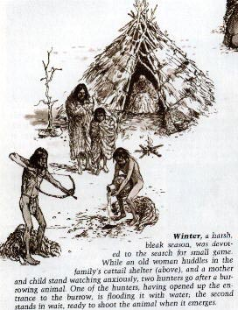
Great Basin
Because these Indians lived in a desert-like environment, food was hard to find. This meant they had to constantly move in order to find food. Because of this, their homes were temporary structures. Willow branches were leaned together with bundles of twigs, branches, and reeds to cover them.

Slide 13
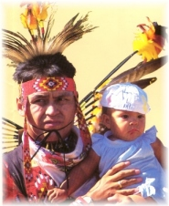
Plateau
Their acorn bread, made by pounding acorns into meal and then leaching it with hot water, was distinctive, and they cooked in baskets filled with water and heated by hot stones. Living in brush shelters or more substantial lean-tos, they had partly buried earth lodges for ceremonies and ritual sweat baths. Basketry, coiled and twined, was highly developed.

Slide 14
They underwent a great cultural change when they obtained from the Plains Indians the horse, the tepee, a form of the sun dance, and deerskin clothes. They continued, however, to fish for salmon with nets and spears and to gather camas bulbs.

Slide 15

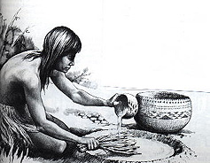
Californian Native Americans
The California Indians were hunters and gatherers. They gathered nuts, seeds, berries, roots, bulbs, and tubers. Deer, rabbits, and game birds provided meat for these Indians. Fish and acorns also provided food the these Indians. All of the California Indians were basket makers, but no tribe was as accomplished in this as the Pomos.

Slide 16
They made baskets as large as 3 feet wide and as small as a thimble. Some of their baskets were covered with shells, others with feathers. They not only wove baskets, but hats, trays, cooking pots, boats, and baby carriers.

Slide 17
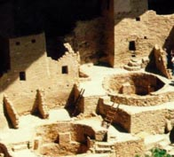
Southwest Traditions
Anasazi men went to a special room for religious ceremonies. This special room was called a kiva. A kiva was a round room built underground at the base of the homes. Only men were allowed into the kiva. To get in and out the men had to go by ladder through the roof.

Slide 18
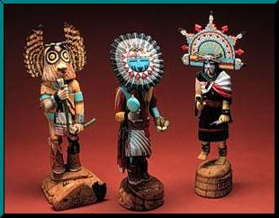
Kachinas were Hopi spirits
or gods which lived within
the mountains. Hopi dancers
would dress like Kachinas to represent, or stand for, the gods. Wooden Kachina dolls were made to teach the children about the gods. Hopi Kachinas talked to the gods by singing and dancing. The Kachinas danced and sang for rain.

Slide 19
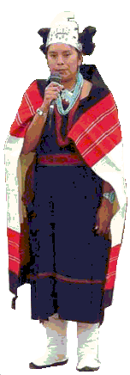
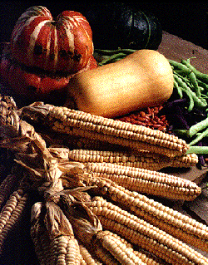
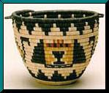

Like the Anasazi, the Hopi grew corn, beans, and squash. But the Hopi Indians depended on the rain to make their crops grow. If
their plants did
not grow, the Hopi might starve. The Hopi also planted cotton and tamed wild turkeys.

Slide 20
Hopi women also made beuatiful baskets, clay bowls, and jewelry. The men hunted, farmed, and wove cloth for blankets, clothing and belts.

Slide 21
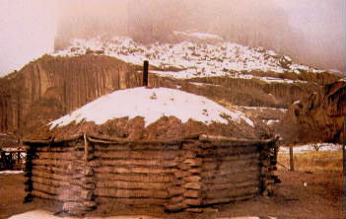
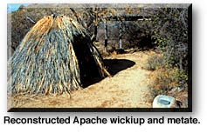
Navajo and Apache
The Apache and the Navajo came from the Far North to settle the Plains and Southwest around A.D. 850.
The Navajo share the Athabscan language with the Apache.
The Apache lived near Pueblo tribes, which they raided for food, and livestock. They dressed in animal skins, used dogs as pack animals, and pitched tentlike dwellings made of brush or hide, called wikiups.

Slide 22
The Navajo copied corn- and bean-growing practices from the Anasazi and raised sheep while some kept the nomadic lifestyle of their ancestors and the Apache and pursued the buffalo and other animals.

Slide 23
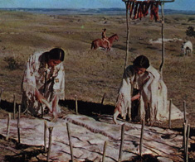
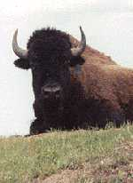
The Great Plains
This culture group of Indians is well-known for the importance of the buffalo, their religious ceremonies, and the use of the tepee. Four important tribes in this culture include the Dakota, Cheyenne, Sioux, and Comanche.

Slide 24
The buffalo was the most important natural resource of the Plains Indians. The Plains Indians were hunters. They hunted many kinds of animals, but it was the buffalo which provided them with all of their basic needs: food, clothing, and shelter.

Slide 25
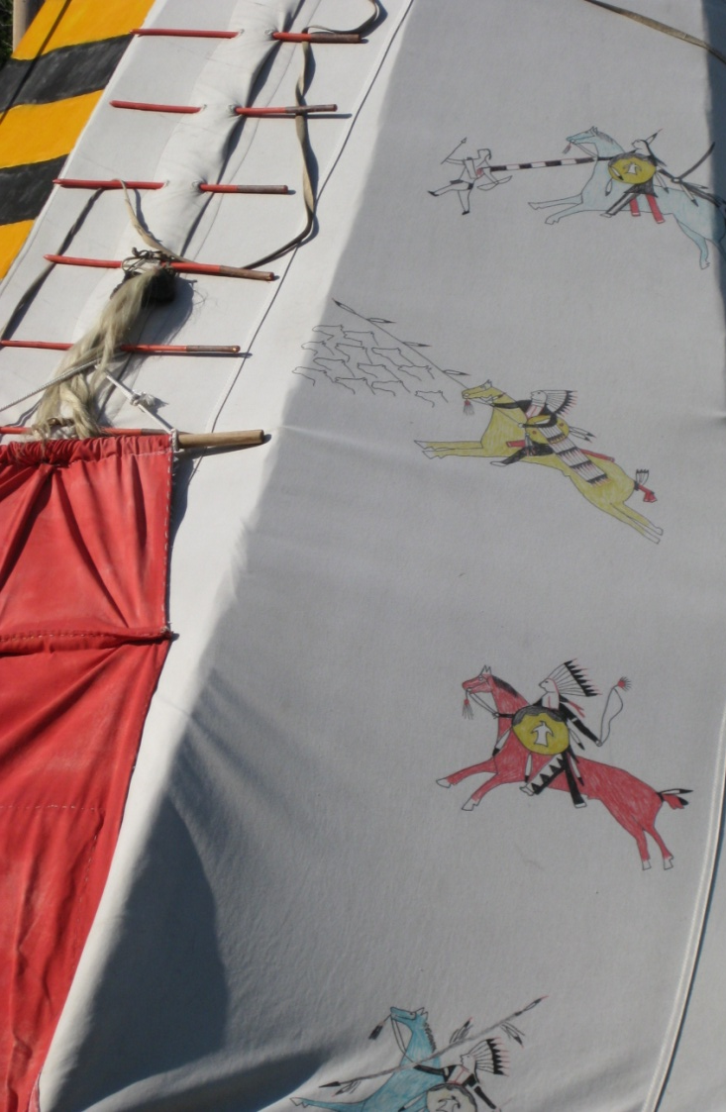
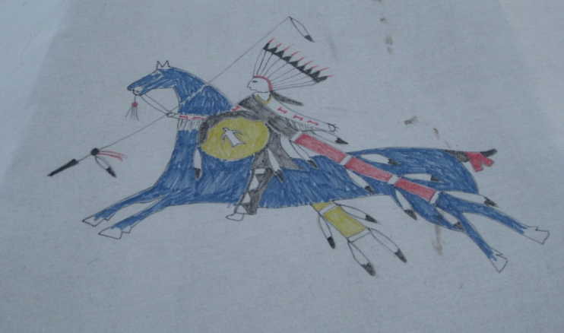
The horse, first introduced by the Spanish of the Southwest, appeared in the Plains about the beginning of the 18th cent. and revolutionized the life of the Plains Indians. Many Native Americans left their villages and joined the nomads. Mounted and armed with bow and arrow, they ranged the grasslands hunting buffalo.

Slide 26
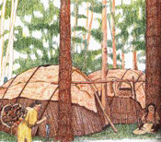
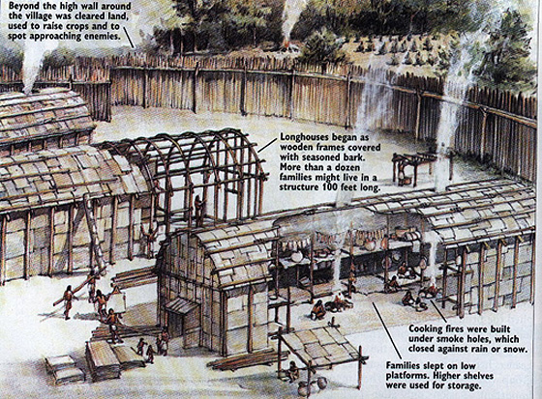
Eastern Woodlands
Their food, shelter, clothing, weapons, and tools came from the forests around them. They lived in villages near a lake or stream. The Woodland Indians lived in wigwams and longhouses. The Iroquois, Cherokee, and Mound Builders were important Woodland tribes.

Slide 27
The Iroquois Indians were actually a "nation" of Indians made up of 5 tribes. These tribes were the Senecas, Onondagas, Oneidas, and Mohawks. These tribes were hostile, or war-like, to each other until they joined together to become the "League of the Five Nations".

Slide 28
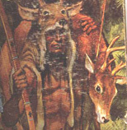
Leaders of each Iroquois Nation also came together to discuss matters that were important to all of them, such as peace, trade, or war.
These council leaders (always men, but chosen by the women) were called sachems. The Iroquois had a total of 50 sachems. All sachems had to agree on a solution before any decision was made.

Slide 29
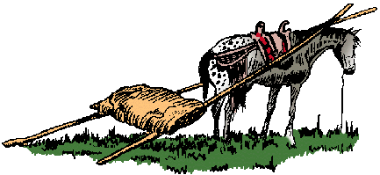
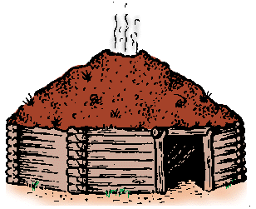
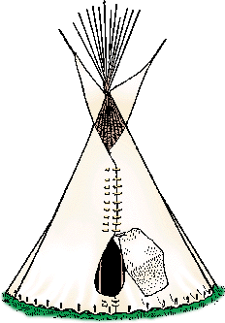
Some Vocabulary
Travois – a simple vehicle used by Plains Indians consisting of two trailing poles serving as shafts and bearing a platform or net for the load
Potlatch – a ceremonial feast of the American Indians of the northwest coast marked by the host's lavish distribution of gifts
Kiva – a Pueblo Indian ceremonial structure that is usually round and partly underground
Culture area – a region where people share a similar way of life.
Kayak – an Eskimo canoe made of a frame covered with skins except for a small opening in the center and propelled by a double-bladed paddle
Hogan – a Navajo Indian dwelling usually made of logs and mud with a door traditionally facing east
3 sisters - corn and beans and squash
Longhouse - a long communal dwelling of some No. American Indians (as the Iroquois)
Tepee - a conical tent usually consisting of skins and used especially by American Indians of the Plains

Slide 30
Agenda
Go over syllabus
Complete Survey
Roll call and discuss survey
Discuss MCC powwow and plans for Native American Days activities
Review Historic Peoples
Assignment

