Slide 1

VNSG 1227
Essentials of Medication Administration

Slide 2

Basic Math Review

Slide 3
Mathematics Skills
Fractions
Decimal fractions
Percents
Ratios
Proportions
Notes:
In a fraction, where are the numerator and the denominator located?
Provide students with practice problems converting percents to fractions and vice versa.
In what instances are the ratio and proportion method of calculations useful?
If a nurse has the patient’s weight in lbs, what must be done first?

Slide 4
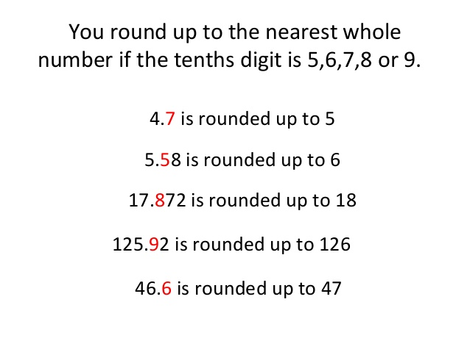

Slide 5
Official VN Rounding Policy
Location: Blackboard VNSG 1327 shell > Course Content
Round only at the end of the problem for the final answer.
Follow the directions of each problem
(i.e.: Round to the tenths place, or Round to the nearest hundredths place)
Oral & Parenteral Medications
Perform calculations to the hundredths place and round to the tenths place as needed.
IV Medications
Perform calculations to the tenths place and round to a whole number
Pediatric dosages:
Perform calculations and round to the hundredths place as applicable & administer using a TB syringe
Notes:
In a fraction, where are the numerator and the denominator located?
Provide students with practice problems converting percents to fractions and vice versa.
In what instances are the ratio and proportion method of calculations useful?
If a nurse has the patient’s weight in lbs, what must be done first?

Slide 6
Rounding Rules:
Round to the tenths place - If the number in hundredths place is 5 or greater, increase the number to the left (tenths place) by 1.
i.e.: (7.46 = 7.5) or (1.96=2)
Round to the hundredths place – If the number in the thousandths place is 5 or greater, increase the number to the left (hundredths place) by 1.
i.e.: (3.238 = 3.24)
If directions say "round to the tenths place" then the answer should have a number in the tenths place.
  i.e.: (5.73 = 5.7) or (3.38 = 3.4)
If directions say ‘round to the hundreds place” then the answer must have a number in the tenths and hundreds place.
i.e: (1.637 = 1.64) or ( 2.249 = 2.25)
Notes:
In a fraction, where are the numerator and the denominator located?
Provide students with practice problems converting percents to fractions and vice versa.
In what instances are the ratio and proportion method of calculations useful?
If a nurse has the patient’s weight in lbs, what must be done first?

Slide 7
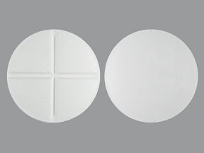
Miscellaneous Rules:
Unscored Tablets – answers must be written as whole numbers
Scored Tablets - answers may be written as:
  whole numbers - i.e.: (2)
  a half - i.e.: (½) or (0.5)
  or a mixture - i.e.: (3 ½) or (3.5)
IV medications:
Round to a whole number
Gravity - answers are written in whole numbers [drops] i.e.: (30 gtt/minute)
For Gravity problems, rounding may be either rounded up or down.
(i.e.: 12.49 gtt/min = 12 or 13 gtt/min - both are acceptable answers)
  Pump - answers are written in whole numbers i.e.: (200 ml/hr) or (50 ml/hr)
Reference:
Gray Morris, D. (2018). Calculate with Confidence, 7th Ed. Elsevier Mosby, St. Louis, Missouri.
Notes:
In a fraction, where are the numerator and the denominator located?
Provide students with practice problems converting percents to fractions and vice versa.
In what instances are the ratio and proportion method of calculations useful?
If a nurse has the patient’s weight in lbs, what must be done first?

Slide 8
Skills Check on Fractions
Watch the YouTube video listed on the next slide for a quick review of working with fractions.
If you feel comfortable with the material then you can skip ahead to the section on decimals beginning with Slide 45.
If you feel rusty and need a refresher then just continue on from here.
Notes:
In a fraction, where are the numerator and the denominator located?
Provide students with practice problems converting percents to fractions and vice versa.
In what instances are the ratio and proportion method of calculations useful?
If a nurse has the patient’s weight in lbs, what must be done first?

Slide 9
Quick Review of Fractions
https://www.youtube.com/watch?v=dG2WSstQyUE
There are two small errors in video:
  Problem # 2
    At 1:52 the answer should be 3 1/3 not 3 1/2
  Problem # 7
    At 13:23 the answer should be 7/3 not 7/2
The oral explanations are correct but he makes errors when writing the answers
Notes:
Ask students to provide the prefixes for measurements using the metric system.

Slide 10
Working with Fractions

Slide 11
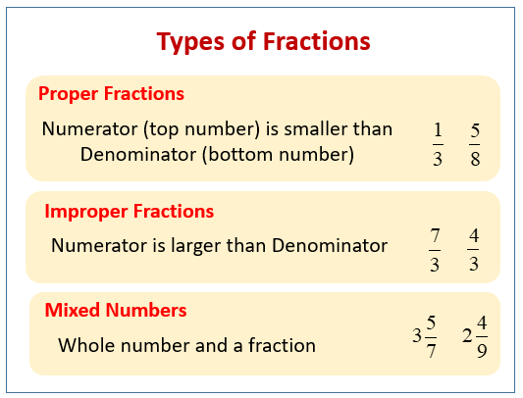

Slide 12
Changing Improper Fraction to
Mixed or Whole Number

Slide 13
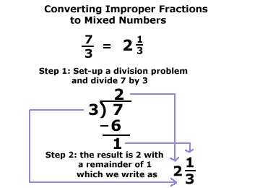

Slide 14
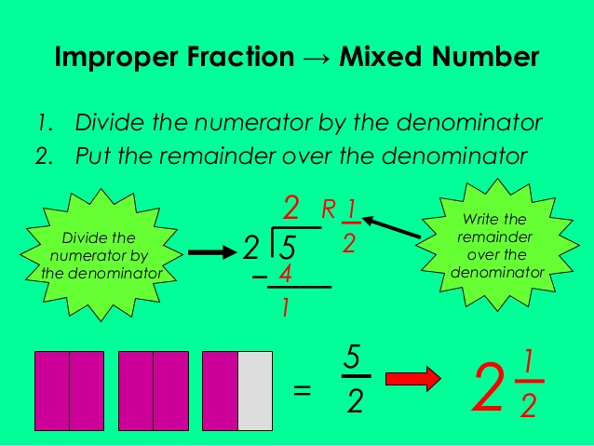

Slide 15
Changing Mixed Number to
Improper Fraction

Slide 16
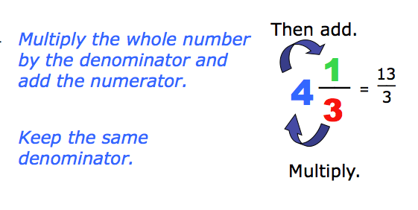

Slide 17
Reducing Fractions

Slide 18
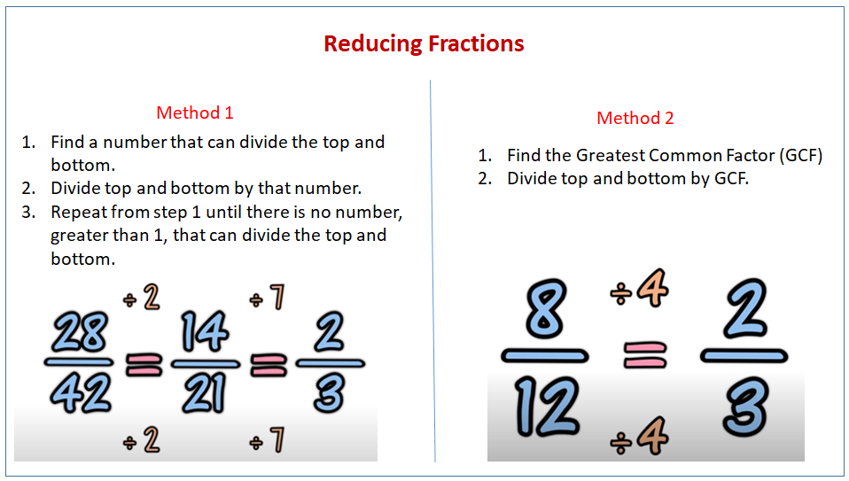

Slide 19
Which Fraction is Larger

Slide 20
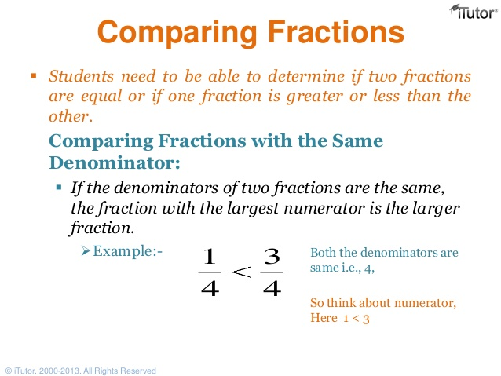

Slide 21
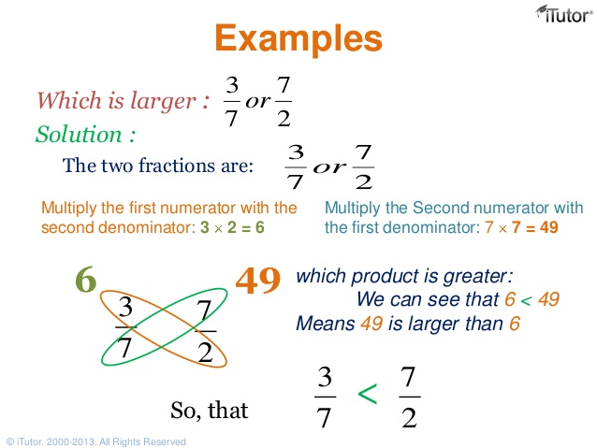

Slide 22
Which Fraction is Larger https://www.youtube.com/watch?v=KNdUJQ_qd4U https://www.youtube.com/watch?v=lQHdX74XjGg

Slide 23
Adding Fractions

Slide 24
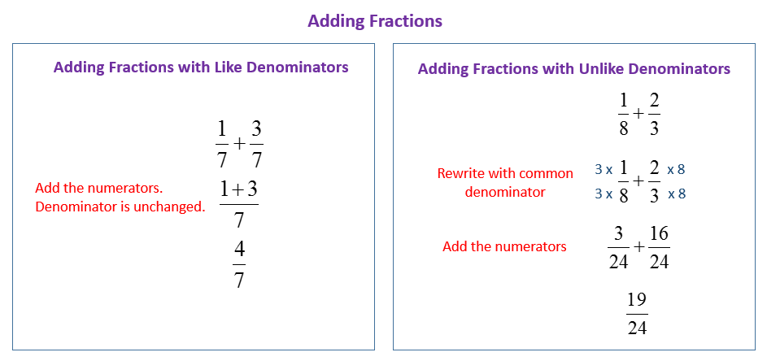

Slide 25
Adding and Subtracting
Mixed Numbers

Slide 26
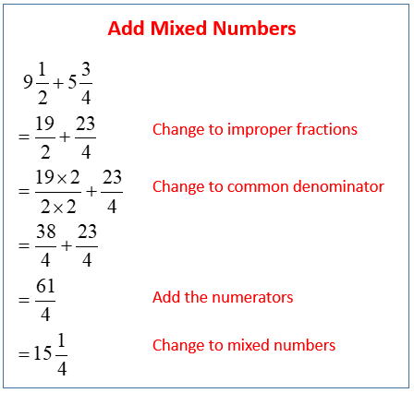

Slide 27
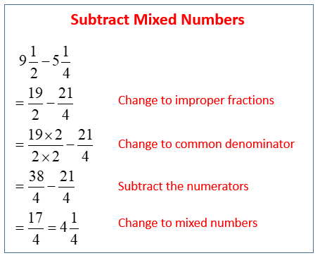

Slide 28
Subtracting Fractions

Slide 29
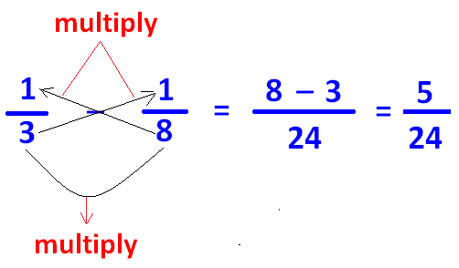
Subtract Fractions with Unlike Denominators

Slide 30
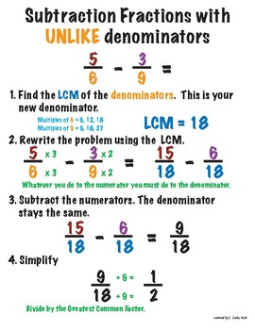

Slide 31
Multiplying Fractions

Slide 32
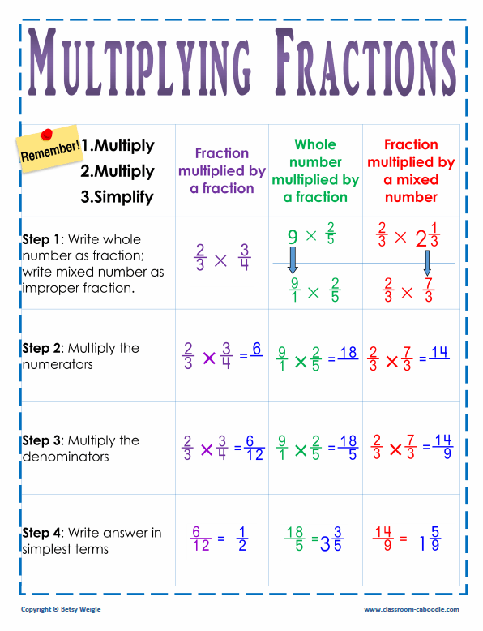

Slide 33
Dividing Fractions

Slide 34
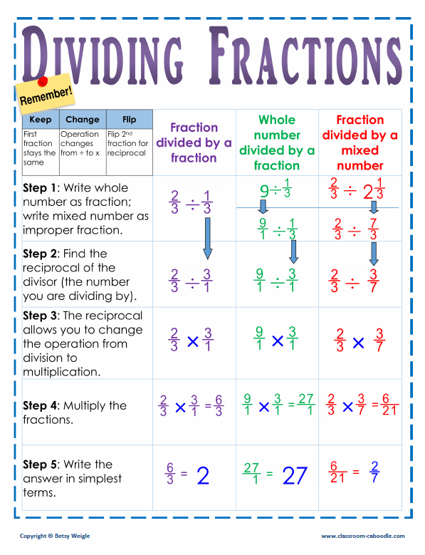

Slide 35
Decimal Fractions

Slide 36
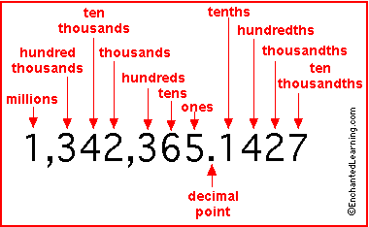

Slide 37
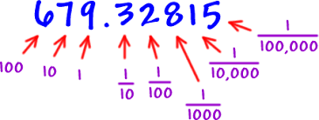

Slide 38
Adding Decimals

Slide 39
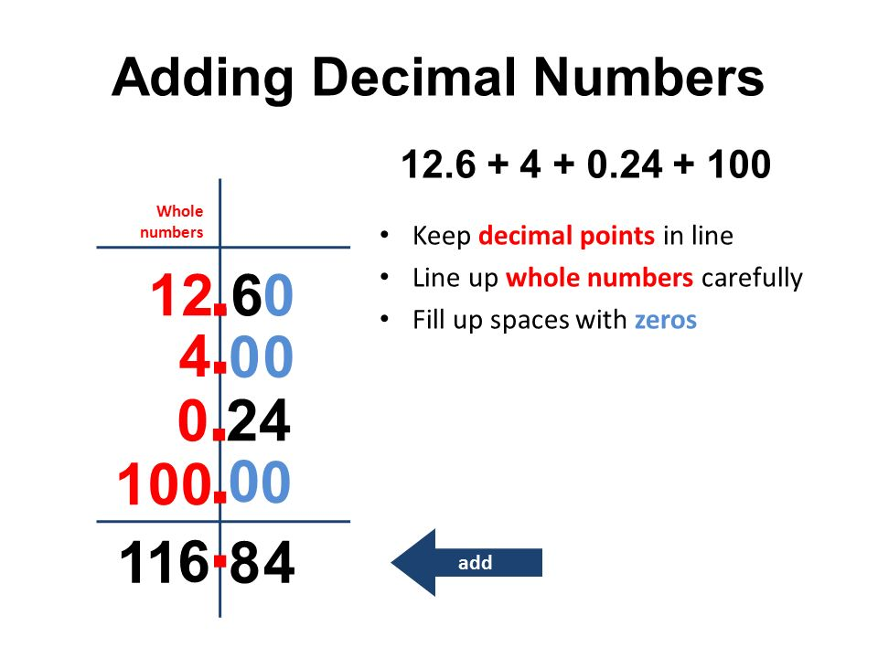

Slide 40
Subtracting Decimals

Slide 41
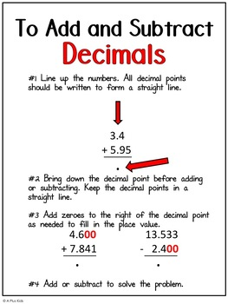

Slide 42
Multiplying Decimals

Slide 43
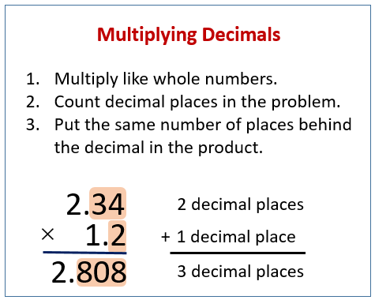

Slide 44
Dividing Decimals

Slide 45
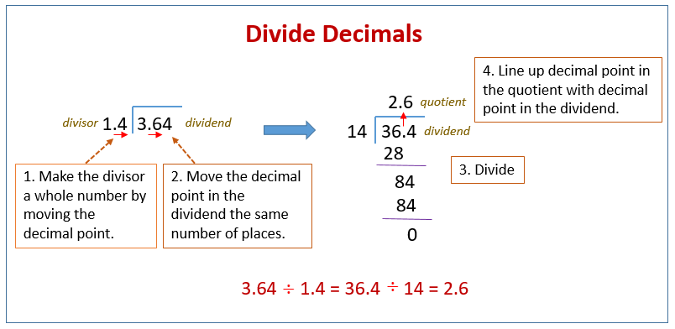

Slide 46
Changing Fractions to Decimals

Slide 47
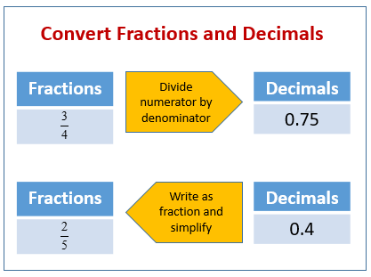

Slide 48
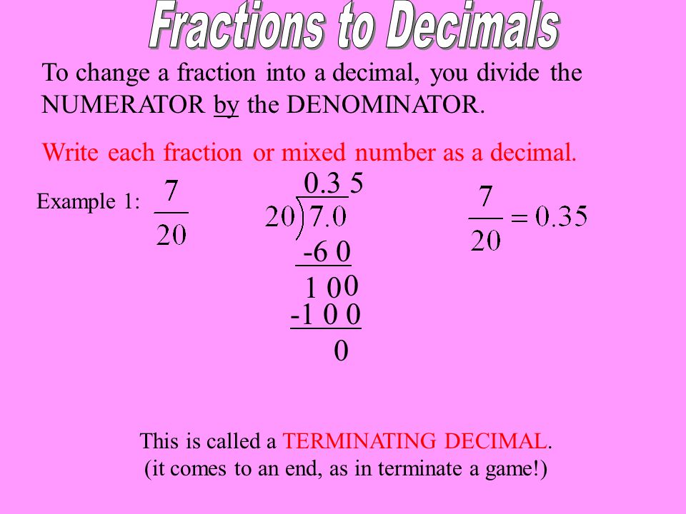

Slide 49
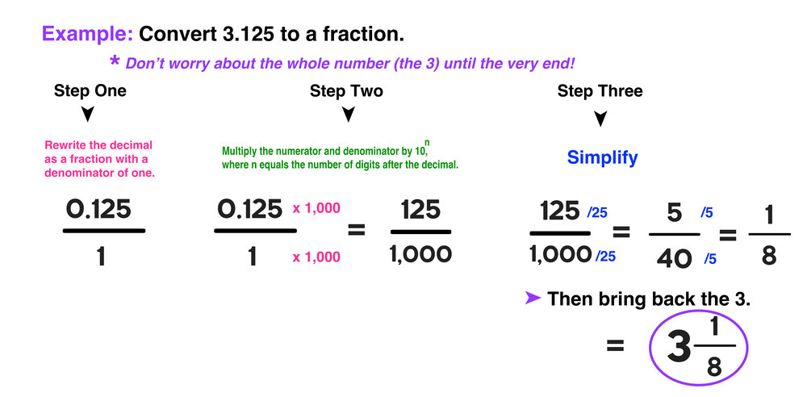
Convert Decimal to a Fraction

Slide 50
Percentages

Slide 51
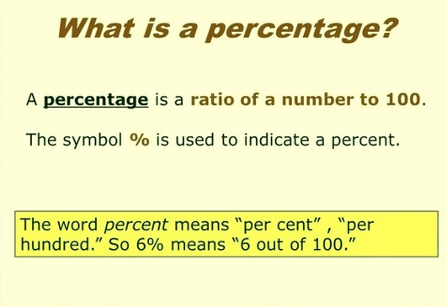

Slide 52
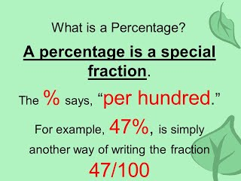

Slide 53
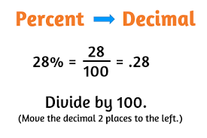

Slide 54
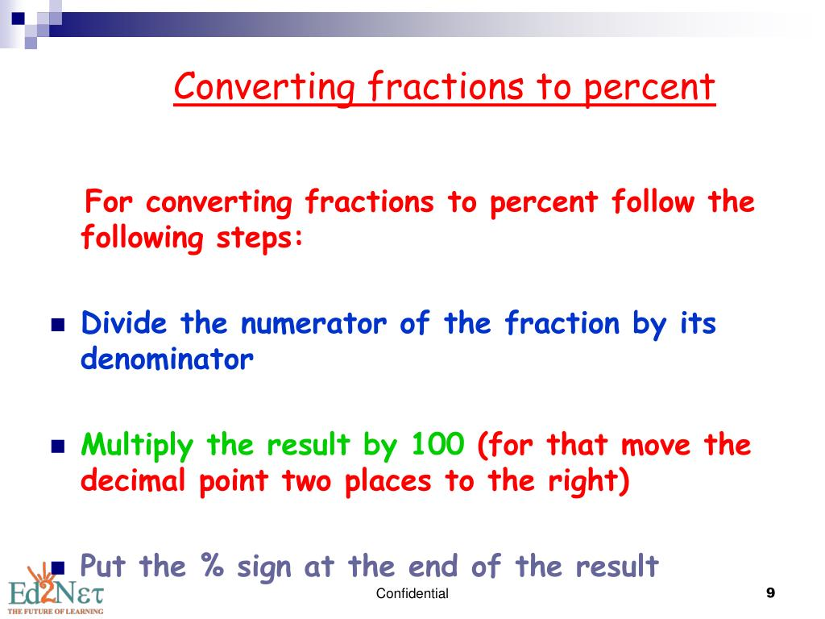

Slide 55
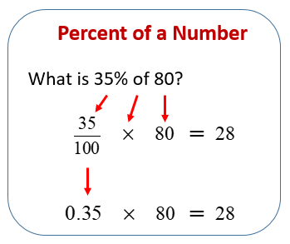

Slide 56
Ratios

Slide 57
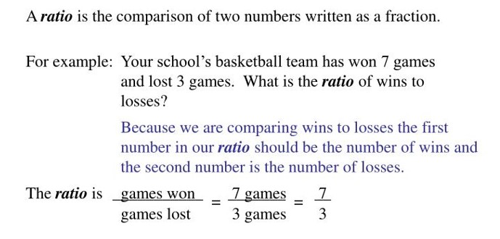

Slide 58
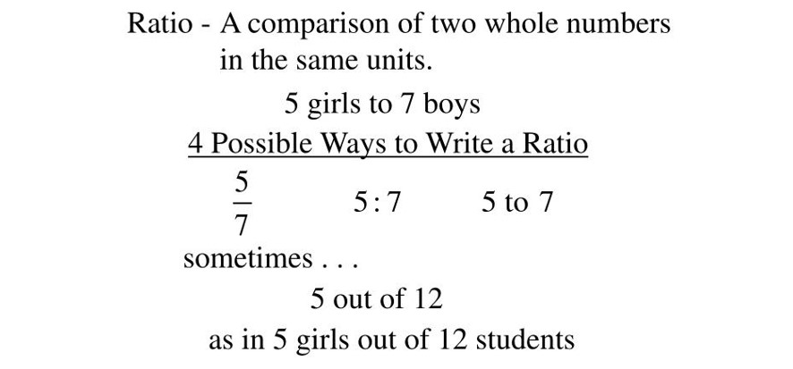

Slide 59
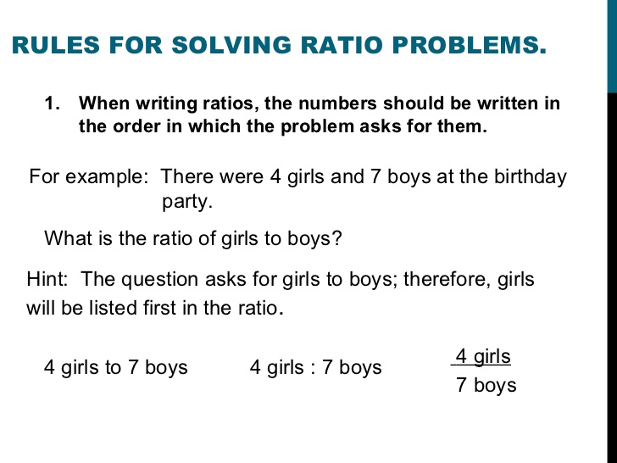

Slide 60
Proportions

Slide 61
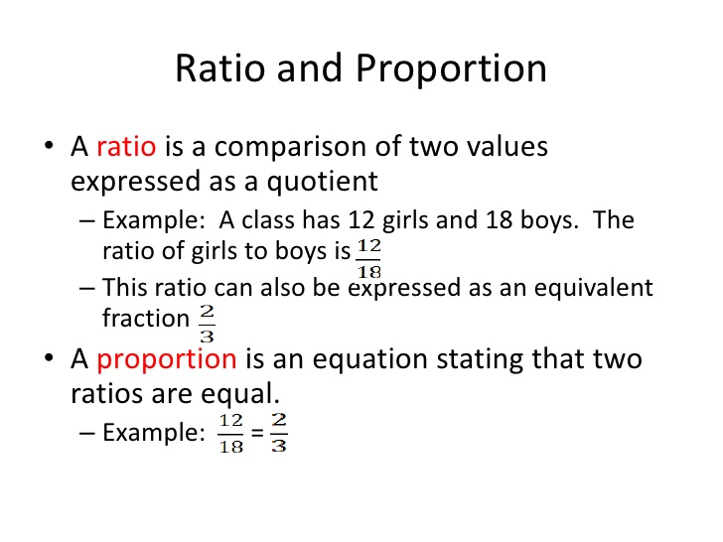

Slide 62
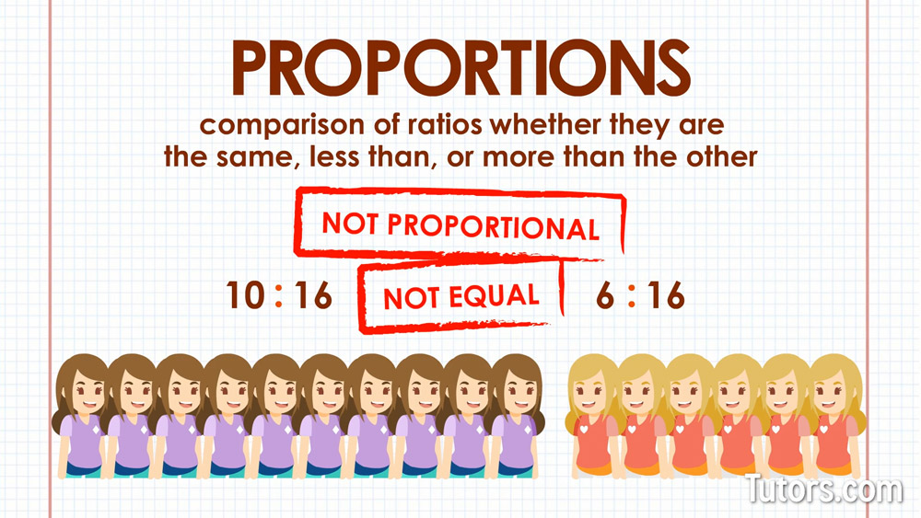

Slide 63
Quick Review of Fractions
https://www.youtube.com/watch?v=dG2WSstQyUE
There are two small errors in video:
  Problem # 2
    At 1:52 the answer should be 3 1/3 not 3 1/2
  Problem # 7
    At 13:23 the answer should be 7/3 not 7/2
The oral explanations are correct but he makes errors when writing the answers
Notes:
Ask students to provide the prefixes for measurements using the metric system.

Slide 64
How to Add and Subtract Fractions
https://www.youtube.com/watch?v=J8x0EkWHhUU
Fractions, Decimals, and Percentages
https://www.youtube.com/watch?v=rqlPKSvQ-YU
Notes:
Ask students to provide the prefixes for measurements using the metric system.

Slide 65
How to Add and Subtract
Mixed Numbers
https://www.youtube.com/watch?v=_BPY1lMO5r0
Notes:
Ask students to provide the prefixes for measurements using the metric system.

Slide 66
Quick Review of Percentages
https://www.youtube.com/watch?v=tfZKwMdTt2w
Notes:
Ask students to provide the prefixes for measurements using the metric system.

Slide 67
Additional Math Resources
https://www.khanacademy.org/
STC Centers for Learning Excellence
  https://www.southtexascollege.edu/cle/
Notes:
Ask students to provide the prefixes for measurements using the metric system.

