Slide 4
MUST BE 100% correct to earn the credit!

Slide 23
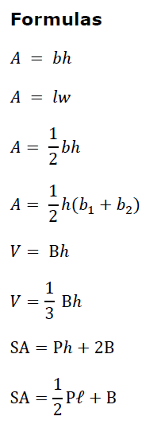

Slide 24
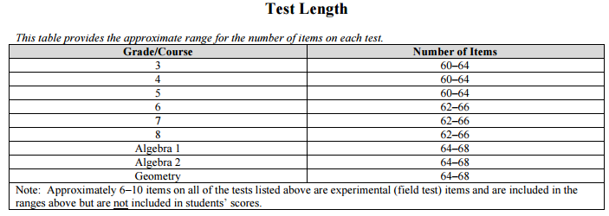

Slide 25
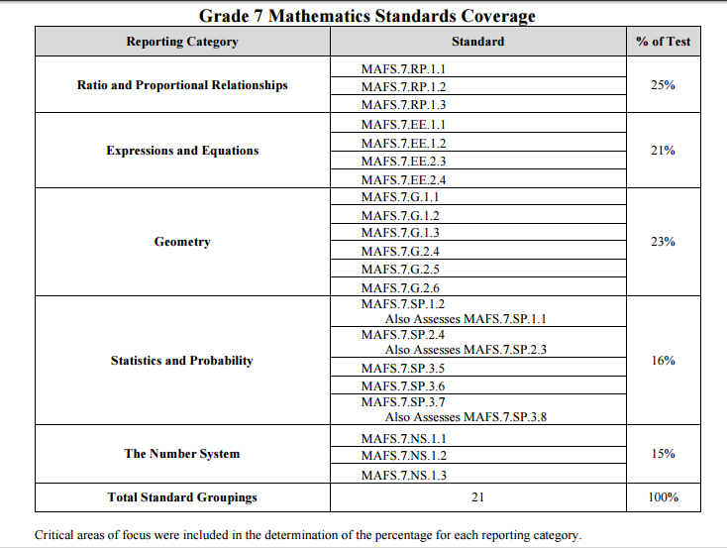

Slide 26
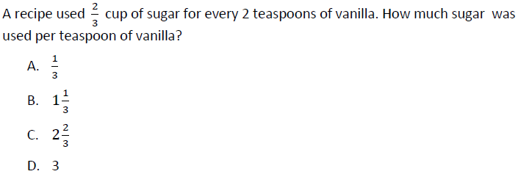
Calculator

Slide 27
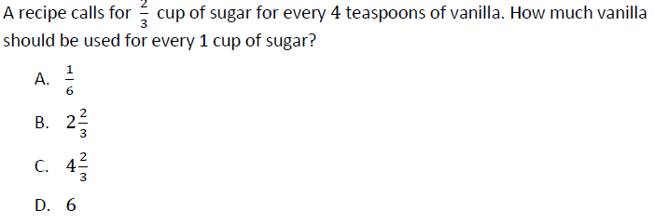
Calculator

Slide 28

4/3 or 1 1/3
Calculator

Slide 29
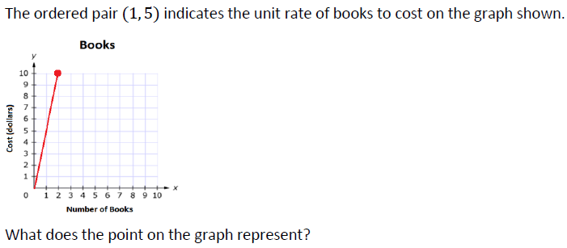
2 books cost $10
Calculator

Slide 30
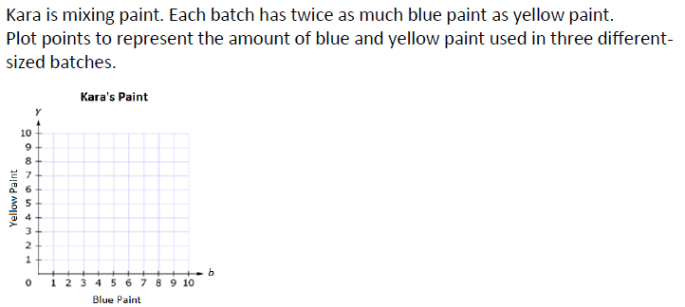
Calculator

Slide 31
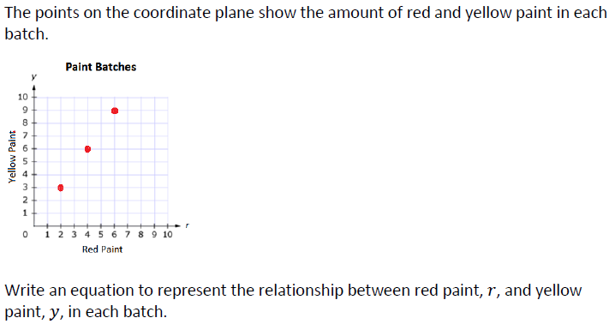
y=3/2r
Calculator

Slide 32
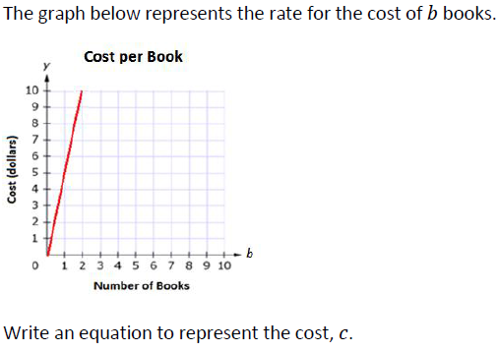
C=5b
Calculator

Slide 33
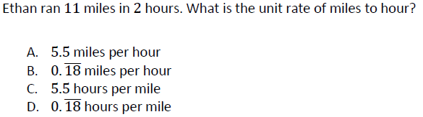
Calculator

Slide 34
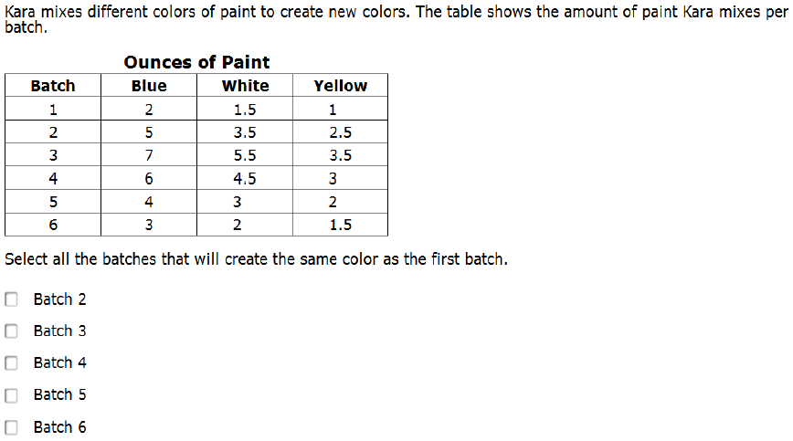
Calculator

Slide 35
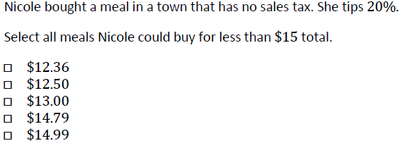
Calculator

Slide 36
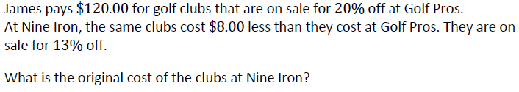
Calculator

Slide 37
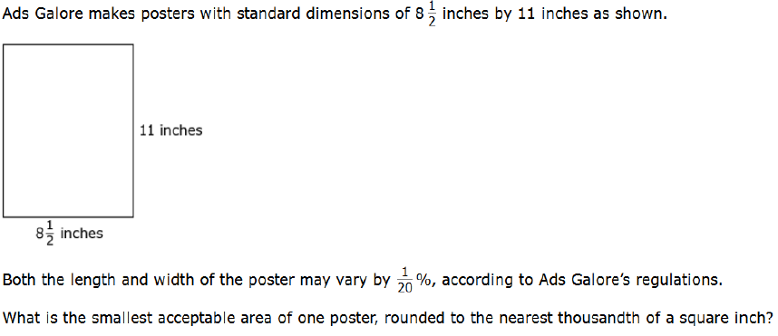
84.38
Calculator

Slide 38
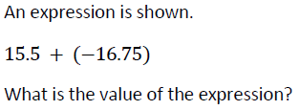
-1.25
Neutral Calculator

Slide 39
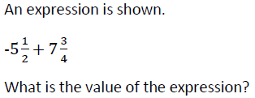
2 1/4
Neutral Calculator

Slide 40
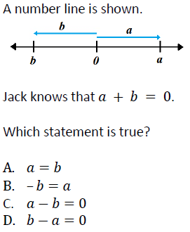
Neutral Calculator

Slide 41
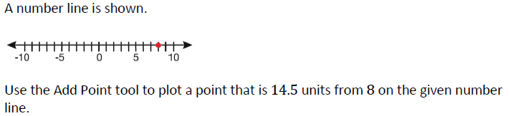
Neutral Calculator

Slide 42
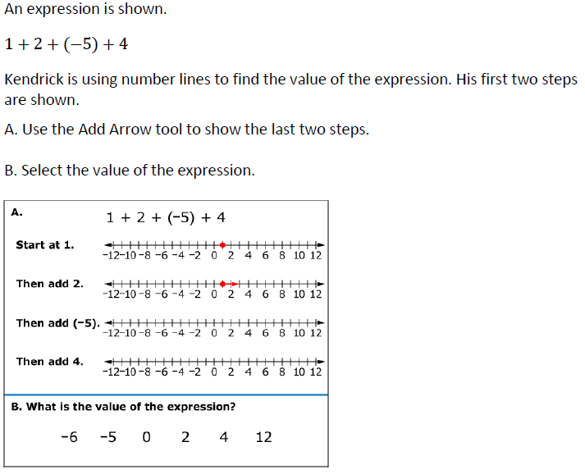
Neutral Calculator

Slide 43
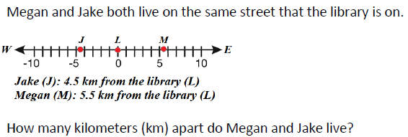
9
Neutral Calculator

Slide 44
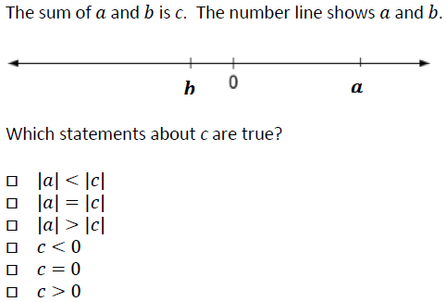
Neutral Calculator

Slide 45
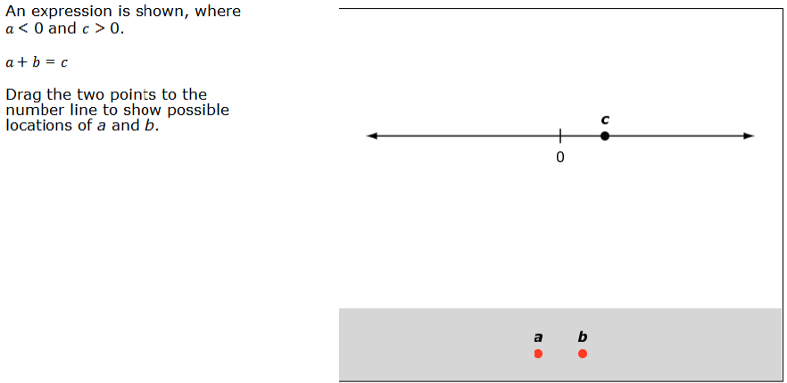
Answers may vary
Neutral Calculator

Slide 46
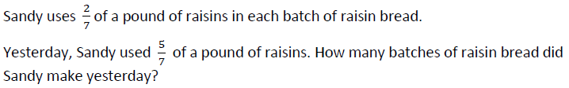
2.5
No Calculator

Slide 47
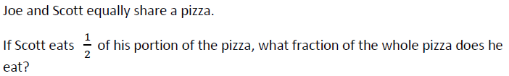
1/4
No Calculator

Slide 48
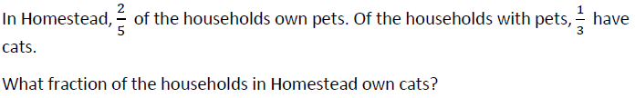
2/15
No Calculator

Slide 49

-450
No Calculator

Slide 50
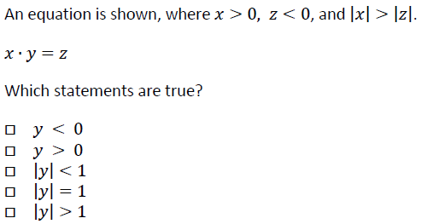
No Calculator

Slide 51
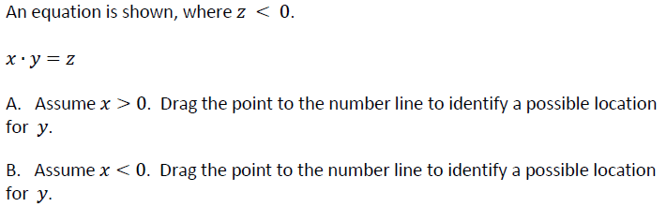
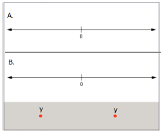
Answers may vary as long as y is negative
Answers may vary as long as y is positive
No Calculator

Slide 52
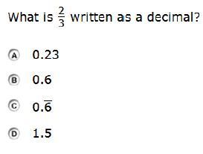
No Calculator

Slide 53
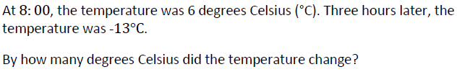
19
Neutral Calculator

Slide 54
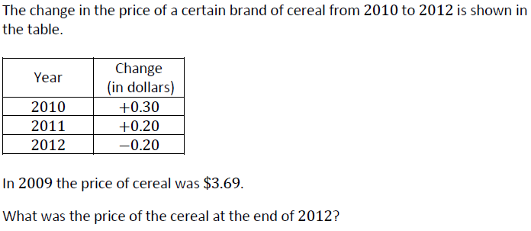
3.89
Neutral Calculator

Slide 55
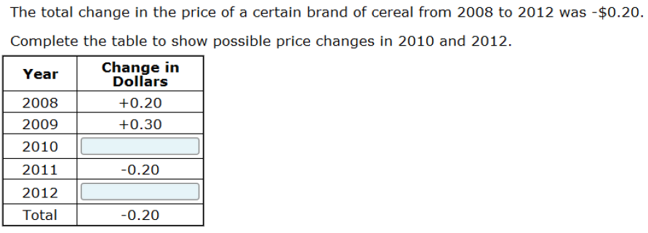
Answers may vary 2010 change +2012 change must = +0.5
Neutral Calculator

Slide 56
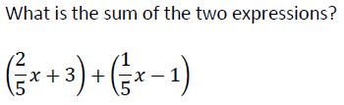
3/5x+2
Calculator

Slide 57
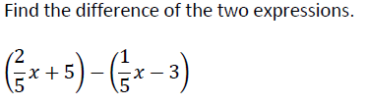
1/5x+8
Calculator

Slide 58
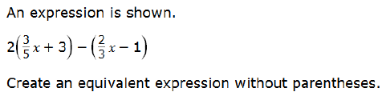
8/15x+7
Calculator

Slide 59
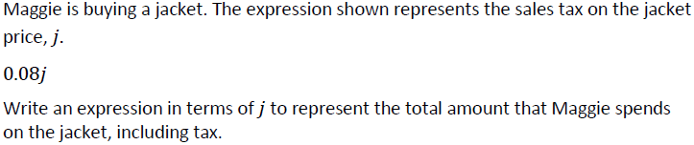
j+0.08j or 1.08j
Neutral Calculator

Slide 60
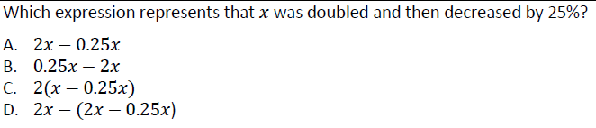
Neutral Calculator

Slide 61
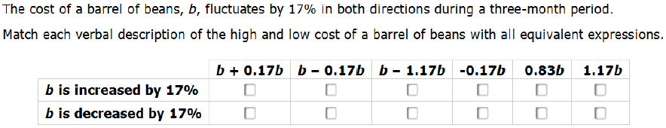
Neutral Calculator

Slide 62

15
Calculator

Slide 63
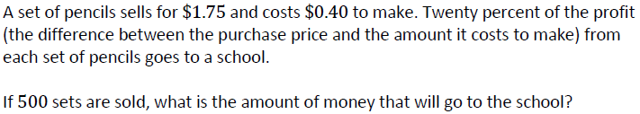
$540
Calculator

Slide 64
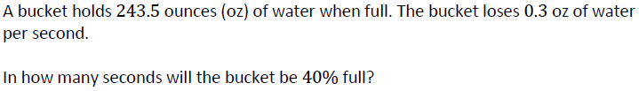
487
Calculator

Slide 65
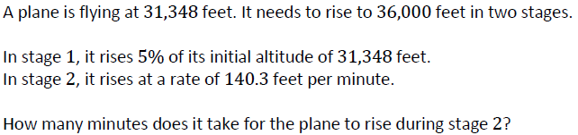
22
Calculator

Slide 66
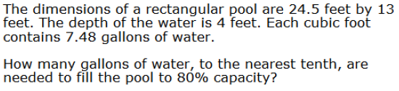
136.3
Calculator

Slide 67
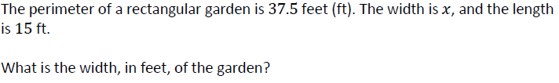
3.75
Calculator

Slide 68
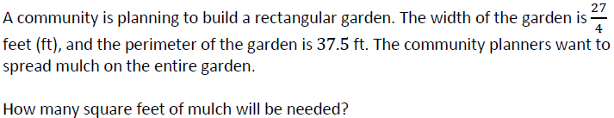
81
Calculator

Slide 69
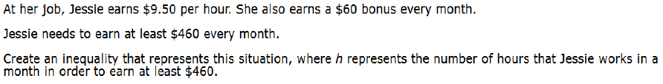
9.5x+60≥460
Calculator

Slide 70
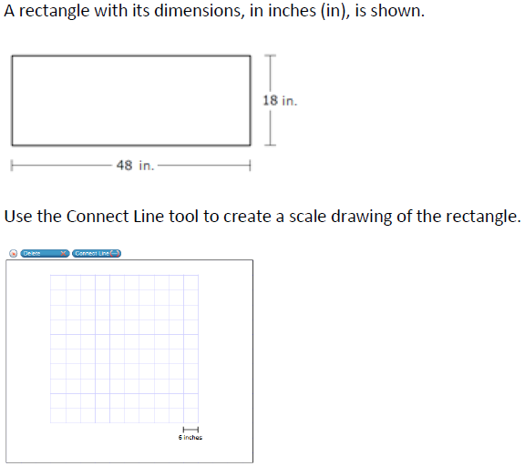
Answers may vary
Calculator

Slide 71
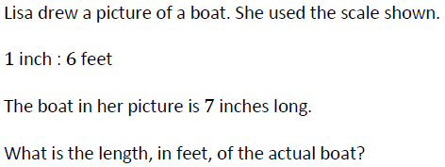
42
Calculator

Slide 72
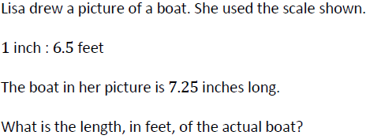
47.125
Calculator

Slide 73
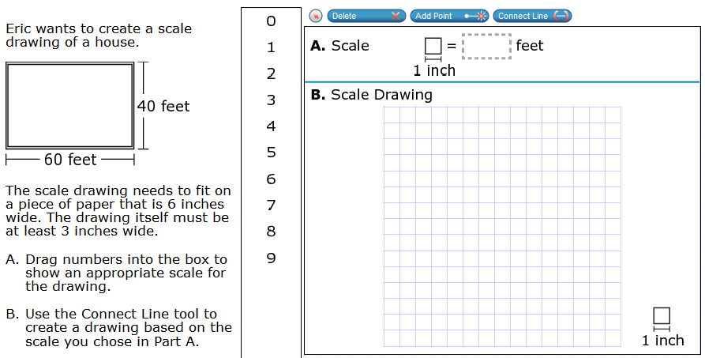
20
Any rectangle that is 3 by 2
Calculator

Slide 74
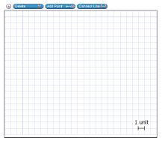
Answers may vary
Neutral Calculator

Slide 75

Answers may vary
Neutral Calculator

Slide 76

Answers may vary
Neutral Calculator

Slide 77

Any size pentagon
Neutral Calculator

Slide 78

Any size rectangle
Neutral Calculator

Slide 79

Answers may vary
Answer should discuss cutting it horizontal compared to cutting it vertical. Possibly include base being a circle.
Neutral Calculator

Slide 80

50.24
Calculator

Slide 81

About 5.37
Calculator

Slide 82

326.56
Calculator

Slide 83

2544.415
Calculator

Slide 84

226.865
Calculator

Slide 85

121
Calculator

Slide 86

72.32
Calculator

Slide 87
1
Calculator

Slide 88

512
Calculator

Slide 89

Answers may vary but the two dimensions must multiply to equal 240
Calculator

Slide 90

80
Calculator

Slide 91

Calculator

Slide 92

Calculator

Slide 93
100
Calculator

Slide 94

Neutral Calculator

Slide 95

About 5
Neutral Calculator

Slide 96

Neutral Calculator

Slide 97

Neutral Calculator

Slide 98

Neutral Calculator

Slide 99

Neutral Calculator

Slide 100

0.46
Neutral Calculator

Slide 101

0.34
Neutral Calculator

Slide 102

1/3
Calculator

Slide 103

Calculator

Slide 104

Calculator

Slide 105

10/49
Calculator

Slide 106

Calculator

Slide 107

Calculator

Slide 108

Calculator

Slide 109

Calculator

