Slide 1
Religious Wars
France, Dutch Revolt and Germany

Slide 2
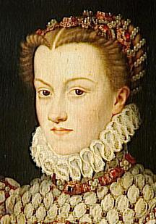
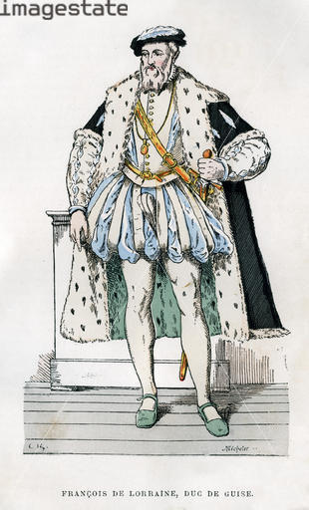
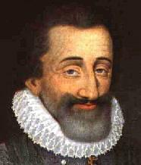
Who’s Who in 16th c France:
2
Catherine de Medici
Valois Family
politique?
rules as regent
sons:
Francis II r. 1559-1560
Charles IX r. 1560 - 1574
Henry III r. 1574-1589
January Edict of 1562
Henry of Navarre
Bourbon Family
Huguenot Noble
Guise Family = Catholic
backed up by
Jesuits
the papacy
Philip II of Spain

Slide 3
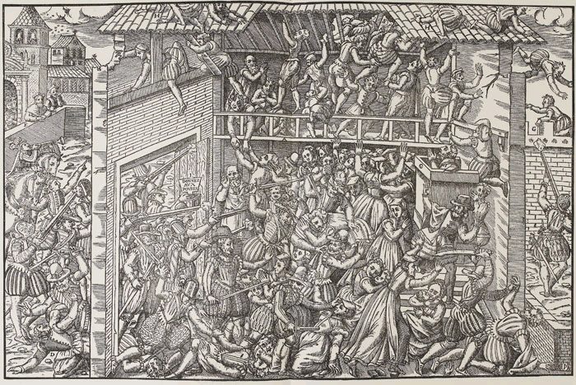
French Religious Wars 1562 - 1598
3
The massacre of worshiping Protestants at Vassy, France 1562

Slide 4
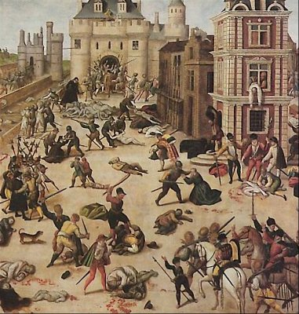
St. Bartholomew’s Day Massacre 1572
Huguenots in town to celebrate wedding of Henry of Navarre to Marguerite of Valois
3000 Huguenots butchered in Paris
internationalizes plight of the Huguenots
Philip II no longer worried about French involvement in Dutch wars

Slide 5
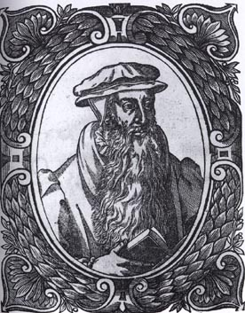

Calvinists turn militant
removal of a heathen tyrant was not only permissible, but a Christian duty
the beginnings of Huguenot theories of resistance
John Knox
1558

Slide 6
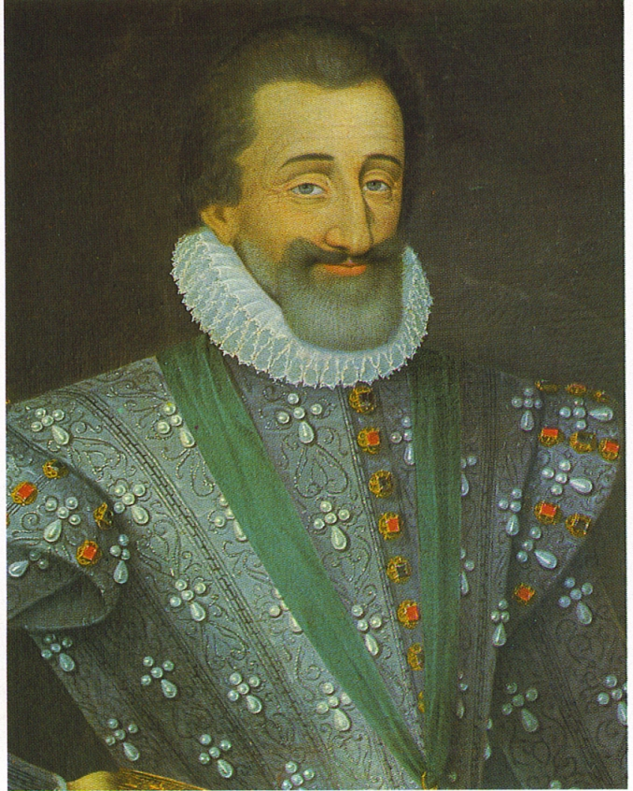
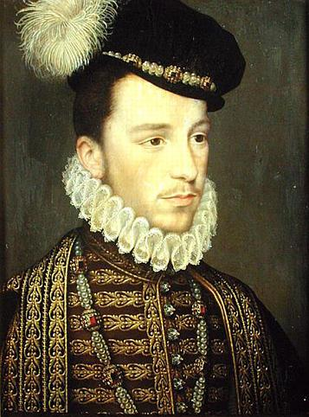
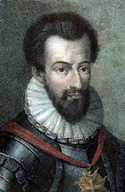
French Religious War, a civil war: Wars of the Three Henries
Henry of Navarre – Catholic, Protestant, Catholic
Henry III, King of France
Valois Dynasty - Catholic
assassinated
Guess who’s the next king?
Henry of Guise formed the Catholic League
Henry of Navarre - Bourbon - Protestant
assassinated

Slide 7
Henry of Navarre (Bourbon): Catholic or Protestant?
Protestant when he weds Marguerite of Valois
Catholic to escape St. Bartholomew’s Massacre
Renounces conversion and back to Protestant
Becomes King of France and converts back to Catholicism “Paris is Worth a Mass.”

Slide 8
Henry of Navarre - Henry IV King of France
“Paris is worth a Mass” - politique
Edict of Nantes 1598:
religious and civil freedoms granted to Huguenots but worship prohibited in Catholic towns
allowed to have protective towns but Catholicism declared the official religion of France
creates a state within a state
Begins setting up stage for absolutism

Slide 9
End of French Religious Wars

Slide 10
politiques
Moderate Huguenots and Catholics tired of anarchy and wars wanted conciliation with each other. Wanted politics to be more important than religious differences. Believed in religious toleration and peace to France.

Slide 11
Politiques open door to. . .
Jean Bodin: Writes during French Religious Wars
intellectual = writes and promotes idea of
a sovereign state
in every society one power must be strong enough to give law to all others, with or without their consent
sounds like the beginning of. . .
absolutism
11

Slide 12
Henry IV points the monarchy towards Absolutism (r. 1589-1610)
Laid the foundations for changing France to an absolutist state along with duke of Sully (a Protestant) becomes the 2nd most important man in France
Cut back the privileges of the French nobility by attacking:
provincial governors
parlements, especially the Parlement of Paris
does not call Estates General
wants to live long enough to see a “chicken in every pot” for every Frenchman
Allows Jesuits to return to France
Pro-Protestant foreign policy: supports Dutch revolt against Spain and Protestant side of 30 Years’ War against Habsburg rule
“nobles of the robe” - men who occupied high positions in the king’s bureaucracy now challenged the exclusivity of the “nobles of the sword”

Slide 13
Reforms of Henry IV and his financial minister, the duke of Sully
Sully – a Protestant
Introduce the paulette, an annual payment to the throne to ensure that the office will be passed on to an heir
Repair roads and bridges and build canals to promote internal trade
Mercantilist policies leads to the introduction of new manufactures of silk and tapestry
New group added to French society which is divided into ranks and privileges:
First estate – the clergy
Second estate – the nobility – “nobles of the robe” added, they were peers and dukes who paid for their title and administrative and judicial position
Third estate – everyone else

Slide 14
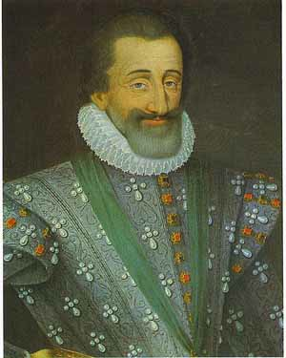
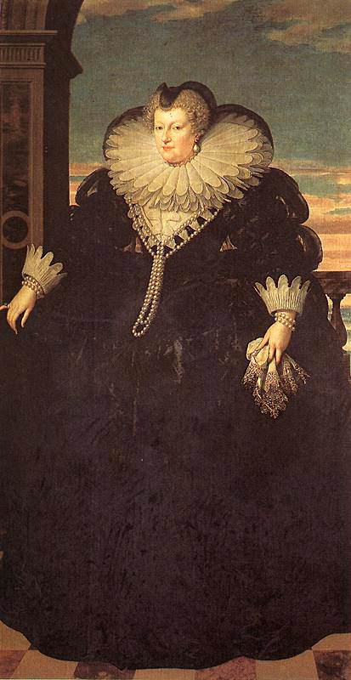
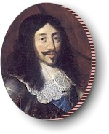
Love-life
Marguerite out - Marie de Medici in
Henry IV + Marie de Medici = Louis XIII
+
=
Cardinal Richelieu rules with
boy king
Bourbon dynasty rules France until French Revolution

Slide 15
Cardinal Richelieu
a politique - supports Dutch and English protestant armies against Catholic Habsburg in Thirty Years’ War
Divided France in generalities (districts) and appoints intendants to govern each.

Slide 16
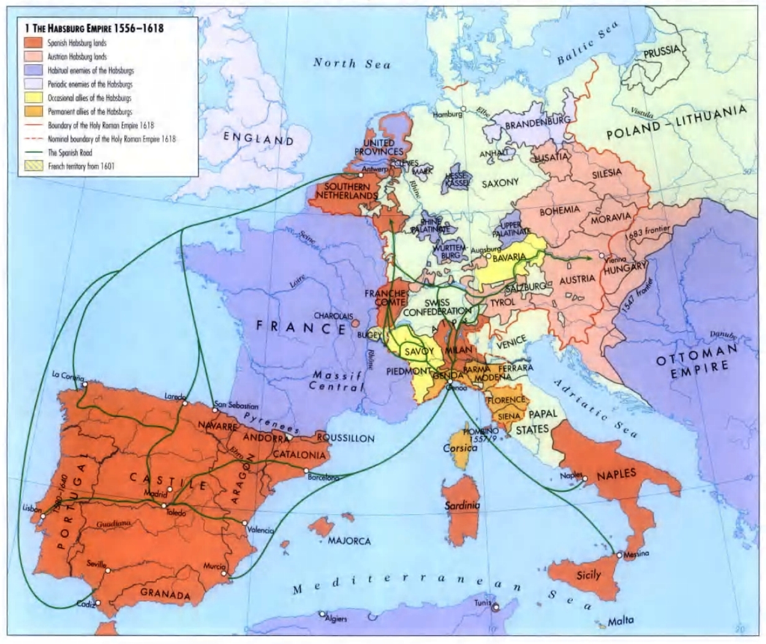
Dutch Revolt 1566-
Philip II of Spain controls the Low Countries. Netherlands, Burgundy

Slide 17
Philip II tightens control of over Netherlands
1566 - league formed by Dutch to protest Spanish rule
Philip then increases taxes to fund the cost of the Spanish empire
Imposes quartering of Spanish soldiers
Insists that decrees of the Council of Trent be enforced throughout the Netherlands - wants to get rid of heresy by imposing the Inquisition
Response:
iconoclast revolt - smashing of Catholic statues
Notes:
Philip II’s friends or foes: Ottomans? The Dutch? The duke of Alba? Elizabeth II? Henry of Navarre who becomes Henry IV?

Slide 18
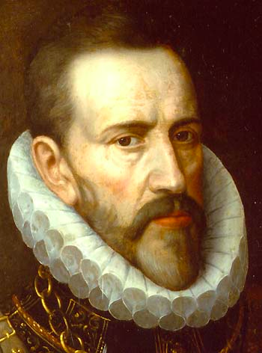
Philip’s attempt control the Dutch
Catholics: The Duke of Alba and his
“Council of Troubles” or the “Council of Blood”
vs.
Protestants: William of Orange - Stadholder, governor of northern provinces, includes Holland
Protestants aided by “Sea Beggars” - pirate ships from England. Who is ruling England at this time?

Slide 19
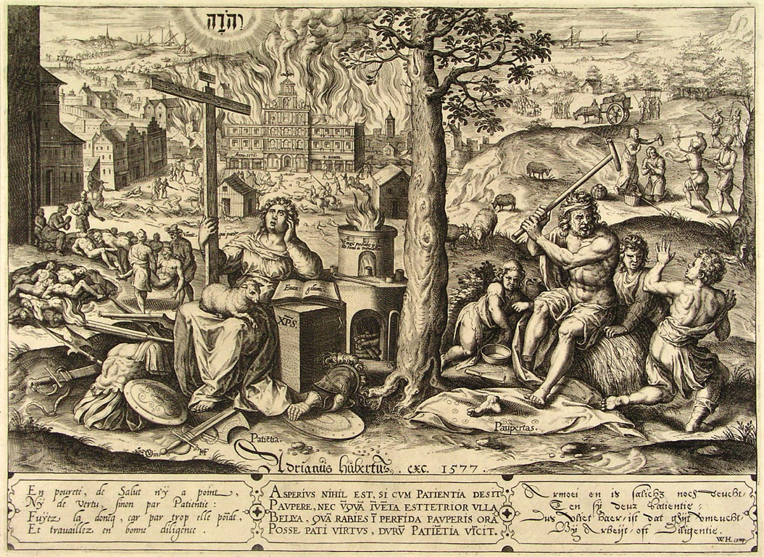
Pacification of Ghent 1576
southern provinces (Belgium) join northern provinces against Spain
Why? Spanish Fury event of Antwerp
union is only temporary - southern provinces fear iconoclast Calvinists and return to Spain

Slide 20
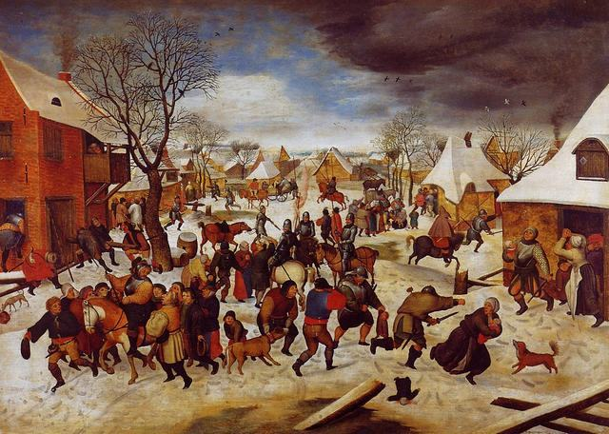
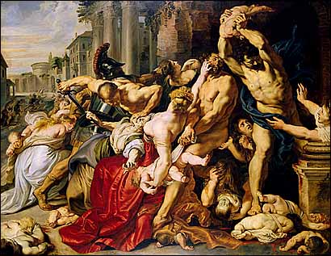
Peter Brueghel’s The Massacre of the Innocent 1565
Peter Paul Ruben’s
Massacre of the Innocents
1611-1612
An indirect criticism of Spanish atrocities against the Dutch in the Netherlands
Based on Biblical story of King Herod’s order of infanticide, massacre at Judea
Baroque
20

Slide 21
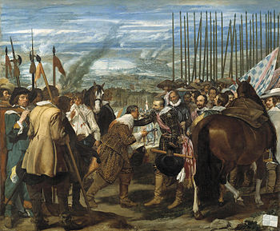
Battle at Breda
Diego Velasquez

Slide 22
The Netherlands Divide
Union of Arras 1579 - southern provinces and make peace with Spain
Union of Utrecht 1579 - Netherlands declares independence - United Provinces of the Netherlands, Dutch Republic
William of Orange “The Apology” denounces Philip II as a heathen tyrant
Elizabeth I helping with her “sea dogs”
Spanish Armada defeated in 1588
Independence recognized in T/Westphalia 1648

Slide 23
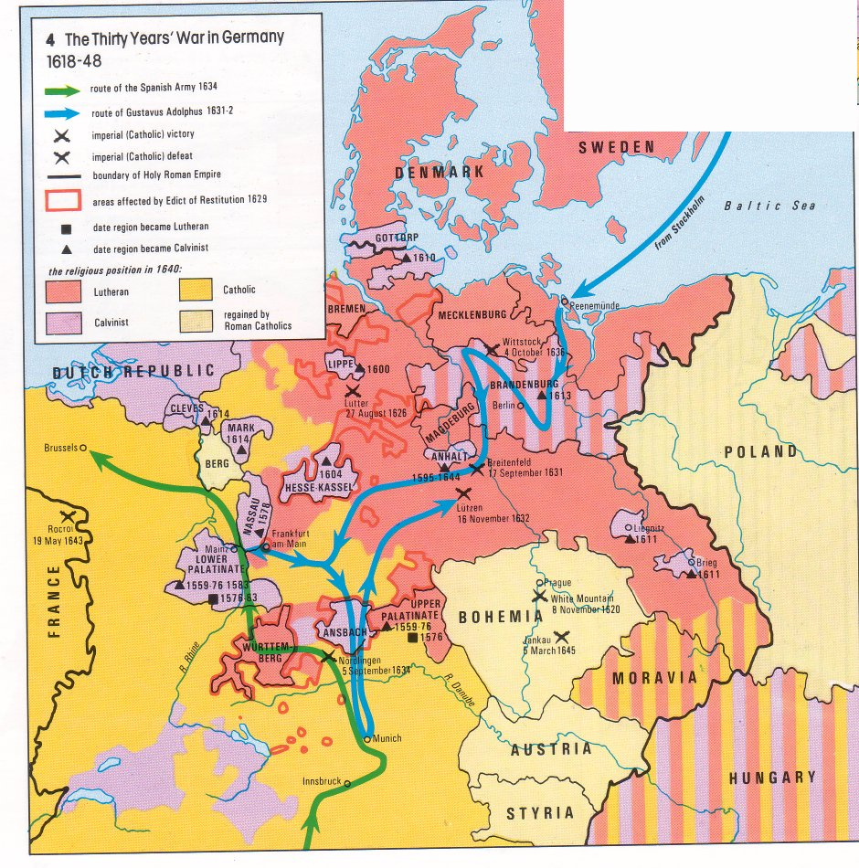
Thirty Years’ War Germany
What starts the tension?
Ruler of the Palatinate,
Frederick V converts to Calvinism 1560
Religious balance created by
Peace of Augsburg is threatened
Ferdinand II’s breaks his promise to Bohemian nobles
nobles throw Ferdinand’s regents
out of window
nobles elect Frederick V of Palatine
as their new king
23

Slide 24
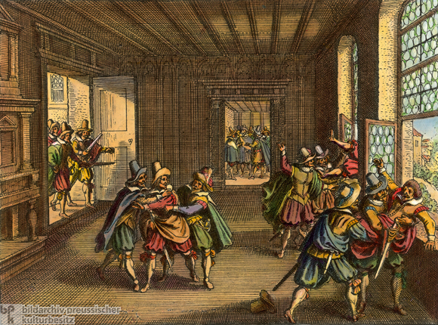
Defenestration of Prague 1618
Holy crap!

Slide 25
Four Stages:
Bohemian stage -
Danish stage - Denmark King Christian IV - Lutheran
Swedish stage - Gustavus Adolphus and Cardinal Richelieu vs. Ferdinand III
Franco-Swedish stage - French openly enter the war

Slide 26
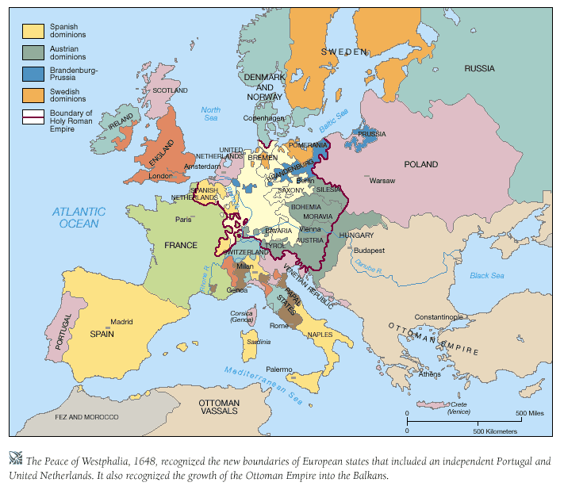
Treaty of Westphalia 1648

Slide 27
End of Religious Wars

