Slide 1
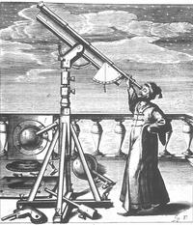
Scientific Revolution
16th century
new ideas
new methods
mathematics - the language of science

Slide 2
Before the Scientific Revolution
Medieval Science
Scholasticism = scholars relied on this method to explain universal truths based on
    Aristotle - motion
    Ptolemy - planets
    Galen - physician
Accepted by scholars and the church: Aristotelian-Ptolemaic theory:
    geocentric view of universe
    revolutions of stars and planets occurred in perfect circles in crystalline spheres
    mathematics was not used to explain universal laws

Slide 3
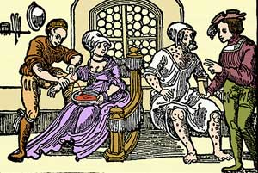
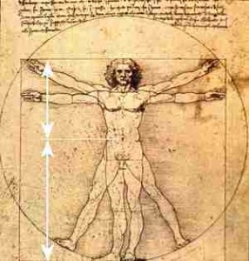
Galen’s theory on the human body
Old - Medieval Science
The human body contained 4 humors:
blood, phlegm, yellow bile and black bile
disease a result of imbalance of humors
treatment = purging and bleeding
dissection prohibited by church
Leonardo did it anyways - sketches

Slide 4
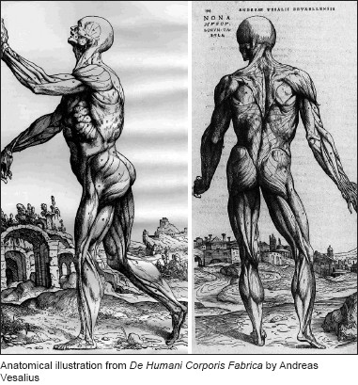
New S.R. theory:
Andreas Vesalius -
    begins dissecting cadavers
    publishes “On the Fabric of the Human Body” 1543
William Harvey -
    theory on blood circulation and the heart as a mechanical pump
However, bleeding and purging continued by faith healers and midwives in “hospitals.”

Slide 5
Why interest in science in 16th century?
The Renaissance sparks interest in learning
A need now arises for celestial navigation to support exploration
The Catholic Church has an interest in a more accurate calendar
  Pope Gregory XIII Gregorian calendar replaces the Julian calendar

Slide 6
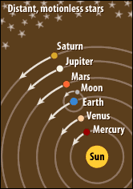
Nicholas Copernicus
1473 - 1543
On the Revolutions of the Heavenly Spheres (1543)
heliocentric theory
“that fool wants to turn the entire science of astronomy upside down!”
        Martin Luther

Slide 7
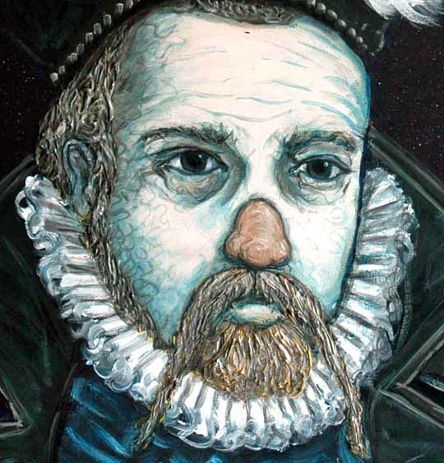
Tycho Brahe
1546 - 1601
observes and records
wants to disprove heliocentric theory
massive collection of data aids others like...

Slide 8
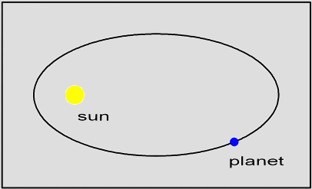
Johannes Kepler
1571 - 1630
Brahe’s assistant
court astronomer for H.R.E. - lives in Prague
planets move in elliptical paths instead of circular
uses mathematics to explain observations

Slide 9
Galileo Galilei
1564 - 1642
Italian - shows scientific community is international
uses empirical evidence to come up with laws of motion - inertia
motion - not rest - was a natural state

Slide 10
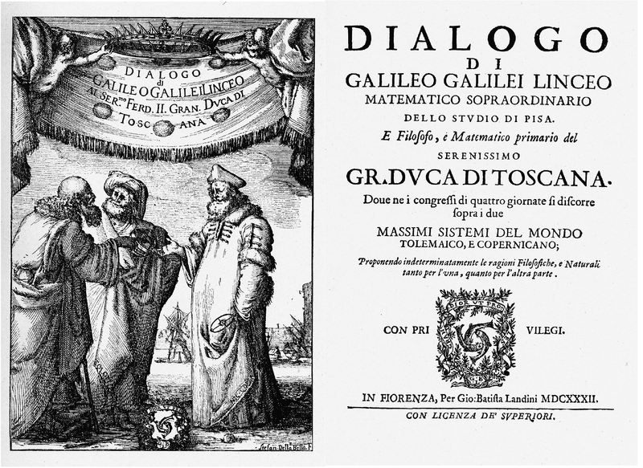
Dialogue Concerning the Two Chief World Systems: Ptolemaic and Copernican 1632
Simplicio
Simplicio defends Ptolemy = offends the Church

Slide 11
Galileo
Roman Inquisition 1633 - written in Italian not Latin
recants but. . .“and yet it moves”
house arrest
What else was the Catholic Church dealing with at this time?

Slide 12
Isaac Newton
1642 - 1727
Principia Mathematica (1687)
“If I have been able to see so far, it is only because I stood on the shoulders of giants.”
3 laws of motion; universal law of gravitation; calculus - mathematics to explain theory
God manipulates from time to time

Slide 13
Alexander Pope on Newton = 18th c poet
“Nature and Nature’s laws lay hid in night; God said, Let Newton be! and all was light!”

Slide 14
Methods
Francis Bacon - inductive reasoning
    investigation, observation and experimentation = inductive resoning
Rene Descartes - deductive reasoning
    start with general principles and move to particular cases by steps of reason - against empiricism = deductive reasoning
    the world can be reduced to two things:
        mind and matter (particles) = materialist view of reality
    God does not manipulate
    Discourse on Method 1637

Slide 15
Religion and Science
S.R. leads to skeptical and secular attitudes by elites
empirical evidence not superstitious ideas = decline of witchcraft persecutions after 1650’s
most sought to reconcile God with new science

Slide 16
Religion and Science - continuation
Catholic Church
    Index of Prohibited Books
    Inquisition
Scientific Revolution does not deny existence of God but sought to understand the laws of nature
Glorify God by demonstrating consistency and harmony and order in His divine creation.
God creates and then steps back - Deism

Slide 17
If you had been a scientist in the 17th... c. . . .
where would you have moved to in order to freely publish your thoughts?
The Dutch Republic - Holland

Slide 18
The state and science
monarch - sponsoring scientific discoveries brings prestige
advances for navigation and military purposes
1660’s scientific societies formed

Slide 19
S.R. in England
Royal Society of London
    privately run until. . .
    Sir Isaac Newton serves as president - dedicates Principia
    received government charter 1662 under Charles II
17th c: Parliament and Puritans v. Stuart absolutism and Catholicism - religious reforms see Catholicism as obstacle to progress, academic freedom
R.S. of London supports James II ousting and Glorious Revolution. . . up to a point

Slide 20
Women and Science
Margaret Cavendish - hosted informal talks
Prevalent thought: women have smaller and softer brains
Descartes: “the mind has no sex”
R.S. of London admits women in 1945

Slide 21
S.R. in France
Louis XIV chartered and more strictly supervised French Royal Academy of Science - 1666 holds its first meeting in Paris - censorship in place
Jean Baptiste Colbert minister of finance for Louis XIV - study of useful subjects - benefit French commerce and industry

Slide 22
S.R. in east
Catholic Reformation prevented spread
Russian obstacle to new science:
    separated from western Europe since days of the Mongols
    Russian Orthodox Church is anti-western culture
Peter the Great’s westernization of Russia - wants to refute idea that “we [Russians] are barbarians who disregard science.” (r 1682-1725)

Slide 23
Scientific Revolution and women
Time for a DBQ

Slide 24
Consequences of the S.R.
The scientific method is now applied to the study of nature and the universe and to explain God’s creation through laws of nature
Apply the same method to society, religion and governments so. . .
People should be ruled by natural laws, not rulers. Leads to. . .

Slide 25
18th century
Enlightenment
Review
John Locke
v.
Thomas Hobbes

Slide 26
Have science and technology helped or hindered humanity?

