Slide 1
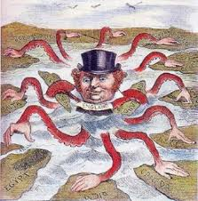
Ch 26 Imperialism Chambers Textbook
1

Slide 2
Forms of Imperialism
Colony - India
Protectorate - Egypt
Sphere of Influence - China, Ottoman Empire
Economic Imperialism - Hawaii - Dole Co.
White settler colonies - British Dominions - Australia

Slide 3
Paternalism vs. Assimilation
Paternalism - policy towards African colonies - govern colonies like a parent by providing them with their needs without giving them rights
assimilation - tried to change the culture of the colony to the “superior” culture of the imperialist nation

Slide 4
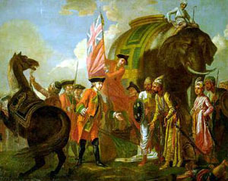
Britain in India begins in Bengal
Battle of Plassey 1757
Robert Clive
British East India Co.
nawab of Bengal
nawabs - provincial governors
Mughal Dynasty weak 1700’s
Analyze the impact of this event on Indian commerce, manufacturing and agriculture.
page 780

Slide 5
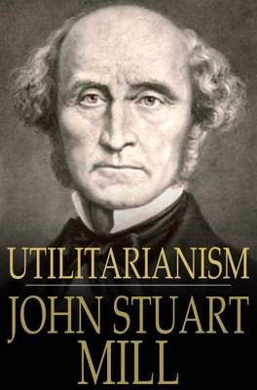
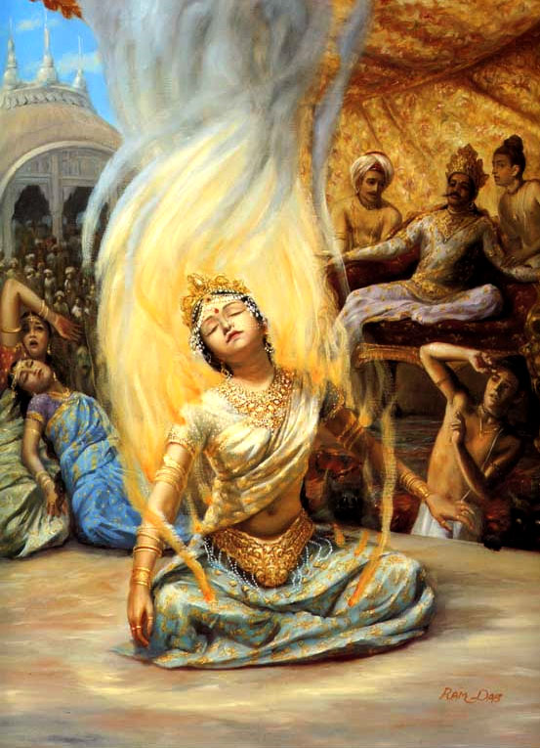

Slide 6
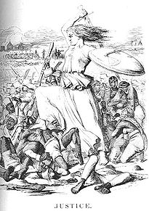
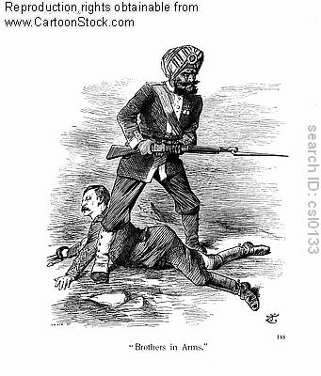
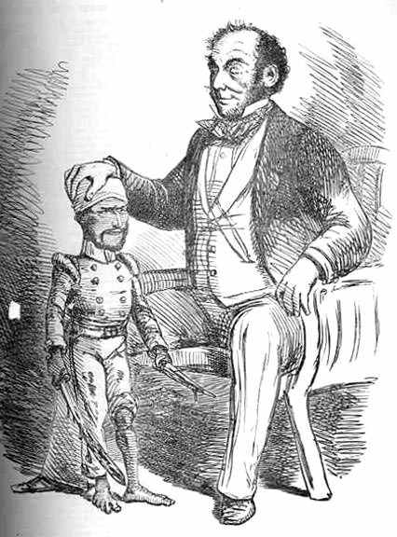
Sepoy Rebellion 1857

Slide 7
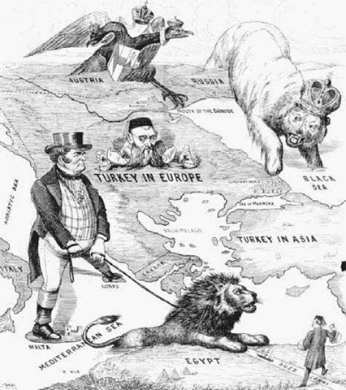
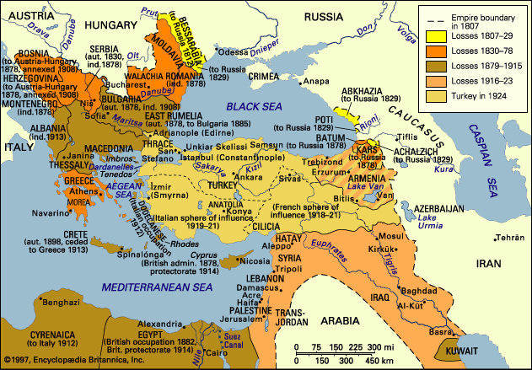
Europe and the Ottoman Empire

Slide 8
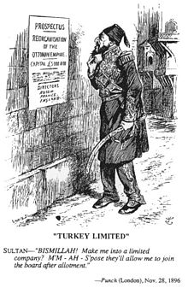
Tanzimat Reforms 1830’s along with Crimean War (1852-54) opens door to British and French domination of Ottoman Empire.
1830’s
Westernization
Ottoman Empire became a de facto (in reality) colony of Britain.
export raw materials - cotton and opium
British and French - extraterritorial rights
British and French control taxes, tariffs and tribute system of the Ottoman Empire.
Civilizing mission against Oriental despotism

Slide 9
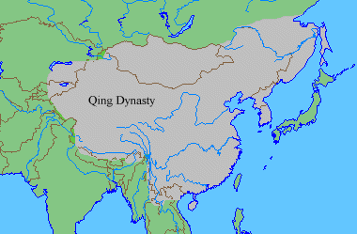
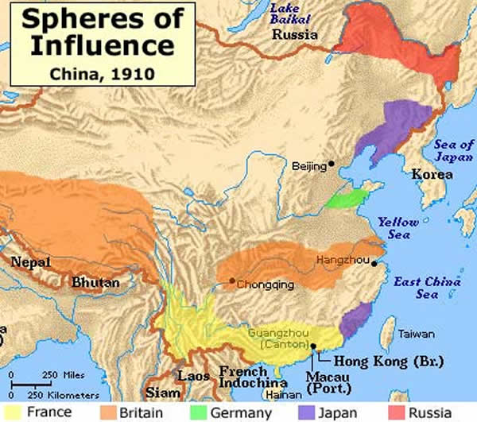
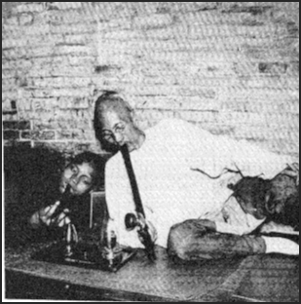
Europe and Qing Dynasty of China
unequal treaties:
Britain gets Hong Kong
extraterritoriality rights
port treaties
China was not colonized like India.
China enjoyed a favorable balance of trade = silver
British merchants introduce opium to Chinese merchants.
Opium War 1840-1842, 1850s
Treaty of Nanjing

Slide 10
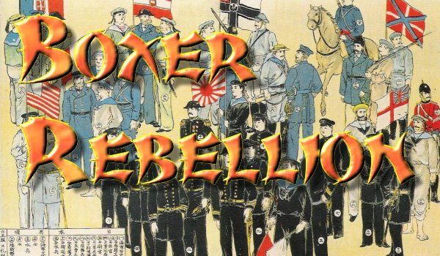
Chinese reaction:
Boxer Rebellion 1900
European nationalism in China
Qing still in power - partly because Westerners are helping them stop the rebellions.
Peasants overtaxed.

Slide 11
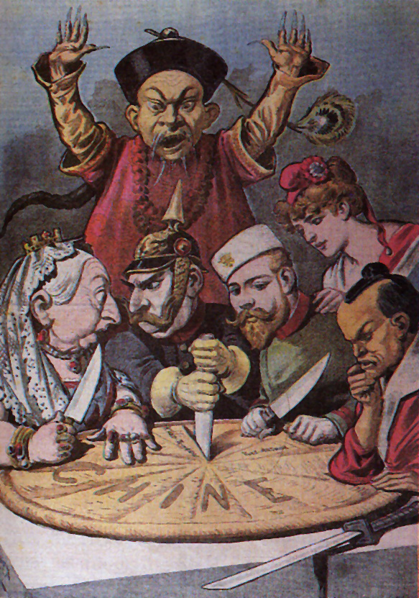
How did European rule over China’s Qing Empire and the Ottoman Empire differ from its rule over India?

Slide 12
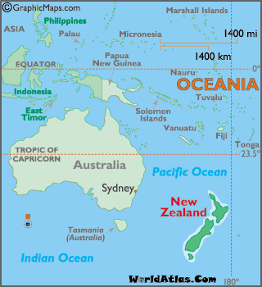
Europeans in Australia
penal colony = 1788
Australian Gold Rush = 1851
New Zealand = 1830’s
White settler colonies
British Dominions:
Canada 1867
Australia 1901
New Zealand 1907
South Africa 1910
What was the similarity between British settlement of the Americas and Australia and New Zealand?

Slide 13
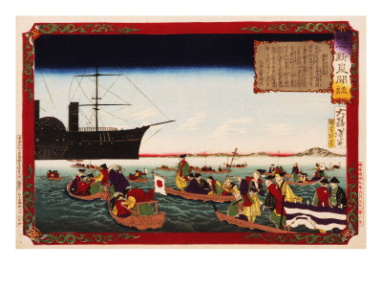
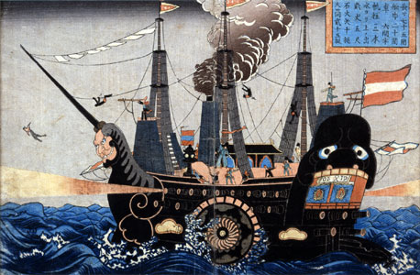
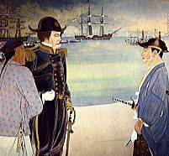
Europe and Japan
American Commodore Matthew Perry
Tokugawa Shogunate
What is this called in U.S. History?
Gunboat Diplomacy
How does the story end?

Slide 14
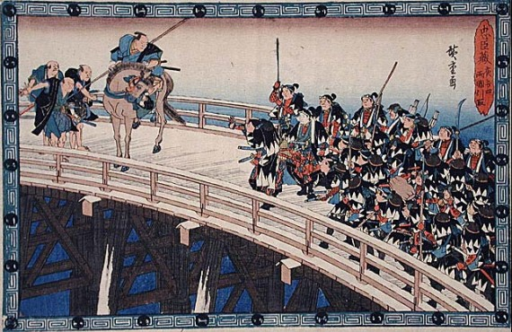
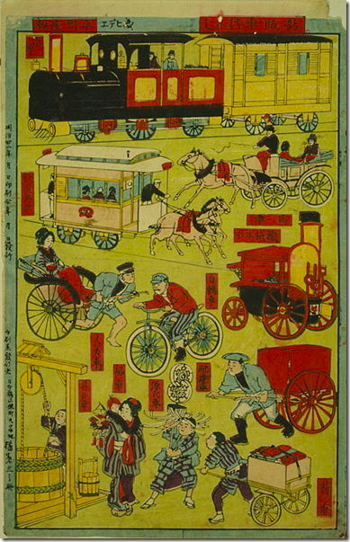
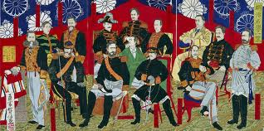
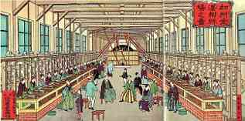
Meiji Restoration
Modernization
Industrialization
Militarization
of Japan
Imperialism will soon follow.

Slide 15

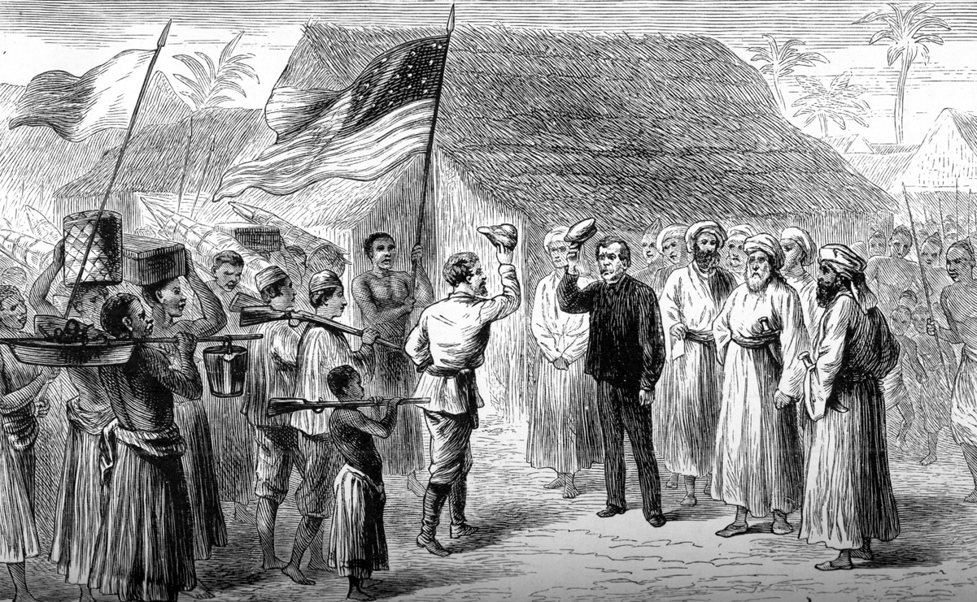
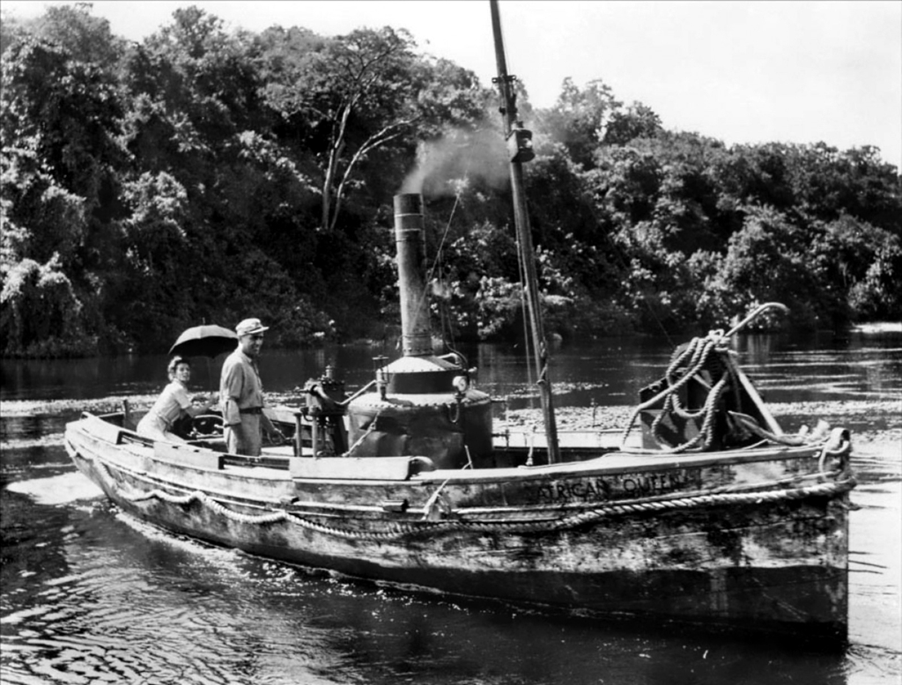

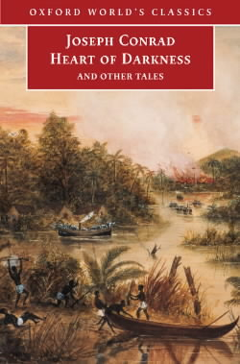
Europeans in Africa
+
=
Henry Stanley finds
David Livingstone
steamship
Novelists define Africa as a place of savagery and darkness:
Based on Tarzan of the Apes
by American novelist Edgar Rice Burroughs
Conrad - British novelist.
Francis Coppola will direct Vietnam film: Apocalypse Now

Slide 16
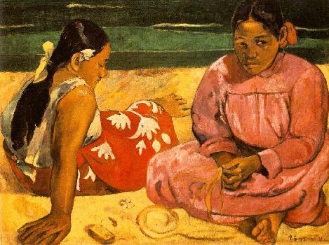
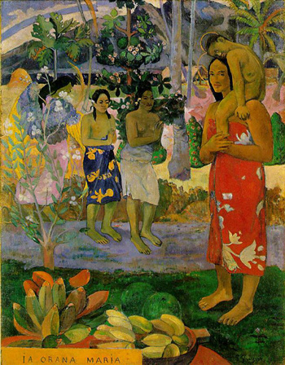
Imperialism and Art
Paul Gauguin
Post-Impressionism 1880-1905
Tahitian Women on the Beach 1891
Main theme:
highlights the exotic, the primitive
Rousseau’s concept of the uncorrupted nature of the uncivilized
We Greet You Mary 1891

Slide 17
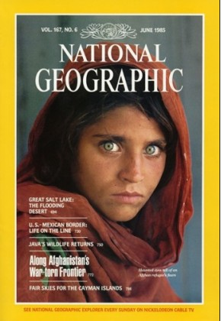

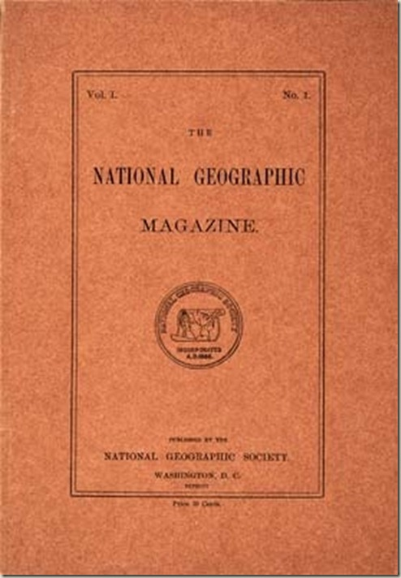


More on the primitive and exotic promoted in literature. . .
1885
Creating the image of
“the other”
“the exotic”
“the primitive”
17

Slide 18
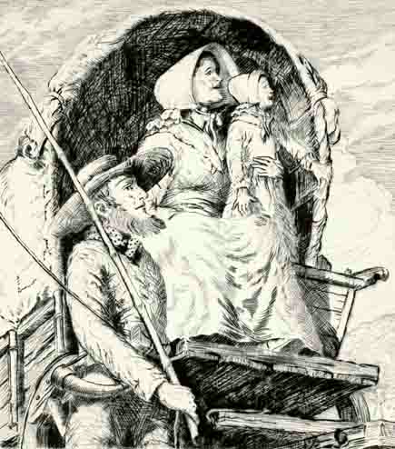
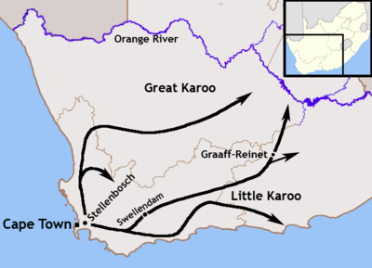
The Great Trek 1830’s-1840’s
South Africa
Boers
Afrikaners
Later: War between British and Boers:
Boer War 1889-1902

Slide 19
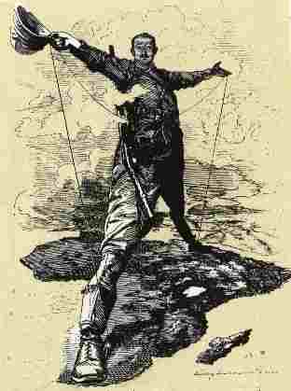
Boer Wars 1899 - 1902
Discovery of diamonds and gold
Cecil Rhodes
Result of war:
Union of South Africa created by the British
Afrikaner’s policy of Apartheid made law

Slide 20
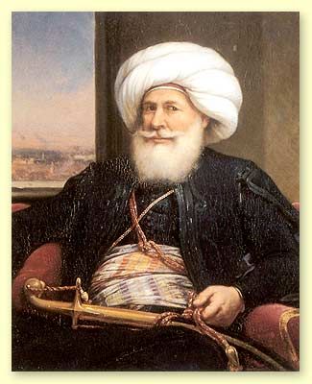
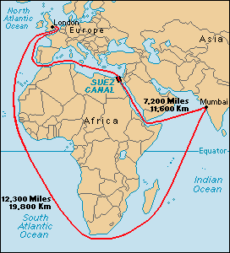
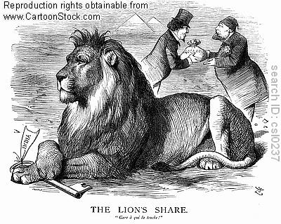
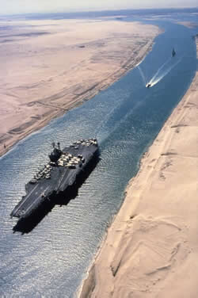
Egypt
Under Ottoman rule
Under rule of Napoleon 1798
Under rule of Mohammed Ali - khedive - governor - viceroy
Modernization of Egypt - builds canal with British funds and French engineer - Ferdinand Lessep 1859 - 1869

Slide 21
What’s fueling Imperialism in 1870 and beyond?
Nationalism more aggressive - national glory now seen through imperialism
New powerful nations: Germany, U.S. and Japan forces Britain and France to compete with each other once more. Both form the largest and 2nd largest empire.
Recession of 1870 - 1890 forces industrialized nations to secure colonies as tariffs are raised preventing free trade.
Imperialism is used by governments to bring unity to their nation as race hierarchy was substitute for social divisions at home.

Slide 22

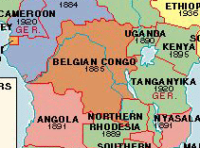
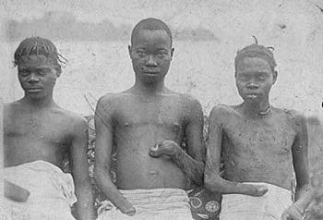
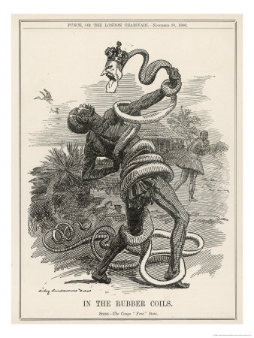
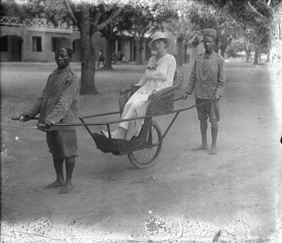
The Belgium Congo
22

Slide 23
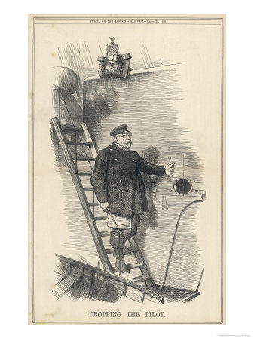
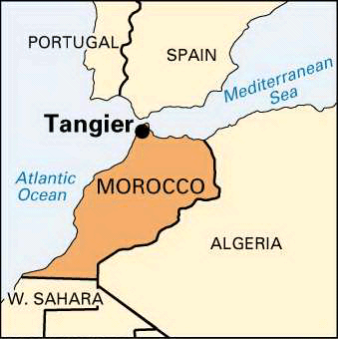
Germany - post Bismarck
Bismarck dismissed in 1890 by Kaiser William II
Germany then begins aggressive foreign policy in Africa - several Moroccan Crises

Slide 24
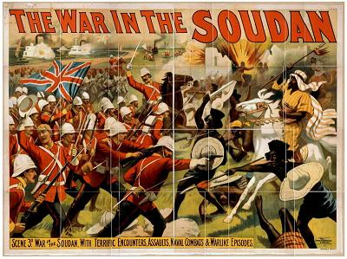
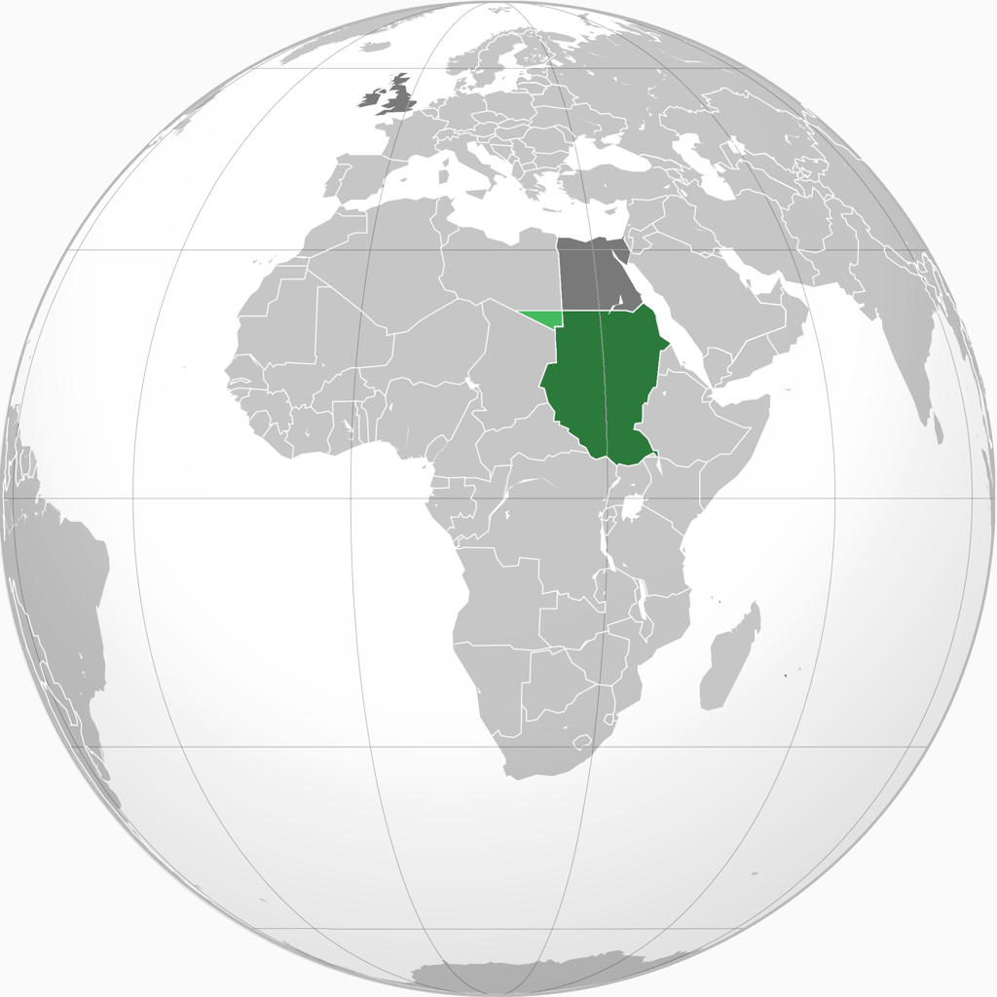
British in Egypt
British Lord Kitchener gains Sudan after war with Muslim Mahdist state

Slide 25
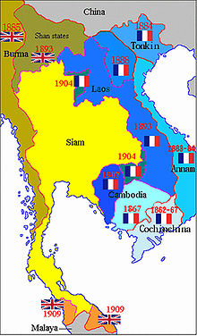
S.E. Asia
French Indochina
U.S. Imperialism
Results of Spanish American War 1898:
U.S.
Cuba
Puerto Rico
The Philippines
Open Door Policy 1898 - China

