Slide 1
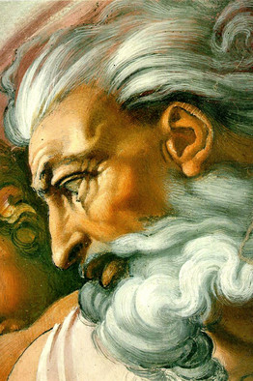
The Sacred Flame
Chapter 13

Slide 2

The Sacred Flame
All men were made in the image and likeness of God. All men are loved by God.
Everyone is worthy of respect, for everyone was made by God to be loved by God and to share in His life.
We must have self-respect and respect for others. To maintain this, we must do what is right and avoid doing what is wrong

Slide 3
The Sacred Flame
Man is fruitful and multiplies. Reproduction is a blessing from God.
Man is free and must use the power of reproduction according to God’s will and design.
God’s Commandments are not mere restrictions, but the way to true freedom and happiness.

Slide 4
The Sacred Flame
The Sixth Commandment guides our actions. The Ninth Commandment guides our thoughts. These Commandments require us to respect ourselves and others, and especially married life and the family.
God reserves the good of human sexuality for marriage. Any use of human sexuality outside of marriage is seriously sinful.
In marriage, we share in God’s creative powers. The love between a man and woman in marriage, made fruitful and blessed by God, lovingly brings a child into the family.

Slide 5
The Sacred Flame
The proper use of our sexual powers is called chastity. Chastity requires self-denial and self-control.
To be chaste, we must avoid occasions for sin and temptations. We must be modest in our appearance and in our observation.
Impurity is a sexual thought or action that violates the Sixth and Ninth Commandments.
All our actions start in our mind, so we should see the importance of properly directing our thoughts and desires.

