Slide 1
Animal structure & function
Chapter 20

Slide 2
Introduction
How can geckos climb walls and stick to the ceiling?
  The surfaces of gecko toes are covered by millions of microscopic hairs.
  Each hair has a slight molecular attraction that helps it stick to the surface.
  This adhesive relationship is an example of the correlation between structure and function.
© 2012 Pearson Education, Inc.
Notes:
2

Slide 3
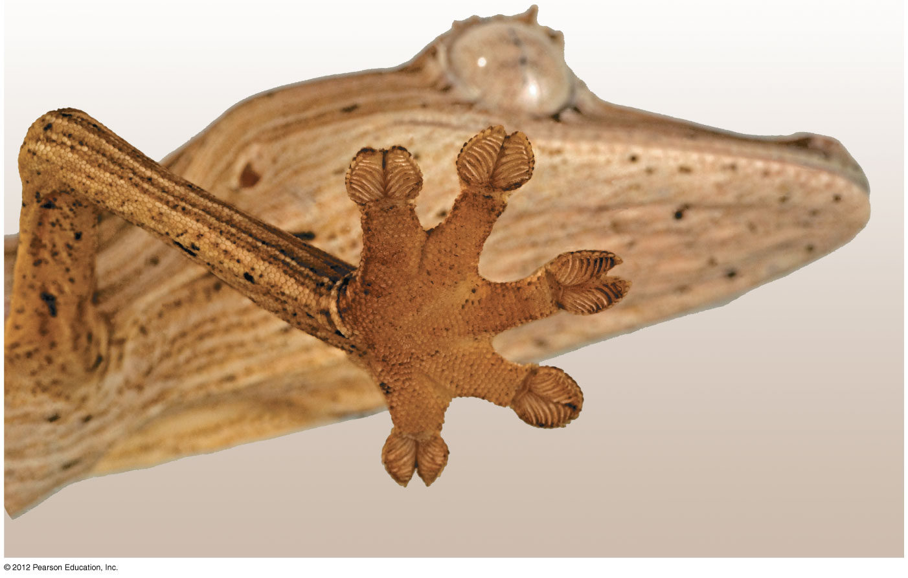
Figure 20.0_3
Microscopic hairs on the toes of a gecko
Notes:
3
Figure 20.0_3 Microscopic hairs on the toes of a gecko

Slide 4
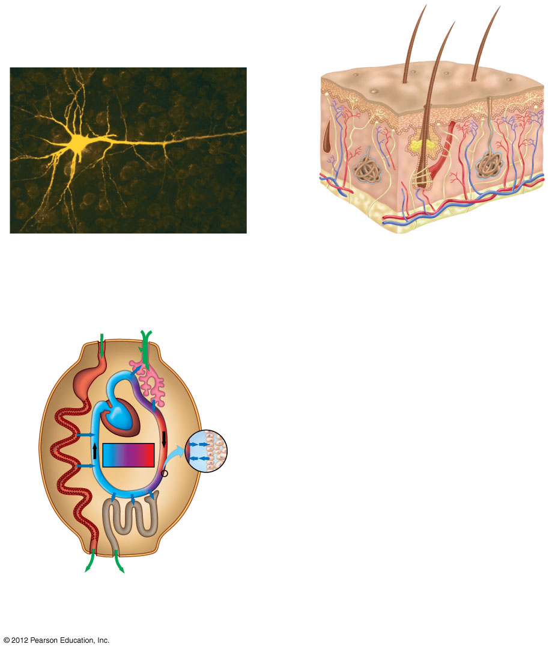
Figure 20.0_2
Chapter 20: Big Ideas
Structure and Function
in Animal Tissues
Organs and Organ
Systems
External Exchange and
Internal Regulation
Notes:
4
Figure 20.0_2 Chapter 20: Big Ideas

Slide 5
STRUCTURE AND FUNCTION IN ANIMAL TISSUES

Slide 6
20.1 Structure fits function at all levels of organization in the animal body
Anatomy is the study of structure.
Physiology is the study of function.
Animals consist of a hierarchy of levels or organization.
  Tissues are an integrated group of similar cells that perform a common function.
  Organs perform a specific task and consist of two or more tissues.
  Organ systems consist of multiple organs that together perform a vital body function.
© 2012 Pearson Education, Inc.
Notes:
6
Student Misconceptions and Concerns
1. Students often find it challenging to gain a proper understanding of the evolution of form and function relationships. Such relationships appear to have been “constructed” to meet a purpose, a consequence of deliberate planning and design. Ask students to explain why we have lungs, and they will typically answer something along the line of “because we need to breathe,” or “because we need oxygen.” Need, however, does not cause evolution. Natural selection involves editing rather than creating diversity. A better answer might be “Because lung-like structures conveyed an advantage in gas exchange in our ancestors.”
2. Relationships between form and function are found all around us. For some of us, noticing the connections is easy. However, many students have spent little time considering why any particular structure has its characteristic shape. Practice with examples helps to build a better understanding of these important relationships.
Teaching Tips
When you discuss form and function relationships, ask students to consider their own teeth as an example. Ask them to use their tongues to feel their teeth and relate the shape of the teeth to the human diet. Incisors and canines slice, while molars are more effective at crushing.

Slide 7
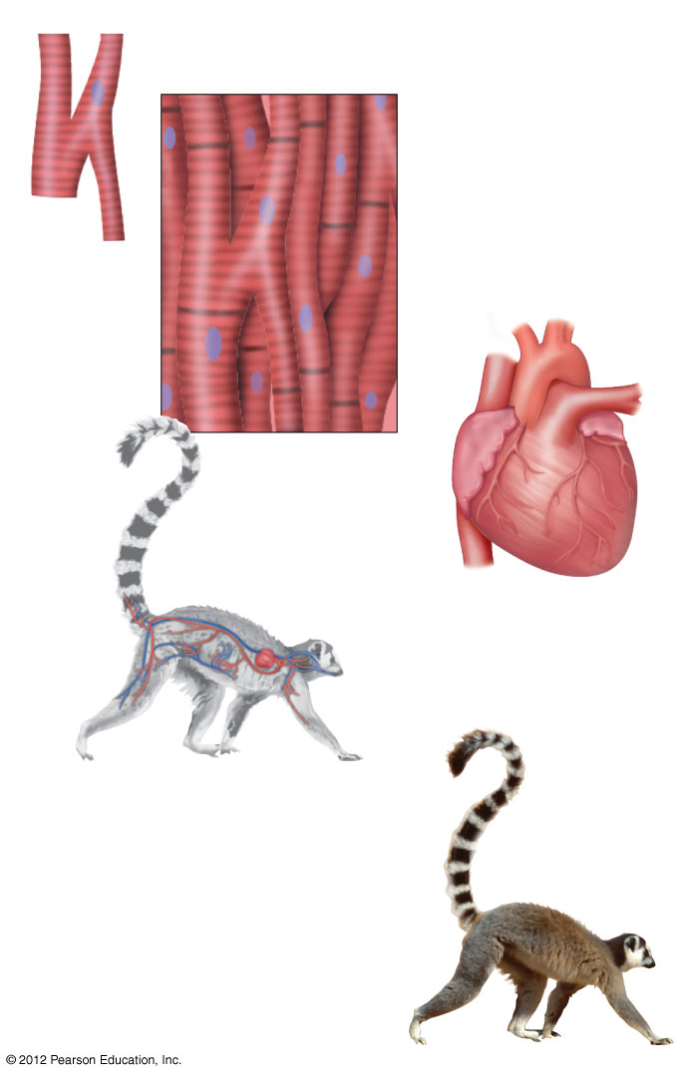
Figure 20.1
Cellular level
Muscle cell
Tissue level
Muscle tissue
Organ level
Heart
Organ system level
Circulatory system
Organism level
Many organ systems
functioning together
Notes:
7
Figure 20.1 A structural hierarchy in a ring-tailed lemur

Slide 8
20.2 EVOLUTION CONNECTION: An animal’s form reflects natural selection
The body plan or design of an organism
  reflects the relationship between form and function,
  results from natural selection
  Streamlined and tapered bodies
  increase swimming speeds and
  have similarly evolved in fish, sharks, and aquatic birds and mammals, representing convergent evolution.
© 2012 Pearson Education, Inc.
Notes:
8
Student Misconceptions and Concerns
1. Students often find it challenging to gain a proper understanding of the evolution of form and function relationships. Such relationships appear to have been “constructed” to meet a purpose, a consequence of deliberate planning and design. Ask students to explain why we have lungs, and they will typically answer something along the line of “because we need to breathe,” or “because we need oxygen.” Need, however, does not cause evolution. Natural selection involves editing rather than creating diversity. A better answer might be “Because lung-like structures conveyed an advantage in gas exchange in our ancestors.”
2. Relationships between form and function are found all around us. For some of us, noticing the connections is easy. However, many students have spent little time considering why any particular structure has its characteristic shape. Practice with examples helps to build a better understanding of these important relationships.
3. As noted in Module 20.2, the use of the term design in biology does not imply conscious invention. Instead, the term identifies the arrangement of the parts and their interrelated functions. Natural selection is not a deliberate process.
Teaching Tips
Students often fail to consider the significance of body size. Consider asking your students to think about the impact of being small. Have they ever had difficulty emerging from a swimming pool because of the adhesive properties of water? Of course not—and yet, small insects that land on a pond’s surface may find these forces to be lethal, preventing them from breaking away from the water’s surface! Ask students if they are ever unable to leave their homes because of high winds, which make it impossible for them to walk around outside. The movements of small insects are often hampered by winds that would do little more than toss around our hair! Many campers know that mosquitoes and flies are less of a nuisance on days when there is a good breeze.

Slide 9
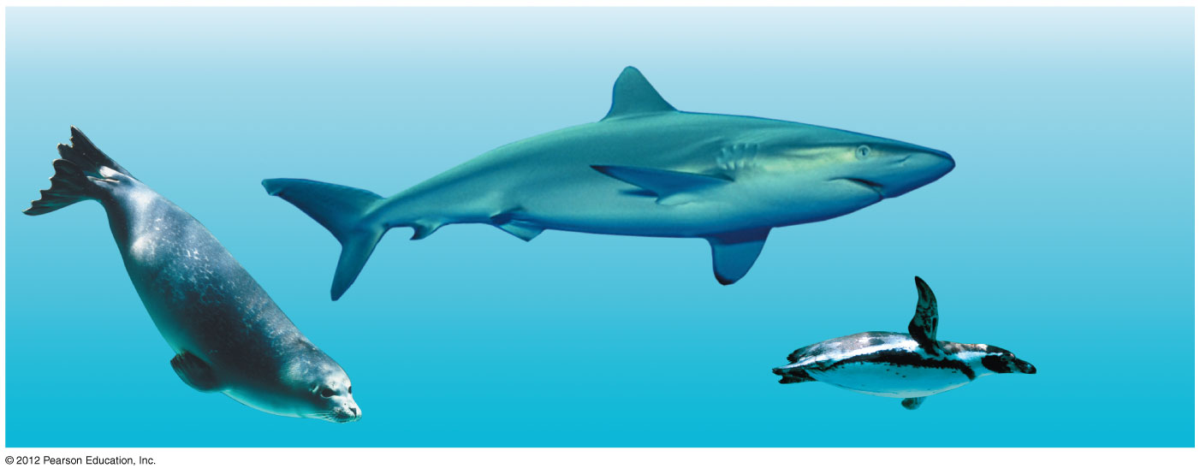
20.2 EVOLUTION CONNECTION: An animal’s form reflects natural selection
The body plan or design of an organism
  reflects the relationship between form and function,
  results from natural selection, and
  does not imply a process of conscious invention.
Streamlined and tapered bodies
  increase swimming speeds and
  have similarly evolved in fish, sharks, and aquatic birds and mammals, representing convergent evolution.
© 2012 Pearson Education, Inc.
Notes:
9
Student Misconceptions and Concerns
1. Students often find it challenging to gain a proper understanding of the evolution of form and function relationships. Such relationships appear to have been “constructed” to meet a purpose, a consequence of deliberate planning and design. Ask students to explain why we have lungs, and they will typically answer something along the line of “because we need to breathe,” or “because we need oxygen.” Need, however, does not cause evolution. Natural selection involves editing rather than creating diversity. A better answer might be “Because lung-like structures conveyed an advantage in gas exchange in our ancestors.”
2. Relationships between form and function are found all around us. For some of us, noticing the connections is easy. However, many students have spent little time considering why any particular structure has its characteristic shape. Practice with examples helps to build a better understanding of these important relationships.
3. As noted in Module 20.2, the use of the term design in biology does not imply conscious invention. Instead, the term identifies the arrangement of the parts and their interrelated functions. Natural selection is not a deliberate process.
Teaching Tips
Students often fail to consider the significance of body size. Consider asking your students to think about the impact of being small. Have they ever had difficulty emerging from a swimming pool because of the adhesive properties of water? Of course not—and yet, small insects that land on a pond’s surface may find these forces to be lethal, preventing them from breaking away from the water’s surface! Ask students if they are ever unable to leave their homes because of high winds, which make it impossible for them to walk around outside. The movements of small insects are often hampered by winds that would do little more than toss around our hair! Many campers know that mosquitoes and flies are less of a nuisance on days when there is a good breeze.

Slide 10
20.3 Tissues are groups of cells with a common structure and function
      Tissues
        are an integrated group of similar cells that perform a common function and
        combine to form organs.
      Animals have four main categories of tissues:
        epithelial tissue,
        connective tissue,
        muscle tissue, and
        nervous tissue.
© 2012 Pearson Education, Inc.
Notes:
10
Student Misconceptions and Concerns
1. Students often find it challenging to gain a proper understanding of the evolution of form and function relationships. Such relationships appear to have been “constructed” to meet a purpose, a consequence of deliberate planning and design. Ask students to explain why we have lungs, and they will typically answer something along the line of “because we need to breathe,” or “because we need oxygen.” Need, however, does not cause evolution. Natural selection involves editing rather than creating diversity. A better answer might be “Because lung-like structures conveyed an advantage in gas exchange in our ancestors.”
2. Relationships between form and function are found all around us. For some of us, noticing the connections is easy. However, many students have spent little time considering why any particular structure has its characteristic shape. Practice with examples helps to build a better understanding of these important relationships.
Teaching Tips
Extracellular substances, such as collagen fibers, are the source of the main functional properties of many connective tissues such as tendons, ligaments, cartilage, and bone.

Slide 11
20.4 Epithelial tissue covers the body and lines its organs and cavities
Epithelial tissues, or epithelia, are sheets of closely packed cells that
  cover body surfaces and
  line internal organs and cavities.
Epithelial cells come in three shapes:
  squamous—like a fried egg,
  cuboidal—as tall as they are wide, and
  columnar—taller than they are wide.
  Epithelial tissues are named according to the
    number of cell layers they have and
    shape of the cells on their apical surface.
© 2012 Pearson Education, Inc.
Notes:
11
Student Misconceptions and Concerns
1. Students often find it challenging to gain a proper understanding of the evolution of form and function relationships. Such relationships appear to have been “constructed” to meet a purpose, a consequence of deliberate planning and design. Ask students to explain why we have lungs, and they will typically answer something along the line of “because we need to breathe,” or “because we need oxygen.” Need, however, does not cause evolution. Natural selection involves editing rather than creating diversity. A better answer might be “Because lung-like structures conveyed an advantage in gas exchange in our ancestors.”
2. Relationships between form and function are found all around us. For some of us, noticing the connections is easy. However, many students have spent little time considering why any particular structure has its characteristic shape. Practice with examples helps to build a better understanding of these important relationships.
Teaching Tips
1. Simple squamous cells have a shape that is generally similar to a fried egg: flattened, with a bump in the middle representing the nucleus or yolk.
2. Students might misunderstand how the cilia lining our respiratory passages work. Cilia do not “filter” the air like a comb. Instead, cilia are covered by a layer of mucus. Dust particles adhere to sticky mucus, which is then swept up the respiratory tract by the cilia. If students clear their throats, they will identify the fate of this mucus. We swallow after clearing our throats!

Slide 12
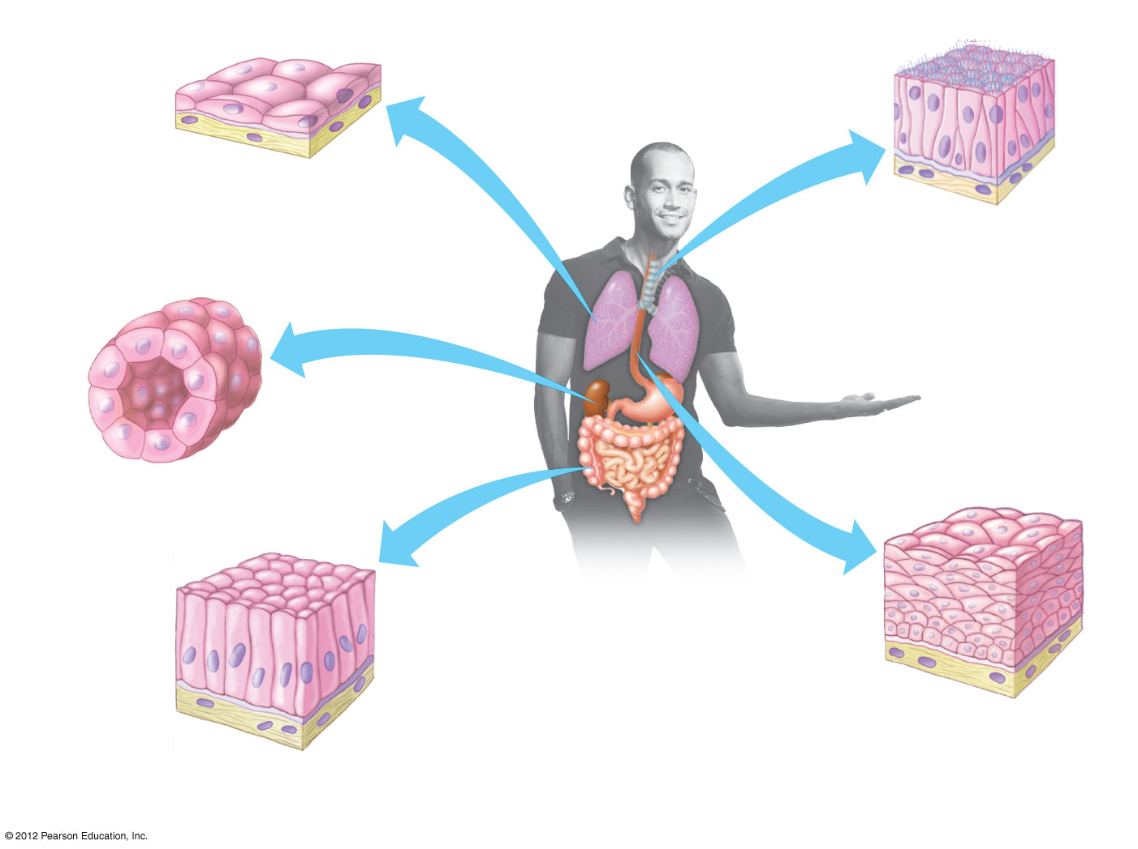
Figure 20.4
Apical surface of
epithelium
Basal
lamina
Underlying
tissue
Cell nuclei
Simple squamous
epithelium
Pseudostratified
ciliated columnar
epithelium
Simple cuboidal
epithelium
Stratified squamous
epithelium
Simple columnar
epithelium
Notes:
12
Figure 20.4 Types of epithelial tissue

Slide 13
20.5 Connective tissue binds and supports other tissues
Connective tissue can be grouped into six major types.
  Loose connective tissue
    is the most widespread,
    consists of ropelike collagen and elastic fibers that are strong and resilient, and
    helps to join skin to underlying tissues.
  Fibrous connective tissue
    has densely packed collagen fibers and
    forms tendons that attach muscle to bone.
© 2012 Pearson Education, Inc.
Notes:
13
Student Misconceptions and Concerns
1. Students often find it challenging to gain a proper understanding of the evolution of form and function relationships. Such relationships appear to have been “constructed” to meet a purpose, a consequence of deliberate planning and design. Ask students to explain why we have lungs, and they will typically answer something along the line of “because we need to breathe,” or “because we need oxygen.” Need, however, does not cause evolution. Natural selection involves editing rather than creating diversity. A better answer might be “Because lung-like structures conveyed an advantage in gas exchange in our ancestors.”
2. Relationships between form and function are found all around us. For some of us, noticing the connections is easy. However, many students have spent little time considering why any particular structure has its characteristic shape. Practice with examples helps to build a better understanding of these important relationships.
Teaching Tips
The elastic cartilage in the human ear is a wonderful example of a form and function relationship. Elastic fibers are abundant in the extracellular matrix, increasing the flexibility of elastic cartilage. Have students bend their own ears to feel the effects.

Slide 14
20.5 Connective tissue binds and supports other tissues
    Adipose tissue stores fat in large, closely packed cells held in a matrix of fibers.
    Cartilage
      is a strong and flexible skeletal material and
      commonly surrounds the ends of bones.
    Bone
      has a matrix of collagen fibers
      embedded in a hard mineral substance containing calcium, magnesium, and phosphate.
    Blood transports substances throughout the body.
© 2012 Pearson Education, Inc.
Notes:
14
Student Misconceptions and Concerns
1. Students often find it challenging to gain a proper understanding of the evolution of form and function relationships. Such relationships appear to have been “constructed” to meet a purpose, a consequence of deliberate planning and design. Ask students to explain why we have lungs, and they will typically answer something along the line of “because we need to breathe,” or “because we need oxygen.” Need, however, does not cause evolution. Natural selection involves editing rather than creating diversity. A better answer might be “Because lung-like structures conveyed an advantage in gas exchange in our ancestors.”
2. Relationships between form and function are found all around us. For some of us, noticing the connections is easy. However, many students have spent little time considering why any particular structure has its characteristic shape. Practice with examples helps to build a better understanding of these important relationships.
Teaching Tips
The elastic cartilage in the human ear is a wonderful example of a form and function relationship. Elastic fibers are abundant in the extracellular matrix, increasing the flexibility of elastic cartilage. Have students bend their own ears to feel the effects.

Slide 15
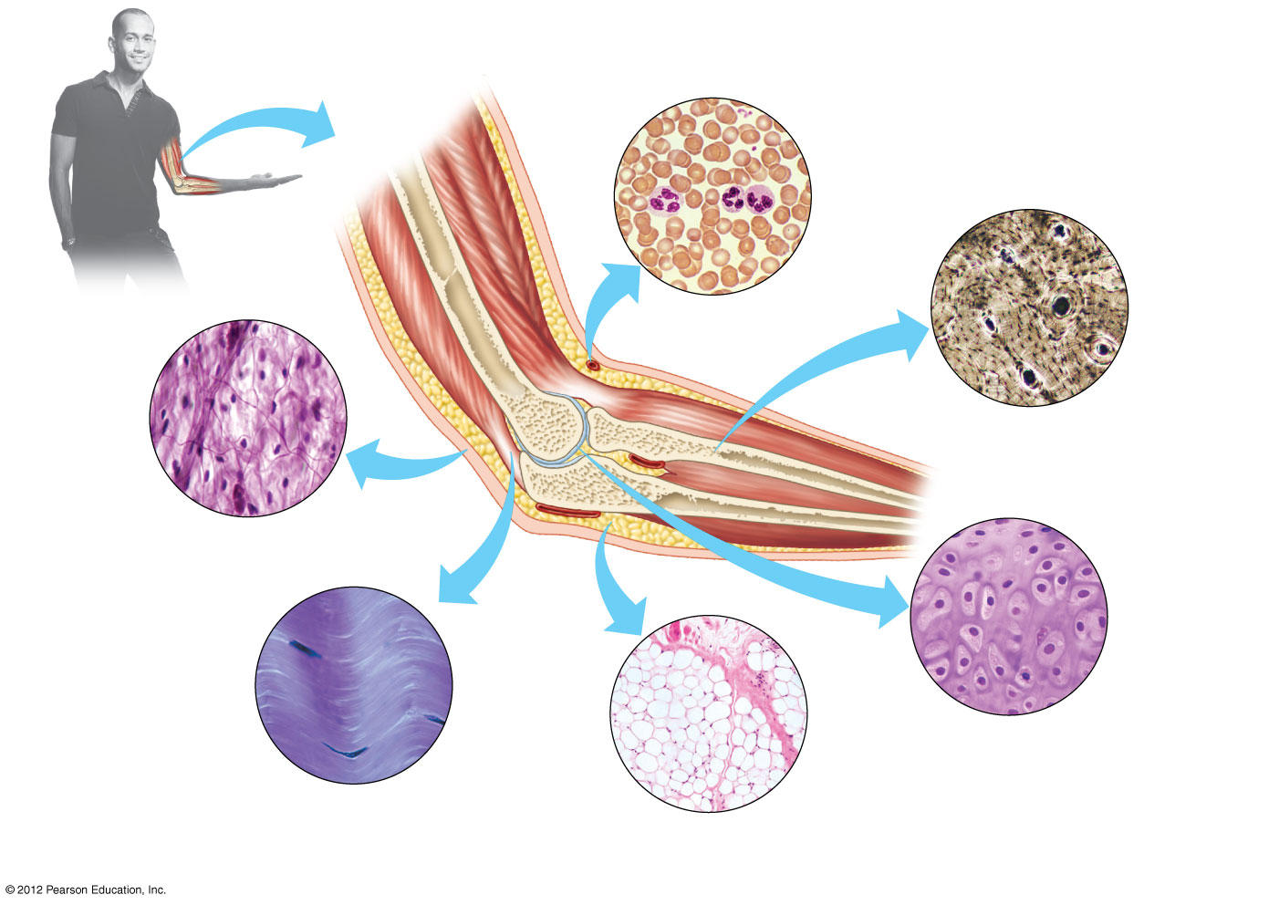
Figure 20.5
White blood
cells
Red blood
cell
Central
canal
Plasma
Cell
nucleus
Blood
Matrix
Collagen
fiber
Bone-
forming
cells
Bone
Elastic
fibers
Loose connective tissue
(under the skin)
Cartilage-
forming
cells
Cell nucleus
Fat
droplets
Matrix
Collagen
fibers
Cartilage
(at the end
of a bone)
Fibrous connective
tissue (forming a tendon)
Adipose
tissue
Notes:
15
Figure 20.5 Types of connective tissue

Slide 16
20.6 Muscle tissue functions in movement
Muscle tissue is the most abundant tissue in most animals.
There are three types of vertebrate muscle tissue:
  Skeletal muscle causes voluntary movements.
  Cardiac muscle pumps blood.
  Smooth muscle moves walls of internal organs, such as the intestines.
© 2012 Pearson Education, Inc.
Notes:
16
Student Misconceptions and Concerns
1. Students often find it challenging to gain a proper understanding of the evolution of form and function relationships. Such relationships appear to have been “constructed” to meet a purpose, a consequence of deliberate planning and design. Ask students to explain why we have lungs, and they will typically answer something along the line of “because we need to breathe,” or “because we need oxygen.” Need, however, does not cause evolution. Natural selection involves editing rather than creating diversity. A better answer might be “Because lung-like structures conveyed an advantage in gas exchange in our ancestors.”
2. Relationships between form and function are found all around us. For some of us, noticing the connections is easy. However, many students have spent little time considering why any particular structure has its characteristic shape. Practice with examples helps to build a better understanding of these important relationships.
Teaching Tips
Muscle cells are only able to contract. None can actively relengthen. Challenge your students to explain how muscle cells return to their extended length. (Answer: Opposing muscles or other forces, such as gravity, act in opposition to relengthen muscle cells when they relax.)

Slide 17
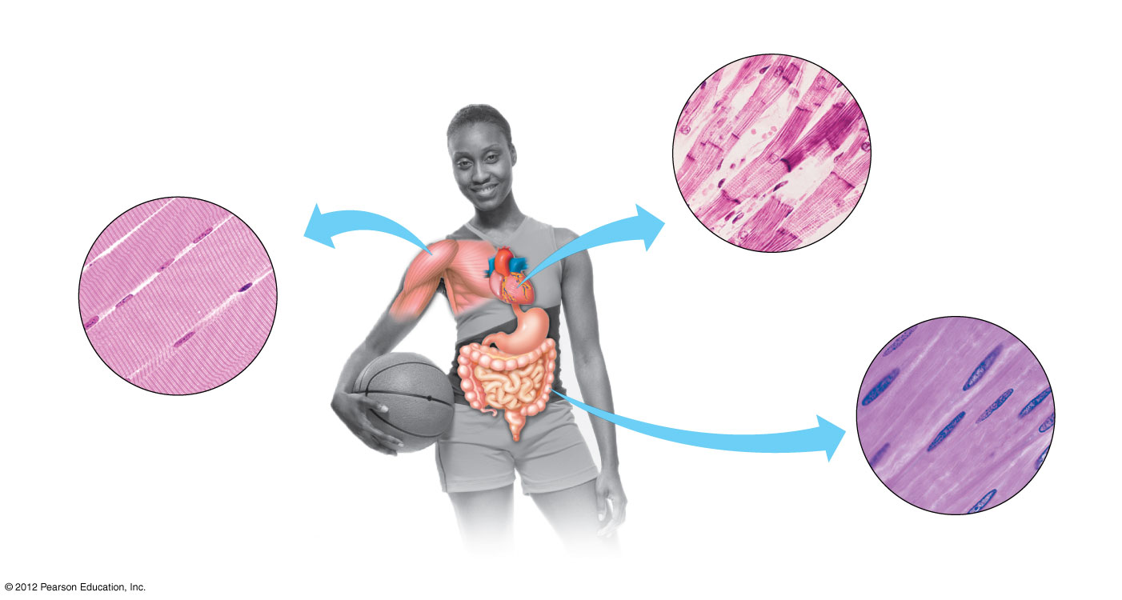
Figure 20.6
Muscle
fiber
Junction
between
two cells
Unit of
muscle
contraction
Muscle
fiber
(cell)
Nucleus
Cardiac
muscle
Muscle
fiber
Nuclei
Nucleus
Skeletal
muscle
Smooth
muscle
Notes:
17
Figure 20.6 The three types of muscle tissue

Slide 18
20.7 Nervous tissue forms a communication network
Nervous tissue
  senses stimuli and
  rapidly transmits information.
Neurons carry signals by conducting electrical impulses.
Other cells in nervous tissue
  insulate axons,
  nourish neurons, and
  regulate the fluid around neurons.
© 2012 Pearson Education, Inc.
Notes:
18
Student Misconceptions and Concerns
1. Students often find it challenging to gain a proper understanding of the evolution of form and function relationships. Such relationships appear to have been “constructed” to meet a purpose, a consequence of deliberate planning and design. Ask students to explain why we have lungs, and they will typically answer something along the line of “because we need to breathe,” or “because we need oxygen.” Need, however, does not cause evolution. Natural selection involves editing rather than creating diversity. A better answer might be “Because lung-like structures conveyed an advantage in gas exchange in our ancestors.”
2. Relationships between form and function are found all around us. For some of us, noticing the connections is easy. However, many students have spent little time considering why any particular structure has its characteristic shape. Practice with examples helps to build a better understanding of these important relationships.
Teaching Tips
Students might enjoy this simple observation when discussing neurons. As we consider the structure and functions of neurons, we are using our own neurons to think about them. Our neurons become self-aware!

Slide 19
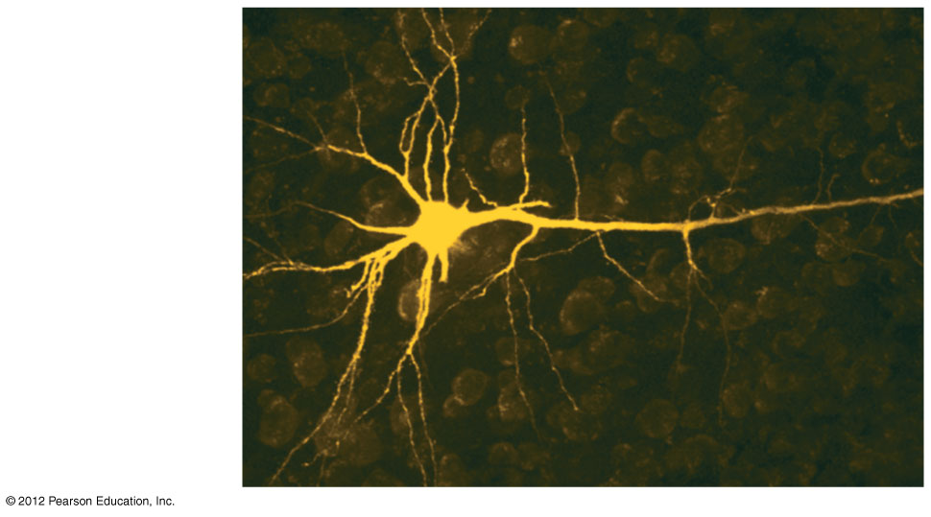
Figure 20.7
Dendrites
Cell body
Axon
Notes:
19
Figure 20.7 A neuron

Slide 20
ORGANS AND ORGAN SYSTEMS
© 2012 Pearson Education, Inc.
Notes:
20

Slide 21
20.8 Organs are made up of tissues
Each tissue performs specific functions.
The heart has
  extensive muscle that generates contractions,
  epithelial tissues that line the heart chambers,
  connective tissues that make the heart elastic, and
  neurons that regulate contractions.
© 2012 Pearson Education, Inc.
Notes:
21
Student Misconceptions and Concerns
1. Students often find it challenging to gain a proper understanding of the evolution of form and function relationships. Such relationships appear to have been “constructed” to meet a purpose, a consequence of deliberate planning and design. Ask students to explain why we have lungs, and they will typically answer something along the line of “because we need to breathe,” or “because we need oxygen.” Need, however, does not cause evolution. Natural selection involves editing rather than creating diversity. A better answer might be “Because lung-like structures conveyed an advantage in gas exchange in our ancestors.”
2. Relationships between form and function are found all around us. For some of us, noticing the connections is easy. However, many students have spent little time considering why any particular structure has its characteristic shape. Practice with examples helps to build a better understanding of these important relationships.
Teaching Tips
Sponges are well adapted to maximize surface area exposed to water. Like the small intestine with its many villi, the highly porous structure of sponges dramatically increases the area available for water filtering.

Slide 22
20.8 Organs are made up of tissues
The small intestine
  is lined by a columnar epithelium,
  includes connective tissues that contain blood vessels, and
  has two layers of smooth muscle that help propel food.
The inner surface of the small intestine has many fingerlike projections that increase the surface area for absorption.
© 2012 Pearson Education, Inc.
Notes:
22
Student Misconceptions and Concerns
1. Students often find it challenging to gain a proper understanding of the evolution of form and function relationships. Such relationships appear to have been “constructed” to meet a purpose, a consequence of deliberate planning and design. Ask students to explain why we have lungs, and they will typically answer something along the line of “because we need to breathe,” or “because we need oxygen.” Need, however, does not cause evolution. Natural selection involves editing rather than creating diversity. A better answer might be “Because lung-like structures conveyed an advantage in gas exchange in our ancestors.”
2. Relationships between form and function are found all around us. For some of us, noticing the connections is easy. However, many students have spent little time considering why any particular structure has its characteristic shape. Practice with examples helps to build a better understanding of these important relationships.
Teaching Tips
Sponges are well adapted to maximize surface area exposed to water. Like the small intestine with its many villi, the highly porous structure of sponges dramatically increases the area available for water filtering.

Slide 23
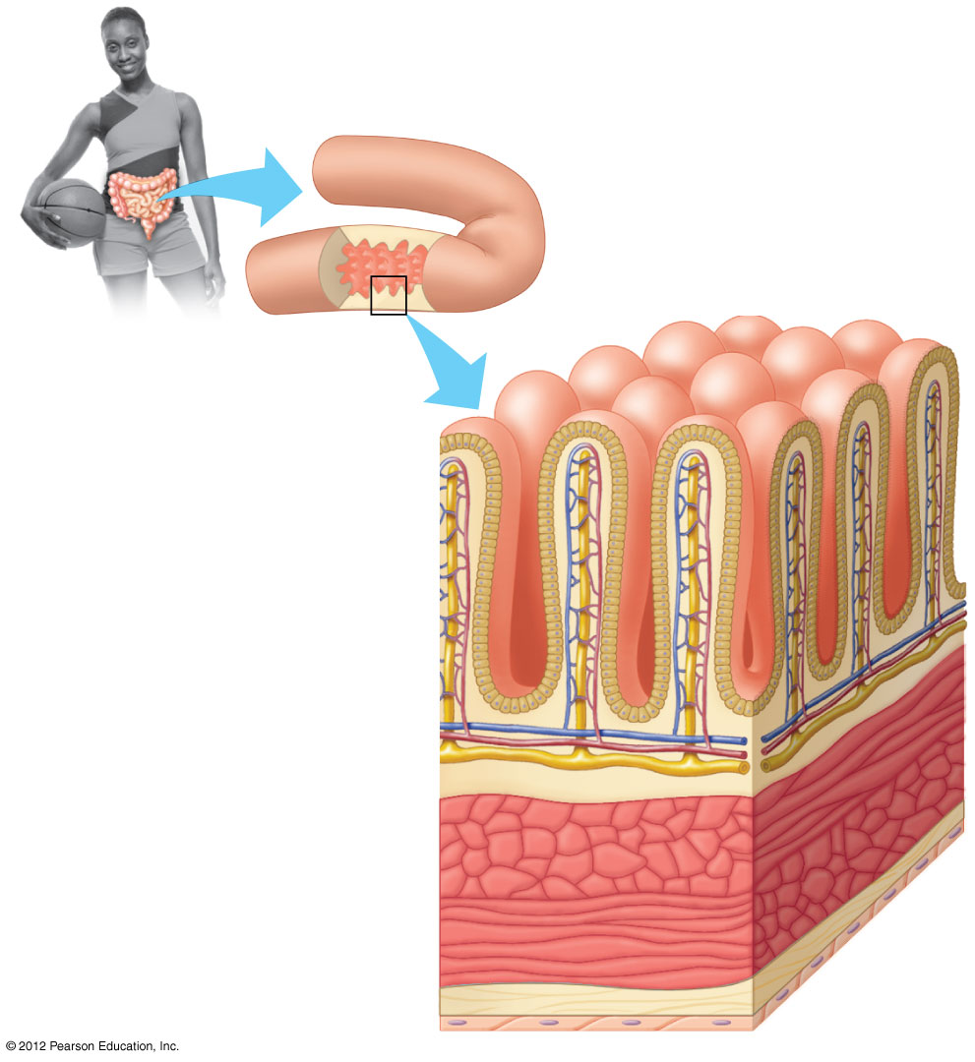
Figure 20.8
Small intestine
Lumen
Epithelial tissue
(columnar epithelium)
Connective tissue
Smooth muscle
tissue (two layers)
Connective tissue
Epithelial tissue
Notes:
23
Figure 20.8 Tissue layers of the wall of the small intestine

Slide 24
20.9 CONNECTION: Bioengineers are learning to produce tissues and organs for transplants
Bioengineering is seeking ways to repair or replace damaged tissues and organs.
New tissues and organs are being grown using a patient’s own cells.
These techniques
  remove the risk of tissue rejection and
  may someday reduce the shortage of organs available for transplants.
© 2012 Pearson Education, Inc.
Notes:
24
Student Misconceptions and Concerns
1. Students often find it challenging to gain a proper understanding of the evolution of form and function relationships. Such relationships appear to have been “constructed” to meet a purpose, a consequence of deliberate planning and design. Ask students to explain why we have lungs, and they will typically answer something along the line of “because we need to breathe,” or “because we need oxygen.” Need, however, does not cause evolution. Natural selection involves editing rather than creating diversity. A better answer might be “Because lung-like structures conveyed an advantage in gas exchange in our ancestors.”
2. Relationships between form and function are found all around us. For some of us, noticing the connections is easy. However, many students have spent little time considering why any particular structure has its characteristic shape. Practice with examples helps to build a better understanding of these important relationships.
Teaching Tips
As noted in Module 20.9, researchers often use cells derived from newborn foreskin tissue. Students may not realize that this is actually the excess tissue removed during circumcision of newborn baby boys. Such tissues are widely available as a by-product of this procedure.

Slide 25
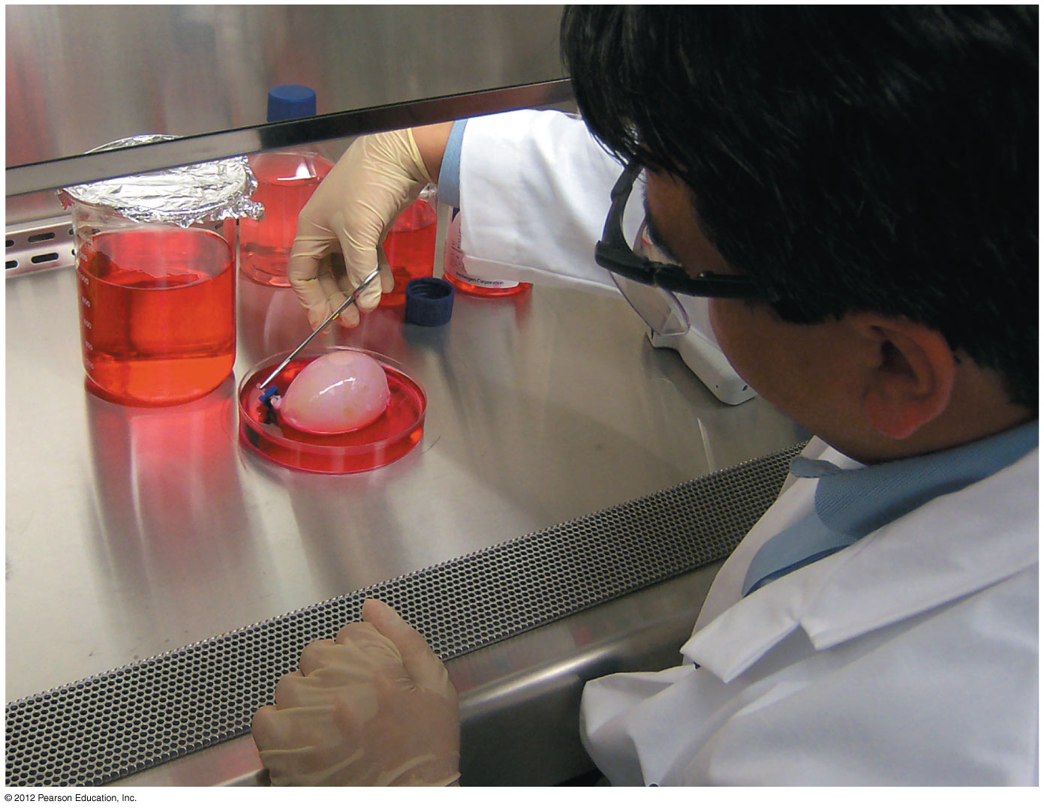
Figure 20.9
A laboratory grown bladder
Notes:
25
Figure 20.9 A laboratory-grown bladder

Slide 26
20.10 Organ systems work together to perform life’s functions
Each organ system
  typically consists of many organs,
  has one or more functions, and
  works with other organ systems to create a functional organism.
© 2012 Pearson Education, Inc.
Notes:
26
Student Misconceptions and Concerns
1. Students often find it challenging to gain a proper understanding of the evolution of form and function relationships. Such relationships appear to have been “constructed” to meet a purpose, a consequence of deliberate planning and design. Ask students to explain why we have lungs, and they will typically answer something along the line of “because we need to breathe,” or “because we need oxygen.” Need, however, does not cause evolution. Natural selection involves editing rather than creating diversity. A better answer might be “Because lung-like structures conveyed an advantage in gas exchange in our ancestors.”
2. Relationships between form and function are found all around us. For some of us, noticing the connections is easy. However, many students have spent little time considering why any particular structure has its characteristic shape. Practice with examples helps to build a better understanding of these important relationships.
Teaching Tips
To help them appreciate the functional integration of the major systems of the body, have students pick any system and discuss its relationship to the other body systems. As a start, you might begin with the circulatory system. As each successive system is covered, you can create a concept map noting the nature of each interrelationship.

Slide 27
20.10 Organ systems work together to perform life’s functions
The skeletal and muscular systems support and move the body.
The digestive and respiratory systems obtain food and oxygen.
The circulatory system transports these materials.
The urinary system disposes of wastes.
The integumentary system covers the body.
© 2012 Pearson Education, Inc.
Notes:
27
Student Misconceptions and Concerns
1. Students often find it challenging to gain a proper understanding of the evolution of form and function relationships. Such relationships appear to have been “constructed” to meet a purpose, a consequence of deliberate planning and design. Ask students to explain why we have lungs, and they will typically answer something along the line of “because we need to breathe,” or “because we need oxygen.” Need, however, does not cause evolution. Natural selection involves editing rather than creating diversity. A better answer might be “Because lung-like structures conveyed an advantage in gas exchange in our ancestors.”
2. Relationships between form and function are found all around us. For some of us, noticing the connections is easy. However, many students have spent little time considering why any particular structure has its characteristic shape. Practice with examples helps to build a better understanding of these important relationships.
Teaching Tips
To help them appreciate the functional integration of the major systems of the body, have students pick any system and discuss its relationship to the other body systems. As a start, you might begin with the circulatory system. As each successive system is covered, you can create a concept map noting the nature of each interrelationship.

Slide 28
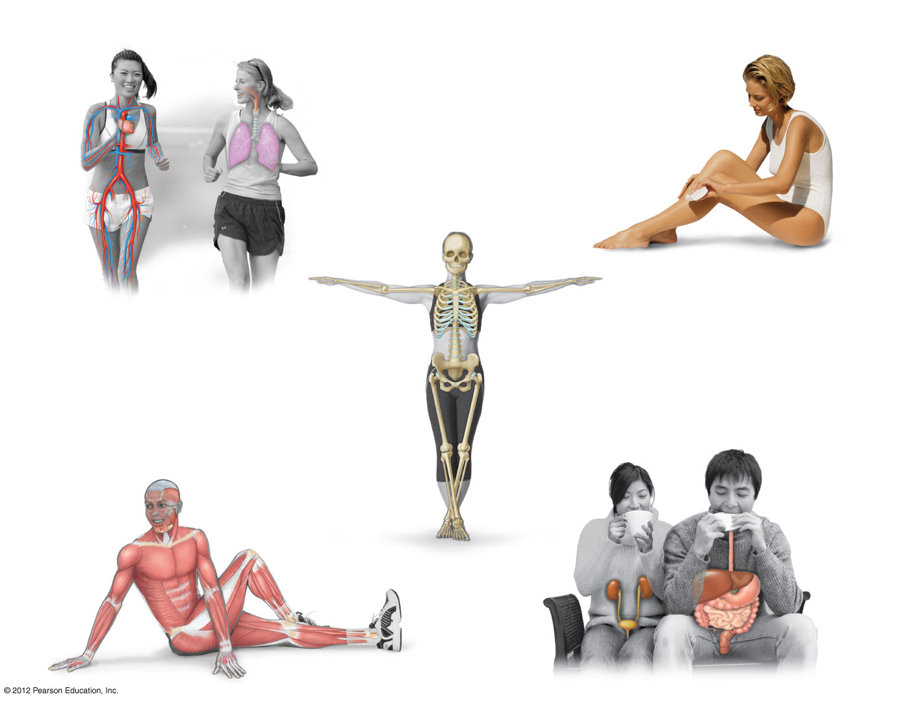
Figure 20.10_L
Circulatory
system
Respiratory
system
Integumentary system
Nasal
cavity
Pharynx
Hair
Larynx
Heart
Trachea
Skin
Bronchus
Lung
Nails
Blood
vessels
Skeletal system
Bone
Cartilage
Urinary
system
Digestive
system
Muscular system
Mouth
Esophagus
Skeletal muscles
Liver
Kidney
Stomach
Ureter
Small
intestine
Urinary
bladder
Large
intestine
Urethra
Anus
Notes:
28
Figure 20.10_L Human organ systems and their component parts (left)

Slide 29
20.10 Organ systems work together to perform life’s functions
The lymphatic and immune systems protect the body from infection.
The nervous and endocrine systems control and coordinate body functions.
The reproductive system produces offspring.
© 2012 Pearson Education, Inc.
Notes:
29
Student Misconceptions and Concerns
1. Students often find it challenging to gain a proper understanding of the evolution of form and function relationships. Such relationships appear to have been “constructed” to meet a purpose, a consequence of deliberate planning and design. Ask students to explain why we have lungs, and they will typically answer something along the line of “because we need to breathe,” or “because we need oxygen.” Need, however, does not cause evolution. Natural selection involves editing rather than creating diversity. A better answer might be “Because lung-like structures conveyed an advantage in gas exchange in our ancestors.”
2. Relationships between form and function are found all around us. For some of us, noticing the connections is easy. However, many students have spent little time considering why any particular structure has its characteristic shape. Practice with examples helps to build a better understanding of these important relationships.
Teaching Tips
To help them appreciate the functional integration of the major systems of the body, have students pick any system and discuss its relationship to the other body systems. As a start, you might begin with the circulatory system. As each successive system is covered, you can create a concept map noting the nature of each interrelationship.

Slide 30
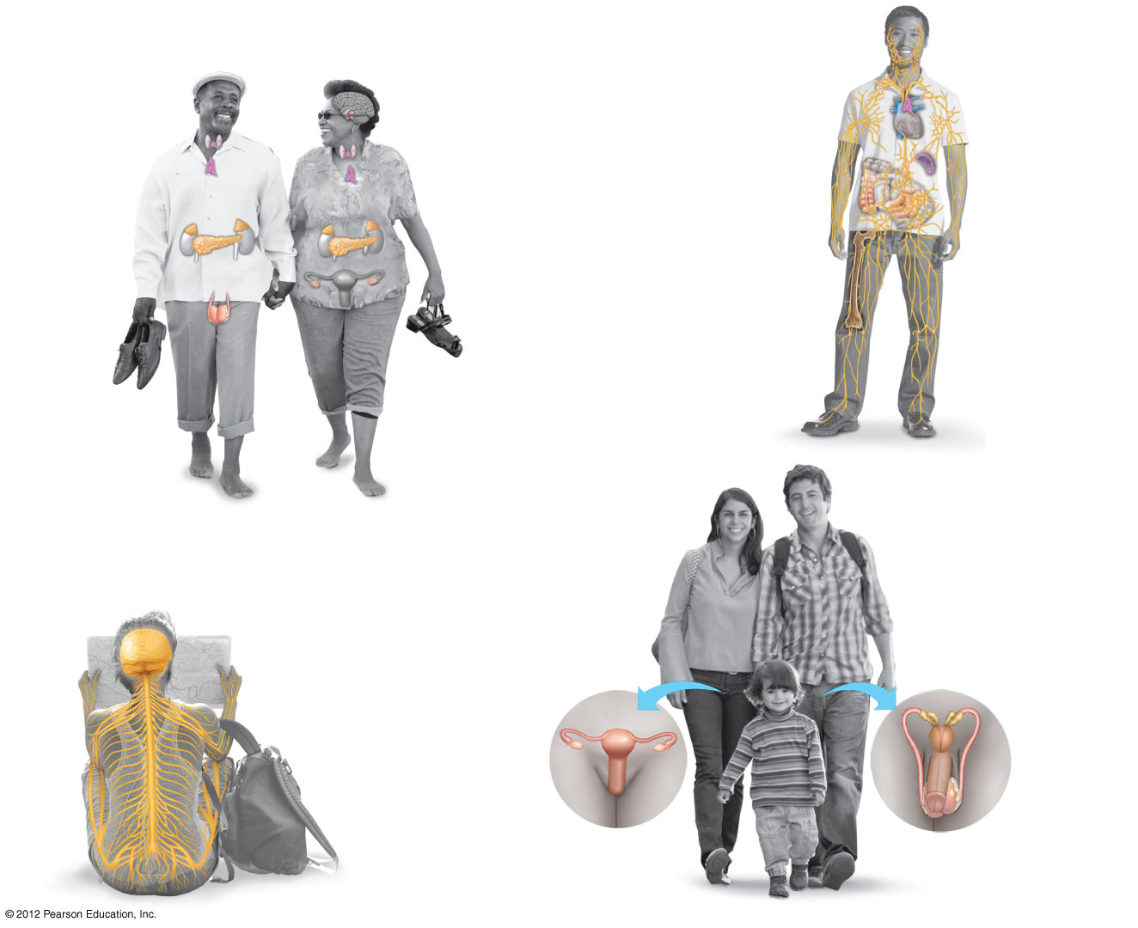
Figure 20.10_R
Endocrine system
Lymphatic and
immune systems
Hypothalamus
Pituitary gland
Lymph
nodes
Thymus
Thymus
Thyroid gland
Spleen
Adrenal
gland
Parathyroid
gland
Appendix
Pancreas
Bone
marrow
Lymphatic
vessels
Testis
(male)
Ovary
(female)
Reproductive
system
Nervous system
Brain
Seminal
vesicles
Sense organ
(ear)
Female
Male
Prostate
gland
Spinal cord
Oviduct
Nerves
Ovary
Vas
deferens
Uterus
Penis
Vagina
Testis
Urethra
Notes:
30
Figure 20.10_R Human organ systems and their component parts (right)

Slide 31
20.11 CONNECTION: New imaging technology reveals the inner body
New technologies
  are used in medical diagnosis and research and
  allow physicians to examine organ systems without surgery.
X-rays help create images of hard structures such as bones and teeth.
Magnetic resonance imaging (MRI)
  takes advantage of the behavior of the hydrogen atoms in water molecules and
  provides three-dimensional images of very small structures.
© 2012 Pearson Education, Inc.
Notes:
31
Student Misconceptions and Concerns
1. Students often find it challenging to gain a proper understanding of the evolution of form and function relationships. Such relationships appear to have been “constructed” to meet a purpose, a consequence of deliberate planning and design. Ask students to explain why we have lungs, and they will typically answer something along the line of “because we need to breathe,” or “because we need oxygen.” Need, however, does not cause evolution. Natural selection involves editing rather than creating diversity. A better answer might be “Because lung-like structures conveyed an advantage in gas exchange in our ancestors.”
2. Relationships between form and function are found all around us. For some of us, noticing the connections is easy. However, many students have spent little time considering why any particular structure has its characteristic shape. Practice with examples helps to build a better understanding of these important relationships.
Teaching Tips
Module 20.11 provides an excellent opportunity to discuss the impact of technology on science and medicine. New ways of viewing, detecting, and monitoring our bodies invite additional avenues of inquiry.

Slide 32
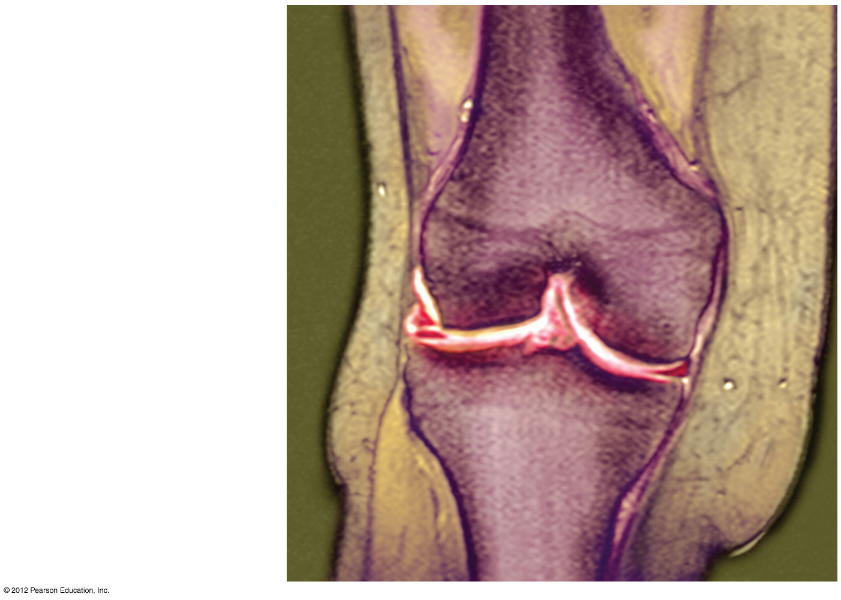
Figure 20.11A
A colorized MRI of knee showing small tear in meniscus
Femur
(thigh bone)
Torn meniscus
Tibia (shin bone)
Notes:
32
Figure 20.11A A colorized MRI scan of a knee joint, showing a tear (small red areas) in the outer meniscus

Slide 33
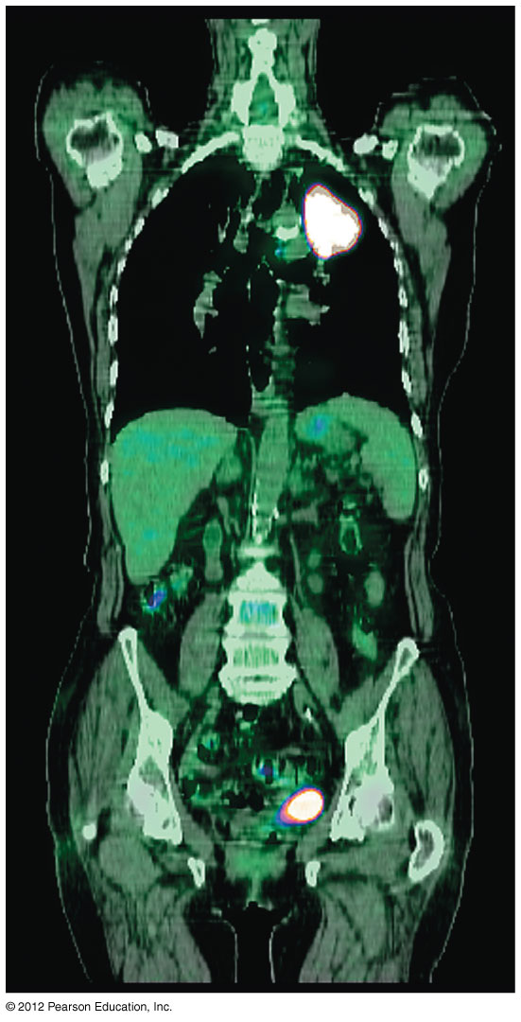
Figure 20.11B
A combined CT-PET scan showing tumors ( bright white) in the upper lung and lower abdomen
Notes:
33
Figure 20.11B A combined CT-PET scan showing tumors (bright white) in the upper left lung and lower abdomen

Slide 34
20.12 The integumentary system protects the body
The skin consists of two layers:
  The epidermis
    is a stratified squamous epithelium and
    forms the surface of the skin.
  The dermis
    forms a deeper skin layer and
    is composed of dense connective tissue with many resilient elastic fibers and strong collagen fibers.
    The dermis contains hair follicles, oil and sweat glands, muscle cells, nerves, sensory receptors, and blood vessels.
© 2012 Pearson Education, Inc.
Notes:
34
Student Misconceptions and Concerns
1. Students often find it challenging to gain a proper understanding of the evolution of form and function relationships. Such relationships appear to have been “constructed” to meet a purpose, a consequence of deliberate planning and design. Ask students to explain why we have lungs, and they will typically answer something along the line of “because we need to breathe,” or “because we need oxygen.” Need, however, does not cause evolution. Natural selection involves editing rather than creating diversity. A better answer might be “Because lung-like structures conveyed an advantage in gas exchange in our ancestors.”
2. Relationships between form and function are found all around us. For some of us, noticing the connections is easy. However, many students have spent little time considering why any particular structure has its characteristic shape. Practice with examples helps to build a better understanding of these important relationships.
Teaching Tips
1. The stratified squamous epithelium on most outside surfaces of our body resists abrasions in part because it is keratinized. However, the nonkeratinized epithelial tissue that lines our body cavities, such as the mouth, pharynx, esophagus, and anus, is also resistant to abrasion as a result of its mucus coatings, which provide friction-reducing lubrication. Students may not realize that the same type of tissue performs similar functions in very different parts of the body.
2. Students might have noticed that their skin wrinkles when soaked in water. Some students may have noticed that their hands wrinkle even faster in soapy water. Skin absorbs water through osmosis (just as a freshwater fish gains water). Oils on our skin reduce the influx of water. Therefore, soapy water, which washes away these oils, speeds up the movement of water into our keratinized skin. The wrinkling occurs because the skin can expand only in certain areas, creating puckers.

Slide 35
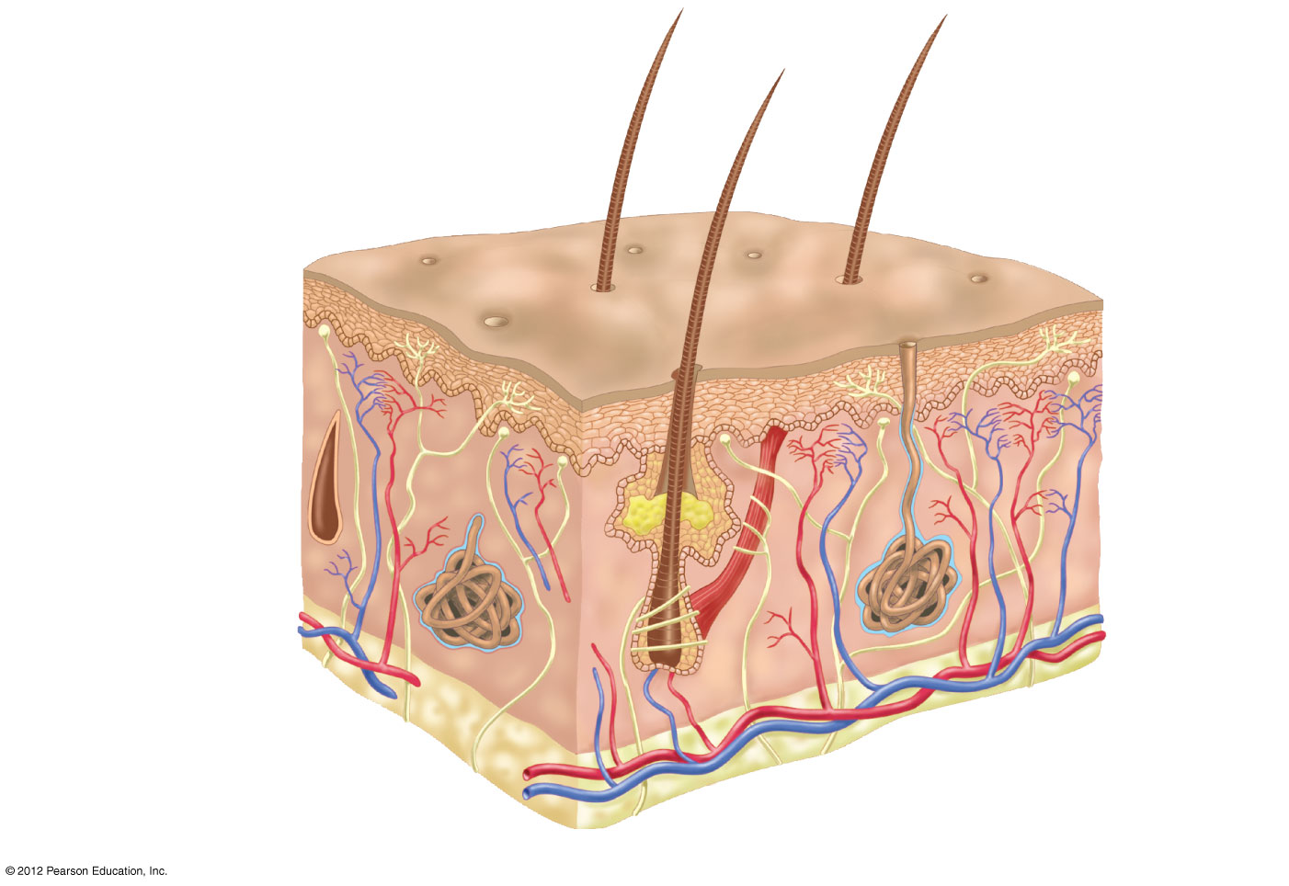
Figure 20.12
Hair
Epidermis
Sweat
pore
Dermis
Muscle
Nerve
Sweat
gland
Hypodermis
(under the skin)
Adipose tissue
Blood vessels
Oil gland
Hair follicle
Notes:
35
Figure 20.12 A section of skin, the major organ of the integumentary system

Slide 36
20.12 The integumentary system protects the body
Skin has many functions.
  The epidermis
    resists physical damage,
    decreases water loss, and
    prevents penetration by microbes.
  The dermis
    collects sensory information,
    synthesizes vitamin D, and
    helps regulate body temperature.
© 2012 Pearson Education, Inc.
Notes:
36
Student Misconceptions and Concerns
1. Students often find it challenging to gain a proper understanding of the evolution of form and function relationships. Such relationships appear to have been “constructed” to meet a purpose, a consequence of deliberate planning and design. Ask students to explain why we have lungs, and they will typically answer something along the line of “because we need to breathe,” or “because we need oxygen.” Need, however, does not cause evolution. Natural selection involves editing rather than creating diversity. A better answer might be “Because lung-like structures conveyed an advantage in gas exchange in our ancestors.”
2. Relationships between form and function are found all around us. For some of us, noticing the connections is easy. However, many students have spent little time considering why any particular structure has its characteristic shape. Practice with examples helps to build a better understanding of these important relationships.
Teaching Tips
1. The stratified squamous epithelium on most outside surfaces of our body resists abrasions in part because it is keratinized. However, the nonkeratinized epithelial tissue that lines our body cavities, such as the mouth, pharynx, esophagus, and anus, is also resistant to abrasion as a result of its mucus coatings, which provide friction-reducing lubrication. Students may not realize that the same type of tissue performs similar functions in very different parts of the body.
2. Students might have noticed that their skin wrinkles when soaked in water. Some students may have noticed that their hands wrinkle even faster in soapy water. Skin absorbs water through osmosis (just as a freshwater fish gains water). Oils on our skin reduce the influx of water. Therefore, soapy water, which washes away these oils, speeds up the movement of water into our keratinized skin. The wrinkling occurs because the skin can expand only in certain areas, creating puckers.

Slide 37
20.12 The integumentary system protects the body
Exposure of the skin to ultraviolet light
  causes skin cells to release melanin, which contributes to a visible tan, and
  damages DNA of skin cells and can lead to
    premature aging of the skin,
    cataracts, and
    skin cancers.
© 2012 Pearson Education, Inc.
Notes:
37
Student Misconceptions and Concerns
1. Students often find it challenging to gain a proper understanding of the evolution of form and function relationships. Such relationships appear to have been “constructed” to meet a purpose, a consequence of deliberate planning and design. Ask students to explain why we have lungs, and they will typically answer something along the line of “because we need to breathe,” or “because we need oxygen.” Need, however, does not cause evolution. Natural selection involves editing rather than creating diversity. A better answer might be “Because lung-like structures conveyed an advantage in gas exchange in our ancestors.”
2. Relationships between form and function are found all around us. For some of us, noticing the connections is easy. However, many students have spent little time considering why any particular structure has its characteristic shape. Practice with examples helps to build a better understanding of these important relationships.
Teaching Tips
1. The stratified squamous epithelium on most outside surfaces of our body resists abrasions in part because it is keratinized. However, the nonkeratinized epithelial tissue that lines our body cavities, such as the mouth, pharynx, esophagus, and anus, is also resistant to abrasion as a result of its mucus coatings, which provide friction-reducing lubrication. Students may not realize that the same type of tissue performs similar functions in very different parts of the body.
2. Students might have noticed that their skin wrinkles when soaked in water. Some students may have noticed that their hands wrinkle even faster in soapy water. Skin absorbs water through osmosis (just as a freshwater fish gains water). Oils on our skin reduce the influx of water. Therefore, soapy water, which washes away these oils, speeds up the movement of water into our keratinized skin. The wrinkling occurs because the skin can expand only in certain areas, creating puckers.

Slide 38
20.12 The integumentary system protects the body
Hair
  is an important component of the integumentary system of mammals,
  helps to insulate their bodies, and
  consists of a shaft of keratin-filled dead cells.
Oil glands release oils that
  are associated with hair follicles,
  lubricate hair,
  condition surrounding skin, and
  inhibit the growth of bacteria.
© 2012 Pearson Education, Inc.
Notes:
38
Student Misconceptions and Concerns
1. Students often find it challenging to gain a proper understanding of the evolution of form and function relationships. Such relationships appear to have been “constructed” to meet a purpose, a consequence of deliberate planning and design. Ask students to explain why we have lungs, and they will typically answer something along the line of “because we need to breathe,” or “because we need oxygen.” Need, however, does not cause evolution. Natural selection involves editing rather than creating diversity. A better answer might be “Because lung-like structures conveyed an advantage in gas exchange in our ancestors.”
2. Relationships between form and function are found all around us. For some of us, noticing the connections is easy. However, many students have spent little time considering why any particular structure has its characteristic shape. Practice with examples helps to build a better understanding of these important relationships.
Teaching Tips
1. The stratified squamous epithelium on most outside surfaces of our body resists abrasions in part because it is keratinized. However, the nonkeratinized epithelial tissue that lines our body cavities, such as the mouth, pharynx, esophagus, and anus, is also resistant to abrasion as a result of its mucus coatings, which provide friction-reducing lubrication. Students may not realize that the same type of tissue performs similar functions in very different parts of the body.
2. Students might have noticed that their skin wrinkles when soaked in water. Some students may have noticed that their hands wrinkle even faster in soapy water. Skin absorbs water through osmosis (just as a freshwater fish gains water). Oils on our skin reduce the influx of water. Therefore, soapy water, which washes away these oils, speeds up the movement of water into our keratinized skin. The wrinkling occurs because the skin can expand only in certain areas, creating puckers.

