Slide 1
DNA Technology
Chapter 12

Slide 2
Introduction
0
  DNA technology
    has rapidly revolutionized the field of forensics,
    permits the use of gene cloning to produce medical and industrial products,
    allows for the development of genetically modified organisms for agriculture,
    permits the investigation of historical questions about human family and evolutionary relationships, and
    is invaluable in many areas of biological research.
© 2012 Pearson Education, Inc.
Notes:
2

Slide 3
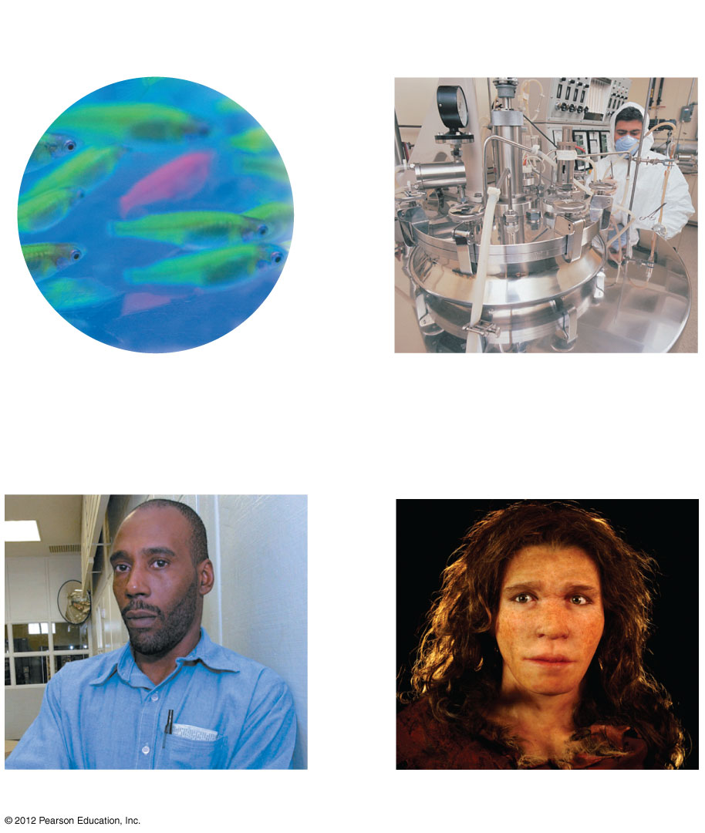
Figure 12.0_1
Chapter 12: Big Ideas
Gene Cloning
Genetically Modified
Organisms
DNA Profiling
Genomics
Notes:
3
Figure 12.0_1 Chapter 12: Big Ideas

Slide 4
GENE CLONING
© 2012 Pearson Education, Inc.
Notes:
4

Slide 5
12.1 Genes can be cloned in recombinant plasmids
0
  Biotechnology is the manipulation of organisms or their components to make useful products.
  For thousands of years, humans have
    used microbes to make wine and cheese and
    selectively bred stock, dogs, and other animals.
  DNA technology is the set of modern techniques used to study and manipulate genetic material.
© 2012 Pearson Education, Inc.
Notes:
5
Student Misconceptions and Concerns
1. Student comprehension of restriction enzymes, nucleic acid probes, and many other aspects of recombinant DNA techniques depends upon a comfortable understanding of basic molecular genetics. Consider addressing Chapter 12 after an exam that covers the content in Chapters 10 and 11.
2. Students might bring some awareness and/or concerns about biotechnology to the classroom, for example, in their reactions to the controversies regarding genetically modified (GM) foods. This experience can be used to generate class interest and to highlight the importance of good information when making judgments. Consider starting class with a headline addressing one of these issues. The recent process of FDA approval for genetically engineered salmon raised for food might be particularly useful and relevant.
Teaching Tips
1. Figure 12.1B is a synthesis of the techniques discussed in further detail in Modules 12.2–12.5. Figure 12.1B is therefore an important integrative piece that lays the foundation of most of the biotechnology discussion. Repeatedly referring to this figure in class helps students relate the text to your lecture.
2. The general genetic engineering challenge discussed in Module 12.1 begins with the need to insert a gene of choice into a plasmid. This process is very similar to film or video editing. What do we need to do to insert a minute of one film into another? We will need techniques to (a) cut and remove the minute of film to be inserted, (b) a way to cut the new film apart, and (c) a way to insert the new minute. In general, this is also like removing one boxcar from one train, and transferring the boxcar to another train. Students can become confused by the details of gene cloning through misunderstanding this basic editing relationship.

Slide 6
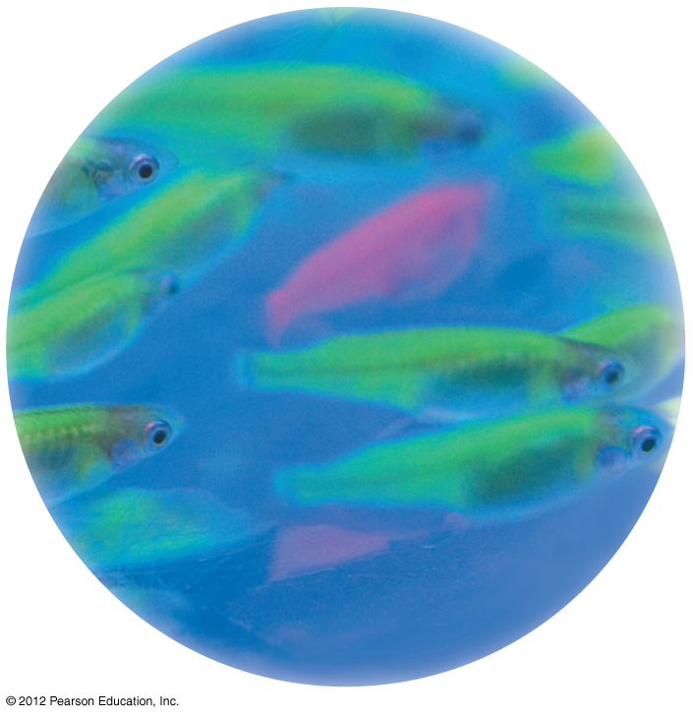
Figure 12.1A
Notes:
6
Figure 12.1A Glowing fish produced by transferring a gene originally obtained from a jelly (cnidarian)

Slide 7
12.1 Genes can be cloned in recombinant plasmids
0
  Genetic engineering involves manipulating genes for practical purposes.
    Gene cloning leads to the production of multiple, identical copies of a gene-carrying piece of DNA.
    Recombinant DNA is formed by joining nucleotide sequences from two different sources.
      One source contains the gene that will be cloned.
      Another source is a gene carrier, called a vector.
      Plasmids (small, circular DNA molecules independent of the bacterial chromosome) are often used as vectors.
© 2012 Pearson Education, Inc.
Notes:
7
Student Misconceptions and Concerns
1. Student comprehension of restriction enzymes, nucleic acid probes, and many other aspects of recombinant DNA techniques depends upon a comfortable understanding of basic molecular genetics. Consider addressing Chapter 12 after an exam that covers the content in Chapters 10 and 11.
2. Students might bring some awareness and/or concerns about biotechnology to the classroom, for example, in their reactions to the controversies regarding genetically modified (GM) foods. This experience can be used to generate class interest and to highlight the importance of good information when making judgments. Consider starting class with a headline addressing one of these issues. The recent process of FDA approval for genetically engineered salmon raised for food might be particularly useful and relevant.
Teaching Tips
1. Figure 12.1B is a synthesis of the techniques discussed in further detail in Modules 12.2–12.5. Figure 12.1B is therefore an important integrative piece that lays the foundation of most of the biotechnology discussion. Repeatedly referring to this figure in class helps students relate the text to your lecture.
2. The general genetic engineering challenge discussed in Module 12.1 begins with the need to insert a gene of choice into a plasmid. This process is very similar to film or video editing. What do we need to do to insert a minute of one film into another? We will need techniques to (a) cut and remove the minute of film to be inserted, (b) a way to cut the new film apart, and (c) a way to insert the new minute. In general, this is also like removing one boxcar from one train, and transferring the boxcar to another train. Students can become confused by the details of gene cloning through misunderstanding this basic editing relationship.

Slide 8
12.1 Genes can be cloned in recombinant plasmids
0
  Steps in cloning a gene
    Plasmid DNA is isolated.
    DNA containing the gene of interest is isolated.
    Plasmid DNA is treated with a restriction enzyme that cuts in one place, opening the circle.
    DNA with the target gene is treated with the same enzyme and many fragments are produced.
    Plasmid and target DNA are mixed and associate with each other.
© 2012 Pearson Education, Inc.
Notes:
8
Student Misconceptions and Concerns
1. Student comprehension of restriction enzymes, nucleic acid probes, and many other aspects of recombinant DNA techniques depends upon a comfortable understanding of basic molecular genetics. Consider addressing Chapter 12 after an exam that covers the content in Chapters 10 and 11.
2. Students might bring some awareness and/or concerns about biotechnology to the classroom, for example, in their reactions to the controversies regarding genetically modified (GM) foods. This experience can be used to generate class interest and to highlight the importance of good information when making judgments. Consider starting class with a headline addressing one of these issues. The recent process of FDA approval for genetically engineered salmon raised for food might be particularly useful and relevant.
Teaching Tips
1. Figure 12.1B is a synthesis of the techniques discussed in further detail in Modules 12.2–12.5. Figure 12.1B is therefore an important integrative piece that lays the foundation of most of the biotechnology discussion. Repeatedly referring to this figure in class helps students relate the text to your lecture.
2. The general genetic engineering challenge discussed in Module 12.1 begins with the need to insert a gene of choice into a plasmid. This process is very similar to film or video editing. What do we need to do to insert a minute of one film into another? We will need techniques to (a) cut and remove the minute of film to be inserted, (b) a way to cut the new film apart, and (c) a way to insert the new minute. In general, this is also like removing one boxcar from one train, and transferring the boxcar to another train. Students can become confused by the details of gene cloning through misunderstanding this basic editing relationship.

Slide 9
12.1 Genes can be cloned in recombinant plasmids
0
    Recombinant DNA molecules are produced when DNA ligase joins plasmid and target segments together.
    The recombinant plasmid containing the target gene is taken up by a bacterial cell.
    The bacterial cell reproduces to form a clone, a group of genetically identical cells descended from a single ancestral cell.
© 2012 Pearson Education, Inc.
Notes:
9
Student Misconceptions and Concerns
1. Student comprehension of restriction enzymes, nucleic acid probes, and many other aspects of recombinant DNA techniques depends upon a comfortable understanding of basic molecular genetics. Consider addressing Chapter 12 after an exam that covers the content in Chapters 10 and 11.
2. Students might bring some awareness and/or concerns about biotechnology to the classroom, for example, in their reactions to the controversies regarding genetically modified (GM) foods. This experience can be used to generate class interest and to highlight the importance of good information when making judgments. Consider starting class with a headline addressing one of these issues. The recent process of FDA approval for genetically engineered salmon raised for food might be particularly useful and relevant.
Teaching Tips
1. Figure 12.1B is a synthesis of the techniques discussed in further detail in Modules 12.2–12.5. Figure 12.1B is therefore an important integrative piece that lays the foundation of most of the biotechnology discussion. Repeatedly referring to this figure in class helps students relate the text to your lecture.
2. The general genetic engineering challenge discussed in Module 12.1 begins with the need to insert a gene of choice into a plasmid. This process is very similar to film or video editing. What do we need to do to insert a minute of one film into another? We will need techniques to (a) cut and remove the minute of film to be inserted, (b) a way to cut the new film apart, and (c) a way to insert the new minute. In general, this is also like removing one boxcar from one train, and transferring the boxcar to another train. Students can become confused by the details of gene cloning through misunderstanding this basic editing relationship.

Slide 10
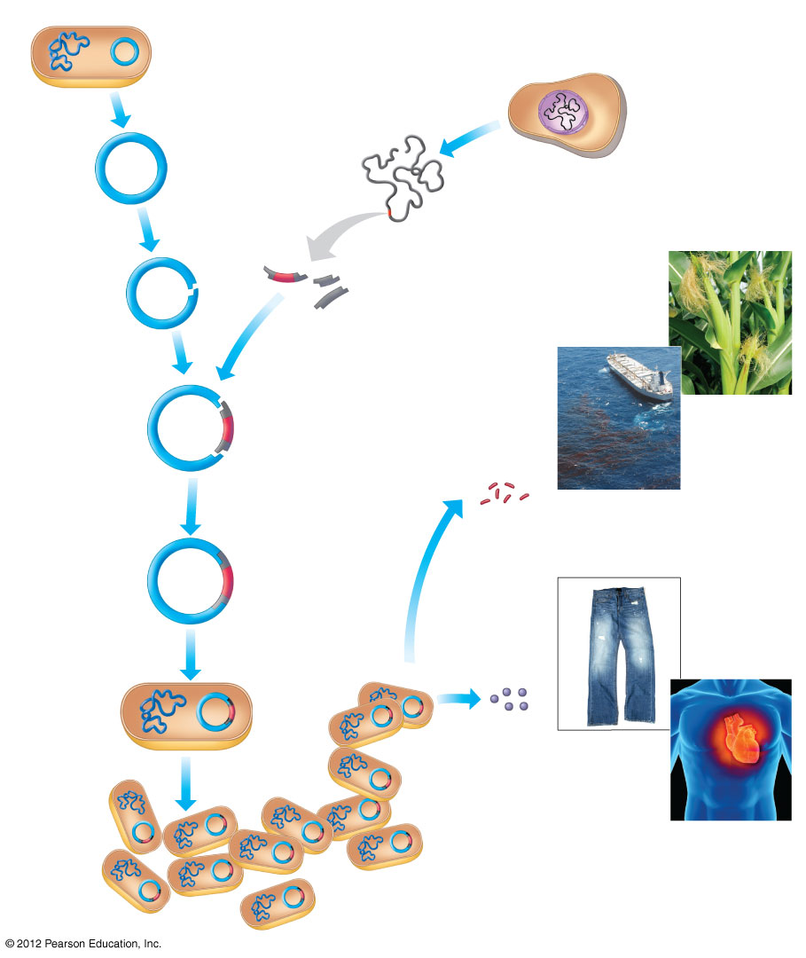
Figure 12.1B
E. coli bacterium
Plasmid
A cell with DNA
containing the gene
of interest
Bacterial
chromosome
1
A plasmid
is isolated.
2
The cell’s DNA
is isolated.
Gene of
interest
DNA
3
The plasmid is cut
with an enzyme.
Examples of gene use
4
The cell’s DNA is cut
with the same enzyme.
Gene
of interest
5
The targeted fragment
and plasmid DNA
are combined.
6
DNA ligase is added,
which joins the two
DNA molecules.
Genes may be inserted
into other organisms.
Recombinant
DNA
plasmid
Examples of protein use
Gene
of interest
7
The recombinant plasmid
is taken up by a bacterium
through transformation.
9
Recombinant
bacterium
Harvested
proteins
may be
used
directly.
8
The bacterium
reproduces.
Clone
of cells
Notes:
10
Figure 12.1B An overview of gene cloning

Slide 11
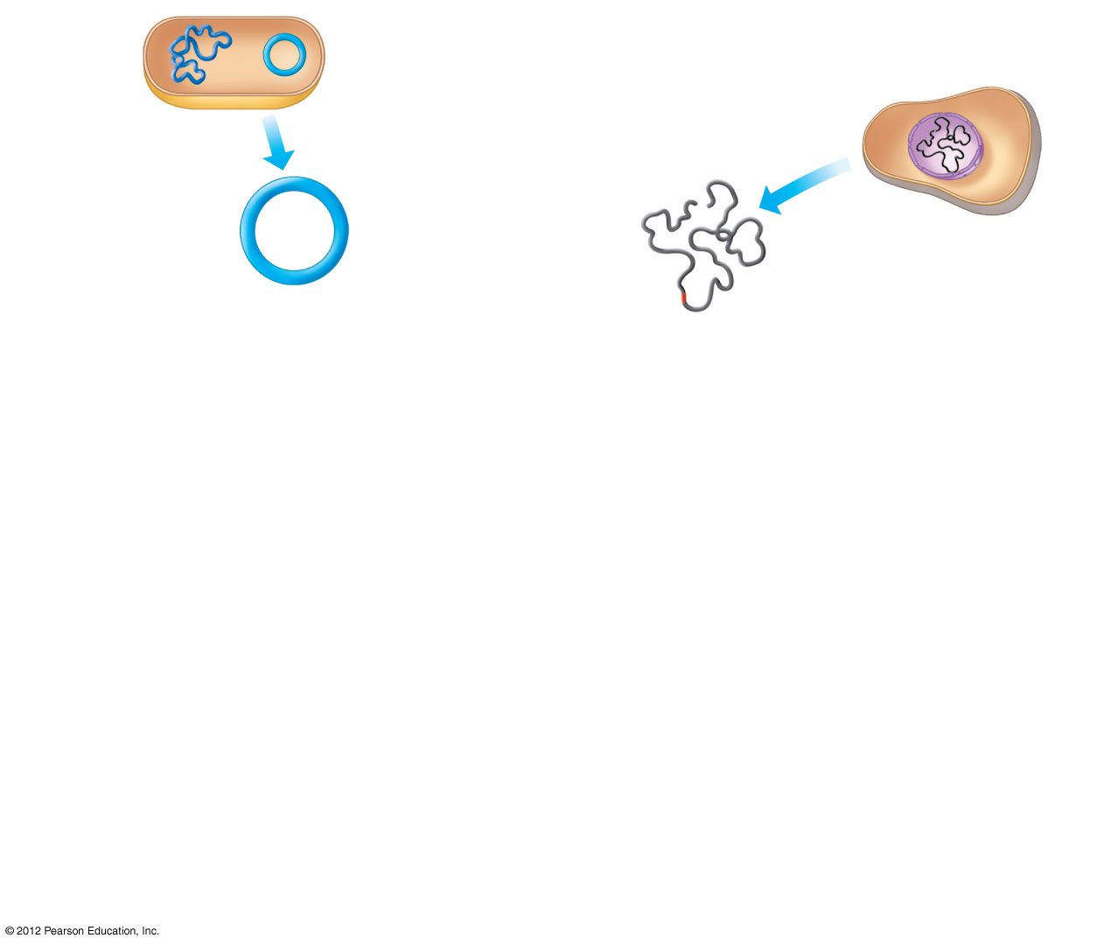
Figure 12.1B_s1
A cell with DNA
containing the gene
of interest
Plasmid
E. coli
bacterium
Bacterial
chromosome
1
A plasmid
is isolated.
2
The cell’s DNA
is isolated.
Gene of
interest
DNA
Notes:
11
Figure 12.1B_s1 An overview of gene cloning (part 1, step 1)

Slide 12
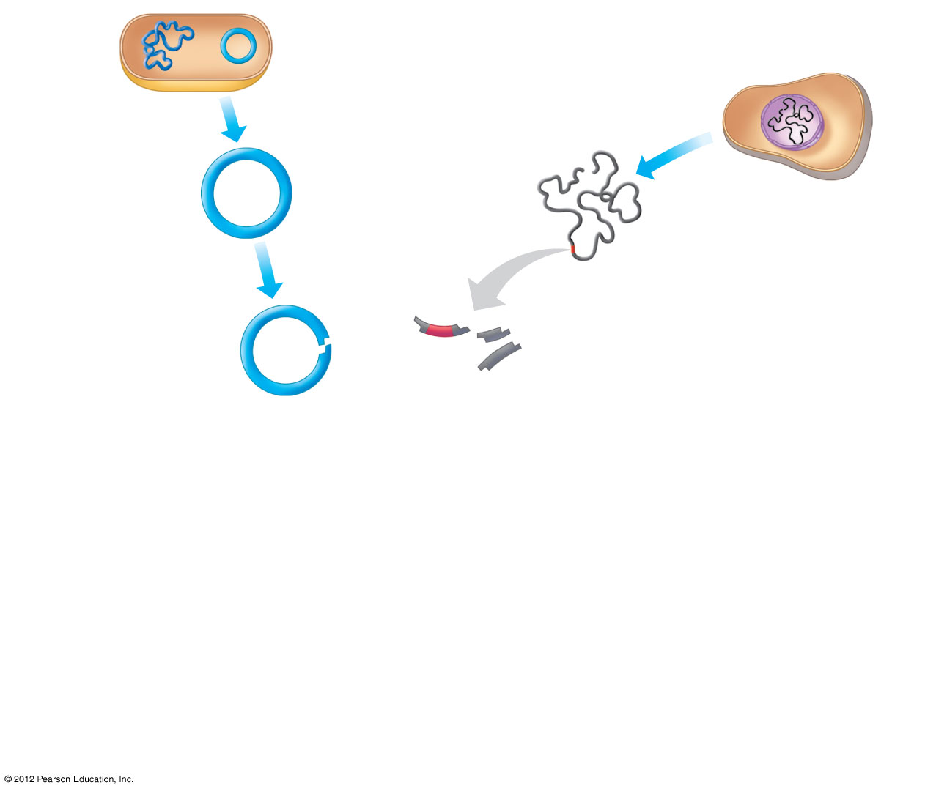
Figure 12.1B_s2
A cell with DNA
containing the gene
of interest
Plasmid
E. coli
bacterium
Bacterial
chromosome
1
A plasmid
is isolated.
2
The cell’s DNA
is isolated.
Gene of
interest
DNA
3
The plasmid is cut
with an enzyme.
4
The cell’s DNA is cut
with the same enzyme.
Gene
of interest
Notes:
12
Figure 12.1B_s2 An overview of gene cloning (part 1, step 2)

Slide 13
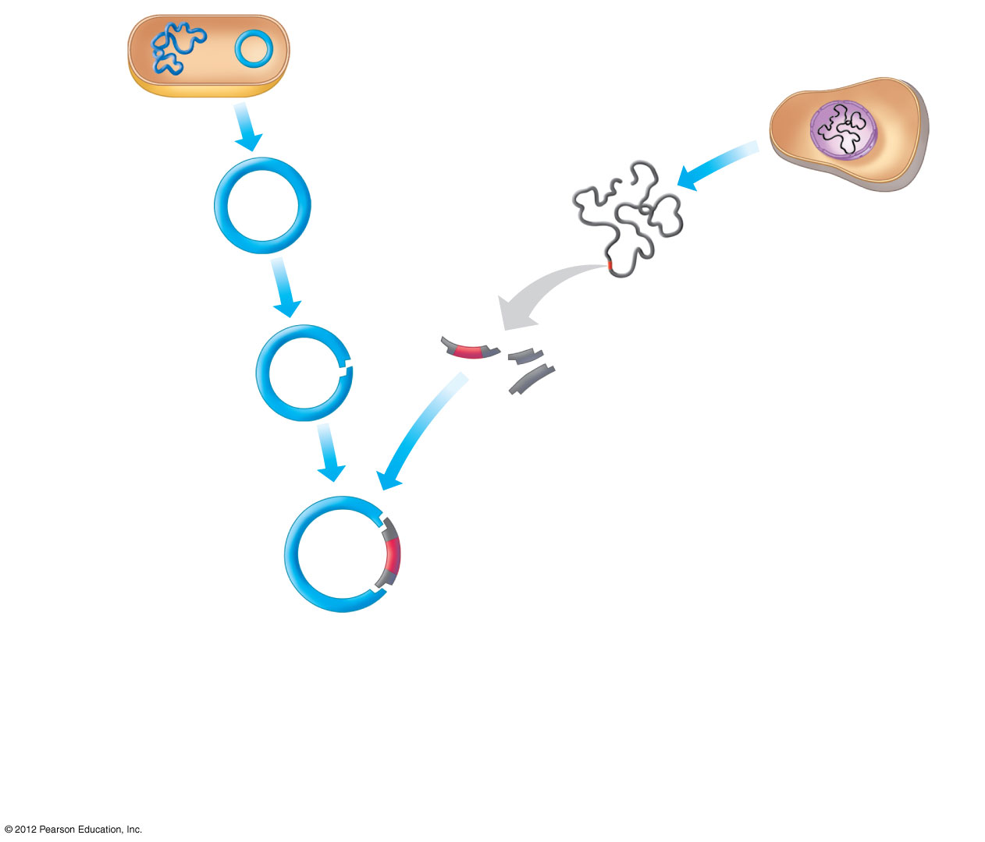
Figure 12.1B_s3
A cell with DNA
containing the gene
of interest
Plasmid
E. coli
bacterium
Bacterial
chromosome
1
A plasmid
is isolated.
2
The cell’s DNA
is isolated.
Gene of
interest
DNA
3
The plasmid is cut
with an enzyme.
4
The cell’s DNA is cut
with the same enzyme.
Gene
of interest
5
The targeted fragment
and plasmid DNA
are combined.
Notes:
13
Figure 12.1B_s3 An overview of gene cloning (part 1, step 3)

Slide 14
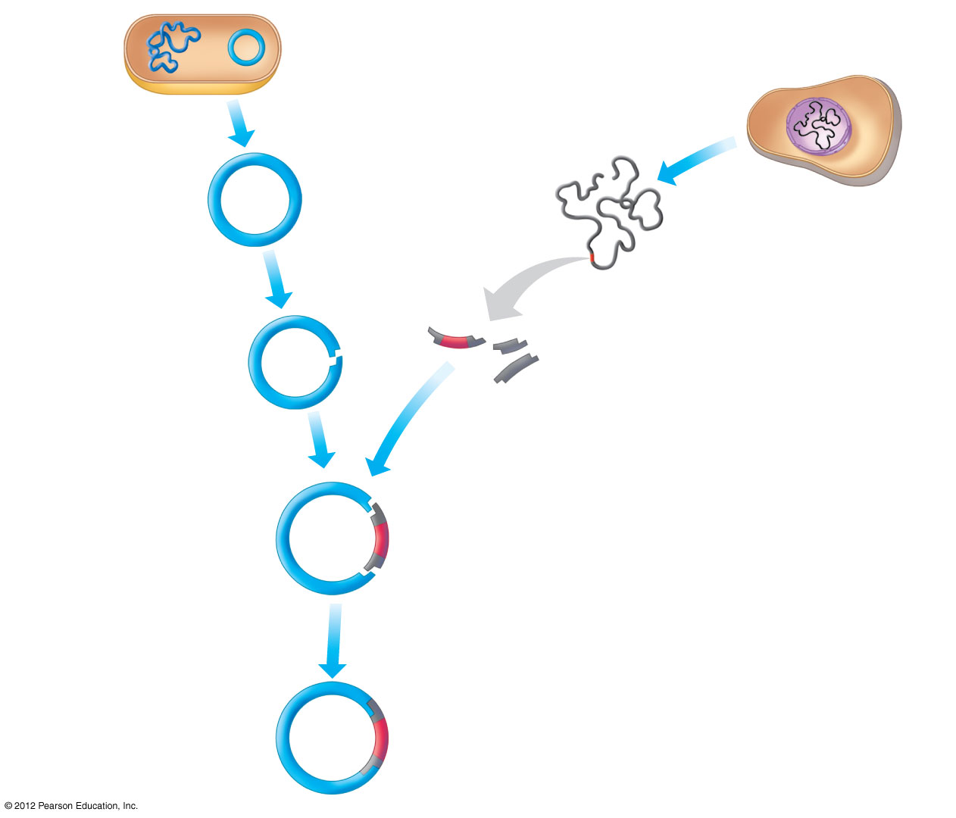
Figure 12.1B_s4
A cell with DNA
containing the gene
of interest
Plasmid
E. coli
bacterium
Bacterial
chromosome
1
A plasmid
is isolated.
2
The cell’s DNA
is isolated.
Gene of
interest
DNA
3
The plasmid is cut
with an enzyme.
4
The cell’s DNA is cut
with the same enzyme.
Gene
of interest
5
The targeted fragment
and plasmid DNA
are combined.
6
DNA ligase is added,
which joins the two
DNA molecules.
Recombinant
DNA
plasmid
Gene
of interest
Notes:
14
Figure 12.1B_s4 An overview of gene cloning (part 1, step 4)

Slide 15
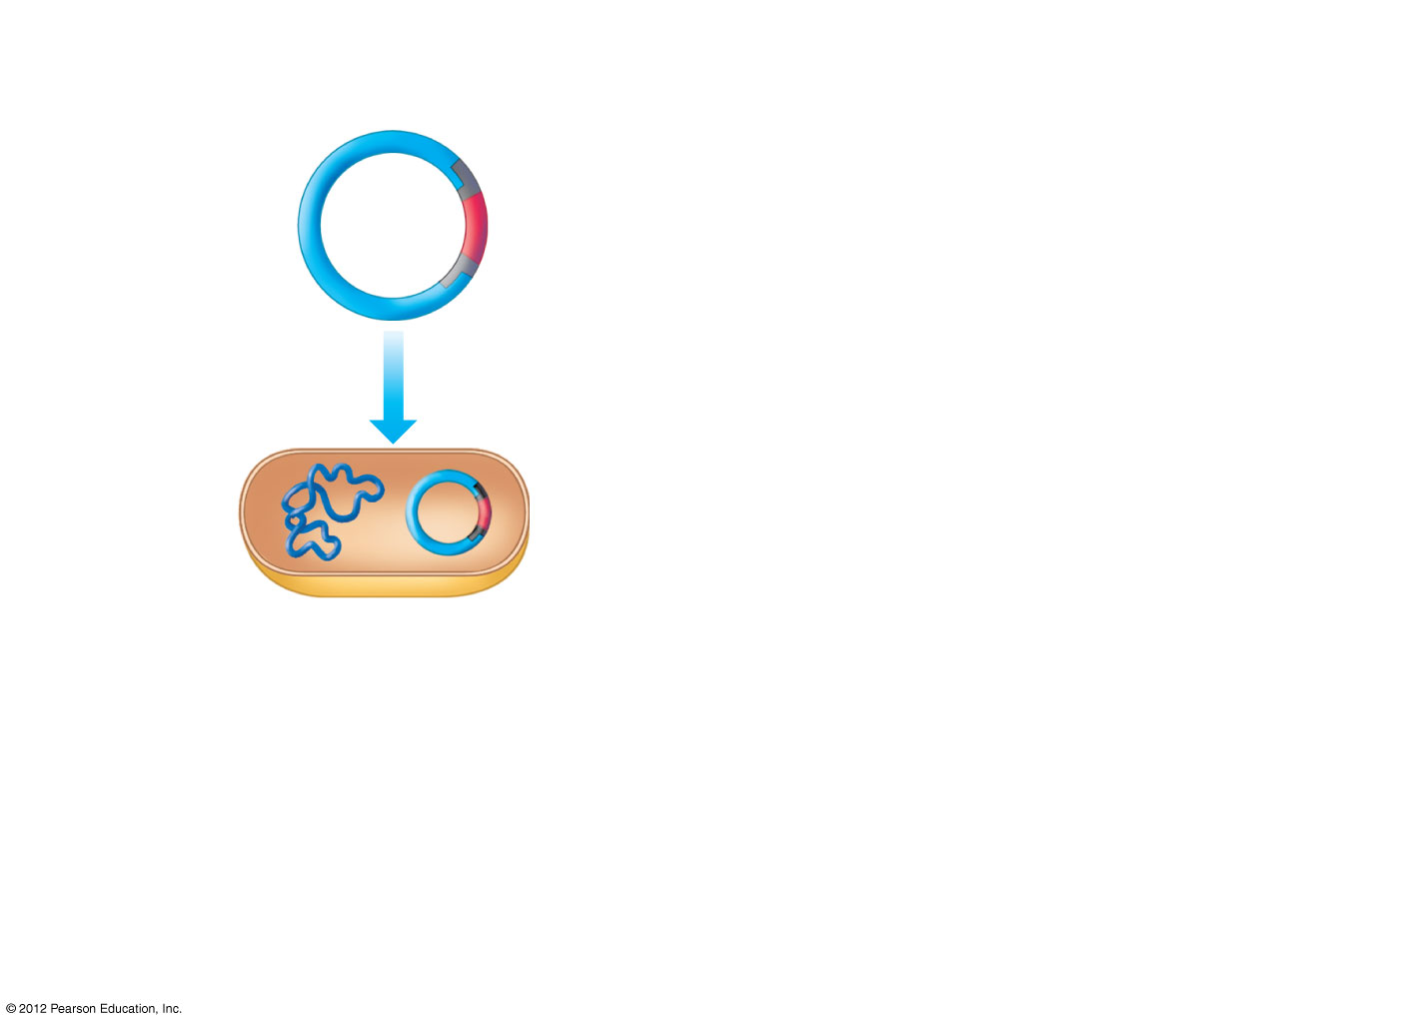
Figure 12.1B_s5
Recombinant
DNA
plasmid
Gene
of interest
7
The recombinant plasmid
is taken up by a bacterium
through transformation.
Recombinant
bacterium
Notes:
15
Figure 12.1B_s5 An overview of gene cloning (part 2, step 1)

Slide 16
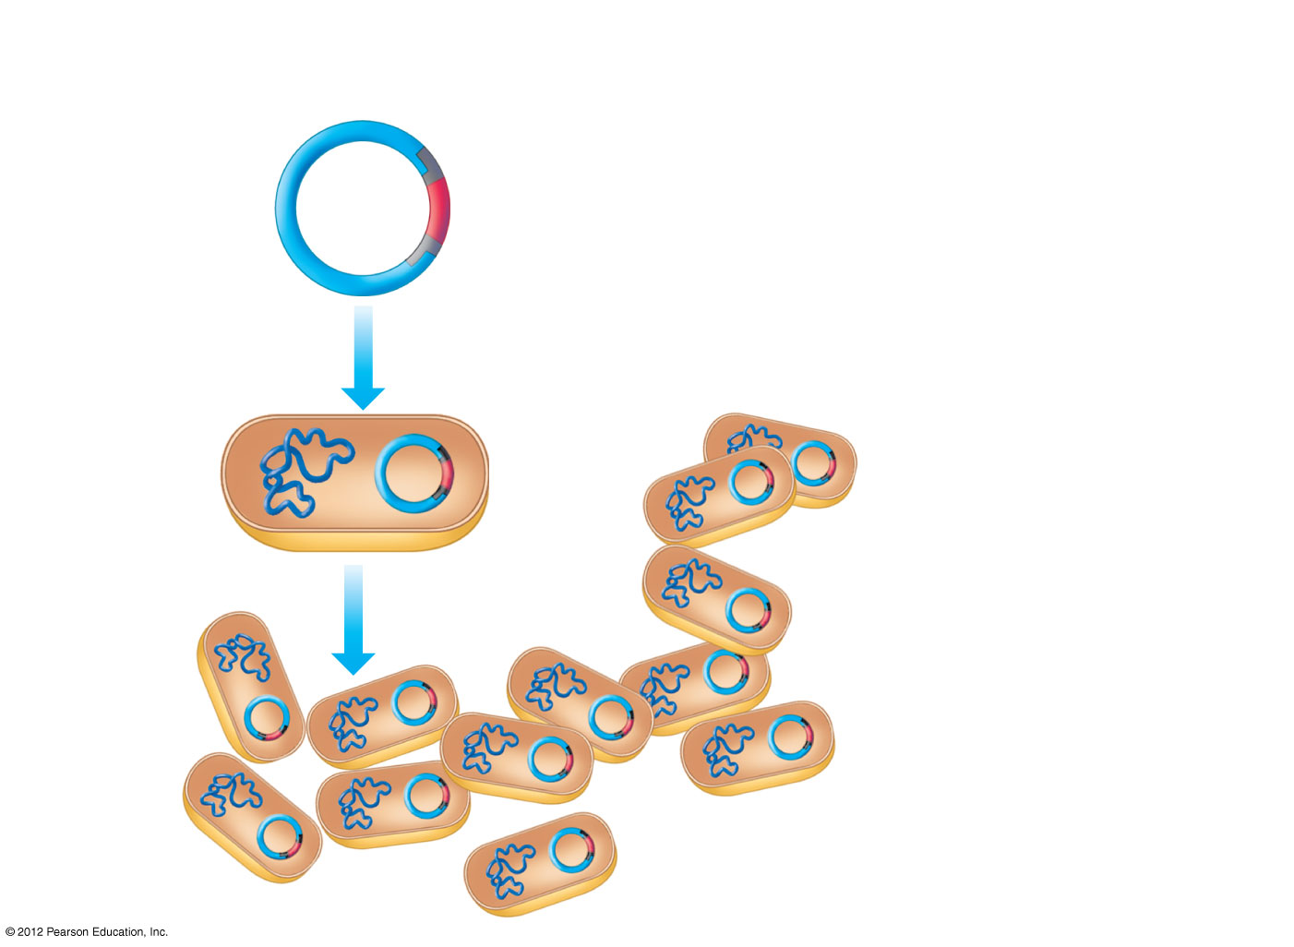
Figure 12.1B_s6
Recombinant
DNA
plasmid
Gene
of interest
7
The recombinant plasmid
is taken up by a bacterium
through transformation.
Recombinant
bacterium
8
The bacterium
reproduces.
Clone
of cells
Notes:
16
Figure 12.1B_s6 An overview of gene cloning (part 2, step 2)

Slide 17
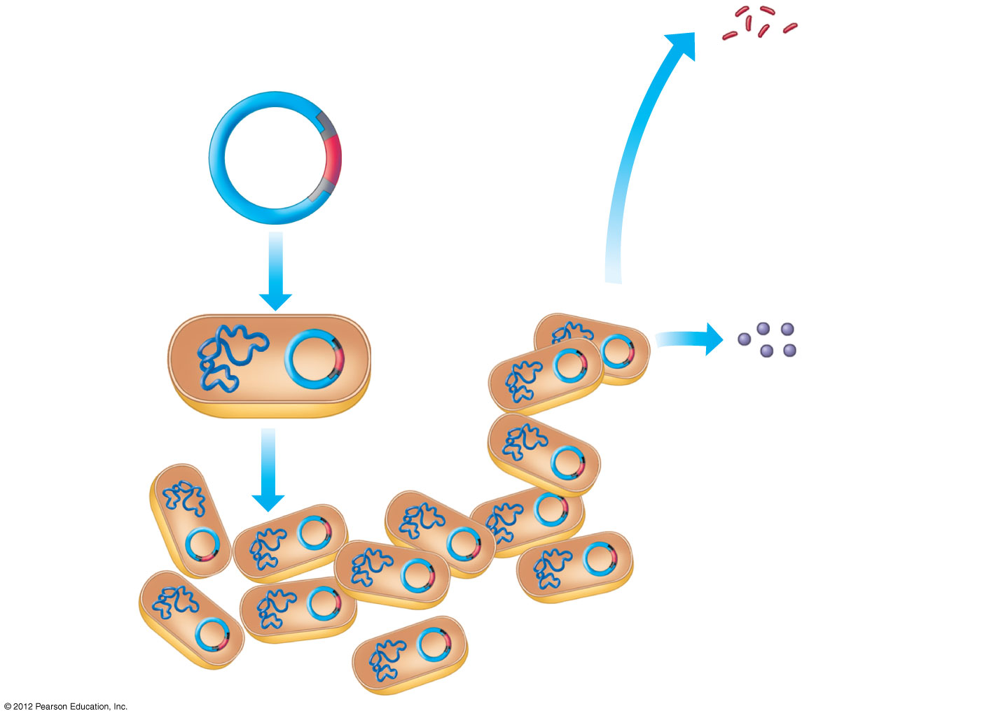
Figure 12.1B_s7
Genes may be inserted
into other organisms.
Recombinant
DNA
plasmid
Gene
of interest
7
The recombinant plasmid
is taken up by a bacterium
through transformation.
9
Recombinant
bacterium
Harvested
proteins
may be
used
directly.
8
The bacterium
reproduces.
Clone
of cells
Notes:
17
Figure 12.1B_s7 An overview of gene cloning (part 2, step 3)

Slide 18
12.2 Enzymes are used to “cut and paste” DNA
0
  Restriction enzymes cut DNA at specific sequences.
    Each enzyme binds to DNA at a different restriction site.
    Many restriction enzymes make staggered cuts that produce restriction fragments with single-stranded ends called “sticky ends.”
    Fragments with complementary sticky ends can associate with each other, forming recombinant DNA.
  DNA ligase joins DNA fragments together.
© 2012 Pearson Education, Inc.
Notes:
18
Student Misconceptions and Concerns
1. Student comprehension of restriction enzymes, nucleic acid probes, and many other aspects of recombinant DNA techniques depends upon a comfortable understanding of basic molecular genetics. Consider addressing Chapter 12 after an exam that covers the content in Chapters 10 and 11.
2. Students might bring some awareness and/or concerns about biotechnology to the classroom, for example, in their reactions to the controversies regarding genetically modified (GM) foods. This experience can be used to generate class interest and to highlight the importance of good information when making judgments. Consider starting class with a headline addressing one of these issues. The recent process of FDA approval for genetically engineered salmon raised for food might be particularly useful and relevant.
Teaching Tips
1. The authors note the origin of the name restriction enzymes. In nature, these enzymes protect bacterial cells against foreign DNA. Thus, these enzymes “restrict” the invasion of foreign genetic material.
2. A genomic library of the sentence you are now reading would be all of the sentence fragments that made up the sentence. One could string together all of the words of this first sentence, without spaces between letters, and then conduct a word processing edit, placing a space between any place where the letter “e” is followed by the letter “n.” The resulting fragments of this original sentence would look like this and would be similar to a genomic library.
Age nomiclibraryofthese nte nceyouare nowreadingwouldbeallofthese nte ncefragme ntsthatmadeupthese nte nce.

Slide 19
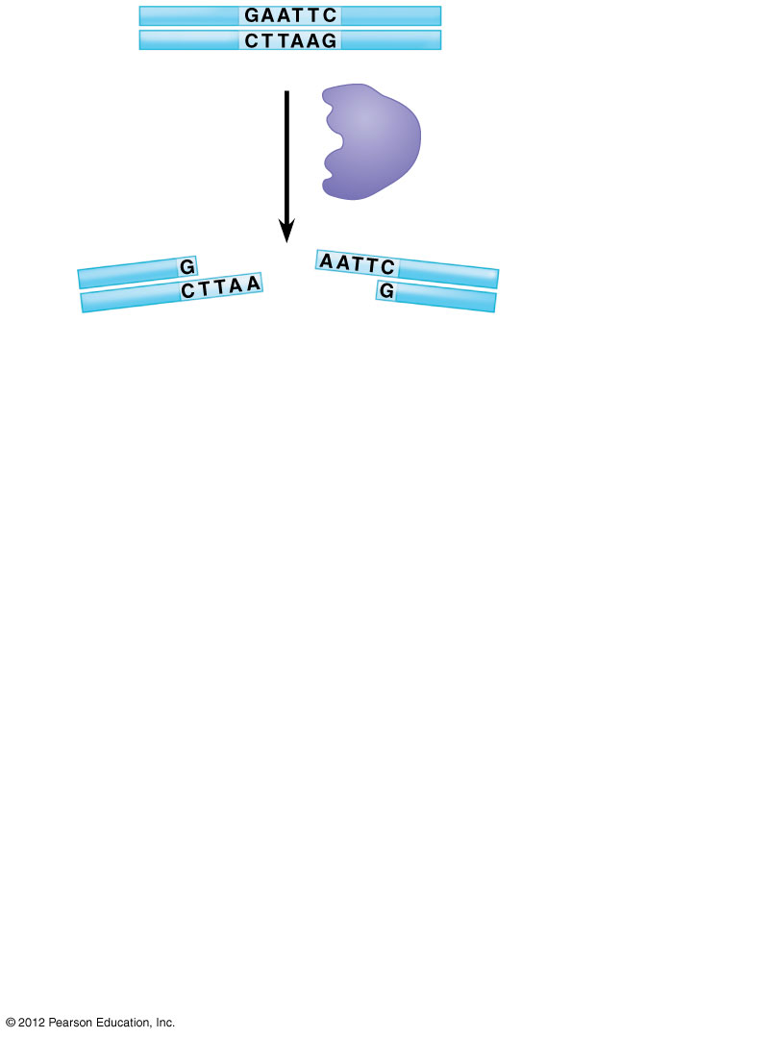
Figure 12.2_s1
1
DNA
Restriction enzyme
recognition sequence
A restriction
enzyme cuts
the DNA into
fragments.
Restriction
enzyme
2
Sticky
end
Sticky
end
Notes:
19
Figure 12.2_s1 Creating recombinant DNA using a restriction enzyme and DNA ligase (step 1)

Slide 20
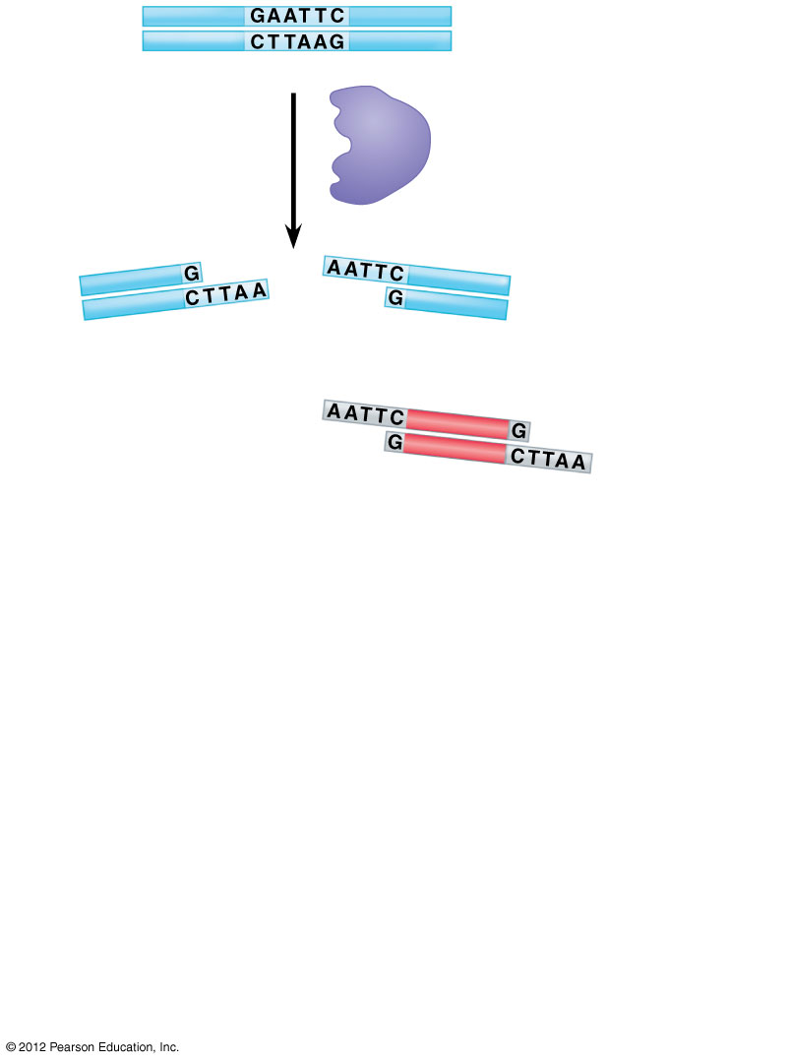
Figure 12.2_s2
1
DNA
Restriction enzyme
recognition sequence
A restriction
enzyme cuts
the DNA into
fragments.
Restriction
enzyme
2
Sticky
end
Sticky
end
Gene of
interest
A DNA fragment
from another
source is added.
3
Notes:
20
Figure 12.2_s2 Creating recombinant DNA using a restriction enzyme and DNA ligase (step 2)

Slide 21
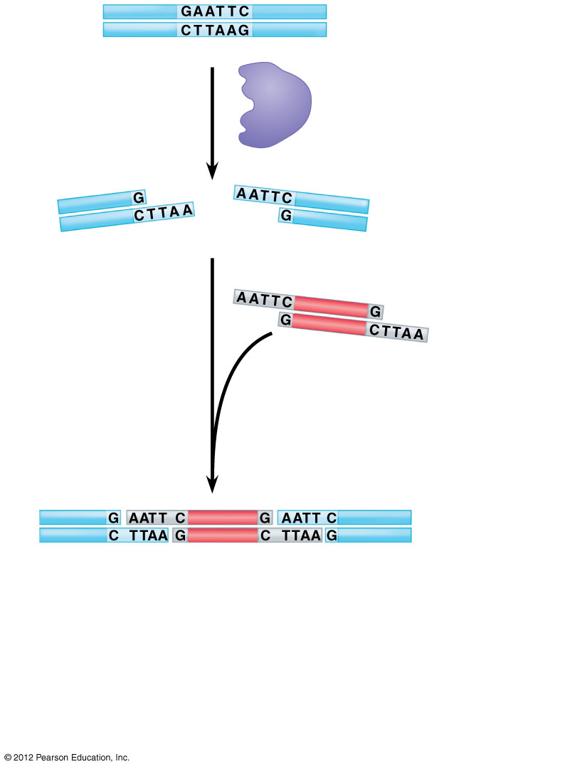
Figure 12.2_s3
1
DNA
Restriction enzyme
recognition sequence
A restriction
enzyme cuts
the DNA into
fragments.
Restriction
enzyme
2
Sticky
end
Sticky
end
Gene of
interest
A DNA fragment
from another
source is added.
3
Two (or more)
fragments stick
together by
base pairing.
4
Notes:
21
Figure 12.2_s3 Creating recombinant DNA using a restriction enzyme and DNA ligase (step 3)

Slide 22
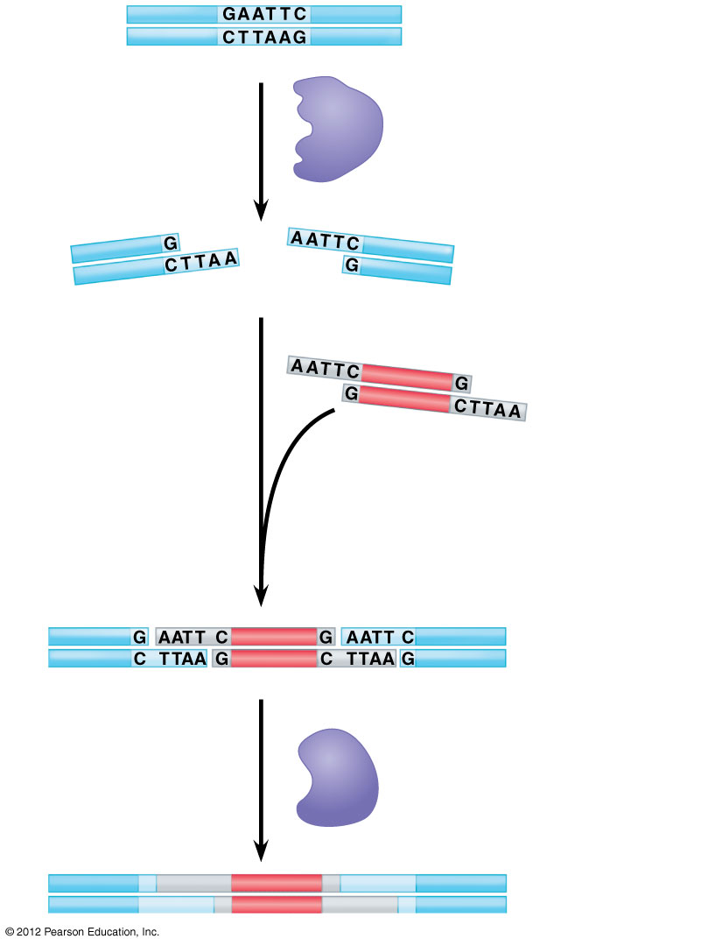
Figure 12.2_s4
1
DNA
Restriction enzyme
recognition sequence
A restriction
enzyme cuts
the DNA into
fragments.
Restriction
enzyme
2
Sticky
end
Sticky
end
Gene of
interest
A DNA fragment
from another
source is added.
3
Two (or more)
fragments stick
together by
base pairing.
4
DNA ligase
pastes the
strands together.
DNA ligase
5
Recombinant
DNA molecule
Notes:
22
Figure 12.2_s4 Creating recombinant DNA using a restriction enzyme and DNA ligase (step 4)

Slide 23
GENETICALLY MODIFIED ORGANISMS
© 2012 Pearson Education, Inc.
Notes:
23

Slide 24
12.6 Recombinant cells and organisms can mass-produce gene products
0
  Recombinant cells and organisms constructed by DNA technologies are used to manufacture many useful products, chiefly proteins.
  Bacteria are often the best organisms for manufacturing a protein product because bacteria
    have plasmids and phages available for use as gene-cloning vectors,
    can be grown rapidly and cheaply,
    can be engineered to produce large amounts of a particular protein, and
    often secrete the proteins directly into their growth medium.
© 2012 Pearson Education, Inc.
Notes:
24
Student Misconceptions and Concerns
1. The genetic engineering of organisms can be controversial, creating various degrees of social unease and resistance. Yet, many debates about scientific issues are confused by misinformation. This provides an opportunity for you to assign students to take a position on such issues and support their arguments with accurate research. Students might debate whether a food or drug made from GM/transgenic organisms should be labeled as such, or discuss the risks and advantages of producing GM organisms.
2. The fact that the technologies described in this chapter can be used to swap genes between prokaryotes and eukaryotes reveals the fundamental similarities in genetic mechanisms shared by all forms of life. This very strong evidence of common descent is evidence of evolution that may be missed by your students.
Teaching Tips
As noted in Module 12.6, DNA technology is primarily used to produce proteins. Challenge your students to explain why lipids and carbohydrates are not typically produced by these processes.

Slide 25
12.6 Recombinant cells and organisms can mass-produce gene products
0
  Yeast cells
    are eukaryotes,
    have long been used to make bread and beer,
    can take up foreign DNA and integrate it into their genomes,
    have plasmids that can be used as gene vectors, and
    are often better than bacteria at synthesizing and secreting eukaryotic proteins.
© 2012 Pearson Education, Inc.
Notes:
25
Student Misconceptions and Concerns
1. The genetic engineering of organisms can be controversial, creating various degrees of social unease and resistance. Yet, many debates about scientific issues are confused by misinformation. This provides an opportunity for you to assign students to take a position on such issues and support their arguments with accurate research. Students might debate whether a food or drug made from GM/transgenic organisms should be labeled as such, or discuss the risks and advantages of producing GM organisms.
2. The fact that the technologies described in this chapter can be used to swap genes between prokaryotes and eukaryotes reveals the fundamental similarities in genetic mechanisms shared by all forms of life. This very strong evidence of common descent is evidence of evolution that may be missed by your students.
Teaching Tips
As noted in Module 12.6, DNA technology is primarily used to produce proteins. Challenge your students to explain why lipids and carbohydrates are not typically produced by these processes.

Slide 26
12.6 Recombinant cells and organisms can mass-produce gene products
0
  Mammalian cells must be used to produce proteins with chains of sugars. Examples include
    human erythropoietin (EPO), which stimulates the production of red blood cells,
    factor VIII to treat hemophilia, and
    tissue plasminogen activator (TPA) used to treat heart attacks and strokes.
© 2012 Pearson Education, Inc.
Notes:
26
Student Misconceptions and Concerns
1. The genetic engineering of organisms can be controversial, creating various degrees of social unease and resistance. Yet, many debates about scientific issues are confused by misinformation. This provides an opportunity for you to assign students to take a position on such issues and support their arguments with accurate research. Students might debate whether a food or drug made from GM/transgenic organisms should be labeled as such, or discuss the risks and advantages of producing GM organisms.
2. The fact that the technologies described in this chapter can be used to swap genes between prokaryotes and eukaryotes reveals the fundamental similarities in genetic mechanisms shared by all forms of life. This very strong evidence of common descent is evidence of evolution that may be missed by your students.
Teaching Tips
As noted in Module 12.6, DNA technology is primarily used to produce proteins. Challenge your students to explain why lipids and carbohydrates are not typically produced by these processes.

Slide 27
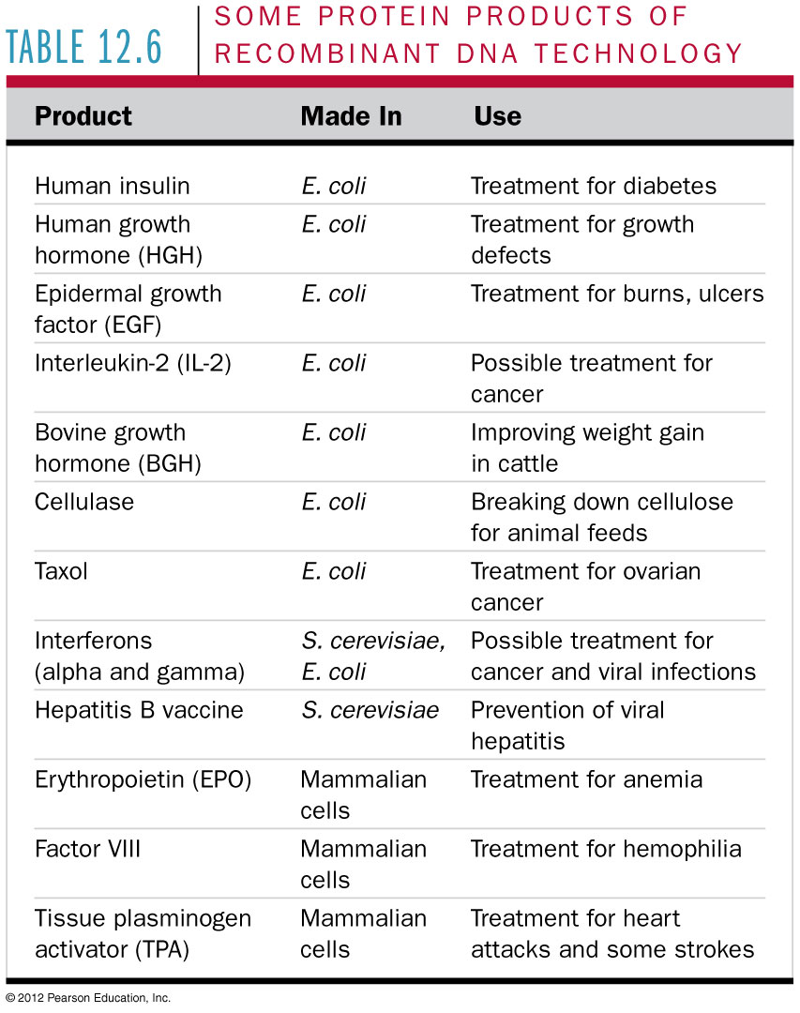
Table 12.6
Notes:
27
Table 12.6 Some Protein Products of Recombinant DNA Technology

Slide 28
12.6 Recombinant cells and organisms can mass-produce gene products
0
  Pharmaceutical researchers are currently exploring the mass production of gene products by
    whole animals or
    plants.
  Recombinant animals
    are difficult and costly to produce and
    must be cloned to produce more animals with the same traits.
© 2012 Pearson Education, Inc.
Notes:
28
Student Misconceptions and Concerns
1. The genetic engineering of organisms can be controversial, creating various degrees of social unease and resistance. Yet, many debates about scientific issues are confused by misinformation. This provides an opportunity for you to assign students to take a position on such issues and support their arguments with accurate research. Students might debate whether a food or drug made from GM/transgenic organisms should be labeled as such, or discuss the risks and advantages of producing GM organisms.
2. The fact that the technologies described in this chapter can be used to swap genes between prokaryotes and eukaryotes reveals the fundamental similarities in genetic mechanisms shared by all forms of life. This very strong evidence of common descent is evidence of evolution that may be missed by your students.
Teaching Tips
As noted in Module 12.6, DNA technology is primarily used to produce proteins. Challenge your students to explain why lipids and carbohydrates are not typically produced by these processes.

Slide 29
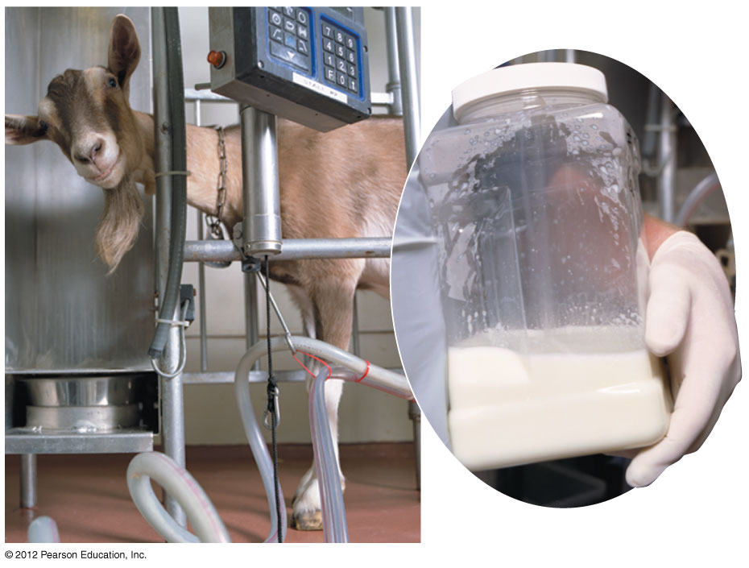
Figure 12.6A
Notes:
29
Figure 12.6A A goat carrying a gene for a human blood protein that is secreted in the milk

Slide 30
12.7 CONNECTION: DNA technology has changed the pharmaceutical industry and medicine
0
  Products of DNA technology are already in use.
    Therapeutic hormones produced by DNA technology include
      insulin to treat diabetes and
      human growth hormone to treat dwarfism.
    DNA technology is used to
      test for inherited diseases,
      detect infectious agents such as HIV, and
      produce vaccines, harmless variants (mutants) or derivatives of a pathogen that stimulate the immune system.
© 2012 Pearson Education, Inc.
Notes:
30
Student Misconceptions and Concerns
1. The genetic engineering of organisms can be controversial, creating various degrees of social unease and resistance. Yet, many debates about scientific issues are confused by misinformation. This provides an opportunity for you to assign students to take a position on such issues and support their arguments with accurate research. Students might debate whether a food or drug made from GM/transgenic organisms should be labeled as such, or discuss the risks and advantages of producing GM organisms.
2. The fact that the technologies described in this chapter can be used to swap genes between prokaryotes and eukaryotes reveals the fundamental similarities in genetic mechanisms shared by all forms of life. This very strong evidence of common descent is evidence of evolution that may be missed by your students.
Teaching Tips
Annual flu vaccinations are a common way to prevent diseases that cannot be easily treated. However, students might not understand why many people receive the vaccine every year. A new annual vaccine is necessary because the flu viruses keep evolving, another lesson in evolution that may be missed by your students.

Slide 31
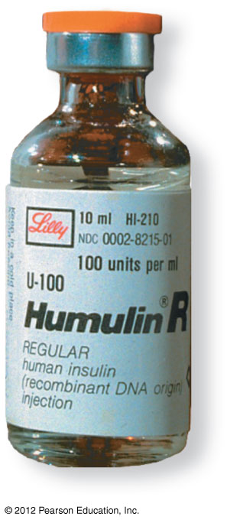
Figure 12.7A
Notes:
31
Figure 12.7A Human insulin produced by bacteria

Slide 32
12.8 CONNECTION: Genetically modified organisms are transforming agriculture
0
  Genetically modified (GM) organisms contain one or more genes introduced by artificial means.
  Transgenic organisms contain at least one gene from another species.
© 2012 Pearson Education, Inc.
Notes:
32
Student Misconceptions and Concerns
1. The genetic engineering of organisms can be controversial, creating various degrees of social unease and resistance. Yet, many debates about scientific issues are confused by misinformation. This provides an opportunity for you to assign students to take a position on such issues and support their arguments with accurate research. Students might debate whether a food or drug made from GM/transgenic organisms should be labeled as such, or discuss the risks and advantages of producing GM organisms.
2. The fact that the technologies described in this chapter can be used to swap genes between prokaryotes and eukaryotes reveals the fundamental similarities in genetic mechanisms shared by all forms of life. This very strong evidence of common descent is evidence of evolution that may be missed by your students.
Teaching Tips
Roundup Ready Corn, a product of the agricultural biotechnology corporation Monsanto, is resistant to the herbicide Roundup. The general strategy for farmers is to spray fields of Roundup Ready corn with the herbicide Roundup, killing weeds but not the corn. A search of the Internet will quickly reveal the controversy associated with this and other genetically modified organisms (GMO), which can encourage interesting discussions and promote critical thinking skills. Module 12.9 discusses some of the issues related to the concerns over the use of GM organisms.

Slide 33
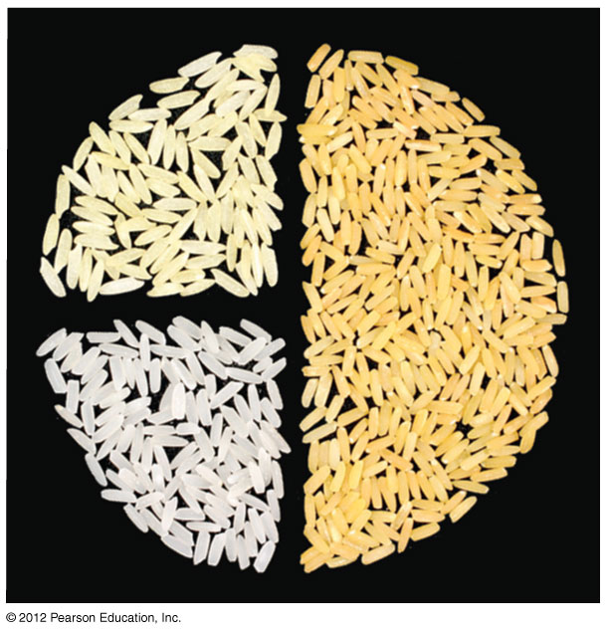
Figure 12.8B
Notes:
33
Figure 12.8B A mix of conventional rice (white), the original Golden Rice (light gold), and Golden Rice 2 (dark gold)

Slide 34
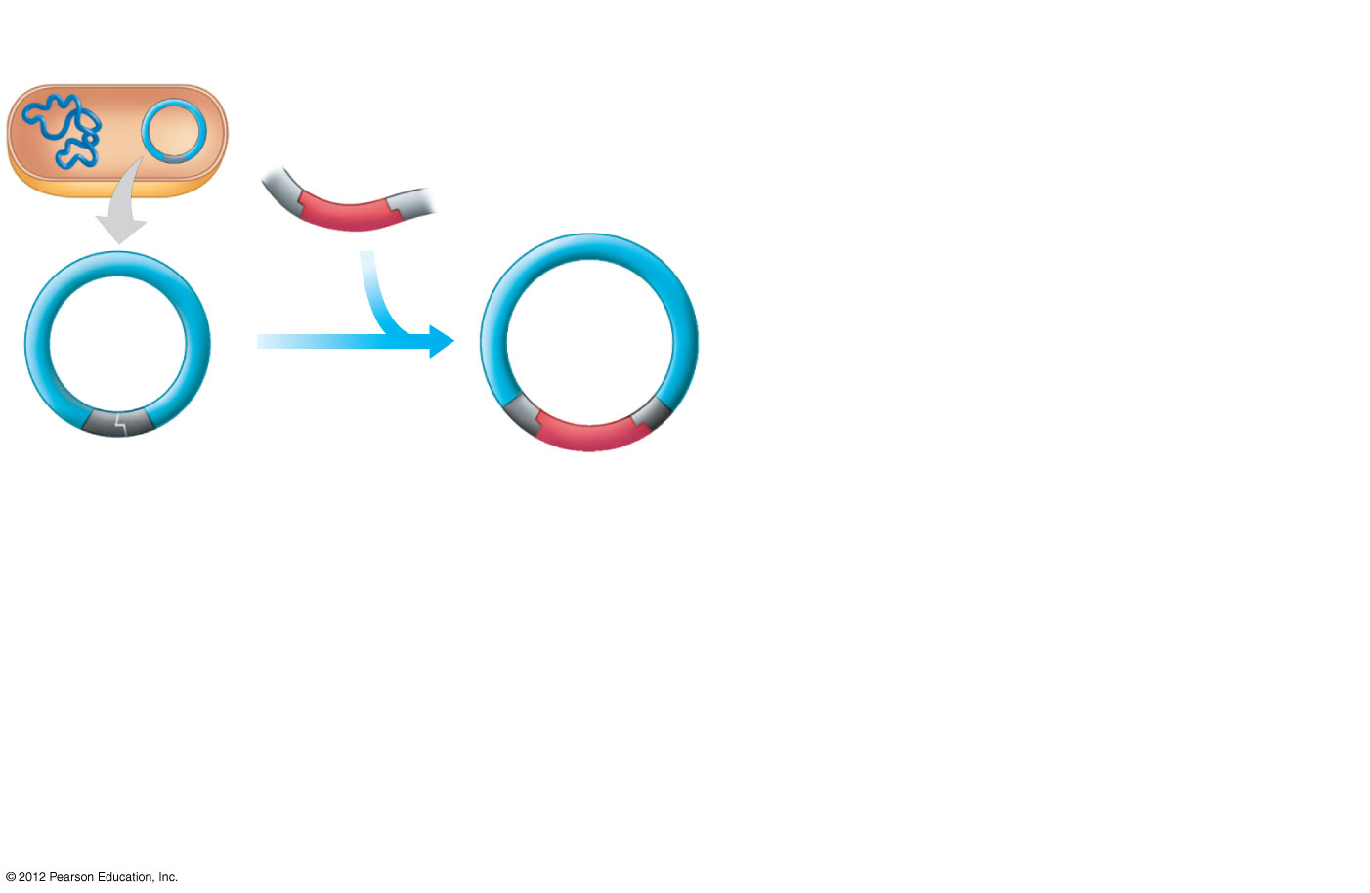
Figure 12.8A_s1
Agrobacterium
tumefaciens
DNA containing the
gene for a desired trait
1
Ti
plasmid
Recombinant
Ti plasmid
The gene is
inserted into
the plasmid.
Restriction
site
Notes:
34
Figure 12.8A_s1 Using the Ti plasmid to genetically engineer plants (step 1)

Slide 35
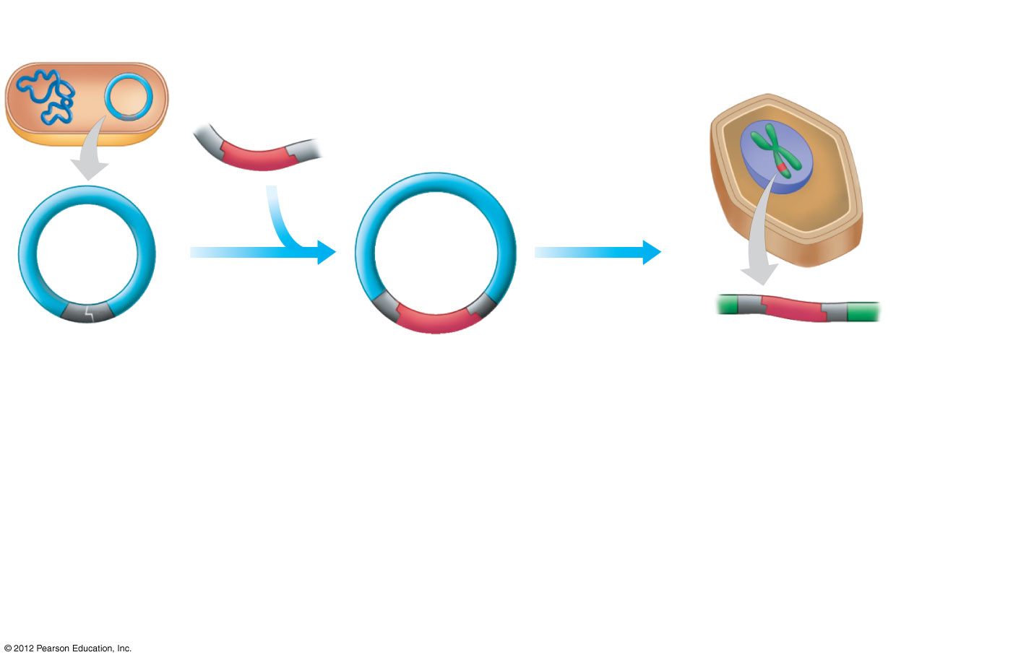
Figure 12.8A_s2
Agrobacterium
tumefaciens
DNA containing the
gene for a desired trait
Plant cell
1
2
Ti
plasmid
Recombinant
Ti plasmid
The gene is
inserted into
the plasmid.
The recombinant
plasmid is
introduced into
a plant cell.
DNA carrying
the new gene
Restriction
site
Notes:
35
Figure 12.8A_s2 Using the Ti plasmid to genetically engineer plants (step 2)

Slide 36
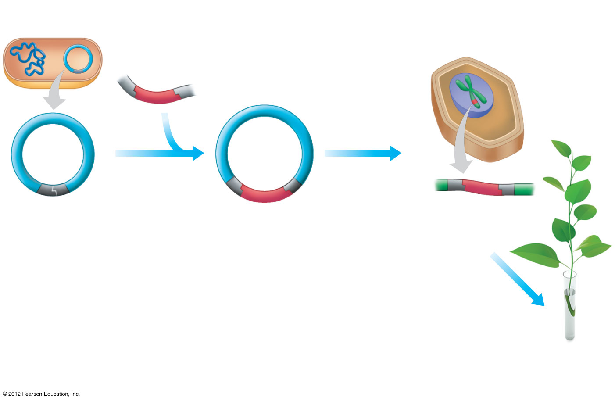
Figure 12.8A_s3
Agrobacterium
tumefaciens
DNA containing the
gene for a desired trait
Plant cell
1
2
Ti
plasmid
Recombinant
Ti plasmid
The gene is
inserted into
the plasmid.
The recombinant
plasmid is
introduced into
a plant cell.
DNA carrying
the new gene
Restriction
site
3
The plant cell
grows into
a plant.
A plant
with the
new trait
Notes:
36
Figure 12.8A_s3 Using the Ti plasmid to genetically engineer plants (step 3)

Slide 37
12.8 CONNECTION: Genetically modified organisms are transforming agriculture
0
  GM plants are being produced that
    are more resistant to herbicides and pests and
    provide nutrients that help address malnutrition.
  GM animals are being produced with improved nutritional or other qualities.
© 2012 Pearson Education, Inc.
Notes:
37
Student Misconceptions and Concerns
1. The genetic engineering of organisms can be controversial, creating various degrees of social unease and resistance. Yet, many debates about scientific issues are confused by misinformation. This provides an opportunity for you to assign students to take a position on such issues and support their arguments with accurate research. Students might debate whether a food or drug made from GM/transgenic organisms should be labeled as such, or discuss the risks and advantages of producing GM organisms.
2. The fact that the technologies described in this chapter can be used to swap genes between prokaryotes and eukaryotes reveals the fundamental similarities in genetic mechanisms shared by all forms of life. This very strong evidence of common descent is evidence of evolution that may be missed by your students.
Teaching Tips
Roundup Ready Corn, a product of the agricultural biotechnology corporation Monsanto, is resistant to the herbicide Roundup. The general strategy for farmers is to spray fields of Roundup Ready corn with the herbicide Roundup, killing weeds but not the corn. A search of the Internet will quickly reveal the controversy associated with this and other genetically modified organisms (GMO), which can encourage interesting discussions and promote critical thinking skills. Module 12.9 discusses some of the issues related to the concerns over the use of GM organisms.

Slide 38
12.10 CONNECTION: Gene therapy may someday help treat a variety of diseases
0
  Gene therapy is an
    alteration of an afflicted individual’s genes and
    attempt to treat disease.
  Gene therapy may be best used to treat disorders traceable to a single defective gene.
© 2012 Pearson Education, Inc.
Notes:
38
Student Misconceptions and Concerns
1. The genetic engineering of organisms can be controversial, creating various degrees of social unease and resistance. Yet, many debates about scientific issues are confused by misinformation. This provides an opportunity for you to assign students to take a position on such issues and support their arguments with accurate research. Students might debate whether a food or drug made from GM/transgenic organisms should be labeled as such, or discuss the risks and advantages of producing GM organisms.
2. The fact that the technologies described in this chapter can be used to swap genes between prokaryotes and eukaryotes reveals the fundamental similarities in genetic mechanisms shared by all forms of life. This very strong evidence of common descent is evidence of evolution that may be missed by your students.
Teaching Tips
1. In 2008, the Genetic Information Nondiscrimination Act (GINA) was signed into law.
The following link to a related US government web site characterizes the effect of the act as follows. GINA “… prohibits U.S. insurance companies and employers from discriminating on the basis of information derived from genetic tests.” The web site can be found at www.ornl.gov/sci/techresources/Human_Genome/elsi/legislat.shtml.
2. As gene therapy technology expands, our ability to modify the genome in human embryos through in vitro fertilization permits genetic modification at the earliest stages of life. Future generations of humans, like our crops today, may include those with and without a genetically modified ancestry. The benefits and challenges of these technologies raise issues many students have never considered. Our students, and the generations soon to follow, will face the potential of directed human evolution.

Slide 39
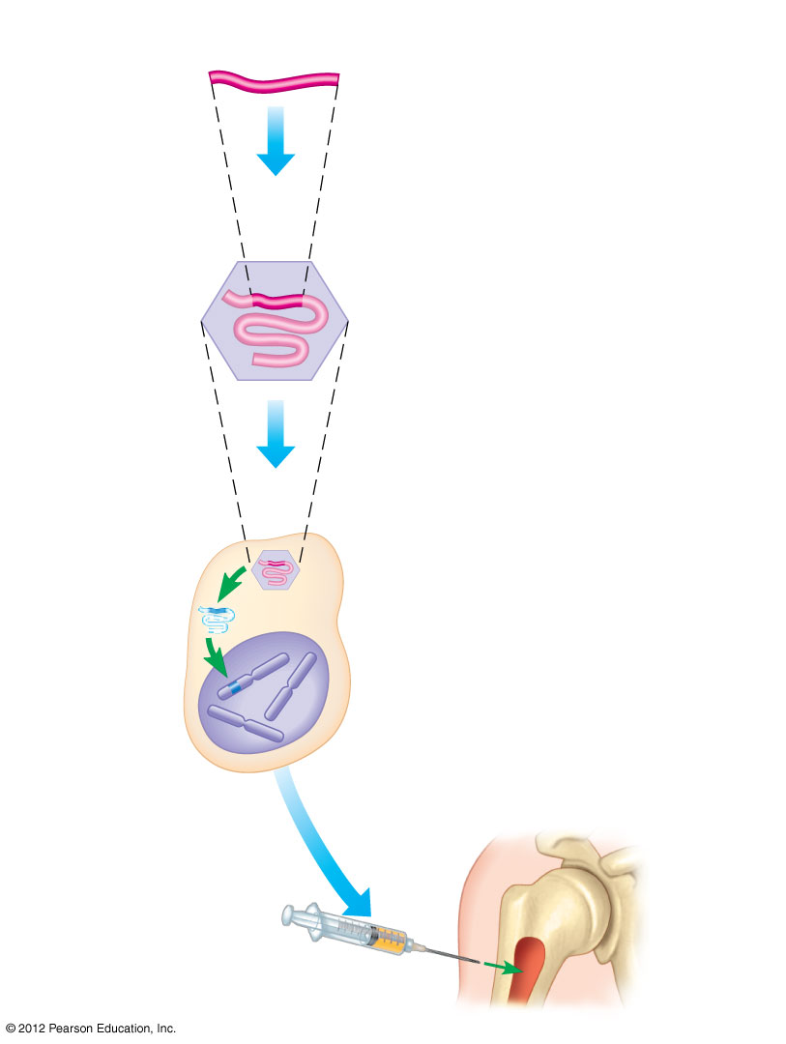
Figure 12.10
Cloned gene
(normal allele)
1
An RNA version of
a normal human
gene is inserted
into a retrovirus.
RNA genome of virus
Retrovirus
2
Bone marrow cells
are infected with
the virus.
3
Viral DNA carrying the
human gene inserts into
the cell’s chromosome.
Bone marrow
cell from the patient
4
The engineered
cells are injected
into the patient.
Bone
marrow
Notes:
39
Figure 12.10 One type of gene therapy procedure

Slide 40
12.10 CONNECTION: Gene therapy may someday help treat a variety of diseases
0
  The first successful human gene therapy trial in 2000
    tried to treat ten children with SCID (severe combined immune deficiency),
    helped nine of these patients, but
    caused leukemia in three of the patients, and
    resulted in one death.
© 2012 Pearson Education, Inc.
Notes:
40
Student Misconceptions and Concerns
1. The genetic engineering of organisms can be controversial, creating various degrees of social unease and resistance. Yet, many debates about scientific issues are confused by misinformation. This provides an opportunity for you to assign students to take a position on such issues and support their arguments with accurate research. Students might debate whether a food or drug made from GM/transgenic organisms should be labeled as such, or discuss the risks and advantages of producing GM organisms.
2. The fact that the technologies described in this chapter can be used to swap genes between prokaryotes and eukaryotes reveals the fundamental similarities in genetic mechanisms shared by all forms of life. This very strong evidence of common descent is evidence of evolution that may be missed by your students.
Teaching Tips
1. In 2008, the Genetic Information Nondiscrimination Act (GINA) was signed into law.
The following link to a related US government web site characterizes the effect of the act as follows. GINA “… prohibits U.S. insurance companies and employers from discriminating on the basis of information derived from genetic tests.” The web site can be found at www.ornl.gov/sci/techresources/Human_Genome/elsi/legislat.shtml.
2. As gene therapy technology expands, our ability to modify the genome in human embryos through in vitro fertilization permits genetic modification at the earliest stages of life. Future generations of humans, like our crops today, may include those with and without a genetically modified ancestry. The benefits and challenges of these technologies raise issues many students have never considered. Our students, and the generations soon to follow, will face the potential of directed human evolution.

Slide 41
12.10 CONNECTION: Gene therapy may someday help treat a variety of diseases
0
  The use of gene therapy raises many questions.
    How can we build in gene control mechanisms that make appropriate amounts of the product at the right time and place?
    How can gene insertion be performed without harming other cell functions?
    Will gene therapy lead to efforts to control the genetic makeup of human populations?
    Should we try to eliminate genetic defects in our children and descendants when genetic variety is a necessary ingredient for the survival of a species?
© 2012 Pearson Education, Inc.
Notes:
41
Student Misconceptions and Concerns
1. The genetic engineering of organisms can be controversial, creating various degrees of social unease and resistance. Yet, many debates about scientific issues are confused by misinformation. This provides an opportunity for you to assign students to take a position on such issues and support their arguments with accurate research. Students might debate whether a food or drug made from GM/transgenic organisms should be labeled as such, or discuss the risks and advantages of producing GM organisms.
2. The fact that the technologies described in this chapter can be used to swap genes between prokaryotes and eukaryotes reveals the fundamental similarities in genetic mechanisms shared by all forms of life. This very strong evidence of common descent is evidence of evolution that may be missed by your students.
Teaching Tips
1. In 2008, the Genetic Information Nondiscrimination Act (GINA) was signed into law.
The following link to a related US government web site characterizes the effect of the act as follows. GINA “… prohibits U.S. insurance companies and employers from discriminating on the basis of information derived from genetic tests.” The web site can be found at www.ornl.gov/sci/techresources/Human_Genome/elsi/legislat.shtml.
2. As gene therapy technology expands, our ability to modify the genome in human embryos through in vitro fertilization permits genetic modification at the earliest stages of life. Future generations of humans, like our crops today, may include those with and without a genetically modified ancestry. The benefits and challenges of these technologies raise issues many students have never considered. Our students, and the generations soon to follow, will face the potential of directed human evolution.

Slide 42
DNA PROFILING
© 2012 Pearson Education, Inc.
Notes:
42

Slide 43
12.11 The analysis of genetic markers can produce a DNA profile
0
  DNA profiling is the analysis of DNA fragments to determine whether they come from the same individual. DNA profiling
    compares genetic markers from noncoding regions that show variation between individuals and
    involves amplifying (copying) of markers for analysis.
© 2012 Pearson Education, Inc.
Notes:
43
Student Misconceptions and Concerns
Television programs might lead some students to expect DNA profiling to be quick and easy. Ask students to consider why DNA profiling actually takes many days or weeks to complete.
Teaching Tips
Figure 12.11 describes the general steps of DNA profiling. This overview is a useful reference to employ while the details of each step are discussed.

Slide 44
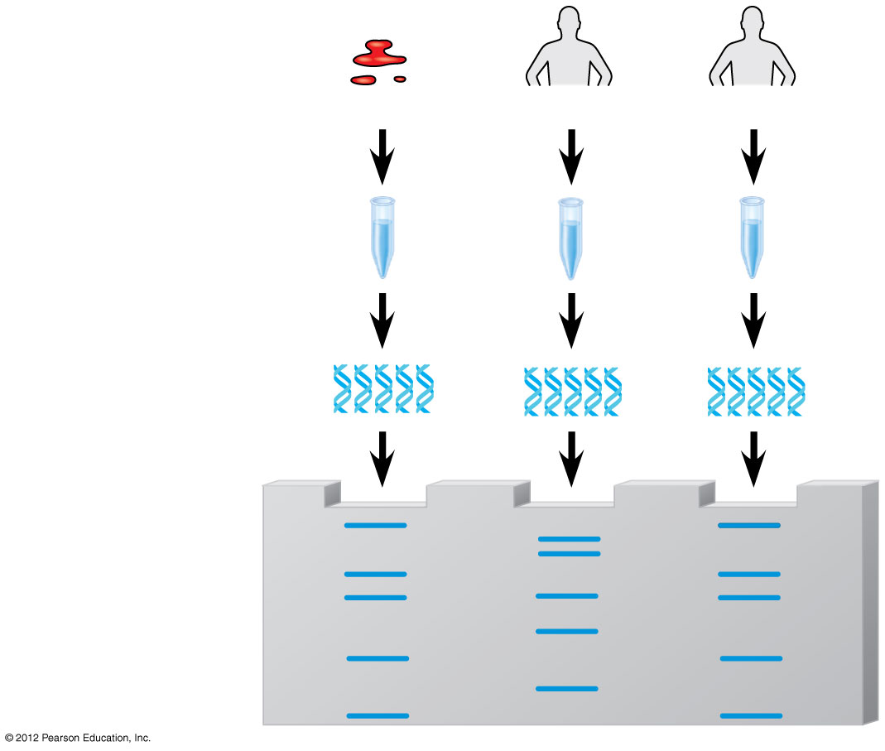
Figure 12.11
Crime scene
Suspect 1
Suspect 2
1
DNA is
isolated.
2
The DNA of
selected
markers is
amplified.
3
The amplified
DNA is
compared.
Notes:
44
Figure 12.11 An overview of DNA profiling

Slide 45
12.12 The PCR method is used to amplify DNA sequences
0
  Polymerase chain reaction (PCR) is a method of amplifying a specific segment of a DNA molecule.
  PCR relies upon a pair of primers that are
    short,
    chemically synthesized, single-stranded DNA molecules, and
    complementary to sequences at each end of the target sequence.
  PCR
    is a three-step cycle that
    doubles the amount of DNA in each turn of the cycle.
© 2012 Pearson Education, Inc.
Notes:
45
Student Misconceptions and Concerns
1. Television programs might lead some students to expect DNA profiling to be quick and easy. Ask students to consider why DNA profiling actually takes many days or weeks to complete.
2. Students might expect DNA profiling for criminal investigations to involve an analysis of the entire human genome. Consider explaining why such an analysis is unrealistic and unnecessary. Modules 12.12–12.16 describe methods used to describe specific portions of the genome of particular interest.
Teaching Tips
In PCR, the product becomes another master copy. Imagine that while you are photocopying, every copy is used as a master at another copy machine. This would require many copy machines. However, it would be very productive!

Slide 46
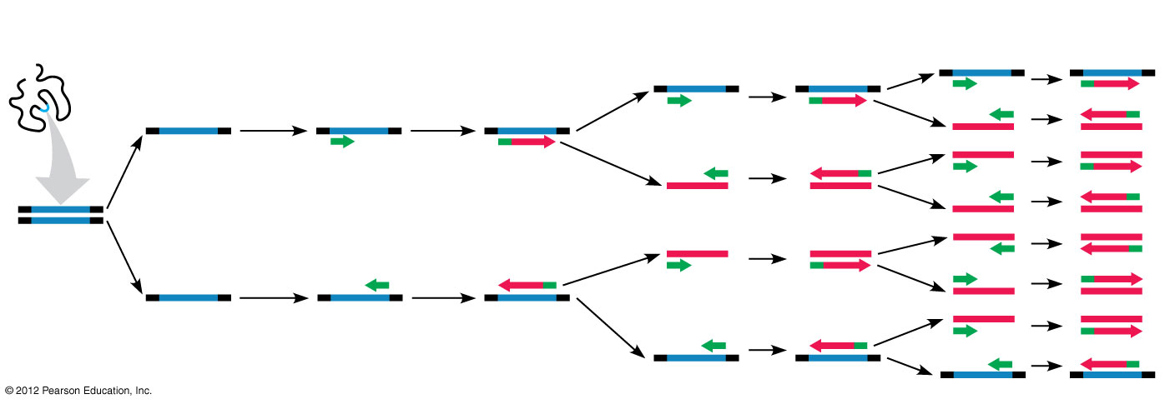
Figure 12.12
Cycle 1
yields two molecules
Cycle 2
yields four molecules
Cycle 3
yields eight molecules
Genomic
DNA
3′
5′
3′
5′
3′
5′
5′
5′
3′
1
Heat
separates
DNA
strands.
Primers bond
with ends
of target
sequences.
DNA
polymerase
adds
nucleotides.
2
3
3′
5′
5′
3′
Target
sequence
3′
5′
5′
5′
3′
5′
3′
5′
3′
Primer
New DNA
Notes:
46
Figure 12.12 DNA amplification by PCR

Slide 47
12.13 Gel electrophoresis sorts DNA molecules by size
0
  Gel electrophoresis can be used to separate DNA molecules based on size as follows:
    A DNA sample is placed at one end of a porous gel.
    Current is applied and DNA molecules move from the negative electrode toward the positive electrode.
    Shorter DNA fragments move through the gel matrix more quickly and travel farther through the gel.
    DNA fragments appear as bands, visualized through staining or detecting radioactivity or fluorescence.
    Each band is a collection of DNA molecules of the same length.
© 2012 Pearson Education, Inc.
Notes:
47
Student Misconceptions and Concerns
1. Television programs might lead some students to expect DNA profiling to be quick and easy. Ask students to consider why DNA profiling actually takes many days or weeks to complete.
2. Students might expect DNA profiling for criminal investigations to involve an analysis of the entire human genome. Consider explaining why such an analysis is unrealistic and unnecessary. Modules 12.12–12.16 describe methods used to describe specific portions of the genome of particular interest.
Teaching Tips
Separating ink using paper chromatography is a simple experiment that approximates some of what occurs in gel electrophoresis. Consider doing this as a class demonstration while addressing electrophoresis. Cut a large piece of filter paper into a rectangle or square. Use markers to color large dots about 2 cm away from one edge of the paper. Separate the dots from each other by 3–4 cm. Place the paper on edge, dots down, into a beaker containing about 1 cm of ethanol or isopropyl alcohol (50% or higher will do). The dots should not be in contact with the pool of alcohol in the bottom of the beaker. As the alcohol is drawn up the filter paper by capillary action, the alcohol will dissolve the ink dots. As the alcohol continues up the paper, the ink follows. Not all of the ink components move at the same speed, based upon their size and chemical properties. If you begin the process at the start of class, you should have some degree of separation by the end of a 50-minute period. Experiment with the technique a day or two before class to fine-tune the demonstration. (Save and air-dry these samples for your class.) Consider using brown, green, and black markers, because these colors are often made by color combinations.

Slide 48
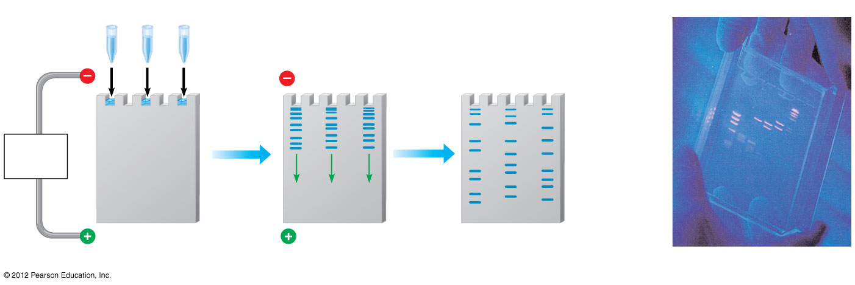
Figure 12.13
A mixture of DNA
fragments of
different sizes
Longer
(slower)
molecules
Power
source
Gel
Shorter
(faster)
molecules
Completed
gel
Notes:
48
Figure 12.13 Gel electrophoresis of DNA

Slide 49
12.14 STR analysis is commonly used for DNA profiling
0
  Repetitive DNA consists of nucleotide sequences that are present in multiple copies in the genome.
  Short tandem repeats (STRs) are short nucleotide sequences that are repeated in tandem,
    composed of different numbers of repeating units in individuals and
    used in DNA profiling.
  STR analysis
    compares the lengths of STR sequences at specific sites in the genome and
    typically analyzes 13 different STR sites.
© 2012 Pearson Education, Inc.
Notes:
49
Student Misconceptions and Concerns
1. Television programs might lead some students to expect DNA profiling to be quick and easy. Ask students to consider why DNA profiling actually takes many days or weeks to complete.
2. Students might expect DNA profiling for criminal investigations to involve an analysis of the entire human genome. Consider explaining why such an analysis is unrealistic and unnecessary. Modules 12.12–12.16 describe methods used to describe specific portions of the genome of particular interest.
Teaching Tips
In most legal cases, the probability of two people having identical DNA profiles can be one in 10 billion or more. However, eyewitness testimony has been a standard part of the justice system. If you want to make the point about the unreliability of eyewitnesses in a trial, compared to techniques such as genetic profiling, consider this exercise. Arrange for a person who is not well known to the class to run into your classroom, take something you have placed near you (perhaps a bag, stack of papers, or box), and leave quickly. You need to take care that no one in the class is so alarmed as to do something dangerous. Once the “thief” is gone, tell the class that this was planned and do not speak. Have them each write a description of the person, including height, hair color, clothing, facial hair, behavior, etc. Many students will be accurate, but some will likely get details wrong. This is also an effective exercise to demonstrate the need for large sample sizes and accurate recording devices for good scientific technique.

Slide 50
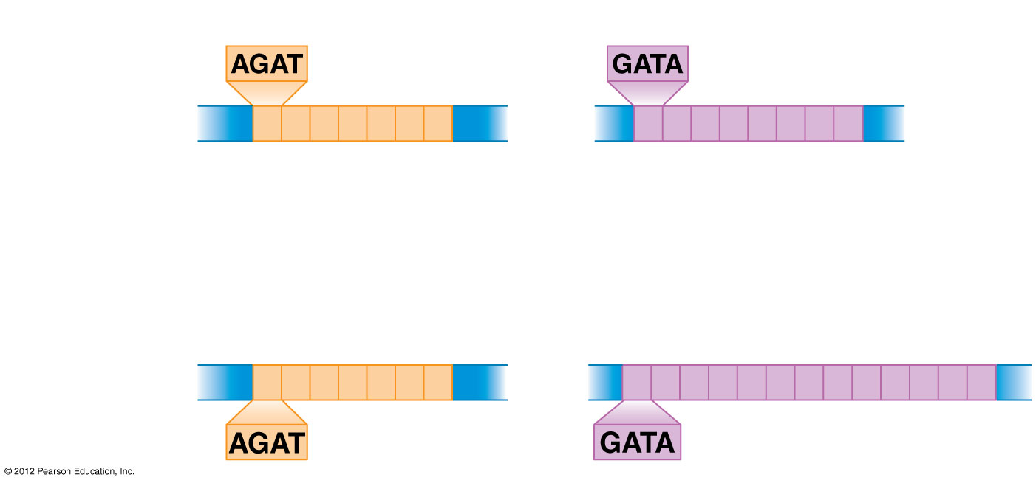
Figure 12.14A
STR site 1
STR site 2
Crime scene
DNA
The number of short
tandem repeats match
The number of short tandem
repeats do not match
Suspect’s
DNA
Notes:
50
Figure 12.14A Two representative STR sites from crime scene DNA samples

Slide 51
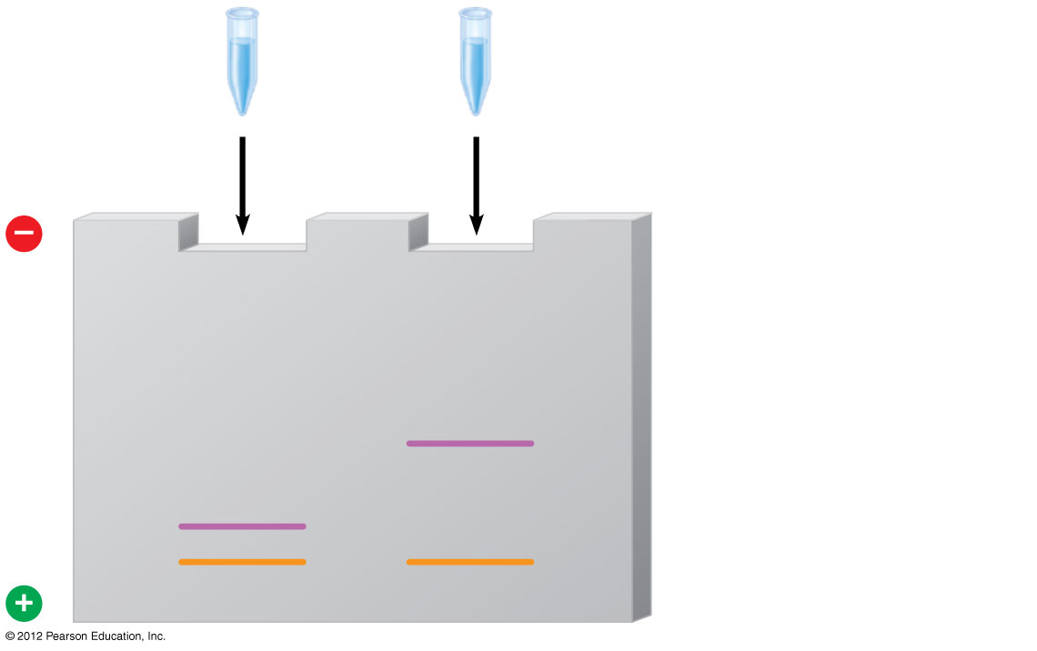
Figure 12.14B
Crime
scene
DNA
Suspect’s
DNA
Longer STR fragments
Shorter STR fragments
Notes:
51
Figure 12.14B DNA profiles generated from the STRs in Figure 12.14A

Slide 52
12.15 CONNECTION: DNA profiling has provided evidence in many forensic investigations
0
  DNA profiling is used to
    determine guilt or innocence in a crime,
    settle questions of paternity,
    identify victims of accidents, and
    probe the origin of nonhuman materials.
© 2012 Pearson Education, Inc.
Notes:
52
Student Misconceptions and Concerns
1. Television programs might lead some students to expect DNA profiling to be quick and easy. Ask students to consider why DNA profiling actually takes many days or weeks to complete.
2. Students might expect DNA profiling for criminal investigations to involve an analysis of the entire human genome. Consider explaining why such an analysis is unrealistic and unnecessary. Modules 12.12–12.16 describe methods used to describe specific portions of the genome of particular interest.
Teaching Tips
Although the statistical odds of a DNA-profiling match can exceed one in 10 billion, the odds of a mistake in the collecting and testing procedures can be much greater. This is an important distinction. An error as simple as mislabeling a sample can confuse the results. Unfortunately, the odds of human error will vary and are difficult to determine.

Slide 53
12.16 RFLPs can be used to detect differences in DNA sequences
0
  A single nucleotide polymorphism (SNP) is a variation at a single base pair within a genome.
  Restriction fragment length polymorphism (RFLP) is a change in the length of restriction fragments due to a SNP that alters a restriction site.
  RFLP analysis involves
    producing DNA fragments by restriction enzymes and
    sorting these fragments by gel electrophoresis.
© 2012 Pearson Education, Inc.
Notes:
53
Student Misconceptions and Concerns
1. Television programs might lead some students to expect DNA profiling to be quick and easy. Ask students to consider why DNA profiling actually takes many days or weeks to complete.
2. Students might expect DNA profiling for criminal investigations to involve an analysis of the entire human genome. Consider explaining why such an analysis is unrealistic and unnecessary. Modules 12.12–12.16 describe methods used to describe specific portions of the genome of particular interest.
Teaching Tips
Here is another way to explain restriction fragment analysis. Consider these two words, equilibrium and equalibrium. Imagine that a mutation produced the spelling error of the second word. If we used a “restriction enzyme” that splits these words between u and i, how will the fragments compare in size and number?
equilibrium = equ ilibri um (three fragments of three, six, and two letters)
equalibrium = equalibri um (two fragments of nine and two letters)

Slide 54
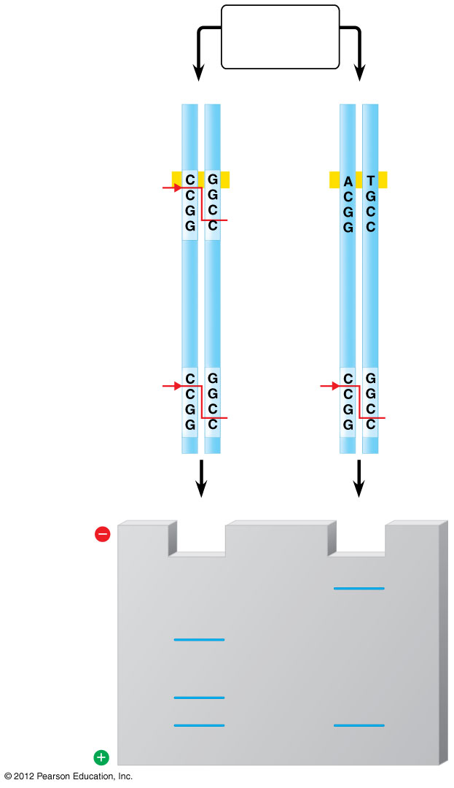
Figure 12.16
Restriction
enzymes
added
DNA sample 1
DNA sample 2
w
Cut
z
x
Cut
Cut
y
y
Sample
1
Sample
2
Longer
fragments
z
x
Shorter
fragments
w
y
y
Notes:
54
Figure 12.16 RFLP analysis

Slide 55
GENOMICS
© 2012 Pearson Education, Inc.
Notes:
55

Slide 56
12.17 Genomics is the scientific study of whole genomes
0
  Genomics is the study of an organism’s complete set of genes and their interactions.
    Initial studies focused on prokaryotic genomes.
    Many eukaryotic genomes have since been investigated.
© 2012 Pearson Education, Inc.
Notes:
56
Student Misconceptions and Concerns
The similarities in genotypes and phenotypes among members of a human family are expected and understood by most students. Yet many students have a difficult time extrapolating this knowledge and applying it to the phylogenetic relationships of other groups. The use of genomics to test phylogenetic relationships is an enormously powerful tool for modern systematics and genomics provides significant support for the other types of evidence for evolution.
Teaching Tips
The first targets of genomics were prokaryotic pathogenic organisms. Consider asking your students in class to suggest why this was a good choice. Students may note that the genomes of these organisms are smaller than eukaryotes and that many of these organisms are of great medical significance.

Slide 57
12.17 Genomics is the scientific study of whole genomes
0
  Genomics allows another way to examine evolutionary relationships.
    Genomic studies showed a 96% similarity in DNA sequences between chimpanzees and humans.
    Functions of human disease-causing genes have been determined by comparing human genes to similar genes in yeast.
© 2012 Pearson Education, Inc.
Notes:
57
Student Misconceptions and Concerns
The similarities in genotypes and phenotypes among members of a human family are expected and understood by most students. Yet many students have a difficult time extrapolating this knowledge and applying it to the phylogenetic relationships of other groups. The use of genomics to test phylogenetic relationships is an enormously powerful tool for modern systematics and genomics provides significant support for the other types of evidence for evolution.
Teaching Tips
The first targets of genomics were prokaryotic pathogenic organisms. Consider asking your students in class to suggest why this was a good choice. Students may note that the genomes of these organisms are smaller than eukaryotes and that many of these organisms are of great medical significance.

Slide 58
12.18 CONNECTION: The Human Genome Project revealed that most of the human genome does not consist of genes
0
  The goals of the Human Genome Project (HGP) included
    determining the nucleotide sequence of all DNA in the human genome and
    identifying the location and sequence of every human gene.
© 2012 Pearson Education, Inc.
Notes:
58
Student Misconceptions and Concerns
1. The similarities in genotypes and phenotypes among members of a human family are expected and understood by most students. Yet many students have a difficult time extrapolating this knowledge and applying it to the phylogenetic relationships of other groups. The use of genomics to test phylogenetic relationships is an enormously powerful tool for modern systematics and genomics provides significant support for the other types of evidence for evolution.
2. Students might assume that the term junk DNA implies that these noncoding regions of DNA are useless. This might be a good time to note the old saying, absence of evidence is not evidence of absence. Our current inability to understand the role(s) of noncoding DNA does not mean that these regions have no significance.
3. Students might know that humans have 23 pairs of chromosomes. Consider asking them how many different types of chromosomes are found in humans. Some will not have realized that there are 24 types, 22 autosomes plus X and Y sex chromosomes.
Teaching Tips
1. The main U.S. Department of Energy Office website in support of the human genome project is found at www.ornl.gov/sci/techresources/Human_Genome/home.shtml.
2. The website for the National Center for Biotechnology Information is www.ncbi.nlm.nih.gov. The center, established in 1988, serves as a national resource for biomedical information related to genomic data.
3. The authors note that there are 3.2 billion nucleotide pairs in the human genome. There are about 3.2 billion seconds in 101.4 years. This simple reference can add meaning to the significance of these large numbers.
4. Challenge students to explain why a complete understanding of an organism’s genome and proteomes is still not enough to understand the full biology of an organism. Ask them to consider the role of the environment in development and physiology. (One striking example of the influence of the environment is that the sex of some reptiles is determined not by the inheritance of certain chromosomes, but by incubation temperature.)
5. Students may enter your course with little appreciation of the scientific questions that remain unanswered. Struggling with the details of what we now know can overwhelm our students, leaving little room to wonder about what is not yet understood. The surprises and questions noted in Modules 12.18–12.21 reveal broad challenges that await the work of our next generation of scientists. Emphasize the many opportunities that exist to resolve unanswered questions, here and throughout your course, as an invitation to future adventures for students.

Slide 59
12.18 CONNECTION: The Human Genome Project revealed that most of the human genome does not consist of genes
0
  Results of the Human Genome Project indicate that
    humans have about 20,000 genes in 3.2 billion nucleotide pairs,
    only 1.5% of the DNA codes for proteins, tRNAs, or rRNAs, and
    the remaining 98.5% of the DNA is noncoding DNA including
      telomeres, stretches of noncoding DNA at the ends of chromosomes, and
      transposable elements, DNA segments that can move or be copied from one location to another within or between chromosomes.
© 2012 Pearson Education, Inc.
Notes:
59
Student Misconceptions and Concerns
1. The similarities in genotypes and phenotypes among members of a human family are expected and understood by most students. Yet many students have a difficult time extrapolating this knowledge and applying it to the phylogenetic relationships of other groups. The use of genomics to test phylogenetic relationships is an enormously powerful tool for modern systematics and genomics provides significant support for the other types of evidence for evolution.
2. Students might assume that the term junk DNA implies that these noncoding regions of DNA are useless. This might be a good time to note the old saying, absence of evidence is not evidence of absence. Our current inability to understand the role(s) of noncoding DNA does not mean that these regions have no significance.
3. Students might know that humans have 23 pairs of chromosomes. Consider asking them how many different types of chromosomes are found in humans. Some will not have realized that there are 24 types, 22 autosomes plus X and Y sex chromosomes.
Teaching Tips
1. The main U.S. Department of Energy Office website in support of the human genome project is found at www.ornl.gov/sci/techresources/Human_Genome/home.shtml.
2. The website for the National Center for Biotechnology Information is www.ncbi.nlm.nih.gov. The center, established in 1988, serves as a national resource for biomedical information related to genomic data.
3. The authors note that there are 3.2 billion nucleotide pairs in the human genome. There are about 3.2 billion seconds in 101.4 years. This simple reference can add meaning to the significance of these large numbers.
4. Challenge students to explain why a complete understanding of an organism’s genome and proteomes is still not enough to understand the full biology of an organism. Ask them to consider the role of the environment in development and physiology. (One striking example of the influence of the environment is that the sex of some reptiles is determined not by the inheritance of certain chromosomes, but by incubation temperature.)
5. Students may enter your course with little appreciation of the scientific questions that remain unanswered. Struggling with the details of what we now know can overwhelm our students, leaving little room to wonder about what is not yet understood. The surprises and questions noted in Modules 12.18–12.21 reveal broad challenges that await the work of our next generation of scientists. Emphasize the many opportunities that exist to resolve unanswered questions, here and throughout your course, as an invitation to future adventures for students.

Slide 60
12.21 EVOLUTION CONNECTION: Genomes hold clues to human evolution
0
  Human and chimp genomes differ by
    1.2% in single-base substitutions and
    2.7% in insertions and deletions of larger DNA sequences.
  Genes showing rapid evolution in humans include
    genes for defense against malaria and tuberculosis,
    a gene regulating brain size, and
    the FOXP2 gene involved with speech and vocalization.
© 2012 Pearson Education, Inc.
Notes:
60
Student Misconceptions and Concerns
The similarities in genotypes and phenotypes among members of a human family are expected and understood by most students. Yet many students have a difficult time extrapolating this knowledge and applying it to the phylogenetic relationships of other groups. The use of genomics to test phylogenetic relationships is an enormously powerful tool for modern systematics and genomics provides significant support of the other types of evidence for evolution.
Teaching Tips
Students may enter your course with little appreciation of the scientific questions that remain unanswered. Struggling with the details of what we now know can overwhelm our students, leaving little room to wonder about what is not yet understood. The surprises and questions noted in Modules 12.18–12.21 reveal broad challenges that await the work of our next generation of scientists. Emphasize the many opportunities that exist to resolve unanswered questions, here and throughout your course, as an invitation to future adventures for students.

Slide 61
12.21 EVOLUTION CONNECTION: Genomes hold clues to human evolution
0
  Neanderthals
    were close human relatives,
    were a separate species,
    also had the FOXP2 gene,
    may have had pale skin and red hair, and
    were lactose intolerant.
© 2012 Pearson Education, Inc.
Notes:
61
Student Misconceptions and Concerns
The similarities in genotypes and phenotypes among members of a human family are expected and understood by most students. Yet many students have a difficult time extrapolating this knowledge and applying it to the phylogenetic relationships of other groups. The use of genomics to test phylogenetic relationships is an enormously powerful tool for modern systematics and genomics provides significant support of the other types of evidence for evolution.
Teaching Tips
Students may enter your course with little appreciation of the scientific questions that remain unanswered. Struggling with the details of what we now know can overwhelm our students, leaving little room to wonder about what is not yet understood. The surprises and questions noted in Modules 12.18–12.21 reveal broad challenges that await the work of our next generation of scientists. Emphasize the many opportunities that exist to resolve unanswered questions, here and throughout your course, as an invitation to future adventures for students.

Slide 62
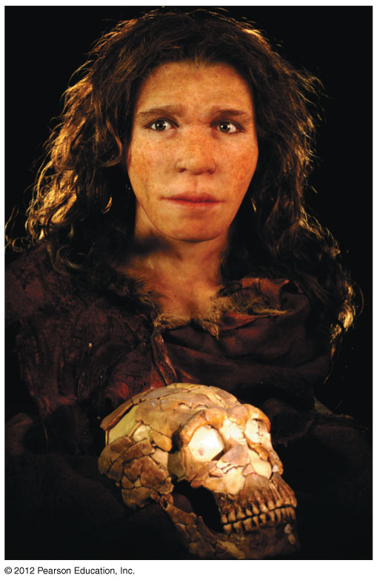
Figure 12.21
Notes:
62
Figure 12.21 Reconstruction of a Neanderthal female, based on a 36,000-year-old skull

