Slide 1
Genetic Engineering
Terms:
Plasmid
– extra circular DNA in some bacteria
Restriction Enzymes
– Enzymes found in bacteria that cut up foreign DNA Why?
protection

Slide 2
CONT.
Recognizes a specific sequence of 4-8 nucleotides
Cuts DNA at that sequence
Bacteria protects itself from restriction by adding CH3 groups to adenine or cytosine
  This keeps restriction enz. from recognizing itself

Slide 3
Restriction Enzymes Are Useful
Sticky ends are produced when DNA is cut.
These ends can now join to new DNA of choice
DNA ligase makes it permanent
DNA can then be sent by a vector to enter new cell
New cell is then cloned

Slide 4
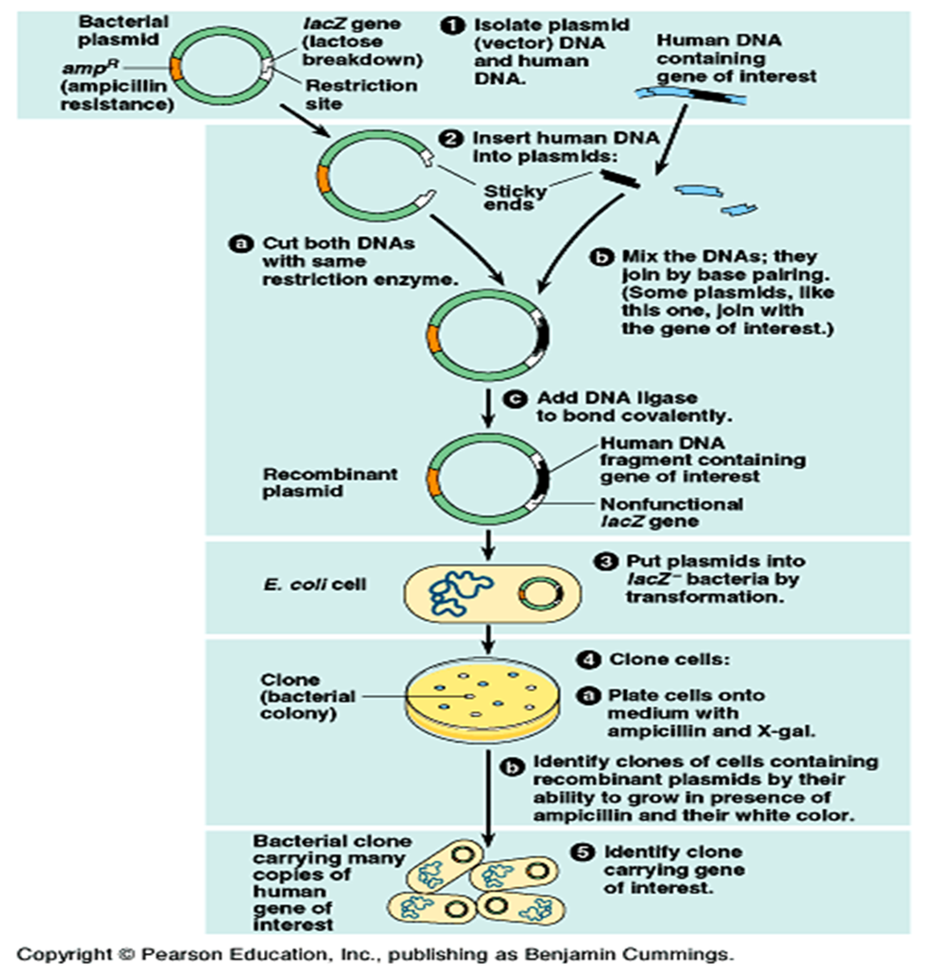

Slide 5
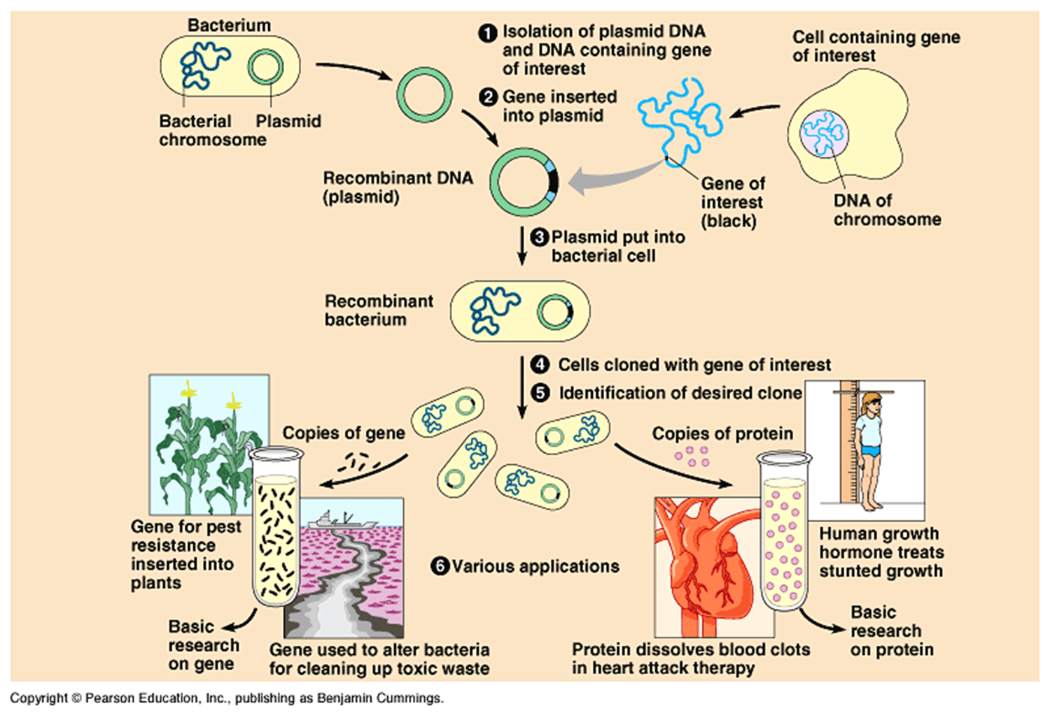

Slide 6
Electrophoresis
Electrophoresis – tool for use with DNA
-- operates with a gel and electricity
Since DNA is negative we can attract it to a positive end
Separates fragments of DNA by size
Can be used to identify individuals
How do you cut DNA?
Restriction Enzymes – cut at known sequences of DNA

Slide 7
How to use electrophoresis
We can use electrophoresis to find if the suspect of a crime is the actual criminal
Electrophoresis is used to find the number of base pairs in each fragment of DNA
-- this is done by sending known DNA fragments alongside of unknown DNA fragments
-- then measure the distance each fragment traveled

Slide 8
Steps for DNA Fingerprinting
Sm. sample of DNA is cut w/restriction enzyme
Fragments are separated by electrophoresis
Fragments w/repeats are labeled
- shows series of bands
- these bands show length of fragment
Pattern of bands are different for every person in the world

Slide 9
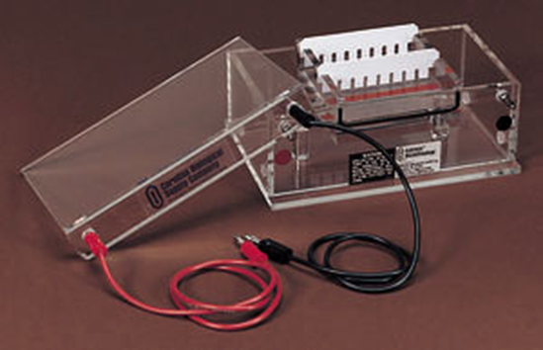
Gel Electrophoresis
Gel electrophoresis is a technique used to separate fragments of DNA.
Separates fragments as a function of size.
Most types use Agarose to separate fragments.
Agarose is a porous gel. It can allow the passage of molecules through, however, larger molecules move more slowly through it since they cannot squeeze through the pores as easily as smaller molecules.
Molecules move from the neg end to the pos end

Slide 10
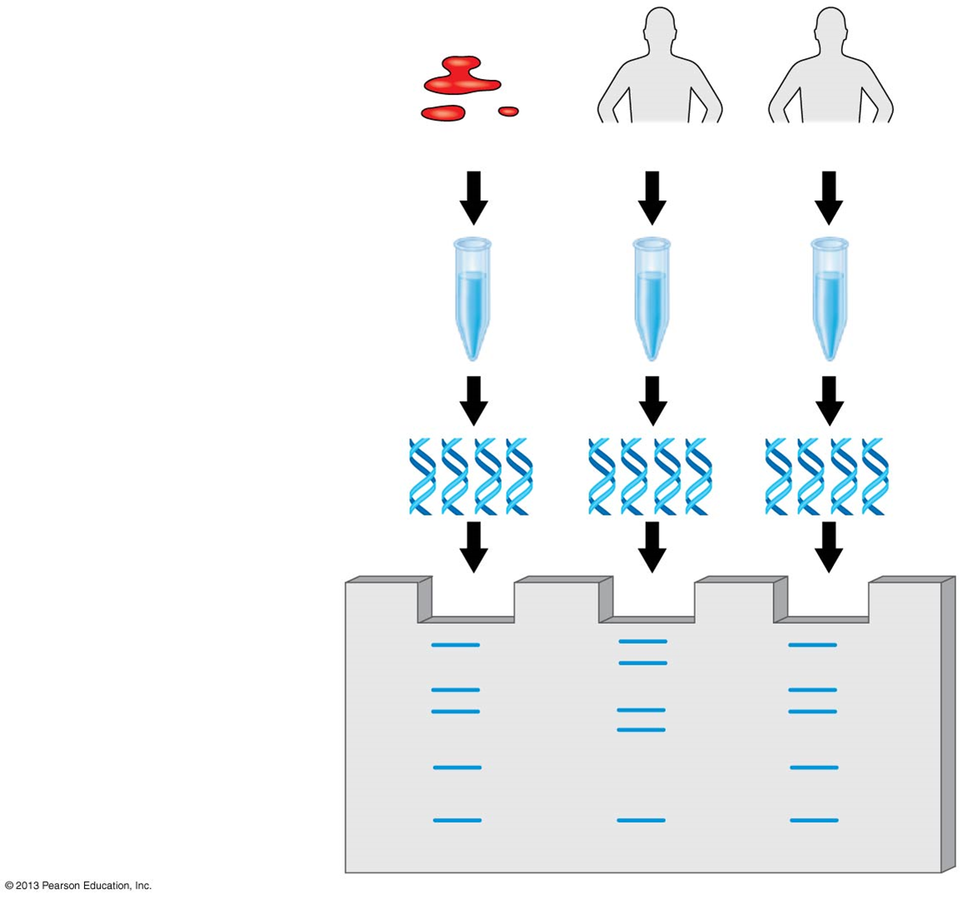

Slide 11
