Slide 1
ANIMAL DIVERSITY
Chapter 18

Slide 2
Introduction
0
  Most octopuses rely on nonaggressive defense mechanisms such as camouflage.
  The blue-ringed octopus is an exception, with
    a toxin 10,000 times more lethal than cyanide and
    sapphire-blue circles that proclaim its identity.
© 2012 Pearson Education, Inc.
Notes:
2

Slide 3
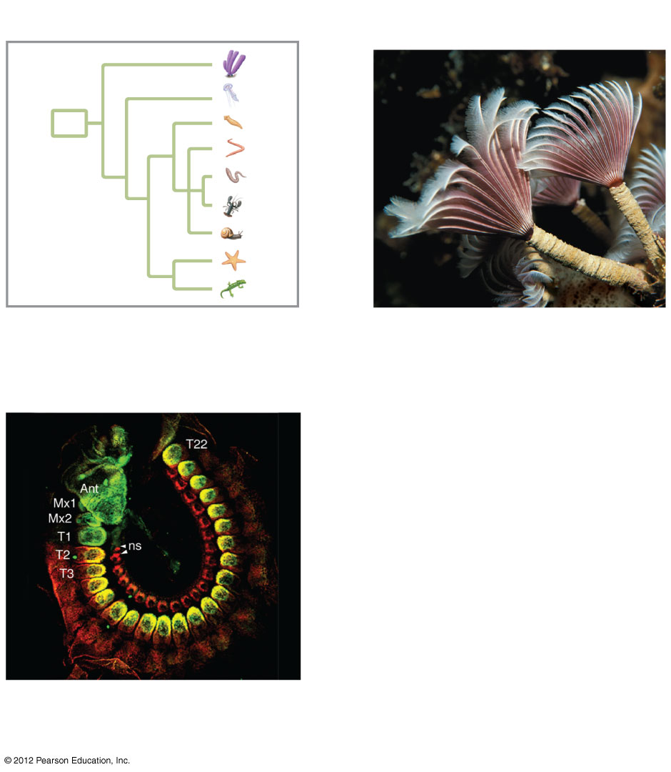
Figure 18.0_1
Chapter 18: Big Ideas
Animal Evolution
and Diversity
Invertebrate Diversity
Animal Phylogeny and
Diversity Revisited
Notes:
3
Figure 18.0_1 Chapter 18: Big Ideas

Slide 4
0
  ANIMAL EVOLUTION AND DIVERSITY
© 2012 Pearson Education, Inc.
Notes:
4

Slide 5
18.1 What is an animal?
0
  Animals are
    eukaryotic,
    multicellular heterotrophs, and
    have cells that lack cell walls.
  Animals also use ingestion, the eating of food.
  Fungi absorb nutrients after digesting food outside their body.
© 2012 Pearson Education, Inc.
Notes:
5
Student Misconceptions and Concerns
1. When considering animals in general, students are typically biased toward vertebrate examples. As a thought exercise, start your first lecture on animal diversity by asking students to write down the name of the very first type of animal that comes to their minds, without giving it any thought. Depending upon your class size, either tabulate their responses quickly or have students raise their hands to indicate the type of animal they chose. In general, fewer than 5% (often fewer than 1%) of my students have thought of an invertebrate. This exercise makes the point that what we tend to think of, when we think of animals, is vertebrates. Many of us have had a dog, cat, or other vertebrate for a pet. Yet, more than 95% of all known species of animals are invertebrates. Students must expand their understanding of what it means to be an animal. The content in Chapter 18 should facilitate that understanding.
2. Students often struggle to conceptualize the basic needs of invertebrates, and may find it challenging to think of the similarities between, for example, an earthworm and a dog, or a tick and a cat. The common features of animals addressed at the start of Chapter 18 can be expanded to include the needs for oxygen, nourishing food, a tolerable environment, and a suitable habitat to reproduce, which apply to animals representing all of the major phyla. Illustrating these common demands can help students build the intellectual foundations that can be so difficult to fully establish.
Teaching Tips
1. Depending upon what chapters you have addressed in your course up to this point, you might begin your lectures on animals by asking your class to compare the features of plants, fungi, and animals. You may want to present a table listing the following characteristics, and ask the class to identify the condition for each kingdom: eukaryotic or prokaryotic cells, single or multicellular organisms, presence of cell walls, and use of photosynthesis.
2. You might wish to share the now somewhat-famous quote of Lewis Wolpert, who in 1986 said, “It is not birth, marriage, or death, but gastrulation, which is truly the most important time in your life.” The development and arrangement of the basic embryonic layers (ectoderm/skin and nervous systems, mesoderm/muscle and bone, and endoderm/digestive tract) establishes the basic body plan.
3. Your students might enjoy discussing whether or not they are larvae and if they can be said to go through metamorphosis. (The answer to both questions is “no”.)

Slide 6
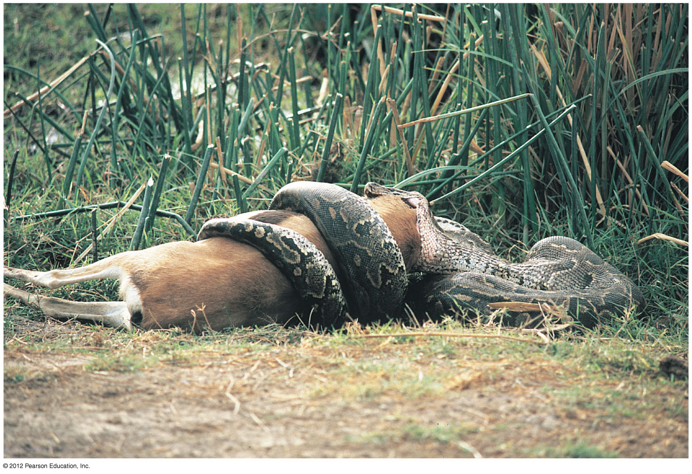
Figure 18.1A
Notes:
6
Figure 18.1A Ingestion, the animal way of life

Slide 7
18.1 What is an animal?
0
  Most adult animals are diploid and reproduce sexually.
    The eggs and sperm
      are produced by meiosis,
      are the only haploid cells, and
      fuse during fertilization to form a zygote.
    The zygote divides by mitosis to form a hollow ball of cells called a blastula.
© 2012 Pearson Education, Inc.
Notes:
7
Student Misconceptions and Concerns
1. When considering animals in general, students are typically biased toward vertebrate examples. As a thought exercise, start your first lecture on animal diversity by asking students to write down the name of the very first type of animal that comes to their minds, without giving it any thought. Depending upon your class size, either tabulate their responses quickly or have students raise their hands to indicate the type of animal they chose. In general, fewer than 5% (often fewer than 1%) of my students have thought of an invertebrate. This exercise makes the point that what we tend to think of, when we think of animals, is vertebrates. Many of us have had a dog, cat, or other vertebrate for a pet. Yet, more than 95% of all known species of animals are invertebrates. Students must expand their understanding of what it means to be an animal. The content in Chapter 18 should facilitate that understanding.
2. Students often struggle to conceptualize the basic needs of invertebrates, and may find it challenging to think of the similarities between, for example, an earthworm and a dog, or a tick and a cat. The common features of animals addressed at the start of Chapter 18 can be expanded to include the needs for oxygen, nourishing food, a tolerable environment, and a suitable habitat to reproduce, which apply to animals representing all of the major phyla. Illustrating these common demands can help students build the intellectual foundations that can be so difficult to fully establish.
Teaching Tips
1. Depending upon what chapters you have addressed in your course up to this point, you might begin your lectures on animals by asking your class to compare the features of plants, fungi, and animals. You may want to present a table listing the following characteristics, and ask the class to identify the condition for each kingdom: eukaryotic or prokaryotic cells, single or multicellular organisms, presence of cell walls, and use of photosynthesis.
2. You might wish to share the now somewhat-famous quote of Lewis Wolpert, who in 1986 said, “It is not birth, marriage, or death, but gastrulation, which is truly the most important time in your life.” The development and arrangement of the basic embryonic layers (ectoderm / skin and nervous systems, mesoderm / muscle and bone, and endoderm / digestive tract) establishes the basic body plan.
3. Your students might enjoy discussing whether or not they are larvae and if they can be said to go through metamorphosis. (The answer to both questions is “no”.)

Slide 8
18.1 What is an animal?
0
    One side of the blastula folds in and cells become rearranged to form a gastrula that establishes three embryonic layers.
      Endoderm forms a lining of the future digestive tract.
      Ectoderm forms an outer layer that will give rise to the skin and nervous system.
      Mesoderm forms a middle layer that will give rise to muscles and most internal organs.
© 2012 Pearson Education, Inc.
Notes:
8
Student Misconceptions and Concerns
1. When considering animals in general, students are typically biased toward vertebrate examples. As a thought exercise, start your first lecture on animal diversity by asking students to write down the name of the very first type of animal that comes to their minds, without giving it any thought. Depending upon your class size, either tabulate their responses quickly or have students raise their hands to indicate the type of animal they chose. In general, fewer than 5% (often fewer than 1%) of my students have thought of an invertebrate. This exercise makes the point that what we tend to think of, when we think of animals, is vertebrates. Many of us have had a dog, cat, or other vertebrate for a pet. Yet, more than 95% of all known species of animals are invertebrates. Students must expand their understanding of what it means to be an animal. The content in Chapter 18 should facilitate that understanding.
2. Students often struggle to conceptualize the basic needs of invertebrates, and may find it challenging to think of the similarities between, for example, an earthworm and a dog, or a tick and a cat. The common features of animals addressed at the start of Chapter 18 can be expanded to include the needs for oxygen, nourishing food, a tolerable environment, and a suitable habitat to reproduce, which apply to animals representing all of the major phyla. Illustrating these common demands can help students build the intellectual foundations that can be so difficult to fully establish.
Teaching Tips
1. Depending upon what chapters you have addressed in your course up to this point, you might begin your lectures on animals by asking your class to compare the features of plants, fungi, and animals. You may want to present a table listing the following characteristics, and ask the class to identify the condition for each kingdom: eukaryotic or prokaryotic cells, single or multicellular organisms, presence of cell walls, and use of photosynthesis.
2. You might wish to share the now somewhat-famous quote of Lewis Wolpert, who in 1986 said, “It is not birth, marriage, or death, but gastrulation, which is truly the most important time in your life.” The development and arrangement of the basic embryonic layers (ectoderm/skin and nervous systems, mesoderm/muscle and bone, and endoderm/digestive tract) establishes the basic body plan.
3. Your students might enjoy discussing whether or not they are larvae and if they can be said to go through metamorphosis. (The answer to both questions is “no”.)

Slide 9
18.1 What is an animal?
0
  After the gastrula stage, many animals develop directly into adults.
  Other animals, such as the sea star, develop into one or more larval stages.
    A larva is an immature individual that looks different from the adult animal.
    A larva undergoes a major change in body form, called metamorphosis, and becomes a reproductively mature adult.
  Clusters of master genes control transformation of the zygote into an adult animal.
© 2012 Pearson Education, Inc.
Notes:
9
Student Misconceptions and Concerns
1. When considering animals in general, students are typically biased toward vertebrate examples. As a thought exercise, start your first lecture on animal diversity by asking students to write down the name of the very first type of animal that comes to their minds, without giving it any thought. Depending upon your class size, either tabulate their responses quickly or have students raise their hands to indicate the type of animal they chose. In general, fewer than 5% (often fewer than 1%) of my students have thought of an invertebrate. This exercise makes the point that what we tend to think of, when we think of animals, is vertebrates. Many of us have had a dog, cat, or other vertebrate for a pet. Yet, more than 95% of all known species of animals are invertebrates. Students must expand their understanding of what it means to be an animal. The content in Chapter 18 should facilitate that understanding.
2. Students often struggle to conceptualize the basic needs of invertebrates, and may find it challenging to think of the similarities between, for example, an earthworm and a dog, or a tick and a cat. The common features of animals addressed at the start of Chapter 18 can be expanded to include the needs for oxygen, nourishing food, a tolerable environment, and a suitable habitat to reproduce, which apply to animals representing all of the major phyla. Illustrating these common demands can help students build the intellectual foundations that can be so difficult to fully establish.
Teaching Tips
1. Depending upon what chapters you have addressed in your course up to this point, you might begin your lectures on animals by asking your class to compare the features of plants, fungi, and animals. You may want to present a table listing the following characteristics, and ask the class to identify the condition for each kingdom: eukaryotic or prokaryotic cells, single or multicellular organisms, presence of cell walls, and use of photosynthesis.
2. You might wish to share the now somewhat-famous quote of Lewis Wolpert, who in 1986 said, “It is not birth, marriage, or death, but gastrulation, which is truly the most important time in your life.” The development and arrangement of the basic embryonic layers (ectoderm/skin and nervous systems, mesoderm/muscle and bone, and endoderm/digestive tract) establishes the basic body plan.
3. Your students might enjoy discussing whether or not they are larvae and if they can be said to go through metamorphosis. (The answer to both questions is “no”.)

Slide 10
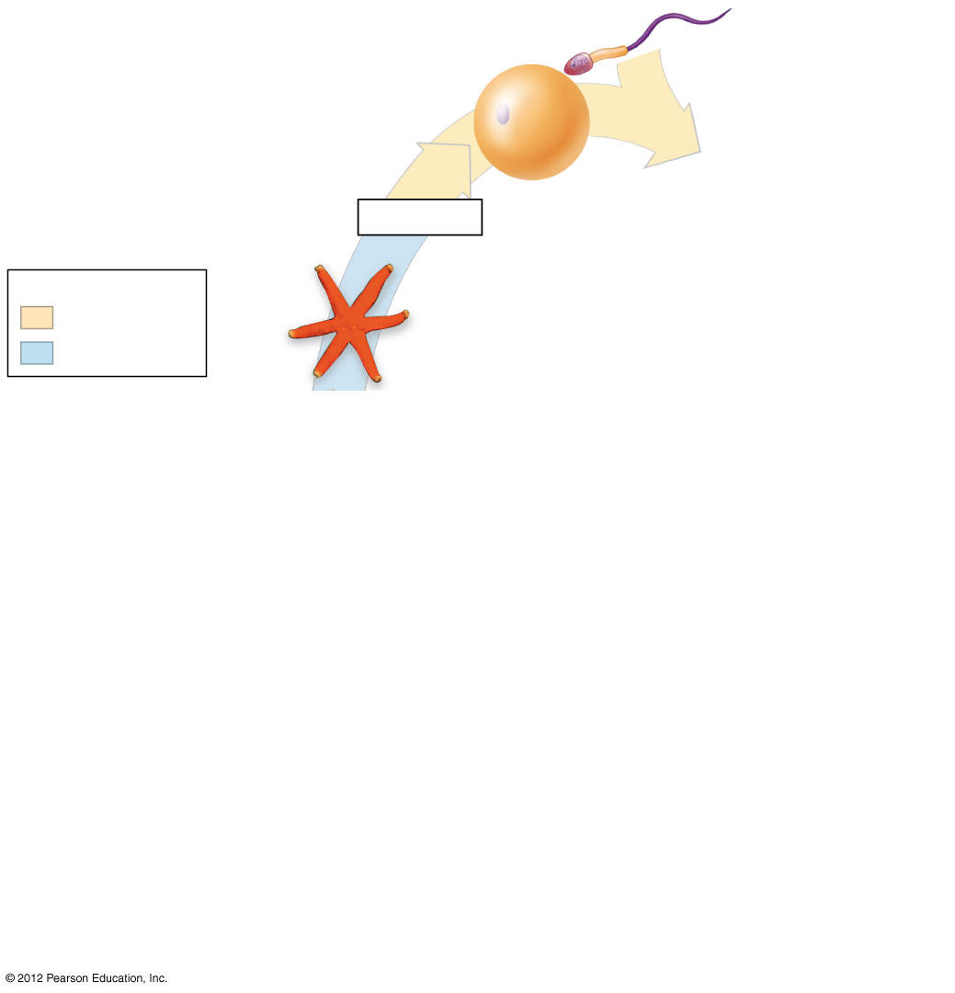
Figure 18.1B_s1
Sperm
1
Egg
Meiosis
Key
Haploid (n)
Diploid (2n)
Adult
Notes:
10
Figure 18.1B_s1 The life cycle of a sea star (step 1)

Slide 11
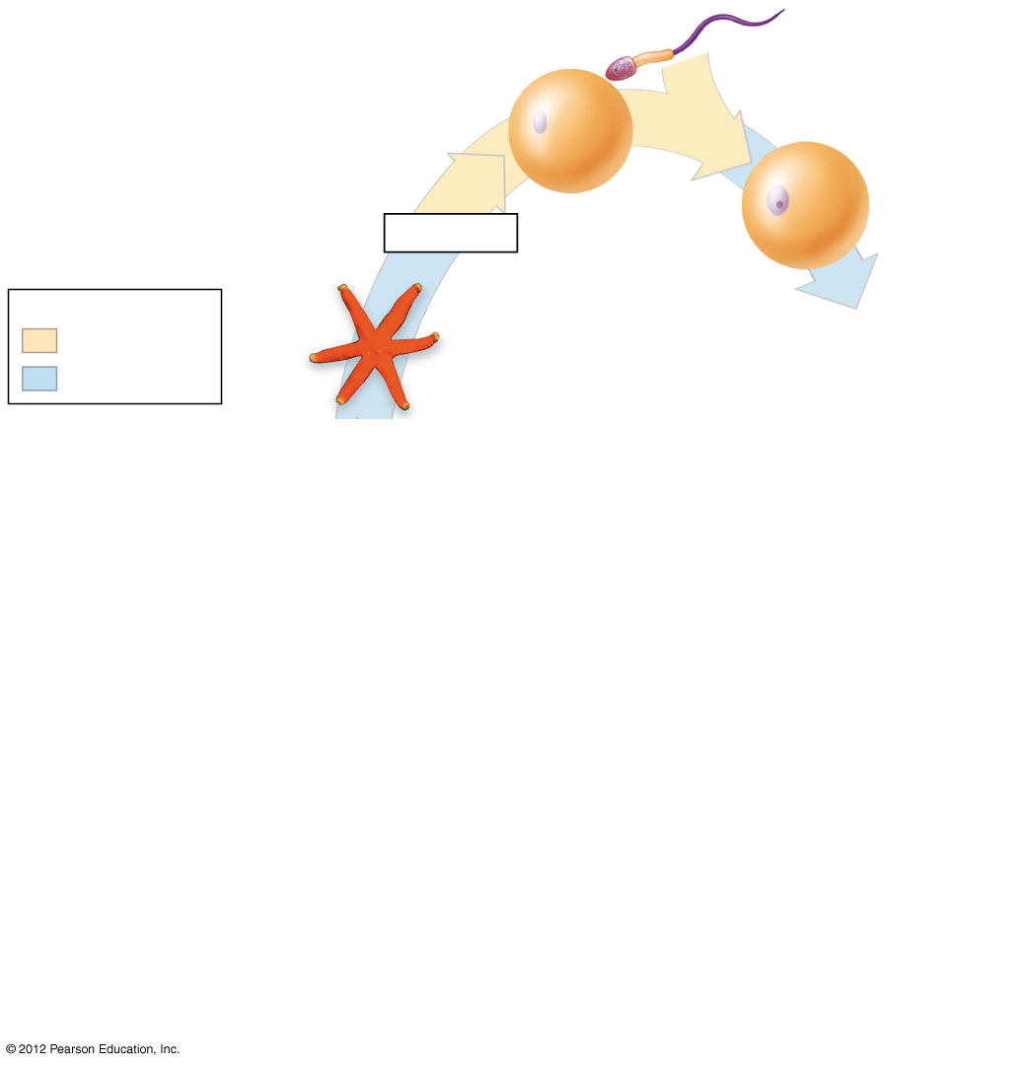
Figure 18.1B_s2
Sperm
2
1
Egg
Meiosis
Zygote
(fertilized egg)
Key
Haploid (n)
Diploid (2n)
Adult
Notes:
11
Figure 18.1B_s2 The life cycle of a sea star (step 2)

Slide 12
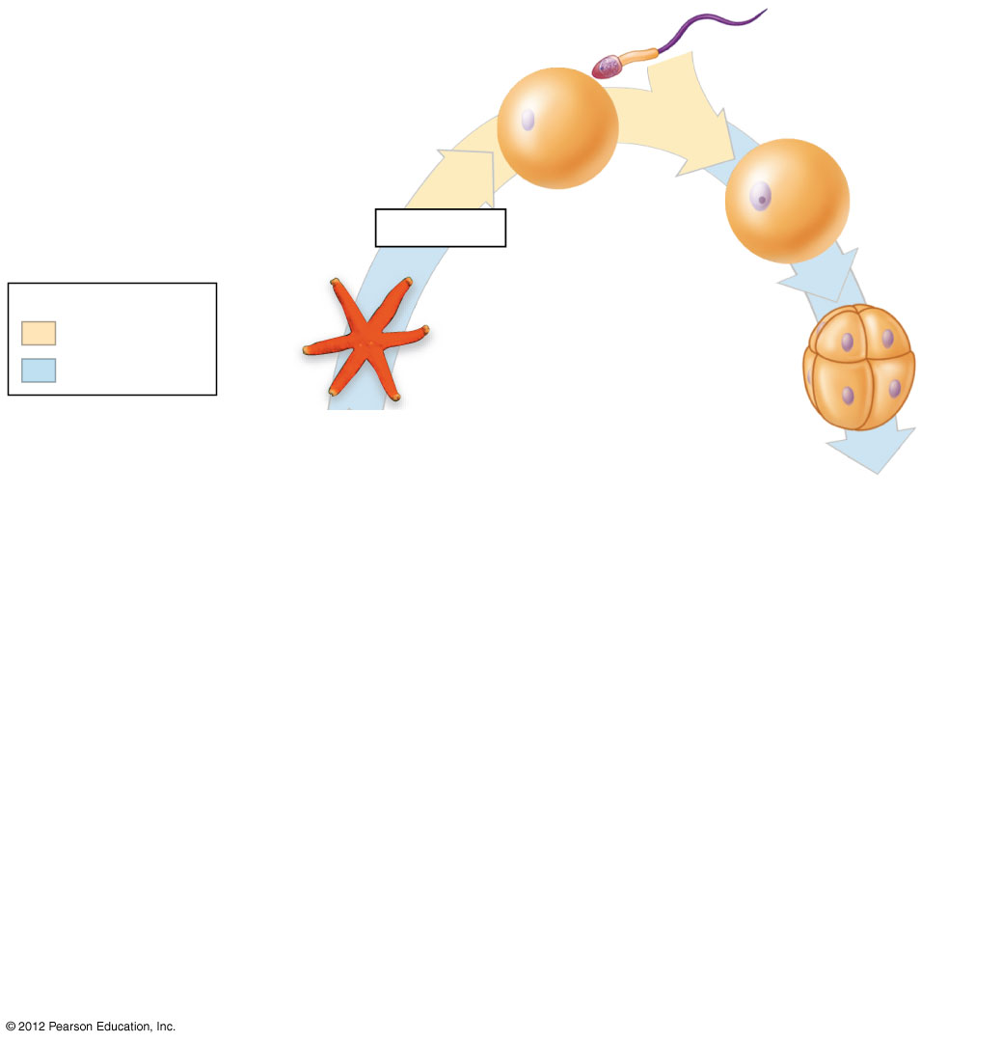
Figure 18.1B_s3
Sperm
2
1
Egg
Meiosis
Zygote
(fertilized egg)
3
Key
Haploid (n)
Diploid (2n)
Adult
Eight-cell stage
Notes:
12
Figure 18.1B_s3 The life cycle of a sea star (step 3)

Slide 13
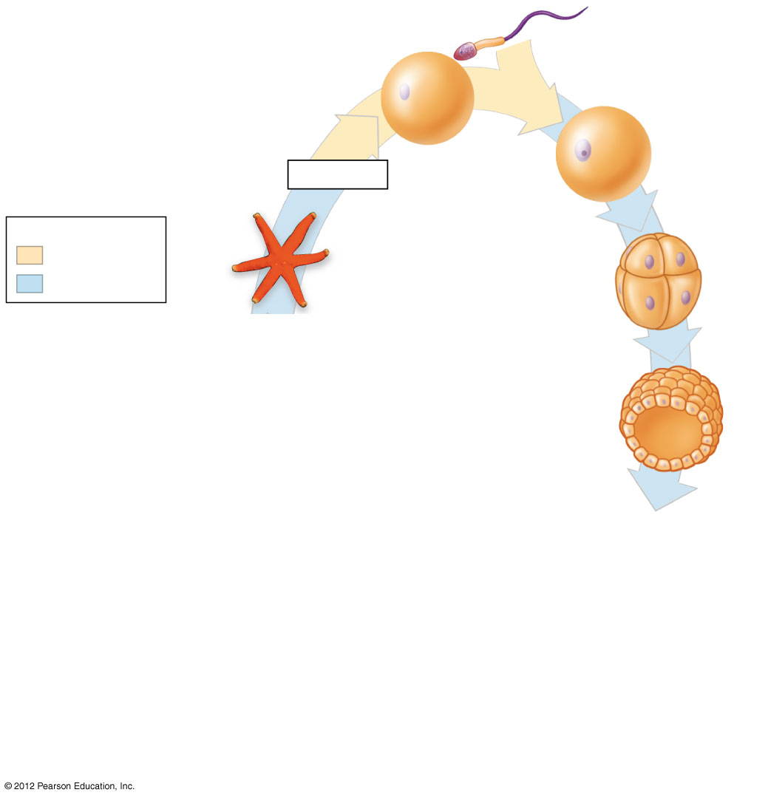
Figure 18.1B_s4
Sperm
2
1
Egg
Meiosis
Zygote
(fertilized egg)
3
Key
Haploid (n)
Diploid (2n)
Adult
Eight-cell stage
4
Blastula
(cross section)
Notes:
13
Figure 18.1B_s4 The life cycle of a sea star (step 4)

Slide 14
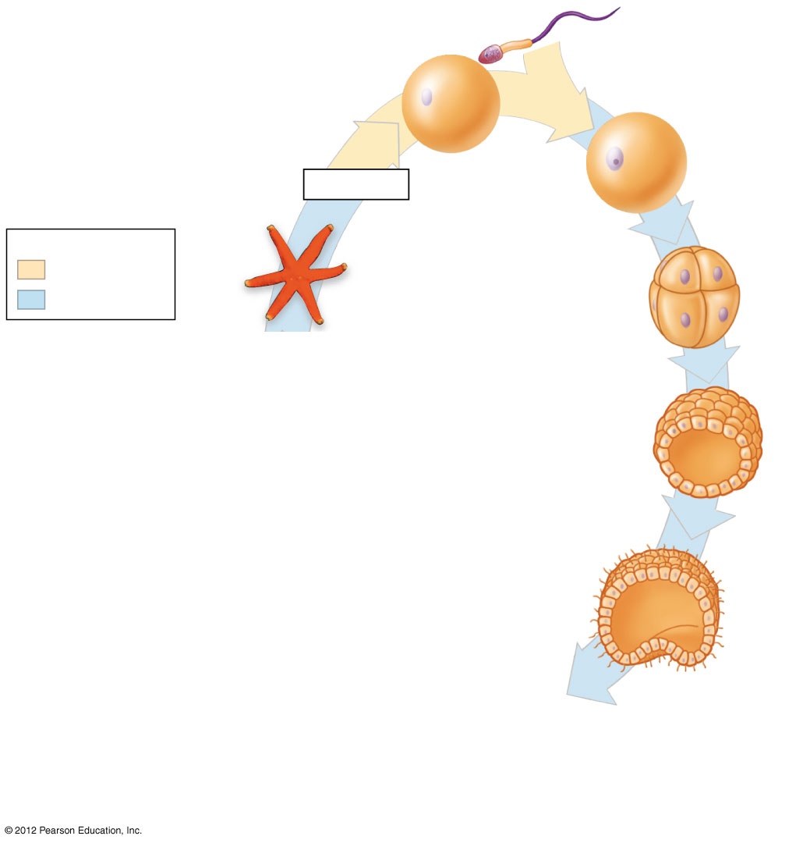
Figure 18.1B_s5
Sperm
2
1
Egg
Meiosis
Zygote
(fertilized egg)
3
Key
Haploid (n)
Diploid (2n)
Adult
Eight-cell stage
4
Blastula
(cross section)
5
Early gastrula
(cross section)
Notes:
14
Figure 18.1B_s5 The life cycle of a sea star (step 5)

Slide 15
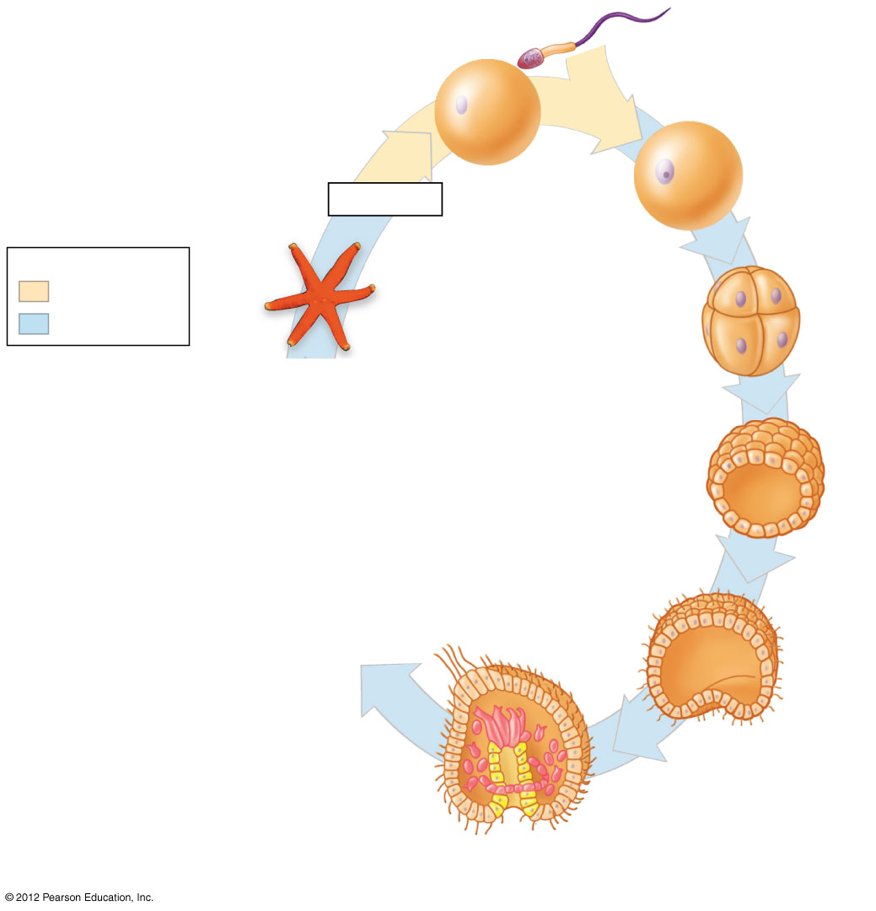
Figure 18.1B_s6
Sperm
2
1
Egg
Meiosis
Zygote
(fertilized egg)
3
Key
Haploid (n)
Diploid (2n)
Adult
Eight-cell stage
4
Blastula
(cross section)
5
Ectoderm
Early gastrula
(cross section)
Endoderm
6
Internal sac
Future mesoderm
Later gastrula
(cross section)
Notes:
15
Figure 18.1B_s6 The life cycle of a sea star (step 6)

Slide 16
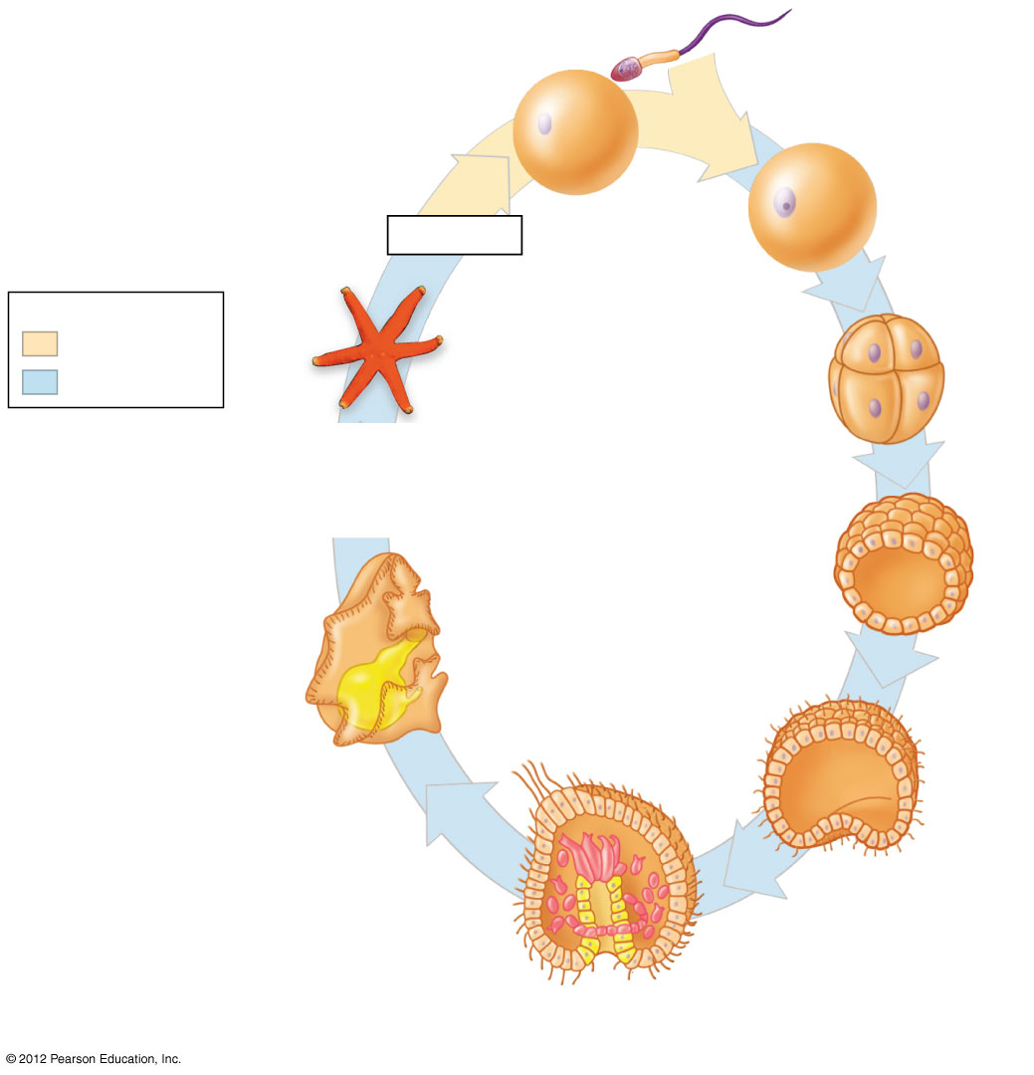
Figure 18.1B_s7
Sperm
2
1
Egg
Meiosis
Zygote
(fertilized egg)
3
Key
Haploid (n)
Diploid (2n)
Adult
Eight-cell stage
4
Blastula
(cross section)
Digestive tract
5
Larva
Ectoderm
7
Early gastrula
(cross section)
Endoderm
6
Internal sac
Future mesoderm
Later gastrula
(cross section)
Notes:
16
Figure 18.1B_s7 The life cycle of a sea star (step 7)

Slide 17
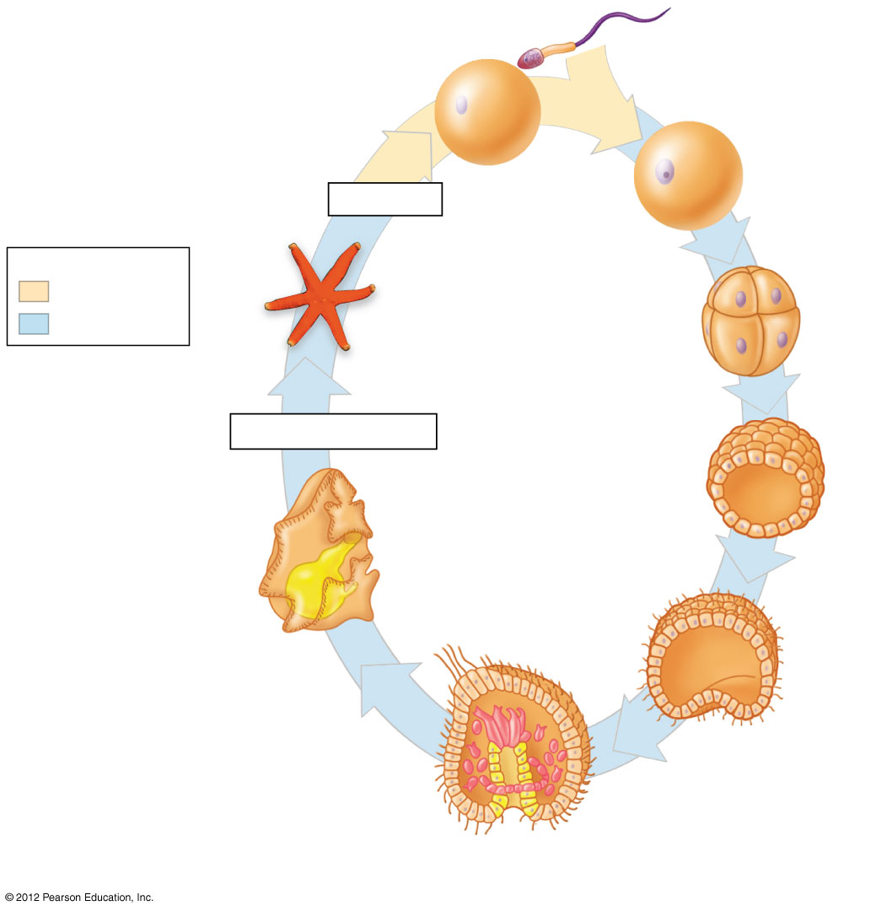
Figure 18.1B_s8
Sperm
2
1
Egg
Meiosis
Zygote
(fertilized egg)
3
Key
Haploid (n)
Diploid (2n)
Adult
Eight-cell stage
8
Metamorphosis
4
Blastula
(cross section)
Digestive tract
5
Larva
Ectoderm
7
Early gastrula
(cross section)
Endoderm
6
Internal sac
Future mesoderm
Later gastrula
(cross section)
Notes:
17
Figure 18.1B_s8 The life cycle of a sea star (step 8)

Slide 18
18.2 Animal diversification began more than half a billion years ago
0
  The Cambrian explosion may have been caused by
    increasingly complex predator-prey relationships or
    an increase in atmospheric oxygen.
  Much of the diversity in body form among the animal phyla is associated with variations in where and when homeotic genes are expressed within developing embryos.
  Of the 35 or so animal phyla, all but one are invertebrates, named because they lack vertebra.
© 2012 Pearson Education, Inc.
Notes:
18
Student Misconceptions and Concerns
1. When considering animals in general, students are typically biased toward vertebrate examples. As a thought exercise, start your first lecture on animal diversity by asking students to write down the name of the very first type of animal that comes to their minds, without giving it any thought. Depending upon your class size, either tabulate their responses quickly or have students raise their hands to indicate the type of animal they chose. In general, fewer than 5% (often fewer than 1%) of my students have thought of an invertebrate. This exercise makes the point that what we tend to think of, when we think of animals, is vertebrates. Many of us have had a dog, cat, or other vertebrate for a pet. Yet, more than 95% of all known species of animals are invertebrates. Students must expand their understanding of what it means to be an animal. The content in Chapter 18 should facilitate that understanding.
2. Students often struggle to conceptualize the basic needs of invertebrates, and may find it challenging to think of the similarities between, for example, an earthworm and a dog, or a tick and a cat. The common features of animals addressed at the start of Chapter 18 can be expanded to include the needs for oxygen, nourishing food, a tolerable environment, and a suitable habitat to reproduce, which apply to animals representing all of the major phyla. Illustrating these common demands can help students build the intellectual foundations that can be so difficult to fully establish.
Teaching Tips
1. You might wish to share the now somewhat-famous quote of Lewis Wolpert, who in 1986 said, “It is not birth, marriage, or death, but gastrulation, which is truly the most important time in your life.” The development and arrangement of the basic embryonic layers (ectoderm/skin and nervous systems, mesoderm/muscle and bone, and endoderm/digestive tract) establishes the basic body plan.
2. Your students might enjoy discussing whether or not they are larvae and if they can be said to go through metamorphosis. (The answer to both questions is “no”.)
3. The website of the University of California at Berkeley’s Museum of Paleontology is an excellent resource for evolution and the history of life, including the portion that specifically addresses the Cambrian period: www.ucmp.berkeley.edu/cambrian/camb.html.

Slide 19
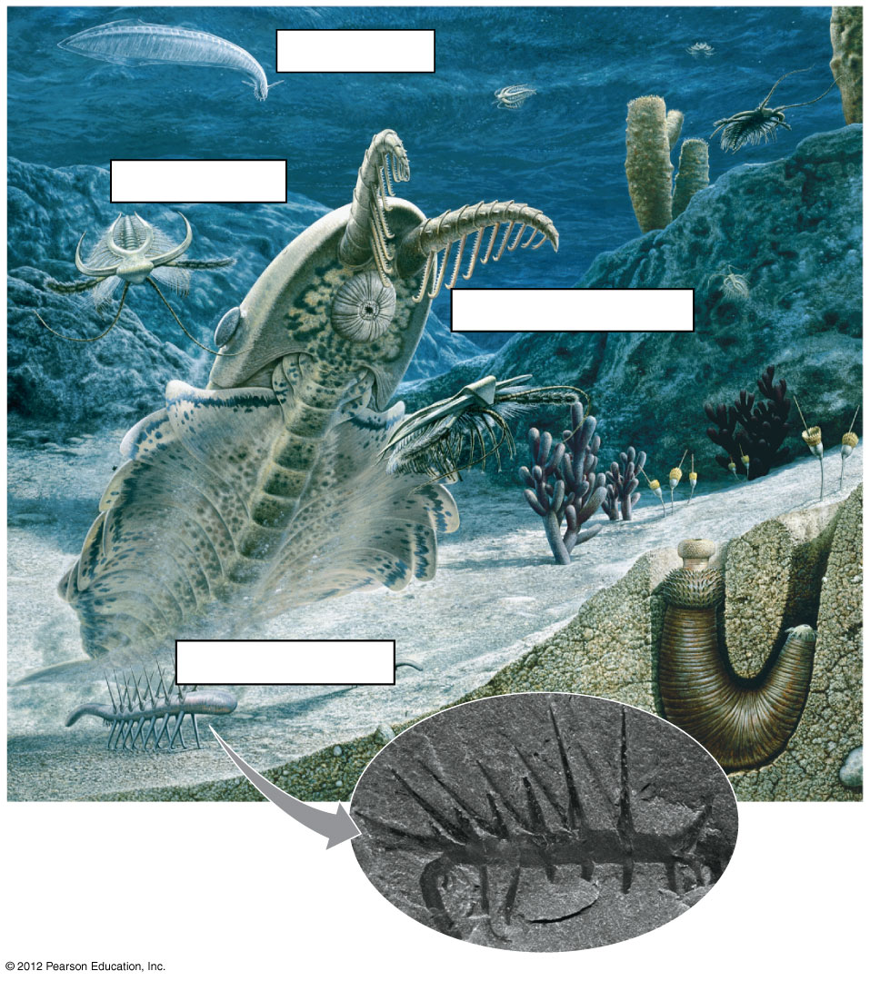
Figure 18.2B
Chordate
Arthropod
Anomalocaris
Hallucigenia
Notes:
19
Figure 18.2B A drawing based on fossils from the early Cambrian period; fossil Hallucigenia (inset)

Slide 20
18.3 Animals can be characterized by basic features of their “body plan”
0
  Animal body plans vary in
    symmetry,
    presence of true tissues,
    number of embryonic layers,
    presence of a body cavity, and
    details of their embryonic development.
© 2012 Pearson Education, Inc.
Notes:
20
Student Misconceptions and Concerns
1. When considering animals in general, students are typically biased toward vertebrate examples. As a thought exercise, start your first lecture on animal diversity by asking students to write down the name of the very first type of animal that comes to their minds, without giving it any thought. Depending upon your class size, either tabulate their responses quickly or have students raise their hands to indicate the type of animal they chose. In general, fewer than 5% (often fewer than 1%) of my students have thought of an invertebrate. This exercise makes the point that what we tend to think of, when we think of animals, is vertebrates. Many of us have had a dog, cat, or other vertebrate for a pet. Yet, more than 95% of all known species of animals are invertebrates. Students must expand their understanding of what it means to be an animal. The content in Chapter 18 should facilitate that understanding.
2. Students often struggle to conceptualize the basic needs of invertebrates, and may find it challenging to think of the similarities between, for example, an earthworm and a dog, or a tick and a cat. The common features of animals addressed at the start of Chapter 18 can be expanded to include the needs for oxygen, nourishing food, a tolerable environment, and a suitable habitat to reproduce, which apply to animals representing all of the major phyla. Illustrating these common demands can help students build the intellectual foundations that can be so difficult to fully establish.
Teaching Tips
1. You might wish to share the now somewhat-famous quote of Lewis Wolpert, who in 1986 said, “It is not birth, marriage, or death, but gastrulation, which is truly the most important time in your life.” The development and arrangement of the basic embryonic layers (ectoderm/skin and nervous systems, mesoderm/muscle and bone, and endoderm/digestive tract) establishes the basic body plan.
2. Your students might enjoy discussing whether or not they are larvae and if they can be said to go through metamorphosis. (The answer to both questions is “no”.)
3. Before addressing the subject of animal symmetry, you might wish to have your students speculate about the adaptive advantages of radial versus bilateral symmetry found in animals. This sort of comparison raises an opportunity to make some larger points about biology. There is no “one” best animal. Each form, each adaptation, and each body plan has advantages and disadvantages. The value of adaptations is relative to the organism’s environment and most adaptations represent a compromise.

Slide 21
18.3 Animals can be characterized by basic features of their “body plan”
0
  Symmetry
    Animals that have radial symmetry have a top and bottom but lack back and front or right and left sides. An imaginary slice through the central axis divides them into mirror images.
    Animals with bilateral symmetry have mirror-image right and left sides and a
      distinct head, or anterior end,
      tail, or posterior end,
      back, or dorsal, surface, and
      bottom, or ventral, surface.
© 2012 Pearson Education, Inc.
Notes:
21
Student Misconceptions and Concerns
1. When considering animals in general, students are typically biased toward vertebrate examples. As a thought exercise, start your first lecture on animal diversity by asking students to write down the name of the very first type of animal that comes to their minds, without giving it any thought. Depending upon your class size, either tabulate their responses quickly or have students raise their hands to indicate the type of animal they chose. In general, fewer than 5% (often fewer than 1%) of my students have thought of an invertebrate. This exercise makes the point that what we tend to think of, when we think of animals, is vertebrates. Many of us have had a dog, cat, or other vertebrate for a pet. Yet, more than 95% of all known species of animals are invertebrates. Students must expand their understanding of what it means to be an animal. The content in Chapter 18 should facilitate that understanding.
2. Students often struggle to conceptualize the basic needs of invertebrates, and may find it challenging to think of the similarities between, for example, an earthworm and a dog, or a tick and a cat. The common features of animals addressed at the start of Chapter 18 can be expanded to include the needs for oxygen, nourishing food, a tolerable environment, and a suitable habitat to reproduce, which apply to animals representing all of the major phyla. Illustrating these common demands can help students build the intellectual foundations that can be so difficult to fully establish.
Teaching Tips
1. You might wish to share the now somewhat-famous quote of Lewis Wolpert, who in 1986 said, “It is not birth, marriage, or death, but gastrulation, which is truly the most important time in your life.” The development and arrangement of the basic embryonic layers (ectoderm/skin and nervous systems, mesoderm/muscle and bone, and endoderm/digestive tract) establishes the basic body plan.
2. Your students might enjoy discussing whether or not they are larvae and if they can be said to go through metamorphosis. (The answer to both questions is “no”.)
3. Before addressing the subject of animal symmetry, you might wish to have your students speculate about the adaptive advantages of radial versus bilateral symmetry found in animals. This sort of comparison raises an opportunity to make some larger points about biology. There is no “one” best animal. Each form, each adaptation, and each body plan has advantages and disadvantages. The value of adaptations is relative to the organism’s environment and most adaptations represent a compromise.

Slide 22
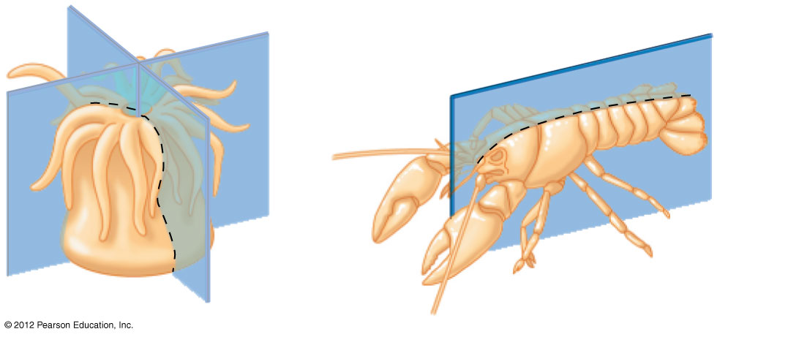
Figure 18.3A
Top
Dorsal surface
Anterior
end
Posterior
end
Bottom
Ventral surface
Notes:
22
Figure 18.3A Radial (left) and bilateral (right) symmetry

Slide 23
18.3 Animals can be characterized by basic features of their “body plan”
0
  Tissues
    Tissues are collections of specialized cells that perform special functions.
    Sponges are the only animals that lack true tissues.
  Embryonic layers
    Some animals have only ectoderm and endoderm.
    Most animals have
      ectoderm,
      mesoderm, and
      endoderm.
© 2012 Pearson Education, Inc.
Notes:
23
Student Misconceptions and Concerns
1. When considering animals in general, students are typically biased toward vertebrate examples. As a thought exercise, start your first lecture on animal diversity by asking students to write down the name of the very first type of animal that comes to their minds, without giving it any thought. Depending upon your class size, either tabulate their responses quickly or have students raise their hands to indicate the type of animal they chose. In general, fewer than 5% (often fewer than 1%) of my students have thought of an invertebrate. This exercise makes the point that what we tend to think of, when we think of animals, is vertebrates. Many of us have had a dog, cat, or other vertebrate for a pet. Yet, more than 95% of all known species of animals are invertebrates. Students must expand their understanding of what it means to be an animal. The content in Chapter 18 should facilitate that understanding.
2. Students often struggle to conceptualize the basic needs of invertebrates, and may find it challenging to think of the similarities between, for example, an earthworm and a dog, or a tick and a cat. The common features of animals addressed at the start of Chapter 18 can be expanded to include the needs for oxygen, nourishing food, a tolerable environment, and a suitable habitat to reproduce, which apply to animals representing all of the major phyla. Illustrating these common demands can help students build the intellectual foundations that can be so difficult to fully establish.
Teaching Tips
1. You might wish to share the now somewhat-famous quote of Lewis Wolpert, who in 1986 said, “It is not birth, marriage, or death, but gastrulation, which is truly the most important time in your life.” The development and arrangement of the basic embryonic layers (ectoderm/skin and nervous systems, mesoderm/muscle and bone, and endoderm/digestive tract) establishes the basic body plan.
2. Your students might enjoy discussing whether or not they are larvae and if they can be said to go through metamorphosis. (The answer to both questions is “no”.)
3. Before addressing the subject of animal symmetry, you might wish to have your students speculate about the adaptive advantages of radial versus bilateral symmetry found in animals. This sort of comparison raises an opportunity to make some larger points about biology. There is no “one” best animal. Each form, each adaptation, and each body plan has advantages and disadvantages. The value of adaptations is relative to the organism’s environment and most adaptations represent a compromise.

Slide 24
18.3 Animals can be characterized by basic features of their “body plan”
0
  Animals with three embryonic layers may have a body cavity, a fluid-filled space between the digestive tract and outer body wall that
    cushions internal organs and that
    enables them to grow and move independently of the body wall.
    In soft-bodied animals, fluid in the body cavity forms a hydrostatic skeleton.
    A true coelom is completely lined by tissues derived from mesoderm.
    A pseudocoelom is a body cavity that is not completely lined by tissues derived from mesoderm.
© 2012 Pearson Education, Inc.
Notes:
24
Student Misconceptions and Concerns
1. When considering animals in general, students are typically biased toward vertebrate examples. As a thought exercise, start your first lecture on animal diversity by asking students to write down the name of the very first type of animal that comes to their minds, without giving it any thought. Depending upon your class size, either tabulate their responses quickly or have students raise their hands to indicate the type of animal they chose. In general, fewer than 5% (often fewer than 1%) of my students have thought of an invertebrate. This exercise makes the point that what we tend to think of, when we think of animals, is vertebrates. Many of us have had a dog, cat, or other vertebrate for a pet. Yet, more than 95% of all known species of animals are invertebrates. Students must expand their understanding of what it means to be an animal. The content in Chapter 18 should facilitate that understanding.
2. Students often struggle to conceptualize the basic needs of invertebrates, and may find it challenging to think of the similarities between, for example, an earthworm and a dog, or a tick and a cat. The common features of animals addressed at the start of Chapter 18 can be expanded to include the needs for oxygen, nourishing food, a tolerable environment, and a suitable habitat to reproduce, which apply to animals representing all of the major phyla. Illustrating these common demands can help students build the intellectual foundations that can be so difficult to fully establish.
Teaching Tips
1. You might wish to share the now somewhat-famous quote of Lewis Wolpert, who in 1986 said, “It is not birth, marriage, or death, but gastrulation, which is truly the most important time in your life.” The development and arrangement of the basic embryonic layers (ectoderm/skin and nervous systems, mesoderm/muscle and bone, and endoderm/digestive tract) establishes the basic body plan.
2. Your students might enjoy discussing whether or not they are larvae and if they can be said to go through metamorphosis. (The answer to both questions is “no”.)
3. Before addressing the subject of animal symmetry, you might wish to have your students speculate about the adaptive advantages of radial versus bilateral symmetry found in animals. This sort of comparison raises an opportunity to make some larger points about biology. There is no “one” best animal. Each form, each adaptation, and each body plan has advantages and disadvantages. The value of adaptations is relative to the organism’s environment and most adaptations represent a compromise.

Slide 25
18.3 Animals can be characterized by basic features of their “body plan”
0
  Animals with three tissue layers can be separated into two groups based on details of their embryonic development. For example, the opening formed during gastrulation develops into the
    mouth in protostomes and
    anus in deuterostomes.
© 2012 Pearson Education, Inc.
Notes:
25
Student Misconceptions and Concerns
1. When considering animals in general, students are typically biased toward vertebrate examples. As a thought exercise, start your first lecture on animal diversity by asking students to write down the name of the very first type of animal that comes to their minds, without giving it any thought. Depending upon your class size, either tabulate their responses quickly or have students raise their hands to indicate the type of animal they chose. In general, fewer than 5% (often fewer than 1%) of my students have thought of an invertebrate. This exercise makes the point that what we tend to think of, when we think of animals, is vertebrates. Many of us have had a dog, cat, or other vertebrate for a pet. Yet, more than 95% of all known species of animals are invertebrates. Students must expand their understanding of what it means to be an animal. The content in Chapter 18 should facilitate that understanding.
2. Students often struggle to conceptualize the basic needs of invertebrates, and may find it challenging to think of the similarities between, for example, an earthworm and a dog, or a tick and a cat. The common features of animals addressed at the start of Chapter 18 can be expanded to include the needs for oxygen, nourishing food, a tolerable environment, and a suitable habitat to reproduce, which apply to animals representing all of the major phyla. Illustrating these common demands can help students build the intellectual foundations that can be so difficult to fully establish.
Teaching Tips
1. You might wish to share the now somewhat-famous quote of Lewis Wolpert, who in 1986 said, “It is not birth, marriage, or death, but gastrulation, which is truly the most important time in your life.” The development and arrangement of the basic embryonic layers (ectoderm/skin and nervous systems, mesoderm/muscle and bone, and endoderm/digestive tract) establishes the basic body plan.
2. Your students might enjoy discussing whether or not they are larvae and if they can be said to go through metamorphosis. (The answer to both questions is “no”.)
3. Before addressing the subject of animal symmetry, you might wish to have your students speculate about the adaptive advantages of radial versus bilateral symmetry found in animals. This sort of comparison raises an opportunity to make some larger points about biology. There is no “one” best animal. Each form, each adaptation, and each body plan has advantages and disadvantages. The value of adaptations is relative to the organism’s environment and most adaptations represent a compromise.

Slide 26
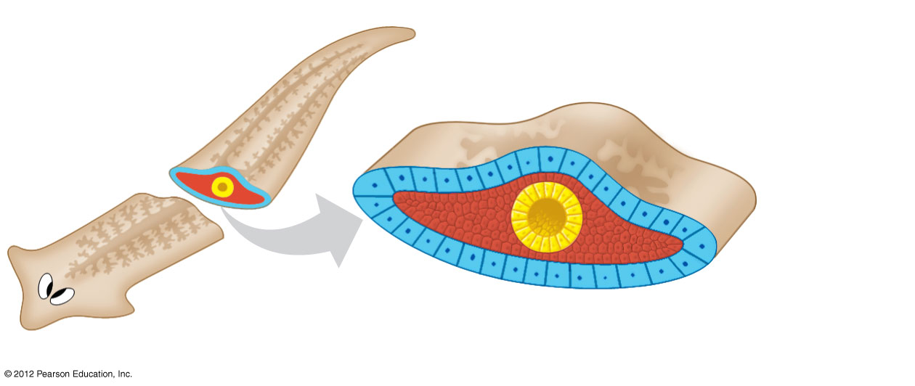
Figure 18.3D
Body covering
(from ectoderm)
Tissue-filled region
(from mesoderm)
Digestive sac
(from endoderm)
Notes:
26
Figure 18.3D No body cavity (a flatworm)

Slide 27
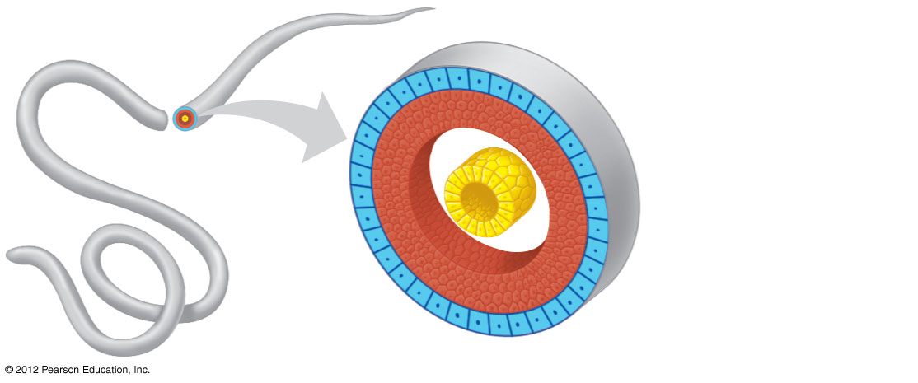
Figure 18.3C
Body covering
(from ectoderm)
Muscle layer
(from mesoderm)
Digestive tract
(from endoderm)
Pseudocoelom
Notes:
27
Figure 18.3C Pseudocoelom (a roundworm)

Slide 28
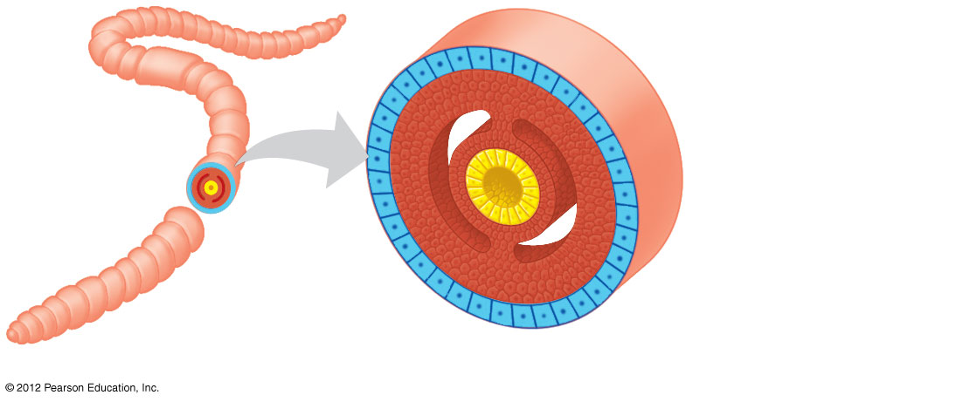
Figure 18.3B
Body covering
(from ectoderm)
Coelom
Tissue layer
lining coelom
and suspending
internal organs
(from mesoderm)
Digestive tract
(from endoderm)
Notes:
28
Figure 18.3B True coelom (a segmented worm)

Slide 29
18.4 The body plans of animals can be used to build phylogenetic trees
0
  Because animals diversified so rapidly on the scale of geologic time, it is difficult to sort out the evolutionary relationships among phyla using the fossil record.
© 2012 Pearson Education, Inc.
Notes:
29
Student Misconceptions and Concerns
1. When considering animals in general, students are typically biased toward vertebrate examples. As a thought exercise, start your first lecture on animal diversity by asking students to write down the name of the very first type of animal that comes to their minds, without giving it any thought. Depending upon your class size, either tabulate their responses quickly or have students raise their hands to indicate the type of animal they chose. In general, fewer than 5% (often fewer than 1%) of my students have thought of an invertebrate. This exercise makes the point that what we tend to think of, when we think of animals, is vertebrates. Many of us have had a dog, cat, or other vertebrate for a pet. Yet, more than 95% of all known species of animals are invertebrates. Students must expand their understanding of what it means to be an animal. The content in Chapter 18 should facilitate that understanding.
2. Students often struggle to conceptualize the basic needs of invertebrates, and may find it challenging to think of the similarities between, for example, an earthworm and a dog, or a tick and a cat. The common features of animals addressed at the start of Chapter 18 can be expanded to include the needs for oxygen, nourishing food, a tolerable environment, and a suitable habitat to reproduce, which apply to animals representing all of the major phyla. Illustrating these common demands can help students build the intellectual foundations that can be so difficult to fully establish.
Teaching Tips
1. You might wish to share the now somewhat-famous quote of Lewis Wolpert, who in 1986 said, “It is not birth, marriage, or death, but gastrulation, which is truly the most important time in your life.” The development and arrangement of the basic embryonic layers (ectoderm/skin and nervous systems, mesoderm/muscle and bone, and endoderm/digestive tract) establishes the basic body plan.
2. Your students might enjoy discussing whether or not they are larvae and if they can be said to go through metamorphosis. (The answer to both questions is “no”.)
3. Before addressing the subject of animal symmetry, you might wish to have your students speculate about the adaptive advantages of radial versus bilateral symmetry found in animals. This sort of comparison raises an opportunity to make some larger points about biology. There is no “one” best animal. Each form, each adaptation, and each body plan has advantages and disadvantages. The value of adaptations is relative to the organism’s environment and most adaptations represent a compromise.

Slide 30
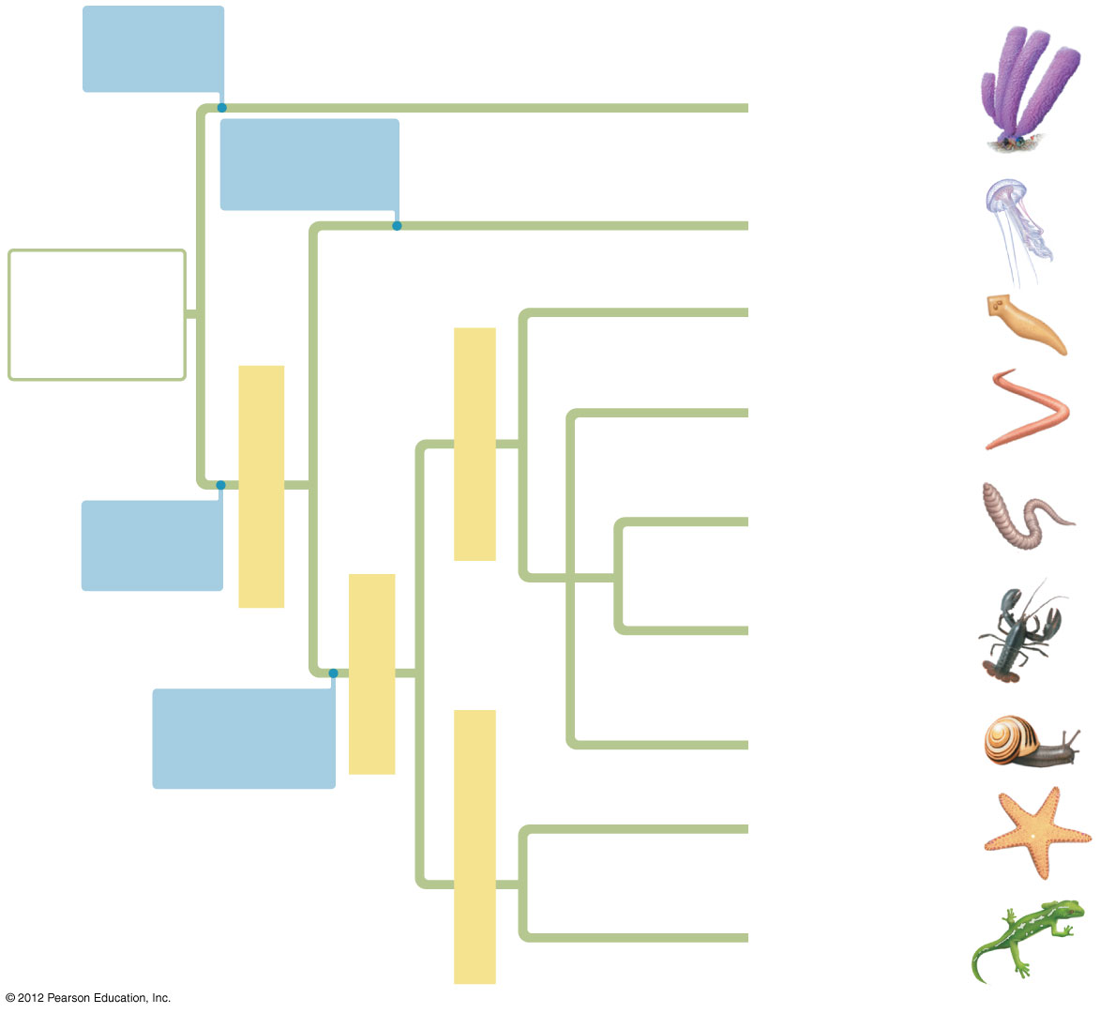
Figure 18.4
No true
tissues
Sponges
Radial
symmetry
Cnidarians
Ancestral
colonial
protist
Flatworms
Nematodes
Protostomes
Eumetazoans
True
tissues
Annelids
Arthropods
Bilaterians
Bilateral
symmetry
Molluscs
Echinoderms
Deuterostomes
Chordates
Notes:
30
Figure 18.4 A hypothesis of animal phylogeny based on morphological comparisons

Slide 31
0
  INVERTEBRATE DIVERSITY
© 2012 Pearson Education, Inc.
Notes:
31

Slide 32
18.5 Sponges have a relatively simple, porous body
0
  Sponges (phylum Porifera) are simple, sedentary animals without true tissues.
  Water enters through pores in the body wall into a central cavity and then flows out through a larger opening.
© 2012 Pearson Education, Inc.
Notes:
32
Student Misconceptions and Concerns
1. Students typically expect that an animal will have a head. The subject of a head might have already been introduced when discussing body plans. As you proceed through the animal phyla, have students consider how sponges and cnidarians meet their basic needs without the benefit of a well-defined head.
2. As students survey the major animal phyla, they might perceive the diversity of animals as spread somewhat evenly across the nine major phyla of invertebrates. Yet, two-thirds of all known species of life (and at least 80% of all described animal species) are arthropods. Although sources disagree on the number of living species that have been described, there is widespread agreement that the number of undescribed species is many times more than the number of described species. By examining the number of described species, some amazing proportions emerge. You might consider this exercise to make the point. Determine how many students represent 1% of the class. Then have the entire class stand. Tell the students that collectively, they represent all of the animal species known to exist today. Have 5% of the class sit, representing the proportion of known animal species that are vertebrates. Next, have 15% of the class sit, representing all of the remaining types of animals except arthropods. At this point, everyone standing (80% of the class) represents the proportion of known animal species that are arthropods (a conservative fraction). Finally, have 50% of the entire class sit, leaving 30% standing. Have the class guess what group of animals is represented now (clearly some subgroup of arthropods). This final 30% represents the known number of species of beetles! (The numbers used are rounded. Even higher percentages for beetles and invertebrates may be more accurate. The point of this exercise is the relative proportions rather than precise percentages.)
Teaching Tips
1. Imagine a country cabin in the winter with a roaring fire in a fireplace. The windows are partially opened to permit air to rush into the house to feed the fire. This flow of air through the windows, through the home, to the fireplace, and then out the chimney is analogous to the flow of water through a sponge. Side note: Many sponges, especially commercial bath sponges, have outer body walls that are highly folded. Simpler vase sponges, with straighter walls, are good examples to show students when discussing this basic water flow pattern.
2. Students may find it challenging to understand why sponges are animals. It might be helpful to return to the distinctions between animals, plants, and fungi when introducing sponges.

Slide 33
18.5 Sponges have a relatively simple, porous body
0
  The body of a sponge consists of two layers of cells separated by a gelatinous region.
    The inner layer of flagellated choanocytes filters food and engulfs it by phagocytosis.
    Amoebocytes wander through the middle body region and produce skeletal fibers composed of
      flexible protein and
      mineralized particles called spicules.
© 2012 Pearson Education, Inc.
Notes:
33
Student Misconceptions and Concerns
1. Students typically expect that an animal will have a head. The subject of a head might have already been introduced when discussing body plans. As you proceed through the animal phyla, have students consider how sponges and cnidarians meet their basic needs without the benefit of a well-defined head.
2. As students survey the major animal phyla, they might perceive the diversity of animals as spread somewhat evenly across the nine major phyla of invertebrates. Yet, two-thirds of all known species of life (and at least 80% of all described animal species) are arthropods. Although sources disagree on the number of living species that have been described, there is widespread agreement that the number of undescribed species is many times more than the number of described species. By examining the number of described species, some amazing proportions emerge. You might consider this exercise to make the point. Determine how many students represent 1% of the class. Then have the entire class stand. Tell the students that collectively, they represent all of the animal species known to exist today. Have 5% of the class sit, representing the proportion of known animal species that are vertebrates. Next, have 15% of the class sit, representing all of the remaining types of animals except arthropods. At this point, everyone standing (80% of the class) represents the proportion of known animal species that are arthropods (a conservative fraction). Finally, have 50% of the entire class sit, leaving 30% standing. Have the class guess what group of animals is represented now (clearly some subgroup of arthropods). This final 30% represents the known number of species of beetles! (The numbers used are rounded. Even higher percentages for beetles and invertebrates may be more accurate. The point of this exercise is the relative proportions rather than precise percentages.)
Teaching Tips
1. Imagine a country cabin in the winter with a roaring fire in a fireplace. The windows are partially opened to permit air to rush into the house to feed the fire. This flow of air through the windows, through the home, to the fireplace, and then out the chimney is analogous to the flow of water through a sponge. Side note: Many sponges, especially commercial bath sponges, have outer body walls that are highly folded. Simpler vase sponges, with straighter walls, are good examples to show students when discussing this basic water flow pattern.
2. Students may find it challenging to understand why sponges are animals. It might be helpful to return to the distinctions between animals, plants, and fungi when introducing sponges.

Slide 34
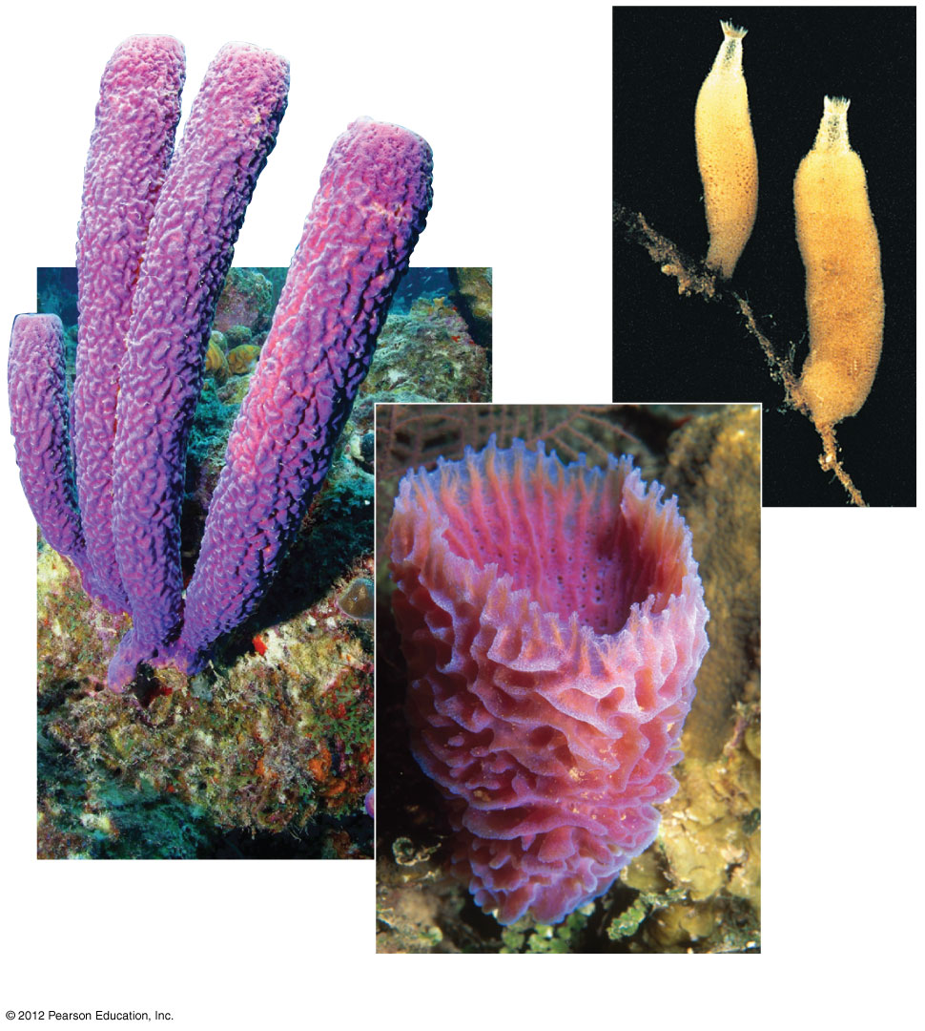
Figure 18.5A
Scypha
A purple tube
sponge
An azure vase sponge
Notes:
34
Figure 18.5A Sponges

Slide 35
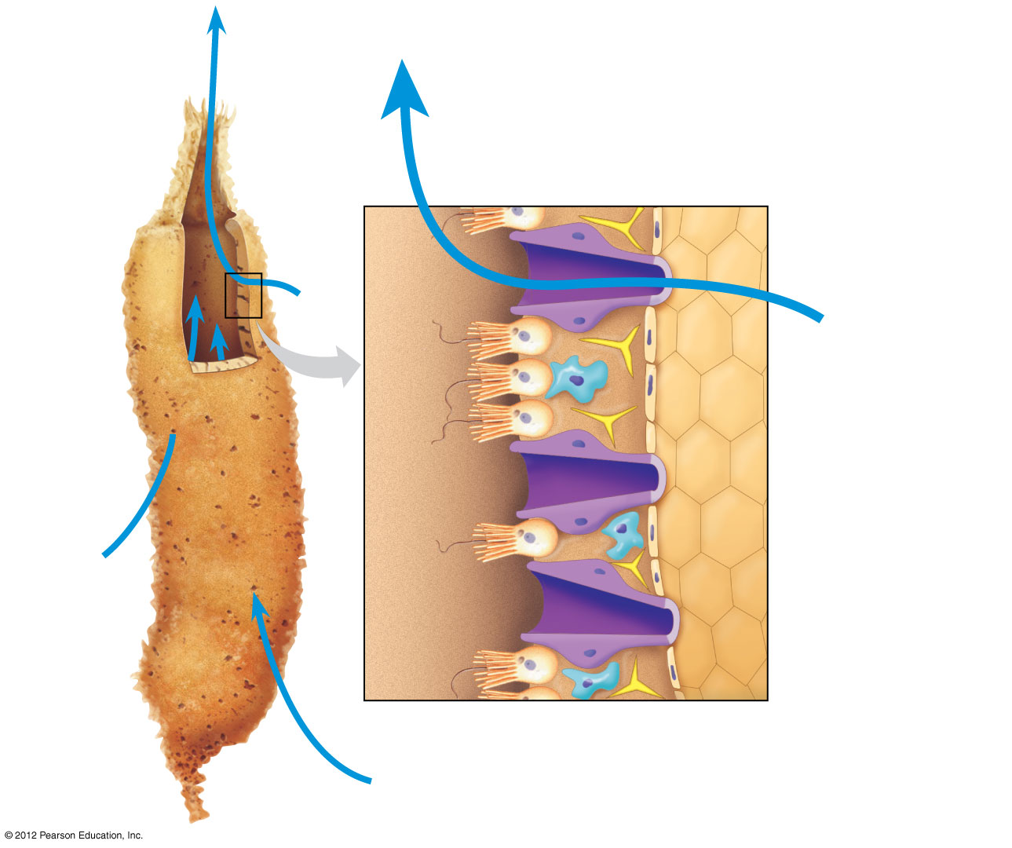
Figure 18.5B
Central
cavity
Skeletal fiber
Water flow
Choanocyte
in contact with
an amoebocyte
Choanocyte
Water
flow
Pore
Pores
Amoebocyte
Flagellum
Water flow
Notes:
35
Figure 18.5B The structure of a simple sponge

Slide 36
18.5 Sponges have a relatively simple, porous body
0
  Sponges are suspension feeders, filtering food particles from water passed through food-trapping equipment.
    To grow by 100 g, a sponge must filter roughly 1,000 kg of water.
    Choanocytes trap food particles in mucus on the membranous collars that surround their flagella.
© 2012 Pearson Education, Inc.
Notes:
36
Student Misconceptions and Concerns
1. Students typically expect that an animal will have a head. The subject of a head might have already been introduced when discussing body plans. As you proceed through the animal phyla, have students consider how sponges and cnidarians meet their basic needs without the benefit of a well-defined head.
2. As students survey the major animal phyla, they might perceive the diversity of animals as spread somewhat evenly across the nine major phyla of invertebrates. Yet, two-thirds of all known species of life (and at least 80% of all described animal species) are arthropods. Although sources disagree on the number of living species that have been described, there is widespread agreement that the number of undescribed species is many times more than the number of described species. By examining the number of described species, some amazing proportions emerge. You might consider this exercise to make the point. Determine how many students represent 1% of the class. Then have the entire class stand. Tell the students that collectively, they represent all of the animal species known to exist today. Have 5% of the class sit, representing the proportion of known animal species that are vertebrates. Next, have 15% of the class sit, representing all of the remaining types of animals except arthropods. At this point, everyone standing (80% of the class) represents the proportion of known animal species that are arthropods (a conservative fraction). Finally, have 50% of the entire class sit, leaving 30% standing. Have the class guess what group of animals is represented now (clearly some subgroup of arthropods). This final 30% represents the known number of species of beetles! (The numbers used are rounded. Even higher percentages for beetles and invertebrates may be more accurate. The point of this exercise is the relative proportions rather than precise percentages.)
Teaching Tips
1. Imagine a country cabin in the winter with a roaring fire in a fireplace. The windows are partially opened to permit air to rush into the house to feed the fire. This flow of air through the windows, through the home, to the fireplace, and then out the chimney is analogous to the flow of water through a sponge. Side note: Many sponges, especially commercial bath sponges, have outer body walls that are highly folded. Simpler vase sponges, with straighter walls, are good examples to show students when discussing this basic water flow pattern.
2. Students may find it challenging to understand why sponges are animals. It might be helpful to return to the distinctions between animals, plants, and fungi when introducing sponges.

Slide 37
18.5 Sponges have a relatively simple, porous body
0
  Adult sponges are sessile and cannot escape from predators. They deter pathogens, parasites, and predators by producing
    defensive toxins and
    antibiotics.
© 2012 Pearson Education, Inc.
Notes:
37
Student Misconceptions and Concerns
1. Students typically expect that an animal will have a head. The subject of a head might have already been introduced when discussing body plans. As you proceed through the animal phyla, have students consider how sponges and cnidarians meet their basic needs without the benefit of a well-defined head.
2. As students survey the major animal phyla, they might perceive the diversity of animals as spread somewhat evenly across the nine major phyla of invertebrates. Yet, two-thirds of all known species of life (and at least 80% of all described animal species) are arthropods. Although sources disagree on the number of living species that have been described, there is widespread agreement that the number of undescribed species is many times more than the number of described species. By examining the number of described species, some amazing proportions emerge. You might consider this exercise to make the point. Determine how many students represent 1% of the class. Then have the entire class stand. Tell the students that collectively, they represent all of the animal species known to exist today. Have 5% of the class sit, representing the proportion of known animal species that are vertebrates. Next, have 15% of the class sit, representing all of the remaining types of animals except arthropods. At this point, everyone standing (80% of the class) represents the proportion of known animal species that are arthropods (a conservative fraction). Finally, have 50% of the entire class sit, leaving 30% standing. Have the class guess what group of animals is represented now (clearly some subgroup of arthropods). This final 30% represents the known number of species of beetles! (The numbers used are rounded. Even higher percentages for beetles and invertebrates may be more accurate. The point of this exercise is the relative proportions rather than precise percentages.)
Teaching Tips
1. Imagine a country cabin in the winter with a roaring fire in a fireplace. The windows are partially opened to permit air to rush into the house to feed the fire. This flow of air through the windows, through the home, to the fireplace, and then out the chimney is analogous to the flow of water through a sponge. Side note: Many sponges, especially commercial bath sponges, have outer body walls that are highly folded. Simpler vase sponges, with straighter walls, are good examples to show students when discussing this basic water flow pattern.
2. Students may find it challenging to understand why sponges are animals. It might be helpful to return to the distinctions between animals, plants, and fungi when introducing sponges.

Slide 38
18.6 Cnidarians are radial animals with tentacles and stinging cells
0
  Cnidarians (phylum Cnidaria)
    are characterized by radial symmetry and
    have only two tissue layers:
      an outer epidermis,
      an inner cell layer lining the digestive cavity, and
      a jelly-filled middle region may have scattered amoeboid cells.
© 2012 Pearson Education, Inc.
Notes:
38
Student Misconceptions and Concerns
1. Students typically expect that an animal will have a head. The subject of a head might have already been introduced when discussing body plans. As you proceed through the animal phyla, have students consider how sponges and cnidarians meet their basic needs without the benefit of a well-defined head.
2. As students survey the major animal phyla, they might perceive the diversity of animals as spread somewhat evenly across the nine major phyla of invertebrates. Yet, two-thirds of all known species of life (and at least 80% of all described animal species) are arthropods. Although sources disagree on the number of living species that have been described, there is widespread agreement that the number of undescribed species is many times more than the number of described species. By examining the number of described species, some amazing proportions emerge. You might consider this exercise to make the point. Determine how many students represent 1% of the class. Then have the entire class stand. Tell the students that collectively, they represent all of the animal species known to exist today. Have 5% of the class sit, representing the proportion of known animal species that are vertebrates. Next, have 15% of the class sit, representing all of the remaining types of animals except arthropods. At this point, everyone standing (80% of the class) represents the proportion of known animal species that are arthropods (a conservative fraction). Finally, have 50% of the entire class sit, leaving 30% standing. Have the class guess what group of animals is represented now (clearly some subgroup of arthropods). This final 30% represents the known number of species of beetles! (The numbers used are rounded. Even higher percentages for beetles and invertebrates may be more accurate. The point of this exercise is the relative proportions rather than precise percentages.)
Teaching Tips
1. Just about any glass bottle with a narrow neck makes a good model of the cnidarian body plan. The narrowed neck of the body represents the constricted region of a cnidarian that regulates what enters and leaves the gastrovascular cavity. Additional note: The name “gastrovascular” represents the dual function of the cavity. It must serve as the site of digestion and the method of delivery of the nutrients. The cavity extends, like a primitive circulatory system, throughout the body, and is thus vascular in nature.
2. If students have been stung by a jellyfish, it was a toxin produced by the cnidocytes that caused a reaction. (Nematocysts are the firing part of a cnidocyte cell. The toxin is delivered by the firing of the nematocysts. A new cnidocyte must take the place of one that has fired its nematocyst, since cnidocytes cannot “reload.”)
3. The gastrovascular cavity of cnidarians and flatworms is the functional equivalent of two systems in our bodies. Ask students to explain how nutrients consumed at a meal nourish the cells in our toes. Nutrients absorbed by our gut are transported throughout our body by the circulatory system. Extensions of the gastrovascular cavity permit nutrient distribution in these cnidarians and flatworms.

Slide 39
18.6 Cnidarians are radial animals with tentacles and stinging cells
0
  Cnidarians exhibit two kinds of radially symmetrical body forms.
    The most sedentary polyp body is cylindrical with tentacles projecting from one end.
    The more mobile medusa form is exemplified by a marine jelly.
© 2012 Pearson Education, Inc.
Notes:
39
Student Misconceptions and Concerns
1. Students typically expect that an animal will have a head. The subject of a head might have already been introduced when discussing body plans. As you proceed through the animal phyla, have students consider how sponges and cnidarians meet their basic needs without the benefit of a well-defined head.
2. As students survey the major animal phyla, they might perceive the diversity of animals as spread somewhat evenly across the nine major phyla of invertebrates. Yet, two-thirds of all known species of life (and at least 80% of all described animal species) are arthropods. Although sources disagree on the number of living species that have been described, there is widespread agreement that the number of undescribed species is many times more than the number of described species. By examining the number of described species, some amazing proportions emerge. You might consider this exercise to make the point. Determine how many students represent 1% of the class. Then have the entire class stand. Tell the students that collectively, they represent all of the animal species known to exist today. Have 5% of the class sit, representing the proportion of known animal species that are vertebrates. Next, have 15% of the class sit, representing all of the remaining types of animals except arthropods. At this point, everyone standing (80% of the class) represents the proportion of known animal species that are arthropods (a conservative fraction). Finally, have 50% of the entire class sit, leaving 30% standing. Have the class guess what group of animals is represented now (clearly some subgroup of arthropods). This final 30% represents the known number of species of beetles! (The numbers used are rounded. Even higher percentages for beetles and invertebrates may be more accurate. The point of this exercise is the relative proportions rather than precise percentages.)
Teaching Tips
1. Just about any glass bottle with a narrow neck makes a good model of the cnidarian body plan. The narrowed neck of the body represents the constricted region of a cnidarian that regulates what enters and leaves the gastrovascular cavity. Additional note: The name “gastrovascular” represents the dual function of the cavity. It must serve as the site of digestion and the method of delivery of the nutrients. The cavity extends, like a primitive circulatory system, throughout the body, and is thus vascular in nature.
2. If students have been stung by a jellyfish, it was a toxin produced by the cnidocytes that caused a reaction. (Nematocysts are the firing part of a cnidocyte cell. The toxin is delivered by the firing of the nematocysts. A new cnidocyte must take the place of one that has fired its nematocyst, since cnidocytes cannot “reload.”)
3. The gastrovascular cavity of cnidarians and flatworms is the functional equivalent of two systems in our bodies. Ask students to explain how nutrients consumed at a meal nourish the cells in our toes. Nutrients absorbed by our gut are transported throughout our body by the circulatory system. Extensions of the gastrovascular cavity permit nutrient distribution in these cnidarians and flatworms.

Slide 40
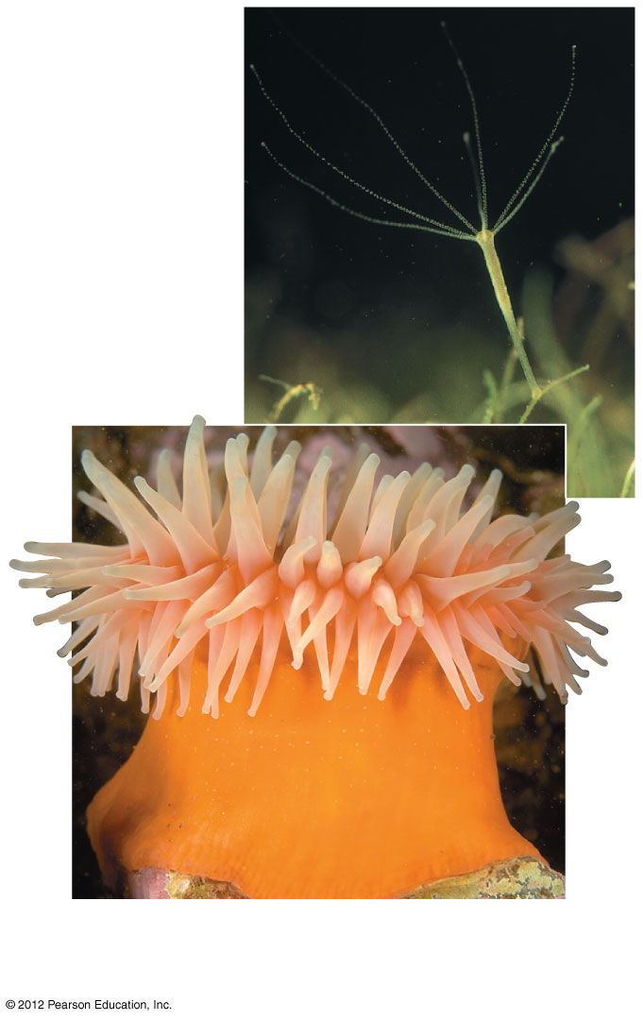
Figure 18.6A
A hydra
(about 2–25
mm tall)
A sea anemone
(about 6 cm in diameter)
Notes:
40
Figure 18.6A Polyp body form

Slide 41
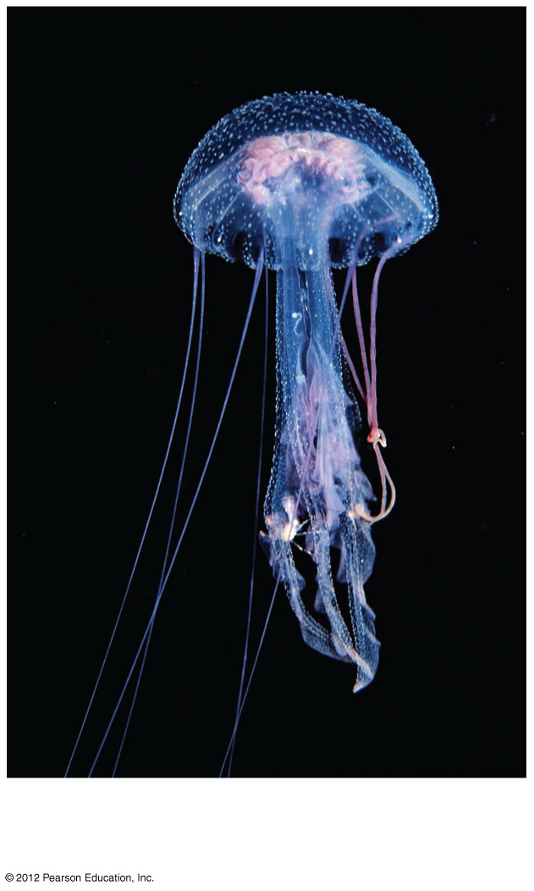
Figure 18.6B
A marine jelly
(about 6 cm in diameter)
Notes:
41
Figure 18.6B Medusa body form: marine jelly (about 6 cm in diameter)

Slide 42
18.6 Cnidarians are radial animals with tentacles and stinging cells
0
  Cnidarians are carnivores that use their tentacles to capture prey and to push prey into their mouths.
    The mouth leads to the gastrovascular cavity, which functions in digestion and circulation and as a hydrostatic skeleton.
    Cnidocytes are unique stinging cells that capture prey and function in defense.
© 2012 Pearson Education, Inc.
Notes:
42
Student Misconceptions and Concerns
1. Students typically expect that an animal will have a head. The subject of a head might have already been introduced when discussing body plans. As you proceed through the animal phyla, have students consider how sponges and cnidarians meet their basic needs without the benefit of a well-defined head.
2. As students survey the major animal phyla, they might perceive the diversity of animals as spread somewhat evenly across the nine major phyla of invertebrates. Yet, two-thirds of all known species of life (and at least 80% of all described animal species) are arthropods. Although sources disagree on the number of living species that have been described, there is widespread agreement that the number of undescribed species is many times more than the number of described species. By examining the number of described species, some amazing proportions emerge. You might consider this exercise to make the point. Determine how many students represent 1% of the class. Then have the entire class stand. Tell the students that collectively, they represent all of the animal species known to exist today. Have 5% of the class sit, representing the proportion of known animal species that are vertebrates. Next, have 15% of the class sit, representing all of the remaining types of animals except arthropods. At this point, everyone standing (80% of the class) represents the proportion of known animal species that are arthropods (a conservative fraction). Finally, have 50% of the entire class sit, leaving 30% standing. Have the class guess what group of animals is represented now (clearly some subgroup of arthropods). This final 30% represents the known number of species of beetles! (The numbers used are rounded. Even higher percentages for beetles and invertebrates may be more accurate. The point of this exercise is the relative proportions rather than precise percentages.)
Teaching Tips
1. Just about any glass bottle with a narrow neck makes a good model of the cnidarian body plan. The narrowed neck of the body represents the constricted region of a cnidarian that regulates what enters and leaves the gastrovascular cavity. Additional note: The name “gastrovascular” represents the dual function of the cavity. It must serve as the site of digestion and the method of delivery of the nutrients. The cavity extends, like a primitive circulatory system, throughout the body, and is thus vascular in nature.
2. If students have been stung by a jellyfish, it was a toxin produced by the cnidocytes that caused a reaction. (Nematocysts are the firing part of a cnidocyte cell. The toxin is delivered by the firing of the nematocysts. A new cnidocyte must take the place of one that has fired its nematocyst, since cnidocytes cannot “reload.”)
3. The gastrovascular cavity of cnidarians and flatworms is the functional equivalent of two systems in our bodies. Ask students to explain how nutrients consumed at a meal nourish the cells in our toes. Nutrients absorbed by our gut are transported throughout our body by the circulatory system. Extensions of the gastrovascular cavity permit nutrient distribution in these cnidarians and flatworms.

Slide 43
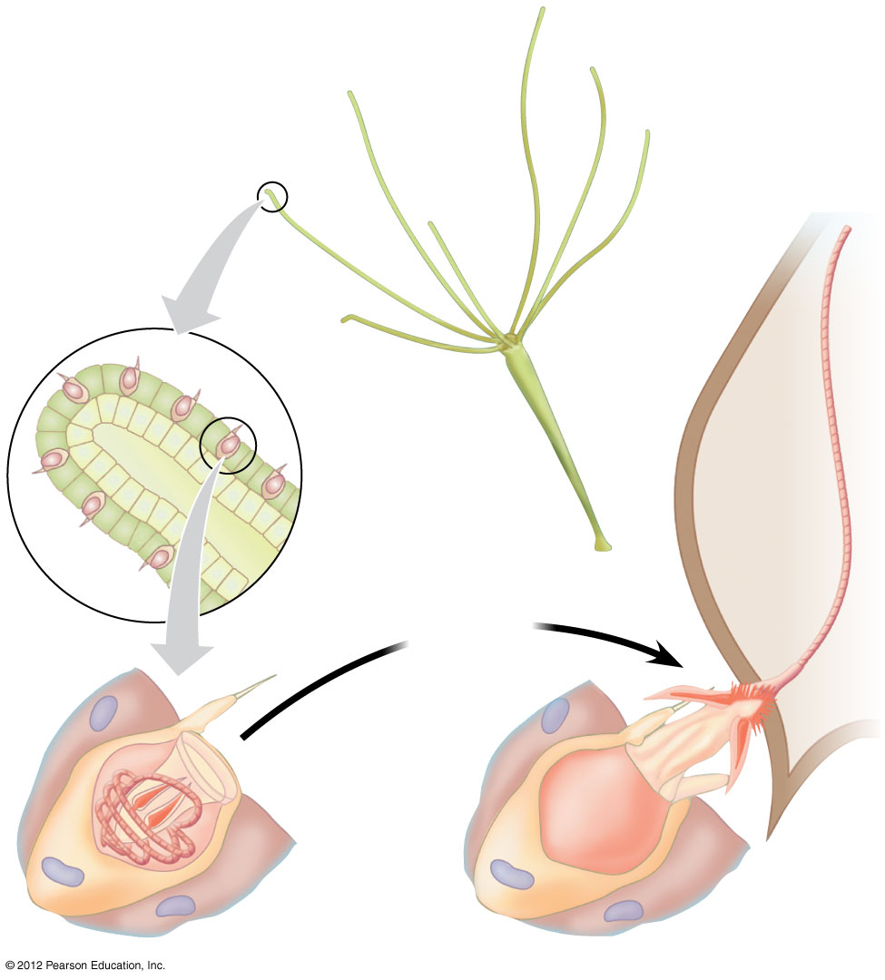
Figure 18.6C
Tentacle
Prey
Discharge
of thread
“Trigger”
Coiled thread
Capsule
Cnidocyte
Notes:
43
Figure 18.6C Cnidocyte action

Slide 44
18.7 Flatworms are the simplest bilateral animals
0
  The vast majority of animal species belong to the clade Bilateria, consisting of animals with bilateral symmetry.
  Flatworms (phylum Platyhelminthes) are the simplest bilaterians.
  Flatworms live in marine, freshwater, and damp terrestrial habitats.
  Some are parasitic and others are free-living.
© 2012 Pearson Education, Inc.
Notes:
44
Student Misconceptions and Concerns
As students survey the major animal phyla, they might perceive the diversity of animals as spread somewhat evenly across the nine major phyla of invertebrates. Yet, two-thirds of all known species of life (and at least 80% of all described animal species) are arthropods. Although sources disagree on the number of living species that have been described, there is widespread agreement that the number of undescribed species is many times more than the number of described species. By examining the number of described species, some amazing proportions emerge. You might consider this exercise to make the point. Determine how many students represent 1% of the class. Then have the entire class stand. Tell the students that collectively, they represent all of the animal species known to exist today. Have 5% of the class sit, representing the proportion of known animal species that are vertebrates. Next, have 15% of the class sit, representing all of the remaining types of animals except arthropods. At this point, everyone standing (80% of the class) represents the proportion of known animal species that are arthropods (a conservative fraction). Finally, have 50% of the entire class sit, leaving 30% standing. Have the class guess what group of animals is represented now (clearly some subgroup of arthropods). This final 30% represents the known number of species of beetles! (The numbers used are rounded. Even higher percentages for beetles and invertebrates may be more accurate. The point of this exercise is the relative proportions rather than precise percentages.)
Teaching Tips
1. The gastrovascular cavity of cnidarians and flatworms is the functional equivalent of two systems in our bodies. Ask students to explain how nutrients consumed at a meal nourish the cells in our toes. Nutrients absorbed by our gut are transported throughout our body by the circulatory system. Extensions of the gastrovascular cavity permit nutrient distribution in these cnidarians and flatworms.
2. A planarian, indicated in Figure 18.7A, ingests food in the middle of its body. Challenge students to think of other animals that have a mouth located far from the head. The discussion that will follow this challenge is likely to touch on the defining features of a head, invoking a critical analysis of animal body plans and providing an important exercise for this chapter.

Slide 45
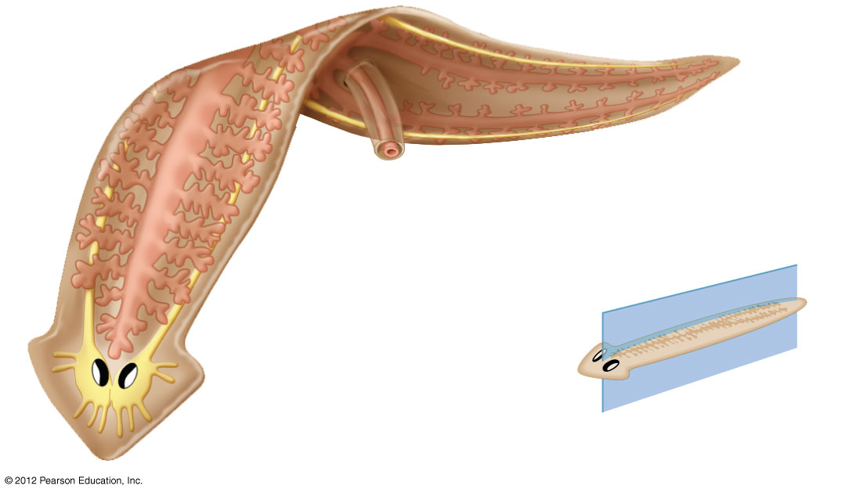
Figure 18.7A
Gastrovascular
cavity
Nerve cords
Mouth
Eyecups
Nervous
tissue clusters
Bilateral symmetry
Notes:
45
Figure 18.7A A free-living flatworm, the planarian (most are about 5–10 mm long)

Slide 46
18.7 Flatworms are the simplest bilateral animals
0
  There are three major groups of flatworms.
    1. Free-living flatworms (planarians) have
      heads with light-sensitive eyespots,
      flaps to detect chemicals,
      dense clusters of nerve cells that form a simple brain and a pair of nerve cords that runs the length of the body, and
      a branched gastrovascular cavity with a single opening.
© 2012 Pearson Education, Inc.
Notes:
46
Student Misconceptions and Concerns
As students survey the major animal phyla, they might perceive the diversity of animals as spread somewhat evenly across the nine major phyla of invertebrates. Yet, two-thirds of all known species of life (and at least 80% of all described animal species) are arthropods. Although sources disagree on the number of living species that have been described, there is widespread agreement that the number of undescribed species is many times more than the number of described species. By examining the number of described species, some amazing proportions emerge. You might consider this exercise to make the point. Determine how many students represent 1% of the class. Then have the entire class stand. Tell the students that collectively, they represent all of the animal species known to exist today. Have 5% of the class sit, representing the proportion of known animal species that are vertebrates. Next, have 15% of the class sit, representing all of the remaining types of animals except arthropods. At this point, everyone standing (80% of the class) represents the proportion of known animal species that are arthropods (a conservative fraction). Finally, have 50% of the entire class sit, leaving 30% standing. Have the class guess what group of animals is represented now (clearly some subgroup of arthropods). This final 30% represents the known number of species of beetles! (The numbers used are rounded. Even higher percentages for beetles and invertebrates may be more accurate. The point of this exercise is the relative proportions rather than precise percentages.)
Teaching Tips
1. The gastrovascular cavity of cnidarians and flatworms is the functional equivalent of two systems in our bodies. Ask students to explain how nutrients consumed at a meal nourish the cells in our toes. Nutrients absorbed by our gut are transported throughout our body by the circulatory system. Extensions of the gastrovascular cavity permit nutrient distribution in these cnidarians and flatworms.
2. A planarian, indicated in Figure 18.7A, ingests food in the middle of its body. Challenge students to think of other animals that have a mouth located far from the head. The discussion that will follow this challenge is likely to touch on the defining features of a head, invoking a critical analysis of animal body plans and providing an important exercise for this chapter.

Slide 47
18.7 Flatworms are the simplest bilateral animals
0
    2. Flukes are parasitic flatworms with
      complex life cycles and
      suckers to attach to their hosts.
    3. Tapeworms
      are parasitic,
      inhabit the digestive tracts of vertebrates,
      consist of a ribbonlike body with repeated units,
      have an anterior scolex armed with hooks and suckers that grasp the host,
      have no mouth, and simply absorb nutrients across their body surface.
      The units at the posterior end of tapeworms are full of ripe eggs that pass out of the host’s body.
© 2012 Pearson Education, Inc.
Notes:
47
Student Misconceptions and Concerns
As students survey the major animal phyla, they might perceive the diversity of animals as spread somewhat evenly across the nine major phyla of invertebrates. Yet, two-thirds of all known species of life (and at least 80% of all described animal species) are arthropods. Although sources disagree on the number of living species that have been described, there is widespread agreement that the number of undescribed species is many times more than the number of described species. By examining the number of described species, some amazing proportions emerge. You might consider this exercise to make the point. Determine how many students represent 1% of the class. Then have the entire class stand. Tell the students that collectively, they represent all of the animal species known to exist today. Have 5% of the class sit, representing the proportion of known animal species that are vertebrates. Next, have 15% of the class sit, representing all of the remaining types of animals except arthropods. At this point, everyone standing (80% of the class) represents the proportion of known animal species that are arthropods (a conservative fraction). Finally, have 50% of the entire class sit, leaving 30% standing. Have the class guess what group of animals is represented now (clearly some subgroup of arthropods). This final 30% represents the known number of species of beetles! (The numbers used are rounded. Even higher percentages for beetles and invertebrates may be more accurate. The point of this exercise is the relative proportions rather than precise percentages.)
Teaching Tips
1. The gastrovascular cavity of cnidarians and flatworms is the functional equivalent of two systems in our bodies. Ask students to explain how nutrients consumed at a meal nourish the cells in our toes. Nutrients absorbed by our gut are transported throughout our body by the circulatory system. Extensions of the gastrovascular cavity permit nutrient distribution in these cnidarians and flatworms.
2. A planarian, indicated in Figure 18.7A, ingests food in the middle of its body. Challenge students to think of other animals that have a mouth located far from the head. The discussion that will follow this challenge is likely to touch on the defining features of a head, invoking a critical analysis of animal body plans and providing an important exercise for this chapter.

Slide 48
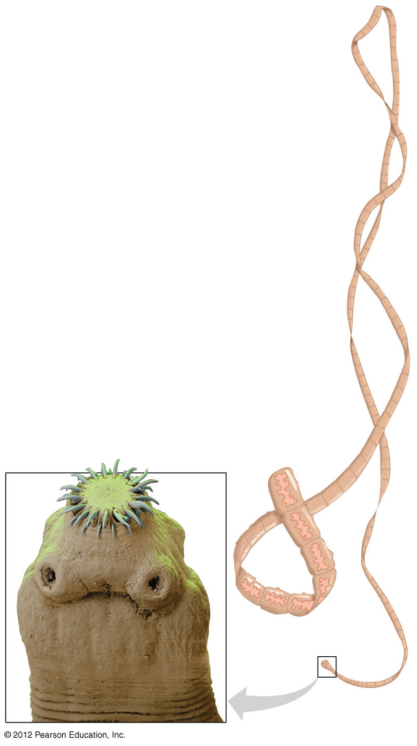
Figure 18.7B
Units with
reproductive
structures
Hooks
Scolex
(anterior
end)
Sucker
Notes:
48
Figure 18.7B A tapeworm, a parasitic flatworm

Slide 49
18.8 Nematodes have a pseudocoelom and a complete digestive tract
0
  Nematodes or roundworms (phylum Nematoda) are abundant and diverse, with an estimated 500,000 species. Nematodes have
    bilateral symmetry,
    three tissue layers,
    a nonliving cuticle covering the body that prevents them from drying out,
    a pseudocoelom body cavity that functions to distribute nutrients and as a hydroskeleton, and
    a complete digestive tract with a mouth and anus.
© 2012 Pearson Education, Inc.
Notes:
49
Student Misconceptions and Concerns
As students survey the major animal phyla, they might perceive the diversity of animals as spread somewhat evenly across the nine major phyla of invertebrates. Yet, two-thirds of all known species of life (and at least 80% of all described animal species) are arthropods. Although sources disagree on the number of living species that have been described, there is widespread agreement that the number of undescribed species is many times more than the number of described species. By examining the number of described species, some amazing proportions emerge. You might consider this exercise to make the point. Determine how many students represent 1% of the class. Then have the entire class stand. Tell the students that collectively, they represent all of the animal species known to exist today. Have 5% of the class sit, representing the proportion of known animal species that are vertebrates. Next, have 15% of the class sit, representing all of the remaining types of animals except arthropods. At this point, everyone standing (80% of the class) represents the proportion of known animal species that are arthropods (a conservative fraction). Finally, have 50% of the entire class sit, leaving 30% standing. Have the class guess what group of animals is represented now (clearly some subgroup of arthropods). This final 30% represents the known number of species of beetles! (The numbers used are rounded. Even higher percentages for beetles and invertebrates may be more accurate. The point of this exercise is the relative proportions rather than precise percentages.)
Teaching Tips
1. The undercooking of meat contributes to the spread of parasitic diseases. If you addressed the denaturation of proteins in Chapter 3, here is a chance to reinforce the points about the effects of heat. Proteins denature and discolor when heated (pink meat turns brown). This same process denatures proteins in parasites and kills them (although some parasites can survive relatively high temperatures). If any portion of a steak is still pink, the meat has not been cooked enough to denature the meat or parasitic proteins. Trichinosis is acquired by eating pork that has not been cooked enough to denature all the proteins (and kill the parasites). The details of just about any parasitic infection of humans will get the attention of your students . . . and likely cause them to start scratching!
2. Annelids (and nematodes, Module 18.8) have the advantage of a digestive tract with openings at both ends. This permits the efficiency of a digestive tract specialized for a one-way flow of ingested materials and enjoying the same advantages as an assembly line, but in reverse, serving in fact as a sort of “disassembly” line. These worms (and all animals with a mouth separate from the anus) “disassemble” food as it moves through the digestive tract.

Slide 50
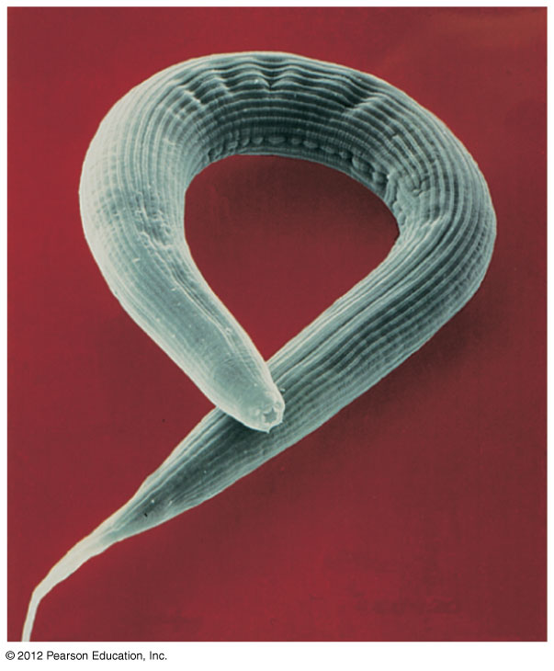
Figure 18.8A
Mouth
Notes:
50
Figure 18.8A A free-living nematode

Slide 51
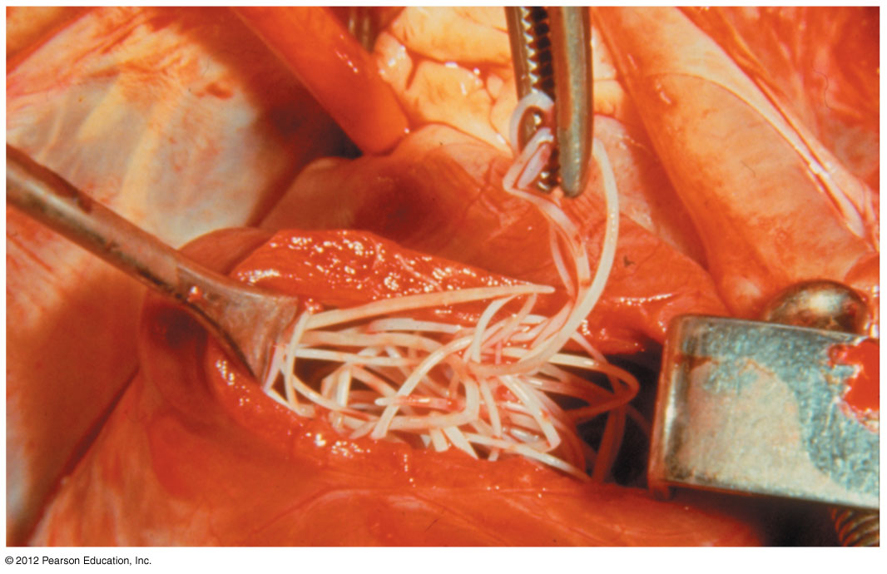
Figure 18.8B
Heartworm –dog heart
Notes:
51
Figure 18.8B A dog heart infested by heartworm, a parasitic nematode

Slide 52
18.9 Diverse molluscs are variations on a common body plan
0
  Molluscs (phylum Mollusca) have
    a muscular foot that functions in locomotion,
    a visceral mass containing most of the internal organs,
    a mantle, which may secrete a shell that encloses the visceral mass, and
    a true coelom and a circulatory system that pumps blood throughout the body.
    Many molluscs feed with a rasping radula, used to scrape up food.
    The life cycle of many marine molluscs includes a ciliated larva called a trochophore.
© 2012 Pearson Education, Inc.
Notes:
52
Student Misconceptions and Concerns
As students survey the major animal phyla, they might perceive the diversity of animals as spread somewhat evenly across the nine major phyla of invertebrates. Yet, two-thirds of all known species of life (and at least 80% of all described animal species) are arthropods. Although sources disagree on the number of living species that have been described, there is widespread agreement that the number of undescribed species is many times more than the number of described species. By examining the number of described species, some amazing proportions emerge. You might consider this exercise to make the point. Determine how many students represent 1% of the class. Then have the entire class stand. Tell the students that collectively, they represent all of the animal species known to exist today. Have 5% of the class sit, representing the proportion of known animal species that are vertebrates. Next, have 15% of the class sit, representing all of the remaining types of animals except arthropods. At this point, everyone standing (80% of the class) represents the proportion of known animal species that are arthropods (a conservative fraction). Finally, have 50% of the entire class sit, leaving 30% standing. Have the class guess what group of animals is represented now (clearly some subgroup of arthropods). This final 30% represents the known number of species of beetles! (The numbers used are rounded. Even higher percentages for beetles and invertebrates may be more accurate. The point of this exercise is the relative proportions rather than precise percentages.)
Teaching Tips
1. When we eat clams, we usually eat strips of the muscular foot. If the clams are mushy and/or contain sand, the serving may also include portions of the intestines.
2. A simple demonstration of the bivalve body plan can be obtained by purchasing smoked oysters in a grocery store. Each smoked oyster (ready to be consumed) is the soft body removed from the paired shells. For an enjoyable demonstration, discuss the anatomy of a specimen and then enjoy it for lunch.

Slide 53
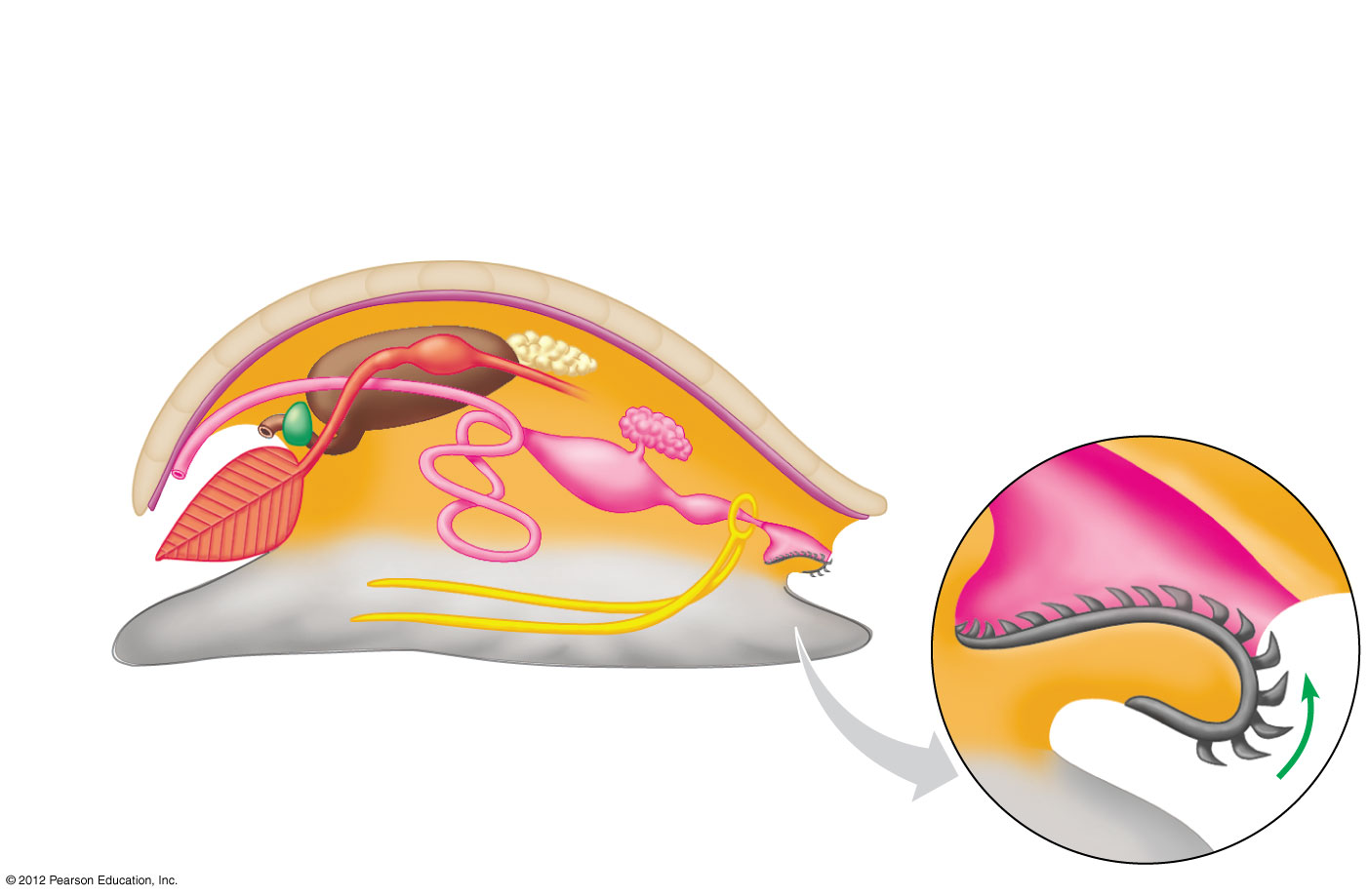
Figure 18.9A
Visceral mass
Coelom
Reproductive
organs
Kidney
Heart
Digestive
tract
Mantle
Mantle
cavity
Shell
Digestive
tract
Radula
Mouth
Anus
Gill
Foot
Nerve
cords
Notes:
53
Figure 18.9A The general body plan of a mollusc

Slide 54
18.9 Diverse molluscs are variations on a common body plan
0
  Gastropods are the largest group of molluscs and include the snails and slugs. Gastropods are
    found in fresh water, salt water, and terrestrial environments,
    the only molluscs that live on land, using the mantle cavity as a lung, and
    often protected by a single, spiral shell.
    Slugs have lost their mantle and shell and have long colorful projections that function as gills.
© 2012 Pearson Education, Inc.
Notes:
54
Student Misconceptions and Concerns
As students survey the major animal phyla, they might perceive the diversity of animals as spread somewhat evenly across the nine major phyla of invertebrates. Yet, two-thirds of all known species of life (and at least 80% of all described animal species) are arthropods. Although sources disagree on the number of living species that have been described, there is widespread agreement that the number of undescribed species is many times more than the number of described species. By examining the number of described species, some amazing proportions emerge. You might consider this exercise to make the point. Determine how many students represent 1% of the class. Then have the entire class stand. Tell the students that collectively, they represent all of the animal species known to exist today. Have 5% of the class sit, representing the proportion of known animal species that are vertebrates. Next, have 15% of the class sit, representing all of the remaining types of animals except arthropods. At this point, everyone standing (80% of the class) represents the proportion of known animal species that are arthropods (a conservative fraction). Finally, have 50% of the entire class sit, leaving 30% standing. Have the class guess what group of animals is represented now (clearly some subgroup of arthropods). This final 30% represents the known number of species of beetles! (The numbers used are rounded. Even higher percentages for beetles and invertebrates may be more accurate. The point of this exercise is the relative proportions rather than precise percentages.)
Teaching Tips
1. When we eat clams, we usually eat strips of the muscular foot. If the clams are mushy and/or contain sand, the serving may also include portions of the intestines.
2. A simple demonstration of the bivalve body plan can be obtained by purchasing smoked oysters in a grocery store. Each smoked oyster (ready to be consumed) is the soft body removed from the paired shells. For an enjoyable demonstration, discuss the anatomy of a specimen and then enjoy it for lunch.

Slide 55
18.9 Diverse molluscs are variations on a common body plan
0
  Bivalves
    include clams, oysters, mussels, and scallops and
    have shells divided into two halves that are hinged together.
    Most bivalves are sedentary suspension feeders, attached to the substrate by strong threads.
© 2012 Pearson Education, Inc.
Notes:
55
Student Misconceptions and Concerns
As students survey the major animal phyla, they might perceive the diversity of animals as spread somewhat evenly across the nine major phyla of invertebrates. Yet, two-thirds of all known species of life (and at least 80% of all described animal species) are arthropods. Although sources disagree on the number of living species that have been described, there is widespread agreement that the number of undescribed species is many times more than the number of described species. By examining the number of described species, some amazing proportions emerge. You might consider this exercise to make the point. Determine how many students represent 1% of the class. Then have the entire class stand. Tell the students that collectively, they represent all of the animal species known to exist today. Have 5% of the class sit, representing the proportion of known animal species that are vertebrates. Next, have 15% of the class sit, representing all of the remaining types of animals except arthropods. At this point, everyone standing (80% of the class) represents the proportion of known animal species that are arthropods (a conservative fraction). Finally, have 50% of the entire class sit, leaving 30% standing. Have the class guess what group of animals is represented now (clearly some subgroup of arthropods). This final 30% represents the known number of species of beetles! (The numbers used are rounded. Even higher percentages for beetles and invertebrates may be more accurate. The point of this exercise is the relative proportions rather than precise percentages.)
Teaching Tips
1. When we eat clams, we usually eat strips of the muscular foot. If the clams are mushy and/or contain sand, the serving may also include portions of the intestines.
2. A simple demonstration of the bivalve body plan can be obtained by purchasing smoked oysters in a grocery store. Each smoked oyster (ready to be consumed) is the soft body removed from the paired shells. For an enjoyable demonstration, discuss the anatomy of a specimen and then enjoy it for lunch.

Slide 56
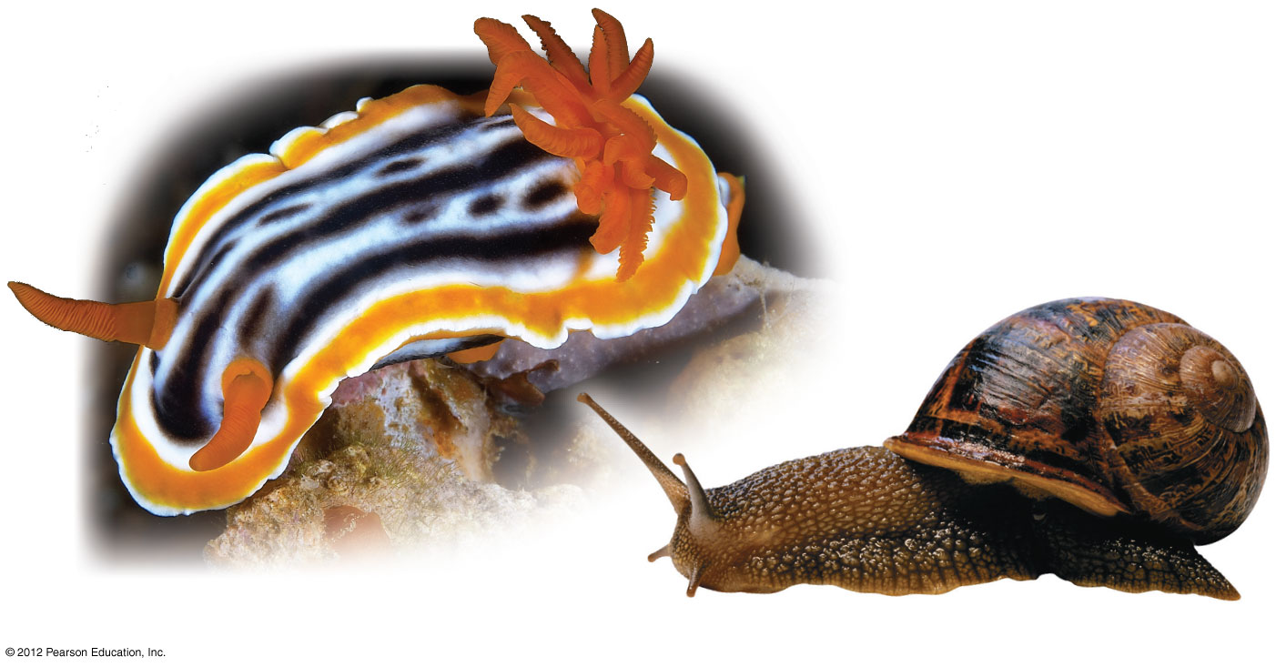
Figure 18.9C
A sea slug (about 5 cm long)
A land snail
Notes:
56
Figure 18.9C Gastropods

Slide 57
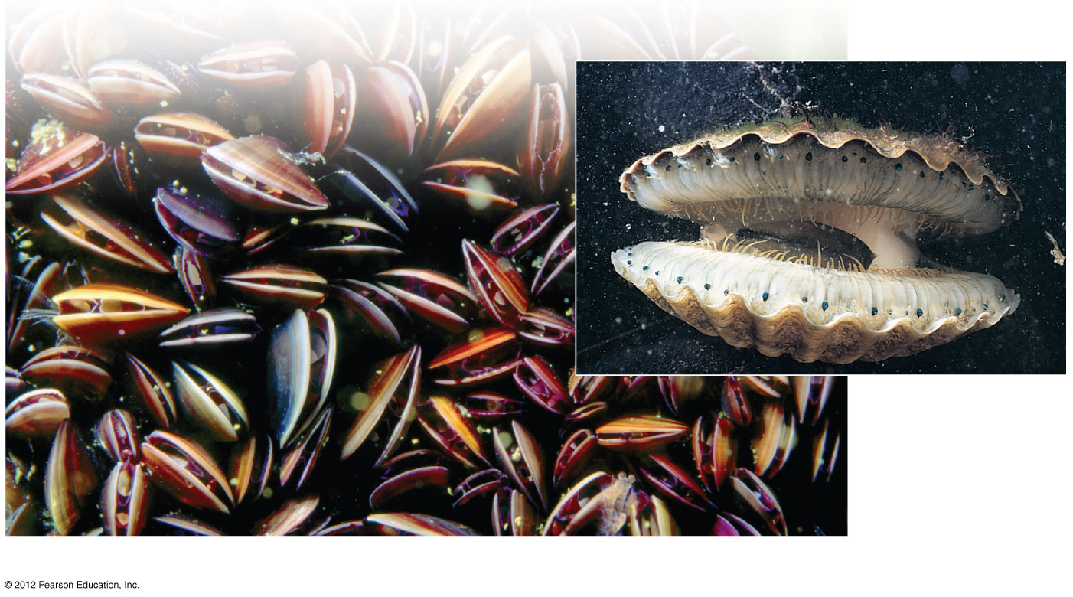
Figure 18.9D
Eyes
A scallop
(about 10 cm
in diameter)
Mussels (each about 6 cm long)
Notes:
57
Figure 18.9D Bivalves

Slide 58
18.9 Diverse molluscs are variations on a common body plan
0
  Cephalopods
    include squids, octopuses, and nautiluses,
    are fast, agile predators,
    have large brains and sophisticated sense organs, including complex image-focusing eyes, and
    a shell that is large in a nautilus, small and internal in a squid, or missing in an octopus.
    Squid are fast, streamlined predators that use a muscular siphon for jet propulsion.
    Octopuses live on the seafloor, where they creep about as active predators.
© 2012 Pearson Education, Inc.
Notes:
58
Student Misconceptions and Concerns
As students survey the major animal phyla, they might perceive the diversity of animals as spread somewhat evenly across the nine major phyla of invertebrates. Yet, two-thirds of all known species of life (and at least 80% of all described animal species) are arthropods. Although sources disagree on the number of living species that have been described, there is widespread agreement that the number of undescribed species is many times more than the number of described species. By examining the number of described species, some amazing proportions emerge. You might consider this exercise to make the point. Determine how many students represent 1% of the class. Then have the entire class stand. Tell the students that collectively, they represent all of the animal species known to exist today. Have 5% of the class sit, representing the proportion of known animal species that are vertebrates. Next, have 15% of the class sit, representing all of the remaining types of animals except arthropods. At this point, everyone standing (80% of the class) represents the proportion of known animal species that are arthropods (a conservative fraction). Finally, have 50% of the entire class sit, leaving 30% standing. Have the class guess what group of animals is represented now (clearly some subgroup of arthropods). This final 30% represents the known number of species of beetles! (The numbers used are rounded. Even higher percentages for beetles and invertebrates may be more accurate. The point of this exercise is the relative proportions rather than precise percentages.)
Teaching Tips
1. When we eat clams, we usually eat strips of the muscular foot. If the clams are mushy and/or contain sand, the serving may also include portions of the intestines.
2. A simple demonstration of the bivalve body plan can be obtained by purchasing smoked oysters in a grocery store. Each smoked oyster (ready to be consumed) is the soft body removed from the paired shells. For an enjoyable demonstration, discuss the anatomy of a specimen and then enjoy it for lunch.

Slide 59
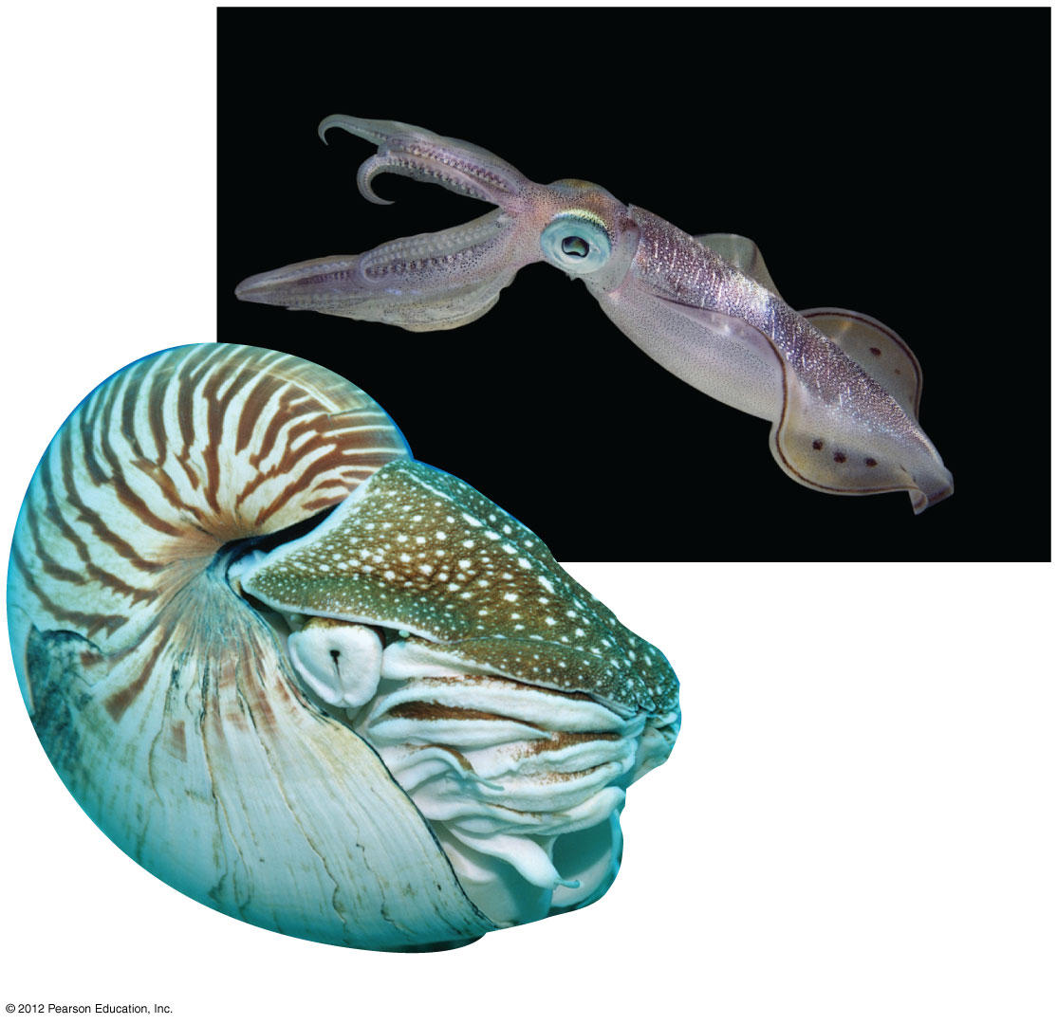
Figure 18.9E
A squid (internal shell)
A chambered nautilus (about 21 cm in diameter)
Notes:
59
Figure 18.9E Cephalopods

Slide 60
18.10 Annelids are segmented worms
0
  Annelids (phylum Annelida) have
    segmentation, the subdivision of the body along its length into a series of repeated parts,
    a true coelom that functions as a hydrostatic skeleton,
    a nervous system that includes a simple brain and ventral nerve cord, and
    a closed circulatory system in which blood remains enclosed in vessels throughout the body.
    Many invertebrates, such as molluscs and arthropods, have an open circulatory system in which blood is pumped through vessels into open body cavities.
© 2012 Pearson Education, Inc.
Notes:
60
Student Misconceptions and Concerns
As students survey the major animal phyla, they might perceive the diversity of animals as spread somewhat evenly across the nine major phyla of invertebrates. Yet, two-thirds of all known species of life (and at least 80% of all described animal species) are arthropods. Although sources disagree on the number of living species that have been described, there is widespread agreement that the number of undescribed species is many times more than the number of described species. By examining the number of described species, some amazing proportions emerge. You might consider this exercise to make the point. Determine how many students represent 1% of the class. Then have the entire class stand. Tell the students that collectively, they represent all of the animal species known to exist today. Have 5% of the class sit, representing the proportion of known animal species that are vertebrates. Next, have 15% of the class sit, representing all of the remaining types of animals except arthropods. At this point, everyone standing (80% of the class) represents the proportion of known animal species that are arthropods (a conservative fraction). Finally, have 50% of the entire class sit, leaving 30% standing. Have the class guess what group of animals is represented now (clearly some subgroup of arthropods). This final 30% represents the known number of species of beetles! (The numbers used are rounded. Even higher percentages for beetles and invertebrates may be more accurate. The point of this exercise is the relative proportions rather than precise percentages.)
Teaching Tips
1. When discussing cephalopods, the subject of animal intelligence may be noted. Defining and identifying animal intelligence is not a simple task. Consider discussing the correlation of intelligence and predation. Why might these two traits be linked? What other characteristics, such as sophistication of communication, correlate with intelligence?
2. Annelids (and nematodes, Module 18.8) have the advantage of a digestive tract with openings at both ends. This permits the efficiency of a digestive tract specialized for a one-way flow of ingested materials and enjoying the same advantages as an assembly line, but in reverse, serving in fact as a sort of “disassembly” line. These worms (and all animals with a mouth separate from the anus) “disassemble” food as it moves through the digestive tract.
3. As noted in Module 18.10, leeches remain an important tool in modern medicine. Consider presenting some examples of the latest use of leeches in medicine to the class, or asking your students to research and discuss them. Such short asides will often liven up your class.

Slide 61
18.10 Annelids are segmented worms
0
  Annelids are found in damp soil, the sea, and most freshwater habitats.
  The three groups of annelids are
    earthworms and their relatives,
    polychaetes, and
    leeches.
  Earthworms ingest soil and extract nutrients, aerating soil and improving its texture.
© 2012 Pearson Education, Inc.
Notes:
61
Student Misconceptions and Concerns
As students survey the major animal phyla, they might perceive the diversity of animals as spread somewhat evenly across the nine major phyla of invertebrates. Yet, two-thirds of all known species of life (and at least 80% of all described animal species) are arthropods. Although sources disagree on the number of living species that have been described, there is widespread agreement that the number of undescribed species is many times more than the number of described species. By examining the number of described species, some amazing proportions emerge. You might consider this exercise to make the point. Determine how many students represent 1% of the class. Then have the entire class stand. Tell the students that collectively, they represent all of the animal species known to exist today. Have 5% of the class sit, representing the proportion of known animal species that are vertebrates. Next, have 15% of the class sit, representing all of the remaining types of animals except arthropods. At this point, everyone standing (80% of the class) represents the proportion of known animal species that are arthropods (a conservative fraction). Finally, have 50% of the entire class sit, leaving 30% standing. Have the class guess what group of animals is represented now (clearly some subgroup of arthropods). This final 30% represents the known number of species of beetles! (The numbers used are rounded. Even higher percentages for beetles and invertebrates may be more accurate. The point of this exercise is the relative proportions rather than precise percentages.)
Teaching Tips
1. When discussing cephalopods, the subject of animal intelligence may be noted. Defining and identifying animal intelligence is not a simple task. Consider discussing the correlation of intelligence and predation. Why might these two traits be linked? What other characteristics, such as sophistication of communication, correlate with intelligence?
2. Annelids (and nematodes, Module 18.8) have the advantage of a digestive tract with openings at both ends. This permits the efficiency of a digestive tract specialized for a one-way flow of ingested materials and enjoying the same advantages as an assembly line, but in reverse, serving in fact as a sort of “disassembly” line. These worms (and all animals with a mouth separate from the anus) “disassemble” food as it moves through the digestive tract.
3. As noted in Module 18.10, leeches remain an important tool in modern medicine. Consider presenting some examples of the latest use of leeches in medicine to the class, or asking your students to research and discuss them. Such short asides will often liven up your class.

Slide 62
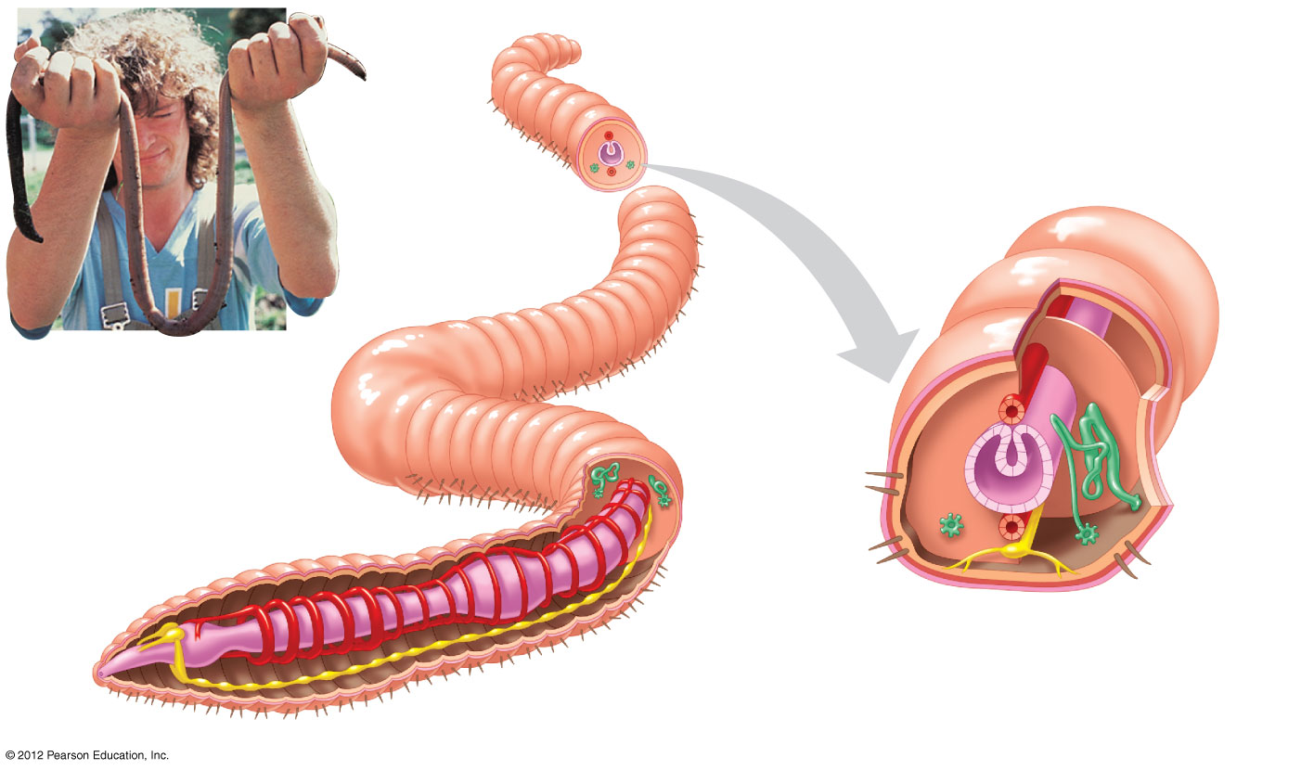
Figure 18.10A
Anus
Epidermis
Segment wall
(partition
between
segments)
Circular
muscle
Segment
wall
Longitudinal
muscle
A giant Australian
earthworm
Bristles
Dorsal
blood
vessel
Mucus-secreting
organ
Digestive
tract
Dorsal
blood vessel
Excretory
organ
Excretory
organ
Coelom
Segment
wall
Bristles
Brain
Ventral
blood vessel
Intestine
Ventral blood vessel
Nerve cord
Mouth
Nerve cord
Pumping segmental vessels
Notes:
62
Figure 18.10A Segmentation and internal anatomy of an earthworm

Slide 63
18.10 Annelids are segmented worms
0
  Polychaetes are the largest group of annelids.
    Each polychaete segment has a pair of fleshy appendages with stiff bristles or chaetae.
    Polychaetes search for prey on the seafloor or live in tubes and filter food particles.
  Most leeches are free-living carnivores, but some suck blood.
    Blood-sucking leeches use razor-like jaws, secrete an anesthetic and an anticoagulant, and suck up to 10 times their own weight in blood.
© 2012 Pearson Education, Inc.
Notes:
63
Student Misconceptions and Concerns
As students survey the major animal phyla, they might perceive the diversity of animals as spread somewhat evenly across the nine major phyla of invertebrates. Yet, two-thirds of all known species of life (and at least 80% of all described animal species) are arthropods. Although sources disagree on the number of living species that have been described, there is widespread agreement that the number of undescribed species is many times more than the number of described species. By examining the number of described species, some amazing proportions emerge. You might consider this exercise to make the point. Determine how many students represent 1% of the class. Then have the entire class stand. Tell the students that collectively, they represent all of the animal species known to exist today. Have 5% of the class sit, representing the proportion of known animal species that are vertebrates. Next, have 15% of the class sit, representing all of the remaining types of animals except arthropods. At this point, everyone standing (80% of the class) represents the proportion of known animal species that are arthropods (a conservative fraction). Finally, have 50% of the entire class sit, leaving 30% standing. Have the class guess what group of animals is represented now (clearly some subgroup of arthropods). This final 30% represents the known number of species of beetles! (The numbers used are rounded. Even higher percentages for beetles and invertebrates may be more accurate. The point of this exercise is the relative proportions rather than precise percentages.)
Teaching Tips
1. When discussing cephalopods, the subject of animal intelligence may be noted. Defining and identifying animal intelligence is not a simple task. Consider discussing the correlation of intelligence and predation. Why might these two traits be linked? What other characteristics, such as sophistication of communication, correlate with intelligence?
2. Annelids (and nematodes, Module 18.8) have the advantage of a digestive tract with openings at both ends. This permits the efficiency of a digestive tract specialized for a one-way flow of ingested materials and enjoying the same advantages as an assembly line, but in reverse, serving in fact as a sort of “disassembly” line. These worms (and all animals with a mouth separate from the anus) “disassemble” food as it moves through the digestive tract.
3. As noted in Module 18.10, leeches remain an important tool in modern medicine. Consider presenting some examples of the latest use of leeches in medicine to the class, or asking your students to research and discuss them. Such short asides will often liven up your class.

Slide 64
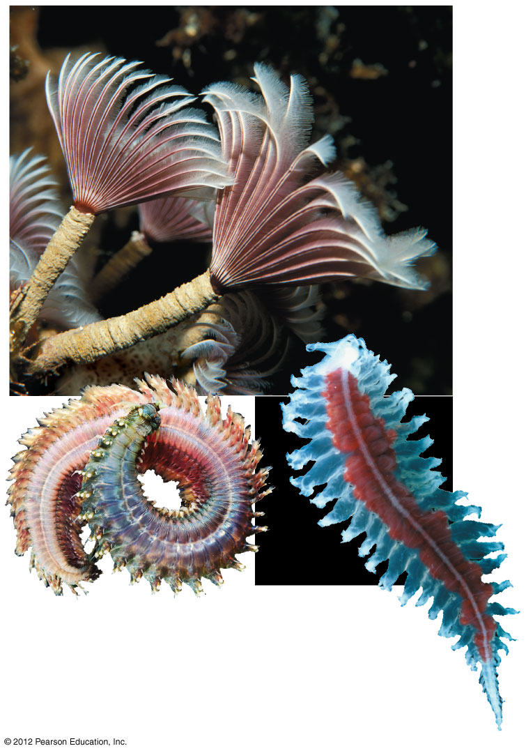
Figure 18.10B
Tube-building
polychaetes
A sandworm
A free-
swimming
polychaete
Notes:
64
Figure 18.10B Polychaetes

Slide 65
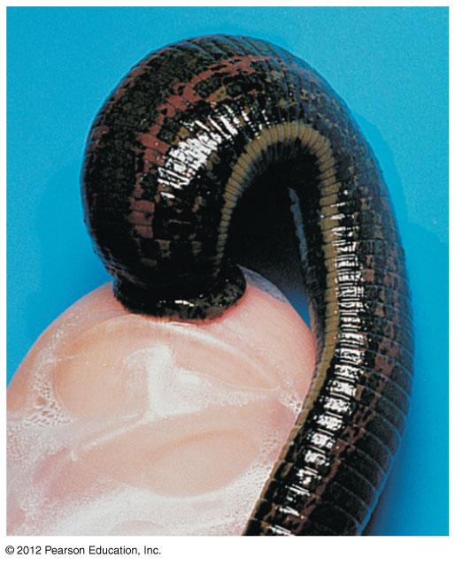
Figure 18.10C
Notes:
65
Figure 18.10C A medicinal leech applied to drain blood from a patient

Slide 66
18.11 Arthropods are segmented animals with jointed appendages and an exoskeleton
0
  There are over a million species of arthropods (phylum Arthropoda), including crayfish, lobsters, crabs, barnacles, spiders, ticks, and insects.
  The diversity and success of arthropods are due to their
    segmentation,
    a hard exoskeleton, and
    jointed appendages, for which the phylum is named.
© 2012 Pearson Education, Inc.
Notes:
66
Student Misconceptions and Concerns
As students survey the major animal phyla, they might perceive the diversity of animals as spread somewhat evenly across the nine major phyla of invertebrates. Yet, two-thirds of all known species of life (and at least 80% of all described animal species) are arthropods. Although sources disagree on the number of living species that have been described, there is widespread agreement that the number of undescribed species is many times more than the number of described species. By examining the number of described species, some amazing proportions emerge. You might consider this exercise to make the point. Determine how many students represent 1% of the class. Then have the entire class stand. Tell the students that collectively, they represent all of the animal species known to exist today. Have 5% of the class sit, representing the proportion of known animal species that are vertebrates. Next, have 15% of the class sit, representing all of the remaining types of animals except arthropods. At this point, everyone standing (80% of the class) represents the proportion of known animal species that are arthropods (a conservative fraction). Finally, have 50% of the entire class sit, leaving 30% standing. Have the class guess what group of animals is represented now (clearly some subgroup of arthropods). This final 30% represents the known number of species of beetles! (The numbers used are rounded. Even higher percentages for beetles and invertebrates may be more accurate. The point of this exercise is the relative proportions rather than precise percentages.)
Teaching Tips
Conceptually, and very generally speaking, the exoskeleton of an arthropod is like the hard outside of an M&M. The exoskeleton prevents physical damage to the internal organs and protects them against desiccation. The outside of an M&M prevents damage to the chocolate and keeps the chocolate from melting or drying out.

Slide 67
18.11 Arthropods are segmented animals with jointed appendages and an exoskeleton
0
  Arthropods have
    an open circulatory system and
    an exoskeleton, an external skeleton that protects the animal but must be shed in the process of molting to permit growth.
    The body of most arthropods includes a head, thorax, and abdomen, although these segments may be fused.
© 2012 Pearson Education, Inc.
Notes:
67
Student Misconceptions and Concerns
As students survey the major animal phyla, they might perceive the diversity of animals as spread somewhat evenly across the nine major phyla of invertebrates. Yet, two-thirds of all known species of life (and at least 80% of all described animal species) are arthropods. Although sources disagree on the number of living species that have been described, there is widespread agreement that the number of undescribed species is many times more than the number of described species. By examining the number of described species, some amazing proportions emerge. You might consider this exercise to make the point. Determine how many students represent 1% of the class. Then have the entire class stand. Tell the students that collectively, they represent all of the animal species known to exist today. Have 5% of the class sit, representing the proportion of known animal species that are vertebrates. Next, have 15% of the class sit, representing all of the remaining types of animals except arthropods. At this point, everyone standing (80% of the class) represents the proportion of known animal species that are arthropods (a conservative fraction). Finally, have 50% of the entire class sit, leaving 30% standing. Have the class guess what group of animals is represented now (clearly some subgroup of arthropods). This final 30% represents the known number of species of beetles! (The numbers used are rounded. Even higher percentages for beetles and invertebrates may be more accurate. The point of this exercise is the relative proportions rather than precise percentages.)
Teaching Tips
Conceptually, and very generally speaking, the exoskeleton of an arthropod is like the hard outside of an M&M. The exoskeleton prevents physical damage to the internal organs and protects them against desiccation. The outside of an M&M prevents damage to the chocolate and keeps the chocolate from melting or drying out.

Slide 68
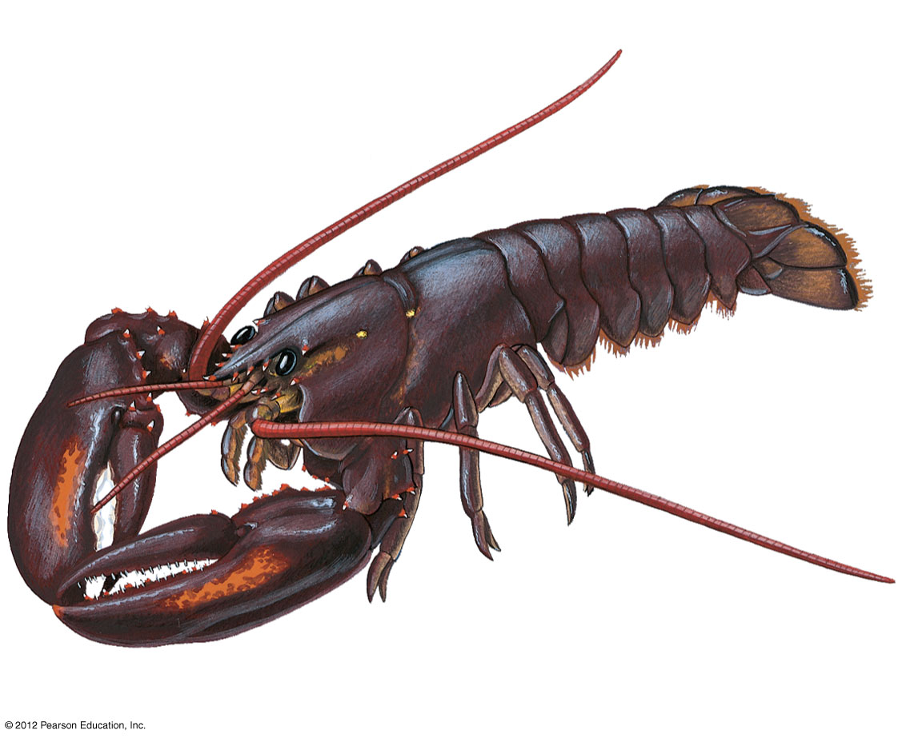
Figure 18.11A
Cephalothorax
Abdomen
Antennae
(sensory
reception)
Thorax
Head
Swimming
appendages
Walking legs
Mouthparts (feeding)
Pincer (defense)
Notes:
68
Figure 18.11A The structure of a lobster, an arthropod

Slide 69
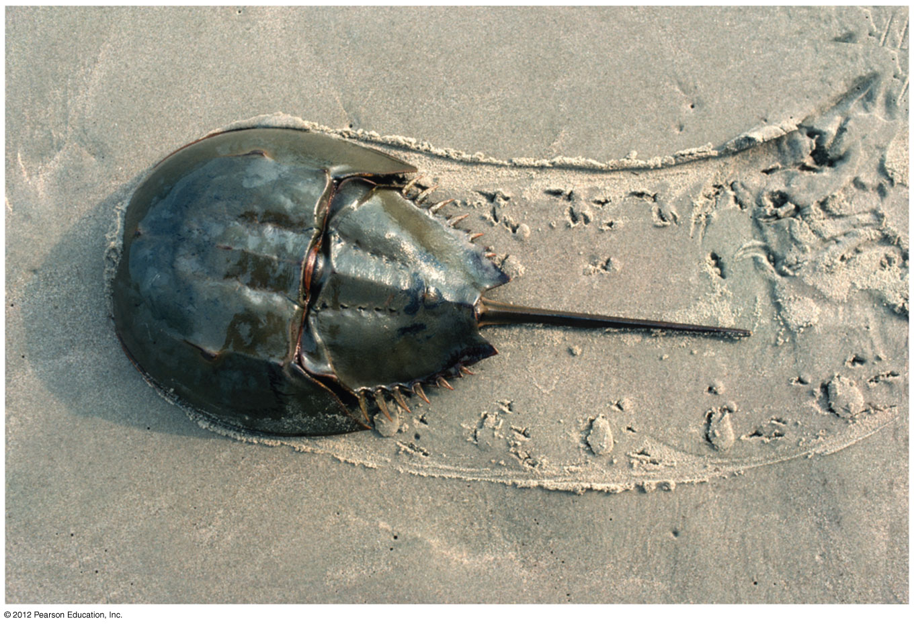
Figure 18.11B
Notes:
69
Figure 18.11B A horseshoe crab (up to about 30 cm wide)

Slide 70
18.11 Arthropods are segmented animals with jointed appendages and an exoskeleton
0
  Living arthropods represent four major lineages.
    1. Chelicerates include horseshoe crabs and arachnids, such as spiders, scorpions, mites, and ticks.
      Most are terrestrial.
      Scorpions are nocturnal hunters.
      Spiders are a diverse group that typically hunt insects or trap them in webs of silk that they spin from specialized glands on their abdomen.
© 2012 Pearson Education, Inc.
Notes:
70
Student Misconceptions and Concerns
As students survey the major animal phyla, they might perceive the diversity of animals as spread somewhat evenly across the nine major phyla of invertebrates. Yet, two-thirds of all known species of life (and at least 80% of all described animal species) are arthropods. Although sources disagree on the number of living species that have been described, there is widespread agreement that the number of undescribed species is many times more than the number of described species. By examining the number of described species, some amazing proportions emerge. You might consider this exercise to make the point. Determine how many students represent 1% of the class. Then have the entire class stand. Tell the students that collectively, they represent all of the animal species known to exist today. Have 5% of the class sit, representing the proportion of known animal species that are vertebrates. Next, have 15% of the class sit, representing all of the remaining types of animals except arthropods. At this point, everyone standing (80% of the class) represents the proportion of known animal species that are arthropods (a conservative fraction). Finally, have 50% of the entire class sit, leaving 30% standing. Have the class guess what group of animals is represented now (clearly some subgroup of arthropods). This final 30% represents the known number of species of beetles! (The numbers used are rounded. Even higher percentages for beetles and invertebrates may be more accurate. The point of this exercise is the relative proportions rather than precise percentages.)
Teaching Tips
Conceptually, and very generally speaking, the exoskeleton of an arthropod is like the hard outside of an M&M. The exoskeleton prevents physical damage to the internal organs and protects them against desiccation. The outside of an M&M prevents damage to the chocolate and keeps the chocolate from melting or drying out.

Slide 71
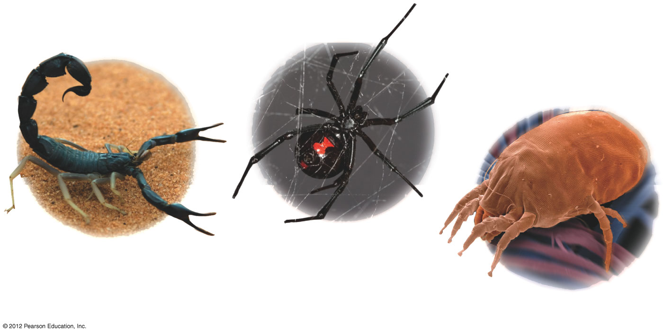
Figure 18.11C
A black widow spider
(about 1 cm wide)
A scorpion
A dust mite
(about 0.4 mm long)
Notes:
71
Figure 18.11C Arachnids

Slide 72
18.11 Arthropods are segmented animals with jointed appendages and an exoskeleton
0
    Millipedes and centipedes are identified by the number of jointed legs per body segment.
      Millipedes are herbivores that have two pairs of short legs per body segment.
      Centipedes are carnivores that have one pair of legs per body segment.
© 2012 Pearson Education, Inc.
Notes:
72
Student Misconceptions and Concerns
As students survey the major animal phyla, they might perceive the diversity of animals as spread somewhat evenly across the nine major phyla of invertebrates. Yet, two-thirds of all known species of life (and at least 80% of all described animal species) are arthropods. Although sources disagree on the number of living species that have been described, there is widespread agreement that the number of undescribed species is many times more than the number of described species. By examining the number of described species, some amazing proportions emerge. You might consider this exercise to make the point. Determine how many students represent 1% of the class. Then have the entire class stand. Tell the students that collectively, they represent all of the animal species known to exist today. Have 5% of the class sit, representing the proportion of known animal species that are vertebrates. Next, have 15% of the class sit, representing all of the remaining types of animals except arthropods. At this point, everyone standing (80% of the class) represents the proportion of known animal species that are arthropods (a conservative fraction). Finally, have 50% of the entire class sit, leaving 30% standing. Have the class guess what group of animals is represented now (clearly some subgroup of arthropods). This final 30% represents the known number of species of beetles! (The numbers used are rounded. Even higher percentages for beetles and invertebrates may be more accurate. The point of this exercise is the relative proportions rather than precise percentages.)
Teaching Tips
Conceptually, and very generally speaking, the exoskeleton of an arthropod is like the hard outside of an M&M. The exoskeleton prevents physical damage to the internal organs and protects them against desiccation. The outside of an M&M prevents damage to the chocolate and keeps the chocolate from melting or drying out.

Slide 73
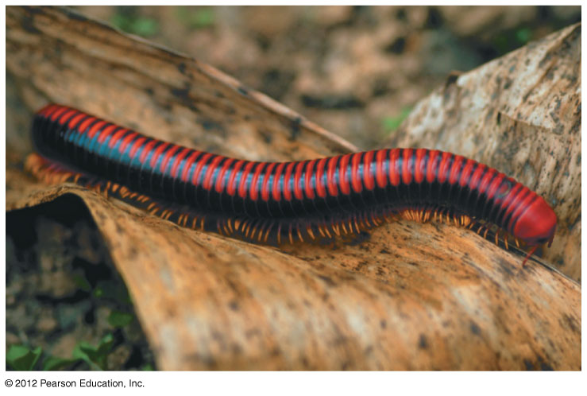
Figure 18.11D
Notes:
73
Figure 18.11D A millipede (about 7 cm long)

Slide 74
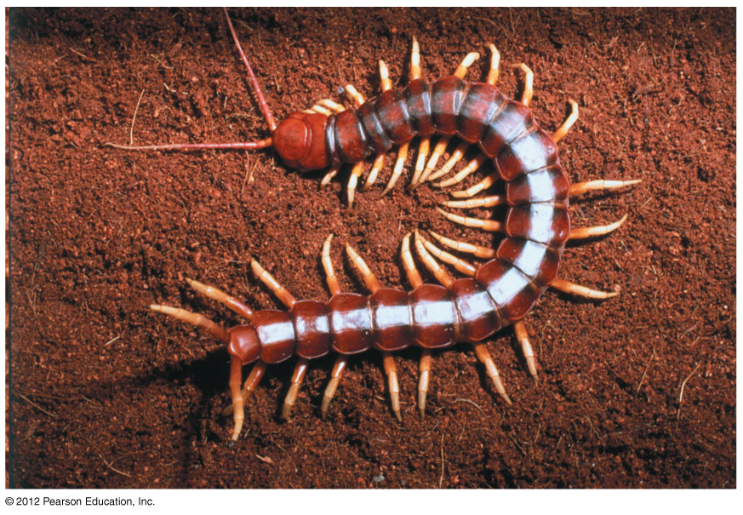
Figure 18.11E
Notes:
74
Figure 18.11E A Peruvian giant centipede (can reach 30 cm in length)

Slide 75
18.11 Arthropods are segmented animals with jointed appendages and an exoskeleton
0
    3. Crustaceans are nearly all aquatic. They include crabs, shrimp, and barnacles, which feed with jointed appendages.
    4. Insects are the fourth lineage of arthropods, addressed next.
© 2012 Pearson Education, Inc.
Notes:
75
Student Misconceptions and Concerns
As students survey the major animal phyla, they might perceive the diversity of animals as spread somewhat evenly across the nine major phyla of invertebrates. Yet, two-thirds of all known species of life (and at least 80% of all described animal species) are arthropods. Although sources disagree on the number of living species that have been described, there is widespread agreement that the number of undescribed species is many times more than the number of described species. By examining the number of described species, some amazing proportions emerge. You might consider this exercise to make the point. Determine how many students represent 1% of the class. Then have the entire class stand. Tell the students that collectively, they represent all of the animal species known to exist today. Have 5% of the class sit, representing the proportion of known animal species that are vertebrates. Next, have 15% of the class sit, representing all of the remaining types of animals except arthropods. At this point, everyone standing (80% of the class) represents the proportion of known animal species that are arthropods (a conservative fraction). Finally, have 50% of the entire class sit, leaving 30% standing. Have the class guess what group of animals is represented now (clearly some subgroup of arthropods). This final 30% represents the known number of species of beetles! (The numbers used are rounded. Even higher percentages for beetles and invertebrates may be more accurate. The point of this exercise is the relative proportions rather than precise percentages.)
Teaching Tips
Conceptually, and very generally speaking, the exoskeleton of an arthropod is like the hard outside of an M&M. The exoskeleton prevents physical damage to the internal organs and protects them against desiccation. The outside of an M&M prevents damage to the chocolate and keeps the chocolate from melting or drying out.

Slide 76
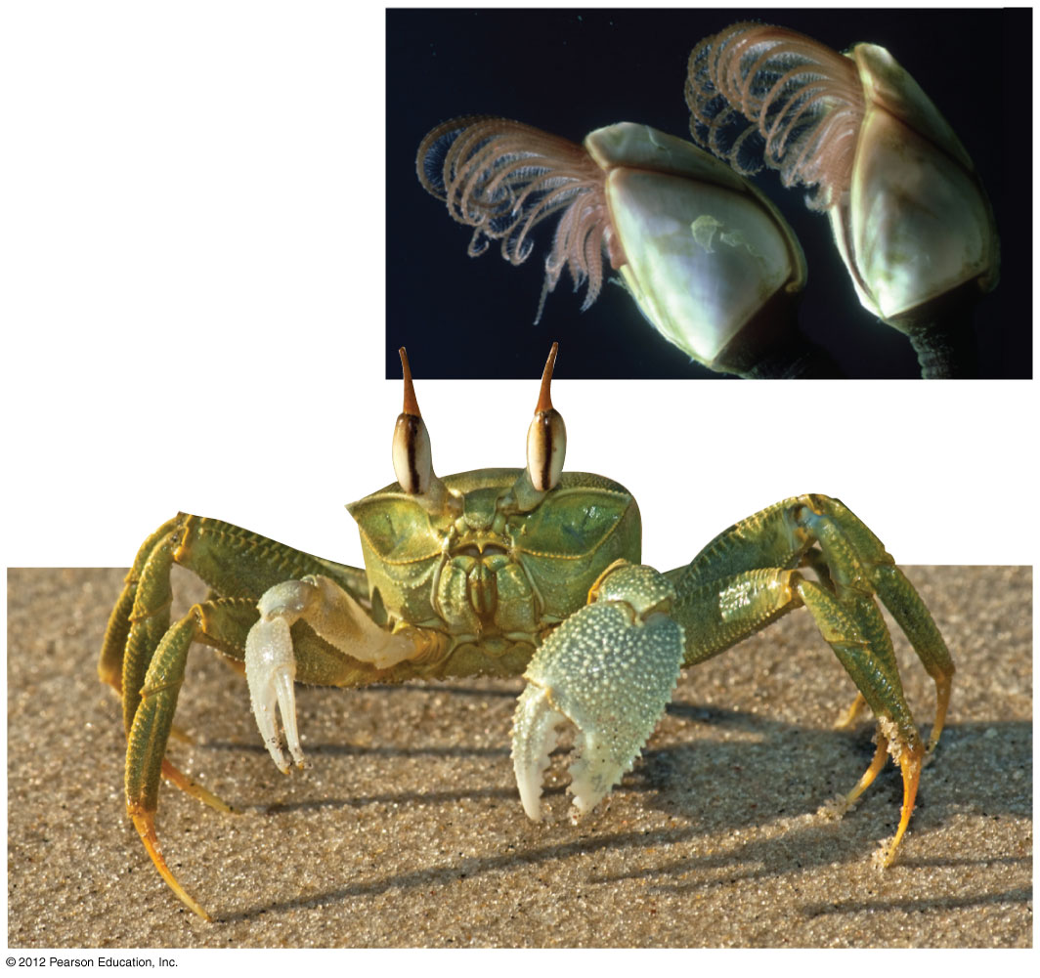
Figure 18.11F
A ghost crab
(body about
2.5 cm across)
Goose barnacles
(about 2 cm high)
Notes:
76
Figure 18.11F Crustaceans

Slide 77
18.12 EVOLUTION CONNECTION: Insects are the most successful group of animals
0
  70% of all identified animal species are insects.
    There may be as many as 30 million insect species.
  The body of an insect typically includes
    a head,
    thorax,
    abdomen,
    three sets of legs, and
    wings (with few exceptions).
© 2012 Pearson Education, Inc.
Notes:
77
Student Misconceptions and Concerns
As students survey the major animal phyla, they might perceive the diversity of animals as spread somewhat evenly across the nine major phyla of invertebrates. Yet, two-thirds of all known species of life (and at least 80% of all described animal species) are arthropods. Although sources disagree on the number of living species that have been described, there is widespread agreement that the number of undescribed species is many times more than the number of described species. By examining the number of described species, some amazing proportions emerge. You might consider this exercise to make the point. Determine how many students represent 1% of the class. Then have the entire class stand. Tell the students that collectively, they represent all of the animal species known to exist today. Have 5% of the class sit, representing the proportion of known animal species that are vertebrates. Next, have 15% of the class sit, representing all of the remaining types of animals except arthropods. At this point, everyone standing (80% of the class) represents the proportion of known animal species that are arthropods (a conservative fraction). Finally, have 50% of the entire class sit, leaving 30% standing. Have the class guess what group of animals is represented now (clearly some subgroup of arthropods). This final 30% represents the known number of species of beetles! (The numbers used are rounded. Even higher percentages for beetles and invertebrates may be more accurate. The point of this exercise is the relative proportions rather than precise percentages.)
Teaching Tips
1. Conceptually, and very generally speaking, the exoskeleton of an arthropod is like the hard outside of an M&M. The exoskeleton prevents physical damage to the internal organs and protects them against desiccation. The outside of an M&M prevents damage to the chocolate and keeps the chocolate from melting or drying out.
2. Many students assume that all insects possess six legs and two pairs of wings. As common examples of variation on this theme, challenge students to consider beetles (in which the outer wings, called elytra, are hardened) and flies (in which one pair of wings is reduced to a pair of structures called halteres).
3. Beetles have a long history in human culture, where they have been used in textiles, ornamentation, and jewelry. A quick image search of the Internet will reveal many examples. In particular, note the significance of scarab beetles in ancient Egypt.
4. The life history of dung beetles is a fun and amusing insect story for lecture, revealing the important role of these animals in recycling animal waste. Details of their interesting life cycle can be obtained from many resources, including those resulting from an Internet search for “dung beetle life history.”

Slide 78
18.12 EVOLUTION CONNECTION: Insects are the most successful group of animals
0
  The extraordinary success of insects is due to
    body segmentation,
    an exoskeleton,
    jointed appendages,
    flight,
    a waterproof cuticle, and
    a complex life cycle with short generations and large numbers of offspring.
© 2012 Pearson Education, Inc.
Notes:
78
Student Misconceptions and Concerns
As students survey the major animal phyla, they might perceive the diversity of animals as spread somewhat evenly across the nine major phyla of invertebrates. Yet, two-thirds of all known species of life (and at least 80% of all described animal species) are arthropods. Although sources disagree on the number of living species that have been described, there is widespread agreement that the number of undescribed species is many times more than the number of described species. By examining the number of described species, some amazing proportions emerge. You might consider this exercise to make the point. Determine how many students represent 1% of the class. Then have the entire class stand. Tell the students that collectively, they represent all of the animal species known to exist today. Have 5% of the class sit, representing the proportion of known animal species that are vertebrates. Next, have 15% of the class sit, representing all of the remaining types of animals except arthropods. At this point, everyone standing (80% of the class) represents the proportion of known animal species that are arthropods (a conservative fraction). Finally, have 50% of the entire class sit, leaving 30% standing. Have the class guess what group of animals is represented now (clearly some subgroup of arthropods). This final 30% represents the known number of species of beetles! (The numbers used are rounded. Even higher percentages for beetles and invertebrates may be more accurate. The point of this exercise is the relative proportions rather than precise percentages.)
Teaching Tips
1. Conceptually, and very generally speaking, the exoskeleton of an arthropod is like the hard outside of an M&M. The exoskeleton prevents physical damage to the internal organs and protects them against desiccation. The outside of an M&M prevents damage to the chocolate and keeps the chocolate from melting or drying out.
2. Many students assume that all insects possess six legs and two pairs of wings. As common examples of variation on this theme, challenge students to consider beetles (in which the outer wings, called elytra, are hardened) and flies (in which one pair of wings is reduced to a pair of structures called halteres).
3. Beetles have a long history in human culture, where they have been used in textiles, ornamentation, and jewelry. A quick image search of the Internet will reveal many examples. In particular, note the significance of scarab beetles in ancient Egypt.
4. The life history of dung beetles is a fun and amusing insect story for lecture, revealing the important role of these animals in recycling animal waste. Details of their interesting life cycle can be obtained from many resources, including those resulting from an Internet search for “dung beetle life history.”

Slide 79
18.12 EVOLUTION CONNECTION: Insects are the most successful group of animals
0
  Insect life cycles often include metamorphosis, during which the animal takes on different body forms as it develops from larva to adult.
    More than 80% of insect species undergo complete metamorphosis in which a free-living larva transforms from a pupa into an adult.
    Other insect species undergo incomplete metamorphosis in which the transition from larva to adult is achieved through multiple molts, but without forming a pupa.
© 2012 Pearson Education, Inc.
Notes:
79
Student Misconceptions and Concerns
As students survey the major animal phyla, they might perceive the diversity of animals as spread somewhat evenly across the nine major phyla of invertebrates. Yet, two-thirds of all known species of life (and at least 80% of all described animal species) are arthropods. Although sources disagree on the number of living species that have been described, there is widespread agreement that the number of undescribed species is many times more than the number of described species. By examining the number of described species, some amazing proportions emerge. You might consider this exercise to make the point. Determine how many students represent 1% of the class. Then have the entire class stand. Tell the students that collectively, they represent all of the animal species known to exist today. Have 5% of the class sit, representing the proportion of known animal species that are vertebrates. Next, have 15% of the class sit, representing all of the remaining types of animals except arthropods. At this point, everyone standing (80% of the class) represents the proportion of known animal species that are arthropods (a conservative fraction). Finally, have 50% of the entire class sit, leaving 30% standing. Have the class guess what group of animals is represented now (clearly some subgroup of arthropods). This final 30% represents the known number of species of beetles! (The numbers used are rounded. Even higher percentages for beetles and invertebrates may be more accurate. The point of this exercise is the relative proportions rather than precise percentages.)
Teaching Tips
1. Conceptually, and very generally speaking, the exoskeleton of an arthropod is like the hard outside of an M&M. The exoskeleton prevents physical damage to the internal organs and protects them against desiccation. The outside of an M&M prevents damage to the chocolate and keeps the chocolate from melting or drying out.
2. Many students assume that all insects possess six legs and two pairs of wings. As common examples of variation on this theme, challenge students to consider beetles (in which the outer wings, called elytra, are hardened) and flies (in which one pair of wings is reduced to a pair of structures called halteres).
3. Beetles have a long history in human culture, where they have been used in textiles, ornamentation, and jewelry. A quick image search of the Internet will reveal many examples. In particular, note the significance of scarab beetles in ancient Egypt.
4. The life history of dung beetles is a fun and amusing insect story for lecture, revealing the important role of these animals in recycling animal waste. Details of their interesting life cycle can be obtained from many resources, including those resulting from an Internet search for “dung beetle life history.”

Slide 80
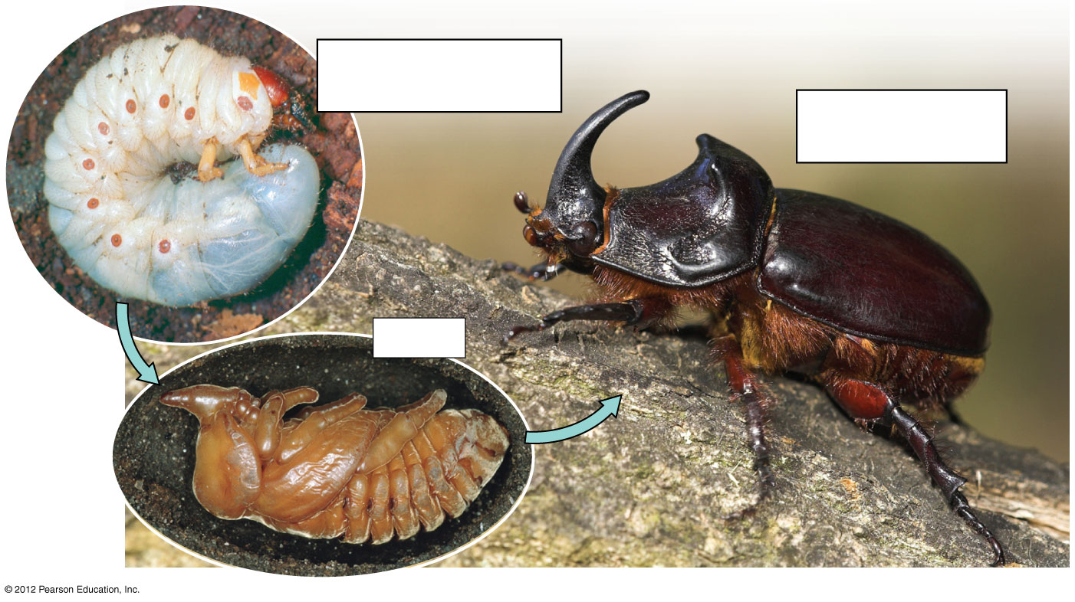
Figure 18.12A
Larva (grub, up
to 12 cm length)
Adult (up to 4
cm length)
Pupa
Notes:
80
Figure 18.12A Complete metamorphosis of a European rhinoceros beetle

Slide 81
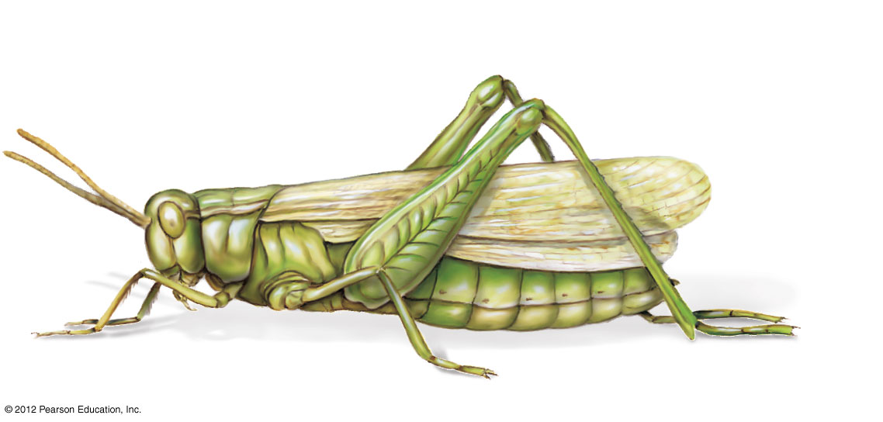
Figure 18.12B
Head
Thorax
Abdomen
Antenna
Wings
(extensions of cuticle)
Specialized
jumping legs
Eye
Mouthparts
Walking legs
Notes:
81
Figure 18.12B Modular body plan of insects, as seen in a grasshopper

Slide 82
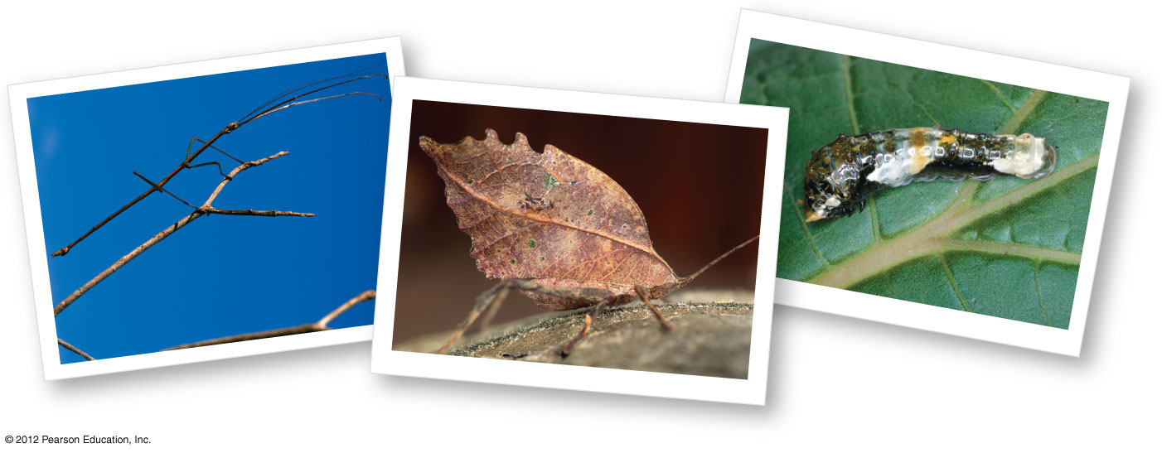
Figure 18.12C
A caterpillar resembling
a bird dropping
A stick insect
A leaf-mimic katydid
Notes:
82
Figure 18.12C Remarkable resemblances

Slide 83
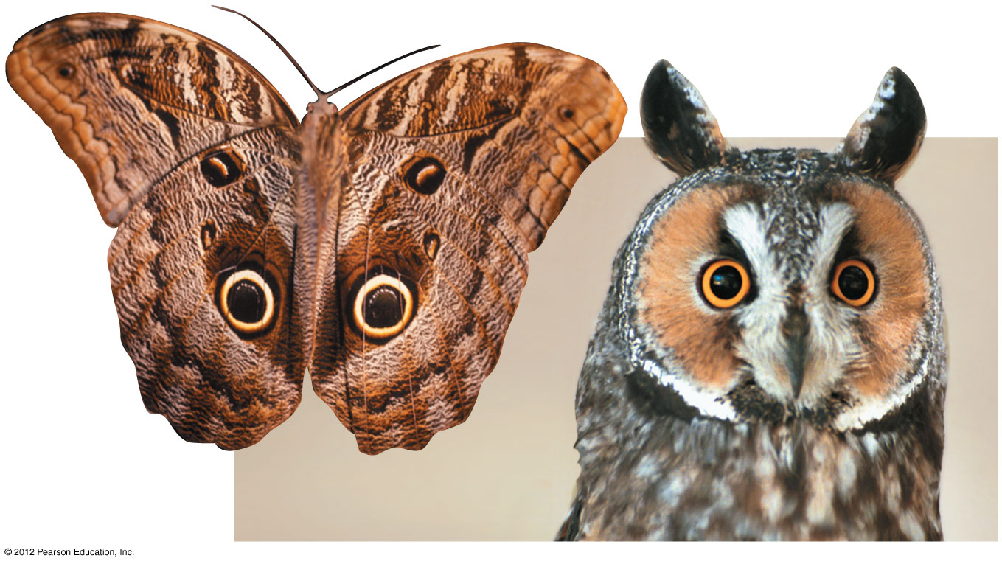
Figure 18.12E
Notes:
83
Figure 18.12E An owl butterfly (left) and a long-eared owl (right)

Slide 84
18.13 Echinoderms have spiny skin, an endoskeleton, and a water vascular system for movement
0
  Echinoderms (phylum Echinodermata) are
    a diverse group including sea stars, sand dollars, and sea urchins,
    slow-moving or sessile,
    all marine,
    radially symmetrical, and
    deuterostomes (along with the chordates).
© 2012 Pearson Education, Inc.
Notes:
84
Student Misconceptions and Concerns
As students survey the major animal phyla, they might perceive the diversity of animals as spread somewhat evenly across the nine major phyla of invertebrates. Yet, two-thirds of all known species of life (and at least 80% of all described animal species) are arthropods. Although sources disagree on the number of living species that have been described, there is widespread agreement that the number of undescribed species is many times more than the number of described species. By examining the number of described species, some amazing proportions emerge. You might consider this exercise to make the point. Determine how many students represent 1% of the class. Then have the entire class stand. Tell the students that collectively, they represent all of the animal species known to exist today. Have 5% of the class sit, representing the proportion of known animal species that are vertebrates. Next, have 15% of the class sit, representing all of the remaining types of animals except arthropods. At this point, everyone standing (80% of the class) represents the proportion of known animal species that are arthropods (a conservative fraction). Finally, have 50% of the entire class sit, leaving 30% standing. Have the class guess what group of animals is represented now (clearly some subgroup of arthropods). This final 30% represents the known number of species of beetles! (The numbers used are rounded. Even higher percentages for beetles and invertebrates may be more accurate. The point of this exercise is the relative proportions rather than precise percentages.)
Teaching Tips
1. The bodies of adult echinoderms reveal degrees of radial symmetry, which may cause students to wonder why echinoderms are not grouped with cnidarians. As discussed in Module 18.13, the bilateral symmetry of embryonic echinoderms demonstrates the acquisition of radial symmetry from a bilaterally symmetrical ancestor. Thus, echinoderms are more closely associated with other bilaterally symmetrical organisms.
2. Radial symmetry, such as that seen in many adult echinoderms, permits an organism to respond well in any direction. You cannot sneak up “behind their back.” This ability is especially adaptive in sedentary or relatively sedentary organisms, such as sea urchins, sea stars, and cnidarians. Ask your students if these same advantages also occur in radially symmetrical plants.

Slide 85
18.13 Echinoderms have spiny skin, an endoskeleton, and a water vascular system for movement
0
  Echinoderms have
    an endoskeleton of hard calcareous plates under a thin skin,
    a water vascular system based on a network of water-filled canals that branch into extensions called tube feet, and
    the ability to regenerate lost arms.
© 2012 Pearson Education, Inc.
Notes:
85
Student Misconceptions and Concerns
As students survey the major animal phyla, they might perceive the diversity of animals as spread somewhat evenly across the nine major phyla of invertebrates. Yet, two-thirds of all known species of life (and at least 80% all described animal species) are arthropods. Although sources disagree on the number of living species that have been described, there is widespread agreement that the number of undescribed species is many times more than the number of described species. By examining the number of described species, some amazing proportions emerge. You might consider this exercise to make the point. Determine how many students represent 1% of the class. Then have the entire class stand. Tell the students that collectively, they represent all of the animal species known to exist today. Have 5% of the class sit, representing the proportion of known animal species that are vertebrates. Next, have 15% of the class sit, representing all of the remaining types of animals except arthropods. At this point, everyone standing (80% of the class) represents the proportion of known animal species that are arthropods (a conservative fraction). Finally, have 50% of the entire class sit, leaving 30% standing. Have the class guess what group of animals is represented now (clearly some subgroup of arthropods). This final 30% represents the known number of species of beetles! (The numbers used are rounded. Even higher percentages for beetles and invertebrates may be more accurate. The point of this exercise is the relative proportions rather than precise percentages.)
Teaching Tips
1. The bodies of adult echinoderms reveal degrees of radial symmetry, which may cause students to wonder why echinoderms are not grouped with cnidarians. As discussed in Module 18.13, the bilateral symmetry of embryonic echinoderms demonstrates the acquisition of radial symmetry from a bilaterally symmetrical ancestor. Thus, echinoderms are more closely associated with other bilaterally symmetrical organisms.
2. Radial symmetry, such as that seen in many adult echinoderms, permits an organism to respond well in any direction. You cannot sneak up “behind their back.” This ability is especially adaptive in sedentary or relatively sedentary organisms, such as sea urchins, sea stars, and cnidarians. Ask your students if these same advantages also occur in radially symmetrical plants.

Slide 86
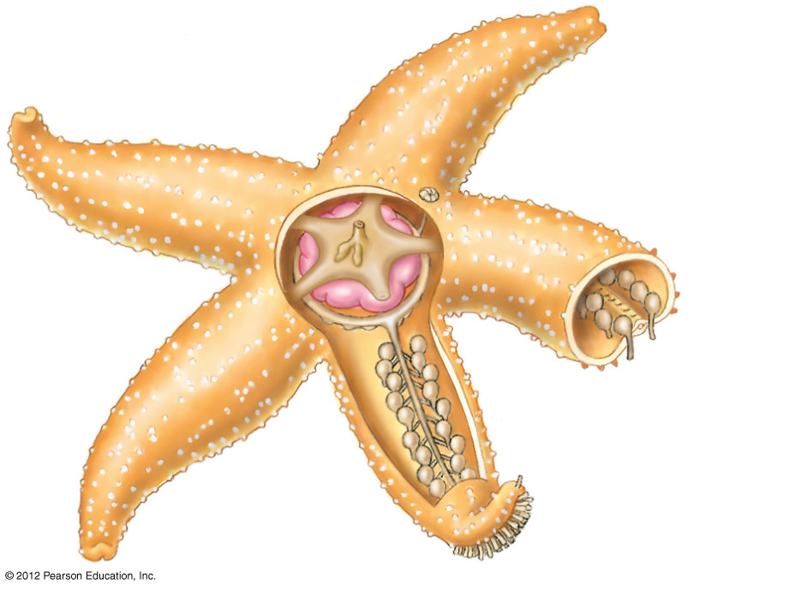
Figure 18.13A
Anus
Spines
Stomach
Tube feet
Canals
Notes:
86
Figure 18.13A The water vascular system (canals and tube feet) of a sea star (top view)

Slide 87
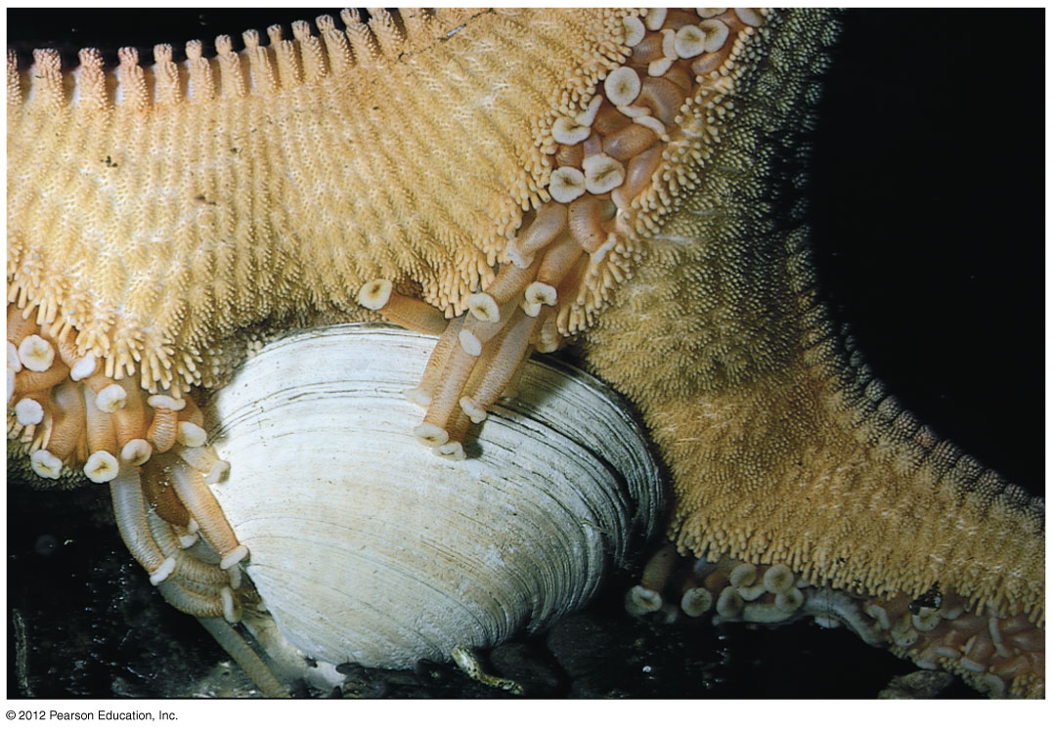
Figure 18.13B
Tube foot
Notes:
87
Figure 18.13B A sea star feeding on a clam

Slide 88
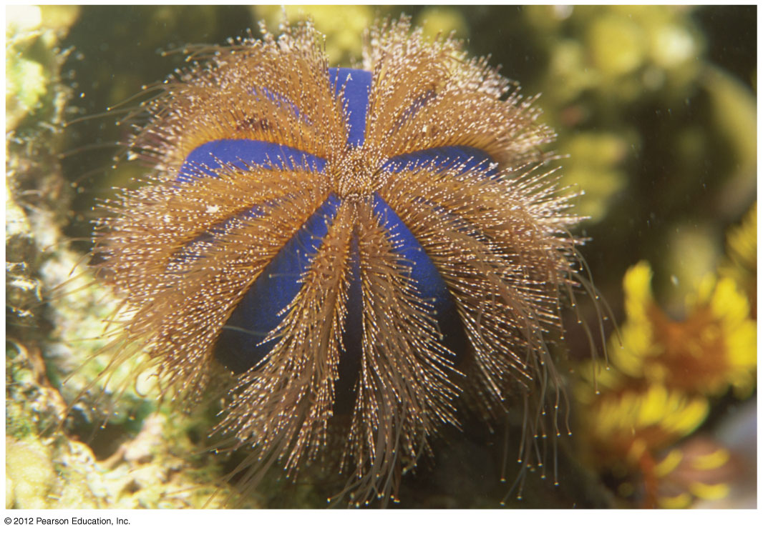
Figure 18.13C
Spines
Tube feet
Notes:
88
Figure 18.13C A sea urchin

Slide 89
18.14 Our own phylum, Chordata, is distinguished by four features
0
  Chordates (phylum Chordata) are defined by
    a dorsal, hollow nerve cord,
    a flexible, supportive notochord,
    pharyngeal slits, and
    a muscular post-anal tail.
© 2012 Pearson Education, Inc.
Notes:
89
Student Misconceptions and Concerns
As students survey the major animal phyla, they might perceive the diversity of animals as spread somewhat evenly across the nine major phyla of invertebrates. Yet, two-thirds of all known species of life (and at least 80% of all described animal species) are arthropods. Although sources disagree on the number of living species that have been described, there is widespread agreement that the number of undescribed species is many times more than the number of described species. By examining the number of described species, some amazing proportions emerge. You might consider this exercise to make the point. Determine how many students represent 1% of the class. Then have the entire class stand. Tell the students that collectively, they represent all of the animal species known to exist today. Have 5% of the class sit, representing the proportion of known animal species that are vertebrates. Next, have 15% of the class sit, representing all of the remaining types of animals except arthropods. At this point, everyone standing (80% of the class) represents the proportion of known animal species that are arthropods (a conservative fraction). Finally, have 50% of the entire class sit, leaving 30% standing. Have the class guess what group of animals is represented now (clearly some subgroup of arthropods). This final 30% represents the known number of species of beetles! (The numbers used are rounded. Even higher percentages for beetles and invertebrates may be more accurate. The point of this exercise is the relative proportions rather than precise percentages.)
Teaching Tips
If you can obtain a model or image of a one-month-old human embryo, you can demonstrate our four main chordate characteristics. A figure of a human embryo, comparing human and dog embryos of similar stages, was prepared by Charles Darwin and included in the first chapter of his book The Descent of Man. This image can be viewed at http://darwin-online.org.uk/converted/published/1871_Descent_F937/1871_Descent_F937.1_fig02.jpg.

Slide 90
18.14 Our own phylum, Chordata, is distinguished by four features
0
  The simplest chordates are tunicates and lancelets, which
    do not have a backbone and
    use their pharyngeal slits for suspension feeding.
    Adult tunicates are stationary and attached, while the tunicate larva is a tadpole-like organism.
    Lancelets are small, bladelike chordates that live in marine sands.
© 2012 Pearson Education, Inc.
Notes:
90
Student Misconceptions and Concerns
As students survey the major animal phyla, they might perceive the diversity of animals as spread somewhat evenly across the nine major phyla of invertebrates. Yet, two-thirds of all known species of life (and at least 80% of all described animal species) are arthropods. Although sources disagree on the number of living species that have been described, there is widespread agreement that the number of undescribed species is many times more than the number of described species. By examining the number of described species, some amazing proportions emerge. You might consider this exercise to make the point. Determine how many students represent 1% of the class. Then have the entire class stand. Tell the students that collectively, they represent all of the animal species known to exist today. Have 5% of the class sit, representing the proportion of known animal species that are vertebrates. Next, have 15% of the class sit, representing all of the remaining types of animals except arthropods. At this point, everyone standing (80% of the class) represents the proportion of known animal species that are arthropods (a conservative fraction). Finally, have 50% of the entire class sit, leaving 30% standing. Have the class guess what group of animals is represented now (clearly some subgroup of arthropods). This final 30% represents the known number of species of beetles! (The numbers used are rounded. Even higher percentages for beetles and invertebrates may be more accurate. The point of this exercise is the relative proportions rather than precise percentages.)
Teaching Tips
If you can obtain a model or image of a one-month-old human embryo, you can demonstrate our four main chordate characteristics. A figure of a human embryo, comparing human and dog embryos of similar stages, was prepared by Charles Darwin and included in the first chapter of his book The Descent of Man. This image can be viewed at http://darwin-online.org.uk/converted/published/1871_Descent_F937/1871_Descent_F937.1_fig02.jpg.

Slide 91
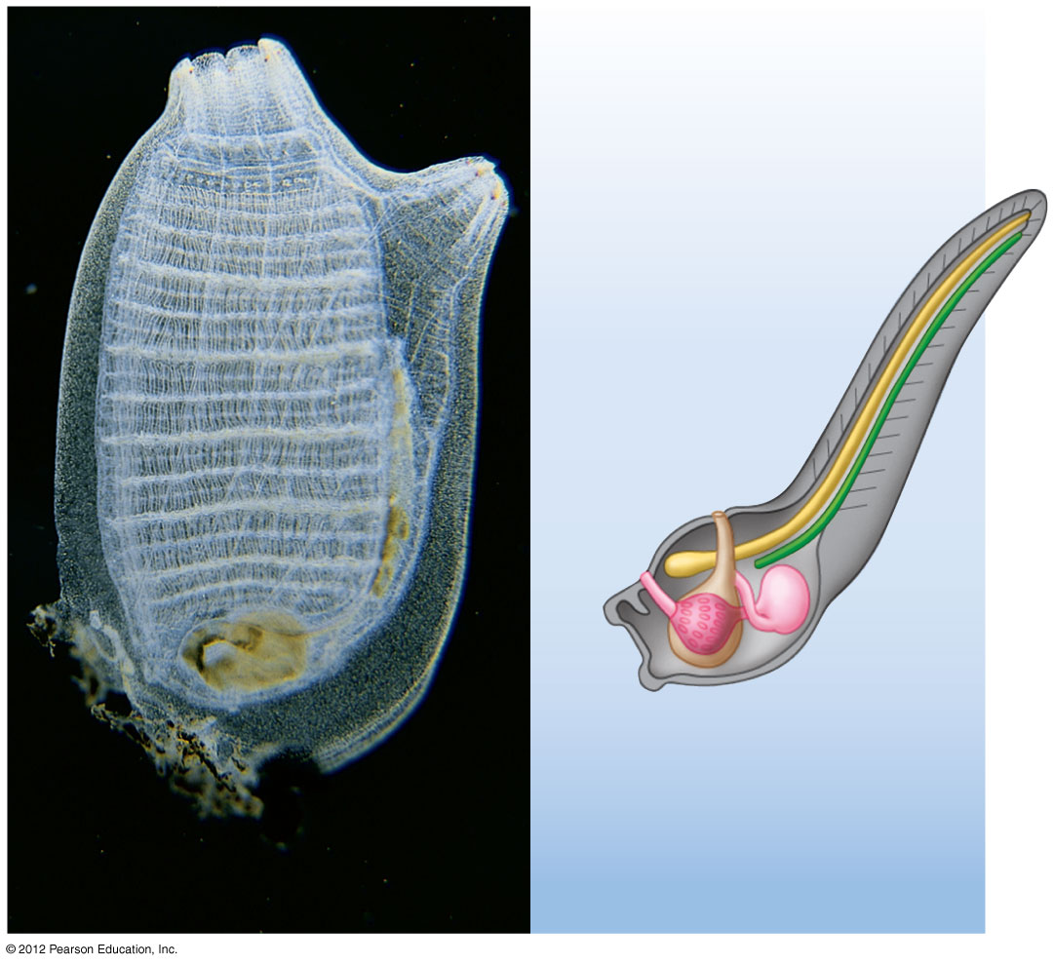
Figure 18.14A
Excurrent
siphon
Post-anal tail
Dorsal, hollow
nerve cord
Notochord
Pharyngeal
slits
Mouth
Muscle
segments
Adult
(about 3 cm high)
Larva
Notes:
91
Figure 18.14A A tunicate

Slide 92
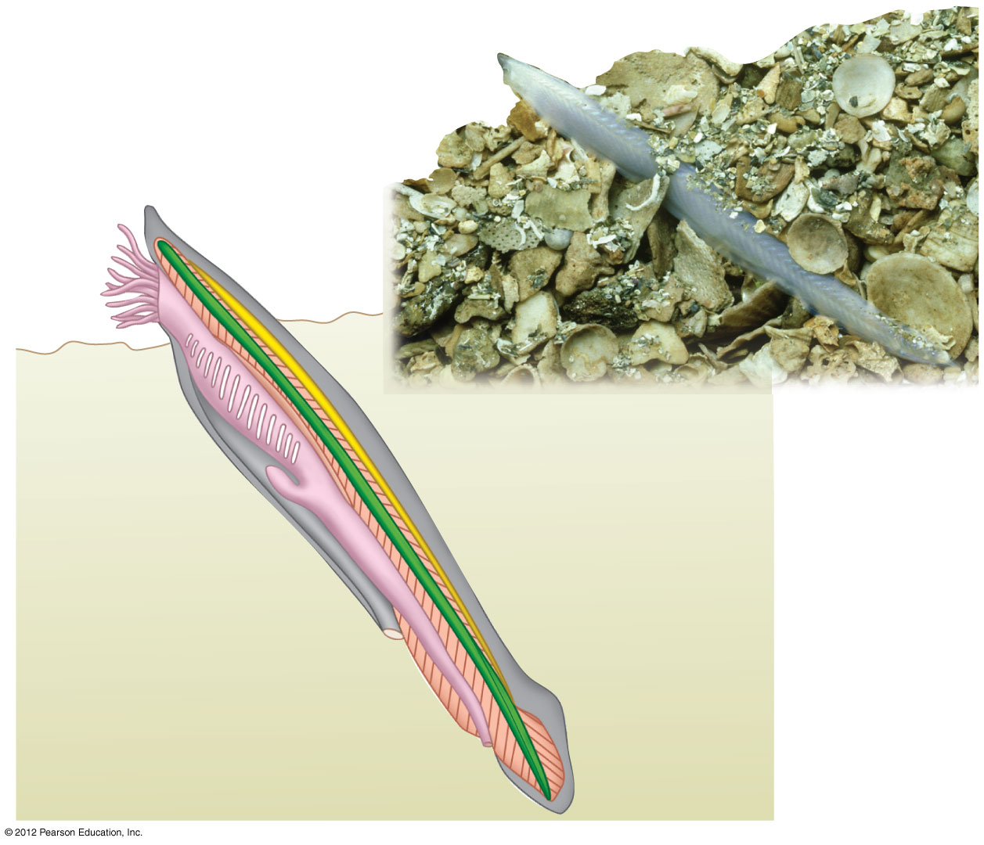
Figure 18.14B
Head
Mouth
Pharynx
Pharyngeal slits
Notochord
Digestive tract
Dorsal, hollow
nerve cord
Water exit
Post-anal tail
Segmental muscles
Anus
Notes:
92
Figure 18.14B A lancelet (5–15 cm long)

Slide 93
0
  ANIMAL PHYLOGENY
  AND DIVERSITY REVISITED
© 2012 Pearson Education, Inc.
Notes:
93

Slide 94
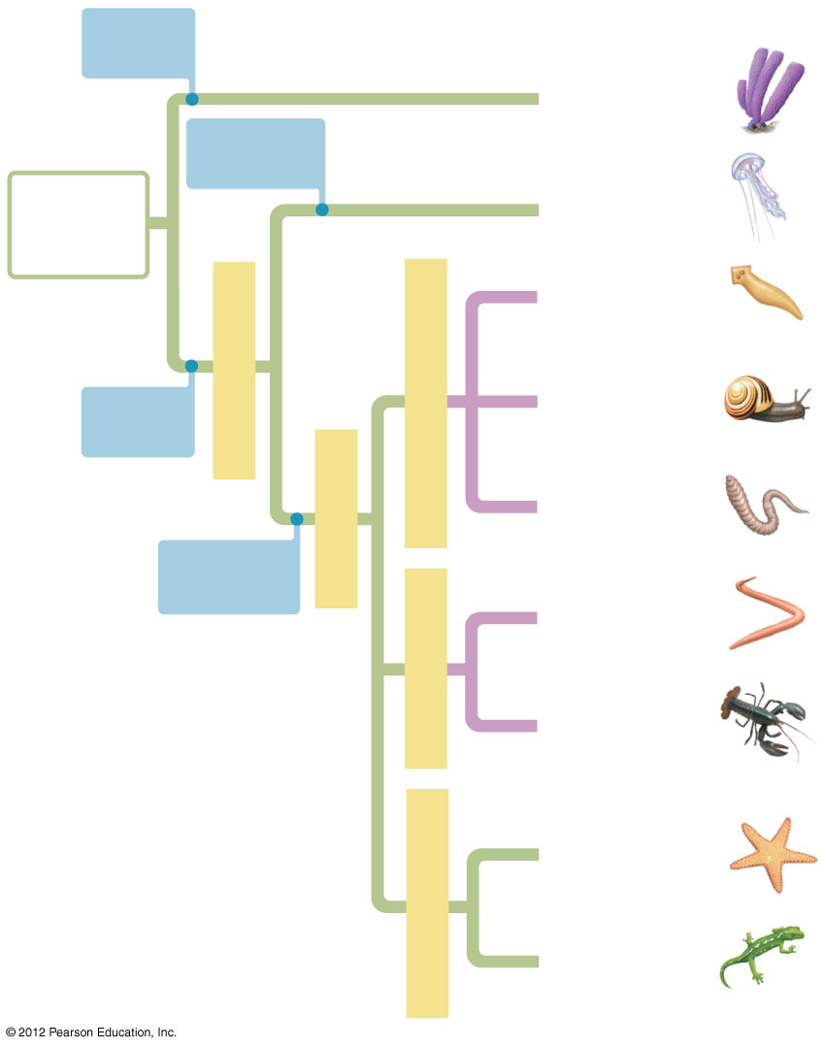
Figure 18.15
No true
tissues
Sponges
Radial
symmetry
Ancestral
colonial
protist
Cnidarians
Flatworms
Eumetazoans
True
tissues
Lophotrochozoans
Molluscs
Bilaterians
Annelids
Bilateral
symmetry
Nematodes
Ecdysozoans
Arthropods
Echinoderms
Deuterostomes
Chordates
Notes:
94
Figure 18.15 A molecular-based phylogenetic tree

