Slide 1
CHORDATES
Chapter 19

Slide 2
Introduction
0
    The duck-billed platypus is a strange animal and hard to classify. It has
      a furry body,
      bill and webbed feet that look like a duck, and
      mammary glands that produce milk for its young.
      In addition, it lays eggs!
© 2012 Pearson Education, Inc.
Notes:
2

Slide 3
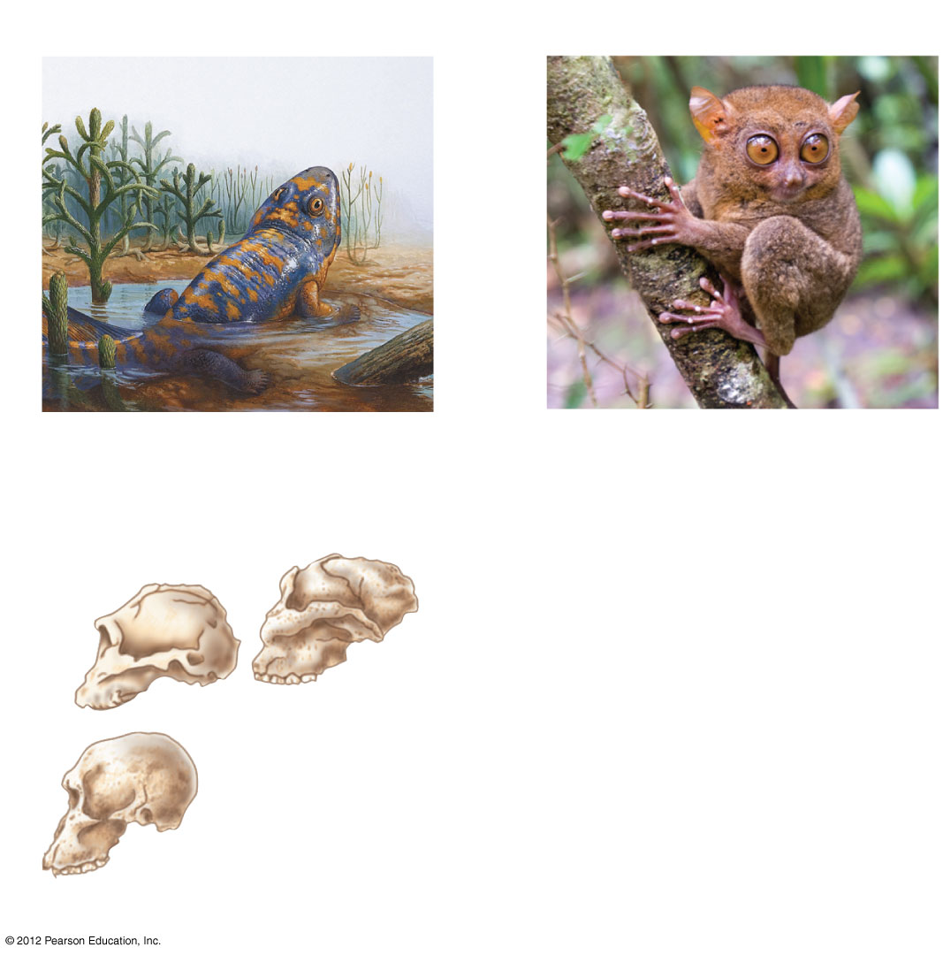
Figure 19.0_1
Chapter 19: Big Ideas
Vertebrate Evolution and
Diversity
Primate Diversity
Hominin Evolution
Notes:
3
Figure 19.0_1 Chapter 19: Big ideas

Slide 4
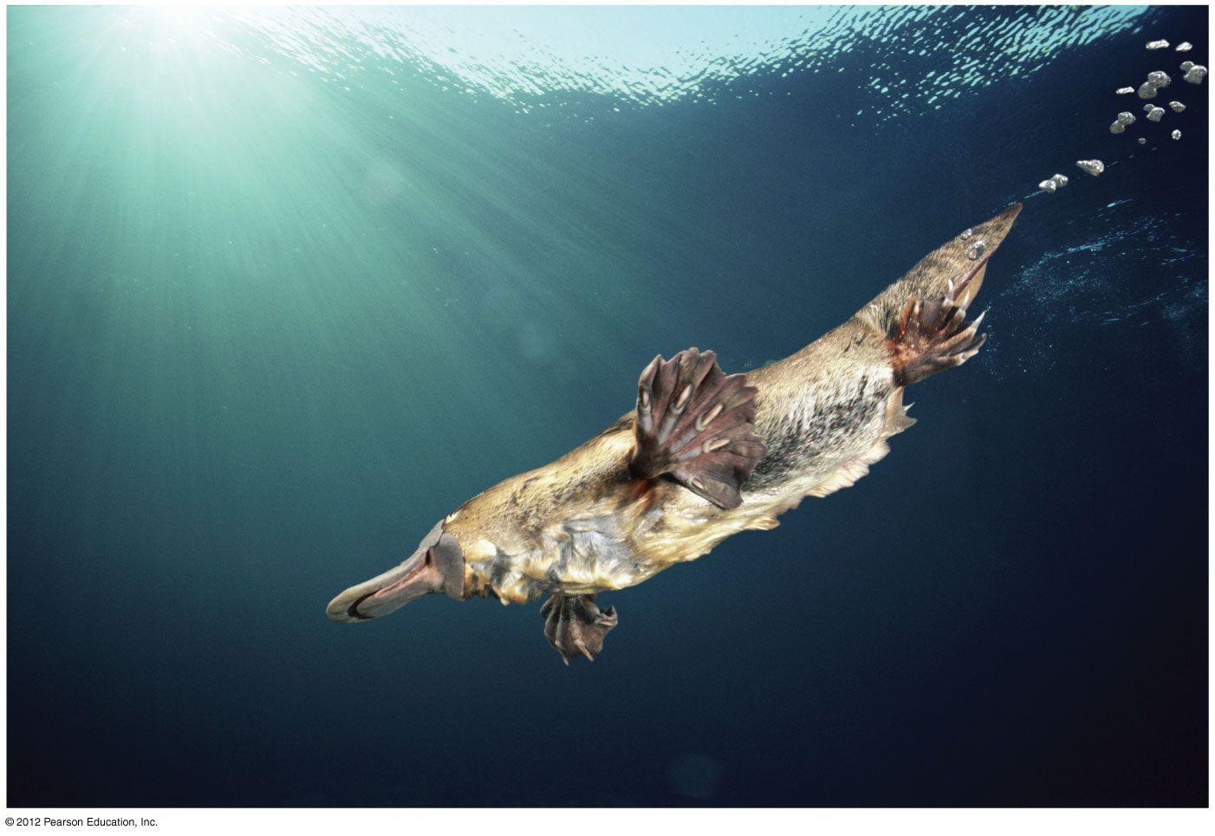
Figure 19.0_2
Duck billed platypus
Notes:
4
Figure 19.0_2 Duck-billed platypus

Slide 5
0
  VERTEBRATE EVOLUTION AND DIVERSITY
© 2012 Pearson Education, Inc.
Notes:
5

Slide 6
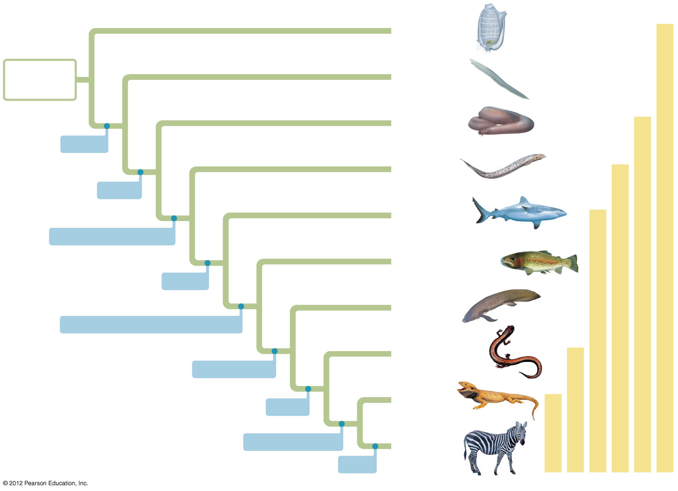
Figure 19.1
Tunicates
Ancestral
chordate
Lancelets
Chordates
Hagfishes
Brain
Lampreys
Craniates
Head
Sharks,
rays
Vertebrates
Vertebral column
Ray-finned
fishes
Jawed vertebrates
Jaws
Lobe-fins
Lungs or lung derivatives
Amphibians
Lobed fins
Reptiles
Tetrapods
Legs
Amniotic egg
Mammals
Amniotes
Milk
Notes:
6
Figure 19.1 A phylogenetic tree of chordates, showing key derived characters

Slide 7
19.2 Hagfishes and lampreys lack hinged jaws
0
  Hagfishes and lampreys
    are craniates,
    have a notochord, but
    lack hinged jaws and paired fins.
  Lampreys but not hagfishes have rudimentary vertebral structures. Thus,
    lampreys are vertebrates but
    hagfishes are not vertebrates.
© 2012 Pearson Education, Inc.
Notes:
7
Student Misconceptions and Concerns
1. The classification of chordates has undergone some major changes with the rearrangement of vertebrate groups. Birds are now commonly classified as reptiles, an association likely not seen previously in older K–12 textbooks. Students may be surprised by this association. Better classification tools and the attempt to classify organisms only into monophyletic groups have required these reconsiderations.
2. Students might think of vertebrate groups as sharply defined, lacking appreciation for the transitional organisms that illuminate aspects of the rich evolutionary history of vertebrates. Recent discoveries such as the 375-million-year-old fossil fish Tiktaalik reveal important traits that are intermediate between ancient fishes and modern amphibians. Discussion of this important transitional species, as well as similar species such as Archaeopteryx and modern monotremes, will reveal the blurry boundary lines between our classifications of vertebrate groups.
Teaching Tips
1. Lampreys possess vertebrae, but hagfishes do not (Figure 19.2). Thus, only lampreys are now classified as vertebrates, a distinction that may not have been made in textbooks used by students before they arrived at college.
2. As the authors note in Module 19.2, “eel-skin” wallets and purses are typically made from the skin of hagfish. It is possible that one or more of your students has such an item.
3. The movement of lampreys from Lake Ontario to the other Great Lakes was historically limited by Niagara Falls. However, the creation of canals (about 180 years ago) to bypass the falls created a channel for lamprey invasion. Lampreys are just one example of the tremendous problem of invasive (exotic) species.

Slide 8
19.2 Hagfishes and lampreys lack hinged jaws
0
  Hagfishes are deep-sea scavengers that produce slime as an anti-predator defense.
  Lamprey adults are parasites that penetrate the sides of fishes with their rasping tongues.
  Larval lampreys
    resemble lancelets and
    are suspension feeders that live in freshwater streams, where they feed, buried in sediment.
© 2012 Pearson Education, Inc.
Notes:
8
Student Misconceptions and Concerns
1. The classification of chordates has undergone some major changes with the rearrangement of vertebrate groups. Birds are now commonly classified as reptiles, an association likely not seen previously in older K–12 textbooks. Students may be surprised by this association. Better classification tools and the attempt to classify organisms only into monophyletic groups have required these reconsiderations.
2. Students might think of vertebrate groups as sharply defined, lacking appreciation for the transitional organisms that illuminate aspects of the rich evolutionary history of vertebrates. Recent discoveries such as the 375-million-year-old fossil fish Tiktaalik reveal important traits that are intermediate between ancient fishes and modern amphibians. Discussion of this important transitional species, as well as similar species such as Archaeopteryx and modern monotremes, will reveal the blurry boundary lines between our classifications of vertebrate groups.
Teaching Tips
1. Lampreys possess vertebrae, but hagfishes do not (Figure 19.2). Thus, only lampreys are now classified as vertebrates, a distinction that may not have been made in textbooks used by students before they arrived at college.
2. As the authors note in Module 19.2, “eel-skin” wallets and purses are typically made from the skin of hagfish. It is possible that one or more of your students has such an item.
3. The movement of lampreys from Lake Ontario to the other Great Lakes was historically limited by Niagara Falls. However, the creation of canals (about 180 years ago) to bypass the falls created a channel for lamprey invasion. Lampreys are just one example of the tremendous problem of invasive (exotic) species.

Slide 9
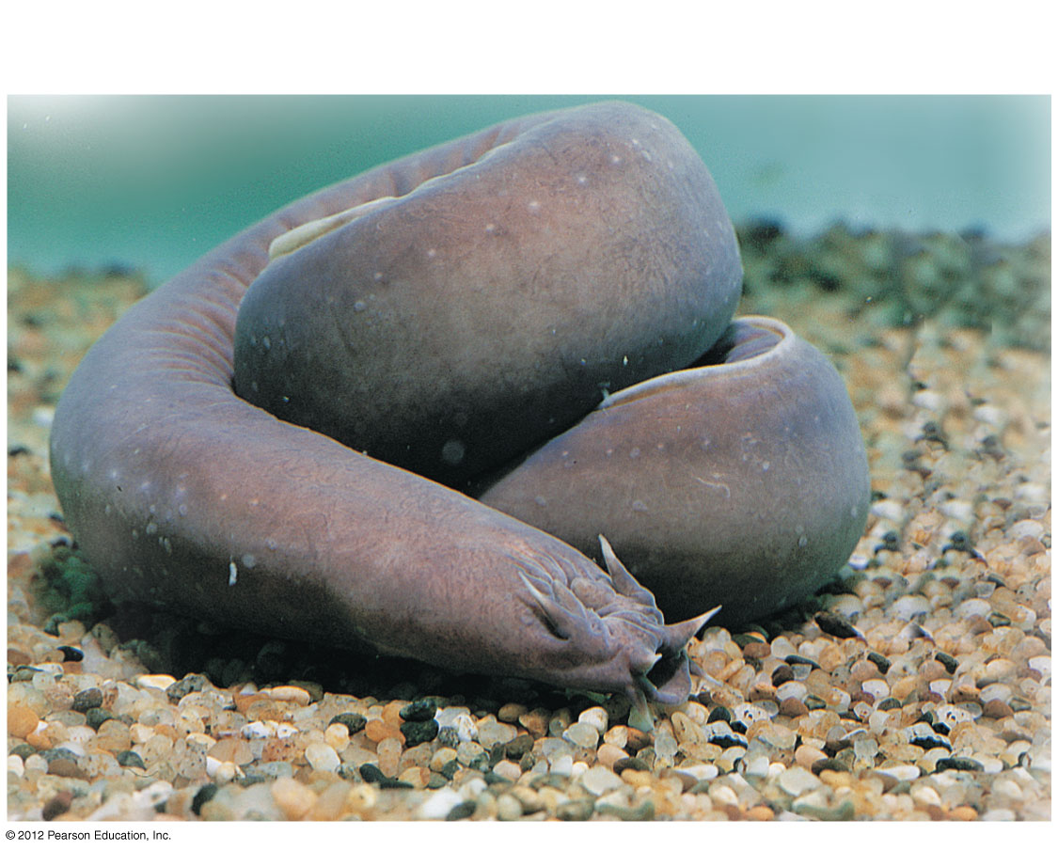
Figure 19.2A
Hagfish
Slime glands
Notes:
9
Figure 19.2A Hagfish

Slide 10
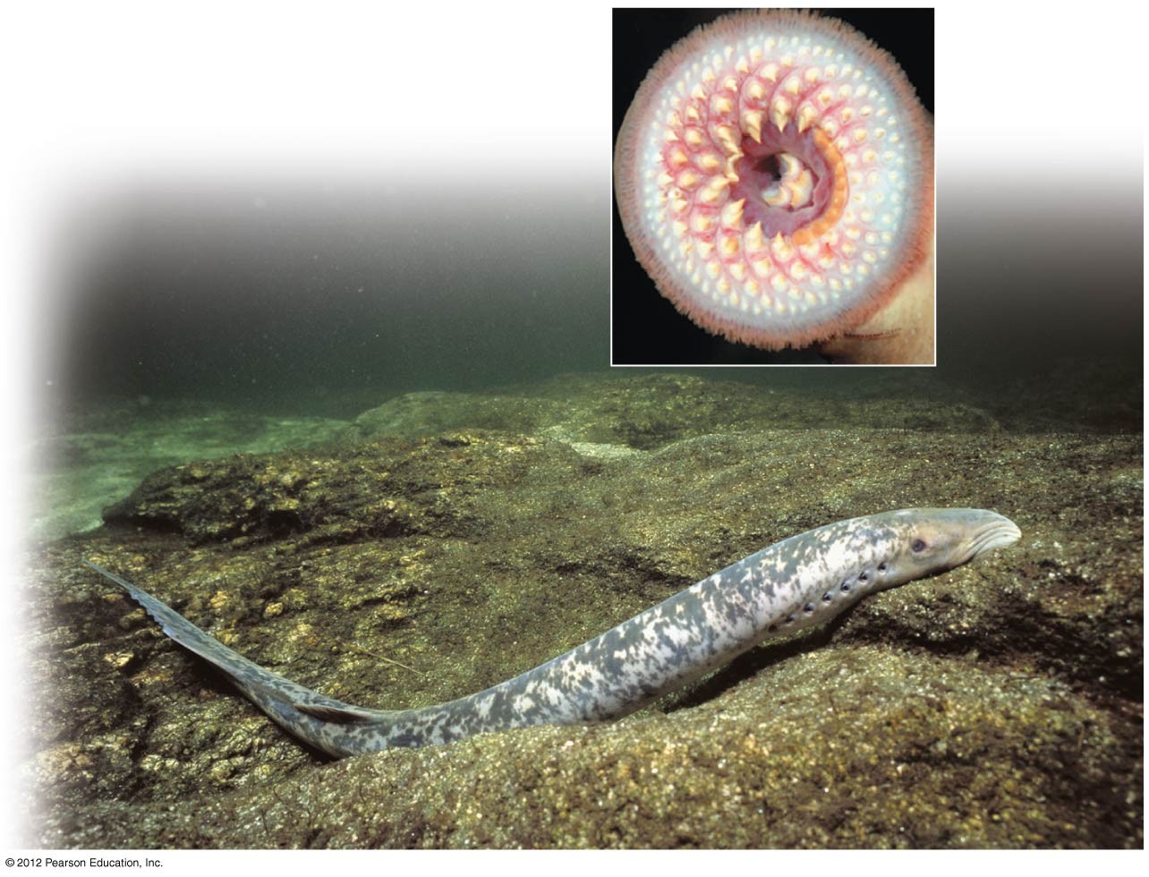
Figure 19.2B
Sea Lamprey
Notes:
10
Figure 19.2B A sea lamprey, with its rasping mouth (inset)

Slide 11
19.3 Jawed vertebrates with gills and paired fins include sharks, ray-finned fishes, and lobe-finned fishes
0
  Jawed vertebrates
    appeared in the fossil record about 470 million years ago and
    quickly diversified using their paired fins and tail to chase a wide variety of prey.
  Jaws may have evolved by modifications of skeletal supports of the anterior pharyngeal (gill) slits.
  The remaining gill slits remained as sites of gas exchange.
© 2012 Pearson Education, Inc.
Notes:
11
Student Misconceptions and Concerns
1. The classification of chordates has undergone some major changes with the rearrangement of vertebrate groups. Birds are now commonly classified as reptiles, an association likely not seen previously in older K–12 textbooks. Students may be surprised by this association. Better classification tools and the attempt to classify organisms only into monophyletic groups have required these reconsiderations.
2. Students might think of vertebrate groups as sharply defined, lacking appreciation for the transitional organisms that illuminate aspects of the rich evolutionary history of vertebrates. Recent discoveries such as the 375-million-year-old fossil fish Tiktaalik reveal important traits that are intermediate between ancient fishes and modern amphibians. Discussion of this important transitional species, as well as similar species such as Archaeopteryx and modern monotremes, will reveal the blurry boundary lines between our classifications of vertebrate groups.
Teaching Tips
1. The wide, flat bodies of rays provide an obvious exception to the general rule that cartilaginous fishes have streamlined bodies. Their ventral mouths and flattened form are well adapted to a life on the ocean bottom.
2. Of all of the vertebrate clades alive today, ray-finned fishes are the most abundant. As noted in Module 19.3, more than 27,000 species of ray-finned fishes have been identified.
3. Sharks, unlike bony fishes, do not have swim bladders. To lift off the bottom, they swim using their stiff pectoral fins and tail for uplift (along with some buoyant materials in their body).
4. The perception of sharks as menacing may be due in part to their particular method of maneuvering in water. Shark fins do not rotate to brake their forward movements. Cruising sharks that swim near an object of interest are not necessarily out to intimidate their prey (although it may have this effect). They may simply be curious, but unable to remain motionless while they investigate their environment.

Slide 12
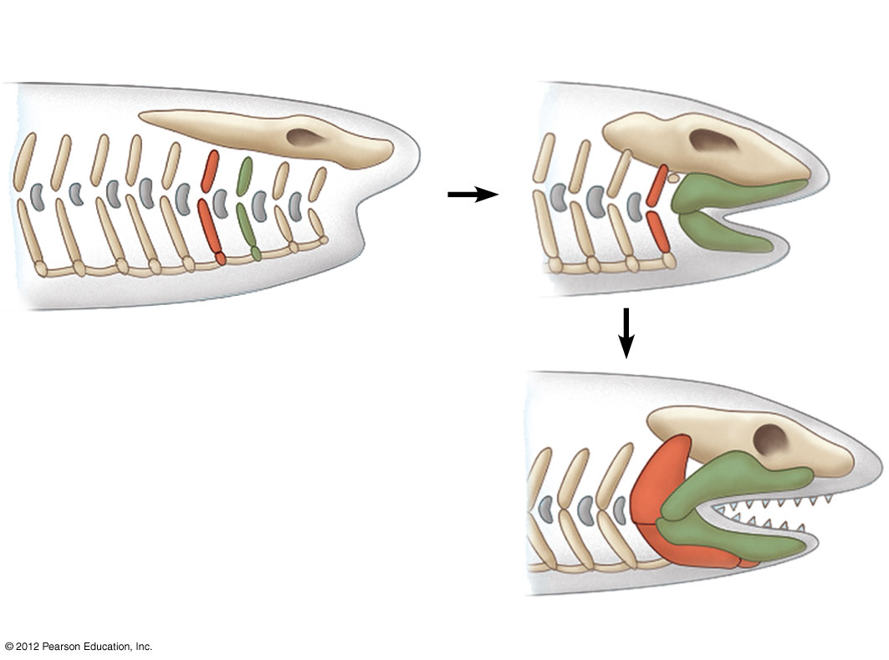
Figure 19.3A
Gill
slits
Skeletal
rods
Skull
Mouth
Hinged jaw
Notes:
12
Figure 19.3A A hypothesis for the origin of vertebrate jaws

Slide 13
19.3 Jawed vertebrates with gills and paired fins include sharks, ray-finned fishes, and lobe-finned fishes
0
  Three lineages of jawed fishes with gills and paired fins are commonly called fishes:
    chondrichthyans—sharks and rays,
    ray-finned fishes—tuna, trout, and goldfish, and
    lobe-finned fishes—coelacanths and lungfishes.
© 2012 Pearson Education, Inc.
Notes:
13
Student Misconceptions and Concerns
1. The classification of chordates has undergone some major changes with the rearrangement of vertebrate groups. Birds are now commonly classified as reptiles, an association likely not seen previously in older K–12 textbooks. Students may be surprised by this association. Better classification tools and the attempt to classify organisms only into monophyletic groups have required these reconsiderations.
2. Students might think of vertebrate groups as sharply defined, lacking appreciation for the transitional organisms that illuminate aspects of the rich evolutionary history of vertebrates. Recent discoveries such as the 375-million-year-old fossil fish Tiktaalik reveal important traits that are intermediate between ancient fishes and modern amphibians. Discussion of this important transitional species, as well as similar species such as Archaeopteryx and modern monotremes, will reveal the blurry boundary lines between our classifications of vertebrate groups.
Teaching Tips
1. The wide, flat bodies of rays provide an obvious exception to the general rule that cartilaginous fishes have streamlined bodies. Their ventral mouths and flattened form are well adapted to a life on the ocean bottom.
2. Of all of the vertebrate clades alive today, ray-finned fishes are the most abundant. As noted in Module 19.3, more than 27,000 species of ray-finned fishes have been identified.
3. Sharks, unlike bony fishes, do not have swim bladders. To lift off the bottom, they swim using their stiff pectoral fins and tail for uplift (along with some buoyant materials in their body).
4. The perception of sharks as menacing may be due in part to their particular method of maneuvering in water. Shark fins do not rotate to brake their forward movements. Cruising sharks that swim near an object of interest are not necessarily out to intimidate their prey (although it may have this effect). They may simply be curious, but unable to remain motionless while they investigate their environment.

Slide 14
19.3 Jawed vertebrates with gills and paired fins include sharks, ray-finned fishes, and lobe-finned fishes
0
  Chondrichthyans have
    a flexible skeleton made of cartilage,
    electrosensors on their heads, and
    a lateral line system that helps them locate prey.
    Most sharks are fast-swimming predators, with sharp vision and a keen sense of smell.
    Most rays are adapted for life on the bottom, with dorso-ventrally flattened bodies and eyes on the top of their heads.
© 2012 Pearson Education, Inc.
Notes:
14
Student Misconceptions and Concerns
1. The classification of chordates has undergone some major changes with the rearrangement of vertebrate groups. Birds are now commonly classified as reptiles, an association likely not seen previously in older K–12 textbooks. Students may be surprised by this association. Better classification tools and the attempt to classify organisms only into monophyletic groups have required these reconsiderations.
2. Students might think of vertebrate groups as sharply defined, lacking appreciation for the transitional organisms that illuminate aspects of the rich evolutionary history of vertebrates. Recent discoveries such as the 375-million-year-old fossil fish Tiktaalik reveal important traits that are intermediate between ancient fishes and modern amphibians. Discussion of this important transitional species, as well as similar species such as Archaeopteryx and modern monotremes, will reveal the blurry boundary lines between our classifications of vertebrate groups.
Teaching Tips
1. The wide, flat bodies of rays provide an obvious exception to the general rule that cartilaginous fishes have streamlined bodies. Their ventral mouths and flattened form are well adapted to a life on the ocean bottom.
2. Of all of the vertebrate clades alive today, ray-finned fishes are the most abundant. As noted in Module 19.3, more than 27,000 species of ray-finned fishes have been identified.
3. Sharks, unlike bony fishes, do not have swim bladders. To lift off the bottom, they swim using their stiff pectoral fins and tail for uplift (along with some buoyant materials in their body).
4. The perception of sharks as menacing may be due in part to their particular method of maneuvering in water. Shark fins do not rotate to brake their forward movements. Cruising sharks that swim near an object of interest are not necessarily out to intimidate their prey (although it may have this effect). They may simply be curious, but unable to remain motionless while they investigate their environment.

Slide 15
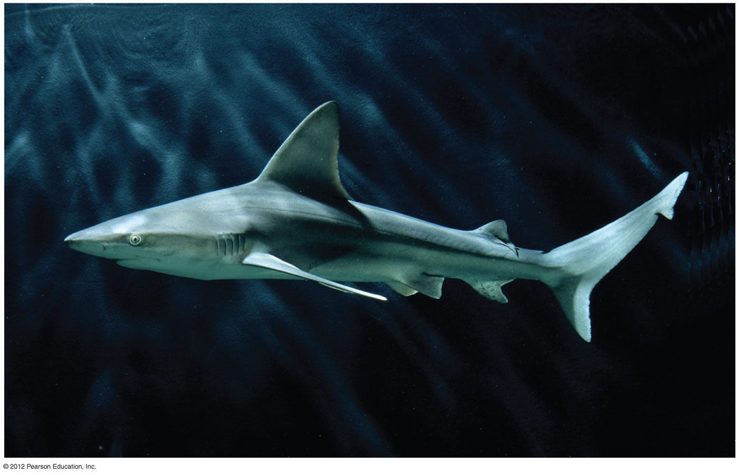
Figure 19.3B
Gill openings
Notes:
15
Figure 19.3B A sand bar shark, a chondrichthyan

Slide 16
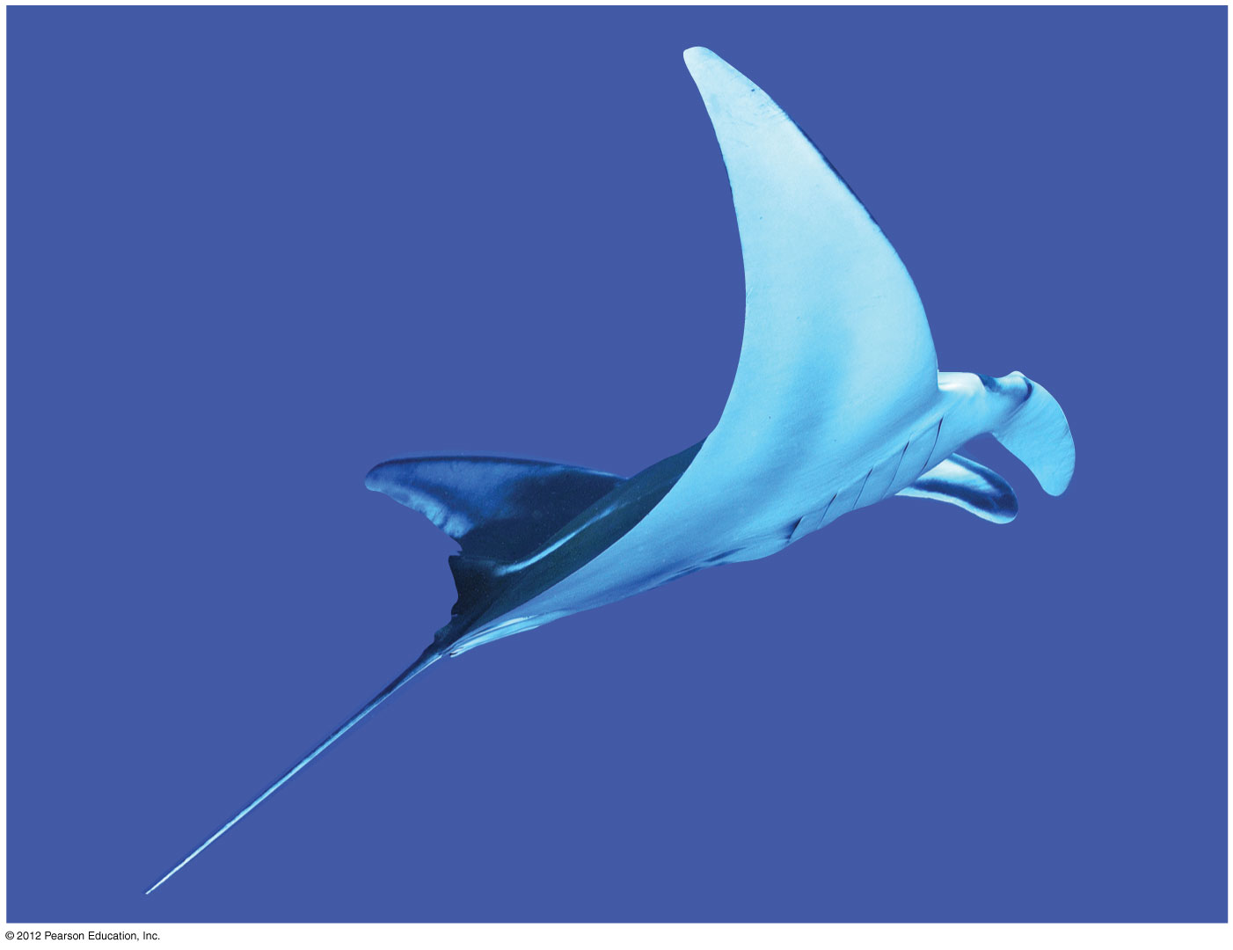
Figure 19.3C
Manta ray
Notes:
16
Figure 19.3C A manta ray, a chondrichthyan

Slide 17
19.3 Jawed vertebrates with gills and paired fins include sharks, ray-finned fishes, and lobe-finned fishes
0
  Ray-finned fishes have
    an internal skeleton reinforced with a hard matrix of calcium phosphate (bone),
    flattened scales covered with mucus,
    an operculum that covers a chamber of gills, and
    a buoyant swim bladder (derived from an ancestral lung).
  With more than 27,000 species, ray-finned fishes are the most diverse group of vertebrates.
© 2012 Pearson Education, Inc.
Notes:
17
Student Misconceptions and Concerns
1. The classification of chordates has undergone some major changes with the rearrangement of vertebrate groups. Birds are now commonly classified as reptiles, an association likely not seen previously in older K–12 textbooks. Students may be surprised by this association. Better classification tools and the attempt to classify organisms only into monophyletic groups have required these reconsiderations.
2. Students might think of vertebrate groups as sharply defined, lacking appreciation for the transitional organisms that illuminate aspects of the rich evolutionary history of vertebrates. Recent discoveries such as the 375-million-year-old fossil fish Tiktaalik reveal important traits that are intermediate between ancient fishes and modern amphibians. Discussion of this important transitional species, as well as similar species such as Archaeopteryx and modern monotremes, will reveal the blurry boundary lines between our classifications of vertebrate groups.
Teaching Tips
1. The wide, flat bodies of rays provide an obvious exception to the general rule that cartilaginous fishes have streamlined bodies. Their ventral mouths and flattened form are well adapted to a life on the ocean bottom.
2. Of all of the vertebrate clades alive today, ray-finned fishes are the most abundant. As noted in Module 19.3, more than 27,000 species of ray-finned fishes have been identified.
3. Sharks, unlike bony fishes, do not have swim bladders. To lift off the bottom, they swim using their stiff pectoral fins and tail for uplift (along with some buoyant materials in their body).
4. The perception of sharks as menacing may be due in part to their particular method of maneuvering in water. Shark fins do not rotate to brake their forward movements. Cruising sharks that swim near an object of interest are not necessarily out to intimidate their prey (although it may have this effect). They may simply be curious, but unable to remain motionless while they investigate their environment.

Slide 18
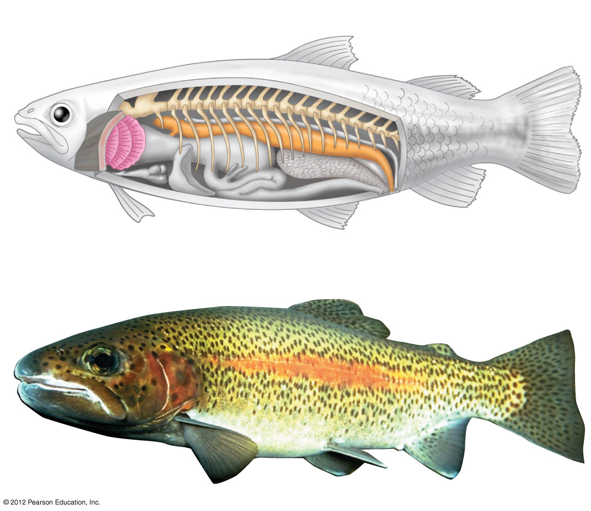
Figure 19.3D
Bony skeleton
Dorsal fin
Gills
Operculum
Anal fin
Pectoral fin
Swim bladder
Heart
Pelvic fin
A rainbow trout,
a ray-fin
Notes:
18
Figure 19.3D The anatomical features of a ray-finned fish

Slide 19
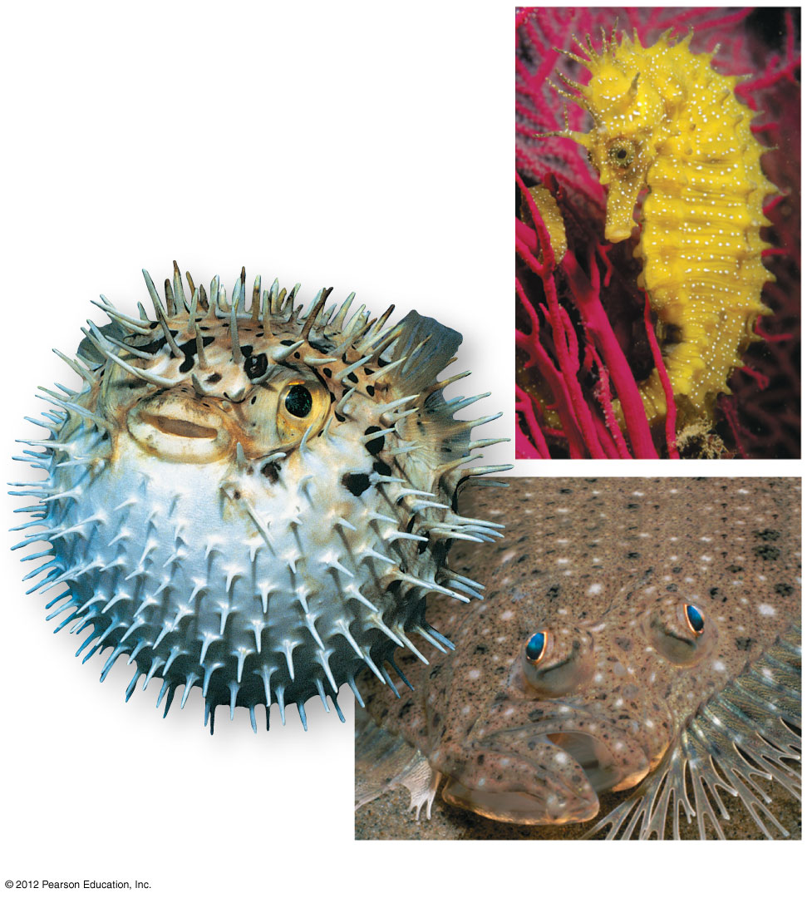
Figure 19.3E
A seahorse
A balloon fish
A flounder
Notes:
19
Figure 19.3E A variety of ray-finned fishes

Slide 20
19.3 Jawed vertebrates with gills and paired fins include sharks, ray-finned fishes, and lobe-finned fishes
0
  Lobe-fins have muscular pelvic and pectoral fins that are supported by rod-shaped bones.
  Today, three lineages of lobe-fins survive:
    coelacanths, living deep in the oceans, were once thought to be extinct,
    lungfishes, which can gulp air into lungs, inhabit stagnant waters in the Southern Hemisphere, and
    tetrapods, adapted to life on land, include terrestrial vertebrates.
© 2012 Pearson Education, Inc.
Notes:
20
Student Misconceptions and Concerns
1. The classification of chordates has undergone some major changes with the rearrangement of vertebrate groups. Birds are now commonly classified as reptiles, an association likely not seen previously in older K–12 textbooks. Students may be surprised by this association. Better classification tools and the attempt to classify organisms only into monophyletic groups have required these reconsiderations.
2. Students might think of vertebrate groups as sharply defined, lacking appreciation for the transitional organisms that illuminate aspects of the rich evolutionary history of vertebrates. Recent discoveries such as the 375-million-year-old fossil fish Tiktaalik reveal important traits that are intermediate between ancient fishes and modern amphibians. Discussion of this important transitional species, as well as similar species such as Archaeopteryx and modern monotremes, will reveal the blurry boundary lines between our classifications of vertebrate groups.
Teaching Tips
1. The wide, flat bodies of rays provide an obvious exception to the general rule that cartilaginous fishes have streamlined bodies. Their ventral mouths and flattened form are well adapted to a life on the ocean bottom.
2. Of all of the vertebrate clades alive today, ray-finned fishes are the most abundant. As noted in Module 19.3, more than 27,000 species of ray-finned fishes have been identified.
3. Sharks, unlike bony fishes, do not have swim bladders. To lift off the bottom, they swim using their stiff pectoral fins and tail for uplift (along with some buoyant materials in their body).
4. The perception of sharks as menacing may be due in part to their particular method of maneuvering in water. Shark fins do not rotate to brake their forward movements. Cruising sharks that swim near an object of interest are not necessarily out to intimidate their prey (although it may have this effect). They may simply be curious, but unable to remain motionless while they investigate their environment.

Slide 21
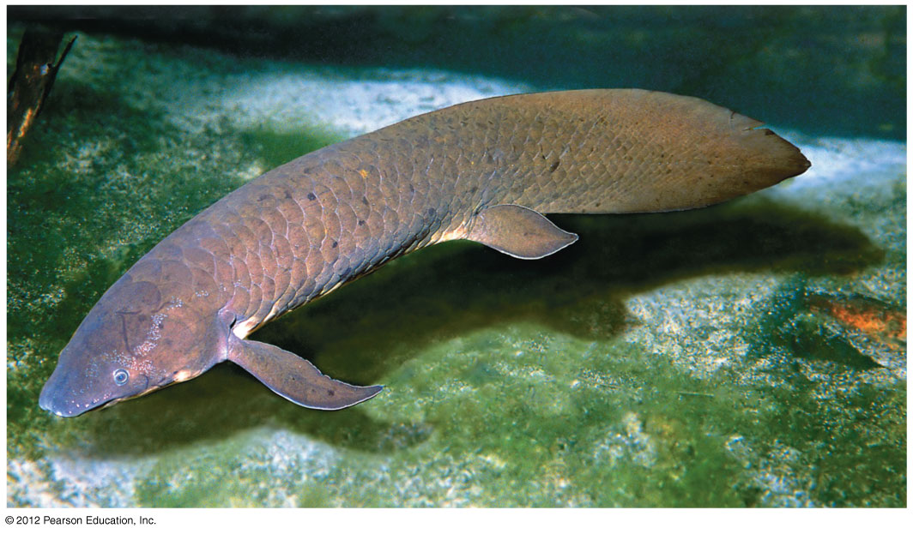
Figure 19.3F
Lobe-finned lungfish
Notes:
21
Figure 19.3F A lobe-finned lungfish (about 1 m long)

Slide 22
19.4 EVOLUTION CONNECTION: New fossil discoveries are filling in the gaps of tetrapod evolution
0
  During the late Devonian, a line of lobe-finned fishes gave rise to tetrapods, jawed vertebrates with limbs and feet that can support weight on land.
  Adapting to life on land was a key event in vertebrate history.
  All subsequent groups are descendants of these early land-dwellers.
© 2012 Pearson Education, Inc.
Notes:
22
Student Misconceptions and Concerns
1. The classification of chordates has undergone some major changes with the rearrangement of vertebrate groups. Birds are now commonly classified as reptiles, an association likely not seen previously in older K–12 textbooks. Students may be surprised by this association. Better classification tools and the attempt to classify organisms only into monophyletic groups have required these reconsiderations.
2. Students might think of vertebrate groups as sharply defined, lacking appreciation for the transitional organisms that illuminate aspects of the rich evolutionary history of vertebrates. Recent discoveries such as the 375-million-year-old fossil fish Tiktaalik reveal important traits that are intermediate between ancient fishes and modern amphibians. Discussion of this important transitional species, as well as similar species such as Archaeopteryx and modern monotremes, will reveal the blurry boundary lines between our classifications of vertebrate groups.
Teaching Tips
1. The transition to a life on land required some major changes. You might ask your students to discuss the challenges of moving from an aquatic to terrestrial lifestyle. These include adaptations to breathing air, additional skeletal support to account for the loss of the support and buoyancy provided by water, loss of a lateral line system, adaptations to hearing in air, mechanisms to reduce water loss through the skin, etc. Reptiles were the first group to be independent of standing water.
2. The way amphibians and reptiles move on land reveals the ancestral derivation of their anatomy. As an alligator swings its body from side to side, moving its legs forward, the lateral undulations of its vertebral column resemble those of a fish. In contrast, the movements of a dolphin in water reveal its more recent terrestrial ancestry. It moves its vertebral column vertically so that its back undulates in the same direction, just like a land mammal such as a horse.

Slide 23
19.4 EVOLUTION CONNECTION: New fossil discoveries are filling in the gaps of tetrapod evolution
0
  Like plants, vertebrates faced obstacles on land in regard to
    gas exchange,
    water conservation,
    structural support,
    a means of locomotion,
    adapting sensory organs that worked well in water but not on land, and
    reproduction.
© 2012 Pearson Education, Inc.
Notes:
23
Student Misconceptions and Concerns
1. The classification of chordates has undergone some major changes with the rearrangement of vertebrate groups. Birds are now commonly classified as reptiles, an association likely not seen previously in older K–12 textbooks. Students may be surprised by this association. Better classification tools and the attempt to classify organisms only into monophyletic groups have required these reconsiderations.
2. Students might think of vertebrate groups as sharply defined, lacking appreciation for the transitional organisms that illuminate aspects of the rich evolutionary history of vertebrates. Recent discoveries such as the 375-million-year-old fossil fish Tiktaalik reveal important traits that are intermediate between ancient fishes and modern amphibians. Discussion of this important transitional species, as well as similar species such as Archaeopteryx and modern monotremes, will reveal the blurry boundary lines between our classifications of vertebrate groups.
Teaching Tips
1. The transition to a life on land required some major changes. You might ask your students to discuss the challenges of moving from an aquatic to terrestrial lifestyle. These include adaptations to breathing air, additional skeletal support to account for the loss of the support and buoyancy provided by water, loss of a lateral line system, adaptations to hearing in air, mechanisms to reduce water loss through the skin, etc. Reptiles were the first group to be independent of standing water.
2. The way amphibians and reptiles move on land reveals the ancestral derivation of their anatomy. As an alligator swings its body from side to side, moving its legs forward, the lateral undulations of its vertebral column resemble those of a fish. In contrast, the movements of a dolphin in water reveal its more recent terrestrial ancestry. It moves its vertebral column vertically so that its back undulates in the same direction, just like a land mammal such as a horse.

Slide 24
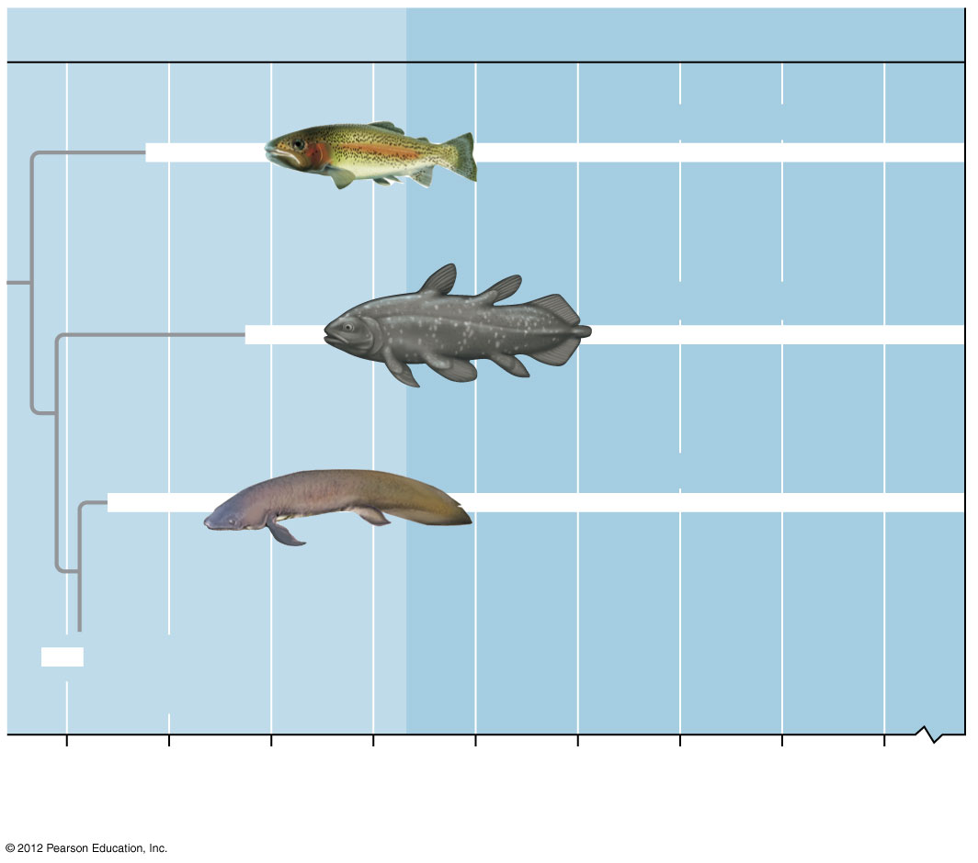
Figure 19.4A_1
Devonian
Carboniferous
Ray-finned fish
Coelocanth
Lungfish
Time known
to exist
420
400
380
360
340
320
300
280
260
0
Millions of years ago
Notes:
24
Figure 19.4A_1 Some of the transitional forms in tetrapod evolution (part 1)

Slide 25
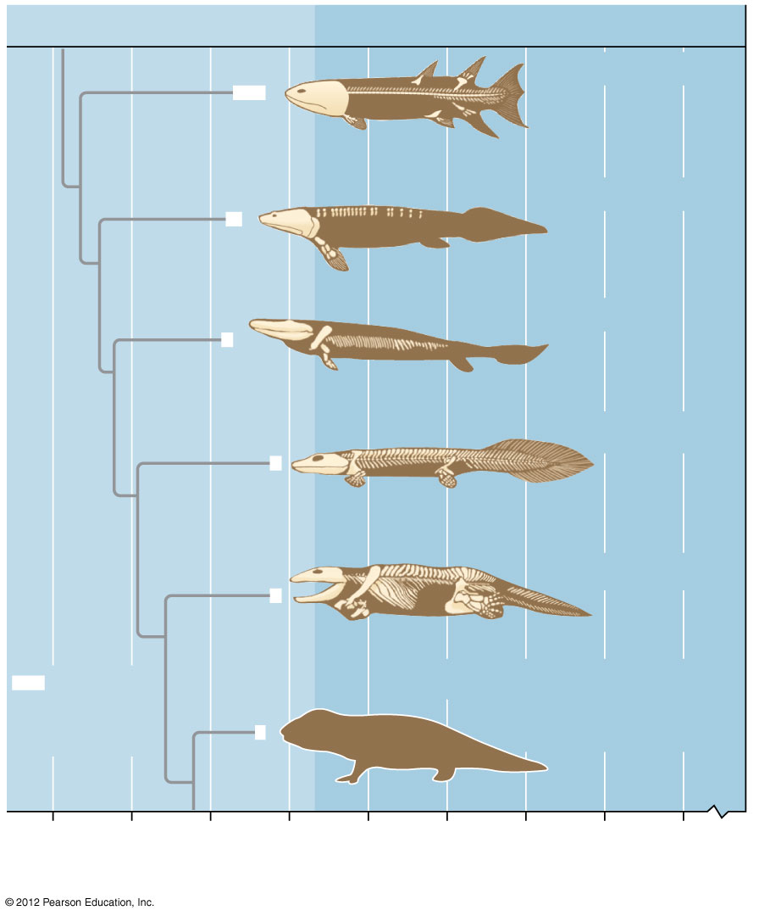
Figure 19.4A_2
Devonian
Carboniferous
Eusthenopteron
Panderichthys
Tiktaalik
Acanthostega
Ichthyostega
Time
known
to exist
Tetrapod with no gills,
limbs better adapted
for bearing weight
420
400
380
360
340
320
300
280
260
0
Millions of years ago
Notes:
25
Figure 19.4A_2 Some of the transitional forms in tetrapod evolution (part 2)

Slide 26
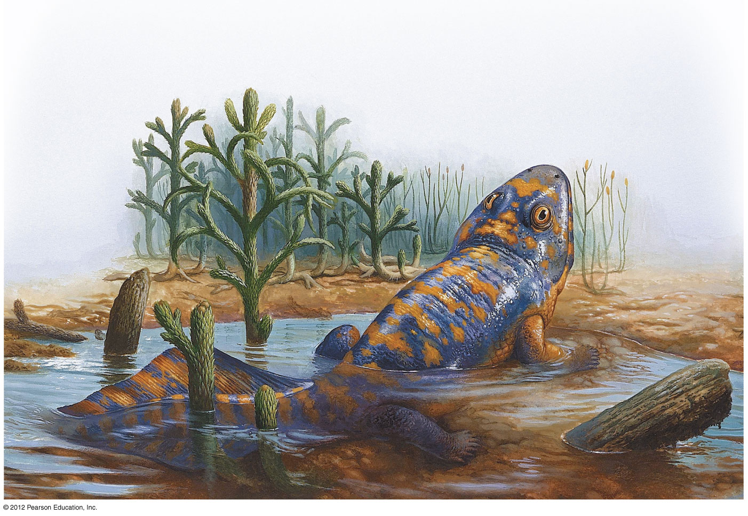
Figure 19.4C
Tetrapod- four limbed fish lived in shallow water, could breathe air
Notes:
26
Figure 19.4C The first tetrapod, a four-limbed fish that lived in shallow water and could breathe air

Slide 27
19.5 Amphibians are tetrapods—vertebrates with two pairs of limbs
0
  Amphibians
    include salamanders, frogs, and caecilians,
    use their moist skins to supplement their lungs for gas exchange,
    often have poison glands in their skins,
    usually return to standing water to reproduce,
    undergo metamorphosis from a larval stage to the adult form, and
    were the first tetrapods able to move on land.
© 2012 Pearson Education, Inc.
Notes:
27
Student Misconceptions and Concerns
1. The classification of chordates has undergone some major changes with the rearrangement of vertebrate groups. Birds are now commonly classified as reptiles, an association likely not seen previously in older K–12 textbooks. Students may be surprised by this association. Better classification tools and the attempt to classify organisms only into monophyletic groups have required these reconsiderations.
2. Students might think of vertebrate groups as sharply defined, lacking appreciation for the transitional organisms that illuminate aspects of the rich evolutionary history of vertebrates. Recent discoveries such as the 375-million-year-old fossil fish Tiktaalik reveal important traits that are intermediate between ancient fishes and modern amphibians. Discussion of this important transitional species, as well as similar species such as Archaeopteryx and modern monotremes, will reveal the blurry boundary lines between our classifications of vertebrate groups.
Teaching Tips
1. The transition to a life on land required some major changes. You might ask your students to discuss the challenges of moving from an aquatic to terrestrial lifestyle. These include adaptations to breathing air, additional skeletal support to account for the loss of the support and buoyancy provided by water, loss of a lateral line system, adaptations to hearing in air, mechanisms to reduce water loss through the skin, etc. Reptiles were the first group to be independent of standing water.
2. The way amphibians and reptiles move on land reveals the ancestral derivation of their anatomy. As an alligator swings its body from side to side, moving its legs forward, the lateral undulations of its vertebral column resemble those of a fish. In contrast, the movements of a dolphin in water reveal its more recent terrestrial ancestry. It moves its vertebral column vertically so that its back undulates in the same direction, just like a land mammal such as a horse.
3. Our knowledge about the basic development of vertebrates was significantly advanced by the early study of amphibian embryos. With clear outer layers, the detailed anatomy of many developing amphibians may be observed without disturbing the organism (see Figure 19.5D). Furthermore, their size permitted the identification of basic systems without requiring magnification.
4. Adult salamanders are the only adult tetrapods that can completely regenerate a lost limb. Although some reptiles can regenerate portions of their tails, no other tetrapod can replace part or all of a limb. Even more amazingly, salamanders that suffer the partial loss of a limb regenerate only the missing sections. Research into the mechanisms of regeneration informs our understanding of limb development and brings hope that medical science may one day be able to achieve the same thing in humans.
5. One of the most widely studied laboratory amphibians over the past 200 years has been the axolotl, a Mexican salamander that retains juvenile characteristics, including gills that persist into the adult state. These animals do not normally undergo metamorphosis, reproducing instead in their strictly aquatic form. Many images of these neotenic/paedomorphic axolotls can be found by performing a simple Internet image search for “axolotl.”

Slide 28
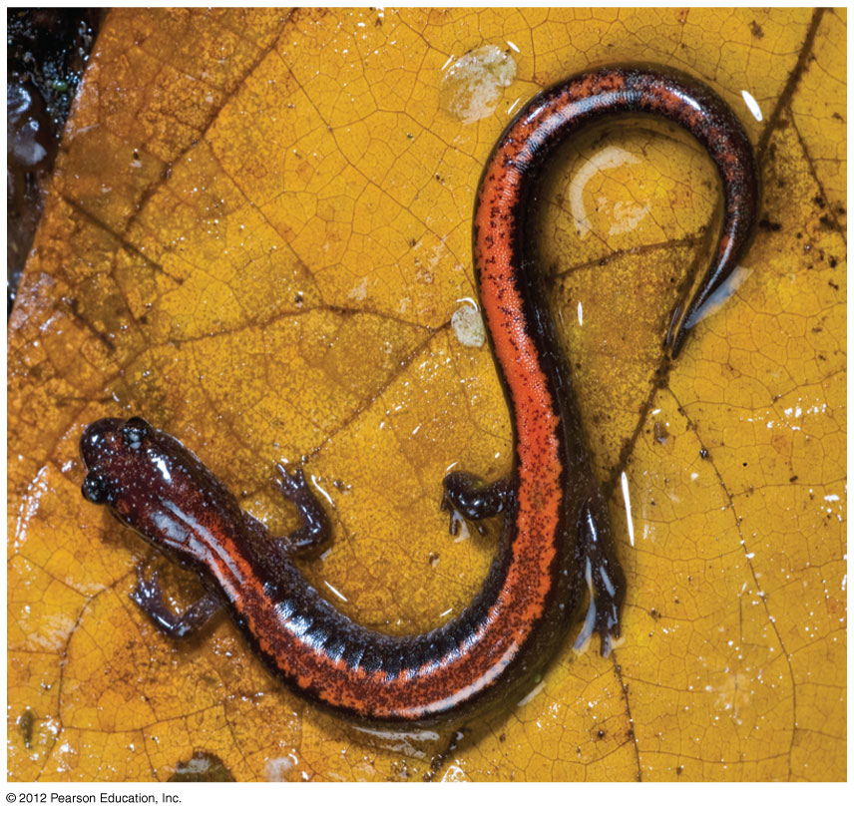
Figure 19.5A
Redback salamander
Notes:
28
Figure 19.5A A redback salamander

Slide 29
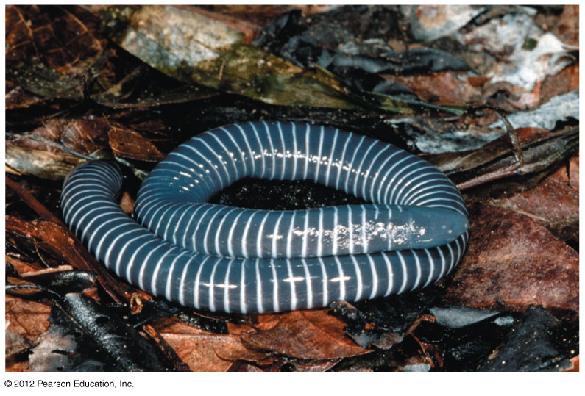
Figure 19.5B
Caecilian –simple salamander, resembles worm- lives hidden in ground
Notes:
29
Figure 19.5B A caecilian

Slide 30
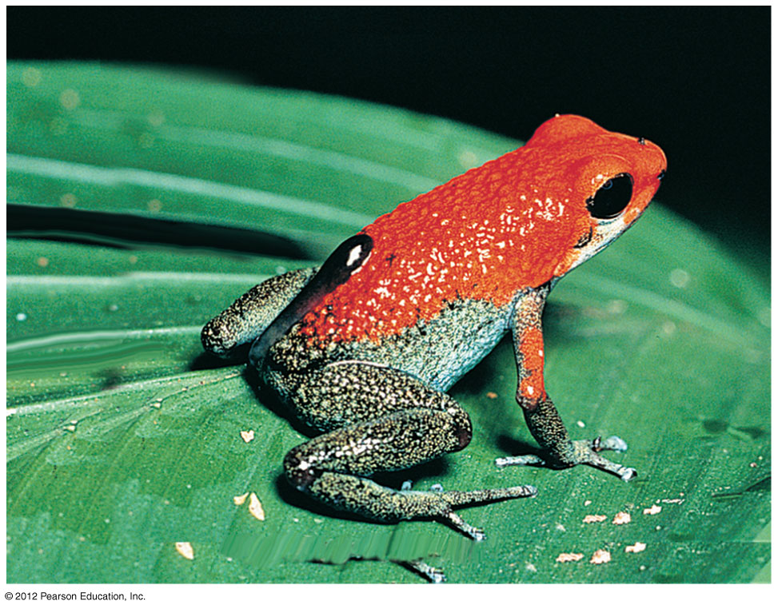
Figure 19.5C
Poison dart frog
Notes:
30
Figure 19.5C An adult poison dart frog

Slide 31
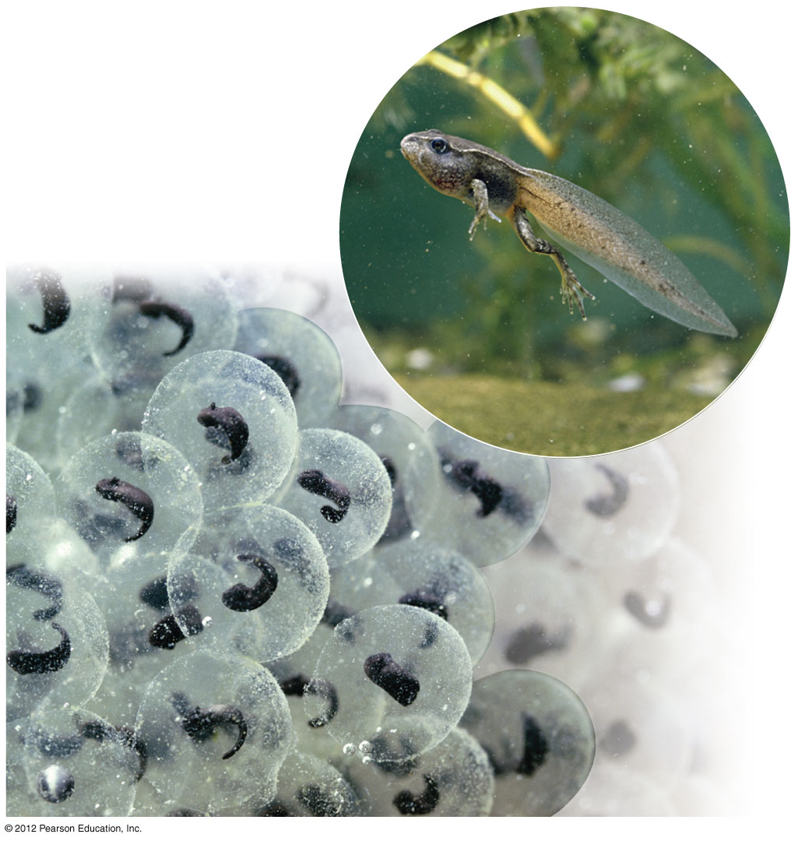
Figure 19.5D-E
Frog eggs & tadpole
Notes:
31
Figure 19.5D-E Frog eggs: a tadpole is developing in the center of each ball of jelly; tadpole undergoing metamorphosis (inset)

Slide 32
19.6 Reptiles are amniotes—tetrapods with a terrestrially adapted egg
0
  Reptiles (including birds) and mammals are amniotes.
  The major derived character of this clade is an amniotic egg with four internal membranes.
    The amnion is a fluid-filled sac surrounding the embryo.
    The yolk sac contains a rich store of nutrients for the developing embryo.
    The allantois also helps dispose of metabolic waste.
    The chorion (and allantois) enable the embryo to obtain oxygen from the air and dispose of carbon dioxide.
© 2012 Pearson Education, Inc.
Notes:
32
Student Misconceptions and Concerns
1. The classification of chordates has undergone some major changes with the rearrangement of vertebrate groups. Birds are now commonly classified as reptiles, an association likely not seen previously in older K–12 textbooks. Students may be surprised by this association. Better classification tools and the attempt to classify organisms only into monophyletic groups have required these reconsiderations.
2. Students might think of vertebrate groups as sharply defined, lacking appreciation for the transitional organisms that illuminate aspects of the rich evolutionary history of vertebrates. Recent discoveries such as the 375-million-year-old fossil fish Tiktaalik reveal important traits that are intermediate between ancient fishes and modern amphibians. Discussion of this important transitional species, as well as similar species such as Archaeopteryx and modern monotremes, will reveal the blurry boundary lines between our classifications of vertebrate groups.
Teaching Tips
1. The transition to a life on land required some major changes. You might ask your students to discuss the challenges of moving from an aquatic to terrestrial lifestyle. These include adaptations to breathing air, additional skeletal support to account for the loss of the support and buoyancy provided by water, loss of a lateral line system, adaptations to hearing in air, mechanisms to reduce water loss through the skin, etc. Reptiles were the first group to be independent of standing water.
2. The way amphibians and reptiles move on land reveals the ancestral derivation of their anatomy. As an alligator swings its body from side to side, moving its legs forward, the lateral undulations of its vertebral column resemble those of a fish. In contrast, the movements of a dolphin in water reveal its more recent terrestrial ancestry. It moves its vertebral column vertically so that its back undulates in the same direction, just like a land mammal such as a horse.
3. Reptiles diversified in the Mesozoic in much the same way that mammals have diversified today. To make this point, choose some well-known dinosaurs and compare their habitats to modern mammals that live in a similar ecological niche. (Triceratops was a grazer, much like a modern bison; a duck-billed hadrosaur shares much the same diet as a hippopotamus today; Tyrannosaurus rex may have been an aggressive hunter like a modern tiger.)

Slide 33
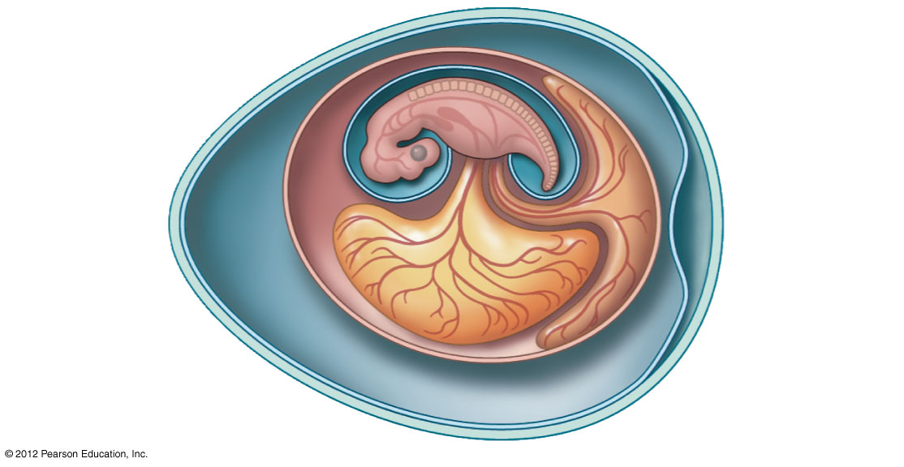
Figure 19.6B
Embryo
Amniotic
cavity with
amniotic fluid
Allantois
Chorion
Amnion
Yolk sac
Yolk
(nutrients)
Shell
Albumen
Notes:
33
Figure 19.6B An amniotic egg

Slide 34
19.6 Reptiles are amniotes—tetrapods with a terrestrially adapted egg
0
  Reptiles
    include lizards, snakes, turtles, crocodilians, birds, and extinct dinosaurs,
    have a skin covered with scales and waterproofed with keratin,
    obtain most of their oxygen using lungs, and
    are ectothermic, absorbing external heat rather than generating much of their own.
© 2012 Pearson Education, Inc.
Notes:
34
Student Misconceptions and Concerns
1. The classification of chordates has undergone some major changes with the rearrangement of vertebrate groups. Birds are now commonly classified as reptiles, an association likely not seen previously in older K–12 textbooks. Students may be surprised by this association. Better classification tools and the attempt to classify organisms only into monophyletic groups have required these reconsiderations.
2. Students might think of vertebrate groups as sharply defined, lacking appreciation for the transitional organisms that illuminate aspects of the rich evolutionary history of vertebrates. Recent discoveries such as the 375-million-year-old fossil fish Tiktaalik reveal important traits that are intermediate between ancient fishes and modern amphibians. Discussion of this important transitional species, as well as similar species such as Archaeopteryx and modern monotremes, will reveal the blurry boundary lines between our classifications of vertebrate groups.
Teaching Tips
1. The transition to a life on land required some major changes. You might ask your students to discuss the challenges of moving from an aquatic to terrestrial lifestyle. These include adaptations to breathing air, additional skeletal support to account for the loss of the support and buoyancy provided by water, loss of a lateral line system, adaptations to hearing in air, mechanisms to reduce water loss through the skin, etc. Reptiles were the first group to be independent of standing water.
2. The way amphibians and reptiles move on land reveals the ancestral derivation of their anatomy. As an alligator swings its body from side to side, moving its legs forward, the lateral undulations of its vertebral column resemble those of a fish. In contrast, the movements of a dolphin in water reveal its more recent terrestrial ancestry. It moves its vertebral column vertically so that its back undulates in the same direction, just like a land mammal such as a horse.
3. Reptiles diversified in the Mesozoic in much the same way that mammals have diversified today. To make this point, choose some well-known dinosaurs and compare their habitats to modern mammals that live in a similar ecological niche. (Triceratops was a grazer, much like a modern bison; a duck-billed hadrosaur shares much the same diet as a hippopotamus today; Tyrannosaurus rex may have been an aggressive hunter like a modern tiger.)

Slide 35
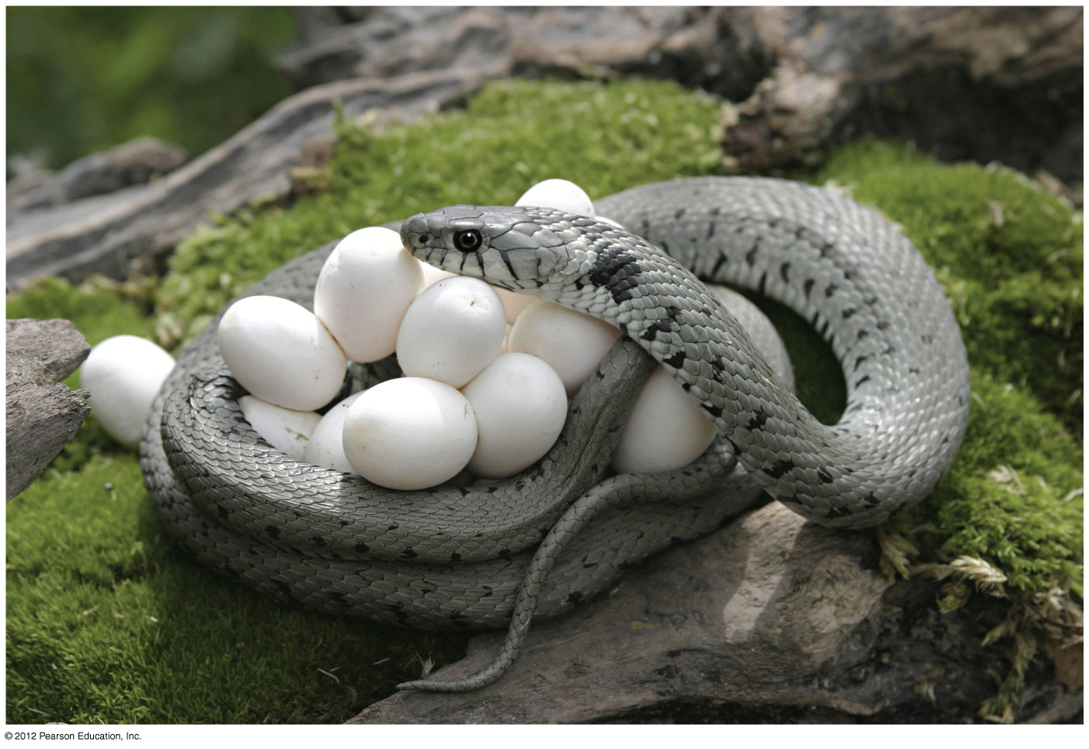
Figure 19.6A
Bull snake laying eggs
Notes:
35
Figure 19.6A A bull snake laying eggs

Slide 36
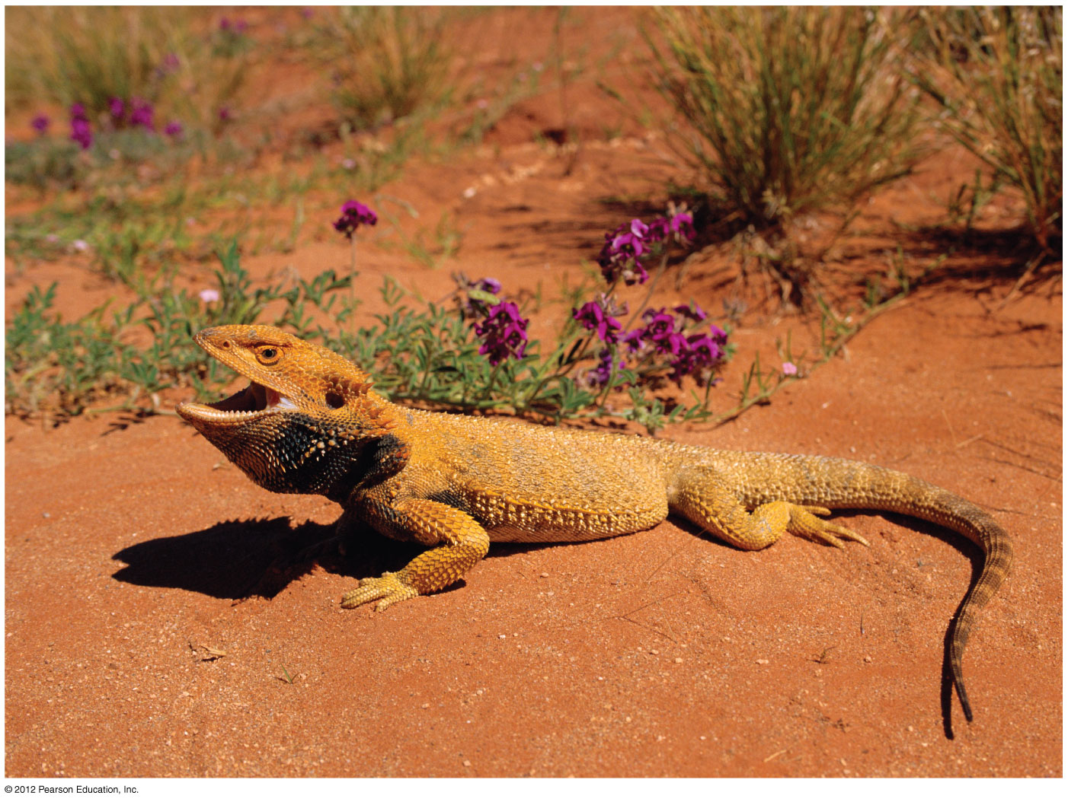
Figure 19.6C
Bearded dragon
Notes:
36
Figure 19.6C A bearded dragon basking in the sun

Slide 37
19.7 Birds are feathered reptiles with adaptations for flight
0
  Most birds can fly, and nearly every part of their bodies reflects adaptations that enhance flight.
    The forelimbs have been remodeled as feather-covered wings that act as airfoils.
    Large flight muscles anchored to a central ridge along the breastbone provide power.
    Many features help reduce weight for flight:
      Present-day birds lack teeth.
      The tail is supported by only a few small vertebrae.
      Feathers have hollow shafts.
      Their bones have a honeycombed structure that makes them strong but light.
© 2012 Pearson Education, Inc.
Notes:
37
Student Misconceptions and Concerns
1. The classification of chordates has undergone some major changes with the rearrangement of vertebrate groups. Birds are now commonly classified as reptiles, an association likely not seen previously in older K–12 textbooks. Students may be surprised by this association. Better classification tools and the attempt to classify organisms only into monophyletic groups have required these reconsiderations.
2. Students might think of vertebrate groups as sharply defined, lacking appreciation for the transitional organisms that illuminate aspects of the rich evolutionary history of vertebrates. Recent discoveries such as the 375-million-year-old fossil fish Tiktaalik reveal important traits that are intermediate between ancient fishes and modern amphibians. Discussion of this important transitional species, as well as similar species such as Archaeopteryx and modern monotremes, will reveal the blurry boundary lines between our classifications of vertebrate groups.
Teaching Tips
1. The intermediate nature of Archaeopteryx can be demonstrated to your students. Have your students compare an Archaeopteryx fossil to the skeleton of a modern chicken. Good photographs of both organisms can be sufficient. Have them note both the shared and unique characteristics of the two organisms.
2. In the last few years, the debate about the evolution of birds has been punctuated by exciting new fossil discoveries from China. Your students should be able to find images and details about these recent discoveries on the Internet.
3. Feathers perform several functions, typically in the same bird. They insulate, they provide species-specific coloration for identification by members of the same species, and they form aerodynamic surfaces. As you list these diverse functions, note that they did not arise simultaneously. Fossil evidence now reveals that feathers first evolved as identifying traits or as an important source of insulation, long before they played any role in flight.

Slide 38
19.7 Birds are feathered reptiles with adaptations for flight
0
  Flight is very costly, and present-day birds have a high rate of metabolism.
  Unlike other living reptiles, birds are endothermic, using heat generated by metabolism to maintain a warm, steady body temperature.
  Birds have relatively large brains and display complex behaviors. They have
    acute senses,
    fine muscle control, and
    excellent eyesight.
© 2012 Pearson Education, Inc.
Notes:
38
Student Misconceptions and Concerns
1. The classification of chordates has undergone some major changes with the rearrangement of vertebrate groups. Birds are now commonly classified as reptiles, an association likely not seen previously in older K–12 textbooks. Students may be surprised by this association. Better classification tools and the attempt to classify organisms only into monophyletic groups have required these reconsiderations.
2. Students might think of vertebrate groups as sharply defined, lacking appreciation for the transitional organisms that illuminate aspects of the rich evolutionary history of vertebrates. Recent discoveries such as the 375-million-year-old fossil fish Tiktaalik reveal important traits that are intermediate between ancient fishes and modern amphibians. Discussion of this important transitional species, as well as similar species such as Archaeopteryx and modern monotremes, will reveal the blurry boundary lines between our classifications of vertebrate groups.
Teaching Tips
1. The intermediate nature of Archaeopteryx can be demonstrated to your students. Have your students compare an Archaeopteryx fossil to the skeleton of a modern chicken. Good photographs of both organisms can be sufficient. Have them note both the shared and unique characteristics of the two organisms.
2. In the last few years, the debate about the evolution of birds has been punctuated by exciting new fossil discoveries from China. Your students should be able to find images and details about these recent discoveries on the Internet.
3. Feathers perform several functions, typically in the same bird. They insulate, they provide species-specific coloration for identification by members of the same species, and they form aerodynamic surfaces. As you list these diverse functions, note that they did not arise simultaneously. Fossil evidence now reveals that feathers first evolved as identifying traits or as an important source of insulation, long before they played any role in flight.

Slide 39
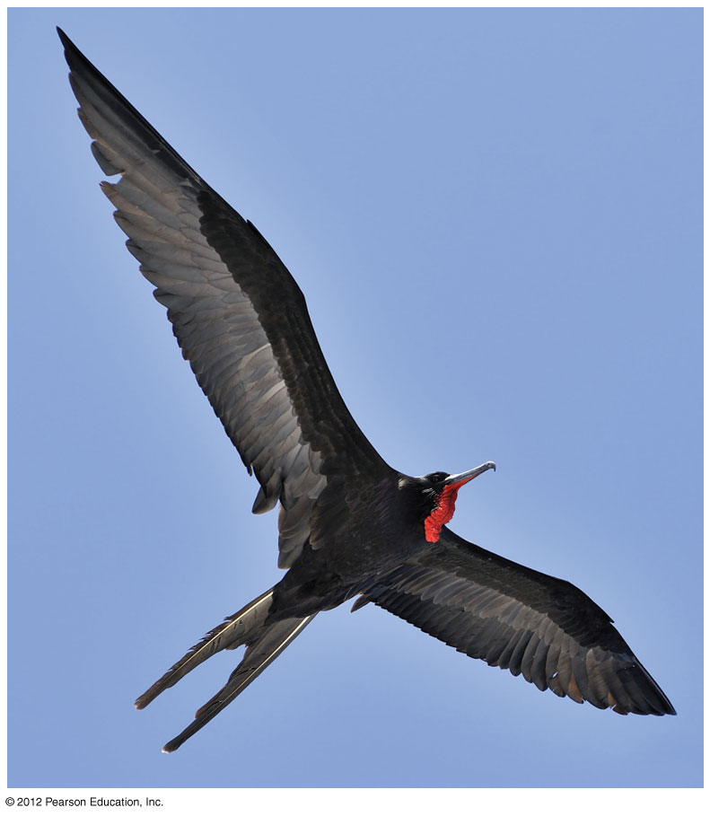
Figure 19.7A
Frigate bird soaring
Notes:
39
Figure 19.7A A soaring frigate bird

Slide 40
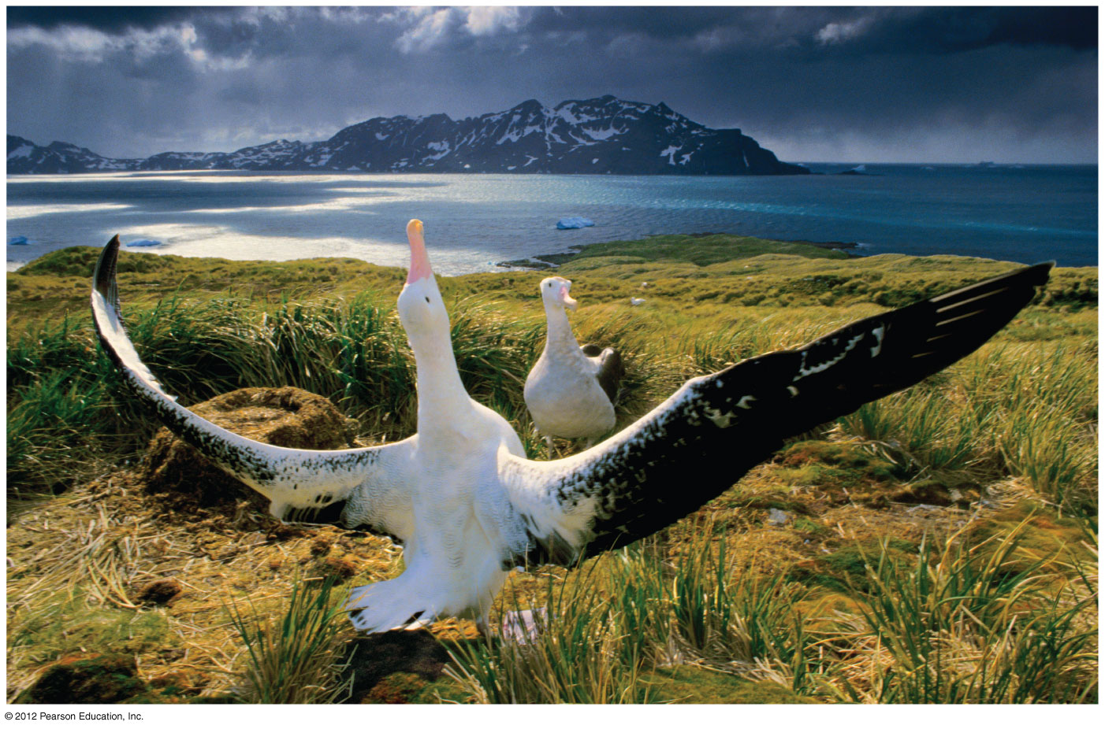
Figure 19.7B
Male albatross courting female
Notes:
40
Figure 19.7B A male wandering albatross performing a courtship display for a potential mate

Slide 41
19.7 Birds are feathered reptiles with adaptations for flight
0
  Birds evolved from a lineage of small, two-legged dinosaurs called theropods.
    Archaeopteryx is the oldest, most primitive known bird (150 million years old), with feathered wings.
    It resembled a small bipedal dinosaur, with teeth, wing claws, and a long tail with many vertebrae.
© 2012 Pearson Education, Inc.
Notes:
41
Student Misconceptions and Concerns
1. The classification of chordates has undergone some major changes with the rearrangement of vertebrate groups. Birds are now commonly classified as reptiles, an association likely not seen previously in older K–12 textbooks. Students may be surprised by this association. Better classification tools and the attempt to classify organisms only into monophyletic groups have required these reconsiderations.
2. Students might think of vertebrate groups as sharply defined, lacking appreciation for the transitional organisms that illuminate aspects of the rich evolutionary history of vertebrates. Recent discoveries such as the 375-million-year-old fossil fish Tiktaalik reveal important traits that are intermediate between ancient fishes and modern amphibians. Discussion of this important transitional species, as well as similar species such as Archaeopteryx and modern monotremes, will reveal the blurry boundary lines between our classifications of vertebrate groups.
Teaching Tips
1. The intermediate nature of Archaeopteryx can be demonstrated to your students. Have your students compare an Archaeopteryx fossil to the skeleton of a modern chicken. Good photographs of both organisms can be sufficient. Have them note both the shared and unique characteristics of the two organisms.
2. In the last few years, the debate about the evolution of birds has been punctuated by exciting new fossil discoveries from China. Your students should be able to find images and details about these recent discoveries on the Internet.
3. Feathers perform several functions, typically in the same bird. They insulate, they provide species-specific coloration for identification by members of the same species, and they form aerodynamic surfaces. As you list these diverse functions, note that they did not arise simultaneously. Fossil evidence now reveals that feathers first evolved as identifying traits or as an important source of insulation, long before they played any role in flight.

Slide 42
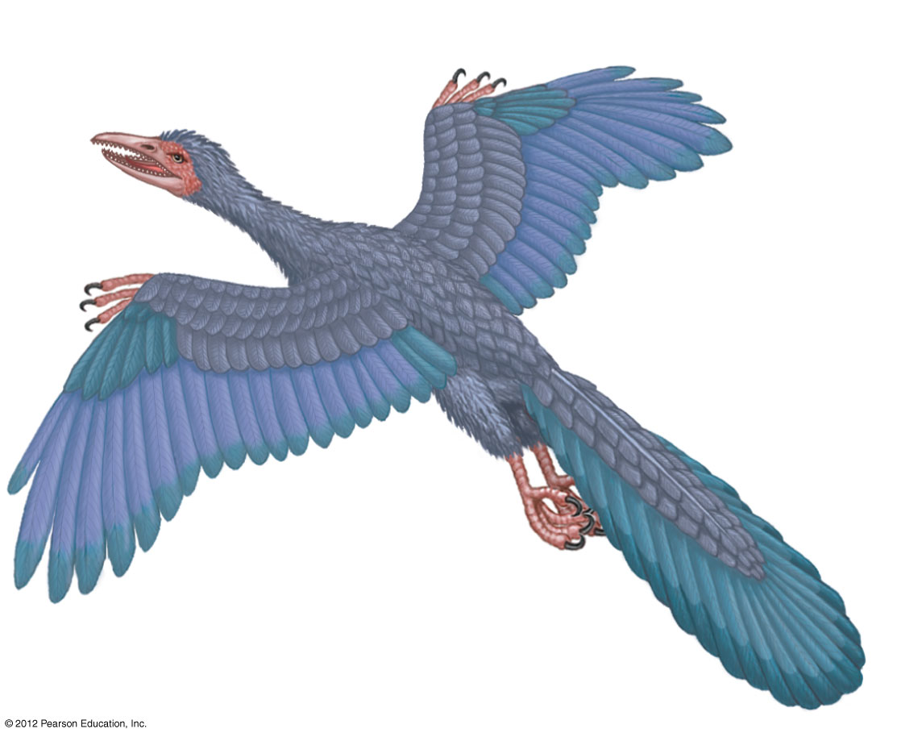
Figure 19.7C
archaeopteryx
Wing claw (like dinosaur)
Teeth
(like dinosaur)
Long tail with
many vertebrae
(like dinosaur)
Feathers
Notes:
42
Figure 19.7C Archaeopteryx, an extinct bird

Slide 43
19.8 Mammals are amniotes that have hair and produce milk
0
  Mammals are endothermic amniotes with
    hair, which insulates their bodies, and
    mammary glands, which produce milk.
  Mammals have efficient respiratory and circulatory systems that support their high rate of metabolism.
  Mammalian teeth are differentiated for many kinds of diets.
© 2012 Pearson Education, Inc.
Notes:
43
Student Misconceptions and Concerns
1. The classification of chordates has undergone some major changes with the rearrangement of vertebrate groups. Birds are now commonly classified as reptiles, an association likely not seen previously in older K–12 textbooks. Students may be surprised by this association. Better classification tools and the attempt to classify organisms only into monophyletic groups have required these reconsiderations.
2. Students might think of vertebrate groups as sharply defined, lacking appreciation for the transitional organisms that illuminate aspects of the rich evolutionary history of vertebrates. Recent discoveries such as the 375-million-year-old fossil fish Tiktaalik reveal important traits that are intermediate between ancient fishes and modern amphibians. Discussion of this important transitional species, as well as similar species such as Archaeopteryx and modern monotremes, will reveal the blurry boundary lines between our classifications of vertebrate groups.
Teaching Tips
1. The way amphibians and reptiles move on land reveals the ancestral derivation of their anatomy. As an alligator swings its body from side to side, moving its legs forward, the lateral undulations of its vertebral column resemble those of a fish. In contrast, the movements of a dolphin in water reveal its more recent terrestrial ancestry. It moves its vertebral column vertically so that its back undulates in the same direction, just like a land mammal such as a horse.
2. The distribution of marsupials on Earth is a fine example of biogeography. The geographic isolation of Australia has allowed them to evolve independently of much of eutherian evolution, resulting in greater diversification of marsupials. As suggested for the dinosaurs, students can be encouraged to draw parallels between the lifestyles of Australian marsupials and eutherian mammals that occupy similar ecological niches elsewhere in the world.
3. Mammals and birds, with their endothermic physiology, require very efficient respiratory and circulatory systems to support high levels of metabolic activity. A bird or mammal the same size as a lizard requires about ten times as many calories per day.

Slide 44
19.8 Mammals are amniotes that have hair and produce milk
0
  Mammals are endothermic amniotes with
    hair, which insulates their bodies, and
    mammary glands, which produce milk.
  Mammals have efficient respiratory and circulatory systems that support their high rate of metabolism.
  Mammalian teeth are differentiated for many kinds of diets.
© 2012 Pearson Education, Inc.
Notes:
44
Student Misconceptions and Concerns
1. The classification of chordates has undergone some major changes with the rearrangement of vertebrate groups. Birds are now commonly classified as reptiles, an association likely not seen previously in older K–12 textbooks. Students may be surprised by this association. Better classification tools and the attempt to classify organisms only into monophyletic groups have required these reconsiderations.
2. Students might think of vertebrate groups as sharply defined, lacking appreciation for the transitional organisms that illuminate aspects of the rich evolutionary history of vertebrates. Recent discoveries such as the 375-million-year-old fossil fish Tiktaalik reveal important traits that are intermediate between ancient fishes and modern amphibians. Discussion of this important transitional species, as well as similar species such as Archaeopteryx and modern monotremes, will reveal the blurry boundary lines between our classifications of vertebrate groups.
Teaching Tips
1. The way amphibians and reptiles move on land reveals the ancestral derivation of their anatomy. As an alligator swings its body from side to side, moving its legs forward, the lateral undulations of its vertebral column resemble those of a fish. In contrast, the movements of a dolphin in water reveal its more recent terrestrial ancestry. It moves its vertebral column vertically so that its back undulates in the same direction, just like a land mammal such as a horse.
2. The distribution of marsupials on Earth is a fine example of biogeography. The geographic isolation of Australia has allowed them to evolve independently of much of eutherian evolution, resulting in greater diversification of marsupials. As suggested for the dinosaurs, students can be encouraged to draw parallels between the lifestyles of Australian marsupials and eutherian mammals that occupy similar ecological niches elsewhere in the world.
3. Mammals and birds, with their endothermic physiology, require very efficient respiratory and circulatory systems to support high levels of metabolic activity. A bird or mammal the same size as a lizard requires about ten times as many calories per day.

Slide 45
19.8 Mammals are amniotes that have hair and produce milk
0
  Monotremes are egg-laying mammals. Living monotremes include
    the duck-billed platypus and
    echidnas.
  Unlike monotremes, the embryos of marsupials and eutherians are nurtured by a placenta, in which nutrients from the mother’s blood diffuse into the embryo’s blood.
© 2012 Pearson Education, Inc.
Notes:
45
Student Misconceptions and Concerns
1. The classification of chordates has undergone some major changes with the rearrangement of vertebrate groups. Birds are now commonly classified as reptiles, an association likely not seen previously in older K–12 textbooks. Students may be surprised by this association. Better classification tools and the attempt to classify organisms only into monophyletic groups have required these reconsiderations.
2. Students might think of vertebrate groups as sharply defined, lacking appreciation for the transitional organisms that illuminate aspects of the rich evolutionary history of vertebrates. Recent discoveries such as the 375-million-year-old fossil fish Tiktaalik reveal important traits that are intermediate between ancient fishes and modern amphibians. Discussion of this important transitional species, as well as similar species such as Archaeopteryx and modern monotremes, will reveal the blurry boundary lines between our classifications of vertebrate groups.
Teaching Tips
1. The way amphibians and reptiles move on land reveals the ancestral derivation of their anatomy. As an alligator swings its body from side to side, moving its legs forward, the lateral undulations of its vertebral column resemble those of a fish. In contrast, the movements of a dolphin in water reveal its more recent terrestrial ancestry. It moves its vertebral column vertically so that its back undulates in the same direction, just like a land mammal such as a horse.
2. The distribution of marsupials on Earth is a fine example of biogeography. The geographic isolation of Australia has allowed them to evolve independently of much of eutherian evolution, resulting in greater diversification of marsupials. As suggested for the dinosaurs, students can be encouraged to draw parallels between the lifestyles of Australian marsupials and eutherian mammals that occupy similar ecological niches elsewhere in the world.
3. Mammals and birds, with their endothermic physiology, require very efficient respiratory and circulatory systems to support high levels of metabolic activity. A bird or mammal the same size as a lizard requires about ten times as many calories per day.

Slide 46
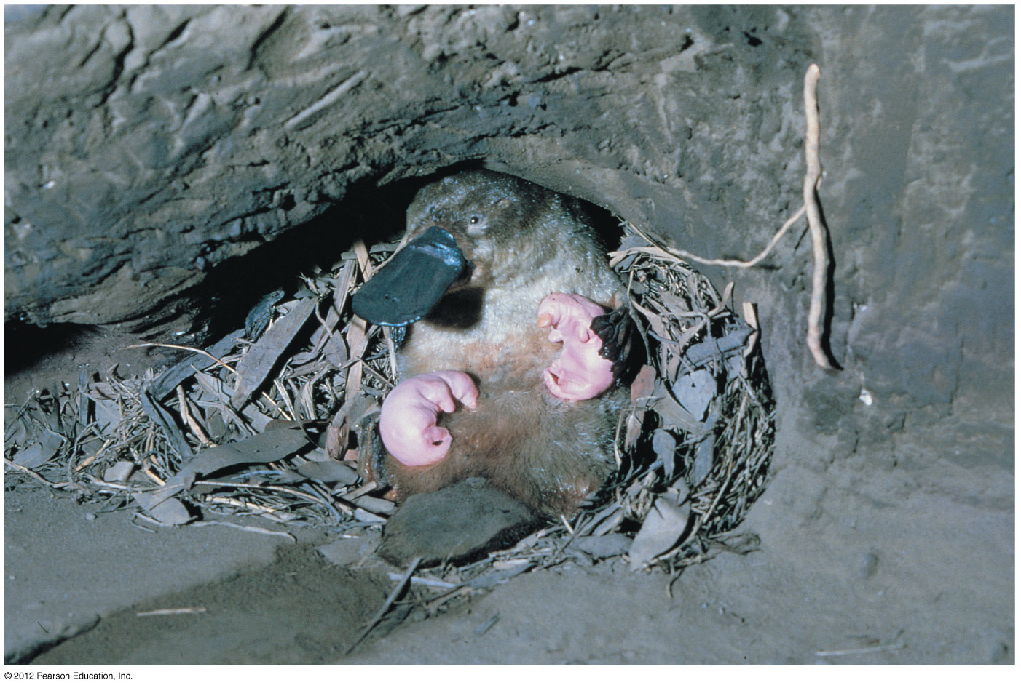
Figure 19.8A
Duckbilled platypus with young
Notes:
46
Figure 19.8A Monotremes: a duckbilled platypus with newly hatched young

Slide 47
19.8 Mammals are amniotes that have hair and produce milk
0
  Marsupials have a brief gestation and give birth to tiny, underdeveloped offspring that complete development while attached to the mother’s nipples-located in a pouch.
  Eutherians are mammals that bear fully developed live young. They are commonly called placental mammals because their placentas are more complex than those of marsupials.
© 2012 Pearson Education, Inc.
Notes:
47
Student Misconceptions and Concerns
1. The classification of chordates has undergone some major changes with the rearrangement of vertebrate groups. Birds are now commonly classified as reptiles, an association likely not seen previously in older K–12 textbooks. Students may be surprised by this association. Better classification tools and the attempt to classify organisms only into monophyletic groups have required these reconsiderations.
2. Students might think of vertebrate groups as sharply defined, lacking appreciation for the transitional organisms that illuminate aspects of the rich evolutionary history of vertebrates. Recent discoveries such as the 375-million-year-old fossil fish Tiktaalik reveal important traits that are intermediate between ancient fishes and modern amphibians. Discussion of this important transitional species, as well as similar species such as Archaeopteryx and modern monotremes, will reveal the blurry boundary lines between our classifications of vertebrate groups.
Teaching Tips
1. The way amphibians and reptiles move on land reveals the ancestral derivation of their anatomy. As an alligator swings its body from side to side, moving its legs forward, the lateral undulations of its vertebral column resemble those of a fish. In contrast, the movements of a dolphin in water reveal its more recent terrestrial ancestry. It moves its vertebral column vertically so that its back undulates in the same direction, just like a land mammal such as a horse.
2. The distribution of marsupials on Earth is a fine example of biogeography. The geographic isolation of Australia has allowed them to evolve independently of much of eutherian evolution, resulting in greater diversification of marsupials. As suggested for the dinosaurs, students can be encouraged to draw parallels between the lifestyles of Australian marsupials and eutherian mammals that occupy similar ecological niches elsewhere in the world.
3. Mammals and birds, with their endothermic physiology, require very efficient respiratory and circulatory systems to support high levels of metabolic activity. A bird or mammal the same size as a lizard requires about ten times as many calories per day.

Slide 48
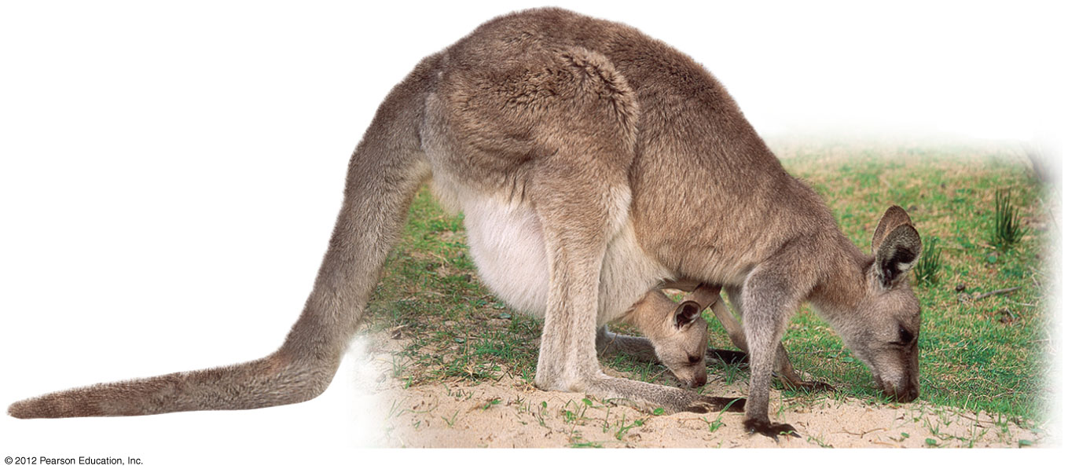
Figure 19.8B
Gray kangaroo with joey
Notes:
48
Figure 19.8B Marsupials: a gray kangaroo with her young in her pouch

Slide 49
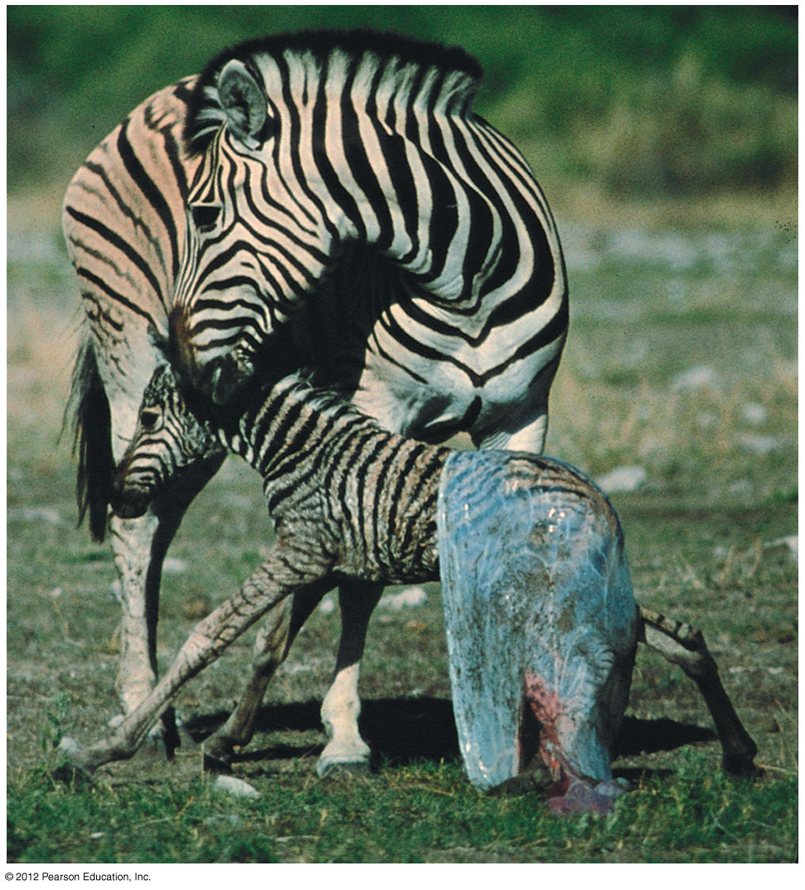
Figure 19.8C
Eutherian- zebra with newborn
Notes:
49
Figure 19.8C Eutherians: a zebra with newborn

Slide 50
19.8 Mammals are amniotes that have hair and produce milk
0
  The first true mammals arose 200 million years ago and were probably small, nocturnal insectivores.
    Monotremes are the oldest lineage of mammals.
    Marsupials diverged from eutherians (placental mammals) about 180 million years ago.
    Mammals underwent an adaptive radiation following the Cretaceous extinction of dinosaurs, giving rise to large terrestrial carnivores and herbivores, bats, and aquatic whales and porpoises.
© 2012 Pearson Education, Inc.
Notes:
50
Student Misconceptions and Concerns
1. The classification of chordates has undergone some major changes with the rearrangement of vertebrate groups. Birds are now commonly classified as reptiles, an association likely not seen previously in older K–12 textbooks. Students may be surprised by this association. Better classification tools and the attempt to classify organisms only into monophyletic groups have required these reconsiderations.
2. Students might think of vertebrate groups as sharply defined, lacking appreciation for the transitional organisms that illuminate aspects of the rich evolutionary history of vertebrates. Recent discoveries such as the 375-million-year-old fossil fish Tiktaalik reveal important traits that are intermediate between ancient fishes and modern amphibians. Discussion of this important transitional species, as well as similar species such as Archaeopteryx and modern monotremes, will reveal the blurry boundary lines between our classifications of vertebrate groups.
Teaching Tips
1. The way amphibians and reptiles move on land reveals the ancestral derivation of their anatomy. As an alligator swings its body from side to side, moving its legs forward, the lateral undulations of its vertebral column resemble those of a fish. In contrast, the movements of a dolphin in water reveal its more recent terrestrial ancestry. It moves its vertebral column vertically so that its back undulates in the same direction, just like a land mammal such as a horse.
2. The distribution of marsupials on Earth is a fine example of biogeography. The geographic isolation of Australia has allowed them to evolve independently of much of eutherian evolution, resulting in greater diversification of marsupials. As suggested for the dinosaurs, students can be encouraged to draw parallels between the lifestyles of Australian marsupials and eutherian mammals that occupy similar ecological niches elsewhere in the world.
3. Mammals and birds, with their endothermic physiology, require very efficient respiratory and circulatory systems to support high levels of metabolic activity. A bird or mammal the same size as a lizard requires about ten times as many calories per day.

