Slide 1
DIGESTION & RESPIRATION
Chapter 21 & 22

Slide 2
Introduction
0
All animals must eat to provide
  energy and
  the building blocks used to assemble new molecules.
Animals also need essential
  vitamins and
  minerals.
© 2012 Pearson Education, Inc.
Notes:
2

Slide 3
Introduction
0
The modern human diet in developed countries allows access to relatively cheap and available calorie-dense foods.
This diet, combined with sedentary jobs and inactive lifestyles, has led to an obesity crisis in the United States leading to
  68% of people categorized as overweight and
  100 million people categorized as obese.
Thus, the modern diet appears to be contributing to shorter, less healthy lives.
© 2012 Pearson Education, Inc.
Notes:
3

Slide 4
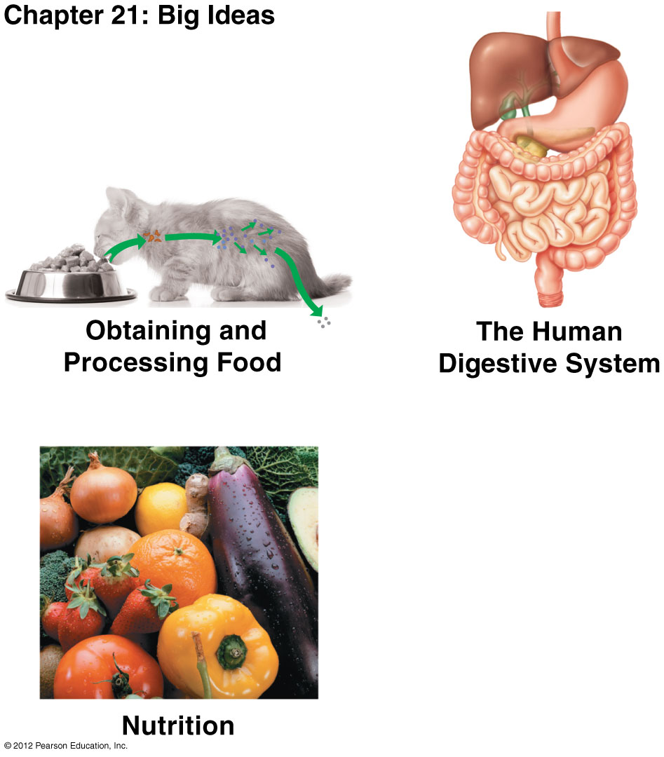

Slide 5
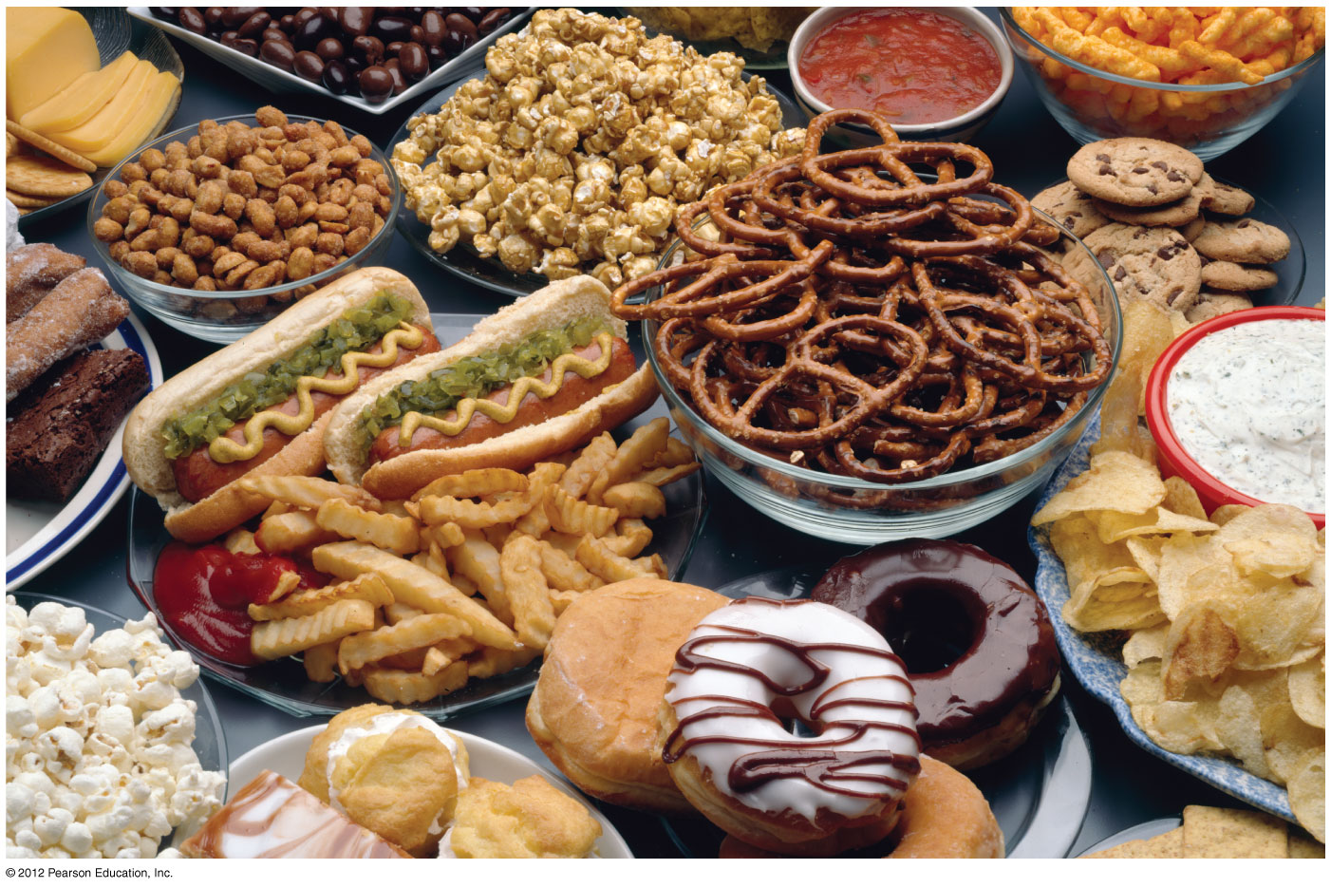
Figure 21.0_2
Notes:
5
Figure 21.0_2 Junk food

Slide 6
0
OBTAINING
AND PROCESSING
FOOD
© 2012 Pearson Education, Inc.
Notes:
6

Slide 7
21.1 Animals obtain and ingest their food in a variety of ways
0
Most animals have one of three kinds of diets.
  Herbivores eat plants and include cattle, snails, and sea urchins.
  Carnivores eat meat and include lions, hawks, and spiders.
  Omnivores eat plants and other animals and include humans, roaches, raccoons, and crows.
© 2012 Pearson Education, Inc.
Notes:
7
Student Misconceptions and Concerns
Students are likely familiar with the basics of the digestive system and the different types of animal diets. However, they are less likely to understand the distinctions between chemical and mechanical digestion and the specific roles of enzymes. An extra effort may be needed to differentiate between these important components of the digestive process.
Teaching Tips
1. If you have just completed Chapter 20, you may wish to point out the similarities between the ciliary mucus mechanism used to trap debris inhaled into our respiratory tract (Module 20.4) and the suspension feeding systems of clams.
2. Humans are omnivores. Consider contrasting the teeth of a carnivore (perhaps a cat), an herbivore (perhaps a rodent or bovine), and a human to reveal the intermediate pattern of omnivore teeth. If appropriate skeletal materials are unavailable, good images can suffice.

Slide 8
21.1 Animals obtain and ingest their food in a variety of ways
0
  Animals obtain and ingest their food in different ways.
    Suspension feeders sift small organisms or food particles from water.
    Substrate feeders live in or on their food source and eat their way through it.
    Fluid feeders suck nutrient-rich fluids from a living host.
    Bulk feeders ingest large pieces of food.
© 2012 Pearson Education, Inc.
Notes:
8
Student Misconceptions and Concerns
Students are likely familiar with the basics of the digestive system and the different types of animal diets. However, they are less likely to understand the distinctions between chemical and mechanical digestion and the specific roles of enzymes. An extra effort may be needed to differentiate between these important components of the digestive process.
Teaching Tips
1. If you have just completed Chapter 20, you may wish to point out the similarities between the ciliary mucus mechanism used to trap debris inhaled into our respiratory tract (Module 20.4) and the suspension feeding systems of clams.
2. Humans are omnivores. Consider contrasting the teeth of a carnivore (perhaps a cat), an herbivore (perhaps a rodent or bovine), and a human to reveal the intermediate pattern of omnivore teeth. If appropriate skeletal materials are unavailable, good images can suffice.

Slide 9
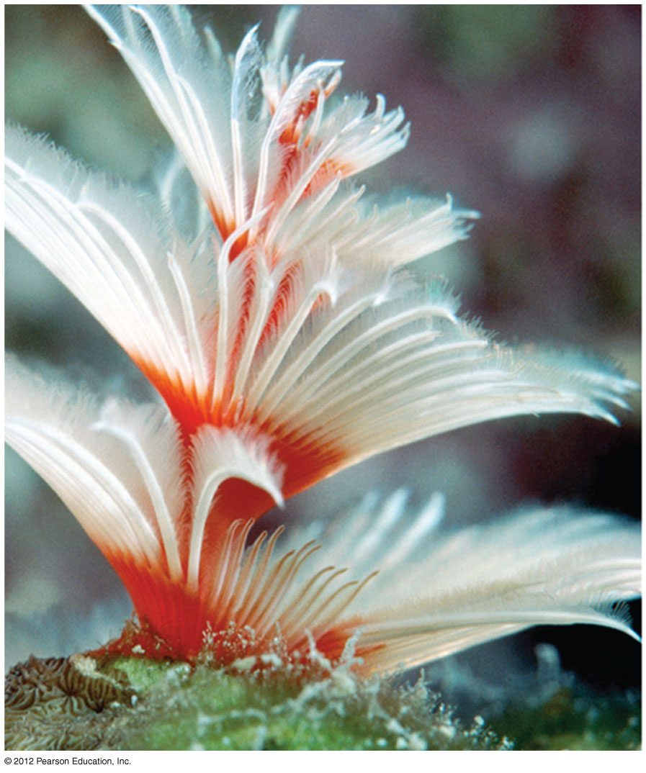
Figure 21.1A
A tube worm- suspension feeder
Notes:
9
Figure 21.1A A suspension feeder: a tube worm filtering food through its tentacles

Slide 10
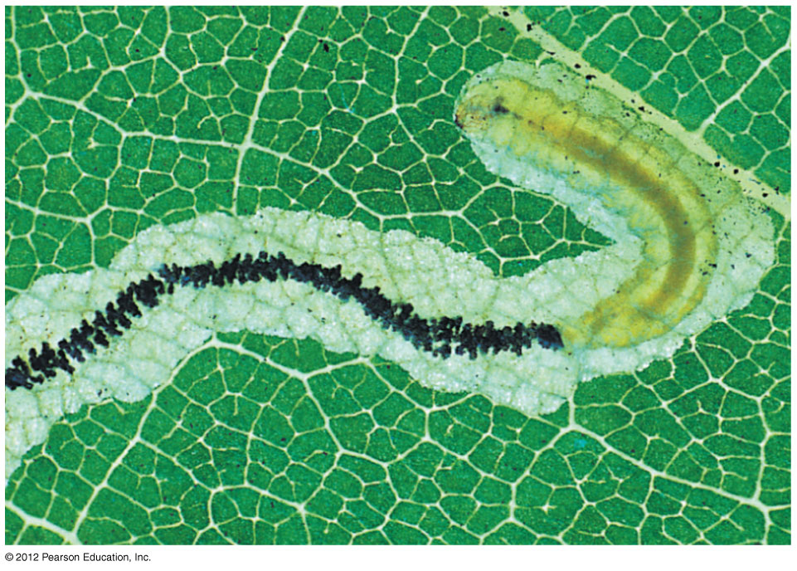
Figure 21.1BA Substrate feeder- caterpillar eating its way through soft tissue inside an oak leaf
Caterpillar
Feces
Notes:
10
Figure 21.1B A substrate feeder: a caterpillar eating its way through the soft tissues inside an oak leaf

Slide 11
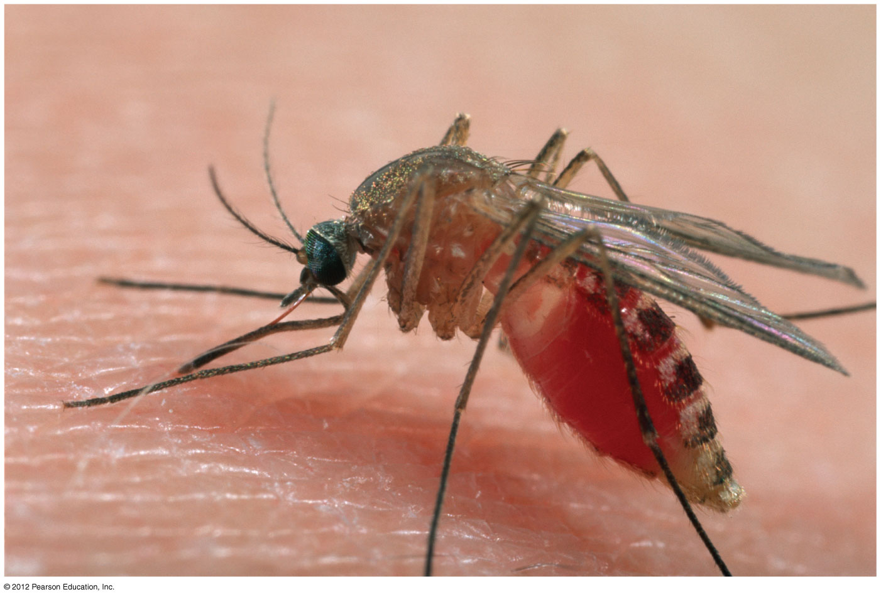
Figure 21.1C
A fluid feeder; a mosquito sucking blood
Notes:
11
Figure 21.1C A fluid feeder: a mosquito sucking blood

Slide 12
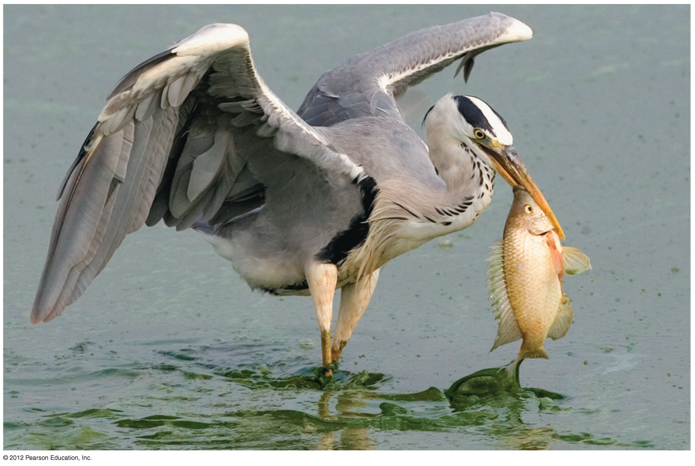
Figure 21.1D
Bulk feeder: a gray heron eating a fish
Notes:
12
Figure 21.1D A bulk feeder: a gray heron preparing to swallow a fish headfirst

Slide 13
21.2 Overview: Food processing occurs in four stages
0
Food is processed in four stages.
  Ingestion is the act of eating.
  Digestion is the breaking down of food into molecules small enough for the body to absorb.
  Absorption is the take-up of the products of digestion, usually by the cells lining the digestive tract.
  Elimination is the removal of undigested materials out of the digestive tract.
© 2012 Pearson Education, Inc.
Notes:
13
Student Misconceptions and Concerns
Students are likely familiar with the basics of the digestive system and the different types of animal diets. However, they are less likely to understand the distinctions between chemical and mechanical digestion and the specific roles of enzymes. An extra effort may be needed to differentiate between these important components of the digestive process.
Teaching Tips
If your class size permits, consider demonstrating the process of chemical digestion in the human mouth by distributing crackers to students. Have students chew the crackers and hold them in their mouths without swallowing. The sweet taste they may notice is produced by the sugars produced by the chemical breakdown of starch by amylase, a digestive enzyme found in human saliva.

Slide 14
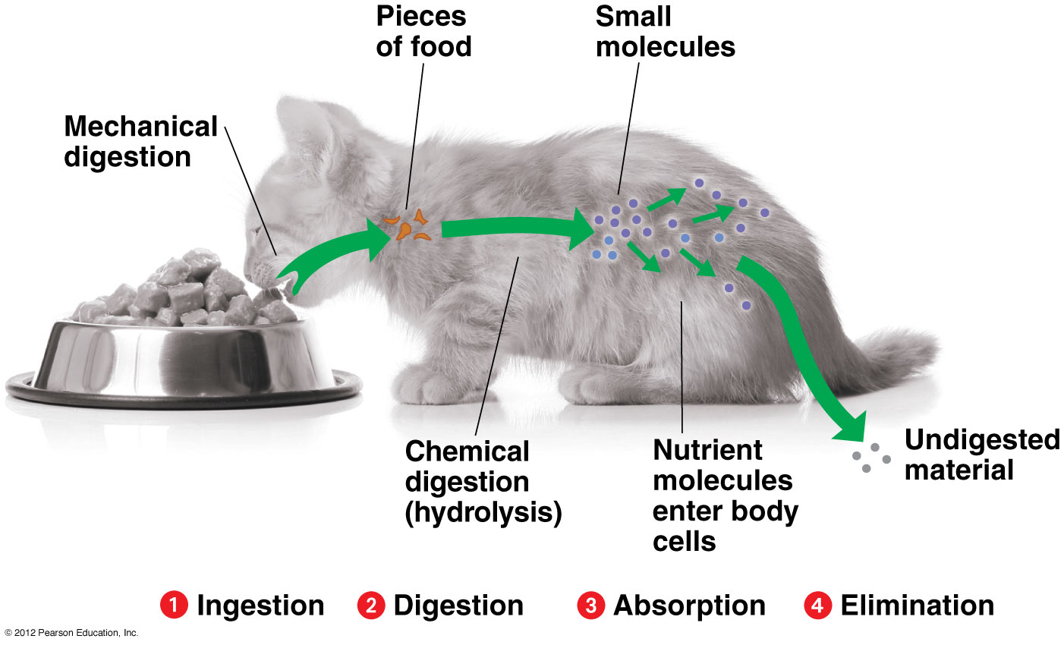

Slide 15
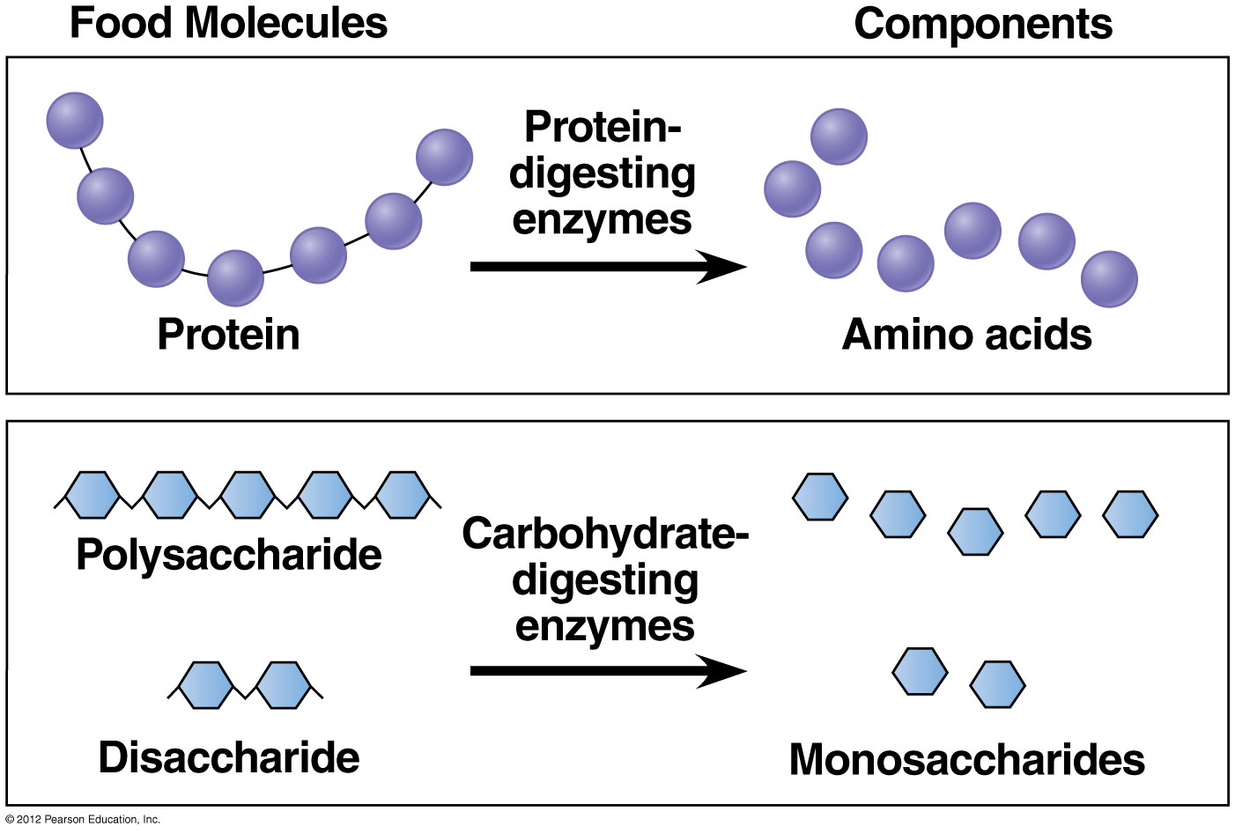

Slide 16
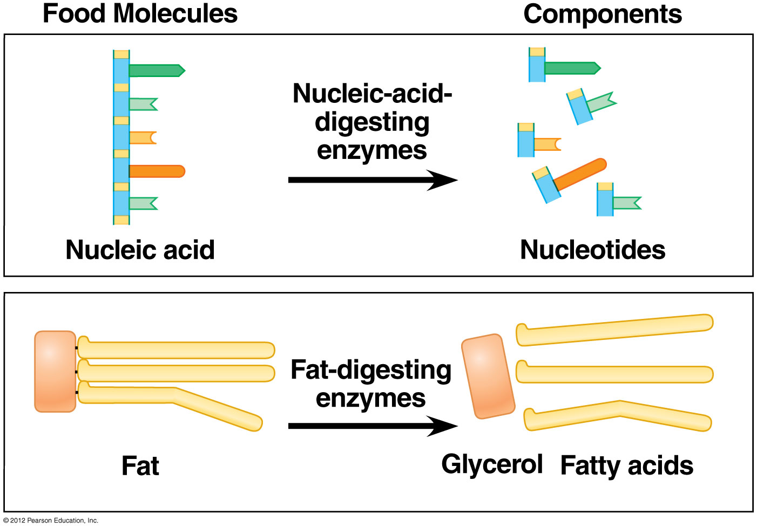

Slide 17
21.3 Digestion occurs in specialized compartments
0
Sponges digest food in vacuoles.
Most animals digest food in compartments.
  Cnidarians and flatworms have a gastrovascular cavity with a single opening, the mouth.
    Food enters the mouth.
    Enzymes break down the food.
    Food particles move into cells lining the compartment.
    Undigested materials are expelled back out the mouth.
© 2012 Pearson Education, Inc.
Notes:
17
Student Misconceptions and Concerns
Students are likely familiar with the basics of the digestive system and the different types of animal diets. However, they are less likely to understand the distinctions between chemical and mechanical digestion and the specific roles of enzymes. An extra effort may be needed to differentiate between these important components of the digestive process.
Teaching Tips
Challenge your students to explain why digestive tubes are more efficient than gastrovascular cavities (such as those found in cnidarians). Point out the advantages of the part-by-part specialization of the digestive tract permitted by the one-way flow of materials through a digestive tube with openings on both ends (mouth and anus). One-way digestive tracts are types of “disassembly” lines.

Slide 18
21.3 Digestion occurs in specialized compartments
0
  Most animals have an alimentary canal with
    a mouth,
    an anus, and
    specialized regions associated with one-way flow of food.
© 2012 Pearson Education, Inc.
Notes:
18
Student Misconceptions and Concerns
Students are likely familiar with the basics of the digestive system and the different types of animal diets. However, they are less likely to understand the distinctions between chemical and mechanical digestion and the specific roles of enzymes. An extra effort may be needed to differentiate between these important components of the digestive process.
Teaching Tips
Challenge your students to explain why digestive tubes are more efficient than gastrovascular cavities (such as those found in cnidarians). Point out the advantages of the part-by-part specialization of the digestive tract permitted by the one-way flow of materials through a digestive tube with openings on both ends (mouth and anus). One-way digestive tracts are types of “disassembly” lines.

Slide 19
21.3 Digestion occurs in specializedcompartments
0
  The normal one-way flow moves food
    into the pharynx or throat,
    down the esophagus to a
      crop where food is softened and stored,
      gizzard, where food is ground and stored, and/or
      stomach where food is ground and stored,
    to the intestines, where chemical digestion and nutrient absorption occur, and finally
    undigested materials are expelled through the anus.
© 2012 Pearson Education, Inc.
Notes:
19
Student Misconceptions and Concerns
Students are likely familiar with the basics of the digestive system and the different types of animal diets. However, they are less likely to understand the distinctions between chemical and mechanical digestion and the specific roles of enzymes. An extra effort may be needed to differentiate between these important components of the digestive process.
Teaching Tips
Challenge your students to explain why digestive tubes are more efficient than gastrovascular cavities (such as those found in cnidarians). Point out the advantages of the part-by-part specialization of the digestive tract permitted by the one-way flow of materials through a digestive tube with openings on both ends (mouth and anus). One-way digestive tracts are types of “disassembly” lines.

Slide 20
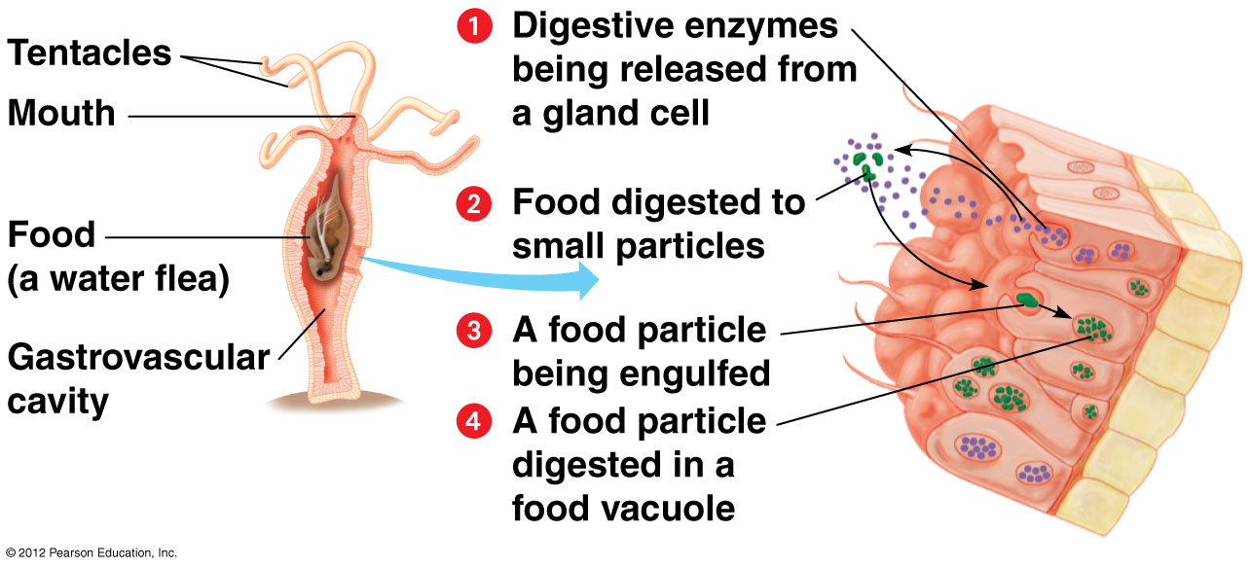

Slide 21
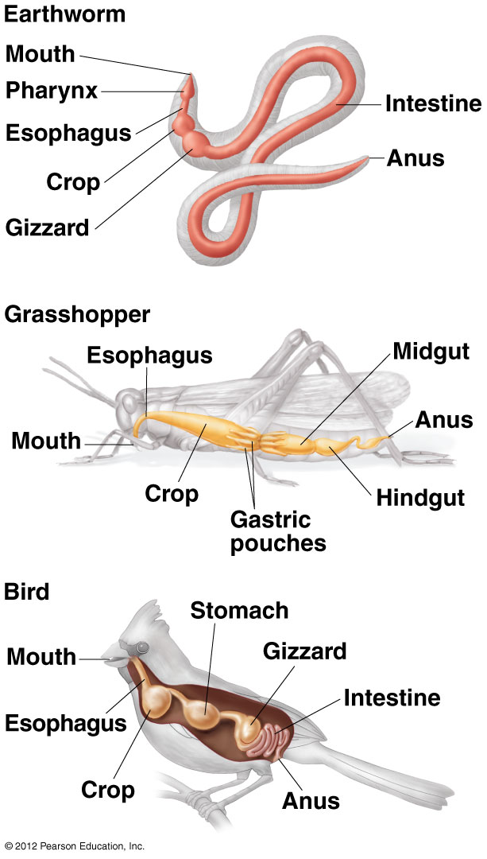

Slide 22
0
THE HUMAN DIGESTIVE SYSTEM
© 2012 Pearson Education, Inc.
Notes:
22

Slide 23
21.4 The human digestive system consists of an alimentary canal and accessory glands
0
In humans, food is
  ingested and chewed in the mouth or oral cavity,
  pushed by the tongue into the pharynx,
  moved along by alternating waves of contraction and relaxation by smooth muscle in the walls of the canal in a process called peristalsis, and
  moved in and out of the stomach by sphincters.
© 2012 Pearson Education, Inc.
Notes:
23
Student Misconceptions and Concerns
1. Students often confuse the structures and functions of the trachea and esophagus. You might point out that the trachea has a structure and function like the hose of a vacuum cleaner. The rigid ribbed walls of the trachea keep the tube open as air is sucked through it. The esophagus, however, relies upon rhythmic changes in the shape of the walls (peristalsis) to push food toward the stomach. If the esophagus had stiff walls, it would not be able to perform this function.
2. Students often confuse pain in the intestines with pain in the stomach. The looping nature of the colon causes fecal material to pass closely to the stomach on its way down the digestive tract. This may cause “stomach” pains before the need to defecate or the more painful contractions of the intestines associated with diarrhea. Young children therefore sometimes confuse the need to defecate with an upset stomach.
Teaching Tips
Ask your students to identify the structures and processes of the human digestive tract that promote one-way flow. Peristalsis in the esophagus, stomach, and intestines, plus the operation of sphincters along the esophagus and stomach, encourage one-way flow. Of course, an exception occurs during vomiting, when contractions of the abdominal cavity force the stomach contents back up the digestive tract and the upper (cardiac) sphincter opens.

Slide 24
21.4 The human digestive system consists of an alimentary canal and accessory glands
0
  The final steps of digestion and nutrient absorption in humans occur in the small intestine.
  Undigested materials move through the large intestine, feces are stored in the rectum, and then expelled out the anus.
© 2012 Pearson Education, Inc.
Notes:
24
Student Misconceptions and Concerns
1. Students often confuse the structures and functions of the trachea and esophagus. You might point out that the trachea has a structure and function like the hose of a vacuum cleaner. The rigid ribbed walls of the trachea keep the tube open as air is sucked through it. The esophagus, however, relies upon rhythmic changes in the shape of the walls (peristalsis) to push food toward the stomach. If the esophagus had stiff walls, it would not be able to perform this function.
2. Students often confuse pain in the intestines with pain in the stomach. The looping nature of the colon causes fecal material to pass closely to the stomach on its way down the digestive tract. This may cause “stomach” pains before the need to defecate or the more painful contractions of the intestines associated with diarrhea. Young children therefore sometimes confuse the need to defecate with an upset stomach.
Teaching Tips
Ask your students to identify the structures and processes of the human digestive tract that promote one-way flow. Peristalsis in the esophagus, stomach, and intestines, plus the operation of sphincters along the esophagus and stomach, encourage one-way flow. Of course, an exception occurs during vomiting, when contractions of the abdominal cavity force the stomach contents back up the digestive tract and the upper (cardiac) sphincter opens.

Slide 25
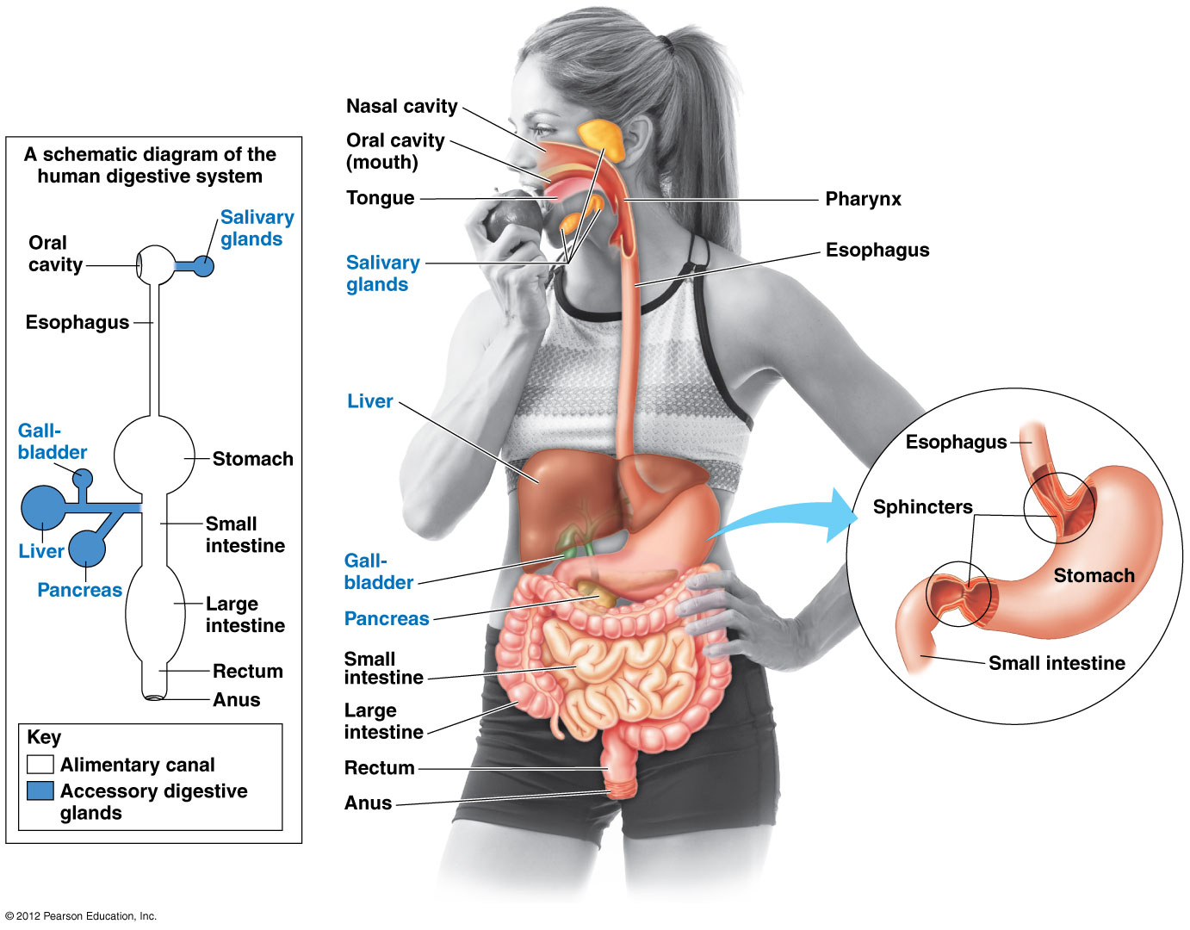

Slide 26
21.5 Digestion begins in the oral cavity
0
Mechanical digestion and chemical digestion begin in the mouth.
Chewing cuts, smashes, and grinds food, making it easier to swallow.
The tongue
  tastes,
  shapes the food into a ball called a bolus, and
  moves it toward the pharynx.
© 2012 Pearson Education, Inc.
Notes:
26
Teaching Tips
1. The role of saliva in causing food particles to adhere into a bolus and lubricating it for easy passage can be demonstrated by eating crackers or pretzels. You might wish to challenge your students to see how many pretzels/crackers they can chew and swallow in a short period of time, without the use of any beverages. The main factor limiting the speed of this consumption is the ability to produce sufficient saliva.
2. If you have not already discussed the functional significance of the structure of human teeth, consider the following exercise. Challenge your students to explain why the teeth in their mouths have different shapes. Help them to understand the form and function relationships of sharp incisors (best suited for cutting and biting) and the flatter, blunter surfaces of molars (more effective at smashing and grinding).

Slide 27
21.5 Digestion begins in the oral cavity
0
Salivary glands release
  a slippery glycoprotein that moistens and lubricates food for easier swallowing,
  buffers that neutralize acids,
  salivary enzyme amylase that begins the hydrolysis of starch, and
  antibacterial agents that kill some bacteria ingested with food.
© 2012 Pearson Education, Inc.
Notes:
27
Teaching Tips
1. The role of saliva in causing food particles to adhere into a bolus and lubricating it for easy passage can be demonstrated by eating crackers or pretzels. You might wish to challenge your students to see how many pretzels/crackers they can chew and swallow in a short period of time, without the use of any beverages. The main factor limiting the speed of this consumption is the ability to produce sufficient saliva.
2. If you have not already discussed the functional significance of the structure of human teeth, consider the following exercise. Challenge your students to explain why the teeth in their mouths have different shapes. Help them to understand the form and function relationships of sharp incisors (best suited for cutting and biting) and the flatter, blunter surfaces of molars (more effective at smashing and grinding).

Slide 28
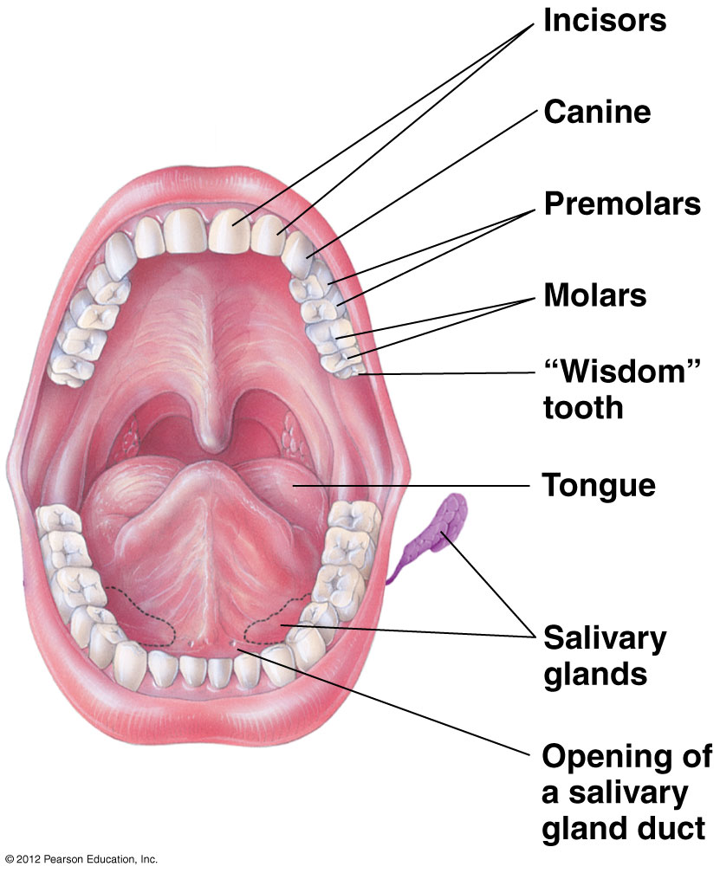

Slide 29
21.6 After swallowing, peristalsis moves food through the esophagus to the stomach
0
Swallowed food and drink move from the pharynx,
  into the esophagus, and
  into the stomach.
During swallowing,
  the tip of the larynx moves upward,
  preventing the food from entering the trachea.
© 2012 Pearson Education, Inc.
Notes:
29
Teaching Tips
1. Demonstrate the process of peristalsis: move a racquetball or golf ball through a tube sock by squeezing behind the ball.
2. Students often invert the “y” and “n” of pharynx and larynx. Consider emphasizing the “inks” sound in these words. This mistake is nearly as common as pronouncing “nuclear” as “nucular”!
3. The esophagus is so efficient at peristalsis that it can propel liquid water along its length against the forces of gravity. If one of your students is willing to endure a little discomfort, have the student fill his/her mouth with water and then bend over at the waist, so that the mouth is lower than the stomach. Ask the student to swallow, then to remain bent over for a further 20–30 seconds. Then ask them a simple question. In answering, your student will demonstrate that his/her mouth is now empty. (Some students might recognize this as a potential cure for hiccups.) It is possible that some water in the pharynx will leak back out the nasal passageway. Thus, this demonstration is best performed using water rather than carbonated beverages!

Slide 30
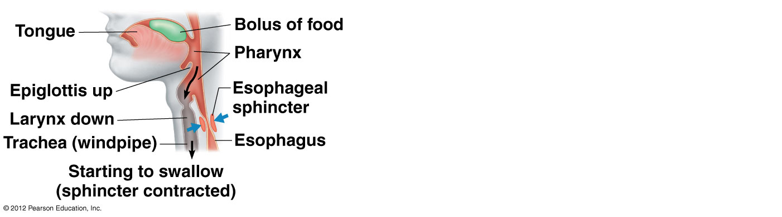

Slide 31
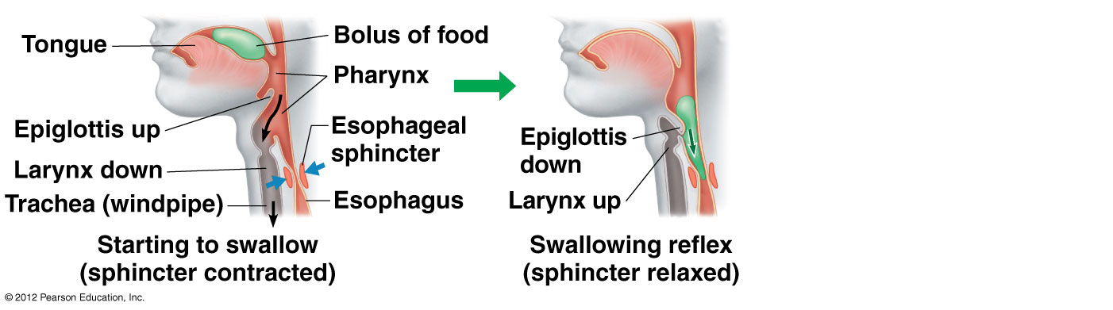

Slide 32
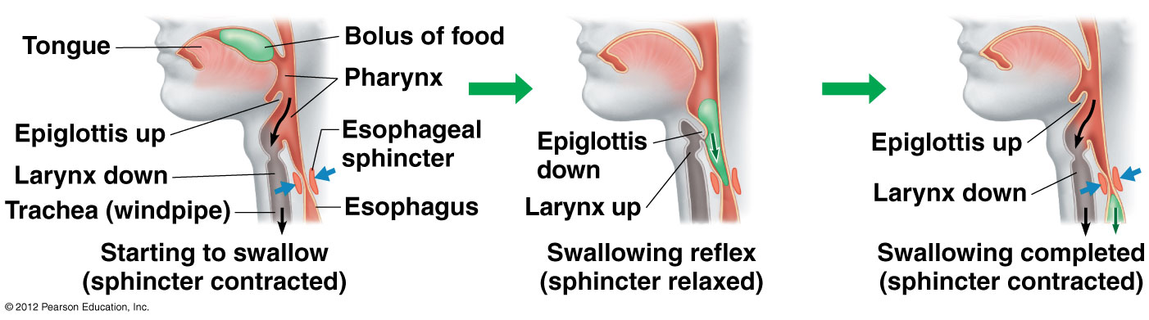

Slide 33
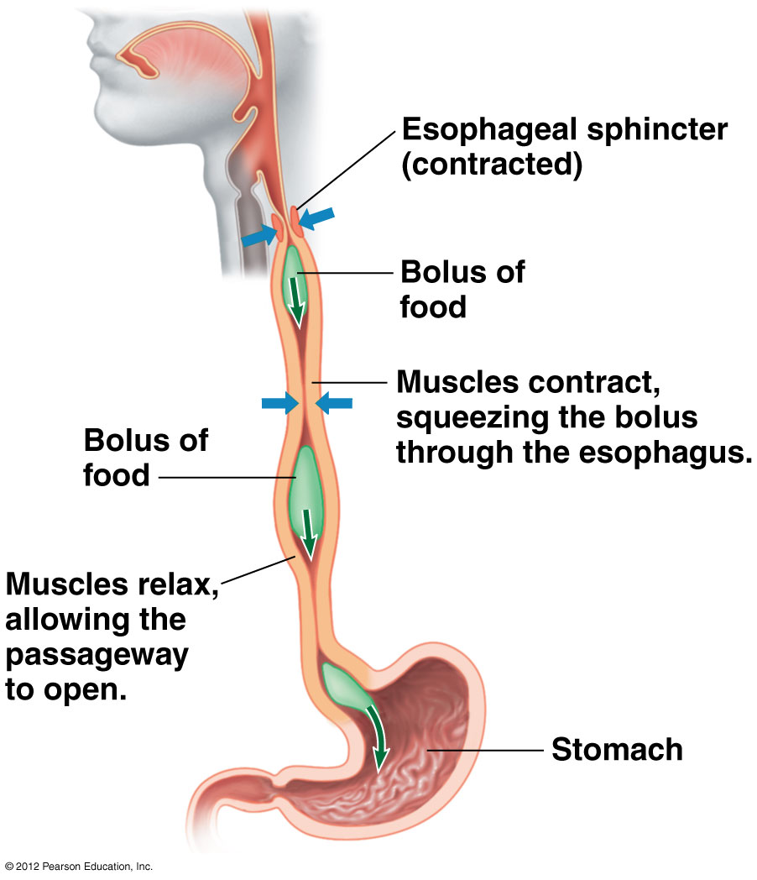

Slide 34


Slide 35
21.8 The stomach stores food and breaks it down with acid and enzymes
0
The stomach can stretch and store up to 2 liters of food and drink.
Some chemical digestion occurs in the stomach.
The stomach secretes gastric juice, made up of
  mucus,
  a protein-digesting enzyme, and
  strong acid with a pH of about 2 that
    kills ingested bacteria,
    breaks apart cells in food, and
    denatures proteins.
© 2012 Pearson Education, Inc.
Notes:
35
Teaching Tips
1. As noted by the authors, one of the important roles of stomach acids is to kill pathogens (mostly bacteria) that we ingest with our meals. Although it is best to wash our hands before we eat, saliva and stomach acids serve as a backup system.
2. The anticipation of a meal may result in an increase in the peristaltic activity of an empty stomach. The movement of gas pockets in the stomach and intestines lead to the sounds of a hungry stomach “growling.”

Slide 36
21.8 The stomach stores food and breaks it down with acid and enzymes
0
What prevents the gastric juices from digesting the walls of the stomach?
  The secretion of pepsin in the inactive form of pepsinogen helps protect the cells of the gastric glands.
  Mucus helps protect the stomach lining against HCl and pepsin.
  New cells lining the stomach are produced about every three days to those that have been damaged.
© 2012 Pearson Education, Inc.
Notes:
36
Teaching Tips
1. As noted by the authors, one of the important roles of stomach acids is to kill pathogens (mostly bacteria) that we ingest with our meals. Although it is best to wash our hands before we eat, saliva and stomach acids serve as a backup system.
2. The anticipation of a meal may result in an increase in the peristaltic activity of an empty stomach. The movement of gas pockets in the stomach and intestines lead to the sounds of a hungry stomach “growling.”

Slide 37
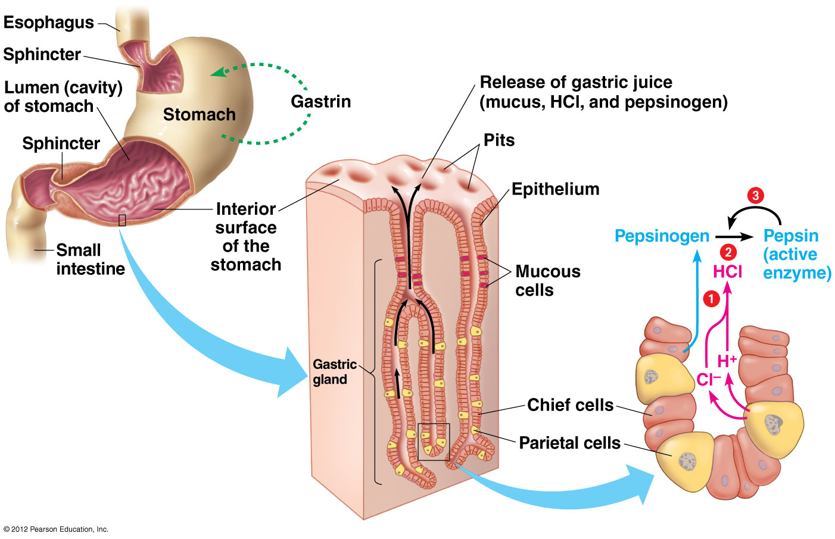

Slide 38
21.9 CONNECTION: Digestive ailments include acid reflux and gastric ulcers
0
Acid reflux of chyme in the stomach back into the esophagus causes the feeling of heartburn.
Gastroesophageal reflux disease (GERD) results from frequent and severe acid reflux that harms the lining of the esophagus.
Open sores in the lining of the stomach, called ulcers, may form.
Bacterial infections (Helicobacter pylori) in the stomach and duodenum can produce ulcers.
© 2012 Pearson Education, Inc.
Notes:
38
Teaching Tips
The finding that most human ulcers result from Helicobacter pylori infections represented a significant shift in medical understanding, and led to the 2005 Nobel Prize in Medicine being awarded to Drs. Robin Warren and Barry Marshall. This new explanation helps to illustrate the tentative nature of scientific knowledge, and the importance of the willingness to reject a hypothesis if another offers a better explanation.

Slide 39
21.10 The small intestine is the major organ of chemical digestion and nutrient absorption
0
The small intestine is
  named for its smaller diameter,
  about 6 meters long,
  the site of much chemical digestion, and
  where most nutrients are absorbed.
© 2012 Pearson Education, Inc.
Notes:
39
Teaching Tips
1. The same process of emulsification that helps break down fats in the small intestine also helps keep oil permanently mixed with vinegar in some commercial salad dressings.
2. A person who continues to vomit after emptying the stomach might eventually bring up a small amount of bitter-tasting green fluid. This is likely to be bile pulled up from the small intestine!

Slide 40
21.10 The small intestine is the major organ of chemical digestion and nutrient absorption
0
The first 25 cm of the small intestine is the duodenum, where chyme squirted from the stomach mixes with digestive juices from the pancreas, liver, gallbladder, and gland cells in the intestinal wall.
  The pancreas produces pancreatic juice containing a mixture of digestive enzymes and an alkaline solution rich in bicarbonate.
  The liver produces bile, which is stored in the gallbladder until it is needed. Bile breaks up fats into small droplets that are more susceptible to attack by digestive enzymes.
  The intestinal wall produces digestive enzymes.
© 2012 Pearson Education, Inc.
Notes:
40
Teaching Tips
1. The same process of emulsification that helps break down fats in the small intestine also helps keep oil permanently mixed with vinegar in some commercial salad dressings.
2. A person who continues to vomit after emptying the stomach might eventually bring up a small amount of bitter-tasting green fluid. This is likely to be bile pulled up from the small intestine!

Slide 41
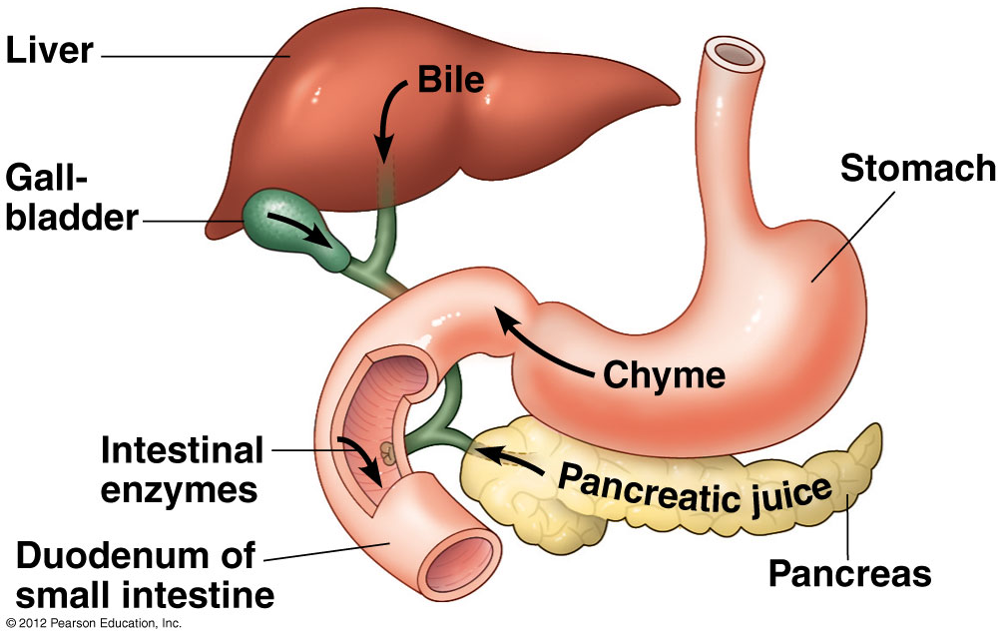

Slide 42
21.10 The small intestine is the major organ of chemical digestion and nutrient absorption
0
  The surface area for absorption in the small intestine is greatly increased by
    folds of the intestinal lining,
    fingerlike projections called villi,
© 2012 Pearson Education, Inc.
Notes:
42
Teaching Tips
1. The same process of emulsification that helps break down fats in the small intestine also helps keep oil permanently mixed with vinegar in some commercial salad dressings.
2. A person who continues to vomit after emptying the stomach might eventually bring up a small amount of bitter-tasting green fluid. This is likely to be bile pulled up from the small intestine!

Slide 43
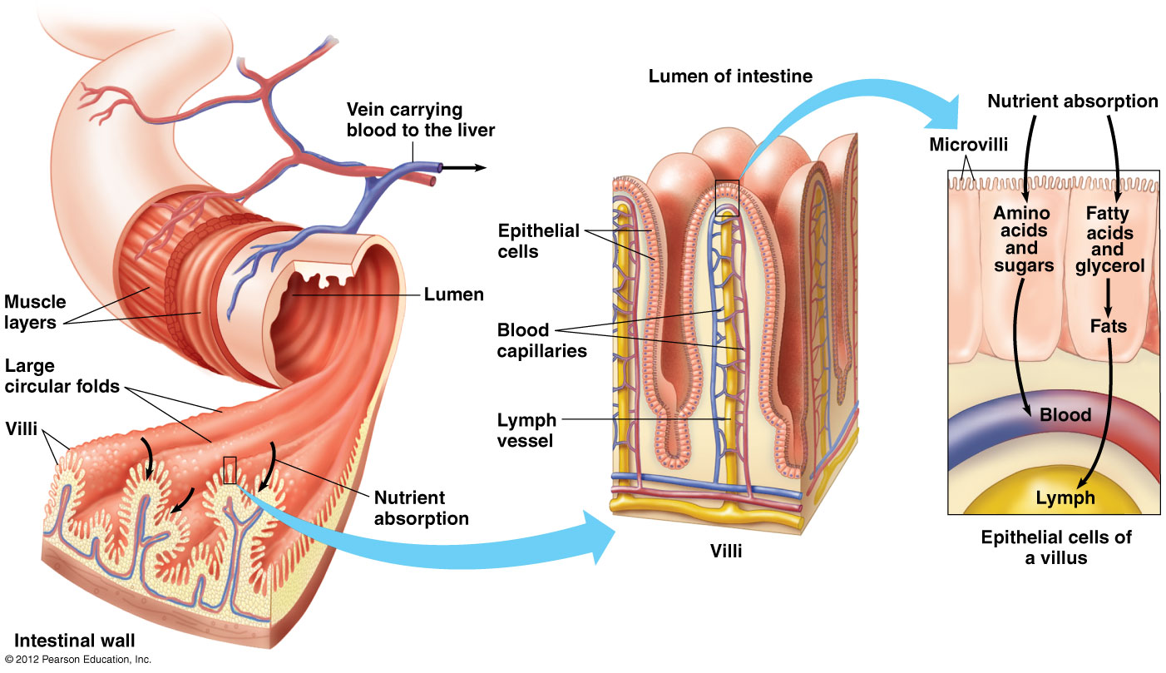

Slide 44
21.10 The small intestine is the major organ of chemical digestion and nutrient absorption
0
  Nutrients pass into epithelial cells by
    diffusion and
    against concentration gradients.
  Fatty acids and glycerol are
    recombined into fats,
    coated with proteins, and
    transported into lymph vessels.
© 2012 Pearson Education, Inc.
Notes:
44
Teaching Tips
1. The same process of emulsification that helps break down fats in the small intestine also helps keep oil permanently mixed with vinegar in some commercial salad dressings.
2. A person who continues to vomit after emptying the stomach might eventually bring up a small amount of bitter-tasting green fluid. This is likely to be bile pulled up from the small intestine!

Slide 45
21.10 The small intestine is the major organ of chemical digestion and nutrient absorption
0
  Other absorbed nutrients such as amino acids and sugars pass
    out of the intestinal epithelium,
    across the thin walls of the capillaries into blood, and finally to the liver.
© 2012 Pearson Education, Inc.
Notes:
45
Teaching Tips
1. The same process of emulsification that helps break down fats in the small intestine also helps keep oil permanently mixed with vinegar in some commercial salad dressings.
2. A person who continues to vomit after emptying the stomach might eventually bring up a small amount of bitter-tasting green fluid. This is likely to be bile pulled up from the small intestine!

Slide 46
21.11 One of the liver’s many functions is processing nutrient-laden blood from the intestines
0
Blood from the digestive tract drains
  into the hepatic portal vein
  to the liver.
© 2012 Pearson Education, Inc.
Notes:
46
Teaching Tips
1. The liver is often said to “filter” the blood. However, unlike a coffee or air filter, the liver does not trap particles. Instead, chemicals are degraded by the liver into less toxic forms.
2. Students might wonder why they might need to take another dose of aspirin or other drug every four hours. What happened to the first dose? The liver is often involved in the breakdown of these medicines, which are eliminated from the bloodstream over time.
3. If a person’s gallbladder is removed, they will continue to produce bile; however, they will no longer have the capacity to release large amounts of it corresponding to the ingestion of a particularly fatty meal.

Slide 47
21.11 One of the liver’s many functions is processing nutrient-laden blood from the intestines
0
The liver performs many functions. The liver
  converts glucose in blood to glycogen,
  stores glycogen and releases sugars back into the blood as needed,
  synthesizes many proteins including blood-clotting proteins and lipoproteins that transport fats and cholesterol to body cells,
  modifies substances absorbed in the digestive tract into less toxic forms, and
  produces bile.
© 2012 Pearson Education, Inc.
Notes:
47
Teaching Tips
1. The liver is often said to “filter” the blood. However, unlike a coffee or air filter, the liver does not trap particles. Instead, chemicals are degraded by the liver into less toxic forms.
2. Students might wonder why they might need to take another dose of aspirin or other drug every four hours. What happened to the first dose? The liver is often involved in the breakdown of these medicines, which are eliminated from the bloodstream over time.
3. If a person’s gallbladder is removed, they will continue to produce bile; however, they will no longer have the capacity to release large amounts of it corresponding to the ingestion of a particularly fatty meal.

Slide 48
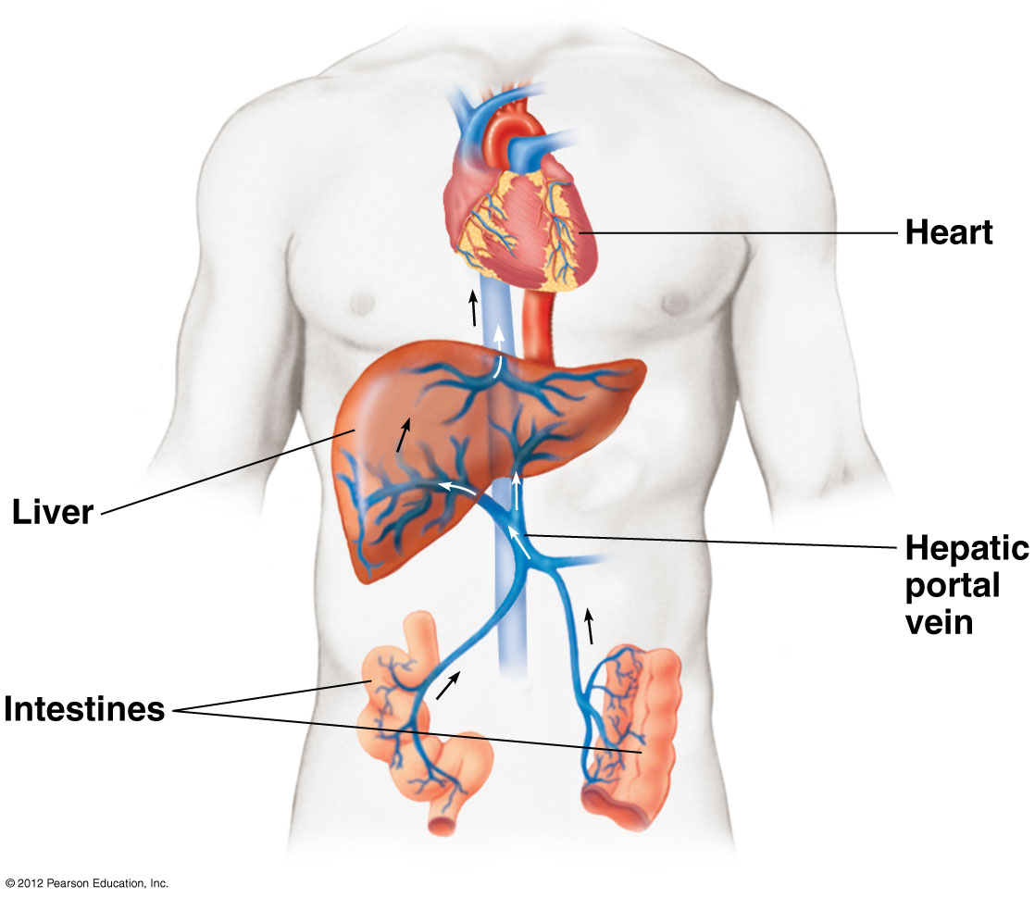

Slide 49
21.12 The large intestine reclaims water and compacts the feces
0
The large intestine, or colon,
  is about 1.5 m long and 5 cm in diameter,
  has a pouch called the cecum near its junction with the small intestine, which bears a small fingerlike extension, the appendix,
  contains large populations of E. coli, which produce important vitamins,
  absorbs these vitamins and water into the bloodstream, and
  helps form firm feces, which are stored in the rectum until elimination.
© 2012 Pearson Education, Inc.
Notes:
49
Teaching Tips
1. Bacteria in the large intestine ferment some of the indigestible carbohydrates, releasing methane, carbon dioxide, and other gases. Most adult humans produce about 500 milliliters of this gas (flatulus) each day. A diet particularly high in certain carbohydrate-rich foods (such as beans) can greatly increase the quantity of flatulus that is produced.
2. In a 2009 report, the United Nations estimated that worldwide, approximately 1.5 million children (under the age of 5) die each year from diarrhea. The report notes that the total annual deaths from diarrhea exceed the combined deaths caused by AIDS, malaria, and measles.

Slide 50
21.12 The large intestine reclaims water and compacts the feces
0
Diarrhea occurs when too little water is reclaimed from the contents of the large intestine.
Constipation occurs when too much water is reclaimed.
© 2012 Pearson Education, Inc.
Notes:
50
Teaching Tips
1. Bacteria in the large intestine ferment some of the indigestible carbohydrates, releasing methane, carbon dioxide, and other gases. Most adult humans produce about 500 milliliters of this gas (flatulus) each day. A diet particularly high in certain carbohydrate-rich foods (such as beans) can greatly increase the quantity of flatulus that is produced.
2. In a 2009 report, the United Nations estimated that worldwide, approximately 1.5 million children (under the age of 5) die each year from diarrhea. The report notes that the total annual deaths from diarrhea exceed the combined deaths caused by AIDS, malaria, and measles.

Slide 51
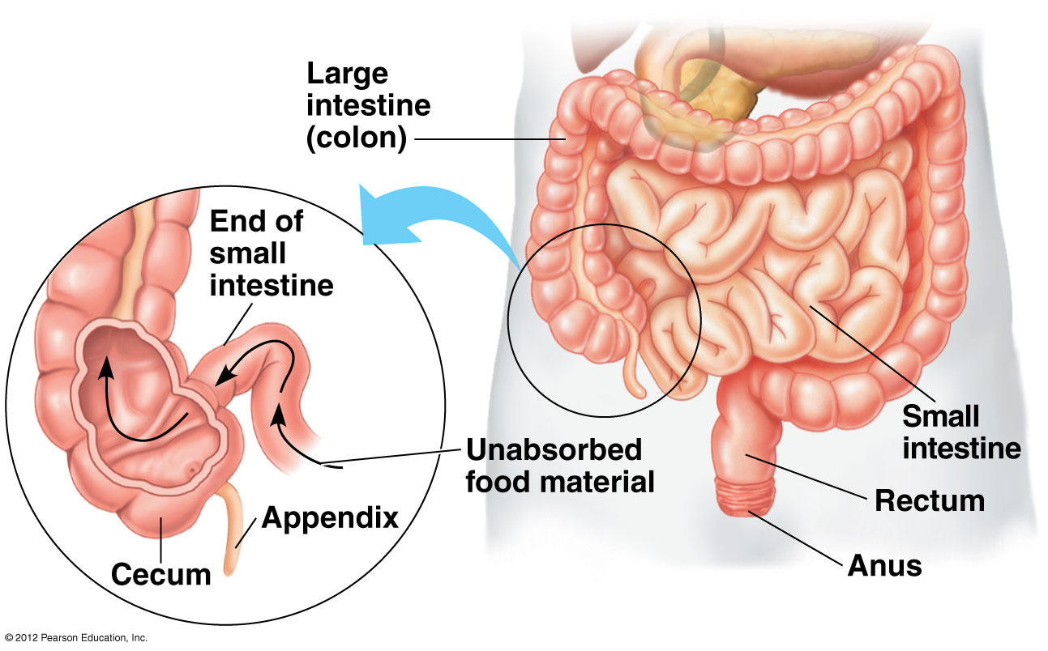

Slide 52
21.13 EVOLUTION CONNECTION: Evolutionary adaptations of vertebrate digestive systems relate to diet
0
The length of the digestive tract often correlates with diet. In general, the alimentary canals relative to their body size are
  longer in herbivores and omnivores and
  shorter in carnivores.
© 2012 Pearson Education, Inc.
Notes:
52
Teaching Tips
1. Many sharks have a spiral valve inside the intestine that increases the surface area in contact with the intestinal contents.
2. Before discussing the digestive tracts of carnivores and herbivores, have your students guess about the differences between them. Which digestive tract do they expect will be longer, and why do they think so? Beginning lectures with such basic questions stimulates student interest and exposes both their background knowledge and their misconceptions.

Slide 53
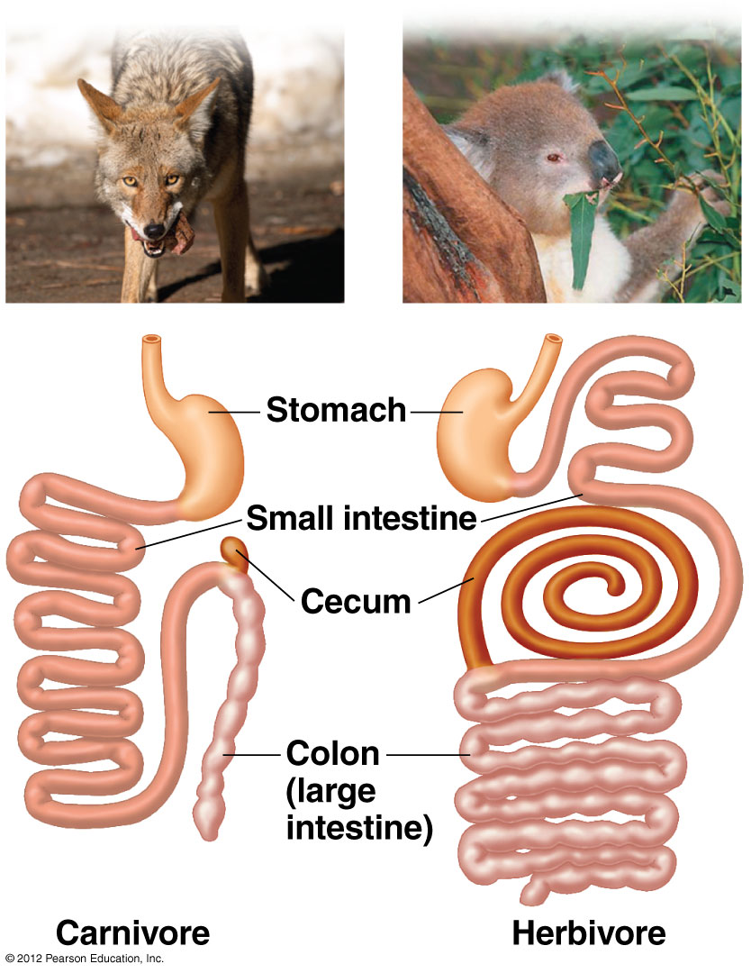

Slide 54
21.16 An animal’s diet must supply essential nutrients
0
Essential nutrients cannot be made from any raw material.
There are four classes of essential nutrients.
  Essential fatty acids, such as linoleic acid, are
    used to make phospholipids of cell membranes and
    found in seeds, grains, and vegetables.
  Essential amino acids are
    used to make proteins and
    found in meats, eggs, and milk.
© 2012 Pearson Education, Inc.
Notes:
54
Student Misconceptions and Concerns
1. Given new choices and greater freedom away from home, young college students frequently experiment with their diets. The details on nutritional requirements are worth additional emphasis in lecture.
2. Advertising frequently creates false expectations about simple shortcuts to dieting. Consider emphasizing the importance of a well-balanced diet and exercise.
3. Students may struggle with the concept that a pound of fat contains more than twice the calories of a pound of sugar. It might seem that a pound of food would simply add a pound of weight. (You might wish to remind them that fiber and water have no caloric value, but still add to the weight of food.) They may also have never understood the concept of dietary calories, but just tried to avoid fatty foods. Consider encouraging class discussions that explore student misconceptions about calories, body weight, and healthy diets.
Teaching Tips
1. One of the challenges zookeepers face is to determine the essential nutrients required in the diets of exotic animals. Without an appreciation of the natural diet of a rare animal, certain dietary requirements may remain undetected, resulting in malnourishment.
2. The U.S. Department of Health and Human Services provides their Dietary Guidelines for All Americans at www.health.gov/dietaryguidelines.

Slide 55
21.16 An animal’s diet must supply essential nutrients
0
    Vitamins are organic nutrients discussed in Module 21.17.
    Minerals are simple inorganic nutrients discussed in Module 21.17.
  Malnutrition is a chronic deficiency in calories or one or more essential nutrients. The most common type of human malnutrition is protein deficiency.
  Undernutrition occurs when
    diets do not supply sufficient chemical energy or
    a person suffers from anorexia nervosa or bulemia.
© 2012 Pearson Education, Inc.
Notes:
55
Student Misconceptions and Concerns
1. Given new choices and greater freedom away from home, young college students frequently experiment with their diets. The details on nutritional requirements are worth additional emphasis in lecture.
2. Advertising frequently creates false expectations about simple shortcuts to dieting. Consider emphasizing the importance of a well-balanced diet and exercise.
3. Students may struggle with the concept that a pound of fat contains more than twice the calories of a pound of sugar. It might seem that a pound of food would simply add a pound of weight. (You might wish to remind them that fiber and water have no caloric value, but still add to the weight of food.) They may also have never understood the concept of dietary calories, but just tried to avoid fatty foods. Consider encouraging class discussions that explore student misconceptions about calories, body weight, and healthy diets.
Teaching Tips
1. One of the challenges zookeepers face is to determine the essential nutrients required in the diets of exotic animals. Without an appreciation of the natural diet of a rare animal, certain dietary requirements may remain undetected, resulting in malnourishment.
2. The U.S. Department of Health and Human Services provides their Dietary Guidelines for All Americans at www.health.gov/dietaryguidelines.

Slide 56
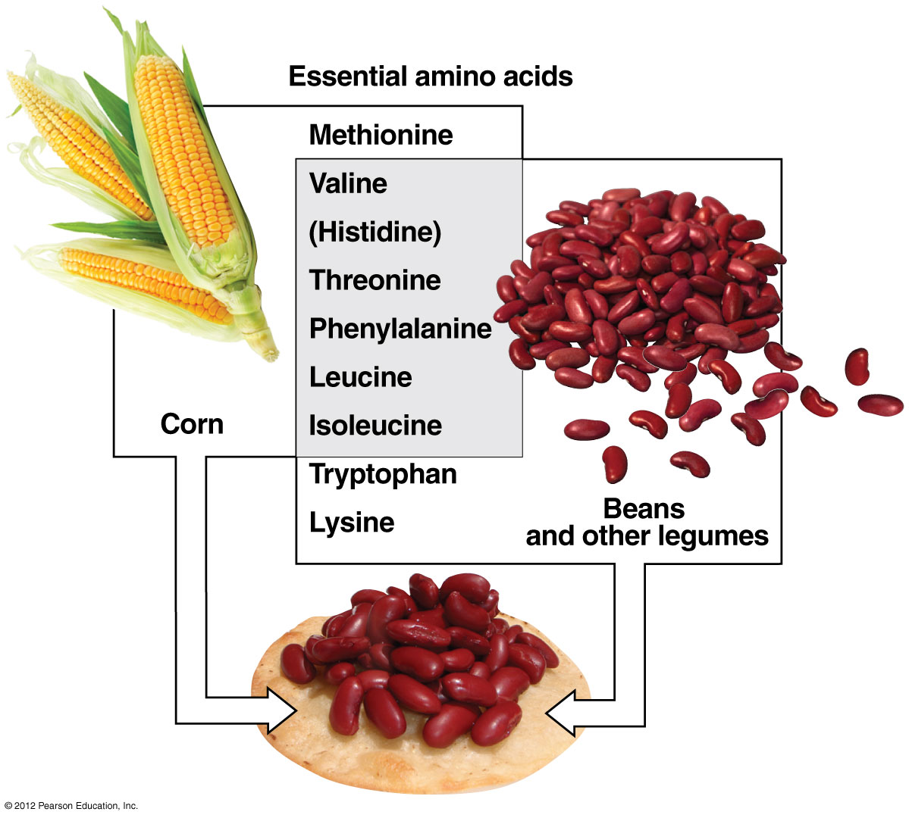

Slide 57
21.17 A healthy human diet includes 13 vitamins and many essential minerals
0
Essential vitamins and minerals are
  required in minute amounts and
  absolutely essential to good health.
Vitamins are organic nutrients that may be
  water soluble, such as vitamins B and C, or
  fat soluble, such as vitamins A, D, E, and K.
© 2012 Pearson Education, Inc.
Notes:
57
Student Misconceptions and Concerns
1. Given new choices and greater freedom away from home, young college students frequently experiment with their diets. The details on nutritional requirements are worth additional emphasis in lecture.
2. Advertising frequently creates false expectations about simple shortcuts to dieting. Consider emphasizing the importance of a well-balanced diet and exercise.
3. Students may struggle with the concept that a pound of fat contains more than twice the calories of a pound of sugar. It might seem that a pound of food would simply add a pound of weight. (You might wish to remind them that fiber and water have no caloric value, but still add to the weight of food.) They may also have never understood the concept of dietary calories, but just tried to avoid fatty foods. Consider encouraging class discussions that explore student misconceptions about calories, body weight, and healthy diets.
Teaching Tips
1. The U.S. Department of Health and Human Services provides their Dietary Guidelines for All Americans at www.health.gov/dietaryguidelines.
2. Students are often surprised to learn that the mineral iron in our diets is the same iron we use as a building material. You might wish to point out that like the rust formed by the reaction of oxygen and iron, blood is also red, due to the bonding of oxygen to iron in our red blood cells. Furthermore, the familiar “metal” taste we experience when we have a cut in our mouth is due to the presence of iron in our blood.
3. Students who take vitamins might recall that fat-soluble vitamins are often taken as gel capsules (such as vitamin E) while water-soluble vitamins are taken in crushable pill form.
4. Table 21.17A illustrates the details of vitamin requirements for humans. Students might benefit from a comparison of this table and the label from a bottle of daily vitamins.

Slide 58
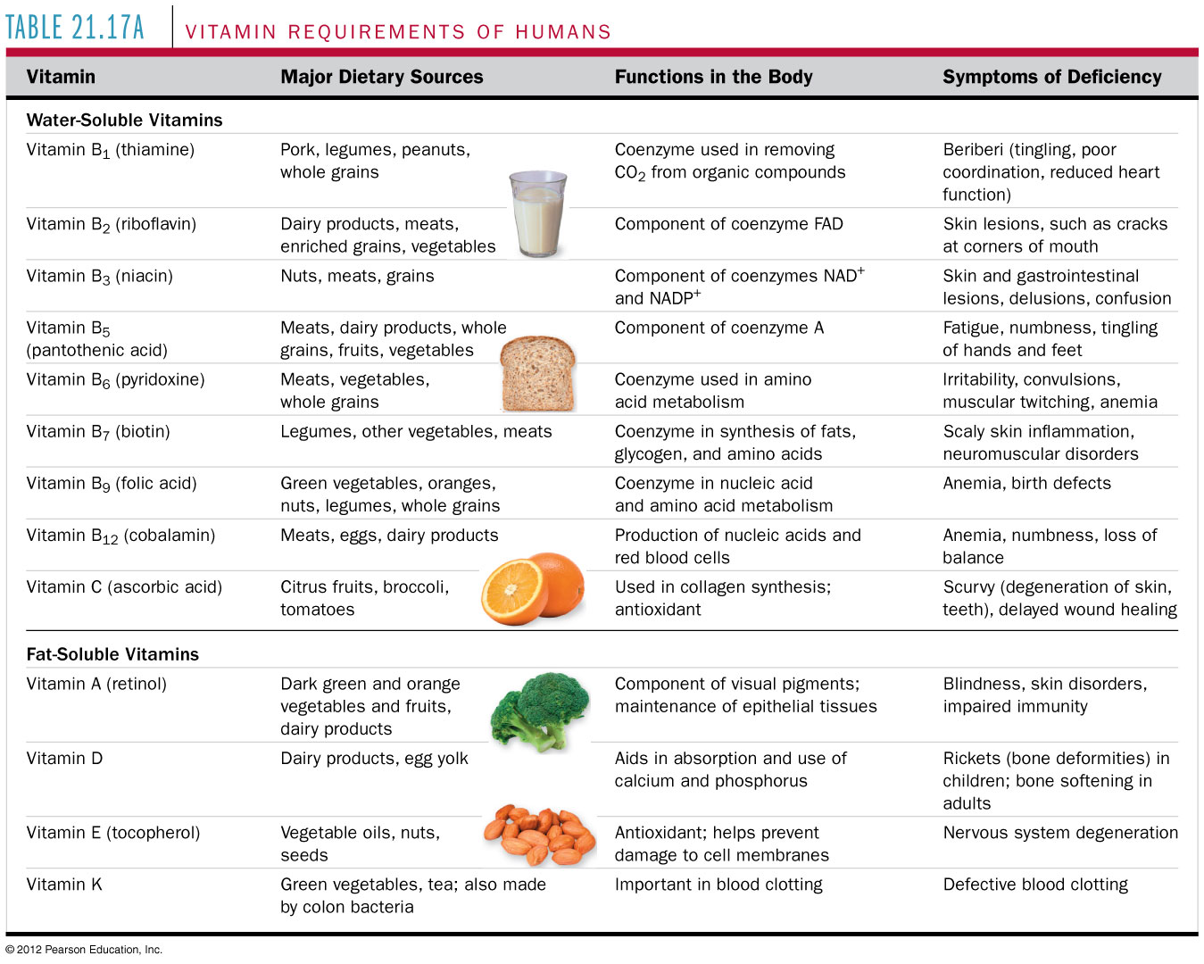
Table 21.17A
Notes:
58
Table 21.17A Vitamin Requirements of Humans

Slide 59
21.17 A healthy human diet includes 13 vitamins and many essential minerals
0
Minerals are simple inorganic nutrients.
  Calcium and phosphorus are required in larger amounts.
  Iron is needed to make hemoglobin.
  Iodine is required to make thyroid hormones.
  Most people ingest more salt than they need.
© 2012 Pearson Education, Inc.
Notes:
59
Student Misconceptions and Concerns
1. Given new choices and greater freedom away from home, young college students frequently experiment with their diets. The details on nutritional requirements are worth additional emphasis in lecture.
2. Advertising frequently creates false expectations about simple shortcuts to dieting. Consider emphasizing the importance of a well-balanced diet and exercise.
3. Students may struggle with the concept that a pound of fat contains more than twice the calories of a pound of sugar. It might seem that a pound of food would simply add a pound of weight. (You might wish to remind them that fiber and water have no caloric value, but still add to the weight of food.) They may also have never understood the concept of dietary calories, but just tried to avoid fatty foods. Consider encouraging class discussions that explore student misconceptions about calories, body weight, and healthy diets.
Teaching Tips
1. The U.S. Department of Health and Human Services provides their Dietary Guidelines for All Americans at www.health.gov/dietaryguidelines.
2. Students are often surprised to learn that the mineral iron in our diets is the same iron we use as a building material. You might wish to point out that like the rust formed by the reaction of oxygen and iron, blood is also red, due to the bonding of oxygen to iron in our red blood cells. Furthermore, the familiar “metal” taste we experience when we have a cut in our mouth is due to the presence of iron in our blood.
3. Students who take vitamins might recall that fat-soluble vitamins are often taken as gel capsules (such as vitamin E) while water-soluble vitamins are taken in crushable pill form.
4. Table 21.17A illustrates the details of vitamin requirements for humans. Students might benefit from a comparison of this table and the label from a bottle of daily vitamins.

Slide 60
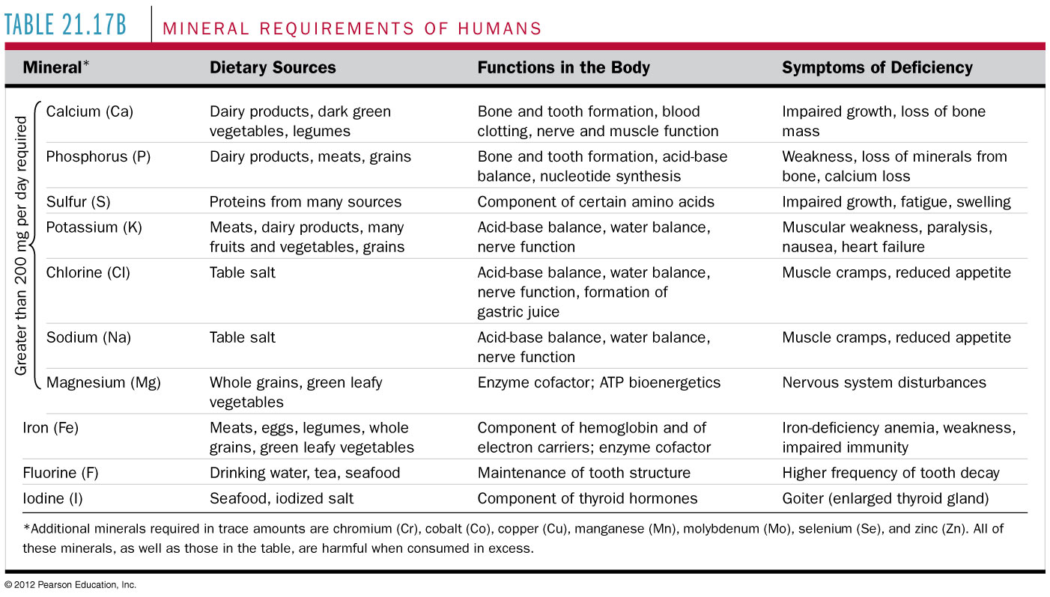
Table 21.17B
Notes:
60
Table 21.17B Mineral Requirements of Humans

Slide 61
21.22 CONNECTION: Diet can influence risk of cardiovascular disease and cancer
0
A healthy diet may reduce the risk of
  cardiovascular disease and
  cancer.
© 2012 Pearson Education, Inc.
Notes:
61
Student Misconceptions and Concerns
1. Given new choices and greater freedom away from home, young college students frequently experiment with their diets. The details on nutritional requirements are worth additional emphasis in lecture.
2. Advertising frequently creates false expectations about simple shortcuts to dieting. Consider emphasizing the importance of a well-balanced diet and exercise.
3. Students may struggle with the concept that a pound of fat contains more than twice the calories of a pound of sugar. It might seem that a pound of food would simply add a pound of weight. (You might wish to remind them that fiber and water have no caloric value, but still add to the weight of food.) They may also have never understood the concept of dietary calories, but just tried to avoid fatty foods. Consider encouraging class discussions that explore student misconceptions about calories, body weight, and healthy diets.
Teaching Tips
1. Margarine commonly comes in liquid squeeze containers, in tubs, and in sticks. These forms reflect increasing amounts of hydrogenation, gradually increasing in firmness from a liquid, to a firmer spread, to a solid stick of margarine. As noted in the text, recent studies have suggested that unsaturated oils become increasingly unhealthy as they are hydrogenated. Public attention to hydrogenation and the health risks of the trans fats that result are causing many people to cut their consumption of trans fats.
2. The American Cancer Society’s website, www.cancer.org, has extensive information on the relationship between diet and cancer. Search within their website for “Common Questions About Diet and Cancer.”

Slide 62
21.22 CONNECTION: Diet can influence risk of cardiovascular disease and cancer
0
Two main types of cholesterol occur in the blood.
  Low-density lipoproteins (LDL) contribute to
    blocked blood vessels and
    higher blood pressure.
  High-density lipoproteins (HDL) help to reduce blocked blood vessels.
    Exercise increases HDL levels.
    Smoking decreases HDL levels.
    Trans fats in the diet tend to increase LDL levels.
    Eating mainly unsaturated fats tends to lower LDL levels.
© 2012 Pearson Education, Inc.
Notes:
62
Student Misconceptions and Concerns
1. Given new choices and greater freedom away from home, young college students frequently experiment with their diets. The details on nutritional requirements are worth additional emphasis in lecture.
2. Advertising frequently creates false expectations about simple shortcuts to dieting. Consider emphasizing the importance of a well-balanced diet and exercise.
3. Students may struggle with the concept that a pound of fat contains more than twice the calories of a pound of sugar. It might seem that a pound of food would simply add a pound of weight. (You might wish to remind them that fiber and water have no caloric value, but still add to the weight of food.) They may also have never understood the concept of dietary calories, but just tried to avoid fatty foods. Consider encouraging class discussions that explore student misconceptions about calories, body weight, and healthy diets.
Teaching Tips
1. Margarine commonly comes in liquid squeeze containers, in tubs, and in sticks. These forms reflect increasing amounts of hydrogenation, gradually increasing in firmness from a liquid, to a firmer spread, to a solid stick of margarine. As noted in the text, recent studies have suggested that unsaturated oils become increasingly unhealthy as they are hydrogenated. Public attention to hydrogenation and the health risks of the trans fats that result are causing many people to cut their consumption of trans fats.
2. The American Cancer Society’s website, www.cancer.org, has extensive information on the relationship between diet and cancer. Search within their website for “Common Questions About Diet and Cancer.”

Slide 63
21.22 CONNECTION: Diet can influence risk of cardiovascular disease and cancer
0
The relationship between food and health is complex.
The American Cancer Society recommends
  regular exercise and
  a diverse diet of healthy foods with an emphasis on plant sources.
© 2012 Pearson Education, Inc.
Notes:
63
Student Misconceptions and Concerns
1. Given new choices and greater freedom away from home, young college students frequently experiment with their diets. The details on nutritional requirements are worth additional emphasis in lecture.
2. Advertising frequently creates false expectations about simple shortcuts to dieting. Consider emphasizing the importance of a well-balanced diet and exercise.
3. Students may struggle with the concept that a pound of fat contains more than twice the calories of a pound of sugar. It might seem that a pound of food would simply add a pound of weight. (You might wish to remind them that fiber and water have no caloric value, but still add to the weight of food.) They may also have never understood the concept of dietary calories, but just tried to avoid fatty foods. Consider encouraging class discussions that explore student misconceptions about calories, body weight, and healthy diets.
Teaching Tips
1. Margarine commonly comes in liquid squeeze containers, in tubs, and in sticks. These forms reflect increasing amounts of hydrogenation, gradually increasing in firmness from a liquid, to a firmer spread, to a solid stick of margarine. As noted in the text, recent studies have suggested that unsaturated oils become increasingly unhealthy as they are hydrogenated. Public attention to hydrogenation and the health risks of the trans fats that result are causing many people to cut their consumption of trans fats.
2. The American Cancer Society’s website, www.cancer.org, has extensive information on the relationship between diet and cancer. Search within their website for “Common Questions About Diet and Cancer.”

Slide 64
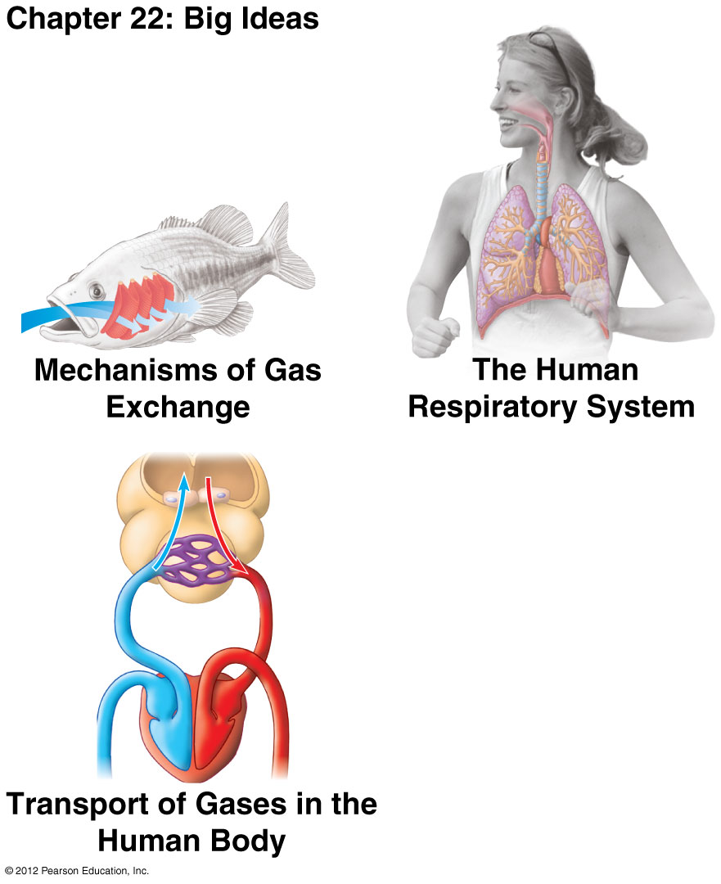

Slide 65
Introduction
0
People cannot survive for long in the air at the world’s highest peaks in the Himalayan Mountains.
Yet twice a year, flocks of geese migrate over the Himalayas.
How can geese fly where people cannot breathe?
  Geese have more efficient lungs than humans, and
  their hemoglobin has a very high affinity for oxygen.
© 2012 Pearson Education, Inc.
Notes:
65

Slide 66
0
MECHANISMS OF GAS EXCHANGE
© 2012 Pearson Education, Inc.
Notes:
66

Slide 67
22.1 Overview: Gas exchange in humans involves breathing, transport of gases, and exchange with body cells
0
  The process of gas exchange is sometimes called respiration, the interchange of
    O₂ and the waste product CO₂
    between an organism and its environment.
© 2012 Pearson Education, Inc.
Notes:
67
Student Misconceptions and Concerns
1. As the authors note (in Module 22.1), it is important to distinguish between the use of the word respiration in the context of the whole organism (breathing) and in the context of cells (cellular respiration).
2. Respiratory structures such as gills, lungs, and insect tracheal systems are highly branched, reflecting an adaptation to increase the surface area and ultimately the surface-to-volume ratio of the animal. Students might not realize the common principles of adaptations to increase surface-to-volume ratios in the highly branched respiratory structures, as well as in the circulatory system (for example, the small size of red blood cells and tiny size of capillaries), discussed in detail in the next chapter. You might consider expanding on this principle as you address other systems that reflect such adaptations (for example, greater surface area of the digestive system for absorption of nutrients).
Teaching Tips
You may want to point out that in scientific artwork, it is common to identify blood vessels in the arterial system by coloring them red, and blood vessels in the venous system by coloring them blue. As experienced biologists, such expectations can be so routine that we forget that we might need to point this out to our students.

Slide 68
22.1 Overview: Gas exchange in humans involves breathing, transport of gases, and exchange with body cells
0
Three phases of gas exchange occur in humans and other animals with lungs:
  breathing,
  transport of oxygen and carbon dioxide in blood, and
  exchange of gases with body cells.
    Body tissues take up oxygen and
    release carbon dioxide.
Cellular respiration requires a continuous supply of oxygen and the disposal of carbon dioxide.
© 2012 Pearson Education, Inc.
Notes:
68
Student Misconceptions and Concerns
1. As the authors note (in Module 22.1), it is important to distinguish between the use of the word respiration in the context of the whole organism (breathing) and in the context of cells (cellular respiration).
2. Respiratory structures such as gills, lungs, and insect tracheal systems are highly branched, reflecting an adaptation to increase the surface area and ultimately the surface-to-volume ratio of the animal. Students might not realize the common principles of adaptations to increase surface-to-volume ratios in the highly branched respiratory structures, as well as in the circulatory system (for example, the small size of red blood cells and tiny size of capillaries), discussed in detail in the next chapter. You might consider expanding on this principle as you address other systems that reflect such adaptations (for example, greater surface area of the digestive system for absorption of nutrients).
Teaching Tips
You may want to point out that in scientific artwork, it is common to identify blood vessels in the arterial system by coloring them red, and blood vessels in the venous system by coloring them blue. As experienced biologists, such expectations can be so routine that we forget that we might need to point this out to our students.

Slide 69
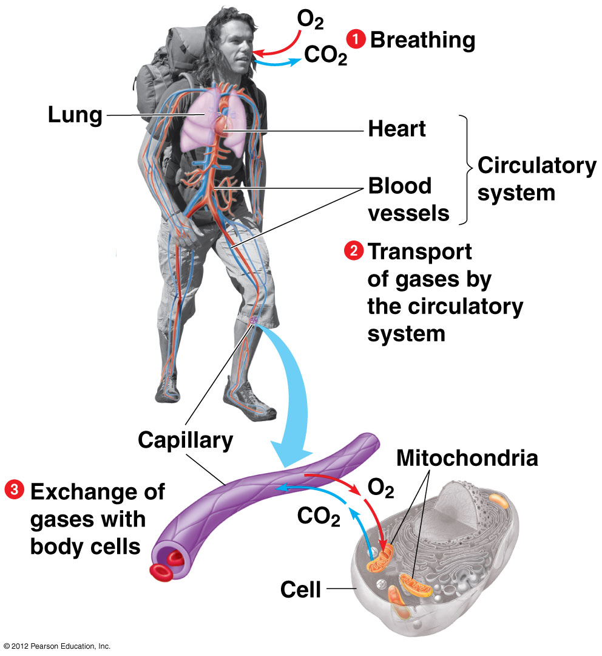

Slide 70
22.2 Animals exchange O₂ and CO₂ across moist body surfaces
0
Respiratory surfaces must be
  moist for diffusion of O₂ and CO₂ and
  thin, to best facilitate diffusion.
The skin may be used for gas exchange in animals that are
  wet and
  small.
  Earthworms are an example.
© 2012 Pearson Education, Inc.
Notes:
70
Student Misconceptions and Concerns
Respiratory structures such as gills, lungs, and insect tracheal systems are highly branched, reflecting an adaptation to increase the surface area and ultimately the surface-to-volume ratio of the animal. Students might not realize the common principles of adaptations to increase surface-to-volume ratios in the highly branched respiratory structures, as well as in the circulatory system (for example, the small size of red blood cells and tiny size of capillaries), discussed in detail in the next chapter. You might consider expanding on this principle as you address other systems that reflect such adaptations (for example, greater surface area of the digestive system for absorption of nutrients).
Teaching Tips
Salamanders in the family Plethodontidae are unusual terrestrial vertebrates that survive mainly on land as adults, yet have no lungs. The adults acquire all of their oxygen through their skin. Consider discussing with your class how this is possible. Their relatively small size, slow metabolic rates, preference for cool environments, and minimal physical activity all permit the absence of lungs.

Slide 71
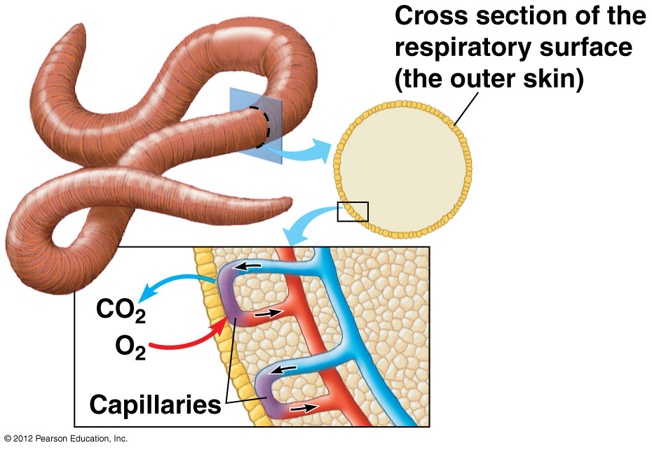

Slide 72
22.2 Animals exchange O₂ and CO₂ across moist body surfaces
0
Most animals have specialized body parts that promote gas exchange:
  gills in fish and amphibians,
  tracheal systems in arthropods, and
  lungs in tetrapods that live on land, such as
    amphibians,
    reptiles including birds, and
    mammals.
© 2012 Pearson Education, Inc.
Notes:
72
Student Misconceptions and Concerns
Respiratory structures such as gills, lungs, and insect tracheal systems are highly branched, reflecting an adaptation to increase the surface area and ultimately the surface-to-volume ratio of the animal. Students might not realize the common principles of adaptations to increase surface-to-volume ratios in the highly branched respiratory structures, as well as in the circulatory system (for example, the small size of red blood cells and tiny size of capillaries), discussed in detail in the next chapter. You might consider expanding on this principle as you address other systems that reflect such adaptations (for example, greater surface area of the digestive system for absorption of nutrients).
Teaching Tips
Salamanders in the family Plethodontidae are unusual terrestrial vertebrates that survive mainly on land as adults, yet have no lungs. The adults acquire all of their oxygen through their skin. Consider discussing with your class how this is possible. Their relatively small size, slow metabolic rates, preference for cool environments, and minimal physical activity all permit the absence of lungs.

Slide 73
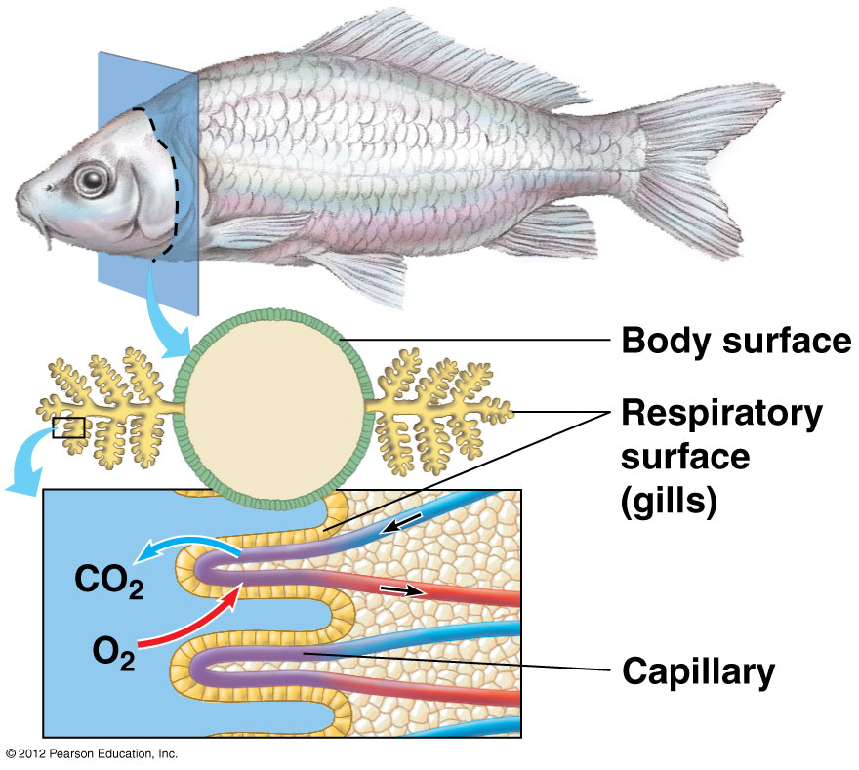

Slide 74
22.3 Gills are adapted for gas exchange in aquatic environments
0
Gills
  are extensions of the body,
  increase the surface to volume ratio, and
  increase the surface area for gas exchange.
    Oxygen is absorbed.
    Carbon dioxide is released.
© 2012 Pearson Education, Inc.
Notes:
74
Student Misconceptions and Concerns
Respiratory structures such as gills, lungs, and insect tracheal systems are highly branched, reflecting an adaptation to increase the surface area and ultimately the surface-to-volume ratio of the animal. Students might not realize the common principles of adaptations to increase surface-to-volume ratios in the highly branched respiratory structures, as well as in the circulatory system (for example, the small size of red blood cells and tiny size of capillaries), discussed in detail in the next chapter. You might consider expanding on this principle as you address other systems that reflect such adaptations (for example, greater surface area of the digestive system for absorption of nutrients).
Teaching Tips
1. Students struggling to recall the conditions that increase the oxygen content of water might benefit by picturing in their mind a scenario that includes all the best conditions. A pool at the base of a waterfall, generated from melting snow, has a very high oxygen content because the water is (a) fresh, (b) cool, and (c) turbulent.
2. As the authors note in Module 22.3, the basic principles of countercurrent exchange apply to the transfer of gases and temperature. Countercurrent exchange as it applies to temperature is addressed in Chapter 25.
3. Challenge your class to explain why fish gills do not work well in air. As noted in Modules 22.2 and 22.3, respiratory surfaces need to remain moist. In addition, the surface area of the gills is greatly reduced as the filaments adhere to each other. You can visually demonstrate this point by simply lifting your hand and spreading your fingers apart, noting that gills are spaced like this in water. In air (bring your fingers together), the filaments adhere into one larger mass with less surface area.

Slide 75
22.3 Gills are adapted for gas exchange in aquatic environments
0
  In a fish, gas exchange is enhanced by
    ventilation of the gills (moving water past the gills) and
    countercurrent flow of water and blood.
© 2012 Pearson Education, Inc.
Notes:
75
Student Misconceptions and Concerns
Respiratory structures such as gills, lungs, and insect tracheal systems are highly branched, reflecting an adaptation to increase the surface area and ultimately the surface-to-volume ratio of the animal. Students might not realize the common principles of adaptations to increase surface-to-volume ratios in the highly branched respiratory structures, as well as in the circulatory system (for example, the small size of red blood cells and tiny size of capillaries), discussed in detail in the next chapter. You might consider expanding on this principle as you address other systems that reflect such adaptations (for example, greater surface area of the digestive system for absorption of nutrients).
Teaching Tips
1. Students struggling to recall the conditions that increase the oxygen content of water might benefit by picturing in their mind a scenario that includes all the best conditions. A pool at the base of a waterfall, generated from melting snow, has a very high oxygen content because the water is (a) fresh, (b) cool, and (c) turbulent.
2. As the authors note in Module 22.3, the basic principles of countercurrent exchange apply to the transfer of gases and temperature. Countercurrent exchange as it applies to temperature is addressed in Chapter 25.
3. Challenge your class to explain why fish gills do not work well in air. As noted in Modules 22.2 and 22.3, respiratory surfaces need to remain moist. In addition, the surface area of the gills is greatly reduced as the filaments adhere to each other. You can visually demonstrate this point by simply lifting your hand and spreading your fingers apart, noting that gills are spaced like this in water. In air (bring your fingers together), the filaments adhere into one larger mass with less surface area.

Slide 76
22.3 Gills are adapted for gas exchange in aquatic environments
0
Gas exchange with water has its limits.
  Water holds only about 3% of the oxygen in air.
  Cold water holds more oxygen than warm water.
  Fresh water holds more oxygen than salt water.
  Turbulent water holds more oxygen than still water.
© 2012 Pearson Education, Inc.
Notes:
76
Student Misconceptions and Concerns
Respiratory structures such as gills, lungs, and insect tracheal systems are highly branched, reflecting an adaptation to increase the surface area and ultimately the surface-to-volume ratio of the animal. Students might not realize the common principles of adaptations to increase surface-to-volume ratios in the highly branched respiratory structures, as well as in the circulatory system (for example, the small size of red blood cells and tiny size of capillaries), discussed in detail in the next chapter. You might consider expanding on this principle as you address other systems that reflect such adaptations (for example, greater surface area of the digestive system for absorption of nutrients).
Teaching Tips
1. Students struggling to recall the conditions that increase the oxygen content of water might benefit by picturing in their mind a scenario that includes all the best conditions. A pool at the base of a waterfall, generated from melting snow, has a very high oxygen content because the water is (a) fresh, (b) cool, and (c) turbulent.
2. As the authors note in Module 22.3, the basic principles of countercurrent exchange apply to the transfer of gases and temperature. Countercurrent exchange as it applies to temperature is addressed in Chapter 25.
3. Challenge your class to explain why fish gills do not work well in air. As noted in Modules 22.2 and 22.3, respiratory surfaces need to remain moist. In addition, the surface area of the gills is greatly reduced as the filaments adhere to each other. You can visually demonstrate this point by simply lifting your hand and spreading your fingers apart, noting that gills are spaced like this in water. In air (bring your fingers together), the filaments adhere into one larger mass with less surface area.

Slide 77
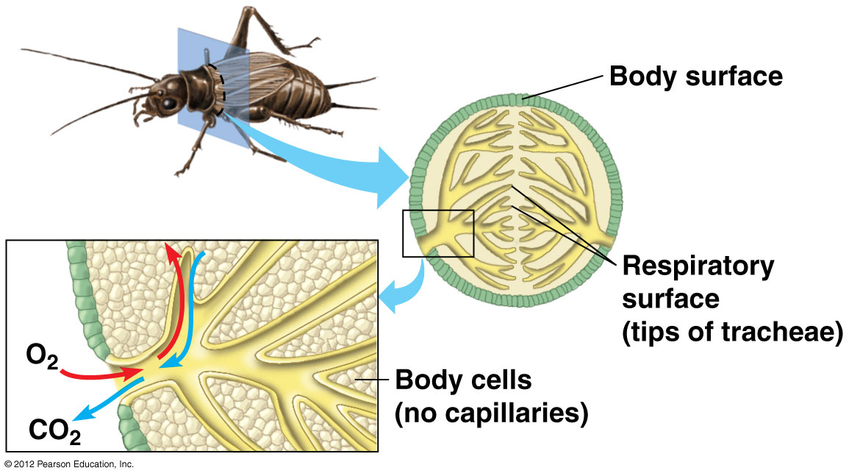

Slide 78
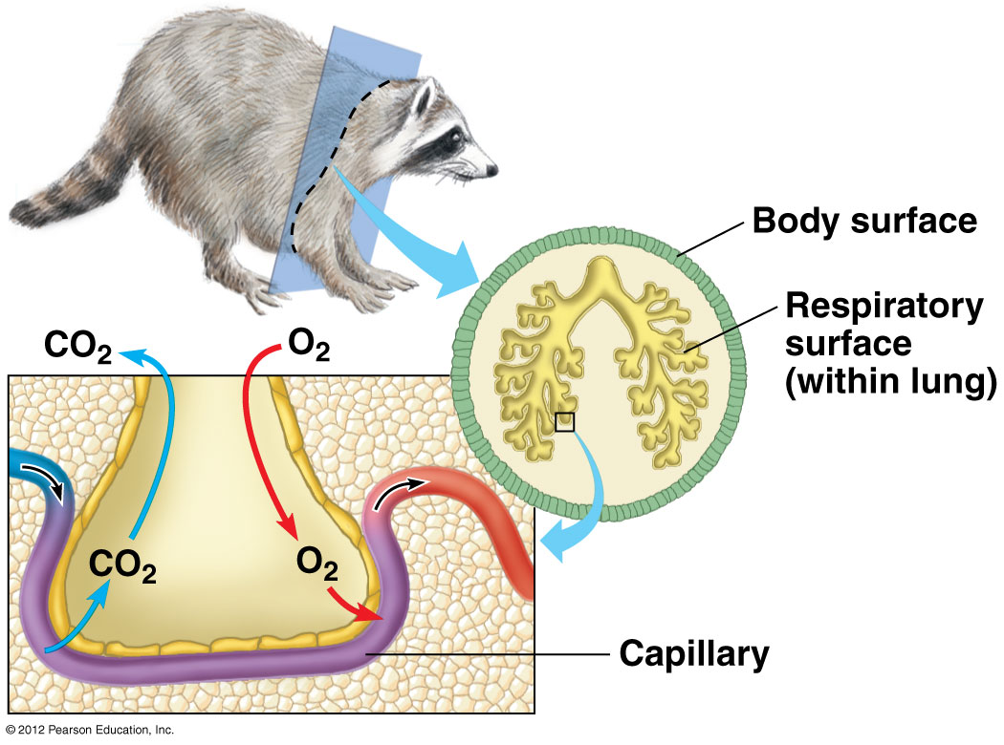

Slide 79
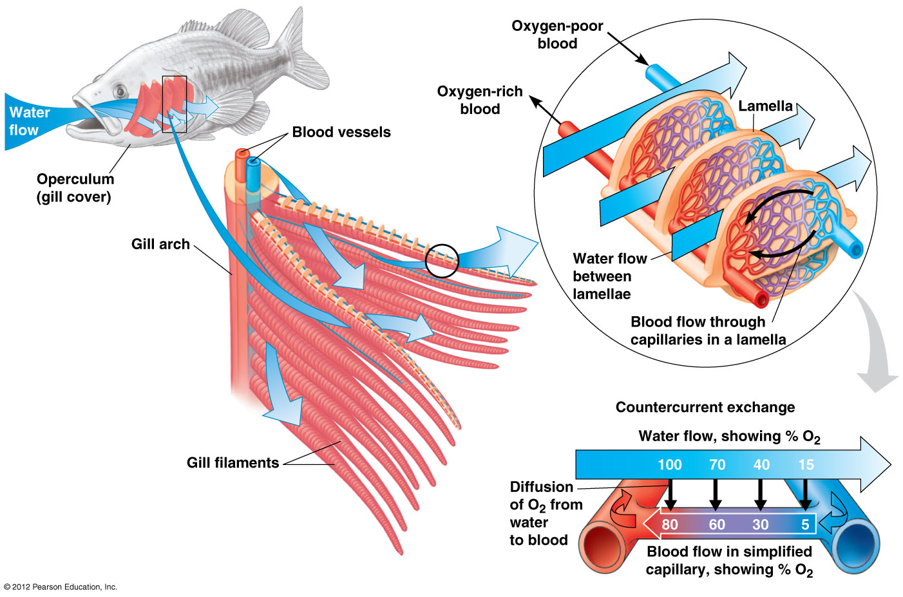

Slide 80
22.4 The tracheal system of insects provides direct exchange between the air and body cells
0
Insect tracheal systems use tiny branching tubes that
  reduce water loss and
  pipe air directly to cells.
© 2012 Pearson Education, Inc.
Notes:
80
Student Misconceptions and Concerns
Respiratory structures such as gills, lungs, and insect tracheal systems are highly branched, reflecting an adaptation to increase the surface area and ultimately the surface-to-volume ratio of the animal. Students might not realize the common principles of adaptations to increase surface-to-volume ratios in the highly branched respiratory structures, as well as in the circulatory system (for example, the small size of red blood cells and tiny size of capillaries), discussed in detail in the next chapter. You might consider expanding on this principle as you address other systems that reflect such adaptations (for example, greater surface area of the digestive system for absorption of nutrients).
Teaching Tips
1. You might mention to your class that most animals use tracheal systems. After all, insects are by far the dominant type of animal on Earth (at least 70% of all known animal species). Therefore, whatever insects do is automatically the most common animal adaptation!
2. In a very general sense, the tracheal system of insects is like the ductwork bringing outside air into the individual offices of a high-rise building. (But unlike a tracheal system, the air is removed from the building by another system.)

Slide 81
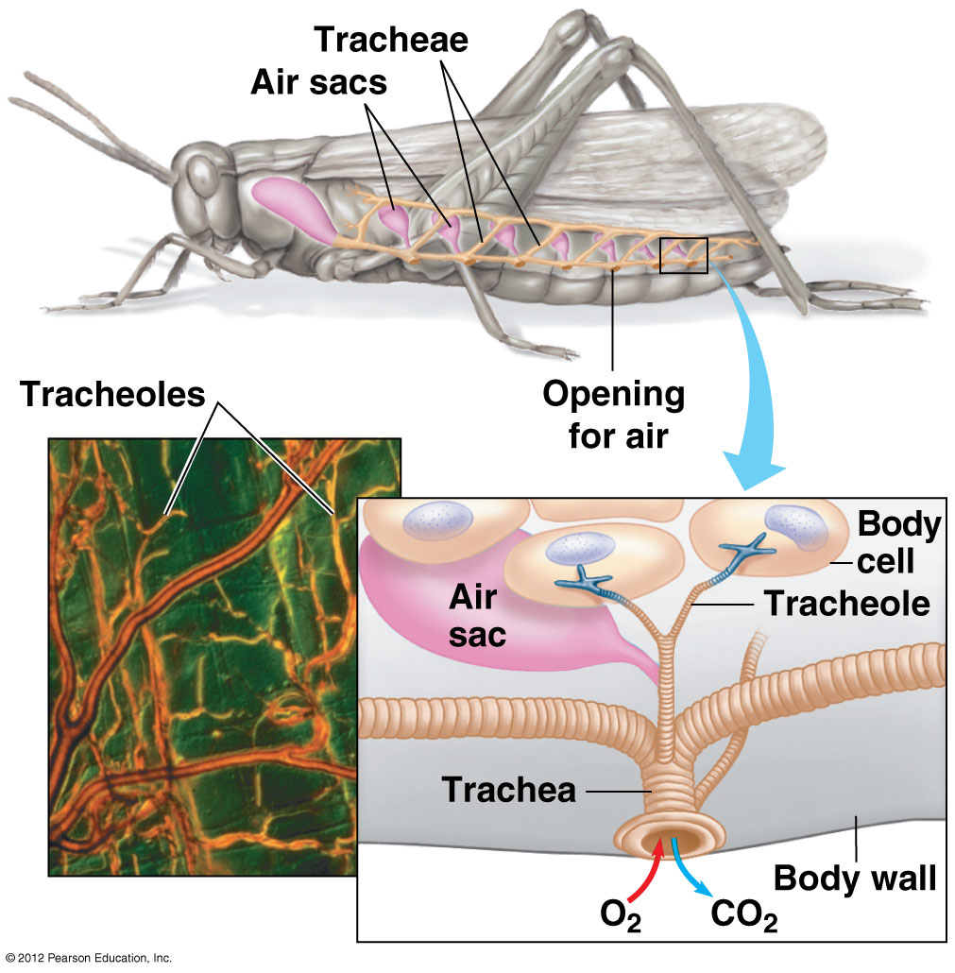

Slide 82
22.5 CONNECTION:The evolution of lungs facilitated the movement of tetrapods onto land
0
The first tetrapods on land diverged into three major lineages.
  Amphibians use small lungs and their body surfaces.
  Nonbird reptiles have
    lower metabolic rates and
    simpler lungs.
  Birds and mammals have
    higher metabolic rates and
    more complex lungs.
© 2012 Pearson Education, Inc.
Notes:
82
Student Misconceptions and Concerns
Respiratory structures such as gills, lungs, and insect tracheal systems are highly branched, reflecting an adaptation to increase the surface area and ultimately the surface-to-volume ratio of the animal. Students might not realize the common principles of adaptations to increase surface-to-volume ratios in the highly branched respiratory structures, as well as in the circulatory system (for example, the small size of red blood cells and tiny size of capillaries), discussed in detail in the next chapter. You might consider expanding on this principle as you address other systems that reflect such adaptations (for example, greater surface area of the digestive system for absorption of nutrients).
Teaching Tips
Many aquatic amphibians, such as the axolotl salamander, use gills, lungs, and skin surfaces for gas exchange. As noted in Module 22.5, this appears to be true of the first tetrapods such as Tiktaalik.

Slide 83
0
© 2012 Pearson Education, Inc.
THE HUMAN RESPIRATORY SYSTEM
Notes:
83

Slide 84
22.6 In mammals, branching tubes convey air to lungs located in the chest cavity
0
  The diaphragm
    separates the abdominal cavity from the thoracic cavity and
    helps ventilate the lungs.
  In mammals, air is inhaled through the nostrils into the nasal cavity. Air is
    filtered by hairs and mucus surfaces,
    warmed and humidified, and
    sampled for odors.
© 2012 Pearson Education, Inc.
Notes:
84
Student Misconceptions and Concerns
Students often confuse the structures and functions of the trachea and esophagus. To help them distinguish, point out that the trachea has a structure and function like the hose of a vacuum cleaner. The rigid ribbed walls of the trachea keep the tube open as air is sucked through it. The esophagus, however, relies upon rhythmic changes in the shape of the walls (peristalsis) to push food toward the stomach. If the esophagus had stiff walls, it would not be able to perform this function.
Teaching Tips
1. The basic principles of the vocal cords can be demonstrated by inflating a balloon and letting air out, while stretching the neck of the balloon. If the balloon neck is stretched tightly, it will produce high-pitched sounds; when it is relaxed, it will produce lower-pitched sounds.
2. Students often appreciate explanations that help them understand their own experiences. When we struggle with respiratory infections or allergies, especially when the air is dry, thick mucus accumulates in our branchial system. A long, warm shower hydrates these mucus films, facilitating their movement up and out of our respiratory systems. Although students might have heard this advice, they might not have fully understood the mechanisms. (Sipping hot tea also helps to hydrate these mucus surfaces.)

Slide 85
22.6 In mammals, branching tubes convey air to lungs located in the chest cavity
0
From the nasal cavity, air next passes
  to the pharynx,
  then larynx, past the vocal cords,
  into the trachea, held open by cartilage rings,
  into the paired bronchi,
  into bronchioles, and finally
  to the alveoli, grapelike clusters of air sacs, where gas exchange occurs.
© 2012 Pearson Education, Inc.
Notes:
85
Student Misconceptions and Concerns
Students often confuse the structures and functions of the trachea and esophagus. To help them distinguish, point out that the trachea has a structure and function like the hose of a vacuum cleaner. The rigid ribbed walls of the trachea keep the tube open as air is sucked through it. The esophagus, however, relies upon rhythmic changes in the shape of the walls (peristalsis) to push food toward the stomach. If the esophagus had stiff walls, it would not be able to perform this function.
Teaching Tips
1. The basic principles of the vocal cords can be demonstrated by inflating a balloon and letting air out, while stretching the neck of the balloon. If the balloon neck is stretched tightly, it will produce high-pitched sounds; when it is relaxed, it will produce lower-pitched sounds.
2. Students often appreciate explanations that help them understand their own experiences. When we struggle with respiratory infections or allergies, especially when the air is dry, thick mucus accumulates in our branchial system. A long, warm shower hydrates these mucus films, facilitating their movement up and out of our respiratory systems. Although students might have heard this advice, they might not have fully understood the mechanisms. (Sipping hot tea also helps to hydrate these mucus surfaces.)

Slide 86
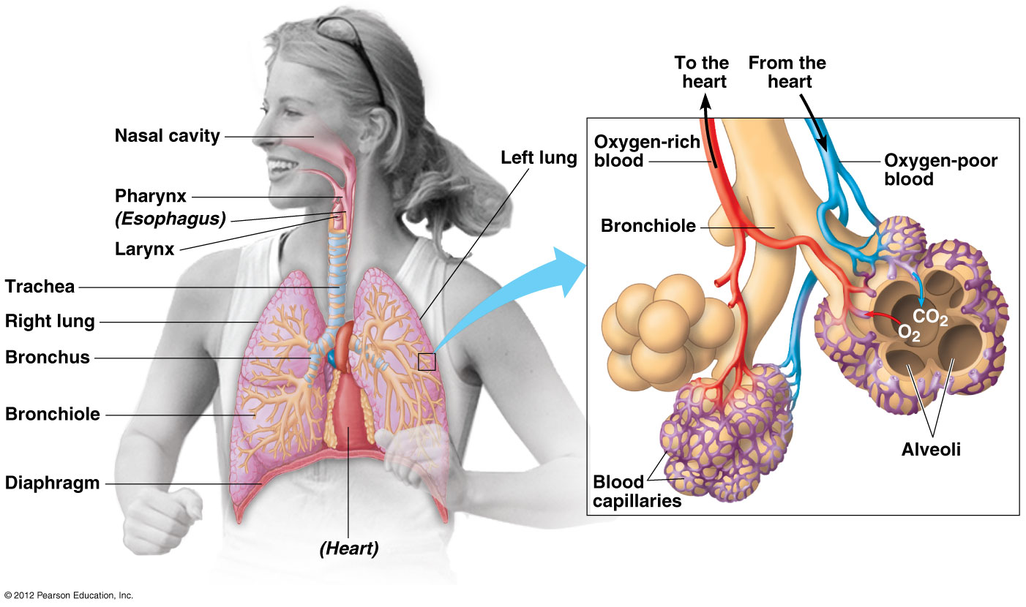

Slide 87
22.6 In mammals, branching tubes convey air to lungs located in the chest cavity
0
Alveoli are well adapted for gas exchange with high surface areas of capillaries.
In alveoli,
  O₂ diffuses into the blood and
  CO₂ diffuses out of the blood.
© 2012 Pearson Education, Inc.
Notes:
87
Student Misconceptions and Concerns
Students often confuse the structures and functions of the trachea and esophagus. To help them distinguish, point out that the trachea has a structure and function like the hose of a vacuum cleaner. The rigid ribbed walls of the trachea keep the tube open as air is sucked through it. The esophagus, however, relies upon rhythmic changes in the shape of the walls (peristalsis) to push food toward the stomach. If the esophagus had stiff walls, it would not be able to perform this function.
Teaching Tips
1. The basic principles of the vocal cords can be demonstrated by inflating a balloon and letting air out, while stretching the neck of the balloon. If the balloon neck is stretched tightly, it will produce high-pitched sounds; when it is relaxed, it will produce lower-pitched sounds.
2. Students often appreciate explanations that help them understand their own experiences. When we struggle with respiratory infections or allergies, especially when the air is dry, thick mucus accumulates in our branchial system. A long, warm shower hydrates these mucus films, facilitating their movement up and out of our respiratory systems. Although students might have heard this advice, they might not have fully understood the mechanisms. (Sipping hot tea also helps to hydrate these mucus surfaces.)

Slide 88
22.6 In mammals, branching tubes convey air to lungs located in the chest cavity
0
Surfactants are specialized secretions required to keep the walls of the small alveoli from sticking shut.
  Babies born 6 weeks or more before their due date often struggle with respiratory distress syndrome due to an inadequate amount of lung surfactant.
  Artificial surfactants are now administered to preterm infants.
© 2012 Pearson Education, Inc.
Notes:
88
Student Misconceptions and Concerns
Students often confuse the structures and functions of the trachea and esophagus. To help them distinguish, point out that the trachea has a structure and function like the hose of a vacuum cleaner. The rigid ribbed walls of the trachea keep the tube open as air is sucked through it. The esophagus, however, relies upon rhythmic changes in the shape of the walls (peristalsis) to push food toward the stomach. If the esophagus had stiff walls, it would not be able to perform this function.
Teaching Tips
1. The basic principles of the vocal cords can be demonstrated by inflating a balloon and letting air out, while stretching the neck of the balloon. If the balloon neck is stretched tightly, it will produce high-pitched sounds; when it is relaxed, it will produce lower-pitched sounds.
2. Students often appreciate explanations that help them understand their own experiences. When we struggle with respiratory infections or allergies, especially when the air is dry, thick mucus accumulates in our branchial system. A long, warm shower hydrates these mucus films, facilitating their movement up and out of our respiratory systems. Although students might have heard this advice, they might not have fully understood the mechanisms. (Sipping hot tea also helps to hydrate these mucus surfaces.)

Slide 89
22.6 In mammals, branching tubes convey air to lungs located in the chest cavity
0
Exposure to pollutants can cause continual irritation and inflammation of the lungs.
  Examples of common lung pollutants include
    air pollution and
    tobacco smoke.
  Chronic obstructive pulmonary disease (COPD) can result, limiting
    lung ventilation and
    gas exchange.
© 2012 Pearson Education, Inc.
Notes:
89
Student Misconceptions and Concerns
Students often confuse the structures and functions of the trachea and esophagus. To help them distinguish, point out that the trachea has a structure and function like the hose of a vacuum cleaner. The rigid ribbed walls of the trachea keep the tube open as air is sucked through it. The esophagus, however, relies upon rhythmic changes in the shape of the walls (peristalsis) to push food toward the stomach. If the esophagus had stiff walls, it would not be able to perform this function.
Teaching Tips
1. The basic principles of the vocal cords can be demonstrated by inflating a balloon and letting air out, while stretching the neck of the balloon. If the balloon neck is stretched tightly, it will produce high-pitched sounds; when it is relaxed, it will produce lower-pitched sounds.
2. Students often appreciate explanations that help them understand their own experiences. When we struggle with respiratory infections or allergies, especially when the air is dry, thick mucus accumulates in our branchial system. A long, warm shower hydrates these mucus films, facilitating their movement up and out of our respiratory systems. Although students might have heard this advice, they might not have fully understood the mechanisms. (Sipping hot tea also helps to hydrate these mucus surfaces.)

Slide 90
22.7 CONNECTION: Smoking is a serious assault on the respiratory system
0
Mucus and cilia in the respiratory passages
  sweep contaminant-laden mucus up and out of the airways and
  can be damaged by smoking.
One of the worst sources of lung-damaging air pollutants is tobacco smoke, containing more than 4,000 chemicals.
Without healthy cilia, smokers must cough to clear dirty mucus from the trachea.
© 2012 Pearson Education, Inc.
Notes:
90
Student Misconceptions and Concerns
Students might misunderstand how the cilia lining our respiratory passages work. Cilia do not filter the air like a comb. Instead, cilia are covered by a layer of mucus. Dust particles adhere to sticky mucus, which is then swept up the respiratory tract by the cilia. If students clear their throats, they will identify the fate of this mucus. We swallow after clearing our throats!
Teaching Tips
The impact of smoking on public health is described in detail in Module 22.7. Despite this increasingly available information, many students still choose to smoke. Consider including some exercise in your class that will provide students with an opportunity to better understand the public health consequences of smoking.

Slide 91
22.7 CONNECTION: Smoking is a serious assault on the respiratory system
0
Smoking can cause
  lung cancer,
  cardiovascular disease, and
  emphysema.
Smoking accounts for 90% of all lung cancer cases.
Smoking increases the risk of other types of cancer.
© 2012 Pearson Education, Inc.
Notes:
91
Student Misconceptions and Concerns
Students might misunderstand how the cilia lining our respiratory passages work. Cilia do not filter the air like a comb. Instead, cilia are covered by a layer of mucus. Dust particles adhere to sticky mucus, which is then swept up the respiratory tract by the cilia. If students clear their throats, they will identify the fate of this mucus. We swallow after clearing our throats!
Teaching Tips
The impact of smoking on public health is described in detail in Module 22.7. Despite this increasingly available information, many students still choose to smoke. Consider including some exercise in your class that will provide students with an opportunity to better understand the public health consequences of smoking.

Slide 92
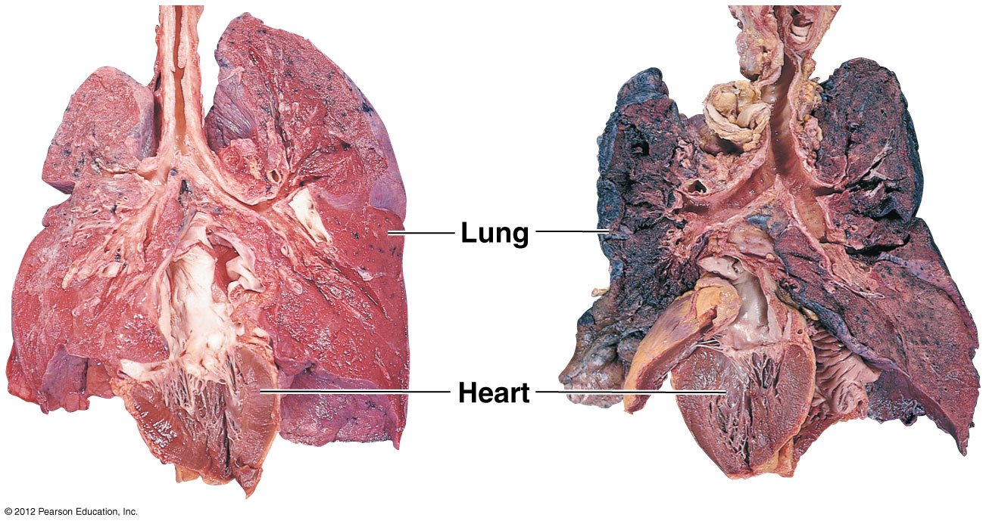

Slide 93
22.8 Negative pressure breathing ventilates your lungs
0
Breathing is the alternate inhalation and exhalation of air (ventilation).
In mammals, inhalation occurs when
  the rib cage expands,
  the diaphragm moves downward,
  the pressure around the lungs decreases, and
  air is drawn into the respiratory tract.
This type of ventilation is called negative pressure breathing.
© 2012 Pearson Education, Inc.
Notes:
93
Teaching Tips
1. In its relaxed state, the human diaphragm is domed upward toward the heart. Contracting the diaphragm pushes down on the intestines and stomach, forcing the abdominal region outward. Thus, it can be more difficult to inhale after having consumed a large volume of food and/or drink.
2. Some of your students may have been taught to breathe deeply by actively extending their stomach outwards. Ask your class to explain why this permits them to take a deeper breath. (The answer: it allows the diaphragm to move down with less resistance from body organs in the abdominal cavity).

Slide 94
22.8 Negative pressure breathing ventilates your lungs
0
Exhalation occurs when
  the rib cage contracts,
  the diaphragm moves upward,
  the pressure around the lungs increases, and
  air is forced out of the respiratory tract.
© 2012 Pearson Education, Inc.
Notes:
94
Teaching Tips
1. In its relaxed state, the human diaphragm is domed upward toward the heart. Contracting the diaphragm pushes down on the intestines and stomach, forcing the abdominal region outward. Thus, it can be more difficult to inhale after having consumed a large volume of food and/or drink.
2. Some of your students may have been taught to breathe deeply by actively extending their stomach outwards. Ask your class to explain why this permits them to take a deeper breath. (The answer: it allows the diaphragm to move down with less resistance from body organs in the abdominal cavity).

Slide 95
22.9 Breathing is automatically controlled
0
Breathing is usually under automatic control.
Breathing control centers in the brain sense and respond to CO₂ levels in the blood.
A drop in blood pH increases the rate and depth of breathing.
© 2012 Pearson Education, Inc.
Notes:
95
Teaching Tips
As noted in Module 22.9, the breathing control centers in the brain are based upon the concentration of carbon dioxide in the blood (and the resulting changes in pH). Challenge your students to explain why this system is usually sufficient to provide adequate levels of oxygen in the blood. (The by-product of aerobic respiration is carbon dioxide.)

Slide 96
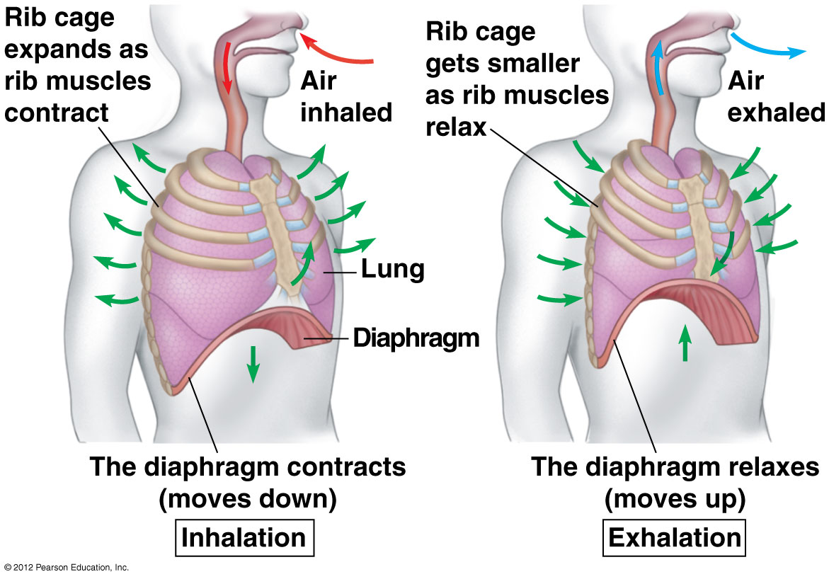

Slide 97
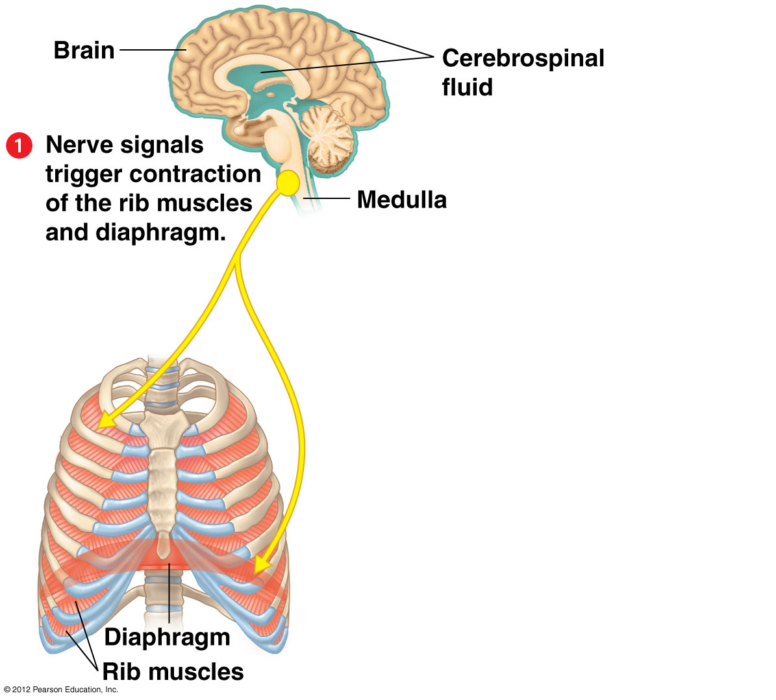

Slide 98
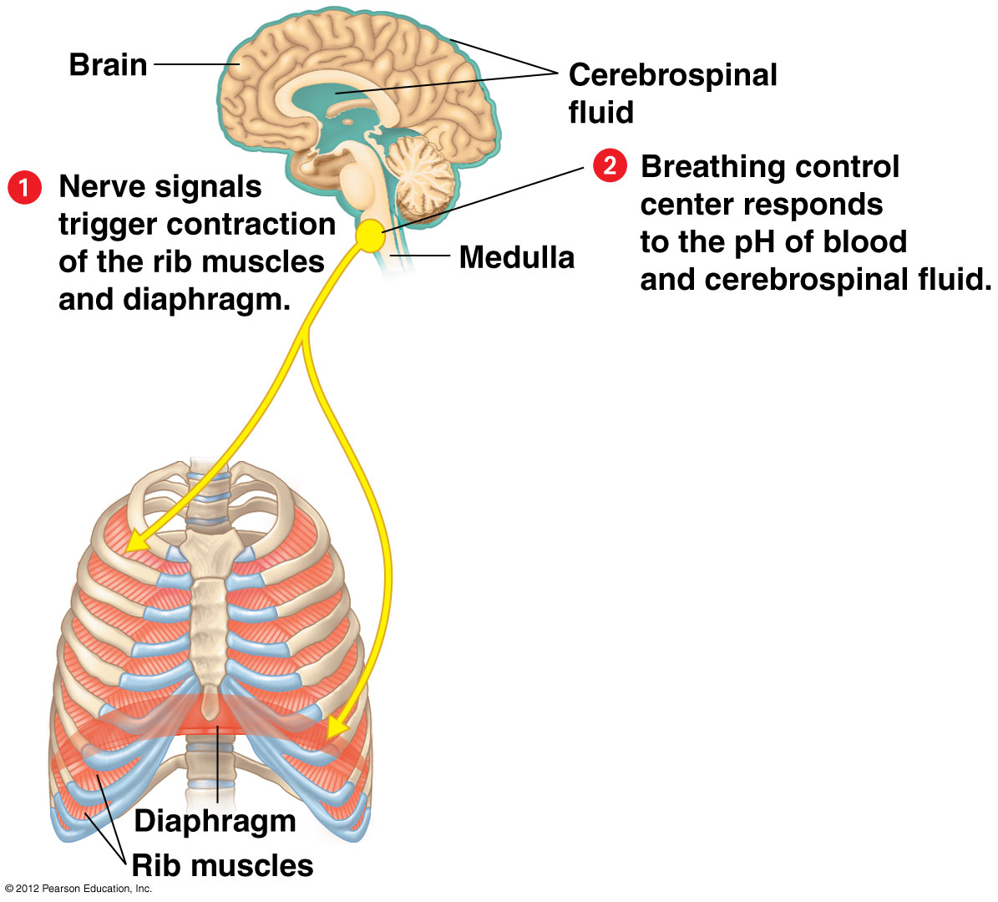

Slide 99
