Slide 1
PLANTS & FUNGI
Chapter 17

Slide 2
Introduction
0
  The Venus flytrap has adaptations to
    capture and
    digest insects.
  More than 600 species of plants
    are carnivores and
    typically live where soil nutrients, including nitrogen levels, are poor.
  Carnivorous plants absorb and use nutrients, including nitrogen, from animals.
© 2012 Pearson Education, Inc.
Notes:
2

Slide 3
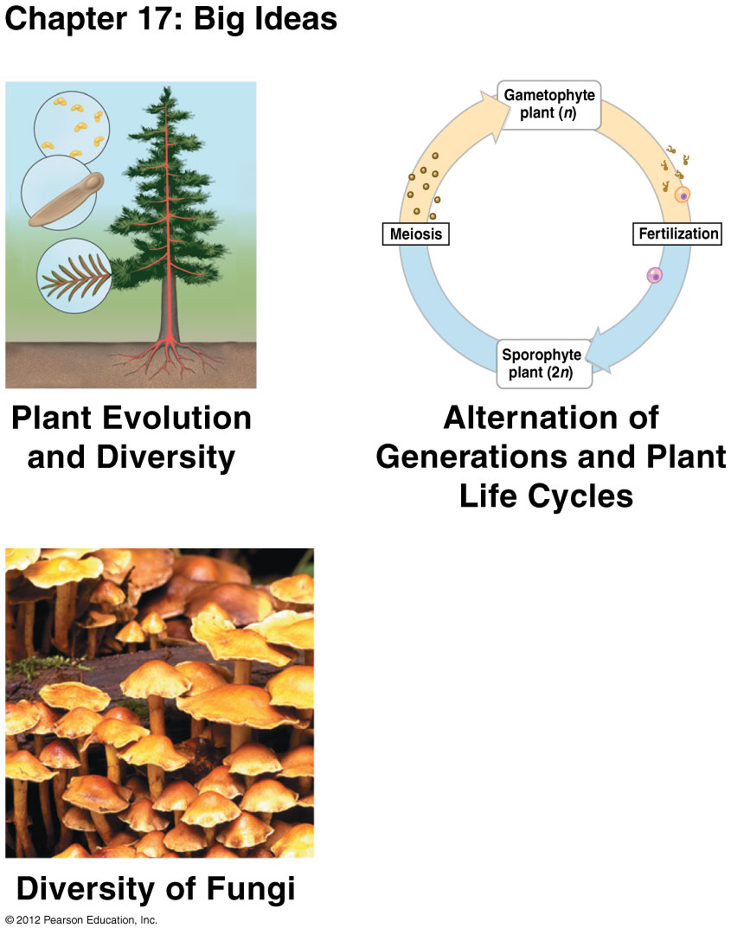

Slide 4
PLANT EVOLUTION AND DIVERSITY
© 2012 Pearson Education, Inc.
Notes:
4

Slide 5
17.1 Plants have adaptations for life on land
0
More than 500 million years ago, the algal ancestors of plants may have lived near moist fringes of lakes and coastal salt marshes.
Plants and green algae called charophytes
  are thought to have evolved from a common ancestor,
  have complex multicellular bodies, and
  are photosynthetic eukaryotes.
© 2012 Pearson Education, Inc.
Notes:
5
Student Misconceptions and Concerns
1. Students often mistakenly conceive of evolution as a deliberate and directed process, in which organisms somehow acquire adaptations out of want or need. This chapter provides good examples of how evolution actually occurs. During the period when plants first moved onto land, the demands of a terrestrial environment selected among the diversity already existing within the various marginal plant species. For example, plants that produced structures that provided some physical support outside of water had an advantage over those without such structures. Plants did not evolve adaptations to address the needs of living on land. Instead, terrestrial adaptations in existing aquatic plants conveyed advantages in this new environment and were therefore favored.
2. The text identifies charophytes as the algal group most closely related to plants. Students might misinterpret this to mean that modern charophytes were the direct ancestors of plants. Instead, modern charophytes and plants share a common ancestor, but each has been evolving since the lineages diverged. This same confusion occurs when considering the evolutionary history of humans and chimps. Humans and chimps share a common ancestor. Modern humans did not evolve from modern chimps. Although such distinctions may be clear to us as instructors, beginning students with little experience can easily be confused.
Teaching Tips
1. Assign your students to work in small groups and list the demands of living on land versus in water. Having them consider the challenges that plants faced when they moved onto land prepares them for the discussion of the resulting adaptations in Chapter 17.
2. Water lilies and whales are two aquatic organisms that evolved from recent terrestrial ancestors. Students might contemplate the changes in these organisms as they returned to the aquatic environment from which their ancestors emerged.
3. Point out to your students that in an aquatic environment, resources such as nutrients and water are accessible to the entire plant. However, structural adaptations such as roots and shoots have evolved in plants that live on land, where such resources are less accessible.
4. Consider the analogy between vascular systems in plants and a major interstate highway, with traffic running in opposite directions. Highways, like vascular tissues, permit the widespread distribution of concentrated resources.
5. Have your students discuss the specific advantages of similar adaptations in the reproductive systems of plants and mammals. What are the advantages to keeping the developing embryos with the parent? (One example: The embryonic environment can be carefully regulated by the parent and the parent can better protect the young from damage, disease, or predation.)

Slide 6
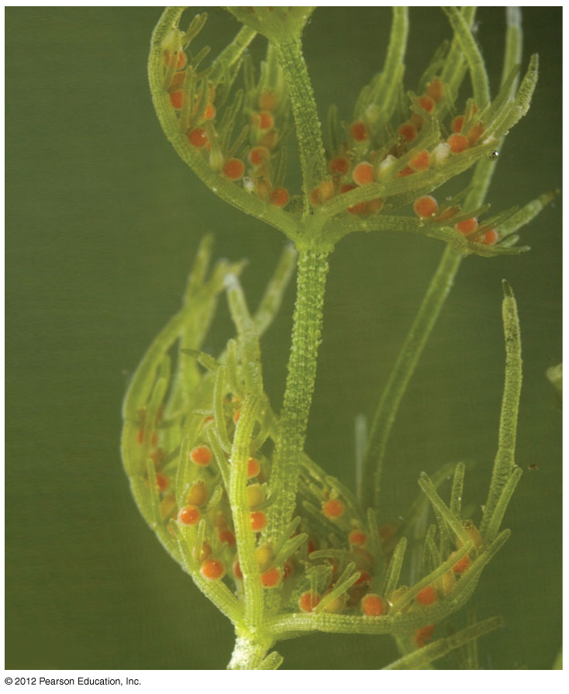
Chara a charophyte
Notes:
6
Figure 17.1A Chara, an elaborate charophyte

Slide 7
17.1 Plants have adaptations for life on land
0
Life on land offered many opportunities for plant adaptations that took advantage of
  unlimited sunlight,
  abundant CO₂, and
  initially, few pathogens or herbivores.
© 2012 Pearson Education, Inc.
Notes:
7
Student Misconceptions and Concerns
1. Students often mistakenly conceive of evolution as a deliberate and directed process, in which organisms somehow acquire adaptations out of want or need. This chapter provides good examples of how evolution actually occurs. During the period when plants first moved onto land, the demands of a terrestrial environment selected among the diversity already existing within the various marginal plant species. For example, plants that produced structures that provided some physical support outside of water had an advantage over those without such structures. Plants did not evolve adaptations to address the needs of living on land. Instead, terrestrial adaptations in existing aquatic plants conveyed advantages in this new environment and were therefore favored.
2. The text identifies charophytes as the algal group most closely related to plants. Students might misinterpret this to mean that modern charophytes were the direct ancestors of plants. Instead, modern charophytes and plants share a common ancestor, but each has been evolving since the lineages diverged. This same confusion occurs when considering the evolutionary history of humans and chimps. Humans and chimps share a common ancestor. Modern humans did not evolve from modern chimps. Although such distinctions may be clear to us as instructors, beginning students with little experience can easily be confused.
Teaching Tips
1. Assign your students to work in small groups and list the demands of living on land versus in water. Having them consider the challenges that plants faced when they moved onto land prepares them for the discussion of the resulting adaptations in Chapter 17.
2. Water lilies and whales are two aquatic organisms that evolved from recent terrestrial ancestors. Students might contemplate the changes in these organisms as they returned to the aquatic environment from which their ancestors emerged.
3. Point out to your students that in an aquatic environment, resources such as nutrients and water are accessible to the entire plant. However, structural adaptations such as roots and shoots have evolved in plants that live on land, where such resources are less accessible.
4. Consider the analogy between vascular systems in plants and a major interstate highway, with traffic running in opposite directions. Highways, like vascular tissues, permit the widespread distribution of concentrated resources.
5. Have your students discuss the specific advantages of similar adaptations in the reproductive systems of plants and mammals. What are the advantages to keeping the developing embryos with the parent? (One example: The embryonic environment can be carefully regulated by the parent and the parent can better protect the young from damage, disease, or predation.)

Slide 8
17.1 Plants have adaptations for life on land
0
But life on land had disadvantages too. On land, plants must
  maintain moisture inside their cells, to keep from drying out,
  support their body in a non-buoyant medium,
  reproduce and disperse offspring without water, and
  obtain resources from soil and air.
© 2012 Pearson Education, Inc.
Notes:
8
Student Misconceptions and Concerns
1. Students often mistakenly conceive of evolution as a deliberate and directed process, in which organisms somehow acquire adaptations out of want or need. This chapter provides good examples of how evolution actually occurs. During the period when plants first moved onto land, the demands of a terrestrial environment selected among the diversity already existing within the various marginal plant species. For example, plants that produced structures that provided some physical support outside of water had an advantage over those without such structures. Plants did not evolve adaptations to address the needs of living on land. Instead, terrestrial adaptations in existing aquatic plants conveyed advantages in this new environment and were therefore favored.
2. The text identifies charophytes as the algal group most closely related to plants. Students might misinterpret this to mean that modern charophytes were the direct ancestors of plants. Instead, modern charophytes and plants share a common ancestor, but each has been evolving since the lineages diverged. This same confusion occurs when considering the evolutionary history of humans and chimps. Humans and chimps share a common ancestor. Modern humans did not evolve from modern chimps. Although such distinctions may be clear to us as instructors, beginning students with little experience can easily be confused.
Teaching Tips
1. Assign your students to work in small groups and list the demands of living on land versus in water. Having them consider the challenges that plants faced when they moved onto land prepares them for the discussion of the resulting adaptations in Chapter 17.
2. Water lilies and whales are two aquatic organisms that evolved from recent terrestrial ancestors. Students might contemplate the changes in these organisms as they returned to the aquatic environment from which their ancestors emerged.
3. Point out to your students that in an aquatic environment, resources such as nutrients and water are accessible to the entire plant. However, structural adaptations such as roots and shoots have evolved in plants that live on land, where such resources are less accessible.
4. Consider the analogy between vascular systems in plants and a major interstate highway, with traffic running in opposite directions. Highways, like vascular tissues, permit the widespread distribution of concentrated resources.
5. Have your students discuss the specific advantages of similar adaptations in the reproductive systems of plants and mammals. What are the advantages to keeping the developing embryos with the parent? (One example: The embryonic environment can be carefully regulated by the parent and the parent can better protect the young from damage, disease, or predation.)

Slide 9
17.1 Plants have adaptations for life on land
0
Unlike land plants, algae
  generally have no rigid tissues,
  are supported by surrounding water,
  obtain CO₂ and minerals directly from the water surrounding the entire algal body,
  receive light and perform photosynthesis over most of their body,
  use flagellated sperm that swim to fertilize an egg, and
  disperse offspring by water.
© 2012 Pearson Education, Inc.
Notes:
9
Student Misconceptions and Concerns
1. Students often mistakenly conceive of evolution as a deliberate and directed process, in which organisms somehow acquire adaptations out of want or need. This chapter provides good examples of how evolution actually occurs. During the period when plants first moved onto land, the demands of a terrestrial environment selected among the diversity already existing within the various marginal plant species. For example, plants that produced structures that provided some physical support outside of water had an advantage over those without such structures. Plants did not evolve adaptations to address the needs of living on land. Instead, terrestrial adaptations in existing aquatic plants conveyed advantages in this new environment and were therefore favored.
2. The text identifies charophytes as the algal group most closely related to plants. Students might misinterpret this to mean that modern charophytes were the direct ancestors of plants. Instead, modern charophytes and plants share a common ancestor, but each has been evolving since the lineages diverged. This same confusion occurs when considering the evolutionary history of humans and chimps. Humans and chimps share a common ancestor. Modern humans did not evolve from modern chimps. Although such distinctions may be clear to us as instructors, beginning students with little experience can easily be confused.
Teaching Tips
1. Assign your students to work in small groups and list the demands of living on land versus in water. Having them consider the challenges that plants faced when they moved onto land prepares them for the discussion of the resulting adaptations in Chapter 17.
2. Water lilies and whales are two aquatic organisms that evolved from recent terrestrial ancestors. Students might contemplate the changes in these organisms as they returned to the aquatic environment from which their ancestors emerged.
3. Point out to your students that in an aquatic environment, resources such as nutrients and water are accessible to the entire plant. However, structural adaptations such as roots and shoots have evolved in plants that live on land, where such resources are less accessible.
4. Consider the analogy between vascular systems in plants and a major interstate highway, with traffic running in opposite directions. Highways, like vascular tissues, permit the widespread distribution of concentrated resources.
5. Have your students discuss the specific advantages of similar adaptations in the reproductive systems of plants and mammals. What are the advantages to keeping the developing embryos with the parent? (One example: The embryonic environment can be carefully regulated by the parent and the parent can better protect the young from damage, disease, or predation.)

Slide 10
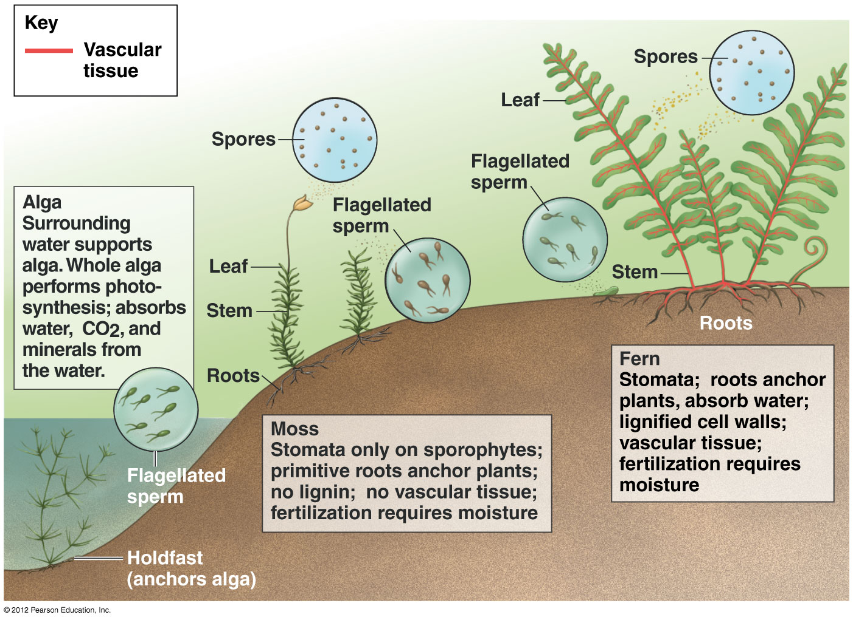

Slide 11
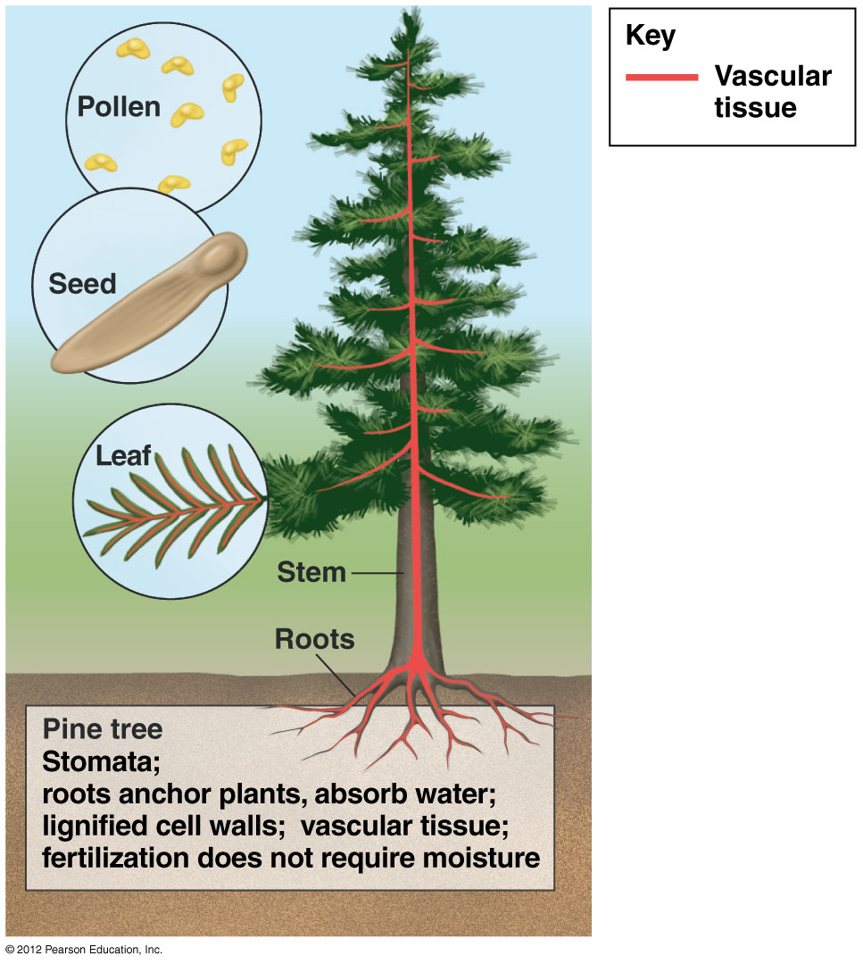

Slide 12
17.1 Plants have adaptations for life on land
0
Land plants maintain moisture in their cells using
  a waxy cuticle and
  cells that regulate the opening and closing of stomata.
Land plants obtain
  water and minerals from roots in the soil and
  CO₂ from the air and sunlight through leaves.
Growth-producing regions of cell division, called apical meristems, are found near the tips of stems and roots.
© 2012 Pearson Education, Inc.
Notes:
12
Student Misconceptions and Concerns
1. Students often mistakenly conceive of evolution as a deliberate and directed process, in which organisms somehow acquire adaptations out of want or need. This chapter provides good examples of how evolution actually occurs. During the period when plants first moved onto land, the demands of a terrestrial environment selected among the diversity already existing within the various marginal plant species. For example, plants that produced structures that provided some physical support outside of water had an advantage over those without such structures. Plants did not evolve adaptations to address the needs of living on land. Instead, terrestrial adaptations in existing aquatic plants conveyed advantages in this new environment and were therefore favored.
2. The text identifies charophytes as the algal group most closely related to plants. Students might misinterpret this to mean that modern charophytes were the direct ancestors of plants. Instead, modern charophytes and plants share a common ancestor, but each has been evolving since the lineages diverged. This same confusion occurs when considering the evolutionary history of humans and chimps. Humans and chimps share a common ancestor. Modern humans did not evolve from modern chimps. Although such distinctions may be clear to us as instructors, beginning students with little experience can easily be confused.
Teaching Tips
1. Assign your students to work in small groups and list the demands of living on land versus in water. Having them consider the challenges that plants faced when they moved onto land prepares them for the discussion of the resulting adaptations in Chapter 17.
2. Water lilies and whales are two aquatic organisms that evolved from recent terrestrial ancestors. Students might contemplate the changes in these organisms as they returned to the aquatic environment from which their ancestors emerged.
3. Point out to your students that in an aquatic environment, resources such as nutrients and water are accessible to the entire plant. However, structural adaptations such as roots and shoots have evolved in plants that live on land, where such resources are less accessible.
4. Consider the analogy between vascular systems in plants and a major interstate highway, with traffic running in opposite directions. Highways, like vascular tissues, permit the widespread distribution of concentrated resources.
5. Have your students discuss the specific advantages of similar adaptations in the reproductive systems of plants and mammals. What are the advantages to keeping the developing embryos with the parent? (One example: The embryonic environment can be carefully regulated by the parent and the parent can better protect the young from damage, disease, or predation.)

Slide 13
17.1 Plants have adaptations for life on land
0
In many land plants, water and minerals move up from roots to stems and leaves using vascular tissues.
  Xylem
    consists of dead cells and
    conveys water and minerals.
  Phloem
    consists of living cells and
    conveys sugars.
© 2012 Pearson Education, Inc.
Notes:
13
Student Misconceptions and Concerns
1. Students often mistakenly conceive of evolution as a deliberate and directed process, in which organisms somehow acquire adaptations out of want or need. This chapter provides good examples of how evolution actually occurs. During the period when plants first moved onto land, the demands of a terrestrial environment selected among the diversity already existing within the various marginal plant species. For example, plants that produced structures that provided some physical support outside of water had an advantage over those without such structures. Plants did not evolve adaptations to address the needs of living on land. Instead, terrestrial adaptations in existing aquatic plants conveyed advantages in this new environment and were therefore favored.
2. The text identifies charophytes as the algal group most closely related to plants. Students might misinterpret this to mean that modern charophytes were the direct ancestors of plants. Instead, modern charophytes and plants share a common ancestor, but each has been evolving since the lineages diverged. This same confusion occurs when considering the evolutionary history of humans and chimps. Humans and chimps share a common ancestor. Modern humans did not evolve from modern chimps. Although such distinctions may be clear to us as instructors, beginning students with little experience can easily be confused.
Teaching Tips
1. Assign your students to work in small groups and list the demands of living on land versus in water. Having them consider the challenges that plants faced when they moved onto land prepares them for the discussion of the resulting adaptations in Chapter 17.
2. Water lilies and whales are two aquatic organisms that evolved from recent terrestrial ancestors. Students might contemplate the changes in these organisms as they returned to the aquatic environment from which their ancestors emerged.
3. Point out to your students that in an aquatic environment, resources such as nutrients and water are accessible to the entire plant. However, structural adaptations such as roots and shoots have evolved in plants that live on land, where such resources are less accessible.
4. Consider the analogy between vascular systems in plants and a major interstate highway, with traffic running in opposite directions. Highways, like vascular tissues, permit the widespread distribution of concentrated resources.
5. Have your students discuss the specific advantages of similar adaptations in the reproductive systems of plants and mammals. What are the advantages to keeping the developing embryos with the parent? (One example: The embryonic environment can be carefully regulated by the parent and the parent can better protect the young from damage, disease, or predation.)

Slide 14
17.1 Plants have adaptations for life on land
0
Many land plants support their body against the pull of gravity using lignin.
The absence of lignified cell walls in mosses and other plants that lack vascular tissue limits their height.
© 2012 Pearson Education, Inc.
Notes:
14
Student Misconceptions and Concerns
1. Students often mistakenly conceive of evolution as a deliberate and directed process, in which organisms somehow acquire adaptations out of want or need. This chapter provides good examples of how evolution actually occurs. During the period when plants first moved onto land, the demands of a terrestrial environment selected among the diversity already existing within the various marginal plant species. For example, plants that produced structures that provided some physical support outside of water had an advantage over those without such structures. Plants did not evolve adaptations to address the needs of living on land. Instead, terrestrial adaptations in existing aquatic plants conveyed advantages in this new environment and were therefore favored.
2. The text identifies charophytes as the algal group most closely related to plants. Students might misinterpret this to mean that modern charophytes were the direct ancestors of plants. Instead, modern charophytes and plants share a common ancestor, but each has been evolving since the lineages diverged. This same confusion occurs when considering the evolutionary history of humans and chimps. Humans and chimps share a common ancestor. Modern humans did not evolve from modern chimps. Although such distinctions may be clear to us as instructors, beginning students with little experience can easily be confused.
Teaching Tips
1. Assign your students to work in small groups and list the demands of living on land versus in water. Having them consider the challenges that plants faced when they moved onto land prepares them for the discussion of the resulting adaptations in Chapter 17.
2. Water lilies and whales are two aquatic organisms that evolved from recent terrestrial ancestors. Students might contemplate the changes in these organisms as they returned to the aquatic environment from which their ancestors emerged.
3. Point out to your students that in an aquatic environment, resources such as nutrients and water are accessible to the entire plant. However, structural adaptations such as roots and shoots have evolved in plants that live on land, where such resources are less accessible.
4. Consider the analogy between vascular systems in plants and a major interstate highway, with traffic running in opposite directions. Highways, like vascular tissues, permit the widespread distribution of concentrated resources.
5. Have your students discuss the specific advantages of similar adaptations in the reproductive systems of plants and mammals. What are the advantages to keeping the developing embryos with the parent? (One example: The embryonic environment can be carefully regulated by the parent and the parent can better protect the young from damage, disease, or predation.)

Slide 15
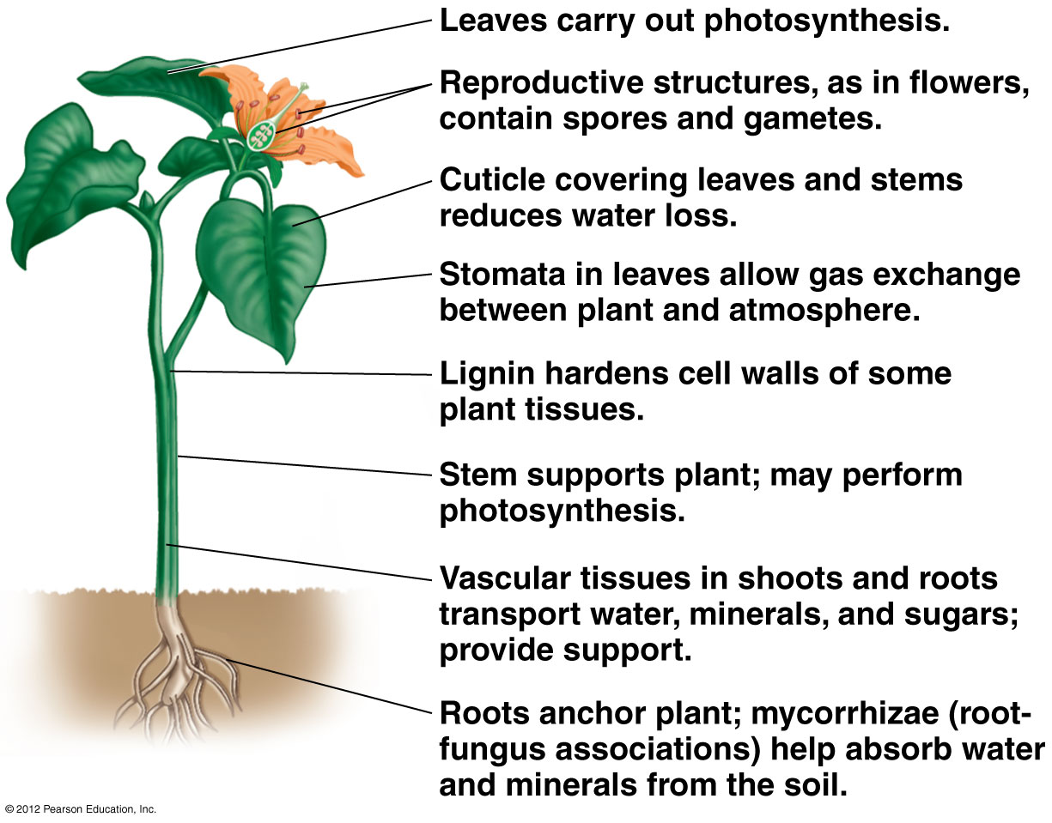

Slide 16
17.2 Plant diversity reflects the evolutionary history of the plant kingdom
0
Four key adaptations for life on land distinguish the main lineages of the plant kingdom.
  Dependent embryos are present in all plants.
  Lignified vascular tissues mark a lineage that gave rise to most living plants.
  Seeds are found in a lineage that includes all living gymnosperms and angiosperms.
  Flowers mark the angiosperm lineage.
© 2012 Pearson Education, Inc.
Notes:
16
Student Misconceptions and Concerns
1. Students often mistakenly conceive of evolution as a deliberate and directed process, in which organisms somehow acquire adaptations out of want or need. This chapter provides good examples of how evolution actually occurs. During the period when plants first moved onto land, the demands of a terrestrial environment selected among the diversity already existing within the various marginal plant species. For example, plants that produced structures that provided some physical support outside of water had an advantage over those without such structures. Plants did not evolve adaptations to address the needs of living on land. Instead, terrestrial adaptations in existing aquatic plants conveyed advantages in this new environment and were therefore favored.
2. The text identifies charophytes as the algal group most closely related to plants. Students might misinterpret this to mean that modern charophytes were the direct ancestors of plants. Instead, modern charophytes and plants share a common ancestor, but each has been evolving since the lineages diverged. This same confusion occurs when considering the evolutionary history of humans and chimps. Humans and chimps share a common ancestor. Modern humans did not evolve from modern chimps. Although such distinctions may be clear to us as instructors, beginning students with little experience can easily be confused.
Teaching Tips
1. An analogy exists between a chicken egg and the first seeds, although the parallels are limited: each consists of a developing embryo enclosed in a water-resistant packet, along with a store of food.
2. The support provided by many tightly packed mosses is analogous to the collective support of the many fibers of plush carpeting. Each fiber of carpet and each individual moss plant might easily collapse without the support of its neighbor.

Slide 17
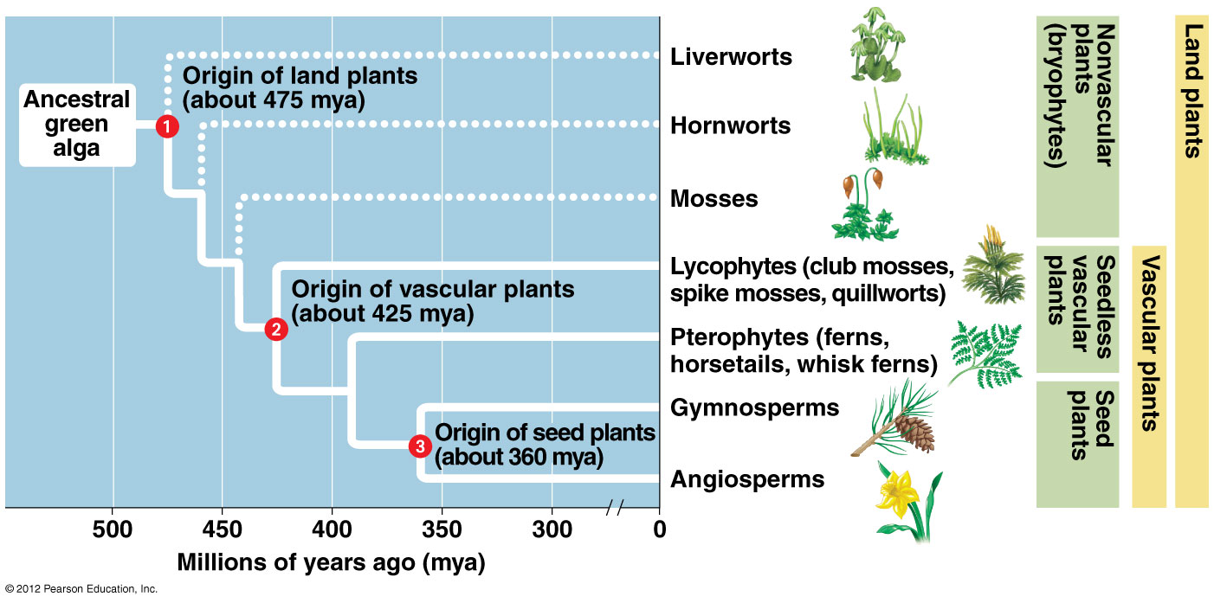

Slide 18
17.2 Plant diversity reflects the evolutionary history of the plant kingdom
0
Early diversification of plants gave rise to seedless, nonvascular plants called bryophytes, including
  mosses,
  liverworts, and
  hornworts.
© 2012 Pearson Education, Inc.
Notes:
18
Student Misconceptions and Concerns
1. Students often mistakenly conceive of evolution as a deliberate and directed process, in which organisms somehow acquire adaptations out of want or need. This chapter provides good examples of how evolution actually occurs. During the period when plants first moved onto land, the demands of a terrestrial environment selected among the diversity already existing within the various marginal plant species. For example, plants that produced structures that provided some physical support outside of water had an advantage over those without such structures. Plants did not evolve adaptations to address the needs of living on land. Instead, terrestrial adaptations in existing aquatic plants conveyed advantages in this new environment and were therefore favored.
2. The text identifies charophytes as the algal group most closely related to plants. Students might misinterpret this to mean that modern charophytes were the direct ancestors of plants. Instead, modern charophytes and plants share a common ancestor, but each has been evolving since the lineages diverged. This same confusion occurs when considering the evolutionary history of humans and chimps. Humans and chimps share a common ancestor. Modern humans did not evolve from modern chimps. Although such distinctions may be clear to us as instructors, beginning students with little experience can easily be confused.
Teaching Tips
1. An analogy exists between a chicken egg and the first seeds, although the parallels are limited: each consists of a developing embryo enclosed in a water-resistant packet, along with a store of food.
2. The support provided by many tightly packed mosses is analogous to the collective support of the many fibers of plush carpeting. Each fiber of carpet and each individual moss plant might easily collapse without the support of its neighbor.

Slide 19
17.2 Plant diversity reflects the evolutionary history of the plant kingdom
0
These plants resemble other plants in having apical meristems and embryos retained on the parent plant, but they lack
  true roots,
  leaves, and
  lignified cell walls.
© 2012 Pearson Education, Inc.
Notes:
19
Student Misconceptions and Concerns
1. Students often mistakenly conceive of evolution as a deliberate and directed process, in which organisms somehow acquire adaptations out of want or need. This chapter provides good examples of how evolution actually occurs. During the period when plants first moved onto land, the demands of a terrestrial environment selected among the diversity already existing within the various marginal plant species. For example, plants that produced structures that provided some physical support outside of water had an advantage over those without such structures. Plants did not evolve adaptations to address the needs of living on land. Instead, terrestrial adaptations in existing aquatic plants conveyed advantages in this new environment and were therefore favored.
2. The text identifies charophytes as the algal group most closely related to plants. Students might misinterpret this to mean that modern charophytes were the direct ancestors of plants. Instead, modern charophytes and plants share a common ancestor, but each has been evolving since the lineages diverged. This same confusion occurs when considering the evolutionary history of humans and chimps. Humans and chimps share a common ancestor. Modern humans did not evolve from modern chimps. Although such distinctions may be clear to us as instructors, beginning students with little experience can easily be confused.
Teaching Tips
1. An analogy exists between a chicken egg and the first seeds, although the parallels are limited: each consists of a developing embryo enclosed in a water-resistant packet, along with a store of food.
2. The support provided by many tightly packed mosses is analogous to the collective support of the many fibers of plush carpeting. Each fiber of carpet and each individual moss plant might easily collapse without the support of its neighbor.

Slide 20
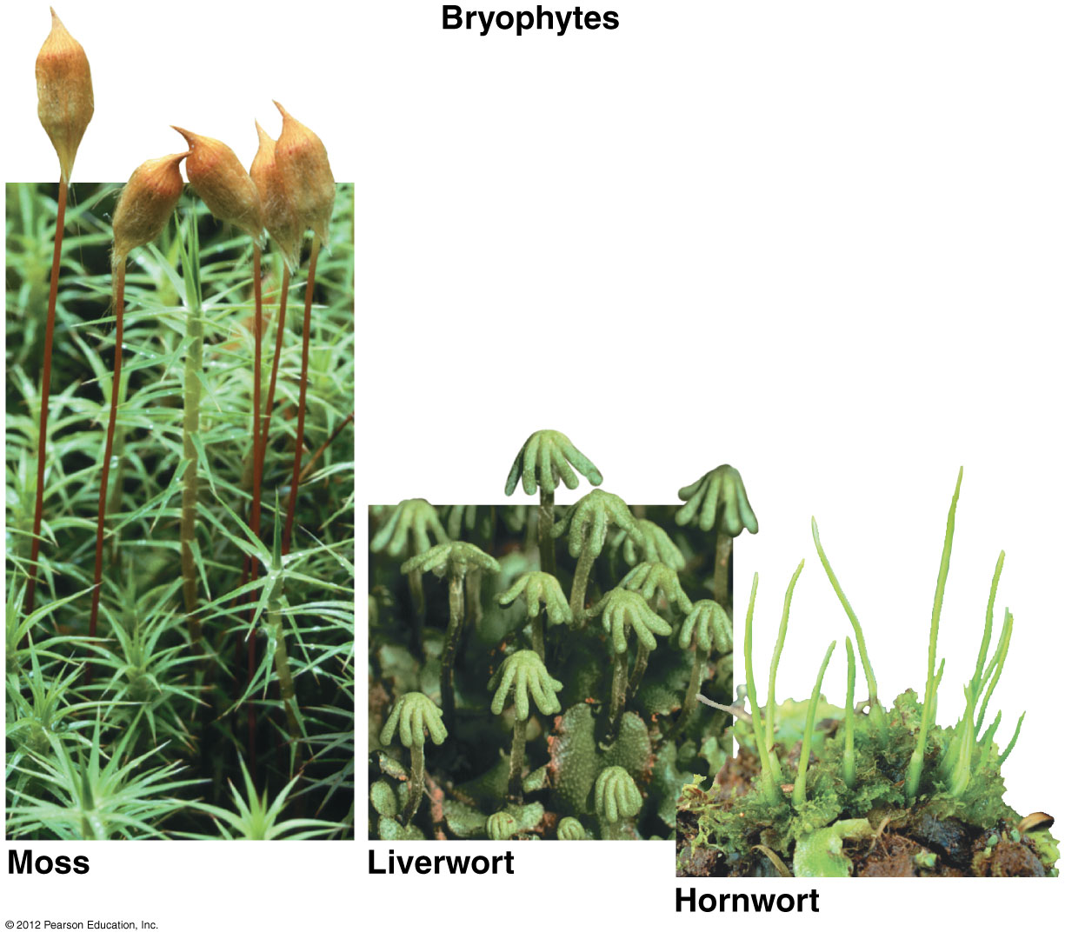

Slide 21
17.2 Plant diversity reflects the evolutionary history of the plant kingdom
0
About 425 million years ago, vascular plants evolved with lignin-hardened vascular tissues.
The seedless vascular plants include
  lycophytes (including club mosses) and
  pterophytes (ferns and their relatives).
© 2012 Pearson Education, Inc.
Notes:
21
Student Misconceptions and Concerns
1. Students often mistakenly conceive of evolution as a deliberate and directed process, in which organisms somehow acquire adaptations out of want or need. This chapter provides good examples of how evolution actually occurs. During the period when plants first moved onto land, the demands of a terrestrial environment selected among the diversity already existing within the various marginal plant species. For example, plants that produced structures that provided some physical support outside of water had an advantage over those without such structures. Plants did not evolve adaptations to address the needs of living on land. Instead, terrestrial adaptations in existing aquatic plants conveyed advantages in this new environment and were therefore favored.
2. The text identifies charophytes as the algal group most closely related to plants. Students might misinterpret this to mean that modern charophytes were the direct ancestors of plants. Instead, modern charophytes and plants share a common ancestor, but each has been evolving since the lineages diverged. This same confusion occurs when considering the evolutionary history of humans and chimps. Humans and chimps share a common ancestor. Modern humans did not evolve from modern chimps. Although such distinctions may be clear to us as instructors, beginning students with little experience can easily be confused.
Teaching Tips
1. An analogy exists between a chicken egg and the first seeds, although the parallels are limited: each consists of a developing embryo enclosed in a water-resistant packet, along with a store of food.
2. The support provided by many tightly packed mosses is analogous to the collective support of the many fibers of plush carpeting. Each fiber of carpet and each individual moss plant might easily collapse without the support of its neighbor.

Slide 22
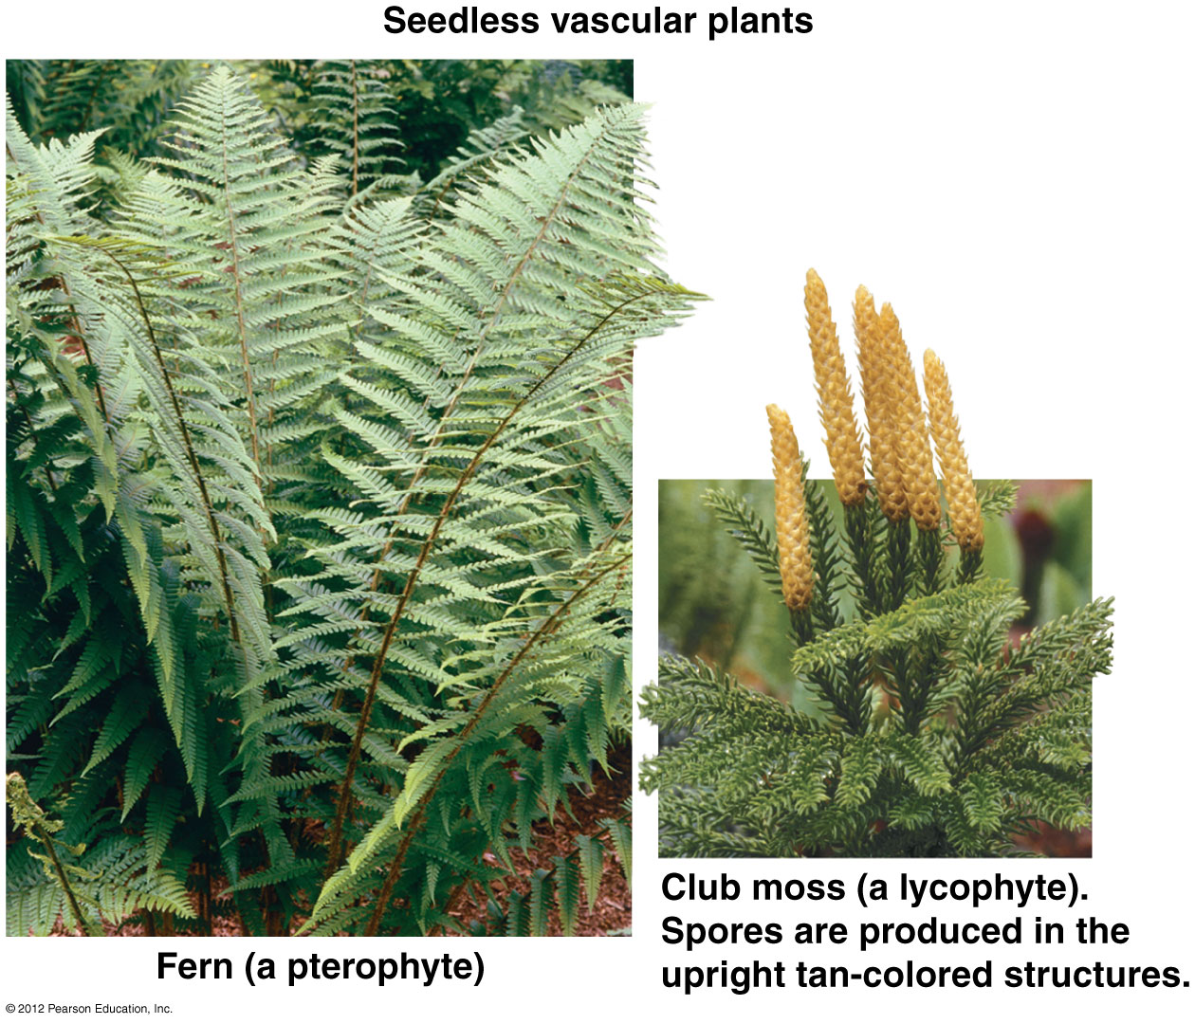

Slide 23
17.2 Plant diversity reflects the evolutionary history of the plant kingdom
0
The first vascular plants with seeds evolved about 360 million years ago.
A seed consists of an embryo packaged with a food supply within a protective covering.
© 2012 Pearson Education, Inc.
Notes:
23
Student Misconceptions and Concerns
1. Students often mistakenly conceive of evolution as a deliberate and directed process, in which organisms somehow acquire adaptations out of want or need. This chapter provides good examples of how evolution actually occurs. During the period when plants first moved onto land, the demands of a terrestrial environment selected among the diversity already existing within the various marginal plant species. For example, plants that produced structures that provided some physical support outside of water had an advantage over those without such structures. Plants did not evolve adaptations to address the needs of living on land. Instead, terrestrial adaptations in existing aquatic plants conveyed advantages in this new environment and were therefore favored.
2. The text identifies charophytes as the algal group most closely related to plants. Students might misinterpret this to mean that modern charophytes were the direct ancestors of plants. Instead, modern charophytes and plants share a common ancestor, but each has been evolving since the lineages diverged. This same confusion occurs when considering the evolutionary history of humans and chimps. Humans and chimps share a common ancestor. Modern humans did not evolve from modern chimps. Although such distinctions may be clear to us as instructors, beginning students with little experience can easily be confused.
Teaching Tips
1. An analogy exists between a chicken egg and the first seeds, although the parallels are limited: each consists of a developing embryo enclosed in a water-resistant packet, along with a store of food.
2. The support provided by many tightly packed mosses is analogous to the collective support of the many fibers of plush carpeting. Each fiber of carpet and each individual moss plant might easily collapse without the support of its neighbor.

Slide 24
17.2 Plant diversity reflects the evolutionary history of the plant kingdom
0
Vascular plants with seeds include
  gymnosperms (including ginkgo, cycad, and conifer species) and
  angiosperms (such as flowering trees and grasses).
© 2012 Pearson Education, Inc.
Notes:
24
Student Misconceptions and Concerns
1. Students often mistakenly conceive of evolution as a deliberate and directed process, in which organisms somehow acquire adaptations out of want or need. This chapter provides good examples of how evolution actually occurs. During the period when plants first moved onto land, the demands of a terrestrial environment selected among the diversity already existing within the various marginal plant species. For example, plants that produced structures that provided some physical support outside of water had an advantage over those without such structures. Plants did not evolve adaptations to address the needs of living on land. Instead, terrestrial adaptations in existing aquatic plants conveyed advantages in this new environment and were therefore favored.
2. The text identifies charophytes as the algal group most closely related to plants. Students might misinterpret this to mean that modern charophytes were the direct ancestors of plants. Instead, modern charophytes and plants share a common ancestor, but each has been evolving since the lineages diverged. This same confusion occurs when considering the evolutionary history of humans and chimps. Humans and chimps share a common ancestor. Modern humans did not evolve from modern chimps. Although such distinctions may be clear to us as instructors, beginning students with little experience can easily be confused.
Teaching Tips
1. An analogy exists between a chicken egg and the first seeds, although the parallels are limited: each consists of a developing embryo enclosed in a water-resistant packet, along with a store of food.
2. The support provided by many tightly packed mosses is analogous to the collective support of the many fibers of plush carpeting. Each fiber of carpet and each individual moss plant might easily collapse without the support of its neighbor.

Slide 25
17.2 Plant diversity reflects the evolutionary history of the plant kingdom
0
Gymnosperms
  have naked seeds that are not produced in special chambers and
  include ginkgo, cycad, and conifer species.
© 2012 Pearson Education, Inc.
Notes:
25
Student Misconceptions and Concerns
1. Students often mistakenly conceive of evolution as a deliberate and directed process, in which organisms somehow acquire adaptations out of want or need. This chapter provides good examples of how evolution actually occurs. During the period when plants first moved onto land, the demands of a terrestrial environment selected among the diversity already existing within the various marginal plant species. For example, plants that produced structures that provided some physical support outside of water had an advantage over those without such structures. Plants did not evolve adaptations to address the needs of living on land. Instead, terrestrial adaptations in existing aquatic plants conveyed advantages in this new environment and were therefore favored.
2. The text identifies charophytes as the algal group most closely related to plants. Students might misinterpret this to mean that modern charophytes were the direct ancestors of plants. Instead, modern charophytes and plants share a common ancestor, but each has been evolving since the lineages diverged. This same confusion occurs when considering the evolutionary history of humans and chimps. Humans and chimps share a common ancestor. Modern humans did not evolve from modern chimps. Although such distinctions may be clear to us as instructors, beginning students with little experience can easily be confused.
Teaching Tips
1. An analogy exists between a chicken egg and the first seeds, although the parallels are limited: each consists of a developing embryo enclosed in a water-resistant packet, along with a store of food.
2. The support provided by many tightly packed mosses is analogous to the collective support of the many fibers of plush carpeting. Each fiber of carpet and each individual moss plant might easily collapse without the support of its neighbor.

Slide 26
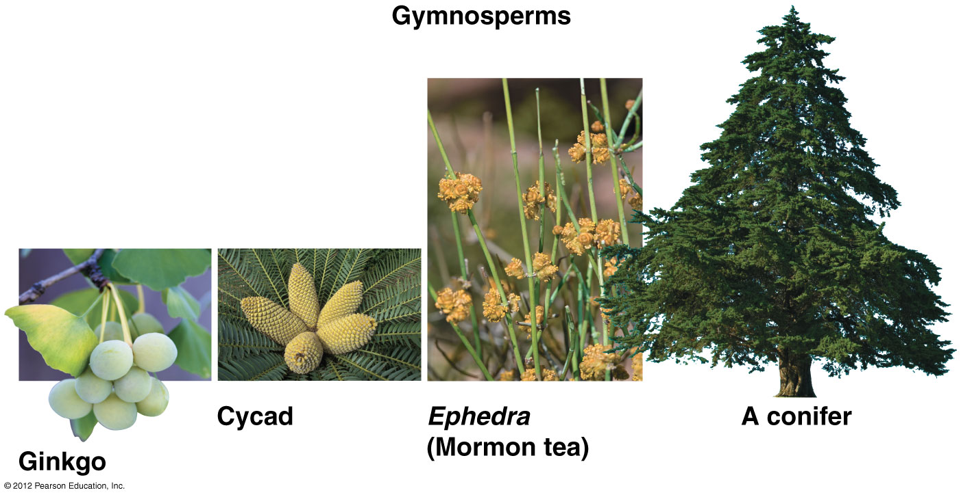

Slide 27
17.2 Plant diversity reflects the evolutionary history of the plant kingdom
0
Angiosperms
  are flowering plants and
  include flowering trees and grasses.
© 2012 Pearson Education, Inc.
Notes:
27
Student Misconceptions and Concerns
1. Students often mistakenly conceive of evolution as a deliberate and directed process, in which organisms somehow acquire adaptations out of want or need. This chapter provides good examples of how evolution actually occurs. During the period when plants first moved onto land, the demands of a terrestrial environment selected among the diversity already existing within the various marginal plant species. For example, plants that produced structures that provided some physical support outside of water had an advantage over those without such structures. Plants did not evolve adaptations to address the needs of living on land. Instead, terrestrial adaptations in existing aquatic plants conveyed advantages in this new environment and were therefore favored.
2. The text identifies charophytes as the algal group most closely related to plants. Students might misinterpret this to mean that modern charophytes were the direct ancestors of plants. Instead, modern charophytes and plants share a common ancestor, but each has been evolving since the lineages diverged. This same confusion occurs when considering the evolutionary history of humans and chimps. Humans and chimps share a common ancestor. Modern humans did not evolve from modern chimps. Although such distinctions may be clear to us as instructors, beginning students with little experience can easily be confused.
Teaching Tips
1. An analogy exists between a chicken egg and the first seeds, although the parallels are limited: each consists of a developing embryo enclosed in a water-resistant packet, along with a store of food.
2. The support provided by many tightly packed mosses is analogous to the collective support of the many fibers of plush carpeting. Each fiber of carpet and each individual moss plant might easily collapse without the support of its neighbor.

Slide 28
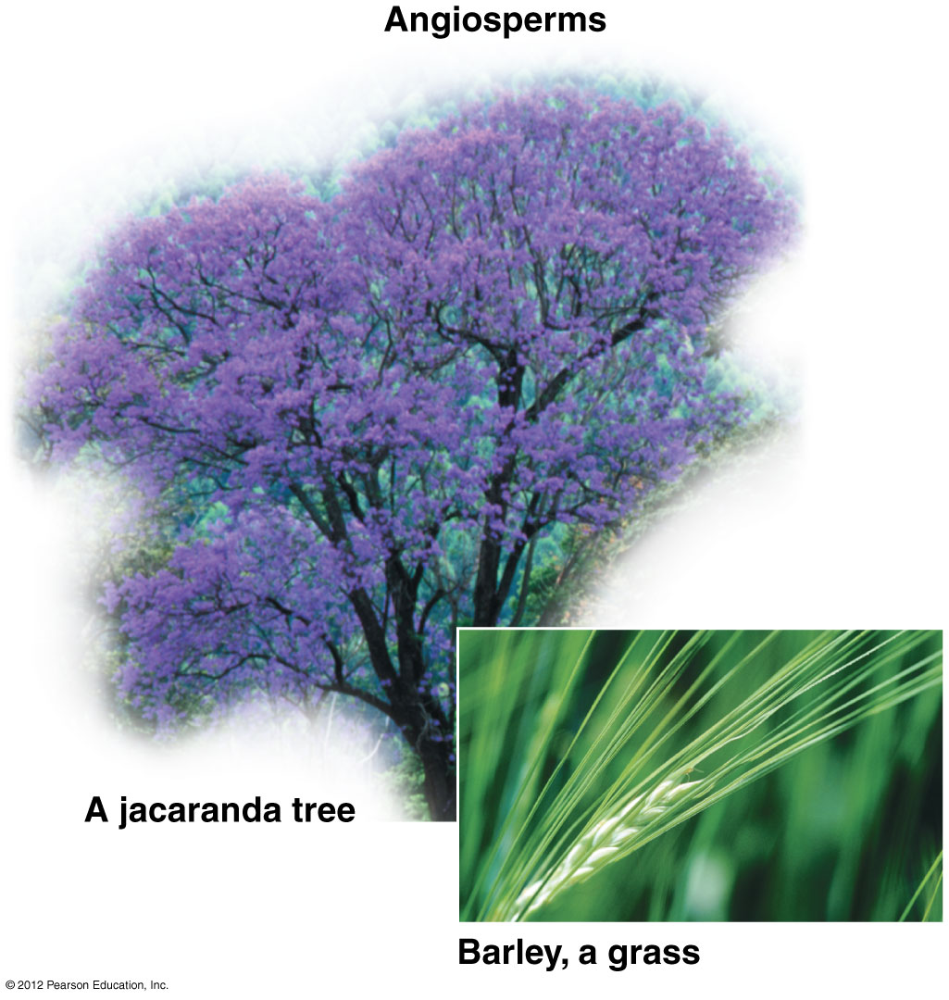

Slide 29
ALTERNATION
OF GENERATIONS
AND PLANT LIFE CYCLES
© 2012 Pearson Education, Inc.
Notes:
29

Slide 30
17.3 Haploid and diploid generations alternate in plant life cycles
Plants have an alternation of generations in which the haploid and diploid stages are distinct, multicellular bodies.
  The haploid gametophyte produces gametes (eggs or sperm) by mitosis.
  Fertilization results in a diploid zygote.
  The zygote develops into the diploid sporophyte, which produces haploid spores by meiosis.
  Spores grow into gametophytes.
© 2012 Pearson Education, Inc.
Notes:
30
Student Misconceptions and Concerns
Students can easily confuse the animal and plant reproductive cycles. However, the unique feature of alternation of generations in plants (and certain algae) makes analogies and parallels challenging and potentially confusing when referencing animal life cycles. One possible relevant exercise would be to compare the timing of mitosis and meiosis in plant and animal life cycles.
Teaching Tips
1. The authors describe four key adaptations for life on land in Module 17.2. The following modules (17.3–17.13) describe how these adaptations distinguish the main lineages of the plant kingdom. This is consistent with good lecture advice: Tell them what you are going to tell them, tell them, then tell them what you told them (summarize).
2. Students might wonder if humans and other animals do not also qualify as having alternation of generations. Although we do have haploid gametes, the haploid and diploid stages do not include multicellular individuals.

Slide 31
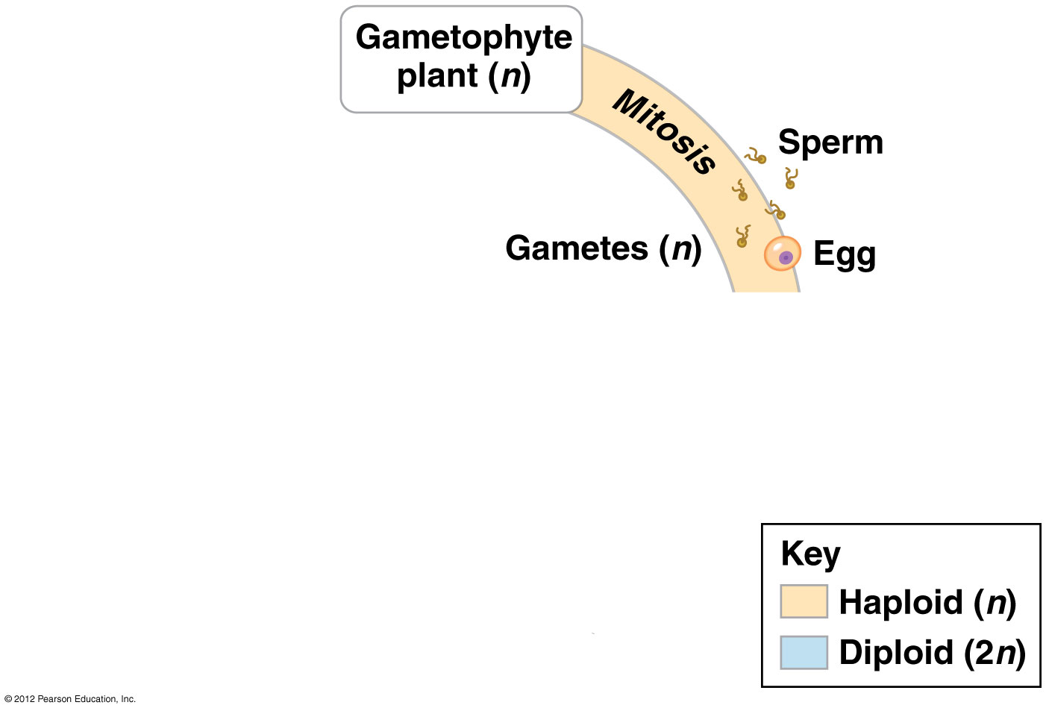

Slide 32
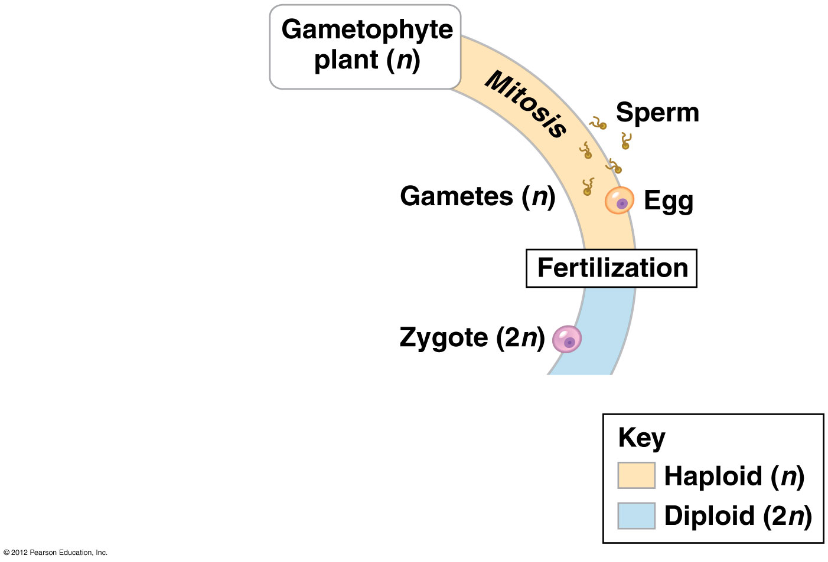

Slide 33
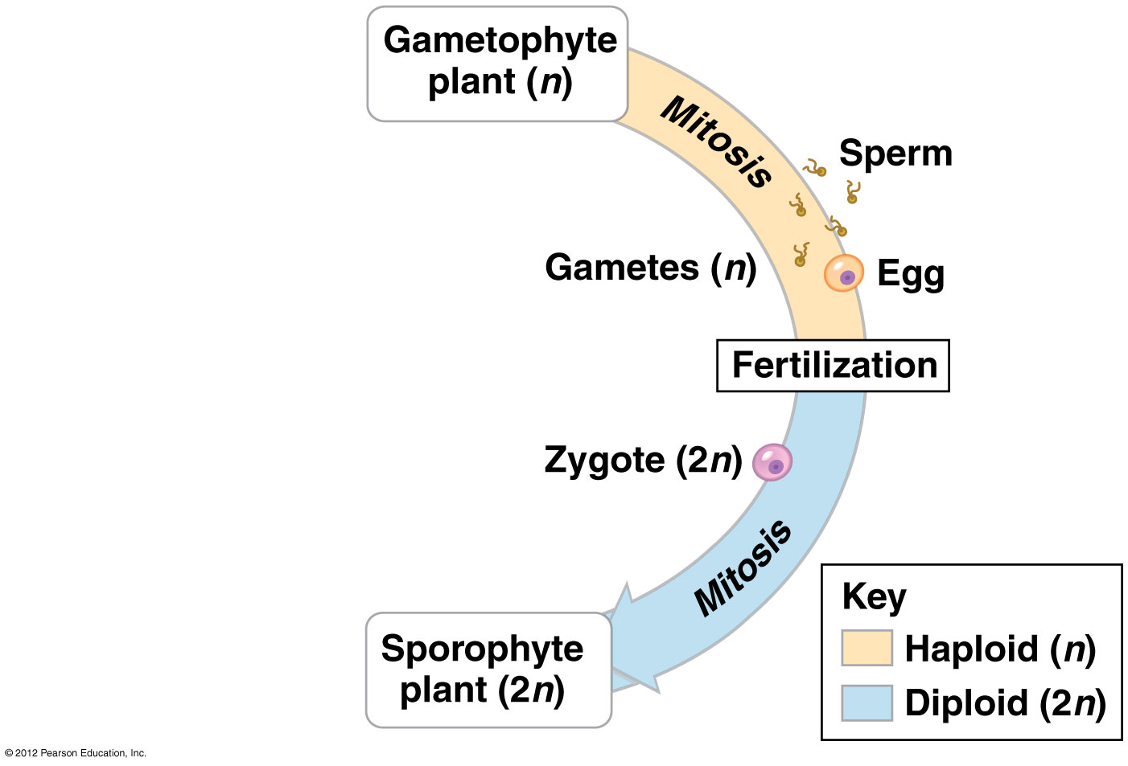

Slide 34
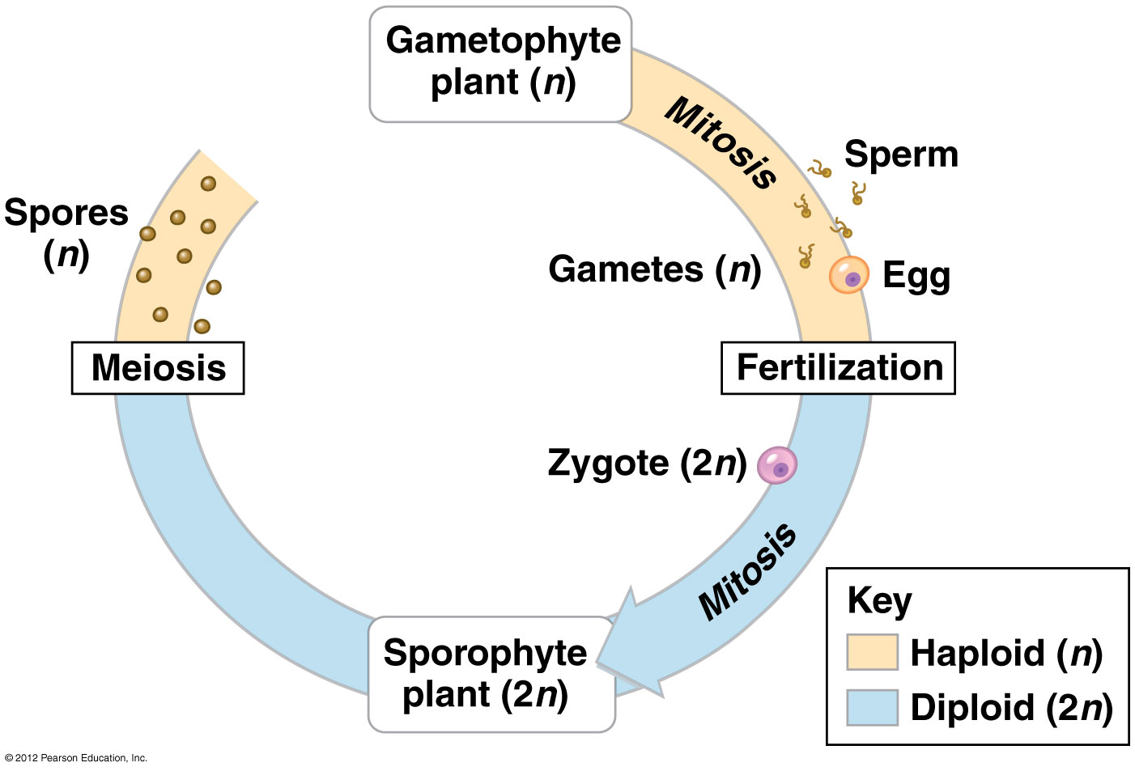

Slide 35
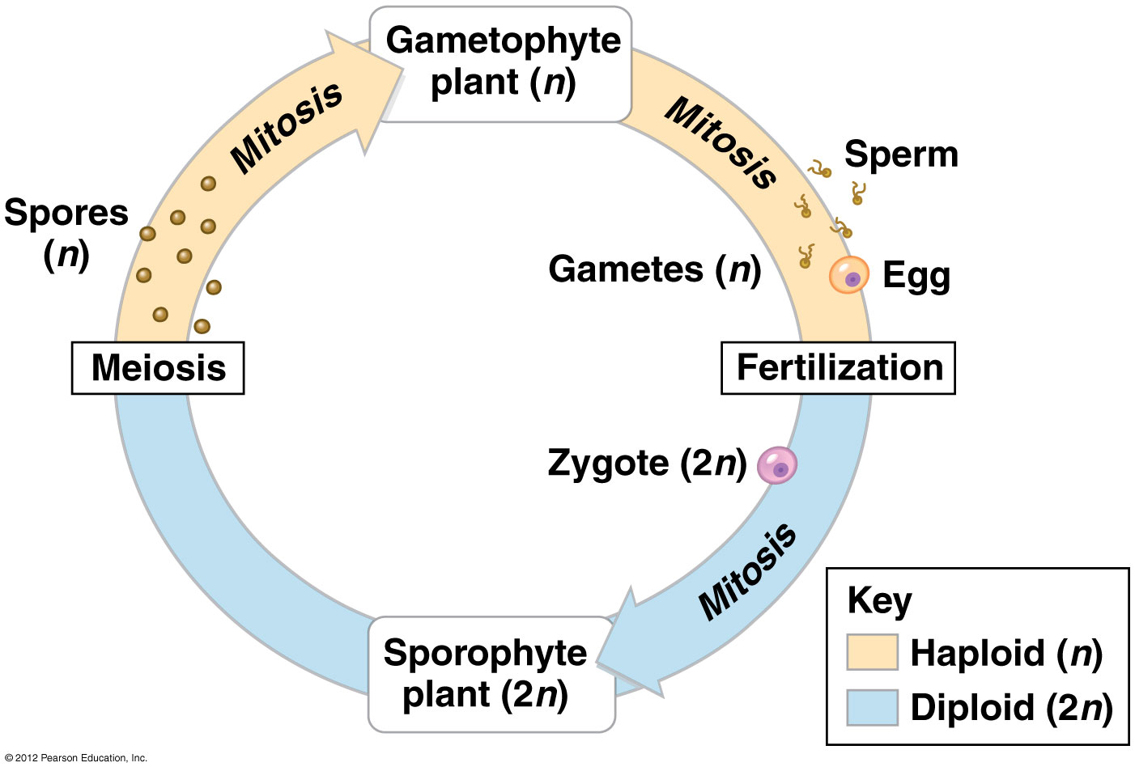

Slide 36
17.4 The life cycle of a moss is dominated by the gametophyte
Gametophytes make up a bed of moss.
  Gametes develop in male and female gametangia.
  Sperm swim through water to the egg in the female gametangium.
© 2012 Pearson Education, Inc.
Notes:
36
Student Misconceptions and Concerns
Students can easily confuse the animal and plant reproductive cycles. However, the unique feature of alternation of generations in plants (and certain algae) makes analogies and parallels challenging and potentially confusing when referencing animal life cycles. One possible relevant exercise would be to compare the timing of mitosis and meiosis in plant and animal life cycles.
Teaching Tips
1. The authors describe four key adaptations for life on land in Module 17.2. The following modules (17.3–17.13) describe how these adaptations distinguish the main lineages of the plant kingdom. This is consistent with good lecture advice: Tell them what you are going to tell them, tell them, then tell them what you told them (summarize).
2. Students might wonder if humans and other animals do not also qualify as having alternation of generations. Although we do have haploid gametes, the haploid and diploid stages do not include multicellular individuals.

Slide 37
17.4 The life cycle of a moss is dominated by the gametophyte
The zygote
  develops within the gametangium into a mature sporophyte,
  which remains attached to the gametophyte.
Meiosis occurs in sporangia at the tips of the sporophyte stalks.
Haploid spores are released from the sporangium and develop into gametophyte plants.
© 2012 Pearson Education, Inc.
Notes:
37
Student Misconceptions and Concerns
Students can easily confuse the animal and plant reproductive cycles. However, the unique feature of alternation of generations in plants (and certain algae) makes analogies and parallels challenging and potentially confusing when referencing animal life cycles. One possible relevant exercise would be to compare the timing of mitosis and meiosis in plant and animal life cycles.
Teaching Tips
1. The authors describe four key adaptations for life on land in Module 17.2. The following modules (17.3–17.13) describe how these adaptations distinguish the main lineages of the plant kingdom. This is consistent with good lecture advice: Tell them what you are going to tell them, tell them, then tell them what you told them (summarize).
2. Students might wonder if humans and other animals do not also qualify as having alternation of generations. Although we do have haploid gametes, the haploid and diploid stages do not include multicellular individuals.

Slide 38
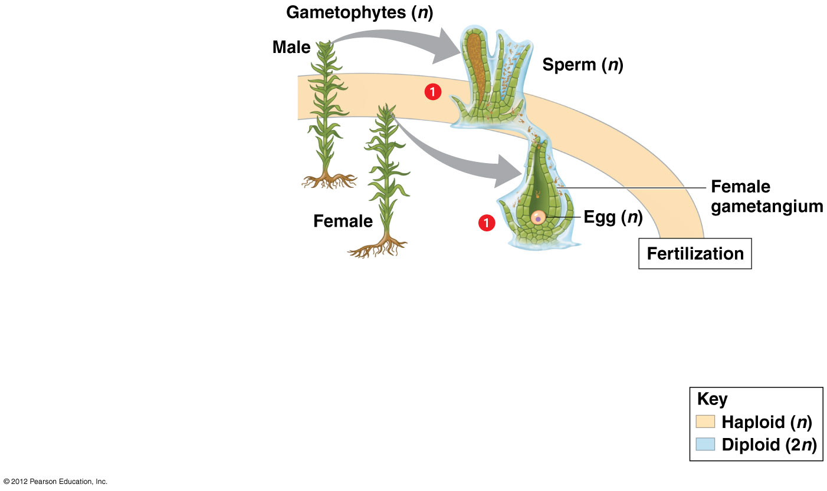

Slide 39
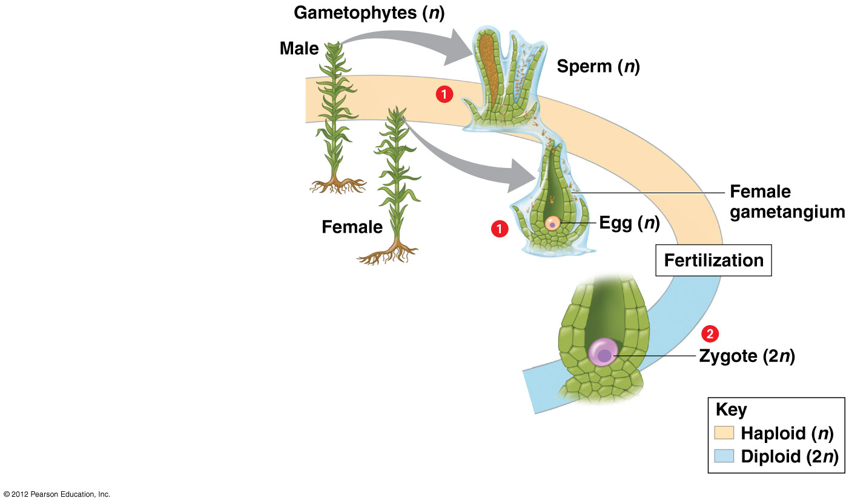

Slide 40
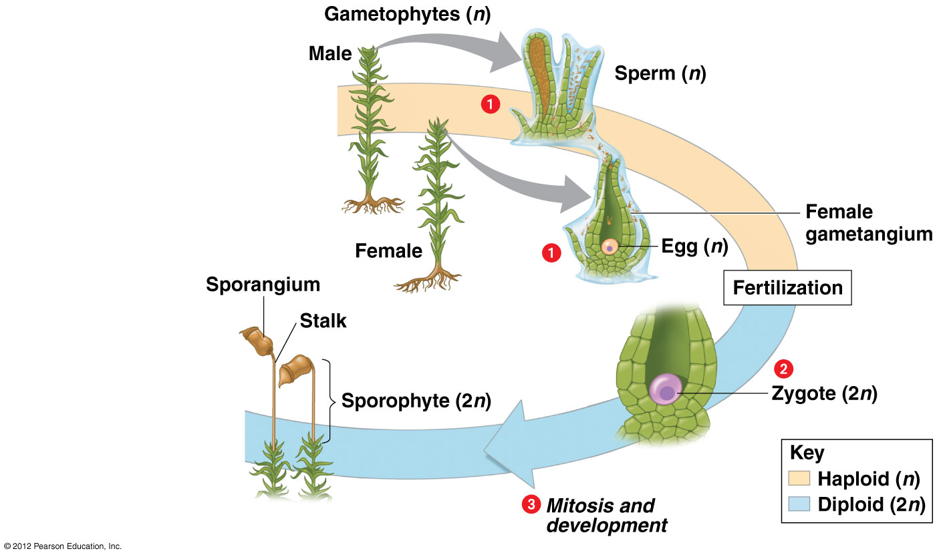

Slide 41
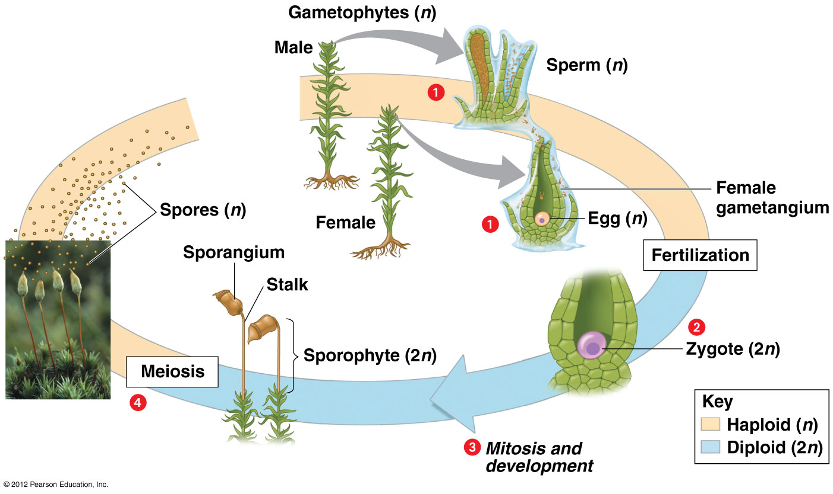

Slide 42
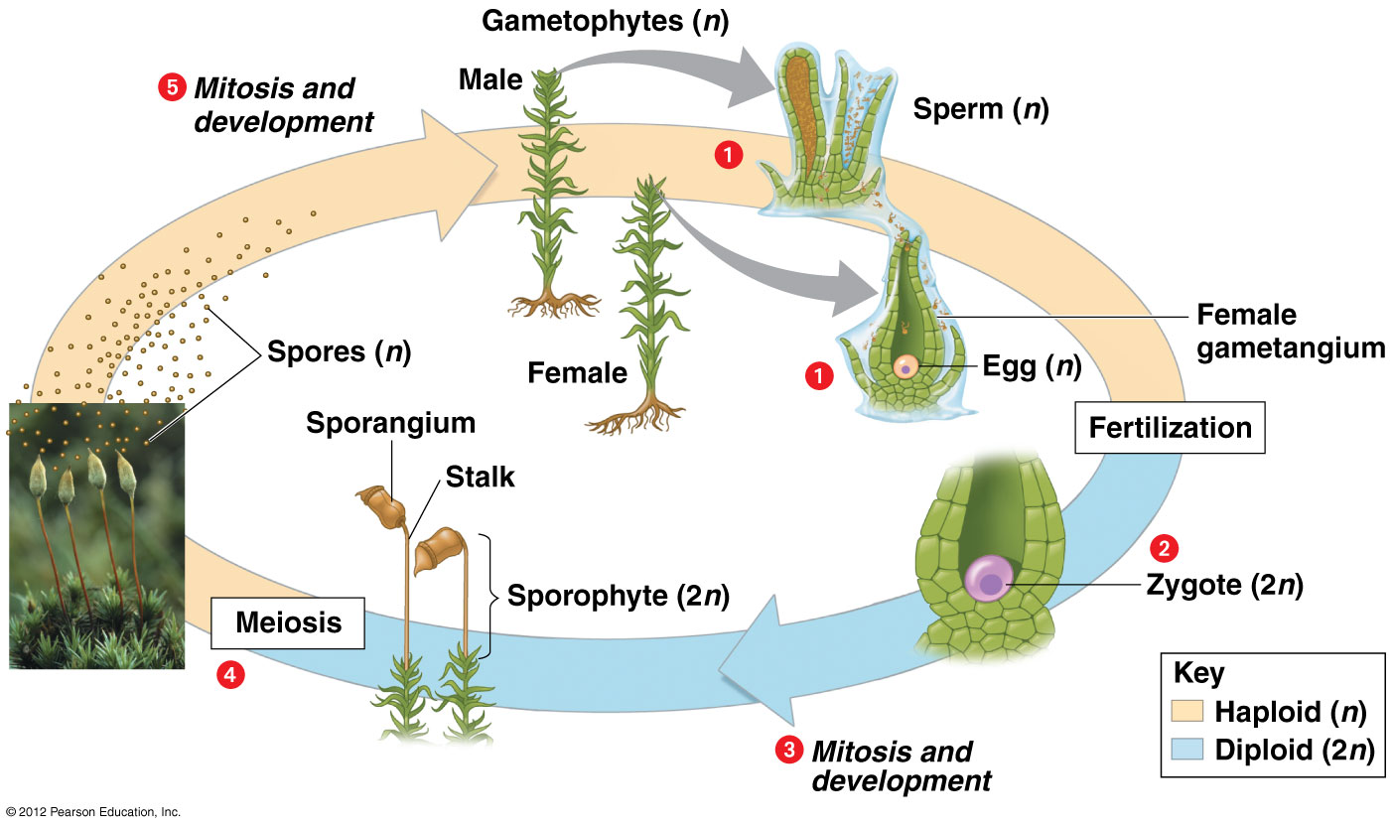

Slide 43
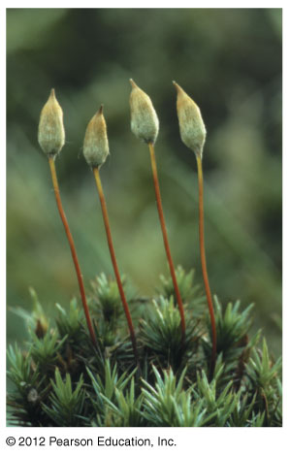
Figure 17.4_6 moss sporangia
Notes:
43
Figure 17.4_6 Life cycle of a moss (moss sporangia)

Slide 44
17.5 Ferns, like most plants, have a life cycle dominated by the sporophyte
Fern gametophytes are small and inconspicuous.
Gametophytes produce flagellated sperm that swim to the egg and fertilize it to produce a zygote.
The zygote initially develops within the female gametangia but eventually develops into an independent sporophyte.
© 2012 Pearson Education, Inc.
Notes:
44
Student Misconceptions and Concerns
Students can easily confuse the animal and plant reproductive cycles. However, the unique feature of alternation of generations in plants (and certain algae) makes analogies and parallels challenging and potentially confusing when referencing animal life cycles. One possible relevant exercise would be to compare the timing of mitosis and meiosis in plant and animal life cycles.
Teaching Tips
1. The authors describe four key adaptations for life on land in Module 17.2. The following modules (17.3–17.13) describe how these adaptations distinguish the main lineages of the plant kingdom. This is consistent with good lecture advice: Tell them what you are going to tell them, tell them, then tell them what you told them (summarize).
2. Students might wonder if humans and other animals do not also qualify as having alternation of generations. Although we do have haploid gametes, the haploid and diploid stages do not include multicellular individuals.

Slide 45
17.5 Ferns, like most plants, have a life cycle dominated by the sporophyte
Sporangia develop on the underside of the leaves of the sporophyte.
Within the sporangia, cells undergo meiosis to produce haploid spores.
Spores are released and develop into gametophytes.
© 2012 Pearson Education, Inc.
Notes:
45
Student Misconceptions and Concerns
Students can easily confuse the animal and plant reproductive cycles. However, the unique feature of alternation of generations in plants (and certain algae) makes analogies and parallels challenging and potentially confusing when referencing animal life cycles. One possible relevant exercise would be to compare the timing of mitosis and meiosis in plant and animal life cycles.
Teaching Tips
1. The authors describe four key adaptations for life on land in Module 17.2. The following modules (17.3–17.13) describe how these adaptations distinguish the main lineages of the plant kingdom. This is consistent with good lecture advice: Tell them what you are going to tell them, tell them, then tell them what you told them (summarize).
2. Students might wonder if humans and other animals do not also qualify as having alternation of generations. Although we do have haploid gametes, the haploid and diploid stages do not include multicellular individuals.

Slide 46
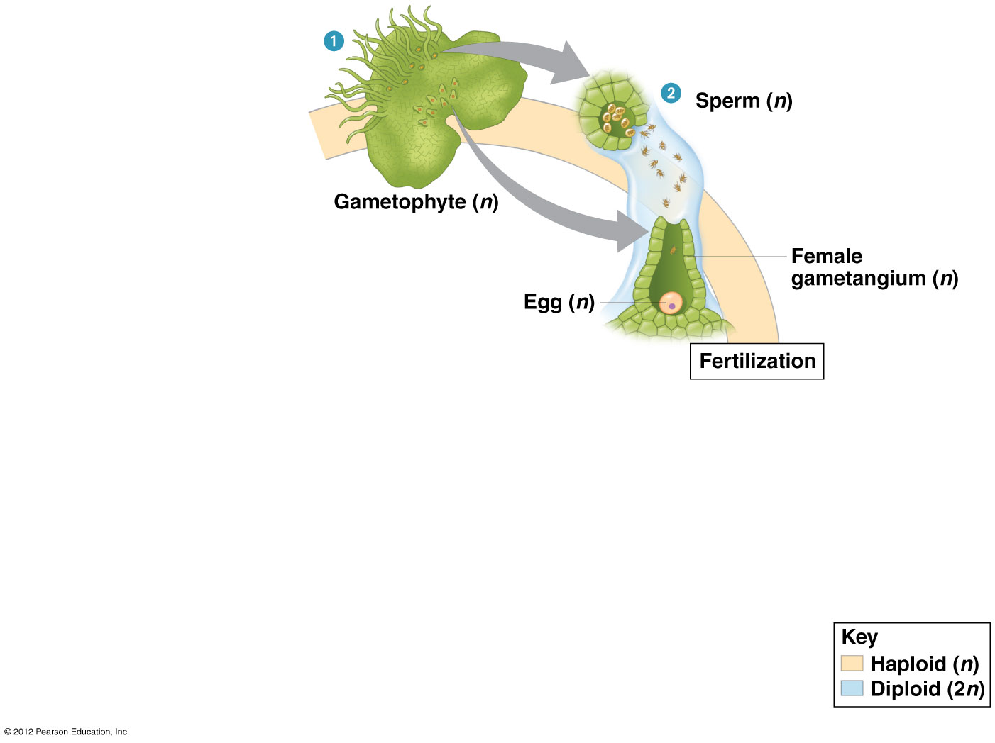

Slide 47
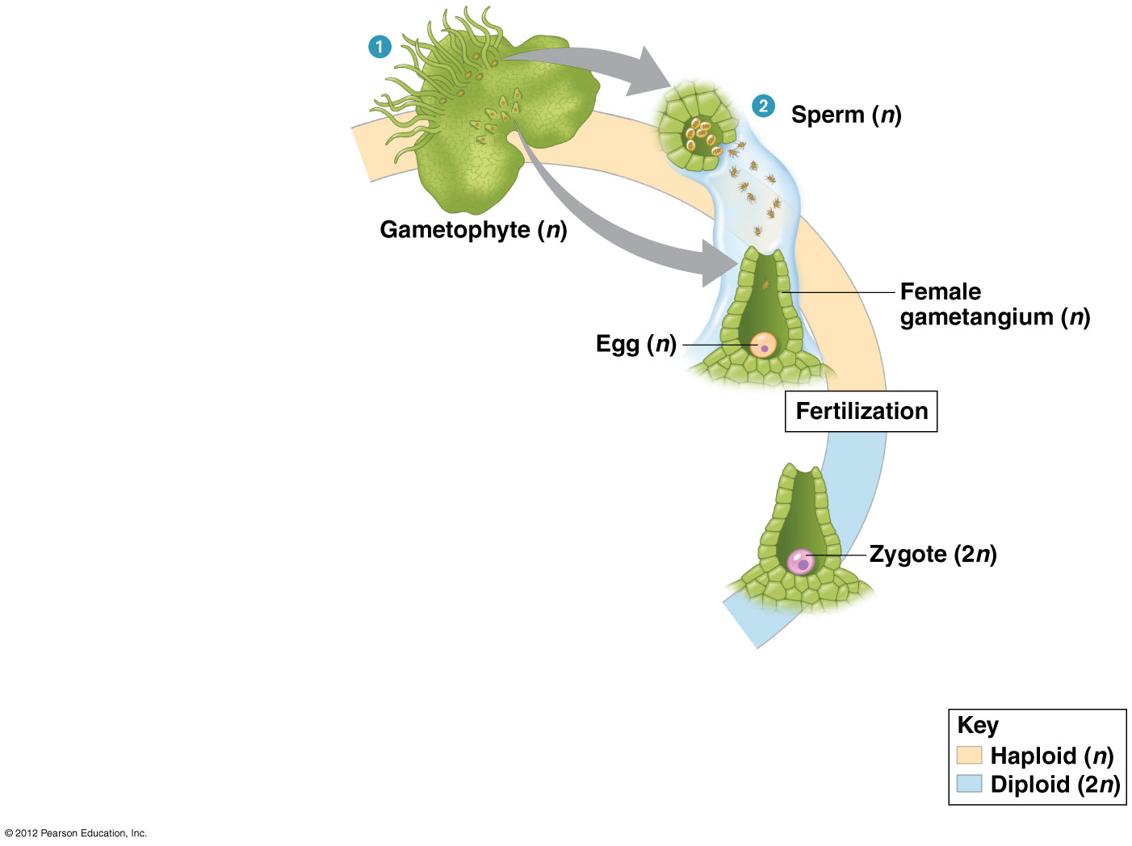

Slide 48
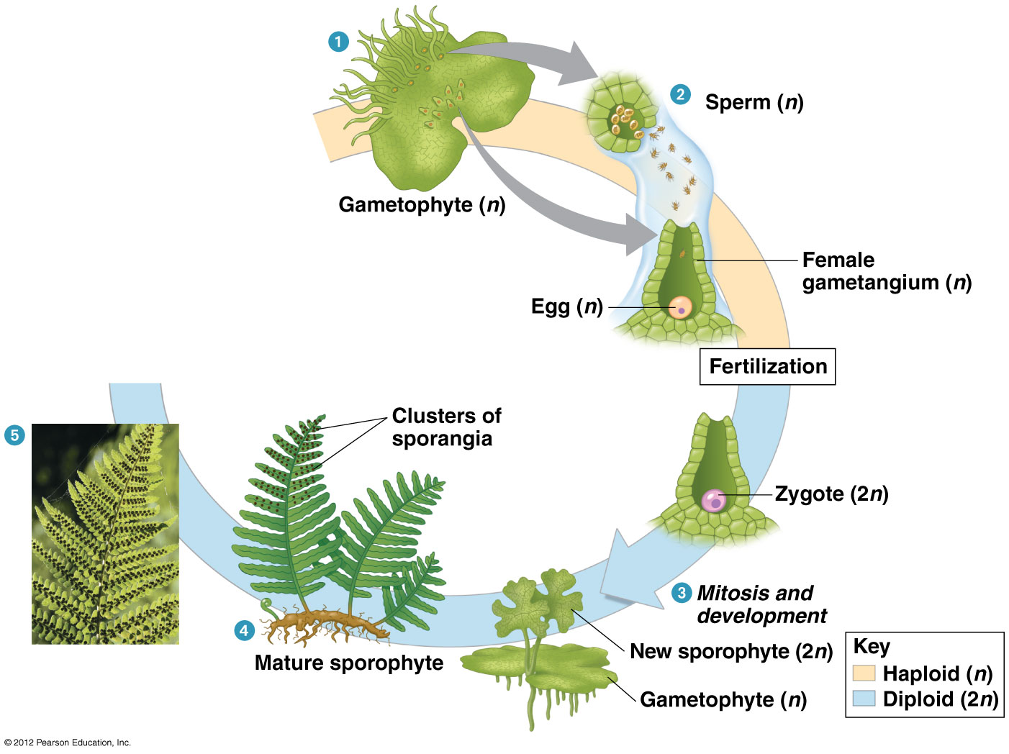

Slide 49
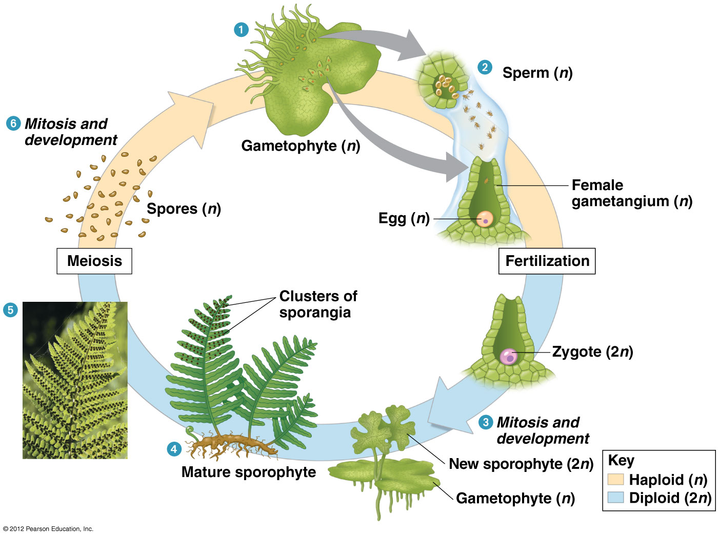

Slide 50
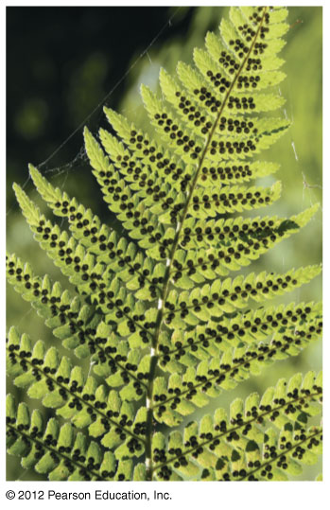
Figure 17.5_5 fern sori (sporangia)
Notes:
50
Figure 17.5_5 Life cycle of a fern (fern sporangia)

Slide 51
17.6 Seedless vascular plants dominated vast “coal forests”
Two groups of seedless plants formed vast ancient forests in low-lying wetlands during the Carboniferous period (360–299 million years ago):
  lycophytes (such as club mosses) and
  pterophytes (such as ferns).
When these plants died, they formed peat deposits that eventually formed coal.
© 2012 Pearson Education, Inc.
Notes:
51
Student Misconceptions and Concerns
Students often confuse global warming with the destruction of the ozone layer. This might be a good time to discuss or clarify global warming. The carbon removed from the air during the Carboniferous period has been locked up in coal (and other fossil fuels) for about 300 million years. By burning fossil fuels, we are reintroducing carbon that has been out of circulation for a significant time. Thus, there is a net gain in global carbon dioxide, which may act like glass in a car to reflect back heat (or glass in a greenhouse). Note that burning ethanol derived from corn does not directly contribute to global warming by adding sequestered carbon dioxide to the atmosphere. This is because the carbon in the ethanol was removed from the air only a year or two ago, instead of hundreds of millions of years ago (although the use of fossil fuels to raise corn does contribute to global warming).
Teaching Tips
1. The authors describe four key adaptations for life on land in Module 17.2. The following modules (17.3–17.13) describe how these adaptations distinguish the main lineages of the plant kingdom. This is consistent with good lecture advice: Tell them what you are going to tell them, tell them, then tell them what you told them (summarize).
2. Depending upon where your course is taught, coal may be an important part of the economy. The geology of these coal deposits helps us interpret the rich history of life on Earth. If you live in a coal region, consider devoting additional time to explaining how coal was deposited, why it is an important source of energy, and how the use of fossil fuels contributes to global warming.

Slide 52
17.6 Seedless vascular plants dominated vast “coal forests”
Coal, oil, and natural gas are fossil fuels.
  Oil and natural gas formed from marine organisms.
  Coal formed from seedless plants.
Burning fossil fuels releases CO₂ and other greenhouse gases into the atmosphere, which are now causing a warming climate.
© 2012 Pearson Education, Inc.
Notes:
52
Student Misconceptions and Concerns
Students often confuse global warming with the destruction of the ozone layer. This might be a good time to discuss or clarify global warming. The carbon removed from the air during the Carboniferous period has been locked up in coal (and other fossil fuels) for about 300 million years. By burning fossil fuels, we are reintroducing carbon that has been out of circulation for a significant time. Thus, there is a net gain in global carbon dioxide, which may act like glass in a car to reflect back heat (or glass in a greenhouse). Note that burning ethanol derived from corn does not directly contribute to global warming by adding sequestered carbon dioxide to the atmosphere. This is because the carbon in the ethanol was removed from the air only a year or two ago, instead of hundreds of millions of years ago (although the use of fossil fuels to raise corn does contribute to global warming).
Teaching Tips
1. The authors describe four key adaptations for life on land in Module 17.2. The following modules (17.3–17.13) describe how these adaptations distinguish the main lineages of the plant kingdom. This is consistent with good lecture advice: Tell them what you are going to tell them, tell them, then tell them what you told them (summarize).
2. Depending upon where your course is taught, coal may be an important part of the economy. The geology of these coal deposits helps us interpret the rich history of life on Earth. If you live in a coal region, consider devoting additional time to explaining how coal was deposited, why it is an important source of energy, and how the use of fossil fuels contributes to global warming.

Slide 53
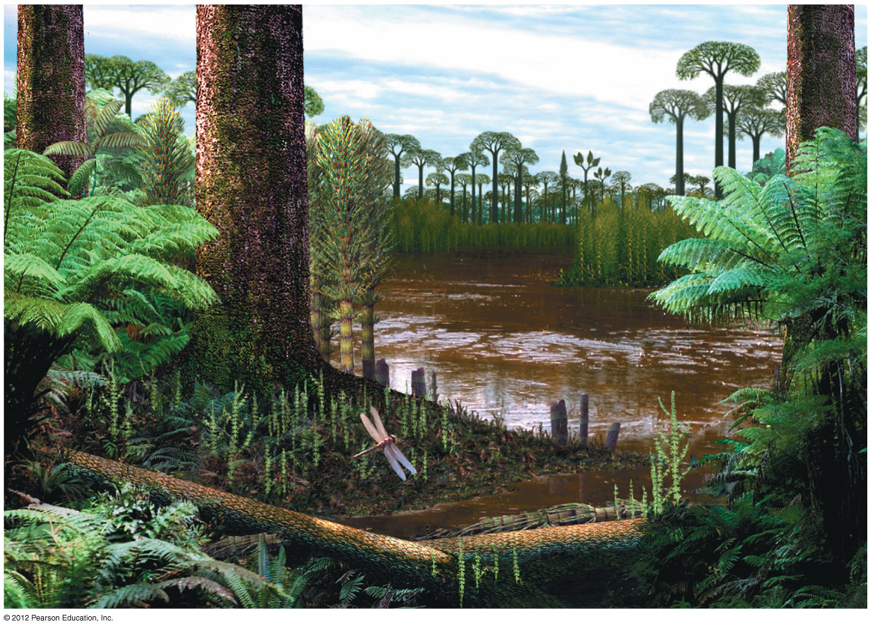
Figure 17.6
Notes:
53
Figure 17.6 A reconstruction of an extinct forest dominated by seedless plants

Slide 54
17.6 Seedless vascular plants dominated vast “coal forests”
As temperatures dropped during the late Carboniferous,
  glaciers formed,
  the climate turned drier,
  the vast swamps and forests began to disappear, and
  wind-dispersed pollen and protective seeds gave seed plants a competitive advantage.
© 2012 Pearson Education, Inc.
Notes:
54
Student Misconceptions and Concerns
Students often confuse global warming with the destruction of the ozone layer. This might be a good time to discuss or clarify global warming. The carbon removed from the air during the Carboniferous period has been locked up in coal (and other fossil fuels) for about 300 million years. By burning fossil fuels, we are reintroducing carbon that has been out of circulation for a significant time. Thus, there is a net gain in global carbon dioxide, which may act like glass in a car to reflect back heat (or glass in a greenhouse). Note that burning ethanol derived from corn does not directly contribute to global warming by adding sequestered carbon dioxide to the atmosphere. This is because the carbon in the ethanol was removed from the air only a year or two ago, instead of hundreds of millions of years ago (although the use of fossil fuels to raise corn does contribute to global warming).
Teaching Tips
1. The authors describe four key adaptations for life on land in Module 17.2. The following modules (17.3–17.13) describe how these adaptations distinguish the main lineages of the plant kingdom. This is consistent with good lecture advice: Tell them what you are going to tell them, tell them, then tell them what you told them (summarize).
2. Depending upon where your course is taught, coal may be an important part of the economy. The geology of these coal deposits helps us interpret the rich history of life on Earth. If you live in a coal region, consider devoting additional time to explaining how coal was deposited, why it is an important source of energy, and how the use of fossil fuels contributes to global warming.

Slide 55
17.7 A pine tree is a sporophyte with gametophytes in its cones
A pine tree is a sporophyte.
Tiny gametophytes grow in sporophyte cones.
The ovule is a key adaptation, a protective device for all the female stages in the life cycle, as well as the site of
  pollination,
  fertilization, and
  embryonic development.
© 2012 Pearson Education, Inc.
Notes:
55
Teaching Tips
1. The authors describe four key adaptations for life on land in Module 17.2. The following modules (17.3–17.13) describe how these adaptations distinguish the main lineages of the plant kingdom. This is consistent with good lecture advice: Tell them what you are going to tell them, tell them, then tell them what you told them (summarize).
2. As the authors note, much time can pass between pollination, fertilization, and the production of seeds in pine trees. This entire process may take two years. This lengthy period of time, the alternation of generations, and other specific details of the gymnosperm life cycle can create confusion. Students with little experience in plant biology may need considerable support in fitting all of these details into the life cycle.
3. As François Jacob suggested, evolution works as a tinkerer and not like an engineer. New forms evolve by remodeling old forms. As the text notes, gymnosperm cones are modified shoots and angiosperm flowers represent the remodeling of leaves. These examples of remodeling might be a subject you may want to explore in additional detail as an important lesson in evolution.

Slide 56
17.7 A pine tree is a sporophyte with gametophytes in its cones
A sperm from a pollen grain fertilizes an egg in the female gametophyte.
The zygote develops into a sporophyte embryo.
The ovule becomes the seed with
  stored food and
  a protective seed coat.
The seed is a key adaptation for life on land and a major factor in the success of seed plants.
© 2012 Pearson Education, Inc.
Notes:
56
Teaching Tips
1. The authors describe four key adaptations for life on land in Module 17.2. The following modules (17.3–17.13) describe how these adaptations distinguish the main lineages of the plant kingdom. This is consistent with good lecture advice: Tell them what you are going to tell them, tell them, then tell them what you told them (summarize).
2. As the authors note, much time can pass between pollination, fertilization, and the production of seeds in pine trees. This entire process may take two years. This lengthy period of time, the alternation of generations, and other specific details of the gymnosperm life cycle can create confusion. Students with little experience in plant biology may need considerable support in fitting all of these details into the life cycle.
3. As François Jacob suggested, evolution works as a tinkerer and not like an engineer. New forms evolve by remodeling old forms. As the text notes, gymnosperm cones are modified shoots and angiosperm flowers represent the remodeling of leaves. These examples of remodeling might be a subject you may want to explore in additional detail as an important lesson in evolution.

Slide 57
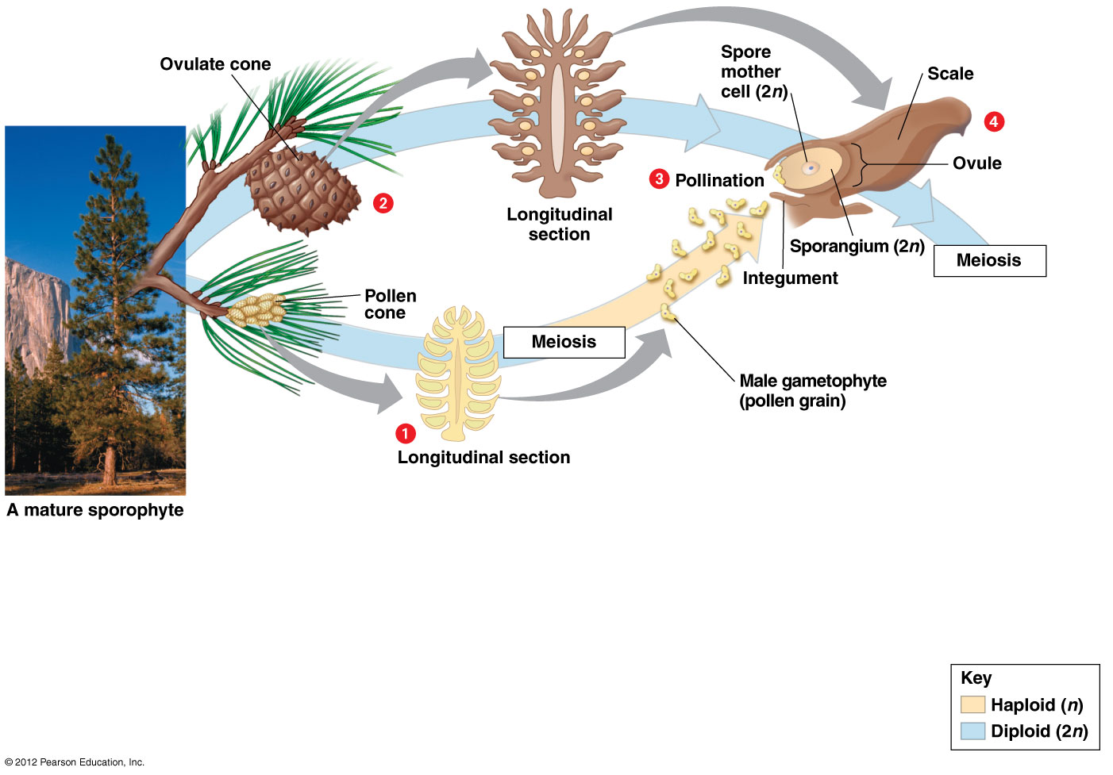

Slide 58
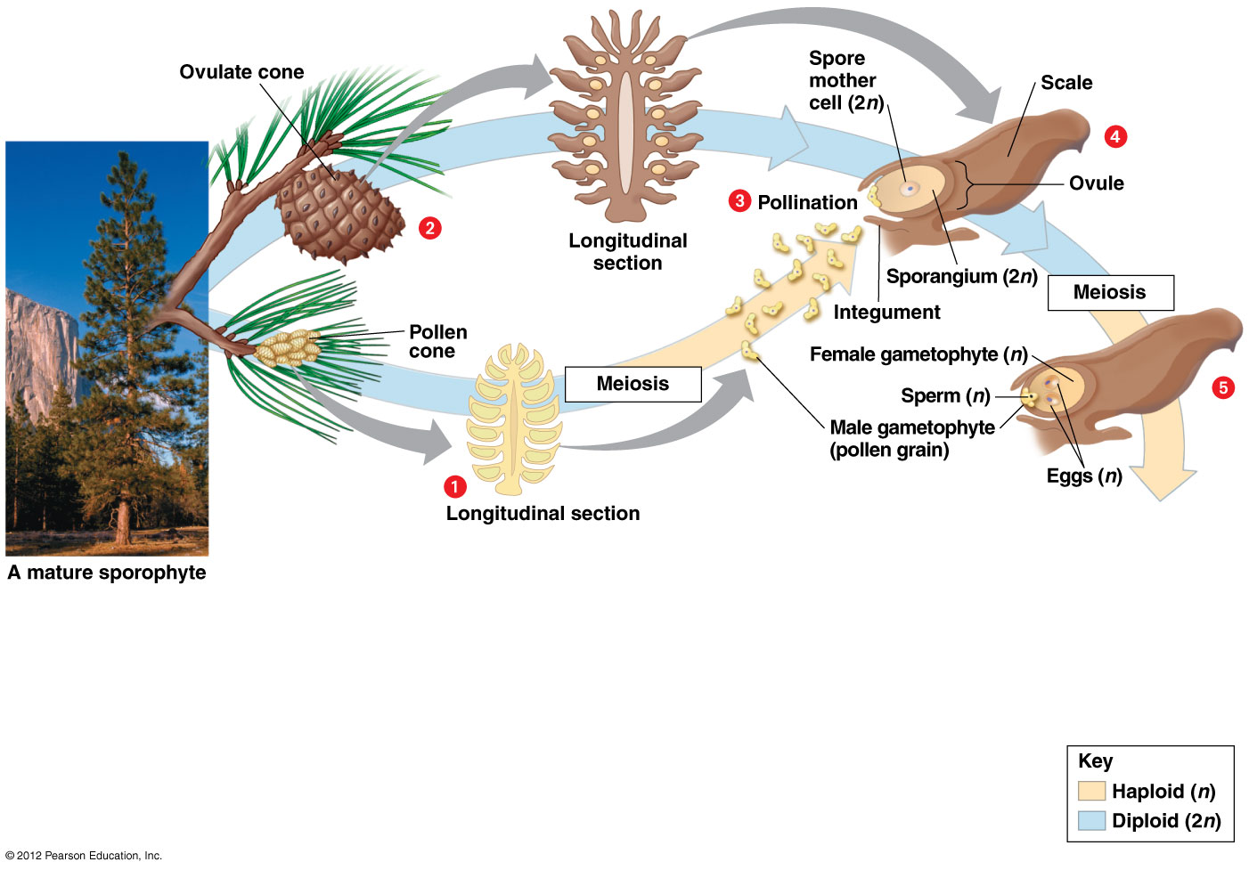

Slide 59
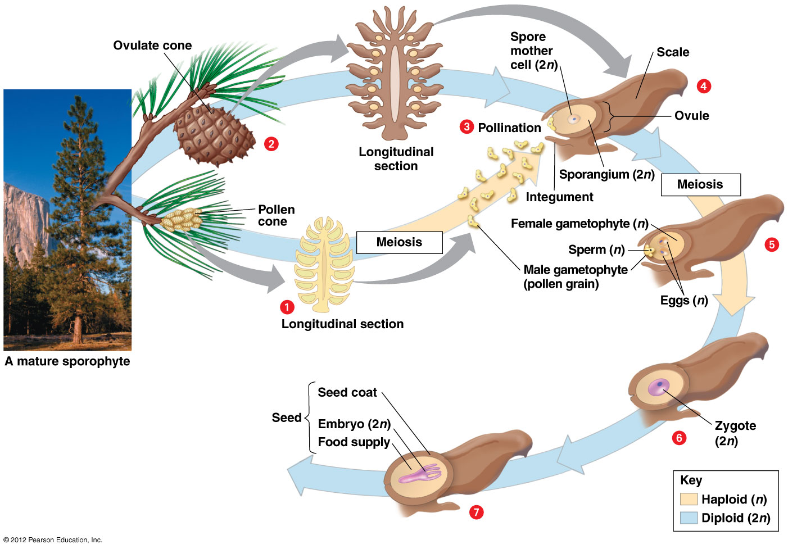

Slide 60
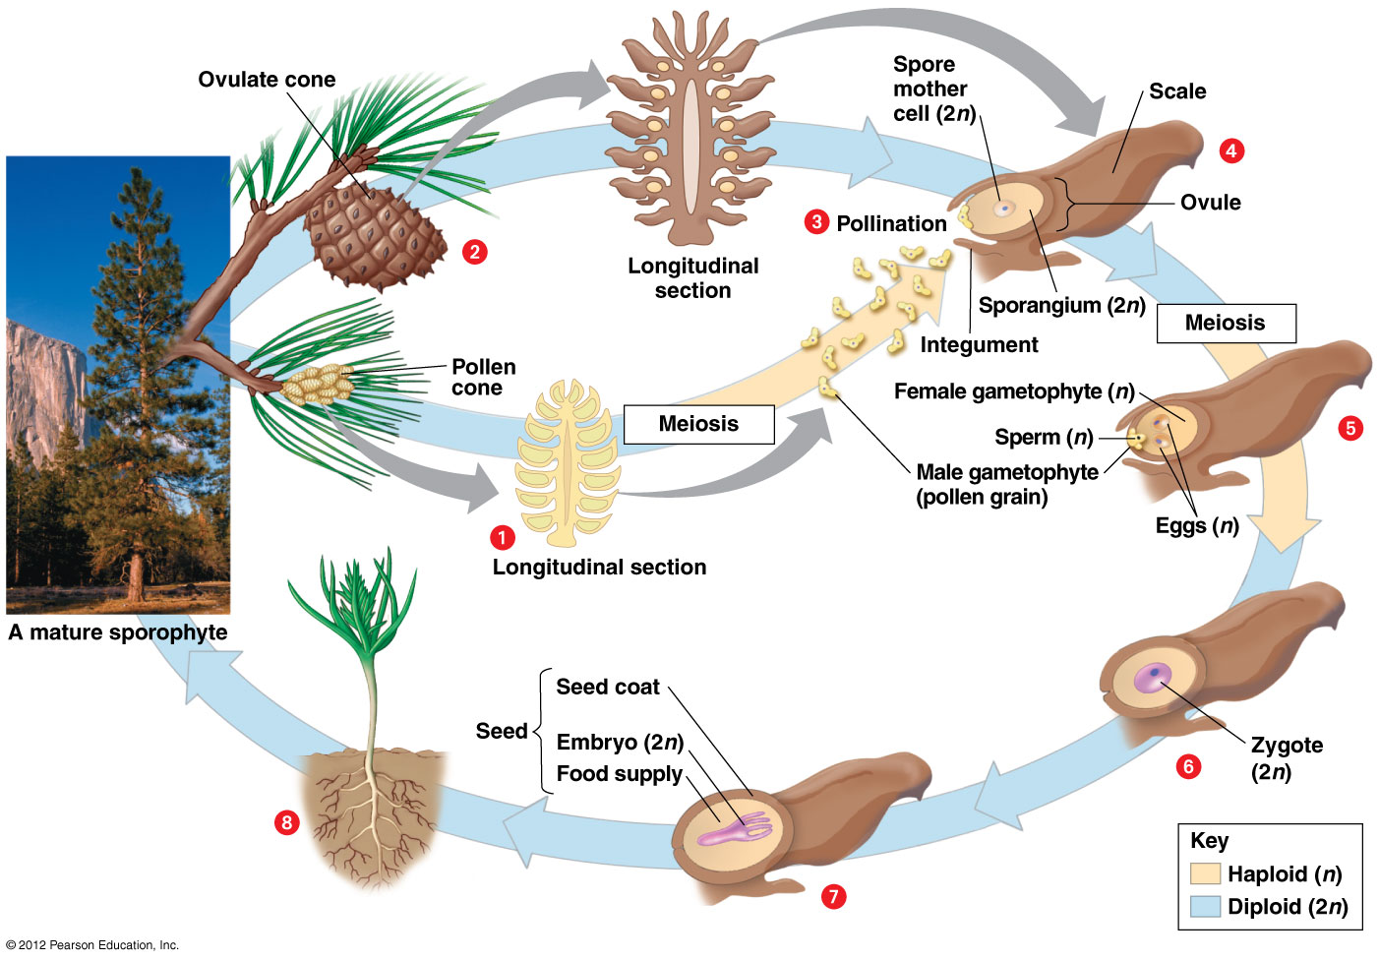

Slide 61
17.8 The flower is the centerpiece of angiosperm reproduction
Flowers house separate male and female sporangia and gametophytes.
Flowers are the sites of
  pollination and
  fertilization.
© 2012 Pearson Education, Inc.
Notes:
61
Teaching Tips
1. The authors describe four key adaptations for life on land in Module 17.2. The following modules (17.3–17.13) describe how these adaptations distinguish the main lineages of the plant kingdom. This is consistent with good lecture advice: Tell them what you are going to tell them, tell them, then tell them what you told them (summarize).
2. As François Jacob suggested, evolution works as a tinkerer and not like an engineer. New forms evolve by remodeling old forms. As the text notes, gymnosperm cones are modified shoots and angiosperm flowers represent the remodeling of leaves. These examples of remodeling might be a subject you may want to explore in additional detail as an important lesson in evolution.
3. Floral shops frequently discard magnificent flowers that are just beyond their peak. Teachers can obtain free discards by contacting local floral shops and sharing their educational needs. Having a variety of flowers on hand can brighten up any discussion of angiosperms.

Slide 62
17.8 The flower is the centerpiece of angiosperm reproduction
Flowers usually consist of
  sepals, which enclose the flower before it opens,
  petals, which attract animal pollinators,
  stamens, which include a filament and anther, a sac at the top of each filament that contains male sporangia and releases pollen, and
  carpels, the female reproductive structure, which produce eggs.
© 2012 Pearson Education, Inc.
Notes:
62
Teaching Tips
1. The authors describe four key adaptations for life on land in Module 17.2. The following modules (17.3–17.13) describe how these adaptations distinguish the main lineages of the plant kingdom. This is consistent with good lecture advice: Tell them what you are going to tell them, tell them, then tell them what you told them (summarize).
2. As François Jacob suggested, evolution works as a tinkerer and not like an engineer. New forms evolve by remodeling old forms. As the text notes, gymnosperm cones are modified shoots and angiosperm flowers represent the remodeling of leaves. These examples of remodeling might be a subject you may want to explore in additional detail as an important lesson in evolution.
3. Floral shops frequently discard magnificent flowers that are just beyond their peak. Teachers can obtain free discards by contacting local floral shops and sharing their educational needs. Having a variety of flowers on hand can brighten up any discussion of angiosperms.

Slide 63
17.8 The flower is the centerpiece of angiosperm reproduction
Ovules develop into seeds.
Ovaries mature into fruit.
© 2012 Pearson Education, Inc.
Notes:
63
Teaching Tips
1. The authors describe four key adaptations for life on land in Module 17.2. The following modules (17.3–17.13) describe how these adaptations distinguish the main lineages of the plant kingdom. This is consistent with good lecture advice: Tell them what you are going to tell them, tell them, then tell them what you told them (summarize).
2. As François Jacob suggested, evolution works as a tinkerer and not like an engineer. New forms evolve by remodeling old forms. As the text notes, gymnosperm cones are modified shoots and angiosperm flowers represent the remodeling of leaves. These examples of remodeling might be a subject you may want to explore in additional detail as an important lesson in evolution.
3. Floral shops frequently discard magnificent flowers that are just beyond their peak. Teachers can obtain free discards by contacting local floral shops and sharing their educational needs. Having a variety of flowers on hand can brighten up any discussion of angiosperms.

Slide 64
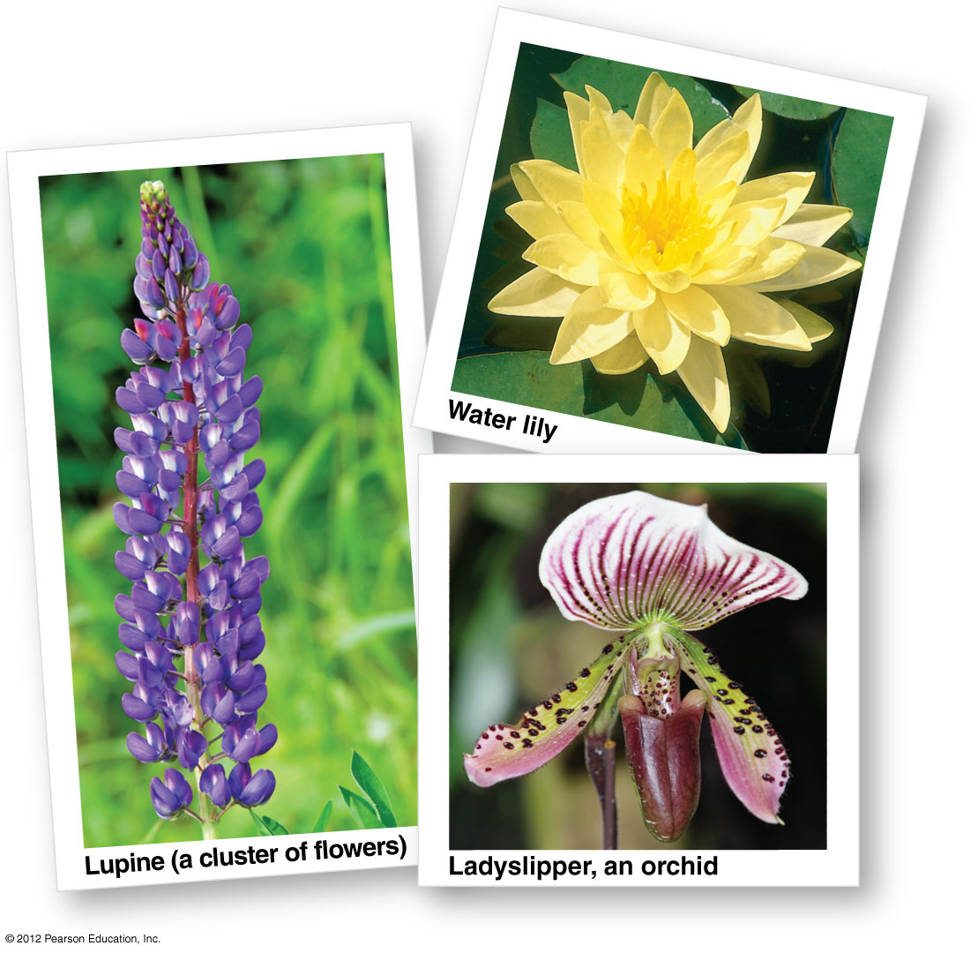

Slide 65
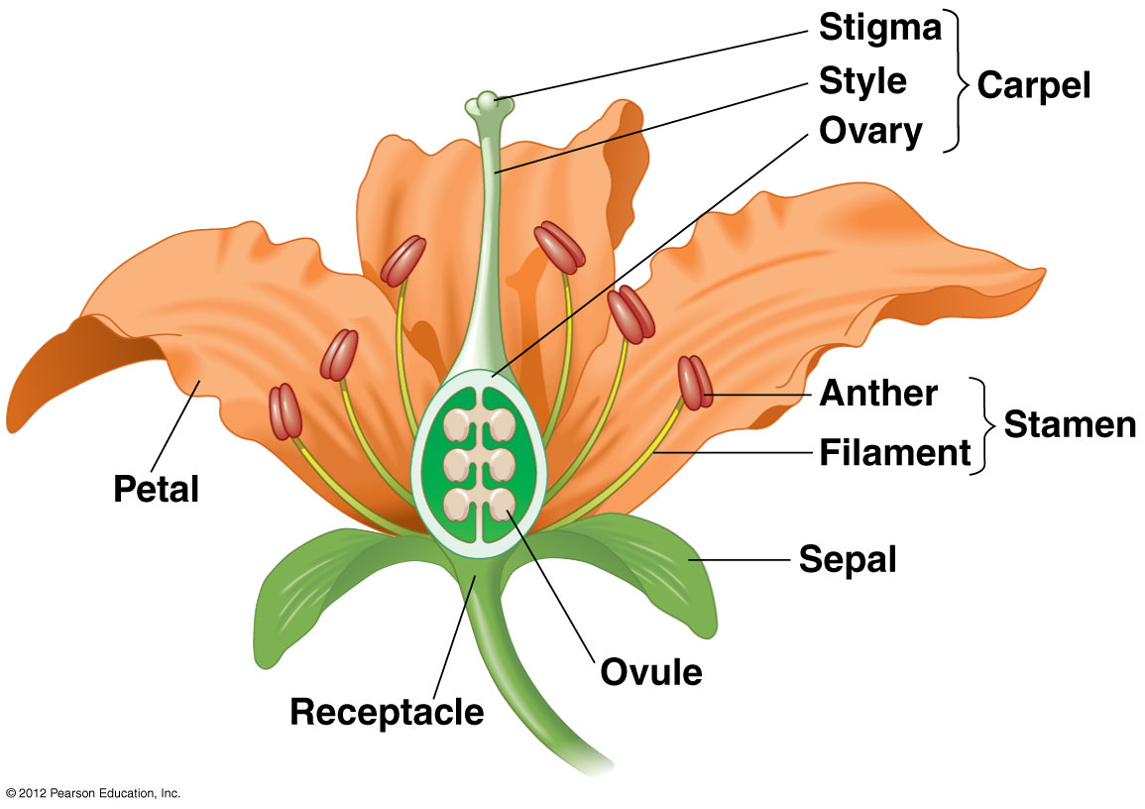

Slide 66
17.9 The angiosperm plant is a sporophyte with gametophytes in its flowers
Key events in a typical angiosperm life cycle
  Meiosis in the anthers produces haploid spores that form the male gametophyte (pollen grains).
  Meiosis in the ovule produces a haploid spore that forms the few cells of the female gametophyte, one of which becomes the egg.
  Pollination occurs when a pollen grain lands on the stigma. A pollen tube grows from the pollen grain to the ovule.
  The tube carries a sperm that fertilizes the egg to form a zygote.
© 2012 Pearson Education, Inc.
Notes:
66
Teaching Tips
1. The authors describe four key adaptations for life on land in Module 17.2. The following modules (17.3–17.13) describe how these adaptations distinguish the main lineages of the plant kingdom. This is consistent with good lecture advice: Tell them what you are going to tell them, tell them, then tell them what you told them (summarize).
2. Floral shops frequently discard magnificent flowers that are just beyond their peak. Teachers can obtain free discards by contacting local floral shops and sharing their educational needs. Having a variety of flowers on hand can brighten up any discussion of angiosperms.
3. Before lecturing on the examples of angiosperm and animal cooperation, let your students try to name as many as they can. They may be assigned to do so as an in-class activity in small groups, or they may compile lists individually that can be brought into class or e-mailed to the instructor.

Slide 67
17.9 The angiosperm plant is a sporophyte with gametophytes in its flowers
Key events in a typical angiosperm life cycle, continued
  Each ovule develops into a seed, consisting of
    an embryo (a new sporophyte) surrounded by a food supply and
    a seed coat derived from the integuments.
  While the seeds develop, the ovary’s wall thickens, forming the fruit that encloses the seeds.
  When conditions are favorable, a seed germinates.
© 2012 Pearson Education, Inc.
Notes:
67
Teaching Tips
1. The authors describe four key adaptations for life on land in Module 17.2. The following modules (17.3–17.13) describe how these adaptations distinguish the main lineages of the plant kingdom. This is consistent with good lecture advice: Tell them what you are going to tell them, tell them, then tell them what you told them (summarize).
2. Floral shops frequently discard magnificent flowers that are just beyond their peak. Teachers can obtain free discards by contacting local floral shops and sharing their educational needs. Having a variety of flowers on hand can brighten up any discussion of angiosperms.
3. Before lecturing on the examples of angiosperm and animal cooperation, let your students try to name as many as they can. They may be assigned to do so as an in-class activity in small groups, or they may compile lists individually that can be brought into class or e-mailed to the instructor.

Slide 68
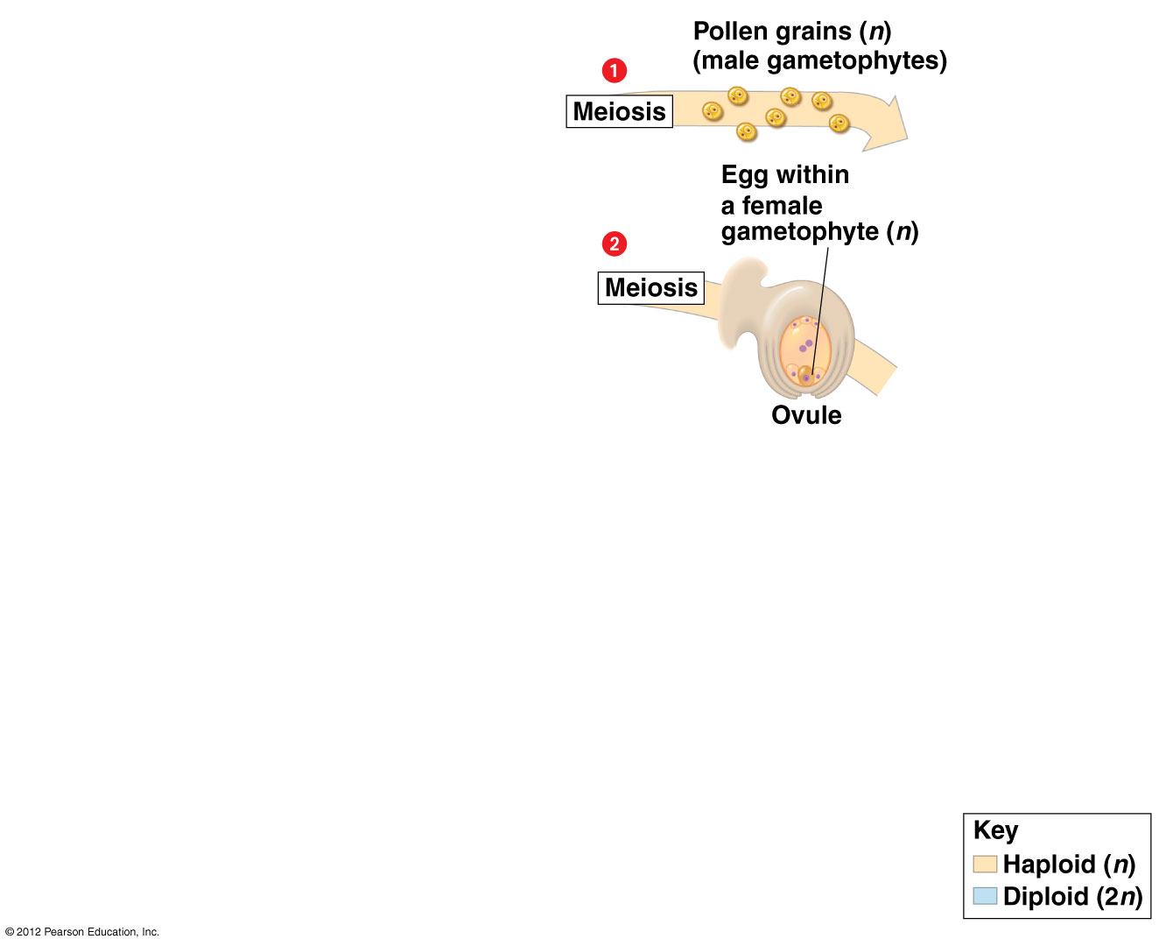

Slide 69
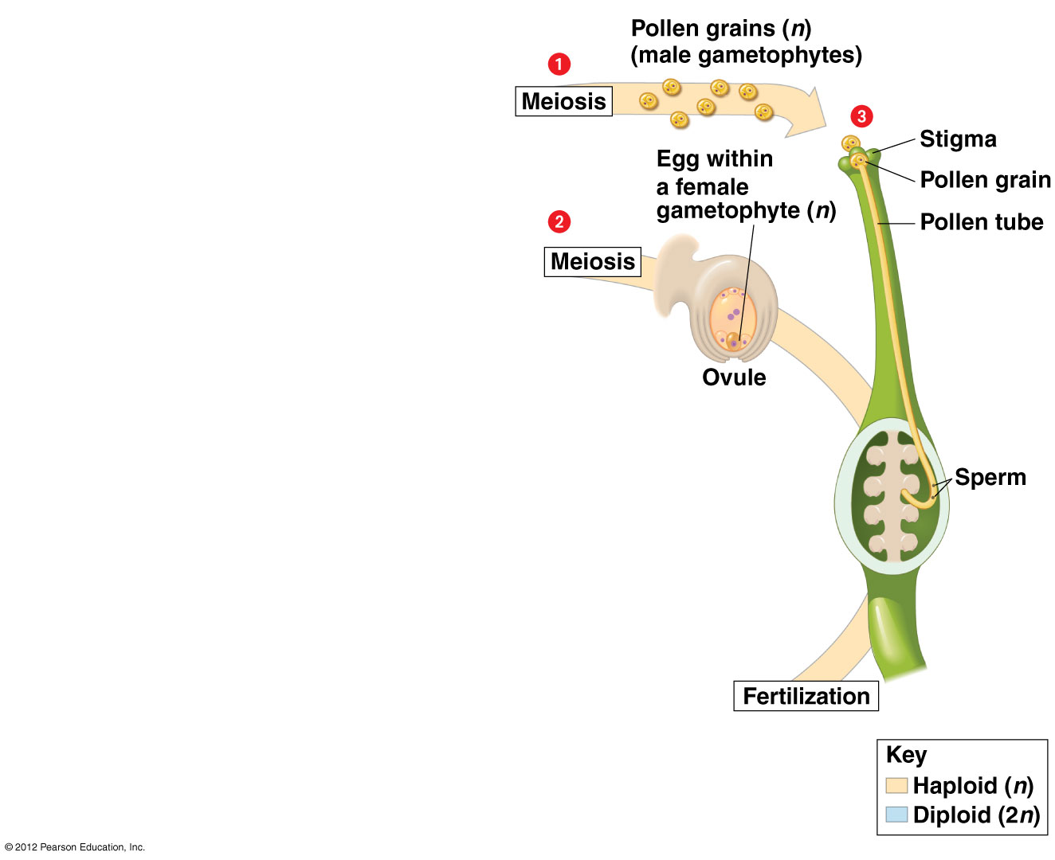

Slide 70
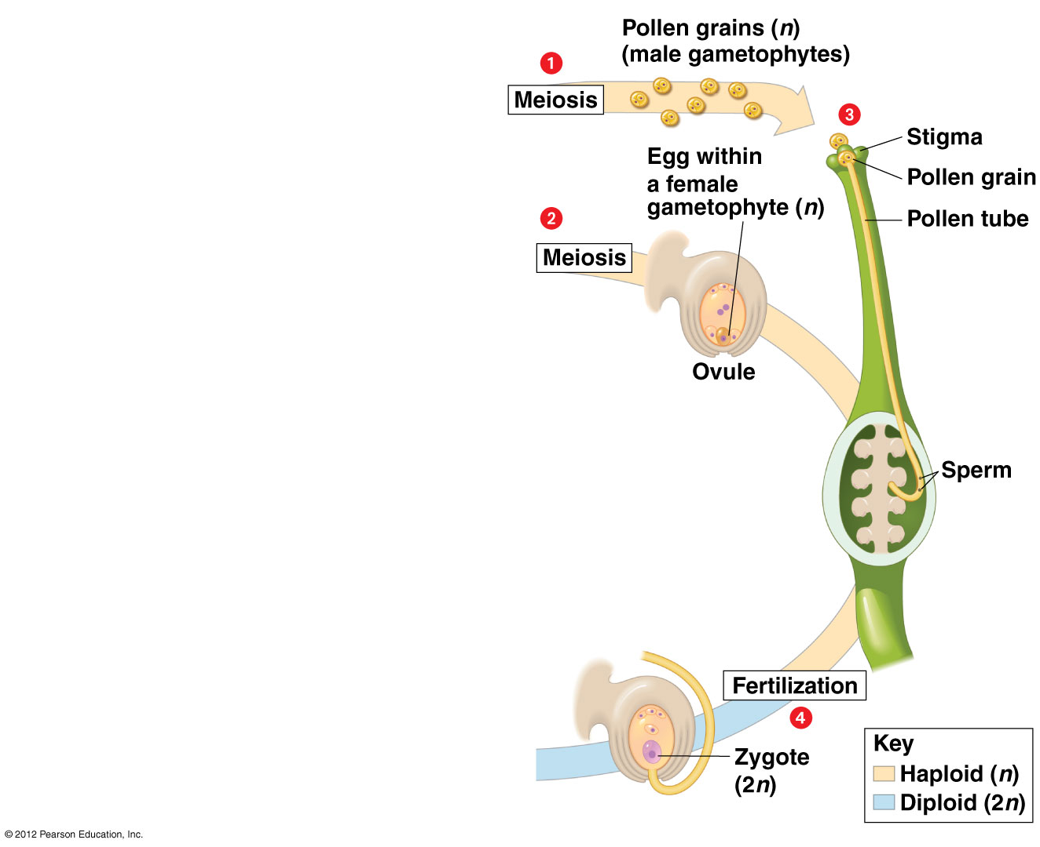

Slide 71
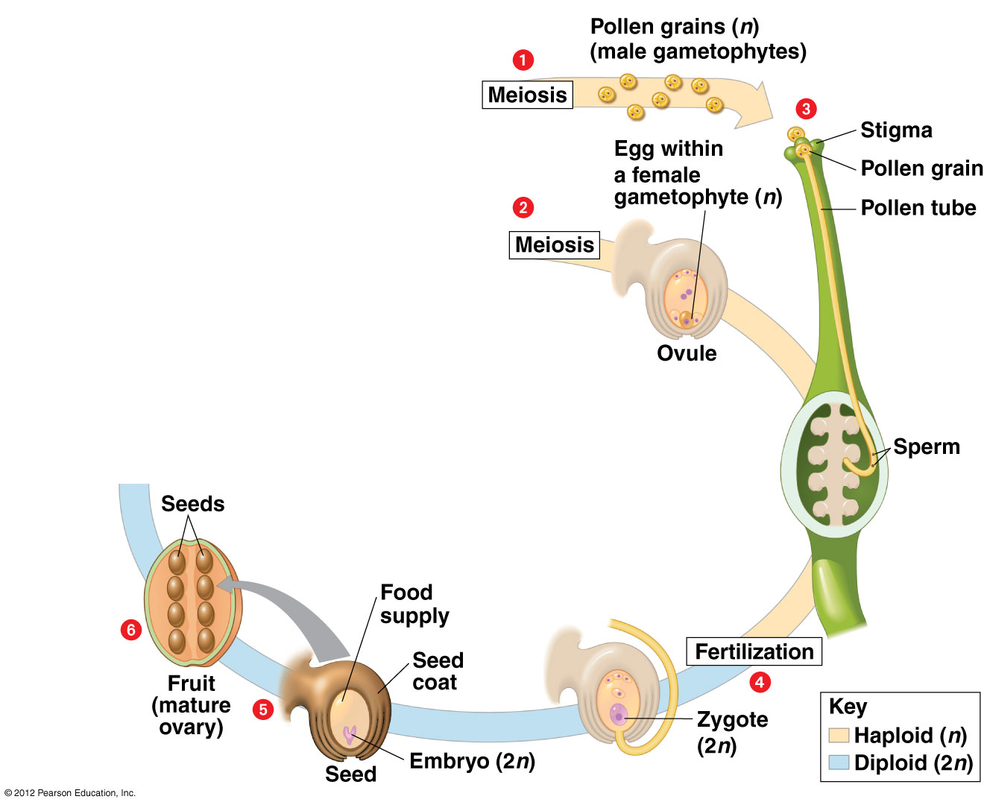

Slide 72
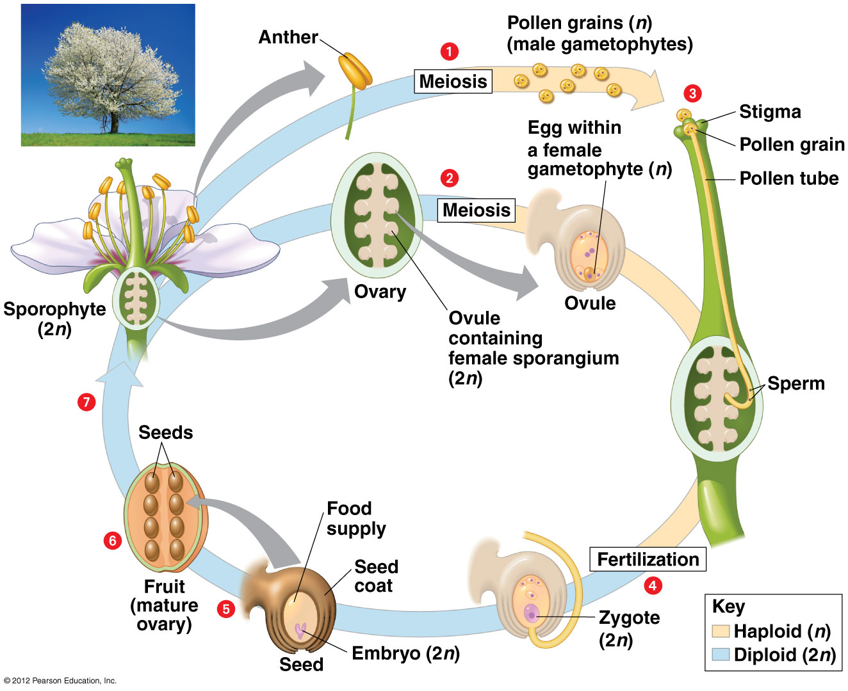

Slide 73
17.10 The structure of a fruit reflects its function in seed dispersal
Fruits are
  ripened ovaries of flowers and
  adaptations that disperse seeds.
Seed dispersal mechanisms include relying on
  wind,
  hitching a ride on animals, or
  fleshy, edible fruits that attract animals, which then deposit the seed in a supply of natural fertilizer at some distance from the parent plant.
© 2012 Pearson Education, Inc.
Notes:
73
Teaching Tips
1. The authors describe four key adaptations for life on land in Module 17.2. The following modules (17.3–17.13) describe how these adaptations distinguish the main lineages of the plant kingdom. This is consistent with good lecture advice: Tell them what you are going to tell them, tell them, then tell them what you told them (summarize).
2. Before lecturing on the examples of angiosperm and animal cooperation, let your students try to name as many as they can. They may be assigned to do so as an in-class activity in small groups, or they may compile lists individually that can be brought into class or e-mailed to the instructor.
3. The symbiotic relationships between angiosperms and animals are extensive. Challenge students to list all of the ways that plant reproduction benefits from animals (examples include the role of nectar in attracting pollinators, seed dispersal in fruit, and hitchhiker strategies such as that revealed in Figure 17.10B). Not all animals benefit from these relationships.

Slide 74
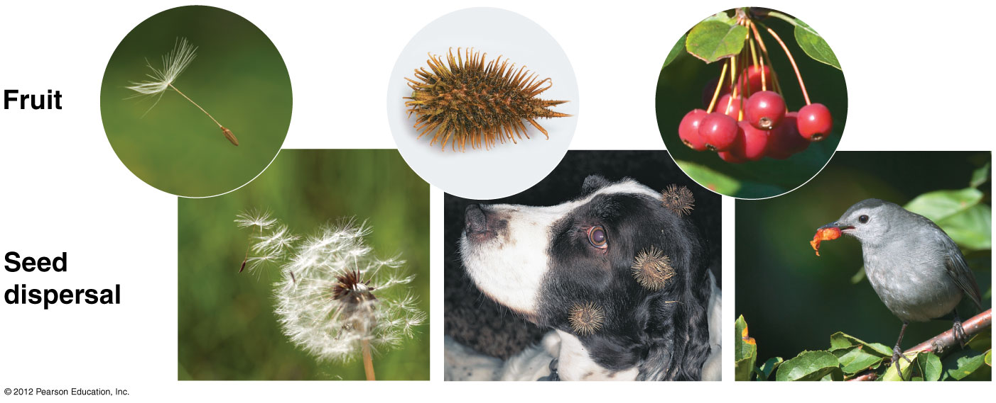

Slide 75
17.11 CONNECTION: Angiosperms sustain us—and add spice to our diets
Most human food is provided by the fruits and seeds of angiosperms.
  Corn, rice, wheat, and other grains are dry fruits.
  Apples, cherries, tomatoes, and squash are fleshy fruits.
  Spices such as nutmeg, cinnamon, cumin, cloves, ginger, and licorice are also angiosperm fruits.
© 2012 Pearson Education, Inc.
Notes:
75
Teaching Tips
1. The authors describe four key adaptations for life on land in Module 17.2. The following modules (17.3–17.13) describe how these adaptations distinguish the main lineages of the plant kingdom. This is consistent with good lecture advice: Tell them what you are going to tell them, tell them, then tell them what you told them (summarize).
2. Before lecturing on the examples of angiosperm and animal cooperation, let your students try to name as many as they can. They may be assigned to do so as an in-class activity in small groups, or they may compile lists individually that can be brought into class or e-mailed to the instructor.
3. The symbiotic relationships between angiosperms and animals are extensive. Challenge students to list all of the ways that plant reproduction benefits from animals (examples include the role of nectar in attracting pollinators, seed dispersal in fruit, and hitchhiker strategies such as that revealed in Figure 17.10B). Not all animals benefit from these relationships.
4. You might have your class spend a minute just listing the plant-derived materials in your classroom. These will include cotton cloth, wood for pencils, paper in many forms, etc. In addition, have students try to imagine how they could spend an entire day without encountering plants or plant products.

Slide 76
17.12 EVOLUTION CONNECTION: Pollination by animals has influenced angiosperm evolution
About 90% of angiosperms use animals to transfer their pollen.
  Birds are usually attracted by colorful flowers, but not scent.
  Most beetles are attracted by fruity odors, but are indifferent to color.
  Night-flying bats and moths are usually attracted by large, highly scented flowers.
  Wind-pollinated flowers typically produce large amounts of pollen.
© 2012 Pearson Education, Inc.
Notes:
76
Teaching Tips
1. The authors describe four key adaptations for life on land in Module 17.2. The following modules (17.3–17.13) describe how these adaptations distinguish the main lineages of the plant kingdom. This is consistent with good lecture advice: Tell them what you are going to tell them, tell them, then tell them what you told them (summarize).
2. Before lecturing on the examples of angiosperm and animal cooperation, let your students try to name as many as they can. They may be assigned to do so as an in-class activity in small groups, or they may compile lists individually that can be brought into class or e-mailed to the instructor.
3. The symbiotic relationships between angiosperms and animals are extensive. Challenge students to list all of the ways that plant reproduction benefits from animals (examples include the role of nectar in attracting pollinators, seed dispersal in fruit, and hitchhiker strategies such as that revealed in Figure 17.10B). Not all animals benefit from these relationships.
4. You might have your class spend a minute just listing the plant-derived materials in your classroom. These will include cotton cloth, wood for pencils, paper in many forms, etc. In addition, have students try to imagine how they could spend an entire day without encountering plants or plant products.
5. The tremendous volume of pollen released into the air is apparent to anyone suffering from allergies. You might wish to have your students find the pollen counts for your area, information that is commonly provided as part of weather reports. It might be interesting to track the pollen counts as you go through the semester.

Slide 77
17.13 CONNECTION: Plant diversity is vital to the future of the world’s food supply
Most of the world’s population is now fed by varieties of
  rice,
  wheat,
  corn, and
  soybeans.
  Agriculture has changed the landscape.
© 2012 Pearson Education, Inc.
Notes:
77
Teaching Tips
1. The authors describe four key adaptations for life on land in Module 17.2. The following modules (17.3–17.13) describe how these adaptations distinguish the main lineages of the plant kingdom. This is consistent with good lecture advice: Tell them what you are going to tell them, tell them, then tell them what you told them (summarize).
2. Before lecturing on the examples of angiosperm and animal cooperation, let your students try to name as many as they can. They may be assigned to do so as an in-class activity in small groups, or they may compile lists individually that can be brought into class or e-mailed to the instructor.
3. You might have your class spend a minute just listing the plant-derived materials in your classroom. These will include cotton cloth, wood for pencils, paper in many forms, etc. In addition, have students try to imagine how they could spend an entire day without encountering plants or plant products.
4. Referencing local examples of monoculture replacing a more diverse native ecosystem can help reinforce the content of Module 17.13. Encouraging students to look around your community and note where old-growth forest has been replaced with a single fast-growing species, or where native prairies have given way to vast fields of corn, wheat, or soybeans, will bring home the loss of plant diversity as modeled in their own backyard.

Slide 78
DIVERSITY OF FUNGI
© 2012 Pearson Education, Inc.
Notes:
78

Slide 79
17.14 Fungi absorb food after digesting it outside their bodies
Fungi
  are absorptive heterotrophic eukaryotes,
  secrete powerful enzymes to digest their food externally, and
  acquire their nutrients by absorption.
© 2012 Pearson Education, Inc.
Notes:
79
Student Misconceptions and Concerns
1. The diverse ecological and medical roles of fungi are often underappreciated by students. Consider quizzing your students on the ecological importance of fungi and the medical and ecological significance of fungi to humans before assigning or lecturing on these topics. Such assessments can generate increased student interest and help you evaluate their background knowledge.
2. Students often view fungi as some type of plant. However, many differences between them exist (for example, fungi are not photosynthetic and have cell walls made of chitin instead of cellulose). Emphasize these basic differences early in your lectures to clearly distinguish fungi as a separate group.
Teaching Tips
1. The physical relationship between a fungus and its hyphae is generally analogous to a fire hydrant and the underground water pipes. Only the fire hydrant emerges above the surface of the ground.
2. Ask your students to distinguish between fungi and animals. Both are multicellular heterotrophs lacking cellulose. Students will have to dig a little to discover that fungi have cell walls primarily composed of chitin. You might further challenge them to identify animals that also absorb their nutrients directly from their environments (for example, tapeworms).

Slide 80
17.14 Fungi absorb food after digesting it outside their bodies
Most fungi consist of a mass of threadlike hyphae making up a mycelium.
Hyphal cells
  are separated by cross-walls with pores large enough for ribosomes, mitochondria, and nuclei to cross,
  are sometimes multinucleate without cross-walls, and
  have a huge surface area to secrete digestive enzymes and absorb food.
© 2012 Pearson Education, Inc.
Notes:
80
Student Misconceptions and Concerns
1. The diverse ecological and medical roles of fungi are often underappreciated by students. Consider quizzing your students on the ecological importance of fungi and the medical and ecological significance of fungi to humans before assigning or lecturing on these topics. Such assessments can generate increased student interest and help you evaluate their background knowledge.
2. Students often view fungi as some type of plant. However, many differences between them exist (for example, fungi are not photosynthetic and have cell walls made of chitin instead of cellulose). Emphasize these basic differences early in your lectures to clearly distinguish fungi as a separate group.
Teaching Tips
1. The physical relationship between a fungus and its hyphae is generally analogous to a fire hydrant and the underground water pipes. Only the fire hydrant emerges above the surface of the ground.
2. Ask your students to distinguish between fungi and animals. Both are multicellular heterotrophs lacking cellulose. Students will have to dig a little to discover that fungi have cell walls primarily composed of chitin. You might further challenge them to identify animals that also absorb their nutrients directly from their environments (for example, tapeworms).

Slide 81
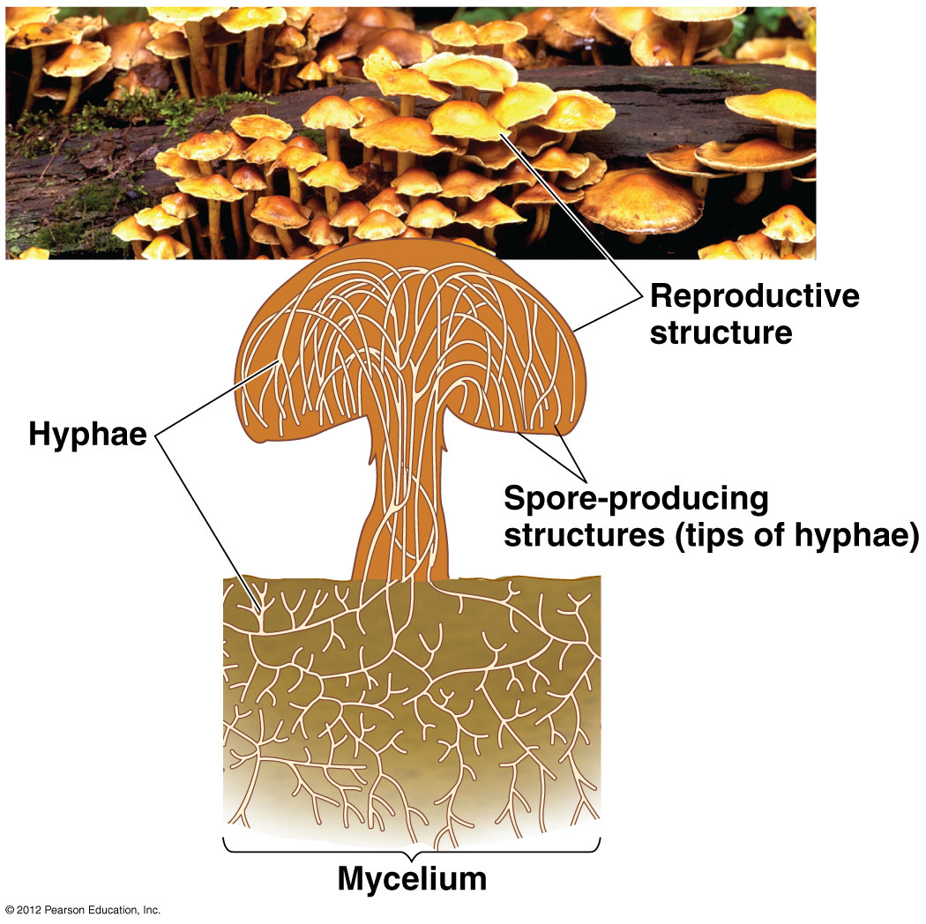

Slide 82
17.14 Fungi absorb food after digesting it outside their bodies
Fungal hyphae
  are surrounded by a cell wall made of chitin instead of cellulose.
Some fungi
  are parasites and
  obtain their nutrients at the expense of living plants or animals.
© 2012 Pearson Education, Inc.
Notes:
82
Student Misconceptions and Concerns
1. The diverse ecological and medical roles of fungi are often underappreciated by students. Consider quizzing your students on the ecological importance of fungi and the medical and ecological significance of fungi to humans before assigning or lecturing on these topics. Such assessments can generate increased student interest and help you evaluate their background knowledge.
2. Students often view fungi as some type of plant. However, many differences between them exist (for example, fungi are not photosynthetic and have cell walls made of chitin instead of cellulose). Emphasize these basic differences early in your lectures to clearly distinguish fungi as a separate group.
Teaching Tips
1. The physical relationship between a fungus and its hyphae is generally analogous to a fire hydrant and the underground water pipes. Only the fire hydrant emerges above the surface of the ground.
2. Ask your students to distinguish between fungi and animals. Both are multicellular heterotrophs lacking cellulose. Students will have to dig a little to discover that fungi have cell walls primarily composed of chitin. You might further challenge them to identify animals that also absorb their nutrients directly from their environments (for example, tapeworms).

Slide 83
17.14 Fungi absorb food after digesting it outside their bodies
Mycorrhizae (plural)
  represent a symbiotic relationship between fungi and plant root cells and
  are present in nearly all vascular plants.
Mycorrhizal fungi absorb phosphorus and other essential materials from the soil and make them available to the plant.
Sugars produced by the plant through photosynthesis nourish the mycorrhizal fungi.
© 2012 Pearson Education, Inc.
Notes:
83
Student Misconceptions and Concerns
1. The diverse ecological and medical roles of fungi are often underappreciated by students. Consider quizzing your students on the ecological importance of fungi and the medical and ecological significance of fungi to humans before assigning or lecturing on these topics. Such assessments can generate increased student interest and help you evaluate their background knowledge.
2. Students often view fungi as some type of plant. However, many differences between them exist (for example, fungi are not photosynthetic and have cell walls made of chitin instead of cellulose). Emphasize these basic differences early in your lectures to clearly distinguish fungi as a separate group.
Teaching Tips
1. The physical relationship between a fungus and its hyphae is generally analogous to a fire hydrant and the underground water pipes. Only the fire hydrant emerges above the surface of the ground.
2. Ask your students to distinguish between fungi and animals. Both are multicellular heterotrophs lacking cellulose. Students will have to dig a little to discover that fungi have cell walls primarily composed of chitin. You might further challenge them to identify animals that also absorb their nutrients directly from their environments (for example, tapeworms).

Slide 84
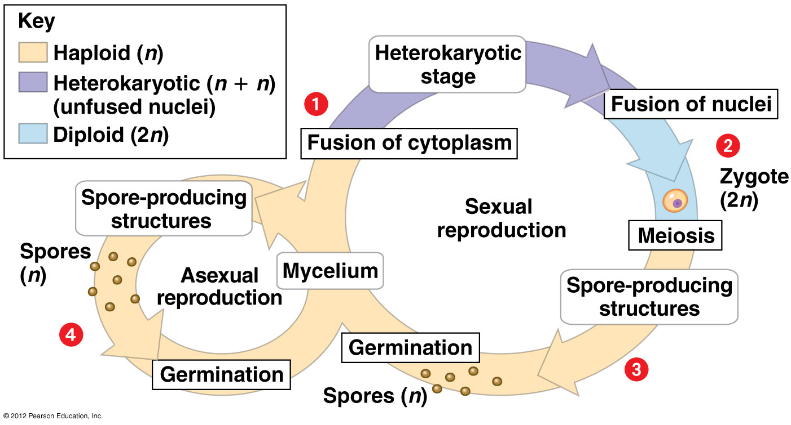

Slide 85
17.15 Fungi produce spores in both asexual and sexual life cycles
Molds are any rapidly growing fungus that reproduces asexually by producing spores.
Yeasts are single-celled fungi that reproduce asexually by cell division or budding.
© 2012 Pearson Education, Inc.
Notes:
85
Student Misconceptions and Concerns
1. The diverse ecological and medical roles of fungi are often underappreciated by students. Consider quizzing your students on the ecological importance of fungi and the medical and ecological significance of fungi to humans before assigning or lecturing on these topics. Such assessments can generate increased student interest and help you evaluate their background knowledge.
2. Students often view fungi as some type of plant. However, many differences between them exist (for example, fungi are not photosynthetic and have cell walls made of chitin instead of cellulose). Emphasize these basic differences early in your lectures to clearly distinguish fungi as a separate group.
Teaching Tips
The heterokaryotic stage is like the merger of two kingdoms in which both kings continue to rule.

Slide 86
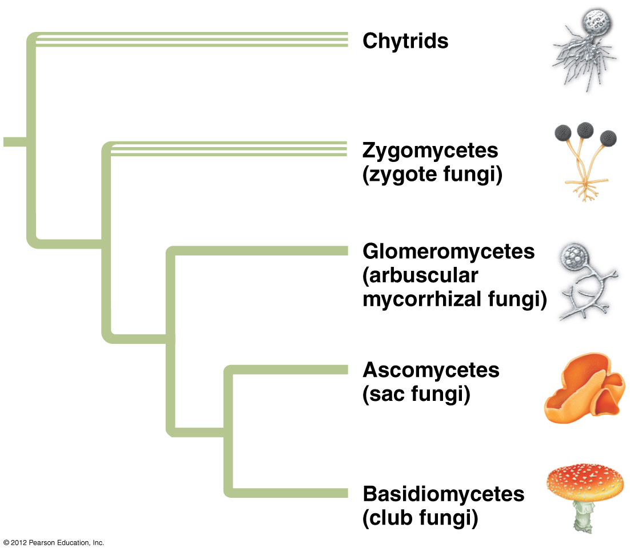

Slide 87
17.18 CONNECTION: Parasitic fungi harm plants and animals
Of the 100,000 known species of fungi, about 30% are either parasites or pathogens in or on plants.
About 80% of plant diseases are caused by fungi.
  Between 10 and 50% of the world’s fruit harvest is lost each year to fungal attack.
  A variety of fungi, including smuts and rusts, infect grain crops.
© 2012 Pearson Education, Inc.
Notes:
87
Student Misconceptions and Concerns
1. The diverse ecological and medical roles of fungi are often underappreciated by students. Consider quizzing your students on the ecological importance of fungi and the medical and ecological significance of fungi to humans before assigning or lecturing on these topics. Such assessments can generate increased student interest and help you evaluate their background knowledge.
2. Students often view fungi as some type of plant. However, many differences between them exist (for example, fungi are not photosynthetic and have cell walls made of chitin instead of cellulose). Emphasize these basic differences early in your lectures to clearly distinguish fungi as a separate group.
Teaching Tips
1. Students often mistakenly conceive of evolution as a deliberate and directed process. Like the elm trees described in Module 17.18, American chestnut trees were nearly driven to extinction because they did not possess adaptations that would have helped them survive the blight fungus. If evolution results from need, why then would the chestnuts or elm trees suffer? (For details on the chestnut blight, see the website of the American Phytopathological Society at www.apsnet.org/online/feature/chestnut/.)
2. Module 17.18 describes a variety of examples of fungal disease, noting that 80% of plant diseases are from fungi. Further, human diseases include athlete’s foot, ringworm, and vaginal yeast infections. If certain fungal infections are particularly problematic in your region, consider emphasizing them in your lecture.
3. Students are unlikely to appreciate the roles that fungi play in natural environments, or in causing human diseases, or the benefits of fungi to human society, including bioremediation and the production of drugs, alcoholic beverages, baked goods, or fuel. To increase student interest, consider starting your lectures on fungi by noting the many effects of fungi on human life. Also, consider outside of class student assignments to investigate specific roles of fungi that may be of particular interest to students with medical, agricultural, environmental, or industrial majors.

Slide 88
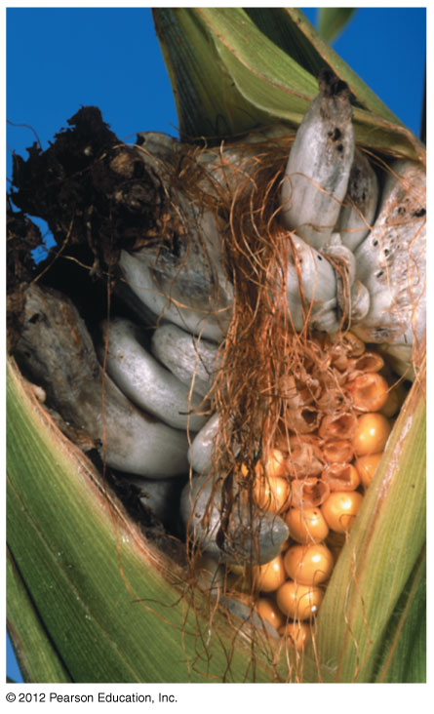
Figure 17.18B
Notes:
88
Figure 17.18B Corn smut

Slide 89
17.18 CONNECTION: Parasitic fungi harm plants and animals
Only about 50 species of fungi are parasitic on animals.
The general term for a fungal infection is mycosis.
Skin mycoses include
  ringworm, named because it appears as circular red areas on the skin,
  athlete’s foot, also caused by the ringworm fungus,
  vaginal yeast infections, and
  deadly lung diseases.
© 2012 Pearson Education, Inc.
Notes:
89
Student Misconceptions and Concerns
1. The diverse ecological and medical roles of fungi are often underappreciated by students. Consider quizzing your students on the ecological importance of fungi and the medical and ecological significance of fungi to humans before assigning or lecturing on these topics. Such assessments can generate increased student interest and help you evaluate their background knowledge.
2. Students often view fungi as some type of plant. However, many differences between them exist (for example, fungi are not photosynthetic and have cell walls made of chitin instead of cellulose). Emphasize these basic differences early in your lectures to clearly distinguish fungi as a separate group.
Teaching Tips
1. Students often mistakenly conceive of evolution as a deliberate and directed process. Like the elm trees described in Module 17.18, American chestnut trees were nearly driven to extinction because they did not possess adaptations that would have helped them survive the blight fungus. If evolution results from need, why then would the chestnuts or elm trees suffer? (For details on the chestnut blight, see the website of the American Phytopathological Society at www.apsnet.org/online/feature/chestnut/.)
2. Module 17.18 describes a variety of examples of fungal disease, noting that 80% of plant diseases are from fungi. Further, human diseases include athlete’s foot, ringworm, and vaginal yeast infections. If certain fungal infections are particularly problematic in your region, consider emphasizing them in your lecture.
3. Students are unlikely to appreciate the roles that fungi play in natural environments, or in causing human diseases, or the benefits of fungi to human society, including bioremediation and the production of drugs, alcoholic beverages, baked goods, or fuel. To increase student interest, consider starting your lectures on fungi by noting the many effects of fungi on human life. Also, consider outside of class student assignments to investigate specific roles of fungi that may be of particular interest to students with medical, agricultural, environmental, or industrial majors.

Slide 90
17.19 CONNECTION: Fungi have enormous ecological benefits
Fungi
  supply essential nutrients to plants through symbiotic mycorrhyizae and
  are essential decomposers in ecosystems, breaking down decomposing leaves, logs, and feces and dead animals.
Fungi may also be used to digest petroleum products to clean up oil spills, such as the 2010 BP spill in the Gulf of Mexico.
© 2012 Pearson Education, Inc.
Notes:
90
Student Misconceptions and Concerns
1. The diverse ecological and medical roles of fungi are often underappreciated by students. Consider quizzing your students on the ecological importance of fungi and the medical and ecological significance of fungi to humans before assigning or lecturing on these topics. Such assessments can generate increased student interest and help you evaluate their background knowledge.
2. Students often view fungi as some type of plant. However, many differences between them exist (for example, fungi are not photosynthetic and have cell walls made of chitin instead of cellulose). Emphasize these basic differences early in your lectures to clearly distinguish fungi as a separate group.
Teaching Tips
Students are unlikely to appreciate the roles that fungi play in natural environments, or in causing human diseases, or the benefits of fungi to human society, including bioremediation and the production of drugs, alcoholic beverages, baked goods, or fuel. To increase student interest, consider starting your lectures on fungi by noting the many effects of fungi on human life. Also, consider outside of class student assignments to investigate specific roles of fungi that may be of particular interest to students with medical, agricultural, environmental, or industrial majors.

Slide 91
17.20 CONNECTION: Fungi have many practical uses
0
Fungi have many practical uses for humans.
  We eat mushrooms and cheeses modified by fungi.
  Yeasts produce alcohol and cause bread to rise.
  Some fungi provide antibiotics that are used to treat bacterial disease.
  Fungi figure prominently in molecular biology and in biotechnology. Yeasts, for example, are often used to study molecular genetics of eukaryotes.
  Fungi may play a major role in the future production of biofuels from plants.
© 2012 Pearson Education, Inc.
Notes:
91
Student Misconceptions and Concerns
1. The diverse ecological and medical roles of fungi are often underappreciated by students. Consider quizzing your students on the ecological importance of fungi and the medical and ecological significance of fungi to humans before assigning or lecturing on these topics. Such assessments can generate increased student interest and help you evaluate their background knowledge.
2. Students often view fungi as some type of plant. However, many differences between them exist (for example, fungi are not photosynthetic and have cell walls made of chitin instead of cellulose). Emphasize these basic differences early in your lectures to clearly distinguish fungi as a separate group.
Teaching Tips
Students are unlikely to appreciate the roles that fungi play in natural environments, or in causing human diseases, or the benefits of fungi to human society, including bioremediation and the production of drugs, alcoholic beverages, baked goods, or fuel. To increase student interest, consider starting your lectures on fungi by noting the many effects of fungi on human life. Also, consider outside of class student assignments to investigate specific roles of fungi that may be of particular interest to students with medical, agricultural, environmental, or industrial majors.

Slide 92
17.21 Lichens are symbiotic associations of fungi and photosynthetic organisms
0
Lichens consist of algae or cyanobacteria within a mass of fungal hyphae.
  Many lichen associations are mutualistic.
  The fungus receives food from its photosynthetic partner.
  The fungal mycelium helps the alga absorb and retain water and minerals.
© 2012 Pearson Education, Inc.
Notes:
92
Student Misconceptions and Concerns
1. The diverse ecological and medical roles of fungi are often underappreciated by students. Consider quizzing your students on the ecological importance of fungi and the medical and ecological significance of fungi to humans before assigning or lecturing on these topics. Such assessments can generate increased student interest and help you evaluate their background knowledge.
2. Students often view fungi as some type of plant. However, many differences between them exist (for example, fungi are not photosynthetic and have cell walls made of chitin instead of cellulose). Emphasize these basic differences early in your lectures to clearly distinguish fungi as a separate group.
Teaching Tips
Wonderful coverage of lichens can be found at the aptly named www.lichen.com/!

Slide 93
17.21 Lichens are symbiotic associations of fungi and photosynthetic organisms
0
Lichens are important pioneers on new land, where they help to form soil.
Lichens are sensitive to air pollution, because they obtain minerals from the air.
© 2012 Pearson Education, Inc.
Notes:
93
Student Misconceptions and Concerns
1. The diverse ecological and medical roles of fungi are often underappreciated by students. Consider quizzing your students on the ecological importance of fungi and the medical and ecological significance of fungi to humans before assigning or lecturing on these topics. Such assessments can generate increased student interest and help you evaluate their background knowledge.
2. Students often view fungi as some type of plant. However, many differences between them exist (for example, fungi are not photosynthetic and have cell walls made of chitin instead of cellulose). Emphasize these basic differences early in your lectures to clearly distinguish fungi as a separate group.
Teaching Tips
Wonderful coverage of lichens can be found at the aptly named www.lichen.com/!

Slide 94
