Slide 1
ORIGIN OF LIFE
TAXONOMY
Chapter 15

Slide 2
Introduction
0
  Different types of wings evolved from the same ancestral tetrapod limb.
    Pterosaur wings consist of a membrane primarily supported by one greatly elongated finger.
    Bird wings consist of feathers supported by an elongated forearm and modified wrist and hand bones.
    Bat wings consist of a membrane supported by arm bones and four very elongated fingers.
© 2012 Pearson Education, Inc.
Notes:
2

Slide 3
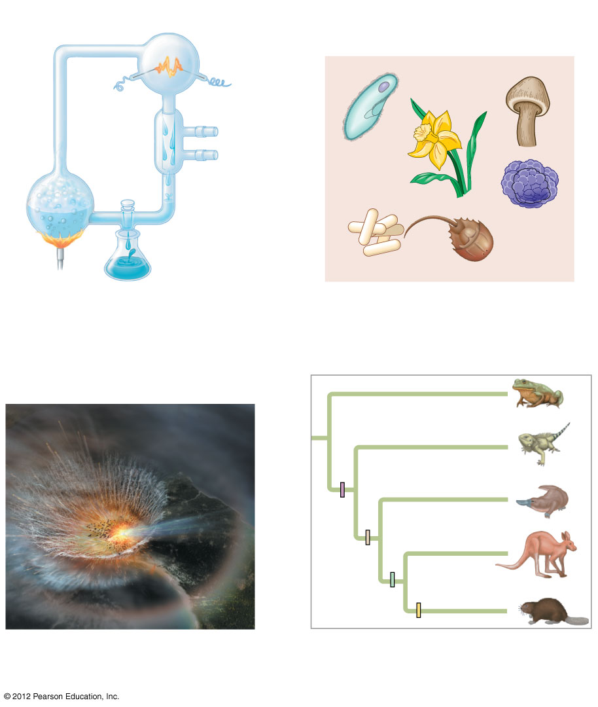
Figure 15.0_1
Chapter 15: Big Ideas
Early Earth and the
Origin of Life
Major Events in the
History of Life
Mechanisms of
Macroevolution
Phylogeny and the
Tree of Life
Notes:
3
Figure 15.0_1 Chapter 15: Big Ideas

Slide 4
0
EARLY EARTH AND THE ORIGIN OF LIFE
© 2012 Pearson Education, Inc.
Notes:
4

Slide 5
15.1 Conditions on early Earth made the origin of life possible
0
    The Earth formed about 4.6 billion years ago.
    As the Earth cooled and the bombardment slowed about 3.9 billion years ago, the conditions on the planet were extremely different from those today.
      The first atmosphere was probably thick with
        water vapor and
        various compounds released by volcanic eruptions, including nitrogen and its oxides, carbon dioxide, methane, ammonia, hydrogen, and hydrogen sulfide.
      Lightning, volcanic activity, and ultraviolet radiation were much more intense than today.
© 2012 Pearson Education, Inc.
Notes:
5
Student Misconceptions and Concerns
1. Students might not have considered that cells today are not created from scratch. Unlike baking a cake or constructing an automobile, where components are assembled to create something new, the reproduction of cells does not currently involve anything other than cells.
2. Some students might think that scientists have answers for all of life’s questions. Other students might rely upon supernatural explanations when faced with scientific uncertainty. The material in this chapter provides a good opportunity to further distinguish between the process of science and other ways of knowing.
3. Most of us are unable to comprehend the vast lengths of time considered by geologists. Exercises and examples can increase this comprehension. Consider (a) the number of seconds in a year = 60 × 60 × 24 × 365.25 = 31,557,600, or (b) that you would live your 1 billionth second of life at age 31 and 8 months of age, or (c) how much money you could spend each day if you spent $1 million dollars a year ($1,000,000/365 = $2,739.73/day).
4. Students may need to be reminded that one billion is 1,000 million. Many students (and some politicians) easily confuse million and billion without realizing the scale of the error. Challenge students to translate either of the examples above to illustrate one billion. (For example, one billion seconds equals about 31.7 years. If you were to spend one billion dollars in a year, you would need to spend $2,739,730 each day of that year!
Teaching Tips
1. Students who have studied cell theory might wonder how the first cells formed. Furthermore, they might wonder if spontaneous generation of cells could occur today. Module 15.1 describes how conditions on the surface of Earth when life first formed were dramatically different from today. Furthermore, if new life were evolving on Earth today, it would face competition from the vast amount of life already present.
2. Consider pointing out the logic of the theory of spontaneous generation, given the state of scientific knowledge during that period in history. Piles of manure and rotting flesh left in the open would apparently produce flies out of nowhere. At that time, so little was understood about eggs, sperm, and fertilization that spontaneous generation was a logical conclusion.
3. The four-stage hypothesis for the origin of life is a little like a recipe for building cells from the bottom up. If your students do not remember details about biological molecules and basic cell structure, you may need to review them before addressing these stages.
4. At some point in the presentation of the four-stage hypothesis for the origin of life, students should be encouraged to consider at what point “life” exists. Are self-replicating, RNA-based, membrane-bound structures alive? Discussing the evolution of the first cells helps clarify definitions of life.

Slide 6
15.1 Conditions on early Earth made the origin of life possible
0
    The earliest evidence for life on Earth
      comes from 3.5-billion-year-old fossils of stromatolites,
      built by ancient photosynthetic prokaryotes still alive today.
    Because these 3.5-billion-year-old prokaryotes used photosynthesis, it suggests that life first evolved earlier, perhaps as much as 3.9 billion years ago.
© 2012 Pearson Education, Inc.
Notes:
6
Student Misconceptions and Concerns
1. Students might not have considered that cells today are not created from scratch. Unlike baking a cake or constructing an automobile, where components are assembled to create something new, the reproduction of cells does not currently involve anything other than cells.
2. Some students might think that scientists have answers for all of life’s questions. Other students might rely upon supernatural explanations when faced with scientific uncertainty. The material in this chapter provides a good opportunity to further distinguish between the process of science and other ways of knowing.
3. Most of us are unable to comprehend the vast lengths of time considered by geologists. Exercises and examples can increase this comprehension. Consider (a) the number of seconds in a year = 60 × 60 × 24 × 365.25 = 31,557,600, or (b) that you would live your 1 billionth second of life at age 31 and 8 months of age, or (c) how much money you could spend each day if you spent $1 million dollars a year ($1,000,000/365 = $2,739.73/day).
4. Students may need to be reminded that one billion is 1,000 million. Many students (and some politicians) easily confuse million and billion without realizing the scale of the error. Challenge students to translate either of the examples above to illustrate one billion. (For example, one billion seconds equals about 31.7 years. If you were to spend one billion dollars in a year, you would need to spend $2,739,730 each day of that year!
Teaching Tips
1. Students who have studied cell theory might wonder how the first cells formed. Furthermore, they might wonder if spontaneous generation of cells could occur today. Module 15.1 describes how conditions on the surface of Earth when life first formed were dramatically different from today. Furthermore, if new life were evolving on Earth today, it would face competition from the vast amount of life already present.
2. Consider pointing out the logic of the theory of spontaneous generation, given the state of scientific knowledge during that period in history. Piles of manure and rotting flesh left in the open would apparently produce flies out of nowhere. At that time, so little was understood about eggs, sperm, and fertilization that spontaneous generation was a logical conclusion.
3. The four-stage hypothesis for the origin of life is a little like a recipe for building cells from the bottom up. If your students do not remember details about biological molecules and basic cell structure, you may need to review them before addressing these stages.
4. At some point in the presentation of the four-stage hypothesis for the origin of life, students should be encouraged to consider at what point “life” exists. Are self-replicating, RNA-based, membrane-bound structures alive? Discussing the evolution of the first cells helps clarify definitions of life.

Slide 7
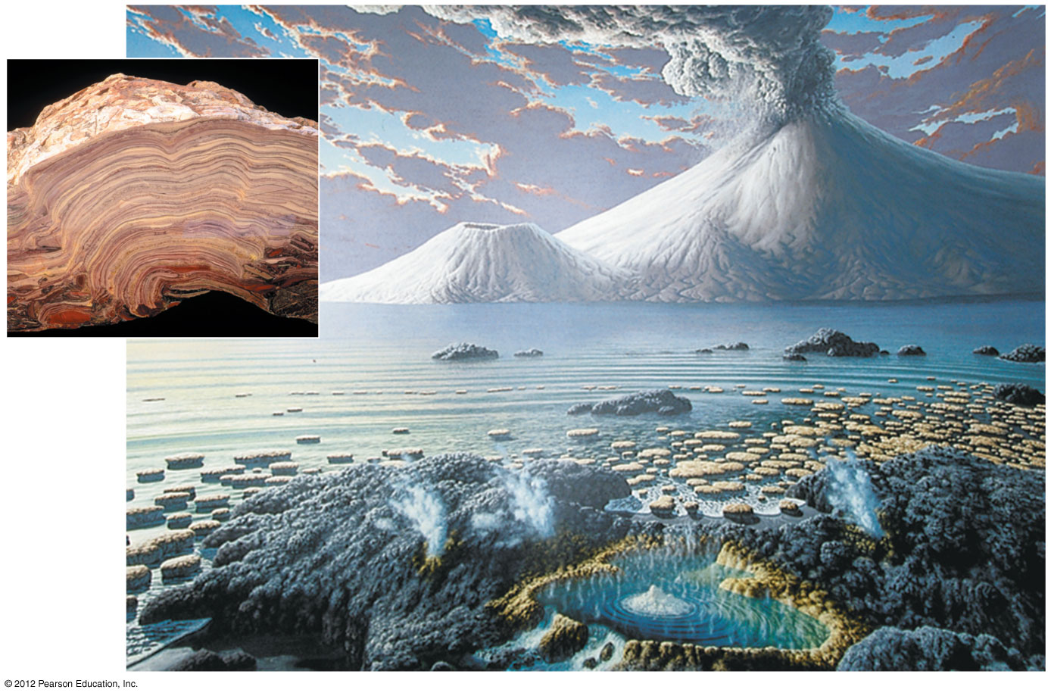
Figure 15.1
Stromatolite- western Australia-formed from photosynthetic bacteria 3.5-3.9 bil yrs ago
Notes:
7
Figure 15.1 A depiction of Earth about 3 billion years ago (inset: photo of a cross section of a fossilized stromatolite)

Slide 8
15.1 Conditions on early Earth made the origin of life possible
0
The first life may have evolved through four stages.
  The abiotic (nonliving) synthesis of small organic molecules, such as amino acids and nitrogenous bases.
  The joining of these small molecules into polymers, such as proteins and nucleic acids.
  The packaging of these molecules into “protocells,” droplets with membranes that maintained an internal chemistry different from that of their surroundings.
  The origin of self-replicating molecules that eventually made inheritance possible.
© 2012 Pearson Education, Inc.
Notes:
8
Student Misconceptions and Concerns
1. Students might not have considered that cells today are not created from scratch. Unlike baking a cake or constructing an automobile, where components are assembled to create something new, the reproduction of cells does not currently involve anything other than cells.
2. Some students might think that scientists have answers for all of life’s questions. Other students might rely upon supernatural explanations when faced with scientific uncertainty. The material in this chapter provides a good opportunity to further distinguish between the process of science and other ways of knowing.
3. Most of us are unable to comprehend the vast lengths of time considered by geologists. Exercises and examples can increase this comprehension. Consider (a) the number of seconds in a year = 60 × 60 × 24 × 365.25 = 31,557,600, or (b) that you would live your 1 billionth second of life at age 31 and 8 months of age, or (c) how much money you could spend each day if you spent $1 million dollars a year ($1,000,000/365 = $2,739.73/day).
4. Students may need to be reminded that one billion is 1,000 million. Many students (and some politicians) easily confuse million and billion without realizing the scale of the error. Challenge students to translate either of the examples above to illustrate one billion. (For example, one billion seconds equals about 31.7 years. If you were to spend one billion dollars in a year, you would need to spend $2,739,730 each day of that year!
Teaching Tips
1. Students who have studied cell theory might wonder how the first cells formed. Furthermore, they might wonder if spontaneous generation of cells could occur today. Module 15.1 describes how conditions on the surface of Earth when life first formed were dramatically different from today. Furthermore, if new life were evolving on Earth today, it would face competition from the vast amount of life already present.
2. Consider pointing out the logic of the theory of spontaneous generation, given the state of scientific knowledge during that period in history. Piles of manure and rotting flesh left in the open would apparently produce flies out of nowhere. At that time, so little was understood about eggs, sperm, and fertilization that spontaneous generation was a logical conclusion.
3. The four-stage hypothesis for the origin of life is a little like a recipe for building cells from the bottom up. If your students do not remember details about biological molecules and basic cell structure, you may need to review them before addressing these stages.
4. At some point in the presentation of the four-stage hypothesis for the origin of life, students should be encouraged to consider at what point “life” exists. Are self-replicating, RNA-based, membrane-bound structures alive? Discussing the evolution of the first cells helps clarify definitions of life.

Slide 9
15.2 SCIENTIFIC DISCOVERY: Experiments show that the abiotic synthesis of organic molecules is possible
0
  In 1953, graduate student Stanley Miller, working under Harold Urey, tested the Oparin-Haldane hypothesis.
    Miller set up an airtight apparatus with gases circulating past an electrical discharge, to simulate conditions on the early Earth.
    He also set up a control with no electrical discharge.
© 2012 Pearson Education, Inc.
Notes:
9
Student Misconceptions and Concerns
1. Students might not have considered that cells today are not created from scratch. Unlike baking a cake or constructing an automobile, where components are assembled to create something new, the reproduction of cells does not currently involve anything other than cells.
2. Some students might think that scientists have answers for all of life’s questions. Other students might rely upon supernatural explanations when faced with scientific uncertainty. The material in this chapter provides a good opportunity to further distinguish between the process of science and other ways of knowing.
3. Most of us are unable to comprehend the vast lengths of time considered by geologists. Exercises and examples can increase this comprehension. Consider (a) the number of seconds in a year = 60 × 60 × 24 × 365.25 = 31,557,600, or (b) that you would live your 1 billionth second of life at age 31 and 8 months of age, or (c) how much money you could spend each day if you spent $1 million dollars a year ($1,000,000/365 = $2,739.73/day).
4. Students may need to be reminded that one billion is 1,000 million. Many students (and some politicians) easily confuse million and billion without realizing the scale of the error. Challenge students to translate either of the examples above to illustrate one billion. (For example, one billion seconds equals about 31.7 years. If you were to spend one billion dollars in a year, you would need to spend $2,739,730 each day of that year!
Teaching Tips
1. Some scientists distinguish between biological evolution and chemical evolution. Biological evolution addresses changes in life once it existed on Earth. Chemical evolution includes the origin of the first forms of life. The word evolution, if strictly defined as a change over time, also applies to changes in the universe.
2. The experiments and hypotheses discussed in Module 15.2 demonstrate the tentative nature of science. As evidence is collected, old hypotheses are tested and new hypotheses arise.

Slide 10
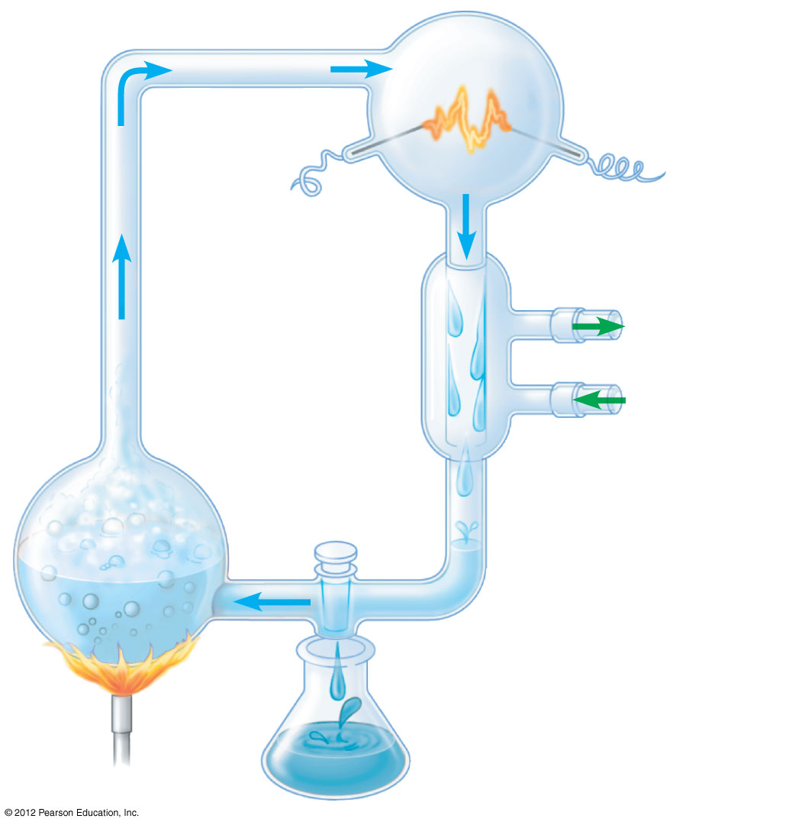
Figure 15.2A
Sparks simulating lightning
CH₄
“Atmosphere”
Water vapor
NH₃
H₂
2
Electrode
Condenser
3
Cold water
1
H₂O
“Sea”
4
Sample for
chemical analysis
Notes:
10
Figure 15.2A The synthesis of organic compounds in Miller’s 1953 experiment

Slide 11
15.2 SCIENTIFIC DISCOVERY: Experiments show that the abiotic synthesis of organic molecules is possible
0
  After a week, Miller’s setup produced abundant amino acids and other organic molecules.
    Similar experiments used other atmospheres and other energy sources, with similar results.
    Stage 1, abiotic synthesis of organic molecules, was demonstrated to be possible by the Miller-Urey experiments.
© 2012 Pearson Education, Inc.
Notes:
11
Student Misconceptions and Concerns
1. Students might not have considered that cells today are not created from scratch. Unlike baking a cake or constructing an automobile, where components are assembled to create something new, the reproduction of cells does not currently involve anything other than cells.
2. Some students might think that scientists have answers for all of life’s questions. Other students might rely upon supernatural explanations when faced with scientific uncertainty. The material in this chapter provides a good opportunity to further distinguish between the process of science and other ways of knowing.
3. Most of us are unable to comprehend the vast lengths of time considered by geologists. Exercises and examples can increase this comprehension. Consider (a) the number of seconds in a year = 60 × 60 × 24 × 365.25 = 31,557,600, or (b) that you would live your 1 billionth second of life at age 31 and 8 months of age, or (c) how much money you could spend each day if you spent $1 million dollars a year ($1,000,000/365 = $2,739.73/day).
4. Students may need to be reminded that one billion is 1,000 million. Many students (and some politicians) easily confuse million and billion without realizing the scale of the error. Challenge students to translate either of the examples above to illustrate one billion. (For example, one billion seconds equals about 31.7 years. If you were to spend one billion dollars in a year, you would need to spend $2,739,730 each day of that year!
Teaching Tips
1. Some scientists distinguish between biological evolution and chemical evolution. Biological evolution addresses changes in life once it existed on Earth. Chemical evolution includes the origin of the first forms of life. The word evolution, if strictly defined as a change over time, also applies to changes in the universe.
2. The experiments and hypotheses discussed in Module 15.2 demonstrate the tentative nature of science. As evidence is collected, old hypotheses are tested and new hypotheses arise.

Slide 12
15.3 Stages in the origin of the first cells probably included the formation of polymers, protocells, and self-replicating RNA
0
Stage 2: The joining of monomers into polymers
  Hot sand, clay, or rock may have helped monomers combine to form polymers.
  Waves may have splashed organic molecules onto fresh lava or other hot rocks and then rinsed polypeptides and other polymers back into the sea.
© 2012 Pearson Education, Inc.
Notes:
12
Student Misconceptions and Concerns
1. Students might not have considered that cells today are not created from scratch. Unlike baking a cake or constructing an automobile, where components are assembled to create something new, the reproduction of cells does not currently involve anything other than cells.
2. Some students might think that scientists have answers for all of life’s questions. Other students might rely upon supernatural explanations when faced with scientific uncertainty. The material in this chapter provides a good opportunity to further distinguish between the process of science and other ways of knowing.
3. Most of us are unable to comprehend the vast lengths of time considered by geologists. Exercises and examples can increase this comprehension. Consider (a) the number of seconds in a year = 60 × 60 × 24 × 365.25 = 31,557,600, or (b) that you would live your 1 billionth second of life at age 31 and 8 months of age, or (c) how much money you could spend each day if you spent $1 million dollars a year ($1,000,000/365 = $2,739.73/day).
4. Students may need to be reminded that one billion is 1,000 million. Many students (and some politicians) easily confuse million and billion without realizing the scale of the error. Challenge students to translate either of the examples above to illustrate one billion. (For example, one billion seconds equals about 31.7 years. If you were to spend one billion dollars in a year, you would need to spend $2,739,730 each day of that year!
Teaching Tips
1. The inherent property of bipolar molecules such as phospholipids to naturally form double membranes or micelles is worth discussing with your class. Because of these properties, membranes heal naturally as the hydrophobic phospholipid tails and polar heads align together.
2. As you discuss the conditions on early Earth and the pathways through which life might have first evolved, you might challenge your class to identify a set of defining traits for something to be considered alive. What are the essential properties of life?

Slide 13
15.3 Stages in the origin of the first cells probably included the formation of polymers, protocells, and self-replicating RNA
0
  Stage 3: Packaging of polymers into protocells
    Small membrane-bounded sacs or vesicles form when lipids are mixed with water.
    These abiotically created vesicles are able to grow and divide (reproduce).
© 2012 Pearson Education, Inc.
Notes:
13
Student Misconceptions and Concerns
1. Students might not have considered that cells today are not created from scratch. Unlike baking a cake or constructing an automobile, where components are assembled to create something new, the reproduction of cells does not currently involve anything other than cells.
2. Some students might think that scientists have answers for all of life’s questions. Other students might rely upon supernatural explanations when faced with scientific uncertainty. The material in this chapter provides a good opportunity to further distinguish between the process of science and other ways of knowing.
3. Most of us are unable to comprehend the vast lengths of time considered by geologists. Exercises and examples can increase this comprehension. Consider (a) the number of seconds in a year = 60 × 60 × 24 × 365.25 = 31,557,600, or (b) that you would live your 1 billionth second of life at age 31 and 8 months of age, or (c) how much money you could spend each day if you spent $1 million dollars a year ($1,000,000/365 = $2,739.73/day).
4. Students may need to be reminded that one billion is 1,000 million. Many students (and some politicians) easily confuse million and billion without realizing the scale of the error. Challenge students to translate either of the examples above to illustrate one billion. (For example, one billion seconds equals about 31.7 years. If you were to spend one billion dollars in a year, you would need to spend $2,739,730 each day of that year!
Teaching Tips
1. The inherent property of bipolar molecules such as phospholipids to naturally form double membranes or micelles is worth discussing with your class. Because of these properties, membranes heal naturally as the hydrophobic phospholipid tails and polar heads align together.
2. As you discuss the conditions on early Earth and the pathways through which life might have first evolved, you might challenge your class to identify a set of defining traits for something to be considered alive. What are the essential properties of life?

Slide 14
15.3 Stages in the origin of the first cells probably included the formation of polymers, protocells, and self-replicating RNA
0
  Stage 4: The origin of self-replicating molecules
    Today’s cells transfer genetic information from DNA to RNA to protein assembly. However, RNA molecules can assemble spontaneously from RNA monomers.
    RNA monomers in the presence of RNA molecules form new RNA molecules complementary to parts of the starting RNA.
    Some RNA molecules, called ribozymes, can carry out enzyme-like functions.
© 2012 Pearson Education, Inc.
Notes:
14
Student Misconceptions and Concerns
1. Students might not have considered that cells today are not created from scratch. Unlike baking a cake or constructing an automobile, where components are assembled to create something new, the reproduction of cells does not currently involve anything other than cells.
2. Some students might think that scientists have answers for all of life’s questions. Other students might rely upon supernatural explanations when faced with scientific uncertainty. The material in this chapter provides a good opportunity to further distinguish between the process of science and other ways of knowing.
3. Most of us are unable to comprehend the vast lengths of time considered by geologists. Exercises and examples can increase this comprehension. Consider (a) the number of seconds in a year = 60 × 60 × 24 × 365.25 = 31,557,600, or (b) that you would live your 1 billionth second of life at age 31 and 8 months of age, or (c) how much money you could spend each day if you spent $1 million dollars a year ($1,000,000/365 = $2,739.73/day).
4. Students may need to be reminded that one billion is 1,000 million. Many students (and some politicians) easily confuse million and billion without realizing the scale of the error. Challenge students to translate either of the examples above to illustrate one billion. (For example, one billion seconds equals about 31.7 years. If you were to spend one billion dollars in a year, you would need to spend $2,739,730 each day of that year!
Teaching Tips
1. The inherent property of bipolar molecules such as phospholipids to naturally form double membranes or micelles is worth discussing with your class. Because of these properties, membranes heal naturally as the hydrophobic phospholipid tails and polar heads align together.
2. As you discuss the conditions on early Earth and the pathways through which life might have first evolved, you might challenge your class to identify a set of defining traits for something to be considered alive. What are the essential properties of life?

Slide 15

Figure 15.3B_s1
G
C
A
G
C
A
U
G
C
U
A
G
C
A
1
Collection of
monomers
Notes:
15
Figure 15.3B_s1 A hypothesis for the origin of the first genes (step 1)

Slide 16
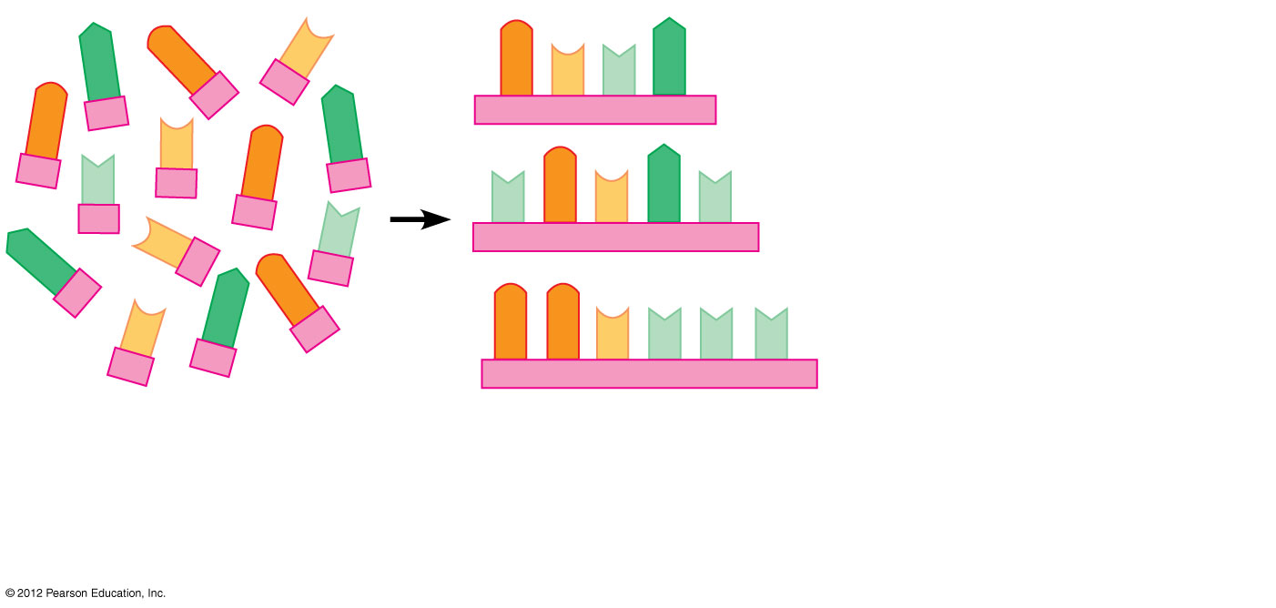
Figure 15.3B_s2
G
C
A
G
C
U
A
G
C
A
U
G
U
G
C
A
U
C
U
A
G
C
A
G
G
C
U
U
U
1
Collection of
monomers
2
Formation of
short RNA
polymers:
simple “genes”
Notes:
16
Figure 15.3B_s2 A hypothesis for the origin of the first genes (step 2)

Slide 17
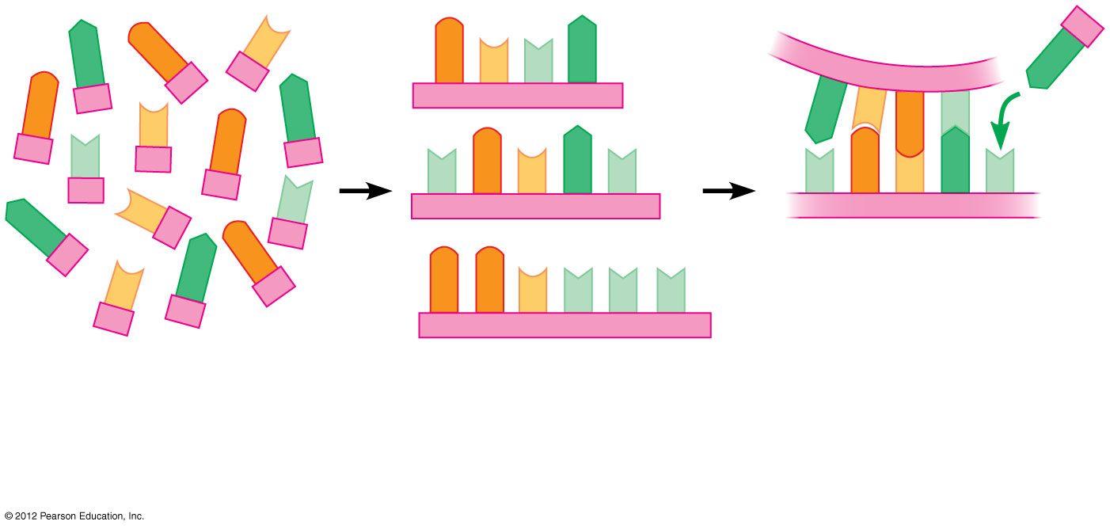
Figure 15.3B_s3
G
C
A
A
G
C
U
A
A
C
G
U
G
C
A
U
G
U
G
C
A
U
U
G
C
A
U
C
U
A
G
C
A
G
G
C
U
U
U
3
Assembly of a
complementary
RNA chain, the first
step in the
replication of the
original “gene”
1
Collection of
monomers
2
Formation of
short RNA
polymers:
simple “genes”
Notes:
17
Figure 15.3B_s3 A hypothesis for the origin of the first genes (step 3)

Slide 18
0
  MAJOR EVENTS IN THE HISTORY OF LIFE
© 2012 Pearson Education, Inc.
Notes:
18

Slide 19
15.4 The origins of single-celled and multicelled organisms and the colonization of land were key events in life’s history
0
  Macroevolution is the broad pattern of changes in life on Earth.
  The entire 4.6 billion years of Earth’s history can be broken into three eons of geologic time.
    The Archaean and Proterozoic eons lasted about 4 billion years.
    The Phanerozoic eon includes the last half billion years.
© 2012 Pearson Education, Inc.
Notes:
19
Student Misconceptions and Concerns
Comprehending the length of time of the major phases of life’s history is problematic for most students. Even the mass extinction of most dinosaurs 65 million years ago took place far beyond any period in recorded human history (65 million years ago is about 27,000 times the period of time since the life of Aristotle). Consider noting, as a reference point, that multicellular animal life, as we know it today, has existed for only about 13% of Earth’s history (0.6 of 4.6 billion years). The period during which only prokaryotic life existed on earth was more than twice as long as the amount of time multicellular life has existed. Other proportional comparisons can help to put these periods in perspective.
Teaching Tips
1. The evolution from prokaryotes to eukaryotes and single-celled life to multicellular life represent major leaps and dramatic change. Consider pointing out to students that extensive amounts of time did pass between each of these dramatic transitions. This is consistent with the gradual evolution of life on Earth.
2. Assigning students, individually or in small groups, to create timelines using the dates in Table 15.6 can help them appreciate the proportional relationship of these periods.

Slide 20
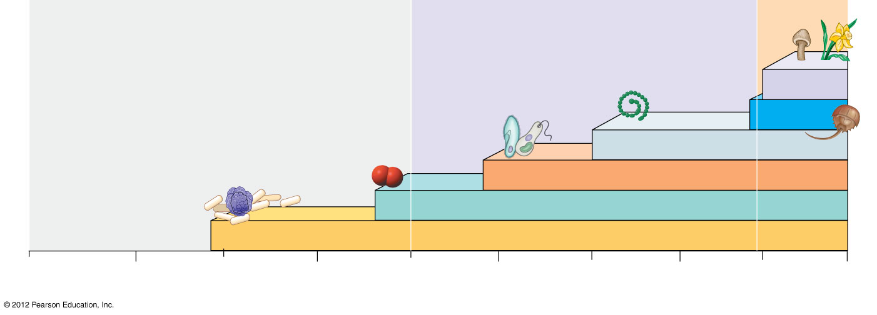
Figure 15.4
Archaean
eon
Proterozoic
eon
Phanerozoic
eon
Colonization
of land
Animals
Multicellular eukaryotes
Single-celled eukaryotes
Origin
of Earth
Atmospheric oxygen
Prokaryotes
4.6
4
3
2
1
Present
Billions of years ago
Notes:
20
Figure 15.4 Some key events in the history of life on Earth

Slide 21
15.4 The origins of single-celled and multicelled organisms and the colonization of land were key events in life’s history
0
  Prokaryotes lived alone on Earth for 1.5 billion years, from 3.5 to 2 billion years ago.
    During this time, prokaryotes transformed the atmosphere.
    Prokaryotic photosynthesis produced oxygen that enriched the water and atmosphere of Earth.
    Anaerobic and aerobic cellular respiration allowed prokaryotes to flourish.
© 2012 Pearson Education, Inc.
Notes:
21
Student Misconceptions and Concerns
Comprehending the length of time of the major phases of life’s history is problematic for most students. Even the mass extinction of most dinosaurs 65 million years ago took place far beyond any period in recorded human history (65 million years ago is about 27,000 times the period of time since the life of Aristotle). Consider noting, as a reference point, that multicellular animal life, as we know it today, has existed for only about 13% of Earth’s history (0.6 of 4.6 billion years). The period during which only prokaryotic life existed on earth was more than twice as long as the amount of time multicellular life has existed. Other proportional comparisons can help to put these periods in perspective.
Teaching Tips
1. The evolution from prokaryotes to eukaryotes and single-celled life to multicellular life represent major leaps and dramatic change. Consider pointing out to students that extensive amounts of time did pass between each of these dramatic transitions. This is consistent with the gradual evolution of life on Earth.
2. Assigning students, individually or in small groups, to create timelines using the dates in Table 15.6 can help them appreciate the proportional relationship of these periods.

Slide 22
15.4 The origins of single-celled and multicelled organisms and the colonization of land were key events in life’s history
0
  The oldest fossils of eukaryotes are about 2.1 billion years old.
  The common ancestor of all multicellular eukaryotes lived about 1.5 billion years ago.
  The oldest fossils of multicellular eukaryotes are about 1.2 billion years old.
  The first multicellular plants and fungi began to colonize land about 500 million years ago.
© 2012 Pearson Education, Inc.
Notes:
22
Student Misconceptions and Concerns
Comprehending the length of time of the major phases of life’s history is problematic for most students. Even the mass extinction of most dinosaurs 65 million years ago took place far beyond any period in recorded human history (65 million years ago is about 27,000 times the period of time since the life of Aristotle). Consider noting, as a reference point, that multicellular animal life, as we know it today, has existed for only about 13% of Earth’s history (0.6 of 4.6 billion years). The period during which only prokaryotic life existed on earth was more than twice as long as the amount of time multicellular life has existed. Other proportional comparisons can help to put these periods in perspective.
Teaching Tips
1. The evolution from prokaryotes to eukaryotes and single-celled life to multicellular life represent major leaps and dramatic change. Consider pointing out to students that extensive amounts of time did pass between each of these dramatic transitions. This is consistent with the gradual evolution of life on Earth.
2. Assigning students, individually or in small groups, to create timelines using the dates in Table 15.6 can help them appreciate the proportional relationship of these periods.

Slide 23
15.4 The origins of single-celled and multicelled organisms and the colonization of land were key events in life’s history
0
  Humans diverged from other primates about 6 to 7 million years ago.
  Our species, Homo sapiens, originated about 195,000 years ago.
  If the Earth’s history were compressed into an hour, humans appeared less than 0.2 seconds ago!
© 2012 Pearson Education, Inc.
Notes:
23
Student Misconceptions and Concerns
Comprehending the length of time of the major phases of life’s history is problematic for most students. Even the mass extinction of most dinosaurs 65 million years ago took place far beyond any period in recorded human history (65 million years ago is about 27,000 times the period of time since the life of Aristotle). Consider noting, as a reference point, that multicellular animal life, as we know it today, has existed for only about 13% of Earth’s history (0.6 of 4.6 billion years). The period during which only prokaryotic life existed on earth was more than twice as long as the amount of time multicellular life has existed. Other proportional comparisons can help to put these periods in perspective.
Teaching Tips
1. The evolution from prokaryotes to eukaryotes and single-celled life to multicellular life represent major leaps and dramatic change. Consider pointing out to students that extensive amounts of time did pass between each of these dramatic transitions. This is consistent with the gradual evolution of life on Earth.
2. Assigning students, individually or in small groups, to create timelines using the dates in Table 15.6 can help them appreciate the proportional relationship of these periods.

Slide 24
15.5 The actual ages of rocks and fossils mark geologic time
0
  Radiometric dating measures the decay of radioactive isotopes.
  The rate of decay is expressed as a half-life, the time required for 50% of an isotope in a sample to decay.
  There are many different isotopes that can be used to date fossils. These isotopes have different half-lives, ranging from thousands to hundreds of millions of years.
© 2012 Pearson Education, Inc.
Notes:
24
Teaching Tips
1. With a half-life of 5,730 years, carbon-14 is an inappropriate measure of large periods of time, such as the dinosaur bones that are 100 million years old. This is like trying to measure the distance across a state with a tape measure.
2. Assigning students, individually or in small groups, to create timelines using the dates in Table 15.6 can help them appreciate the proportional relationship of these periods.
3. The sequence of layers, but not their absolute age, is revealed by the stratifications in sedimentary rocks. Imagine peeling the layers of wallpaper from the walls of a very old house that has been inhabited by many owners. We can tell which layers are older than others, but not the exact age of each.

Slide 25
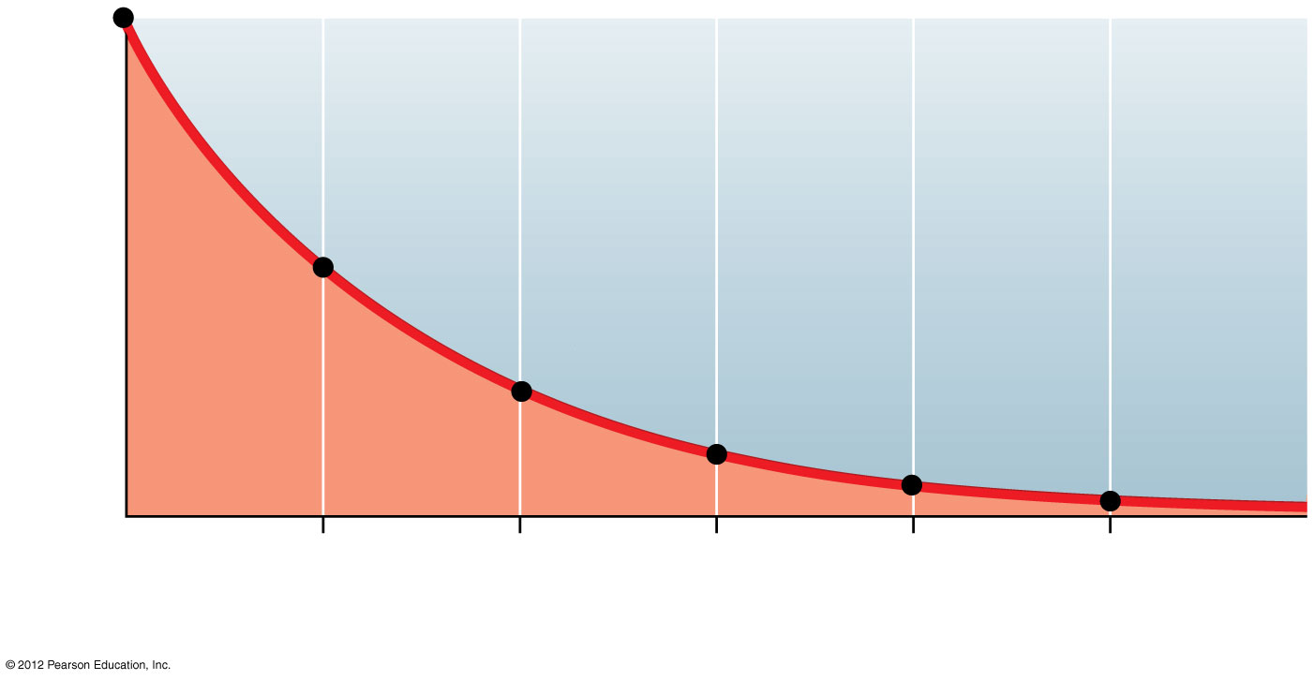
Figure 15.5
Fraction of carbon-14
remaining
0
5.7
11.4
17.1
22.8
28.5
Time (thousands of years)
Notes:
25
Figure 15.5 Radiometric dating using carbon-14

Slide 26
15.6 The fossil record documents the history of life
0
  The geologic record is based on the sequence and age of fossils in the rock strata.
  The most recent Phanerozoic eon
    includes the past 542 million years and
    is divided into three eras
      Paleozoic,
      Mesozoic, and
      Cenozoic.
  The boundaries between eras are marked by mass extinctions.
© 2012 Pearson Education, Inc.
Notes:
26
Student Misconceptions and Concerns
Table 15.6 includes a timeline of the entire history of Earth, with a large section focused on the most recent 13% of Earth’s history. Students might not notice that this enlarged section is an expansion of this proportionately small, but significant, period. Furthermore, the bottom of the enlarged portion is not scaled to the top portion. These clarifications may be needed for proper appreciation of this table. Coupling Table 15.6 and Figure 15.4 may also help clarify this information.
Teaching Tips
1. Students might not appreciate the difficulty of finding fossils of early life. Early life forms were likely microscopic and lacked hard parts such as shells and bone. Furthermore, over time, heat, pressure, friction, and erosion may destroy what fossils were formed or render them difficult to detect.
2. Assigning students, individually or in small groups, to create timelines using the dates in Table 15.6 can help them appreciate the proportional relationship of these periods.
3. The sequence of layers, but not their absolute age, is revealed by the stratifications in sedimentary rocks. Imagine peeling the layers of wallpaper from the walls of a very old house that has been inhabited by many owners. We can tell which layers are older than others, but not the exact age of each.

Slide 27
0
  MECHANISMS OF MACROEVOLUTION
© 2012 Pearson Education, Inc.
Notes:
27

Slide 28
15.7 Continental drift has played a major role in macroevolution
0
  According to the theory of plate tectonics,
    the Earth’s crust is divided into giant, irregularly shaped plates that
    essentially float on the underlying mantle.
  In a process called continental drift, movements in the mantle cause the plates to move.
  Since the origin of multicellular life roughly 1.5 billion years ago, there have been three occasions in which the landmasses of Earth came together to form a supercontinent.
© 2012 Pearson Education, Inc.
Notes:
28
Student Misconceptions and Concerns
Student backgrounds in earth sciences may be uneven based upon their specific high school and college coursework. An emphasis on chemistry, physics, and biology may leave large gaps in basic content regarding geology and Earth’s history.
Teaching Tips
Consider this analogy to help students understand the biological consequences of speciation as continents drifted apart. As your students left high school and entered the workforce or continued their education, their high school social groups lost contact and drifted apart. Your students, in their new circumstances, adapted and changed in different ways, separate from the members of their old social groups. A note of caution: This analogy to individual social changes is not an example of biological evolution, which occurs over generations.

Slide 29
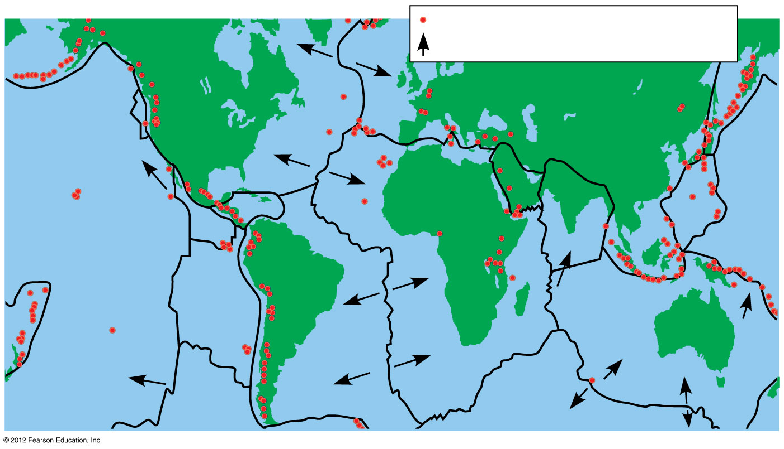
Figure 15.7B
Zones of violent tectonic activity
Direction of movement
North
American
Plate
Eurasian Plate
Juan de Fuca
Plate
Caribbean
Plate
Philippine
Plate
Arabian
Plate
Indian
Plate
Cocos Plate
Pacific
Plate
South
American
Plate
Nazca
Plate
African
Plate
Australian
Plate
Scotia Plate
Antarctic
Plate
Notes:
29
Figure 15.7B Earth’s tectonic plates

Slide 30
15.7 Continental drift has played a major role in macroevolution
0
  About 250 million years ago
    plate movements brought all the landmasses together and
    the supercontinent of Pangaea was formed.
  During the Mesozoic era,
    Pangaea started to break apart,
    the physical environment and climate changed dramatically,
    Australia became isolated, and
    biological diversity was reshaped.
© 2012 Pearson Education, Inc.
Notes:
30
Student Misconceptions and Concerns
Student backgrounds in earth sciences may be uneven based upon their specific high school and college coursework. An emphasis on chemistry, physics, and biology may leave large gaps in basic content regarding geology and Earth’s history.
Teaching Tips
Consider this analogy to help students understand the biological consequences of speciation as continents drifted apart. As your students left high school and entered the workforce or continued their education, their high school social groups lost contact and drifted apart. Your students, in their new circumstances, adapted and changed in different ways, separate from the members of their old social groups. A note of caution: This analogy to individual social changes is not an example of biological evolution, which occurs over generations.

Slide 31
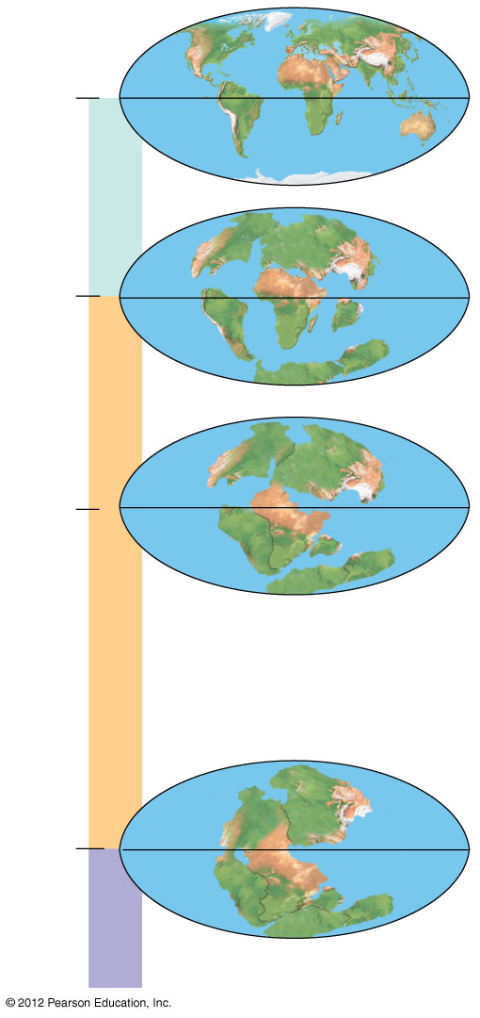
Figure 15.7C
Present
4
Cenozoic
North America
Eurasia
65.5
3
Africa
South
America
India
Madagascar
Australia
Antarctica
Laurasia
Millions of years ago
135
2
Gondwana
Mesozoic
Pangaea
251
1
Paleozoic
Notes:
31
Figure 15.7C Continental drift during the Phanerozoic eon

Slide 32
15.7 Continental drift has played a major role in macroevolution
0
  Continental drift explains the distribution of lungfishes.
    Fossils of lungfishes are found on every continent except Antarctica.
    Today, living lungfishes are found in
      South America,
      Africa, and
      Australia.
    This evidence suggests that lungfishes evolved when Pangaea was still intact.
© 2012 Pearson Education, Inc.
Notes:
32
Student Misconceptions and Concerns
Student backgrounds in earth sciences may be uneven based upon their specific high school and college coursework. An emphasis on chemistry, physics, and biology may leave large gaps in basic content regarding geology and Earth’s history.
Teaching Tips
Consider this analogy to help students understand the biological consequences of speciation as continents drifted apart. As your students left high school and entered the workforce or continued their education, their high school social groups lost contact and drifted apart. Your students, in their new circumstances, adapted and changed in different ways, separate from the members of their old social groups. A note of caution: This analogy to individual social changes is not an example of biological evolution, which occurs over generations.

Slide 33
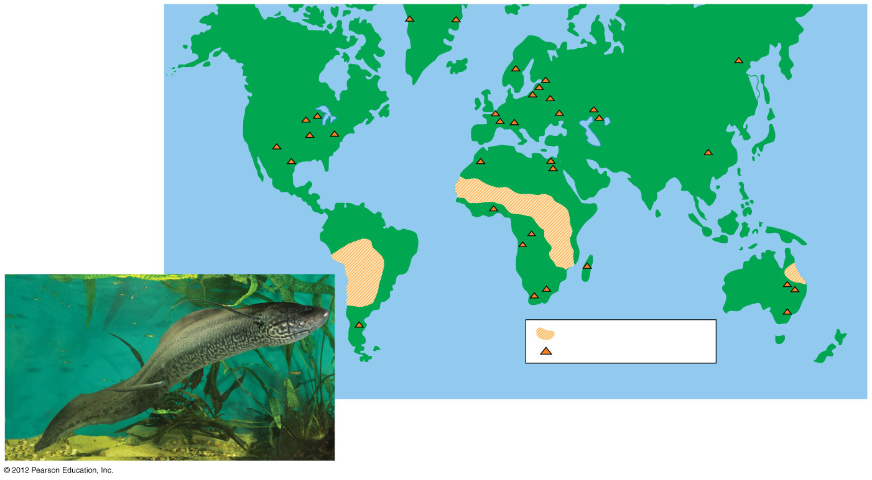
Figure 15.7D
North
America
Asia
Europe
Africa
South
America
Australia
Living lungfishes
Fossilized lungfishes
Notes:
33
Figure 15.7D Lungfish distribution, a result of continental drift

Slide 34
15.8 CONNECTION: Plate tectonics may imperil human life
0
  Volcanoes and earthquakes result from the movements of crustal plates.
    The boundaries of plates are hotspots of volcanic and earthquake activity.
    An undersea earthquake caused the 2004 tsunami, when a fault in the Indian Ocean ruptured.
© 2012 Pearson Education, Inc.
Notes:
34
Student Misconceptions and Concerns
Student backgrounds in earth sciences may be uneven based upon their specific high school and college coursework. An emphasis on chemistry, physics, and biology may leave large gaps in basic content regarding geology and Earth’s history.
Teaching Tips
The mid-Atlantic ridge can be easily seen via satellite in Google maps.

Slide 35
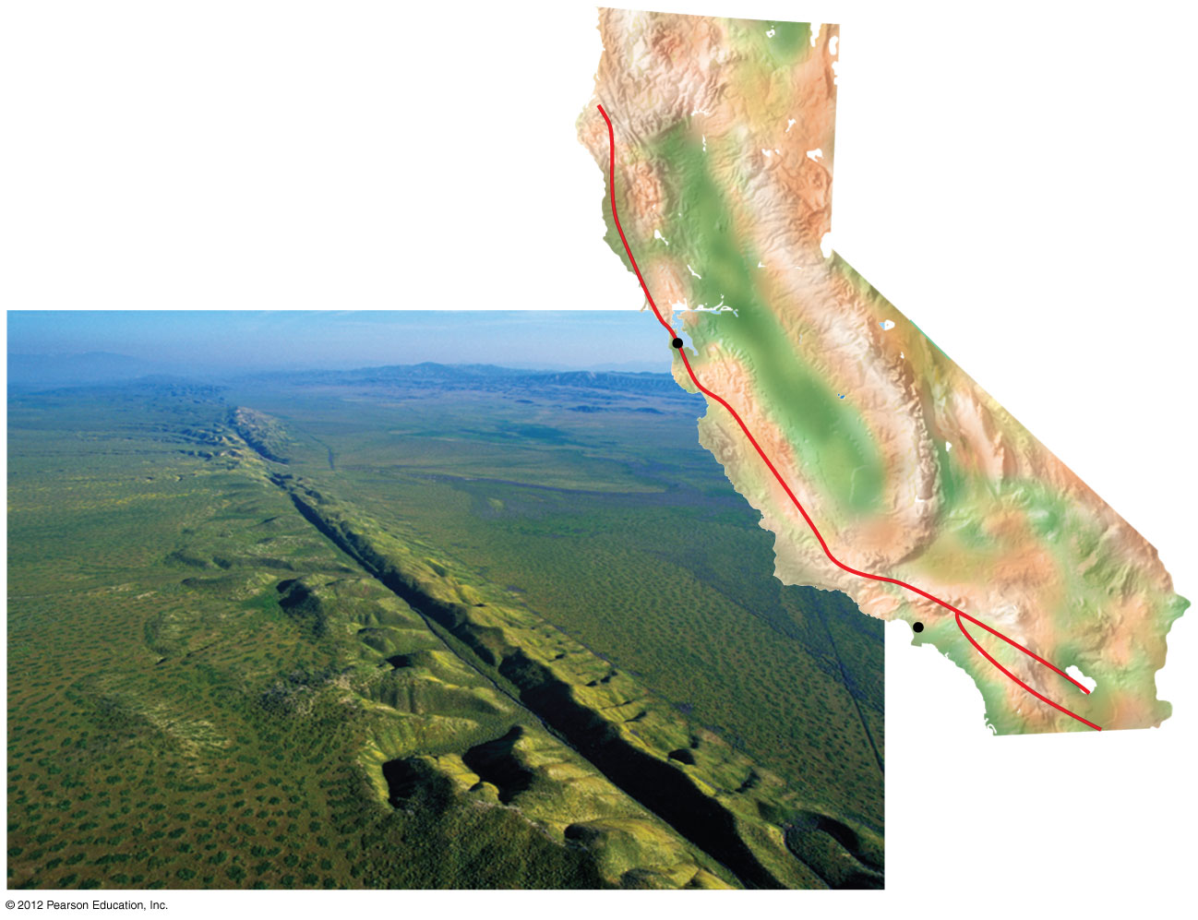
Figure 15.8
Pacific
Plate
North
American
Plate
San Francisco
San Andreas Fault
Los Angeles
California
Notes:
35
Figure 15.8 The San Andreas Fault, a boundary between two crustal plates

Slide 36
15.9 During mass extinctions, large numbers of species are lost
0
  Extinction is inevitable in a changing world.
  The fossil record shows that the vast majority of species that have ever lived are now extinct.
  Over the last 500 million years,
    five mass extinctions have occurred, and
    in each event, more than 50% of the Earth’s species went extinct.
© 2012 Pearson Education, Inc.
Notes:
36
Student Misconceptions and Concerns
1. Student backgrounds in earth sciences may be uneven based upon their specific high school and college coursework. An emphasis on chemistry, physics, and biology may leave large gaps in basic content regarding geology and Earth’s history.
2. The slow speed at which life can evolve in response to human damage of natural systems may not be appreciated by our students. As noted in Module 15.9, it may take 5 to 10 million years for the planet to recover from the ongoing human-induced loss of biological diversity.
Teaching Tips
1. The consequences of an asteroid impact, large or small, reveal the role of random events in evolution. Like throwing a dart at a spinning globe, where the asteroid hits and what continents and forms of life are most affected can change greatly if the impact occurs even a few hours earlier or later. An asteroid delayed by 12 hours, in what might be a journey of millions or billions of years, will land on the opposite side of the Earth!
2. Students might not realize that entire categories of animals have come and gone. The once-abundant Trilobites and nonavian dinosaurs are now extinct. Birds and mammals are relatively recent additions. Such examples of macroevolution are apparent in the fossil record.

Slide 37
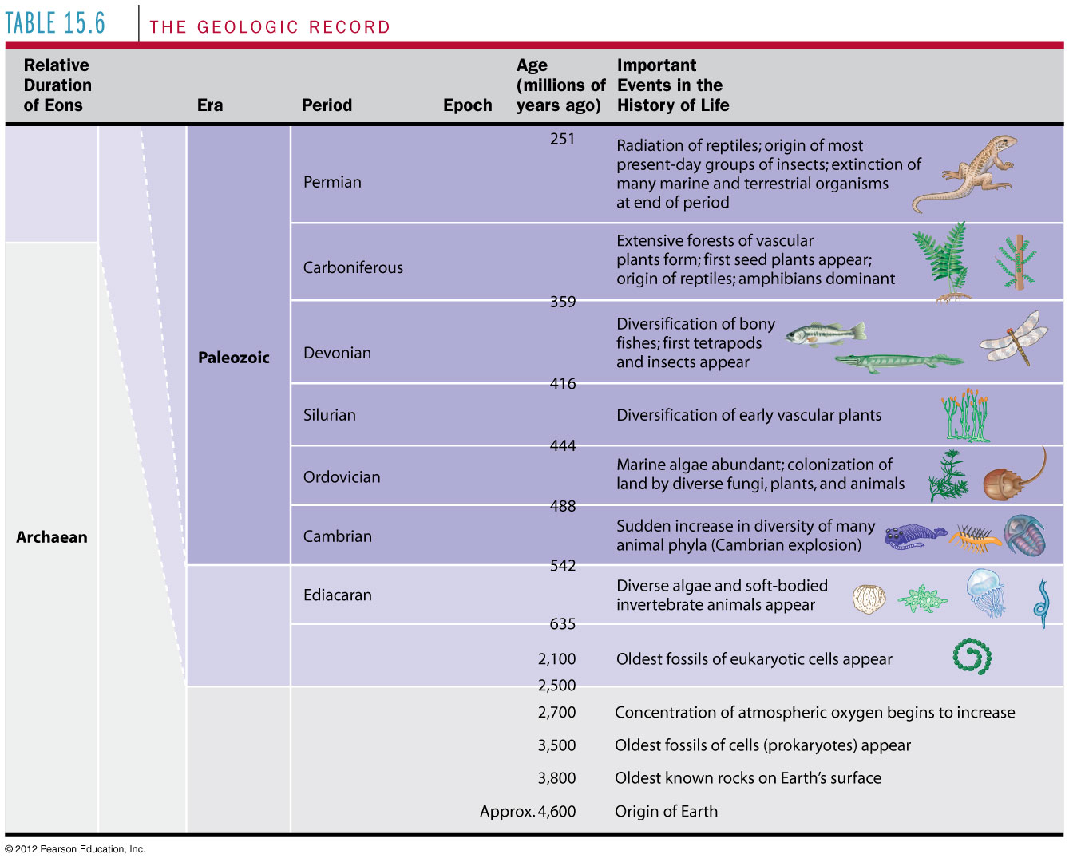
Table 15.6_2
Order
Notes:
37
Table 15.6_2 The geologic record (part 2)

Slide 38
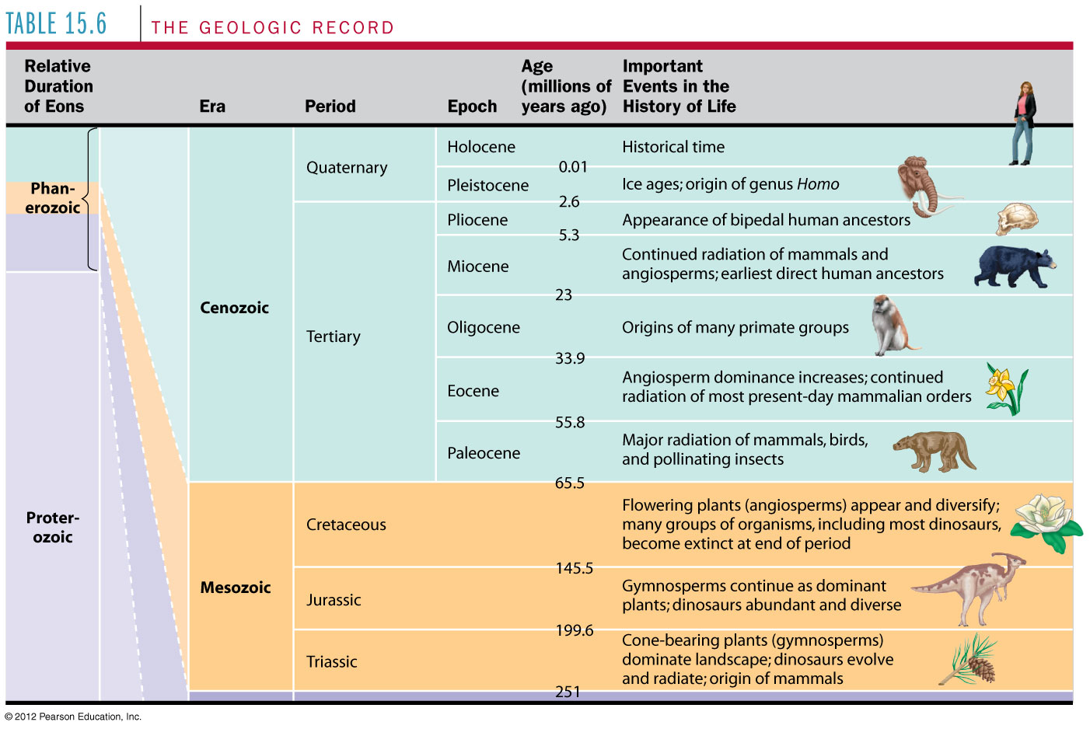
Table 15.6_1
Order
Notes:
38
Table 15.6_1 The geologic record (part 1)

Slide 39
0
  PHYLOGENY AND THE TREE OF LIFE
© 2012 Pearson Education, Inc.
Notes:
39

Slide 40
15.14 Phylogenies based on homologies reflect evolutionary history
0
  Phylogeny is the evolutionary history of a species or group of species.
  Phylogeny can be inferred from
    the fossil record,
    morphological homologies, and
    molecular homologies.
© 2012 Pearson Education, Inc.
Notes:
40
Student Misconceptions and Concerns
Homologous and analogous relationships can be confusing for students. Simple explanations and concrete examples can serve as guides to understanding each process. Homologous relationships reflect modifications of one form for many functions. Analogous relationships reflect modifications of many forms for one function.
Teaching Tips
1. The National Center for Science Education is an organization working to support the teaching of evolution and defend it against sectarian attack. Its website, http://ncse.com, contains a great deal of useful information.
2. Our hierarchical classification system is analogous to sorting mail first by zip code, then by street, house number, and finally individual name. Such a system of classification based upon hierarchical categories is also common in the military and many other places in our lives.

Slide 41
15.14 Phylogenies based on homologies reflect evolutionary history
0
  Homologies are similarities due to shared ancestry, evolving from the same structure in a common ancestor.
  Generally, organisms that share similar morphologies are closely related.
    However, some similarities are due to similar adaptations favored by a common environment, a process called convergent evolution.
    A similarity due to convergent evolution is called analogy.
© 2012 Pearson Education, Inc.
Notes:
41
Student Misconceptions and Concerns
Homologous and analogous relationships can be confusing for students. Simple explanations and concrete examples can serve as guides to understanding each process. Homologous relationships reflect modifications of one form for many functions. Analogous relationships reflect modifications of many forms for one function.
Teaching Tips
1. The National Center for Science Education is an organization working to support the teaching of evolution and defend it against sectarian attack. Its website, http://ncse.com, contains a great deal of useful information.
2. Our hierarchical classification system is analogous to sorting mail first by zip code, then by street, house number, and finally individual name. Such a system of classification based upon hierarchical categories is also common in the military and many other places in our lives.

Slide 42
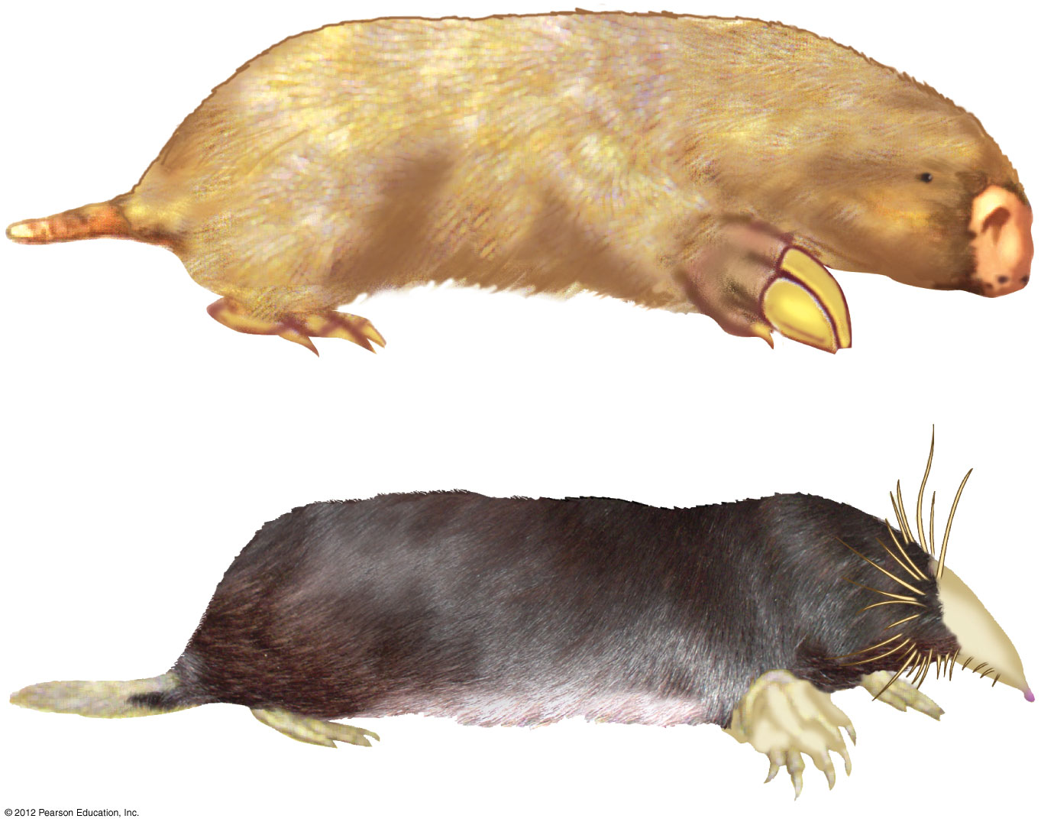
Figure 15.14
Notes:
42
Figure 15.14 Australian “mole” (top) and North American mole (bottom)

Slide 43
15.15 Systematics connects classification with evolutionary history
0
  Systematics is a discipline of biology that focuses on
    classifying organisms and
    determining their evolutionary relationships.
  Carolus Linnaeus introduced taxonomy, a system of naming and classifying species.
© 2012 Pearson Education, Inc.
Notes:
43
Student Misconceptions and Concerns
1. Students can be frustrated by the changing state of systematics. Some comfort can be offered by noting that this is true about many active areas of science. For example, scientists continue to learn more and revise advice regarding the causes, treatment, and prevention of heart disease and cancer.
2. Students might express concern over the need to learn scientific names, when common names already seem sufficient. Depending upon where you live, find some examples of common organisms with more than one common name. Fishermen are famous for the various names they assign to the same species, depending upon the geographic region where they fish. Have your students imagine the problems of using common names when communicating with someone in another language. Clearly, there are advantages to scientific names!
Teaching Tips
1. The National Center for Science Education is an organization working to support the teaching of evolution and defend it against sectarian attack. Its website, http://ncse.com, contains a great deal of useful information.
2. Although Linnaeus recognized a hierarchical structure in the natural world, he had no natural explanation for the occurrence of such groups. One might wonder why all life does not blend evenly from one form to another. One of Darwin’s greatest insights was to understand that these clusters reflect similarities due to shared ancestry, i.e., life itself is grouped into family trees. Furthermore, Darwin proposed a natural mechanism for the formation of new species and the generation of this diversity.

Slide 44
15.15 Systematics connects classification with evolutionary history
0
  Biologists assign each species a two-part scientific name, or binomial, consisting of
    a genus and
    a unique part for each species within the genus.
  Genera are grouped into progressively larger categories.
  Each taxonomic unit is a taxon.
© 2012 Pearson Education, Inc.
Notes:
44
Student Misconceptions and Concerns
1. Students can be frustrated by the changing state of systematics. Some comfort can be offered by noting that this is true about many active areas of science. For example, scientists continue to learn more and revise advice regarding the causes, treatment, and prevention of heart disease and cancer.
2. Students might express concern over the need to learn scientific names, when common names already seem sufficient. Depending upon where you live, find some examples of common organisms with more than one common name. Fishermen are famous for the various names they assign to the same species, depending upon the geographic region where they fish. Have your students imagine the problems of using common names when communicating with someone in another language. Clearly, there are advantages to scientific names!
Teaching Tips
1. The National Center for Science Education is an organization working to support the teaching of evolution and defend it against sectarian attack. Its website, http://ncse.com, contains a great deal of useful information.
2. Although Linnaeus recognized a hierarchical structure in the natural world, he had no natural explanation for the occurrence of such groups. One might wonder why all life does not blend evenly from one form to another. One of Darwin’s greatest insights was to understand that these clusters reflect similarities due to shared ancestry, i.e., life itself is grouped into family trees. Furthermore, Darwin proposed a natural mechanism for the formation of new species and the generation of this diversity.

Slide 45
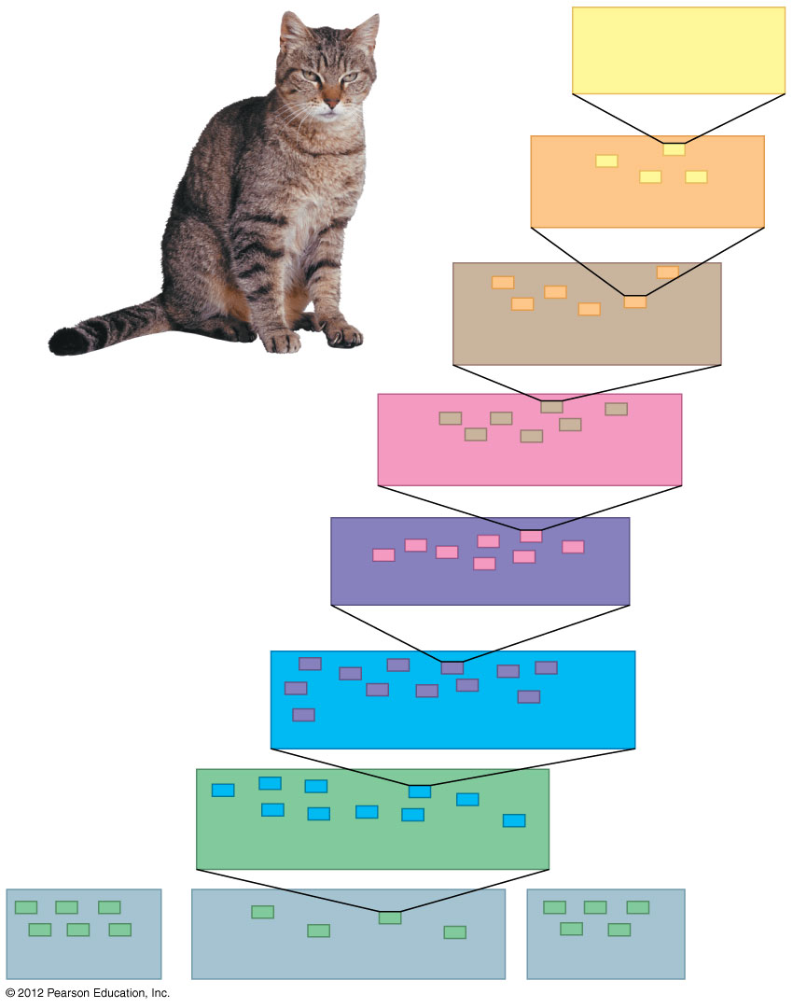
Figure 15.15A
Species:
Felis catus
Genus: Felis
Family: Felidae
Order: Carnivora
Class: Mammalia
Phylum: Chordata
Kingdom: Animalia
Bacteria
Domain: Eukarya
Archaea
Notes:
45
Figure 15.15A Hierarchical classification of the domestic cat

Slide 46
15.15 Systematics connects classification with evolutionary history
0
  Biologists traditionally use phylogenetic trees to depict hypotheses about the evolutionary history of species.
    The branching diagrams reflect the hierarchical classification of groups nested within more inclusive groups.
    Phylogenetic trees indicate the probable evolutionary relationships among groups and patterns of descent.
© 2012 Pearson Education, Inc.
Notes:
46
Student Misconceptions and Concerns
1. Students can be frustrated by the changing state of systematics. Some comfort can be offered by noting that this is true about many active areas of science. For example, scientists continue to learn more and revise advice regarding the causes, treatment, and prevention of heart disease and cancer.
2. Students might express concern over the need to learn scientific names, when common names already seem sufficient. Depending upon where you live, find some examples of common organisms with more than one common name. Fishermen are famous for the various names they assign to the same species, depending upon the geographic region where they fish. Have your students imagine the problems of using common names when communicating with someone in another language. Clearly, there are advantages to scientific names!
Teaching Tips
1. The National Center for Science Education is an organization working to support the teaching of evolution and defend it against sectarian attack. Its website, http://ncse.com, contains a great deal of useful information.
2. Although Linnaeus recognized a hierarchical structure in the natural world, he had no natural explanation for the occurrence of such groups. One might wonder why all life does not blend evenly from one form to another. One of Darwin’s greatest insights was to understand that these clusters reflect similarities due to shared ancestry, i.e., life itself is grouped into family trees. Furthermore, Darwin proposed a natural mechanism for the formation of new species and the generation of this diversity.

Slide 47
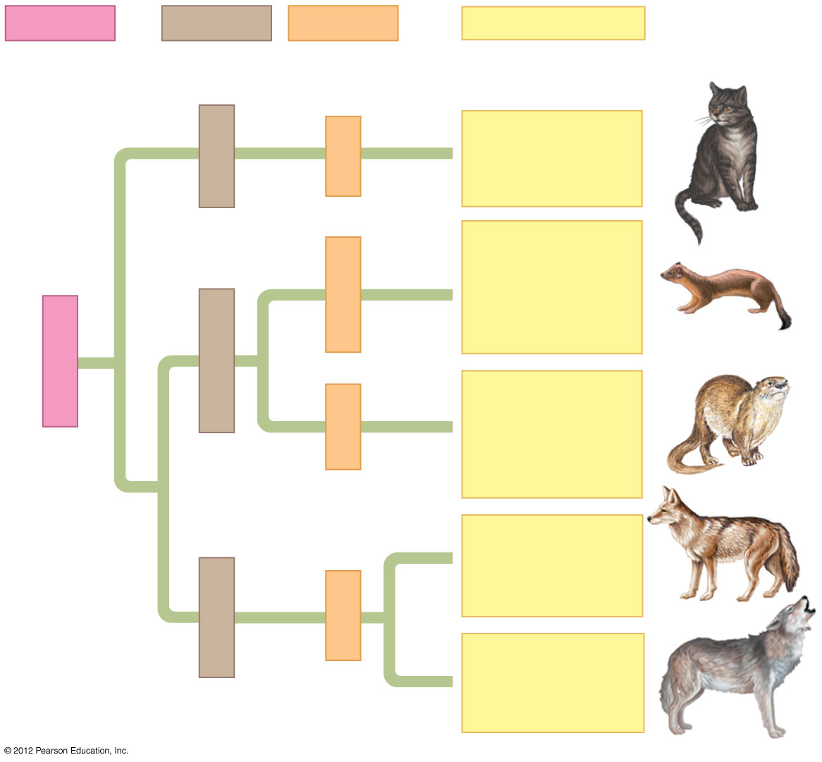
Figure 15.15B
Order
Family
Genus
Species
Felis catus
(domestic
cat)
Felidae
Felis
Mustela
frenata
(long-tailed
weasel)
Mustela
Carnivora
Mustelidae
Lutra lutra
(European
otter)
Lutra
Canis
latrans
(coyote)
Canidae
Canis
Canis lupus
(wolf)
Notes:
47
Figure 15.15B Relating classification to phylogeny

Slide 48
15.16 Shared characters are used to construct phylogenetic trees
0
  Cladistics
    is the most widely used method in systematics and
    groups organisms into clades.
  Each clade is a monophyletic group of species that
    includes an ancestral species and
    all of its descendants.
© 2012 Pearson Education, Inc.
Notes:
48
Student Misconceptions and Concerns
Students may struggle with many aspects of phylogenetic trees, including: (a) Students may not realize that each node/branch can be rotated to rearrange the groups without changing the nature of the relationships. For example, in Figure 15.16A, the position of the beaver and kangaroo can be reversed without changing any relationships represented in the phylogenetic tree. (b) The length of each branch is not meaningful and is not intended to be proportional to time. (c) The spacing between groups is not meaningful and does not denote the degree of divergence between them. Whether the tree is compressed or expanded in size, the information communicated in it remains the same.
Teaching Tips
1. The National Center for Science Education is an organization working to support the teaching of evolution and defend it against sectarian attack. Its website, http://ncse.com, contains a great deal of useful information.
2. Emphasize to students that phylogenetic trees are tentative hypotheses. As new data are collected, the hypotheses are modified or rejected outright.

Slide 49
15.19 Constructing the tree of life is a work in progress
0
    Molecular systematics and cladistics are remodeling some trees.
    Biologists currently recognize a three-domain system consisting of
      two domains of prokaryotes: Bacteria and Archaea, and
      one domain of eukaryotes called Eukarya including
        fungi,
        plants, and
        animals.
© 2012 Pearson Education, Inc.
Notes:
49
Teaching Tips
1. The National Center for Science Education is an organization working to support the teaching of evolution and defend it against sectarian attack. Its website, http://ncse.com, contains a great deal of useful information.
2. The authors reference Modules 10.22 and 10.23 for information on horizontal gene transfer. If this module was not previously addressed, consider covering it in your final discussion of the early evolution of life.
3. For some students, the discussion of the ambiguous relationships of early life and the three domains can be unsettling. Students who expect clear answers and sharp definitions from science may be uncomfortable with such ambiguity.

Slide 50
15.19 Constructing the tree of life is a work in progress
0
    Molecular and cellular evidence indicates that
      Bacteria and Archaea diverged very early in the evolutionary history of life and
      Archaea are more closely related to eukaryotes than to bacteria.
© 2012 Pearson Education, Inc.
Notes:
50
Teaching Tips
1. The National Center for Science Education is an organization working to support the teaching of evolution and defend it against sectarian attack. Its website, http://ncse.com, contains a great deal of useful information.
2. The authors reference Modules 10.22 and 10.23 for information on horizontal gene transfer. If this module was not previously addressed, consider covering it in your final discussion of the early evolution of life.
3. For some students, the discussion of the ambiguous relationships of early life and the three domains can be unsettling. Students who expect clear answers and sharp definitions from science may be uncomfortable with such ambiguity.

Slide 51
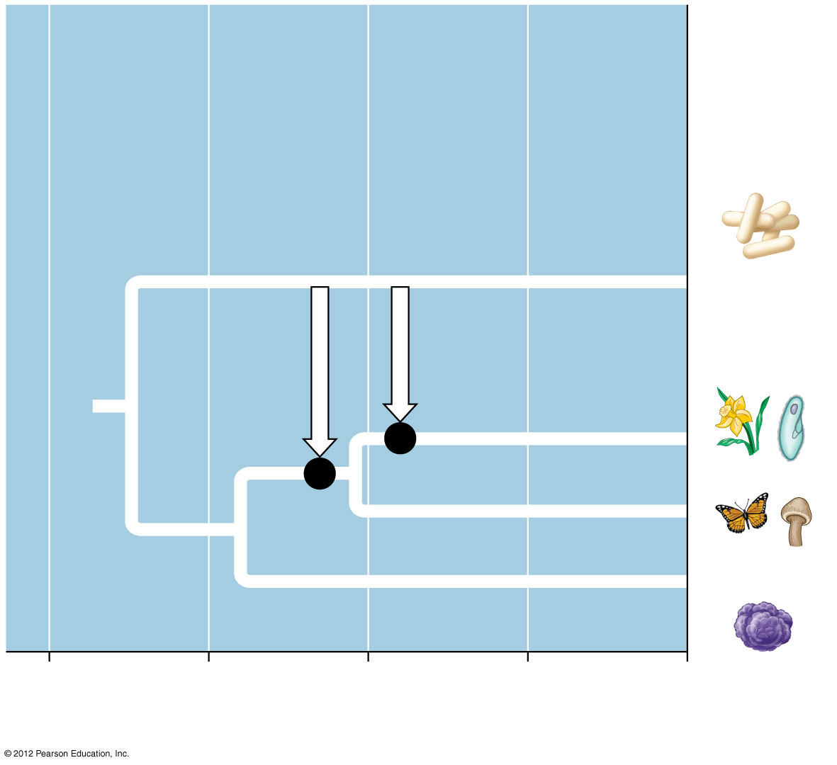
Figure 15.19A
1
Most recent common ancestor of all living things
2
Gene transfer between mitochondrial ancestor
and ancestor of eukaryotes
3
Gene transfer between chloroplast ancestor
and ancestor of green plants
Bacteria
3
2
1
Eukarya
Archaea
4
3
2
1
0
Billions of years ago
Notes:
51
Figure 15.19A Two major episodes of horizontal gene transfer in the history of life (dates are uncertain)

