Slide 1
EVOLUTION
Chapter 13

Slide 2
Introduction
0
  The blue-footed booby has adaptations that make it suited to its environment. These include
    webbed feet,
    streamlined shape that minimizes friction when it dives, and
    a large tail that serves as a brake.
© 2012 Pearson Education, Inc.
Notes:
2

Slide 3
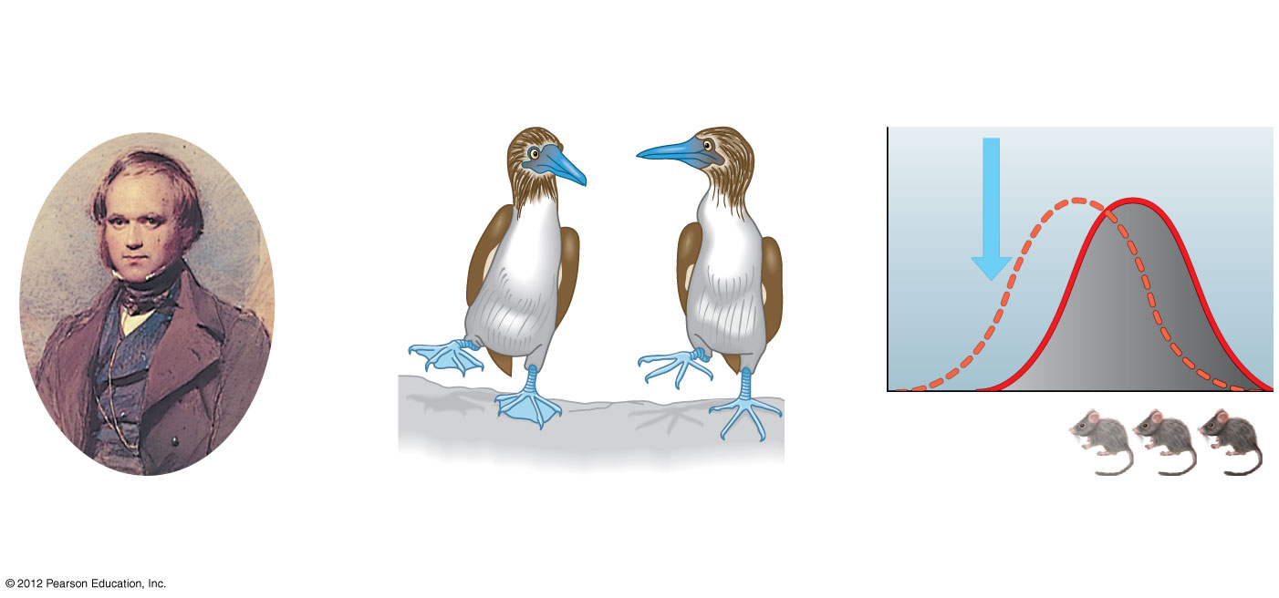
Figure 13.0_2
Chapter 13: Big Ideas
Darwin’s Theory
of Evolution
The Evolution of
Populations
Mechanisms of
Microevolution
Notes:
3
Figure 13.0_2 Chapter 13: Big Ideas

Slide 4
  DARWIN’S THEORY OF EVOLUTION
© 2012 Pearson Education, Inc.
Notes:
4

Slide 5
13.1 A sea voyage helped Darwin frame his theory of evolution
0
    A five-year voyage around the world helped Darwin make observations that would lead to his theory of evolution, the idea that Earth’s many species are descendants of ancestral species that were different from those living today.
© 2012 Pearson Education, Inc.
Notes:
5
Student Misconceptions and Concerns
1. Students often think that Charles Darwin was the first to suggest that life evolves: the early contributions by Greek philosophers such as Anaximander and the work of Jean Baptiste de Lamarck are unappreciated. Consider emphasizing these earlier contributions.
2. Students often misunderstand the basic process of evolution and instead express a Lamarckian point of view. Organisms do not evolve structures because of want or need. Instead, evolution is a passive process in which the environment favors certain traits that exist within a population. Adaptations evolve in populations. Organisms do not actively or willingly evolve.
Teaching Tips
1. Consider beginning your unit on evolution by asking each student to explain how a particular adaptation evolved. The evolution of flight in birds is a good example. Reviewing these student explanations can provide great insight into the misconceptions that students may bring to the class.
2. Many resources related to Charles Darwin are available on the Internet. The following are only a few examples:
www.ucmp.berkeley.edu/history/evolution.html and www.natcenscied.org are extensive sites rich with details and references.
www.literature.org/authors/darwin-charles/ includes the texts of The Voyage of the Beagle, The Origin of Species first and sixth editions, and The Descent of Man.
http://williamcalvin.com/bookshelf/down_hse.htm includes details of Charles Darwin’s home.
www.talkorigins.org is an extensive usenet newsgroup devoted to the discussion and debate of biological and physical origins.

Slide 6
13.1 A sea voyage helped Darwin frame his theory of evolution
0
  In the early 1800s, Jean Baptiste Lamarck suggested that life on Earth evolves, but by a different mechanism than that proposed by Darwin.
  Lamarck proposed that
    organisms evolve by the use and disuse of body parts and
    these acquired characteristics are passed on to offspring.
© 2012 Pearson Education, Inc.
Notes:
6
Student Misconceptions and Concerns
1. Students often think that Charles Darwin was the first to suggest that life evolves: the early contributions by Greek philosophers such as Anaximander and the work of Jean Baptiste de Lamarck are unappreciated. Consider emphasizing these earlier contributions.
2. Students often misunderstand the basic process of evolution and instead express a Lamarckian point of view. Organisms do not evolve structures because of want or need. Instead, evolution is a passive process in which the environment favors certain traits that exist within a population. Adaptations evolve in populations. Organisms do not actively or willingly evolve.
Teaching Tips
1. Consider beginning your unit on evolution by asking each student to explain how a particular adaptation evolved. The evolution of flight in birds is a good example. Reviewing these student explanations can provide great insight into the misconceptions that students may bring to the class.
2. Many resources related to Charles Darwin are available on the Internet. The following are only a few examples:
www.ucmp.berkeley.edu/history/evolution.html and www.natcenscied.org are extensive sites rich with details and references.
www.literature.org/authors/darwin-charles/ includes the texts of The Voyage of the Beagle, The Origin of Species first and sixth editions, and The Descent of Man.
http://williamcalvin.com/bookshelf/down_hse.htm includes details of Charles Darwin’s home.
www.talkorigins.org is an extensive usenet newsgroup devoted to the discussion and debate of biological and physical origins.

Slide 7
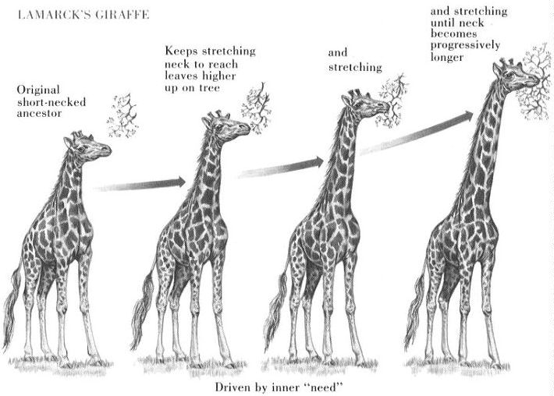

Slide 8
13.1 A sea voyage helped Darwin frame his theory of evolution
0
  During his voyage, Darwin
    collected thousands of plants and animals and
    noted their characteristics that made them well suited to diverse environments.
© 2012 Pearson Education, Inc.
Notes:
8
Student Misconceptions and Concerns
1. Students often think that Charles Darwin was the first to suggest that life evolves: the early contributions by Greek philosophers such as Anaximander and the work of Jean Baptiste de Lamarck are unappreciated. Consider emphasizing these earlier contributions.
2. Students often misunderstand the basic process of evolution and instead express a Lamarckian point of view. Organisms do not evolve structures because of want or need. Instead, evolution is a passive process in which the environment favors certain traits that exist within a population. Adaptations evolve in populations. Organisms do not actively or willingly evolve.
Teaching Tips
1. Consider beginning your unit on evolution by asking each student to explain how a particular adaptation evolved. The evolution of flight in birds is a good example. Reviewing these student explanations can provide great insight into the misconceptions that students may bring to the class.
2. Many resources related to Charles Darwin are available on the Internet. The following are only a few examples:
www.ucmp.berkeley.edu/history/evolution.html and www.natcenscied.org are extensive sites rich with details and references.
www.literature.org/authors/darwin-charles/ includes the texts of The Voyage of the Beagle, The Origin of Species first and sixth editions, and The Descent of Man.
http://williamcalvin.com/bookshelf/down_hse.htm includes details of Charles Darwin’s home.
www.talkorigins.org is an extensive usenet newsgroup devoted to the discussion and debate of biological and physical origins.

Slide 9
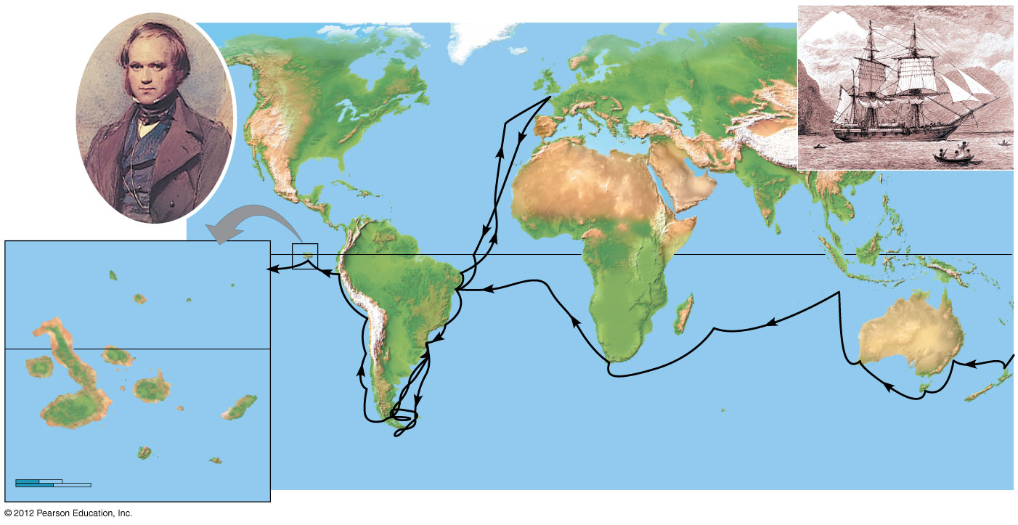
Figure 13.1C
Darwin in 1840
HMS Beagle in port
Great
Britain
Europe
Asia
North
America
ATLANTIC
OCEAN
Africa
PACIFIC
OCEAN
PACIFIC
OCEAN
Galápagos
Islands
Equator
Pinta
South
America
Marchena
Genovesa
Santiago
Equator
Andes
Australia
Daphne Islands
Cape of
Good Hope
Fernandina
Pinzón
PACIFIC
OCEAN
Isabela
Santa
Cruz
Santa
Fe
Cape Horn
Tasmania
San
Cristobal
Tierra del Fuego
New
Zealand
0
40 km
Florenza
Española
0
40 miles
Notes:
9
Figure 13.1C The voyage of the Beagle (1831–1836)

Slide 10
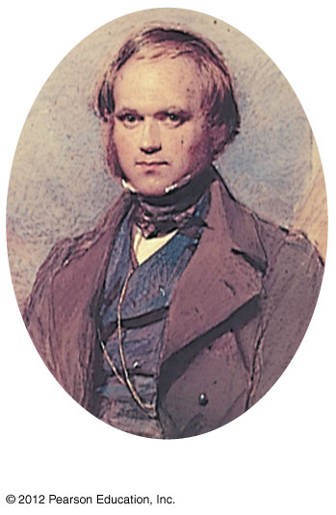
Figure 13.1C_3
Darwin in 1840
Notes:
10
Figure 13.1C_3 The voyage of the Beagle (1831–1836) (part 3)

Slide 11
Observations that lead Darwin to that conclusion.
Species tend to produce excessive numbers of offspring.
- What problems does this create?
Population may grow faster than rate of food production.
This leads to struggle for existence.

Slide 12
Observations continued
Individuals vary in characteristics and many of these traits are inherited. (genetics)
Individuals whose characteristics adapt them best to environment will survive and reproduce.
This is called Natural Selection-descent with modification

Slide 13
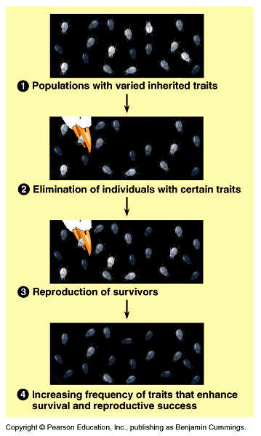

Slide 14
13.2 Darwin proposed natural selection as the mechanism of evolution
0
    Darwin devoted much of The Origin of Species to exploring adaptations of organisms to their environment.
    Darwin discussed many examples of artificial selection, in which humans have modified species through selection and breeding.
© 2012 Pearson Education, Inc.
Notes:
14
Student Misconceptions and Concerns
1. Students often think of evolution as a process that improves. As the text notes, an adaptation in one context might be a handicap in another context. Reptiles are not “better” animals than fish. Neither could survive long in the other’s environment. Instead, the adaptations found in reptiles allow them to survive in a terrestrial environment, as those of fish allow them to survive in an aquatic one.
2. Students often misunderstand the basic process of evolution and instead express a Lamarckian point of view. Organisms do not evolve structures because of want or need. Instead, evolution is a passive process in which the environment favors certain traits that exist within a population. Adaptations evolve in populations. Organisms do not actively or willingly evolve.
Teaching Tips
Students may be asked to consider this question: Can individuals evolve? Sometimes such simple questions require complex answers. Might Lamarck have answered this question differently from Darwin? Module 13.2 addresses this question.

Slide 15

Figure 13.2
Cabbage
Lateral
buds
Terminal bud
Flowers
and stems
Brussels sprouts
Broccoli
Stem
Leaves
Kale
Kohlrabi
Wild mustard
Notes:
15
Figure 13.2 Artificial selection: different vegetables produced as humans have selected for variations in different parts of the wild mustard plant

Slide 16
13.2 Darwin proposed natural selection as the mechanism of evolution
0
    There are three key points about evolution by natural selection that clarify this process.
      Individuals do not evolve: populations evolve.
      Natural selection can increase or decrease only heritable traits. Acquired characteristics cannot be passed on to offspring.
      Evolution is not goal directed and does not lead to perfection. Favorable traits vary as environments change.
© 2012 Pearson Education, Inc.
Notes:
16
Student Misconceptions and Concerns
1. Students often think of evolution as a process that improves. As the text notes, an adaptation in one context might be a handicap in another context. Reptiles are not “better” animals than fish. Neither could survive long in the other’s environment. Instead, the adaptations found in reptiles allow them to survive in a terrestrial environment, as those of fish allow them to survive in an aquatic one.
2. Students often misunderstand the basic process of evolution and instead express a Lamarckian point of view. Organisms do not evolve structures because of want or need. Instead, evolution is a passive process in which the environment favors certain traits that exist within a population. Adaptations evolve in populations. Organisms do not actively or willingly evolve.
Teaching Tips
Students may be asked to consider this question: Can individuals evolve? Sometimes such simple questions require complex answers. Might Lamarck have answered this question differently from Darwin? Module 13.2 addresses this question.

Slide 17
13.3 Scientists can observe natural selection in action
0
    Camouflage adaptations in insects that evolved in different environments are examples of the results of natural selection.
© 2012 Pearson Education, Inc.
Notes:
17
Student Misconceptions and Concerns
1. Students often think of evolution as a process that improves. As the text notes, an adaptation in one context might be a handicap in another context. Reptiles are not “better” animals than fish. Neither could survive long in the other’s environment. Instead, the adaptations found in reptiles allow them to survive in a terrestrial environment, as those of fish allow them to survive in an aquatic one.
2. Students must understand that the environment does the selecting (editing) in natural selection. Species do not evolve because of need. Biological diversity exists, and the environment selects. Evolution is not deliberate, it is reactive. As teachers, we must be careful in how we express evolution to best reflect this process. For example, the statement “Birds evolved wings” may make it sound as if birds did something deliberately. “Wings evolved in birds” is more accurate, in that something happened to birds through a process. This use of the passive voice in our descriptions of evolution better reflects the nature of evolution.
3. Students often misunderstand the basic process of evolution and instead express a Lamarckian point of view. Organisms do not evolve structures because of want or need. Instead, evolution is a passive process in which the environment favors certain traits that exist within a population. Adaptations evolve in populations. Organisms do not actively or willingly evolve.
Teaching Tips
An analogy can be made between the specialized functions of finch beaks and the many types of screwdrivers (or pliers) that exist today. Each type of screwdriver (Phillips, flathead, hex, etc.) represents a specialization for a particular job.

Slide 18
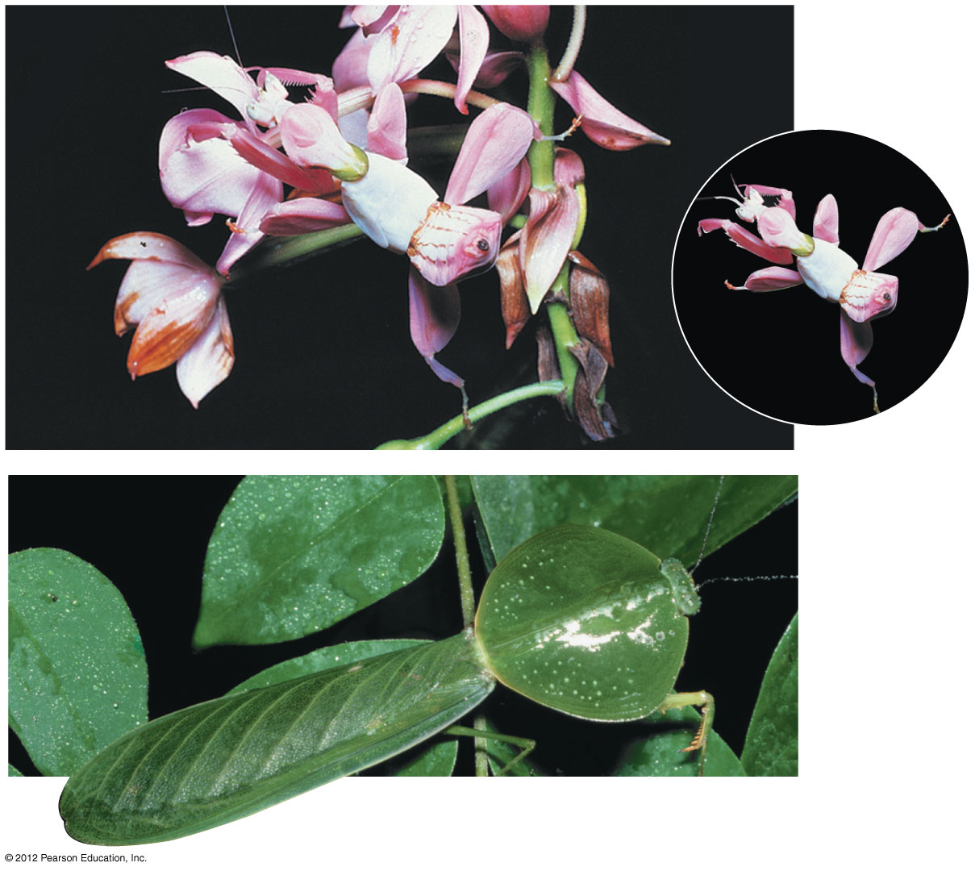
Figure 13.3A
A flower
mantid in
Malaysia
A leaf mantid in Costa Rica
Notes:
18
Figure 13.3A Camouflage as an example of evolutionary adaptation

Slide 19
13.3 Scientists can observe natural selection in action
0
    Biologists have documented natural selection in action in thousands of scientific studies.
    Rosemary and Peter Grant have worked on Darwin’s finches in the Galápagos for over 30 years. They found that
      in wet years, small seeds are more abundant and small beaks are favored, but
      in dry years, large strong beaks are favored because all seeds are in short supply and birds must eat more larger seeds.
© 2012 Pearson Education, Inc.
Notes:
19
Student Misconceptions and Concerns
1. Students often think of evolution as a process that improves. As the text notes, an adaptation in one context might be a handicap in another context. Reptiles are not “better” animals than fish. Neither could survive long in the other’s environment. Instead, the adaptations found in reptiles allow them to survive in a terrestrial environment, as those of fish allow them to survive in an aquatic one.
2. Students must understand that the environment does the selecting (editing) in natural selection. Species do not evolve because of need. Biological diversity exists, and the environment selects. Evolution is not deliberate, it is reactive. As teachers, we must be careful in how we express evolution to best reflect this process. For example, the statement “Birds evolved wings” may make it sound as if birds did something deliberately. “Wings evolved in birds” is more accurate, in that something happened to birds through a process. This use of the passive voice in our descriptions of evolution better reflects the nature of evolution.
3. Students often misunderstand the basic process of evolution and instead express a Lamarckian point of view. Organisms do not evolve structures because of want or need. Instead, evolution is a passive process in which the environment favors certain traits that exist within a population. Adaptations evolve in populations. Organisms do not actively or willingly evolve.
Teaching Tips
An analogy can be made between the specialized functions of finch beaks and the many types of screwdrivers (or pliers) that exist today. Each type of screwdriver (Phillips, flathead, hex, etc.) represents a specialization for a particular job.

Slide 20
13.3 Scientists can observe natural selection in action
0
    Another example of natural selection in action is the evolution of pesticide resistance in insects.
      A relatively small amount of a new pesticide may kill 99% of the insect pests, but subsequent sprayings are less effective.
      Those insects that initially survived were fortunate enough to carry alleles that somehow enable them to resist the pesticide.
      When these resistant insects reproduce, the percentage of the population resistant to the pesticide increases.
© 2012 Pearson Education, Inc.
Notes:
20
Student Misconceptions and Concerns
1. Students often think of evolution as a process that improves. As the text notes, an adaptation in one context might be a handicap in another context. Reptiles are not “better” animals than fish. Neither could survive long in the other’s environment. Instead, the adaptations found in reptiles allow them to survive in a terrestrial environment, as those of fish allow them to survive in an aquatic one.
2. Students must understand that the environment does the selecting (editing) in natural selection. Species do not evolve because of need. Biological diversity exists, and the environment selects. Evolution is not deliberate, it is reactive. As teachers, we must be careful in how we express evolution to best reflect this process. For example, the statement “Birds evolved wings” may make it sound as if birds did something deliberately. “Wings evolved in birds” is more accurate, in that something happened to birds through a process. This use of the passive voice in our descriptions of evolution better reflects the nature of evolution.
3. Students often misunderstand the basic process of evolution and instead express a Lamarckian point of view. Organisms do not evolve structures because of want or need. Instead, evolution is a passive process in which the environment favors certain traits that exist within a population. Adaptations evolve in populations. Organisms do not actively or willingly evolve.
Teaching Tips
An analogy can be made between the specialized functions of finch beaks and the many types of screwdrivers (or pliers) that exist today. Each type of screwdriver (Phillips, flathead, hex, etc.) represents a specialization for a particular job.

Slide 21
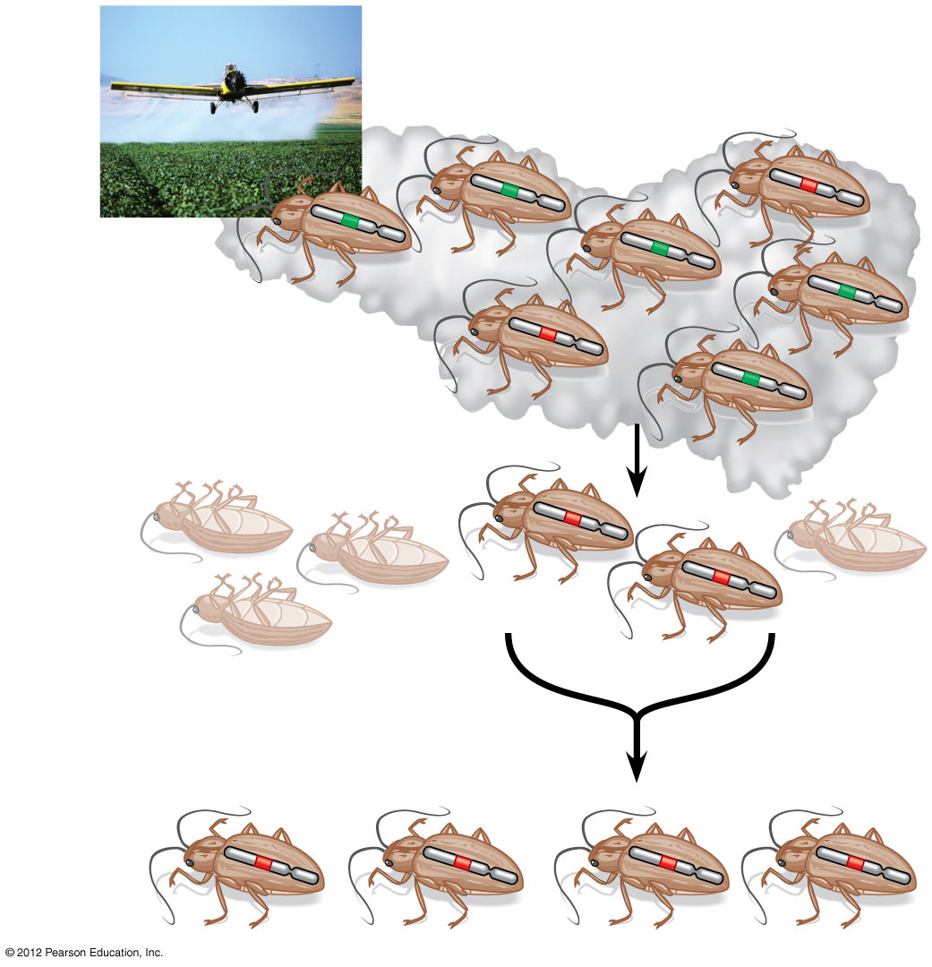
Figure 13.3B
Pesticide
application
Chromosome with
allele conferring
resistance to pesticide
Additional applications of the
same pesticide will be less effective,
and the frequency of resistant
insects in the population will grow.
Survivors
Notes:
21
Figure 13.3B Evolution of pesticide resistance in an insect population

Slide 22
13.3 Scientists can observe natural selection in action
0
    These examples of evolutionary adaptation highlight two important points about natural selection.
      Natural selection is more of an editing process than a creative mechanism.
      Natural selection is contingent on time and place, favoring those characteristics in a population that fit the current, local environment.
© 2012 Pearson Education, Inc.
Notes:
22
Student Misconceptions and Concerns
1. Students often think of evolution as a process that improves. As the text notes, an adaptation in one context might be a handicap in another context. Reptiles are not “better” animals than fish. Neither could survive long in the other’s environment. Instead, the adaptations found in reptiles allow them to survive in a terrestrial environment, as those of fish allow them to survive in an aquatic one.
2. Students must understand that the environment does the selecting (editing) in natural selection. Species do not evolve because of need. Biological diversity exists, and the environment selects. Evolution is not deliberate, it is reactive. As teachers, we must be careful in how we express evolution to best reflect this process. For example, the statement “Birds evolved wings” may make it sound as if birds did something deliberately. “Wings evolved in birds” is more accurate, in that something happened to birds through a process. This use of the passive voice in our descriptions of evolution better reflects the nature of evolution.
3. Students often misunderstand the basic process of evolution and instead express a Lamarckian point of view. Organisms do not evolve structures because of want or need. Instead, evolution is a passive process in which the environment favors certain traits that exist within a population. Adaptations evolve in populations. Organisms do not actively or willingly evolve.
Teaching Tips
An analogy can be made between the specialized functions of finch beaks and the many types of screwdrivers (or pliers) that exist today. Each type of screwdriver (Phillips, flathead, hex, etc.) represents a specialization for a particular job.

Slide 23
13.4 The study of fossils provides strong evidence for evolution
0
    Darwin’s ideas about evolution also relied on the fossil record, the sequence in which fossils appear within strata (layers) of sedimentary rocks.
    Paleontologists, scientists who study fossils, have found many types of fossils.
© 2012 Pearson Education, Inc.
Notes:
23
Student Misconceptions and Concerns
1. Students might expect that every living organism will leave fossils and that we should be able to find them. Furthermore, they might falsely conclude that the absence of evidence is evidence of absence. Understanding the rare circumstances under which fossils form (the scientific study of fossil formation is referred to as taphonomy), the geological processes that distort and destroy layers (for example, earthquakes and glaciers), and the long odds against the discovery of fossils helps students understand why the fossil record is limited.
2. Students who struggle with the concept of evolution may also bring personal objections to the classroom. Modules 13.4 and 13.5, on the evidence of evolution, permits a demonstration of the scientific method, in which confidence in our conclusions increases based on multiple, independent lines of evidence. Science requires evidence and cannot rely upon faith or supernatural explanations.
3. Students often misunderstand the basic process of evolution and instead express a Lamarckian point of view. Organisms do not evolve structures because of want or need. Instead, evolution is a passive process in which the environment favors certain traits that exist within a population. Adaptations evolve in populations. Organisms do not actively or willingly evolve.
Teaching Tips
1. Beginning college students are likely to have scant or uneven knowledge of the subject of fossils. Describe several of the ways that a fossil’s age can be determined (for example, radiometric dating, association with other fossils of known age in the same layer, correlation to other strata of known ages). These methods demonstrate the importance of independent lines of evidence and consistency.
2. Any sort of a fossil makes a nice visual aid. Of course, the larger the fossil, the better. Many shops in natural history museums carry large and common fossils that can be purchased for less than $50.00. Crinoid stems from the Midwest or marine shells from Montana can make the point that life and ecosystems change over time.
3. The sequence, but not the absolute age, of layers is revealed by the stratifications in sedimentary rocks. This is like peeling the layers of wallpaper from the walls of a very old house that has been inhabited by many owners. By the sequence, we can tell which layers are older, but not the absolute ages of each layer.

Slide 24
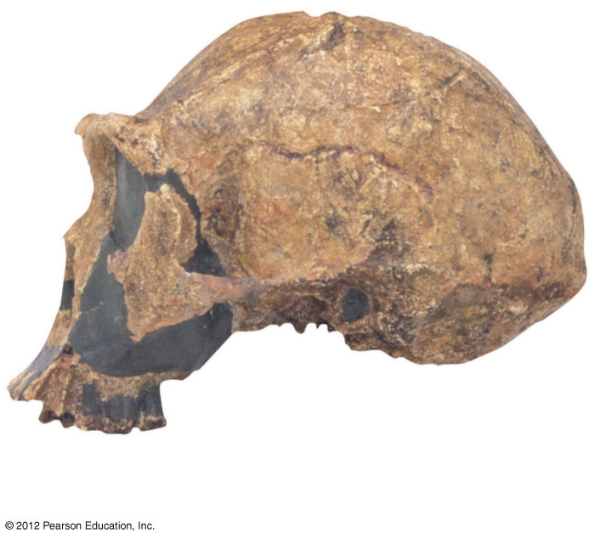
Figure 13.4A
Skull of
Homo erectus
Notes:
24
Figure 13.4A A gallery of fossils: skull of Homo erectus

Slide 25
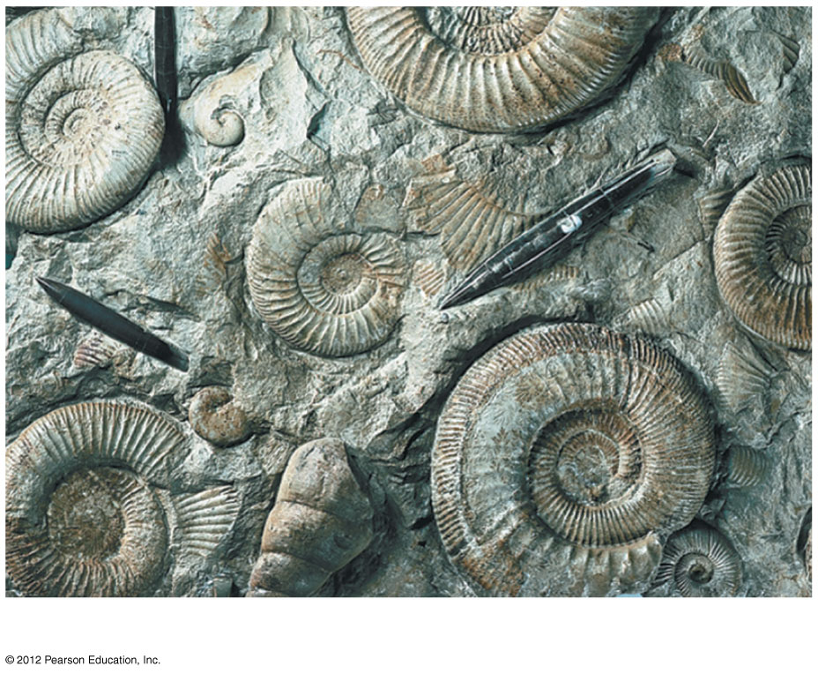
Figure 13.4B
Ammonite casts
Notes:
25
Figure 13.4B A gallery of fossils: ammonite casts

Slide 26
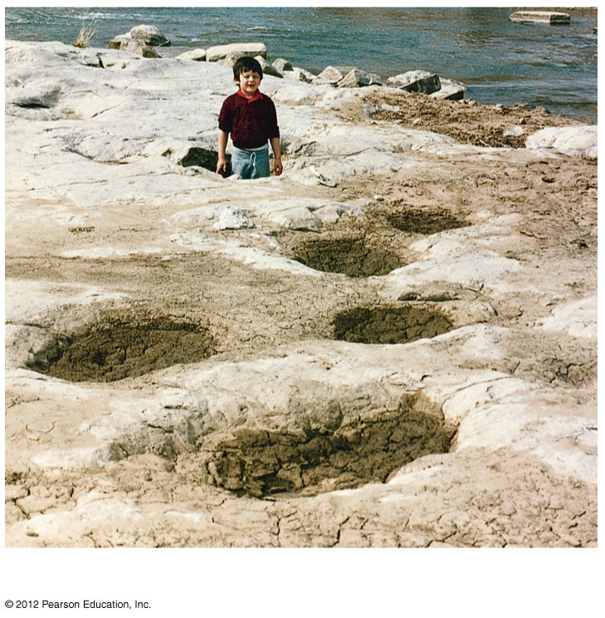
Figure 13.4C
Dinosaur tracks
Notes:
26
Figure 13.4C A gallery of fossils: dinosaur tracks

Slide 27
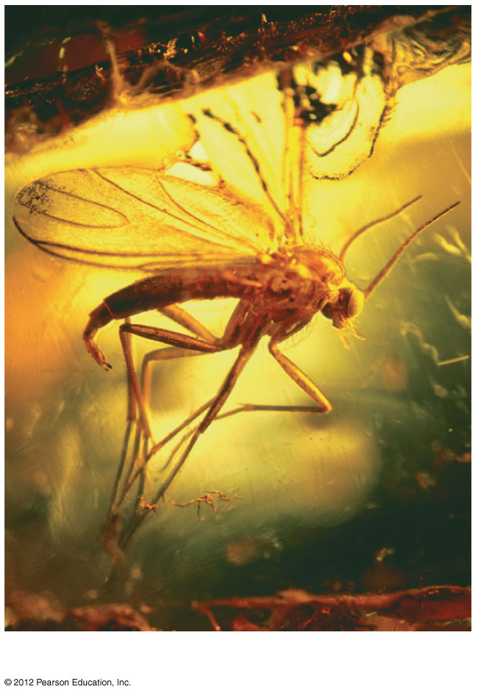
Figure 13.4E
Insect in amber
Notes:
27
Figure 13.4E A gallery of fossils: insect in amber

Slide 28
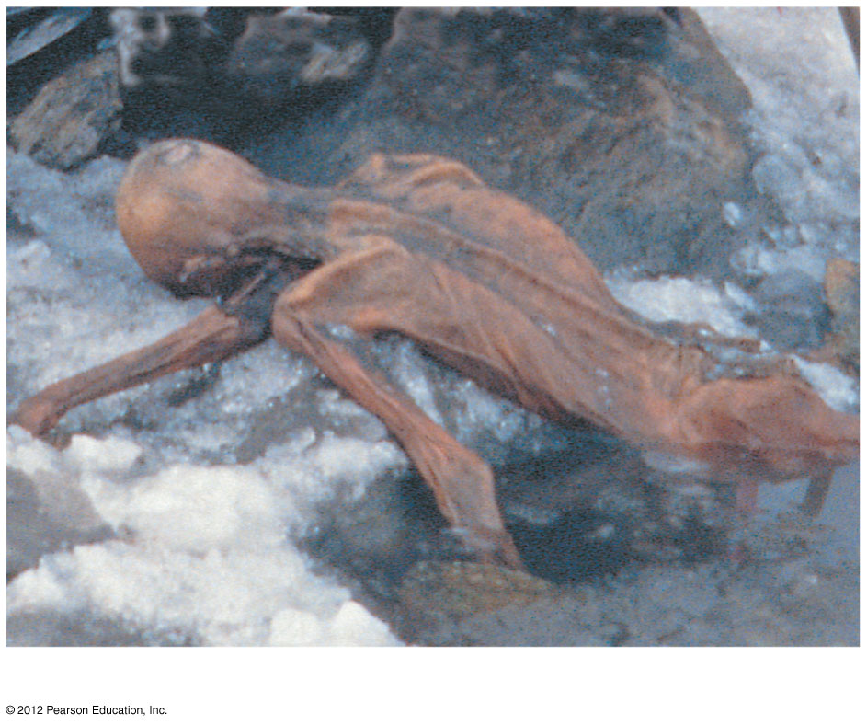
Figure 13.4F
“Ice Man”
Notes:
28
Figure 13. 4F A gallery of fossils: “Ice Man”

Slide 29
13.4 The study of fossils provides strong evidence for evolution
0
    The fossil record shows that organisms have evolved in a historical sequence.
      The oldest known fossils, extending back about 3.5 billion years ago, are prokaryotes.
      The oldest eukaryotic fossils are about a billion years younger.
      Another billion years passed before we find fossils of multicellular eukaryotic life.
© 2012 Pearson Education, Inc.
Notes:
29
Student Misconceptions and Concerns
1. Students might expect that every living organism will leave fossils and that we should be able to find them. Furthermore, they might falsely conclude that the absence of evidence is evidence of absence. Understanding the rare circumstances under which fossils form (the scientific study of fossil formation is referred to as taphonomy), the geological processes that distort and destroy layers (for example, earthquakes and glaciers), and the long odds against the discovery of fossils helps students understand why the fossil record is limited.
2. Students who struggle with the concept of evolution may also bring personal objections to the classroom. Modules 13.4 and 13.5, on the evidence of evolution, permits a demonstration of the scientific method, in which confidence in our conclusions increases based on multiple, independent lines of evidence. Science requires evidence and cannot rely upon faith or supernatural explanations.
3. Students often misunderstand the basic process of evolution and instead express a Lamarckian point of view. Organisms do not evolve structures because of want or need. Instead, evolution is a passive process in which the environment favors certain traits that exist within a population. Adaptations evolve in populations. Organisms do not actively or willingly evolve.
Teaching Tips
1. Beginning college students are likely to have scant or uneven knowledge of the subject of fossils. Describe several of the ways that a fossil’s age can be determined (for example, radiometric dating, association with other fossils of known age in the same layer, correlation to other strata of known ages). These methods demonstrate the importance of independent lines of evidence and consistency.
2. Any sort of a fossil makes a nice visual aid. Of course, the larger the fossil, the better. Many shops in natural history museums carry large and common fossils that can be purchased for less than $50.00. Crinoid stems from the Midwest or marine shells from Montana can make the point that life and ecosystems change over time.
3. The sequence, but not the absolute age, of layers is revealed by the stratifications in sedimentary rocks. This is like peeling the layers of wallpaper from the walls of a very old house that has been inhabited by many owners. By the sequence, we can tell which layers are older, but not the absolute ages of each layer.

Slide 30
Carbon 14 (¹⁴C) dating
Two types of C in living things - ¹⁴C & ¹²C. The ratio between the 2 is calculated.
Same two types in atmosphere. Therefore a ratio can also be calculated for atmospheric C. This ratio is the same in the atmosphere as it is in living things.
Once an organism dies the ¹⁴C starts to decay and the ratio changes.
This ratio is then compared to the atmospheres ratio.
The rate of decay is: ½ of ¹⁴C decays in 5,730 years. This is called it’s half life.
This will tell a scientist how old the fossil is.

Slide 31

Figure 13.4G
Notes:
31
Figure 13.4G Strata of sedimentary rock at the Grand Canyon

Slide 32
13.5 Many types of scientific evidence support the evolutionary view of life
0
  Biogeography, the geographic distribution of species, suggested to Darwin that organisms evolve from common ancestors.
  Darwin noted that Galápagos animals resembled species on the South American mainland more than they resembled animals on islands that were similar but much more distant.
© 2012 Pearson Education, Inc.
Notes:
32
Student Misconceptions and Concerns
1. Students who struggle with the concept of evolution may also bring personal objections to the classroom. Modules 13.4 and 13.5, on the evidence of evolution, permit a demonstration of the scientific method, in which confidence in our conclusions increases based on multiple, independent lines of evidence. Science requires evidence and cannot rely upon faith or supernatural explanations.
2. Students often misunderstand the basic process of evolution and instead express a Lamarckian point of view. Organisms do not evolve structures because of want or need. Instead, evolution is a passive process in which the environment favors certain traits that exist within a population. Adaptations evolve in populations. Organisms do not actively or willingly evolve.
Teaching Tips
1. Another popular example of biogeography is the distribution of lungfish in Australia, southern South America, and southern Africa. At one time, these three continents were united as Gondwana.
2. One striking example of evolutionary remodeling is the shell of turtles, which is primarily made from modified ribs and vertebrae. If you find an old turtle shell and soak it in water, the shell may fall apart, leaving isolated ribs and vertebrae that make interesting visual aids.
3. You can have some fun with this analogy to molecular evidence for evolution. As teachers, we have to be keenly aware of cheating. Certainly, if two students turned in written assignments that differed by just a few words, we would conclude that they had a “common heritage” or that one was derived from the other.

Slide 33
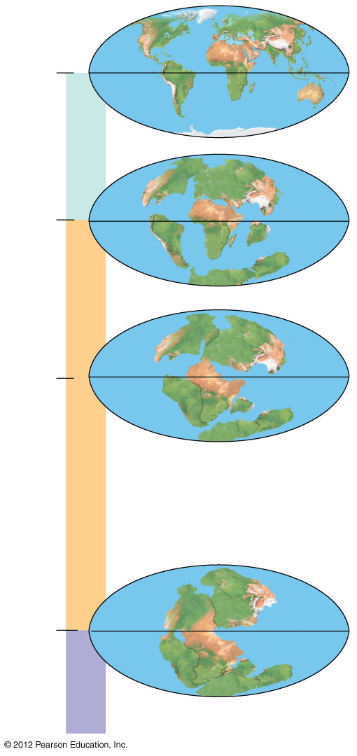
Figure 15.7C
Present
4
Cenozoic
North America
Eurasia
65.5
3
Africa
South
America
India
Madagascar
Australia
Antarctica
Laurasia
Millions of years ago
135
2
Gondwana
Mesozoic
Pangaea
251
1
Paleozoic
Notes:
33
Figure 15.7C Continental drift during the Phanerozoic eon

Slide 34
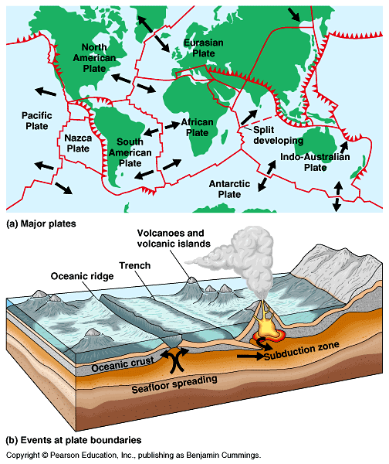

Slide 35
13.5 Many types of scientific evidence support the evolutionary view of life
0
  Comparative anatomy
    is the comparison of body structures in different species,
    was extensively cited by Darwin, and
    illustrates that evolution is a remodeling process.
    Homology is the similarity in characteristics that result from common ancestry.
    Homologous structures have different functions but are structurally similar because of common ancestry.
© 2012 Pearson Education, Inc.
Notes:
35
Student Misconceptions and Concerns
1. Students who struggle with the concept of evolution may also bring personal objections to the classroom. Modules 13.4 and 13.5, on the evidence of evolution, permit a demonstration of the scientific method, in which confidence in our conclusions increases based on multiple, independent lines of evidence. Science requires evidence and cannot rely upon faith or supernatural explanations.
2. Students often misunderstand the basic process of evolution and instead express a Lamarckian point of view. Organisms do not evolve structures because of want or need. Instead, evolution is a passive process in which the environment favors certain traits that exist within a population. Adaptations evolve in populations. Organisms do not actively or willingly evolve.
Teaching Tips
1. Another popular example of biogeography is the distribution of lungfish in Australia, southern South America, and southern Africa. At one time, these three continents were united as Gondwana.
2. One striking example of evolutionary remodeling is the shell of turtles, which is primarily made from modified ribs and vertebrae. If you find an old turtle shell and soak it in water, the shell may fall apart, leaving isolated ribs and vertebrae that make interesting visual aids.
3. You can have some fun with this analogy to molecular evidence for evolution. As teachers, we have to be keenly aware of cheating. Certainly, if two students turned in written assignments that differed by just a few words, we would conclude that they had a “common heritage” or that one was derived from the other.

Slide 36
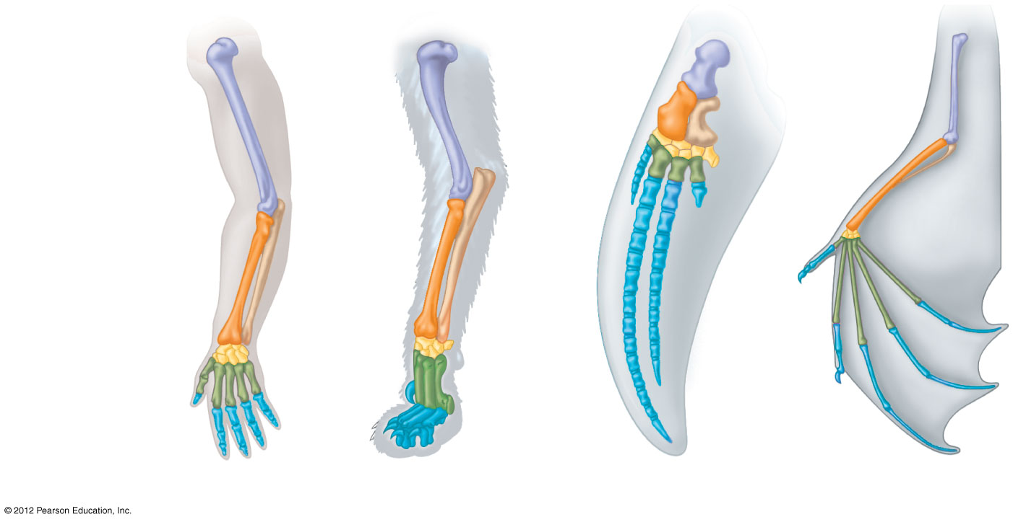
Figure 13.5A
Humerus
Radius
Ulna
Carpals
Metacarpals
Phalanges
Human
Cat
Whale
Bat
Notes:
36
Figure 13.5A Homologous structures: vertebrate forelimbs

Slide 37
13.5 Many types of scientific evidence support the evolutionary view of life
0
  Comparative embryology
    is the comparison of early stages of development among different organisms and
    reveals homologies not visible in adult organisms.
    For example, all vertebrate embryos have, at some point in their development,
      a tail posterior to the anus and
      pharyngeal throat pouches.
    Vestigial structures are remnants of features that served important functions in an organism’s ancestors.
© 2012 Pearson Education, Inc.
Notes:
37
Student Misconceptions and Concerns
1. Students who struggle with the concept of evolution may also bring personal objections to the classroom. Modules 13.4 and 13.5, on the evidence of evolution, permit a demonstration of the scientific method, in which confidence in our conclusions increases based on multiple, independent lines of evidence. Science requires evidence and cannot rely upon faith or supernatural explanations.
2. Students often misunderstand the basic process of evolution and instead express a Lamarckian point of view. Organisms do not evolve structures because of want or need. Instead, evolution is a passive process in which the environment favors certain traits that exist within a population. Adaptations evolve in populations. Organisms do not actively or willingly evolve.
Teaching Tips
1. Another popular example of biogeography is the distribution of lungfish in Australia, southern South America, and southern Africa. At one time, these three continents were united as Gondwana.
2. One striking example of evolutionary remodeling is the shell of turtles, which is primarily made from modified ribs and vertebrae. If you find an old turtle shell and soak it in water, the shell may fall apart, leaving isolated ribs and vertebrae that make interesting visual aids.
3. You can have some fun with this analogy to molecular evidence for evolution. As teachers, we have to be keenly aware of cheating. Certainly, if two students turned in written assignments that differed by just a few words, we would conclude that they had a “common heritage” or that one was derived from the other.

Slide 38
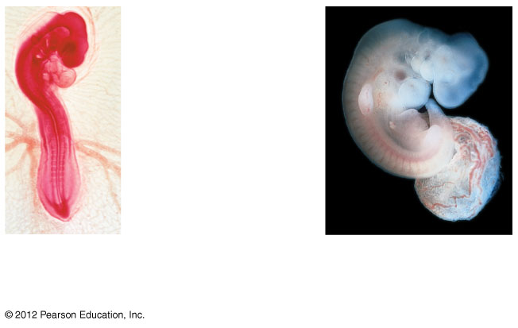
Figure 13.5B
Comparative embryology
Pharyngeal
pouches
Post-anal
tail
Chick
embryo
Human
embryo
Notes:
38
Figure 13.5B Homologous structures in vertebrate embryos

Slide 39
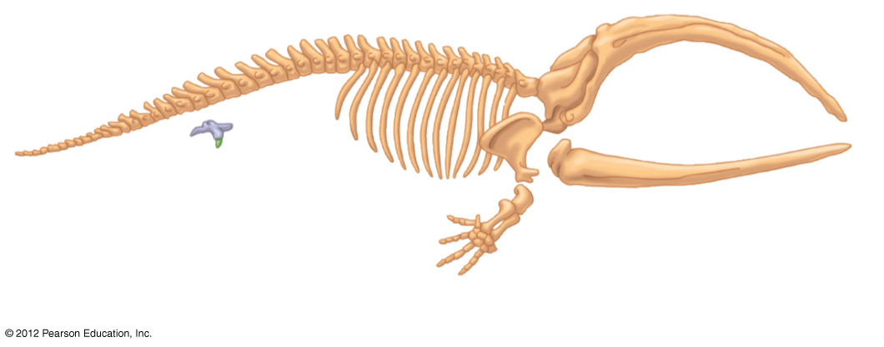
Figure 13.4H_2
Vestigial structures / organs
Pelvis and
hind limb
Balaena (recent whale ancestor)
Notes:
39
Figure 13.4H_2 A transition to life in the sea: fossils of four species that link whales with their land-dwelling ancestors (part 2)

Slide 40
13.5 Many types of scientific evidence support the evolutionary view of life
0
      Advances in molecular biology reveal evolutionary relationships by comparing DNA and amino acid sequences between different organisms. These studies indicate that
        all life-forms are related,
        all life shares a common DNA code for the proteins found in living cells, and
        humans and bacteria share homologous genes that have been inherited from a very distant common ancestor.
© 2012 Pearson Education, Inc.
Notes:
40
Student Misconceptions and Concerns
1. Students who struggle with the concept of evolution may also bring personal objections to the classroom. Modules 13.4 and 13.5, on the evidence of evolution, permit a demonstration of the scientific method, in which confidence in our conclusions increases based on multiple, independent lines of evidence. Science requires evidence and cannot rely upon faith or supernatural explanations.
2. Students often misunderstand the basic process of evolution and instead express a Lamarckian point of view. Organisms do not evolve structures because of want or need. Instead, evolution is a passive process in which the environment favors certain traits that exist within a population. Adaptations evolve in populations. Organisms do not actively or willingly evolve.
Teaching Tips
1. Another popular example of biogeography is the distribution of lungfish in Australia, southern South America, and southern Africa. At one time, these three continents were united as Gondwana.
2. One striking example of evolutionary remodeling is the shell of turtles, which is primarily made from modified ribs and vertebrae. If you find an old turtle shell and soak it in water, the shell may fall apart, leaving isolated ribs and vertebrae that make interesting visual aids.
3. You can have some fun with this analogy to molecular evidence for evolution. As teachers, we have to be keenly aware of cheating. Certainly, if two students turned in written assignments that differed by just a few words, we would conclude that they had a “common heritage” or that one was derived from the other.

Slide 41
13.6 Homologies indicate patterns of descent that can be shown on an evolutionary tree
0
      Darwin was the first to represent the history of life as a tree,
        with multiple branchings from a common ancestral trunk
        to the descendant species at the tips of the twigs.
      Today, biologists
        represent these patterns of descent with an evolutionary tree, but
        often turn the trees sideways.
© 2012 Pearson Education, Inc.
Notes:
41
Student Misconceptions and Concerns
1. Students might become confused by some scientific debates. Evolution can be considered on three levels, sometimes referred to as (a) fact, (b) course, and (c) mechanism: (a) Does evolution occur? (b) Who gave rise to whom? and (c) Is natural selection the only mechanism of evolution that produces adaptations? Students who listen to scientific debates about the course of evolution might think that evolution itself is under attack. Doubts about ancestry can be misconstrued as doubts about evolution itself. Make sure students understand these distinctions.
2. Students often misunderstand the basic process of evolution and instead express a Lamarckian point of view. Organisms do not evolve structures because of want or need. Instead, evolution is a passive process in which the environment favors certain traits that exist within a population. Adaptations evolve in populations. Organisms do not actively or willingly evolve.
Teaching Tips
Students often fail to fully understand all of the information and meaning communicated in cladograms. Consider spending extra time to help students understand how shared traits imply an evolutionary sequence.

Slide 42
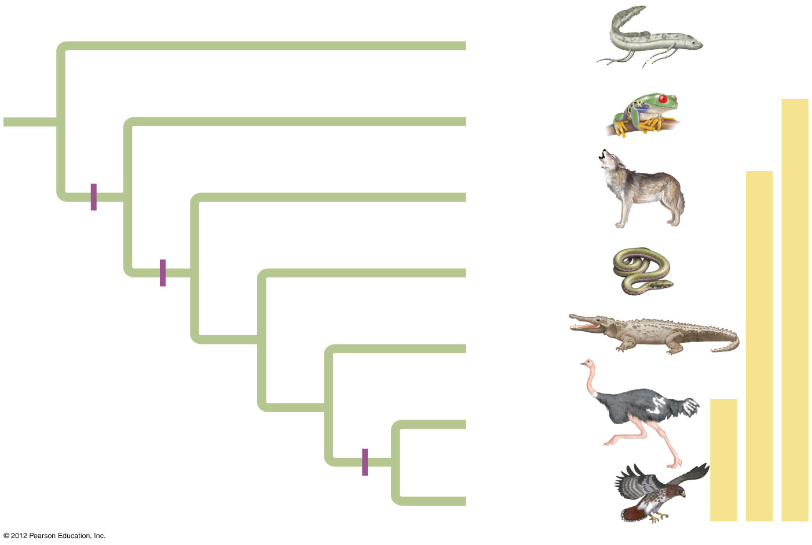
Figure 13.6
Lungfishes
1
Amphibians
Tetrapods
2
Mammals
Tetrapod
limbs
Amniotes
3
Lizards
and snakes
Amnion
4
Crocodiles
5
Ostriches
Birds
6
Feathers
Hawks and
other birds
Notes:
42
Figure 13.6 An evolutionary tree for tetrapods and their closest living relatives, the lungfishes

Slide 43
  THE EVOLUTION OF POPULATIONS
© 2012 Pearson Education, Inc.
Notes:
43

Slide 44
13.7 Evolution occurs within populations
0
    A population is
      a group of individuals of the same species and
      living in the same place at the same time.
    Populations may be isolated from one another (with little interbreeding).
    Individuals within populations may interbreed.
    We can measure evolution as a change in heritable traits in a population over generations.
© 2012 Pearson Education, Inc.
Notes:
44
Student Misconceptions and Concerns
1. Students often suggest that individuals evolve. As this module clarifies, populations are the smallest units that can evolve. Individuals do not have genetic diversity from which to select. However, individuals can change during their lifetime in response to the environment. Muscles can grow larger through use. But these individual changes are not passed on to the next generation (after all, boys have been circumcised for thousands of years, but are still born with a foreskin).
2. Another misperception is that evolution results from need. Challenge your students to explain how need and want cannot drive evolution (because neither need nor want can generate genetic variation!).
3. Challenge your students to explain how extinction is predicted by an understanding of natural selection. (Genetic diversity is generated by random processes, but the variety generated may not be sufficient for the survival of a population or species, leading to its extinction.)
Teaching Tips
Try to find good local examples of populations. If you are near a seashore, the many invertebrate populations (starfish, sea urchin, and kelp) might be ideal. Further inland, you might find somewhat isolated populations of fish and continuous and clumped populations of squirrels, separated by vast fields of corn, wheat, or soybeans! Bring the subject home with local examples.

Slide 45
13.7 Evolution occurs within populations
0
    A gene pool is the total collection of genes in a population at any one time.
    Microevolution is a change in the relative frequencies of alleles in a gene pool over time.
© 2012 Pearson Education, Inc.
Notes:
45
Student Misconceptions and Concerns
1. Students often suggest that individuals evolve. As this module clarifies, populations are the smallest units that can evolve. Individuals do not have genetic diversity from which to select. However, individuals can change during their lifetime in response to the environment. Muscles can grow larger through use. But these individual changes are not passed on to the next generation (after all, boys have been circumcised for thousands of years, but are still born with a foreskin).
2. Another misperception is that evolution results from need. Challenge your students to explain how need and want cannot drive evolution (because neither need nor want can generate genetic variation!).
3. Challenge your students to explain how extinction is predicted by an understanding of natural selection. (Genetic diversity is generated by random processes, but the variety generated may not be sufficient for the survival of a population or species, leading to its extinction.)
Teaching Tips
Try to find good local examples of populations. If you are near a seashore, the many invertebrate populations (starfish, sea urchin, and kelp) might be ideal. Further inland, you might find somewhat isolated populations of fish and continuous and clumped populations of squirrels, separated by vast fields of corn, wheat, or soybeans! Bring the subject home with local examples.

Slide 46
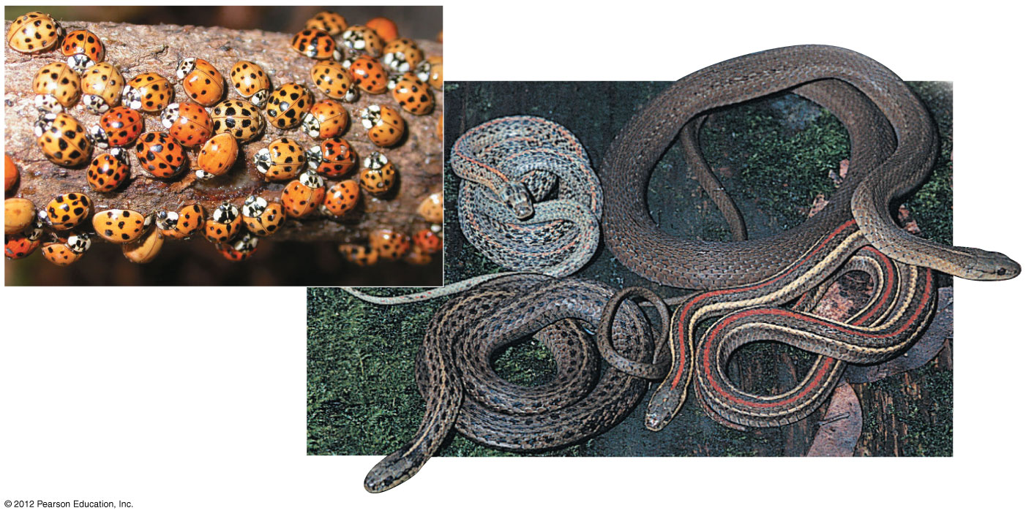
Figure 13.8
Variations within a species
Notes:
46
Figure 13.8 Variation within a species of Asian lady beetles (above) and within a species of garter snakes (right)

Slide 47
13.8 Mutation and sexual reproduction produce the genetic variation that makes evolution possible
0
    Mutations are
      changes in the nucleotide sequence of DNA and
      the ultimate source of new alleles.
© 2012 Pearson Education, Inc.
Notes:
47
Student Misconceptions and Concerns
1. Students may think of mutations in a positive sense, as if they come as needed. Yet, mutations in key genes are the cause of cancer and other diseases. It is rare that a mutation leads to a change that increases the chances for survival. However, these rare events can become significant if given enough time. This is an opportunity to emphasize an important related point: given a long enough span of time, even rare events will occur, and can be expected to do so.
2. Extending the point made directly above, our comprehension of time and what constitutes a rare event are on a different scale than most evolutionary change. Ask your students if they think it would be rare for something to happen one time every one thousand years. Then ask how many times that event will occur in one million years (answer: one thousand times!). What is rare to us may be relatively frequent in geological history.
3. Students often suggest that individuals evolve. As this chapter section clarifies, populations are the smallest units that can evolve. Individuals do not have genetic diversity from which to select. However, individuals can change during their lifetime in response to the environment. Muscles can grow larger through use. But these individual changes are not passed on to the next generation (after all, boys have been circumcised for thousands of years, but are still born with a foreskin).
4. Another misperception is that evolution results from need. Challenge your students to explain how need and want cannot drive evolution (because neither need nor want can generate genetic variation!).
5. Challenge your students to explain how extinction is predicted by an understanding of natural selection. (Genetic diversity is generated by random processes, but the variety generated may not be sufficient for the survival of a population or species, leading to its extinction.)
Teaching Tips
1. A single bacterium can reproduce by fission as quickly as every 20 minutes. Given unlimited resources (a mostly unlikely assumption), after 36 hours, there would be enough bacteria to cover Earth’s surface 1 foot deep. Natural selection is premised on this overpopulation and the expected death of many of the bacteria.
2. It might be interesting to discuss with students whether the Internet would have helped Mendel and Darwin. Is the Internet facilitating scientific communication? Has this technology created new problems in the process?

Slide 48
13.8 Mutation and sexual reproduction produce the genetic variation that makes evolution possible
0
    On rare occasions, mutant alleles improve the adaptation of an individual to its environment.
      This kind of effect is more likely when the environment is changing such that mutations that were once disadvantageous are favorable under new conditions.
      The evolution of DDT-resistant houseflies is such an example.
© 2012 Pearson Education, Inc.
Notes:
48
Student Misconceptions and Concerns
1. Students may think of mutations in a positive sense, as if they come as needed. Yet, mutations in key genes are the cause of cancer and other diseases. It is rare that a mutation leads to a change that increases the chances for survival. However, these rare events can become significant if given enough time. This is an opportunity to emphasize an important related point: given a long enough span of time, even rare events will occur, and can be expected to do so.
2. Extending the point made directly above, our comprehension of time and what constitutes a rare event are on a different scale than most evolutionary change. Ask your students if they think it would be rare for something to happen one time every one thousand years. Then ask how many times that event will occur in one million years (answer: one thousand times!). What is rare to us may be relatively frequent in geological history.
3. Students often suggest that individuals evolve. As this chapter section clarifies, populations are the smallest units that can evolve. Individuals do not have genetic diversity from which to select. However, individuals can change during their lifetime in response to the environment. Muscles can grow larger through use. But these individual changes are not passed on to the next generation (after all, boys have been circumcised for thousands of years, but are still born with a foreskin).
4. Another misperception is that evolution results from need. Challenge your students to explain how need and want cannot drive evolution (because neither need nor want can generate genetic variation!).
5. Challenge your students to explain how extinction is predicted by an understanding of natural selection. (Genetic diversity is generated by random processes, but the variety generated may not be sufficient for the survival of a population or species, leading to its extinction.)
Teaching Tips
1. A single bacterium can reproduce by fission as quickly as every 20 minutes. Given unlimited resources (a mostly unlikely assumption), after 36 hours, there would be enough bacteria to cover Earth’s surface 1 foot deep. Natural selection is premised on this overpopulation and the expected death of many of the bacteria.
2. It might be interesting to discuss with students whether the Internet would have helped Mendel and Darwin. Is the Internet facilitating scientific communication? Has this technology created new problems in the process?

Slide 49
  MECHANISMS
  OF MICROEVOLUTION
© 2012 Pearson Education, Inc.
Notes:
49

Slide 50
13.11 Natural selection, genetic drift, and gene flow can cause microevolution
0
0
  The three main causes of evolutionary change are
    natural selection,
    genetic drift, and
    gene flow.
© 2012 Pearson Education, Inc.
Notes:
50
Student Misconceptions and Concerns
The concept of a genetic bottleneck contributing to a loss of diversity can be difficult for some students to understand. Without an appreciation for population genetics, students might think that a recovery in terms of sheer numbers is all that is needed. Yet the loss of genetic diversity might ultimately doom a population that is later faced with widespread disease.
Teaching Tips
1. To demonstrate the concept of genetic drift, consider a demonstration with several colored beans (different kinds of dried beans are cheap and easy to find in grocery stores). Fill a bottle with ten beans of five different colors. Then remove ten beans as a population sample. It is very likely that the sample will not adequately represent the diversity of the original bean collection. In fact, it is common for not all colors to be represented. As an alternative, draw eight cards out of a shuffled deck of 52 cards. Are all four suits represented? Are they represented equally?
2. Sampling error, a cause of genetic drift, can be difficult for some students to understand, but the following exercise may help. Have students work in pairs to flip a coin ten times. For each pair, list the number of heads on the board as just a long list of numbers (no need to keep track of heads and tails). This can be done quickly, as long as you have been sure to bring enough pennies. Now analyze the results. There should be considerable variation from the expected five. Now determine the average of all the groups and the collective sample size. By pooling the results, and increasing the sample size, the means should be closer to five.
3. The loss of genetic diversity in a population due to bottlenecks is a significant problem in conservation. When a species is reduced to relatively few individuals, and then is brought back to abundance by extraordinary efforts, the species is not fully recovered. The lost genetic diversity may be a prerequisite for the long-term survival of the species. Consider challenging your students to identify modern endangered species not mentioned in the textbook that might suffer from a genetic bottleneck.
4. The following thought exercise might help students understand founder effect “bias.” Ask them to imagine that all the students present in today’s class are the only survivors of some global catastrophe. Would your class adequately represent the biological diversity of the current human population?

Slide 51
13.11 Natural selection, genetic drift, and gene flow can cause microevolution
0
0
0
  2. Genetic drift
    Genetic drift is a change in the gene pool of a population due to chance.
    In a small population, chance events may lead to the loss of genetic diversity.
© 2012 Pearson Education, Inc.
Notes:
51
Student Misconceptions and Concerns
The concept of a genetic bottleneck contributing to a loss of diversity can be difficult for some students to understand. Without an appreciation for population genetics, students might think that a recovery in terms of sheer numbers is all that is needed. Yet the loss of genetic diversity might ultimately doom a population that is later faced with widespread disease.
Teaching Tips
1. To demonstrate the concept of genetic drift, consider a demonstration with several colored beans (different kinds of dried beans are cheap and easy to find in grocery stores). Fill a bottle with ten beans of five different colors. Then remove ten beans as a population sample. It is very likely that the sample will not adequately represent the diversity of the original bean collection. In fact, it is common for not all colors to be represented. As an alternative, draw eight cards out of a shuffled deck of 52 cards. Are all four suits represented? Are they represented equally?
2. Sampling error, a cause of genetic drift, can be difficult for some students to understand, but the following exercise may help. Have students work in pairs to flip a coin ten times. For each pair, list the number of heads on the board as just a long list of numbers (no need to keep track of heads and tails). This can be done quickly, as long as you have been sure to bring enough pennies. Now analyze the results. There should be considerable variation from the expected five. Now determine the average of all the groups and the collective sample size. By pooling the results, and increasing the sample size, the means should be closer to five.
3. The loss of genetic diversity in a population due to bottlenecks is a significant problem in conservation. When a species is reduced to relatively few individuals, and then is brought back to abundance by extraordinary efforts, the species is not fully recovered. The lost genetic diversity may be a prerequisite for the long-term survival of the species. Consider challenging your students to identify modern endangered species not mentioned in the textbook that might suffer from a genetic bottleneck.
4. The following thought exercise might help students understand founder effect “bias.” Ask them to imagine that all the students present in today’s class are the only survivors of some global catastrophe. Would your class adequately represent the biological diversity of the current human population?

Slide 52
13.11 Natural selection, genetic drift, and gene flow can cause microevolution
0
0
0
0
  2. Genetic drift, continued
    The bottleneck effect leads to a loss of genetic diversity when a population is greatly reduced.
      For example, the greater prairie chicken once numbered in the millions, but was reduced to about 50 birds in Illinois by 1993.
      A survey comparing the DNA of the surviving chickens with DNA extracted from museum specimens dating back to the 1930s showed a loss of 30% of the alleles.
© 2012 Pearson Education, Inc.
Notes:
52
Student Misconceptions and Concerns
The concept of a genetic bottleneck contributing to a loss of diversity can be difficult for some students to understand. Without an appreciation for population genetics, students might think that a recovery in terms of sheer numbers is all that is needed. Yet the loss of genetic diversity might ultimately doom a population that is later faced with widespread disease.
Teaching Tips
1. To demonstrate the concept of genetic drift, consider a demonstration with several colored beans (different kinds of dried beans are cheap and easy to find in grocery stores). Fill a bottle with ten beans of five different colors. Then remove ten beans as a population sample. It is very likely that the sample will not adequately represent the diversity of the original bean collection. In fact, it is common for not all colors to be represented. As an alternative, draw eight cards out of a shuffled deck of 52 cards. Are all four suits represented? Are they represented equally?
2. Sampling error, a cause of genetic drift, can be difficult for some students to understand, but the following exercise may help. Have students work in pairs to flip a coin ten times. For each pair, list the number of heads on the board as just a long list of numbers (no need to keep track of heads and tails). This can be done quickly, as long as you have been sure to bring enough pennies. Now analyze the results. There should be considerable variation from the expected five. Now determine the average of all the groups and the collective sample size. By pooling the results, and increasing the sample size, the means should be closer to five.
3. The loss of genetic diversity in a population due to bottlenecks is a significant problem in conservation. When a species is reduced to relatively few individuals, and then is brought back to abundance by extraordinary efforts, the species is not fully recovered. The lost genetic diversity may be a prerequisite for the long-term survival of the species. Consider challenging your students to identify modern endangered species not mentioned in the textbook that might suffer from a genetic bottleneck.
4. The following thought exercise might help students understand founder effect “bias.” Ask them to imagine that all the students present in today’s class are the only survivors of some global catastrophe. Would your class adequately represent the biological diversity of the current human population?

Slide 53

Figure 13.11A_s1
Original
population
Notes:
53
Figure 13.11A_s1 The bottleneck effect (step 1)

Slide 54
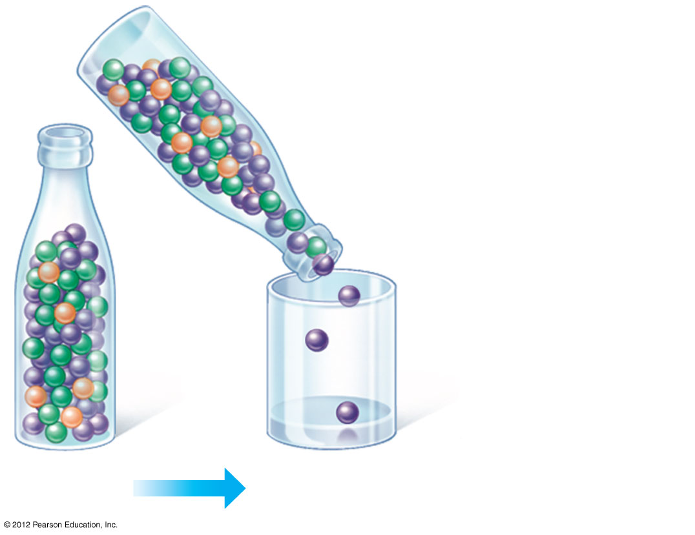
Figure 13.11A_s2
Original
population
Bottlenecking
event
Notes:
54
Figure 13.11A_s2 The bottleneck effect (step 2)

Slide 55
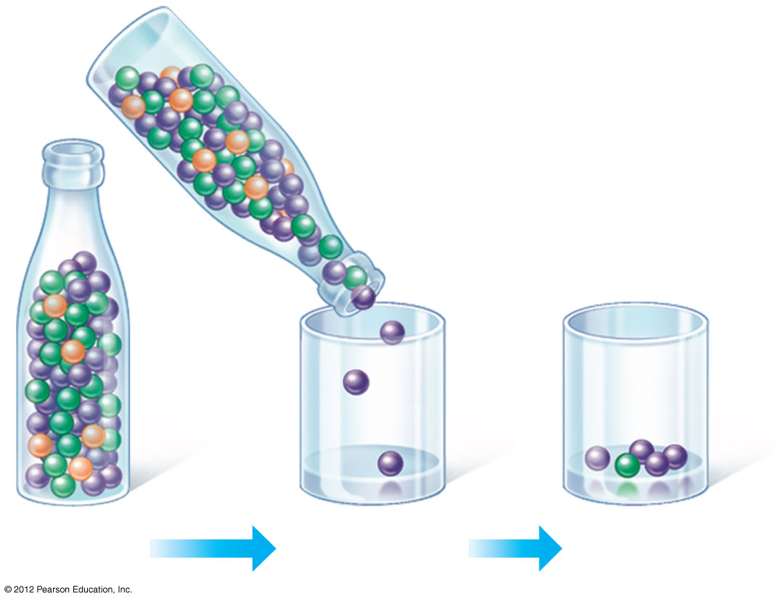
Figure 13.11A_s3
Original
population
Bottlenecking
event
Surviving
population
Notes:
55
Figure 13.11A_s3 The bottleneck effect (step 3)

Slide 56
13.
11 Natural selection, genetic drift, and gene flow can cause microevolution
0
  2. Genetic drift, continued
    Genetic drift also results from the founder effect, when a few individuals colonize a new habitat.
      A small group cannot adequately represent the genetic diversity in the ancestral population.
      The frequency of alleles will therefore be different between the old and new populations.
© 2012 Pearson Education, Inc.
Notes:
56
Student Misconceptions and Concerns
The concept of a genetic bottleneck contributing to a loss of diversity can be difficult for some students to understand. Without an appreciation for population genetics, students might think that a recovery in terms of sheer numbers is all that is needed. Yet the loss of genetic diversity might ultimately doom a population that is later faced with widespread disease.
Teaching Tips
1. To demonstrate the concept of genetic drift, consider a demonstration with several colored beans (different kinds of dried beans are cheap and easy to find in grocery stores). Fill a bottle with ten beans of five different colors. Then remove ten beans as a population sample. It is very likely that the sample will not adequately represent the diversity of the original bean collection. In fact, it is common for not all colors to be represented. As an alternative, draw eight cards out of a shuffled deck of 52 cards. Are all four suits represented? Are they represented equally?
2. Sampling error, a cause of genetic drift, can be difficult for some students to understand, but the following exercise may help. Have students work in pairs to flip a coin ten times. For each pair, list the number of heads on the board as just a long list of numbers (no need to keep track of heads and tails). This can be done quickly, as long as you have been sure to bring enough pennies. Now analyze the results. There should be considerable variation from the expected five. Now determine the average of all the groups and the collective sample size. By pooling the results, and increasing the sample size, the means should be closer to five.
3. The loss of genetic diversity in a population due to bottlenecks is a significant problem in conservation. When a species is reduced to relatively few individuals, and then is brought back to abundance by extraordinary efforts, the species is not fully recovered. The lost genetic diversity may be a prerequisite for the long-term survival of the species. Consider challenging your students to identify modern endangered species not mentioned in the textbook that might suffer from a genetic bottleneck.
4. The following thought exercise might help students understand founder effect “bias.” Ask them to imagine that all the students present in today’s class are the only survivors of some global catastrophe. Would your class adequately represent the biological diversity of the current human population?

Slide 57
13.13 Natural selection can alter variation in a population in three ways
  Natural selection can affect the distribution of phenotypes in a population.
    Stabilizing selection favors intermediate phenotypes, acting against extreme phenotypes.
    Directional selection acts against individuals at one of the phenotypic extremes.
    Disruptive selection favors individuals at both extremes of the phenotypic range.
© 2012 Pearson Education, Inc.
Notes:
57
Teaching Tips
1. Students will better understand each type of selection if they can think of their own examples. Consider a short homework assignment or small in-class group work to suggest other examples beyond those that are in the text.
2. Students are often surprised to learn that overweight human newborns can be as unhealthy as underweight newborns. Thus, stabilizing selection favors human birth weights clustered narrowly around a mean weight.

Slide 58
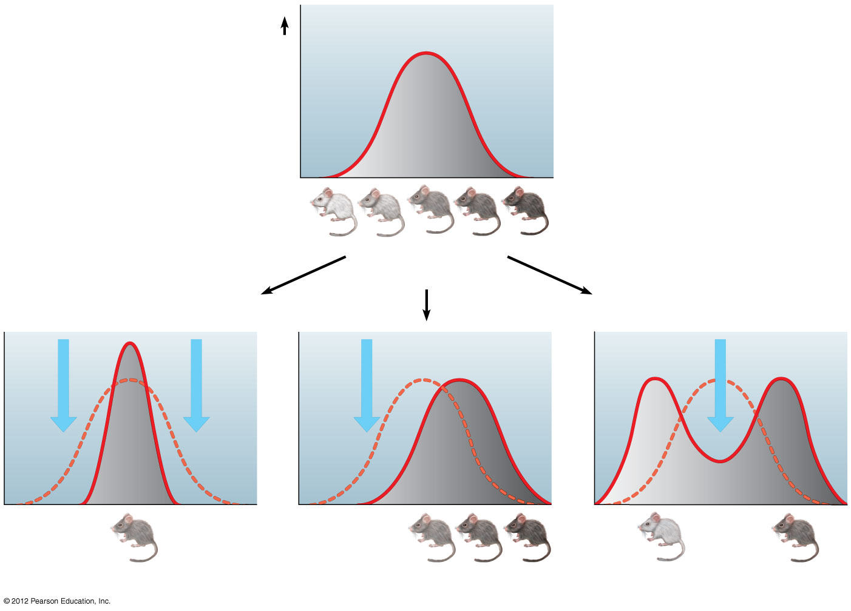
Figure 13.13
Original
population
Frequency of
individuals
Original
population
Evolved
population
Phenotypes
(fur color)
Stabilizing selection
Directional selection
Disruptive selection
Notes:
58
Figure 13.13 Three possible effects of natural selection on a phenotypic character

Slide 59
13.14 Sexual selection may lead to phenotypic differences between males and females
0
  Sexual selection
    is a form of natural selection
    in which individuals with certain characteristics are more likely than other individuals to obtain mates.
  In many animal species, males and females show distinctly different appearances, called sexual dimorphism.
  Intrasexual selection (within the same sex) involves competition for mates, usually by males.
© 2012 Pearson Education, Inc.
Notes:
59
Teaching Tips
Challenge your students to distinguish between natural selection, sexual selection, and artificial selection. One criterion for comparison is the nature of the selective environment. In natural selection, the interaction is between the organism and its immediate environment. In sexual selection, competition occurs within a species for access to mates. In artificial selection, humans are an important component of the environment, favoring traits of human interest.

Slide 60
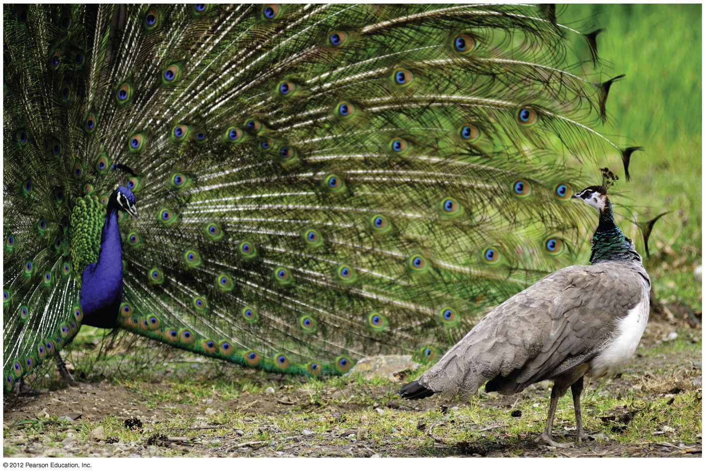
Figure 13.14A
Sexual dimorphism- peacock & peahen
Notes:
60
Figure 13.14A Extreme sexual dimorphism (peacock and peahen)

Slide 61
13.15 EVOLUTION CONNECTION: The evolution of antibiotic resistance in bacteria is a serious public health concern
0
0
  The excessive use of antibiotics is leading to the evolution of antibiotic-resistant bacteria.
  As a result, natural selection is favoring bacteria that are naturally resistant to antibiotics.
    Natural selection for antibiotic resistance is particularly strong in hospitals.
    Methicillin-resistant (MRSA) bacteria can cause “flesh-eating disease” and potentially fatal infections.
© 2012 Pearson Education, Inc.
Notes:
61
Teaching Tips
Module 13.15 can be used to remind students why an understanding of evolution is necessary for modern human medicine. Without the explanatory power of evolution, we would not understand why our once-powerful antibiotics are increasingly ineffective. The failure to properly understand evolution can result in the deaths of many people.

Slide 62
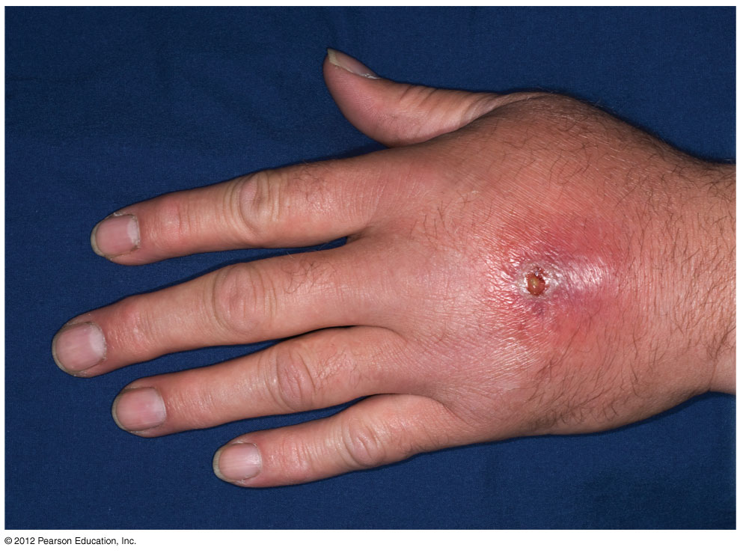
Figure 13.15
Notes:
62
Figure 13.15 A MRSA skin infection

