Slide 1
GENETICS-study of heredity- passing traits from parent to offspring
Chapter 9

Slide 2
Review
Gamete
Egg or sperm cell - haploid
Zygote
Fertilized egg-diploid

Slide 3
Review
Gene
- Segment of DNA
- An allele is a form of a gene
ie. Blue or brown eyes
Tall or short plants
- locus – location of the gene

Slide 4
9.3 Mendel’s law of segregation describes the inheritance of a single trait
0
  A cross between two individuals differing in a single trait (character) is a monohybrid cross.
  Mendel performed a monohybrid cross between a pea plant with purple flowers and a pea plant with white flowers.
    The F₁ generation produced all plants with purple flowers.
    A cross of F₁ plants with each other produced an F₂ generation with ¾ purple and ¼ white flowers.
© 2012 Pearson Education, Inc.
Notes:
4
Student Misconceptions and Concerns
Students using Punnett squares need to be reminded that the calculations are expected statistical probabilities and not absolutes. We would expect that any six playing cards dealt might be half black and half red, but we frequently find that this is not true. This might be a good time to show how larger sample sizes increase the likelihood that sampling will reflect expected ratios.
Teaching Tips
1. This early material introduces many definitions that are vital to understanding the later discussions in this chapter. Therefore, students need to be encouraged to master these definitions immediately. This may be a good time for a short quiz to encourage their progress.
2. Many students benefit from a little quick practice with a Punnett square. Have them try these crosses for practice: (a) PP × pp and (b) Pp × pp.
3. For students struggling with basic terminology, an analogy between a genetic trait and a pair of shoes might be helpful. A person might wear a pair of shoes in which both shoes match (homozygous), or less likely, a person might wear shoes that do not match (heterozygous).
4. Another analogy that might help struggling students is a pair of people trying to make a decision about where to eat tonight. One person wants to eat at a restaurant, the other wants to eat a meal at home. This (heterozygous) couple eats at home (the dominant allele “wins”).

Slide 5
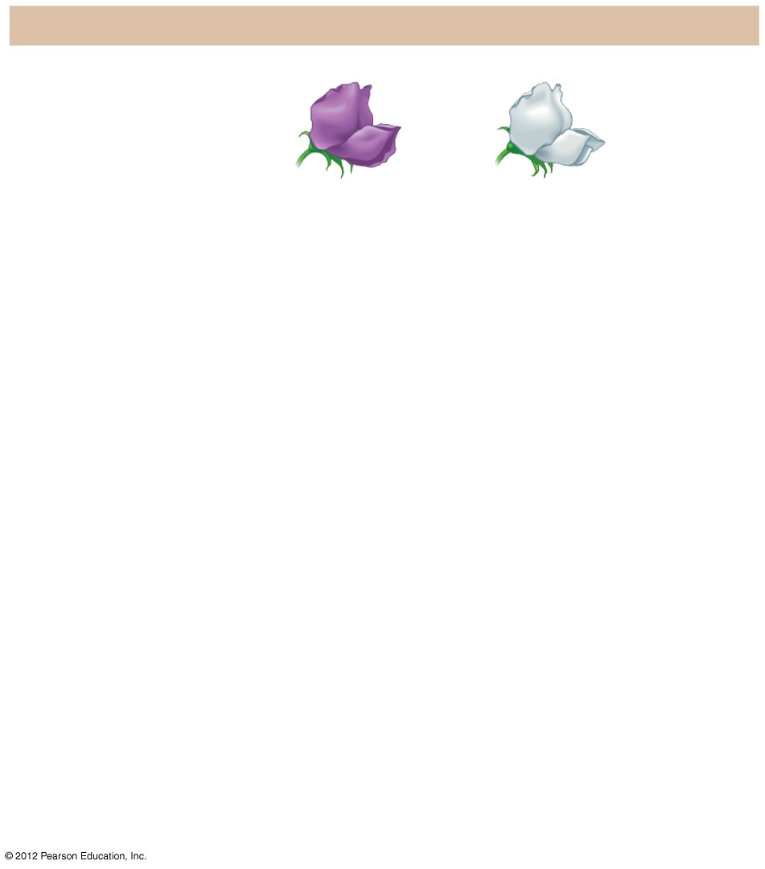
Figure 9.3A_s1
The Experiment
P generation
(true-breeding
parents)
×
Purple
flowers
White
flowers
Notes:
5
Figure 9.3A_s1 Crosses tracking one character (flower color) (step 1)

Slide 6
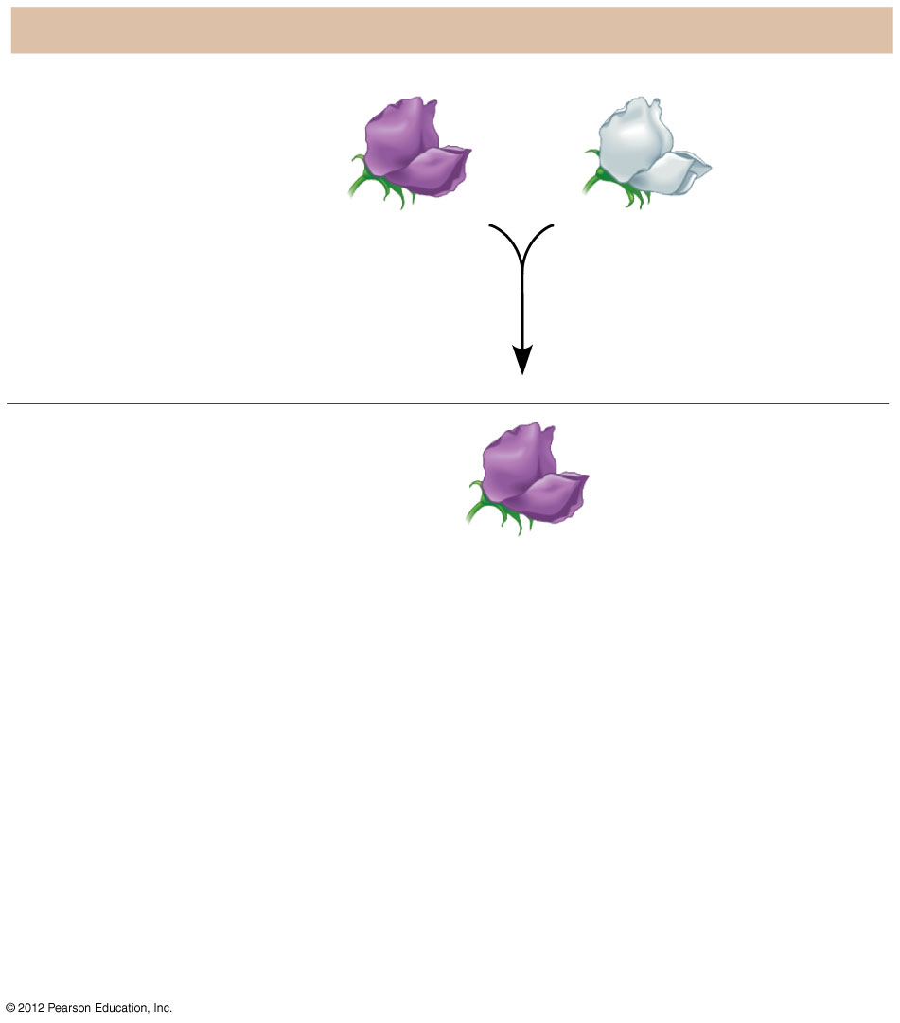
Figure 9.3A_s2
The Experiment
P generation
(true-breeding
parents)
×
Purple
flowers
White
flowers
F₁ generation
All plants have
purple flowers
Notes:
6
Figure 9.3A_s2 Crosses tracking one character (flower color) (step 2)

Slide 7
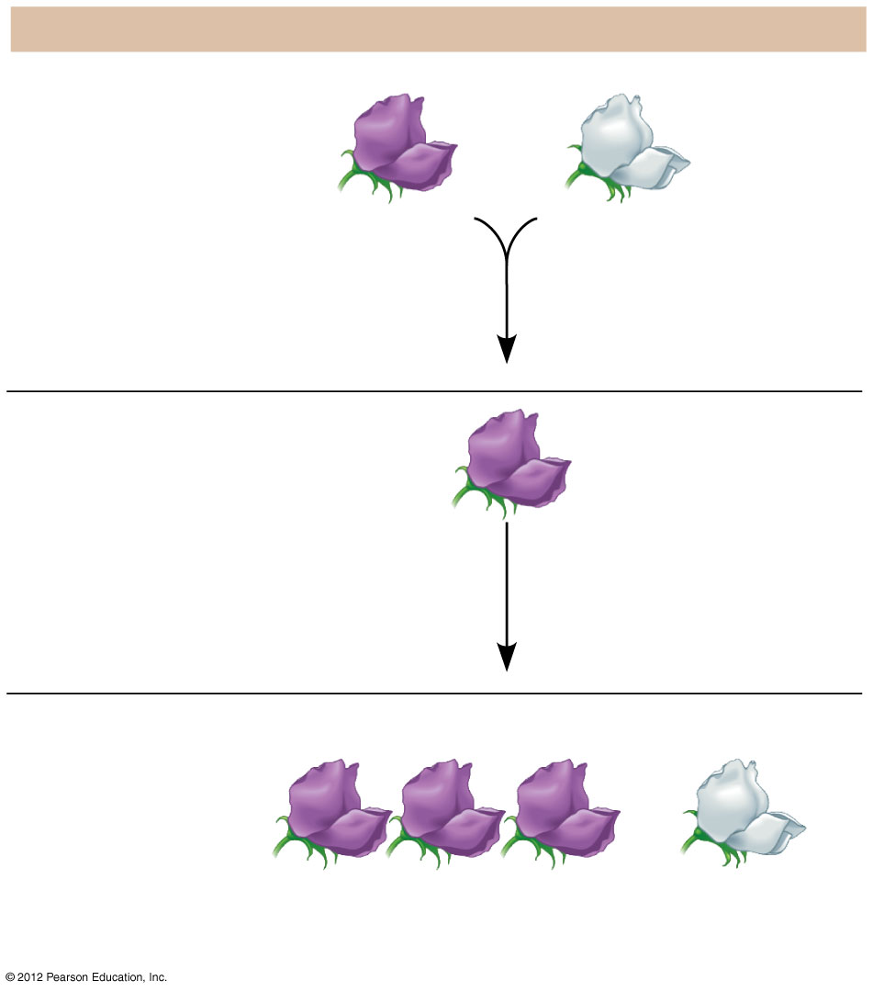
Figure 9.3A_s3
The Experiment
P generation
(true-breeding
parents)
×
Purple
flowers
White
flowers
F₁ generation
All plants have
purple flowers
Fertilization
among F₁ plants
(F₁ × F₁)
F₂ generation
3
1
of plants
have purple flowers
of plants
have white flowers
4
4
Notes:
7
Figure 9.3A_s3 Crosses tracking one character (flower color) (step 3)

Slide 8
9.3 vocabulary
0
    1. Alleles are different versions of genes that account for variations in inherited characters.
    2. For each characteristic, an organism inherits two alleles, one from each parent. The alleles can be the same or different.
      A homozygous genotype has identical alleles-TT
      A heterozygous genotype has two different alleles-Tt
© 2012 Pearson Education, Inc.
Notes:
8
Student Misconceptions and Concerns
Students using Punnett squares need to be reminded that the calculations are expected statistical probabilities and not absolutes. We would expect that any six playing cards dealt might be half black and half red, but we frequently find that this is not true. This might be a good time to show how larger sample sizes increase the likelihood that sampling will reflect expected ratios.
Teaching Tips
1. This early material introduces many definitions that are vital to understanding the later discussions in this chapter. Therefore, students need to be encouraged to master these definitions immediately. This may be a good time for a short quiz to encourage their progress.
2. Many students benefit from a little quick practice with a Punnett square. Have them try these crosses for practice: (a) PP × pp and (b) Pp × pp.
3. For students struggling with basic terminology, an analogy between a genetic trait and a pair of shoes might be helpful. A person might wear a pair of shoes in which both shoes match (homozygous), or less likely, a person might wear shoes that do not match (heterozygous).
4. Another analogy that might help struggling students is a pair of people trying to make a decision about where to eat tonight. One person wants to eat at a restaurant, the other wants to eat a meal at home. This (heterozygous) couple eats at home (the dominant allele “wins”).

Slide 9
vocabulary
3. Some genes are dominant and some are recessive
Dominant - trait shows whenever it is present
Recessive - trait shows only when 2 of these genes are present
Mendel’s experiment- purple flower dominant-showed up in F1 generation- tall dominates over short
      The phenotype is the appearance or expression of a trait-blue eyes, tall plant
      The genotype is the genetic makeup of a trait-TT, Tt, tt

Slide 10
9.3 Mendel’s law of segregation describes the inheritance of a single character
0
    4. A sperm or egg carries only one allele for each inherited trait because allele pairs separate (segregate) from each other during the production of gametes. This statement is called the law of segregation.
  Mendel’s hypotheses also explain the 3:1 ratio in the F₂ generation.
    The F₁ hybrids all have a Pp genotype.
    A Punnett square shows the four possible combinations of alleles that could occur when these gametes combine.
© 2012 Pearson Education, Inc.
Notes:
10
Student Misconceptions and Concerns
Students using Punnett squares need to be reminded that the calculations are expected statistical probabilities and not absolutes. We would expect that any six playing cards dealt might be half black and half red, but we frequently find that this is not true. This might be a good time to show how larger sample sizes increase the likelihood that sampling will reflect expected ratios.
Teaching Tips
1. This early material introduces many definitions that are vital to understanding the later discussions in this chapter. Therefore, students need to be encouraged to master these definitions immediately. This may be a good time for a short quiz to encourage their progress.
2. Many students benefit from a little quick practice with a Punnett square. Have them try these crosses for practice: (a) PP × pp and (b) Pp × pp.
3. For students struggling with basic terminology, an analogy between a genetic trait and a pair of shoes might be helpful. A person might wear a pair of shoes in which both shoes match (homozygous), or less likely, a person might wear shoes that do not match (heterozygous).
4. Another analogy that might help struggling students is a pair of people trying to make a decision about where to eat tonight. One person wants to eat at a restaurant, the other wants to eat a meal at home. This (heterozygous) couple eats at home (the dominant allele “wins”).

Slide 11
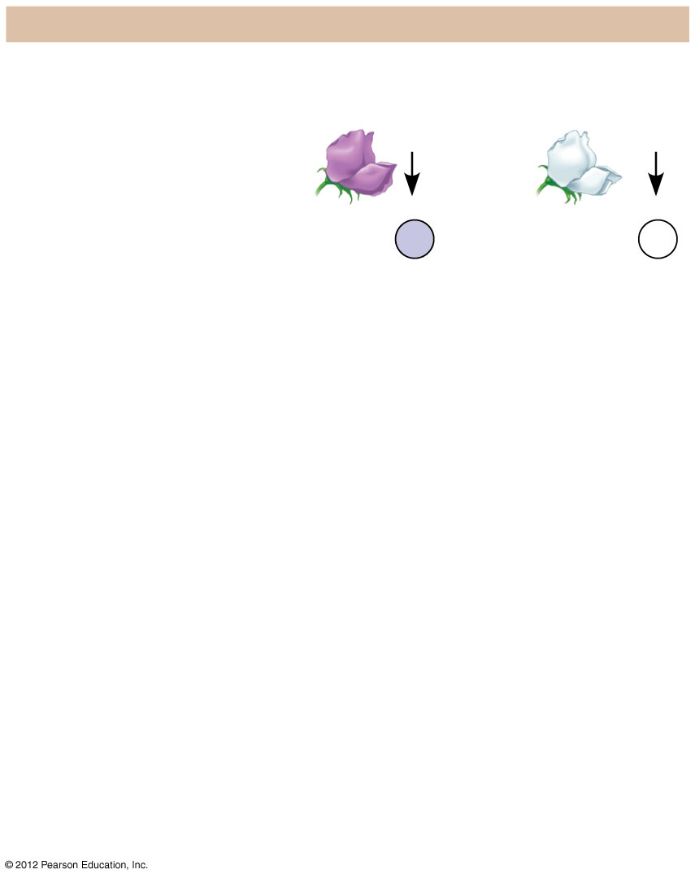
Figure 9.3B_s1
The Explanation
P generation
Genetic makeup (alleles)
Purple flowers
White flowers
PP
pp
Gametes
All
P
All p
Notes:
11
Figure 9.3B_s1 An explanation of the crosses in Figure 9.3A (step 1)

Slide 12
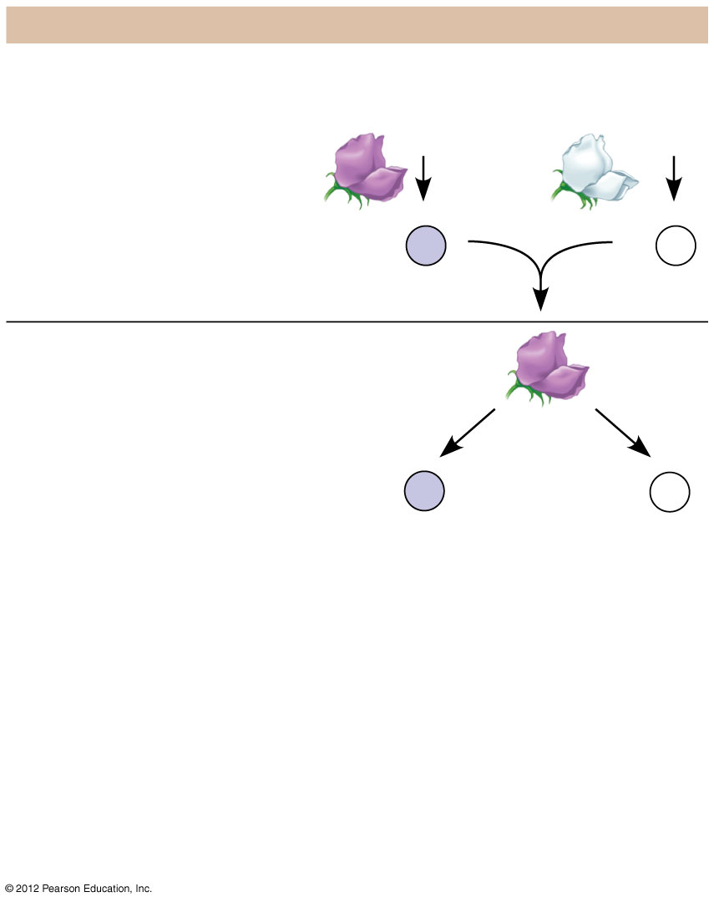
Figure 9.3B_s2
The Explanation
P generation
Genetic makeup (alleles)
Purple flowers
White flowers
PP
pp
Gametes
All
P
All p
F₁ generation
(hybrids)
All Pp
Gametes
1
P
1
p
2
2
Notes:
12
Figure 9.3B_s2 An explanation of the crosses in Figure 9.3A (step 2)

Slide 13
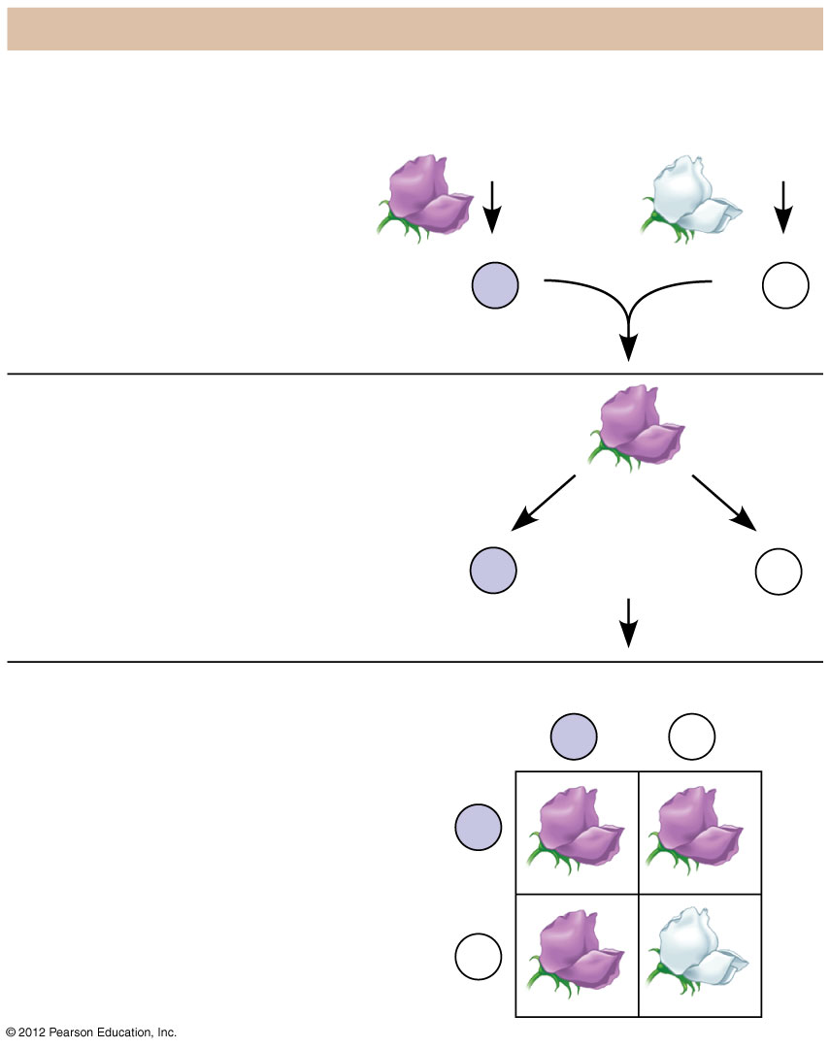
Figure 9.3B_s3
The Explanation
P generation
Genetic makeup (alleles)
Purple flowers
White flowers
PP
pp
Gametes
All
P
All p
F₁ generation
(hybrids)
All Pp
Alleles
segregate
Gametes
1
P
1
p
2
2
Fertilization
F₂ generation
Sperm from F₁ plant
P
p
Phenotypic ratio
3 purple : 1 white
P
PP
Pp
Eggs
from F₁
plant
Genotypic ratio
1 PP : 2 Pp : 1 pp
p
Pp
pp
Notes:
13
Figure 9.3B_s3 An explanation of the crosses in Figure 9.3A (step 3)

Slide 14
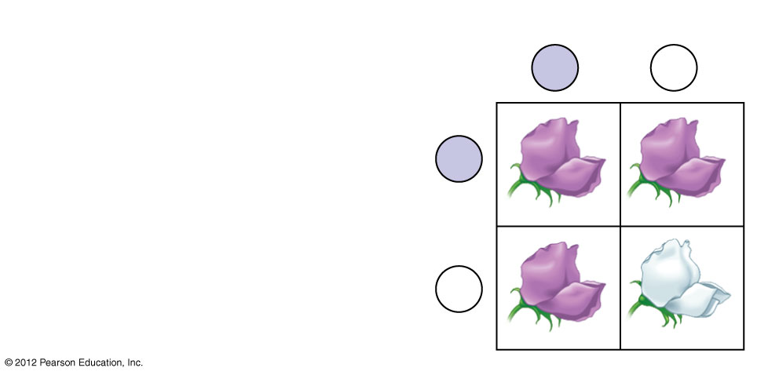
Figure 9.3B_4
F₂ generation
Sperm from F₁ plant
P
p
Phenotypic ratio
3 purple : 1 white
P
PP
Pp
Eggs
from F₁
plant
Genotypic ratio
1 PP : 2 Pp : 1 pp
p
Pp
pp
Notes:
14
Figure 9.3B_4 An explanation of the crosses in Figure 9.3A (F₂ generation)

Slide 15
9.4 Homologous chromosomes bear the alleles for each character
0
  A locus (plural, loci) is the specific location of a gene along a chromosome.
  For a pair of homologous chromosomes, alleles of a gene reside at the same locus.
    Homozygous individuals have the same allele on both homologues.
    Heterozygous individuals have a different allele on each homologue.
© 2012 Pearson Education, Inc.
Notes:
15
Student Misconceptions and Concerns
Students using Punnett squares need to be reminded that the calculations are expected statistical probabilities and not absolutes. We would expect that any six playing cards dealt might be half black and half red, but we frequently find that this is not true. This might be a good time to show how larger sample sizes increase the likelihood that sampling will reflect expected ratios.
Teaching Tips
Figure 9.4 can be of great benefit when introducing genetic terminology. For students struggling to think abstractly, such a visual aid may be essential when describing these features in lecture.

Slide 16
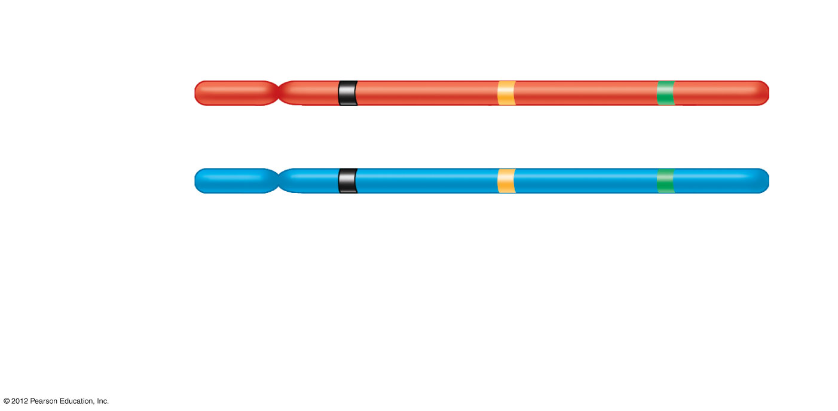
Figure 9.4
Gene loci
Dominant
allele
P
a
B
Homologous
chromosomes
P
a
b
Recessive
allele
Genotype:
PP
aa
Bb
Homozygous
for the
dominant
allele
Homozygous
for the
recessive
allele
Heterozygous,
with one dominant
and one recessive
allele
Notes:
16
Figure 9.4 Three gene loci on homologous chromosomes

Slide 17
9.8 CONNECTION: Genetic traits in humans can be tracked through family pedigrees
0
  The inheritance of human traits follows Mendel’s laws.
  A pedigree
    shows the inheritance of a trait in a family through multiple generations,
    demonstrates dominant or recessive inheritance, and
    can also be used to deduce genotypes of family members.
© 2012 Pearson Education, Inc.
Notes:
17
Student Misconceptions and Concerns
Students might think that dominant alleles are naturally (a) more common, (b) more likely to be inherited, and (c) better for an organism. The text notes that this is not necessarily true. However, this might need to be emphasized further in lecture.
Teaching Tips
Students seem to learn much from Figure 9.8b by analyzing the possible genotypes for the people whose complete genotype is not known. Consider challenging your students to suggest the possible genotypes for these people, perhaps during lecture.

Slide 18
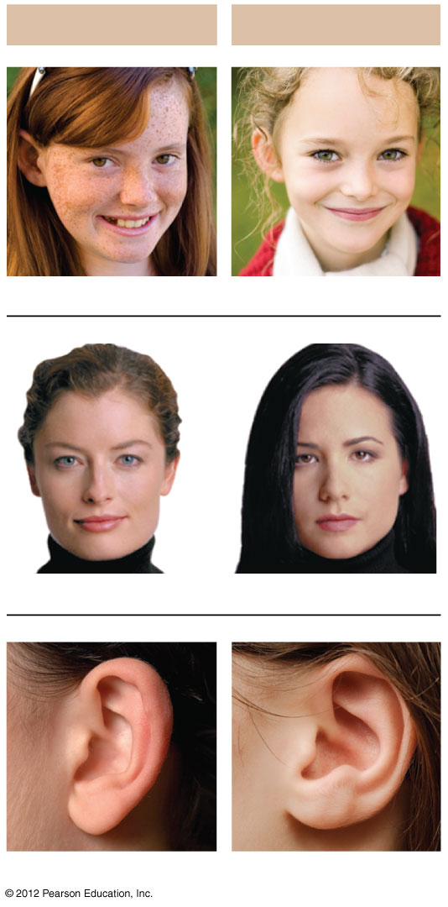
Figure 9.8A
Dominant Traits
Recessive Traits
Freckles
No freckles
Widow’s peak
Straight hairline
Free earlobe
Attached earlobe
Notes:
18
Figure 9.8A Examples of single-gene inherited traits in humans

Slide 19
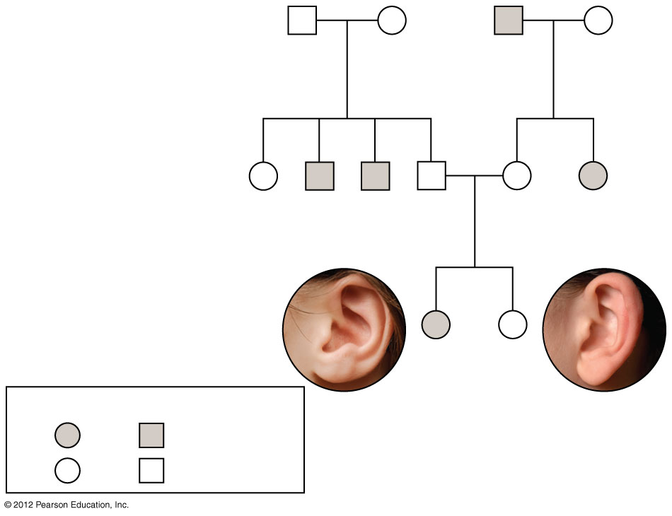
Figure 9.8B
First generation
(grandparents)
Ff
Ff
ff
Ff
Second generation
(parents, aunts,
and uncles)
FF
or
Ff
ff
ff
Ff
Ff
ff
Third generation
(two sisters)
ff
FF
or
Ff
Female
Male
Attached
Free
Notes:
19
Figure 9.8B A pedigree showing the inheritance of attached versus free earlobes in a hypothetical family

Slide 20
9.9 CONNECTION: Many inherited disorders in humans are controlled by a single gene
0
  Inherited human disorders show either
    recessive inheritance in which
      two recessive alleles are needed to show disease,
      heterozygous parents are carriers of the disease-causing allele, and
      the probability of inheritance increases with inbreeding, mating between close relatives.
    dominant inheritance in which
      one dominant allele is needed to show disease and
      dominant lethal alleles are usually eliminated from the population.
© 2012 Pearson Education, Inc.
Notes:
20
Teaching Tips
1. The 2/3 fraction noted in the discussion of carriers of a recessive disorder for deafness often catches students off guard . . . as they are expecting odds of 1/4, 1/2, or 3/4. However, when we eliminate the dd (deaf) possibility, as it would not be a carrier, we have three possible genotypes. Thus, the odds are based out of the remaining three genotypes Dd, dD, and DD. Consider adding this point of clarification to your lecture.
2. As a simple test of comprehension, ask students to explain why lethal alleles are not eliminated from a population. Several possibilities exist: a) The lethal allele might be recessive, persisting in the population due to the survival of carriers, or b) the lethal allele might be dominant, but is not expressed until after the age of reproduction.
3. Ask your class a) what the odds are of a person developing Huntington’s disease if a parent has this disease (50%) and b) whether they would want this genetic test if they were a person at risk. The Huntington Disease Society website, www.hdsa.org, offers many additional details. It is a good starting point for those who want to explore this disease in more detail.

Slide 21
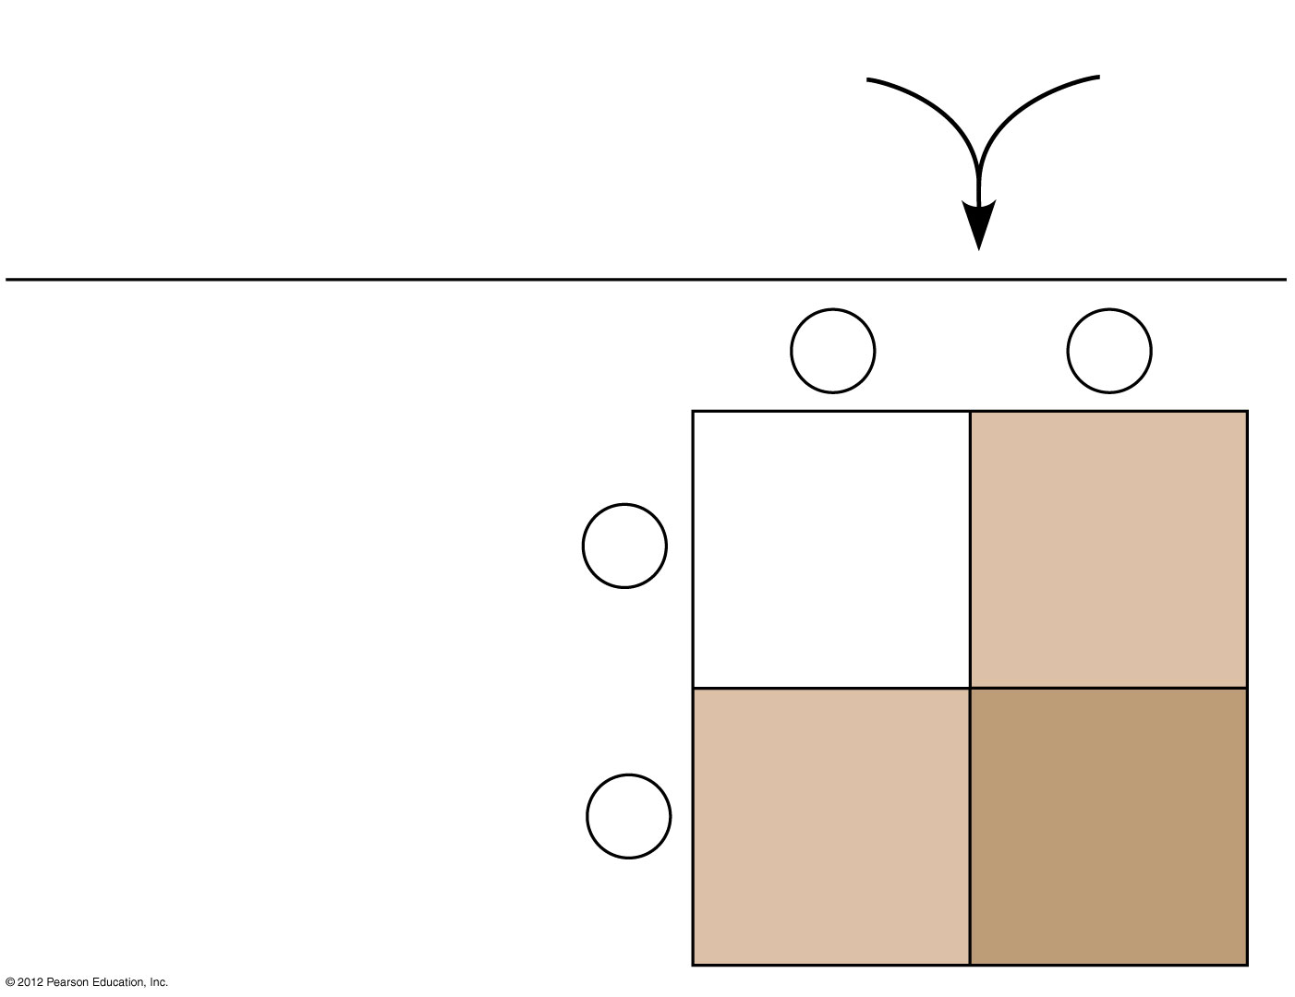
Figure 9.9A
Normal
Dd
Normal
Dd
Parents
×
D
Sperm
d
Dd
Normal
(carrier)
DD
Normal
D
Offspring
Eggs
Dd
Normal
(carrier)
dd
Deaf
d
Notes:
21
Figure 9.9A Offspring produced by parents who are both carriers for a recessive disorder, a type of deafness

Slide 22
9.9 CONNECTION: Many inherited disorders in humans are controlled by a single gene
0
  The most common fatal genetic disease in the United States is cystic fibrosis (CF), resulting in excessive thick mucus secretions. The CF allele is
    recessive and
    carried by about 1 in 31 Americans.
  Dominant human disorders include
    achondroplasia, resulting in dwarfism, and
    Huntington’s disease, a degenerative disorder of the nervous system.
© 2012 Pearson Education, Inc.
Notes:
22
Teaching Tips
1. The 2/3 fraction noted in the discussion of carriers of a recessive disorder for deafness often catches students off guard . . . as they are expecting odds of 1/4, 1/2, or 3/4. However, when we eliminate the dd (deaf) possibility, as it would not be a carrier, we have three possible genotypes. Thus, the odds are based out of the remaining three genotypes Dd, dD, and DD. Consider adding this point of clarification to your lecture.
2. As a simple test of comprehension, ask students to explain why lethal alleles are not eliminated from a population. Several possibilities exist: a) The lethal allele might be recessive, persisting in the population due to the survival of carriers, or b) the lethal allele might be dominant, but is not expressed until after the age of reproduction.
3. Ask your class a) what the odds are of a person developing Huntington’s disease if a parent has this disease (50%) and b) whether they would want this genetic test if they were a person at risk. The Huntington Disease Society website, www.hdsa.org, offers many additional details. It is a good starting point for those who want to explore this disease in more detail.

Slide 23
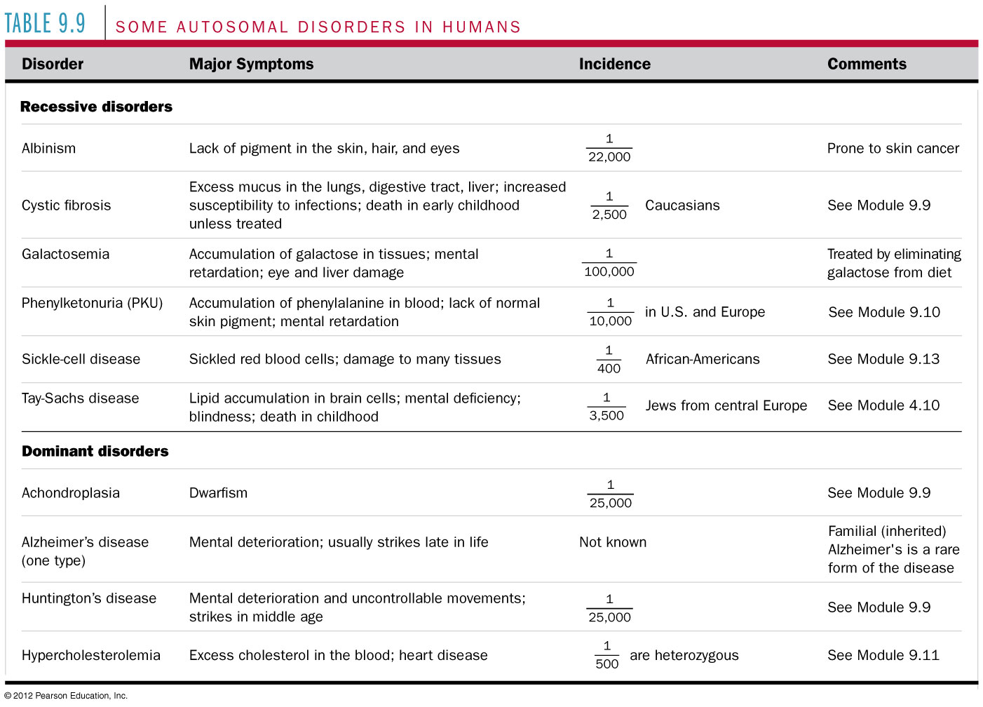
Table 9.9
Notes:
23
Table 9.9 Some Autosomal Disorders in Humans

Slide 24
9.10 CONNECTION: New technologies can provide insight into one’s genetic legacy
0
  New technologies offer ways to obtain genetic information
    before conception,
    during pregnancy, and
    after birth.
  Genetic testing can identify potential parents who are heterozygous carriers for certain diseases.
© 2012 Pearson Education, Inc.
Notes:
24
Teaching Tips
Medical technology raises many ethical issues. Consider asking your students this practical question. How much routine fetal testing do we want our insurance companies to cover and at what cost for health insurance? Ultrasound, for example, is routinely performed on pregnant women as a normal part of prenatal care. What other tests should be standard? Who should decide? Who should pay?

Slide 25
9.10 CONNECTION: New technologies can provide insight into one’s genetic legacy
0
  Several technologies can be used for detecting genetic conditions in a fetus.
    Amniocentesis extracts samples of amniotic fluid containing fetal cells and permits
      karyotyping and
      biochemical tests on cultured fetal cells to detect other conditions, such as Tay-Sachs disease.
    Chorionic villus sampling removes a sample of chorionic villus tissue from the placenta and permits similar karyotyping and biochemical tests.
© 2012 Pearson Education, Inc.
Notes:
25
Teaching Tips
Medical technology raises many ethical issues. Consider asking your students this practical question. How much routine fetal testing do we want our insurance companies to cover and at what cost for health insurance? Ultrasound, for example, is routinely performed on pregnant women as a normal part of prenatal care. What other tests should be standard? Who should decide? Who should pay?

Slide 26
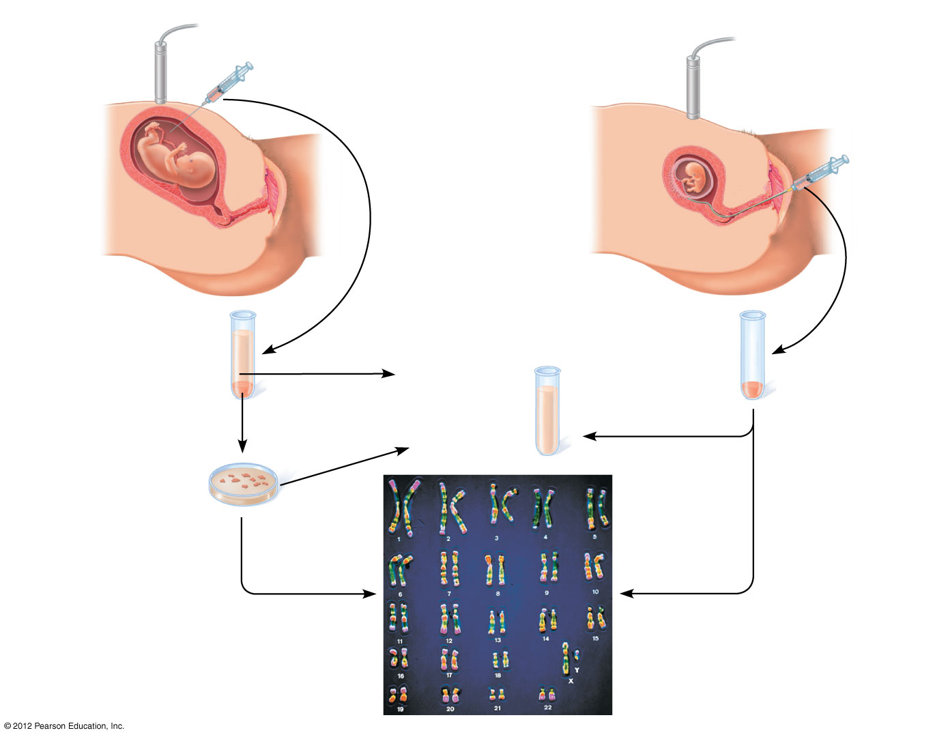
Figure 9.10A
Amniocentesis
Chorionic Villus Sampling (CVS)
Amniotic fluid
extracted
Tissue extracted
from the
chorionic villi
Ultrasound
transducer
Ultrasound
transducer
Fetus
Fetus
Placenta
Placenta
Uterus
Chorionic
villi
Cervix
Cervix
Uterus
Centrifugation
Amniotic fluid
Biochemical
and genetics
tests
Fetal cells
Fetal cells
Several
hours
Several
hours
Cultured
cells
Several
weeks
Several
weeks
Several
hours
Karyotyping
Notes:
26
Figure 9.10A Testing a fetus for genetic disorders

Slide 27
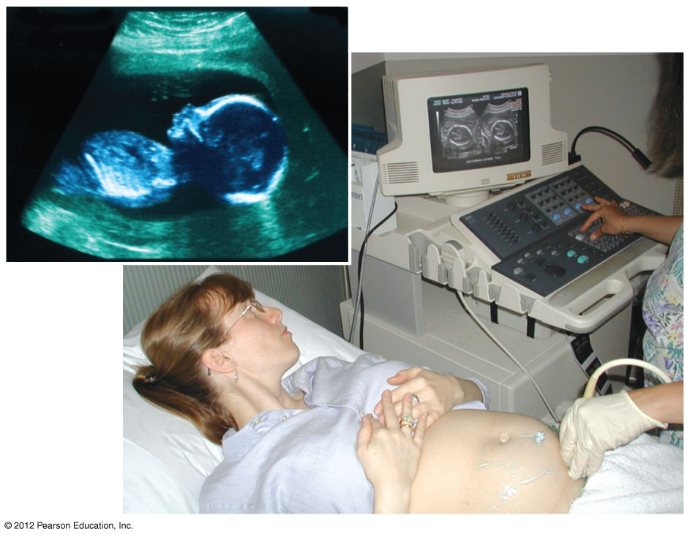
Figure 9.10B
Notes:
27
Figure 9.10B Ultrasound scanning of a fetus

Slide 28
Incomplete Dominance
When a dominant allele does not completely dominate or hide the recessive allele
Hybrid will be seen as a mixture
Snapdragons
  Red RR
  White rr
  Pink Rr

Slide 29
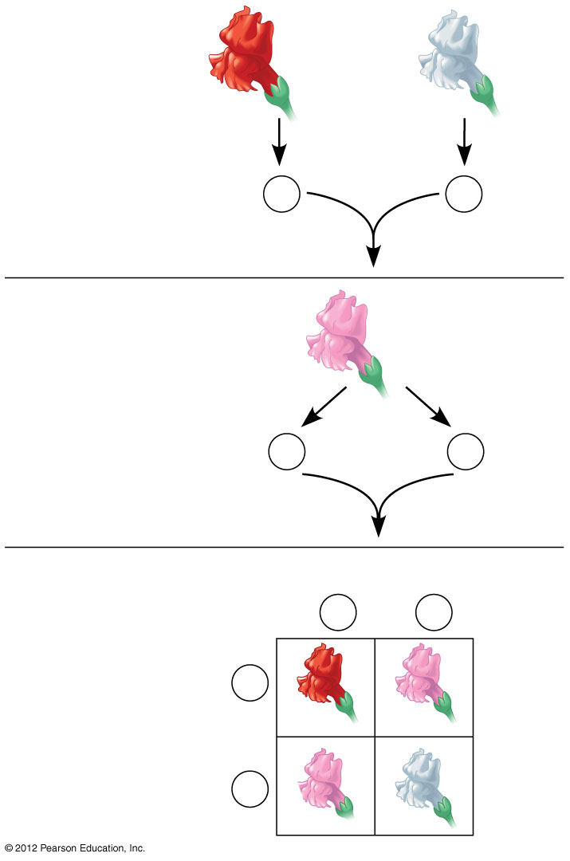
Figure 9.11A
P generation
×
Red
RR
White
rr
Gametes
R
r
F₁ generation
Pink hybrid
Rr
Gametes
1
R
1
r
2
2
F₂ generation
Sperm
1
R
1
r
2
2
1
R
RR
rR
2
Eggs
1
r
Rr
rr
2
Notes:
29
Figure 9.11A Incomplete dominance in snapdragon flower color

Slide 30
9.11 Incomplete dominance results in intermediate phenotypes
0
  One example of incomplete dominance in humans is hypercholesterolemia (high cholesterol), in which
    dangerously high levels of cholesterol occur in the blood and
    heterozygotes have intermediately high cholesterol levels.
© 2012 Pearson Education, Inc.
Notes:
30
Student Misconceptions and Concerns
1. After reading the preceding modules, students might expect all traits to be governed by a single gene with two alleles, one dominant over the other. Modules 9.11–9.15 describe deviations from simplistic models of inheritance.
2. As these variations of Mendel’s laws are introduced, students are likely to get confused and become uncertain about the prior definitions. Consider keeping a clear definition of these different patterns of inheritance available for the class to refer to as new patterns are discussed (perhaps as a handout for student reference).
3. As your class size increases, the chances increase that at least one student will have a family member with one of the genetic disorders discussed. Some students may find this embarrassing, but others might have a special interest in learning more about these topics, and may even be willing to share some of their family’s experiences with the class.
Teaching Tips
1. Incomplete dominance is analogous to a compromise, or a gray shade. The key concept is that both “sides” have input. Complete dominance is analogous to an authoritarian style, overruling others and insisting on things being a certain way. Although these analogies might seem obvious to instructors, many students new to genetics appreciate them.
2. Another analogy for cholesterol receptors is fishing poles. The more fishing poles you use, the more fish you can catch. Heterozygotes for hypercholesterolemia have fewer “fishing poles” for cholesterol. Thus, fewer “fish” are caught and more “fish” remain in the water.

Slide 31
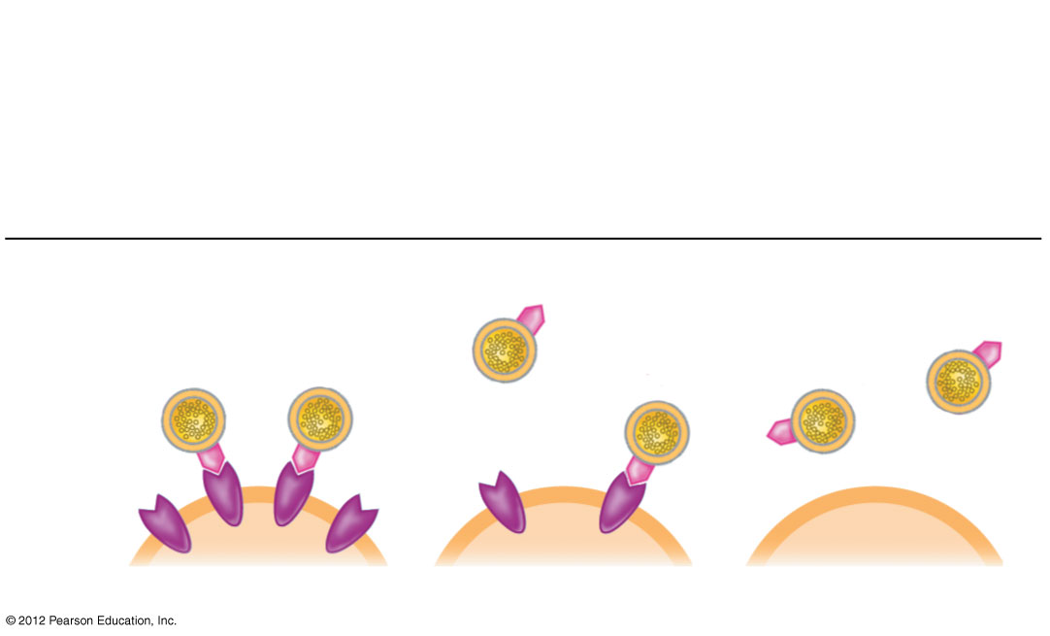
Figure 9.11B
Genotypes
Hh
Heterozygous
HH
Homozygous
for ability to make
LDL receptors
hh
Homozygous
for inability to make
LDL receptors
Phenotypes
LDL
LDL
receptor
Cell
Normal
Mild disease
Severe disease
Notes:
31
Figure 9.11B Incomplete dominance in human hypercholesterolemia

Slide 32
9.12 Many genes have more than two alleles in the population
0
  Although an individual can at most carry two different alleles for a particular gene, more than two alleles often exist in the wider population.
  Human ABO blood group phenotypes involve three alleles for a single gene.
  The four human blood groups, A, B, AB, and O, result from combinations of these three alleles.
  The A and B alleles are both expressed in heterozygous individuals, a condition known as codominance.
© 2012 Pearson Education, Inc.
Notes:
32
Student Misconceptions and Concerns
1. After reading the preceding modules, students might expect all traits to be governed by a single gene with two alleles, one dominant over the other. Modules 9.11–9.15 describe deviations from simplistic models of inheritance.
2. As these variations of Mendel’s laws are introduced, students are likely to get confused and become uncertain about the prior definitions. Consider keeping a clear definition of these different patterns of inheritance available for the class to refer to as new patterns are discussed (perhaps as a handout for student reference).
3. As your class size increases, the chances increase that at least one student will have a family member with one of the genetic disorders discussed. Some students may find this embarrassing, but others might have a special interest in learning more about these topics, and may even be willing to share some of their family’s experiences with the class.
Teaching Tips
1. Students can think of blood types as analogous to socks on their feet. You can have socks that match, a sock on one foot but not the other, you can wear two socks that do not match, or you can even go barefoot (type O blood)! Developed further, think of Amber (A) and Blue (B) socks. Type A blood can have an Amber sock with either another Amber sock or a bare foot (or “zero” sock). Blue socks work the same way. One amber and one blue sock represent the AB blood type. No socks, as already noted, represent type O.
2. Consider specifically comparing the principles of codominance (expression of both alleles) and incomplete dominance (expression of one intermediate trait). Students will likely benefit from this direct comparison.

Slide 33
9.12 Many genes have more than two alleles in the population
0
  In codominance,
    neither allele is dominant over the other and
    expression of both alleles is observed as a distinct phenotype in the heterozygous individual.
    AB blood type is an example of codominance.
© 2012 Pearson Education, Inc.
Notes:
33
Student Misconceptions and Concerns
1. After reading the preceding modules, students might expect all traits to be governed by a single gene with two alleles, one dominant over the other. Modules 9.11–9.15 describe deviations from simplistic models of inheritance.
2. As these variations of Mendel’s laws are introduced, students are likely to get confused and become uncertain about the prior definitions. Consider keeping a clear definition of these different patterns of inheritance available for the class to refer to as new patterns are discussed (perhaps as a handout for student reference).
3. As your class size increases, the chances increase that at least one student will have a family member with one of the genetic disorders discussed. Some students may find this embarrassing, but others might have a special interest in learning more about these topics, and may even be willing to share some of their family’s experiences with the class.
Teaching Tips
1. Students can think of blood types as analogous to socks on their feet. You can have socks that match, a sock on one foot but not the other, you can wear two socks that do not match, or you can even go barefoot (type O blood)! Developed further, think of Amber (A) and Blue (B) socks. Type A blood can have an Amber sock with either another Amber sock or a bare foot (or “zero” sock). Blue socks work the same way. One amber and one blue sock represent the AB blood type. No socks, as already noted, represent type O.
2. Consider specifically comparing the principles of codominance (expression of both alleles) and incomplete dominance (expression of one intermediate trait). Students will likely benefit from this direct comparison.

Slide 34
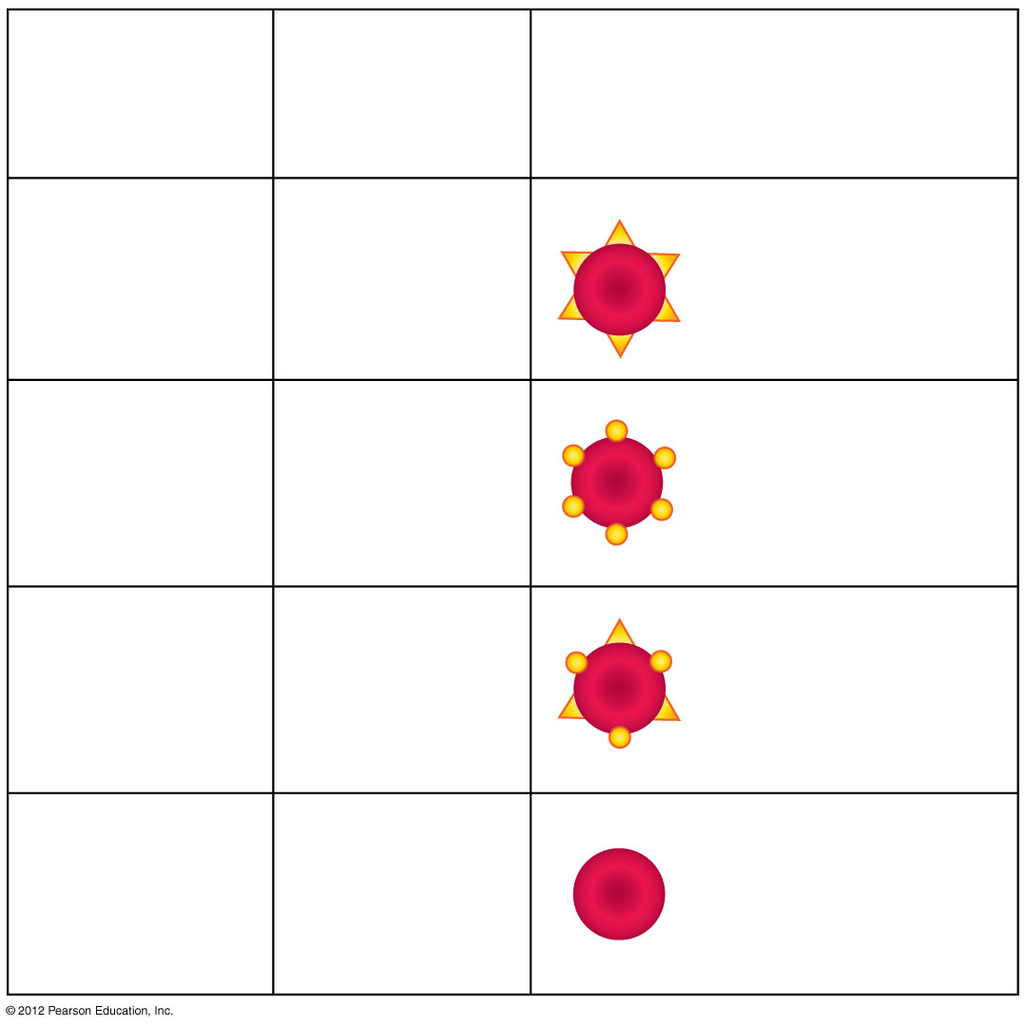
Figure 9.12_1
Blood
Group
(Phenotype)
Carbohydrates Present
on Red Blood Cells
Genotypes
I^{A}I^{A}
or
I^{A}i
Carbohydrate A
A
I^{B}I^{B}
or
I^{B}i
Carbohydrate B
B
Carbohydrate A
and
Carbohydrate B
AB
I^{A}I^{B}
O
ii
Neither
Notes:
34
Figure 9.12_1 Multiple alleles for the ABO blood groups (part 1)

Slide 35
9.13 A single gene may affect many phenotypic characters
0
  Pleiotropy occurs when one gene influences many characteristics.
  Sickle-cell disease is a human example of pleiotropy. This disease
    affects the type of hemoglobin produced and the shape of red blood cells and
    causes anemia and organ damage.
    Sickle-cell and nonsickle alleles are codominant.
    Carriers of sickle-cell disease are resistant to malaria.
© 2012 Pearson Education, Inc.
Notes:
35
Student Misconceptions and Concerns
1. After reading the preceding modules, students might expect all traits to be governed by a single gene with two alleles, one dominant over the other. Modules 9.11–9.15 describe deviations from simplistic models of inheritance.
2. As these variations of Mendel’s laws are introduced, students are likely to get confused and become uncertain about the prior definitions. Consider keeping a clear definition of these different patterns of inheritance available for the class to refer to as new patterns are discussed (perhaps as a handout for student reference).
3. As your class size increases, the chances increase that at least one student will have a family member with one of the genetic disorders discussed. Some students may find this embarrassing, but others might have a special interest in learning more about these topics, and may even be willing to share some of their family’s experiences with the class.
Teaching Tips
The American Sickle Cell Anemia Association’s website, www.ascaa.org, is a good place to find additional details.

Slide 36
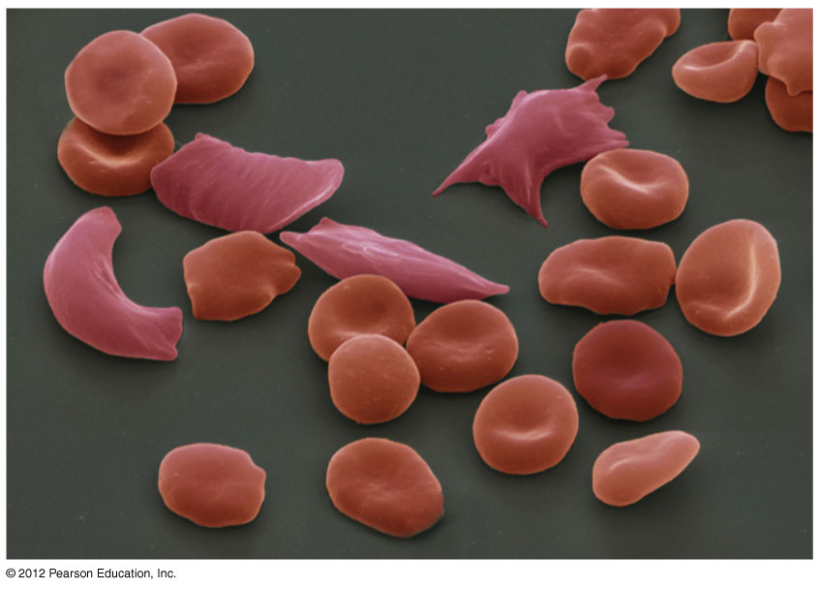
Figure 9.13A
Notes:
36
Figure 9.13A In this micrograph, you can see several jagged sickled cells in the midst of normal red blood cells.

Slide 37
9.14 A single character may be influenced by many genes
0
  Many characteristics result from polygenic inheritance, in which a single phenotypic character results from the additive effects of two or more genes.
  Human skin color is an example of polygenic inheritance.
© 2012 Pearson Education, Inc.
Notes:
37
Student Misconceptions and Concerns
1. After reading the preceding modules, students might expect all traits to be governed by a single gene with two alleles, one dominant over the other. Modules 9.11–9.15 describe deviations from simplistic models of inheritance.
2. As these variations of Mendel’s laws are introduced, students are likely to get confused and become uncertain about the prior definitions. Consider keeping a clear definition of these different patterns of inheritance available for the class to refer to as new patterns are discussed (perhaps as a handout for student reference).
3. As your class size increases, the chances increase that at least one student will have a family member with one of the genetic disorders discussed. Some students may find this embarrassing, but others might have a special interest in learning more about these topics, and may even be willing to share some of their family’s experiences with the class.
Teaching Tips
1. Polygenic inheritance makes it possible for children to inherit genes to be taller or shorter than either parent. Similarly, skin tones can be darker or lighter than either parent. The environment also contributes significantly to the final phenotype for both of these traits.
2. The authors note that polygenic inheritance is the converse of pleiotropy. This is worth noting in lecture as these concepts are discussed. We often remember concepts better when they are contrasted in pairs.

Slide 38
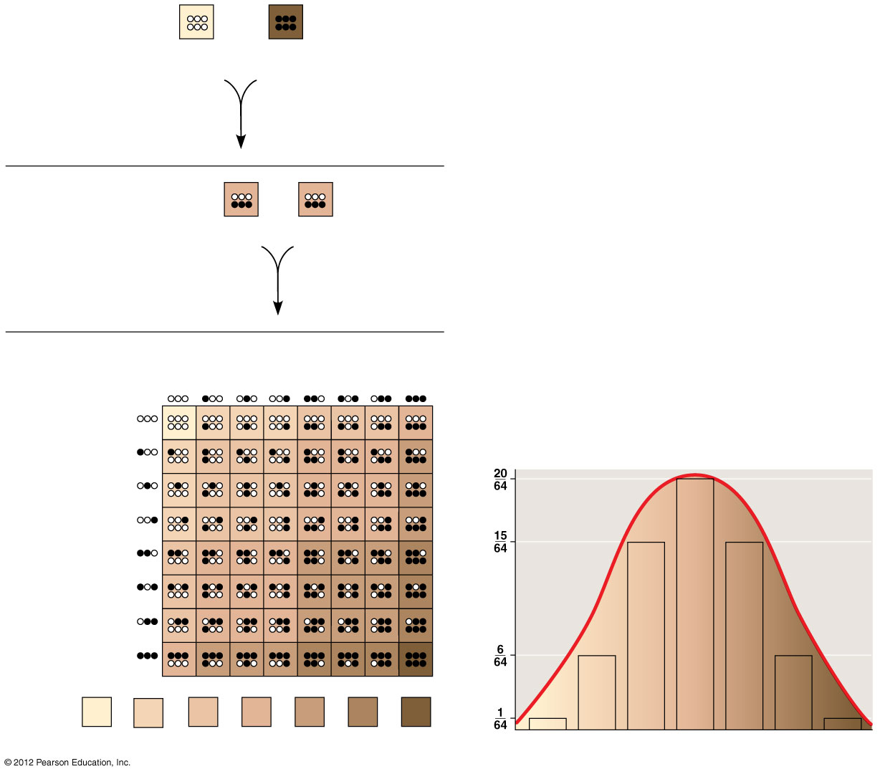
Figure 9.14
P generation
×
aabbcc
(very light)
AABBCC
(very dark)
F₁ generation
×
AaBbCc
AaBbCc
Sperm
1
1
1
1
1
1
1
1
F₂ generation
8
8
8
8
8
8
8
8
1
8
1
8
1
8
1
Eggs
8
1
8
1
Fraction of population
8
1
8
1
8
1
6
15
20
15
6
1
Skin color
64
64
64
64
64
64
64
Notes:
38
Figure 9.14 A model for polygenic inheritance of skin color

Slide 39
9.20 Chromosomes determine sex in many species
0
  Many animals have a pair of sex chromosomes,
    designated X and Y,
    that determine an individual’s sex.
  In mammals,
    males have XY sex chromosomes,
    females have XX sex chromosomes,
    the Y chromosome has genes for the development of testes, and
    an absence of the Y allows ovaries to develop.
© 2012 Pearson Education, Inc.
Notes:
39
Teaching Tips
As the text notes, in crocodilians and many turtles, sex is not genetically determined. Instead, the incubation temperature of the eggs determines an animal’s sex. Students may enjoy researching this unique form of sex determination, often identified as TSD (temperature-dependent sex determination).

Slide 40
9.20 Chromosomes determine sex in many species
0
  Many animals have a pair of sex chromosomes,
    designated X and Y,
    that determine an individual’s sex.
  In mammals,
    males have XY sex chromosomes,
    females have XX sex chromosomes,
    the Y chromosome has genes for the development of testes, and
    an absence of the Y allows ovaries to develop.
© 2012 Pearson Education, Inc.
Notes:
40
Teaching Tips
As the text notes, in crocodilians and many turtles, sex is not genetically determined. Instead, the incubation temperature of the eggs determines an animal’s sex. Students may enjoy researching this unique form of sex determination, often identified as TSD (temperature-dependent sex determination).

Slide 41
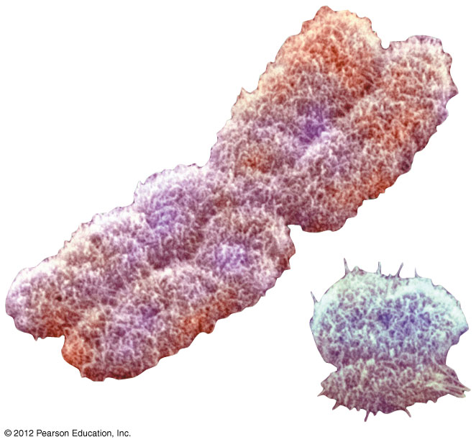
Figure 9.20A
X
Y
Notes:
41
Figure 9.20A The human sex chromosomes

Slide 42
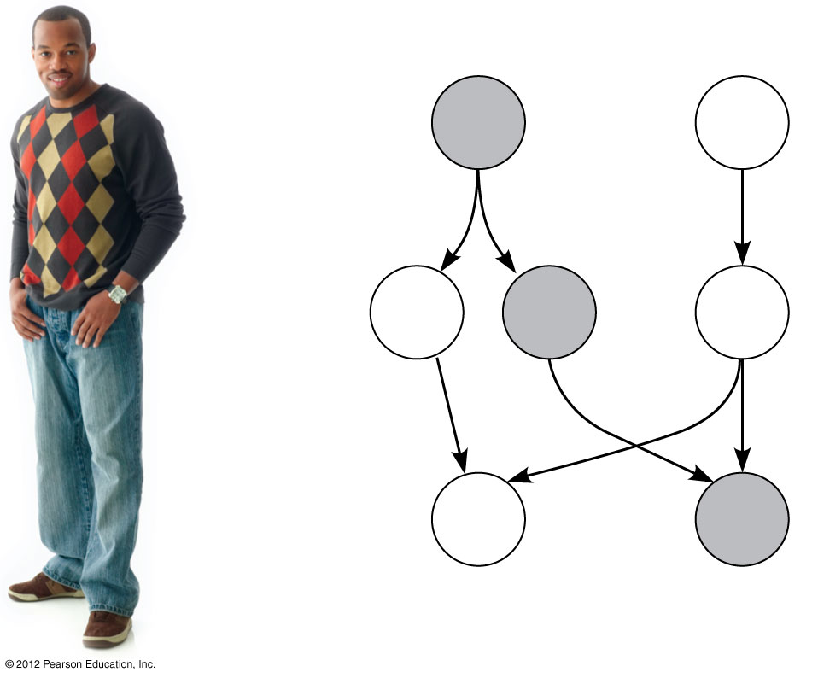
Figure 9.20B
Male
Female
Parents
(diploid)
44
+
XY
44
+
XX
Gametes
(haploid)
22
+
X
22
+
Y
22
+
X
Sperm
Egg
Offspring
(diploid)
44
+
XX
44
+
XY
Female
Male
Notes:
42
Figure 9.20B The X-Y system

Slide 43
9.22 CONNECTION: Human sex-linked disorders affect mostly males
0
  Most sex-linked human disorders are
    due to recessive alleles and
    seen mostly in males.
  A male receiving a single X-linked recessive allele from his mother will have the disorder.
  A female must receive the allele from both parents to be affected.
© 2012 Pearson Education, Inc.
Notes:
43
Student Misconceptions and Concerns
The likelihood that at least some students in larger classes are color-blind is very high. Some of these students might find this interesting and want to discuss it further. However, others might be embarrassed and not wish to self-identify.
Teaching Tips
1. Female hemophiliacs are very rare because both X chromosomes would need to have the recessive trait. Although very unlikely, female hemophiliacs are known. Students may enjoy searching for details of these rare cases. For additional information about hemophilia, consider visiting the website of the National Hemophilia Foundation at www.hemophilia.org.
2. Hemophilia and other genetic diseases may also result from spontaneous mutations in a family with no known history of the disease. Although rare, this possibility should always be considered when tracing the history of an inherited disease.

Slide 44
9.22 CONNECTION: Human sex-linked disorders affect mostly males
0
  Recessive and sex-linked human disorders include
    hemophilia, characterized by excessive bleeding because hemophiliacs lack one or more of the proteins required for blood clotting,
    red-green color blindness, a malfunction of light-sensitive cells in the eyes, and
    Duchenne muscular dystrophy, a condition characterized by a progressive weakening of the muscles and loss of coordination.
© 2012 Pearson Education, Inc.
Notes:
44
Student Misconceptions and Concerns
The likelihood that at least some students in larger classes are color-blind is very high. Some of these students might find this interesting and want to discuss it further. However, others might be embarrassed and not wish to self-identify.
Teaching Tips
1. Female hemophiliacs are very rare because both X chromosomes would need to have the recessive trait. Although very unlikely, female hemophiliacs are known. Students may enjoy searching for details of these rare cases. For additional information about hemophilia, consider visiting the website of the National Hemophilia Foundation at www.hemophilia.org.
2. Hemophilia and other genetic diseases may also result from spontaneous mutations in a family with no known history of the disease. Although rare, this possibility should always be considered when tracing the history of an inherited disease.

Slide 45
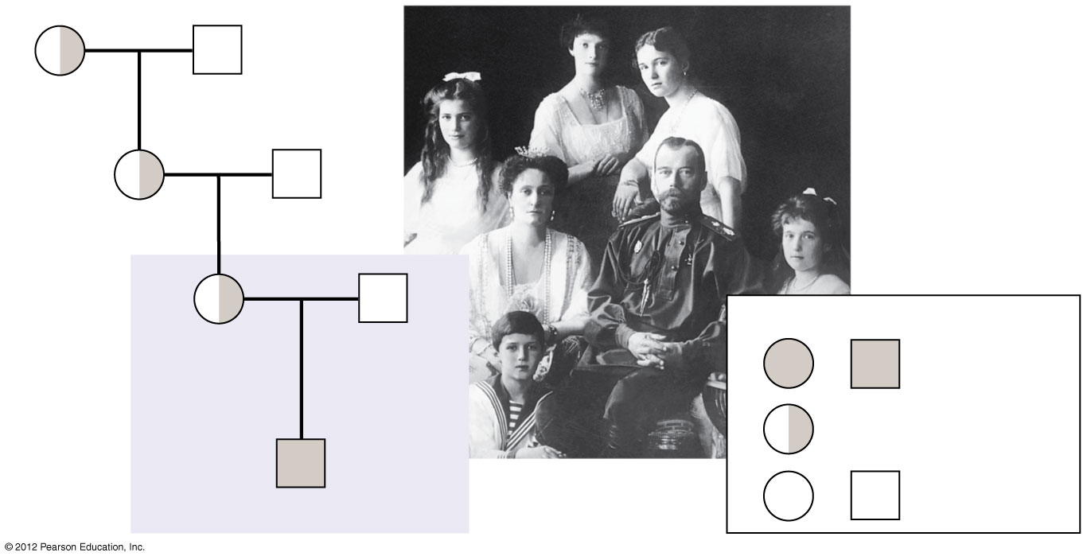
Figure 9.22
Queen
Victoria
Albert
Alice
Louis
Female
Male
Alexandra
Czar
Nicholas II
of Russia
Hemophilia
Carrier
Alexis
Normal
Notes:
45
Figure 9.22 Hemophilia in the royal family of Russia

