Slide 1
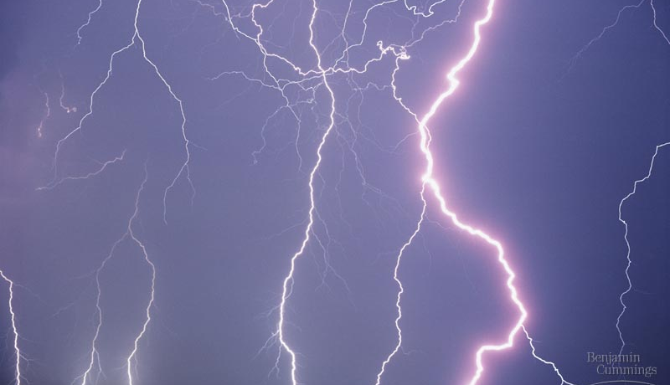
The Evolution of Microbial Life
UNIT IX
In the beginning, there was methane, and there was ammonia, and there was no free oxygen

Slide 2
Biology and Society:
Has Life Been Created in the Lab?
  How did life first arise on Earth?
  To gain insight, scientists have
    synthesized from scratch the entire genome of a small bacterium known as Mycoplasma mycoides and
    transplanted the artificial genome into the cells of a closely related species called Mycoplasma capricolum.

Slide 3
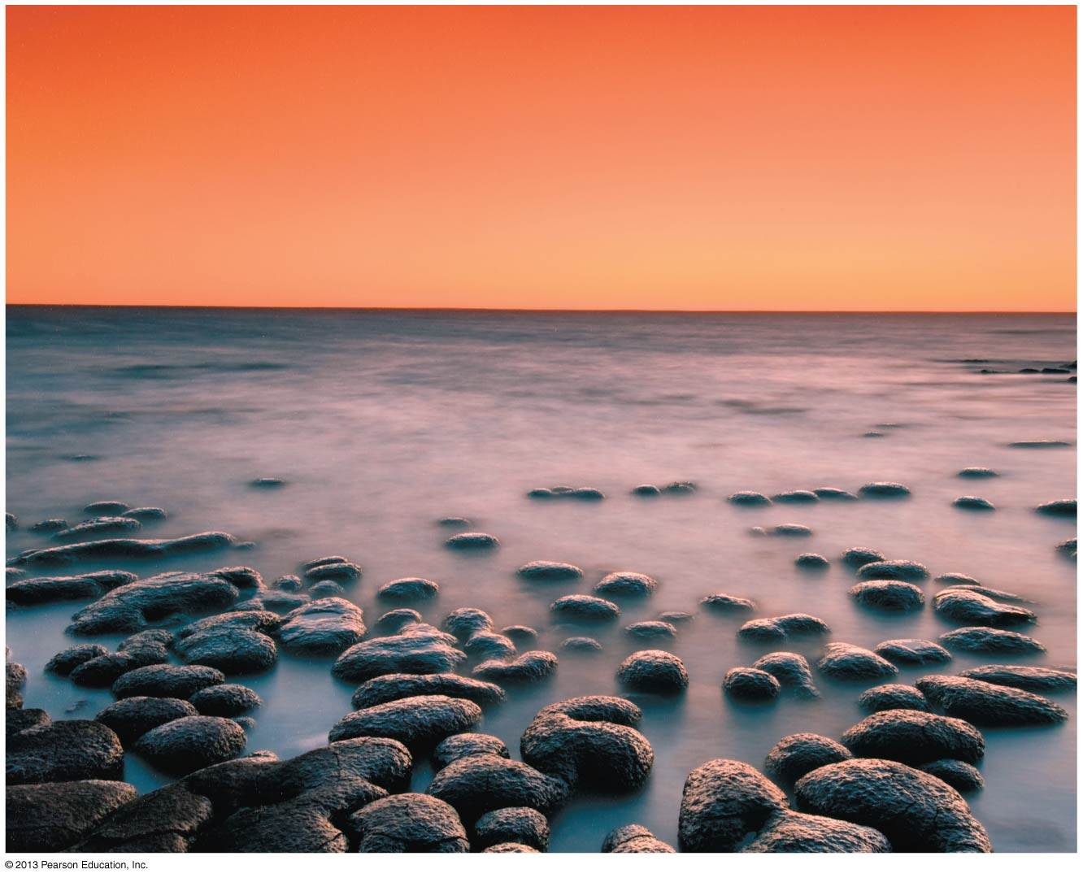
These present-day rocky outcrops closely resemble fossils of prokaryotes at the dawn of life.
The newly installed genome
took over the recipient cells,
began cranking out M. mycoides proteins, and
reproduced to make more cells containing the synthetic M. mycoides genome.

Slide 4
MAJOR EPISODES IN THE HISTORY OF LIFE
  Earth was formed about 4.6 billion years ago.
  Prokaryotes
    evolved by about 3.5 billion years ago,
    began oxygen production about 2.7 billion years ago,
    lived alone for more than a billion years, and
  Single-celled eukaryotes first evolved about 2.1 billion years ago.
  Multicellular eukaryotes first evolved at least 1.2 billion years ago.

Slide 5
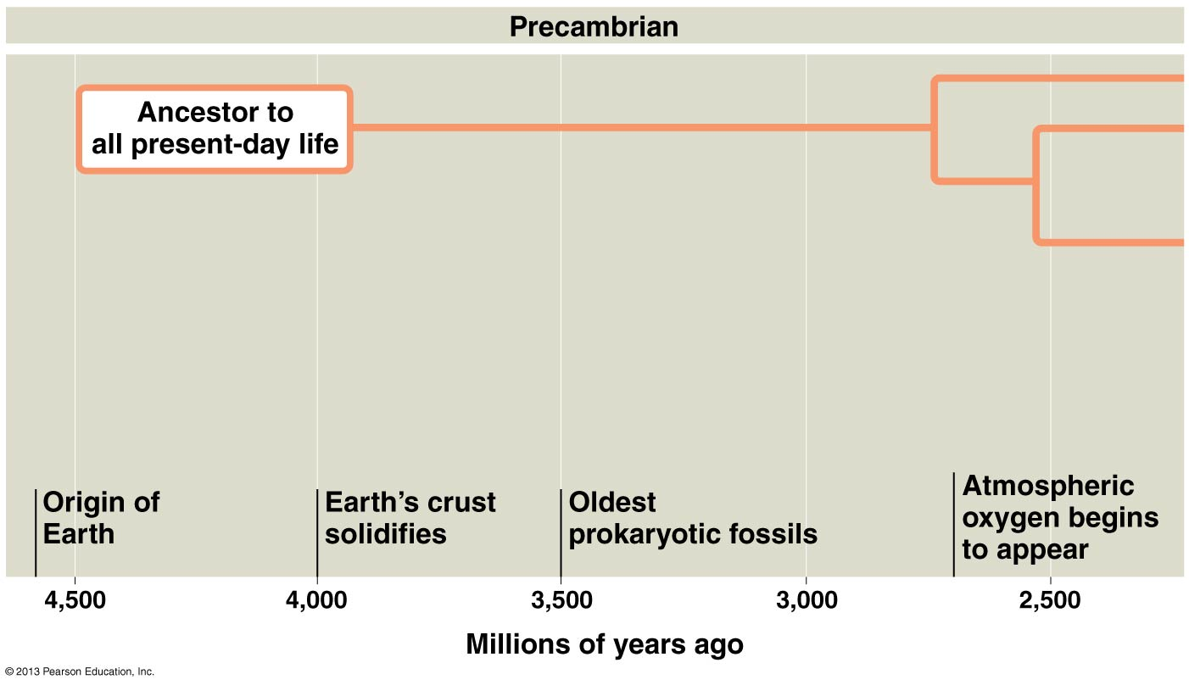

Slide 6
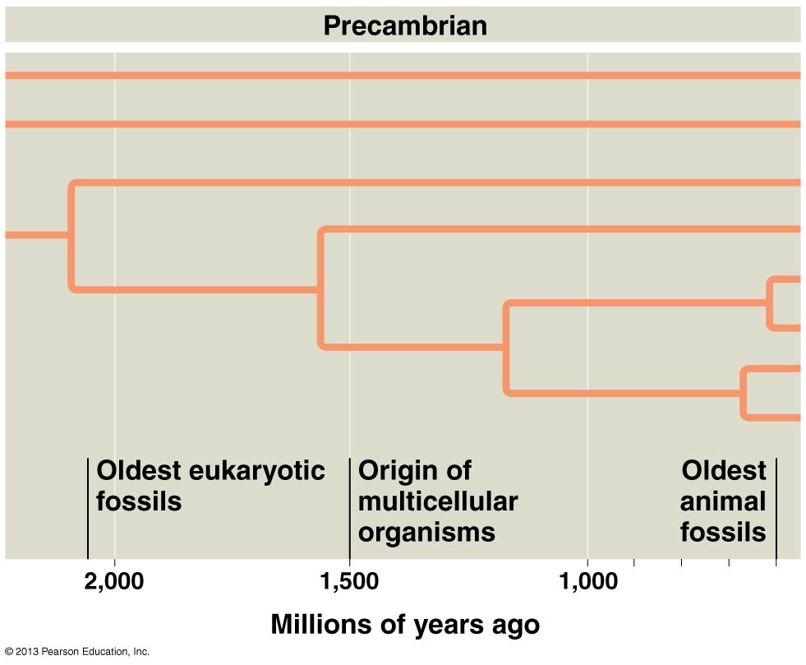

Slide 7
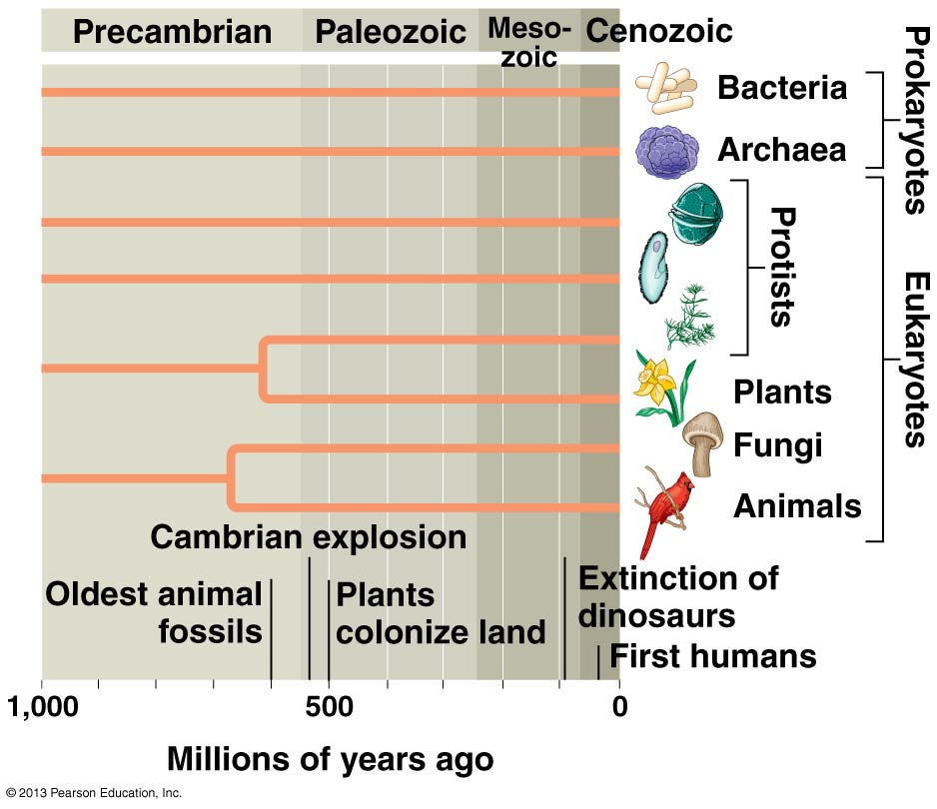

Slide 8
MAJOR EPISODES IN THE HISTORY OF LIFE
  All the major phyla of animals evolved by the end of the Cambrian explosion, which
    began about 540 million years ago and
    lasted about 10 million years.
  Plants and fungi
    first colonized land about 500 million years ago and
    were followed by amphibians that evolved from fish.

Slide 9
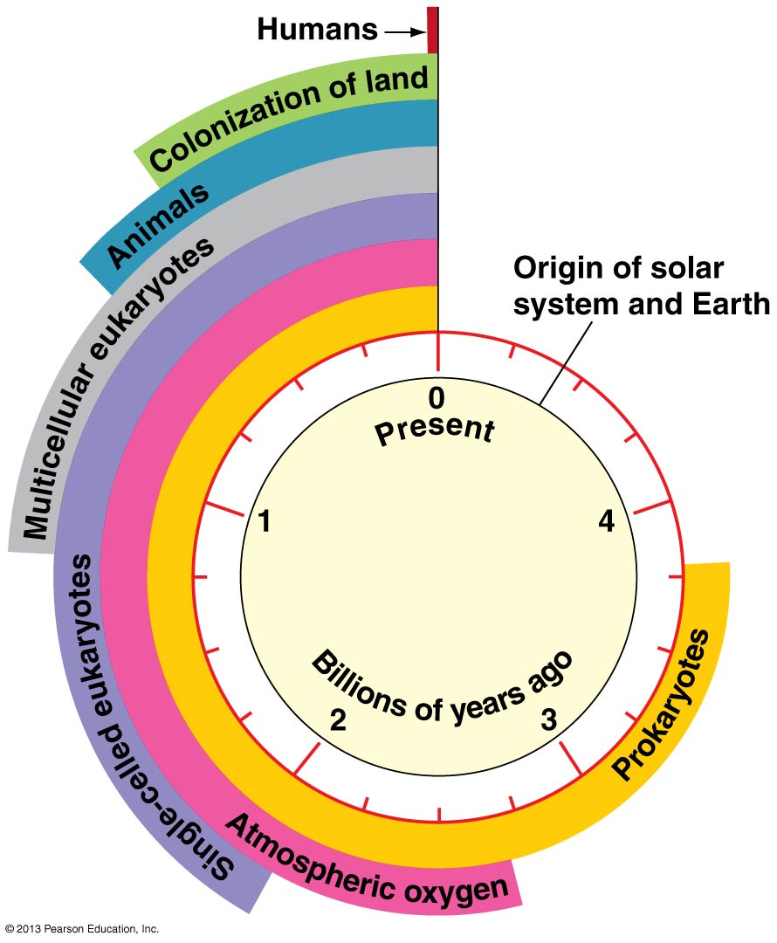
  What if we use a clock analogy to tick down all of the major events in the history of life on Earth?

Slide 10
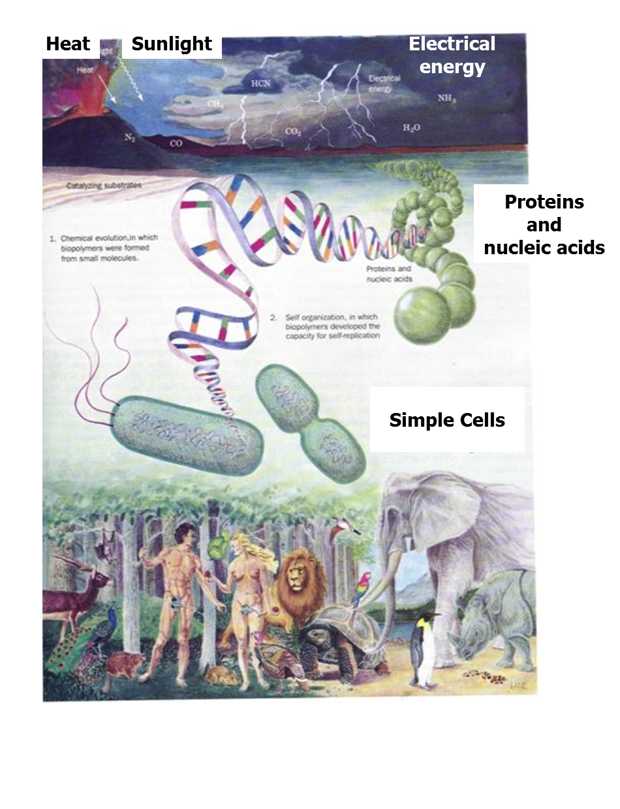
THE ORIGIN OF LIFE
  We may never know for sure how life on Earth began. So let us begin by:
Resolving the Biogenesis Paradox

Slide 11
Resolving the Biogenesis Paradox
  All life today arises by the reproduction of preexisting life, or biogenesis.
  If this is true, how could the first organisms arise?
  From the time of the ancient Greeks until well into the 1800s, it was commonly believed that life regularly arises from nonliving matter, an idea called spontaneous generation.
  Today, most biologists think it is possible that life on early Earth evolved from simple cells produced by
    chemical and
    physical processes.

Slide 12
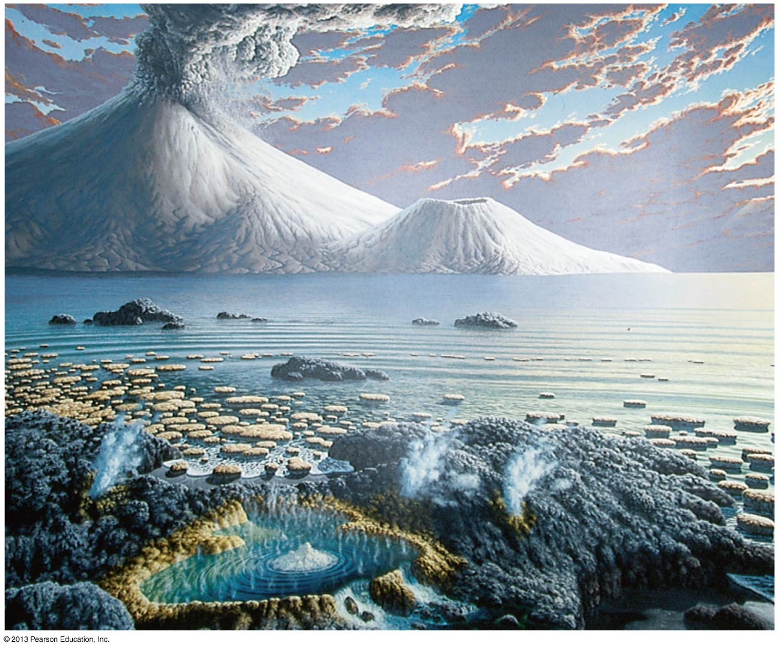
An artist’s rendition of Earth about 3 billion years ago

Slide 13
A Four-Stage Hypothesis for the Origin of Life
  According to one hypothesis, the first organisms were products of chemical evolution in four stages.
Stage 1: Abiotic Synthesis of Organic Monomers (The first stage in the origin of life was the first to be extensively studied in the laboratory)
Scientists asked the question:
Can Biological Monomers Form Spontaneously?
  Observation: Modern biological macromolecules are all composed of elements that were present in abundance on early Earth.
  Question: Could biological molecules arise spontaneously under conditions like those on early Earth?

Slide 14
  Hypothesis: A closed system designed to simulate early Earth conditions could produce biologically important organic molecules from inorganic ingredients.
  Prediction: Organic molecules would form and accumulate.
  Experiment: An apparatus was built to mimic the early Earth atmosphere and included
    hydrogen gas (H₂), methane (CH₄), ammonia (NH₃), and water vapor (H₂O),
    sparks that were discharged into the chamber to mimic the prevalent lightning of early Earth, and
    a condenser that cooled the atmosphere, causing water and dissolved compounds to “rain” into the miniature “sea.”

Slide 15
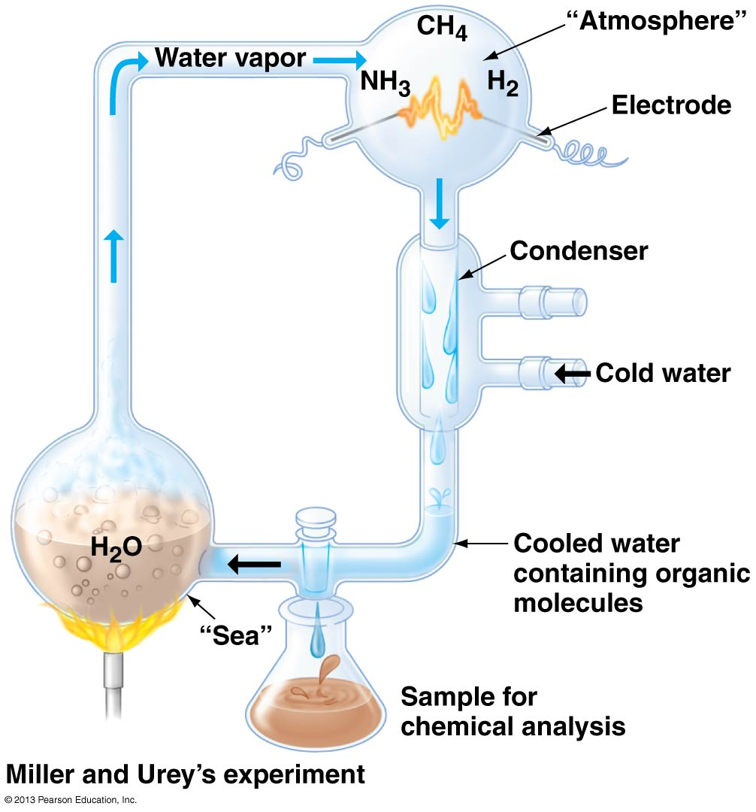

Slide 16
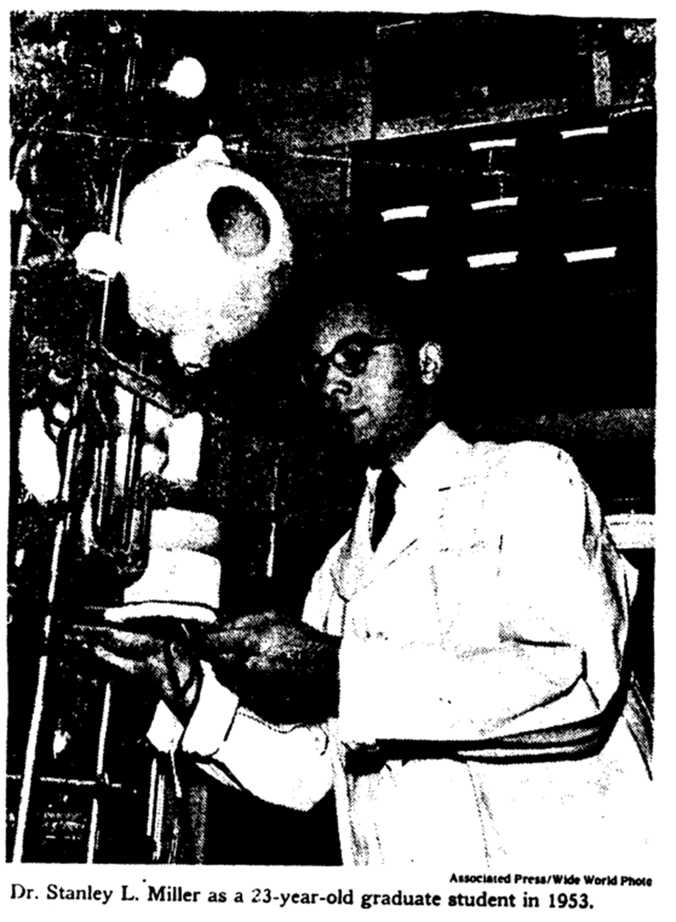
The experiment
Stanley Miller, 1953
Chemistry graduate student at University of Chicago

Slide 17
Results:
After the apparatus had run for a week, an abundance of organic molecules essential for life had collected in the “sea,” including amino acids, the monomers of proteins. The initial Miller-Urey experiment and various similar experiments succeeded in producing
  All 20 amino acids
  Several sugars
  Lipids
  Purines and pyrimidines
  ATP (when phosphate was added)
  These laboratory experiments
    have been repeated and extended by other scientists and
    support the idea that organic molecules could have arisen abiotically on early Earth.

Slide 18
Stage 2: Abiotic Synthesis of Polymers
  Researchers have brought about the polymerization of monomers to form polymers, such as proteins and nucleic acids, by dripping solutions of organic monomers onto
    hot sand,
    clay, or
    rock.

Slide 19
Stage 3: Formation of Pre-Cells
  A key step in the origin of life was the isolation of a collection of abiotically created molecules within a membrane.
  Laboratory experiments demonstrate that pre-cells could have formed spontaneously from abiotically produced organic compounds.
  Such pre-cells produced in the laboratory display some lifelike properties. They
    have a selectively permeable surface,
    can grow by absorbing molecules from their surroundings, and
    swell or shrink when placed in solutions of different salt concentrations.

Slide 20
Stage 4: Origin of Self-Replicating Molecules
  Life is defined partly by the process of inheritance, which is based on self-replicating molecules.
  One hypothesis is that the first genes were short strands of RNA that replicated themselves
    without the assistance of proteins,
    perhaps using RNAs that can act as enzymes, called ribozymes.

