Slide 1
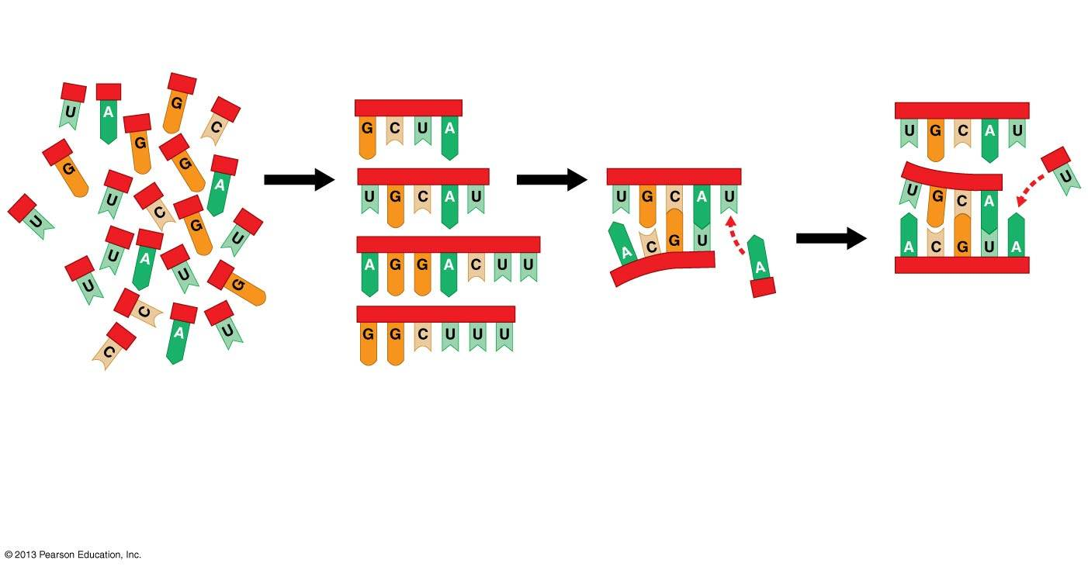
Self-replication of RNA “genes”

Slide 2
From Chemical Evolution to Darwinian Evolution
  Over millions of years
    natural selection favored the most efficient pre-cells and
    the first prokaryotic cells evolved.
  Prokaryotes lived and evolved all alone on Earth for about 2 billion years.
  Prokaryotes
    are found wherever there is life,
    have a collective biomass that is at least ten times that of all eukaryotes,
    thrive in habitats too cold, too hot, too salty, too acidic, or too alkaline for any eukaryote,
    cause about half of all human diseases, and
    are more commonly benign or beneficial.

Slide 3
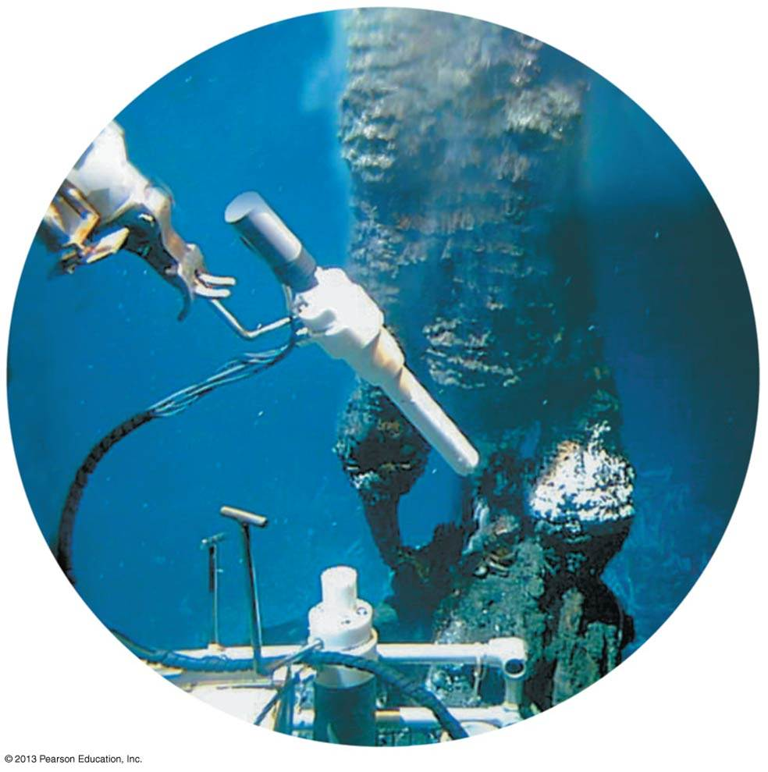
A window to early life?

Slide 4
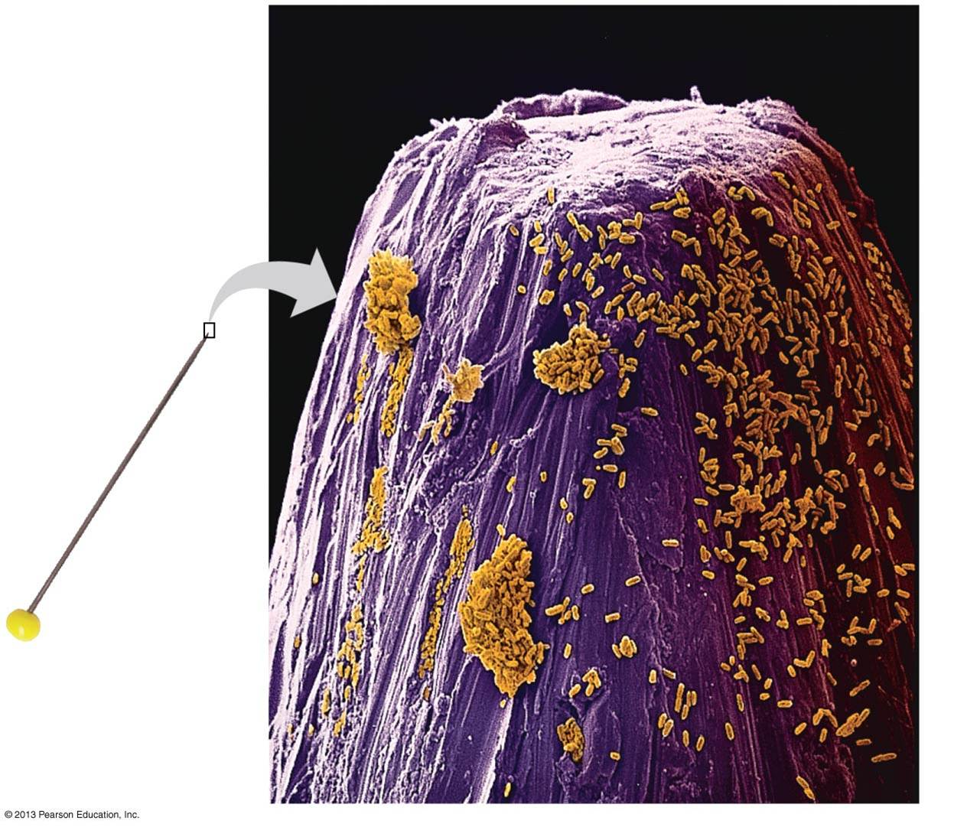
They’re Everywhere!
  Compared to eukaryotes, prokaryotes are
    much more abundant and
    typically much smaller.
The picture to the right shows Bacteria on the point of a pin.
  Prokaryotes living in soil and at the bottom of lakes, rivers, and oceans help to decompose dead organisms and other organic waste material, returning vital chemical elements to the environment.

Slide 5
The Structure and Function of Prokaryotes
  Prokaryotic cells
    lack a membrane-enclosed nucleus,
    lack other membrane-enclosed organelles,
    typically have cell walls exterior to their plasma membranes, but
    display an enormous range of diversity.

Slide 6
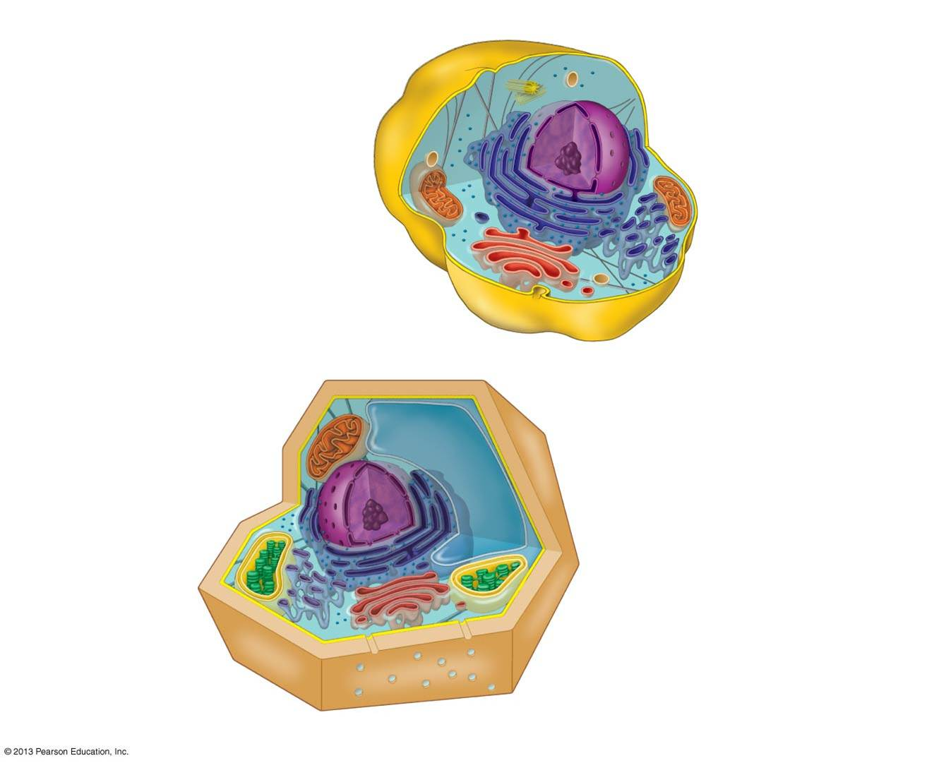
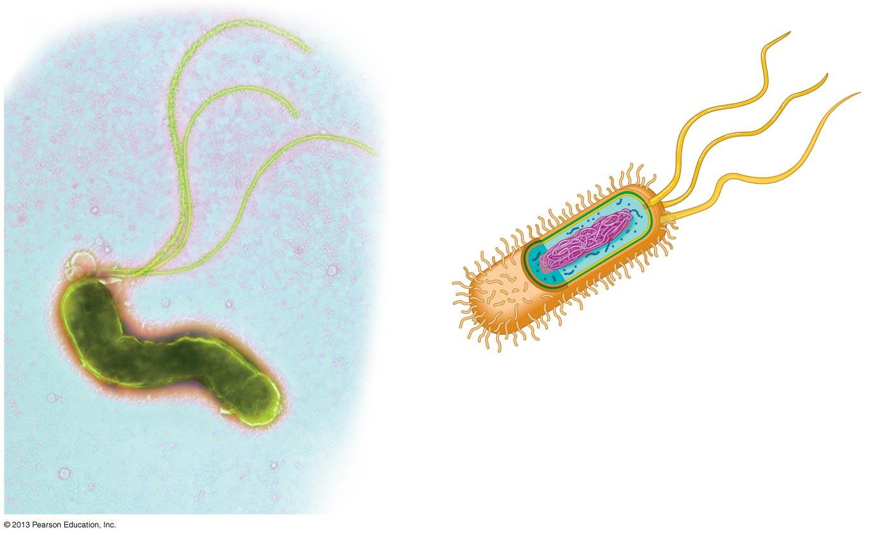
Comparison of Prokaryotic vs. Eukaryotic Cells
Prokaryotic
Eukaryotic

Slide 7
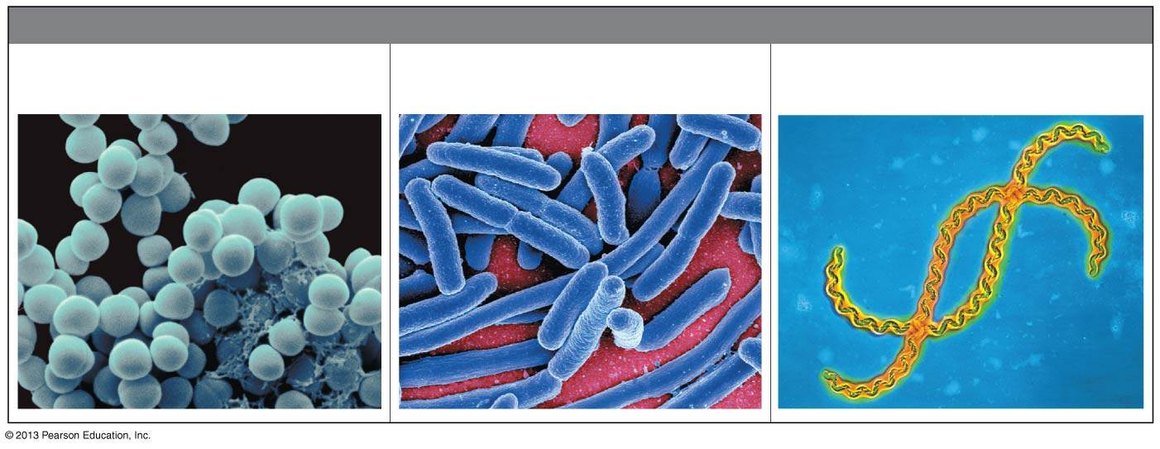
Prokaryotic Forms
  The three most common shapes of prokaryotes are
    spherical (cocci),
    rod-shaped (bacilli), and
    spiral or curved

Slide 8
Prokaryotic Forms
  All prokaryotes are unicellular.
  Some species
    exist as groups of two or more cells,
    exhibit a simple division of labor among specialized cell types, or
    are very large, dwarfing most eukaryotic cells.
  About half of all prokaryotes are mobile, and many of these travel using one or more flagella.

Slide 9
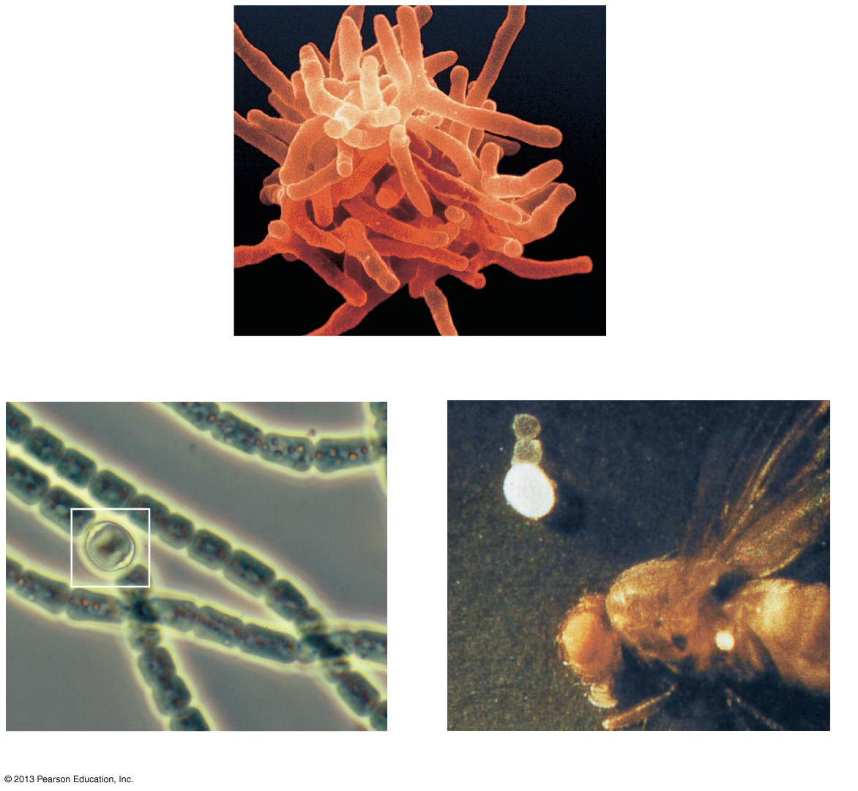
A diversity of prokaryotic shapes and sizes

Slide 10
Prokaryotic Forms(cont.)
  About half of all prokaryotes are mobile, and many of these travel using one or more flagella.
  In many natural environments, prokaryotes attach to surfaces in a highly organized colony called a biofilm, which
    may consist of one or several species of prokaryotes,
    may include protists and fungi,
    can show a division of labor and defense against invaders, and
    can form on almost any type of surface, including
      rocks,
      metal,
      plastic, and
      organic material including teeth.

Slide 11
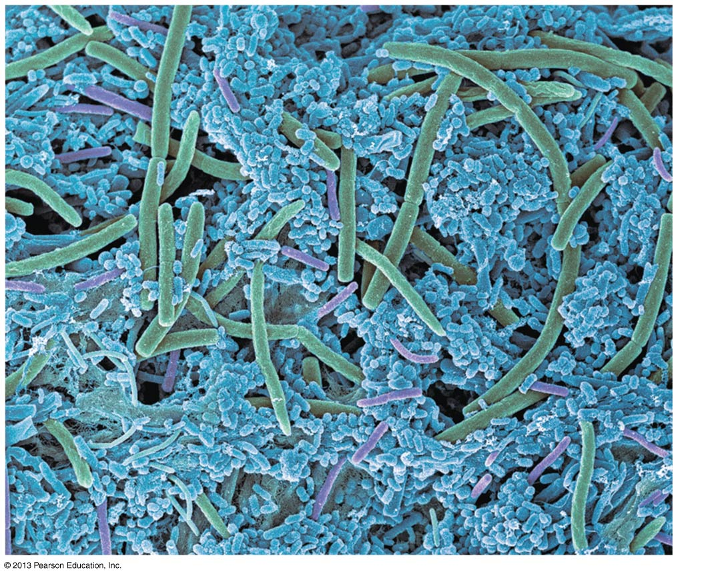
Dental plaque, a biofilm that forms on teeth

Slide 12
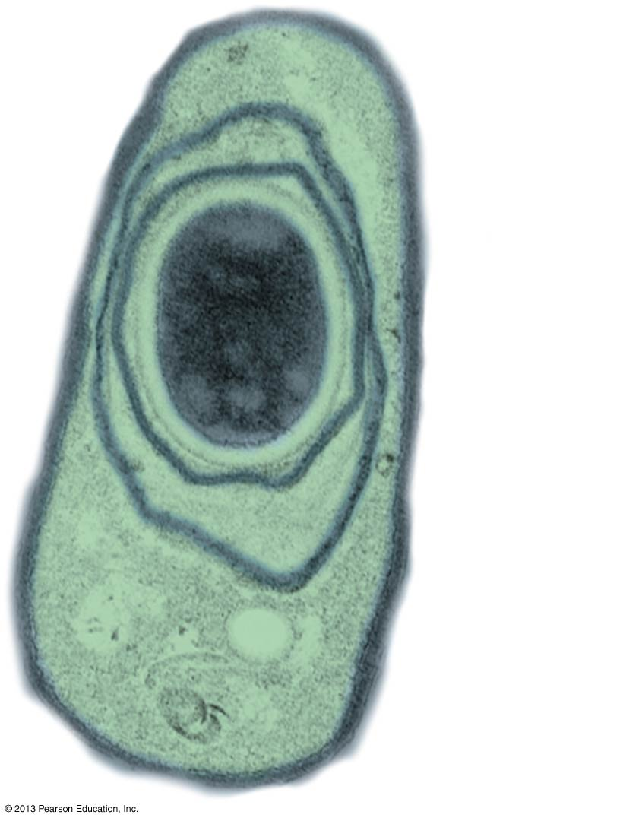
Prokaryotic Reproduction
  Most prokaryotes can reproduce
    by dividing in half by binary fission and
    at very high rates if conditions are favorable.
  Some prokaryotes form endospores, which are
    thick-coated, protective cells
    produced when the prokaryote is exposed to unfavorable conditions.
An endospore in an anthrax bacterium
Endospore

Slide 13
Prokaryotic Nutrition
  Biologists use the phrase “mode of nutrition” to describe how organisms obtain energy and carbon.
    Energy
      Phototrophs obtain energy from light.
      Chemotrophs obtain energy from environmental chemicals.
    Carbon
      Autotrophs obtain carbon from carbon dioxide (CO₂).
      Heterotrophs obtain carbon from at least one organic nutrient—the sugar glucose, for instance.

Slide 14
Prokaryotic Nutrition
  We can group all organisms according to the four major modes of nutrition if we combine the
    energy source (phototroph versus chemotroph) and
    carbon source (autotroph versus heterotroph).
  Dominant among multicellular organisms are
    photoautotrophs and
    chemoheterotrophs.
  The other two modes are used only by certain prokaryotes.

Slide 15
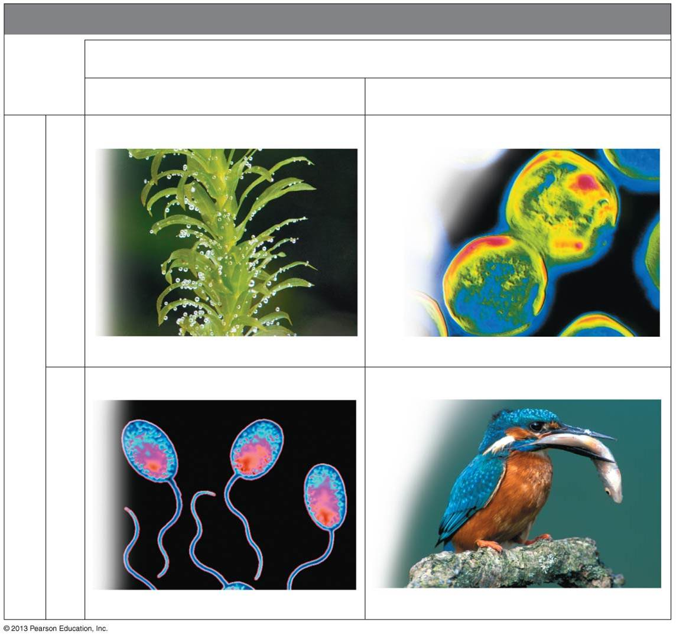
Modes of Nutrition
ENERGY SOURCE
LIGHT
CHEMICAL
Photoautotroph
Chemoautotroph
CO2
Elodea
Bacteria from hot spring
Chemo heterotroph
PHOTOHETEROTROPH
organicCmpds.
Rhodopseudomona
KINGFISHER

Slide 16
The Two Main Branches of Prokaryotic Evolution: Bacteria and Archaea
  By comparing diverse prokaryotes at the molecular level, biologists have identified two major branches of prokaryotic evolution:
    bacteria and
    archaea (more closely related to eukaryotes).
  Thus, life is organized into three domains:
    Bacteria,
    Archaea, and
    Eukarya

Slide 17
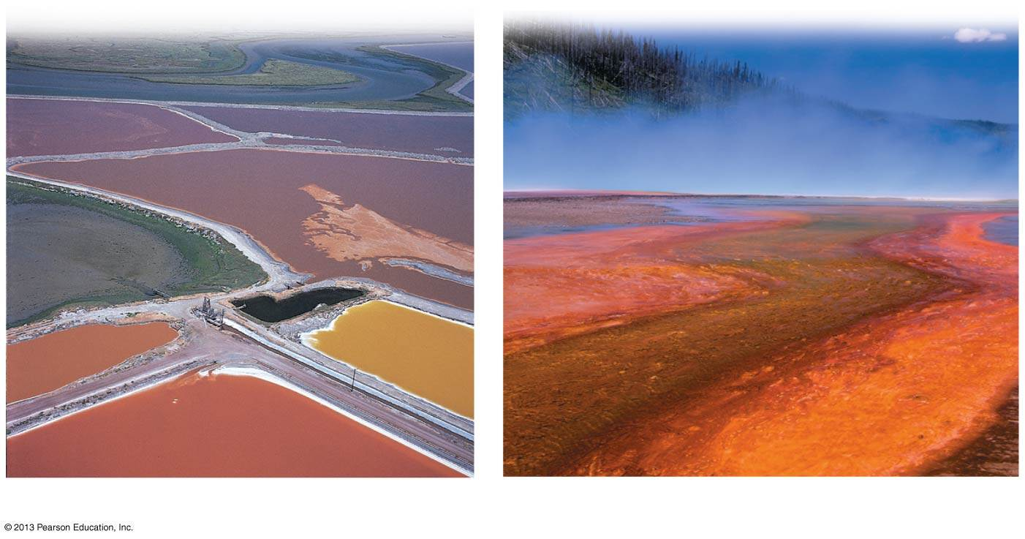
The Two Main Branches of Prokaryotic Evolution: Bacteria and Archaea
  Some archaea are “extremophiles.”
    Halophiles thrive in salty environments.
    Thermophiles inhabit very hot water.
    Methanogens
      inhabit the bottoms of lakes and swamps and
      aid digestion in cattle and deer.
Salt-loving archaea
Heat-loving archaea

Slide 18
Bacteria and Disease
Bacteria That Cause Disease
  Bacteria and other organisms that cause disease are called pathogens.
  Most pathogenic bacteria produce poisons.
    Exotoxins are proteins bacterial cells secrete into their environment.
    Endotoxins are
      not cell secretions but instead
      chemical components of the outer membrane of certain bacteria.

Slide 19
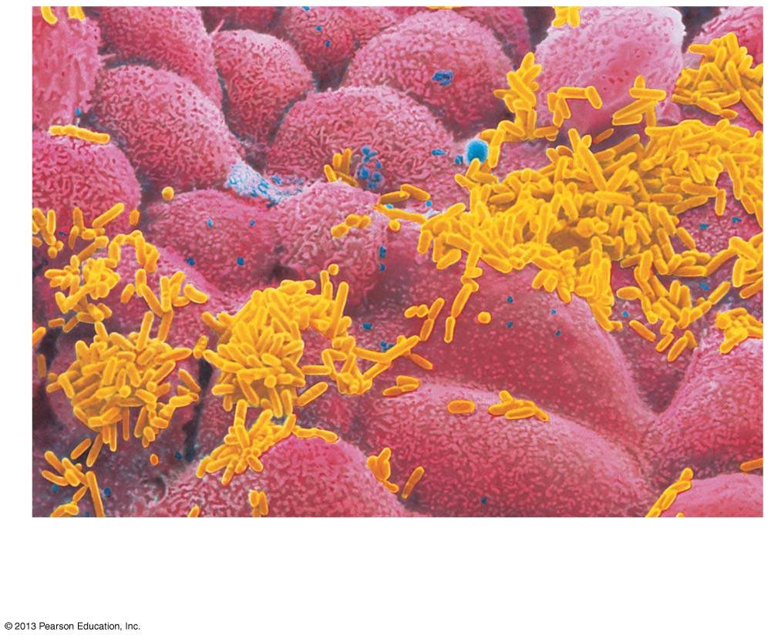
Haemophilus
influenzae
Cells of nasal
lining

Slide 20
Bacteria That Cause Disease
  The best defenses against bacterial disease are
    sanitation,
    antibiotics, and
    education.
  Lyme disease is
    caused by bacteria carried by ticks and
    treated with antibiotics, if detected early.

Slide 21
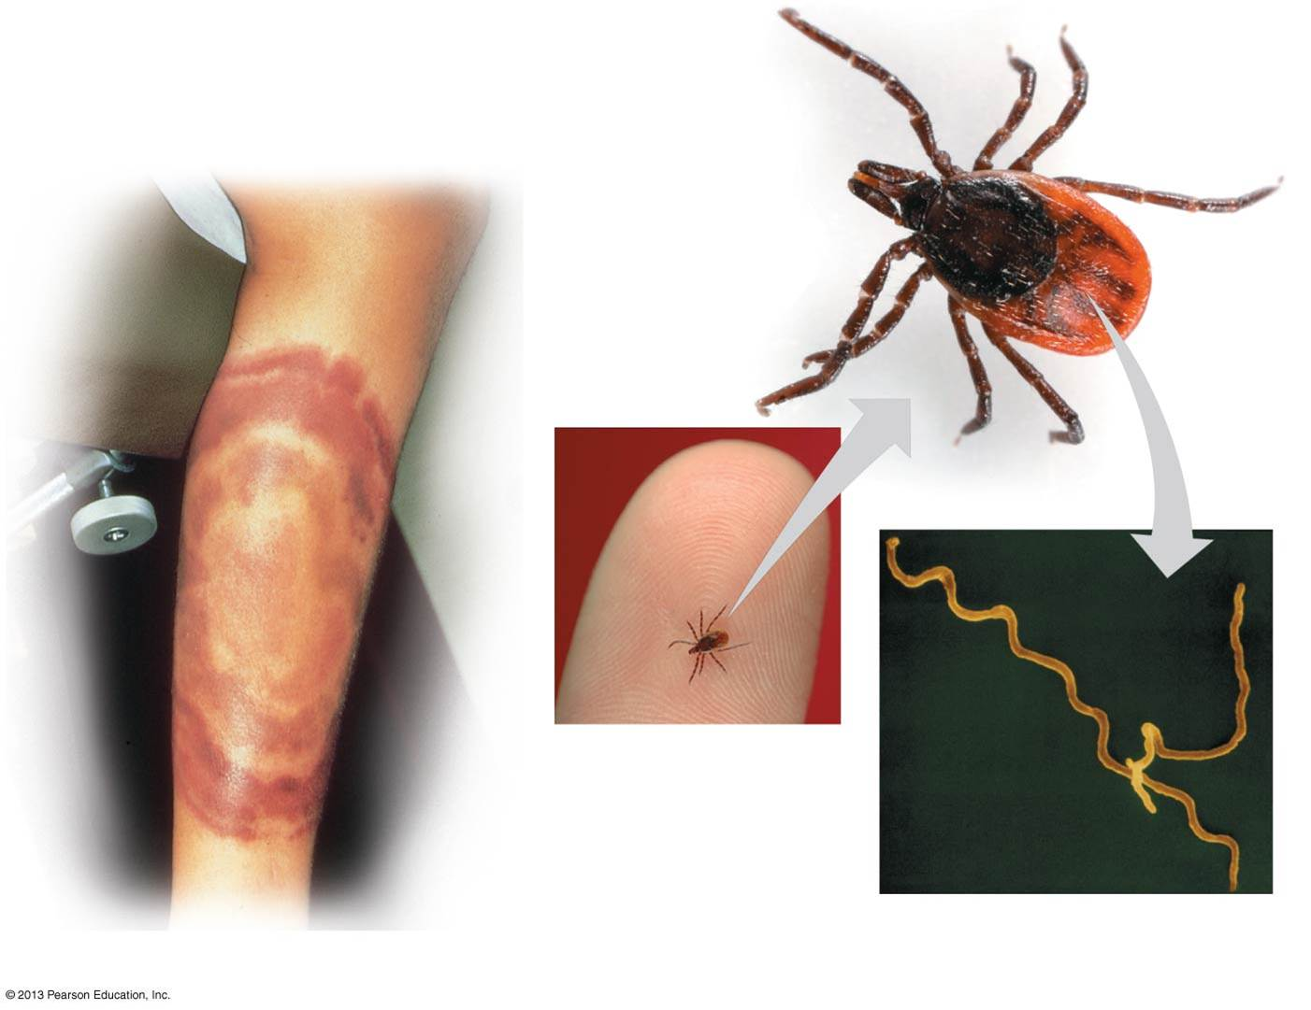
Tick that carries
the Lyme disease
bacterium
Spirochete that causes
Lyme disease
Bull’s-eye” rash

Slide 22
Biological Weapons
  In October 2001, endospores of the bacterium that causes anthrax were mailed to members of the news media and the U.S. Senate.
  Five people died from this attack.
  Another bacterium considered to have dangerous potential as a weapon is Clostridium botulinum, producer of the exotoxin botulinum, which
    blocks transmission of nerve signals that cause muscle contraction and
    is the deadliest poison on Earth.

Slide 23
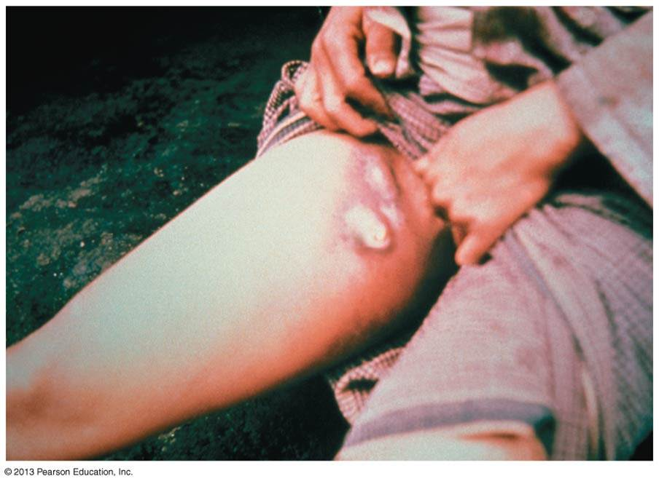
Biological Weapons
  The bacterium that causes plague
    is also a potential biological weapon,
    is carried by rodents, and transmitted by fleas,
    produces egg-size swellings called buboes under the skin, and
    can be treated with antibiotics if diagnosed early

Slide 24
The Ecological Impact of Prokaryotes
  Pathogenic bacteria are in the minority among prokaryotes.
  Far more common are species that are essential to our well-being, either directly or indirectly.
  Prokaryotes play essential roles in
    chemical cycles in the environment and
    the breakdown of organic wastes and dead organisms.
  Bioremediation is the use of organisms to remove pollutants from
    water,
    air, and
    soil.
  A familiar example is the use of prokaryotic decomposers in sewage treatment.
  Certain bacteria
    can decompose petroleum and
    are useful in cleaning up oil spills.

Slide 25
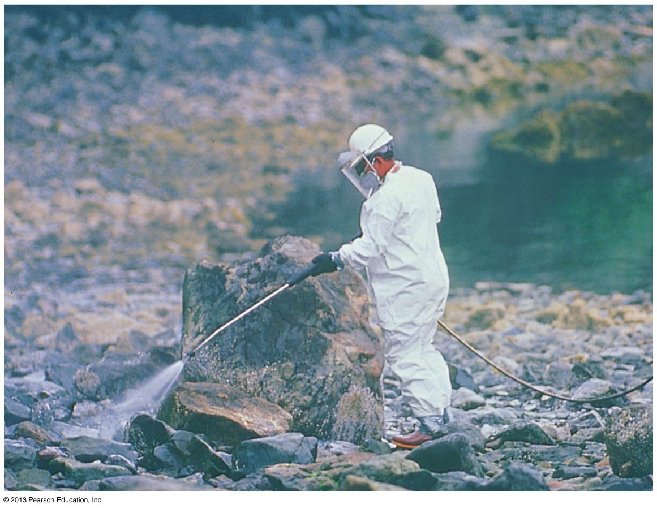
Treatment of an oil spill in Alaska

Slide 26
PROTISTS
  Protists are
    eukaryotes that are not fungi, animals, or plants,
    mostly unicellular, and
    ancestral to all other eukaryotes.
  The group called protists
    consists of multiple clades but
    remains a convenient term to refer to eukaryotes that are not plants, animals, or fungi.

Slide 27
The Origin of Eukaryotic Cells
  Eukaryotic cells evolved by
    the infolding of the plasma membrane of a prokaryotic cell to form the endomembrane system and
    a process known as endosymbiosis.
  Symbiosis is a more general association between organisms of two or more species.
  Endosymbiosis
    refers to one species living inside another host species and
    is the process by which eukaryotes gained mitochondria and chloroplasts.

Slide 28
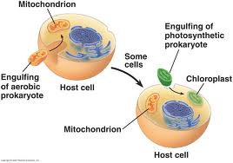
Endosymbiosis Hypothesis

Slide 29
The Diversity of Protists
  Protists obtain their nutrition in a variety of ways.
    Algae are autotrophs, producing their food by photosynthesis.
    Other protists are heterotrophs.
      Some protists eat bacteria or other protists.
      Other protists are fungus-like and obtain organic molecules by absorption.
      Parasites derive their nutrition from a living host, which is harmed by the interaction. Parasitic trypanosomes infect blood and cause sleeping sickness.

Slide 30
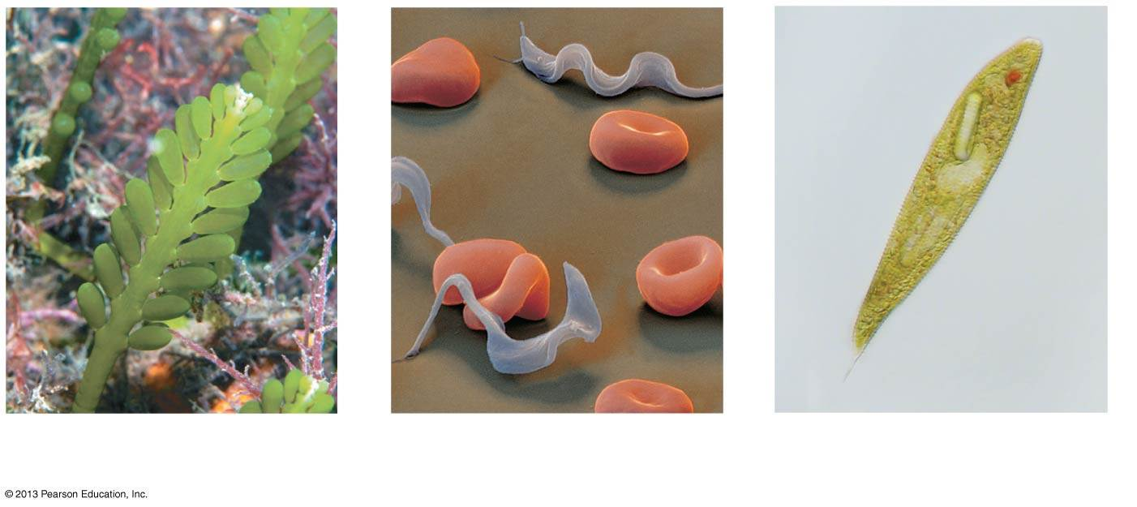
The Diversity of Protists
(a) An autotroph: Caulerpa,
a multicellular alga
A heterotroph: parasitic
trypanosome
A mixotroph: Euglena

Slide 31
The Diversity of Protists
  Protist habitats are diverse and include
    oceans, lakes, and ponds,
    damp soil and leaf litter, and
    the bodies of host organisms with which they share mutually beneficial relationships, such as
      unicellular algae and reef-building coral animals, and
      cellulose-digesting protists and termites.
  Protists that live primarily by ingesting food are called protozoans.
  Protozoans with flagella are called flagellates and
    are typically free-living, but
    some are nasty parasites.

Slide 32
Protozoans
  Amoebas are characterized by
    great flexibility in their body shape and
    the absence of permanent organelles for locomotion.
  Most species move and feed by means of pseudopodia (singular, pseudopodium), temporary extensions of the cell.
  Ciliates are protozoans that
    are named for their use of hair-like structures called cilia to move and sweep food into their mouths,
    are mostly free-living (nonparasitic), such as the freshwater ciliate Paramecium, and
    include heterotrophs and mixotrophs.

Slide 33
Evolution Connection:
The Origin of Multicellular Life
  Multicellular organisms have
    specialized cells that are dependent on each other and perform different functions, such as
      feeding,
      waste disposal,
      gas exchange, and
      protection.
  Colonial protists likely formed the evolutionary links between
    unicellular and
    multicellular organisms.
  The colonial green alga Volvox demonstrates one level of specialization and cooperation.

Slide 34
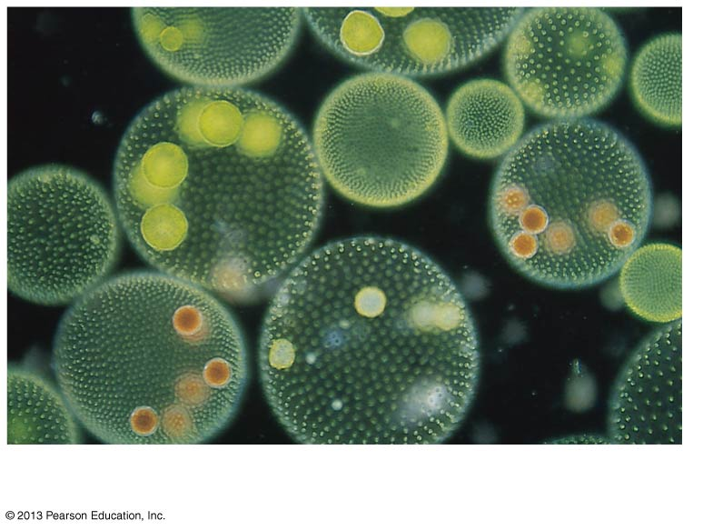
Volvox, a colonial green alga

Slide 35
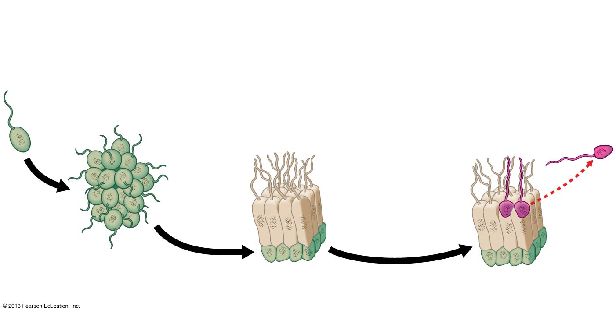
A model for the evolution of multicellular organisms from unicellular protists
An ancestral
colony may have
formed when a
cell divided and
remained
attached to
its offspring.
Cells in the
colony may
have become
specialized and
interdependent
Additional
specialization may
have led to sex cells
(gametes) and
nonreproductive
cells (somatic cells).
Unicellular
protist
Gamete
Food-
synthesizing
cells

Slide 36
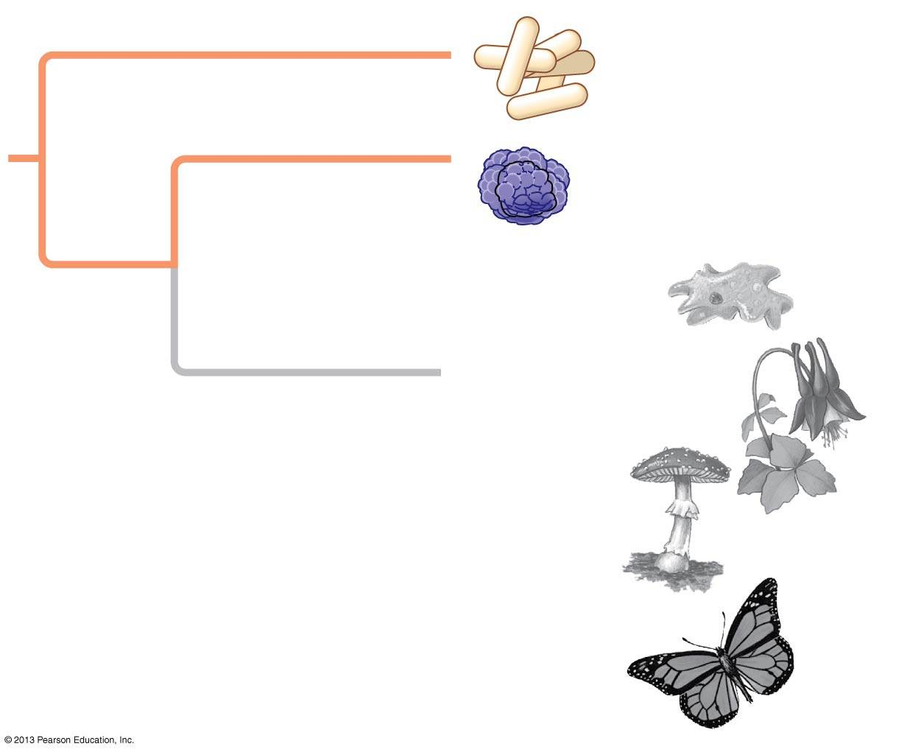
Review of main concepts

