Slide 1
Viruses, Bacteria & Genetic Engineering

Slide 2
VIRUSES AND OTHER NONCELLULAR INFECTIOUS AGENTS
  Viruses share some, but not all, characteristics of living organisms. Viruses
    possess genetic material in the form of nucleic acids wrapped in a protein coat,
    are not cellular, and
    cannot reproduce on their own.

Slide 3
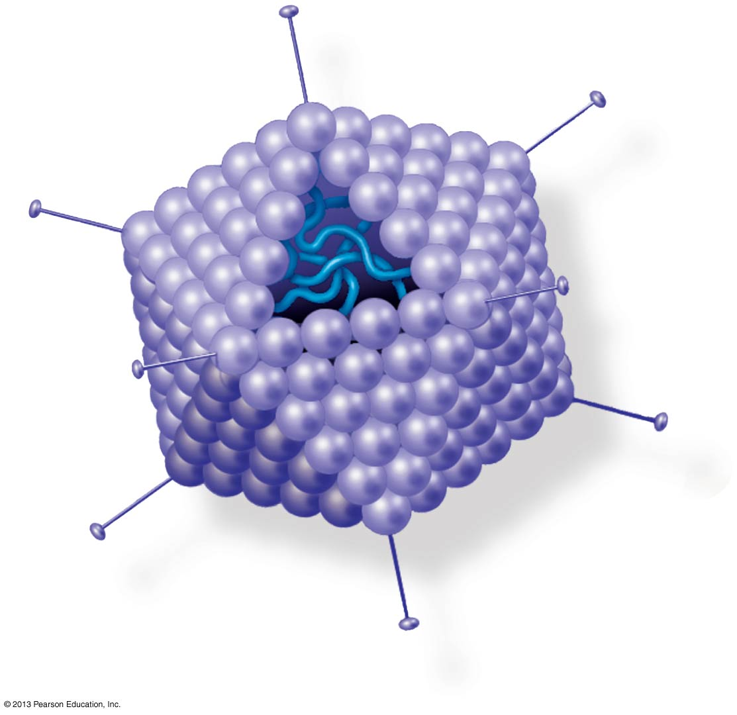
Figure 10.24a
Protein coat
DNA
Notes:
Figure 10.24 Adenovirus (part 1)

Slide 4
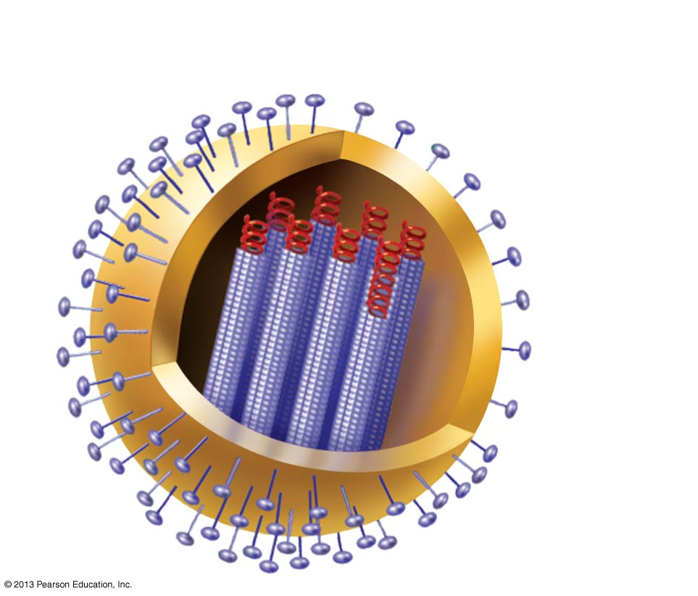
Figure 10.28
Protein spike
Membranous
envelope
RNA
Protein coat
Influenza virus
Notes:
Figure 10.28 An influenza virus

Slide 5
Bacteriaphages
  Bacteriophages, or phages, are viruses that attack bacteria.
  Phages consist of a molecule of DNA, enclosed within an elaborate structure made of proteins.

Slide 6
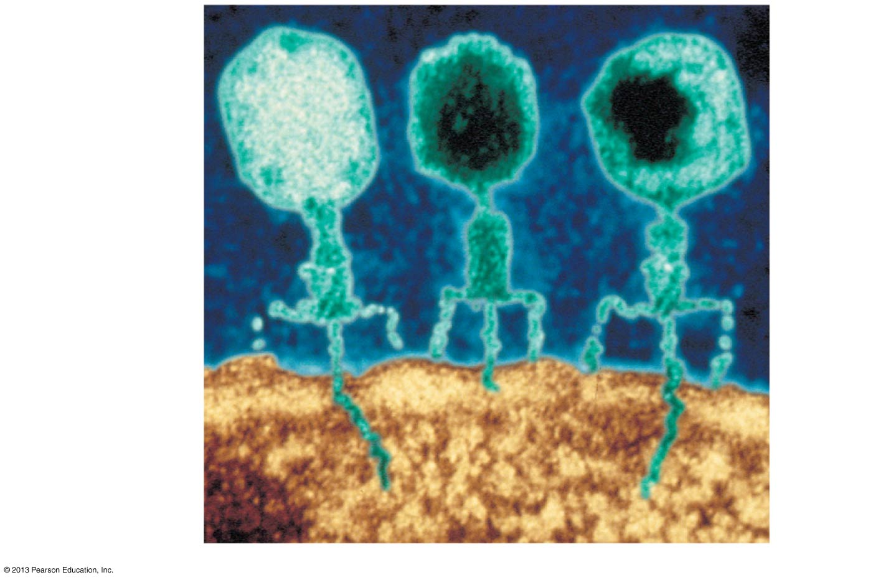
Figure 10.25
Head
Bacteriophage
(200 nm tall)
Tail
Tail
fiber
Bacterial cell
DNA
of virus
Colorized TEM
Notes:
Figure 10.25 Bacteriophages (viruses) infecting a bacterial cell

Slide 7
Two types of Viruses
Lytic Viruses
Lysogenic Viruses

Slide 8
Life cycle of a Lytic Virus
Attaches to cell by tail fibers
Nucleic acid is deposited into cell and attaches to the chromosome of cell
Cell will make new virus parts.
Host cell will eventually lyse (burst) releasing 100’s of virus particles
New viruses invade other cells
Examples cold, flu, mumps, measles, chicken pox

Slide 9
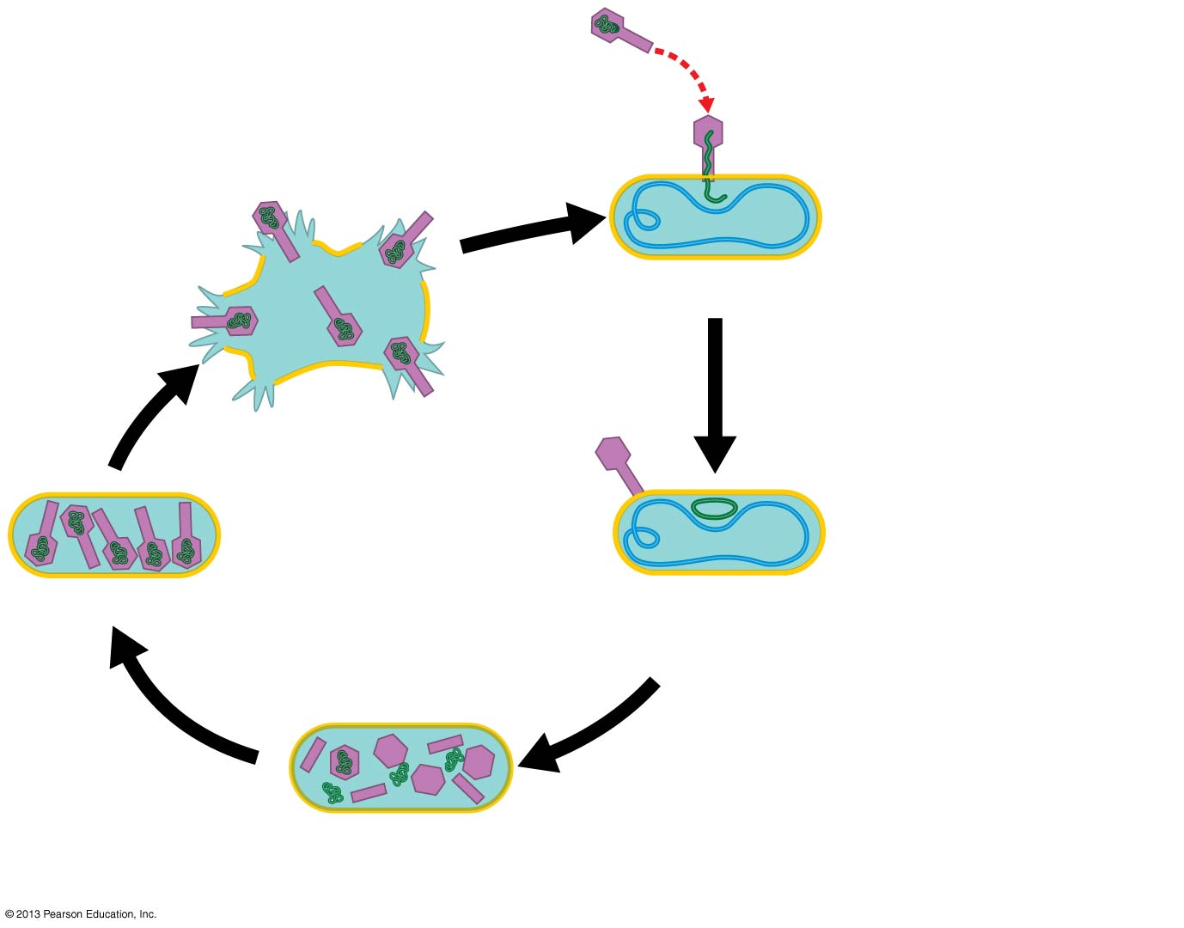
Figure 10.26a
Phage
1
Phage
attaches
to cell.
Phage DNA
4
Cell lyses,
releasing
phages.
Bacterial
chromosome (DNA)
Phage injects DNA
LYTIC CYCLE
Phages assemble
2
Phage DNA
circularizes.
3
New phage DNA and
proteins are synthesized.
Notes:
Figure 10.26 Alternative phage reproductive cycles (part 1)

Slide 10
Life Cycle of Lysogenic viruses
Inserts nucleic acid into cell.
Viral DNA (prophage) can stay for yrs. and block entry of other viruses.
Host cell can divide and carry with it the viral DNA.
One day the virus becomes activated (trigger) and goes into the lytic cycle.
Examples HIV, herpes, cold sores

Slide 11
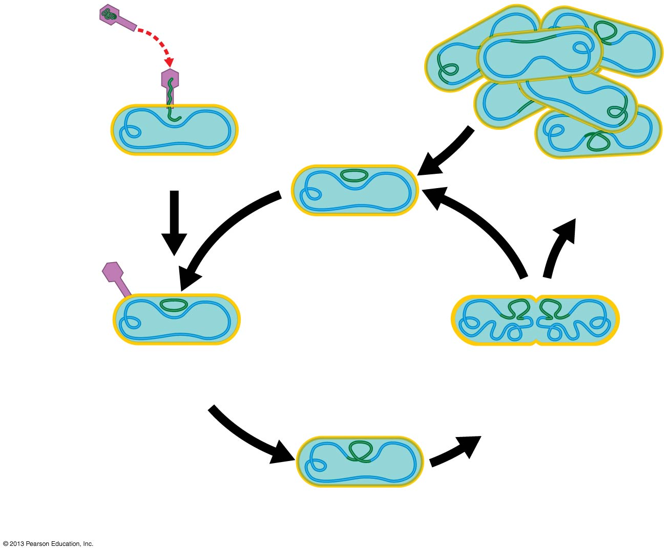
Figure 10.26b
Phage
1
Phage
attaches
to cell.
Phage DNA
Bacterial
chromosome (DNA)
Phage injects DNA
Many cell
divisions
7
Prophage
may leave
chromosome.
LYSOGENIC
CYCLE
2
Phage DNA
circularizes.
6
Prophage replicated
at each normal cell
division.
Prophage
5
Phage DNA is inserted into
the bacterial chromosome.
Notes:
Figure 10.26 Alternative phage reproductive cycles (part 2)

Slide 12
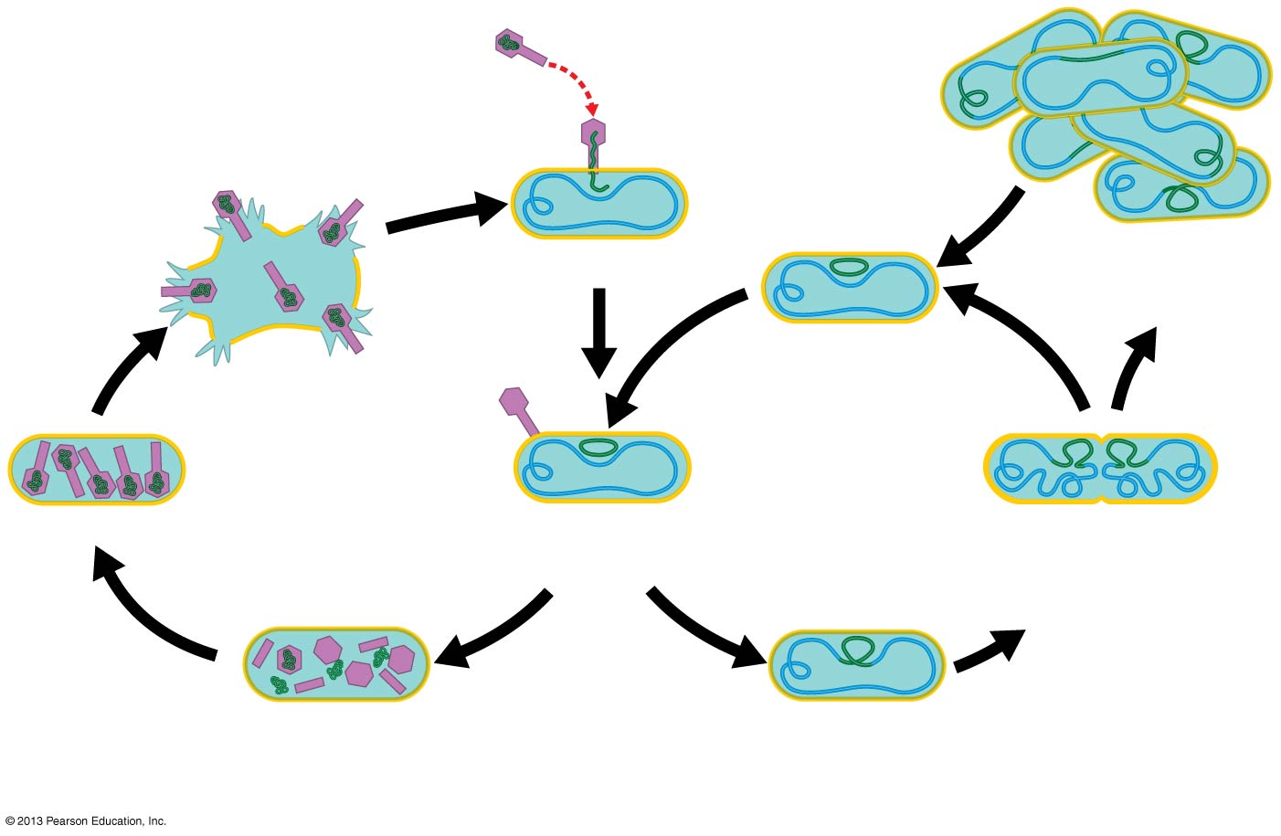
Figure 10.26
Phage
1
Phage
attaches
to cell.
Phage DNA
4
Cell lyses,
releasing
phages.
Bacterial
chromosome (DNA)
Phage injects DNA
Many cell
divisions
7
Prophage
may leave
chromosome.
LYTIC CYCLE
LYSOGENIC
CYCLE
Phages assemble
2
Phage DNA
circularizes.
6
Prophage replicated
at each normal cell
division.
Prophage
OR
3
New phage DNA
and proteins are
synthesized.
5
Phage DNA is inserted
into the bacterial
chromosome.
Notes:
Figure 10.26 Alternative phage reproductive cycles

Slide 13
Plant viruses
  Viruses that infect plants can
    stunt growth and
    diminish plant yields.
  Most known plant viruses have RNA rather than DNA as their genetic material.
  Viral plant diseases
    have no cure and
    are best prevented by producing plants that resist viral infection.

Slide 14
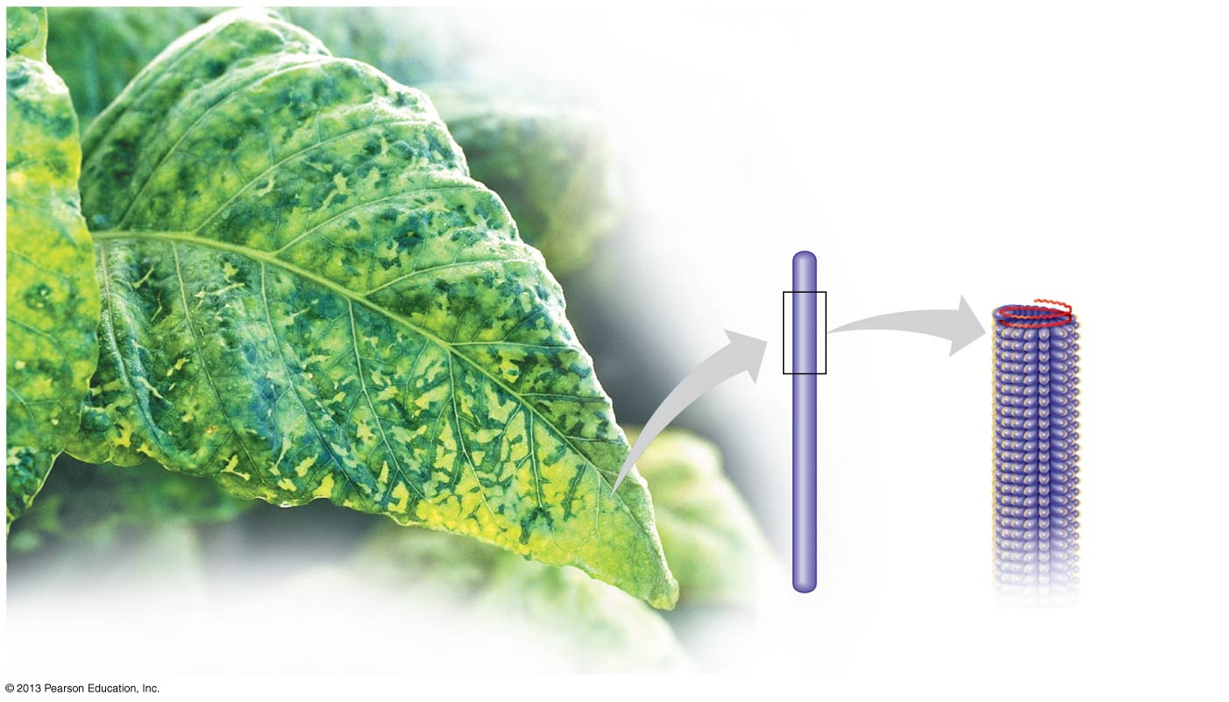
Figure 10.27
RNA
Protein
Tobacco mosaic virus
Notes:
Figure 10.27 Tobacco mosaic virus

Slide 15
Animal viruses
  Viruses that infect animals cells
    are a common cause of disease and
    may have RNA or DNA genomes.

Slide 16
Figure 10.28
Membranous
envelope
Protein spike
RNA
Protein coat
Notes:
Figure 10.28 An influenza virus

Slide 17
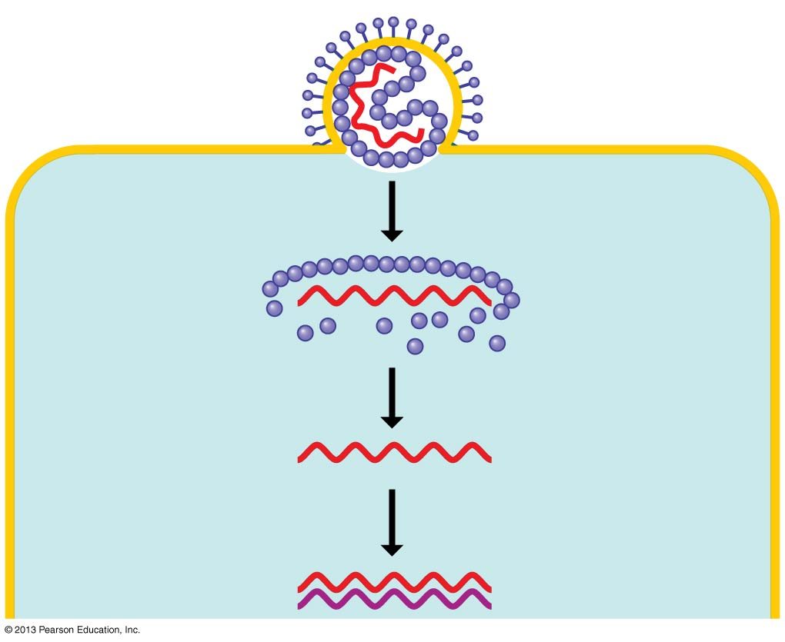
Figure 10.29a
Virus
Protein spike
Viral RNA
(genome)
Protein coat
Envelope
Plasma membrane
of host cell
1
Entry
2
Uncoating
Viral RNA
(genome)
3
RNA synthesis
by viral enzyme
Notes:
Figure 10.29 The reproductive cycle of an enveloped virus (part 1)

Slide 18
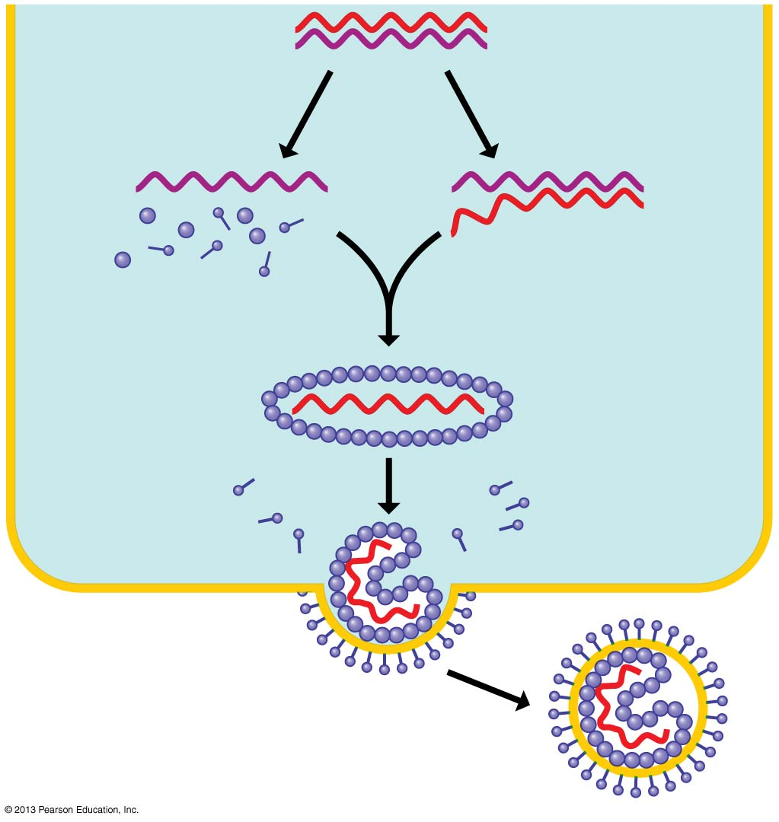
Figure 10.29b
4
Protein
synthesis
5
RNA synthesis
(other strand)
mRNA
Template
New viral
genome
New
viral proteins
6
Assembly
Exit
7
Notes:
Figure 10.29 The reproductive cycle of an enveloped virus (part 2)

Slide 19
DNA Technology and Genetic Engineering chapter 12

Slide 20
Biology and Society:
DNA, Guilt, and Innocence
  DNA profiling is the analysis of DNA samples that can be used to determine whether the samples come from the same individual.
  DNA profiling can therefore be used in courts to indicate if someone is guilty of a crime.
  DNA technology has led to other advances in the
    creation of genetically modified crops and
    identification and treatment of genetic diseases.
© 2013 Pearson Education, Inc.
Notes:
20

Slide 21
Recombinant DNA technology
  Biotechnology
    is the manipulation of organisms or their components to make useful products and
    has been used for thousands of years to
      make bread using yeast and
      selectively breed livestock for desired traits.

Slide 22
Recombinant DNA technology
  Recombinant DNA is constructed when scientists combine pieces of DNA from two different sources to form a single DNA molecule.
  Recombinant DNA technology is widely used in genetic engineering, the direct manipulation of genes for practical purposes.

Slide 23
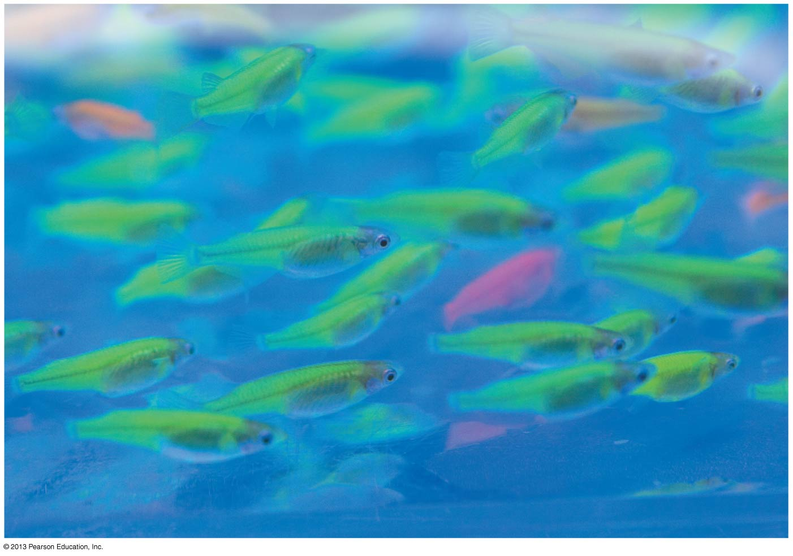
Figure 12.1
Glowing fish
Notes:
Figure 12.1 Glowing fish

Slide 24
Applications of DNA technology
  By transferring the gene for a desired protein into a bacterium or yeast, proteins that are naturally present in only small amounts can be produced in large quantities.
  In 1982, the world’s first genetically engineered pharmaceutical product was sold.
  Humulin, human insulin
    was produced by genetically modified bacteria and
    is used today by more than 4 million people with diabetes.

Slide 25
Applications of DNA technology
Today, humulin is continuously produced in gigantic fermentation vats filled with a liquid culture of bacteria

Slide 26
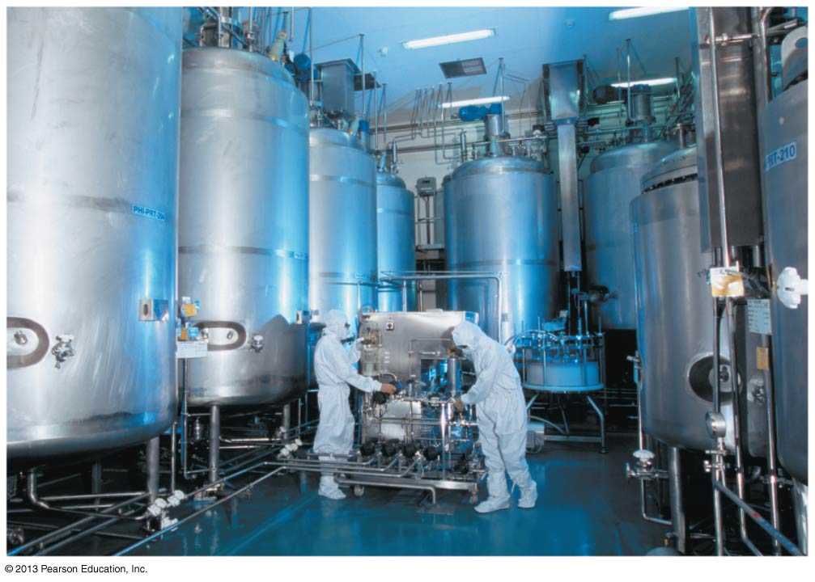
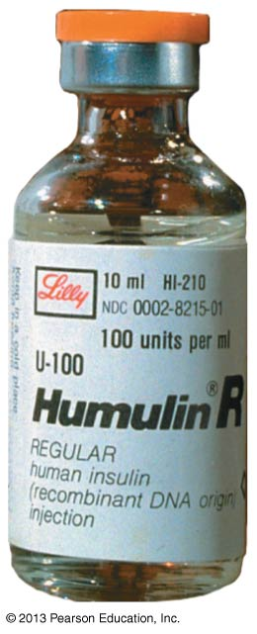
Figure 12.3
Notes:
Figure 12.3 A factory that produces genetically engineered insulin

Slide 27
Applications of DNA technology
  DNA technology is used to produce medically valuable molecules, including
    human growth hormone (HGH),
    the hormone erythropoietin (EPO), which stimulates production of red blood cells, (Lance Armstrong)
    vaccines, weak or dead form of a pathogen used to prevent infectious diseases. Stimulates immune system to produce antibodies against germ
      Flu vaccine-CDC picks several strains put them together
      Must get shot each year
      Measles, mumps, DPT-childhood vaccines-effective for years

Slide 28
Transgenic organisms
  Today, DNA technology is quickly replacing traditional breeding programs.
  Scientists have produced many types of genetically modified (GM) organisms, organisms that have acquired one or more genes by artificial means.
  A transgenic organism contains a gene from another organism, typically of another species.

Slide 29
  In the United States today, roughly half of the corn crop and more than three-quarters of the soybean and cotton crops are genetically modified.
  Corn has been genetically modified to resist insect infestation, attack by an insect called the European corn borer.

Slide 30
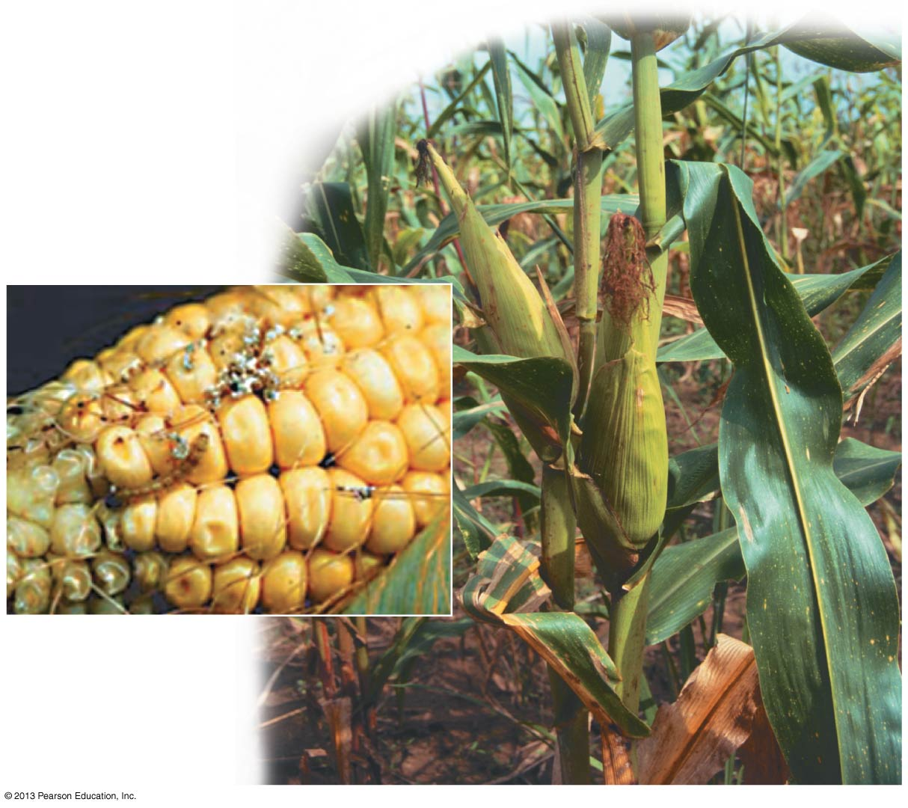
Figure 12.4
Notes:
Figure 12.4 Genetically modified corn

Slide 31
Genetically modified foods
Strawberry plants produce bacterial proteins that act as a natural antifreeze, protecting the plants from cold weather
  “Golden rice 2”
    is a transgenic variety of rice that carries genes from daffodils and corn and
    could help prevent vitamin A deficiency and resulting blindness.

Slide 32
“pharm” animals
  A transgenic pig has been produced that carries a gene for human hemoglobin, which can be
    isolated and
    used in human blood transfusions.
  However, unlike transgenic plants, no transgenic animals are yet sold as food.

Slide 33
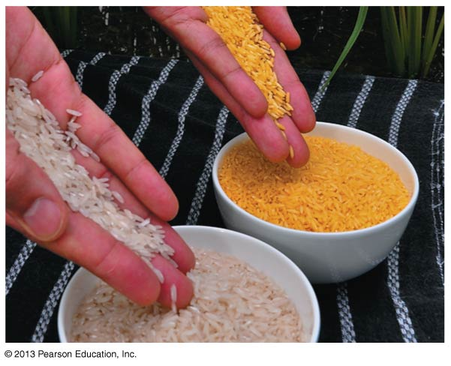
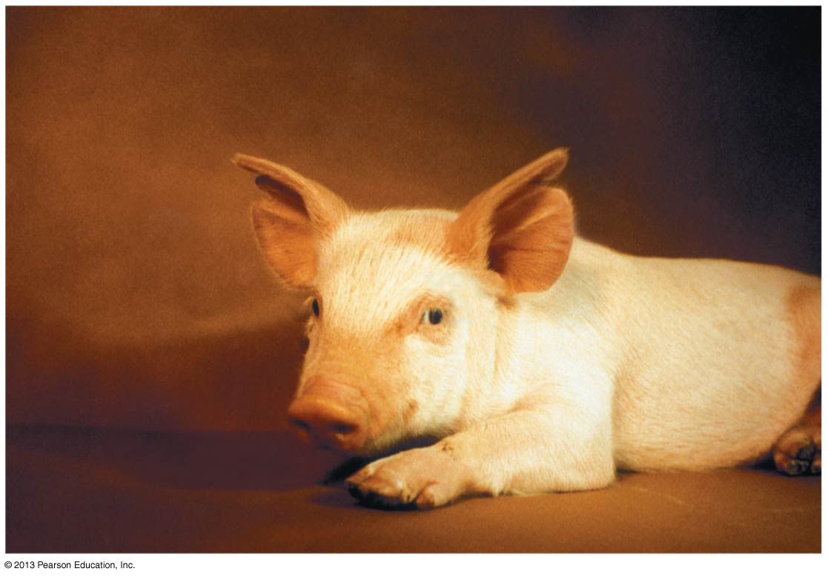
Figure 12.5
Genetically modified rice
Transgenic pig
Notes:
Figure 12.5 Genetically modified rice

Slide 34
Recombinant DNA techniques
  Bacteria are the workhorses of modern biotechnology.
  To work with genes in the laboratory, biologists often use bacterial plasmids, small, circular DNA molecules that replicate separately from the larger bacterial chromosome.

Slide 35
  Plasmids
    can carry virtually any gene,
    can act as vectors, DNA carriers that move genes from one cell to another, and
    are ideal for gene cloning, the production of multiple identical copies of a gene-carrying piece of DNA.
Recombinant DNA techniques can help biologists produce large quantities of a desired protein

Slide 36
Steps to make a transgenic organism
Cut plasmid with restriction enzyme-short DNA sequence-like a chemical scissors
This leaves “sticky ends” that are open and ready to pair with new DNA

Slide 37
Step 2
Add new gene to plasmid
This gene has also been cut and has matching “sticky ends”
Result is recombinant DNA

Slide 38
Steps 3 & 4
Mix new plasmid and bacteria w/salt solution and heat shock
This makes bacteria take in the plasmid
New cell called transgenic organism
Step 4
Make many copies of the transgenic organism – Clone

Slide 39
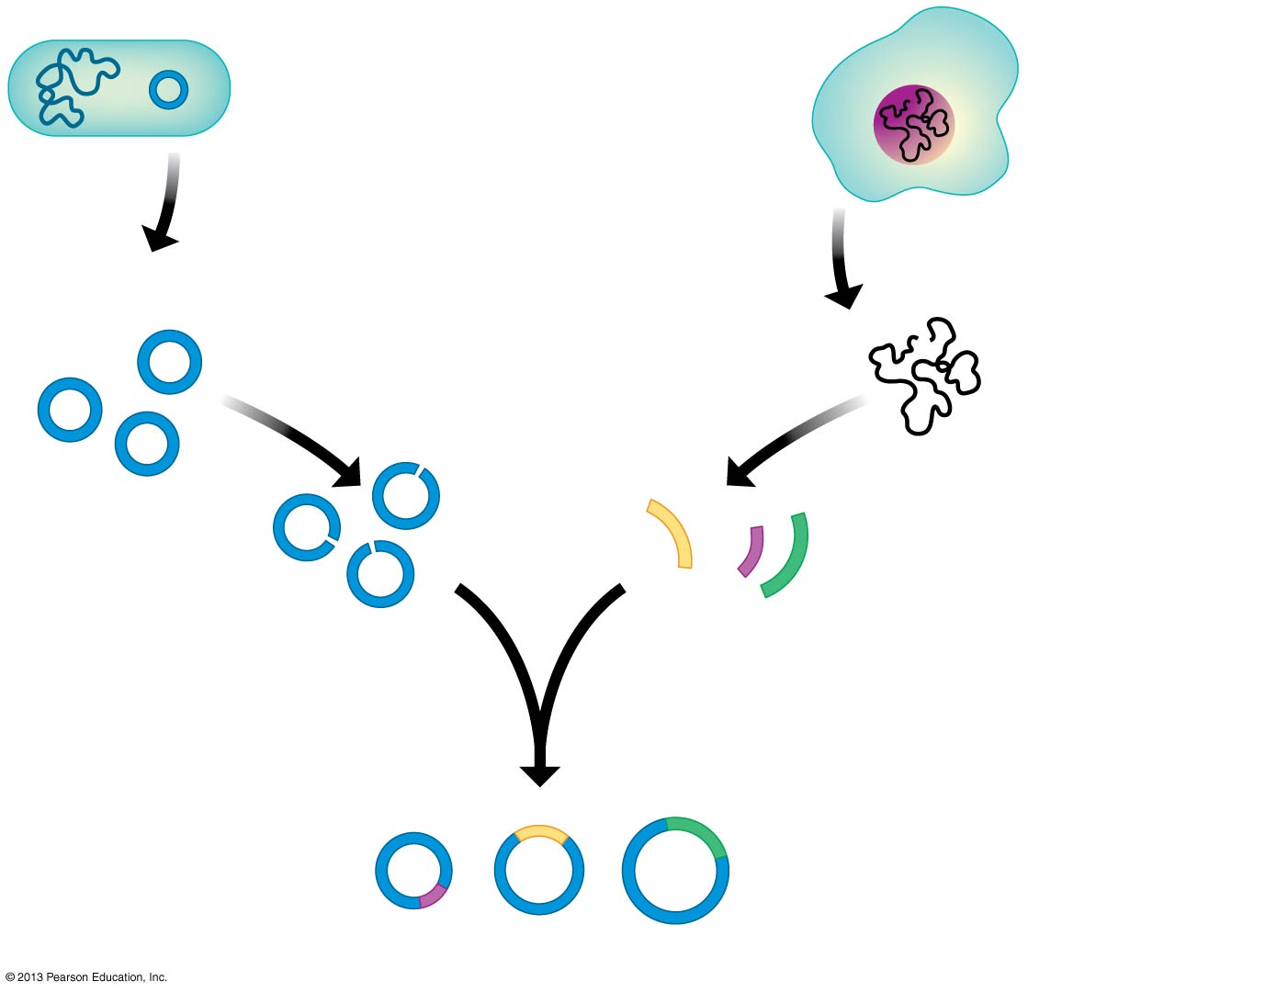
Figure 12.8a
Bacterial cell
Cell containing
the gene of
interest
Plasmid
DNA
1
Isolate plasmids.
2
Isolate DNA.
3
Cut both DNAs
with same
enzyme.
DNA fragments
from cell
Gene
of
interest
Other
genes
4
Mix the DNA fragments and join them together.
Gene of interest
Recombinant DNA plasmids
Notes:
Figure 12.8 Using recombinant DNA technology to produce useful products (part 1)

Slide 40
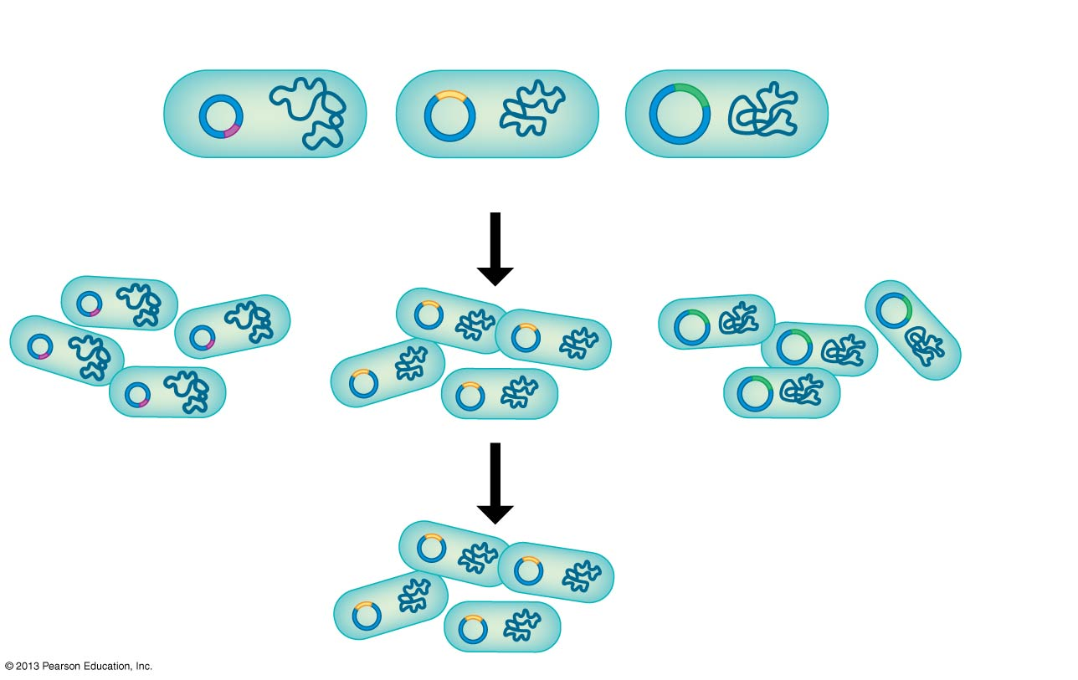
Figure 12.8b
5
Bacteria take up recombinant plasmids.
Recombinant bacteria
Bacterial clone
6
Clone the bacteria.
7
Find the clone with the gene of interest.
Notes:
Figure 12.8 Using recombinant DNA technology to produce useful products (part 2)

Slide 41
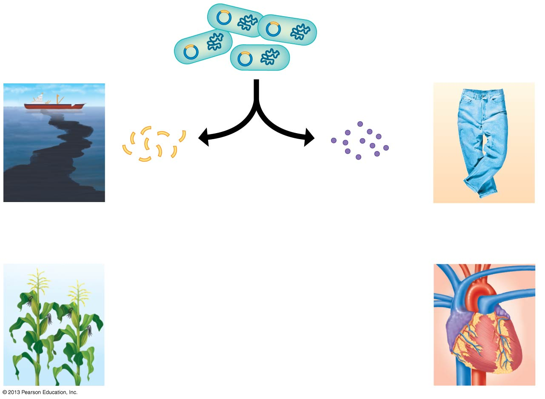
Figure 12.8c
Some uses
of genes
Some uses
of proteins
8
The gene
and protein
of interest
are isolated
from the
bacteria.
Genes may
be inserted
into other
organisms.
Harvested
proteins
may be
used
directly.
Genes for
cleaning up
toxic waste
Protein for
“stone-washing”
jeans
Gene
for pest
resistance
Protein for
dissolving
clots
Notes:
Figure 12.8 Using recombinant DNA technology to produce useful products (part 3)

Slide 42
DNA profiling and forensic science
  DNA profiling
    can be used to determine if two samples of genetic material are from a particular individual and
    has rapidly revolutionized the field of forensics, the scientific analysis of evidence from crime scenes.
  To produce a DNA profile, scientists compare sequences in the genome that vary from person to person.

Slide 43
DNA Profiling & PCR (polymerase chain reaction)
DNA samples isolated from crime scene, suspects, victims, evidence
Selected DNA samples from above are amplified (copied many times) using PCR
  Sample mixed with nucleotides, enzymes and heated, cooled so DNA is doubled
DNA regions compared using a gel

Slide 44
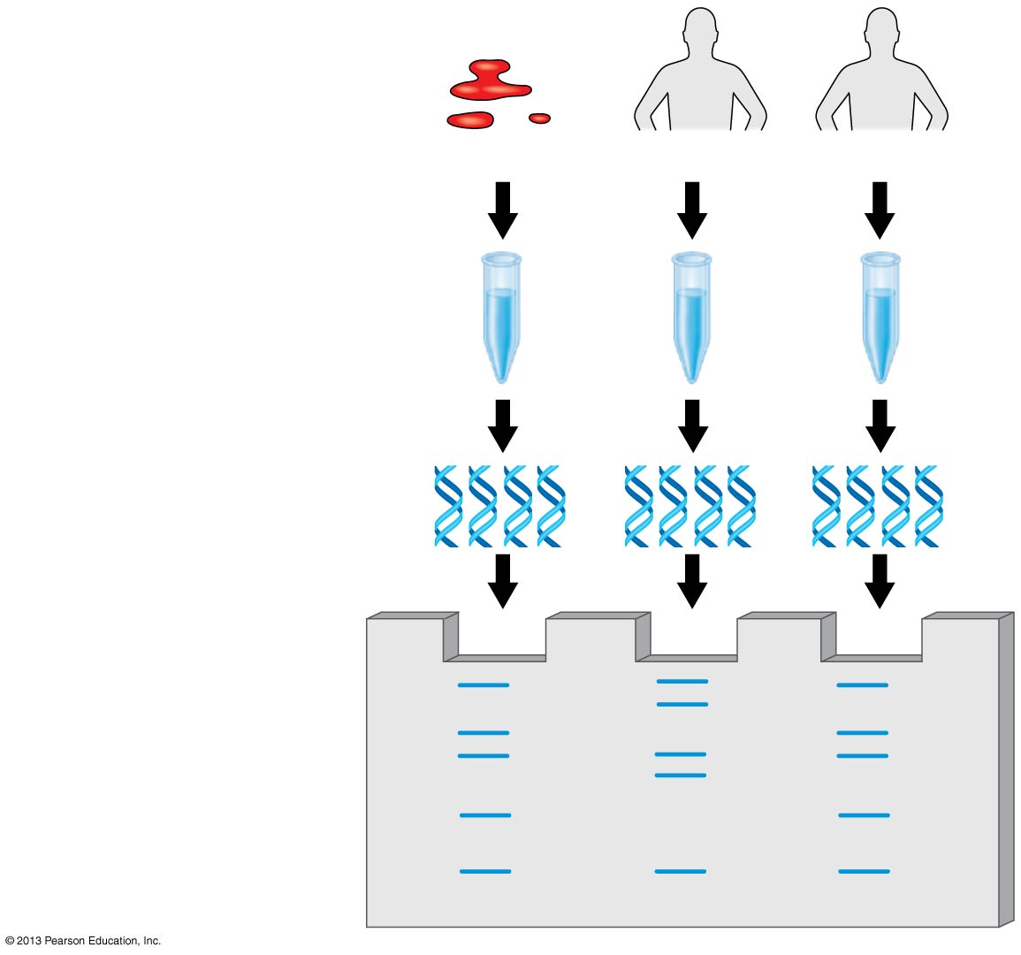
Figure 12.13-3
1
DNA isolated
Crime scene
Suspect 1
Suspect 2
2
DNA amplified
3
DNA compared
Notes:
Figure 12.13 Overview of DNA profiling (step 3)

Slide 45
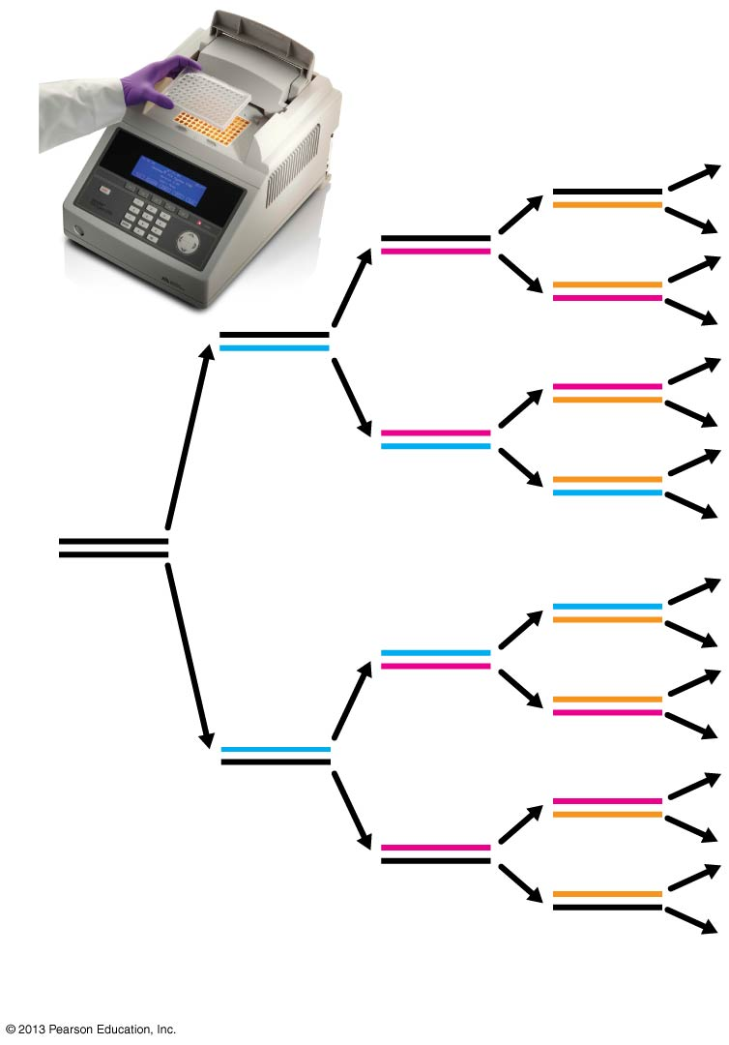
Figure 12.15
PCR
Initial
DNA
segment
1
2
4
8
Number of DNA molecules
Notes:
Figure 12.15 DNA amplification by PCR

Slide 46
GEL Electrophoresis
Gel electrophoresis is a technique that sorts nucleic acids (DNA) or proteins by
  Electrical charge and size
Has many uses
  DNA sequencing
    Uses STR –short tandem repeats- cuts DNA at specific places
  DNA fingerprinting

Slide 47
DNA sequencing
Make 4 groups of DNA
Treat each with different chemical so that the strand breaks at a certain base
Send samples through electrophoresis
DNA pieces will appear as bands
Pattern of bands reveals the sequence

Slide 48
DNA fingerprinting
Techniques used for identifying individuals
Uses “junk DNA”
The number of repeats is different for every person- called short tandem repeats STR

Slide 49
Steps for DNA Fingerprinting
Sm. sample of DNA is cut w/restriction enzyme
Fragments are separated by electrophoresis
Fragments w/repeats are labeled
- shows series of bands
- these bands show length of fragment
Pattern of bands are different for every person in the world

Slide 50
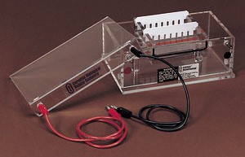
Gel Electrophoresis
Gel electrophoresis is a technique used to separate fragments of DNA.
Separates fragments as a function of size.
Most types use Agarose to separate fragments.
Agarose is a porous gel. It can allow the passage of molecules through, however, larger molecules move more slowly through it since they cannot squeeze through the pores as easily as smaller molecules.
Molecules move from the neg end to the pos end

Slide 51
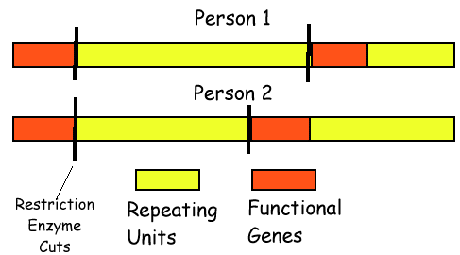
DNA fingerprinting –Short Tandem Repeats
Based on the fact that the amount of "junk DNA" differs uniquely between individuals.
Structural genes are often separated by large regions of repeating base pairs.
The number of these repeats is unique to an individual.
Therefore when DNA from a person is cut with a restriction enzyme, the length of the fragments will be unique to an individual.

Slide 52
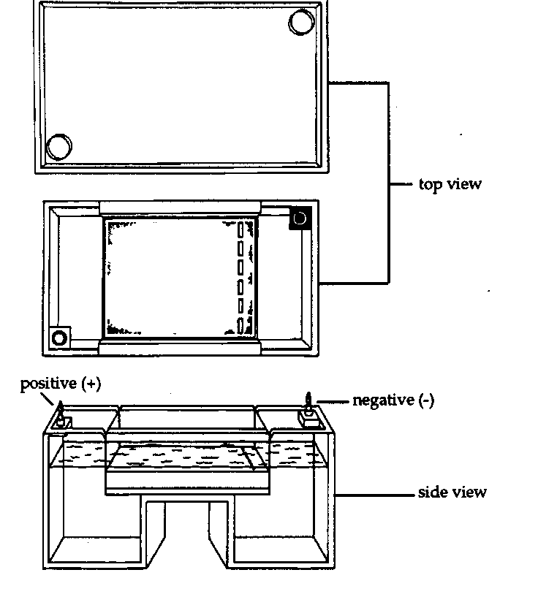
Electrical leads are attached to the ends of the box creating an electrical potential across the apparatus.
Samples of digested DNA are placed in the wells
Because DNA has a negative electrical charge. It is "pulled" towards the positive side of the apparatus.
Also, since the smaller molecules travel faster through the agarose. Over time this separates the various sized fragments of DNA.

Slide 53
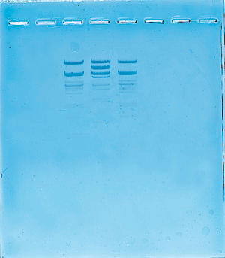
Completed gel

