Slide 1
Viruses and bacteria
Chpt 10

Slide 2
10.17 Viral DNA may become part of the host chromosome
0
  A virus is essentially “genes in a box,” an infectious particle consisting of
    a bit of nucleic acid,
    wrapped in a protein coat called a capsid, and
    in some cases, a membrane envelope.
  Viruses have two types of reproductive cycles.
© 2012 Pearson Education, Inc.
Notes:
2
Student Misconceptions and Concerns
1. Students and many parents with young children expect antibiotics to be used to treat many respiratory infections, even though such infections may result from a virus. Students will benefit from a thorough explanation of why antibiotics are inappropriate for viral infections as well as the rising numbers of antibiotic-resistant bacteria that have evolved as a result of the overuse of antibiotics.
2. The success of modern medicine has perhaps led to overconfidence in our ability to treat disease. Students often do not understand that there are few successful treatments for viral infections. Instead, the best defense against viruses is prevention, by reducing the chances of contacting the virus and through the use of vaccines.
Teaching Tips
Students (and instructors) might enjoy thinking of a prophage as a smudge mark on the master copy of a class handout. The smudge is replicated every time the original is copied!

Slide 3
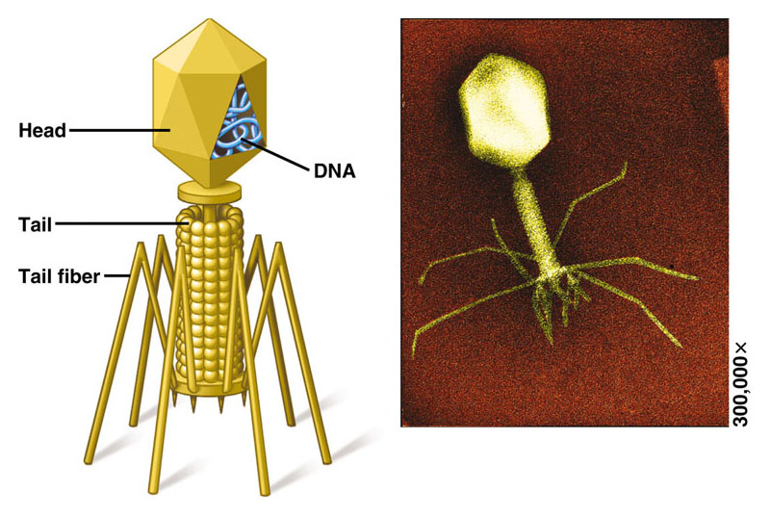

Slide 4
Life Cycle of Lytic Virus
Attaches to cell by tail fibers
Nucleic acid is deposited into cell and attaches to the chromosome of cell
Cell will make new virus parts.
Host cell will eventually lyse (burst) releasing 100’s of virus particles
New viruses invade other cells
Examples include cold, flu, measles, mumps, chicken pox

Slide 5
Lysogenic Virus Life cycle Steps
Inserts nucleic acid into cell.
Viral DNA (prophage) can stay for yrs. and block entry of other viruses.
Host cell can divide and carry with it the viral DNA.
One day the virus becomes activated (usually due to an environmental trigger) and goes into the lytic cycle.
Examples HIV, herpes, cold sores

Slide 6
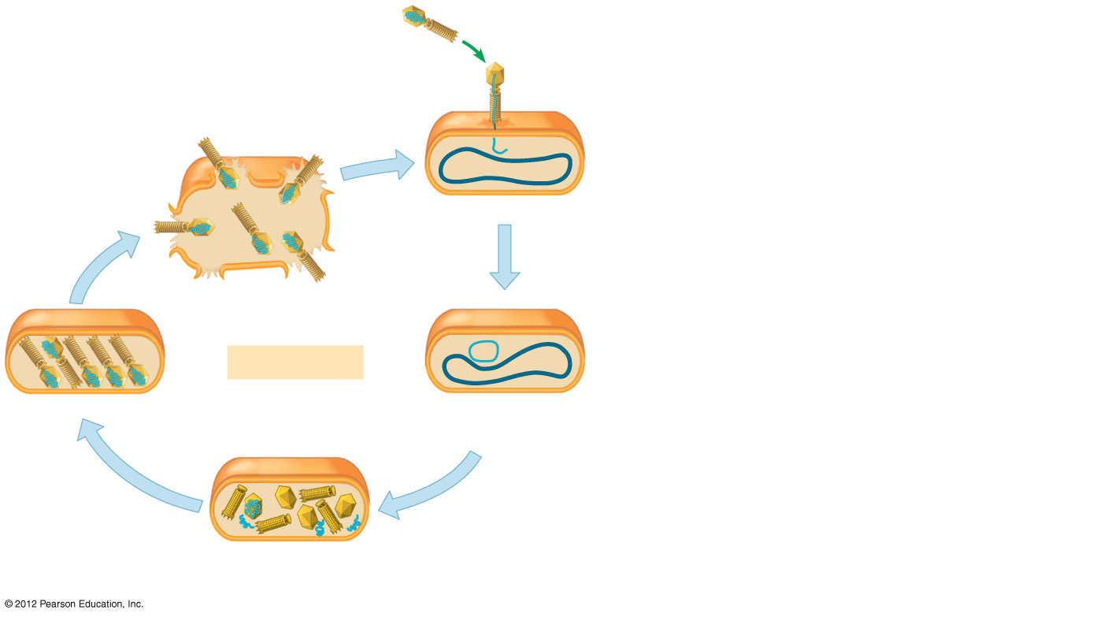
Figure 10.17_s1
Phage
Attaches
to cell
Phage DNA
Bacterial
chromosome
4
The cell lyses,
releasing
phages
1
The phage injects its DNA
Lytic cycle
Phages assemble
2
The phage DNA
circularizes
3
New phage DNA and
proteins are synthesized
Notes:
6
Figure 10.17_s1 Two types of phage replication cycles (step 1)

Slide 7
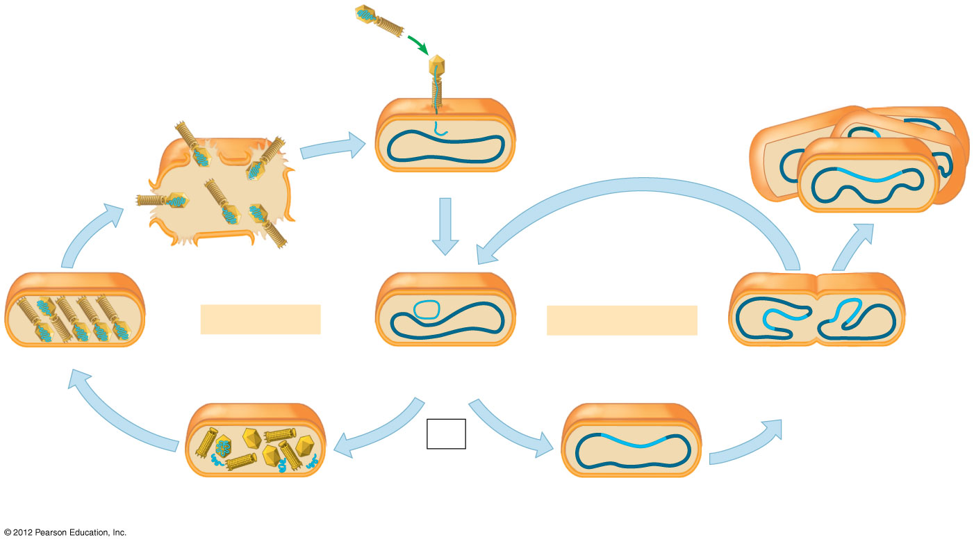
Figure 10.17_s2
Phage
Attaches
to cell
Phage DNA
Bacterial
chromosome
4
The cell lyses,
releasing
phages
1
The phage injects its DNA
7
Environmental
stress
Many cell
divisions
Lytic cycle
Lysogenic cycle
Phages assemble
2
The phage DNA
circularizes
6
The lysogenic bacterium
replicates normally
Prophage
OR
3
New phage DNA and
proteins are synthesized
5
Phage DNA inserts into the bacterial
chromosome by recombination
Notes:
7
Figure 10.17_s2 Two types of phage replication cycles (step 2)

Slide 8
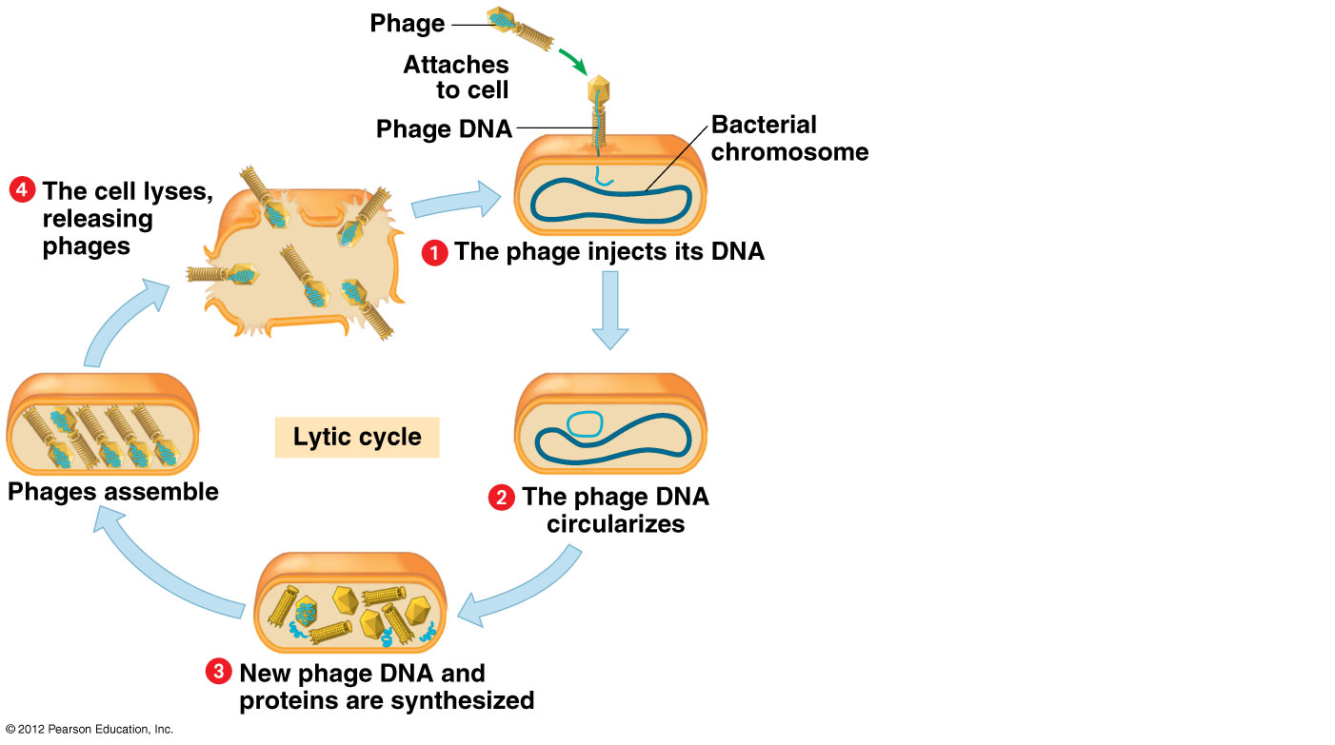

Slide 9
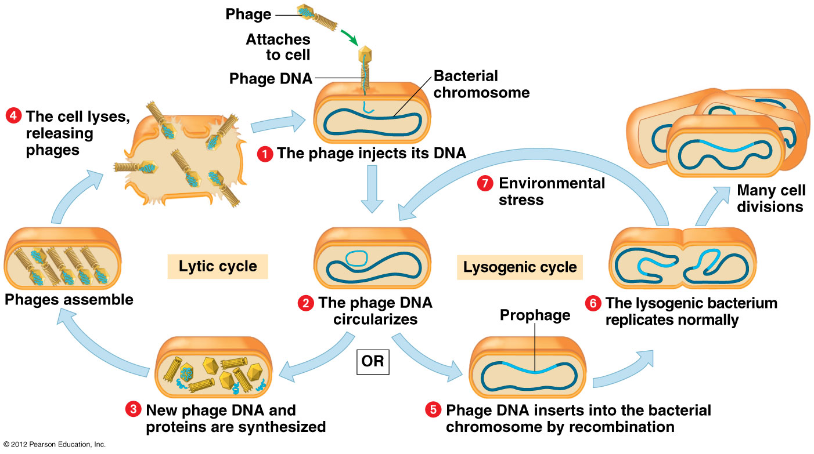

Slide 10
Viruses can attack bacteria cells
Virus that attacks the bacteria is called bacteriaphage (phage)
Some bacteria become harmful when they contain the prophage-(virus DNA inside a host bacteria DNA)
- botulism, diptheria, scarlet fever

Slide 11
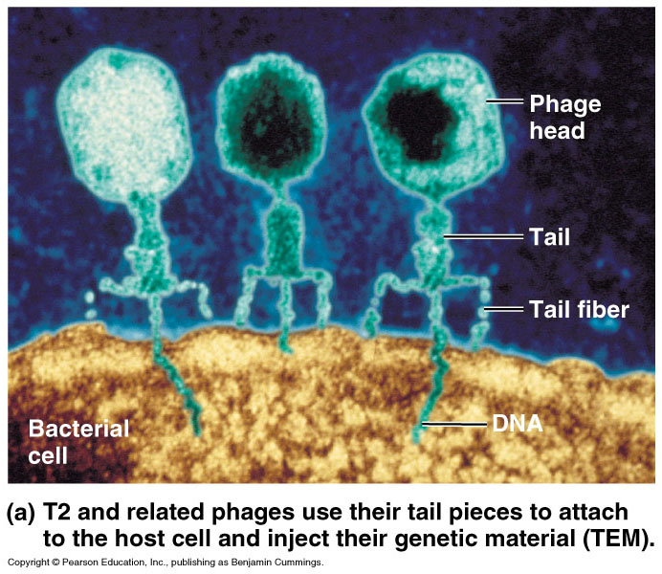

Slide 12
Bacteria
Prokaryotes
Contain a single chromosome usually circular
Some contain an extra circle of DNA called a plasmid which is very useful in genetic engineering.

Slide 13
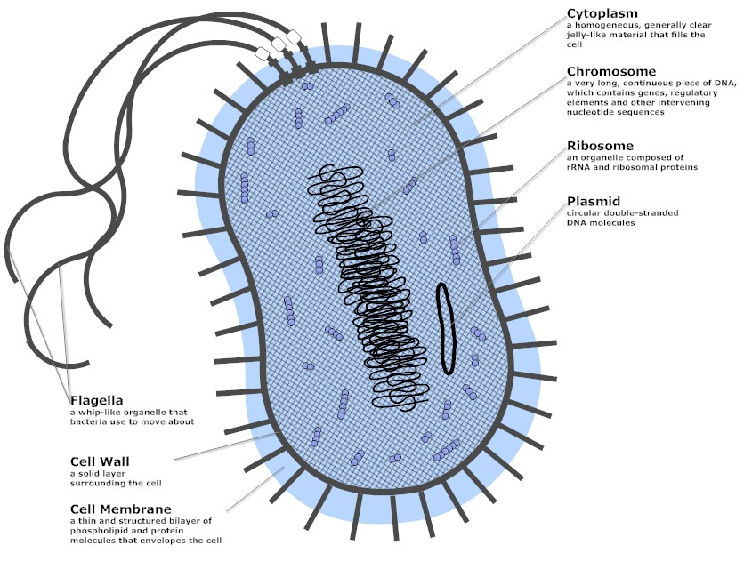

Slide 14
10.19 EVOLUTION CONNECTION: Emerging viruses threaten human health
0
  Viruses that appear suddenly or are new to medical scientists are called emerging viruses. These include the
    AIDS virus,
    Ebola virus-hemorrhagic fever-Africa
    West Nile virus-spread by mosquitoes
    SARS virus-severe acute respiratory syndrome- China-2002
© 2012 Pearson Education, Inc.
Notes:
14
Student Misconceptions and Concerns
1. Students and many parents with young children expect antibiotics to be used to treat many respiratory infections, even though such infections may result from a virus. Students will benefit from a thorough explanation of why antibiotics are inappropriate for viral infections as well as the rising numbers of antibiotic-resistant bacteria that have evolved as a result of the overuse of antibiotics.
2. The success of modern medicine has perhaps led to overconfidence in our ability to treat disease. Students often do not understand that there are few successful treatments for viral infections. Instead, the best defense against viruses is prevention, by reducing the chances of contacting the virus and through the use of vaccines.
Teaching Tips
1. There is an interesting relationship between the speed at which a virus kills or debilitates a host and the extent to which it spreads from one organism to another. This is something to consider for a class discussion. Compare two viral infections. Infection A multiplies within the host, is spread by the host to other people through casual contact, but does not cause its lethal symptoms until 5–10 years after infection. Virus B kills the host within 1–2 days of infection, is easily transmitted, and causes severe symptoms within hours of contact. Which virus is likely to spread the fastest through the human population on Earth? Which might be considered the most dangerous to humans?
2. Students might wonder why a person needs to get a new seasonal flu vaccination every year. The annual mutations and variations in flu viruses require the production of a new flu vaccine annually. The Centers for Disease Control and Prevention monitors patterns of flu outbreaks, especially in Asia (where many variations of flu viruses originate). They must predict which strains are most likely to be dangerous in the coming year and then synthesize an appropriate vaccine.

Slide 15
10.19 EVOLUTION CONNECTION: Emerging viruses threaten human health
0
  Three processes contribute to the emergence of viral diseases:
    mutation—RNA viruses mutate rapidly.
    contact between species—viruses from other animals spread to humans.
    spread from isolated human populations to larger human populations, often over great distances.
© 2012 Pearson Education, Inc.
Notes:
15
Student Misconceptions and Concerns
1. Students and many parents with young children expect antibiotics to be used to treat many respiratory infections, even though such infections may result from a virus. Students will benefit from a thorough explanation of why antibiotics are inappropriate for viral infections as well as the rising numbers of antibiotic-resistant bacteria that have evolved as a result of the overuse of antibiotics.
2. The success of modern medicine has perhaps led to overconfidence in our ability to treat disease. Students often do not understand that there are few successful treatments for viral infections. Instead, the best defense against viruses is prevention, by reducing the chances of contacting the virus and through the use of vaccines.
Teaching Tips
1. There is an interesting relationship between the speed at which a virus kills or debilitates a host and the extent to which it spreads from one organism to another. This is something to consider for a class discussion. Compare two viral infections. Infection A multiplies within the host, is spread by the host to other people through casual contact, but does not cause its lethal symptoms until 5–10 years after infection. Virus B kills the host within 1–2 days of infection, is easily transmitted, and causes severe symptoms within hours of contact. Which virus is likely to spread the fastest through the human population on Earth? Which might be considered the most dangerous to humans?
2. Students might wonder why a person needs to get a new seasonal flu vaccination every year. The annual mutations and variations in flu viruses require the production of a new flu vaccine annually. The Centers for Disease Control and Prevention monitors patterns of flu outbreaks, especially in Asia (where many variations of flu viruses originate). They must predict which strains are most likely to be dangerous in the coming year and then synthesize an appropriate vaccine.

Slide 16
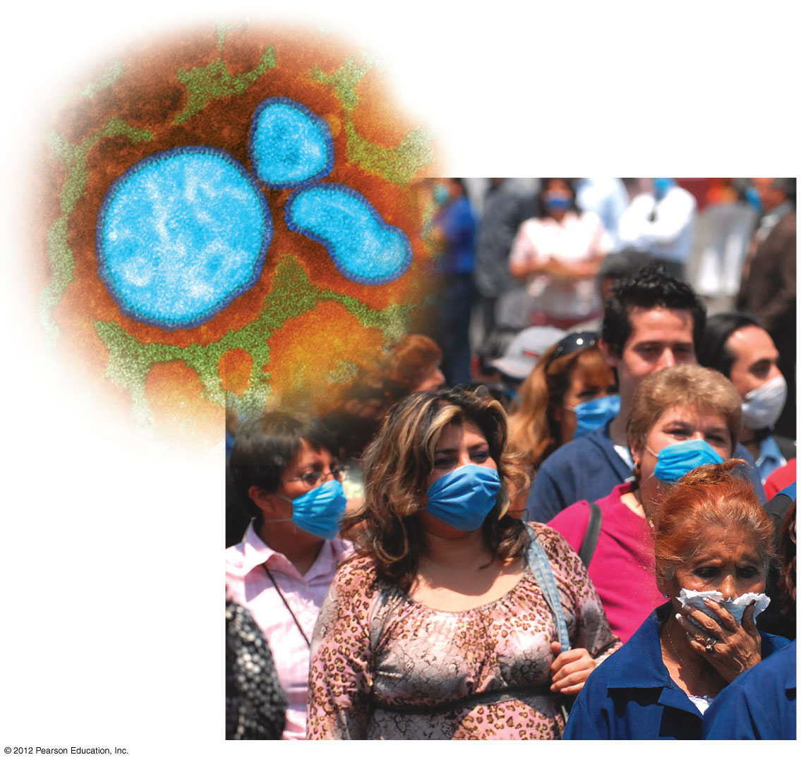
Figure 10.19
People in Mexico City wearing masks in 2009 to prevent spread of H1N1 virus
Notes:
16
Figure 10.19 People in Mexico City wearing masks in an attempt to prevent spread of the 2009 H1N1 virus

Slide 17
10.20 The AIDS virus makes DNA on an RNA template
0
  AIDS (acquired immunodeficiency syndrome) is caused by HIV (human immunodeficiency virus).
  HIV
    is an RNA virus,
    has two copies of its RNA genome,
    carries molecules of reverse transcriptase, which causes reverse transcription, producing DNA from an RNA template.
    Invades white blood cells destroying them. Immune system degenerates
© 2012 Pearson Education, Inc.
Notes:
17
Student Misconceptions and Concerns
1. Students and many parents with young children expect antibiotics to be used to treat many respiratory infections, even though such infections may result from a virus. Students will benefit from a thorough explanation of why antibiotics are inappropriate for viral infections as well as the rising numbers of antibiotic-resistant bacteria that have evolved as a result of the overuse of antibiotics.
2. The success of modern medicine has perhaps led to overconfidence in our ability to treat disease. Students often do not understand that there are few successful treatments for viral infections. Instead, the best defense against viruses is prevention, by reducing the chances of contacting the virus and through the use of vaccines.
3. Many misconceptions about AIDS exist. A list of 18 common misconceptions is located at www.gng.org/currents/teachers/hiv101/misconceptions.html.
Teaching Tips
1. The Centers for Disease Control and Prevention has extensive information about AIDS at www.cdc.gov/hiv/.
2. Students often do not understand the disproportionate distribution of HIV infections and AIDS in our world. Consider an Internet assignment, asking students to identify the regions of the world most affected by HIV/AIDS and then discuss why this uneven distribution of disease exists.

Slide 18
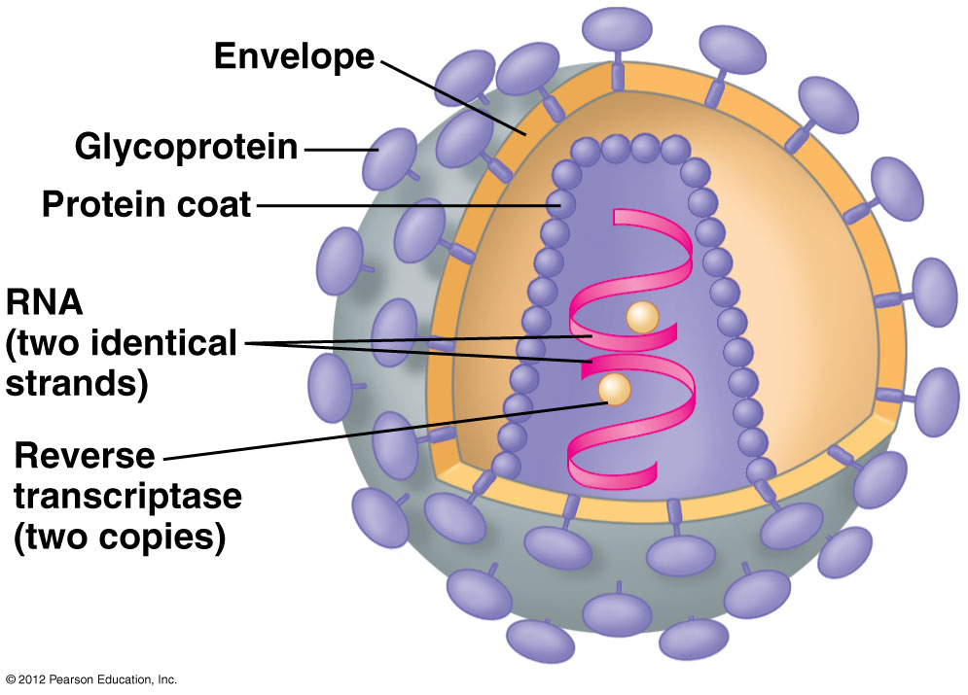

Slide 19
10.21 Viroids and prions are formidable pathogens in plants and animals
0
  Some infectious agents are made only of RNA or protein.
    Viroids are small, circular RNA molecules that infect plants. Viroids
      replicate within host cells without producing proteins and
      interfere with plant growth-stunted & abnormal development
    Prions are infectious proteins that cause degenerative brain diseases in animals. Prions
      appear to be misfolded forms of normal brain proteins,
      which convert normal protein to misfolded form.- that clump- leading to loss of brain tissue
      Examples include mad cow disease, chronic wasting in deer & elk, Creutzfeldt-Jakob in humans- no cure
© 2012 Pearson Education, Inc.
Notes:
19
Student Misconceptions and Concerns
1. Students and many parents with young children expect antibiotics to be used to treat many respiratory infections, even though such infections may result from a virus. Students will benefit from a thorough explanation of why antibiotics are inappropriate for viral infections as well as the rising numbers of antibiotic-resistant bacteria that have evolved as a result of the overuse of antibiotics.
2. The success of modern medicine has perhaps led to overconfidence in our ability to treat disease. Students often do not understand that there are few successful treatments for viral infections. Instead, the best defense against viruses is prevention, by reducing the chances of contacting the virus and through the use of vaccines.
Teaching Tips
Viroids can cause significant damage to plants. More than 30 million coconut palms in the Philippines have been killed by viroids.

