Slide 1
Imperialism

Slide 2
Part I: Imperialism in the World
Look at the “Colonial Empires 1914” Map on the next slide
Use it to answer the questions on slide 4
Write the answers on your own sheet of paper

Slide 3
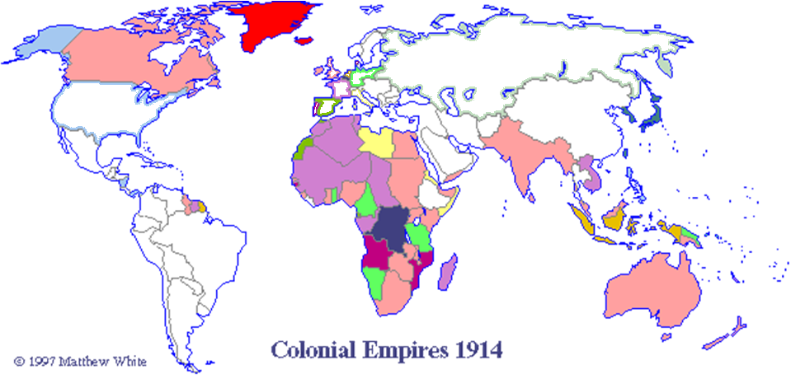
Hint: the countries that are outlined in color are the actual countries who are colonizing in the key

Slide 4
Part I: Imperialism in the World
How many different countries have colonies?
Which country has the largest colonial empire?
Which continents are almost completely controlled by other countries?
Which continents are only controlled by a few countries?
What could be a different title for this map?

Slide 5
Part II: Imperialism in Africa
Berlin Conference 1884
Use the link above to answer the following questions
List 3 reasons why Europeans wanted to take over Africa?
What agreements came out of the Berlin Conference?
Make a guess: How will the decisions made at the conference change Africa?

Slide 6
Part II: Imperialism in Africa
Scramble for Africa Cartoon
Click on the link above and answer the following questions
According to the cartoon, which European countries were fighting for a position in Africa?
What do you think is the message of this cartoon?

Slide 7
Part II: Imperialism in Africa
African Imperialism Maps
Click on the link above to answer the following questions
What is the main difference between the two maps?
According to Map 2-- Which 2 European countries held the most territory in Africa?

Slide 8
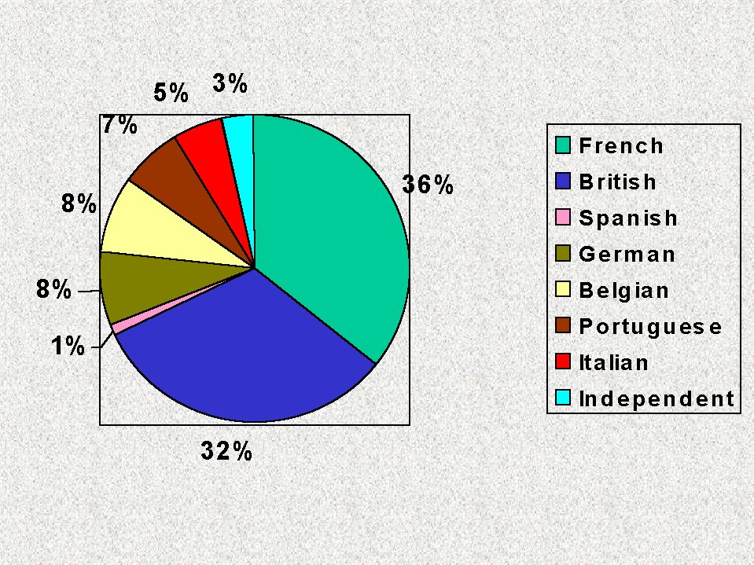
Part II: Imperialism in Africa
What percentage of Africa was colonized by 1913?
Percentage of control in Africa, 1913

Slide 9
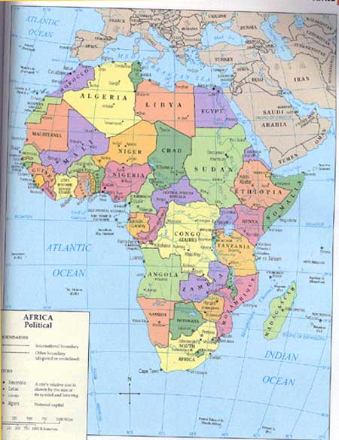
Look at the map of Africa today
How did the Scramble for Africa in the 1800's and 1900's effect the current borders of Africa?

Slide 10
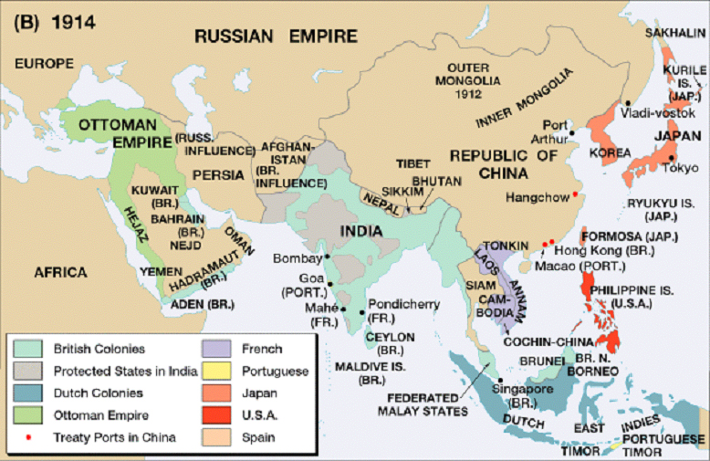
Part III: Imperialism in Asia

Slide 11
Part III: Imperialism in Asia
Use the map on the previous slide to answer the following questions.
What European country owned most of India?
What did Japan own (other than its own islands)?
What did the US own?
Who owned the East Indies?

Slide 12
Spheres of Influence
Throughout the nineteenth century, China's emperors had watched as foreigners encroached further and further upon their land. Time and again, foreigners forced China to make humiliating concessions. Foreign regiments, armed with modern weapons, consistently defeated entire imperial armies. Now, as a new century was about to begin, Tsu Hsi, empress dowager of the Ch'ing Dynasty, searched for a way to rid her empire of foreign parasites.
Austria, France, Germany, Great Britain, Italy, Japan, and Russia all claimed exclusive trading rights to certain parts of China. They were dividing China into "spheres of influence." Some even claimed to own the territory within their spheres. By acquiring the Philippines, the United States became an Asian power too. Now, with a strong base of operations just 400 miles from China, American businesses hoped to take advantage of China's vast resources. The foreign spheres of influence, however, threatened their ambitions.
So while the empress was hoping to close China to foreigners, Americans were looking for a way in. John Hay, now Secretary of State, had an idea. Since public opinion, strained by the Philippines war, would never support the use of force, he decided to negotiate. He sent letters to all the foreign powers and suggested an "Open Door" policy in China. This policy would guarantee equal trading rights for all and prevent one nation from discriminating against another within its sphere.
The nations replied that they liked the concept of the Open Door, but that they could not support or enforce it. Hay's plan had been politely rejected. Nevertheless Hay announced that since all of the powers had accepted the Open Door in principle, the United States considered their agreement "final and definitive.“ Source: http://www.smplanet.com/teaching/imperialism/#boxer

Slide 13
Part III: Imperialism in Asia
Answer these questions from the reading on the
previous page.
What countries claimed spheres of influence in China?
What was the Open Door Policy?

Slide 14
Part III: Imperialism in Asia
Imperialism in India
Use the link to answer the following questions
What countries made claims in India?
Which country won the whole of India?

Slide 15
Part III: Imperialism in Asia
Japanese Imperialism
Use the link above to answer the following questions.
What countries/regions did Japan take and what did they get from them (explanation of expansion section)?
Was Japanese imperialism different from European imperialism? Why or why not?

