Slide 1
Part TWO
THE WRITING PROCESS
Research
Gathering Your Evidence
Understanding Your Evidence

Slide 2
Research
Do not begin your assignment by starting with what some may consider to be “research” – often called googling!
  Work on and complete, to the extent possible, your TD – this is an ongoing process so come back to it and expand it as you move through your work
Do not begin your assignment by deciding what you are going to prove!
  This will generally lead you into ‘confirmation bias’ and will/may significantly negate the value of much of your research
Leave time to research, reflect and let information ‘settle’.
Your research will be divided into several parts:
  Preliminary research
  Extended research
  Ongoing research

Slide 3
Research
Preliminary research
  This will be general in nature and will be based on the key words, terms and questions that you raised in your TD.
  Is general in nature and will generally involve the use of tertiary sources to give you a broad overview of the subject
  Is not intended to come up with the evidence that you will rely on in your arguments although you may determine many areas that need to be investigated
  Is intended to give you an overview of the different interpretations that are possible relating to your subject
  “He who knows only his side of the case knows little of that. His reasons may be good, and no one may have been able to refute them. But if he is equally unable to refute the reasons on the opposite side, if he does not so much as know what they are, he has no ground for preferring either opinion.” ¹
  1. Mill, John Stuart. On Liberty. Liberal Arts Press (Indianapolis, 1956) 45
  May give you sources that you can use for deeper (later) research.

Slide 4
Research - Principles
There are a number of resources online to help you with your search practices. Learn from them and continue to try to improve yours.
Number 2 – this is a site provided by Google
    http://www.powersearchingwithgoogle.com/assets/PowerSearchingQuickReference.pdf
Number 3 – another of Googles resources that has some more advanced techniques
    http://www.powersearchingwithgoogle.com/assets/misc/AdvancedPowerSearchingQuickReference.pdf
Number 5 – remember to use sources from other countries if they are appropriate to the exercise
    http://www.searchenginejournal.com/how-to-see-google-search-results-for-other-locations/25203/
Number 6 – see Google tutorials on power searching
    http://www.powersearchingwithgoogle.com/

Slide 5
Research
Once you have completed your TD/Preliminary Research, you can begin to establish various areas that could represent focus points for your broad topic. If your topic was water, for example, your TD/Preliminary Research might have pointed you (use your own ideas as well) towards:
Water
A Human Ownership Environment Quality Quantity Usage …….
Right?
Public Private Contaminants
Industry Fracking
Chemicals

Slide 6
Research
The focus points that you identify are not independent – they are part of the same topic and are interrelated.
They are there to help you identify the area in which you will proceed with your research – that area may change as you learn more or reach a dead end.
The focus points are there to help you identify a question that is worth pursuing.
You might, for example, look at the focus on Quantity → to how to divide it → to criteria such as Ownership and Need → to Short Term Usage versus Long Term Usage → to Humanitarian needs versus Ownership to a question such as:
Should private ownership take precedence over humanitarian need? …. or a right to potable water? …. or …….?

Slide 7
Accessing Information
What type of sources should I use?
Tertiary Sources
  A tertiary source presents summaries or condensed versions of materials, usually with references to primary and/or secondary sources. They can be used as a source of key words or terms, a broad overview of a topic, a place to find basic information.
  Note the warning in found on Wikipedia citation pages (Tools >> Cite this page).
  ” Most educators and professionals do not consider it appropriate to use tertiary sources such as encyclopedias as a sole source for any information—citing an encyclopedia as an important reference in footnotes or bibliographies may result in censure or a failing grade. Wikipedia articles should be used for background information, as a reference for correct terminology and search terms, and as a starting point for further research.”
Secondary Sources
  A secondary source contains commentary on, discussion about, or an interpretation of information gathered from or found in primary sources.
Primary Sources
  For our purposes, primary sources are direct evidence or first-hand accounts of events without secondary analysis or interpretation. A primary source is a work that was created or written at or about the time of the event or subject under investigation.

Slide 8
Research - Accessing Information
Once you have a starting point, you can begin thinking about where you can find information that will open up the issue and question that you are considering. Be willing and ready to change.
Where can you start? Think about types of sources and kinds of information.
Accessing information
  What kinds of information do you need?
    Examples could include different forms of material such as definitions, quotations (have previous commentators made significant and telling comments about the topic?), maps, diaries, political/editorial or other cartoons, songs or lyrics to songs, diagrams, statistics, narratives, etc.

Slide 9
Research - Accessing Information
Accessing information
  Where can you find the information?
    Books, Magazines, Newspapers, Maps or Atlases, Experts, Museums, Various Media Sources such as TV, Radio, Audio or Visual Recordings, Electronic or other Databases, Websites, Encyclopedia, Reference Books and Resources, …..
Note: Different types of sources have different formats for their citations. It is important to ensure that you have all necessary information for your citations.
Keep notes of that information and of the information for your work.

Slide 10
Accessing Information
Finding and Recording your information
  Why? If you don’t know how to find information effectively, you will waste a lot of time and may miss information that is valuable for your assignment.
  How do I find the information?
    Learn how information is organized in various sources – some of this you know – some you need to learn as you use particular sources
      Books – use the Table of Contents and the Index as a starting point
      Websites – use various search tools – (Ctrl + F + the term for which you are searching) will in most cases will give you a usable search box.
  How do I keep track of the information that I find?
    You need to record almost all of the information that you find because you have not yet determined what it is that you are going to try to establish – don’t try to shortcut this by choosing something that you “think” you want to prove.
    Try a variety of recording methods and determine which one works best for you
      Cue cards are common but how are you going to store them – they are easy to lose.
      Using separate pages in a notebook for each source is another method.

Slide 11
Accessing Information
Source Cards and Note Cards
Your Source Card will contain all of the information that you need to cite the source and to find the source again if you need to check or verify something
  An unrecorded source is much like lost treasure – it will only be found when it wants to be found and that is generally long after the due date for the exercise.
Your Note Card will contain the information that you believe to be potentially useful from the source that you have reviewed
  It is in note form and may be in a format that includes the following information

Slide 12
Note Cards
Include a subtopic heading – for what purpose is the information useful?
Limit the card to one main point plus supporting evidence/examples.
Only write information that is directly related to your potential purpose.
Only write essential words, use abbreviations.
Be accurate
Identify direct quotes with quotation marks and the person's name.
Bracket your own words [ ] when you add them into a quote.
Use ellipsis points (...) where you leave out words from a quote.
Distinguish between 'fact' and 'opinion'.

Slide 13
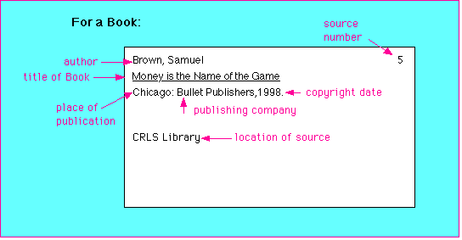
A Source Card for a Book Might Look Like This from http://www.crlsresearchguide.org/

Slide 14
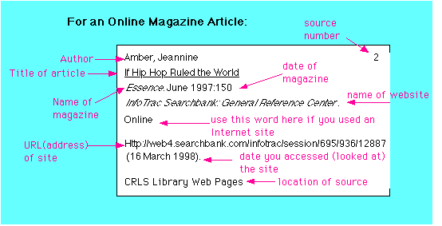
A Source Card from the Web Might Look Like This from http://www.crlsresearchguide.org/

Slide 15
Accessing Information - Notes
What do you include and what do you exclude?
What criteria do you use to decide?
  You will be using criteria a lot – and in different places for different purposes - so get used to understanding that you need a reason to take or not take an action – that is where the criteria come in.
Formatting your note taking.
  Don’t jam thing in – you may/will need to add comments or cross-references or additional information
  You can use a card system or a page system but ensure that the information on specific points is separated
  Make notes – don’t “copy’ down sources

Slide 16
Accessing Information - Notes
Write the purpose for or heading of the note at the top of each note card or section on your page.
Write only one main point on a note card or page section – add evidence or refer to the location of the evidence that supports the point.
Make notes only on information directly related to your focus or question.
Write only essential words, abbreviate when possible.
Be accurate: double check direct quotes and statistics.
Identify direct quotes with quotation marks and the person's name.

Slide 17
Accessing Information - Notes
Bracket your own words [ ] when you add them into a quote.
Use ellipsis points (...) where you leave out non-essential words from a quote.
Distinguish between 'fact' and 'opinion'.
Include a numbering system on your note cards or page system so that you can easily identify where material is located.
Identify the location in the source where you found the evidence about which you are making notes – page number for a book or print source – an identifier that will put you back in the correct location for web resources – other reference particulars for different sources.
Use the word 'over' at the bottom of the note car/page to indicate that information continues on the back of the card/page.

Slide 18
Organizing your Notes
Once you have all of your notes – your evidence at this point – be willing to add to that information at any time or to question the value of specific points that you have recorded.
Determine a method of organizing your information
  Some form of graphic organizer will often work best – be willing to change
    T-Chart; Venn Diagram, Table, etc.
Start arranging your material (evidence) under main headings (arguments) and supporting material (evidence)
Establish criteria for putting a value on both the headings and your evidence
  In SS or History PERSIAT GM or INSPECT can be useful for headings.

Slide 19
An Example
The materials that I will provide are based on a book on historical writing for high school level students.
The issue relates to WW I and narrowing the topic to a manageable focus – the conscription crisis
From there, we will look at building the argument for or against conscription.
Step 1
  Read the material in your TB and WB on the Conscription Crisis in WW I so that you have some background knowledge to apply to the topic and the discussion.

Slide 20
IS THE INFORMATION “USABLE”?
The relationship between accessing information and assessing information cannot be clearly distinguished.
When you are accessing information, you need to be aware of the type of information that you are using, the reliability of the information, issues of bias, how up-to-date the information is, whether there is other research that supports or contradicts the sources that you are using, and ….
We will look at the issues of assessing information, reliability and validity separately.

