Slide 1
Part four
THE WRITING PROCESS
References and Citations
BIBLIOGRAPHIES

Slide 2
Creating the Bibliography
If you do this first, it is available:
  To help you complete endnotes. We will use the term ‘endnote’ and ‘footnote’) interchangeably.
    Endnote entries have a slightly different format than bibliography citations. At this stage you may use either
  To help you with In-Text citations if you use them
  It gives you a chance to check what information you need for In-Text citations where you have more than one entry starting with the same first term
  It gives you a chance to check for missing information

Slide 3
Creating the Bibliography
What do we want as the end result?
  A single list of sources – NO DIVISIONS
  Properly formatted
    Separate page with the title centered
    Margins of 2.54 cm (1”)
    Each entry is single-spaced with double-spacing between each entry
    Entries are arrange alphabetically by first letter of entry
    Start URLs on a separate line unless they fit completely
    No numbering -no bullets – no markings of any kind
    No page numbers for book entries
    Same font and size of font – do not change the italics or underlining that may be present – this year
    First line of each entry is at the left margin and all other lines in that entry are indented one tab stop

Slide 4
Citation Handout #1
This handout (to show you what we are talking about) at (http://www.quia.com/pages/cpocock/page68 >> Writing >> Citations – Handout Number 1), is based on a sample Works Cited page from the Owl Purdue site, a site with which you should become familiar to help you in answering many of the questions that you will encounter in citation practice.
The sample page has been changed to a format that I want you to follow.
Remember that there are many different styles that you may encounter. We will work with the MLA format. Others can be easily learned if you understand one format.

Slide 5
Other Citation Formats
We will work with the MLA format. Most of you will use this for English courses but look at other formats to see the differences.
Other common formats include
  APA (Education, Psychology, Sciences)
  Chicago (History, Business, Fine Arts)
  Turabian (Is a variation on the Chicago style)
  Others include ACS (AMERICAN CHEMICAL SOCIETY), AMA Citation Style, IEEE (INSTITUTE OF ELECTRICAL AND ELECTRONICS ENGINEERS), NLM (NATIONAL LIBRARY OF MEDICINE), AAA (AMERICAN ANTHROPOLOGICAL ASSOCIATION), APSA (AMERICAN POLITICAL SCIENCE ASSOCIATION) – there are more.

Slide 6

Creating the Bibliography
Start with the Bibliography as you will have kept the information for those citations as you did your research
Take all of the citations that you have gathered and put them on a Word document
Line all of the references up with the left margin
Sort alphabetically
  Use the (this tab as this may make it easier but it may change your line spacing and you may need to insert blank line spaces between entries
  You may need to sort some or all of your entries manually if the formatting ‘scrambles’ when you use the computer sorting function

Slide 7
More on the Bibliography
Your bibliography is contained on a separate page or pages at the end of your work.
When you list in alphabetical order by the first word, ignore short words such as ‘A’, ‘An’, and ‘The’ as well as “ marks of the entry. There are no divisions for different types of sources
The lines for each entry are single-spaced and you double-space between entries
The first line starts at the margin and if there are additional lines they are indented one tab
  Using the Hanging Indent function may save you time and frustration.
  There are no bullets or numbers.

Slide 8
On With the Bibliography
Citations follow the MLA (Modern Language Association) format. There are many formats so look for and follow the MLA system if the source provides the citation format.
Highlight your entries and change them all to the same font type and size
Some sources will italicize titles and some will underline them. You do not need to worry about that – this year
The entry in a bibliographical reference consists of three or more “statements”

Slide 9
More on Bibliography
The three statements (at least three) are separated by periods. See the example below. (Coloured for clarity only.)
Frye, Northrop. Anatomy of Criticism: Four Essays. Princeton: Princeton U.P., 1957. Print.
Reyes, Sergio. Victor Jara of Chile, Presente! Now and Forever. n.p., n.d. Web. 8 Oct. 2009. < http://www.sreyes.org/vjindex.htm >
Ostro, A. "Twitter is frozen in time." Mashable. Mashable, 8 Oct. 2009. Web. 8 Oct. 2009. [Note → No URL (current practice) but you will add it (my practice).]
    A period after the ‘author’ statement (Red)
    A period after the ‘title’ statement (Green), and
    A period after the ‘publication’ statement (Blue)
    Include the URL for electronic sources in your bibliography
    You do not use colours in your Bibliography.
Database sources are cited differently.
Note that in the bibliography that it is Last Name, First Name (This is different than the practice in Endnotes.)
Notes:
NOTE: Foot/Endnotes have only one statement but I will not be marking punctuation in foot/endnotes so you can use bibliographical format if you wish. There are other differences, however.

Slide 10
Basic Information for Print Citations
WHAT MUST BE INCLUDED IN A BIBLIOGRAPHY?
  This is what you look for:
AUTHOR
TITLE
PLACE OF PUBLICATION
PUBLISHER
DATE OF PUBLICATION
PAGE NUMBER(S)
  (For articles from magazines, journals, periodicals, newspapers, encyclopedias, or in anthologies).
  (Page numbers are not included for books in your bibliography. There are included in your footnotes.)
It is not always easy to find all of the information but it is your task to find it, We will look at some of the ways to find the information.

Slide 11
To Cite an Electronic Source
Collect as much of the following as is available
  1. Author or editor's last name, then first name.
  2. Title of the article in quotation marks.
  3. Web site name, italicized – if you are creating the citation. (Underlining is no longer used.)
  4. Edition or version number.
  5. Web site owner or sponsor if available.
  6. Date of publication (DD MM YYYY as in 15 June 2009). If a publication date is not

Slide 12
Information Needed for a Citation
available, use n.d. for "no date." This is not to be used as a copout. If the date can be found, find it.
  7. The word Web and a period to indicate the publication medium. There are many other forms as well – don’t ignore other sources.
  8. The date you accessed the site and a period.
  9. Include the URL (uniform resource locator--that is, the Web address) of the document <in angle brackets> followed by a period.
  The MLA Guidebook will indicate that the URL is not required. It is.

Slide 13
Information Needed for a Citation
Frequently you will not find or be able to find all of this information.
  Some of it is just not provided on some sites
  Before you leave it out, be certain that it isn’t available. You may need to trace through links to other sites or search online for the missing info.
Two common problems are:
  No article date (use n.d.), or
  When the date is automatically updated to “today’s date” (the date on which you view it)
    If the date is in question put a question mark in brackets behind the date (?) but that is a questionable practice.

Slide 14
What Goes Where in the Citation?
The rules for citations are changing regularly. There is only one correct way (but it changes constantly) to write citations. What is it?
Some standard formats include:
For example - For a book – single author
Author. Title: Subtitle. City or Town: Publisher, Year of Publication. Print.
For an Internet site article:
Author’s Name. Title of Document. Title of Web Page. Title of Organization or Website. Date Last Updated. Web. Date Accessed <URL>

Slide 15
Indenting the Bibliography
Once you have your entries listed alphabetically, you need to indent the second and any subsequent lines
The Hanging Indent function may help you do this. Highlight all of your entries
Go to the angled arrow in the paragraph menu → click on that arrow to bring up the paragraph screen → go to Indentation → go to Special → click on the Down Arrow → click on Hanging → click on OK
All lines except in all entries except the first line should be indented one tab stop
  If the spacing (indentation) is incorrect, change the indentation value in the ‘By’ box after you click on Hanging

Slide 16
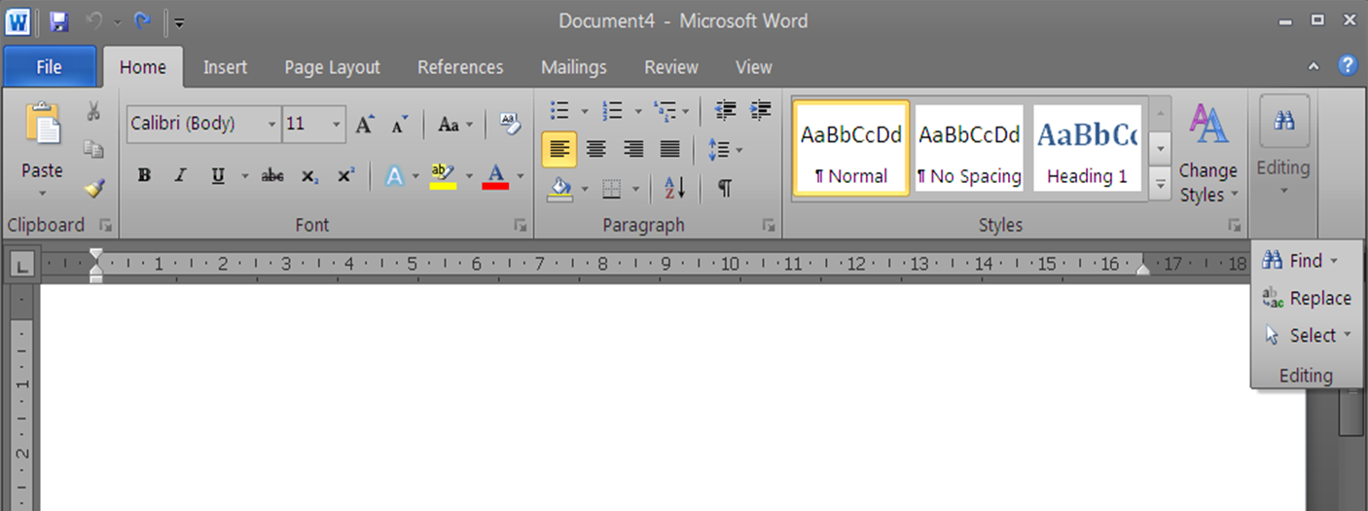
Using the Hanging Indent
Indent the second and any subsequent lines. Try using the Hanging Indent function.
Click on the Paragraph arrow

Slide 17
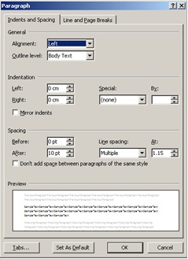
Using the Hanging Indent
Click on Down Arrow under Special

Slide 18
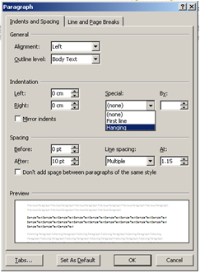
Using the Hanging Indent
Click on Hanging – Change the Indentation here

Slide 19
Hanging Indent
Click on Okay
The second and subsequent lines will be indented one tab stop.
Occasionally the formatting of the citation that you have copied and pasted is fixed and you will need to enter the material manually.
Remember to change your font type size to the same format – do not worry about italics or underlining of titles.
Check everything over and fix any errors manually.

Slide 20
Research
Research
  Use the best possible sources
    Distinguish (not in your bibliography) between Primary, Secondary and Tertiary resources and use them appropriately
    There is an article on the Class Page that you can refer to on PST sources. It is just one of many. Look at others.
    Avoid sources that cannot be identified – no author
  Avoid sources of questionable reliability or validity such as Ask.com, answers.yahoo.com, etc., and many Wiki sites although Wikipedia can be a good starting point
  How questionable sources may be used
    To obtain background information, keywords for future research, specific sources cited in the article, links to other material, etc.

Slide 21
Wikipedia ‘Caution’
“IMPORTANT NOTE: Most educators and professionals do not consider it appropriate to use tertiary sources such as encyclopedias as a sole source for any information—citing an encyclopedia as an important reference in footnotes or bibliographies may result in censure or a failing grade. Wikipedia articles should be used for background information, as a reference for correct terminology and search terms, and as a starting point for further research.”
  Excerpted from Wikipedia > Tools > Cite this page.

Slide 22
Research
Start accumulating a list of useful resources. Start small and add as you come across other resources or add those you learn about from others.
Take time to create proper citations as you go along. It is much easier. Keep a list of how to cite these sources.
Some sources that may be useful in Social Studies and History are;
  The History Place (H) - johndclare (H)
  BBC (H) - History Learning Site (H)
  historyworld.net (H) - A Brief History of Canada
  History of Canada Online - mapleleafweb.com
Get used to using Scholarly Sources. See the list of Academic Search Engines (http://www.teachthought.com/technology/100-search-engines-for-academic-research/) on the Class Page.

Slide 23
Using Google …
Google – is more than just typing in the name of the assignment on which you need information.
The Academic Search Engine site is just one example of the type of resource that you can find.
Spend some time finding out how Google works. See The Writing Process – Handout Number 2 and 3 mentioned earlier and given out as part of the notes on Research.
You can also take a quick online course with one of the google gurus by going to https://coursebuilder.withgoogle.com/sample/preview

Slide 24
Using Google …
Numerous other resources on research and searching are available such as the Ted Talk mentioned below
    http://ed.ted.com/on/r1rfAPV2
These are just some of the types of resources that you can find. They are the type of resource with which you should become increasingly familiar.
Search for and use other resources

Slide 25
Endnotes and More
An Endnote is, generally, the most commonly used form to direct the reader to specific material used in your work
  Endnotes are produced on a separate sheet of paper at the end of your essay
Previously, footnotes were commonly used
  Footnotes are produced at the bottom (foot) of each page
In-Text citation are another form of reference that is now commonly used. The relevant information is placed in parentheses (brackets) after the ‘borrowed’ material.

Slide 26
Footnote Format
Here – this year - you will have an option.
  You can use the same format as the format that is required for your Bibliography
  You can use the proper format for an MLA footnote (or endnote) in order to practice the methods that you will need in post-ssecondary.
The format for footnotes is that they consist of a single statement – not three statements as in a bibliographical citation.

Slide 27
Footnote Format/Examples
Footnotes are numbered
Footnotes are, preferably, inserted using the reference functions available through Word
The first line of the footnote is indented
A footnote looks like the following example – note the use of brackets around the publication data in the ‘note’ – not in the works cited citation
¹ Jerry White, ed. Death and Taxes: Beating One of the Two Certainties in Life (Toronto: Warwick, 1998) 7-8.

Slide 28
Finding the Information
Different types of sources will require different types of searching to get the necessary information
Primary Sources – You will normally need to search for all of the necessary information
Secondary Sources – some will provide the citation that they prefer
Tertiary Sources – generally provide the format that is preferred.

Slide 29
Ways to Find and Deal with Information
Dictionary (and similar) entries
  Generally start with the term in quotation marks
  The first letter is what you use for your alphabetical listing (ignore the “_____”)
Using Bibtex and other bibliography creators
  Often take as much time as just doing it
  Don’t work well, in most cases, with tertiary sources
Google ‘how to cite ………’
  This gives you general information on citing an online dictionary or thesaurus and specifics on citing the Merriam-Webster dictionary

Slide 30
Finding the Information
We will look at some examples and by seeing how their citations can be found, you may come up with ideas on how others may be found.
In the these examples we will look for ‘Cite’ or ‘Link/Cite’ or ‘Citations’ or ‘Cite As’, etc.
  This is to help find if the source has specified a way in which they want to reference their source.
  If you have difficulty, use the Edit > Search or Find - or Ctrl + F function, it will frequently simplify the process but it is no guarantee.
  The search function is one with which you should be familiar for general purposes.
  If you are searching for the citation practice on a particular site try using just ‘cit’ in your search.

Slide 31
Finding the Information – Tertiary
Look at some of the common sources
Dictionaries
  http://dictionary.reference.com/browse/totalitarianism
  http://www.thefreedictionary.com/totalitarian
Encyclopedia
  http://www.thecanadianencyclopedia.ca/en/article/nationalism/
  https://en.wikipedia.org/wiki/Nationalism

Slide 32
Ways to Find and Deal with Information
Check the Class Page under “Writing” and “Useful Links” for specific information
  Government documents
  In-Text citations
  Other topics and resources from time to time
Use other sources to see how they have cited various sources
Remember that examples are just that – examples. Practices change and you cannot rely on someone’s past practice.

Slide 33
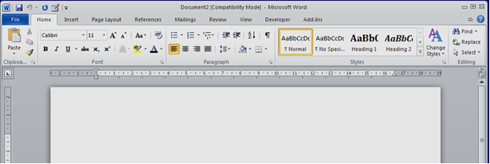


Word 2010 Menu Bar
Pay attention to all of the functions but, in particular, the following:

Slide 34
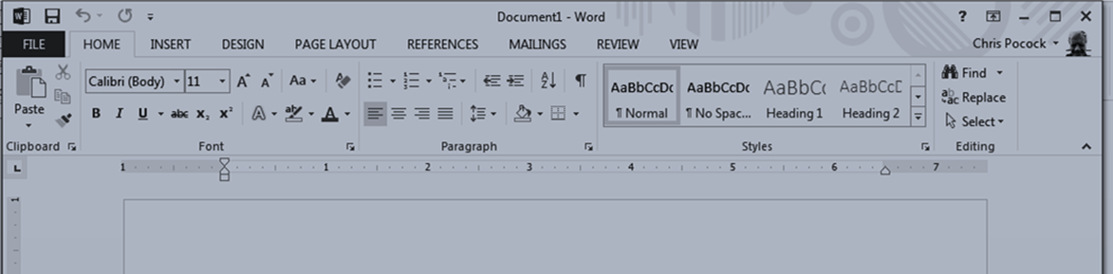
Using the Find Function
The Menu Bars at the top of your screen looks like this in Word 2013

Slide 35
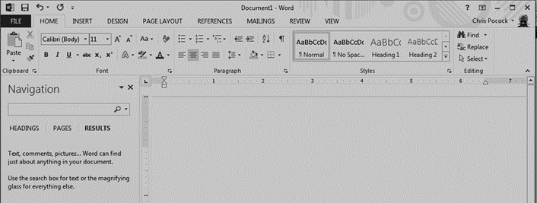
Using the Find Function
If you click on the Find on the Menu Bar, you will get a search box that looks like this
Enter the term that you are looking for.

Slide 36
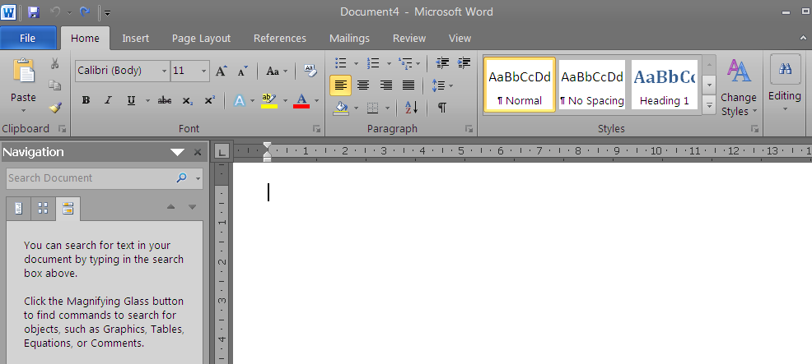
Using the Edit Function
When you click on Find you will get a screen that looks like this

Slide 37
Using the Edit Function
Type the word or phrase for which you are looking into the search box in the Navigation screen in the left margin.
It will generate a list of the uses of the term as shown on the next slide.
It will also highlight the locations in which the term is used.
If you click on one of the entries it will bring you to the location of that entry in your document.
Alternatively, use Ctrl + F to bring up the Search Box.

Slide 38
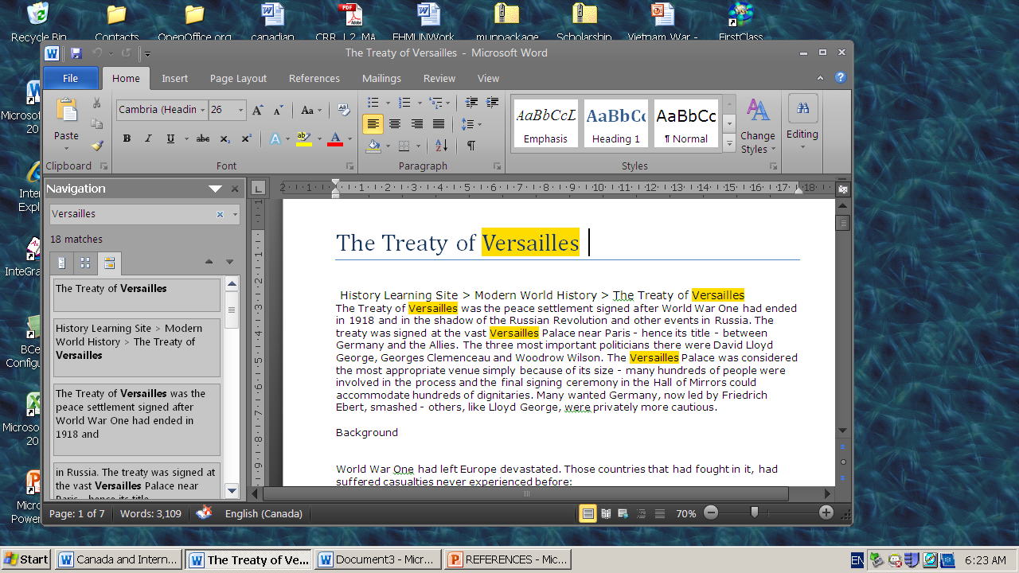

Slide 39
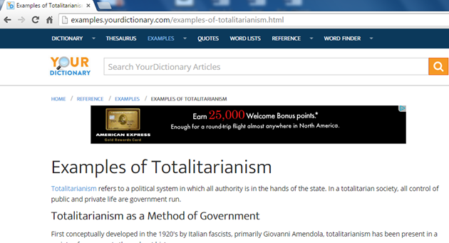
Your Dictionary
This is an example – not a suggestion of a preferred source. You will get a page that looks like this – many other sites are similar

Slide 40
Your Dictionary - Citation
If you scroll through the page you may find the link to the preferred method of citation – you may also miss it as it is relatively insignificant.
Try using Ctrl + F and typing in cit (cit will give you any term containing those three letters – some you want – some you don’t. Learn how to use the function.
Using Ctrl + F and entering cit we get;

Slide 41
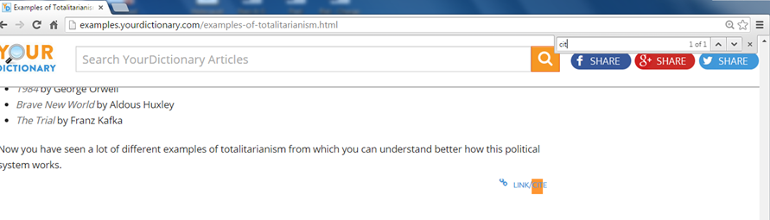

Slide 42
Some Other Specific Examples
Take a look at Wikipedia http://en.wikipedia.org/wiki/Totalitarianism
On the menu on the left side of the screen (see the next slide), there are a number of expandable links
One of these says “Tools”. This menu is now expanded, by default. If you see a menu that is collapsed or that says Toolbox – click on it to expand it.
Click on Cite this page

Slide 43
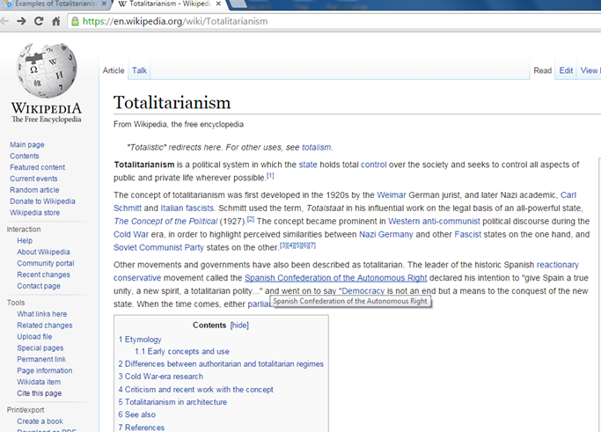

Slide 44
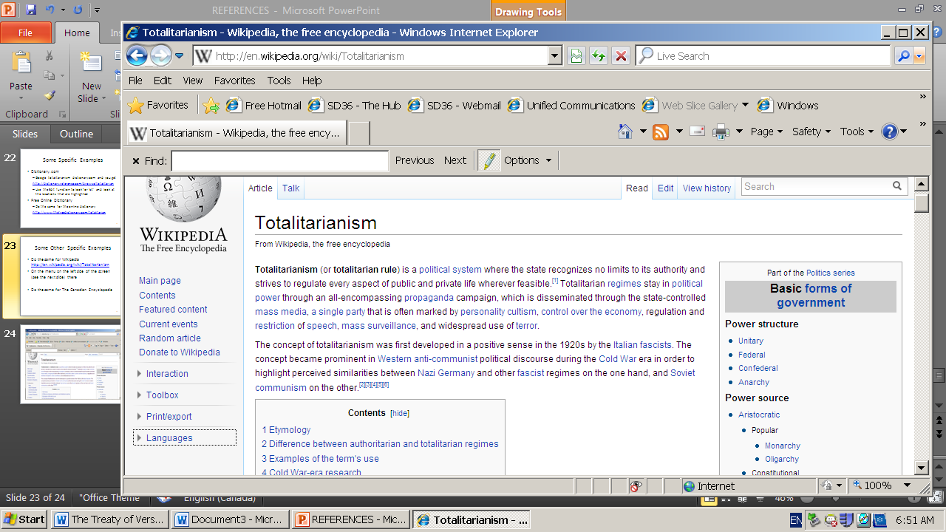

Slide 45
Wikipedia
Click on Cite This Page and it takes you to http://en.wikipedia.org/w/index.php?title=Special:Cite&page=Totalitarianism&id=474785295
Note the warning – pay attention to it.
Look for the MLA citation and copy and paste it onto a Word document for use when and where you need it.
Wikipedia contributors. "Totalitarianism." Wikipedia, The Free Encyclopedia. Wikipedia, The Free Encyclopedia, 3 Feb. 2012. Web. 7 Feb. 2012.
<The URL of the site that you used will go between these two pointed brackets>
- but only in your bibliography.
→ Note: You need the URL from the “article” page not from the citation page.

Slide 46
Another Example
Google responsible government in The Canadian Encyclopedia
http://www.thecanadianencyclopedia.ca/en/article/socialism/
If you are using IE or some other search engines you may not get the cite link to (“)
If you try using the Edit function and ‘cit’ you will not get any results.
You need to look for possibilities. The most common places to look are the top and bottom of the page and any menus on the sides.
Make use of the information that you just learned – where could you find the type of information that you need?

Slide 47

The Canadian Encyclopedia
At the top right is a box that looks like the one on the right
If you click on the “ symbol it will provide you with the citation information – shown below
Whitehorn, Alan and Walter D. Young.“Socialism”. The Canadian Encuclopedia. Toronto: Historica Canada, 2006. Web. 8 Feb 2006.
<URL is added here>

Slide 48
Creating the Bibliography
Take all of the citations that you have gathered on your Word document
Line all of the references up with the left margin
Sort alphabetically (this may change your line spacing and you may need to insert blank line spaces between entries) and then indent the second and any subsequent lines. It is easiest, generally, to use the Hanging Indent function.

Slide 49
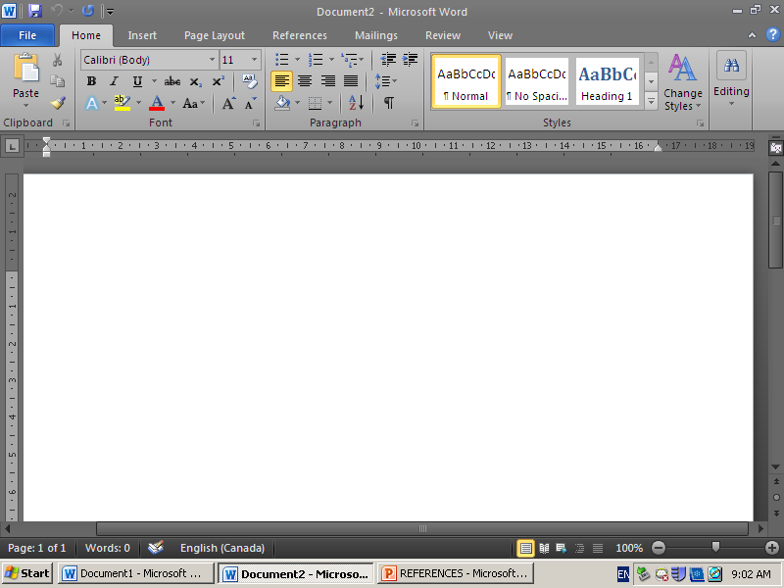
Using The Hanging Indent

Slide 50
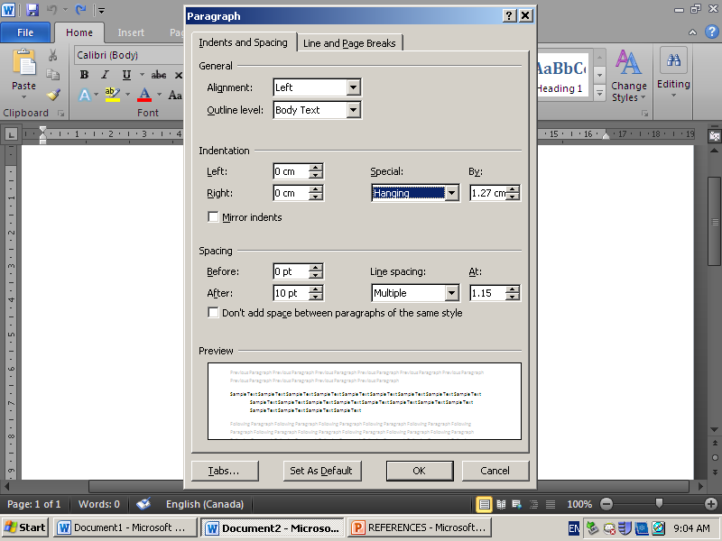
Hanging Indent
Click on Paragraph and then on the Down Arrow under Indentation >> Special

Slide 51
Hanging Indent
Click on Okay
The second and subsequent lines will be indented one tab stop.
Occasionally the formatting of the citation that you have copied and pasted is fixed and you will need to enter the material manually.
Remember to change your font type size to the same format – do not worry (this year) about italics or underlining of titles.
Check everything over and fix any errors manually.

Slide 52
An Example to try to Consolidate
You take the following sentence from an article on Adolf Hitler from The History Place
  “After the elections of March 5, 1933, the Nazis began a systematic takeover of the state governments throughout Germany, ending a centuries-old tradition of local political independence.”
  http://www.historyplace.com/worldwar2/riseofhitler/dictator.htm
The information that you need for the Internet:
  Author
  Title of Document and Title of Article if there is one
  Date Last Updated
  Title of Organization, Website, Database …
  Date Accessed
  URL
  Title of Print Source if there is one.

Slide 53
Finding The Information
What you Need
Author
Title of Document
Title of Article
Title of Website
Date Updated
Date Accessed
URL
What you can Find
Phillip Gavin
The Rise of Adolph Hitler
Hitler Becomes Dictator
The History Place
nd or (1996)
8 Feb. 2012
http://www.historyplace.com/worldwar2/riseofhitler/dictator.htm

Slide 54
Bibliographical Entry
Your Works Cited/Bibliography reference would look like
Author Last Name, First Name, and Second Author First Name and Last Name. "Title of Article: Subtitle of article." Title of Website. Name of publisher. Date of publication. Web. Date of access.
Gavin, Phillip. “The Rise of Adolf Hitler: Hitler is Homeless in Vienna”. The History Place The History Place. July 4, 1996. Web. 22 June. 2012. <http://www.historyplace.com/worldwar 2/riseofhitler/homeless.htm>

Slide 55
Footnote Entry
Your Footnote or Endnote reference would look like
Phillip Gavin, “The Rise of Adolf Hitler: Hitler is Homeless in Vienna”. The History Place, The History Place. July 4, 1996. Web. 22 June. 2012.

Slide 56
In-Text Examples – Web Source
In October 1908, Hitler tried for the second time to gain admission to the Vienna Academy of Fine Arts. However, his test drawings were judged as so poor that he was not even allowed to take the formal exam (Gavin).

Slide 57
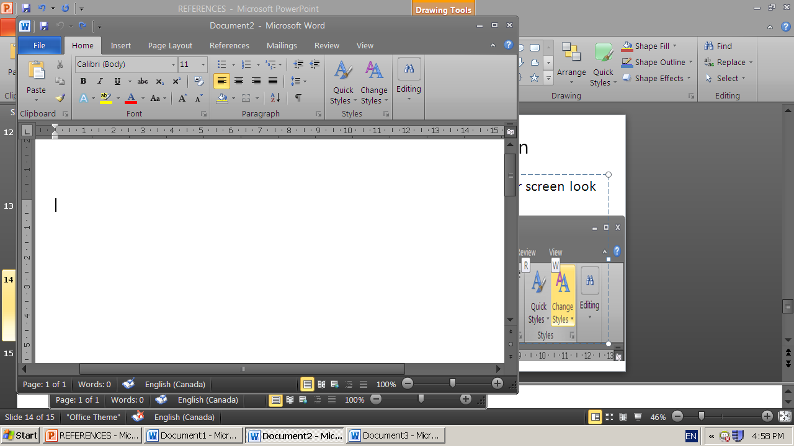
Adding an Endnote
On your Word page, click on References

Slide 58
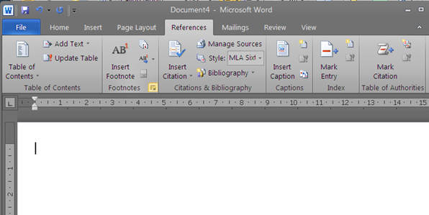
Adding an Endnote
After you click on References, you will get a screen that looks like this

Slide 59
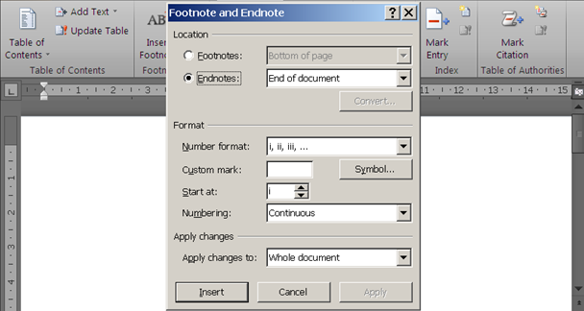
Adding an Endnote
Click on the arrow to the right of Footnotes and you will get a drop-down menu like this

Slide 60
Adding an Endnote
On the drop-down menu
  Click on circle beside Endnotes (the default is normally) footnotes
  Click on the ‘down arrow’ to the right of the Number Format and change it to ‘1, 2, 3, …’
  Start at # ’1’, have the numbering ‘Continuous’ and have it Apply Change to “Whole Document’
  Click on Apply in the bottom right corner to apply your choices to the whole document.

Slide 61
Inserting an Endnote
In your document, locate the position where you need to insert an endnote
On the reference screen, click on ‘Insert Endnote’
The next, sequential superscript number will appear where you positioned your cursor and in the endnote list.
Add the citation for the endnote and indented the first line
Remember that you may use a bib. citation here now, as this is practice only. Later, you will need to enter a properly formatted endnote citation.
See the Class Page link to Endnote and Bibliography citations in the Written Response section.

Slide 62
In-Text Citations
An In-Text citation is also referred to as Parenthetical citation
An In-Text citation means simply:
  That your reference to a source is done within the text of your work
  The reference is placed in brackets
  It includes a short form citation that corresponds with the complete citation on your Works Cited page

Slide 63
In-Text Examples – Author & Book
Excerpts from
http://owl.english.purdue.edu/owl/resource/747/02/
Wordsworth stated that Romantic poetry was marked by a "spontaneous overflow of powerful feelings" (263).
  The author’s name is given so only the page number is needed.
Romantic poetry is characterized by the "spontaneous overflow of powerful feelings" (Wordsworth 263).
  Here both the author and page are required.

Slide 64
In-Text Examples – Author & Book
The parenthetical references in both cases shown indicate that tell readers that the information in the sentence can be located on page 263 of a work by an author named Wordsworth.
That source can be found on the Works Cited page under the name of Wordsworth where they would find
Wordsworth, William. Lyrical Ballads. London: Oxford U.P., 1967. Print.
  Note: There are no page #s in the Bibliography for book sources.

Slide 65
Some Observations
To avoid confusion with the specific information that is being referred to, it is often preferable to create “markers” at the beginning – author’s name – and at the end (page reference) of the referenced material
Short quotations are marked with quotation marks
Web sources often have no author. Use the corporate authorship
  When the polishing error was discovered, the Hubble mirror was described as “needing glasses” (NASA 234).

Slide 66
Some observations
When there is no human or corporate author, use a shortened form of the first part of the Title of the web article
Do not make up page numbers. Web pages generally do not have paragraph or page numbers.

Slide 67
In Summary
Most of these examples are based on tertiary sources
You will be allowed to use tertiary sources for many purposes in high school
  YOU WILL NOT BE ALLOWED TO AT UNIVERSITY
Start getting used to using the best possible resources – academic sources – primary sources – good secondary sources
  You will not receive full marks if you use poor sources
Use these examples to help you get used to the challenge of looking for the information that you need for a proper citation.

