Slide 1
Part FIVE
THE WRITING PROCESS
References and Citations
BIBLIOGRAPHIES
Research & Using Information – Part 2

Slide 2
Research
Research
  Use the best possible sources
    Distinguish (not in your bibliography) between Primary, Secondary and Tertiary resources and use them appropriately
    There is an article on the Class Page that you can refer to on PST sources. It is just one of many. Look at others.
    Avoid sources that cannot be identified – no author
  Avoid sources of questionable reliability or validity such as Ask.com, answers.yahoo.com, etc., and many Wiki sites although Wikipedia can be a good starting point
  How questionable sources may be used
    To obtain background information, keywords for future research, specific sources cited in the article, links to other material, etc.

Slide 3
Wikipedia ‘Caution’
“IMPORTANT NOTE: Most educators and professionals do not consider it appropriate to use tertiary sources such as encyclopedias as a sole source for any information—citing an encyclopedia as an important reference in footnotes or bibliographies may result in censure or a failing grade. Wikipedia articles should be used for background information, as a reference for correct terminology and search terms, and as a starting point for further research.”
  Excerpted from Wikipedia > Tools > Cite this page.

Slide 4
Research
Start accumulating a list of useful resources. Start small and add as you come across other resources or add those you learn about from others.
Take time to create proper citations as you go along. It is much easier. Keep a list of how to cite these sources.
Some sources that may be useful in Social Studies and History as a starting point include:
  The History Place (H) - johndclare (H)
  BBC (H) - History Learning Site (H)
  historyworld.net (H) - A Brief History of Canada
  History of Canada Online - mapleleafweb.com
Get used to using Scholarly Sources. See the list of Academic Search Engines (http://www.teachthought.com/technology/100-search-engines-for-academic-research/) on the Class Page.

Slide 5
Using Google …
Google – is more than just typing in the name of the assignment on which you need information.
Spend some time finding out how Google works. See The Writing Process – Handout Number 2 and 3 mentioned earlier and given out as part of the notes on Research.
You can also take a quick online course with one of the google gurus by going to https://coursebuilder.withgoogle.com/sample/preview
The Academic Search Engine site is just one example of the type of resource that you can find. See the Class Page.

Slide 6
Using Google …
Numerous other resources on research and searching are available such as the Ted Talk mentioned below
    http://ed.ted.com/on/r1rfAPV2
These are just some of the types of resources that you can find. They are the type of resource with which you should become increasingly familiar.
Search for and use other resources

Slide 7
Finding the Information
Different types of sources will require different types of searching to get the necessary information
Primary Sources – You will normally need to search for all of the necessary information
Secondary Sources – some will provide the citation that they prefer – use it.
Tertiary Sources – generally provide the format that is preferred – use it.

Slide 8
Ways to Find and Deal with Information
Dictionary (and similar) entries
  Generally start with the term in quotation marks
  The first letter is what you use for your alphabetical listing (ignore the “_____”)
Using Bibtex and other bibliography creators
  Often take as much time as just doing it
  Don’t work well, in most cases, with tertiary sources
Google ‘how to cite ………’
  This gives you general information on citing an online dictionary or thesaurus and specifics on citing the Merriam-Webster dictionary

Slide 9
Finding the Information
We will look at some examples and, by seeing how their citations can be found, you may come up with ideas on how others may be found.
In the these examples we will look for ‘Cite’ or ‘Link/Cite’ or ‘Citations’ or ‘Cite As’, etc.
  This is to help find if the source has specified a way in which they want to reference their source.
  If you have difficulty, use the Edit > Search or Find - or Ctrl + F function, it will frequently simplify the process but it is no guarantee.
  The search function is one with which you should be familiar for general purposes.
  If you are searching for the citation practice on a particular site try using just ‘cit’ in your search.

Slide 10
Finding the Information – Tertiary
Look at some of the common sources
Dictionaries
  http://dictionary.reference.com/browse/totalitarianism
  http://www.thefreedictionary.com/totalitarian
Encyclopedia
  http://www.thecanadianencyclopedia.ca/en/article/nationalism/
  https://en.wikipedia.org/wiki/Nationalism

Slide 11
Ways to Find and Deal with Information
Check the Class Page under “Writing” and “Useful Links” for specific information
  Government documents
  In-Text citations
  Other topics and resources from time to time
Use other sources to see how they have cited various sources
Remember that examples are just that – examples. Practices change and you cannot rely on someone’s past practice.

Slide 12
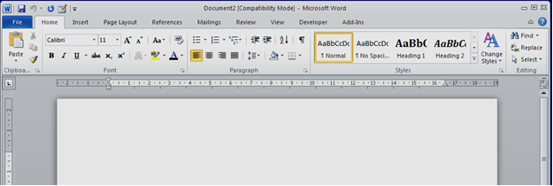


Word 2010 Menu Bar
Pay attention to all of the functions but, in particular, the following:

Slide 13
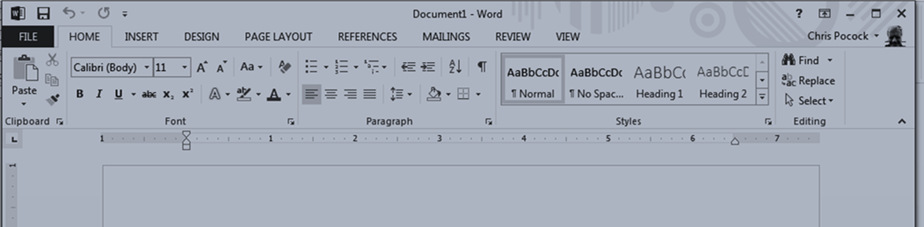
Using the Find Function
The Menu Bars at the top of your screen looks like this in Word 2013

Slide 14
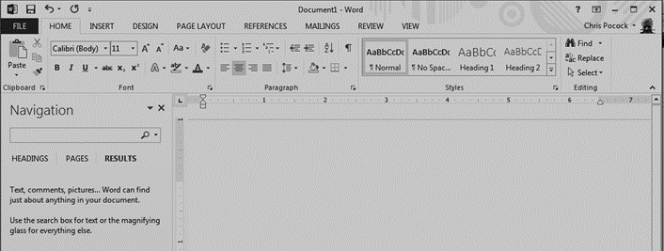
Using the Find Function
If you click on the Find on the Menu Bar, you will get a search box that looks like this
Enter the term that you are looking for.

Slide 15
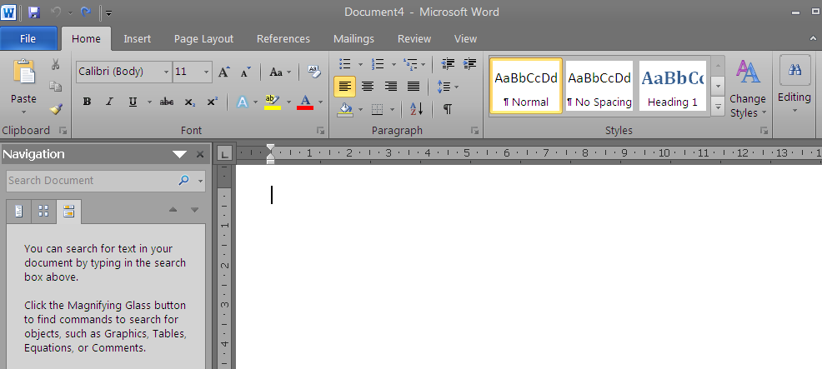
Using the Edit Function
When you click on Find you will get a screen that looks like this

Slide 16
Using the Edit Function
Type the word or phrase for which you are looking into the search box in the Navigation screen in the left margin.
It will generate a list of the uses of the term as shown on the next slide.
It will also highlight the locations in which the term is used.
If you click on one of the entries it will bring you to the location of that entry in your document.
Alternatively, use Ctrl + F to bring up the Search Box.

Slide 17
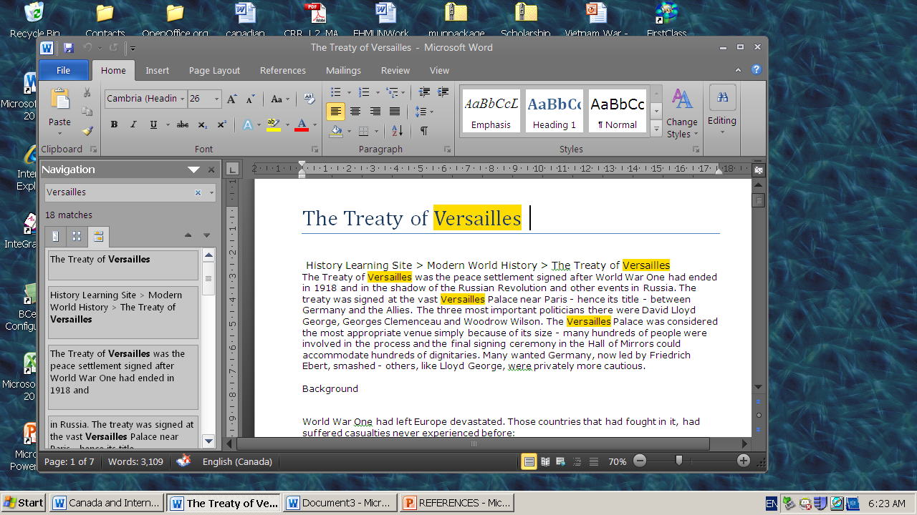

Slide 18
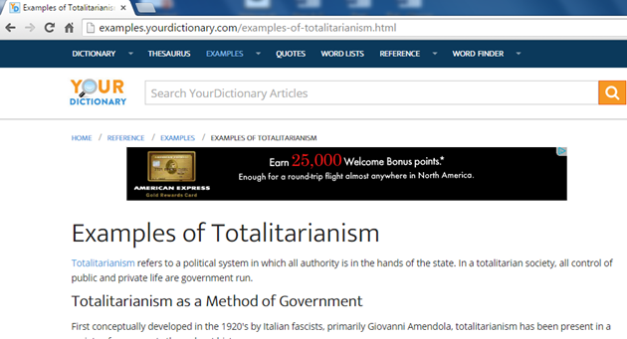
Your Dictionary
This is an example – not a suggestion of a preferred source. You will get a page that looks like this – many other sites are similar

Slide 19
Your Dictionary - Citation
If you scroll through the page you may find the link to the preferred method of citation – you may also miss it as it is relatively insignificant.
Try using Ctrl + F and typing in cit (cit will give you any term containing those three letters – some you want – some you don’t. Learn how to use the function.
Using Ctrl + F and entering cit we get;

Slide 20
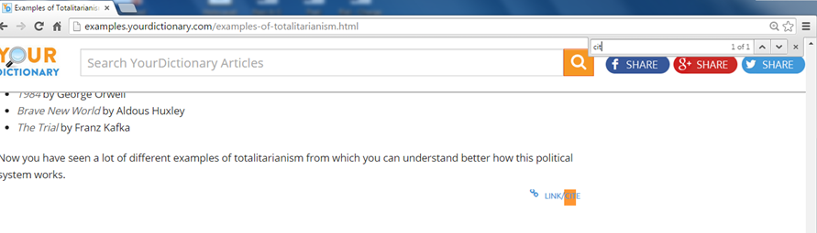

Slide 21
Some Other Specific Examples
Take a look at Wikipedia http://en.wikipedia.org/wiki/Totalitarianism
On the menu on the left side of the screen (see the next slide), there are a number of expandable links
One of these says “Tools”. This menu is now expanded, by default. If you see a menu that is collapsed or that says Toolbox – click on it to expand it.
Click on Cite this page

Slide 22
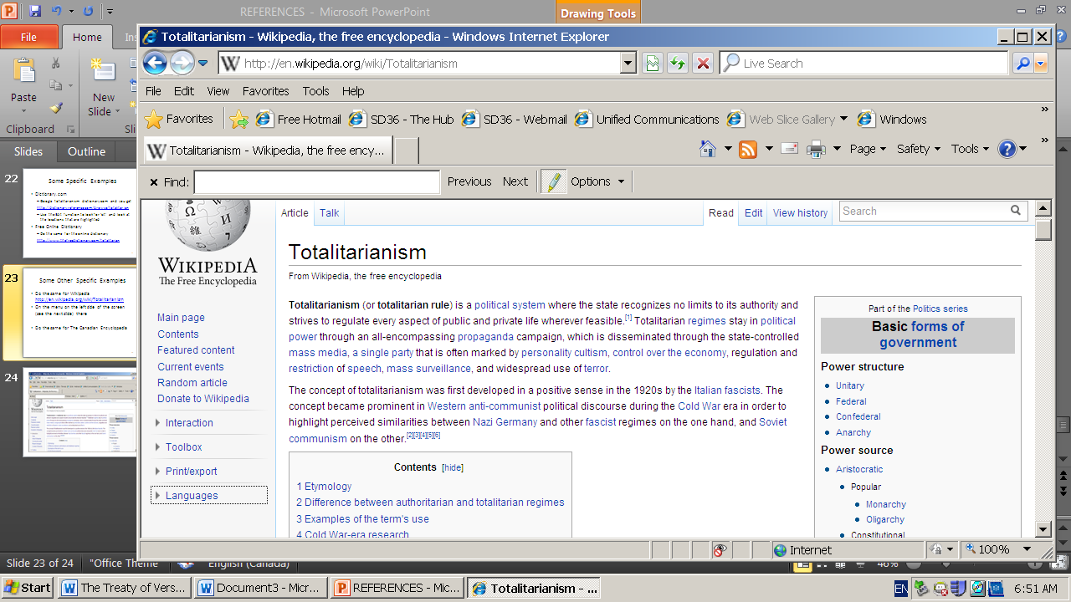

Slide 23
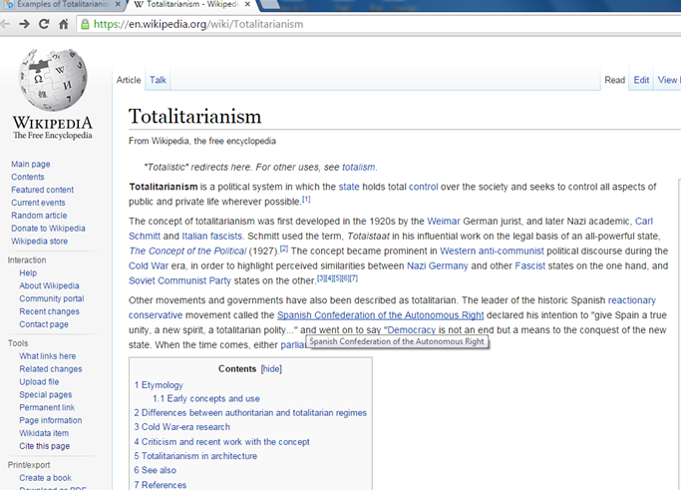

Slide 24
Wikipedia
Click on Cite This Page and it takes you to http://en.wikipedia.org/w/index.php?title=Special:Cite&page=Totalitarianism&id=474785295
Note the warning – pay attention to it.
Look for the MLA citation and copy and paste it onto a Word document for use when and where you need it.
Wikipedia contributors. "Totalitarianism." Wikipedia, The Free Encyclopedia. Wikipedia, The Free Encyclopedia, 3 Feb. 2012. Web. 7 Feb. 2012.
<The URL of the site that you used will go between these two pointed brackets>
- but only in your bibliography.
→ Note: You need the URL from the “article” page not from the citation page → Go back to the “article” page.

Slide 25
Another Example
Google responsible government in The Canadian Encyclopedia
http://www.thecanadianencyclopedia.ca/en/article/socialism/
If you are using IE or some other search engines you may not get the cite link to (“)
If you try using the Edit function and ‘cit’ you will not get any results.
You need to look for possibilities. The most common places to look are the top and bottom of the page and any menus on the sides.
Make use of the information that you just learned – where could you find the type of information that you need?

Slide 26
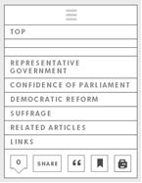
The Canadian Encyclopedia
At the top right is a box that looks like the one on the right
If you click on the “ symbol it will provide you with the citation information – shown below
Whitehorn, Alan and Walter D. Young.“Socialism”. The Canadian Encuclopedia. Toronto: Historica Canada, 2006. Web. 8 Feb 2006.
<URL is added here>

Slide 27
An Example to try to Consolidate
You take the following sentence from an article on Adolf Hitler from The History Place
  “After the elections of March 5, 1933, the Nazis began a systematic takeover of the state governments throughout Germany, ending a centuries-old tradition of local political independence.”
  http://www.historyplace.com/worldwar2/riseofhitler/dictator.htm
The information that you need for the Internet:
  Author
  Title of Document and Title of Article if there is one
  Date Last Updated
  Title of Organization, Website, Database …
  Date Accessed
  URL
  Title of Print Source if there is one.

Slide 28
Finding The Information
What you Need
Author
Title of Document
Title of Article
Title of Website
Date Updated
Date Accessed
URL
What you can Find
Phillip Gavin
The Rise of Adolph Hitler
Hitler Becomes Dictator
The History Place
nd or (1996)
8 Feb. 2012
http://www.historyplace.com/worldwar2/riseofhitler/dictator.htm

Slide 29
Bibliographical Entry
Your Works Cited/Bibliography reference would look like
Author Last Name, First Name, and Second Author First Name and Last Name. "Title of Article: Subtitle of article." Title of Website. Name of publisher. Date of publication. Web. Date of access.
Gavin, Phillip. “The Rise of Adolf Hitler: Hitler is Homeless in Vienna”. The History Place The History Place. July 4, 1996. Web. 22 June. 2012. <http://www.historyplace.com/worldwar 2/riseofhitler/homeless.htm>

Slide 30
Some Observations
Web sources often have no author. Use the corporate authorship
  When the polishing error was discovered, the Hubble mirror was described as “needing glasses” (NASA 234).
When there is no human or corporate author, use a shortened form of the first part of the Title of the web article
Do not make up page numbers. Web pages generally do not have paragraph or page numbers.

Slide 31
In Summary
Most of these examples are based on tertiary sources – to give you examples and practice.
You will be allowed to use tertiary sources for many purposes in high school
  YOU WILL NOT BE ALLOWED TO AT UNIVERSITY
Start getting used to using the best possible resources – academic sources – primary sources – good secondary sources
  You will not receive full marks if you use poor sources
Use these examples to help you get used to the challenge of looking for the information that you need for a proper citation.

