Slide 1
Part SIX
THE WRITING PROCESS
References and Citations
FOOTNOTES or ENDNOTES or
IN-TEXT CITATIONS

Slide 2
Endnotes and More
Endnotes, footnotes and in text citations are all forms of references that direct the reader to a specific source of information that you have used or upon which you are relying.
They are all contained (to some extent) within the body of your essay – either by a number (EN and FN) or by a reference to the author or title to direct the reader to the source listed in your bibliography.

Slide 3
What You Will End Up With
With Footnotes and Endnotes, you will have:
  A single numerical list using Arabic numerals (1, 2, 3, 4, ……..).
  This format will be created using the “Reference” menu tab on the Word screen. See the next slide.
  A ‘separator’ line will be inserted.
  All of your entries will be lined up on the left margin in numerical order. You will then need to:
    Change them all to the same font and size
    Indent the first line – this is the same process as for the Hanging Indent except you choose “First Line”
  The footnotes will adjust automatically to the page to which they apply.
  Numbers will adjust automatically if you add/delete.

Slide 4
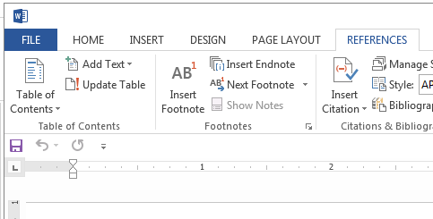
Portion of Word Menu
First – Click on
Then – Click on

Slide 5
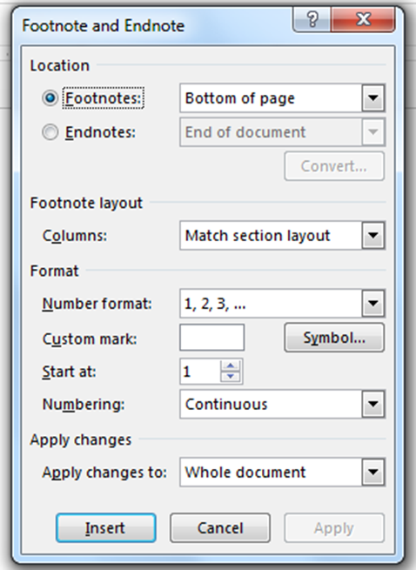

Footnote/Endnote Menu
Choose Footnotes or Endnotes
Choose Arabic numerals
The expanded menu looks like this.
Default item – leave it.
Click

Slide 6
Endnotes and More
An Endnote is, generally, the most commonly used form to direct the reader to specific material or ideas used in your work
  Endnotes are produced on a separate sheet of paper at the end of your essay before the bibliography.
Previously, footnotes were commonly used
  Footnotes are produced at the bottom (foot) of each page. You will start by using footnotes.
In-Text citation are another form of reference that is now commonly used. The relevant information is placed in parentheses (brackets) after the ‘borrowed’ material.

Slide 7
Footnote Format
This year - you will have a formatting option.
  You can use the same format as the format that is required for your Bibliography
  You can use the proper format for an MLA footnote (or endnote) in order to practice the methods that you will need in post-secondary.
The format for footnotes is that they consist of a single statement – not three statements as in a bibliographical citation.

Slide 8
Footnote Format/Examples
Footnotes are numbered
Footnotes are inserted using the reference functions available through Word
The first line of the footnote is numbered and indented
A footnote looks like the following example – note the use of brackets around the publication data in the ‘note’ – not in the works cited citation
¹ Jerry White, ed. Death and Taxes: Beating One of the Two Certainties in Life (Toronto: Warwick, 1998) 7-8.
The page numbers are NOT included in the bib. citation.

Slide 9
Footnote Entry
Look back at the example taken from The History Place on Hitler in the bibliography PoewrPoint.
Your Footnote or Endnote reference would look like:
Phillip Gavin, “The Rise of Adolf Hitler: Hitler is Homeless in Vienna”. The History Place, The History Place. July 4, 1996. Web. 22 June. 2012.

Slide 10
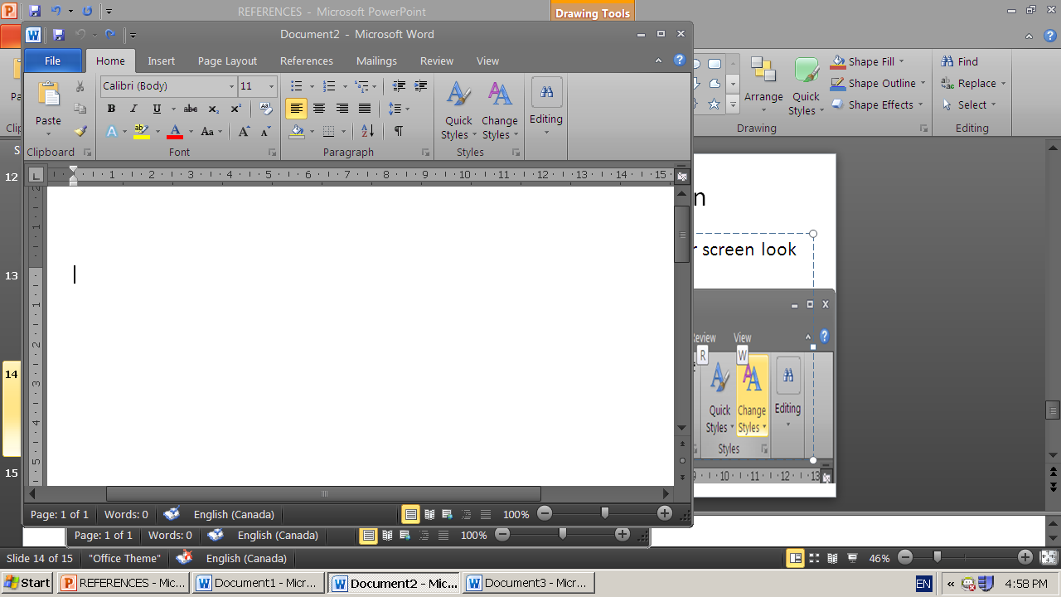
Adding an Footnote
On your Word page, click on References

Slide 11
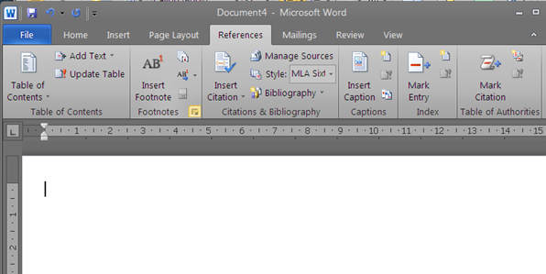
Adding an Endnote
After you click on References, you will get a screen that looks like this

Slide 12
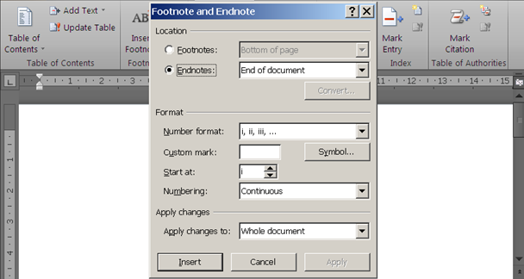
Adding an Endnote
Click on the arrow to the right of Footnotes and you will get a drop-down menu like this

Slide 13
Adding a Footnote
On the drop-down menu
  Click on circle beside Footnotes(the default is normally) footnotes
  Click on the ‘down arrow’ to the right of the Number Format and change it to ‘1, 2, 3, …’
  Start at # ’1’, have the numbering ‘Continuous’ and have it Apply Change to “Whole Document’
  Click on Apply in the bottom right corner to apply your choices to the whole document.

Slide 14
Inserting an Footnote
In your document, locate the position where you need to insert a footnote
For Footnotes, you may need to open the menu and click on “Insert”. For Endnotes simply click on ‘Insert Endnote’
The next, sequential superscript number will appear where you positioned your cursor and in the footnote list.
Add the citation for the footnote and indent the first line or do all of the indentation at one time later.
Remember that you may use a bib. citation here now, as this is practice only. Later, you will need to enter a properly formatted endnote citation.
See the links on the Class Page in the Written Response section for these and other notes and examples.

Slide 15
An Example of Some Footnotes
See Handout #5 with some comments on some examples that were handed in for a previous exercise.
… or go to (http://www.quia.com/pages/cpocock/page68 >> Writing >> Citations – Handout Number 5)
For additional information see the material at (http://www.quia.com/pages/cpocock/page68 >> Writing >> Citations – Exercise Comments)

Slide 16
In-Text Citations
An In-Text citation is also referred to as Parenthetical citation
An In-Text citation means simply:
  That your reference to a source is done within the text of your work
  The reference is placed in brackets
  It includes a short form citation that corresponds with the complete citation on your Works Cited page

Slide 17
In-Text Examples – Author & Book
Excerpts from
http://owl.english.purdue.edu/owl/resource/747/02/
Wordsworth stated that Romantic poetry was marked by a "spontaneous overflow of powerful feelings" (263).
  The author’s name is given so only the page number is needed.
Romantic poetry is characterized by the "spontaneous overflow of powerful feelings" (Wordsworth 263).
  Here both the author and page are required.

Slide 18
In-Text Examples – Author & Book
The parenthetical references in both cases shown tell readers that the information in the sentence can be located on page 263 of a work by an author named Wordsworth.
That source can be found on the Works Cited page under the name of Wordsworth where they would find
Wordsworth, William. Lyrical Ballads. London: Oxford U.P., 1967. Print.
  Note: There are no page #s in the Bibliography for book sources.

Slide 19
In-Text Examples – Web Source
In October 1908, Hitler tried for the second time to gain admission to the Vienna Academy of Fine Arts. However, his test drawings were judged as so poor that he was not even allowed to take the formal exam (Gavin).
What would the Works Cited page entry look like?

Slide 20
Some Observations
To avoid confusion with the specific information that is being referred to, it is often preferable to create “markers” at the beginning – author’s name – and at the end (page reference) of the referenced material
Short quotations are marked with quotation marks
Web sources often have no author. Use the corporate authorship
  When the polishing error was discovered, the Hubble mirror was described as “needing glasses” (NASA 234).

Slide 21
Some observations
When there is no human or corporate author, use a shortened form of the first part of the Title of the web article
Do not make up page numbers. Web pages generally do not have paragraph or page numbers.

Slide 22
In Summary
Most of these examples are based on tertiary sources
You will be allowed to use tertiary sources for many purposes in high school
  YOU WILL NOT BE ALLOWED TO AT UNIVERSITY
Start getting used to using the best possible resources – academic sources – primary sources – good secondary sources
  You will not receive full marks if you use poor sources
Use these examples to help you get used to the challenge of looking for the information that you need for a proper citation.

