Slide 1
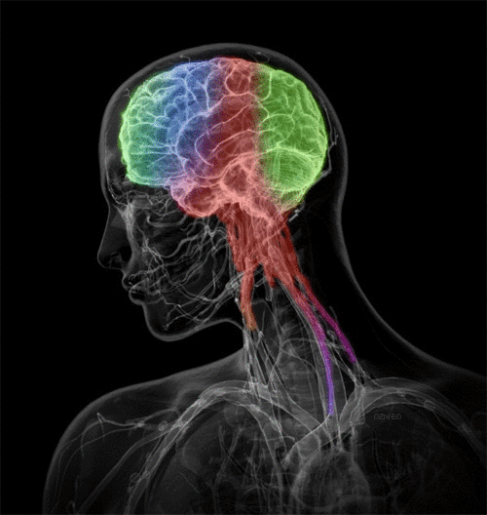
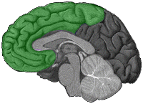
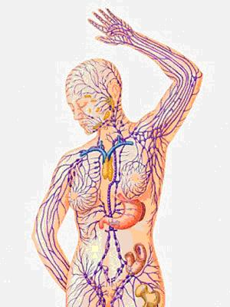
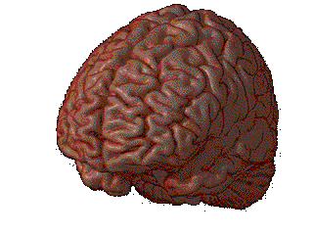

Biological
The Brain
How the brain, nervous system, and endocrine system effect behavior

Slide 2
Three Main Parts and the Limbic System
A. Cerebrum
B. Cerebellum
C. Brain stem
D. The Limbic System

Slide 3
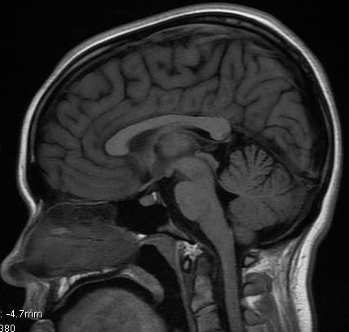
cerebrum
limbic system
cerebellum
brain stem
sagittal view

Slide 4
Cerebrum
  1. cerebral cortex
  2. right and left hemispheres
  3. lobes

Slide 5
1. Cerebral cortex
a. Forms the outmost part of the forebrain
b. Surface is made-up of many ridges and grooves
c. Plays a role in:
Learning, storing complex information
Ability to see, read, and understand

Slide 6
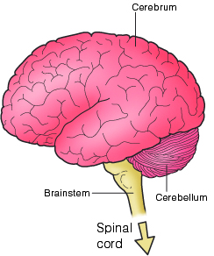
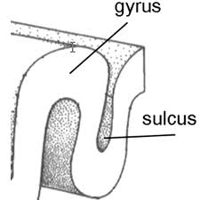

Slide 7
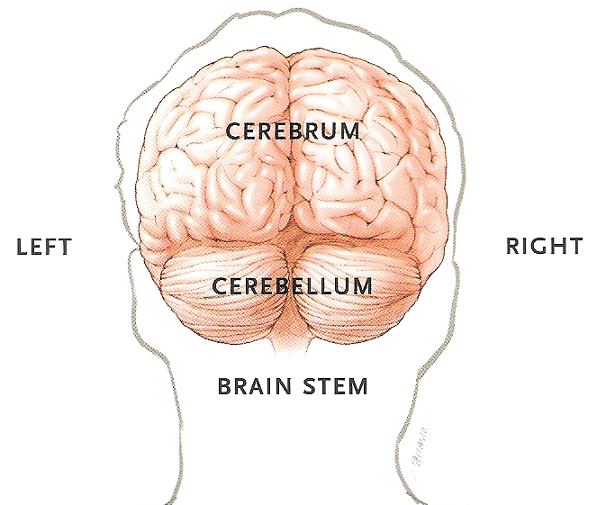
2. Left and Right Hemisphere
Left
Language
Speaking
Reading
Writing
Math
Logical thinking
Analytical thinking
Right
Spatial
Holistic
Visual
Perceptual
Music
Art
Creativity
coronal view

Slide 8
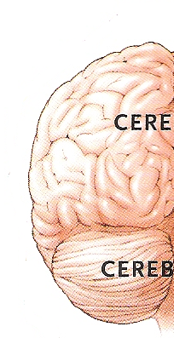
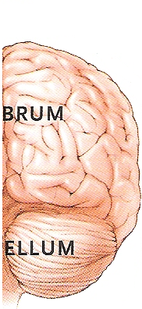
Corpus Callosum
Bundle of nerve fibers which sends messages to both hemispheres
corpus callosum
Bundle of nerve fibers which sends messages to both hemispheres
coronal view

Slide 9
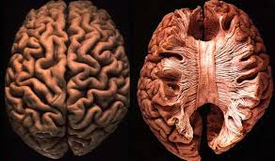
Corpus Callosum
Bundle of nerve fibers
Sends messages to both hemispheres
axial view

Slide 10

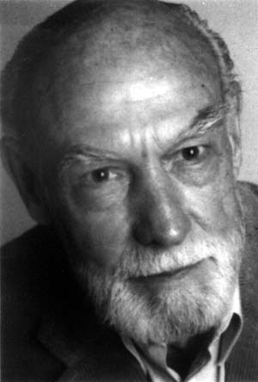
Roger Sperry
1913-1994
Michael Gazzaniga
1939 - present

Slide 11
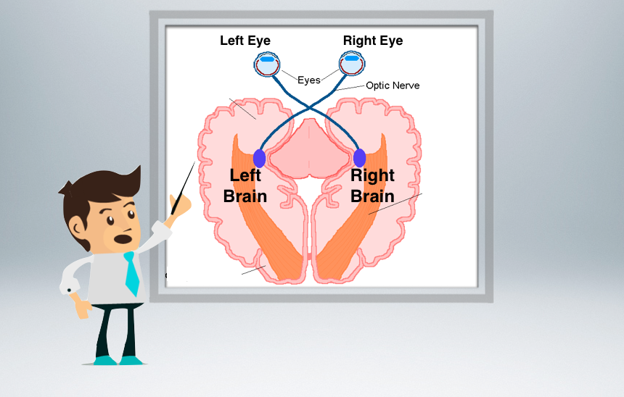
Corpus Callosum
axial view

Slide 12
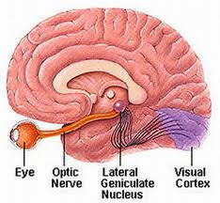
corpus callosum
optic nerve
sagittal view

Slide 13
Corpus Callosum
Speak
Draw
axial view

Slide 14
Corpus Callosum
Speak
Draw
axial view

Slide 15
Corpus Callosum
Speak
Draw
axial view

Slide 16
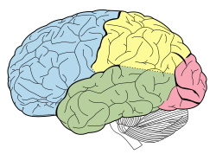
parietal
frontal
temporal
occipital
sagittal view

Slide 17
3. The Lobes of the Brain
a. Frontal
  Organizing, planning, creative thinking, motivation
    Broca’s Area – ability to speak (Pierre Paul Broca 1824-1880)
    Motor cortex
b. Parietal
  Information from senses from all over the body
  Sensory cortex
c. Temporal
  Hearing, memory, emotion,
    Wernicke’s Area – understand language
    (Carl Wernicke 1848-1905)
d. Occipital
  Visual signals

Slide 18
parietal
frontal
temporal
occipital
sagittal view

Slide 19
parietal
frontal
occipital
temporal
sagittal view

Slide 20
parietal
Broca’s Area
frontal
Wernicke’s Area
temporal
occipital
sagittal view

Slide 21
motor cortex
sensory cortex
parietal
frontal
temporal
occipital
sagittal view

Slide 22


Slide 23
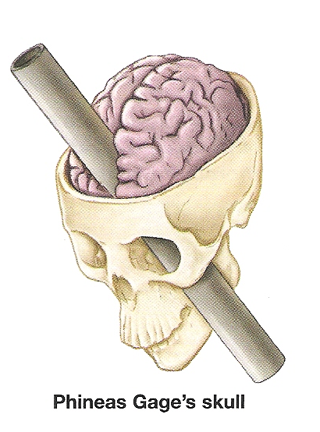

Slide 24
Three Main Parts and the Limbic System
B. Cerebellum

Slide 25
B. Cerebellum
Posture, balance, coordination, movement

Slide 26
C. Brain Stem
1. mid brain
  Above the pons
  Helps control eye movements
2. pons
  Sends messages – plays a role in sleep
3. medulla oblongata
  breathing, heart beat, digestion, vomiting, swallowing
4. reticular formation
  Deep within the brain stem
  Awareness, attention, wakefulness

Slide 27
mid brain
pons
medulla
reticular formation
sagittal view

Slide 28
D. Limbic system
Regulates emotion and motivation
  1. Thalamus
    Relay station for all info coming from the cortex
  2. Hypothalamus
    Hunger, thirst, sex, body temperature
  3. Hippocampus
    Memory
  4. Amygdala
    Controls rage and violence

Slide 29
thalamus
limbic system
hypothalamus

Slide 30
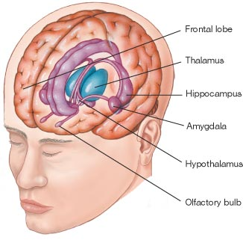
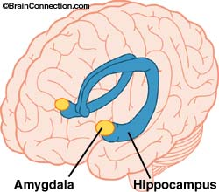

Slide 31
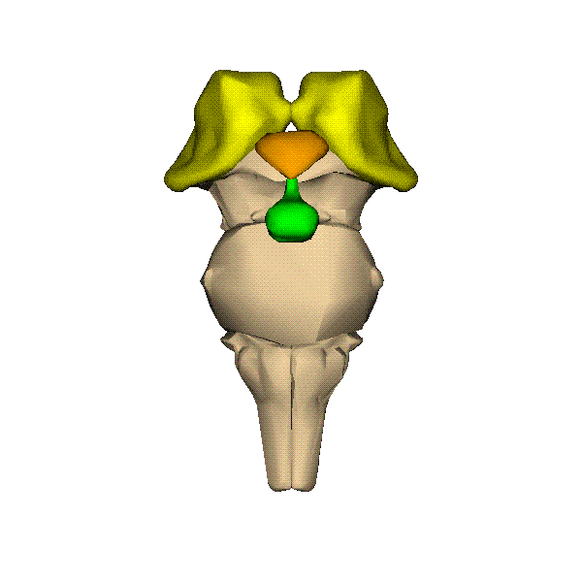
thalamus
hypothalamus
midbrain
pituitary gland
pons
medulla oblongata

Slide 32
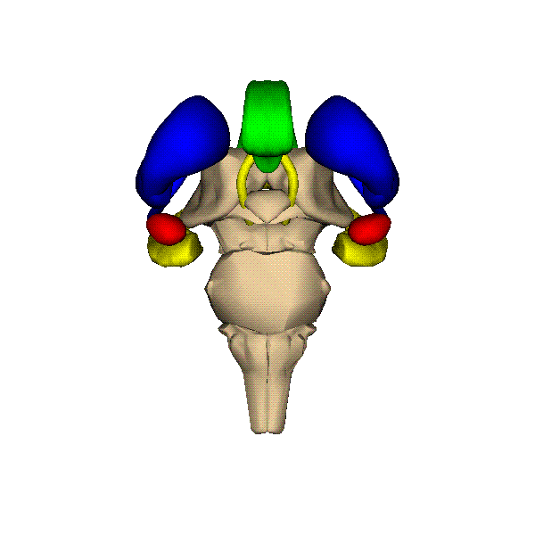
corpus callosum
hippocampus
amygdala

Slide 33
How Psychologists Study the Brain
Electroencephalograph (EEG)
  Used to record electrical activity
Stimulation
  Electrodes used to fire off neurons
Lesions
  Cutting or destroying parts of the brain
Images
  CAT, PET, MRI
Accidents
  Most famous – Phineas Gage

Slide 34
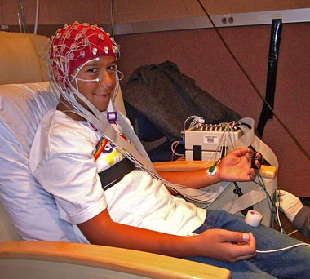
EEG

Slide 35

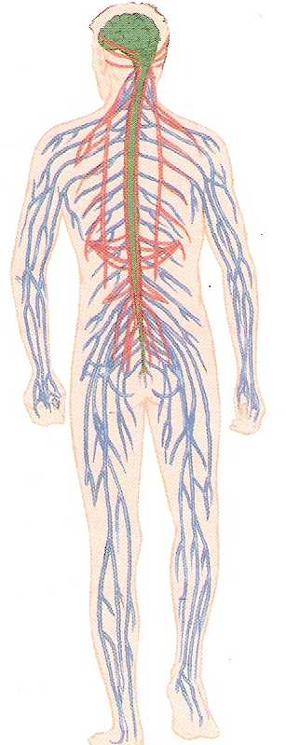
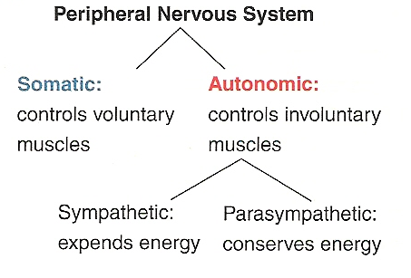

Slide 36

Neurons
Long, thin cells along which messages travel from the brain
Impulse sent by chemicals called
  Neurotransmitters

Slide 37
Many different neurotransmitters:
Norepinephine – Memory and learning
Endorphin – inhibits pain
Epinephrine – (adrenaline)
  Mental attention, focus, arousal
Dopamine – motivation, interest, drive
Serotonin – feelings of happiness
Histamine – sleep/wake cycle; emotions

Slide 38
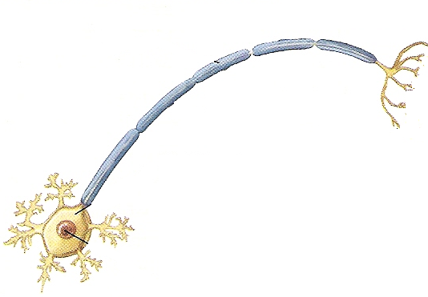
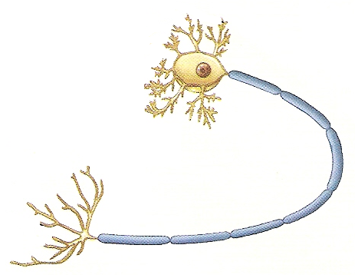

Axon
Axon terminals
Cell body
Dendrites
Dendrites
nucleus
Axon
Axon terminals

Slide 39
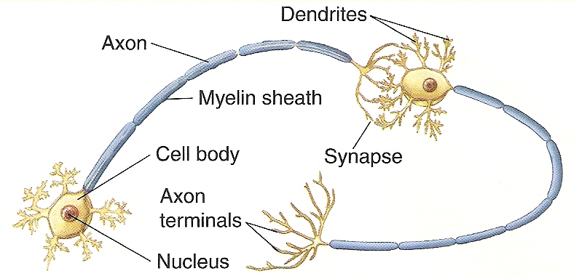

Slide 40

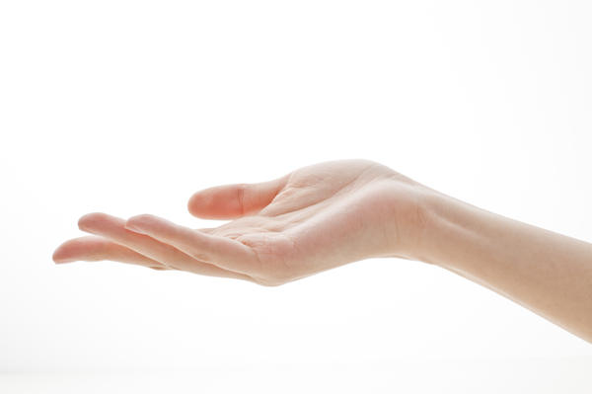
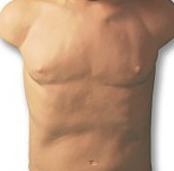

Dendrites
Axon
Cell body
Terminals
Synapse

Slide 41

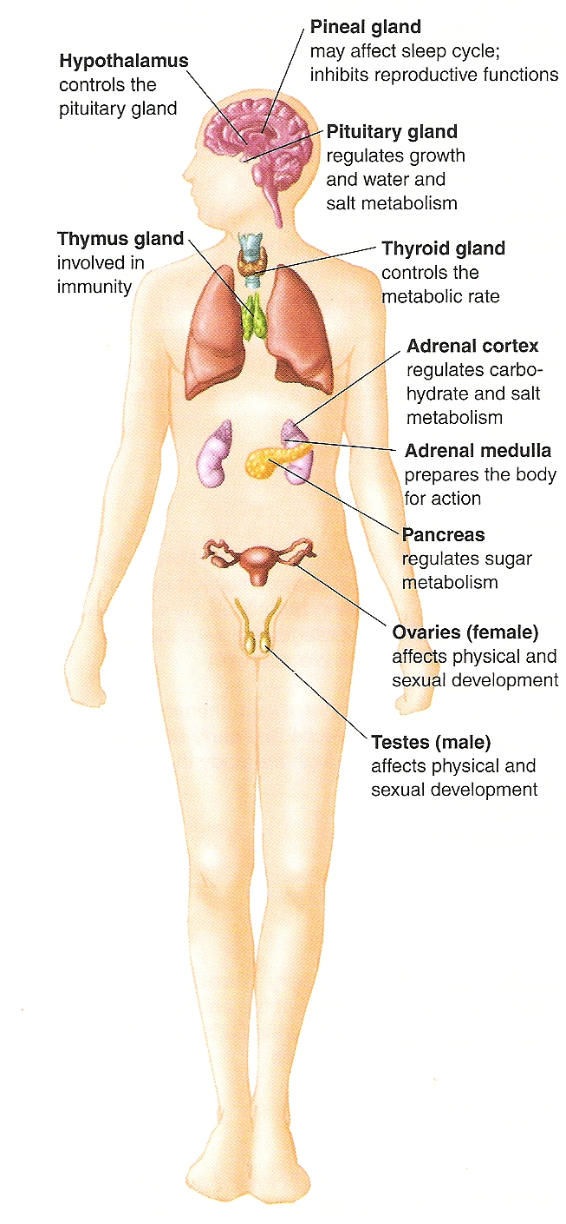

Slide 42
Sends chemical messages called hormones.
Hormones are produced in the endocrine glands.
Distributed by the blood and body fluids.
Hormones have various effects on behavior.
  Growth
  Metabolic processes
  Sex differences
  Moods and drives

Slide 43
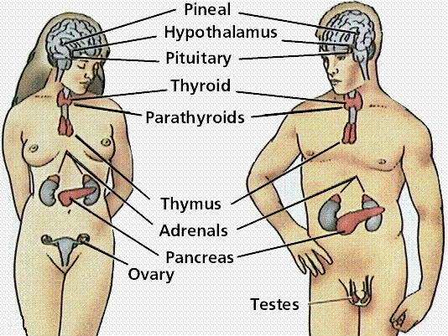

Slide 44
What’s on the test?
The Brain
  Parts and functions
The Nervous System
  Neurotransmitters (Brain chemicals)
    Travel along neurons
The Endocrine System
  Hormones (Produced in glands)
    Travel through the blood

