Slide 1
Chapter 11
Distribution Customer Service and Logistics
Copyright © 2014 by The McGraw-Hill Companies, Inc. All rights reserved
Notes:
For use only with Perreault/Cannon/McCarthy or Perreault/McCarthy texts.
© 2014 McGraw-Hill Companies, Inc. McGraw-Hill/Irwin
CHAPTER ELEVEN
Lecture Notes for
Basic Marketing 19e

Slide 2
At the end of this presentation, you should be able to:
11-2
Understand why logistics (physical distribution) is such an important part of Place and marketing strategy planning.
Understand why the physical distribution customer service level is a key marketing strategy variable.
Understand the physical distribution concept and why the coordination of storing, transporting, and related activities is so important.
See how firms can cooperate and share logistics activities that will provide added value to their customers.
Notes:
At the end of this presentation, you should be able to:
1. Understand why logistics (physical distribution) is such an important part of Place and marketing strategy planning.
Understand why the physical distribution customer service level is a key marketing strategy variable.
Understand the physical distribution concept and why the coordination of storing, transporting, and related activities is so important.
4. See how firms can cooperate and share logistics activities that will provide added value to their customers.
This slide refers to material on p. 280.

Slide 3
At the end of this presentation, you should be able to:
11-3
Know about the advantages and disadvantages of various transportation methods.
Know how inventory and storage decisions affect marketing strategy.
Understand the distribution center concept.
Understand important new terms.
Notes:
At the end of this presentation, you should be able to:
Know about the advantages and disadvantages of various transportation methods.
Know how inventory and storage decisions affect marketing strategy.
Understand the distribution center concept.
Understand important new terms.
This slide refers to material on p. 280.

Slide 4
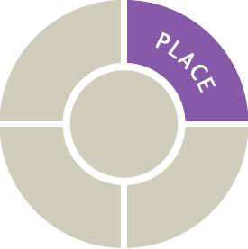
Marketing Strategy Planning Process
11-4
Notes:
In this presentation we will continue our discussion of one of the four Ps – Place.
When managers think about Place, they are concerned with making goods and services available in the right quantities, right locations, when customers want them.
This slide refers to material on p. 281.

Slide 5
The Role of Logistics and Physical Distribution Customer Service in Marketing Strategy (Exhibit 11-1)
11-5
CH 10: Place & Development of Channel Systems
CH 11: Distribution Customer Service & Logistics
CH 12: Retailers, Wholesalers & Their Strategy Planning
Logistics customer service
What is it?
Level to offer
Cost
JIT and EDI
Transporting
Transportation modes
Benefits and limitations
Storing
Storage & strategy planning
Inventory costs
Storage facilities
Distribution centers
Notes:
Summary Overview
There are many different combinations of logistics decisions. Each combination can result in a different level of distribution service and different costs.
Key Issues
Chapter 11 begins by discussing the best way to provide the level of distribution service that customers want and are willing to pay for.
Next, the choice among different modes of transportation, each with its own costs and benefits, is reviewed.
In the end, this chapter will investigate decisions about inventory and the use of distribution centers.
This slide refers to material on p. 281.
→ Indicates place where slide “builds” to include the corresponding point (upon mouse click).

Slide 6
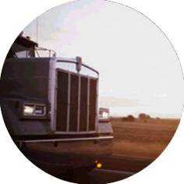


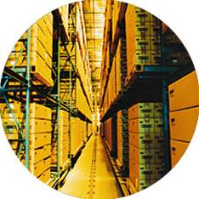

Physical Distribution Gets It to Customers
11-6
Logistics
or
Physical
Distribution
Notes:
Summary Overview
Logistics is the transporting, storing, and handling of goods in ways that match target customers’ needs with a firm’s marketing mix. Physical distribution (PD) is another name for logistics. Whenever the product includes a physical good, Place requires decisions about logistics.
Key Issues
There are many different combinations of logistics decisions.
Each combination can result in a different level of distribution service and different costs.
Firms must determine the best way to provide the level of distribution service that customers want and are willing to pay for.
Logistics costs are very important to both firms and consumers. These costs vary from firm to firm and, from a macro-marketing perspective, from country to country.
Differences in logistics costs across countries can be substantial.
Discussion Question: What consumer trends have contributed to an increased emphasis on physical distribution as an element of Place?
This slide refers to material on pp. 281-282.
→ Indicates place where slide “builds” to include the corresponding point (upon mouse click).

Slide 7
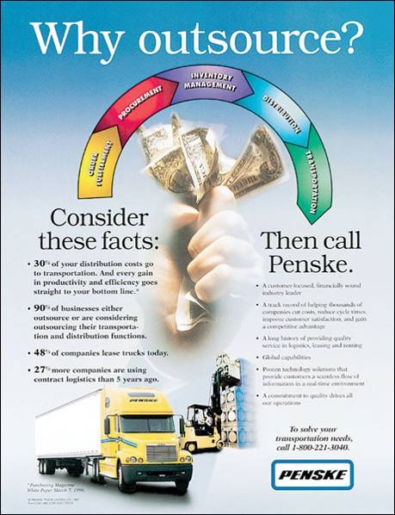
Physical Distribution Customer Service
11-7
Notes:
Summary Overview
Customers think about physical distribution in terms of the customer service level—how rapidly and dependably a firm can deliver what the customer wants. Customers tend to care about their own needs, not about how the product was moved or stored. In other words, customers want products, not excuses.
Key Issues
To improve the customer service level, some firms outsource some or all of their distribution work to specialists like Penske.
Penske can handle order fulfillment and inventory management in addition to transportation.
Its expertise in logistics can help firms reduce large inventories and other distribution costs while improving the level of customer service provided.
A firm with limited financial resources or a lack of people with expertise in logistics can turn to an outside supplier like Penske.
Physical distribution is invisible to most consumers.
The only time many consumers notice the physical distribution system is if they have special needs or if something goes wrong.
If it is handled properly, as is usually the case in well-developed macro-marketing systems, physical distribution is taken for granted by customers.
Discussion Question: What are the good points and the bad points about having consumers take the physical distribution system for granted?
This slide relates to material on pp. 281-282.

Slide 8
Trade-Offs among Physical Distribution Costs, Customer Service Level, and Sales (Exhibit 11-2)
11-8
Total cost of
physical distribution
Inventory cost
Cost
Lost sales*
Transportation
cost
0
0
90%
Customer service level
(percent of customers served
within some time period—say, four days)
*Note: Sales may be lost because of poor customer service or because
of the high price charged to pay for too high a customer service level.
Notes:
Summary Overview
In physical distribution, there are always trade-offs among costs, the customer service level, and sales. Because physical distribution costs can be substantial for various levels of service, marketers must determine what level of service is possible and appropriate for each target market.
Key Issues
For example, a retailer might reason that providing faster transportation than consumers demand will maximize customer service and reduce lost sales.
However, this diagram illustrates the important trade-off between customer service and costs.
Providing additional levels of customer service, such as more inventory to prevent stockouts, or faster transportation, eventually increases the total cost of physical distribution.
Notice that the curve of lost sales goes down as customer service increases, but only to a certain point.
At certain points, providing too much customer service can actually detract from the overall marketing effort, because it can increase costs, and possibly price the product out of the reach of consumers in the target market.
Discussion Question: Have you ever ordered software from an Internet site where the product can be immediately downloaded for use? Is this a new paradigm for physical distribution that changes the trade-off ratio?
This slide refers to material on pp. 282-283.
→ Indicates place where slide “builds” to include the corresponding point (upon mouse click).

Slide 9
Physical Distribution Concept Focuses on the Whole Distribution System (Exhibit 11-3)
11-9
Info on Product Availability
Online Status Information
Order Processing Time
Advance Info on Delays
Factors
Affecting PD
Service
Levels
Backorder Procedures
Delivery Time and Reliability
Inventory Storage
Compliance with Customers
Order Accuracy
Defect – Free Deliveries
Damage in Transit
Handling Adjustments/
Returns
Notes:
Summary Overview
The physical distribution concept dictates that all transporting, storing, and product-handling activities of a business and a whole channel system should be coordinated as one system that seeks to minimize the cost of distribution for a given customer service level. Unfortunately, too many firms still treat physical distribution activities as separate and unrelated.
Key Issues
The first thing organizations must do in implementing the physical distribution concept is to decide what service level to offer.
Marketing research can help to determine the appropriate service level, and it typically takes into account the various factors shown on this slide.
Order processing, inventory management, shipping, storage, and returns are all key factors affecting the service level.
Discussion Question: What is the danger in providing more service than customers really need or want?
Marketers must then find the lowest total cost for the right service level.
Total cost approach: evaluating each possible physical distribution system and identifying the total costs of each alternative system.
This slide refers to material on pp. 283-285.
→ Indicates place where slide “builds” to include the corresponding point (upon mouse click).

Slide 10

Physical Distribution Customer Service Level
11-10
Notes:
The physical distribution customer service level—including fast and reliable transportation—is critical to many business customers. Buyers don’t care how a product was moved or stored. Rather, they think in terms of how fast and dependably a firm can deliver what they want. This idea is portrayed in this UPS commercial. The COE (Chief Operating Elf) of Santa’s Workshop talks about how UPS helps Santa deliver billions of toys to billions of kids, overnight.
Video Operation:
Use the onscreen player controls to operate the video.
To view the video at Full Screen, right-click the video and choose Full Screen. To go back to your presentation you can either hit the Escape key, right-click on the video and uncheck Full Screen, or type Alt+Enter. You can do this at anytime during the video playback.
Under certain circumstances, the video may not fill the video player window. To restore, right-click the video player object and select Zoom 200%.
The videos will only play in Slide Show View. Macros must be enabled in order to play the videos from within PowerPoint.
This slide refers to material on pp. 283-284.
10

Slide 11
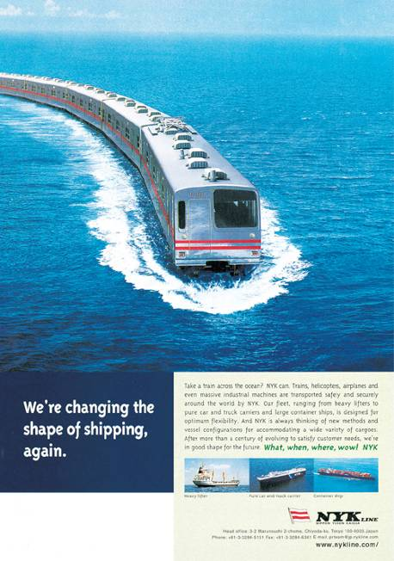
The Total Cost Approach
11-11
Notes:
Summary Overview
As shown in this ad for NYK Line, shipping expense is an important element of the total cost in a physical distribution system.
Key Issues
When using the total cost approach, all of the costs—including transportation, inventory, packing, and damage—are identified and considered for each possible PD system.
Discussion Question: How could packing raise total distribution costs? How could packing lower total distribution costs?
Sometimes, there are so many possible combinations of physical distribution functions in each PD system that identifying all the alternatives is sometimes difficult. For instance, water transportation may be combined with other forms of transportation to get a product from its origin to its final destination.
Some companies use computer simulations to compare the alternatives.
This slide relates to material on pp. 284.

Slide 12
Checking Your Knowledge
11-12
A manufacturer of accessories for personal computers evaluates all the alternative systems by combining order processing, transportation, inventory management, and storage. If the total cost approach is followed, which physical distribution system should the manufacturer select?
A. The one that maximizes customer service at the highest total cost.
B. The one that maximizes customer service at the lowest total cost.
C. The one that meets the customer service requirement at the lowest total cost.
D. The one that meets the customer service requirement and minimizes transportation cost.
E. The one that maximizes customer service and minimizes the cost of each individual component of physical distribution.
Notes:
ANSWER: C
Checking your knowledge (answer explanation):
When using the total cost approach, all of the costs—including transportation, inventory, packing, and damage—are identified and considered for each possible PD system. The goal in this approach would be to meet customer service needs at the lowest total cost. The best answer selection is ‘C’.
This slide relates to material on pp. 284.
12

Slide 13

Coordinating Logistics Activities
11-13
Shifting and Sharing
JIT
Supply Chain
Notes:
Summary Overview
Physical distribution functions must be apportioned across the channel to facilitate the flow of goods and services. In this way, each member functions efficiently and maximum value can be passed on to the consumer.
Key Issues
Functions can be shifted and shared in a channel.
How PD is shared affects the rest of a strategy, especially Price.
→ JIT requires a close, cooperative relationship among the channel members, which also helps to reduce conflict.
One result of JIT is that some channels see an increase in the number of participants contributing to the final product.
→ A supply chain may involve even more firms than a channel of distribution.
Supply chain: the complete set of firms, facilities, and logistics activities involved in procuring materials, transforming them into intermediate and finished products, and distributing them to customers.
Discussion Question: Some firms put a single executive in charge of supply chain decisions. What would be the advantages and disadvantages of doing so?
This slide refers to material on pp. 285-286.
→ Indicates place where slide “builds” to include the corresponding point (upon mouse click).
13

Slide 14
Better Information Helps Coordinate PD
11-14
Areas Where
Computers
Help PD
Service
Continuously Updated Information Systems
Electronic Data Interchange
Notes:
Summary Overview
Trying to coordinate physical distribution throughout an entire supply chain is a difficult task. Computers and the Internet are becoming more and more important to marketing managers who need to keep track of inventory levels, when to order, and where goods are when they move.
Key Issues
→ Continuously updated information systems, such as the ones fed by supermarket checkout scanners, can provide marketers with an up-to-the-minute inventory count and also an instantaneous readout of what consumers are buying.
Discussion Question: What packaging innovation has contributed greatly to the development of continuously updated systems? Hint: refer to Chapter 9.
→ Electronic data interchange (EDI) sets a standard, by putting information in a structured format that allows suppliers and customers to access each other’s computer systems.
It helps speed the processing of orders, inventory tracking, and customer service requests.
In addition, EDI brings buyers and suppliers in channels of distribution closer together.
This slide refers to material on pp. 287-288.
→ Indicates place where slide “builds” to include the corresponding point (upon mouse click).

Slide 15

Ethical Issues May Arise
11-15
Product
Availability
Coordination of PD
False expectations about delivery speed
Selling products that are not available
Running out of popular products
Intentional delays in order confirmation
Shifting of burden of holding inventory
Notes:
Summary Overview
As in all areas of marketing, physical distribution raises some ethical concerns.
Key Issues
Most of the ethical issues that come up in physical distribution are about communications over product availability.
Some Internet vendors are being criticized for creating false expectations about the speed of delivery or for selling products that are not available.
Conventional retailers also receive criticism for running out of products that they promote heavily.
Some retailers offer rain checks to deal with the situation, or try to manage demand proactively by taking advance orders.
→ Coordination of PD activities can also generate ethical problems.
Discussion Question: Suppose you were a retailer and told a supplier that you planned to place an order, but didn’t confirm the order until the last minute. You wanted to see how sales were going before making a commitment. Thus, you were able to shift the burden of holding inventory to the supplier. Is this an ethical practice on your part? Why or why not?
This slide refers to material on pp. 288.
→ Indicates place where slide “builds” to include the corresponding point (upon mouse click).

Slide 16

Physical Distribution (PD) Concept
11-16
Notes:
Both lower costs and better service help to increase customer value. Trying to reduce the cost of the individual functional activities associated with physical distribution may actually increase distribution costs and lead to the wrong customer service level. W.B. Mason prides itself on low prices and excellent service. Thus, appropriate implementation of the PD Concept is critical to this firm.
Video Operation:
Use the onscreen player controls to operate the video.
To view the video at Full Screen, right-click the video and choose Full Screen. To go back to your presentation you can either hit the Escape key, right-click on the video and uncheck Full Screen, or type Alt+Enter. You can do this at anytime during the video playback.
Under certain circumstances, the video may not fill the video player window. To restore, right-click the video player object and select Zoom 200%.
The videos will only play in Slide Show View. Macros must be enabled in order to play the videos from within PowerPoint.
This slide refers to material on pp. 283.
16

Slide 17
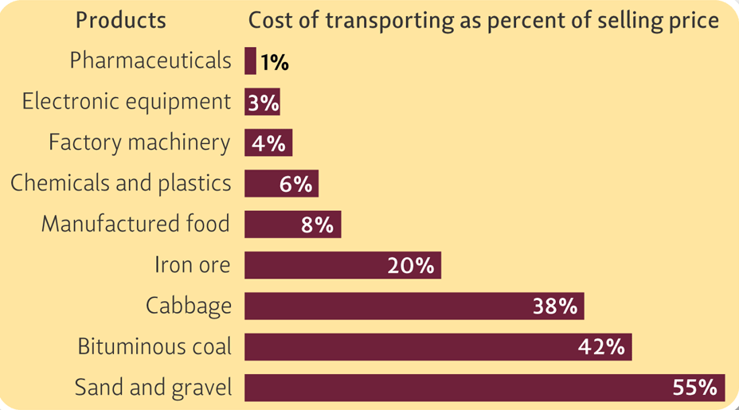
The Transporting Function Adds Value to a Marketing Strategy (Exhibit 11-4)
11-17
Notes:
Summary Overview
Transporting is the marketing function of moving goods. Transportation makes products available when and where they need to be—at a cost. Transporting aids economic development and exchange; without low-cost transportation, there would be no mass distribution as we know it today.
Key Issues
As shown in Exhibit 11-5, Transporting can be costly.
Note that for products that are relatively inexpensive, such as basic commodities, transportation costs are a large part of the selling price.
Transportation costs are a smaller part of the selling price for products that have a higher per-unit value, such as manufactured goods.
Because transporting often crosses regional, national, or international borders, governments may influence transportation by developing transportation systems or by regulating them.
Discussion Question: What impact does the deregulation of the trucking industry in the U. S. have on the marketing strategies of trucking companies as they try to acquire additional business?
This slide refers to material on pp. 288-289.

Slide 18
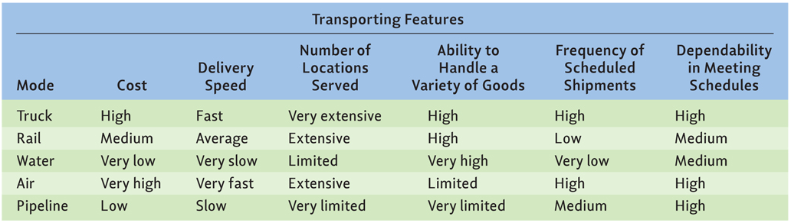
Benefits and Limitations of Different Transport Modes (Exhibit 11-5)
11-18
Notes:
Summary Overview
The transporting function must fit the whole marketing strategy. There really is no such thing as a single “best” transportation alternative that applies to every case. As shown in this exhibit, all of the transportation modes have advantages and disadvantages. Therefore, the marketer must choose an appropriate mode, taking into account the product, other physical distribution decisions, and the level of customer service required.
Key Issues
In the U.S., railroads carry more freight over more miles than any other mode of transportation.
Railroads can move large loads at low cost.
Railcar shipping is slow and limited to where track is laid, but it is ideal for many bulky and nonperishable goods.
Trucks are more expensive, but flexible and essential.
At least 75% of U.S. consumer products travel at least part of the way by truck.
In countries with good road systems, trucks are also a fast transportation alternative.
→ So, which transportation mode is best? It depends. Each transportation mode offers some advantage. The purple rings highlight the “best” alternative for each transporting feature.
Discussion Question: Marketing critics often complain that trucks damage highways and contribute to traffic congestion. Are these “costs” of trucking worth the benefits from transporting by truck? Explain.
This slide refers to material on pp. 290.
→ Indicates place where slide “builds” to include the corresponding point (upon mouse click).

Slide 19
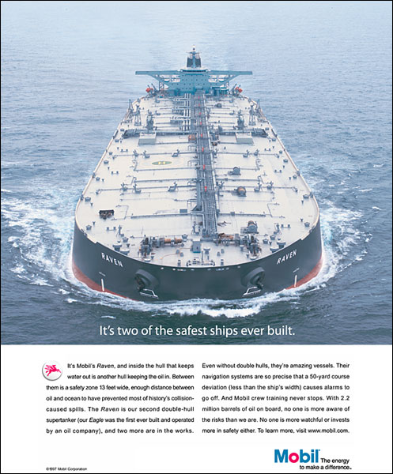
Water Transportation
11-19
Notes:
Summary Overview
Water transportation is the slowest shipping mode, but it is also low in cost and can handle a wide variety of goods. Water transportation is a very important means of international shipping. Often, it is the only practical approach.
Key Issues
This ad suggests that marketing managers must be sensitive to the environmental effect of transportation decisions.
For example, this ship has 2.2 million barrels of oil on board. Mobil built this ship with both an inner hull (to keep the oil in) and an outer hull (to keep the water out) to reduce the odds of a oil spill.
The double hull design is more expensive to build and operate.
Aside from international shipments like the one shown in this ad, inland waterways are important, too.
Examples include the Mississippi River in the U. S. and the Danube River in Europe.
They are key conduits for large shipments of bulky, nonperishable goods.
Discussion Question: What can a marketer do when ice closes down a freshwater harbor in order to maintain service and keep total distribution costs under control?
Pipelines move oil and gas in oil-producing and oil-consuming countries.
Many of these pipelines link oil fields and refineries, leaving other modes of transportation to carry finished petroleum products.
This slide relates to material on pp. 291.

Slide 20
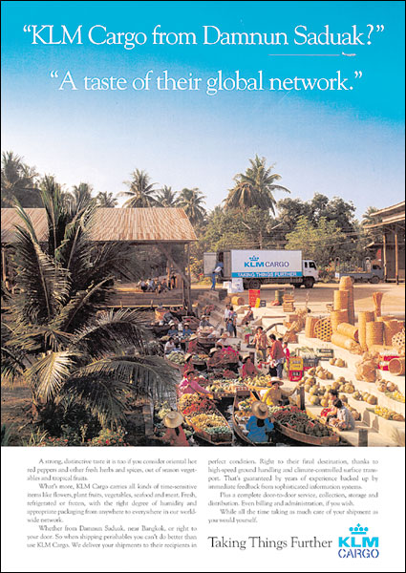
Airfreight Is Expensive but Fast and Growing
11-20
Notes:
Summary Overview
Airfreight is expensive, but fast. It has an extensive number of locations served, a high frequency of scheduled shipments, and is dependable. Airplanes may cut the total cost of distribution, and have proven to be the most efficient method of shipping for many firms. Further, time-sensitive materials and business documents can be worth the cost of quick delivery.
Key Issues
As this ad shows, many firms that want to reach international markets can now do it more easily—with help from transportation firms like KLM Cargo that handle deliveries all over the world.
Its information systems provide immediate feedback and updating.
Its high service level is critical to many business customers.
For many international shipments, it makes sense for shipping companies to put many products in a container so that it is easier to move between different transportation modes.
Containerization involves grouping individual items into economical shipping quantities and sealing them in protective containers for shipping to their final location.
Piggyback service loads truck trailers on railcars to provide both speed and flexibility. In other words, piggyback is a ride on two or more modes.
Transportation choices are usually not as good in developing countries and can cost more.
Marketing managers must be sensitive to the environment effects of whichever transportation mode is selected.
This slide relates to material on pp. 289-291.

Slide 21
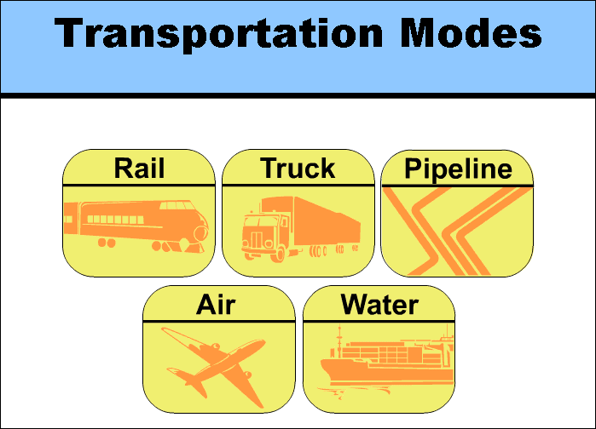
Interactive Exercise: Transportation Modes
11-21
Notes:
The purpose of this exercise is to help students understand and evaluate the benefits and limitations of various transportation alternatives. Five transportation scenarios are described; students are challenged to identify the correct transportation mode for each example.
For complete information and suggestions on using this Interactive Exercise, please refer to the “Notes on the Interactive Exercise” section for this chapter in the Multimedia Lecture Support Package to Accompany Basic Marketing. That same information is available as a Word document in the assets folder for the PowerPoint file.
This slide refers to material on pp. 290-292.
21

Slide 22
Checking Your Knowledge
11-22
The best transportation alternative for shipping chickens from farms in West Virginia to processing plants in Maryland would be:
A. air.
B. truck.
C. rail.
D. water.
E. none of the above.
Notes:
ANSWER: B
Checking your knowledge (answer explanation):
It is important to get the chickens from the farm to the processing plant quickly. Additionally, the area to be covered between West Virginia and Maryland is quite short. Therefore, trucking the chickens would be the best transportation option. Answer ‘B’ is the best choice.
This slide relates to material on pp. 290.
22

Slide 23
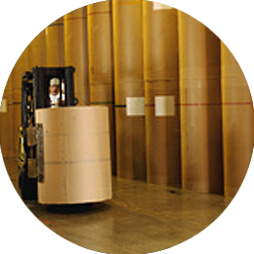
The Storing Function and Marketing Strategy
11-23
Needed When Production Doesn’t Match Consumption
Keeps Prices Steady
Achieves Production Economies of Scale
Builds Channel Flexibility
Notes:
Summary Overview
Storing is the marketing function of holding goods so they’re available when they’re needed. Inventory refers to the amount of goods being stored. → Storing is necessary when production does not evenly match consumption and it can increase the value of goods by making them more available when customers want them. Thus, storing can smooth out sales, increase profits, and enhance consumer satisfaction.
Key Issues
→ Storing helps keep prices steady.
Storing helps balance supply and demand and keeps prices from sudden rises or falls.
→ Storing allows producers to manufacture larger quantities of a product and to take advantage of economies of scale in production.
→ Storing varies the channel system by increasing flexibility.
Storing allows producers and intermediaries to keep stocks at convenient locations, ready to meet customers’ needs.
Therefore, marketers have more ways to vary the firm’s marketing mix to better meet consumer demand.
Discussion Question: If you were a retailer, how would decisions made by a producer in regard to holding inventory affect your retail marketing strategy? Discuss what might happen if a producer asked you to: a.) keep higher quantities of product in stock; or b.) hold less inventory because a wholesaler had been recruited to carry more.
This slide refers to material on pp. 294.
→ Indicates place where slide “builds” to include the corresponding point (upon mouse click).

Slide 24
Total Inventory Cost (Exhibit 11-6)
11-24
Cost of storage facilities
Interest expense & opportunity cost
Handling costs
Total
Inventory
Cost
Cost of inventory becoming obsolete
Cost of damage while in inventory
Cost of risks
Notes:
Summary Overview
Storing goods can increase their value by keeping them available, but goods are stored at a cost.
Key Issues
Among these costs are:
1. Interest expense and opportunity cost of money tied up in inventory.
→ Cost of storage facilities and maintaining them.
→ Handling costs.
→ Costs of damage to products while in inventory.
→ Cost of risks such as theft and fire.
→ Costs of inventory becoming obsolete.
Discussion Question: A seasoned retail manager once said, “Having excess inventory that won’t move is like seeing a $20 bill on the ground and being unable to pick it up.” What does he mean by this statement, and what implications does it have for managing the storing function?
Rapid response cuts inventory costs.
If producers and intermediaries can coordinate their activities using just-in-time (JIT) inventory or efficient customer response (ECR) systems, storing costs will drop because less inventory is needed at any particular point in time.
Electronic data interchange (EDI) linkages that spark replenishment orders will also help to make storing more efficient.
This slide refers to material on pp. 294-295.
→ Indicates place where slide “builds” to include the corresponding point (upon mouse click).

Slide 25
Specialized Storing Facilities May Be Required (Exhibit 11-7)
11-25
 | Type of Warehouse
Characteristics | Private | Public
Fixed investment | Very high | No fixed investment
Unit cost | High if volume is low – very low if volume is very high | Low – charges are made only for space needed
Control | High | Low managerial control
Adequacy for product line | Highly adequate | May not be convenient
Flexibility | Low – fixed costs have already been committed | High – easy to end arrangement
Notes:
Summary Overview
Specialized storing functions may sometimes be better accomplished through intermediaries with a very particular area of expertise.
Key Issues
Private warehouses: storing facilities owned or leased by companies for their own use.
Firms use private warehouses when large quantities of goods must be stored regularly. The cost of private warehousing may be offset by the increased control a marketer has over the distribution of a product.
→ Public warehouses are independent storing facilities offering all the storing and regrouping activities of a company’s warehouse, but they are open to many firms.
There is more flexibility available when using a public warehouse.
There is no fixed investment involved, but the marketer relinquishes some of the control over a product’s distribution when using a public warehouse.
Discussion Question: Would small manufacturers be more likely to utilize public or private warehouses? Why?
Warehousing facilities cut handling costs, too, but much depends on where the warehouse is located and how modern it is.
Distribution center: a special kind of warehouse designed to speed the flow of goods when regrouping activities are needed but storing is not. The objective in the distribution center is not to store the product, but to distribute it.
Direct store delivery skips the distribution center.
Managers must be innovative to provide customers with superior value.
This slide refers to material on pp. 295-297.
→ Indicates place where slide “builds” to include the corresponding point (upon mouse click).

Slide 26
Distribution Center
11-26
Notes:
This video highlights the distribution center technology utilized by Saks.
(video clip length 1:17)
Video Operation:
Use the onscreen player controls to operate the video.
To view the video at Full Screen, right-click the video and choose Full Screen. To go back to your presentation you can either hit the Escape key, right-click on the video and uncheck Full Screen, or type Alt+Enter. You can do this at anytime during the video playback.
Under certain circumstances, the video may not fill the video player window. To restore, right-click the video player object and select Zoom 200%.
The videos will only play in Slide Show View. Macros must be enabled in order to play the videos from within PowerPoint.
This slide refers to material on pp. 296-297.
26

Slide 27
You should now be able to:
11-27
Understand why logistics (physical distribution) is such an important part of Place and marketing strategy planning.
Understand why the physical distribution customer service level is a key marketing strategy variable.
Understand the physical distribution concept and why the coordination of storing, transporting, and related activities is so important.
See how firms can cooperate and share logistics activities that will provide added value to their customers.
Notes:
At the end of this presentation, you should be able to:
1. Understand why logistics (physical distribution) is such an important part of Place and marketing strategy planning.
Understand why the physical distribution customer service level is a key marketing strategy variable.
Understand the physical distribution concept and why the coordination of storing, transporting, and related activities is so important.
4. See how firms can cooperate and share logistics activities that will provide added value to their customers.
This slide refers to material on pp. 280.

Slide 28
You should now be able to:
11-28
Know about the advantages and disadvantages of various transportation methods.
Know how inventory and storage decisions affect marketing strategy.
Understand the distribution center concept.
Understand important new terms.
Notes:
At the end of this presentation, you should be able to:
Know about the advantages and disadvantages of various transportation methods.
Know how inventory and storage decisions affect marketing strategy.
Understand the distribution center concept.
Understand important new terms.
This slide refers to material on pp. 280.

Slide 29
Key Terms
11-29
logistics
physical distribution (PD)
customer service level
physical distribution concept
total cost approach
supply chain
electronic data interchange (EDI)
transporting
containerization
piggyback service
storing
inventory
private warehouses
public warehouses
distribution center
Notes:
Summary Overview
These are key terms you should be familiar with based upon the material in this presentation.
Key Issues
Logistics: the transporting, storing, and handling of goods in ways that match target customers' needs with a firm's marketing mix—both within individual firms and along a channel of distribution (i.e., another name for physical distribution).
Physical distribution (PD): the transporting, storing, and handling of goods in ways that match target customers' needs with a firm's marketing mix—both within individual firms and along a channel of distribution.
Customer service level: how rapidly and dependably a firm can deliver what customers want.
Physical distribution concept: all transporting, storing, and product-handling activities of a business and a whole channel system should be coordinated as one system which seeks to minimize the cost of distribution for a given customer service level.
Total cost approach: evaluating each possible physical distribution system and identifying all of the costs of each alternative.
Supply chain: the complete set of firms and facilities and logistics activities that are involved in procuring materials, transforming them into intermediate and finished products, and distributing them to customers.
Electronic data interchange (EDI): an approach that puts information in a standardized format easily shared between different computer systems.
Transporting: the marketing function of moving goods.
Containerization: grouping individual items into an economical shipping quantity and sealing them in protective containers for transit to the final destination.
Piggyback service: loading truck trailers or flat-bed trailers carrying containers on railcars to provide both speed and flexibility.
Storing: the marketing function of holding goods.
Inventory: the amount of goods being stored.
Private warehouses: storing facilities owned or leased by companies for their own use.
Public warehouses: independent storing facilities.
Distribution center: a special kind of warehouse designed to speed the flow of goods and avoid unnecessary storing costs.
This slide refers to boldfaced terms appearing in Chapter 11.

