Slide 1
Chapter 12
Retailers, Wholesalers, and Their Strategy Planning
Copyright © 2014 by The McGraw-Hill Companies, Inc. All rights reserved
Notes:
For use only with Perreault/Cannon/McCarthy or Perreault/McCarthy texts.
© 2014 McGraw-Hill Companies, Inc. McGraw-Hill/Irwin
CHAPTER TWELVE
Lecture Notes for
Basic Marketing 19e

Slide 2
At the end of this presentation, you should be able to:
12-2
Understand how retailers plan their marketing strategies.
Know about the many kinds of retailers that work with producers and wholesalers as members of channel systems.
Understand how retailers evolve, including the roles of technology, scrambled merchandising and the “wheel of retailing.”
See why size or belonging to a chain can be important to a retailer.
Notes:
At the end of this presentation, you should be able to:
1. Understand how retailers plan their marketing strategies.
Know about the many kinds of retailers that work with producers and wholesalers as members of channel systems.
Understand how retailers evolve, including the roles of technology, scrambled merchandising and the “wheel of retailing.”
See why size or belonging to a chain can be important to a retailer.
This slide refers to material on p. 302.

Slide 3
At the end of this presentation, you should be able to:
12-3
Understand some of the differences in retailing in different nations.
Know what progressive wholesalers are doing to modernize their operations and marketing strategies.
Know the various kinds of merchant and agent wholesalers and the strategies they use.
Understand important new terms
Notes:
At the end of this presentation, you should be able to:
Understand some of the differences in retailing in different nations.
Know what progressive wholesalers are doing to modernize their operations and marketing strategies.
Know the various kinds of merchant and agent wholesalers and the strategies they use.
Understand important new terms
This slide refers to material on p. 302.

Slide 4

Marketing Strategy Planning Process
12-4
Notes:
In this presentation we will continue our discussion of one of the four Ps—Place.
When managers think about Place, they are concerned with making goods and services available in the right quantities, right locations, when customers want them.
This slide refers to material on p. 303.

Slide 5
Marketing Strategy Planning for Retailers and Wholesalers (Exhibit 12-1)
12-5
CH 10: Place and Development of Channel Systems
CH 11: Distribution Customer Service & Logistics
CH 12: Retailers, Wholesalers & Their Strategy Planning
Strategy planning for retailers
Nature of retailing
Strategy planning for wholesalers
Notes:
Summary Overview
This chapter provides an overview of the decisions that retailers and
wholesalers make in developing their own strategies.
Key Issues
The chapter discusses retailers and wholesalers in four main topics:
Strategy planning for retailers;
The nature of retailing; and
Strategy planning for different types of wholesalers
This slide refers to material on p. 303.
→ Indicates place where slide “builds” to include the corresponding point (upon mouse click).

Slide 6
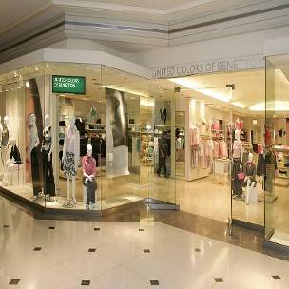
The Nature of Retailing
12-6
Must Select Target Markets and Marketing Mixes Carefully
Marketers Must Understand Retailer/ Wholesaler Evolution
Retailing Deals with Final Customers
Notes:
Summary Overview
Wholesalers and retailers are vital links in a channel system. As consumers, we are much more familiar with retailing than wholesaling, because we all shop at retail stores at one time or another. Wholesaling takes place out of the view of most consumers. → Both wholesalers and retailers must select their target markets and marketing mixes carefully.
Key Issues
→ Marketers should understand the how and why of past changes in retailing and wholesaling.
The pace of this evolution has accelerated.
Technology is changing the ways in which intermediaries interact with customers.
Understanding the evolution of retailers and wholesalers will provide clues about what to expect in the future.
Discussion Question: Many retailers have developed websites, but simply having a website is no guarantee of success, and the numerous failures of online retailers demonstrate that fact. What lessons can “e-tailers” learn from traditional retailers when it comes to serving customers?
→ Retailing: all of the activities involved in the sale of products to final consumers.
Retailing is crucial to consumers in every macro-marketing system.
Consumers spend more than $4.5 trillion a year buying goods and services from U.S. retailers.
In service retailing, the retailer is also the producer.
This slide refers to material on pp. 302-304.
→ Indicates place where slide “builds” to include the corresponding point (upon mouse click).

Slide 7
Planning a Retailer’s Strategy
12-7
Product Selection
Key Features
Affecting Consumers’ Retail Choice
Place Decisions
Promotion
Prices
Emotional Needs
Shopping Atmosphere
Notes:
Summary Overview
Different consumers prefer different kinds of retailers. A retailer should carefully identify possible target markets and try to understand why these people buy where they do. That helps the retailer fine-tune its marketing mix to the needs of specific target markets.
Key Issues
Features of a retailer’s offering that relate to economic needs include:
→ Product Selection: Most customers want a choice of assortment, brands, and quality.
Promotion: Knowledgeable salespeople, displays, demonstrations, and product information can be principal reasons for choosing a particular retailer.
Place Decisions: Where stores will be located—online and/or brick-and-mortar, the number of stores, as well as store layout and design.
Prices. Customers use price to weigh the value offered. Price can be varied by the use of credit terms and special discounts.
Discussion Question: Using discounts and credit to attract customers can be a sensible part of a marketing mix. But is there an unethical side to this practice?
Features of a retailer’s offering that relate to social or emotional needs include:
→ Social Image: Some customers seek status, prestige, or a feeling of “fitting in.”
→ Shopping Atmosphere: Comfort, safety, excitement, relaxation, sounds, smells.
Retail strategy requires carefully set policies about all of these needs, because each of them can be a source of competitive advantage. Consumer needs also relate to segmentation and positioning, because different retailers emphasize different strategies.
This slide refers to material on pp. 305-306.
→ Indicates place where slide “builds” to include the corresponding point (upon mouse click).

Slide 8

Shopping Atmosphere
12-8
Notes:
Explore this interesting retailing experience offered by the Rain Forest Café.
(video clip length 2:37)
Video Operation:
Use the onscreen player controls to operate the video.
To view the video at Full Screen, right-click the video and choose Full Screen. To go back to your presentation you can either hit the Escape key, right-click on the video and uncheck Full Screen, or type Alt+Enter. You can do this at anytime during the video playback.
Under certain circumstances, the video may not fill the video player window. To restore, right-click the video player object and select Zoom 200%.
The videos will only play in Slide Show View. Macros must be enabled in order to play the videos from within PowerPoint.
This slide refers to material on pp. 305.

Slide 9




Planning a Retailer’s Strategy (Exhibit 12-2)
12-9
Product selection (width and depth of assortment, brands, quality)
After-sale service
Special services (special orders, entertainment, gift wrap)
Physical stores and/or sales over the internet
Number/location of stores
Shopping atmosphere (comfort, safety)
Store size, layout & design
Store hours
TARGET
MARKET
Credit cards – whether to offer a store card
Discount policies
Frequency and level of sale prices
Charge (or not) for delivery or other services
Advertising
Publicity
Salespeople (number and training)
Helpful information (demonstrations, displays, online videos, reviews)
Notes:
Summary Overview
Retailers make decisions on the whole marketing mix.
Key Issues
Retailers start by selecting a target market.
→ Then retailers make decisions about Product, including product selection, After-sale service, Special services to offer
→ Place decisions include whether to have an online and/or physical store, the number and location of outlets, the shopping atmosphere, store size, layout and design, store hours and more.
→ Price decisions made by retailers include whether to offer a store credit card, discount policies, frequency and level of sale prices, and whether or not to charge for delivery or other services.
Discussion Question: Think about two very different restaurants in your town. Choose one fast-food chain and other sit-down restaurant. Now compare each of these restaurants on marketing strategy – target market, product, place, price, and promotion.
This slide refers to material on pp. 305-306.
→ Indicates place where slide “builds” to include the corresponding point (upon mouse click).

Slide 10
Conventional Retailers—Try to Avoid Price Competition (Exhibit 12-3)
12-10
Specialty
shops &
dept. stores
Ritz Camera,
Coach, Gap,
Macy’s
Expanded
assortment
& service
Expanded
assortment
&/or reduced
margins &
service
Supermarkets,
disc. houses,
mass merch.,
super-, club-
stores
Safeway,
IKEA, Home
Depot,
Costco
Conventional
Offerings
Single- &
limited-
line stores
Added conv.,
higher margins,
reduced
assortment
C-stores,
vending, door-
to-door, phone,
mail, some
e-tail
7-11, Pepsi
vending,
Avon, Lands’
End, QVC
Expanded
assortment,
reduced
margins, more
information
Internet
eBay,
Amazon,
Zappos,
Netflix, Dell
Notes:
Summary Overview
It is too simplistic to characterize retailers on the basis of a single characteristic. Developing an understanding of retail strategy begins with considering basic types of retailers and how they differ along a variety of dimensions. This exhibit displays several types of retailers.
Key Issues
General stores: stores that carried anything they could sell in reasonable volume. These were the main retailers in the U.S. in the mid-1800s. However, these stores could not keep up with the proliferation of products that were developed to meet consumer needs.
Single-line or limited-line stores: specialize by product area and offer a wide assortment in that area. Now, most stores in the U.S. fall into this category.
However, single-line (limited-line) stores have to stock some slow-moving items in order to satisfy the store’s target market.
Discussion Question: Many of these stores are small with high sales expenses and low volume. What types of things might they do in order to avoid head-to-head price competition?
These stores are being squeezed because they face competition from other retailers that have different marketing mixes.
This slide refers to material on pp. 306.

Slide 11
Conventional Retailers—Try to Avoid Price Competition (Exhibit 12-3)
12-11
Specialty
shops &
dept. stores
Ritz Camera,
Coach, Gap,
Macy’s
Expanded
assortment
& service
Conventional
Offerings
Single- &
limited-
line stores
Notes:
Summary Overview
It is too simplistic to characterize retailers on the basis of a single characteristic. Developing an understanding of retail strategy begins with considering basic types of retailers and how they differ along a variety of dimensions. This exhibit displays several types of retailers.
Key Issues-
→ Specialty & Department Stores
Specialty shop: a type of conventional limited-line store, that is usually small and has a distinct “personality” or shopping environment.
Specialty shops usually sell shopping products, and focus on a narrow target market with better service, knowledgeable salespeople, and a unique assortment.
This combination generally supports higher prices for products.
Department stores: larger stores that are organized into many separate departments and offer many product lines.
Department stores combine many limited-line stores and specialty shops.
The number of department stores, their average sales per store, and their share of total retail sales are all declining.
Discussion Question: Provide some examples of both specialty shops and department stores. What are their differences and similarities in assortment and service?
This slide refers to material on pp. 306.
→ Indicates place where slide “builds” to include the corresponding point (upon mouse click).

Slide 12
Conventional Retailers—Try to Avoid Price Competition (Exhibit 12-3)
12-12
Specialty
shops &
dept. stores
Ritz Camera,
Coach, Gap,
Macy’s
Expanded
assortment
& service
Expanded
assortment
&/or reduced
margins &
service
Supermarkets,
disc. houses,
mass merch.,
super-, club-
stores
Safeway,
IKEA, Home
Depot,
Costco
Conventional
Offerings
Single- &
limited-
line stores
Notes:
Summary Overview
It is too simplistic to characterize retailers on the basis of a single characteristic. Developing an understanding of retail strategy begins with considering basic types of retailers and how they differ along a variety of dimensions. This exhibit displays several types of retailers.
Key Issues
→ Another set of stores focuses on expanded assortment and/or reduced margins and service.
Supermarkets & Mass Merchants
Mass-merchandising concept: retailers should offer low prices to get faster turnover and greater sales volumes—by appealing to larger markets.
Supermarkets: large stores specializing in groceries with self-service and wide assortments. Survival is based on efficiency—high volume and low costs.
Discount houses started by offering wide assortments of name brand goods at 20 to 30% off the list price. Discounters had lower costs--low rent, less convenient locations, and less service, and thus upset some conventional retailers.
Mass-merchandisers are more than discounters: large, self-service stores with many departments that emphasize “soft goods” and staples, with low prices and lower margins to get faster turnover. Mass-merchandisers have also led the way in streamlining distribution with technology. They are now trying to be more convenient also.
Some supermarkets and mass-merchandisers have moved toward becoming supercenters (hypermarkets): very large stores that carry groceries and meet all routine needs for goods and services.
New mass-merchandising formats keep coming. Warehouse clubs: consumers pay a membership fee to shop in large, bare-bones facilities that carry homogeneous shopping items. Their rapid growth was fueled in large part by small business customers.
Single-line mass-merchandisers are coming on strong. These stores are called “category killers” because it’s so hard for less specialized retailers to compete. They carry large assortments of a specific product category and attract many consumers because of their selection and low prices.
Discussion Question: Which are your favorite mass-merchandisers? Why?
This slide refers to material on pp. 307-309.
→ Indicates place where slide “builds” to include the corresponding point (upon mouse click).

Slide 13
Checking Your Knowledge
12-13
Parties R Us is a large store containing nothing but party supplies. The store carries everything from costumes to party favors, decorations to invitations, and paper plates to birthday candles. The selection is huge and prices are low. There is even a party consultant on hand to help plan parties. Parties R Us is a:
A. department store.
B. catalog retailer.
C. category killer.
D. convenience store.
Notes:
Answer: C
Checking your knowledge (answer explanation):
Single-line mass-merchandisers carry a large assortment and low prices in a specific product category. These stores are called category killers because it’s hard for less specialized retailers to compete. “Parties R Us” is an example of this type of retailer. The best answer selection is ‘C’.
This slide relates to material on pp. 309.

Slide 14
Conventional Retailers – Try to Avoid Price Competition (Exhibit 12-3)
12-14
Specialty
shops &
dept. stores
Ritz Camera,
Coach, Gap,
Macy’s
Expanded
assortment
& service
Expanded
assortment
&/or reduced
margins &
service
Supermarkets,
disc. houses,
mass merch.,
super-, club-
stores
Safeway,
IKEA, Home
Depot,
Costco
Conventional
Offerings
Single- &
limited-
line stores
Added conv.,
higher margins,
reduced
assortment
Added conv.,
higher
margins,
reduced
assortment
7-11, Pepsi
vending,
Avon, Lands’
End, QVC
Notes:
Summary Overview
It is too simplistic to characterize retailers on the basis of a single characteristic. Developing an understanding of retail strategy begins with considering basic types of retailers and how they differ along a variety of dimensions. This exhibit displays several types of retailers.
Key Issues
The next set of single- and limited line stores adds convenience, higher margins, and a reduced assortment. Examples include…
Convenience Store, Vending, and Shop at Home
Convenience (food) stores carry limited assortments of fast moving items and are located conveniently near people’s homes.
Goods cost 10 to 20% more than at supermarkets.
Convenience stores must have the right assortment in order to succeed, because they have such a limited amount of space.
The items carried must move quickly enough to contribute to profitability.
Discussion Question: The lines between convenience stores and gasoline stations have blurred in recent years. In your experience, what innovations have you seen in the convenience store/gas station hybrid? To whom do these innovations appeal?
Automatic vending is selling and delivering products through vending machines.
Vending machines are convenient, and the business has grown, but it only accounts for about 1.5 percent of U. S. retail sales.
This slide refers to material on p. 310.
→ Indicates place where slide “builds” to include the corresponding point (upon mouse click).

Slide 15
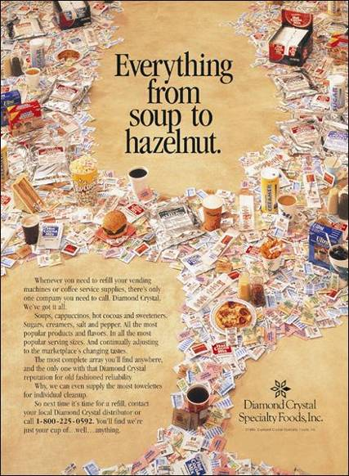
Vending
Machines are Convenient
12-15
Notes:
Summary Overview
In spite of the fact that vending machine sales are only a small percentage of total retail sales, their impact in some target markets is very significant.
Key Issues
Diamond Crystal recognizes this fact and prepares “all the most popular products and flavors, in all the most popular serving sizes” for vending machine operators.
Diamond Crystal knows that the firms in its target market want a convenient source of supply.
So, its product assortment includes an extensive array of products with packaging designed specifically for vending machines and coffee service supplies—all supported with reliable service.
An 800 number makes it easy for prospects to locate a local distributor.
The major disadvantage to automatic vending is high cost. The machines are expensive to buy, stock, and repair compared to the volume they sell.
As a result, prices are higher in vending machines than in other retail forms.
Discussion Question: How much does a soft drink from a vending machine cost a consumer, compared to one purchased at a convenience store? What does the extra cost provide to the consumer?
This slide relates to material on p. 310.

Slide 16
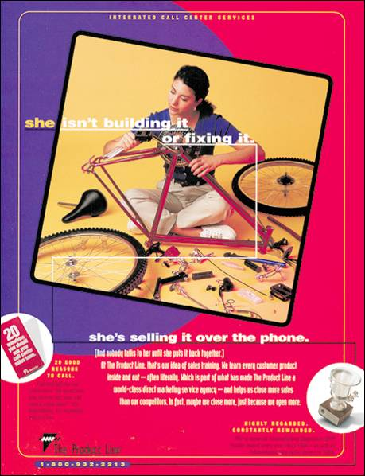
Shop at Home in a Variety of Ways
12-16
Notes:
Summary Overview
In-home shopping has been around for a long time, but it is more varied and more popular now than ever before.
Key Issues
Door-to-door selling: a salesperson goes directly to the consumer’s home. Unlike the U. S., door-to-door selling has grown in popularity in international markets.
Discussion Question: Forty-five years ago, the U. S. retail landscape was teeming with door-to-door salespeople. In the twenty-first century, door-to-door sales are much less prominent. Why?
Telephone and direct-mail retailing: consumers shop at home, usually by placing orders through the mail or via toll-free telephone numbers for home delivery.
Profit margins tend to be higher that in traditional retail formats.
A significant portion of telephone and direct-mail sales are outsourced to firms like The Product Line, featured in this ad.
These subcontractors specialize in selling products over the phone. It can be more efficient and effective for some retailers to use them, instead of performing these tasks themselves.
Other retailers succeed by putting a catalog on cable TV or on computer. QVC, Home Shopping Channel, and others are taking advantage of the proliferation of cable TV channels to reach millions of homes. They are also building a significant presence on the Internet.
This slide relates to material on p. 310.

Slide 17
Shop at Home in a
Variety of Ways
12-17
Door-to-door
Selling
Cable Television
QVC
In-Home
Shopping
Notes:
Summary Overview
In-home shopping has been around for a long time, but it is more varied and more popular now than ever before.
Key Issues
Door-to-door selling: a salesperson goes directly to the consumer’s home. Unlike the U. S., door-to-door selling has grown in popularity in international markets.
Discussion Question: Forty-five years ago, the U. S. retail landscape was teeming with door-to-door salespeople. In the twenty-first century, door-to-door sales are much less prominent. Why?
Other retailers succeed by putting a catalog on cable TV or on computer. QVC, Home Shopping Channel, and others are taking advantage of the proliferation of cable TV channels to reach millions of homes. They are also building a significant presence on the Internet.
This slide relates to material on p. 310.

Slide 18
Conventional Retailers—Try to Avoid Price Competition (Exhibit 12-3)
12-18
Specialty
shops &
dept. stores
Ritz Camera,
Coach, Gap,
Macy’s
Expanded
assortment
& service
Expanded
assortment
&/or reduced
margins &
service
Supermarkets,
disc. houses,
mass merch.,
super-, club-
stores
Safeway,
IKEA, Home
Depot,
Costco
Conventional
Offerings
Single- &
limited-
line stores
Added conv.,
higher margins,
reduced
assortment
C-stores,
vending, door-
to-door, phone,
mail, some
e-tail
7-11, Pepsi
vending,
Avon, Lands’
End, QVC
Expanded
assortment,
reduced
margins, more
information
Internet
eBay,
Amazon,
Zappos,
Netflix, Dell
Notes:
Summary Overview
It is too simplistic to characterize retailers on the basis of a single characteristic. Developing an understanding of retail strategy begins with considering basic types of retailers and how they differ along a variety of dimensions. This exhibit displays several types of retailers.
Key Issues
Finally, a number of different online retailers will offer expanded assortment, reduced margins and more information.
Internet
How should one think of the Internet and its role in retailing? At this stage in its development, there are alternative ways of considering the Internet. When it comes to retailing, is the Internet:
Another aspect of how low-margin mass-merchandisers are trying to appeal to a large target market with wide assortments and low prices?
Just another way to add convenient in-home shopping?
Something that is a really different retail form?
Discussion Question: Which of these three views do you support and why?
Although all three of these perspectives have merit, the Internet will likely prove to be a truly new retail form.
This slide refers to material on p. 311.
→ Indicates place where slide “builds” to include the corresponding point (upon mouse click).

Slide 19
Retailing on the Internet
12-19
Brick & mortar
stores add online capabilities
New Meaning of Convenience
Internet
Retailing
Online Costs for Retailers & Customers
Showrooming
Big Data
Notes:
Summary Overview
Internet retailing is still in the growth stage. By 2015 internet sales will grow to 9% of all retail sales in the U.S.
Key Issues
→ Online costs for retailers and customers—higher and lower.
With no storefront and limited sales help, online retailers usually have lower operating costs than brick-and-mortar stores.
Customers may not have to pay sales taxes either.
→ Showrooming.
Consumers may go to a brick-and-mortar store, inspect a product, and then purchase it from an online retailer with a lower price.
There is some pushback by retailers – price controls, and exclusive products than cannot be found online
→ Big Data.
Online retailers have access to extensive consumer behavior data.
Cookies and other techniques allow online retailers to track behavior at other sites, and even glean information from a users Facebook account.
→ Convenience takes on new meanings.
A consumer can have an unlimited assortment on the Internet; however, the consumer is limited by other elements of the product.
Shipping delays and shipping costs.
Consumer can’t touch product.
→ Brick-and-mortar stores add online capabilities.
This multichannel approach—physical store plus website—offers customers some of the best of both worlds.
In-store pickup of online orders
This slide refers to material on pp. 311-313.
→ Indicates place where slide “builds” to include the corresponding point (upon mouse click).

Slide 20
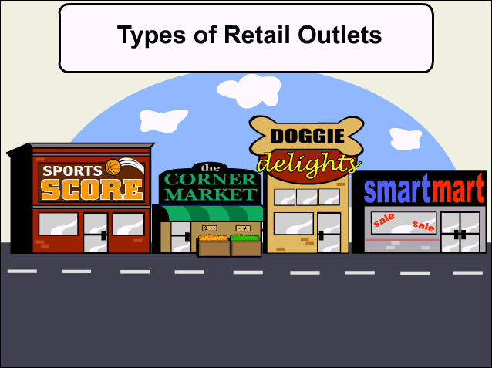
Interactive Exercise:
Types of Retail Outlets
12-20
Notes:
The purpose of this drop and drag exercise is to enhance student’s understanding of the different forms of retail organizations. Four hypothetical retailers are described in terms of the depth and width of their product mix, the level of customer service provided and the relative level of prices charged. After reviewing each store description, students are challenged to identify the correct form of retail organization from among the following seven choices: Mass Merchandiser, Convenience Store, Category Killer, Specialty Shop, Supermarket, Hypermarket, and Supercenter.
For complete information and suggestions on using this Interactive Exercise, please refer to the “Notes on the Interactive Exercise” section for this chapter in the Multimedia Lecture Support Package to Accompany Basic Marketing. That same information is available as a Word document in the assets folder for the PowerPoint file.
This slide refers to material on p. 309.

Slide 21

Competitive Effects Influence Other Retailers
12-21
Notes:
Men’s Wearhouse began as a traditional in-store retailer in 1973. Since then, the firm’s sales have grown to well over $1 billion annually. Many established retailers, like Men’s Wearhouse, are attempting to determine the best method of meeting their customers’ needs by combining their normal retail operations with online website operations.
As traditional retailers gain Internet experience, there is no doubt that competition will spur an increase in customer value. Also, look for retailers to try and incorporate ideas from Web marketing into older forms of retailing as well.
Video Operation:
Use the onscreen player controls to operate the video.
To view the video at Full Screen, right-click the video and choose Full Screen. To go back to your presentation you can either hit the Escape key, right-click on the video and uncheck Full Screen, or type Alt+Enter. You can do this at anytime during the video playback.
Under certain circumstances, the video may not fill the video player window. To restore, right-click the video player object and select Zoom 200%.
The videos will only play in Slide Show View. Macros must be enabled in order to play the videos from within PowerPoint.
This slide refers to material on p. 311.

Slide 22
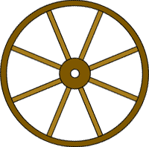
Why Retailers Evolve and Change
12-22
The “Wheel of Retailing” Keeps on Rolling!
Technology
Driven
Scrambled Merchandising
= Higher Profits
AND
Ethical Issues May Arise
Product Life Cycle Applies
to Retailing
Notes:
Summary Overview
There are several explanations for the evolution of retailers over time.
Key Issues
Technology drives retail change: For some fairly obvious reasons, technology has recently had a big influence on retail evolution. Collection and analysis of customers’ online activity are changing shopping and retailing. Physical stores are leveraging technology to improve the in-store shopping experience.
Big Data, combining both online and in-store behavior, is a comprehensive tool for offering consumers promotions, rebates and carefully targeted catalogs.
Wheel of retailing theory: new types of retailers enter the market as low-status, low-margin, low-price operators and then, if successful, evolve into more conventional retailers offering more services with higher operating costs and higher prices.
This theory is often used to explain the evolution of department stores, supermarkets, and mass-merchandisers.
It doesn’t explain the development of vending machines, convenience stores, and the Internet.
→ Scrambled merchandising: a retailer carries any product lines that will sell profitably, even if they are outside the retailer’s traditional lines of business.
→ The product life cycle concept applies to retailer types, too.
As the retailer matures, competition gets tougher, and eventually, a new form may replace the older retailer.
Discussion Question: What types of retailers are in the decline stage of their life cycles?
→ Ethical issues may arise.
Some retailers have been criticized for advertising low prices on an item but not stocking enough to meet demand. Once consumers are in the store, they are pressured to switch to more expensive items.
This slide refers to material on pp. 314-315.
→ Indicates place where slide “builds” to include the corresponding point (upon mouse click).

Slide 23
Checking Your Knowledge
12-23
Walgreen’s, CVS, and other “drugstores” have become scaled-down versions of mass-merchandisers by adding small appliances, housewares, food, and other items to their traditional lines. This type of “scrambled merchandising” is meant to deal with the increasing desire that consumers have for:
A. personal service.
B. convenience.
C. low prices.
D. prestigious brand names.
E. quality.
Notes:
Answer: B
Checking your knowledge answer explanation:
Scrambled merchandising is the term to describe retailers carrying any product lines that they think they can sell profitably. The consumer desire for convenience is driving this approach. The best answer selection is ‘B’.
This slide relates to material on pp. 310.

Slide 24
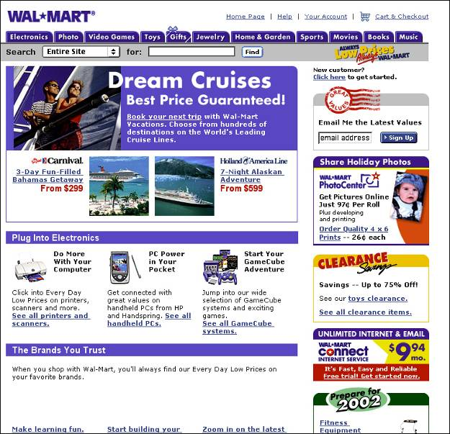
An Example of a Large Retail Chain
12-24
Notes:
Summary Overview
Among the large retailers, many are chain stores.
Key Issues
Corporate chain: a firm that owns and manages more than one store. An example is Wal-Mart, whose website is shown here.
The corporate chain uses centralized buying to get quantity discounts.
Corporate chains can also use EDI and their own distribution centers to control inventory and stockouts.
Cooperative chains: retailer-sponsored groups formed by independent retailers that cooperate on promotions while running their individual stores separately.
Voluntary chains: wholesaler-sponsored groups that may contract with independent retailers to standardize common operating procedures, storefronts, names, and joint promotions.
Franchisors form chains, too. The franchisor usually offers training and management support while the franchisees run the individual stores.
Discussion Question: Why do you think franchising has more self-made millionaires than any other retailing form?
This slide refers to material on pp. 316-317.

Slide 25
Retailer Size and Profits
12-25
Franchise
Operations
Corporate
Chain
Big
Retailers
Voluntary
Chain
Cooperative
Chain
Notes:
Summary Overview
The larger retail stores—those selling more than $5 million annually—do most of the business; they account for almost 75 percent of all retail sales.
Key Issues
Corporate chain: a firm that owns and manages more than one store. An example is Wal-Mart, whose website is shown here.
The corporate chain uses centralized buying to get quantity discounts.
Corporate chains can also use EDI and their own distribution centers to control inventory and stockouts.
Cooperative chains: retailer-sponsored groups formed by independent retailers that cooperate on promotions while running their individual stores separately.
Voluntary chains: wholesaler-sponsored groups that may contract with independent retailers to standardize common operating procedures, storefronts, names, and joint promotions.
Franchisors form chains, too. The franchisor usually offers training and management support while the franchisees run the individual stores.
Discussion Question: Why do you think franchising has more self-made millionaires than any other retailing form?
This slide refers to material on pp. 315.

Slide 26

Big Chains Are Building Market Clout
12-26
Notes:
Chains, such as The Great Indoors, are expected to continue to grow and take business from independent stores, because size matters. Large chains are able to buy larger quantities at significant discounts, and take advantage of vertical integration—including the development of their own efficient distribution centers.
Video Operation:
Use the onscreen player controls to operate the video.
To view the video at Full Screen, right-click the video and choose Full Screen. To go back to your presentation you can either hit the Escape key, right-click on the video and uncheck Full Screen, or type Alt+Enter. You can do this at anytime during the video playback.
Under certain circumstances, the video may not fill the video player window. To restore, right-click the video player object and select Zoom 200%.
The videos will only play in Slide Show View. Macros must be enabled in order to play the videos from within PowerPoint.
This slide refers to material on p. 316.

Slide 27

Differences in Retailing in Different Nations
12-27
New Ideas Spread
Mass-Marketing Requires Mass Markets
Online Retailing Varies
Must Adapt Marketing Strategies
Notes:
Summary Overview
Several factors in the international market affect the development of retailing.
Key Issues
Successful new ideas spread across countries. Much of the self-service retailing that originated in the United States has now migrated to countries around the world.
→ For example, mass-merchandising requires mass markets. In some countries, such as less-developed nations, consumers do not have the income to support mass distribution.
→ Retailers moving to international markets must adapt marketing strategies. Legal and cultural differences in international markets may outweigh a competitive advantage that worked well at home.
→ Online shopping behavior and online retailing, varies considerably across countries.
Discussion Question: Do these types of statutory restrictions lead to higher prices for consumers? How?
This slide refers to material on pp. 317-318.
→ Indicates place where slide “builds” to include the corresponding point (upon mouse click).

Slide 28
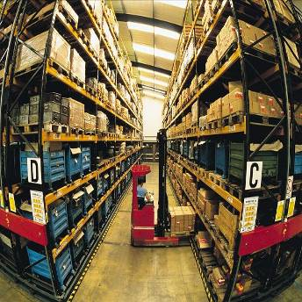
What Is a Wholesaler?
12-28
Changing With the Times
In Decline
Progressive Wholesalers Adapt
Goodbye to Some?
Ethical Issues?
New Strategies Needed To Survive
Notes:
Summary Overview
Wholesaling is concerned with the activities of persons or establishments (wholesalers) that sell to retailers, other merchants, business users, or institutional users, but do not sell in large amounts to final consumers.
Key Issues
Wholesaling is changing with the times, and innovative forms of competition will lead to new business models.
→ As producers became larger many have bypassed wholesalers. Some large retail chains, including Walmart and Lowe’s, even refuse to deal with some wholesalers who represent small producers.
→ Progressive wholesalers have used technology to offer better service, streamlined their operations, switched to selective distribution policies, and modernized their facilities.
→ Not all wholesalers are progressive, and perhaps we will say good-bye to some.
→ Discussion Question: Some wholesalers feel they are begin squeezed out of business because powerful producers and/or wholesalers are bypassing them.
Is this an ethical issue? Is it fair, or is it just part of doing business?
→ Survivors will need to add value, based on the marketing concept.
This slide refers to material on pp. 319-320.
→ Indicates place where slide “builds” to include the corresponding point (upon mouse click).

Slide 29
Wholesalers Add Value in Different Ways (Exhibit 12-5)
12-29
Pe
r
cent of
84.9%
wholesale
10.4%
establishments
4.7%
Pe
r
cent of all
64.1%
wholesale
9.6%
sales
26.3%
Merchant wholesalers
13.1%
Costs as a
3.7%
Agent wholesalers
pe
r
cent of sales
Manufacturer sales branches
7.9%
0.0%
20.0%
40.0%
60.0%
80.0%
100.0%
Notes:
Summary Overview
This exhibit compares the number, sales volume, and operating expenses of some major types of wholesalers.
Manufacturers’ sales branches—warehouses that producers set up at separate locations away from their factories.
Key Issues
As shown, most wholesale establishments are merchant wholesalers, followed by agent wholesalers, and then manufacturer sales branches.
Merchant wholesalers also have the greatest percentage of all wholesale sales (64.1 percent), followed by manufacturer sales branches (26.3 percent) and then agent wholesalers (9.6 percent).
Merchant wholesalers have the highest costs as a percentage of sales, 13.1 percent compared to 7.9 percent for manufacturer sales branches. Agent wholesalers have the lowest costs as a percentage of sales (3.7 percent).
Discussion Question: What does the difference in operating expenses suggest about the functions of these types of wholesalers?
This slide refers to material on pp. 320-321.

Slide 30
Types of Wholesalers (Exhibit 12-6)
12-30
Does wholesaler own the products?
Agent wholesalers
Auction companies
Brokers
Manufacturers’ agents
Selling agents
No
Yes (Merchant wholesalers)
How many functions does the wholesaler perform?
All functions
Some functions
Service merchant wholesaler
General merchandise wholesalers (or mill supply houses)
Single-line or general-line wholesalers
Specialty wholesalers
Limited-function merchant wholesaler
Cash-and-carry wholesaler
Drop-shippers
Truck wholesalers
Rack jobbers
Catalog wholesalers
Notes:
Summary Overview
In order to understand the differences among types of wholesalers in terms of their number, their sales, and their costs, it’s essential to develop a clear picture of what wholesalers do.
Key Issues
To understand the many different types of wholesalers, it is useful to start by determining whether the wholesaler takes ownership of products it handles—and how many wholesaling functions the wholesaler performs.
Independent wholesalers are classified first based on whether or not they own the products they resell. If they do, they are merchant wholesalers. Merchant wholesalers are the most numerous type of wholesale establishment.
Merchant wholesalers may also be further classified based on the number of functions performed.
If the wholesaler doesn’t own the products it resells, it is an agent wholesaler.
Some of the different types of wholesalers are shown in this slide, which reproduces Exhibit 12-5 from your text book. Let’s look at each of these types of wholesalers in a little more detail.
This slide refers to material on p. 321.
→ Indicates place where slide “builds” to include the corresponding point (upon mouse click).

Slide 31
Types of Merchant Wholesalers
12-31
Service
Limited -
Function
Types of Merchant Wholesalers
General merchandise
Single-line (or general-line)
Specialty
Cash-and- Carry
Drop-Shippers
Truck
Rack Jobbers
Catalog
Notes:
Summary Overview
Merchant wholesalers own (take title to) the products they sell.
There are many types of merchant wholesalers. Service merchant wholesalers provide all the wholesaling functions. Limited-function merchant wholesalers provide only some wholesaling functions.
Key Issues
Among the service wholesalers are:
General merchandise wholesalers: They carry a wide variety of nonperishable items.
Single- or general-line wholesalers: They carry a narrower line, usually specializing in serving a single or limited product line for business or consumer marketers.
Specialty Wholesalers. These carry a very narrow range of products and offer specialized technical knowledge related to that area.
Among the limited-function wholesalers are:
Cash-and-carry wholesalers: They operate like service wholesalers except that customers must pay cash.
Drop-shippers: They take title but do not handle products. Instead, they arrange for other buyers and the producer ships the products directly.
Truck wholesalers: They specialize in delivering products—at a cost—that they stock in their own trucks.
Rack jobbers: They sell hard-to-handle assortments of products, on their own point-of-purchase display racks.
Catalog wholesalers: They sell out of catalogs that are distributed widely to smaller customers. Thus, they can reach outlying areas.
Discussion Question: Why is it important for marketers to know about the various types of merchant wholesalers?
This slide refers to material on pp. 321-322.
→ Indicates place where slide “builds” to include the corresponding point (upon mouse click).

Slide 32
Agents Are Strong on Selling
12-32
Manufacturer’s Agents
Brokers
Types of
Agent
Wholesalers
Auction Companies
Selling Agents
Notes:
Summary Overview
Agents wholesalers are wholesalers who do not own the products they sell. Their main purpose is to bring together buyers and sellers. They offer fewer services and have lower selling costs than merchants. They are important in international trade where specialized skills are needed that other channel members don’t have.
Key Issues
Agent wholesalers normally specialize by customer type and product or product line. Among the different types of agents are:
Manufacturer’s agents: They sell similar products for several noncompeting producers and receive a commission on sales. Such agents are free-wheeling sales reps who can easily add product lines from a variety of producers to meet the customer’s needs. Export or import agents are basically manufacturers’ agents specializing in international trade.
Brokers: They provide information and bring buyers and sellers together. Their distinction is that their relationship with buyers and sellers tends to be temporary, lasting only while the deal is negotiated. Export and import brokers specialize in bringing together buyers and sellers from different countries.
Selling agents: They take over the whole marketing job of producers. They have control over pricing, selling, and advertising, operating as the producers’ marketing manager. A combination export manager is a blend of manufacturers’ agent and selling agent.
Auction companies: They speed up the sale, by providing a place where buyers and sellers can complete a transaction. The Internet has spurred growth of auction companies in many lines of business.
Discussion Question: Why is it important for marketers to know about the various types of agents?
This slide refers to material on pp. 324-325.
→ Indicates place where slide “builds” to include the corresponding point (upon mouse click).

Slide 33
Checking Your Knowledge
12-33
Atlantic Music distributes various types of musical instruments, sheet music, and accessories that are sold through independent music stores. It carries many different brands, such as Remo and Ludwig drums, and brass instruments from Yamaha, Hohner, and other manufacturers. Atlantic takes title to the musical instruments and supplies it resells, and provides a wide variety of services to its customers. Atlantic Music is a(n):
A. merchant wholesaler.
B. limited service merchant wholesaler.
C. auction company.
D. manufacturer’s broker.
E. intermediary.
Notes:
Answer: A
Checking your knowledge (answer explanation):
Merchant wholesalers own the products they sell and they often specialize by certain types of products. Atlantic Music is an example of a merchant wholesaler. The best answer selection is ‘A’.
This slide relates to material on pp. 322.

Slide 34
You should now be able to:
12-34
Understand how retailers plan their marketing strategies.
Know about the many kinds of retailers that work with producers and wholesalers as members of channel systems.
Understand how retailers evolve, including the roles of technology, scrambled merchandising and the “wheel of retailing.”
See why size or belonging to a chain can be important to a retailer.
Notes:
At the end of this presentation, you should be able to:
Understand how retailers plan their marketing strategies.
Know about the many kinds of retailers that work with producers and wholesalers as members of channel systems.
Understand how retailers evolve, including the roles of technology, scrambled merchandising and the “wheel of retailing.”
See why size or belonging to a chain can be important to a retailer.
This slide refers to material on pp. 302.

Slide 35
You should now be able to:
12-35
Understand some of the differences in retailing in different nations.
Know what progressive wholesalers are doing to modernize their operations and marketing strategies.
Know the various kinds of merchant and agent wholesalers and the strategies they use.
Understand important new terms
Notes:
At the end of this presentation, you should be able to:
Understand some of the differences in retailing in different nations.
Know what progressive wholesalers are doing to modernize their operations and marketing strategies.
Know the various kinds of merchant and agent wholesalers and the strategies they use.
Understand important new terms
This slide refers to material on pp. 302.

Slide 36
Key Terms
12-36
retailing
general stores
single-line stores
limited-line stores
specialty shop
department stores
mass-merchandising concept
supermarkets
discount houses
mass-merchandisers
supercenters (hypermarkets)
convenience (food) stores
automatic vending
door-to-door selling
wheel of retailing theory
Notes:
Summary Overview
These are key terms you should be familiar with based upon the material in this presentation.
Key Issues
Retailing: all of the activities involved in the sale of products to final consumers.
General stores: early retailers who carried anything they could sell in reasonable volume.
Single‑line stores: stores that specialize in certain lines of related products rather than a wide assortment—sometimes called limited-line stores.
Limited-line stores: stores that specialize in certain lines of related products rather than a wide assortment—sometimes called single-line stores.
Specialty shop: a type of conventional limited‑line store‑‑usually small and with a distinct personality.
Department stores: larger stores that are organized into many separate departments and offer many product lines.
Mass-merchandising concept: the idea that retailers should offer low prices to get faster turnover and greater sales volume by appealing to larger numbers.
Supermarkets: large stores specializing in groceries—with self‑service and wide assortments.
Discount houses: stores that sell hard goods (cameras, TVs, appliances) at substantial price cuts to customers who go to discounter's low-rent store, pay cash, and take care of any service or repair problems themselves.
Mass-merchandisers: large, self‑service stores with many departments that emphasize soft goods (housewares, clothing, and fabrics) and staples (like health and beauty aids) and selling on lower margins to get faster turnover.
Supercenters (hypermarkets): very large stores that try to carry not only foods and drug items, but all goods and services that the consumer purchases routinely (also called hypermarkets).
Convenience (food) stores: a convenience‑oriented variation of the conventional limited‑line food stores.
Automatic vending: selling and delivering products through vending machines.
Door‑to‑door selling: going directly to the consumer's home.
Wheel of retailing theory: new types of retailers enter the market as low‑status, low‑margin, low‑price operators and then—if successful—evolve into more conventional retailers offering more services with higher operating costs and higher prices.
This slide refers to boldfaced terms appearing in Chapter 12.

Slide 37
Key Terms
12-37
scrambled merchandising
corporate chain
cooperative chains
voluntary chains
franchise operation
wholesaling
wholesalers
manufacturers’ sales branches
merchant wholesalers
service wholesalers
general merchandise wholesalers
single-line (or general-line) wholesalers
specialty wholesalers
limited-function wholesalers
cash-and-carry wholesalers
drop-shippers
Notes:
Summary Overview
These are additional key terms.
Key Issues
Scrambled merchandising: retailers carrying any product lines that they think they can sell profitably.
Corporate chain: a firm that owns and manages more than one store—and often it's many.
Cooperative chains: retailer‑sponsored groups, formed by independent retailers, to run their own buying organizations and conduct joint promotion efforts.
Voluntary chains: wholesaler‑sponsored groups that work with independent retailers.
Franchise operation: a franchisor develops a good marketing strategy, and the retail franchise holders carry out the strategy in their own units.
Wholesaling: the activities of those persons or establishments that sell to retailers and other merchants, and/or to industrial, institutional, and commercial users, but who do not sell in large amounts to final consumers.
Wholesalers: firms whose main function is providing wholesaling activities.
Manufacturers' sales branches: separate warehouses that producers set up away from their factories.
Merchant wholesalers: wholesalers who own (take title to) the products they sell.
Service wholesalers: merchant wholesalers who provide all the wholesaling functions.
General merchandise wholesalers: service wholesalers who carry a wide variety of nonperishable items such as hardware, electrical supplies, furniture, drugs, cosmetics, and automobile equipment.
Single‑line (or general‑line) wholesalers: service wholesalers who carry a narrower line of merchandise than general merchandise wholesalers.
Specialty wholesalers: service wholesalers who carry a very narrow range of products and offer more information and service than other service wholesalers.
Limited‑function wholesalers: merchant wholesalers who provide only some wholesaling functions.
Cash‑and‑carry wholesalers: like service wholesalers, except that the customer must pay cash.
Drop‑shippers: wholesalers who own (take title to) the products they sell—but do not actually handle, stock, or deliver them.
This slide refers to boldfaced terms appearing in Chapter 12.

Slide 38
Key Terms
12-38
truck wholesalers
rack jobbers
catalog wholesalers
agent wholesalers
manufacturer’s agents
export agents
import agents
brokers
export brokers
import brokers
selling agents
combination export manager
auction companies
Notes:
Summary Overview
These are additional key terms.
Key Issues
Truck wholesalers: wholesalers who specialize in delivering products that they stock in their own trucks.
Rack jobbers: merchant wholesalers who specialize in hard-to-handle assortments of products that a retailer doesn't want to manage—and they often display the products on their own wire racks.
Catalog wholesalers: sell out of catalogs that may be distributed widely to smaller industrial customers or retailers who might not be called on by other wholesalers.
Agent wholesalers: wholesalers who do not own (take title to) the products they sell.
Manufacturers' agents: agent wholesalers who sell similar products for several noncompeting producers for a commission on what is actually sold.
Export agents: manufacturers' agents who specialize in export trade.
Import agents: manufacturers' agents who specialize in import trade.
Brokers: agent wholesalers who specialize in bringing buyers and sellers together.
Export brokers: brokers who specialize in bringing together buyers and sellers from different countries.
Import brokers: brokers who specialize in bringing together buyers and sellers from different countries.
Selling agents: agent wholesalers who take over the whole marketing job of producers—not just the selling function.
Combination export manager: a blend of manufacturers' agent and selling agent—handling the entire export function for several producers of similar but noncompeting lines.
Auction companies: agent wholesalers who provide a place where buyers and sellers can come together and complete a transaction.
This slide refers to boldfaced terms appearing in Chapter 12.

