Slide 1
Chapter 2
Marketing Strategy Planning
Copyright © 2014 by The McGraw-Hill Companies, Inc. All rights reserved
Notes:
For use only with Perreault/Cannon/McCarthy or Perreault/McCarthy texts.
© 2014 McGraw-Hill Companies, Inc. McGraw-Hill/Irwin
CHAPTER TWO
Lecture Notes for
Basic Marketing 19e

Slide 2
At the end of this presentation, you should be able to:
2-2
Understand what a marketing manager does.
Know what marketing strategy planning is—and why it is the focus of this book.
Understand target marketing.
Be familiar with the four Ps in a marketing mix.
Know the difference between a marketing strategy, a marketing plan, and a marketing program.
Notes:
At the end of this presentation, you should be able to:
Understand what a marketing manager does.
Know what marketing strategy planning is—and why it is the focus of the book.
Understand target marketing.
Be familiar with the four Ps in a marketing mix.
Know the difference between a marketing strategy, a marketing plan, and a marketing program.
This slide refers to material on pp. 32.

Slide 3
You should now be able to:
2-3
Understand what customer lifetime value and customer equity are and why marketing strategy planners seek to increase them.
Be familiar with the text’s framework for marketing strategy planning..
Know four broad types of marketing opportunities that help in identifying new strategies.
Understand why strategies for opportunities in international markets should be considered.
Understand the important new terms.
Notes:
You should now be able to:
Understand what customer lifetime value and customer equity are and why marketing strategy planners seek to increase them.
Be familiar with the text’s framework for marketing strategy planning.
Know four broad types of marketing opportunities that help in identifying new strategies.
Understand why strategies for opportunities in international markets should be considered.
Understand the important new terms.
This slide refers to material on pp. 32.

Slide 4
The Management Job in Marketing (Exhibit 2-1)
2-4
Whole-Company
Strategic
Management
Planning
Marketing
Planning
Control Marketing
Plan(s) and Program
Implement Marketing
Plan(s) and Program
Notes:
Summary Overview
The marketing management process refers to the planning, implementation, and control of marketing activities. These activities are continuous, and decisions made in the past in one area can have implications on the other areas as well.
Key Issues
Planning—required because marketing managers must seek new opportunities.
→Implementation—the process of putting marketing plans into action.
Discussion Question: Which is more important—good planning or good implementation? Explain.
→Control—assessing and evaluating marketing performance.
When performance falls short of expectations, the marketing manager must take corrective action.
→Strategic (management) planning—developing and maintaining a match between an organization’s resources and its market opportunities.
It is a top management job.
It includes planning for marketing, production, finance, human resources, and other areas.
Though, marketing strategies are not whole-company plans, company plans should be market-oriented.
The marketing plan sets the tone and direction for the whole company.
This slide relates to material on pp. 32-33.
→Indicates place where slide “builds” to include the corresponding point (upon mouse click).

Slide 5
What is a Marketing Strategy? (Exhibit 2-2)
2-5
The
marketing mix
TARGET
MARKET
Notes:
Summary Overview
Marketing strategy planning means finding opportunities and developing profitable marketing strategies that the company can use to capitalize on the opportunities.
Key Issues
Marketing strategy—specifies a target market and a related marketing mix; provides a “big picture” of what the firm will do.
Target market—a fairly homogeneous (similar) group of customers to whom a company wishes to appeal.
Marketing mix—the controllable variables the company puts together to satisfy the target market.
The customer is surrounded by the controllable variables that we call the “marketing mix.”
Discussion Question: Why does the target market appear in the center of the diagram of a marketing strategy?
This slide relates to material on pp. 33-34.
→Indicates place where slide “builds” to include the corresponding point (upon mouse click).

Slide 6


Selecting a Marketing-Oriented Strategy Is Target Marketing (Exhibit 2-3)
2-6
Production-oriented manager sees everyone as basically similar and practices “mass marketing”
Marketing-oriented manager sees everyone as different and practices “target marketing”
Notes:
Summary Overview
The difference between target marketing and mass marketing is directly linked to the concept of a marketing strategy, because a marketing strategy specifies some particular target customers.
Key Issues
Target marketing—tailoring the marketing mix to meet the needs of a specific group of target customers.
It can be considered as “rifle approach.”
→Mass marketing—offering a single marketing mix combination to everyone.
It can be considered as “shotgun approach.”
It assumes that everyone is the same.
It considers everyone to be a potential customer.
Mass marketing and mass marketers do not mean the same thing.
Mass marketers like Kraft Foods and Walmart are aiming at clearly defined target markets.
Their target markets are large and spread out.
Discussion Question: Why are organizations moving in the direction of target marketing as opposed to mass marketing?
→Target marketing can mean big markets and profits
Target marketing is not limited to small market segments—only to fairly homogeneous ones.
The basic reason to focus on some specific target customers is so that you can develop a marketing mix that satisfies those customers’ specific needs better than they are satisfied by some other firm.
This slide relates to material on pp. 34-35.
→Indicates place where slide “builds” to include the corresponding point (upon mouse click).

Slide 7
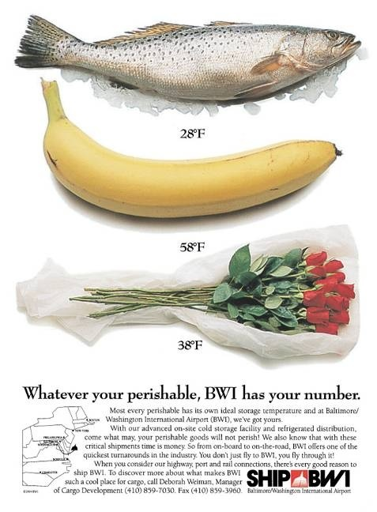
An Application of Target Marketing
2-7
Notes:
Summary Overview
This ad for BWI airport is an example of target marketing, because BWI is promoting “application-specific” distribution facilities.
Key Issues
BWI can meet all storage/distribution needs.
BWI saves time with its efficient distribution centers.
The ad copy states that BWI can handle air, port, and rail connections.
BWI serves the shipper, no matter what their needs.
Discussion Question: How are consumers’ shipping needs different from the customers BWI is trying to attract in this ad? How does the marketing mix (product, place, promotion, price) for FedEx or UPS differ from that of BWI?
This slide relates to material on pp. 34-35.

Slide 8




Developing Marketing Mixes for Target Markets (Exhibit 2-4)
2-8
TARGET
MARKET
Notes:
Summary Overview
Marketers have to make many decisions in developing a marketing mix that will satisfy their target customers. All of these variables making up the marketing mix can be reduced to four basic categories.
Key Issues
The four Ps make up a marketing mix:
product;
place;
promotion;
and price.
These “Four Ps” are combined in differing ways to match the needs and wants of different target markets.
The C stands for some specific customers— the target market.
→Product: concerned with developing the right “product” for the target market.
→Place: concerned with all the decisions involved in getting the “right” product to the target market’s place.
→Promotion: concerned with telling the target market or others in the channel of distribution about the “right” product.
→Price: concerned with the kind of competition in the target market and the cost of the whole marketing mix.
Discussion Question: The customer is not part of the marketing mix. Why?
The four Ps are things that the marketer can control, but the marketer cannot directly control the customer’s behavior.
This slide relates to material on pp. 35-38.
→Indicates place where slide “builds” to include the corresponding point (upon mouse click).

Slide 9
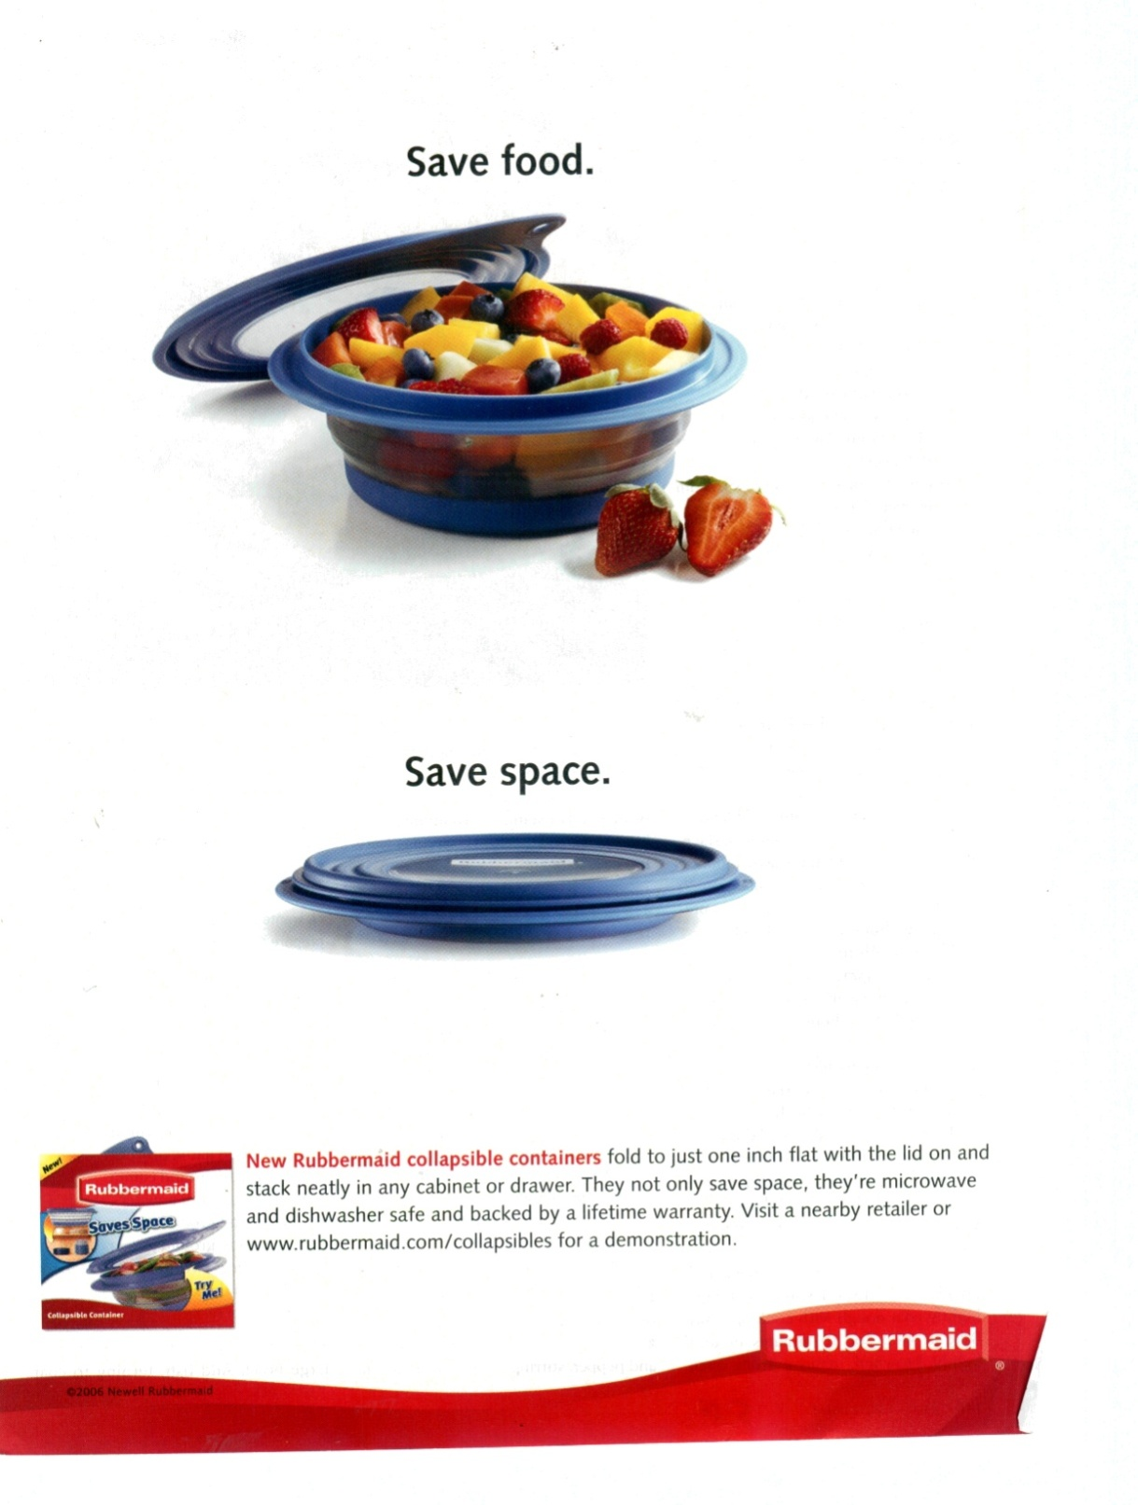
The Product Element of the Marketing Mix
2-9
Courtesy of Clear Blue Inc.
Notes:
Summary Overview
Newell Rubbermaid is a global marketer of consumer and commercial products.
Key Issues
New Rubbermaid collapsible containers can be collapsed with the lid on and they are only one inch high for storage.
The size of the container can be changed once it is filled, so there is less air in the container, which keeps food fresh for longer time.
The collapsing feature is easy to use.
The containers take lesser space in the shelves or drawers.
Discussion Question: What are the tangible elements of the New Rubbermaid collapsible containers promoted in this ad?
Product considerations include:
physical characteristics;
warranties;
new product development.
This slide relates to material on p. 36.

Slide 10
The Place Element of the Marketing Mix (Exhibit 2-6)
2-10
Manufacturer or producer
Geico
Toyota
Sara
Nestle´
Lee
Wholesaler
Wholesaler
Wholesaler
Retailer
Retailer
Retailer
Consumer
Notes:
Summary Overview
The objective for the place, or distribution, element of the marketing mix is to get the right product, to the right consumer, in the right place, at the right time, in the right quantity, and in the right condition, hopefully all at a reasonable cost.
Key Issues
Channel of distribution—any series of firms or persons used to move goods from producers to final users. Channels can be:
short;
complex.
Marketers must:
find the best kinds and types of channels for the product;
effectively manage the channel.
Discussion Question: What are some of the reasons why marketers are paying increased attention to their distribution strategies and tactics? Hint: Think about what happens when distribution does not work as it should.
This slide relates to material on pp. 37.

Slide 11
The Promotion Element of the Marketing Mix
2-11
Personal
Selling
Mass Selling
Telling and
Selling
the Customer
Sales
Promotion
Notes:
Summary Overview
Promotion involves telling the target market about the product and selling the product to the target customer. There are three main types of promotion.
Key Issues
→Personal selling—direct spoken communication between sellers and potential customers. Sometimes this involves customer service—a personal communication between a seller and a customer who wants the seller to resolve a problem with a purchase.
→Mass selling—communicates with large numbers of customers at the same time.
Advertising—any paid form of nonpersonal presentation of ideas, goods, and services by an identified sponsor.
Publicity—unpaid, nonpersonal presentation of ideas, goods, or services. It also includes creating and placing content on the web for customers to find or pass along to others.
Discussion Question: An old adage in marketing is that “Advertising is paid for, publicity is prayed for.” What is meant by this statement? What implications does the statement have for the marketing manager?
→Sales promotion—promotion activities—other than advertising, publicity, and personal selling—that stimulate interest, trial, or purchase.
This slide relates to material on pp. 38.
→Indicates place where slide “builds” to include the corresponding point (upon mouse click).

Slide 12
The Price Element of the Marketing Mix
2-12
Pricing Objectives
Price Flexibility
Price
Setting
Competition
Price Over the Life Cycle
Geographic Pricing Terms
Discounts and Allowances
Notes:
Summary Overview
Price is the revenue-generating function of the marketing mix. In setting the “right” price, marketing managers must consider many factors, all of which combine to make pricing a combination of science and art.
Key Issues
→Marketers can choose from several different pricing objectives and policies. Among the policies are:
→price flexibility;
how price changes over the product life cycle;
→various allowances, discounts;
geographic terms that affect the final price; and
→competition.
A manager must try to estimate customer reaction to possible prices.
The manager must know current practices as to markups, discounts, and other terms of sale.
Discussion Question: Can you think of examples of products, introduced in the last few years, whose prices changed significantly the longer they were in the market? Is the age of the product the only factor in these price changes?
This slide relates to material on pp. 36, 38.
→Indicates place where slide “builds” to include the corresponding point (upon mouse click).

Slide 13
All Four Ps Contribute to the Whole
2-13
Product
Place
Selection
of Target
Market
Promotion
Price
Understanding the Target Market Leads to Good Strategies!
Notes:
Summary Overview
All of the four Ps—product, place, promotion, and price—have an impact on satisfying the needs of consumers in the target market. No single area is more important than the others—they are all interconnected.
Key Issues
When a marketing mix is being developed, all decisions about the Ps should be made at the same time. That’s why the four Ps are arranged around the target customer in a circle—to show that they all are equally important.
Strategy jobs must be done together.
→ Understanding target markets leads to good strategies
Discussion Question: Choose a product or service and discuss how the elements of the marketing mix interact with each other. For example, how do product decisions affect decisions about place, promotion, and price?
Your text provides an example of Toddler University, a shoe company whose shoes were targeted to a specific type of parent. The company’s founder understood the target market very well, developed a marketing mix aimed at the needs of the target market, and increased sales from $100,000 to $40 million in four years!
This slide relates to material on pp. 38-40.
→Indicates place where slide “builds” to include the corresponding point (upon mouse click).

Slide 14
Checking Your Knowledge
2-14
General Motors is considering increasing the length of its bumper-to-bumper warranty on new vehicles from 3 years to 5 years. The marketing mix variable being considered here is:
A. product.
B. personnel.
C. place.
D. promotion.
E. price.
Notes:
ANSWER: A
Checking your knowledge (answer explanation):
The four basic variables in the marketing mix are product, place, promotion, and price. Selection ‘A’ is the best option because warranties fall under the umbrella term of “product”. The product area may involve a physical good, a service, or a blend of both. (p.36)
This slide relates to material on p. 36.

Slide 15
Checking Your Knowledge
2-15
A television network is trying to generate interest in a new television show in advance of its premiere. The network sends out press releases and makes the star of the new show available for guest appearances on TV and radio talk shows. The marketing mix variable involved here is:
A. product.
B. personnel.
C. place.
D. promotion.
E. price.
Notes:
ANSWER: D
Checking your knowledge (answer explanation):
The four basic variables in the marketing mix are product, place, promotion, and price. Selection ‘D’ is the best option because the press releases and the guest appearance match the broad definition of promotion. Promotion is defined as “telling and selling the customer”. (p.37)
This slide relates to material on p. 37.

Slide 16
Elements of a Firm’s Marketing Program (Figure 2-8)
2-16
Target Market
Marketing Strategy
+
=
Marketing Mix
Marketing Plan
+
=
A Firm’s Marketing Program
Time-Related Details
+
=
Other Marketing Plans
Notes:
Summary Overview
A marketing plan is a written statement that fills out the marketing strategy by specifying the time-related details for carrying out the strategy.
Key Issues
A marketing strategy, as we have already discussed, includes a target market and a marketing mix.
→When time related details are added to the marketing strategy, you have a marketing plan. Marketing plans should make clear the following:
What marketing mix will be offered, to whom, and for how long.
What company resources will be needed at what rate.
What results are expected (this should also specify some means of control).
The plan should also include some control procedures—so that whoever is to carry out the plan will know if things are going wrong.
→Adding together more than one marketing plan results in a firm’s marketing program.
Marketing program: blends all of the firm’s marketing plans into one “big” plan.
This slide relates to material on pp. 40-42.
→Indicates place where slide “builds” to include the corresponding point (upon mouse click).

Slide 17
Checking Your Knowledge
2-17
An entrepreneurial teenager decides to start a new dog- walking business aimed at dog owners who have to leave their pets at home alone during regular working hours. The teenager develops a thorough description of the people in her target market and their needs. She then comes up with a general outline of the services she will offer, some price ranges, the geographic area she will serve, and some low- cost promotion ideas. What has she developed so far?
A. A marketing program
B. A marketing plan
C. A SWOT analysis
D. A marketing strategy
E. Differentiation and segmentation
Notes:
ANSWER: D
Checking your knowledge (answer explanation):
In the question, the teenager has developed a description of the target market, their needs, and a general outline of the business (marketing strategy). Because she has not yet identified the time-related details of carrying out this strategy, she has not yet developed a marketing plan. Selection ‘D’ is the best option because the teenager has developed a marketing strategy so far. (p. 33)
This slide relates to material on p. 33.

Slide 18
Checking Your Knowledge
2-18
A large consumer products company markets several different lines of products, with many individual products in each line. Each product has its own marketing plan. The company president wants to bring together all of the different marketing plans into a single integrated document that can become part of the company’s strategic plan. It appears that the company president plans to create a(n):
A. marketing super-plan.
B. marketing program.
C. marketing strategy.
D. operational plan.
E. mass-marketing approach.
Notes:
ANSWER: B
Checking your knowledge (answer explanation):
A marketing program blends all of the firm’s marketing plans into one “big” plan . Selection ‘B’ is the best option because by trying to integrate all of the different marketing plans, the president needs a marketing program. (p. 42)
This slide relates to material on pp. 42.

Slide 19
Customer Lifetime Value
2-19
Relationships That Develop
Satisfied Customers
Time
Return Business
+
=
Notes:
Summary Overview
→Customer Lifetime Value is the total stream of purchases that a customer could contribute to the company over the length of the relationship.
Key Issues
Recall from chapter 1 that developing relationships with satisfied customers leads them to buy more over time. Over a customer’s lifetime, this can add up.
Consider a customer of fast food restaurant Taco Bell. If their parents go to Taco Bell even just once a month during their youth, this person could purchase $600 worth of fast Mexican food before they turn 18. This assumes about $4 per visit, leading to about $50 for 12 years a year from age 6 – 18. At age 18, consumption could double or triple – or more, as college students tend to eat more cheap, fast food. Possibly resulting in purchases of $150 a year during that time – another $600 over four years. Later as an adult consumption may increase if this person has children and takes them to Taco Bell.
The point here is to recognize that while a single transaction at Taco Bell may be small, a single satisfied customer might be worth thousands of dollars. This is customer lifetime value and reinforces the importance of satisfying customers.
This slide relates to material on p. 42.
→Indicates place where slide “builds” to include the corresponding point (upon mouse click).

Slide 20
Customer Equity
2-20
Profits depend on customer equity
Identify opportunities to enhance customer equity
Marketing
Program
should benefit
firm
Focus should be on long-term profits
Notes:
Summary Overview
→Customer equity is the expected earnings stream or the profitability of a firm’s current and prospective customers over time. Marketing strategy planning should guide the firm to increasing customer equity.
Key Issues
→Top management expects marketing strategy planners to help identify opportunities that will lead to an increase in the firm’s customer equity.
→Customer equity directs managers to focus on long-term profits.
This slide relates to material on pp. 42-43.
→Indicates place where slide “builds” to include the corresponding point (upon mouse click).

Slide 21

The Importance of Marketing Strategy Planning
2-21
Revise Marketing Strategies to Address Evolving Customer Needs
Mid-1920s: Model A
launched in more than 20 different styles
Model T produced using an assembly line
2009: Ford uses Hybrid Viral Marketing to Launch new Subcompact
1960s: Launched Mustang, a sporty car
2004: Launched Escape, the first hybrid SUV
Notes:
Summary Overview
Strategy decisions dictate what business a company is in and what strategies it follows. Marketing strategy planning is emphasized in this presentation because strategy decisions usually determine success and failure.
→ Strategy decisions should evolve to adapt to changing customer needs.
Key Issues
Case history—the auto industry
→Henry Ford built an assembly line to produce his durable and practical Model T. The line helped him make cars for much less than his competitors.
→By the early 1920s the Model T sold for just $290; the price helped the car appeal to larger market.
By the mid-1920s, Ford faced increased competition.
Ford realized it had to become more market oriented—Produced the new Model A, which came in more than 20 different styles.
By the mid-1950s, the company needed a new line of cars positioned between its economical and the more upscale models — Launch of Edsel was a failure.
→In 1961 Ford saw an opportunity for a sporty car—Mustang launched in 1964 was an instant hit.
In the 1970s when gas prices spiked and the U.S. government mandated that cars pollute less, Ford struggled to find a marketing strategy to appeal to customers.
Ford has been more successful in the highly profitable truck and SUV segments.
→Ford invested in gas-electric hybrid technology to gain greater fuel economy—In 2004 Escape, first hybrid SUV, was launched.
→Ford and Microsoft has cooperated to develop the SYNC in-car communications and entertainment system.
→Ford used a hybrid marketing campaign in the United States to launch the Fiesta subcompact, donating 100 to existing YouTube personalities, who then chronicled their experiences with the cars
The case history demonstrates that changes in the market are always occurring and that planning must be ongoing.
This slide relates to material on pp. 43-45.
→Indicates place where slide “builds” to include the corresponding point (upon mouse click).

Slide 22
Attractive Opportunities
2-22
Breakthrough Opportunities
Competitive Advantage
Avoid Hit-or-Miss Marketing
Notes:
Summary Overview
Proactively satisfying the needs of customers means that marketers need to engage in a search for opportunities.
Key Issues
Breakthrough opportunity: one that helps innovators develop hard-to-copy marketing strategies that will be profitable for a long time.
Competitive advantage: a firm has a marketing mix that the target market sees as being better than a competitor's mix. Competitive advantage:
has to be viewed from the customer's perspective, not the firm's perspective;
can be achieved through excellence in any area of the four Ps or because of the firm's other resources.
Discussion Question: Think about the pizza business, and major national chains such as Domino’s, Little Caesar’s, Pizza Hut, and Papa John’s. What is the competitive advantage for each chain?
→Marketers must avoid “hit-or-miss” marketing by:
following a logical marketing strategy planning process;
basing the process on sound marketing research.
This slide relates to material on pp. 45-46.
→Indicates place where slide “builds” to include the corresponding point (upon mouse click).

Slide 23
The Importance of Good Research
2-23
Notes:
This ad for SlimFast bars pokes fun at the typical fast food snack. However, serious marketing research really is the foundation for the marketing strategy planning process and for the promotion element of the marketing mix. The ad is clearly aimed at white collar males who are often challenged by the need to satisfy their hunger quickly. The selection of an appropriate target market and the development of a marketing mix that fit the needs of the target market both require good information gained through research.
Video Operation:
Use the onscreen player controls to operate the video.
To view the video at Full Screen, right-click the video and choose Full Screen. To go back to your presentation you can either hit the Escape key, right-click on the video and uncheck Full Screen, or type Alt+Enter. You can do this at anytime during the video playback.
Under certain circumstances, the video may not fill the video player window. To restore, right click the video player object and select Zoom 200%.
The videos will only play in Slide Show View. Macros must be enabled in order to play the videos from within PowerPoint.
This slide relates to material on pp. 42.

Slide 24
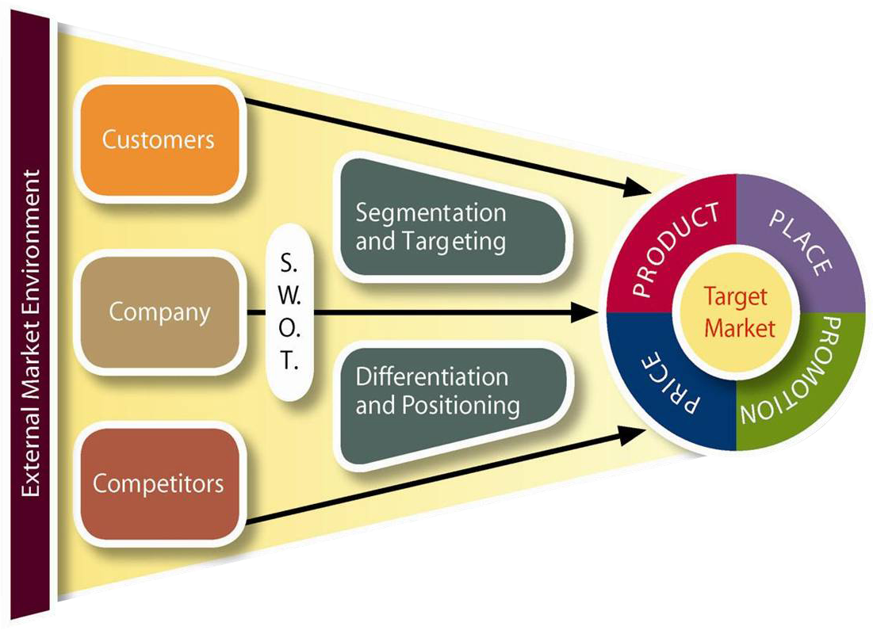
Marketing Strategy Planning Process Highlights Opportunities (Exhibit 2-9)
2-24
Notes:
Summary Overview
The marketing strategy planning process guides the selection of a target market and the development of a marketing mix.
Key Issues
Marketing strategy planning begins by gathering information about the market and company.
Marketing strategy planning narrows down from broad opportunities to specific strategy.
Screening criteria makes it clear why you select a strategy.
Segmentation helps pinpoint the target.
Narrow down to a superior marketing mix.
S.W.O.T. analysis highlights advantages and disadvantages.
This slide relates to material on pp. 47-49.
→Indicates place where slide “builds” to include the corresponding point (upon mouse click).

Slide 25
Marketing Strategy Planning
2-25
Notes:
This video illustrates how the John Deere Company implements the marketing strategy planning process.
(video length 2:47)
Video Operation:
Use the onscreen player controls to operate the video.
To view the video at Full Screen, right-click the video and choose Full Screen. To go back to your presentation you can either hit the Escape key, right-click on the video and uncheck Full Screen, or type Alt+Enter. You can do this at anytime during the video playback.
Under certain circumstances, the video may not fill the video player window. To restore, right click the video player object and select Zoom 200%.
The videos will only play in Slide Show View. Macros must be enabled in order to play the videos from within PowerPoint.
This slide relates to material on pp. 43.

Slide 26
Interactive Exercise: Marketing Strategy
2-26
Present products
New products
Present
Market
Product
markets
penetration
development
New
Market
Diversification
markets
development
Notes:
The purpose of this exercise is to help students extend their conceptual knowledge of the strategic marketing planning process, specifically as it relates to the broad types of strategies that a firm might choose to pursue.
For each of the four strategic opportunities (market penetration, market development, product development, and diversification), students are shown statements describing marketing actions undertaken in the context of specific brands. Students are expected to select the statement description that best illustrates the particular type of strategic opportunity that is under consideration.
For complete information and suggestions on using this Interactive Exercise, please refer to the “Notes on the Interactive Exercise” section for this chapter in the Multimedia Lecture Support Package to Accompany Basic Marketing. That same information is available as a Word document in the assets folder for the PowerPoint file.
This slide relates to material on pp. 50-51.
→Indicates place where slide “builds” to include the corresponding point (upon mouse click).

Slide 27
Checking Your Knowledge
2-27
A large metropolitan university has an established summer- school program that offers a wide variety of classes to its current students. To expand enrollment, the school started promoting its summer school to students who live in the area and are home for the summer, even though they attend other universities during the regular school year. This effort is an example of:
A. market penetration.
B. market development.
C. product development.
D. diversification.
E. a breakthrough opportunity.
Notes:
ANSWER: B
Checking your knowledge (answer explanation):
Selection ‘B’ is the best option because the university is trying to increase enrollment (sales) by selling established summer-school program classes (present products) to students at home for the summer (new markets). This is the definition of market development. (p. 50)
This slide relates to material on p. 50.

Slide 28
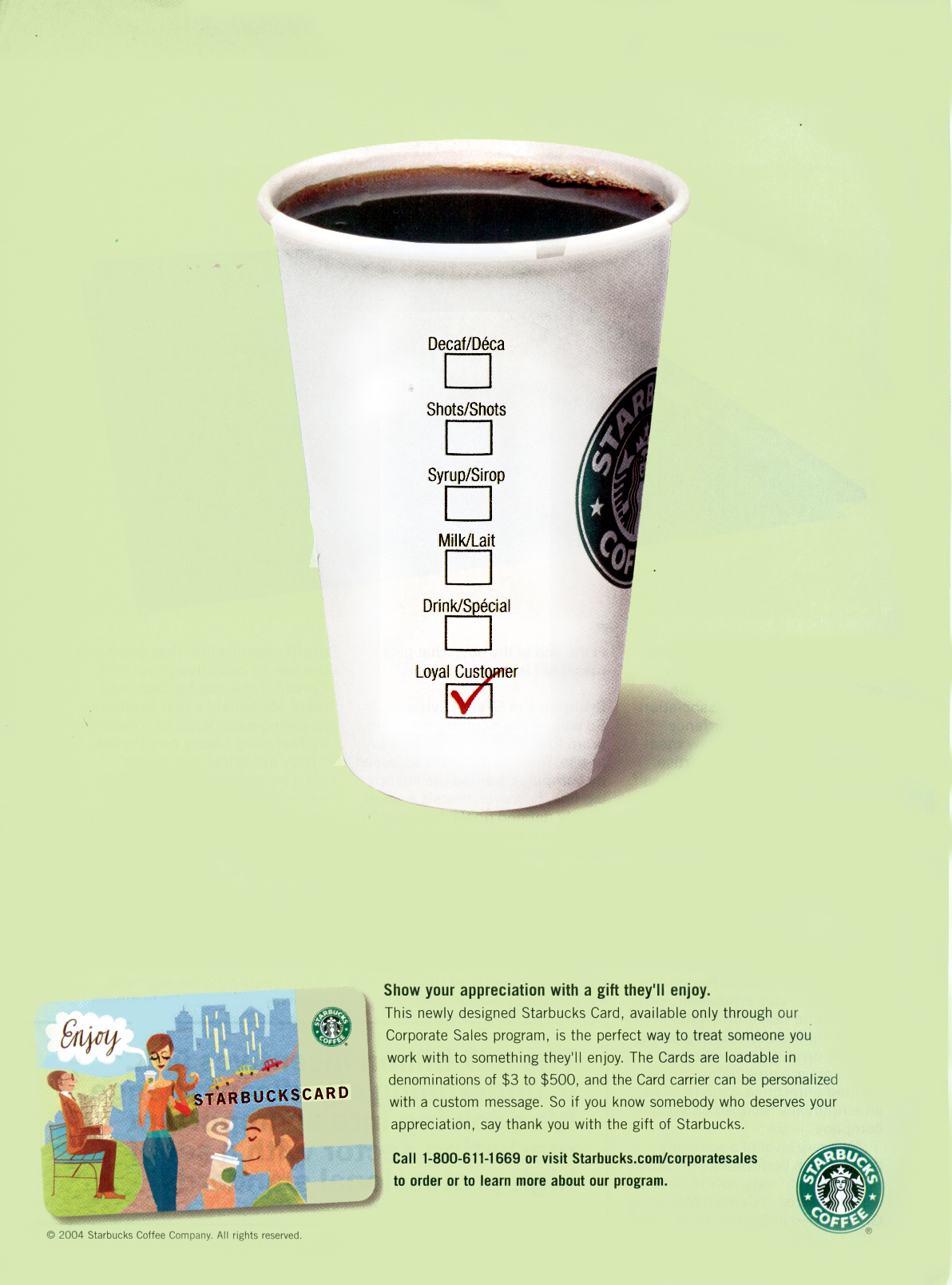
Market Penetration
2-28
Notes:
Summary Overview
Starbucks Corporation’s corporate sales program is a good example of market penetration. Starbucks practices market penetration in this ad by attempting to increase sales of the firm’s present products in its present markets. The company is also attempting to take customer relationship management to the next level.
Key Issues
The Starbucks Card which can be given away as a token of appreciation is an attempt to further penetrate the corporate market.
In doing so, it strengthens its relationship with its customers and increases the frequency of usage.
The card carrier can be personalized with a custom message.
Discussion Question: Can a company pursue a market penetration strategy and simultaneously pursue other types of opportunities (market development, product development, or diversification)?
This slide relates to material on p. 50.

Slide 29
Checking Your Knowledge
2-29
An electronics superstore sends a special coupon to its current customers offering them a special discount for purchases made during an upcoming week that occurs during a traditionally slow sales period. This is an example of:
A. market penetration.
B. market development.
C. product development.
D. diversification.
E. a breakthrough opportunity.
Notes:
ANSWER: A
Checking your knowledge (answer explanation):
Selection ‘A’ is the best option because the superstore is trying to increase the rate of sales of present products by current customers. This is the definition of market penetration. (p. 50)
This slide relates to material on p. 50.

Slide 30

Product Development
2-30
Courtesy of McNeil Consumer Healthcare.
Notes:
Summary Overview
Tylenol offers an improved product for its existing markets—Tylenol Extra Strength Rapid Release Gels.
Key Issues
Tylenol Extra Strength Rapid Release Gels work faster than Tylenol Arthritis Pain 650mg Caplets and contains only 500mg of pain reliever.
It starts working within 5 minutes. This can be attributed to the laser holes that are drilled into the side of each capsule so the capsule doesn't have to dissolve first.
Manufacturers, such as McNeil Consumer Healthcare, have ongoing new-product development processes to meet emerging needs.
Many manufacturers have accelerated their new-product development in recent years, including new packaging for improved customer convenience.
Service firms also practice “product” development, by offering new services.
Discussion Question: Can you provide an example of a service firm that practices “product” development?
This slide relates to material on pp. 50.

Slide 31
Product Development
2-31
Notes:
Mentholatum (US) has been doing business since 1899. In 1988, Japan’s ROHTO acquired The Mentholatum Company, Inc., a global manufacturer and marketer of consumer healthcare products. Today, the combined ROHTO group of companies have established operations in 13 major markets, with marketing/distribution agreements in more than 150 countries globally. This British ad, introducing ZI, is an example of product development—offering a new product (eye drops) for a new market (women 16-35).
Video Operation:
Use the onscreen player controls to operate the video.
To view the video at Full Screen, right-click the video and choose Full Screen. To go back to your presentation you can either hit the Escape key, right-click on the video and uncheck Full Screen, or type Alt+Enter. You can do this at anytime during the video playback.
Under certain circumstances, the video may not fill the video player window. To restore, right click the video player object and select Zoom 200%.
The videos will only play in Slide Show View. Macros must be enabled in order to play the videos from within PowerPoint.
This slide relates to material on p. 50.

Slide 32

International Opportunities Should Be Considered
2-32
Smaller World
Risks Involved
Competitive Advantage
Better Trends?
Early Start
Notes:
Summary Overview
In the ever-increasing interdependency of the global economy, marketing managers should consider international opportunities.
Key Issues
→The world is getting smaller:
Traditional barriers to international trade are improving in favor of more trade.
Telecommunications infrastructure is rapidly improving and expanding.
→Competitive advantage: Successful expansion into international markets can help drive down per unit manufacturing costs.
→Getting an early start in a new international market may be the key to long-term success for many firms.
→Marketers may also find better trends in international markets, because there may be more favorable combinations of variables affecting how well a firm competes.
→Risks are high in foreign markets.
Discussion Question: The percentage of cigarette smokers in the U.S. population has declined dramatically in the past several years. However, there is still industry growth in international markets. Why?
This slide relates to material on pp. 51-52.
→Indicates place where slide “builds” to include the corresponding point (upon mouse click).

Slide 33

Global Competitive Advantage
2-33
Notes:
Summary Overview
Adero helps companies develop a competitive advantage globally by addressing their networking and connectivity needs.
Key Issues
The Web is connecting consumers and business like never before:
Many Fortune 500 companies do a lion’s share of their business overseas;
Many foreign firms are strong players in the US market.
Discussion Question: What other firms help companies develop a competitive advantage overseas?
This slide relates to material on p. 52.

Slide 34
You should now be able to:
2-34
Understand what a marketing manager does.
Know what marketing strategy planning is—and why it is the focus of this book.
Understand target marketing.
Be familiar with the four Ps in a marketing mix.
Know the difference between a marketing strategy, a marketing plan, and a marketing program.
Notes:
You should now be able to:
Understand what a marketing manager does.
Know what marketing strategy planning is—and why it is the focus of the book.
Understand target marketing.
Be familiar with the four Ps in a marketing mix.
Know the difference between a marketing strategy, a marketing plan, and a marketing program.
This slide refers to material on p. 32.

Slide 35
You should now be able to:
2-35
Understand what customer lifetime value and customer equity are and why marketing strategy planners seek to increase them.
Be familiar with the text’s framework for marketing strategy planning..
Know four broad types of marketing opportunities that help in identifying new strategies.
Understand why strategies for opportunities in international markets should be considered.
Understand the important new terms.
Notes:
You should now be able to:
Understand what customer lifetime value and customer equity are and why marketing strategy planners seek to increase them.
Be familiar with the text’s framework for marketing strategy planning.
Know four broad types of marketing opportunities that help in identifying new strategies.
Understand why strategies for opportunities in international markets should be considered.
Understand the important new terms.
This slide refers to material on pp. 32.

Slide 36
Key Terms
2-36
marketing management process
strategic (management) planning
marketing strategy
target market
marketing mix
target marketing
mass marketing
channel of distribution
personal selling
customer service
mass selling
advertising
publicity
sales promotion
marketing plan
implementation
operational decisions
marketing program
Notes:
Summary Overview
These are key terms you should be familiar with based upon the material in this presentation.
Key Issues
Marketing management process: the process of (1) planning marketing activities, (2) directing the implementation of the plans, and (3) controlling these plans.
Strategic (management) planning: the managerial process of developing and maintaining a match between an organization’s resources and its market opportunities.
Marketing strategy: specifies a target market and a related marketing mix.
Target market: a fairly homogeneous (similar) group of customers to whom a company wishes to appeal.
Marketing mix: the controllable variables the company puts together to satisfy this target group.
Target marketing: a marketing mix that is tailored to fit some specific target customers.
Mass marketing: the typical production-oriented approach—vaguely aims at “everyone” with the same marketing mix.
Channel of distribution: any series of firms (or individuals) that participate in the flow of products from producer to final user or consumer.
Personal selling: direct spoken communication between sellers and potential customers.
Customer service: a personal communication between a seller and a customer who wants the seller to resolve a problem with a purchase.
Mass selling: communicating with large numbers of customers at the same time.
Advertising: any paid form of nonpersonal presentation of ideas, goods, or services by an identified sponsor.
Publicity: any unpaid form of nonpersonal presentation of ideas, goods, or services.
Sales promotion: promotion activities—other than advertising, publicity, and personal selling—that stimulate interest, trial, or purchase by final customers or others in the channel.
Marketing plan: a written statement of a marketing strategy and the time-related details for carrying out the strategy.
Implementation: putting marketing plans into operation.
Operational decisions: short-run decisions to help implement strategies.
Marketing program: blends all of the firm’s marketing plans into one “big” plan.
Customer equity: the expected earnings stream (profitability) of a firm’s current and prospective customers over some period of time.
This slide refers to boldfaced terms appearing in Chapter 2.

Slide 37
Key Terms
2-37
customer lifetime value
customer equity
breakthrough opportunities
competitive advantage
s.w.o.t. analysis
differentiation
market penetration
market development
product development
diversification
Notes:
Summary Overview
These are additional key terms you should be familiar with based upon the material in this presentation.
Key Issues
Breakthrough opportunities: opportunities that help innovators develop hard-to-copy marketing strategies that will be very profitable for a long time.
Competitive advantage: when a firm has a marketing mix that the target market sees as better than a competitor’s mix.
S.W.O.T. analysis: an aid which includes and lists the firm’s strengths and weaknesses and its opportunities and threats.
Differentiation: the marketing mix is distinct from and better than what is available from a competitor.
Market penetration: trying to increase sales of a firm’s present products in its present markets—probably through a more aggressive marketing mix.
Market development: trying to increase sales by selling present products in new markets.
Product development: offering new or improved products for present markets.
Diversification: moving into totally different lines of business—perhaps unfamiliar products, markets, or even levels in the production-marketing system.
This slide refers to boldfaced terms appearing in Chapter 2.

