Slide 1
Chapter 6
Business and Organizational Customers and Their Buying Behavior
Copyright © 2014 by The McGraw-Hill Companies, Inc. All rights reserved
Notes:
For use only with Perreault/Cannon/McCarthy or Perreault/McCarthy texts.
© 2014 McGraw-Hill Companies, Inc. McGraw-Hill/Irwin
CHAPTER SIX
Lecture Notes for
Basic Marketing 19e

Slide 2
At the end of this presentation, you should be able to:
6-2
Describe who the business and organizational buyers are.
See why business and organizational purchase decisions often involve multiple influences.
Understand the problem-solving behavior of organizational buyers, and how they get market information.
Understand the different types of buyer-seller relationships and their benefits and limitations.
Notes:
At the end of this lecture, you should be able to:
Describe who the business and organizational buyers are.
See why business and organizational purchase decisions often involve multiple influences.
Understand the problem-solving behavior of organizational buyers, and how they get market information.
Understand the different types of buyer-seller relationships and their benefits and limitations.
This slide refers to material on p. 144.

Slide 3
At the end of this presentation, you should be able to:
6-3
Know about the number and distribution of manufacturers and why they are an important customer group.
Know how buying by service firms, retailers, wholesalers, and governments is similar to—and different from—buying by manufacturers.
Understand important new terms.
Notes:
At the end of this lecture, you should be able to:
5. Know about the number and distribution of manufacturers and why they are an important customer group.
Know how buying by service firms, retailers, wholesalers, and governments is similar to—and different from—buying by manufacturers.
Understand important new terms.
This slide refers to material on p. 144.

Slide 4
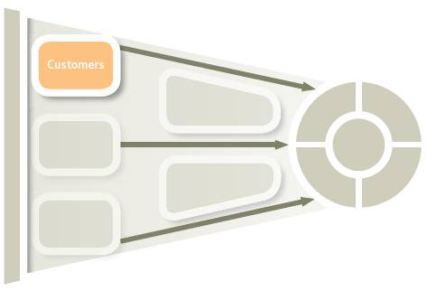
Understanding Business & Organizational Customers for Marketing Strategy Planning (Exhibit 6-1)
6-4
Chapter 5
Final Consumers
and Their Buying
Behavior
Chapter 6
Business and Organizational
Customers and Their Buying
Behavior
Key differences between
organizational customers
& final consumers
Purchase criteria &
specifications
Multiple buying influence
Problem-solving process
B2B e-commerce
Buyer-seller relationships
Key characteristics of specific
types of organizational
Customers
Manufacturers
Producers of services
Retailers & wholesalers
Government units
Notes:
Summary Overview
Specific aspects of organizational customers are considered in this chapter.
Key Issues
In Chapter 5, we focused on buying by final consumers.
Chapter 6 examines the buying behavior of business and organizational customers.
In this chapter, we explore the important ways that organizational buying tends to be different from buying by final consumers. We look at five factors that define differences between organizational customers & final consumers.
We also examine the key characteristics of four specific types of organizational customers.
Discussion Question: Can you think why the study of organizational customers is so different from that of final consumers?
This slide refers to material on pp. 144-145.
→ Indicates place where slide “builds” to include the corresponding point (upon mouse click).

Slide 5
Business and Organizational Customers – A Big Opportunity
6-5
Manufacturers
Farms, mines, etc.
Financial Institutions
Other providers
Producers
All Business & Organizational Customers
Wholesalers
Retailers
Intermediaries
Federal
State and Local
Government Units
National
Local
Nonprofits
Notes:
Summary Overview
Individual people make purchases to satisfy their needs, but so do organizations. In fact, the organizational market is actually bigger than the final consumer market, at least in terms of the number of purchases made. Thus, it presents significant opportunities for marketers.
Key Issues
The organizational consumer market is often referred to as the industrial market, or the business-to-business (B2B) market.
What type of customers are involved?
Business and organizational customers buy for resale or to produce other goods and services. There are four main categories of these customers:
Producers of goods and services: manufacturers, farmers, real estate developers, etc.
Discussion Question: What types of products might a manufacturer buy?
→ Intermediaries—wholesalers and retailers.
→ Government units, at the federal, state, and local levels, as well as foreign governments.
→ Nonprofit organizations, including both national and local organizations.
This slide refers to material on pp. 144.
→ Indicates place where slide “builds” to include the corresponding point (upon mouse click).

Slide 6
Business and Organizational Customers
6-6
Notes:
Video Clip: (2) Original Equipment Manufacturers (OEMs)
(Cummins Engine)
This clip highlights the many different customers of the Cummins Engine.
(video length 0:19)
Video Operation:
Use the onscreen player controls to operate the video.
To view the video at Full Screen, right-click the video and choose Full Screen. To go back to your presentation you can either hit the Escape key, right-click on the video and uncheck Full Screen, or type Alt+Enter. You can do this at anytime during the video playback.
Under certain circumstances, the video may not fill the video player window. To restore, right-click the video player object and select Zoom 200%.
The videos will only play in Slide Show View. Macros must be enabled in order to play the videos from within PowerPoint.
This slide refers to material on pp. 144-145.

Slide 7

Serving Small
Business
Customers
6-7
Notes:
Summary Overview
Marketers frequently aim their advertising and promotion at specific segments of the B2B market, as illustrated in this ad from Kyocera.
Key Issues
The ad’s message highlights the fact that the printing costs can be a headache for small businesses.
It also emphasizes a $2,000 rebate, which helps small business customers.
Discussion Question: How might the printing needs for a small business be different than the needs of a large company?
During the current economic downturn, watching marginal costs has become more important.
This slide relates to material on p. 144.

Slide 8

Organizational Customers Are Different
6-8
Notes:
Summary Overview
There are important differences between how businesses and organizations make purchase decisions and how individual consumers make those decisions.
Key Issues
Most organizations buy for a basic purpose: they buy goods and services that will help them meet the demand for the goods and services that they in turn supply to their markets.
Basic purchasing needs are economic. Organizational buyers are usually less emotional in their buying behavior than are final consumers. They usually focus on economic needs, such as increasing sales, when making buying decisions. In today’s online shopping environment, intelligent search tools can help online sellers improve sales.
Promotion to organizational buyers often focuses on economic factors. This Applied Discovery ad, targeted at data aggregators, promises to double a customer’s productivity by reducing risks and offering uniquely customizable e-discovery solutions.
Small differences are important. Every organization has a unique identity and the differences between organizations are important. Marketers must never assume that a marketing mix that is successful for one company will automatically fit the needs of other companies—even in the same industry.
Discussion Question: Salespeople in companies that are successful at marketing to organizations are often trained to detect and authorized to act on subtle company differences when making on-site visits. If you were a sales representative calling on a B2B customer, how might you observe these small differences?
There are good opportunities to serve business customers in different countries. Business customers are often willing to work with distant suppliers who have developed superior marketing mixes.
This slide relates to material on pp. 145-146.

Slide 9
Serving International Markets
6-9
Notes:
Like the market for individual consumers, internationalization is prevalent in the B2B market. As an example, this ad for FedEx focuses on serving customers in international markets.
Regarding customers in international markets, marketers must understand national and cultural differences.
Video Operation:
Use the onscreen player controls to operate the video.
To view the video at Full Screen, right-click the video and choose Full Screen. To go back to your presentation you can either hit the Escape key, right-click on the video and uncheck Full Screen, or type Alt+Enter. You can do this at anytime during the video playback.
Under certain circumstances, the video may not fill the video player window. To restore, right-click the video player object and select Zoom 200%.
The videos will only play in Slide Show View. Macros must be enabled in order to play the videos from within PowerPoint.
This slide refers to material on pp. 146.

Slide 10

Specifications and Quality
6-10
Specifications Describe the Need
Quality Certification
- ISO 9000
Notes:
Summary Overview
Unlike the individual consumer market, organizational buyers tend to focus more on quality and exacting purchase specifications.
Key Issues
→ Purchasing specifications—written or electronic descriptions of what the firm wants to buy.
The specifications describe the needs that organizational buyers have.
Specifications may be fairly simple, or they may be very detailed.
Discussion Question: How can specifications help a buyer to distinguish among the offerings of various potential suppliers when doing a vendor analysis?
→ Organizational buyers often concentrate on quality certification in making purchases.
ISO 9000 is a way for a supplier to document its quality procedures according to internationally recognized standards.
This slide refers to material on pp. 146-147.
→ Indicates place where slide “builds” to include the corresponding point (upon mouse click).

Slide 11
Multiple Influence and Roles in the Buying Center
6-11
Buyers
Users
Buying
Center
Influencers
Gatekeepers
Deciders
Notes:
Summary Overview
Organizations differ from individual consumers in their buying behavior.
Key Issues
Purchasing managers are specialists in buying activities for their employers.
Multiple buying influence: several people play a part in making a purchase decision.
The collection of these influences is a buying center:
→ Buyers—the purchasing managers who are responsible for working with suppliers and arranging for the terms of the sale.
→ Users—the people who will actually use the product. They may be production workers or support staff.
→ Influencers—people whose expertise is used to help determine which products are needed. Influencers are often technical people who help write specifications.
Gatekeepers—people in key positions in the organization who control the flow of information. Gatekeepers can include receptionists, secretaries, researchers, and others.
Discussion Question: Why is it important for marketers to establish a good rapport with gatekeepers when selling or marketing to organizations?
→ Deciders—the people in the organization who have the power to select or approve the supplier.
Marketers must identify and market to every buying center member.
The members of the buying center may change from purchase to purchase.
This slide refers to material on pp. 147-150.
→ Indicates place where slide “builds” to include the corresponding point (upon mouse click).

Slide 12
Checking Your Knowledge
6-12
Consuela Velasquez is a receptionist for a group of seven physicians. As she controls the calendars for the physicians, any sales representatives from pharmaceutical companies wanting to call on the physicians have to go through Consuela. As a result, it is very important for sales reps to cultivate a good relationship with her. In the buying center, Consuela would be best described as a:
A. buyer.
B. user.
C. influencer.
D. gatekeeper.
E. decider.
Notes:
ANSWER: D
Checking your knowledge (answer explanation):
In the above question, Consuela is best described as a gatekeeper — a person who controls the flow of information within the organization. The best answer selection is ‘D’.
This slide relates to material on p. 148.

Slide 13
Checking Your Knowledge
6-13
Ahmed Jamison is a purchasing specialist for a large company. He has the authority to execute purchase orders or amounts up to $100,000. On a purchase order for a higher amount, Ahmed arranges the terms of sale, but the transaction has to be approved by the company president. In the buying center for a purchase in excess of $100,000, Ahmed is a _________ and the president is a _________:
A. buyer; influencer.
B. influencer; buyer.
C. buyer; decider.
D. gatekeeper; decider.
E. user; influencer.
Notes:
ANSWER: C
Checking your knowledge (answer explanation):
The “buyer” is the purchasing manager(s) who has the responsibility for working with suppliers and arranging the terms of the sale. The “decider” is the person in the organization who has the power to select or approve the supplier. In the above question for purchases in excess of $100,000, Ahmed would be considered the buyer and the company president would be considered the decider since he/she makes the final approval on the sale. The best answer selection is ‘C’.
This slide relates to material on p. 148.

Slide 14

Evaluating Organizational Buying Influences
6-14
Vendor Analysis Considers All Influences
Behavioral Needs Are Important Too
Ethical Conflicts May Arise
Purchasing May Be Centralized
Notes:
Summary Overview
Although most buyers in organizational markets are professionals, a comprehensive vendor analysis considers all influences on purchase decisions.
Key Issues
→ Vendor analysis is a formal rating of suppliers on all relevant areas of performance.
The goal of a vendor analysis is to lower the total costs of a purchase.
→ A buyer’s behavioral needs are relevant, too.
Example: if a buyer’s main contact with the supplier is through a sales representative who is uncooperative, the supplier is less attractive to the buyer.
→ Ethical conflicts may arise in buyer-supplier relationships.
Some organizations have provisions in their codes of conduct governing these interactions.
Discussion Question: Is there anything wrong with a buyer accepting a gift from a potential supplier while a vendor analysis is underway? Is there a difference between accepting a lunch invitation and accepting an expensive watch?
→ Purchasing may also be centralized in many organizations by concentrating the purchasing for all branches at one location.
This may help the buying organization to manage spending or achieve economies of scale.
Requisition: a request to buy something; it eventually becomes a purchase order. Electronic requisitions are becoming more popular.
This slide refers to material on pp. 149-151.
→ Indicates place where slide “builds” to include the corresponding point (upon mouse click).

Slide 15
Overlapping Needs of Individual Influencers and the Customer Organization (Exhibit 6-2)
6-15
Risk
Innovation
Job security
Survival
Comfort
Customer
satisfaction
Individual’s
needs
Overlap in needs
Company’s needs
Career
advancement
Growth
Money/rewards
Profit
Other needs
Other needs
Notes:
Summary Overview
A seller’s marketing mix should satisfy both the needs of the customer company and the needs of individuals who influence the purchase.
Key Issues
When making buying decisions, buyers focus on company needs for innovation, survival, growth and profit.
On the other hand, buyer’s are people working in organizations. They are also concerned about their own careers and personal interests.
A seller’s marketing mix should satisfy both the needs of the company and the needs of the individual buyers.
This slide refers to material on pp. 150
→ Indicates place where slide “builds” to include the corresponding point (upon mouse click).

Slide 16
Organizational Buying Processes
(Exhibit 6-3)
6-16
Characteristics
Type of Process
New-Task
Buying
Modified
Rebuy
Straight
Rebuy
Time required
Much
Medium
Little
Multiple influence
Much
Some
Little
Review of suppliers
Much
Some
None
Information needed
Much
Some
Little
Notes:
Summary Overview
Like individual consumers, organizational buyers are problem-solvers. In organizational problem-solving, three kinds of buying processes are useful.
Key Issues
New-task buying occurs when a customer organization has a new need and wants a great deal of information. New-task buying often involves:
setting product specifications;
evaluating sources of supply; and
establishing an order routine to follow in the future.
→ A straight rebuy is a routine repurchase that uses existing suppliers to fill a standard order.
→ A modified rebuy is the in-between process. Some review of the buying process is done but not as much as in a new-task buy.
Discussion Question: If you were selling to an organization, which of the three buying processes would present the easiest opportunity to make a sale? Why? Which buying process would present the greatest challenge? Why?
Straight rebuys often use e-commerce order systems.
New-task buying requires information.
This slide refers to material on pp. 152-153.
→ Indicates place where slide “builds” to include the corresponding point (upon mouse click).

Slide 17
Major Sources of Information Used by Organizational Buyers (Exhibit 6-4)
6-17
Marketing sources
Nonmarketing sources
Salespeople
Others from suppliers firm
Trade shows
Buying centre members
Outside business associates
Consultants and outside experts
Personal Sources
Online events and virtual trade shows
Sales literature and catalogs
Emails & newsletters
Web site content including blogs, videos, case studies, & white papers
Online searches
Rating services
Trade associations
News publications
Product directories
Online communities
Impersonal
Sources
Notes:
Summary Overview
A new-task buy starts with a user who becomes aware of a need and begins researching solutions. This exhibit lists the sources available for the business buyers.
Even though a wide variety of information sources are available business buyers will use the sources they trust. To build trust, a marketer must make sure its information is reliable.
Key Issues
One source of information comes from the marketing firm. This includes personal information that comes from talking to the selling firm’s personnel.
In addition, the firm produces information that appears in print form on paper or online.
Buyers will also turn to sources of information outside the direct control of the seller. These can be personal sources or
Impersonal sources.
This slide refers to material on pp. 152.
→ Indicates place where slide “builds” to include the corresponding point (upon mouse click).

Slide 18
New-Task Buying Requires Information
6-18
Search Engines
Web sites
New-Task
Buying
Requires
Information
Competitive Bids
Online Communities
Notes:
Summary Overview
New-task buying situations provide a good opportunity for a new supplier to make inroads with a customer.
Key Issues
→ Search engines — a first step to gather information.
→ Buyers want sites with useful content.
→ Buyers share experiences in online communities.
→ Buyers ask for competitive bids to compare offerings:
When buyers in B2B markets have identified potential suppliers, they might ask them to submit a competitive bid — the terms of sale offered by the supplier in response to the purchase specifications posted by a buyer.
Buyers make important decisions about how to deal with one or more suppliers.
A buyer might want to rely on competition among all available vendors to get the best price on each and every order it places.
A buyer might just routinely buy from one vendor with whom it already has a good relationship.
This slide refers to material on pp. 152-154.
→ Indicates place where slide “builds” to include the corresponding point (upon mouse click).

Slide 19
Checking Your Knowledge
6-19
Nikita Jackson, a sales representative for an industrial supply house, calls on a prospective business customer. The customer has an established relationship with another supplier, but says that there have been some reliability problems with deliveries. Nikita seizes the opportunity to describe her company’s state-of-the-art logistics and transportation system that provides outstanding delivery reliability at low shipping costs. Nikita is encouraged because her customer seems to be in a ___________ situation.
A. straight rebuy
B. modified rebuy
C. new-task
D. extensive problem-solving
E. limited problem-solving
Notes:
ANSWER: B
Checking your knowledge (answer explanation):
In the above question, Nikita’s customer appears to be in a modified rebuy situation. A modified rebuy is in-between new-task buying and a straight rebuy. It is a process where some review of the buying situation is done—though not as much as in new-task buying. This modified rebuy situation appears to be an opportunity for Nikita. Although the customer has been purchasing from another supplier, the buyer is now receptive to information from Nikita. The best answer selection is ‘B’.
This slide relates to material on p. 152.

Slide 20
Checking Your Knowledge
6-20
Auto parts wholesaler Fixem, Inc. decides to invest in a new data management system to increase the efficiency of its warehouse operations. Previously, all record-keeping was done via printed documents, but now all transactions will be electronic. This change will require Fixem to expend a significant amount of money for hardware, software, and training. However, in the long run, the cost savings should exceed the up-front investment. Fixem has arranged for presentations to be made by three different vendors. Fixem seems to be facing a ______________ buying situation.
A. straight rebuy
B. modified rebuy
C. new-task
D. extensive problem-solving
E. limited problem-solving
Notes:
ANSWER: C
Checking your knowledge (answer explanation):
New-task buying occurs when an organization has a new need and the customer wants a great deal of information. In the above question, Fixem is investing in a new data management system (a new need) and they want to hear presentations from three different vendors. Fixem appears to be facing a new-task buying situation. The best answer selection is ‘C’.
This slide relates to material on pp. 152.

Slide 21
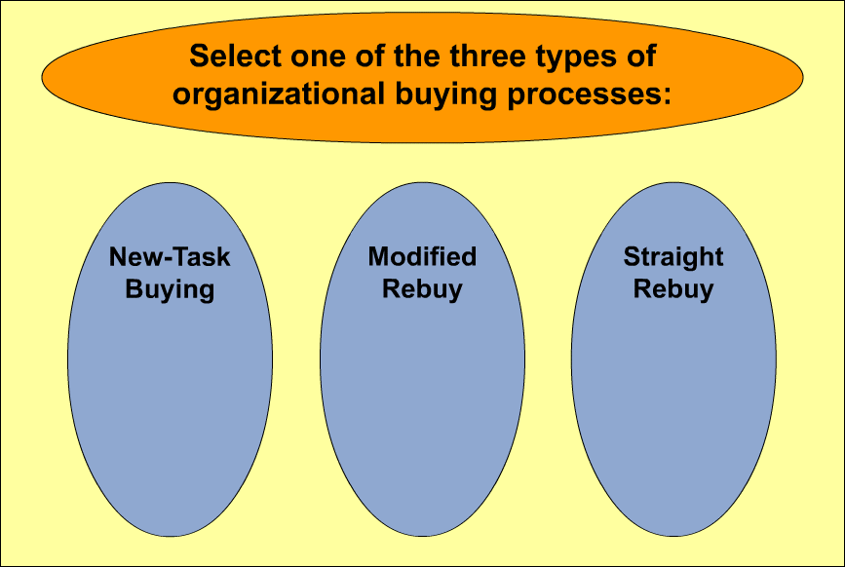
Interactive Exercise:
Organizational Buying
6-21
Notes:
The purpose of this exercise is to help students extend their conceptual knowledge of the new-task buying, modified rebuy, and straight rebuy organizational buying situations. For each type of buying situation, students are shown three descriptions of business-to-business purchase scenarios. Students are then challenged to identify the example that best represents the particular buying situation being studied.
For complete information and suggestions on using this Interactive Exercise, please refer to the “Notes on the Interactive Exercise” section for this chapter in the Multimedia Lecture Support Package to Accompany Basic Marketing. That same information is available as a Word document in the assets folder for the PowerPoint file.
This slide refers to material on pp. 152.

Slide 22
Buyer-Seller Relationships in Business Markets
6-22
Close Relationships
May Produce
Mutual Benefits
Relationships May
Not Make Sense
Mutual trust
Long-term outlook
Share tasks at lower total cost
Reduced flexibility
Some purchases are too small or infrequent
Some purchases require much special attention
BUT
Notes:
Summary Overview
Relationships between buyers and sellers in the B2B market may be casual, “arm’s length” relationships, or they can be close, long-lasting partnerships. Marketers should know the degree of closeness that is appropriate for a given relationship.
Key Issues
Close relationships between buyers and sellers may produce mutual benefits.
The best relationships involve real partnerships where there’s mutual trust and a long-term outlook.
Closely tied firms often share tasks at lower total cost than would be possible working at arm’s length.
Discussion Question: What factors would contribute to the development of a close partnership between a buyer and seller in the B2B market?
→ Close relationships may not make sense.
They can reduce a buyer’s flexibility and leverage.
Some purchases are simply too small or too infrequent.
Some purchases require so much special attention that the relationship would never be profitable for the seller.
This slide refers to material on pp. 154-155.
→ Indicates place where slide “builds” to include the corresponding point (upon mouse click).

Slide 23
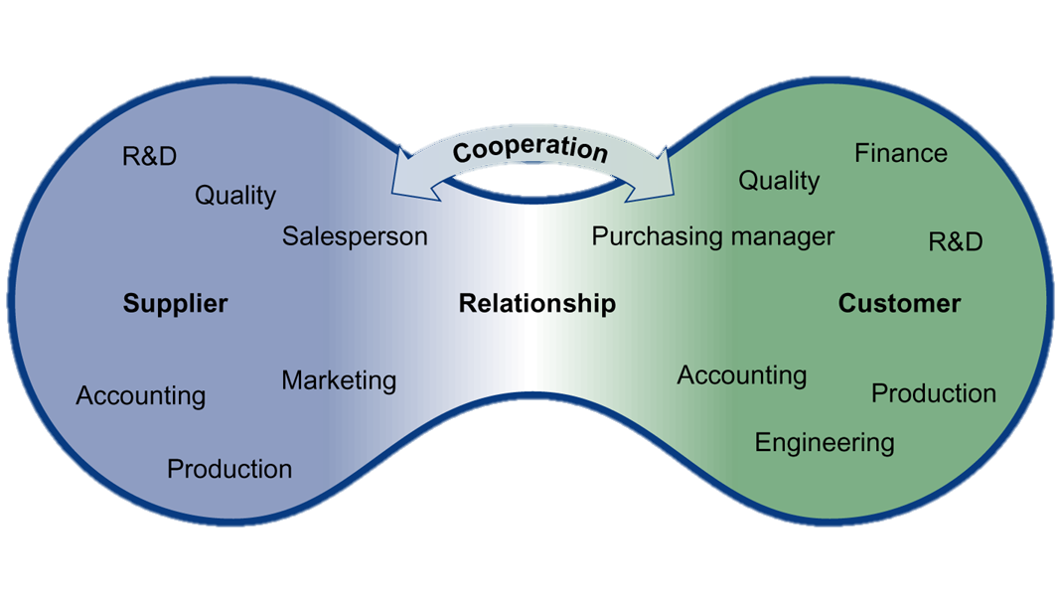
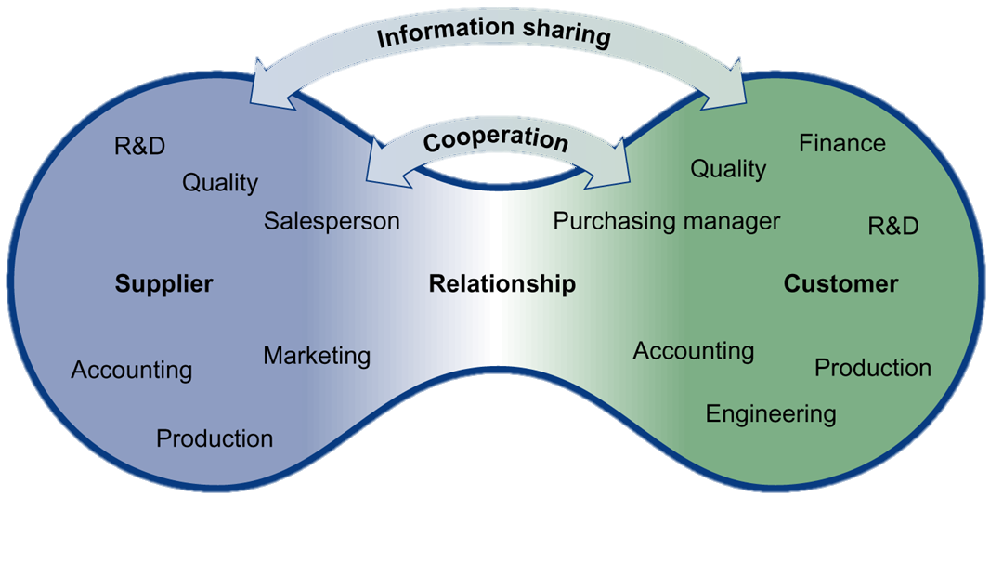
Relationships Have Many Dimensions (Exhibit 6-5)
6-23
Notes:
Summary Overview
There are several key dimensions that characterize a close working relationship between organizational buyers and sellers.
Key Issues
Cooperation treats problems as joint responsibilities.
The buyer and seller work together to achieve both mutual and individual objectives.
Both sides are involved in problem resolution.
Both the supplier and the buyer benefit when they can share information. Types of shared information may include:
It includes the exchange of proprietary cost data, discussion of demand forecasts, and joint work on new product designs.
It is fast and easy to update the information.
It saves time.
It can lead to better decisions, reduced uncertainty about the future, and better planning.
Even though shared information is useful, it may be risky if there is a possibility that one of the partners will misuse it.
Discussion Question: If you represented an organizational buyer, what types of information might you be reluctant to share with a supplier? If you represented a supplier, what types of information might you be reluctant to share with a buyer?
This slide refers to material on pp. 156-157.

Slide 24
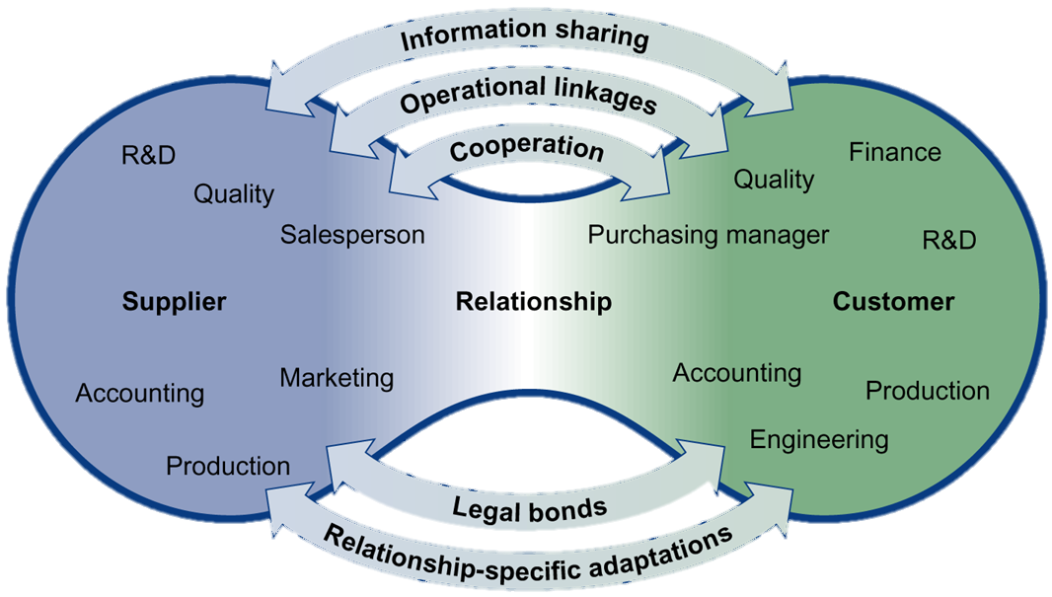
Relationships Have Many Dimensions (Exhibit 6-5)
6-24
Notes:
Summary Overview
Aside from cooperation and information sharing, there are other key dimensions of close buyer-seller relationships in the B2B market.
Key Issues
Operational linkages are direct ties between the internal operations of the buyer and seller firms. These linkages usually involve ongoing coordination of activities between the firms.
Just-in-time delivery: reliably getting products there just before the customer needs them.
This arrangement reduces inventory and carrying costs, especially for the buyer.
Discussion Question: Wal-Mart, a major retailer, has a direct computer connection to Procter and Gamble, a manufacturer, to speed up order and delivery of P&G’s products. How does this move the relationship toward a straight rebuy situation?
Legal bonds, such as contracts, spell out the obligations of each party in the relationship.
Negotiated contract buying: agreeing to a contract that allows for changes in the purchase arrangements.
This method is preferred when it is difficult or impossible to specify all that is needed on a particular project in advance.
Relationship-specific adaptations invest in the relationship.
These adaptations involve changes in a firm’s product or procedures that are unique to the needs or capabilities of a relationship partner.
Specific adaptations are usually made when the buying organization chooses to outsource—contract with an outside firm to produce goods or services rather than to produce them internally.
This slide refers to material on pp. 156-157.
→ Indicates place where slide “builds” to include the corresponding point (upon mouse click).

Slide 25
Relationship Dimensions
6-25
Notes:
Cargill “Florence” commercial:
Close buyer-seller relationships can help both buyers and sellers. In this advertising campaign, Cargill wants to communicate to its customers that by working closely with them it is helping them to succeed.
Discussion Question: Which relationship dimensions do you think Cargill is emphasizing in this commercial?
Video Operation:
Use the onscreen player controls to operate the video.
To view the video at Full Screen, right-click the video and choose Full Screen. To go back to your presentation you can either hit the Escape key, right-click on the video and uncheck Full Screen, or type Alt+Enter. You can do this at anytime during the video playback.
Under certain circumstances, the video may not fill the video player window. To restore, right-click the video player object and select Zoom 200%.
The videos will only play in Slide Show View. Macros must be enabled in order to play the videos from within PowerPoint.
This slide refers to material on pp. 154-157.

Slide 26
Relationship Dimensions
6-26
Notes:
Cargill “Chocolate” commercial :
Close buyer-seller relationships can help both buyers and sellers. In this advertising campaign, Cargill wants to communicate to customers that by working closely with them it is helping them to succeed.
Discussion Question: How does Cargill create value for its customers?
Video Operation:
Use the onscreen player controls to operate the video.
To view the video at Full Screen, right-click the video and choose Full Screen. To go back to your presentation you can either hit the Escape key, right-click on the video and uncheck Full Screen, or type Alt+Enter. You can do this at anytime during the video playback.
Under certain circumstances, the video may not fill the video player window. To restore, right-click the video player object and select Zoom 200%.
The videos will only play in Slide Show View. Macros must be enabled in order to play the videos from within PowerPoint.
This slide refers to material on pp. 154-157.

Slide 27
Checking Your Knowledge
6-27
Gotcha! is a chain of trendy stores catering to the urban contemporary market. As part of its close relationship with suppliers, Gotcha! has an Internet site that is accessible only by suppliers, and it provides up-to-the minute point-of-sale information from all of the Gotcha! stores. Suppliers can see how their products are doing at retail during any time of the day or night. In the relationship between Gotcha! and its suppliers, the Gotcha! supplier site is an example of:
A. information sharing.
B. legal bonds.
C. reciprocity.
D. operational linkages.
E. negotiated contracts.
Notes:
ANSWER: A
Checking your knowledge (answer explanation):
Some relationships involve open sharing of information. This might include exchanges of proprietary cost data, discussion of demand forecasts, etc. The relationship between Gotcha! and its suppliers is one in which information is shared via the Gotcha! Internet site. The best answer selection for this question is ‘A’.
This slide relates to material on pp. 156.

Slide 28

Dynamics of Buyer-Seller Relationships
6-28
Powerful Customer May Control the Relationship
Buyers May Use Several Sources to Spread Risks
Buying Varies by Customer Type
Notes:
Summary Overview
In addition to the five main dimensions of buyer-seller relationships in the B2B market, there are other dynamics that can affect the overall relationship.
Key Issues
There may be an imbalance of power favoring one of the partners.
→ A powerful customer may control the relationship
Although a marketing manager may want to work in a cooperative partnership, that may be impossible with large customers who have the power to dictate how the relationship will work.
→ Buyers may still use several sources to reduce their risk.
Buyers often look for several dependable sources of supply to protect themselves from unpredictable events.
→ Variations in buying by customer type.
This slide refers to material on pp. 158-159.
→ Indicates place where slide “builds” to include the corresponding point (upon mouse click).

Slide 29

Manufacturers Are Important Customers
6-29
Not Many Big Ones
Clustered in Geographic Areas
NAICS Codes
Business Data Classifies Industries
Notes:
Summary Overview
Manufacturers are important organizational buyers because a relatively small number account for a large proportion of organizational buying.
Key Issues
In the U. S. and in other countries, there are relatively few manufacturers compared to the number of final consumers.
→ There are not many big ones.
In the U. S., over half of the manufacturers have less than 10 workers.
Discussion Question: Why would it make sense for marketers to segment manufacturing consumers by size?
→ Customers cluster in geographic areas.
In the U. S., manufacturers are concentrated in the big metropolitan areas—especially in New York, Pennsylvania, Ohio, Illinois, Texas, and California.
There is concentration by industry too.
→ Business data often classifies industries.
The products an industrial customer needs to buy depend on the business it is in.
Because of this, sales of a product are often concentrated among customers in similar businesses.
Marketing managers must focus their marketing mixes on prospective customers who exhibit characteristics similar to their current customers.
North American Industry Classification System (NAICS) codes: groups of firms in similar lines of business.
This slide refers to material on pp. 159-160.
→ Indicates place where slide “builds” to include the corresponding point (upon mouse click).

Slide 30
Illustrative NAICS Code Breakdown for Apparel Manufacturers (Exhibit 6-7)
6-30
Construction (23)
Manufacturing (31)
Retail
(44)
others…
Food (311)
Apparel (315)
Leather (316)
others…
Knitting Mills (3151)
Cut & Sew Apparel (3152)
Apparel accessories (3159)
others…
Men’s & boys’ (31522)
Women’s & girls’ (31523)
Other cut & sew (31529)
others…
Lingerie (315231)
Blouses (315232)
Dresses (315233)
others…
Notes:
Summary Overview
This exhibit contains an example of how the NAICS codes apply to the apparel industry.
Key Issues
The broadest category is the general industry category. Manufacturing, for example, has a two-digit NAICS code of 31.
→ Adding a digit to the manufacturing code narrows the industry definition to apparel — code 315.
→ The industry definition gets narrower if another digit is added to the code, in this case, cut and sew apparel, code 3152.
→ Adding still another digit reduces the category to women’s and girls’ cut and sew apparel, NAICS code 31523.
→ Finally, a sixth digit narrows the industry definition to blouses, NAICS code 315232.
Knowing the appropriate NAICS code for an industry opens the door to a wide range of government and privately compiled information, such as lists of companies, trade publication articles, and industry-wide statistics.
This slide refers to material on pp. 161.
→ Indicates place where slide “builds” to include the corresponding point (upon mouse click).

Slide 31






Producers of Services — Smaller and More Spread Out
6-31
Car Repair
Medical Services
Legal Services
Housekeeping
Services
Library
Service
Small Service
Buyers
Buying May Not Be Formal
Notes:
Summary Overview
Service producers are more geographically dispersed than are manufacturers. In the U. S., this segment of the economy is large and growing fast.
Key Issues
There are about 4.6 million service firms in the U. S.
Some of these firms have names that are widely recognized.
Many of the service providers are quite small.
These service firms are also dispersed over a wide geographic area.
→ Because of their small size, many service firms have buying that may not be as formal as in larger organizations.
Many of these buyers need more help in making their purchases than do the purchasing managers in a large company.
Small service customers like Internet buying.
Discussion Question: What types of products or services might be purchased by the types of service providers illustrated on this slide?
This slide refers to material on pp. 161.
→ Indicates place where slide “builds” to include the corresponding point (upon mouse click).

Slide 32

Retailers & Wholesalers Buy for Their Customers
6-32
Committee Buying Is Impersonal
Reorders Are Straight Rebuys
Buyers Watch Computer Output Closely
Notes:
Summary Overview
Retailers and wholesalers see themselves as purchasing agents for their target customers. Retailers buy what they think they can profitably sell to final consumers.
Key Issues
Committee buying assigns the buying decision to a committee that reviews reports submitted by the buyer.
Committee buying is impersonal.
→ Computers track inventory, sales, and prices. Buyers watch this computer output closely.
→ Many reorder decisions are made automatically via computer links to suppliers.
Reorders are straight rebuys.
Discussion Question: What types of valuable information could a salesperson give a buyer?
This slide refers to material on pp. 162-163.
→ Indicates place where slide “builds” to include the corresponding point (upon mouse click).

Slide 33

The Government Market
6-33
Size and Diversity
FCPA
Competitive Bids
Foreign Governments
“Approved” Supplier List
Government Wants
Notes:
Summary Overview
Government buyers typically use competitive bidding and approved supplier lists, and put legal constraints on the latitude of individual buyers.
Key Issues
→ The size and diversity of the government market make it an attractive target.
→ Government buyers are restrained by purchasing regulations, and competitive bids may be required.
Discussion Question: What is the objective in requiring competitive bids and exacting specifications?
→ For routine purchases, a government unit can prepare an approved supplier list.
→ Government publications help marketers to learn what government wants to buy.
→ In dealing with foreign governments, information is less available, and there may be significant obstacles that favor a domestic supplier.
→ Is it unethical to buy help in dealing with foreign governments?
Not in some countries.
→ In the U. S., the Foreign Corrupt Practices Act (FCPA) prohibits U.S. firms from paying bribes to foreign officials.
This slide refers to material on pp. 163-165.
→ Indicates place where slide “builds” to include the corresponding point (upon mouse click).

Slide 34
You should now be able to:
6-34
Describe who the business and organizational buyers are.
See why business and organizational purchase decisions often involve multiple influences.
Understand the problem-solving behavior of organizational buyers, and how they get market information.
Understand the different types of buyer-seller relationships and their benefits and limitations.
Notes:
At the end of this lecture, you should be able to:
Describe who the business and organizational buyers are.
See why business and organizational purchase decisions often involve multiple influences.
Understand the problem-solving behavior of organizational buyers, and how they get market information.
Understand the different types of buyer-seller relationships and their benefits and limitations.
This slide refers to material on pp. 144.

Slide 35
You should now be able to:
6-35
Know about the number and distribution of manufacturers and why they are an important customer group.
Know how buying by service firms, retailers, wholesalers, and governments is similar to—and different from—buying by manufacturers.
Understand important new terms.
Notes:
At the end of this lecture, you should be able to:
5. Know about the number and distribution of manufacturers and why they are an important customer group.
Know how buying by service firms, retailers, wholesalers, and governments is similar to—and different from—buying by manufacturers.
Understand important new terms.
This slide refers to material on pp. 144.

Slide 36
Key Terms
6-36
business and organizational customers
purchasing specifications
ISO 9000
purchasing managers
multiple buying influence
buying center
vendor analysis
requisition
new-task buying
straight rebuy
modified rebuy
competitive bid
just-in-time delivery
negotiated contract buying
outsource
North American Industry Classification System (NAICS) codes
Foreign Corrupt Practices Act
Notes:
Summary Overview
These are key terms you should be familiar with based upon the material in this presentation.
Key Issues
Business and organizational customers: any buyers who buy for resale or to produce other goods and services.
Purchasing specifications: a written or electronic description of what a firm wants to buy.
ISO 9000: a way for a supplier to document its quality procedures according to internationally recognized standards.
Purchasing managers: buying specialists for their employers.
Multiple buying influence: several people share in making a purchase decision--perhaps even top management.
Buying center: all the people who participate in or influence a purchase.
Vendor analysis: formal rating of suppliers on all relevant areas of performance.
Requisition: a request to buy something.
New-task buying: when an organization has a new need and the buyer wants a great deal of information.
Straight rebuy: a routine repurchase that may have been made many times before.
Modified rebuy: the in-between process where some review of the buying situation is done — though not as much as in new-task buying or as little as in straight rebuys.
Competitive bid: terms of sale offered by different suppliers in response to the buyer's purchase specifications.
Just-in-time delivery: reliably getting products there just before the customer needs them.
Negotiated contract buying: agreeing to a contract that allows for changes in the purchase arrangements.
Outsource: contract with an outside firm to produce goods or services rather than to produce them internally.
North American Industry Classification System (NAICS) codes: codes used to identify groups of firms in similar lines of business.
Foreign Corrupt Practices Act: a law passed by the U.S. Congress in 1977 that prohibits U.S. firms from paying bribes to foreign officials.
This slide refers to boldfaced terms appearing in Chapter 6.

