Slide 1
Chapter 8
Elements of Product Planning for Goods and Services
Copyright © 2014 by The McGraw-Hill Companies, Inc. All rights reserved
Notes:
For use only with Perreault/Cannon/McCarthy or Perreault/McCarthy texts.
© 2014 McGraw-Hill Companies, Inc. McGraw-Hill/Irwin
CHAPTER EIGHT
Lecture Notes for
Basic Marketing 19e

Slide 2
At the end of this presentation, you should be able to:
8-2
Understand what “Product” really means.
Know the key differences between goods and services.
Understand what branding is and how to use it in strategy planning.
Understand the importance of packaging in strategy planning.
Understand the role of warranties in strategy planning.
Notes:
At the end of this presentation, you should be able to:
1. Understand what “Product” really means.
2. Know the key differences between goods and services.
3. Understand what branding is and how to use it in strategy planning.
Understand the importance of packaging in strategy planning.
Understand the role of warranties in strategy planning.
This slide refers to material on p. 198.

Slide 3
At the end of this presentation, you should be able to:
8-3
Know the differences among various consumer and business product classes.
Understand how product classes can help a marketing manager plan marketing strategies.
Understand important new terms.
Notes:
At the end of this presentation, you should be able to:
Know the differences among various consumer and business product classes.
Understand how product classes can help a marketing manager plan marketing strategies.
Understand important new terms.
This slide refers to material on p. 198.

Slide 4
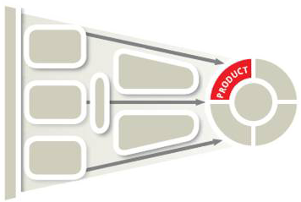
Product Decisions for Marketing Strategy Planning (Exhibit 8-1)
8-4
Notes:
Summary Overview
Having looked at a numbers of critical factors in the development of marketing strategy, we now look at the first of the four Ps: Product.
Key Issues
Once a firm has examined its external market environment, company, competitors and customers, and understands its segmentation, targeting, differentiation and positioning, it is ready to start developing its marketing mix.
Here, we start with Product.
This slide refers to material on p. 199.

Slide 5
Product Decisions for Marketing Strategy Planning (Exhibit 8-1)
8-5
Chapter 8 Elements of Product Planning for Goods & Services
Chapter 9
Product Management & New-Product Development
Product idea
Branding
Packaging
Warranty
Product classes
Notes:
Summary Overview
Chapter 8 introduces Product Planning, while Chapter 9 will cover Product Management & New-Product Development.
Key Issues
What is a product? Product means the need-satisfying offering of a firm.
Discussion Question: Why should the main focus of the product area be on consumers?
→ The product idea encompasses many attributes of a physical good or service: its features, benefits, and quality level, as well as its accessories, installation requirements, and instructions. Any product must also be positioned relative to the other offerings of the organization in its product line.
Branding is a key product strategy area. Marketers need to decide what types of brands they wish to produce.
The package is more than just a means of protecting the product. It can help to promote the product or enhance its use.
Marketers must decide if they want to offer product warranties, and if they do, how extensive the warranties will be.
The type of consumer (product class) that will use it determines if a product is a consumer or business product.
This slide refers to material on p. 199.
→ Indicates place where slide “builds” to include the corresponding point (upon mouse click).

Slide 6
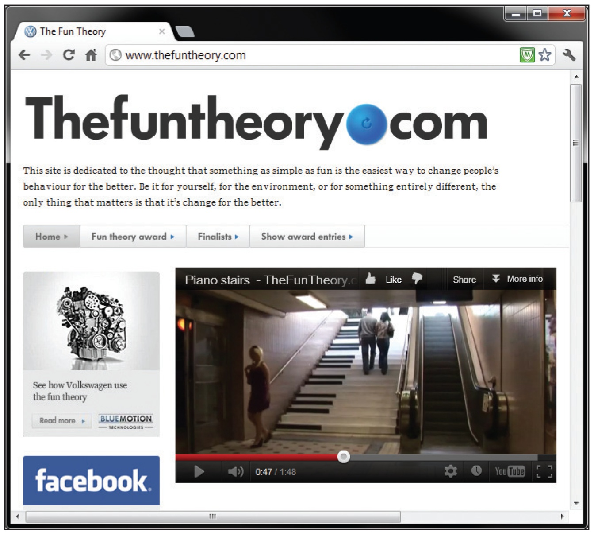
Product Quality and Customer Needs
8-6
Notes:
Summary Overview
From a marketing perspective, quality means a product’s ability to satisfy a customer’s needs or requirements.
Key Issues
Quality may be absolute or relative, but in all cases the customer’s expectations for quality in a given product form the basis for determining how to achieve customer satisfaction.
When Volkswagen introduced its environmentally friendly Bluemotion Technology cars, the idea that it can be fun to do the right thing was showcased.
The ‘fun/doing the right thing’ idea is then tied to Volkswagen’s green technology, and eco-friendly cars.
Discussion Question: Is Volkswagen’s Bluemotion Technology add quality to the product if a consumer doesn’t really care about fuel efficiency or the environment?
This slide relates to material on pp. 199.

Slide 7
Examples of Possible Blends of Physical Goods and Services in a Product (Exhibit 8-2)
8-7
Canned soup, steel pipe, paper towels
Restaurant meal, cell phone, automobile tune-up
Satellite radio, hair styling, postal service
100% physical good emphasis
100% service emphasis
Blend of physical
good and service
Notes:
Summary Overview
A product can be a physical good or an intangible service, or it can be a blend of both.
Key Issues
This diagram shows how one can position products in terms of their physical good emphasis or their service emphasis.
Some products, such as canned soup, steel pipe, and paper towels, have an emphasis that is almost completely physical.
Other products have a significant service component, such as a restaurant meal, a cellular phone, or an automobile tune-up.
Still other products have an emphasis mainly on the service component, such as an satellite radio, a hair stylist, or a postal service.
Consumers are increasingly demanding more services with the goods they buy. Both the physical good and the service make up the total product the customer buys.
Discussion Question: Why does the increased demand for more service make product management more difficult?
This slide refers to material on pp. 201.
→ Indicates place where slide “builds” to include the corresponding point (upon mouse click).

Slide 8
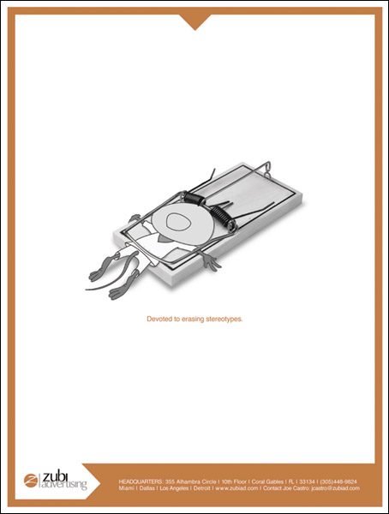
Differences in
Goods and
Services
8-8
Notes:
Summary Overview
Since both products and services make up the total product, a distinction between them is not usually necessary. But in fine-tuning a product’s position, recognizing the differences between physical products and pure services can aid marketers in planning. This ad, run in an Advertising Age Marketing to Hispanics Special Report, is for Zubi Advertising. Zubi is not attempting to sell a product, but a service. Key questions marketers must answer about services include:
Key Issues
How tangible is the product? Goods have a physical existence (tangible). Services are deeds performed for a customer (intangible).
Where the product is produced? Goods are typically mass-produced in a factory far away from the customer. A service is usually produced in person—where the customer is located—after the customer has committed to buy.
Quality consistency: Quality control measures are in place at most factory locations. Satisfaction of customers and whether they recommend a service to their friends is often influenced by interactions with the service firm’s employees.
How perishable is it? Services cannot be stored or transported to another location for sale.
Discussion Question: How does perishability influence the promotion and pricing of residential service providers, such as chimney sweeps and painting contractors, who have highly seasonal businesses?
This slide relates to material on pp. 201-203.

Slide 9
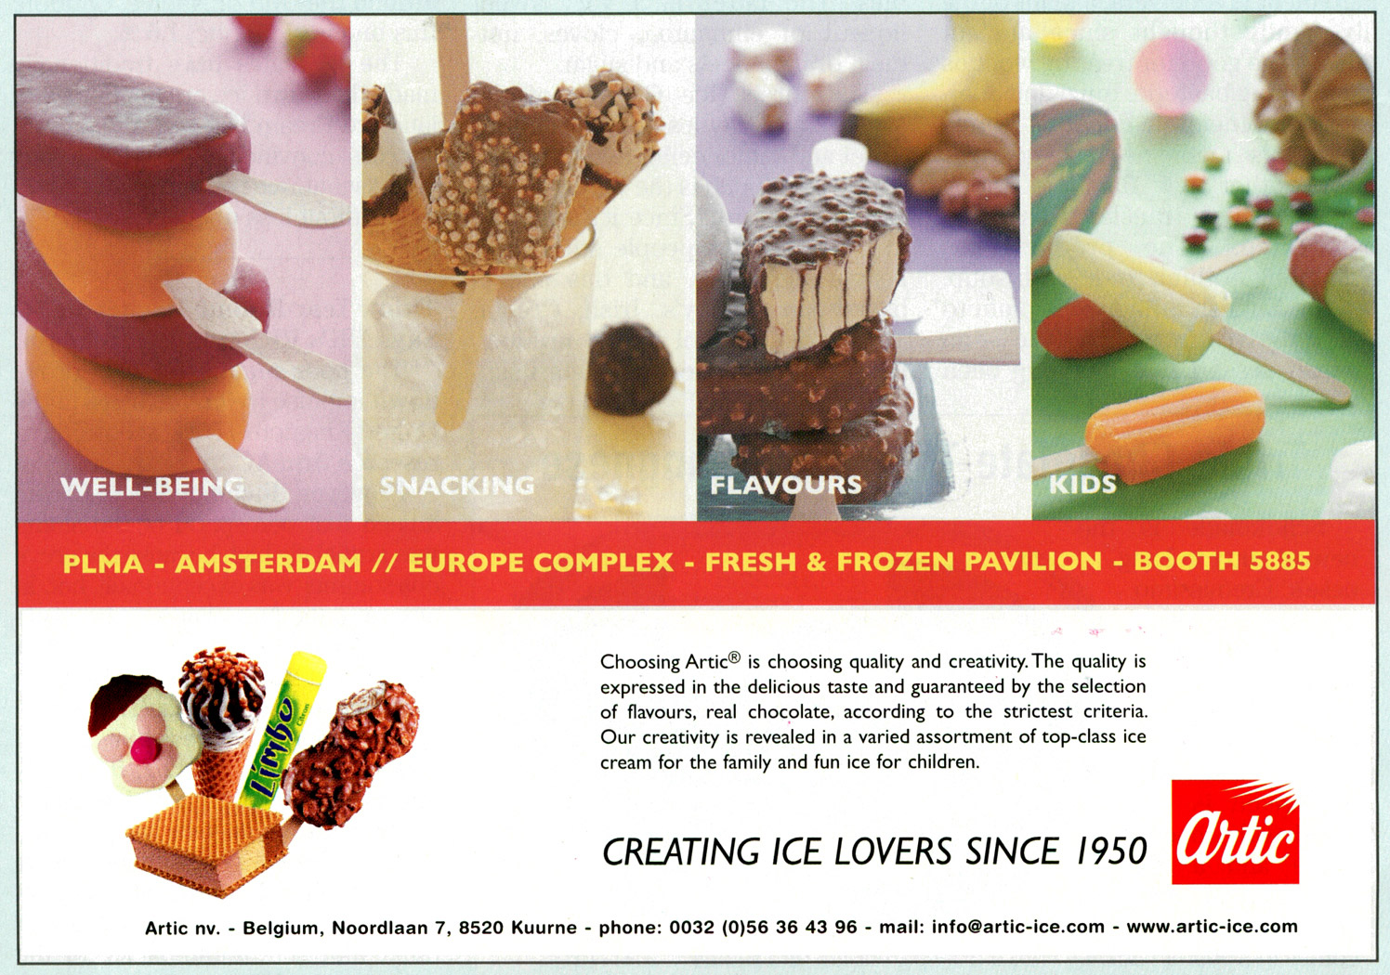
Whole Product Lines Must Be Developed Too
8-9
Notes:
Summary Overview
There are many different product arrangements within organizations, depending upon the number of products offered and how diverse the offerings are.
Key Issues
A product assortment is the set of all product lines and individual products that a firm sells.
In this ad, Artic is advertising a wide product assortment.
A product line is a set of individual products that are closely related.
They may be related because they are produced or operate in a similar way.
They may be sold to the same target market, through similar types of outlets, or they may be similarly priced.
An individual product is a particular product within a product line.
It is usually differentiated by brand, level of service offered, price, or some other characteristic.
Each individual product and target market may require a separate strategy.
Discussion Question: Think about Sony, an electronics manufacturer. Can you describe its: a.) product assortment; b.) product lines; and c.) individual products?
This slide relates to material on pp. 203.

Slide 10
Product Assortment, Product Line, or Individual Product?
8-10
Notes:
Dunkin’ Donuts’ product assortment is the set of all the product lines and individual products that the firm sells. Its product lines include donuts and coffees. An individual product is a particular product within a product line, for example each size, flavor, and type of coffee. Dunkaccino is an individual product, within the coffee product line, which is part of Dunkin Donuts’ product assortment.
Video Operation:
Use the onscreen player controls to operate the video.
To view the video at Full Screen, right-click the video and choose Full Screen. To go back to your presentation you can either hit the Escape key, right-click on the video and uncheck Full Screen, or type Alt+Enter. You can do this at anytime during the video playback.
Under certain circumstances, the video may not fill the video player window. To restore, right-click the video player object and select Zoom 200%.
The videos will only play in Slide Show View. Macros must be enabled in order to play the videos from within PowerPoint.
This slide refers to material on pp. 203.

Slide 11
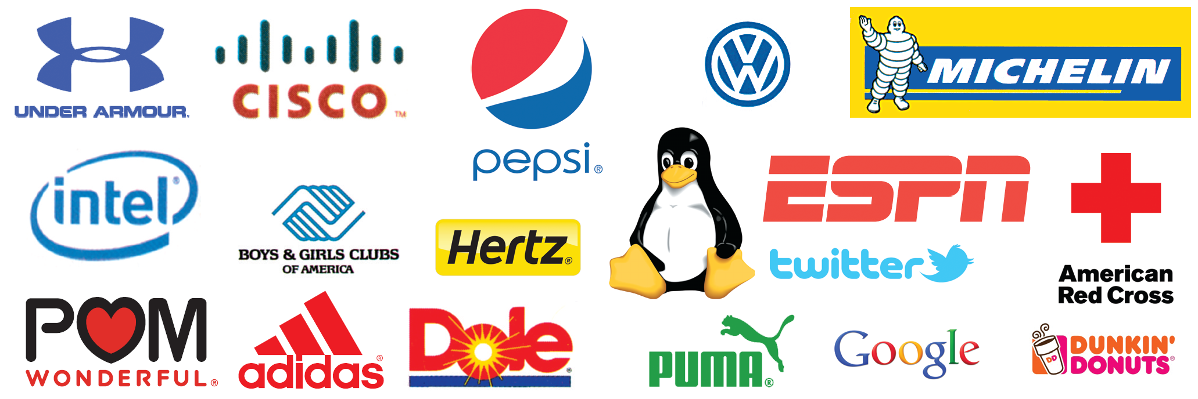
Recognized Trademarks and Symbols Help in Promotion (Exhibit 8-3)
8-11
Notes:
Summary Overview
What is branding? Branding means the use of a name, term, symbol, or design to identify a product. Some companies use a combination of some or all of these when branding. This exhibit shows many familiar brands.
Key Issues
A brand name is a word, letter, or a group of words or letters.
A trademark includes only those words, symbols, or marks that are legally registered for use by a single company.
A service mark is a trademark that refers to a service offering.
Discussion Question: Can you provide other examples of brand names, trademarks, or service marks?
Brands meet needs. For example, brands make shopping easier, because consumers can identify levels of quality with specific products and shorten the time needed for information search.
Branding also helps marketers, because it can:
reduce selling time and cost;
improve the company’s image.
This slide refers to material on pp. 204-205.

Slide 12
Conditions Favorable to Branding
8-12
Product quality and best value
Easy to label and identify
Dependable, widespread availability
Key
Issues
Favorable shelf or display space
Market price can be high
Economies of scale
Notes:
Summary Overview
There are several conditions favorable to successful branding.
Key Issues
The product is easy to label and identify by brand or trademark.
The product quality is easy to maintain and is the best value for the price.
Dependable and widespread availability is possible.
Demand is strong enough that the market price can be high enough to make the branding effort profitable.
There are economies of scale. If branding is really successful, costs should drop and profits should increase.
Favorable shelf locations or display space in stores will help.
In general, these conditions are less common in less-developed economies.
Discussion Question: Consider a product category that has popular, easy-to-recall brand names (such as soft drinks, computers, or automobiles), compared to a product category for which brand names are difficult to remember (file folders, nails, electric extension cords, or something similar). How do the two product categories match up on the six conditions favorable to successful branding?
This slide refers to material on p. 205.
→ Indicates place where slide “builds” to include the corresponding point (upon mouse click).

Slide 13
Achieving Brand Familiarity Is Not Easy
8-13
Brand
Insistence
Brand
Preference
Brand
Recognition
Brand Non-
Recognition
Brand Rejection
Notes:
Summary Overview
Brand familiarity means how well customers recognize and accept a company’s brand.
Key Issues
Five levels of brand familiarity are useful for strategy planning:
Brand rejection means that potential customers won’t buy a brand unless its image is changed.
→ Brand nonrecognition means final consumers don’t recognize a brand at all, even though middlemen may use it for identification and inventory control.
Brand recognition means that customers remember the brand.
Discussion Question: A supermarket may hold 20,000 different products and many varieties of a single type of product. In this environment, why is it so critical to achieve brand recognition?
→ Brand preference means that target customers usually choose the brand over other brands.
→ Brand insistence means customers insist on a firm’s branded product and are willing to search for it.
This slide refers to material on pp. 206-207.
→ Indicates place where slide “builds” to include the corresponding point (upon mouse click).

Slide 14
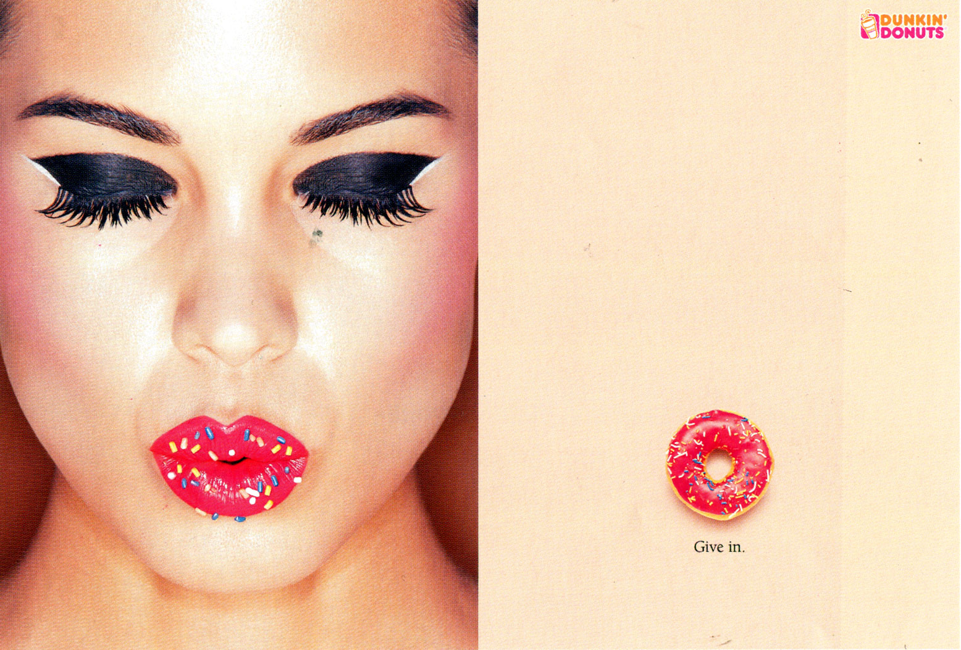
Brand Familiarity
8-14
Notes:
Summary Overview
It takes time and money to build brand awareness.
Key Issues
Dunkin' Donuts is an international donut and coffee retailer.
It is a major player in the food and beverage industry.
It is one of the world's largest coffee and baked goods chain.
Discussion Question: What other aspects of the marketing mix other than advertising might be useful in generating brand recognition, preference, or insistence?
This slide relates to material on pp. 206.

Slide 15
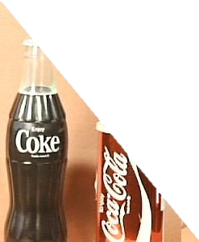
Characteristics of a Good
Brand Name (Exhibit 8-4)
8-15
Short & Simple
Easy to Spell & Read
Easy to Recognize & Remember
Easy to Pronounce
Can Pronounce in Only One Way
Can Pronounce in All Languages
Suggests Product Benefits
Adapts to Packaging/Labeling Needs
No Undesirable Imagery
Always Timely
Adapts to Any Advertising Medium
Legally Available for Use
Notes:
Summary Overview
There are several characteristics of a good brand name. Some successful brand names are exceptions to all or many of these guidelines, but many of them originated when they faced little competition.
Key Issues
Among the characteristics of a good brand name are the following:
Short and simple.
Easy to spell and read.
→ Easy to recognize and remember.
Easy to pronounce.
→ Can be pronounced in only one way.
Can be pronounced in all languages.
→ Suggests product benefits.
Adapts to packaging and labeling needs.
→ No undesirable imagery.
Always timely.
→ Adapts to any advertising medium.
Legally available.
Discussion Question: Think of a popular brand name. How does it measure up on these characteristics of a good brand name?
A respected name builds brand equity—the value of the brand’s overall strength in the market.
This slide refers to material on pp. 207-208.
→ Indicates place where slide “builds” to include the corresponding point (upon mouse click).

Slide 16
A Good Brand Name?
8-16
Notes:
AFLAC has become one of the most familiar brand names in the U.S., even though it identifies a business service—business insurance. The use of clever, humorous ads has helped to accelerate the progression of the brand through the stages of brand familiarity. Which of the characteristics of a good brand name does AFLAC possess?
Video Operation:
Use the onscreen player controls to operate the video.
To view the video at Full Screen, right-click the video and choose Full Screen. To go back to your presentation you can either hit the Escape key, right-click on the video and uncheck Full Screen, or type Alt+Enter. You can do this at anytime during the video playback.
Under certain circumstances, the video may not fill the video player window. To restore, right-click the video player object and select Zoom 200%.
The videos will only play in Slide Show View. Macros must be enabled in order to play the videos from within PowerPoint.
This slide refers to material on pp. 208.

Slide 17

Protecting Brand Names & Trademarks
8-17
Lanham Act
You Must Protect
Your Own
Counterfeiting Is Accepted In Some Cultures
Notes:
Summary Overview
Registering brand names and trademarks is important because it means that no one else can use them without specific authorization from the owner.
Key Issues
U. S. common law and civil law protect the rights of trademark and brand name owners.
The Lanham Act (1946) spells out what kinds of marks (including brand names) can be protected and the exact method of protecting them.
→ A brand can be a real asset to a company, but each company must protect its own.
If a brand becomes a generic descriptive word for a product category, protection is lost and the brand becomes public property.
Discussion Question: Why do the makers of Kleenex, Q-Tips, Band-Aids, and other widely used brand names refer to their products as, for example, “Band-Aid brand adhesive bandages,” instead of just Band-Aids?
→ Even if brands are registered, counterfeiting is accepted in some cultures, especially in developing nations. Many popular branded products, such as Levi’s jeans and Rolex watches, have been copied without authorization. Weak regulation in many developing countries makes it difficult for companies to protect their brands from counterfeits.
This slide refers to material on pp. 208-209.
→ Indicates place where slide “builds” to include the corresponding point (upon mouse click).

Slide 18
What Kind of Brand to Use?
8-18
Family Brand
Licensed Brand
Brand
Choices
Generic “Brand”
Individual Brand
Notes:
Summary Overview
In developing a product concept, a marketing manager must consider the different possible approaches for branding.
Key Issues
A family brand is the same brand name used for several products, such as Sunkist, which appears on fresh fruit, juice, vitamins, and soft drinks.
Using a family brand is a good approach if the individual products are of a similar quality.
→ A special case of family branding is a licensed brand, a well-known brand that sellers pay a fee to use.
→ Individual brands may be used for outside and inside competition.
When a company makes very unrelated products that require a separate identity to avoid confusion, developing individual brands for each can be a good idea.
Some companies develop several versions of a product such as toothpaste, each with a unique position in the market.
Discussion Question: Proctor and Gamble markets many individual brands of laundry detergent. Aside from differentiating the products, what other advantages are there to having so many individual brands in a product category?
Generic “brands” are products that have no brand at all other than the identification of their contents.
They can be important, low-cost alternatives for consumers, such as in the market for prescription drugs.
This slide refers to material on p. 209.
→ Indicates place where slide “builds” to include the corresponding point (upon mouse click).

Slide 19
Licensing
8-19
Notes:
This video clip highlights the licensing of the Louisville Slugger Brand.
(video clip length 3:31)
Video Operation:
Use the onscreen player controls to operate the video.
To view the video at Full Screen, right-click the video and choose Full Screen. To go back to your presentation you can either hit the Escape key, right-click on the video and uncheck Full Screen, or type Alt+Enter. You can do this at anytime during the video playback.
Under certain circumstances, the video may not fill the video player window. To restore, right-click the video player object and select Zoom 200%.
The videos will only play in Slide Show View. Macros must be enabled in order to play the videos from within PowerPoint.
This slide refers to material on pp. 209.

Slide 20
Who Should Do the Branding?
8-20
Manufacturer
Brands
Dealer Brands
Battle of the Brands
Also called national brands
Created/owned by producers
Also called private brands or private labels
Created/owned by intermediaries
Notes:
Summary Overview
In addition to the type of brand, the brand’s creation and ownership are also part of the overall product strategy.
Key Issues
Manufacturer brands are brands created by producers.
Manufacturer brands are sometimes called national brands because of their wide appeal.
→ Dealer brands are also called private brands.
Intermediaries, such as wholesalers and retailers, create these brands.
→ The “battle of the brands” is a competition between manufacturer and dealer brands.
Many retailers have expanded the lines of products sold under their store brands, while reducing the amount of space given to manufacturer brands.
Discussion Question: Think about a recent trip you made to a grocery store or discount drugstore. Can you think of specific ways in which dealers position their brands against comparable manufacturer brands?
Who’s winning the battle of brands? The big winner is the consumer, who benefits from greater choice and more intense price competition.
This slide refers to material on pp. 210-211.
→ Indicates place where slide “builds” to include the corresponding point (upon mouse click).

Slide 21
Checking Your Knowledge
8-21
Target’s “Cherokee” brand of men’s clothing is available only at Target stores. The brand provides a low-cost alternative to other men’s fashions available at department stores and via catalogs. The Cherokee brand is a(n):
A. manufacturer brand.
B. dealer brand.
C. licensed brand.
D. national brand.
E. generic brand.
Notes:
ANSWER: B
Checking your knowledge (answer explanation):
Dealer brands are brands created by intermediaries. The Cherokee brand available only at Target stores is an example of the dealer brand. The best answer selection is ‘B’.
This slide relates to material on pp. 210.

Slide 22
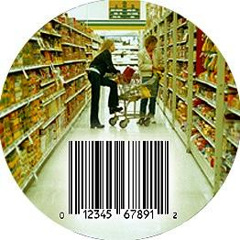
Packaging Promotes,
Protects, and Enhances
8-22
Packaging Can Enhance the Product
Packaging Sends a Message
Packaging Can Lower Distribution Costs
Notes:
Summary Overview
Packaging involves promoting, protecting, and enhancing the product. Good packaging makes products easier to identify and promotes the brand.
Key Issues
Packaging can enhance the product. Packaging can do more than contain and protect the product. The package can make the product easier to use or safer to use. Packaging can deter shoplifting and it can also be designed to achieve ecological objectives.
Packaging sends a message. Creative use of design in packaging can visually help to tie the product to other elements of the promotion mix. Packages also convey information, such as the nutritional information on food products. The package can also promote the brand at the point of purchase or in use.
Packaging may lower distribution costs. Good packages save space and weight so they are easier to transport, handle, and display. In helping distributors and end-sale retailers, good packages are more welcome by these intermediaries.
Discussion Question: Do you have any favorite products that never seem to get scanned at a checkout counter? How much more time does it take to hand enter the code? Could time savings lead to lower costs? How can packages be re-designed to make them easier to scan?
This slide refers to material on pp. 211-212.
→ Indicates place where slide “builds” to include the corresponding point (upon mouse click).

Slide 23
Ways Packaging Benefits Consumers and Marketers
8-23
Protecting
Promoting
Enhancing
Benefits
Notes:
Summary Overview
Good packaging makes products easier to identify and promotes the brand at the point of purchase and even in use.
Key Issues
Few factors to be considered are:
Promoting
Link product to promotion
Branding at point of purchase or consumption
Product information
→ Protecting
For shipping and storing
From tampering
From shoplifting
From spoiling
→ Enhancing
The environment
Convenience in use
Added product functions
This slide refers to material on pp. 212.
→ Indicates place where slide “builds” to include the corresponding point (upon mouse click).

Slide 24
What Is Socially Responsible Packaging?
8-24
Federal Fair Packaging and Labeling Act
Packaging
Can Hurt Environment
Ethical Decisions Remain
Socially Responsible Packaging Issues
Notes:
Summary Overview
In determining what is socially responsible packaging, marketers are helped somewhat by the clarity of legal regulations. However, other issues require them to make ethical judgments.
Key Issues
Packaging can hurt the environment. Ecological concerns are becoming more prominent in packaging decisions.
Producers have been criticized for developing packages that harm the environment.
Others contend that manufacturers do not disclose all of the possible harmful effects of their products.
→ The Federal Fair Packaging and Labeling Act (1966) requires that consumer goods be clearly labeled in easy-to-understand terms, to give consumers more information. The law also calls on industry to try to reduce the number of package sizes and to make labels more useful.
→ Ethical issues remain, and examples of such issues are easy to find.
Some companies have been accused of designing packages that conceal downsized products.
Dealer-branded products are often packaged to look very similar to manufacturer brands.
Discussion Question: Have you ever purchased products and thought that the packaging wasted resources? Which ones?
This slide refers to material on pp. 212-213.
→ Indicates place where slide “builds” to include the corresponding point (upon mouse click).

Slide 25
Checking Your Knowledge
8-25
Heinz has a new ketchup bottle that has the cap on the bottom, instead of the top. The bottle uses gravity to help the consumer get every last drop of ketchup out of the bottle. The cap is also designed to pour cleanly, so that dried ketchup does not accumulate around the opening. This new bottle demonstrates how packaging can:
A. promote product.
B. protect the product.
C. lower distribution costs.
D. incorporate UP codes.
E. enhance product usage.
Notes:
ANSWER: E
Checking your knowledge (answer explanation):
In the above question, Heinz has redesigned the ketchup bottle to enhance product usage. The placement of the cap on the bottom allows for a clean pour and complete usage of all the product (little waste left in the bottle). The best answer selection is ‘E’.
This slide relates to material on pp. 212.

Slide 26

Warranty Policies Are a Part of Strategy Planning
8-26
Promises in Writing
Magnuson-Moss Act
Service Guarantees
May Improve Marketing Mix
Notes:
Summary Overview
A warranty puts the seller’s promises about a product in writing. A marketing manager should decide whether to offer a warranty and if so, what the warranty will cover and how it will be communicated to target customers.
Key Issues
→ The Magnuson-Moss Act (1975) says that producers must provide a clearly written warranty if they choose to offer any warranty. The warranty does not have to be strong.
→ Warranties may improve the marketing mix. A warranty says that the company stands behind the product.
This fact is reassuring to customers and can make a big difference in whether customers buy the product, especially if the product is complex or expensive.
Discussion Question: For which products would the terms of the warranty be a key factor in determining whether or not you would buy the product? Do marketers of these products emphasize their warranties in promotion?
→ Backing up a product or service with service guarantees helps consumers focus on specific levels of satisfaction and expectations.
Service guarantees are becoming more common but there’s more risk in offering a service guarantee than a warranty on a physical product.
This slide refers to material on pp. 213-214.
→ Indicates place where slide “builds” to include the corresponding point (upon mouse click).

Slide 27
Checking Your Knowledge
8-27
McDonald’s announced that at select locations, if drive-through customers do not get exactly what they want within two minutes of placing the order, their next meal will be free. This promise by McDonald’s is a good example of a(n):
A. service guarantee.
B. warranty.
C. unit price.
D. limited warranty.
E. no-fault insurance policy.
Notes:
ANSWER: A
Checking your knowledge (answer explanation):
McDonald’s promise of a two-minute delivery time in the drive-through is a service guarantee. If the food is not delivered correctly within two minutes of placing the order, the next meal is free. The best answer selection is ‘A’.
This slide relates to material on pp. 214.

Slide 28
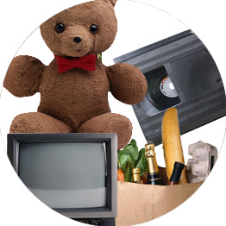

Product Classes Help Plan Marketing Strategies
8-28
Consumer Products
Business Products
Notes:
Summary Overview
Developing product strategies is simplified somewhat because some product classes require similar marketing mixes. Understanding the product classes is a useful strategic starting point.
Key Issues
Consumer products are products meant for the final consumer.
Business products are products meant for use in producing other products.
It is possible that some products might be in both groups.
Discussion Question: Have you ever been to a warehouse club, such as Sam’s or Costco? Business and final consumers often purchase the same items there. How might their purchases be different?
Selling the same product to final consumers and business customers requires (at least) two different strategies.
This slide refers to material on pp. 214-215.
→ Indicates place where slide “builds” to include the corresponding point (upon mouse click)

Slide 29
Consumer Product Classes
8-29
Staples
Convenience Products
Impulse
Emergency
Homogeneous
Shopping Products
Heterogeneous
Specialty Products
New Unsought
Unsought Products
Regularly Unsought
Notes:
Summary Overview
Consumer product classes are based on how consumers think about and shop for products:
Key Issues
Convenience products are purchased quickly with little effort. They may be inexpensive, bought often, require little service or selling, and bought by habit.
Staples are bought often, routinely, and without much thought. Branding is used for many staples to make them easier to remember and find.
→ Impulse products are bought quickly, as unplanned purchases, because of a strongly felt need. They may be strongly affected by the immediate situation.
Emergency products are purchased immediately when the need is great. Consumers don’t shop around for these products or ask how much they cost.
→ Shopping products are compared with competing products.
Homogeneous shopping products are ones that the customer sees as basically the same and wants at the lowest price.
→ Heterogeneous shopping products are seen as different in quality and/or suitability.
→ Specialty products are ones that the consumer really wants, because there are no acceptable substitutes. They are characterized by the consumer’s willingness to search.
→ Unsought products need promotion; they are those that customers don’t want yet or don’t know that they can buy.
New unsought products represent ideas potential customers don’t know about yet.
→ Regularly unsought products are ones that don’t motivate customers to seek them out, even though they may need them.
Discussion Question: Can you provide an example of each product class?
This slide refers to material on pp. 215-217.
→ Indicates place where slide “builds” to include the corresponding point (upon mouse click).

Slide 30

One Product May Be Seen in Several Ways
8-30
Notes:
Summary Overview
It is possible that consumers may see a single product in several ways.
Key Issues
This fish could be a convenience good for someone as wealthy as Bill Gates who has a salt water aquarium in his outer office or waiting room.
The fish could be a shopping good for the owner of a salt water aquarium who is on a tighter budget.
Discussion Question: Under what circumstances would the fish be: a.) a homogeneous shopping good; b.) a heterogeneous shopping good?
The fish could be a specialty good for a salt water aquarium that must have this particular type of fish and will accept no substitute.
Like so many other concepts in marketing, product classes need to be viewed from the standpoint of the consumer, not of the manager.
This slide refers to material on pp. 217.

Slide 31
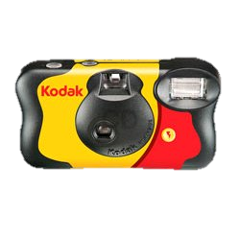
Classifying consumer products
8-31
Ingrid Stevenson decided to take her boyfriend to a “water amusement park” as a birthday present. She also wanted to take pictures so that he’d remember the day, but didn’t want her expensive digital camera to get wet near the pools, slides, and water rides. So, she decided she would also give him a disposable camera at the start of the day--although she didn’t want to spend more than $20 on top of what the park tickets cost. Ingrid didn’t know much about disposable cameras, but she went in the University Camera Shop and asked the salesperson for advice about what to buy that would meet her budget, make pictures of reasonable quality, and hopefully work in the water. He recommended that she buy a waterproof Kodak model that came with high speed film and would even work for underwater shots.
Homogeneous Shopping Products
Staples
New Unsought Products
Impulse Products
Heterogeneous Shopping Products
Regular Unsought Products
Emergency Products
Specialty Products
Notes:
Summary Overview
This next series of slides is adapted from a similar exercise in the no longer produced Learning Aid. Consumer product classes are based on the way people think about and buy products. However, different groups of potential customer may have different needs and buying behavior for the same product. That same product could be placed in two or more product classes – depending on the needs and behavior of target customers. This exercise will give students practice in using consumer product classes. It emphasizes that the product classes only have meaning related to specific target markets.
The slide is set up such that the first click removes some of the alternatives. This could allow the questions to be used with “clickers” – with five alternatives remaining.
The scenarios each consider the purchase of a Kodak disposable camera.
Question: Read the scenario and decide which product class best fits this situation.
Answer: Heterogeneous shopping product
Reason: Customer spends time and effort to compare quality and features, has little concern for brand, and is not too concerned about price as long as it's within her budget.
Related definitions
Shopping products are compared with competing products.
Homogeneous shopping products are ones that the customer sees as basically the same and wants at the lowest price.
Heterogeneous shopping products are seen as different in quality and/or suitability.
This slide refers to material on pp. 215-217.
→ Indicates place where slide “builds” to include the corresponding point (upon mouse click).

Slide 32
Classifying consumer products
8-32
Jeremy Bower walked into a CVS drugstore and told the clerk at the camera counter that he wanted to buy a disposable camera with a built‑in flash. The clerk said the store carried several such cameras, including ones with the Kodak, Fuji, and CVS brands. "I'll take the one with the lowest price," Jeremy told the clerk.
Homogeneous Shopping Products
Staples
New Unsought Products
Impulse Products
Heterogeneous Shopping Products
Regular Unsought Products
Emergency Products
Specialty Products
Notes:
Summary Overview
See description of the exercise on the first slide in this series.
The slide is set up such that the first click removes some of the alternatives. This could allow the questions to be used with “clickers” – with five alternatives remaining.
The scenarios each consider the purchase of a Kodak disposable camera.
Question: Read the scenario and decide which product class best fits this situation.
Answer: Homogeneous shopping product
Reason: Customer apparently views all products with the features described in the case as homogeneous commodities--i.e., there is no perceived difference in quality or performance. Demand is very elastic, and the customer is willing to shop for the brand with the lowest price.
Related definitions:
Shopping products are compared with competing products.
Homogeneous shopping products are ones that the customer sees as basically the same and wants at the lowest price.
Heterogeneous shopping products are seen as different in quality and/or suitability.
This slide refers to material on pp. 215-217.
→ Indicates place where slide “builds” to include the corresponding point (upon mouse click).

Slide 33
Classifying consumer products
8-33
Dawn Brady was at her cousin's house and saw some photographs that her cousin had taken with a Kodak disposable camera. She was so surprised by the quality of the pictures that she decided to purchase the same camera. The next day she went to a nearby camera store and found that the store did not have the Kodak in stock‑‑although it did have other brands in stock at about the same price. The salesperson in the store assured her that the others were just as good. But Dawn ignored this advice and tried two other stores that were also out of stock. Getting frustrated, Dawn was ready to drive across town to a Target store. However, when she stopped for gas at a convenience store, she came upon a display of Kodak disposable cameras. She quickly bought one‑‑even though she felt the price would be lower at Target.
Homogeneous Shopping Products
Staples
New Unsought Products
Impulse Products
Heterogeneous Shopping Products
Regular Unsought Products
Emergency Products
Specialty Products
Notes:
Summary Overview
See description of the exercise on the first slide in this series.
The slide is set up such that the first click removes some of the alternatives. This could allow the questions to be used with “clickers” – with five alternatives remaining.
The scenarios each consider the purchase of a Kodak disposable camera.
Question: Read the scenario and decide which product class best fits this situation.
Answer: Specialty product
Reason: Customer displays brand insistence and a willingness to spend considerable time and effort searching for the product. Price is not critical, and customer will not accept substitutes.
Related definitions:
Specialty products are ones that the consumer really wants, because there are no acceptable substitutes. They are characterized by the consumer’s willingness to search.
This slide refers to material on pp. 215-217.
→ Indicates place where slide “builds” to include the corresponding point (upon mouse click).

Slide 34
Classifying consumer products
8-34
While deep‑sea fishing off the coast of Hawaii, Toby Rosso caught a large swordfish. He decided that his friends back home would never believe his "fish story" if he didn't have pictures. But he did not have a camera. As soon as the boat got back to the dock, Toby went to a nearby tourist shop. He was pleased to see a display of Kodak disposable cameras, but was sorry to see a much higher price than the same camera sold for in his hometown. He bought one anyway, because he wanted to take some pictures right away before the fish was taken away to the fish market.
Homogeneous Shopping Products
Staples
New Unsought Products
Impulse Products
Heterogeneous Shopping Products
Regular Unsought Products
Emergency Products
Specialty Products
Notes:
Summary Overview
See description of the exercise on the first slide in this series.
The slide is set up such that the first click removes some of the alternatives. This could allow the questions to be used with “clickers” – with five alternatives remaining.
The scenarios each consider the purchase of a Kodak disposable camera.
Question: Read the scenario and decide which product class best fits this situation.
Answer: Emergency convenience product
Reason: Customer has immediate need for product: price and perhaps even quality are of small concern. Demand is inelastic and place is important.
Relevant definitions:
Emergency products are purchased immediately when the need is great. Consumers don’t shop around for these products or ask how much they cost.
This slide refers to material on pp. 215-217.
→ Indicates place where slide “builds” to include the corresponding point (upon mouse click).

Slide 35
Classifying consumer products
8-35
Wesley Pierce teaches high school science courses. He spends most of his leisure time doing amateur photography. In fact, he enjoys photography so much that for several years he has volunteered to teach the advanced photography workshop offered by the city recreation department. He has won several awards for his photographs of mountain landscapes. Wesley has even earned extra cash by selling some of his photos to companies that print postcards. Several of his friends have encouraged him to turn professional, but he prefers using his talents mainly as a hobby.
Homogeneous Shopping Products
Staples
New Unsought Products
Impulse Products
Heterogeneous Shopping Products
Regular Unsought Products
Emergency Products
Specialty Products
Notes:
Summary Overview
See description of the exercise on the first slide in this series.
The slide is set up such that the first click removes some of the alternatives. This could allow the questions to be used with “clickers” – with five alternatives remaining.
The scenarios each consider the purchase of a Kodak disposable camera.
Question: Read the scenario and decide which product class best fits this situation.
Answer: Unsought product (probably regularly unsought
Reason: This is a tricky question for students. A serious camera enthusiast would probably want high‑quality equipment--perhaps with a larger negative format. He probably would not consider buying a Kodak disposable camera--unless an additional promotion theme was used (e.g., promote the camera as a handy spare or for his wife or kids to use).
Relevant definitions:
Unsought products need promotion; they are those that customers don’t want yet or don’t know that they can buy.
New unsought products represent ideas potential customers don’t know about yet.
Regularly unsought products are ones that don’t motivate customers to seek them out, even though they may need them.
This slide refers to material on pp. 215-217.
→ Indicates place where slide “builds” to include the corresponding point (upon mouse click).

Slide 36
Classifying consumer products
8-36
While Hope Jekubovich was shopping in her local supermarket, she came upon an end-of-aisle display with several different types of Kodak disposable cameras. At first, she doubted the product quality because the cameras all had plastic lenses. But remembering the Kodak advertisements she had seen on television and in magazines, she decided to buy one so that her grandchildren, who were visiting for the week, could take pictures during their stay.
Homogeneous Shopping Products
Staples
New Unsought Products
Impulse Products
Heterogeneous Shopping Products
Regular Unsought Products
Emergency Products
Specialty Products
Notes:
Summary Overview
See description of the exercise on the first slide in this series.
The slide is set up such that the first click removes some of the alternatives. This could allow the questions to be used with “clickers” – with five alternatives remaining.
The scenarios each consider the purchase of a Kodak disposable camera.
Question: Read the scenario and decide which product class best fits this situation.
Answer: Impulse convenience products
Reason: Customer has decided to buy on sight--an unplanned purchase. She is unwilling to search for a better buy. Place and price are important, as is advertising in this case.
Relevant definition:
Impulse products are bought quickly, as unplanned purchases, because of a strongly felt need. They may be strongly affected by the immediate situation.
This slide refers to material on pp. 215-217.
→ Indicates place where slide “builds” to include the corresponding point (upon mouse click).

Slide 37
Checking Your Knowledge
8-37
Jack White wanted to purchase a new dress shirt. He went to a local department store, toured the men’s department, and thought all the brands looked about the same. He decided to buy the store brand shirt, because it was the cheapest. For Jack, the new shirt was a(n):
A. convenience product.
B. heterogeneous shopping product.
C. specialty product.
D. homogeneous shopping product.
E. impulse product.
Notes:
ANSWER: D
Checking your knowledge (answer explanation):
Homogeneous shopping products are products the customer sees as basically the same and wants at the lowest price. In the above question, Jack sees all the brands as the same and selects the store brand based on the price. The best answer selection for this question is ‘D’.
This slide relates to material on pp. 216.

Slide 38

Business Products Are Different
8-38
Derived Demand
Inelastic Industry Demand
Tax Treatments Differ
Notes:
Summary Overview
Many factors affect strategy planning for business products.
Key Issues
Derived demand means that the demand for business products derives from the demand for the final consumer products they are used to make.
Discussion Question: How might one derive an estimate of the demand for steel?
This means that total industry demand tends to be inelastic—a change in price doesn’t have much effect on the quantity ordered.
As a result, price increases might not reduce the quantity purchased.
However, the demand facing individual business suppliers may be extremely elastic—a situation approaching pure competition.
Tax treatments affect buying, too. An expense item is deducted as a business expense in the year it is bought.
A capital item lasts for years and is depreciated over its life, and is often very expensive.
Customers pay for the capital item in the year it is purchased, but for tax purposes, the cost is spread over several years, reducing the cash available for other purchases.
This slide refers to material on pp. 217-218.
→ Indicates place where slide “builds” to include the corresponding point (upon mouse click).

Slide 39
Business Product Classes – How They Are Defined
8-39
Accessories
Installations
Raw Materials
Business
Product
Classes
Professional Services
Component Parts & Materials
MRO Supplies
Notes:
Summary Overview
Business product classes are based on how buyers see products and their uses:
Key Issues
Installations are important capital items. One-of-a-kind installations such as office buildings and custom-made equipment require special negotiations for each sale. Installations are a boom-or-bust business. Economic upturns spur expansion while downturns cause sales of installations to fall off sharply. Suppliers sometimes include special services with an installations at no extra cost.
→ Accessories are important but short-lived capital items, such as tools and production equipment.
→ Raw materials are unprocessed expense items that become a physical part of a physical good the firm makes and are expense items. Farm products are grown or raised by farmers. Natural products are those that occur in nature, such as timber and mineral ores.
→ Components are processed expense items that become part of a finished product. Component parts are finished or nearly finished products that go into other products. Component materials require more processing before becoming part of the final product. Both component parts and materials must meet the specifications of the buyer.
→ Supplies for maintenance, repair, and operating (MRO) are another category. Maintenance supplies include products like paint and light bulbs. Repair supplies are parts needed to fix worn or broken equipment. Operating supplies include things needed to do work, like copier toner and paper clips.
→ Professional services are specialized services firms pay for in order to get them done. They support a firm’s operations, such as consulting services might.
This slide refers to material on pp. 218-221.
→ Indicates place where slide “builds” to include the corresponding point (upon mouse click).

Slide 40
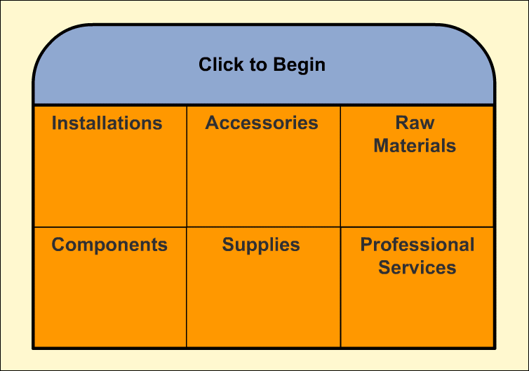
Interactive Exercise: Business Product Classes
8-40
Notes:
The purpose of this exercise is to help students learn how to differentiate between the different business product classifications based on the intended use of a product within an organization. Six business product purchase / usage situations are described; students are challenged to identify the correct business product classification for each example using a simple drag and drop exercise.
For complete information and suggestions on using this Interactive Exercise, please refer to the “Notes on the Interactive Exercise” section for this chapter in the Multimedia Lecture Support Package to Accompany Basic Marketing. That same information is available as a Word document in the assets folder for the PowerPoint file.
This slide refers to material on pp. 219.

Slide 41
You should now be able to:
8-41
Understand what “Product” really means.
Know the key differences between goods and services.
Understand what branding is and how to use it in strategy planning.
Understand the importance of packaging in strategy planning.
Understand the role of warranties in strategy planning.
Notes:
At the end of this presentation, you should be able to:
1. Understand what “Product” really means.
2. Know the key differences between goods and services.
3. Understand what branding is and how to use it in strategy planning.
Understand the importance of packaging in strategy planning.
Understand the role of warranties in strategy planning.
This slide refers to material on pp. 198.

Slide 42
You should now be able to:
8-42
Know the differences among various consumer and business product classes.
Understand how product classes can help a marketing manager plan marketing strategies.
Understand important new terms.
Notes:
At the end of this presentation, you should be able to:
Know the differences among various consumer and business product classes.
Understand how product classes can help a marketing manager plan marketing strategies.
Understand important new terms.
This slide refers to material on pp. 198.

Slide 43
Key Terms
8-43
product
quality
product assortment
product line
individual product
branding
brand name
trademark
service mark
brand familiarity
brand rejection
brand nonrecognition
brand recognition
brand preference
brand insistence
brand equity
Lanham Act
Notes:
Summary Overview
These are key terms you should be familiar with based upon the material in this presentation.
Key Issues
Product: the need satisfying offering of a firm.
Quality: a product's ability to satisfy a customer's needs or requirements.
Product assortment: the set of all product lines and individual products that a firm sells.
Product line: a set of individual products that are closely related.
Individual product: a particular product within a product line.
Branding: the use of a name, term, symbol, or design—or a combination of these—to identify a product.
Brand name: a word, letter, or a group of words or letters.
Trademark: those words, symbols, or marks that are legally registered for use by a single company.
Service mark: those words, symbols, or marks that are legally registered for use by a single company to refer to a service offering.
Brand familiarity: how well customers recognize and accept a company's brand.
Brand rejection: potential customers won't buy a brand unless its image is changed.
Brand nonrecognition: final customers don't recognize a brand at all—even though intermediaries may use the brand name for identification and inventory control.
Brand recognition: customers remember the brand.
Brand preference: target customers usually choose the brand over other brands, perhaps because of habit or favorable past experience.
Brand insistence: customers insist on a firm's branded product and are willing to search for it.
Brand equity: the value of a brand's overall strength in the market.
Lanham Act: a 1946 law that spells out what kinds of marks (including brand names) can be protected and the exact method of protecting them.
This slide refers to boldfaced terms appearing in Chapter 8.

Slide 44
Key Terms
8-44
family brand
licensed brand
individual brands
generic products
manufacturer brands
dealer brands
private brands
battle of the brands
packaging
Federal Fair Packaging and Labeling Act
warranty
Magnuson-Moss Act
consumer products
business products
convenience products
staples
impulse products
Notes:
Summary Overview
These are additional key terms.
Key Issues
Family brand: a brand name that is used for several products.
Licensed brand: a well-known brand that sellers pay a fee to use.
Individual brands: separate brand names used for each product.
Generic products: products that have no brand at all other than identification of their contents and the manufacturer or middleman.
Manufacturer brands: brands created by producers.
Dealer brands: brands created by intermediaries—sometimes referred to as private brands.
Private brands: brands created by intermediaries—sometimes referred to as dealer brands.
Battle of the brands: the competition between dealer brands and manufacturer brands.
Packaging: promoting and protecting the product.
Federal Fair Packaging and Labeling Act: a 1966 law requiring that consumer goods be clearly labeled in easy‑to‑understand terms.
Warranty: what the seller promises about its product.
Magnuson‑Moss Act: a 1975 law requiring that producers provide a clearly written warranty if they choose to offer any warranty.
Consumer products: products meant for the final consumer.
Business products: products meant for use in producing other products.
Convenience products: products a consumer needs but isn't willing to spend much time or effort shopping for.
Staples: products that are bought often, routinely, and without much thought.
Impulse products: products that are bought quickly as unplanned purchases because of a strongly felt need.
This slide refers to boldfaced terms appearing in Chapter 8.

Slide 45
Key Terms
8-45
emergency products
shopping products
homogeneous shopping products
heterogeneous shopping products
specialty products
unsought products
new unsought products
regularly unsought products
derived demand
expense item
capital item
installations
accessories
raw materials
farm products
natural products
components
supplies
professional services
Notes:
Summary Overview
These are additional key terms.
Key Issues
Emergency products: products that are purchased immediately when the need is great.
Shopping products: products that a customer feels are worth the time and effort to compare with competing products.
Homogeneous shopping products: shopping products the customer sees as basically the same and wants at the lowest price.
Heterogeneous shopping products: shopping products the customer sees as different and wants to inspect for quality and suitability.
Specialty products: consumer products that the customer really wants and makes a special effort to find.
Unsought products: products that potential customers don't yet want or know they can buy.
New unsought products: products offering really new ideas that potential customers don't know about yet.
Regularly unsought products: products that stay unsought but not unbought forever.
Derived demand: demand for business products derives from the demand for final consumer products.
Expense item: a product whose total cost is treated as a business expense in the period it's purchased.
Capital item: a long-lasting product that can be used and depreciated for many years.
Installations: important capital items such as buildings, land rights, and major equipment.
Accessories: short‑lived capital items—tools and equipment used in production or office activities.
Raw materials: unprocessed expense items such as logs, iron ore, and wheat that are moved to the next production process with little handling.
Farm products: products grown by farmers, such as oranges, sugar cane, and cattle.
Natural products: products that occur in nature such as timber, iron ore, oil, and coal.
Components: processed expense items that become part of a finished product.
Supplies: expense items that do not become part of a finished product.
Professional services: specialized services that support a firm's operations.
This slide refers to boldfaced terms appearing in Chapter 8.

