Slide 1
Chapter 9
Product Management and New–Product Development
Copyright © 2014 by The McGraw-Hill Companies, Inc. All rights reserved
Notes:
For use only with Perreault/Cannon/McCarthy or Perreault/McCarthy texts.
© 2014 McGraw-Hill Companies, Inc. McGraw-Hill/Irwin
CHAPTER NINE
Lecture Notes for
Basic Marketing 19e

Slide 2
At the end of this presentation, you should be able to:
9-2
Understand how product life cycles affect strategy planning.
Know what is involved in designing new products and what “new products” really are.
Understand the new-product development process.
Appreciate the team effort that goes into new-product development.
Understand the need for product or brand managers.
Understand how total quality management can improve goods and services.
Understand important new terms.
Notes:
At the end of this presentation, you should be able to:
Understand how product life cycles affect strategy planning.
Know what is involved in designing new products and what “new products” really are.
Understand the new-product development process.
Appreciate the team effort that goes into new-product development.
Understand the need for product or brand managers.
Understand how total quality management can improve goods and services.
Understand important new terms.
This slide refers to material on p. 226.

Slide 3

The Role of Product Management and New-Product Development in Marketing Strategy (Exhibit 9-1)
9-3
Chapter 8: Elements of Product Planning for Goods & Services
Chapter 9: Product Management & New- Product Development
The Product Life Cycle Development
Stages
Strategy planning for stages
New Product Development
5 Step Process
Success factors
Managing brands
Product managers
Managing product quality
Notes:
Summary Overview
Ch 8 introduced Product Planning, while Ch 9 covers Product Management & New-Product Development.
Key Issues
Chapter 8 discussed the strategy planning decisions that need to be made for new products and sometimes changed for existing products.
In this chapter, we’ll investigate how successful new products are developed in the first place—and what marketing managers need to know and do to manage their growth. We’ll also talk about total quality management.
Three major areas of discussion will be:
Product life cycle,
New-product development, and
Managing brands.
This slide refers to material on p. 227.
→ Indicates place where slide “builds” to include the corresponding point (upon mouse click).

Slide 4
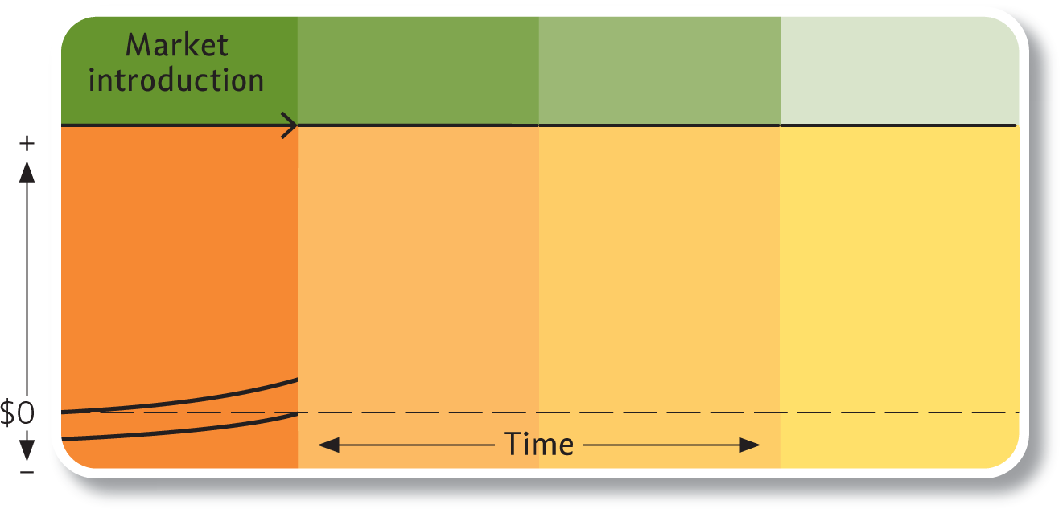
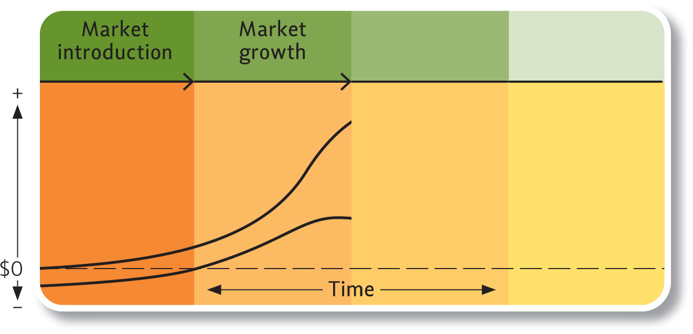
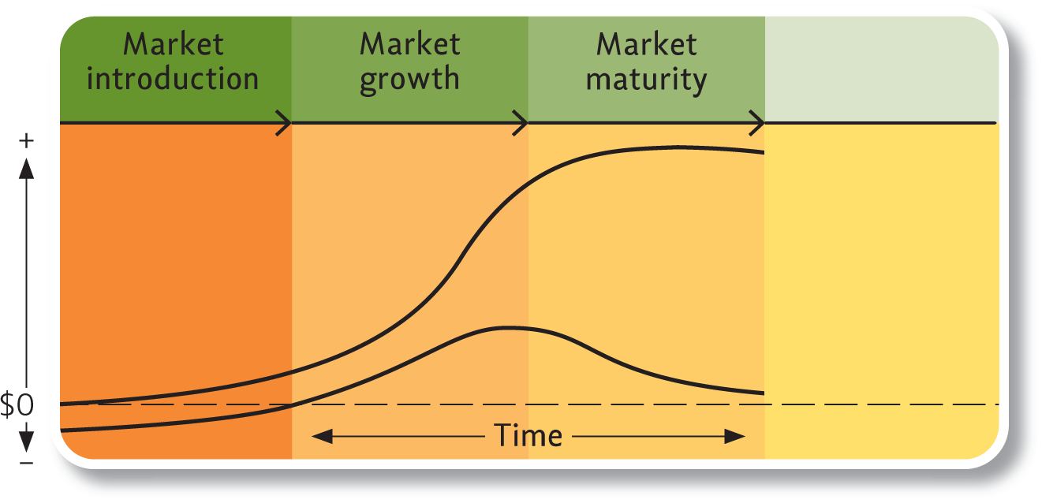
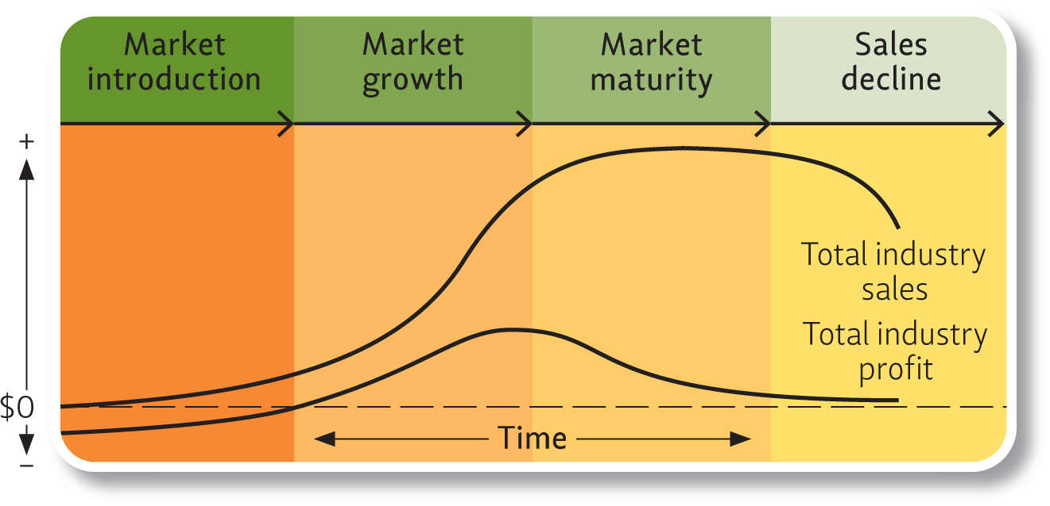
Typical Life Cycle of a New Product Concept (Exhibit 9-2)
9-4
Total industry
sales
Total industry
profit (initially loss)
Notes:
Summary Overview
It is useful to think of product concepts as passing through various stages in their “life.” The product life cycle describes the stages a really new product idea goes through from beginning to end. Marketing managers can identify specific types of decisions for strategy planning that characterize each stage.
Key Issues
The product life cycle has four major stages:
market introduction;
→ market growth;
→ market maturity; and
→ sales decline.
The product life cycle is concerned with new product categories, and not individual brands.
The marketing mix usually changes throughout the product life cycle, in response to changes in customer needs or attitudes, repositioning of the product, or changes in the competitive structure of the industry.
Total industry sales start out very low in market introduction, increase to their peak in market maturity, and then decline.
Profits can also change during the life cycle, but not in tandem with industry sales. Industry profits decline while industry sales are still rising.
Discussion Question: Why do you think that the sales and profit curves differ in their shape over time?
This slide refers to material on pp. 221-223.
→ Indicates place where slide “builds” to include the corresponding point (upon mouse click).

Slide 5

Market Introduction—Investing in the Future
9-5
Notes:
Summary Overview
In the market introduction stage, sales are low as the idea is first introduced to the market.
Key Issues
Informative promotion is needed to tell potential customers about the advantages and uses of the new product. In this ad, Procter & Gamble is announcing the introduction of ThermaCare pain relief pads. These heated pads are a new product concept: one that combines old-fashioned heating pad pain relief with the convenience of disposable, mobile (and discrete) application.
Note also that the ad includes a discount coupon, to encourage consumers to try the product. Therefore, consumers become aware of the new product and receive an incentive to purchase it and test its effectiveness vs. the pain relief provided by Advil.
The ad also assists consumers in locating the product in the store (by mentioning that the product can be found in the pain relief aisle).
Because the process of informing and educating consumers takes time, company resources are being spent in market introduction, but revenues are not very large. They may even be nonexistent.
Discussion Question: Can you think of other examples of new product ideas for which promotion is more informative than persuasive?
This slide relates to material on pp. 228.

Slide 6

Market Growth Stage—Profits Go Up and Down
9-6
Innovation Attracts Competition
Monopolistic Competition Develops
Profits Peak and Then Decline
Don’t Ignore Long-Term Competitive Trends!
Notes:
Summary Overview
In the market growth stage, industry sales grow fast but industry profits rise and then start falling.
Key Issues
The innovator realizes big profits and attracts competition.
Competitors may try to copy the innovator, or to improve on what the innovator has introduced.
Some competitors may try to offer a product to a more narrowly defined target market.
→ As competitors enter, monopolistic competition develops, leading to downward sloping demand curves.
Industry profits reach their peak in this stage, but then begin to decline with more competition and increasing consumer price sensitivity.
Discussion Question: Why do consumers become more price sensitive in the market growth stage?
→ Too much focus on current profits while ignoring long-term competitive trends is a common mistake.
This slide refers to material on pp. 228.
→ Indicates place where slide “builds” to include the corresponding point (upon mouse click).

Slide 7

Market Maturity Stage—Sales Level Off, Profits Continue Down
9-7
Persuasive, More Costly Promotion
Brands Are More Similar
Greater Price Competition/Price Sensitivity
Maturity May Last a Long Time
Notes:
Summary Overview
In the market maturity stage, sales level off and competition continues to increase. Most of the products we use every day are mature products.
Key Issues
Promotion costs increase and price competition in some segments cuts into profits.
As a result, some firms that are less efficient are forced to drop out of the market.
Some new firms may enter the market in the maturity phase, but competing with established strong competitors is difficult.
Persuasive promotion becomes more important, as competitors try to encourage consumers to buy one brand over another.
As consumers view the brands as being more and more similar,
They become more price sensitive, and demand becomes increasingly elastic.
The maturity phase may last many years, until a new product idea comes along.
Discussion Question: High-definition television (HDTV) is the first real product innovation in television in many years. What other mature products can you think of that are starting to see revolutionary innovations?
This slide refers to material on pp. 228-229.
→ Indicates place where slide “builds” to include the corresponding point (upon mouse click).

Slide 8
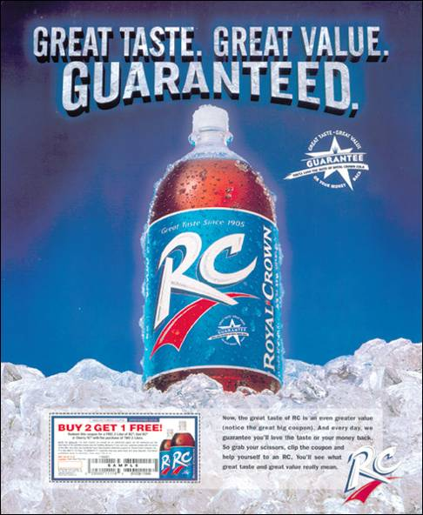
Sales Decline —A Time of Replacement
9-8
Notes:
Summary Overview
During the sales decline stage, new products replace older ones.
Key Issues
Price competition is common and sales are primarily to the most loyal customers or to those who have waited the longest to enter the market.
In this ad, RC Cola introduces the first-ever refund offer in the soft drink industry. The company is also using a “buy 2, get 1 free” coupon to increase its market share, relative to Coca-Cola and Pepsi brands.
Strong brands may continue to be profitable, especially if marketers cut back on their expenditures and lower the costs of production and marketing.
Discussion Question: Other examples of product categories in sales decline might be things such as hard contact lenses, small capacity floppy disk drives, and traditional “2 by 2” roller skates. Can you think of other examples? Remember, products in sales decline are products that are ripe for replacement by newer innovations.
This slide relates to material on pp. 229.

Slide 9
Which Stage of PLC?
9-9
Notes:
At what stage of the product life cycle is Dial antibacterial soap?
Video Operation:
Use the onscreen player controls to operate the video.
To view the video at Full Screen, right-click the video and choose Full Screen. To go back to your presentation you can either hit the Escape key, right-click on the video and uncheck Full Screen, or type Alt+Enter. You can do this at anytime during the video playback.
Under certain circumstances, the video may not fill the video player window. To restore, right-click the video player object and select Zoom 200%.
The videos will only play in Slide Show View. Macros must be enabled in order to play the videos from within PowerPoint.
This slide refers to material on pp. 228-229.

Slide 10
Checking Your Knowledge
9-10
Kodak announced that it would no longer produce 35 millimeter film cameras, but would manufacture digital cameras exclusively. Sales of digital cameras have grown steadily and have far outpaced the sale of 35 mm cameras in recent years, even among professional photographers. Kodak’s decision indicates that 35 mm cameras are probably in the ________ stage of the product life cycle.
A. Market introduction
B. Market growth
C. Sales decline
D. Market maturity
Notes:
Answer: C
Checking your knowledge answer explanation:
The sales decline stage is marked by new products replacing old ones. Kodak’s decision to manufacture digital cameras and abandon the 35 mm film camera indicates its belief that the 35 mm camera is in the sales decline stage. The best answer to this question is ‘C’.
This slide relates to material on pp. 229.

Slide 11
Product Life Cycles Should Be Related to Specific Markets
9-11
Individual
Brands
Market
Definitions
May not follow the classic pattern
May be introduced in market growth or maturity
Not all brands are equally strong
Should be carefully developed
Different markets, different stages
Contribute to the length of the cycle
AND
Notes:
Summary Overview
It’s important to remember that the product life cycle concept applies mainly to product categories or product classes. It is often the case that sales and profits for an individual brand will not follow the classic life cycle pattern.
Key Issues
Individual brands may not follow the pattern.
For example, a new brand may be introduced as a “me-too” product in the growth stage in order to capture a piece of a fast-growing market.
A weak brand may not achieve the same results as a preferred brand.
→ Each market should be carefully defined.
A product in the maturity stage in one country might be in the market growth stage in another country.
The breadth of the market definition can also determine the overall length of the life cycle. Wider market definitions may contribute to longer life cycles.
Discussion Question: Why would defining the market broadly contribute to lengthening the life cycle? Conversely, why would a narrow market definition tend to shorten the life cycle?
This slide refers to material on pp. 229.
→ Indicates place where slide “builds” to include the corresponding point (upon mouse click).

Slide 12
Product Life Cycles Vary in Length
9-12
Comparative Advantage
Easy to Use
Some Products
Move Fast
Compatible
Easy to Communicate
Can Be Tried
Notes:
Summary Overview
How long a product life cycle takes may vary considerably across different product categories. Managers can estimate the likely length based on the life cycles for similar products, if there are any. Marketing research can also help, but managers are typically more concerned with the length of a life cycle stage than with the length of the whole cycle.
Key Issues
Some products move fast through their life cycles. Several factors contribute to the speed with which a product moves through its life cycle.
The greater the comparative advantage that a product has over others that are already on the market, the more quickly its sales will grow.
Sales also grow faster if the product is easy to use and its advantages are
easy to communicate.
If consumers can try the product with little risk, then the product can proceed more quickly through market introduction.
If the product is compatible with the values and experiences of the target customers, they will be more likely to purchase it, thus quickening the pace of sales.
Discussion Question: Consider the iPod music player. Using the five criteria that affect the speed of a product’s movement through the life cycle, can you account for the rapid penetration of these products?
This slide refers to material on pp. 230-231.
→ Indicates place where slide “builds” to include the corresponding point (upon mouse click).

Slide 13

Interactive Exercise: Adoption
9-13
Notes:
The purpose of this exercise is to help students understand the factors that facilitate product adoption, and the importance that advertising plays in influencing consumers’ perceptions of these factors. Four print ads are offered for examination; students must identify whether the ads stress compatibility, ease of use, comparable advantage, ease of communication or trialability.
For complete information and suggestions on using this Interactive Exercise, please refer to the “Notes on the Interactive Exercise” section for this chapter in the Multimedia Lecture Support Package to Accompany Basic Marketing. That same information is available as a Word document in the assets folder for the PowerPoint file.
This slide refers to material on pp. 229.

Slide 14



Other Issues in Product
Life Cycle Length
9-14
Product Life Cycles Are
Getting Shorter
The Early Bird Usually Makes Profits
Fashions and Fads
Notes:
Summary Overview
There are several other issues contributing to the length of product life cycles.
Key Issues
Product life cycles are getting shorter.
More innovation yields more new products available to replace older ones.
→ The early bird usually makes the profits, because being first in the market can give a firm a chance to gain a critical foothold in market share.
→ The nature of the product—whether it is a fashion or fad product—can also affect the length of the life cycle.
Fashion: the currently accepted or popular style.
Fad: an idea that is fashionable only to certain groups who are enthusiastic about it.
The product life cycles for fashions and fads tend to be happy, but short, in that they may sell extremely well for a limited period of time.
Discussion Question: Can you provide examples of fashion and fad products?
This slide refers to material on pp. 231.
→ Indicates place where slide “builds” to include the corresponding point (upon mouse click).

Slide 15
Planning for Different Stages of the Product Life Cycle
9-15
Allocate Sufficient Money
Consider all Four Ps
Market
Introduction
& Growth
Be Flexible
Anticipate Speed of Movement
Competitors May Help Adoption
Notes:
Summary Overview
Where a product is in its life cycle and the length of the cycle both affect marketing strategy planning.
Key Issues
Marketing managers must allocate sufficient money to cover the costs of introducing new products, such as design, development, and packaging.
Planning must specify how the new product will be distributed, which means setting up channels of distribution.
Promotion must sell the whole idea—not just a specific brand.
Discussion Question: Many marketers are tempted to set a high initial price for a new product—especially one that is a unique product idea. Why might they want to set a relatively high price early in the product’s life?
How fast the product is moving through its life cycle also affects strategy planning. For example, it may not be a good idea to build a company-owned distribution system for a fad.
The market pioneer may need help from competitors in order to speed the adoption of a really new product concept.
The key for marketers is to be flexible in the early stages of the product life cycle. The ability to respond quickly to market dynamics may improve sluggish early sales.
This slide refers to material on pp. 232-233.
→ Indicates place where slide “builds” to include the corresponding point (upon mouse click).

Slide 16

Managing Mature Products
9-16
Notes:
Summary Overview
A product must have a clear competitive advantage as it moves into maturity. Ideally, this advantage will have been identified and developed throughout introduction and growth. But it is also important that the market knows what that advantage is—products seldom “speak” for themselves.
Key Issues
In maturity, promotion emphasizes the building of selective demand—demand for the brand.
For example, maturing products, like Simmons brand mattresses, can demonstrate their competitive advantage by means of promotion. In the ad, Simmons explains how 75 years of research has led to a “better” mattress.
Discussion Question: How does the development of memorable advertising “tag lines”—such as “Mmmm, mmmm, good,” (Campbell’s soup); or “Raise your hand if you’re sure,” (Sure deodorant) contribute to the building of selective demand?
Distribution coverage in market maturity moves toward intensive distribution as more and more outlets carry the product, or as alternative channels develop.
The fierce competition leads to price dealing and price cutting as marketers try to maintain their current market shares and attempt to induce brand switching.
Management cannot expect the same level of profits as in the growth stage. Placing unrealistic expectations on marketing personnel may provide fertile ground for unethical practices.
This slide refers to material on pp. 234.

Slide 17
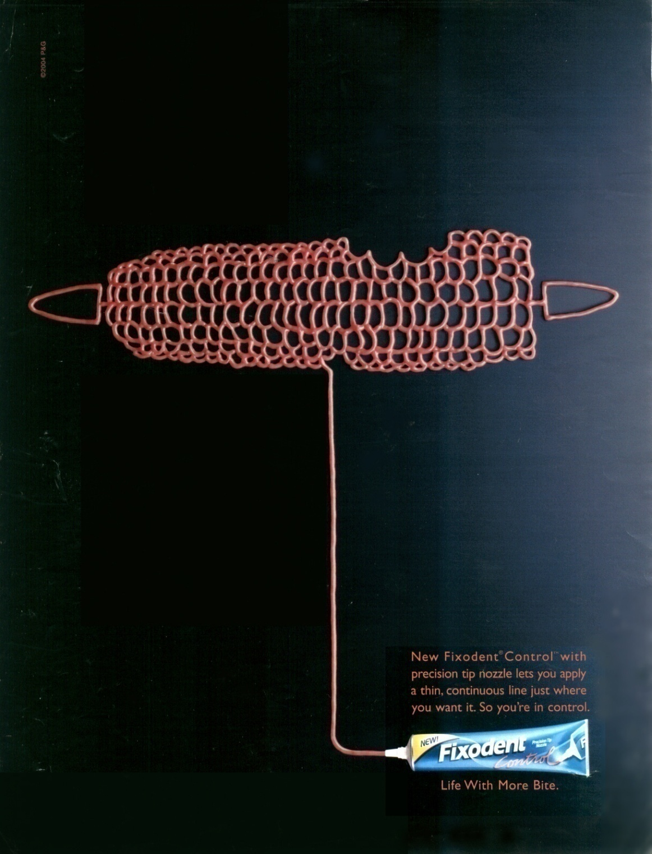
Are Product Modifications Really New Products?
9-17
Notes:
Summary Overview
When marketers make improvements to their products, are they creating wholly new product concepts that should have their own life cycles, or are they merely technical adjustments of the original product idea?
Key Issues
The key is the product idea—if it is dramatically different, then the modification is a new product with a new life cycle.
If not, it’s a modification of an older product. Even if it is only a modification, it can help to extend the maturity stage of the product life cycle.
This ad illustrates the New Fixodent Control denture adhesive, with precision tip nozzle, which lets you apply a thin and continuous line.
Discussion Question: Compared to a denture adhesive, is the development of a “nozzle tip” denture adhesive deserving of its own life cycle, or is it a refinement of the old product?
In a mature market, a firm may be fighting to keep or increase its market share. But if the firm finds a new use for the product, it may stimulate overall demand.
This slide relates to material on pp. 234-235.

Slide 18
Phasing Out Dying Products
9-18
Phase-out May Be Necessary
Don’t Pull the Plug So Quickly
Product Line
Customer
Support
Profitability
Sales Decline Can Be Profitable
Notes:
Summary Overview
At some point it may become necessary to discontinue the product. This decision must weigh profitability against product line considerations and customer support obligations.
Key Issues
In sales decline, if it is determined that the product will not contribute to the achievement of the organization’s objectives in the future, a phase-out strategy may be necessary.
Discussion Question: How might marketers go about determining if a product is suffering from a temporary sales decline or if the decline is symptomatic of a long-term change in consumer preferences?
→ If marketers “pull the plug” on a product too quickly, they may incur losses because of distribution and promotion expenditures that have already been made to cover the immediate future.
→ If marketing costs are reduced in accordance with the phase-out strategy, loyal customers may still continue to purchase the product, and this residual demand may generate profits.
This slide refers to material on pp. 235-236.
→ Indicates place where slide “builds” to include the corresponding point (upon mouse click).

Slide 19

New Product Planning
9-19
What Is a New Product?
FTC Rule: 6 Months
Ethical Dilemmas Exist
Notes:
Summary Overview
Competition is strong and dynamic in most markets, so it is essential for firms to keep developing new products and modifying old products.
Key Issues
New product: anything that in any way provides the company with another way to meet customer needs.
This “newness” includes totally new inventions and simple color changes in existing products.
Discussion Question: What’s the difference between this idea of a new product, and the notion of a new product in the context of the product life cycle?
→ Federal Trade Commission (FTC): the federal government agency that polices antimonopoly laws.
The FTC says a product is “new” only six months.
In the FTC’s view, a new product must be either entirely new, or changed in a “functionally significant or substantial respect.”
→ Ethical issues in new-product planning abound. These ethical debates include:
Criticisms against companies for holding back new product innovations.
“Planned obsolescence”—releasing products the company will soon replace.
Failure to supply replacement parts throughout the useful life of a product.
Continuous release of minor product variations in markets that are saturated.
Marketers need to be sensitive to the possible consumer backlash caused by these ethical dilemmas.
This slide refers to material on pp. 236-238.
→ Indicates place where slide “builds” to include the corresponding point (upon mouse click).

Slide 20
New Product
9-20
Notes:
The commercial introduces the New Mr. Clean Auto Dry product. The ad suggests that carwash “technology” has been surpassed by automotive technology in the past but that this new product revolutionizes carwash technology.
Discussion Question: What questions do you have about this new product after viewing the commercial? What are your opinions given that the product carries the Mr. Clean brand name?
Video Operation:
Use the onscreen player controls to operate the video.
To view the video at Full Screen, right-click the video and choose Full Screen. To go back to your presentation you can either hit the Escape key, right-click on the video and uncheck Full Screen, or type Alt+Enter. You can do this at anytime during the video playback.
Under certain circumstances, the video may not fill the video player window. To restore, right-click the video player object and select Zoom 200%.
The videos will only play in Slide Show View. Macros must be enabled in order to play the videos from within PowerPoint.
This slide refers to material on pp. 236.

Slide 21
New-Product Development Process (Exhibit 9-4)
9-21
1. Idea generation
2. Screening
3. Idea evaluation
4.Development
5. Commercial-ization
Notes:
Summary Overview
New product development is essential, but risky. An organized new-product development process may help.
Key Issues
New-product development is expensive and many of these products fail!
Some products don’t offer a unique benefit, or competition is underestimated.
Design and cost problems, or poor timing—either too quick an introduction or too slow—may doom a product to failure.
The new-product development process is an organized approach for bringing new products to market. It has five stages:
Idea generation;
→ Screening;
→ Idea evaluation;
→ Development; and
→ Commercialization.
The process tries to kill new products, economically, by progressively weeding out products that have a low likelihood of success before they are introduced to the entire target market.
Discussion Question: In applying the new-product development process, marketers usually start with a hypothesis that a new product idea will not be profitable. The process then tests this hypothesis. Do you think this is a defeatist approach? Why not assume that the product will succeed?
This slide refers to material on pp. 240-243.
→ Indicates place where slide “builds” to include the corresponding point (upon mouse click).

Slide 22
Step 1: Idea Generation
9-22
1. Idea generation
1. Idea generation
Ideas from:
Customers and users
Marketing research
Competitors
Other markets
Company people, intermediaries, etc.
2. Screening
3. Idea evaluation
4.Development
5. Commercial-ization
Notes:
Summary Overview
New product ideas come from all over—salespeople, production workers, customers, competitors—anywhere! Sharp companies keep an open mind and eye to many relevant sources of new product ideas.
Key Issues
The key emphasis in idea generation is not on discarding ideas—the later stages of the new product development process take care of weeding out bad ideas and nurturing good ones. Instead, gathering ideas is the key in idea generation.
As mentioned, ideas can come from many sources. In reverse engineering, companies buy competitors’ products, disassemble them, determine how they work, and find ways to improve them.
Discussion Question: Do you think reverse engineering is ethical? Why or why not?
International markets should not be overlooked for new ideas.
Customers are a tremendous source of new ideas. Marketing research can help in gaining the perspectives of customers, wholesalers or retailers, and competitors.
Idea generation can’t be left to chance. It depends on having a formal procedure for seeking new ideas, so there is a constant influx of new possibilities.
This slide refers to material on pp. 240.
→ Indicates place where slide “builds” to include the corresponding point (upon mouse click).

Slide 23
Step 2: Screening
9-23
1. Idea generation
2. Screening
Strengths and weaknesses
Fit with objectives
Market trends
Rough ROI estimate
2. Screening
3. Idea evaluation
4.Development
5. Commercial-ization
Notes:
Summary Overview
Screening involves evaluating the new idea in relation to strengths, weaknesses, opportunities, and threats (S.W.O.T. analysis) facing the company—and also the company’s objectives and resources.
Key Issues
Marketing managers should be careful to screen out opportunities that fail to meet these criteria.
Consumer Product Safety Act: encourages safety in product design and better quality control.
Product liability: the company has the legal obligation to pay damages to persons injured by defective or unsafe products.
Finally, return on investment (ROI) is a crucial screening criterion, and ROI forecasts can help prioritize product ideas.
This slide refers to material on pp. 240-241.
→ Indicates place where slide “builds” to include the corresponding point (upon mouse click).

Slide 24
Step 3: Idea evaluation
9-24
1. Idea generation
3. Idea Evaluation
2. Screening
Concept testing
Reactions from customers
Rough estimates of costs, sales, and profits
3. Idea evaluation
4.Development
5. Commercial-ization
Notes:
Summary Overview
In the idea evaluation stage, the product ideas that survive the screening process are scrutinized more carefully.
Key Issues
Concept testing: getting reactions from customers about how well a new product idea fits their needs.
Informal studies may include focus groups of customers who are asked to react to various aspects of the product idea.
More formal studies may involve surveys in which consumers rate different dimensions of the product idea.
Discussion Question: Is there a difficulty associated with asking consumers about the likelihood that they will purchase a product when it is still an idea, and not a tangible product? Why or why not?
In the idea evaluation stage, companies often make rough estimates of costs, revenue, and profitability. They do so based on the reactions of final consumers, wholesalers and retailers.
This slide refers to material on pp. 241-242.
→ Indicates place where slide “builds” to include the corresponding point (upon mouse click).

Slide 25
Step 4: Development
9-25
1. Idea generation
2. Screening
4. Development
R&D
Develop model or service
Test marketing mix
Revise plans as needed
ROI estimate
3. Idea evaluation
4.Development
5. Commercial-ization
Notes:
Summary Overview
In the development stage, the product idea is translated into a tangible prototype, in the case of a physical good. For a service, the organization works out the details of the training, equipment, and staff required to deliver the service.
Key Issues
Technology has had a big impact on the development of physical products, mainly in the use of computer-aided design (CAD) software.
Once marketers have product and service prototypes, they often get consumer reactions to them before expending the resources needed for a full production run.
Marketers may conduct test marketing, which is in essence a “dry run” of a new product introduction, bringing the full marketing mix into play in selected geographic areas.
Test marketing is costly and time-consuming, and it may also provide information to competitors.
Discussion Question: Some marketing research firms monitor test market activity and sell the information to competitors of the firms doing the test marketing. What is the tradeoff that marketers must make in deciding to do a test market?
Sometimes, the risk of not having the information gathered in a test market is greater than the risk from “tipping one’s hand” to competitors.
And, in some cases, the advantages of getting to the market quickly outweigh the advantages gained from a time-consuming test market.
This slide refers to material on pp. 242-243.
→ Indicates place where slide “builds” to include the corresponding point (upon mouse click).

Slide 26
Step 5: Commercialization
9-26
1. Idea generation
2. Screening
5. Commercialization
Finalize product and marketing plan
Start production and marketing
“Roll out” in select markets
Final ROI estimate
3. Idea evaluation
4.Development
5. Commercial-ization
Notes:
Summary Overview
A product that survives the first four stages of the new product development process is ready for commercialization—introduction to the full target market.
Key Issues
Commercializing a new product is expensive and success usually requires cooperation from the whole organization:
Manufacturing or service facilities are established.
Goods are produced in order to fill channels of distribution.
Service personnel must be hired and trained.
Introductory promotion is executed.
Discussion Question: If a new product is a really new product idea, not just a modification of an existing product, what stage of the product life cycle overlaps the commercialization stage of the new product development process?
Due to the cost and complexity of a product rollout, some companies prefer to do it gradually, perhaps by geographic area, until the whole market is covered.
This approach may give the marketing staff an opportunity to recognize and correct marketing mix problems before they appear in all areas.
This slide refers to material on pp. 243.
→ Indicates place where slide “builds” to include the corresponding point (upon mouse click).

Slide 27
Checking Your Knowledge
9-27
Top management of a large company recently approached the dean of a major business school about starting a specialized MBA program for the company’s employees. After further discussions, the dean decided that the program did not fit well with the objectives and resources of the school, so the program was put on the “back burner” until conditions changed. The proposed MBA program was at what stage of the new-product development process when it was shelved?
A. Idea generation
B. Screening
C. Idea evaluation
D. Development
E. Commercialization
Notes:
Answer: B
Checking your knowledge (answer explanation):
The screening process of new-product development involves evaluating the new idea with a S.W.O.T. analysis as well as a long-run trends analysis and a thorough understanding of company objectives. It appears that the specialized MBA program described above was stalled at the screening process. The dean performed the analysis and decided it was not a good match at present. The best answer selection is ‘B’.
This slide relates to material on pp. 240-241.

Slide 28
New Product Development: A Total Company Effort (Exhibit 9-5)
9-28
Complete marketing plan
Effective transition to regular operations
Organized new-product development process
A basis for superior customer value
New-product success
Effective design
Notes:
Summary Overview
New product success depends on many factors.
Key Issues
The primary outcome is new-product success, but how do we get there?
→ Marketing managers must assure an effective transition of a new product to regular operations.
→ This requires marketing managers to carefully develop a complete marketing plan.
→ The careful analysis that goes into a marketing plan also assures that new products actually deliver superior customer value—another key to success.
→ And products need to be based on effective design.
→ Delivering superior customer value emerges from a well designed and well implemented new-product development process like the 5-step model we have described. A well-organized new-product development process does not just happen. It is really a total company effort. On the next slide we will see the factors that contribute to that process.
This slide refers to material on p. 244.
→ Indicates place where slide “builds” to include the corresponding point (upon mouse click).

Slide 29
New Product Development: A Total Company Effort (Exhibit 9-5)
9-29
Top management support
Cross-functional team
Clear understanding of customer needs
Culture of innovation
Organized new-product development process
Product champion with authority
Timely development cycle
Cost management (costs add value)
Notes:
Summary Overview
Managing new-product development requires a company-wide effort with clear authority and coordination of complicated activities.
Key Issues
Top-level support is vital and the commitment must be real and explicit.
The highest level of the company can make new-product development part of the core business of the company, part of its mission statement, and its culture.
Allocation of adequate resources can help communicate that commitment.
Firms that foster a culture of innovation also develop a more effective new-product development process.
Discussion Question: At some companies, management insists that researchers spend a few hours a week just tinkering around with their own ideas on company time and in the company labs! How do these things support new-product development?
Someone must be put in charge of new-product development and the person must have a clear line of authority to get things done across different departments.
Cross-functional teams are an important element in new-product success. Firms must coordinate research and development with production, finance, and marketing to assure products meet customer needs and come to market in a timely manner.
Timeliness is key as firms increasingly find they need to get products to market before customer needs’ change and ahead of competitors’ offerings.
Market research, listening to customers, and anticipating customer needs assures that the firm has a clear understanding of customers’ needs.
Finally, the entire process needs to be conducted in an efficient manner that recognizes trade-offs between costs and customer benefits.
This slide refers to material on pp. 244-245.
→ Indicates place where slide “builds” to include the corresponding point (upon mouse click).

Slide 30
Checking Your Knowledge
9-30
Which of the following statements about new-product development are true?
A. The process should be informal to encourage innovation.
B. The greatest number of product ideas is in the idea evaluation stage.
C. The best criteria for evaluating new product ideas in the early stages is return on investment (ROI).
D. The process should have top management support.
E. All of the above statements are true.
Notes:
Answer: D
Checking your knowledge (answer explanation):
A – actually a structured process can generate innovation and keep costs in line.
B – the NPD process is a weeding out process—starting with many new ideas and narrowing down over time.
C – in the early stages, ROI is only a rough estimate so other criteria are important.
D – the process requires top management support.
This slide relates to material on pp. 244.

Slide 31

Need for Product Managers
9-31
Product/Brand Managers
Common in Large Companies
Some Are “Product Champions”
Notes:
Summary Overview
When an organization develops many product categories, management may decide to put someone in charge of each category or brand, to make sure that appropriate attention is paid to these products.
Key Issues
Product managers or brand managers manage specific products, and often have promotion as a major responsibility.
Some brand managers begin their tasks in the new product development process and continue from there.
→ Product managers are especially common in large companies that produce many kinds of products.
Several product managers may serve under a marketing manager, and product managers are sometimes responsible for their product’s entire marketing effort.
Discussion Question: A product manager responsible for a product’s entire marketing effort has to coordinate his/her activities with sales managers, advertising agencies, production people, marketing researchers, and channel members. What problems might this arrangement cause?
→ To avoid the problems that sometimes occur when a product manager has to coordinate several marketing activities, some companies use their product managers as “product champions” who are mainly concerned with implementing promotional efforts.
The activities of product managers vary a lot depending on their experience and aggressiveness and the company’s organizational philosophy.
Product managers may work with managers in other countries to decide whether and how to adapt products for different markets.
This slide refers to material on pp. 245-246.
→ Indicates place where slide “builds” to include the corresponding point (upon mouse click).

Slide 32
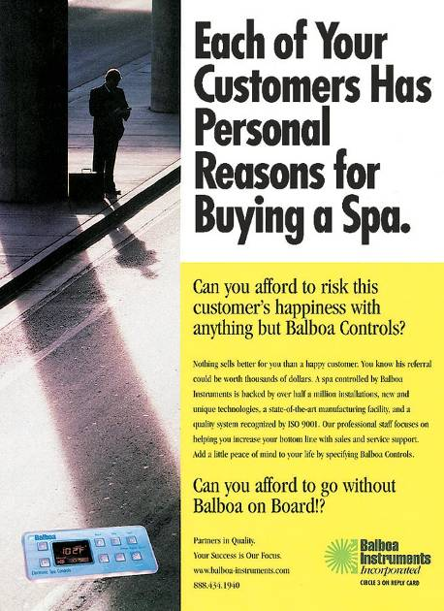
Managing Product Quality
9-32
Notes:
Summary Overview
At its core, total quality management (TQM) meets customer requirements. It is about everyone in the organization being committed to quality improvement, throughout all of the firm’s activities, in order to better serve customer needs. For marketers, this means applying TQM concepts to the whole marketing mix.
Key Issues
Production companies have been concerned about reducing defects for a long time.
The cost of poor quality is lost customers.
Japanese manufacturers are world leaders in showing that it costs far less to do something right the first time than it does to pay to fix it later.
Defects—either in physical products or in services--mean dissatisfied customers who may go elsewhere.
In this ad, Balboa wants producers of spas to know that its controls meet ISO 9001 quality standards and that, as a supplier, it is dedicated to satisfying the needs of the spa producer’s final consumers.
Discussion Question: Have you ever bought a product to find that it was broken, didn’t work, or was substandard in some way? How did you react? What action, if any, did you take to correct the problem? What was the outcome? How did your experience affect future purchases?
This slide relates to material on p. 246.

Slide 33

Building Quality into Services
9-33
Server Is Linked
To the Service
Training Is Crucial
Empowerment Works
Notes:
Summary Overview
Recently, marketers in service businesses have been paying a lot of attention to improving service quality through TQM. Even producers of basic commodities have customer service concerns that are part of their overall marketing plans.
Key Issues
Service improvements are somewhat more difficult to implement than improvements in physical goods.
One reason is that the server is inseparable from the service. For example, a technically competent physician may have a horrible “bedside manner.”
The best ways to improve service are to train people and then empower them to serve.
→ Role-playing exercises and showing employees how their jobs relate to the total company effort are two effective training techniques.
→ Empowerment: giving employees the authority to correct a problem without checking with management.
Line-level employees are much closer to problems, so giving them the power to correct problems is a way to improve customer satisfaction.
Discussion Question: What other things does empowerment do for the employees of an organization, beyond making it possible to solve customers’ problems more quickly?
This slide refers to material on pp. 246-247.
→ Indicates place where slide “builds” to include the corresponding point (upon mouse click).

Slide 34

Other Issues in Quality Implementation Efforts
9-34
Managers Lead the Effort
Specify Jobs and Measure Performance
Get a Return on Quality
Notes:
Summary Overview
There are several other things marketers can do to make the implementation of quality improvement efforts more successful.
Key Issues
Managers must lead the quality effort through their actions and involvement.
TQM won’t work without top-level support.
→ Firms that are successful clearly specify jobs and measure performance.
Firms must detail what tasks need to be done, how, and by whom.
→ Getting a return on quality is important, so managers must take care to deal with the most critical customer satisfaction issues in order to control costs.
This slide refers to material on pp. 248-249.
→ Indicates place where slide “builds” to include the corresponding point (upon mouse click).

Slide 35
You should now be able to:
9-35
Understand how product life cycles affect strategy planning.
Know what is involved in designing new products and what “new products” really are.
Understand the new-product development process.
Appreciate the team effort that goes into new-product development.
Understand the need for product or brand managers.
Understand how total quality management can improve goods and services.
Understand important new terms.
Notes:
At the end of this presentation, you should be able to:
Understand how product life cycles affect strategy planning.
Know what is involved in designing new products and what “new products” really are.
Understand the new-product development process.
Appreciate the team effort that goes into new-product development.
Understand the need for product or brand managers.
Understand how total quality management can improve goods and services.
Understand important new terms.
This slide refers to material on pp. 226.

Slide 36
Key Terms
9-36
product life cycle
market introduction
market growth
market maturity
sales decline
fashion
fad
new product
Federal Trade Commission (FTC)
Consumer Product Safety Act
product liability
concept testing
prototype
product managers
brand managers
total quality management (TQM)
continuous improvement
empowerment
Notes:
Summary Overview
These are key terms you should be familiar with based upon the material in this presentation.
Key Issues
Product life cycle: the stages a new product idea goes through from beginning to end.
Market introduction: a stage of the product life cycle when sales are low as a new idea is first introduced to a market.
Market growth: a stage of the product life cycle when industry sales grow fast but industry profits rise and then start falling.
Market maturity: a stage of the product life cycle when industry sales level off and competition gets tougher.
Sales decline: a stage of the product life cycle when new products replace the old.
Fashion: currently accepted or popular style.
Fad: an idea that is fashionable only to certain groups who are enthusiastic about it—but these groups are so fickle that a fad is even more short lived than a regular fashion.
New product: a product that is new in any way for the company concerned.
Federal Trade Commission (FTC): federal government agency that polices antimonopoly laws.
Consumer Product Safety Act: a 1972 law that set up the Consumer Product Safety Commission to encourage more awareness of safety in product design and better quality control.
Product liability: the legal obligation of sellers to pay damages to individuals who are injured by defective or unsafe products.
Concept testing: getting reactions from customers about how well a new product idea fits their needs.
Prototype: An early sample or model built to test a concept.
Product managers: manage specific products, often taking over the jobs formerly handled by an advertising manager—sometimes called brand managers.
Brand managers: manage specific products, often taking over the jobs formerly handled by an advertising manager—sometimes called product managers.
Total quality management (TQM): the philosophy that everyone in the organization is concerned about quality, throughout all of the firm's activities, to better serve customer needs.
Continuous improvement: a commitment to constantly make things better one step at a time.
Empowerment: giving employees the authority to correct a problem without first checking with management.
This slide refers to boldfaced terms appearing in Chapter 9.

