Slide 1

Business in Action
Eighth Edition
Chapter 2
Understanding Basic Economics
Copyright © 2017, 2015, 2013 Pearson Education, Inc. All Rights Reserved
Notes:
If this PowerPoint presentation contains mathematical equations, you may need to check that your computer has the following installed:
1) MathType Plugin
2) Math Player (free versions available)
3) NVDA Reader (free versions available)

Slide 2
Introduction
This chapter offers
  A brief introduction to economics from a business professional’s perspective
  A high-level look at the study of economics, types of economic systems, and the interaction of supply and demand
Understanding basic economic principles is essential to successful business management

Slide 3
Learning Objectives (1 of 2)
2.1 Define economics, and explain why scarcity is central to economic decision making.
2.2 Differentiate among the major types of economic systems.
2.3 Explain the interaction between demand and supply.

Slide 4
Learning Objectives (2 of 2)
2.4 Identify four macroeconomic issues that are essential to understanding the behavior of the economy.
2.5 Outline the debate over deregulation, and identify four key roles that governments play in the economy.
2.6 Identify the major ways of measuring economic activity.

Slide 5
What Is This Thing Called The Economy? (1 of 1)
Economy
  The sum total of all the economic activity within a given region
Economics
  The study of how a society uses its scarce resources to produce and distribute goods and services
Notes:
The economy is the sum total of all the economic activity within a given region, from a single city to a whole country to the entire world. The economy can be a difficult thing to get your mind wrapped around because it is so complex, constantly in motion, and at times hard to see—even though it’s everywhere around us.
Economics is the study of how a society uses its scarce resources to produce and distribute goods and services.

Slide 6
What Is This Thing Called The Economy? (2 of 2)
Microeconomics
  The study of how consumers, businesses, and industries collectively determine the quantity of goods and services demanded and supplied at different prices
Macroeconomics
  The study of “big picture” issues in an economy, including competitive behavior among firms, the effect of government policies, and overall resource allocation issues
Notes:
Economics is roughly divided into a small-scale perspective and a large-scale perspective. The study of economic behavior among consumers, businesses, and industries that collectively determine the quantity of goods and services demanded and supplied at different prices is termed microeconomics. The study of a country’s larger economic issues, such as how firms compete, the effect of government policies, and how an economy maintains and allocates its scarce resources, is termed macroeconomics.

Slide 7
Factors of Production (1 of 4)
Natural resources
  Land, forests, minerals, water, and other tangible assets usable in their natural state
Human resources
  All the people who work in an organization or on its behalf
Notes:
Each society must decide how to use its economic resources, or factors of production (see Exhibit 2.1). Natural resources are things that are useful in their natural state, such as land, forests, minerals, and water. Human resources are people and their individual talents and capacities.

Slide 8
Factors of Production (2 of 4)
Capital
  The funds that finance the operations of a business as well as the physical, human-made elements used to produce goods and services, such as factories and computers
Entrepreneurship
  The combination of innovation, initiative, and willingness to take the risks required to create and operate new businesses
Notes:
Capital includes money, machines, tools, and buildings that a business needs in order to produce goods and services. Entrepreneurship is the spirit of innovation, the initiative, and the willingness to take the risks involved in creating and operating businesses.

Slide 9
Factors of Production (3 of 4)
Knowledge
  Expertise gained through experience or association
Notes:
Knowledge is the collective intelligence of an organization. Knowledge workers, employees whose primary contribution is the acquisition and application of business knowledge, are a key economic resource for businesses in the 21st century.

Slide 10
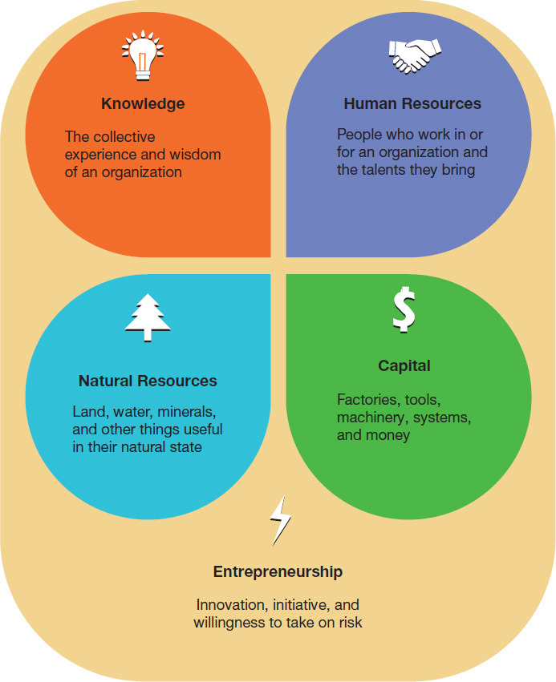
Exhibit 2.1 Factors of Production (4 of 4)

Slide 11
The Economic Impact of Scarcity
Scarcity
  A condition of any productive resource that has finite supply
Opportunity cost
  The value of the most appealing alternative not chosen
Notes:
The impact of scarcity, meaning that a given resource has a finite supply, is fundamental to understanding economics. Looking back over the factors of production, you can see that the supply of all these resources is limited. Even entrepreneurial energy is limited in the sense that there are only so many entrepreneurs in the economy, and each entrepreneur can accomplish only so much during a given time span.
Economists have a name for the most-attractive option not selected when making a trade-off. Opportunity cost refers to the value of the most appealing alternative from all those that weren’t chosen. In other words, opportunity cost is a way to measure the value of what you gave up when you pursued a different opportunity.

Slide 12
Economic Systems (1 of 2)
Economic system
  The policies that define a society’s particular economic structure; the rules by which a society allocates economic resources
  Free-market, planned
Notes:
The roles that individuals, businesses, and the government play in allocating a society’s resources depend on the society’s economic system, the basic set of rules for allocating resources to satisfy its citizens’ needs. Economic systems are generally categorized as either free-market systems or planned systems, although these are really theoretical extremes; every economy combines aspects of both approaches.

Slide 13
Free Market Systems
Free-market system
  An economic system in which decisions about what to produce and in what quantities are decided by the market’s buyers and sellers
Capitalism
  Economic system based on economic freedom and competition
Notes:
In a free-market system, individuals and companies are largely free to decide what products to produce, how to produce them, whom to sell them to, and at what price to sell them. In other words, they have the chance to succeed—or fail—by their own efforts. Capitalism and private enterprise are the terms most often used to describe the free-market system, one in which private parties (individuals, partnerships, or corporations) own and operate the majority of businesses, and where competition, supply, and demand determine which goods and services are produced.

Slide 14
Planned Systems
Planned system
  Economic system in which the government controls most of the factors of production and regulates their allocation
Socialism
  Economic system characterized by public ownership and operation of key industries combined with private ownership and operation of less-vital industries
Notes:
In a planned system, governments largely control the allocation of resources and limit freedom of choice in order to accomplish government goals. Because social equality is a major goal of planned systems, private enterprise and the pursuit of private gain are generally regarded as wasteful and exploitive.
Socialism lies somewhere between capitalism and communism, with a fairly high degree of government planning and some government ownership of capital resources. However, government ownership tends to be focused on industries considered vital to the common welfare, such as transportation, healthcare, and communications. Private ownership is permitted in other industries.

Slide 15
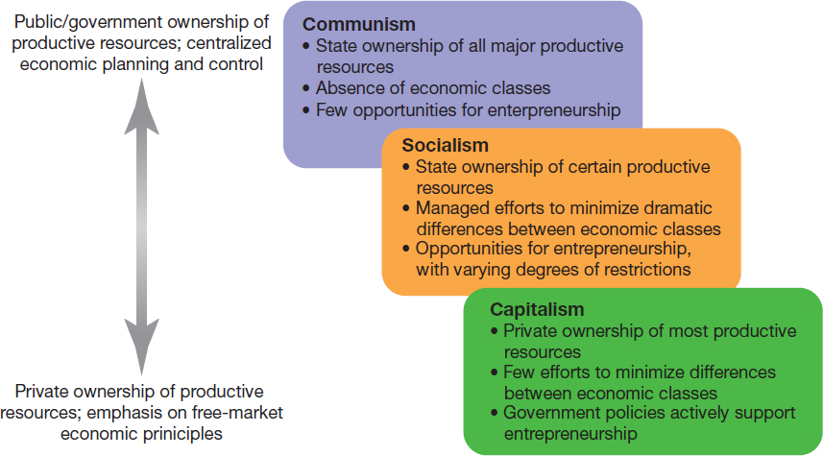
Exhibit 2.2 Economic Systems (2 of 2)

Slide 16
Nationalization and Privatization
Nationalization
  A government’s takeover of selected companies or industries
Privatization
  Turning over services once performed by the government and allowing private businesses to perform them instead
Notes:
The line between socialism and capitalism isn’t always easy to define, and it doesn’t always stay in the same place either. Governments can change the structure of the economy by nationalizing—taking ownership of—selected companies, or in extreme cases, even entire industries. They can also move in the opposite direction, privatizing services that were once performed by the government by allowing private businesses to perform them instead.

Slide 17
The Forces of Demand and Supply
Demand
  Buyers’ willingness and ability to purchase products at various price points
Supply
  A specific quantity of a product that the seller is able and willing to provide at various prices
Demand curve
  A graph of the quantities of a product that buyers will purchase at various prices
Notes:
In a free-market system, the marketplace (composed of individuals, firms, and industries) and the forces of demand and supply determine the quantity of goods and services produced and the prices at which they are sold. Demand refers to the amount of a good or service that customers will buy at a given time at various prices. Supply refers to the quantities of a good or service that producers will provide on a particular date at various prices. In other words, demand refers to the behavior of buyers, whereas supply refers to the behavior of sellers. The two forces work together to impose a kind of dynamic order on the free-market system.
The airline industry offers a helpful demonstration of supply and demand. A demand curve is a graph that shows the relationship between the amount of product that buyers will purchase at various prices, all other factors being equal. Demand curves typically slope downward, implying that as price drops, more people are willing to buy.

Slide 18
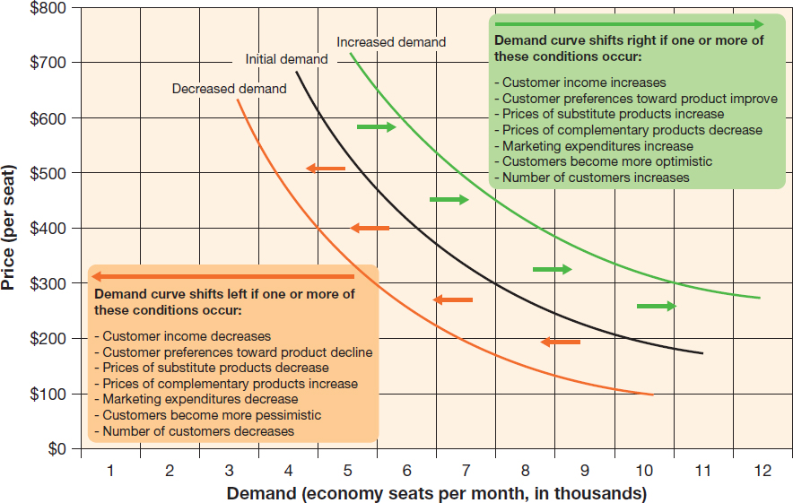
Exhibit 2.3 Demand Curve
Notes:
The black line labeled “Initial demand” in Exhibit 2.3 shows a possible demand curve for the monthly number of economy tickets on one airline’s Chicago-to-Denver route. You can see that as price decreases, demand increases, and vice versa. If demand is strong, airlines can keep their prices consistent or perhaps even raise them. If demand weakens, they can lower prices to stimulate more purchases. (Airlines use sophisticated yield management software to constantly adjust prices in order to keep average ticket prices as high as possible while also keeping their planes as full as possible.)

Slide 19
Understanding Supply
Supply curve
  A graph of the quantities of a product that sellers will offer for sale, regardless of demand, at various prices
Notes:
Demand alone is not enough to explain how a company operating in a free-market system sets its prices or production levels. In general, a firm’s willingness to produce and sell a product increases as the price it can charge and its profit potential per item increase. In other words, as the price goes up, the quantity supplied generally goes up. The depiction of the relationship between prices and quantities that sellers will offer for sale, regardless of demand, is called a supply curve.

Slide 20
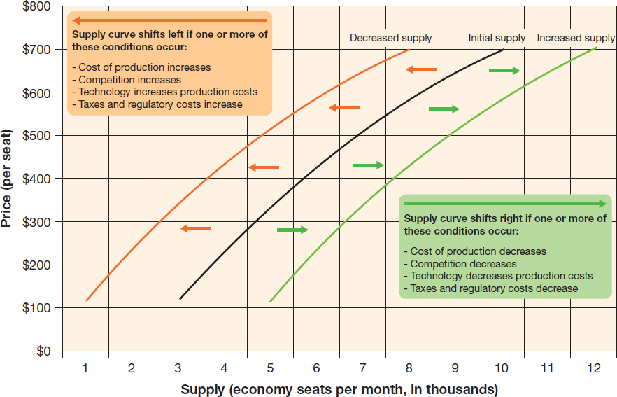
Exhibit 2.4 Supply Curve
Notes:
Exhibit 2.4 shows a possible supply curve for the monthly number of economy tickets (seats) supplied on an airline’s Chicago-to-Denver route at different prices. The graph shows that increasing prices for economy tickets on that route should increase the number of tickets (seats) an airline is willing to provide for that route, and vice versa.

Slide 21
Understanding How Demand and Supply Interact
Equilibrium point
  The point at which quantity supplied equals quantity demanded
Because the supply and demand curves are dynamic, so is the equilibrium point
As variables affecting supply and demand change, so will the equilibrium price
Notes:
The market in effect arranges a compromise known as the equilibrium point, at which the demand and supply curves intersect.

Slide 22
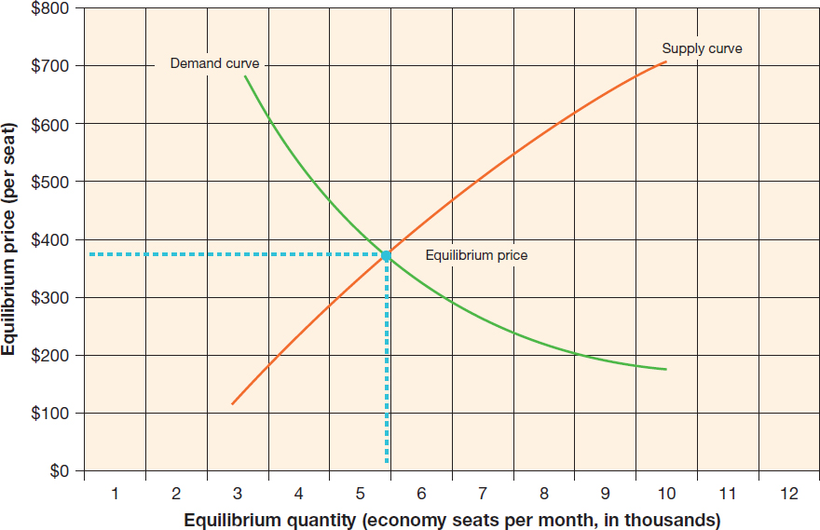
Exhibit 2.5 The Relationship Between Supply and Demand

Slide 23
Competition in a Free-Market System (1 of 3)
Competition
  Rivalry among businesses for the same customers
Pure competition
  A situation in which so many buyers and sellers exist that no single buyer or seller can individually influence market prices
Notes:
Competition is the situation in which two or more suppliers of a product are rivals in the pursuit of the same customers. At one extreme is pure competition, in which no single firm becomes large enough to influence prices and thereby distort the workings of the free-market system. At the other extreme, in a monopoly, one supplier so thoroughly dominates a market that it can control prices and essentially shut out other competitors.

Slide 24
Competition in a Free-Market System (2 of 3)
Monopoly
  A situation in which one company dominates a market to the degree that it can control prices
Monopolistic competition
  A situation in which many sellers differentiate their products from those of competitors in at least some small way
Notes:
Most of the competition in advanced free-market economies is monopolistic competition, in which numerous sellers offer products that can be distinguished from competing products in at least some small way.
The risk/reward nature of capitalism promotes constant innovation in pursuit of competitive advantage, rewarding companies that do the best job of satisfying customers.

Slide 25
Competition in a Free-Market System (3 of 3)
Oligopoly
  A market situation in which a very small number of suppliers, sometimes only two, provide a particular good or service
Notes:
When the number of competitors in a market is quite small, a situation known as oligopoly is created. In an oligopoly, customers have some choice (unlike in a monopoly), but not as many choices as in monopolistic competition.

Slide 26
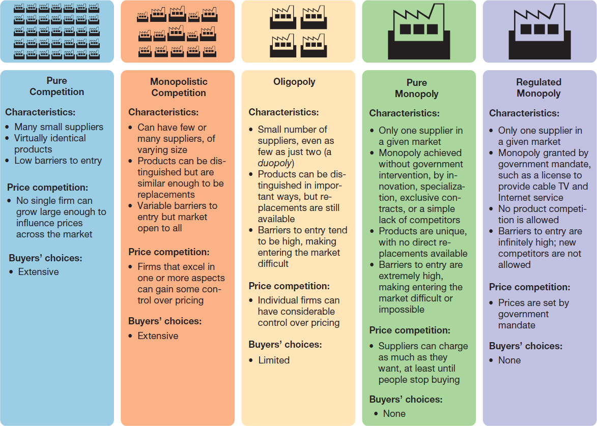
Exhibit 2.6 Categories of Competition

Slide 27
Business Cycles
Recession
  A period during which national income, employment, and production all fall; defined as at least six months of decline in the GDP
Business cycles
  Fluctuations in the rate of growth that an economy experiences over a period of several years
Notes:
If the period of downward swing is severe, the nation may enter into a recession, traditionally defined as two consecutive quarters of decline in the gross domestic product (GDP).
When a downward swing or recession is over, the economy enters into a period of recovery. These up-and-down swings are commonly known as business cycles, although this term is somewhat misleading, because real economies do not expand and contract in regular and predictable “cycles.”

Slide 28
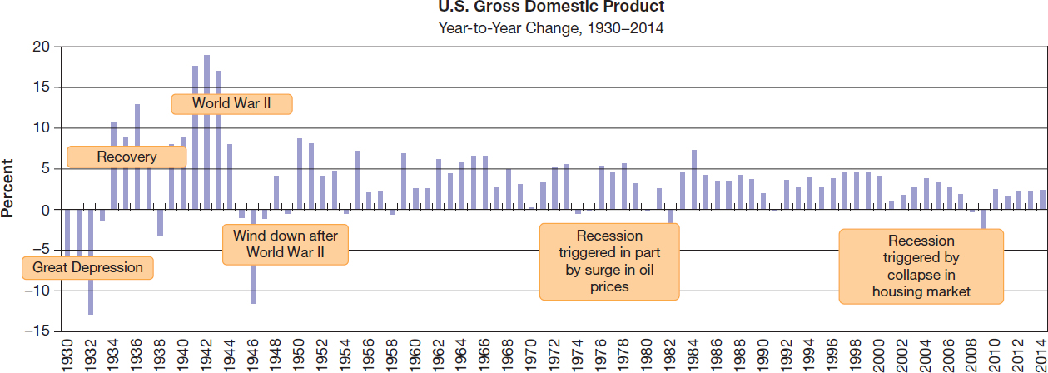
Exhibit 2.7 Fluctuations in the U.S. Economy
Notes:
The U.S. economy has a long history of expansion and contraction. This chart shows the year-to-year change (as a percentage of the previous year) in gross domestic product.

Slide 29
Unemployment
Unemployment rate
  The portion of the labor force (everyone over 16 who has or is looking for a job) currently without a job
Notes:
The unemployment rate indicates the percentage of the labor force currently without employment. The labor force consists of people ages 16 and older who are either working or looking for jobs. However, not all cases of unemployment are the same.

Slide 30
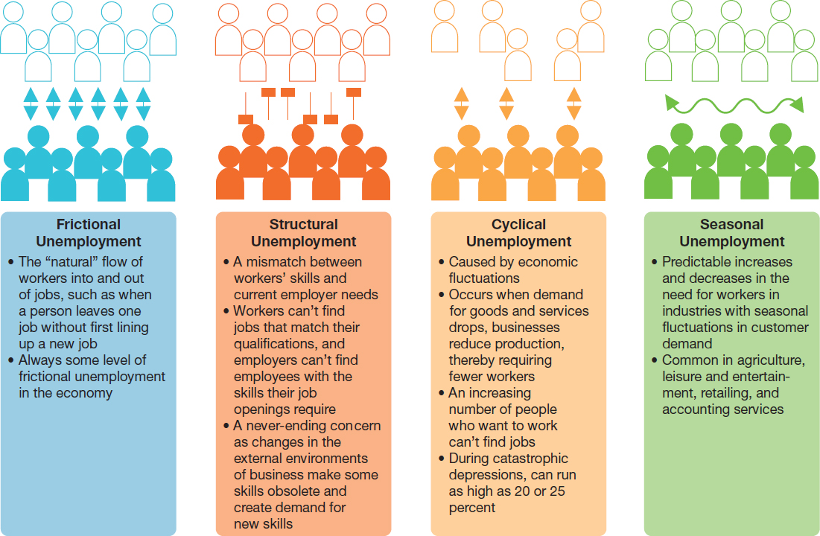
Exhibit 2.8 Types of Unemployment
Notes:
As Exhibit 2.8 explains, each of the four types of unemployment—frictional, structural, cyclical, and seasonal—has unique implications for business and political leaders.

Slide 31
Inflation and Deflation
Inflation
  An economic condition in which prices rise steadily throughout the economy
Deflation
  An economic condition in which prices fall steadily throughout the economy
Notes:
Like almost everything else in the economy, prices of goods and services rarely stay the same for very long. Inflation is a steady rise in the average prices of goods and services throughout the economy. Deflation, on the other hand, is a sustained fall in average prices. Inflation is a major concern for consumers, businesses, and government leaders because of its effect on purchasing power, or the amount of a good or service you can buy for a given amount of money.

Slide 32
Government’s Role in a Free-Market System (1 of 2)
Protecting stakeholders
Fostering competition
Encouraging innovation and economic development
Stabilizing and stimulating the economy

Slide 33
Government’s Role in a Free-Market System (2 of 2)
Regulation
  Relying more on laws and policies than on market forces to govern economic activity
Deregulation
  Removing regulations to allow the market to prevent excesses and correct itself over time
Notes:
Much of the debate about the government’s role can be framed as a question of regulation versus deregulation—having more rules in place to govern economic activity (i.e., regulation) or having fewer rules in place and relying more on the market to prevent excesses and correct itself over time (i.e., deregulation).

Slide 34
Stabilizing and Stimulating the Economy
Monetary policy
  Government policy and actions taken by the Federal Reserve Board to regulate the nation’s money supply
Fiscal policy
  Strategy for the use of government revenue collection and spending to influence the business cycle
Notes:
Monetary policy involves adjusting the nation’s money supply – the amount of “spendable” money in the economy at any given time – by increasing or decreasing interest rates. In the United States, monetary policy is controlled primarily by the Federal Reserve Board (often called “the Fed”), a group of government officials who oversee the country’s central banking system. Chapter 20 discusses the objectives and activities of the Fed in more detail. Fiscal policy involves changes in the government’s revenues and expenditures to stimulate a slow economy or dampen a growing economy that is in danger of overheating and causing inflation.

Slide 35
Exhibit 2.9 Major Government Agencies and What They Do (1 of 2)
Government Agency or Commission | Major Areas of Responsibility
Consumer Financial Protection Bureau (CFPB) | Educates consumers about and supervises providers of consumer financial services
Consumer Product Safety Commission (CPSC) | Regulates and protects public from unreasonable risks of injury from consumer products
Environmental Protection Agency (EPA) | Develops and enforces standards to protect the environment
Equal Employment Opportunity Commission (EEOC) | Protects and resolves discriminatory employment practices
Federal Aviation Administration (FAA) | Sets rules for the commercial airline industry
Federal Communications Commission (FCC) | Oversees communication by telephone, telegraph, radio, and television
Federal Energy Regulatory Commission (FERC) | Regulates rates and sales of electric power and natural gas

Slide 36
Exhibit 2.9 Major Government Agencies and What They Do (2 of 2)
Government Agency or Commission | Major Areas of Responsibility
Federal Highway Administration (FHA) | Regulates vehicle safety requirements
Federal Trade Commission (FTC) | Enforces laws and guidelines regarding unfair business practices and acts to stop false and deceptive advertising and labeling
Food and Drug Administration (FDA) | Enforces laws and regulations to prevent distribution of harmful foods, drugs, medical devices, and cosmetics
Interstate Commerce Commission (ICC) | Regulates and oversees carriers engaged in transportation between states: railroads, bus lines, trucking companies, oil pipelines, and waterways
Occupational Safety and Health Administration (OSHA) | Promotes worker safety and health
Securities and Exchange Commission (SEC) | Protects investors and maintains the integrity of the securities markets
Transportation Security Administration (TSA) | Transportation Security Administration (TSA) Protects the national transportation infrastructure

Slide 37
Exhibit 2.10 Major Types of Taxes
Type of Tax | Levied On
Income taxes | Income earned by individuals and businesses. Income taxes are the government’s largest single source of revenue.
Real property taxes | Assessed value of the land and structures owned by businesses and individuals.
Sales taxes | Retail purchases made by customers. Sales taxes are collected by retail businesses at the time of the sale and then forwarded to state governments. Disputes continue over taxes e-commerce sales made across state lines.
Excise taxes | Selected items such as gasoline, tobacco, and liquor. Often referred to as “sin” taxes, excise taxes are implemented in part to help control potentially harmful practices.
Payroll taxes | Earnings of individuals to help fund Social Security, Medicare, and unemployment compensation. Corporations match employee contributions.
Notes:
Running a government is an expensive affair. Here are the major types of taxes that national governments, states, counties, and cities collect to fund government operations and projects.

Slide 38
Economic Measures and Monitors
Economic indicators
  Statistics that measure the performance of the economy
  Leading, lagging
Notes:
Economic indicators are statistics such as interest rates, unemployment rates, housing data, and industrial productivity that let business and political leaders measure and monitor economic performance. Leading indicators suggest changes that may happen to the economy in the future and are therefore valuable for planning. In contrast, lagging indicators provide confirmation that something has occurred in the past.

Slide 39
Price Indexes
Consumer Price Index (CPI)
  A monthly statistic that measures changes in the prices of a representative collection of consumer goods and services
Producer Price Index (PPI)
  A statistical measure of price trends at the producer and wholesaler levels
Notes:
The consumer price index (CPI), measures the rate of inflation by comparing the change in prices of a representative “basket” of consumer goods and services, such as clothing, food, housing, and transportation (see Exhibit 2.11). The CPI has always been a hot topic because the government uses it to adjust Social Security payments, businesses use it to calculate cost-of-living increases for employees, and many use it as a gauge of how well the government is keeping inflation under control. In contrast to the CPI, the producer price index (PPI) measures prices at the producer or wholesaler level, reflecting what businesses are paying for the products they need. (Like the CPI, the PPI is often referred to as a single index, but it is actually a family of more than 600 industry-specific indexes.)

Slide 40
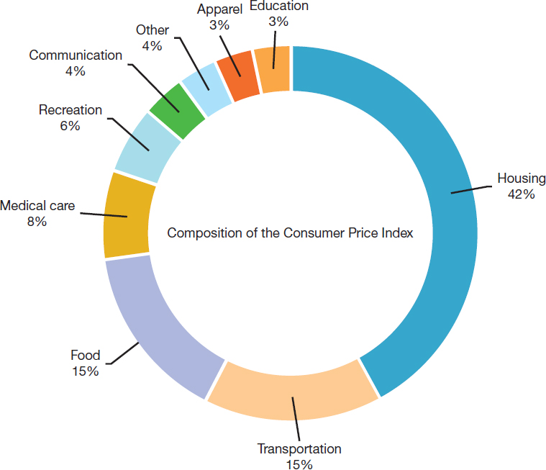
Exhibit 2.11 Composition of the Consumer Price Index

Slide 41
National Economic Output
Gross domestic product (GDP)
  The value of all the final goods and services produced by businesses located within a nation’s borders; excludes outputs from overseas operations of domestic companies
Notes:
The broadest measure of an economy’s health is the gross domestic product (GDP). The GDP measures a country’s output—its production, distribution, and use of goods and services— by computing the sum of all goods and services produced for final use in a country during a specified period (usually a year).

Slide 42
Applying What You’ve Learned (1 of 2)
Define economics, and explain why scarcity is central to economic decision making.
Differentiate among the major types of economic systems.
Explain the interaction between demand and supply.

Slide 43
Applying What You’ve Learned (2 of 2)
Identify four macroeconomic issues that are essential to understanding the behavior of the economy.
Outline the debate over deregulation, and identify four key roles that governments play in the economy.
Identify the major ways of measuring economic activity.

Slide 44
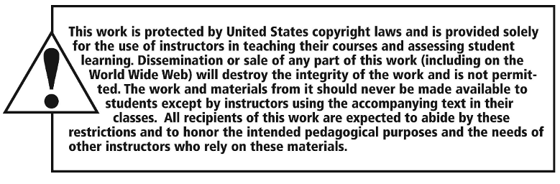
Copyright

