Slide 1
AP BIOLOGY
EVOLUTION

Slide 2
AP BIOLOGY: EVOLUTION
Early Theories of Evolution
Aristotle: viewed species as fixed and unchanging
scala naturae “scale of nature”
Each form of life was perfect and unchanging
Each form of life had a place on a ladder

Slide 3
AP BIOLOGY: EVOLUTION
Early Theories of Evolution
Lamarck:
Use and Disuse
Inheritance of Acquired Characteristics
Evolution happens because organism have an innate (inborn, natural) drive to become more complex

Slide 4
AP BIOLOGY: EVOLUTION
Darwin
Sailed to the Galapagos Islands – studied finches and tortoises
Published On the Origin of Species
http://darwin-online.org.uk/
Natural Selection: A process in which organisms with certain inherited characteristics are more likely to survive and reproduce than are organisms with other characteristics.

Slide 5
AP BIOLOGY: EVOLUTION
Natural Selection
More organisms/individuals are born than can survive
There is variation (natural differences) within a species
Individuals compete for resources. Resources may be limited – leads to a struggle for existence
Those individuals who are most fit (have traits better suited) for their environment survive and reproduce
Beneficial traits are selected for and will therefore increase – while other traits may decrease

Slide 6
AP BIOLOGY: EVOLUTION
EVIDENCE FOR EVOLUTION
Paleontology: fossil record
Embryology: similarities in embryonic development among different species
Comparative Anatomy: homologous and analogous structures. Vestigial structures
Biogeography: distribution of life on earth
Molecular Biology: DNA and RNA are shared by all modern living systems. DNA (nucleotide) and Protein (amino acid) sequences

Slide 7
AP BIOLOGY: EVOLUTION
Hardy Weinberg Equilibrium
Large Population
Random Mating
No Migration
No Mutations
No Selection
p + q = 1
p2 + 2pq + q2 = 1
A population’s allele frequencies (p value and q value) WILL STAY THE SAME IF these condition are met.
No change in allele frequency means no evolution is taking place.
This principle is important because it gives scientists a standard from which to measure changes allele frequencies in a population.

Slide 8
AP BIOLOGY: EVOLUTION
p + q = 1
This equation is for the allele frequency – the dominant and/or the recessive allele frequency.
You must ALWAYS find ‘q’ before plugging and chugging.
p2 + 2pq + q2 = 1
This equation is used to find population percentages or numbers. p2 is homozygous dominant; 2pq is heterozygous q2 is homozygous recessive

Slide 9
AP BIOLOGY: EVOLUTION
TYPES OF SELECTION [see page 480 in text book]
Stabilizing Selection: removes extreme variants from the population and preserves intermediate types.
Directional Selection: shifts the overall makeup of the population by favoring variants that are at one extreme of the distribution.
Disruptive or Diversifying Selection: favors variants at both ends of the distribution.

Slide 10
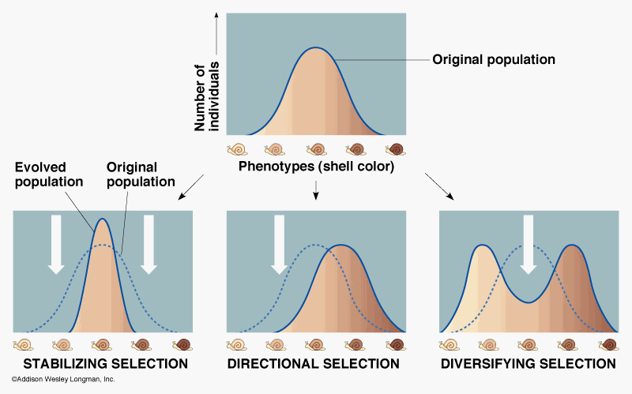
AP BIOLOGY: EVOLUTION
TYPES OF SELECTION
What is the significance of selection?

Slide 11
AP BIOLOGY: EVOLUTION
Mechanisms for Evolution
Genetic Drift: random chance affects a gene pool
Founder effect: certain individuals leave and start a new population
Bottleneck effect: only certain individuals survive a catastrophic event
Natural selection
Mutations
Gene Flow
Sexual Selection: mates choose partners with specific traits.

Slide 12
AP BIOLOGY: EVOLUTION
Speciation: Forming New Species
Species: interbreeding organisms that can produce fertile offspring
Speciation rates can vary, especially when adaptive radiation occurs and new habitats become available.
Species extinction rates are rapid at times of ecological stress (five major extinctions; human impact).

Slide 13
AP BIOLOGY: EVOLUTION
Speciation: Forming New Species
Isolation of populations contribute to speciation (members cannot interbreed) which can be rapid or over millions of years
Types of isolation: prezygotic- habitat, behavioral, temporal, or mechanical
Allopatric Speciation – geographical isolation
Sympatric Speciation – no geological isolation , but gene flow is reduced by polyploidy in plants, habitat differentiation, or sexual selection
Postzygotic

Slide 14
AP BIOLOGY: EVOLUTION
Patterns of Evolution
Gradualism: Gradual change through time. Example: Evolution of elephants
I found this really cool website you may want to check this out
http://www.sanparks.org/parks/kruger/elephants/about/evolution.php
Punctuated equilibrium: long periods of stasis (stability) with bursts of rapid speciation due to environmental pressure

Slide 15
AP BIOLOGY: EVOLUTION
Phylogenetics and Math Models
Phylogenetic trees and cladograms can represent traits that are either derived or lost due to evolution.
Phylogenetic trees and cladograms illustrate speciation that has occurred, in that relatedness of any two groups on the tree is shown by how recently two groups had a common ancestor.
Phylogenetic trees and cladograms can be constructed from morphological similarities of living or fossil species, and from DNA and protein sequence similarities by using computer programs (ie BLAST)
Phylogenetic trees and cladograms are dynamic (constantly being revised) based on the biological data used, new mathematical and computational ideas, and current and emerging knowledge.

Slide 16
AP BIOLOGY: EVOLUTION

