Slide 1
SCRUB, GOWN AND GLOVE
Objective: Explain and demonstrate the proper techniques for the surgical hand scrub, gowning , gloving and assisting team members.

Slide 2
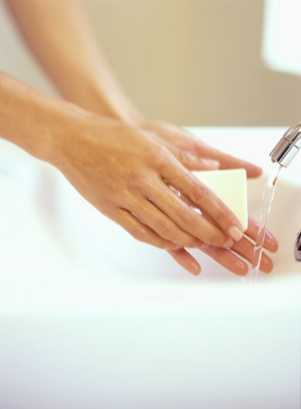
“THE SURGICAL SCRUB”
Once the sterile field had been established
All personal needs are taken care of….(necessary PPE’S)
These items need to be donned, before the surgical scrub!

Slide 3
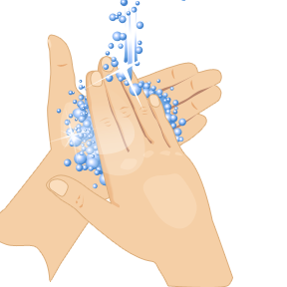
“SURGICAL SCRUB”
To remove as many microorganisms as possible from the hands and arms.
TRANSIENT
RESIDENT
To render them surgically clean, prior to donning the sterile gown and gloves

Slide 4
SURGICAL SCRUB…..Solution
Solution that provides a film of protection lasting for several hours:
Chlorhexidine Gluconate-Hibiclens
Iodophor-Povodine iodine in detergent
Triclosan
Alcohol

Slide 5

Equipment and Methods For the Surgical Scrub….
Disposable (impregnated) scrub brushes or plain scrub brushes (with nail cleaner)
Containers of various antiseptic solutions (operated by a foot pump)

Slide 6

Methods….
Timed Method
Counted Brush Stroke Method

Slide 7
Timed Method:
The hands and arms are scrubbed for a prescribed length of time
3 to 5 minutes- (maybe even 10)

Slide 8
Counted Brush-Stroke Method
Requires a measured number of brush strokes for each anatomical area to be scrubbed.
Healthcare facility policy will dictate the method of scrub to be performed.

Slide 9

Avagard
Alternative to surgical hand antisepsis

Slide 10
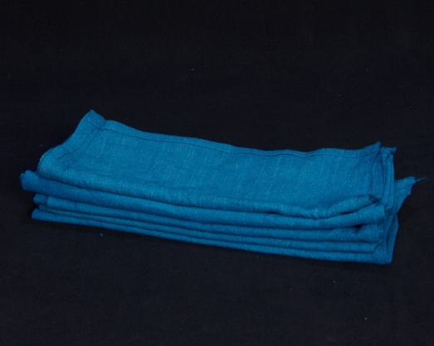
Drying and Gowning
Once scrub is complete, proceed directly to OR suite
Keeping hands between the waist and the mid-chest (avoid touching anything with hands and arms)
Gown and gloves were opened by STSR on mayo stand prior to surgical scrub

Slide 11

Drying and Gowning Continued…
Approach sterile field with caution
Keep elbows bent
Pinch and Lift towel without dripping
Step away, arms extended
Unfold towel without allowing the edges to fall below waist.
Bend slightly at waist
Hold towel in palm of one hand
Transfer towel to opposite hand
Dry opposite hand and arm
Discard towel in the proper manner

Slide 12
Gowning
Heightened awareness of the total environment
Pick up gown after drying hand and arms
Lift gown while keeping body away from Mayo stand
Identify collar, orient gown
Release lower portion and identify arm openings
Enter sleeves
Flex arms to hold gown in place

Slide 13
Gowning continued…..
Fasteners at shoulders and waist must be secured….by?
Circulator
Surgical Tech
Anesthesia tech
Anesthesiologist
Surgeon
Turning the gown

Slide 14
CLOSED GLOVED METHOD
Donning gloves following the surgical scrub and after the sterile gown has been donned
Working off the mayo stand (never the back table)
Secure the first glove, keeping the fingers within the cuff
Align the glove on the palm of the hand that will be gloved first, with thumb side of the glove toward your palm and the fingertips toward your elbows

Slide 15
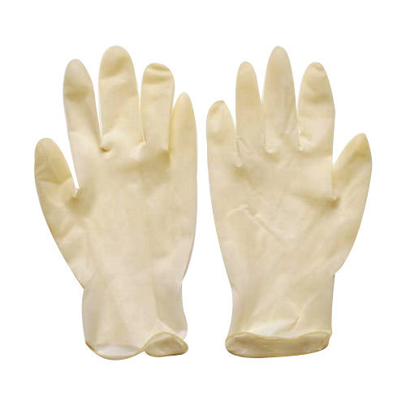
Closed Glove Method Continued…
3. Pull the cuff of the glove over the cuff of the gown
4. Unfold the cuff to completely cover the cuff of the gown
5. Grasp the glove and the gown at wrist level
6. Work the fingers into the glove as the glove is pulled into position
7. Secure the second glove and apply using the same technique
8. DOUBLE GLOVE

