Slide 1
COUNTS, SPONGES AND DRESSINGS
Counts are required for most procedures according to facility policy. Countable
items include, but are not limited to, sharps, instruments, and sponges. The
number of counts required for an individual case will also vary according to the
situation.
PURPOSE OF COUNTING……
To protect the patient
Protect you and your hospital
-- Each hospital has their own policy and procedure
according to AORN standards.
WHEN DO WE DO A COUNT????
Initial count (before the Dr. makes the incision
Intra-operatively (if a hollow organ is involved in the procedure)
(before certain layers are closed, abdominal hysterectomy, C-section;
uterus, vaginal cuff etc.
When sponges are added to the field
Changing shifts, relief
Especially bloody cases, lots of sponges being added to the procedure
IMPORTANT THINGS TO REMEMBER!!!!!!
Silently or out-loud
Appropriate talk and timing
Count don’t add
Always start your count from the field (don’t forget sponges in wound)
Make sure you see each sponge when counting with circulator
Open sponge all the way before discarding off the field
Watch out for prep sponges (sponge sticks, D&C, OB-Gyn, abdominal
vaginal hysterectomy
Sponges are never to leave the OR suite
Never use sponges to pass off specimens
Circulator should bag them into count bags (hung from Iv pole)
When using sponges blot do not rub tissue
Make sure count goes up on dry erase board
Utilize kick buckets
Do not collect soiled sponges on surgical field
Always have a clean sponge ready for the Doctor/assistant

Slide 2
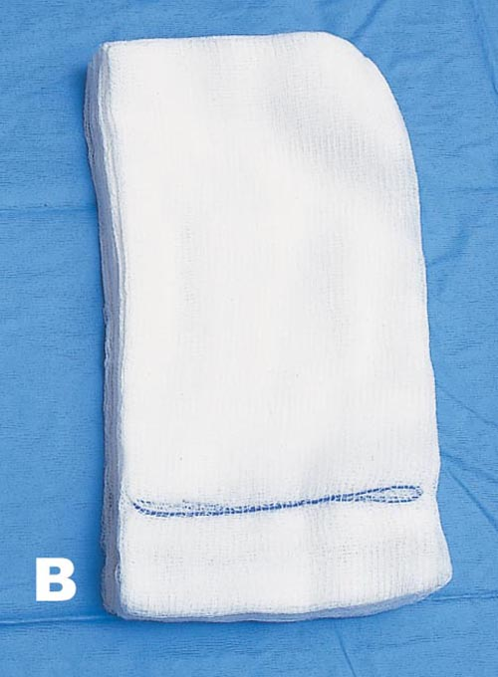
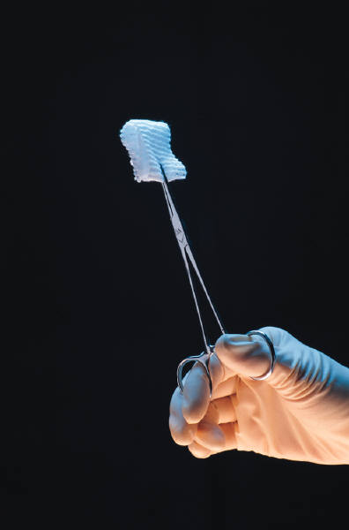
VARIETIES OF SPONGES AND SPECIAL USES
RAY-TEC, 4x4, 4x8
SM INCISIONS
SKIN SPONGES
SPONGE STICKS
NOT LOOSE OR IN LARGE CAVITY
TIED OR SECURED
MOIST (DEPENDS)
NEVER USE FOR DRESSINGS
10 to a pack

Slide 3
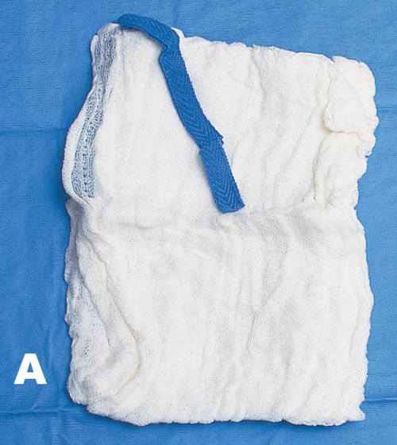
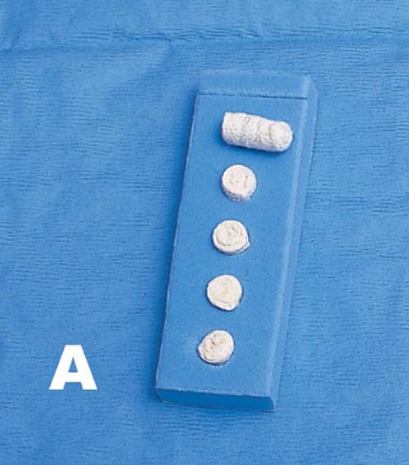
LAP SPONGES (LAPAROTOMY)
Typically abbreviated as “lap” other examples include lap tape, lap
Pad, or lap pack. Large piece of gauze with a radiopaque marker,
Most often used in the abdominal cavity to isolate an organ while
Keeping others moist and warm.
Abdominal, chest wounds
Other large incisions
Usually moist
Packing
Dry skin sponges
Protection wound, skin edges
Never to be used as dressings
5 to a pack
DISSSECTORS, KITNERS, PEANUTS, CHERRIES
Blunt dissection
Hold with instrument (kelly, peon usually longer) hole in the middle
Never loose
Do not discard form field
Used moist or dry
keep adhered to mayo-stand (sticky backing)
Always counted (comes 5 to a pack)

Slide 4
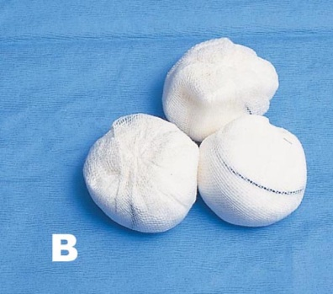
TONSIL SPONGES
Used in tonsillectomies
Used with tonsil tenaculum
Always counted
Sometimes soaked in local or saline depending on Dr.
Come with strings, do not cut or remove unless asked
radiopaque embedded throughout\
5 to a pack
NEURO PATTIES, COTTONOIDS
Used mostly in neuro cases (craniotomies, laminectomies, cervical fusions)
Sometimes ENT
Radiopaque throughout do not cut strings
Do not throw off field
Be very careful handling these
Lint free, always moist- saline, meds
10 to one size
WECK SPEARS
Used mostly in eye cases, or plastics
Lint free
No counting
Holds about 16 cc fluid

Slide 5
DRESSINGS
Used to protect wound from contamination, absorption of drainage
And support. To enhance well being. Support, application of
pressure
4x4
Telfa
ABD
Pants (mesh underwear)
Fluffs
Adaptic
Montgomery straps
Kling
Kerlix
Ace
Binders
Splints
Kotex
Bias rolls
Owens silk (plastics)
Bandaids
Xeroform (impregnated with iodine)
Packing (used in body cavity long strips of gauze impregnated
with meds, saline or lubricant
--vag packing
.drain sponges
Items used in conjunction with these dressings are as follows-
tape (several different kinds)
Colloidian
Dermabond
Mastisol
Safety pins

Slide 6
IT IS YOUR RESPONSIBILITY AS THE SURGCIAL
TECHNOLOGIST TO MAKE CERTAIN THAT YOU HAVE
CHECKED THE DR’S PREFRENCE CARD TO MAKE SURE
THAT YOU HAVE THE PROPER SURGICAL DRESSINGS
PREPARED AND READY TO ADHERE TO THE PATIENT,
PRIOR TO THE DRAPES BEING REMOVED.
4X4’S OPENED
BANDAIDS TAKEN OUT OF WRAPPER
TAPE CUT TO PROPER LENGTH
CLEAN ALL BLOOD AND BETADINE FROM PATIENT BEFORE DRESSINGS
Why is it so important not to use counted sponges as
Dressings on the surgical patient???????

