Slide 1
CHAPTER 11
Wound Healing, Sutures,
Needles, and Stapling Devices

Slide 2
Types of Wounds
Surgical Wound
  Incisional
  Excisional
Traumatic Wound
  Closed
  Open
  Simple
  Complicated
  Clean
  Contaminated

Slide 3
Wound Classification
Class I : Clean
Class II: Clean Contaminated
Class III: Contaminated
Class IV: Dirty

Slide 4
Phases of Wound Healing
First intention (primary union)
  Lag/inflammatory response
  Proliferation
  Maturation/differentiation
Second intention (granulation)
Third intention (delayed primary closure)

Slide 5
Principles of Wound Closure
Minimize bacterial contamination
Remove foreign bodies and devitalized tissue
Achieve hemostasis

Slide 6
Principles of Wound Closure
Handle tissue gently
  Use toothed forcep ex: Adson
Do not use smooth forceps
  Since these crush tissue because they require greater pressure to grasp

Slide 7
Inflammatory Process
Pain (dolor)
Heat (calor)
Redness (rubor)
Swelling (tumor)
Loss of function (functio laesa)

Slide 8
Factors
Influencing Wound Healing
Age
Nutrition
Disease
Smoking
Radiation
Immune deficiency

Slide 9
Terminology
Dehiscence
Evisceration
Adhesion
Herniation
Fistula
Sinus tract

Slide 10
Suture
Two basic types:
  Monofilament: Prolene, Nylon, Catgut, PDS, Monocryl
  Multifilament (braided or twisted): Silk, Vicryl, Braided Polyester

Slide 11
Monofilament
Monofilament sutures
  More difficult to handle and tie and require more knots
  Preferred for closing an infected wound (no wicking)

Slide 12
Monofilament
© 2004 by Delmar Learning, a division of Thomson Learning, Inc. All Rights Reserved.
11-12
Prolene
Nylon
Catgut
PDS
Monocryl

Slide 13
Multifilament
Multifilament sutures are reactive and prone to infection
Vicryl
Silk
Braided Polyester

Slide 14
Characteristics of a Common Suture
Absorption rate
Size
Tensile strength
Elasticity
Knot strength
Memory
Wicking
Tissue reaction

Slide 15
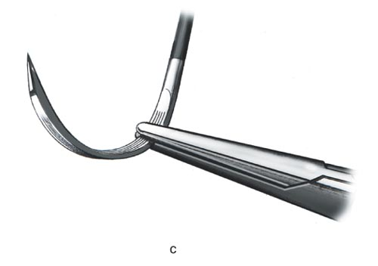
Needles
Characteristics
  Eye
  Point
  Body
  Shape
Placement on needle holder

Slide 16
Needle Point
Cutting
  Tough tissue
    Skin
  Reverse
  Side
    Ophthalmology

Slide 17
Needle Point
Tapered
  Delicate tissue
    Bowel, artery
  Tapercut

Slide 18
Needle Point
Blunt
  Kidney, liver

Slide 19
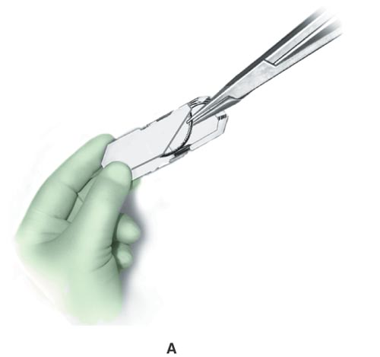
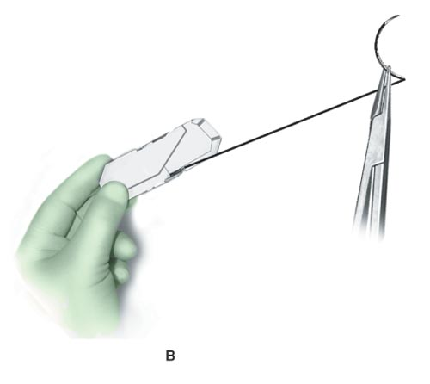
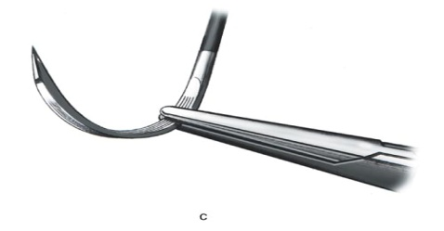
Loading Needle

Slide 20
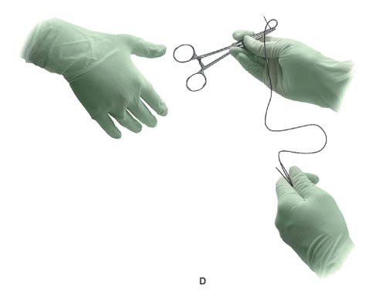
Passing Suture

Slide 21
Terminology
Tensile strength
Absorbable
Nonabsorbable
Monofilament
Multifilament
Inert

Slide 22
Tie Terms
Free-tie
  Place a tie into the surgeons hands
Stick-tie
  A suture on a needle holder

Slide 23
Tie Terms
Tie on a passer
  Place just the tie on an instrument, usually a tonsil or right angle clamp
Ligate
  To tie

Slide 24
Commonly Used Needle Codes
- CP - KS - SH
- CT - MO - TF
- CTX - OS - UR
- CV - PS
- FS - RB
- FSL - S

Slide 25
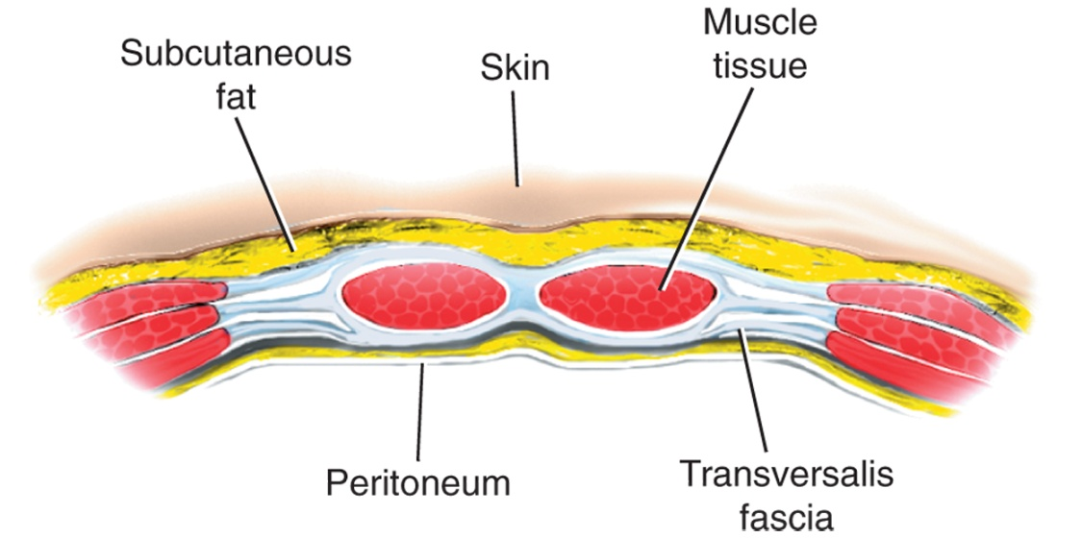
Layer Closure for Abdominal Wounds
Peritoneum
Fascia
Muscle
Subcutaneous
Subcuticular
Skin

Slide 26
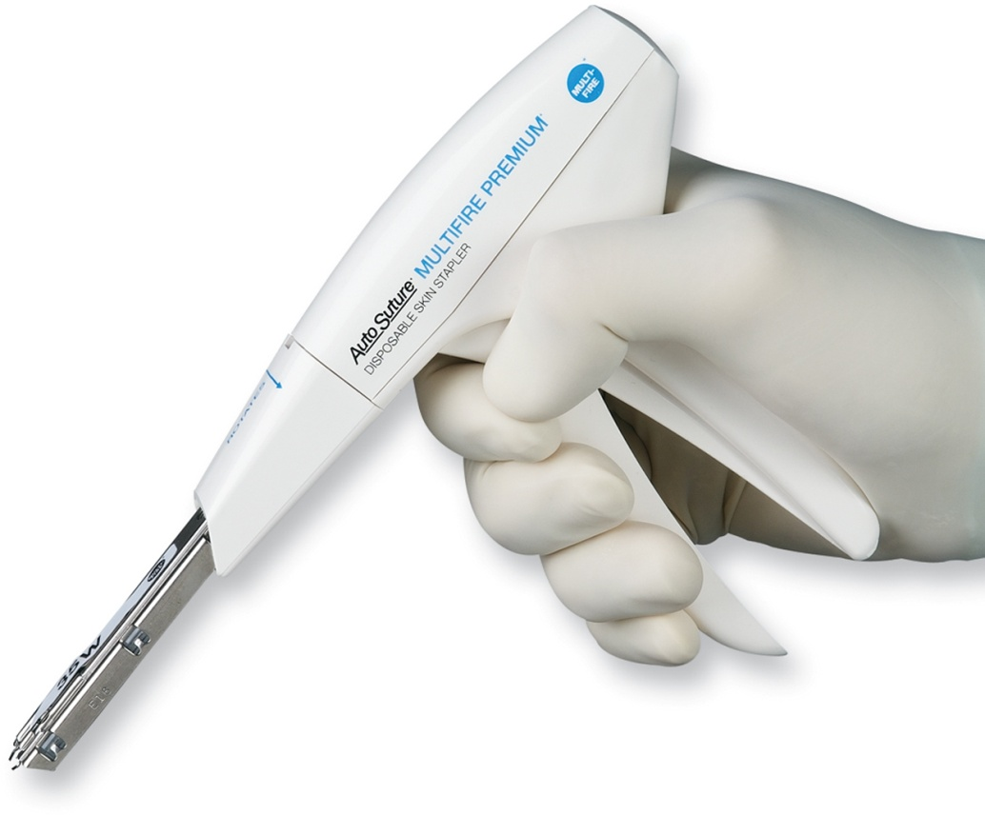
Stapling Devices
Skin Stapler

Slide 27
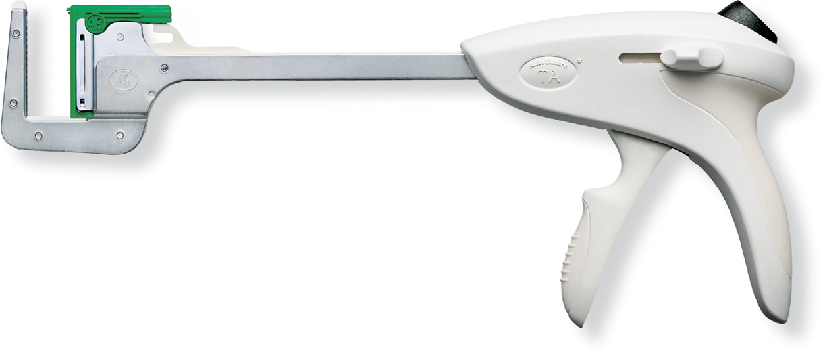
Stapling Devices
Linear Stapler

Slide 28
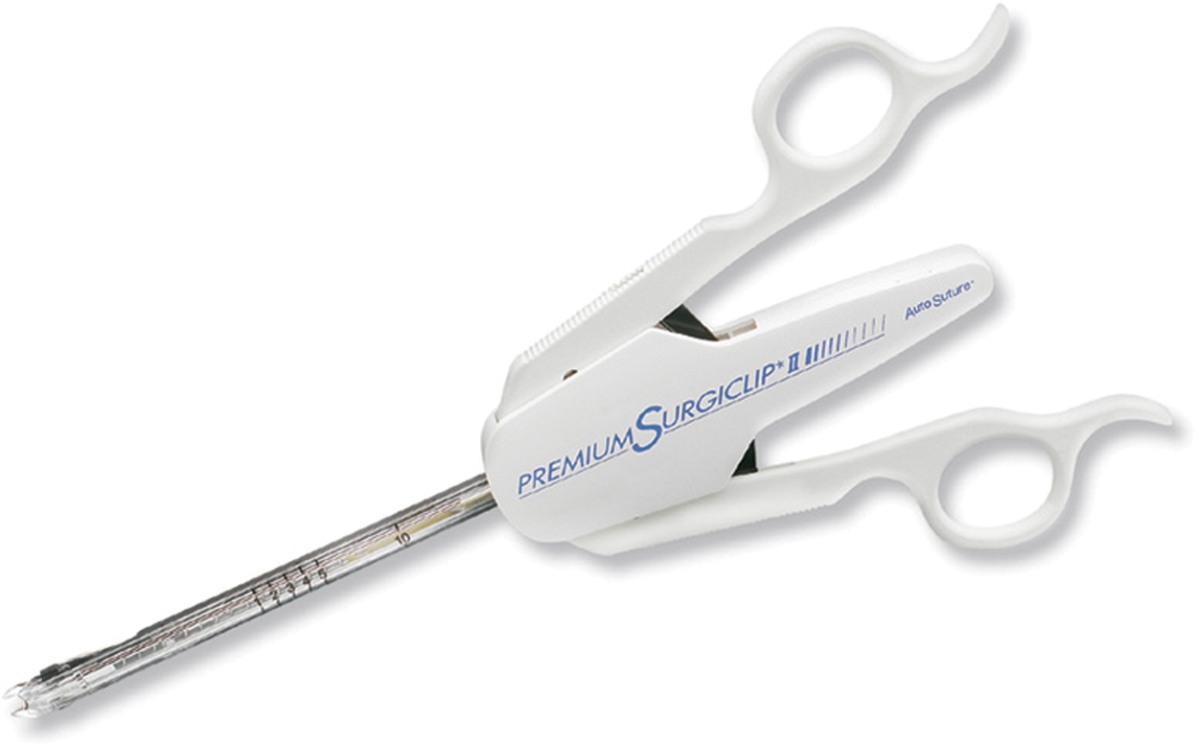
Stapling Devices
Automated Ligating Clip Applier

Slide 29
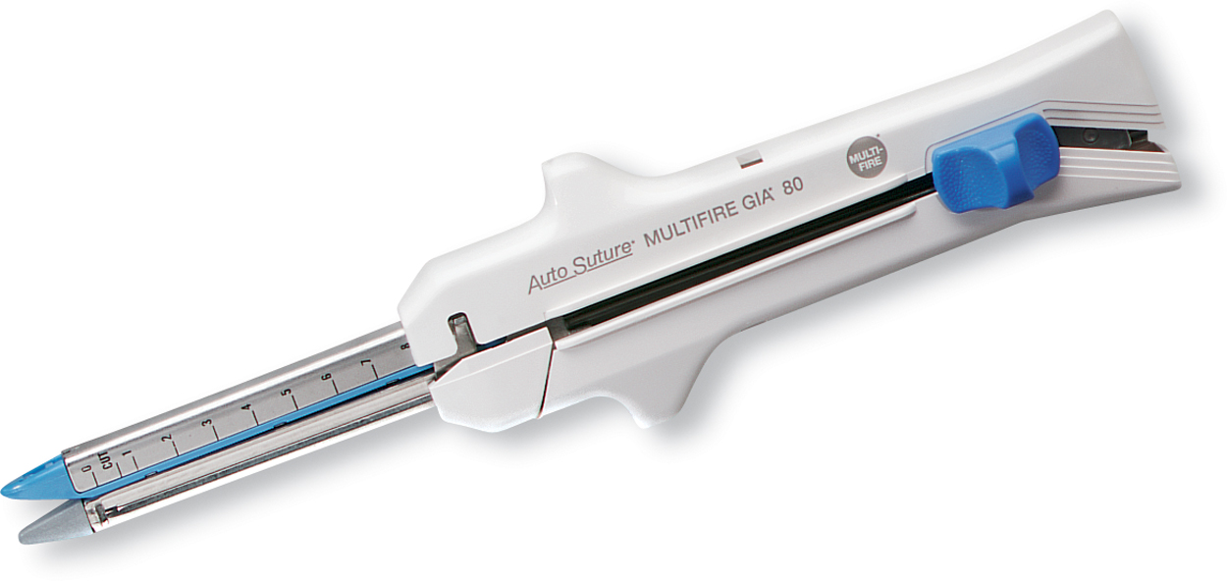
Stapling Devices
Linear Cutter

Slide 30
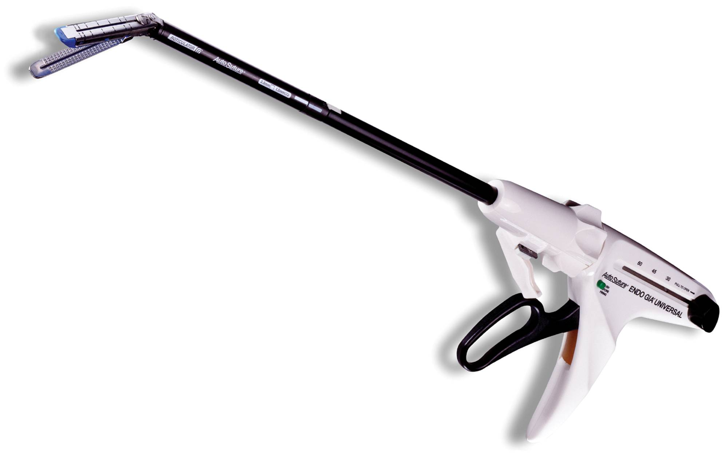
Stapling Devices
Endoscopic Linear Cutter

Slide 31
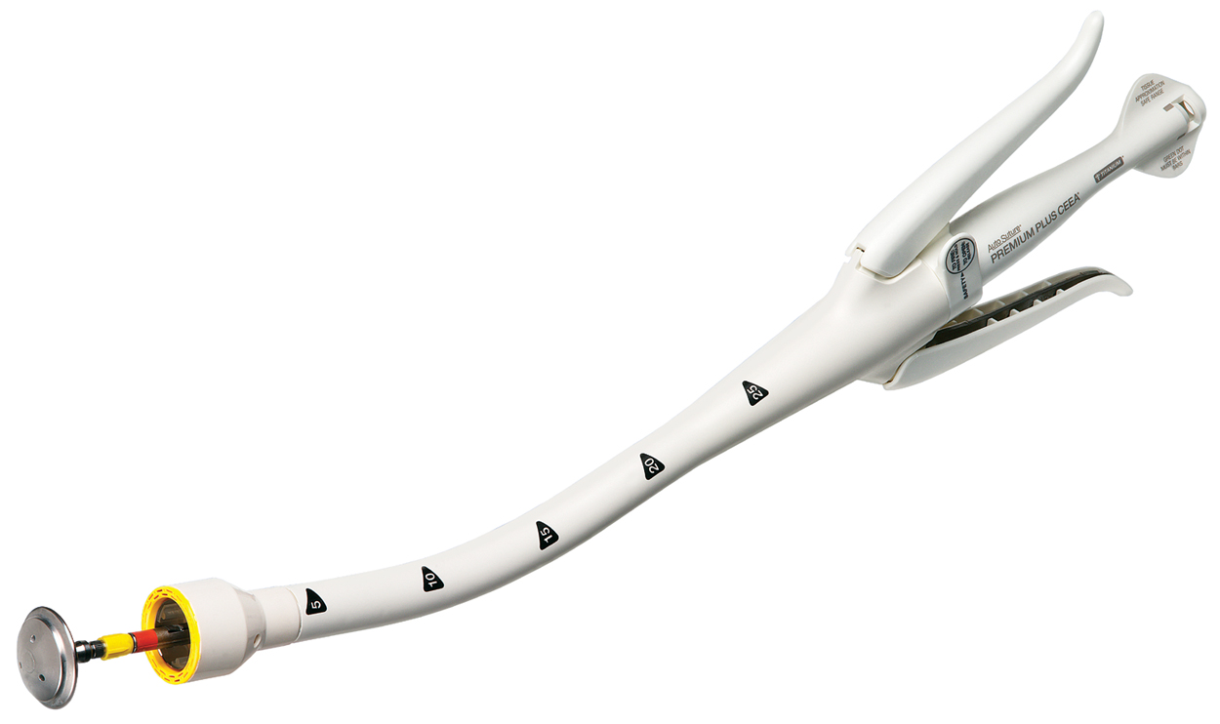
Stapling Devices
Open Intraluminal Stapler

Slide 32
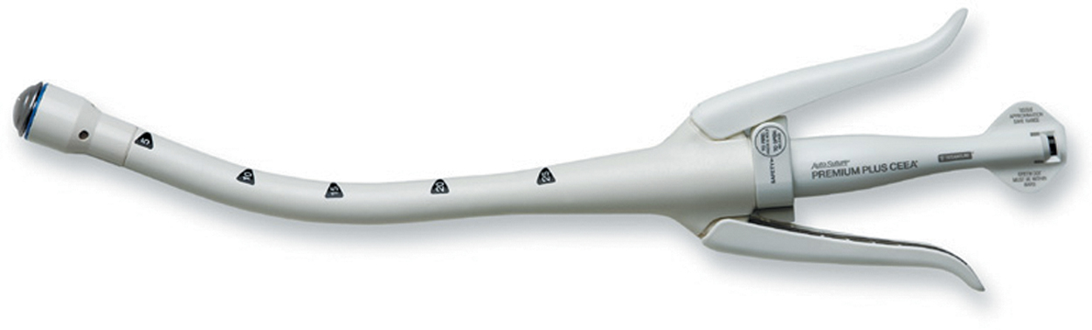
Stapling Devices
Closed Intraluminal Stapler

