Slide 1
EQ:
How do you:
solve an equation for “y”?
solve an equation for “y” in terms of “x”?
write an equation in slope/intercept form?
( y = mx + b )

Slide 2
Activate:
Solve:
2x + 7 = 4x – 8
JUSTIFY EACH STEP!!

Slide 3
Teacher Tube
  Solve an Equation for “Y”

Slide 4
2 steps:
  Add or subtract the “x” term,
  Divide by the coefficient of “y”!

Slide 5
  Add or subtract the “x” term,
  Divide by the coefficient of “y”!

Slide 6
Model: Justify each step!
4x + 4y = 8

Slide 7
Assessment Prompt
How do you move the x term?

Slide 8
Danger, Will Robinson!!
Divide EACH term in the equation by the coefficient of “y”.
If you have “-y” on the left, you must divide EACH term by -1.

Slide 9
Assessment Prompt
What does solving for y mean? Or really solving for any variable mean?
When isolating y from its coefficient, what gets divided by the coefficient?

Slide 10
Your Turn: Pair/Share
2y + 3x = 2
5x – y = -1

Slide 11
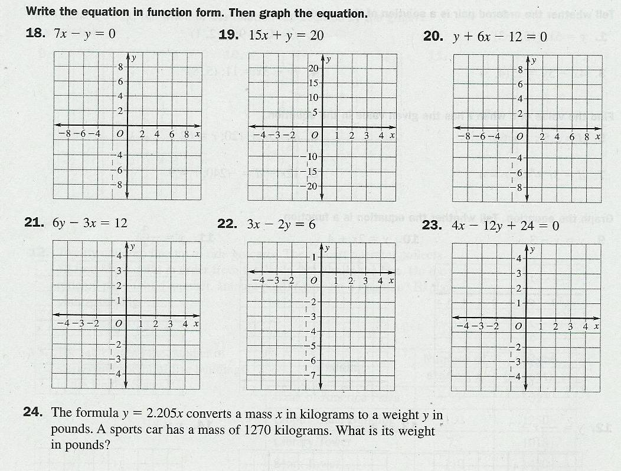

Slide 12
Homework: Worksheet 8.3 #4-15
For #4-15 solve each problem for y or for f(x)
That means isolate y.

Slide 13
Summarize:
Sing along with G-Dawg!
ELO:
Pizzazz 148
(Show your work on the back!!)

