Slide 1
Disinfection
Chapter 10 7th Ed.
Rosemary Thurston RN

Slide 2
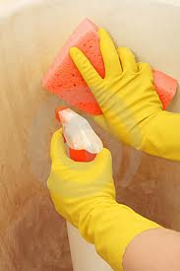
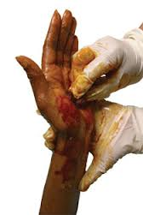
Disinfection
Chemical process
  Kills most pathogenic microorganisms
  Used on inanimate surface
Disinfectant
  Chemical that kills most microorganisms
  BUT DOES NOT KILL SPORES
Antiseptics – used on living tissue
  Slows the growth of microorganisms

Slide 3
Sterilization
  Process that kills / destroys
  ALL FORMS OF MICROORGANISMS
Processes
  Steam
  Dry heat
  ETO
  Hydrogen peroxide / Plasma
  Parasitic Acid / Steris
Except Prions -
  We will discuss them later

Slide 4

Items must be CLEAN
  Before you can Disinfect OR Sterilize
  Must be able to get to surface to sterilize / disinfect
“You can clean without disinfecting/sterilizing,
You can’t disinfect / sterilize without cleaning”

Slide 5
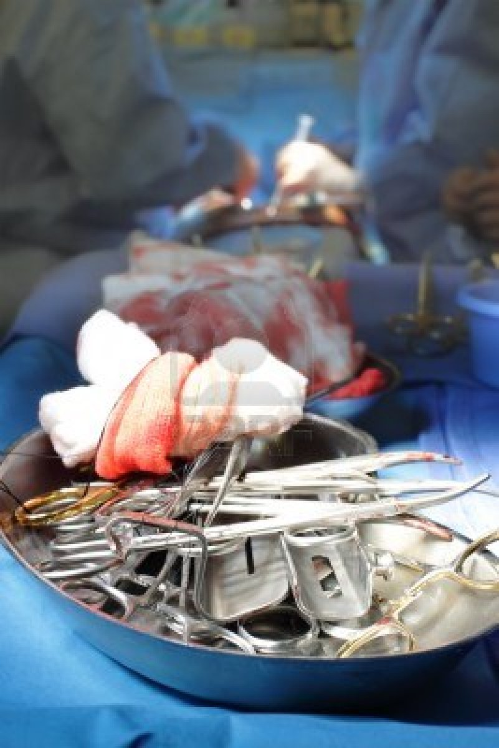
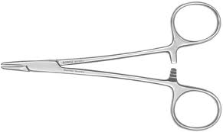
Factors for Effectiveness
Organic matter :
  Blood / serum
  Fecal material
  Pus
Can:
  Stop the agent from contact with item
  Inactivate some disinfectant liquids
MUST BE . . . CLEAN!!!!! 1st

Slide 6
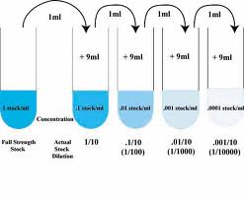
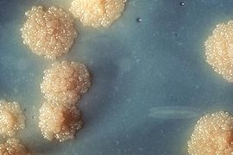
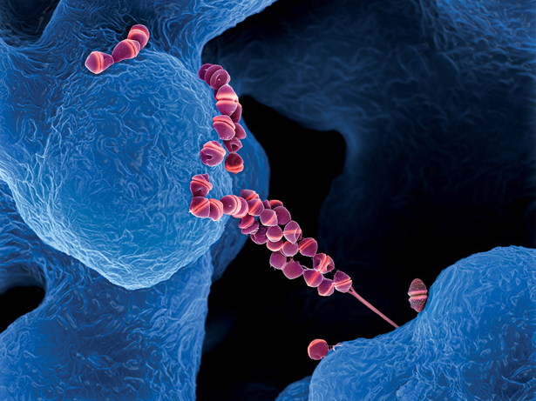
Excessive Moisture
  Dilutes the disinfectant
    Concentration is lower
    May be unable to kill organisms in time specified
Type and number of microorganisms
  Some are resistant to aqueous solution
    TB has waxy coat – water can’t penetrate
  Number / bioburden can be overwhelming
    If it is still dirty – it won’t work

Slide 7
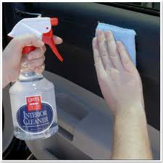

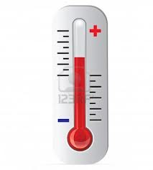
Must have direct contact with item
  No oils, protein, soil on item
Time to be bacteriocidal
  Can be a problem –
    ie. alcohol dries quickly
Temperature
  May have to be heated to be optimal

Slide 8
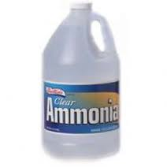
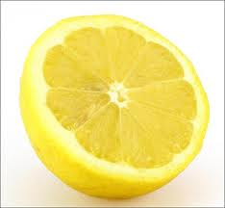
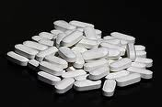
pH
  Most work in a range of pH
  Some work better with alkaline pH – higher than 7
  Some work better with acid pH – lower than 7
Hardness of water
  Calcium / magnesium may combine
  With disinfectant = inactive
    must know your water quality

Slide 9

Material compatibility of device
  Must match disinfectant to material
  Per OEM’s instructions
Position of device
  Soaking device with lumen horizontally
    May leave air bubbles
    Bubbles prevent contact with disinfectant
      http://www.youtube.com/watch?v=r5Y1VvNC85c
  Soaking vertically allows bubbles to rise out of solution / lumen (no air pockets)
      http://www.youtube.com/watch?v=me16E6BDX20

Slide 10
US Agencies regulating Germicides
  EPA
  FDA
Risk Levels – relationship between:
  Intended Use of an item AND
  Selecting a disinfectant
  Based on Spaulding Classification system
    Adopted by the CDC and AAMI

Slide 11
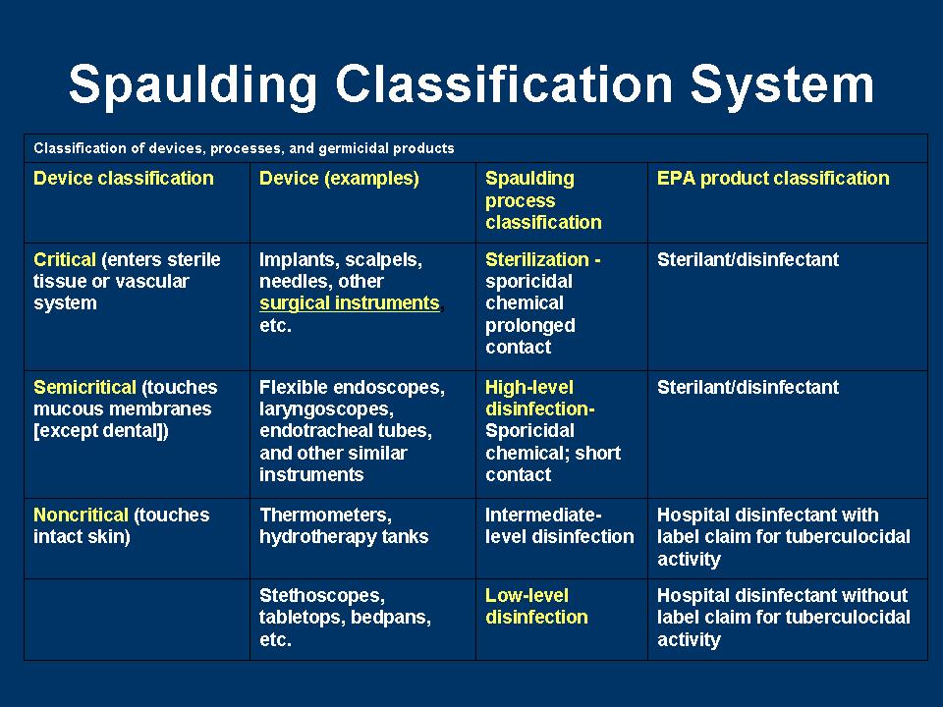

Slide 12
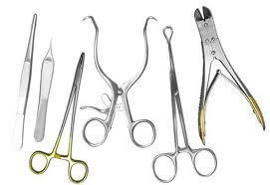
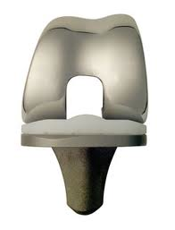
Selection based on:
  Intended us of device
  Degree of disinfection required
3 categories based on risk of infection from pt.
  Critical
    Used in blood steam / sterile areas of body
      Instruments, implants, catheters, dialysis
    Must be STERILE

Slide 13
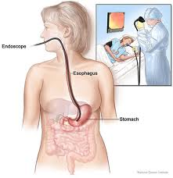
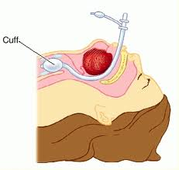
  Semi-critical
    Contact intact mucous membranes – don’t penetrate
      Flexible fiberoptic endoscopes, endotracheal tubes, anesthesia breathing circuits
    Sterilization is desirable – not essential
    Should have HIGH LEVEL DISINFECTION
      Must destroy –
        Vegetative organisms
        Fungus spores
        TB (waxy coat)
        Viruses – lipid and non-lipid
      Must be CLEAN first

Slide 14
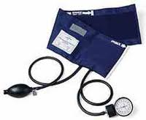
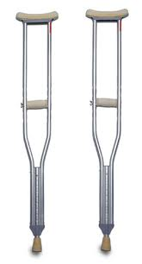
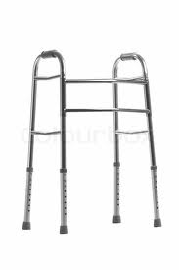
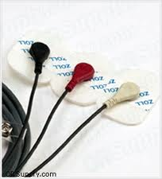
  Non-critical
    Usually contact intact skin
      Blood pressure cuff, crutches, EKG electrodes

Slide 15
Classification of Pt. Care Items
BODY CONTACT | ITEM CLASS | DESTRUCTION METHOD
INTACT SKIN | NON-CRITICAL | LOW LEVEL
MUCOUS MEMBRANES | SEMI-CRITICAL | HIGH-LEVEL
STERILE BODY CAVITY OR AREA | CRITICAL | STERILIZATION

Slide 16
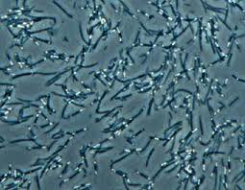
Disinfectant ACTIVITY Levels
  High level if sterilization is not possible
    Per the CDC
    Destroys vegetative microorganisms, incl. TB, most fungi, non-lipid and small viruses
      Except high numbers of bacterial spores
Except many Bacterial SPORES

Slide 17
  Intermediate-Level
    Destroys most microorganisms that high-level does, not necessarily Bacterial SPORES
  Low-Level
    Destroys vegetative forms of bacteria, some fungi and lipid viruses
    Doesn’t kill any spores, Mycobacterium (TB), some fungi and some dviruses

Slide 18
Chemical Action
& Selection
Effectiveness depends on:
  Type of material
  Are items disassembled partially or completely
  OEM’s recommended parameters for effectiveness
    For hIgh-level disinfection
      If dilution is needed, check:
        Quality of water
        Temperature of water
      How long or how many times it can be reused

Slide 19

  Positioning of device in the agent
    http://www.youtube.com/watch?v=3FbOSSsu58U
  Testing to measure / monitor process effectiveness, how used and frequency
    Test strips for a disinfectant – gluteraldehyde
    http://www.metrex.com/metrex-pdf-action/whitepaper-77-1194-1.pdf

Slide 20
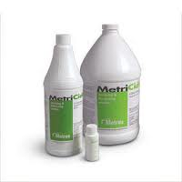
  Expiration dates for shelf life and use life
    Shelf life
      2 years
      Couldn’t find it
    Use life
      14 days

Slide 21
  Preparation by mixing or other method
    Must follow manufacturer’s instructions
  Reuse factors
    Dilution
    Time
    Temperature
    Organic soil
    Bio-burden

Slide 22
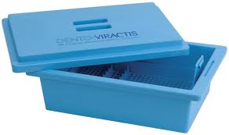
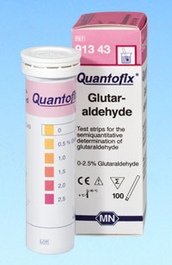
Other factors
Dedicated container?
Measuring efficacy?
  How often

Slide 23
Limitations of product or process?
How to clean item?
Time required for process?
How many steps are required?
  Are High level disinfection parameters required?
    Time, Temp, and concentration???

Slide 24
Special prep for item before processing
Is water quality critical?
Is it potentially toxic to staff?
Instructions to avoid toxicity?

Slide 25
Is an exhaust hood required?
Special storage conditions?
Are there toxic residues on items?
  Method to reduce to nontoxic levels

Slide 26
Are there physical hazards?
  Fire / explosion
Environmental conditions that can change chemical makeup of disinfectant?
  Heat?

Slide 27
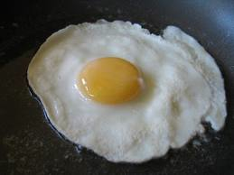
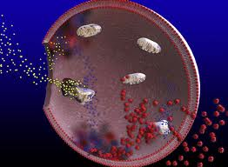
Health Care Disinfectants
Quaternary Ammonium Compounds
  “Quats” – Low Level Disinfectant
    Environmental housekeeping – floors, walls, furniture
  Surface active “wetting agent”
    Allows more penetration of disinfectant into the soil
    Cationic – carry a positive charge
      Soap is anionic – they are incompatible
  Action
    Inactivates enzymes
    Denatures protein
    Disrupts cell membranes

Slide 28

Phenol (carbolic acid)
  Intermediate to low-level disinfectant
    Bacteriocidal –kill bacteria
    Bacteriostatic – inhibits growth
  Used for housekeeping
    Leaves film – reactivated when it becomes wet again
      Mopping floors – should be wet for 20 minutes
      Can be removed by copious rinsing
    Inactivated by organic material – milk, serum, feces
  Skin irritant
    Don’t use on items in contact with skin
  Corrosive

Slide 29
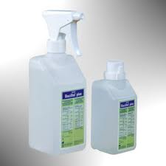
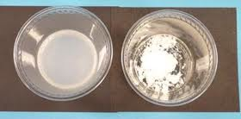
Alcohol
  70% -
    Used on surfaces, stethescope, ear specula
    Most common concentration –
      90% is available, but must have water to enter cell
    Must be clean – residual proteins deactivate disinfectants
  Prolonged contact
    Effectiveness requires wet contact for at least 5 minutes
    Can work in 2 – 20 minutes for veg. organisms
    Viruses can take longer – they live inside of proteins
      Proteins precipitate in alcohol

Slide 30
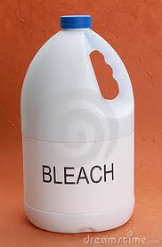
Halogens
  Intermediate-level – can disinfect and sterilize
    Chlorine – used as disinfectant –
      housekeeping and sanitizer for dishwashing
        Rapid acting
        Corrosive
        Stains
        Unstable
        NOT SPORICIDAL
      SOLUTION OF Hypochlorite
        1:10 solution
        Used in lab for surfaces

Slide 31
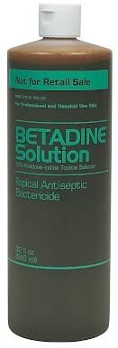
    Iodine – iodophor (Buffered with detergent)
        Becomes water soluble
      Used as surface disinfectant
        Rapid action against vegetative organisms
        Corrosive – (use with anticorrosive agent)
        Harms rubber and some plastic
        Can burn tissue
        Stains
        May need LONG CONTACT TIME
      Primarily – used as ANTISEPTIC
        Inhibits the growth of microorganisms on the skin
        Antiseptic only used on animate objects

Slide 32
Gluteraldehyde
  High-level disinfectant
    Used for semi-critical devices
      Endoscopes
      Ultrasound probes
    Conditions
      Time
        At 10 hours – is sterilant
        Different concentrations may require different time
      Temperature
    Activated by pre-measured activator
      Turns green

Slide 33
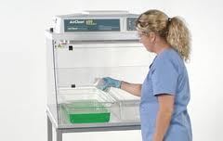
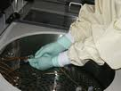
    Safety
      Has strong odor
      Respiratory irritant
      Eye irritant
        Should have eye wash available
      Should be in it’s own area / room
      Requires at least 10 air exchanges / hour
      Local exhaust ventilation should control the vapor
      Must wear special gloves
    Automated equipment
      Still requires vapor control

Slide 34
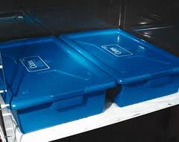
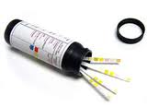
  Use
    Kept in properly marked location
    Kept in a rightly closed container labeled with activation date
      Can be reused 14 to 28 days
      Must be tested for recommended solution
      Record is kept of results
    Automated processors
      Control temperature
      Computerized reprocessing cycles
      Filters for rinse water
      Filters to remove suspended materials
        Able to reuse solution
    Compatible with many devices

Slide 35
Ortho-Phthalaldehyde – OPA
  High-level disinfectant
    Compatible with many materials
    0.55% is effective at room temperature
      Excellent tuberulodcidal
      NOT A STERILANT
      Soak time is 12 minutes
      Higher temperature reduced soak time
      Must be rinsed at least 2X with fresh water
      Checked for Minimum Effective Concentration – MEC
        Before each use
      Reuse for 14 days – Shelf Life – 2 years
      http://www.youtube.com/watch?v=_l8dBbS41as

Slide 36
  Safety
    No odor – still requires ventilation
    Gloves are required
      STAINS tissue
  Must be clean before disinfecting
    Items must be fairly dry before submerging
    Items still wet will dilute the solution
      Decreases concentration

Slide 37
Formaldehyde
  Can be all levels of disinfectant
    High level – 8% with 70% alcohol
    Intermediate level - 4 -8% with water
    Low level – 4%
  Use
    4% Used to disinfect hemodialysis equipment
    Tested for residual after rinsing

Slide 38
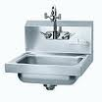
Disinfectants
Safety Review
  PPE required
  Exhaust hood for fumes
    Protects respiratory tract
  Develop a spill plan
  Eye wash close by
  Phone and emergency
  phone numbers

Slide 39
High-level Disinfectant Solution Log
  Date opened
  Date solution expires
  Date and time solution tested
  MEC results (minimum effective concentration)
  Tested by - Initials
  Temperature in ºF before use
  Comments

Slide 40
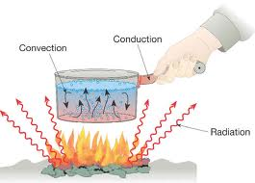
Thermal Disinfection
Heat / Thermal energy
  TEMPERATURE
    Comes from heated WATER
    Must monitor surface temperature of instruments
      Usually monitored in drain area
  TIME
  MUST BE CLEAN FIRST!!!!!
    Inspect
    Can also use test packs for disinfection and bioburden

Slide 41
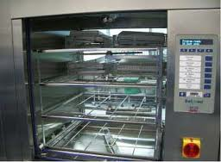
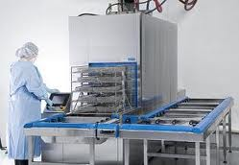
  Washer Disinfectors
    http://www.youtube.com/watch?v=6Y9pCL35C_A&playnext=1&list=PLFF6D1DB258191D4E&feature=results_video
    Must clean strainers daily
    Nozzles should not be clogged
  Wash-check monitor
http://www.youtube.com/watch?v=yUExWAKTVRI

