Slide 1
Surgical Instrumentation
Chapter 11 7th Ed.
Rosemary Thurston RN

Slide 2
Stainless Steel
  Not really “stainless”
    Stainresistant
  Martensitic – 400 Series Stainless Steel
    Hardened – holds a sharp edge
      Used on cutting instruments
        Scissors, osteotomes, chisels, rongeurs
        Forceps, hemostats, needleholders

Slide 3
  Austenitic – 300 Series Stainless Steel
    Softer – high corrosion resistance
      Used on retractors, and tubular structures
Manufacture
  Stamping outline –
  Forging - compressing with heat and cooling
  Grinding and milling
    Parts need to fit together
    Need finger rings, serrations and ratchets

Slide 4
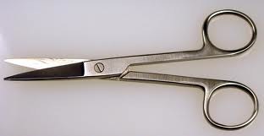
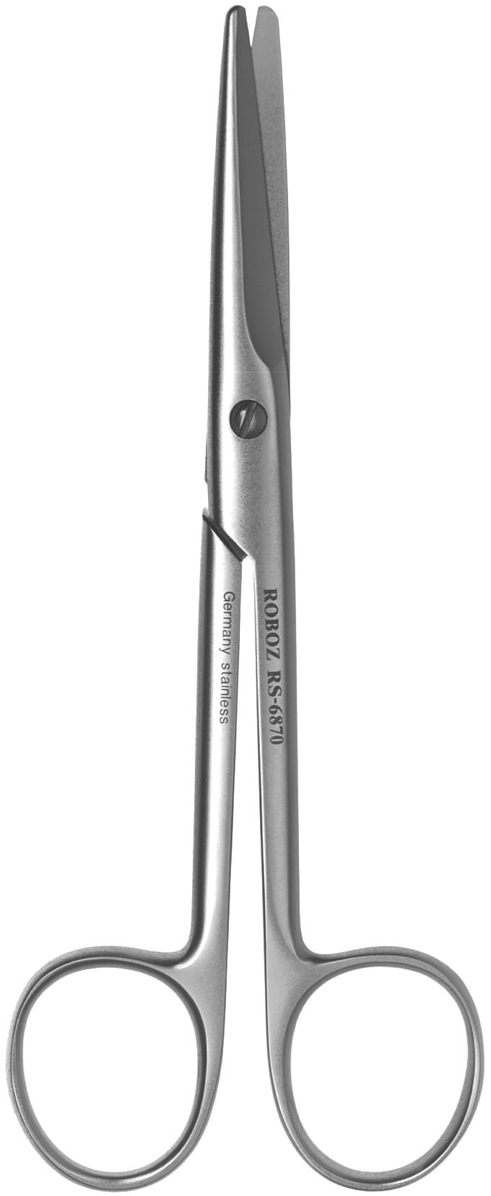
Tempering – hardening
  With controlled heat and cooling
Polishing – smooth finish
  Mirror finish –
    shiny – stains less
  Satin finish –
    dull – doesn’t reflect light

Slide 5
Passivation – corrosion resistance
  Nitric Acid – removes iron content on surface
    Builds protective layer of chromium oxide
    Continues as instrument is used
    http://www.youtube.com/watch?v=fb7ugFNj8jc
http://youtu.be/Xw7s4iNsAfM
http://youtu.be/RU6Ri_1vdss - optional

Slide 6

  Inspected and tested
  Etched with manufacturer’s name / number
Manufacturers
  Good instruments come from Germany
  Poorer usually come from Pakistan

Slide 7
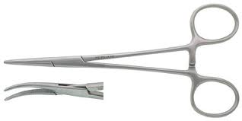
Instrument Parts
Tip – working part
Jaw - serations
Hinge / Box lock
Shank
Ratchet
Finger Rings
Length

Slide 8
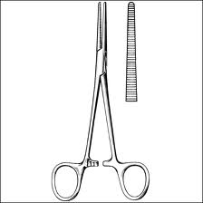
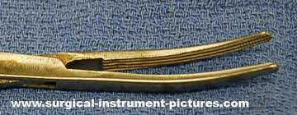
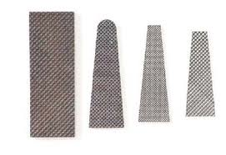
Jaw face
  Serations
  Needle holders

Slide 9
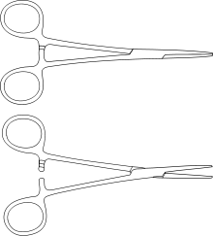
Classifications
Hemostat

Slide 10
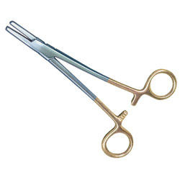

Tungston Carbide
  Harder material
  Grip better
  Last longer
Inserted into
  Needleholder tips
  Scissors blades
Have Gold Handles

Slide 11
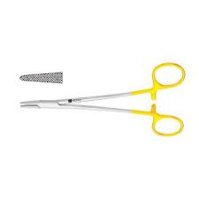
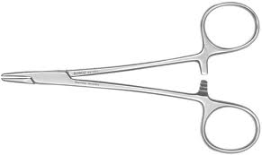
Needle holders

Slide 12
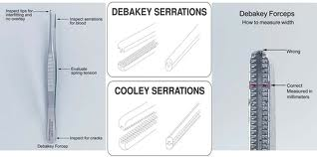
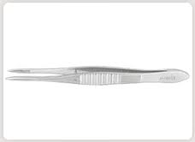

Forceps

Slide 13
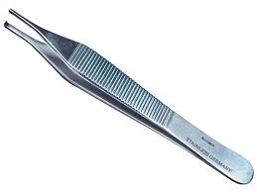
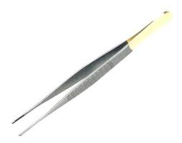
Tissue Forceps
  Have teeth in tip
Dressing forceps
  Have serrations

Slide 14
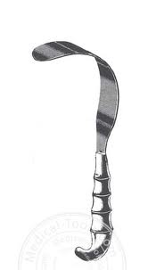
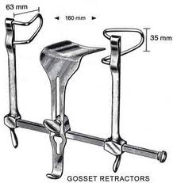
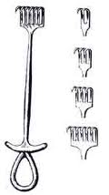
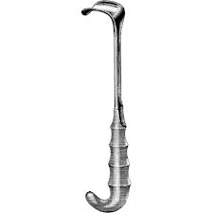
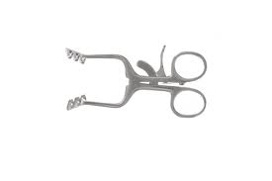
Retractors

Slide 15
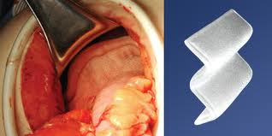
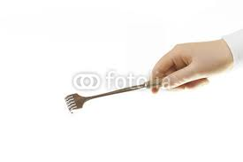
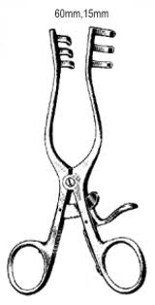
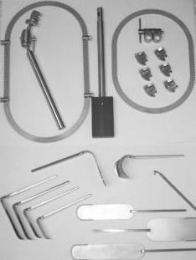
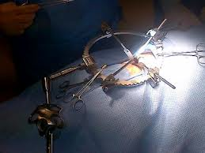
Retractors
  Hand held
  Self-retaining
  Table-mounted

Slide 16
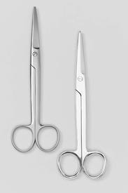
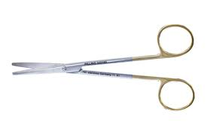
Scissors

Slide 17
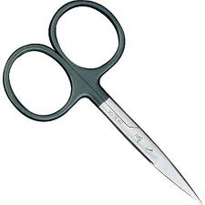
Scissors
  Regular scissors have a crushing action
  Gold handled = tungston carbide blades
    Stay sharp longer
  Black Handle
    Supercut / Microgrind blades
    Simulate cutting action to slice tissue
      One knife is sharpened like a knife
      Other is standard action like guillotine

Slide 18
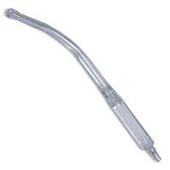
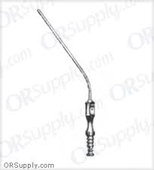
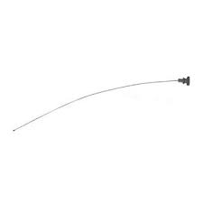
Suction device
  May have a Stylet

Slide 19
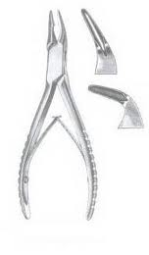
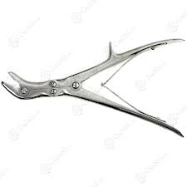
Rongeurs
  Singe action
  Double action
    Reduces force needed
    to close instrument

Slide 20
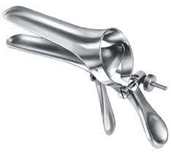
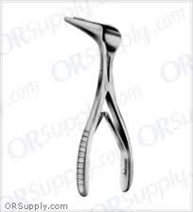
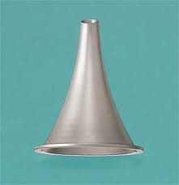
Speculums

Slide 21
Manufacturing instruments
http://youtu.be/oDY2qCG3GS8
http://youtu.be/RU6Ri_1vdss

Slide 22
Post op care of instruments
Should be:
  Opened
  Moist – to prevent drying out
    with moist towel
    Sprayed with enzymatic solution

Slide 23
Solutions that damage
  Saline (salt water) – also blood
  Betadine Household lubricants
  Peroxide Household powder cleaners
  Bleach Dish soap
  Iodine Laundry soap
  Soaking in water or saline
  Long term soaking in rust or stain remover

Slide 24
Checking for Damage
Complete the worksheet
  Use the book to see what areas need to be checked
Circle areas that need checking and write down what you are checking for

Slide 25
Testing for sharpness
  Scissors 4.5” long or more
    Red test material
    Cut material length of blade 3 – 4 X
    Tip must cut well
  Scissors 4” or less
    Yellow test material
    As above

Slide 26
Index card test material
  Bone Cutter
    Cut off a piece
  Kerrison Rongeur
    Punch a hole
  Laminectomy Rongeur
    Use half of jaw for clean bite
  Double action Rongeur
    Clean bite out of edge

Slide 27
Plastic dowel rod
  Bone Curette
    Shave off pieces with bowl down
  Chisels and Osteotomes
    Shave off pieces

Slide 28

Identification
Marking instruments
  Tape
    For specific procedures or specialties
      Clean your hands with alcohol
      Clean instrument in area where tape will be placed (shank)
      Cut tape at an angle
      Wrap around 1 to 1.5X around shank only
        Use firm pulling tension
      Autoclave after so tape will bond

Slide 29
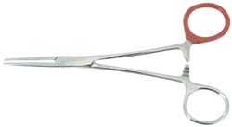
Heat Fused Nylon
  “dipping” of colored nylon coating
  Powder coating process
  Can last years
    Once it starts to chip – must be all removed

Slide 30
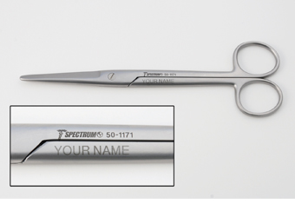
  Acid Base Etching –
    Semi permanent
    Can be buffed off
    Procedure:
      Use a stencil
      Solutions
      Electricity
      http://www.youtube.com/watch?v=ILPQDXV_Rf0&feature=share&list=PL626DB81D87B2582B

Slide 31
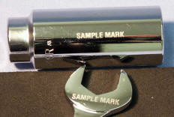
Laser Etching
  Permanent
  Costly
Electric etching (engraving)
  Damages the surface of the instrument

Slide 32
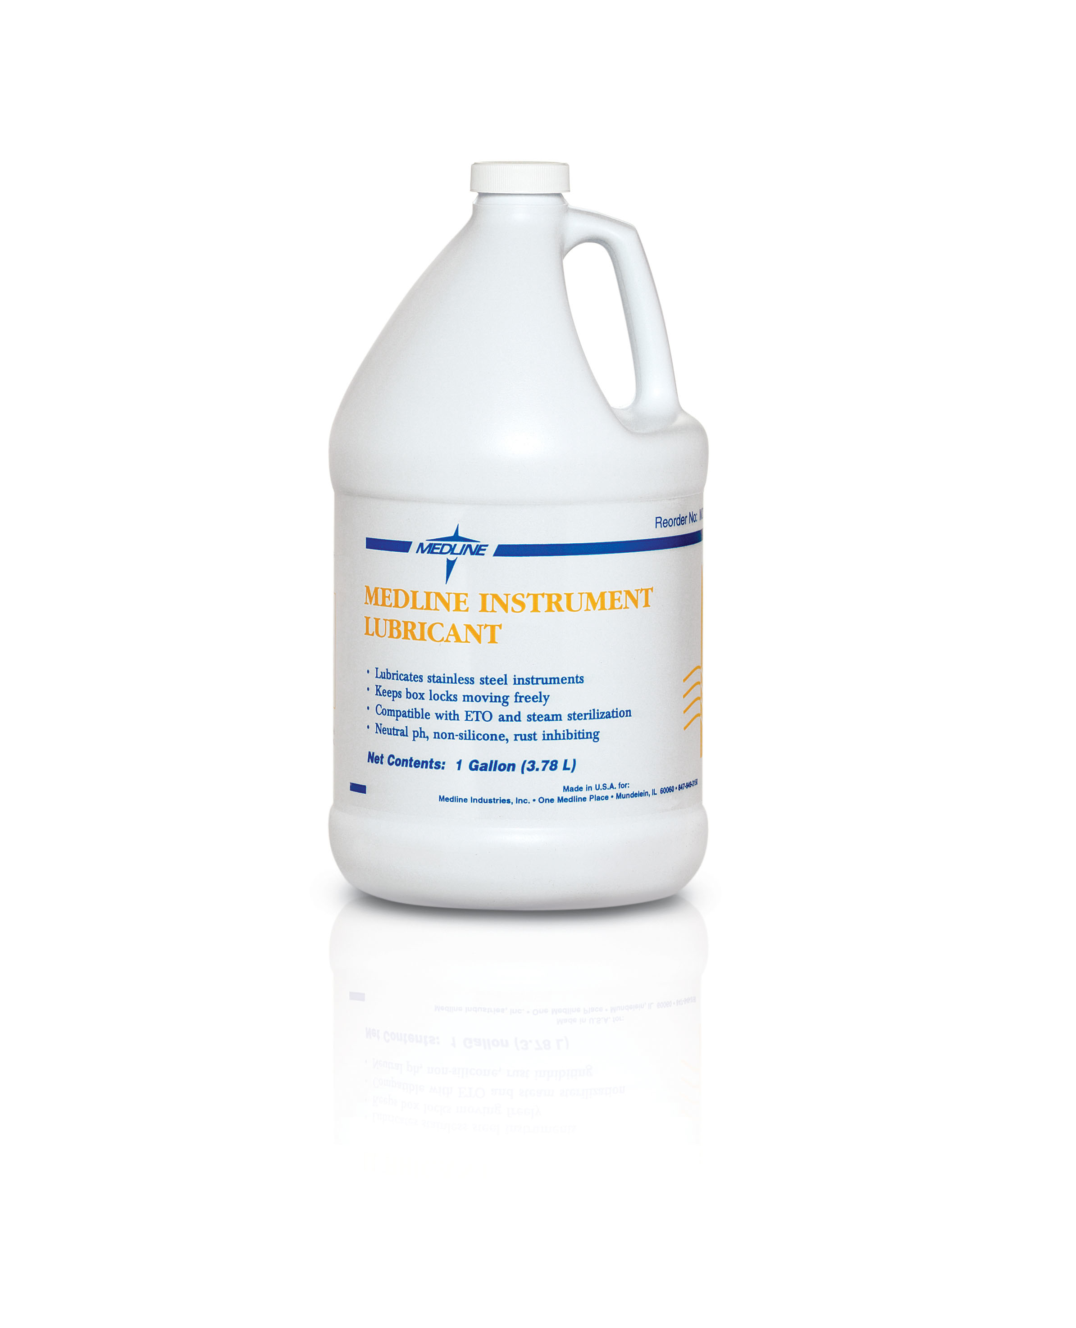
Lubrication
  Neutral pH
  Easier to use
  Extends life of the instrument
Available in
  Spray bottle
  Dipping
Application
  Especially all moving areas

Slide 33
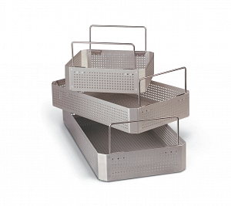
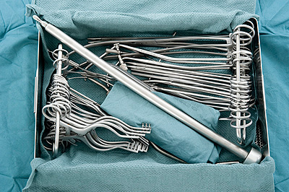
Tray Assembly
Organization factors:
  Presenting to sterile field
  Protecting instruments
Recommendations:
  Heavy on bottom
  Tray must allow
  adequate space for
  weight distribution
  Curved tips go in
  same direction
  Forceps should be
  gently nested together

Slide 34
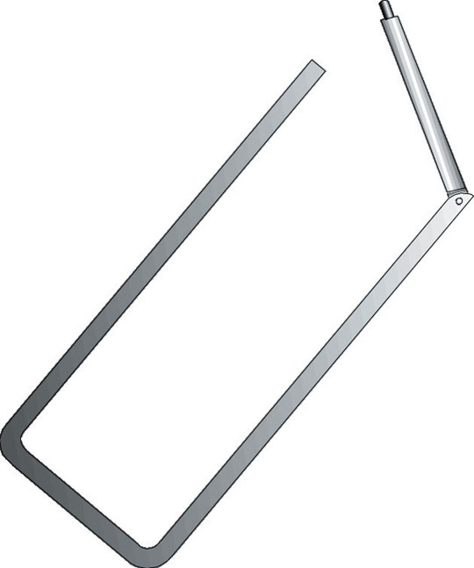
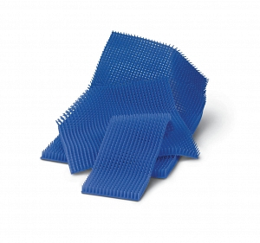
  Stringers hold finger ring of instruments
    Helps with faster setup of sterile field
    Keeps instruments safer
  Laser coated instrument
    Keep separated to prevent damaging coating
    Use silicon nipple mat, foam or lint-free towel

Slide 35
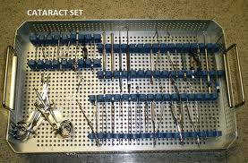
  Delicate in protective case in tray

