Slide 1
Complex Surgical Instruments
Chapter 12 7th Ed.
Rosemary Thurston RN

Slide 2
Technology and instrumentation
  New generation of instruments
    Technically advanced
    Very costly
    Fragile / breakable
  Increases the difficulty to
    Clean
    Disinfect
    Sterilize

Slide 3
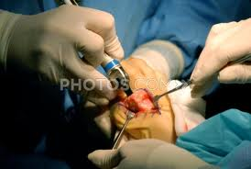
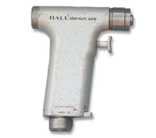
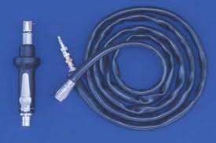
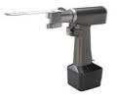
Special concern re:
  Electric motor powered
    And cable
  Pneumatic (air powered)
    And cable
  Battery powered
Sizes vary:
  Saws for bones
  Drills for middle ear bones

Slide 4
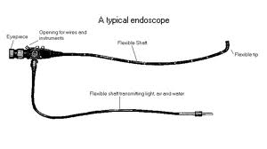
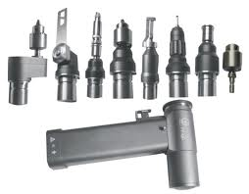
Concerns:
  Saws and drills can’t be submerged
  Cleaners must be compatible with materials
    Must follow OEM’s recommendations
    Must prove efficacy of
  Damage can occur to the following:
    Lumens
    Channels
    Attachments
    Multiple parts

Slide 5
Cleaning
  Done manually
  Fluid must not enter cable or hand-piece
    Called FLUID INVASION
    Some OEM suggest connecting them to prevent damage

Slide 6
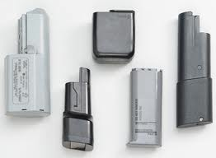
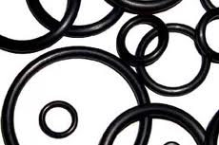
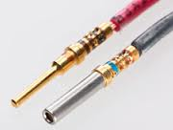
Common Problems
Damage to electrical parts during Sterilization
Condensation enters when seals wear out
Electrical contacts get worn and affect handling

Slide 7
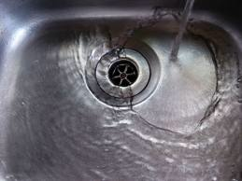

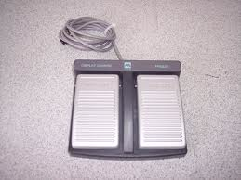
Procedures to Protect
Do NOT immerse in ANY SOLUTION
USE only specified solvents / lubricants by OEM
Use NYLON bristle brush to clean distal tip
Dry equipment with lint-free towel
Electrical cords
  Foot pedals – avoid pulling on cord

Slide 8
Pneumatic powered (Air)
  Hose from Nitrogen compressed gas must be sterilized
    Coiled in 9 – 12” coil – not too tightly
  Hoses
    Inspect for cuts / damage / bubble / bleb
      Check with pressure in hose – 100 psi – check first
      Take out of service if found
    Connect cord to hand-piece to prevent fluid invasionN

Slide 9
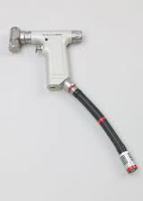
  Cleaning
    Don’t immerse
    Use brush into attachments
    Wipe / rinse outer case
    Use decontamination hose to protect components
    Lubricate burr guards per OEM

Slide 10
Battery Powered
Batteries give freedom on sterile field
  Must be charged
  Chargers specific by system
  Follow OEM recommendation for flash Sterilization
Care of battery powered instruments
  Never immerse instrument / battery
  Clean debris using nylon brush / mild detergent
  Rise under running water –
    Prevent contact with battery contact area
  Use decontamination battery to protect electrical components
    This batter is used only for this purpose -

Slide 11
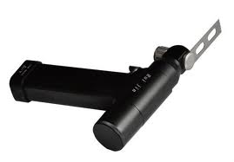
Processing
Use PPE
Care – some have saw blades and drill bits / burrs
  Be able to safely disarm them
Follow OEM’s recommendations for each

Slide 12
POU
  Remove debris during use with water moistened sponge – no saline
  Remove bits, burrs, blades
  Remove attachment from handpiece
    Disconnect from power source
  Separate devices that can be soaked
    Burrs, holding devices

Slide 13
Decontamination
  Prevent fluid invasion by keeping hose attached during cleaning
  Clean exterior with germicidal detergent (EOM)
    Soft bristle brush
    Attention to recessions
      Moving levers
      Switches
      Controls
    Check for smooth operation
  Clean recessions and cannulas
    Use stiff bristle brush – right length and diameter

Slide 14
  Clean, rinse, inspect hose, cable or battery pack
    Inspect for damage / wear
  Lubricate handpiece with lubricant per OEM
    May recommend running to check performance and lubricate
  Dry with soft cloth
  Package and sterilize per OEM

Slide 15
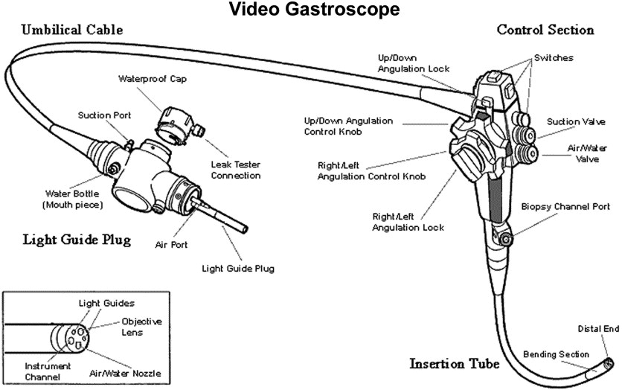
Endoscope

Slide 16
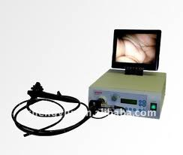
Components
Head with controls
Flexible shaft
  Fiberoptic
    Special light carrying fibers carry light
      Delicate – can break if bumped or coiled too tight
    Connected to light source
  Imaging cable/viewing sheath
    To see video
  Cables
    Control movement of tip
  Impervious sheath (covering)

Slide 17
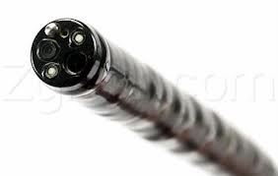
  Length
    36 – 60”
  Lumens
    Allows suctioning
      Connected to suction container
    Allows irrigation
      Connected to water bottle
    Largest is Biopsy channel

Slide 18
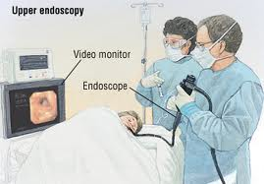
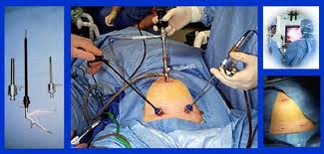
Endoscopes
Used within – “instrument to view within”
  Through opening in body
  Through small incision
  Have cameras and fiberoptic lighting / viewing
  http://www.youtube.com/watch?v=WHFRCrPj0SQ
  http://www.youtube.com/watch?v=ewCIqAAJGPg
CS concerns:
  Nosocomial infection
  Expensive equipment
  Difficult to reprocess

Slide 19
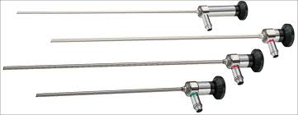
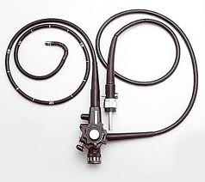
Structure
  Rigid
  Flexible

Slide 20
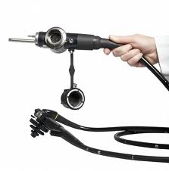
Processing Concerns
Sensitive to pressure and bending
End connection protected from fluids

Slide 21
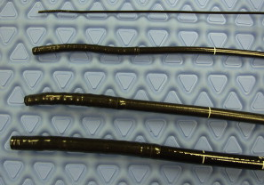
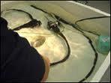
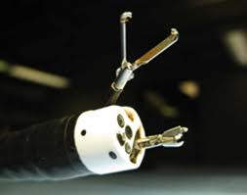
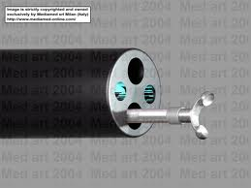
Flexible must be leak tested before submersion
  Protects elements inside of sheath
  http://www.youtube.com/watch?v=vt6G_sOh3WU
Care when cleaning channels

Slide 22
Sterilization / disinfection
  According to Spaulding Classification System
  Endscopes that enter tissue
    Critical Device = must be sterilized
      Arthroscopes
      Laparoscopes
  Endoscopes that touch intact mucous membranes
    Semi-critical Device = can be high-level disinfected
      Esophagogastroduodenoscopes (EGD)
      Colonoscope
      Bronchoscope

Slide 23
Infection Control
Concerns:
  Cleaning channels
    Removing bioburden
    Drying after disinfection and rinsing
      Water grows organisms
  Potential training issues for employees
    Inadequate cleaning / disinfection
    Damage to scope
  Time for adequate processing

Slide 24
  Inadequate inspection before reprocessing
  Not following instructions for reprocessing equipment
  Not following instructions on chemicals
  Not leak testing
  Poor manual cleaning
  Not fully submersing in disinfectant
  Improper drying / storage
  Not sterilizing biopsy forceps (critical = sterile)

Slide 25
Disinfecting Agents for Endoscopes
Gluteraldehyde
  Advantages:
    Active agent against microorganisms
    Acidic-base compatible with endoscope materials
    Sterilization can be done with extended time
  Disadvantages
    Stability – only last 14 days
    Dilution - can be diluted if scopes are not dry
    Corrosive to metals – high carbon
    Can cause sticky buildup – from fixative agent
    Difficult to rinse

Slide 26
Safety issues:
  Patient burns -
    Ineffective rinsing – leaves residual agent
  Employee –
    Respiratory inhalation of fumes
    Contact dermatitis

Slide 27
Ortho-Phthalaldehyde (OPA)
  Advantages
    High-level disinfectant
    Can be reused up to 14 days
    Ready to use solution
      Must check MEC
  Disadvantage
    Must be in well ventilated area
    Must be in closed container

Slide 28
Peracetic Acid - Steris
  Advantage
    Sterilant
      12 minutes at 122ºF
    Single use cups for each cycle
    Rinse water is sterile
      Tap water after filtering
    Cycle is monitored - has print out
    Biologic and chemical indicators should be used

Slide 29
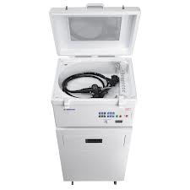
AER – Automatic Endoscope Reprocessor
    Clean, Disinfect, Rinse endoscopes
  Facts
    Only holds one scope at a time – decreases possible compression damage
    Scope has a tray to protect it
    Chemical is premeasured for each cycle
    Printout listing parameters
      Time
      Temp

Slide 30
    Items are sterile for immediate use
      Can’t be held for later sterile use
    More expense for monitoring
    Scopes may not be compatible
    Endoscopy water bottles can’t be processed
    http://www.youtube.com/watch?v=8ihIZchvUq0

Slide 31
Can AER’s be used for ALL scopes?
  Must ask OEM if:
    Is it effective for each kind of scope
    Some must be done manually
  Advantages
    Timed cleaning
    Consistent exposure to agent
    Timed contact with agent
    Air flush cycle – dries channel
    Copious rinse

Slide 32
  Limitations:
    Manual preprocessing – cleaning
    Manual post processing – drying
      Rinsing with 70% alcohol to dry channel
  When using:
    Follow OEM instructions to connect scope to AER
    Place valves / other parts in AER
    Attach channel cleaning connectors to all channels
    Follow agent’s instructions
    Set for recommended time

Slide 33
Kinds of scopes
Bronchoscope
  Trachea, bronchi, into lung a bit
Cystoscope
  Rigid and flexible
Ureteroscope
  Flexible – to check for obstruction in ureter
    Kidney stones
Gastroscope / Esophagoscope
  Stomach and esophagus
Colonoscope
  Entire colon
Sigmoidoscope
  Distal end of colon – just before rectum
  Polypectomy – removal of polyp (in colon)

Slide 34
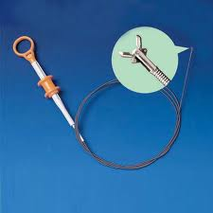
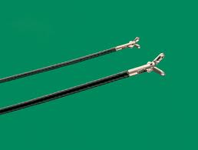
Cleaning
Biopsy forceps
  Critical item – goes through mucous membrane
    Must be STERILIZED

Slide 35
Cleaning Flexible Scopes
Pre Cleaning - POU cleaning
  Removes gross debris
    Suction enzymatic detergent solution through channels
      Until solution appears clean
      Then with water
    Sheath should be wiped with same Enzymatic detergent with soft cloth or sponge

Slide 36
Leak Testing
  To ensure that the sheath covering is not damaged
    Will allow solution / debris to enter working part of scope – fiberoptics, cables, etc
    Inspect scope for tears, holes, joints
    Remove valves / attachments
    Connect sheath to positive pressure line and pressure up (per EOM)
      To venting connector or to the video cap
      Forces air into sheath

Slide 37
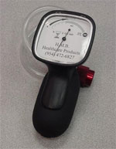
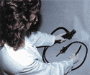
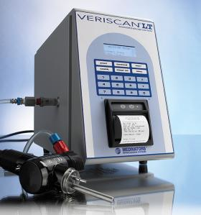
    Place scope into water
      If there is damage to scope / connections / channels
      Air will leak out - but will not let solution enter
        Solution entering sheath will damage it
      Continuous stream of bubbles indicate a leak
      With control head out of water – manipulate tip – most likely to leak area
      Put head into solution and
      see if head leaks
    Remove from water – drain
    Release pressure
    Disconnect tester
    If damaged –
      Must be sent for repair immediately
      Sent as Biohazard

Slide 38
Cleaning
  Detach removable parts
    Soak / scrub with brush
  Immerse in Enzymatic detergent
    Clean exterior
    Brush all channels to remove particulate matter
      Use appropriate size brush/sponge
        Clean after each passage through channel
      Biopsy
      Suction
      Air/water
  Rinse and dry excess water
  Attach cleaning adaptors

Slide 39
High-level disinfection / Sterilization (STERIS)AER
  Manual
    Immerse entire scope in disinfectant
      Don’t coil too tight
    Fill all channels with disinfectant
      Attach syringe to cleaning adaptors
      Fill until no air is escaping
    Place all valves / parts into disinfectant
    Cover with tight lid
    Leave immersed for correct time – set timer
      Remove at end of that time

Slide 40
    Rinse thoroughly
      Exterior
      Lumens flushed - with syringe if needed
      Valves and other parts
    Processing LOG must be completed
      Date
      Time
      Scope serial number
      Effectiveness of disinfectant
      Your name
      AER printout are filed

Slide 41

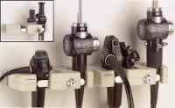
Drying
  Channels may still have moisture after rinsing
    Moisture supports growth of microorganisms
  Channels are flushed with alcohol 70%
    Evaporates quickly
    Takes water with it
  Blow channels with pressurized air
Hung to dry –
  Most hung on hangers
    Facilitates drainage if needed
    Stored as “CLEAN” not sterile

Slide 42
Ethylene Oxide (ETO) Sterilization
  Gas sterilization can be used
    If used, a venting cap must be used
    Attached to same area on head where leak testing occurs
  More on ETO - later

Slide 43
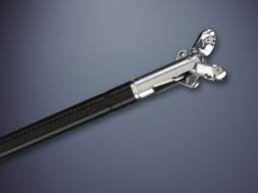
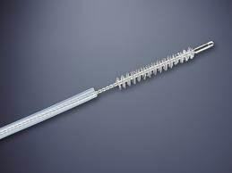
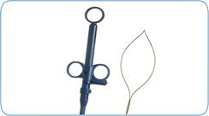
Endoscopic Accessories
Diagnostic accessories
  Biopsy Forceps
    Hot biopsy forceps –
    Electro Coagulating
  Brush for Cytology
  Cannulas
    Catheter type device
    May be marked with bands to enable measuring
  Polypectomy snares
    Tip surrounds and cuts off polyp

Slide 44
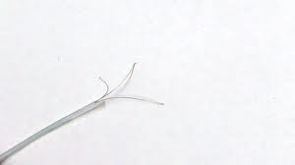
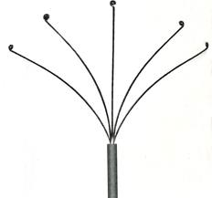
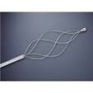
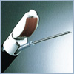
  Polyp Retriever
    Able to spread and grasp tissue in colon
  Injection needle

Slide 45
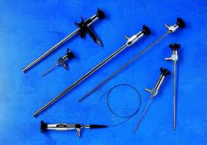
Rigid Endoscopes
Sizes vary according to
the specialty needs
  Very fragile
  Must be handled with care
    Will break fiberoptics
Connected to
  Video camera
  Projected to video monitor
  Cables carry light and video
    Very fragile

Slide 46
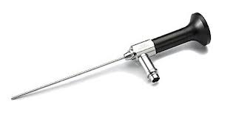
Rigid endoscope
  Telescope – optical element
    Provides light
    Provides image
  Eyepiece with lens
    Near the eye
  Metal shaft
  Fiberoptic bundles
    Inside of shaft
  Objective lens
    Near the object being viewed
    May have different angles of view
  Light source attachment area for fiberoptic light cable

Slide 47
  Handling
    Handle on heavier eyepiece end
    Avoid touching the lenses
    Don’t loosen eyepiece
    Don’t drop, bend shaft, knock against hard surfaces
      Fractures glass fibers
    Protect from falling
    Place in perforated case – made for scopes

Slide 48
Reprocessing
  After surgery - POU
    Clean off gross debris
    Disconnect light cable and adaptor
  Clean Follow EOM’s recommendation for scope
    Soak in Enzyme Detergent and Warm Water (100º)
      Do not soak in metal pan – can react with dissimilar metal
      May need to soak vertically if there are channels
      (no detergents only – can leave surfactant film on scope)
      Use flush ports if available – rinse with distilled water – flush with air

Slide 49
    Hand clean /soft brush / soft cotton cloth
      Can not be placed in ultrasonic cleaner – especially lensed instruments
      May fracture or loosen fibers
    Use applicator and alcohol 70% to remove residue after cleaning
      Lenses - Check with EOM
        Don’t touch lenses with finger tips
      Fiberoptic inlet post
    Rinse well
    Dry – very well

Slide 50
  Inspect
    Clean?
    Visible damage
      Scratches, dents, protrusions, burns at distal tips, other
      Lens
        View white paper with print
        Move toward paper to ¼ “
        Image should be crisp and clear
        IF not CLEAR – Do NOT use scope –
      Fiberoptics
        Point light post at light source
        Check distal tip for light around perimeter

Slide 51
    Missing parts?
    Test moving parts if present
  High-level disinfection
    Only for scopes that touch intact mucous membranes
    Don’t use disinfectants that have long life surfactants
      Leave residue
      Create conductive pathway for electrical current
      Can create pathway into scope and leave residue
  Sterilization
    Scopes that go through tissue into cavities

Slide 52
  Sterilization types for scopes
    Ethylene oxide – ETO gas
    Steam autoclave
    Low temperature sterilization
      STERIS – peracetic acid solution
      Must be used immediately
        Can’t be stored for use later

Slide 53
  Accessories
    Accessory instruments can be cleaned in ultrasonic
      Graspers, scissors
      Dissectors
      Many have channels
    Verres Needle
      Used to inflate the peritoneal cavity
      Disassemble

Slide 54
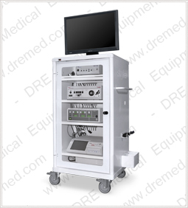
Laparoscopy
  Equipment
    Scope
    Camera
    Light source
    Insuflator
    Monitor
    Electrosurgial Unit

Slide 55
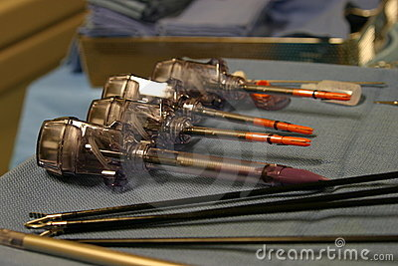
Laparoscopic instruments
  Perform surgery through small holes
  May conduct electricity to distal tip
    Shaft is insulated with black material

Slide 56

  Electrically conductive instruments
    Check for
      Pin holds
      Cracks
      Tears
      Loosening
    Can cause electricity to escape and cause
      burns in patient
      Infections

Slide 57
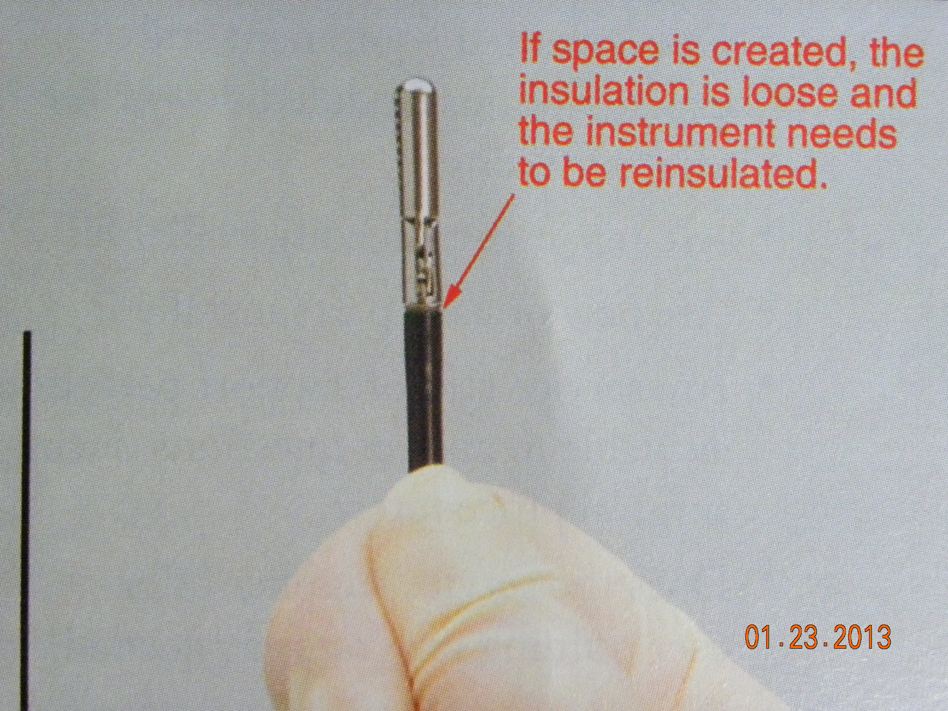
  Check:
    Metal collar at distal tip
      Insulation should be snug without space
    Shaft
      Does the insulation slides on shaft
      See if there area
        Nicks
        Cuts
        Cracks
        Chips

Slide 58
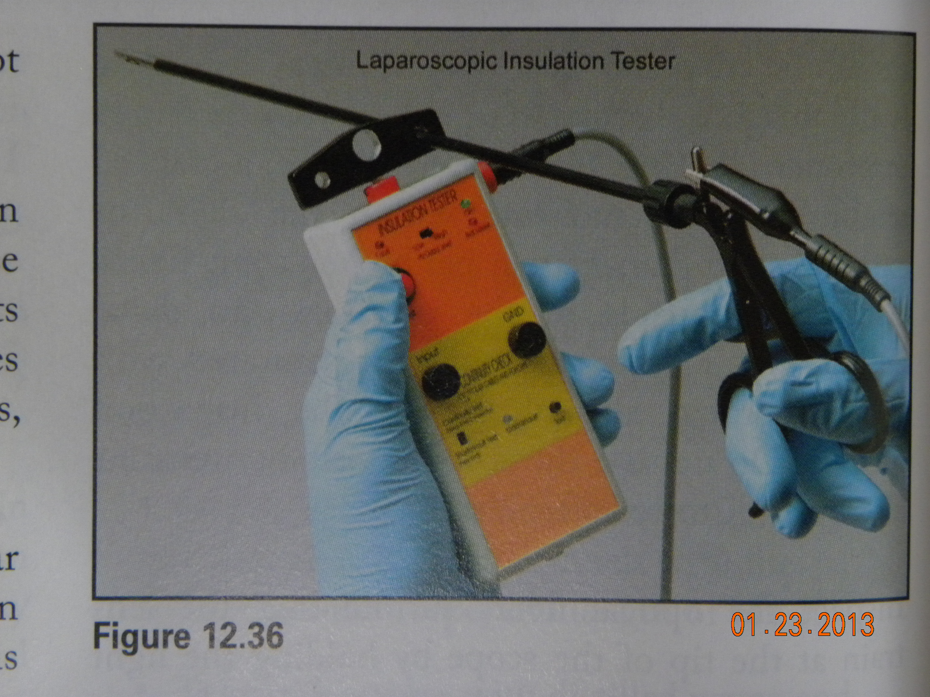
    Electronic testing
      Check for electrical leaks of current
      Prior to set assembly
      Can be used on:
        Cables
        Forceps
        Electrodes
        Bipolar forceps

Slide 59
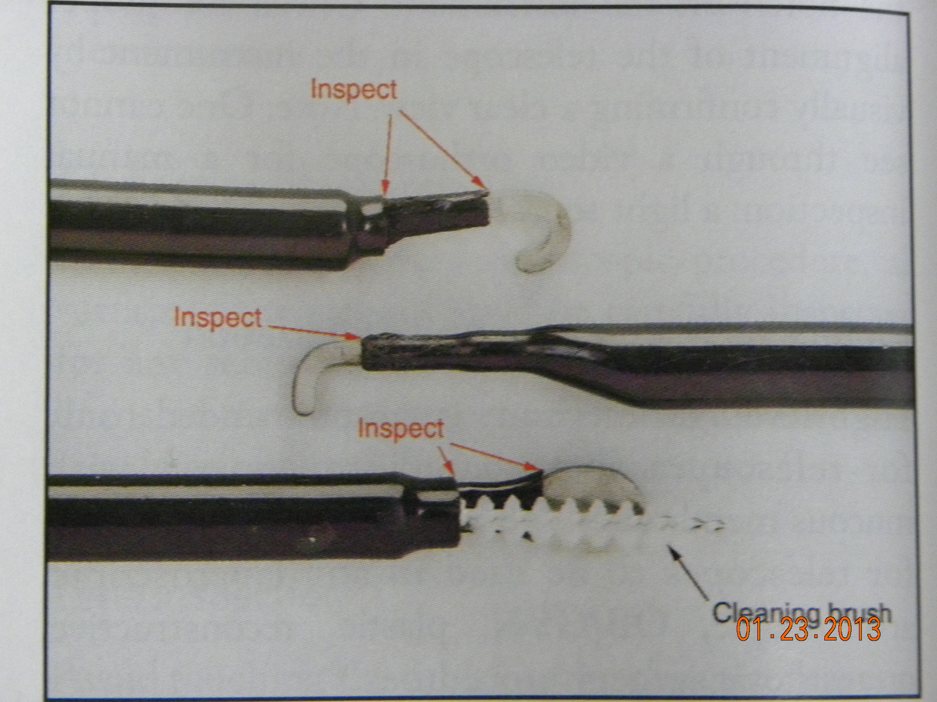
    Laparaoscopic
      Those used to cauterize / cut
      Cannulated shaft – have lumen

Slide 60
  Different styles of laparoscopic ring handles
    Free handle
    Ratchet handle
    Spring handle
    Cleaning must be done following OEM’s recommendations

Slide 61
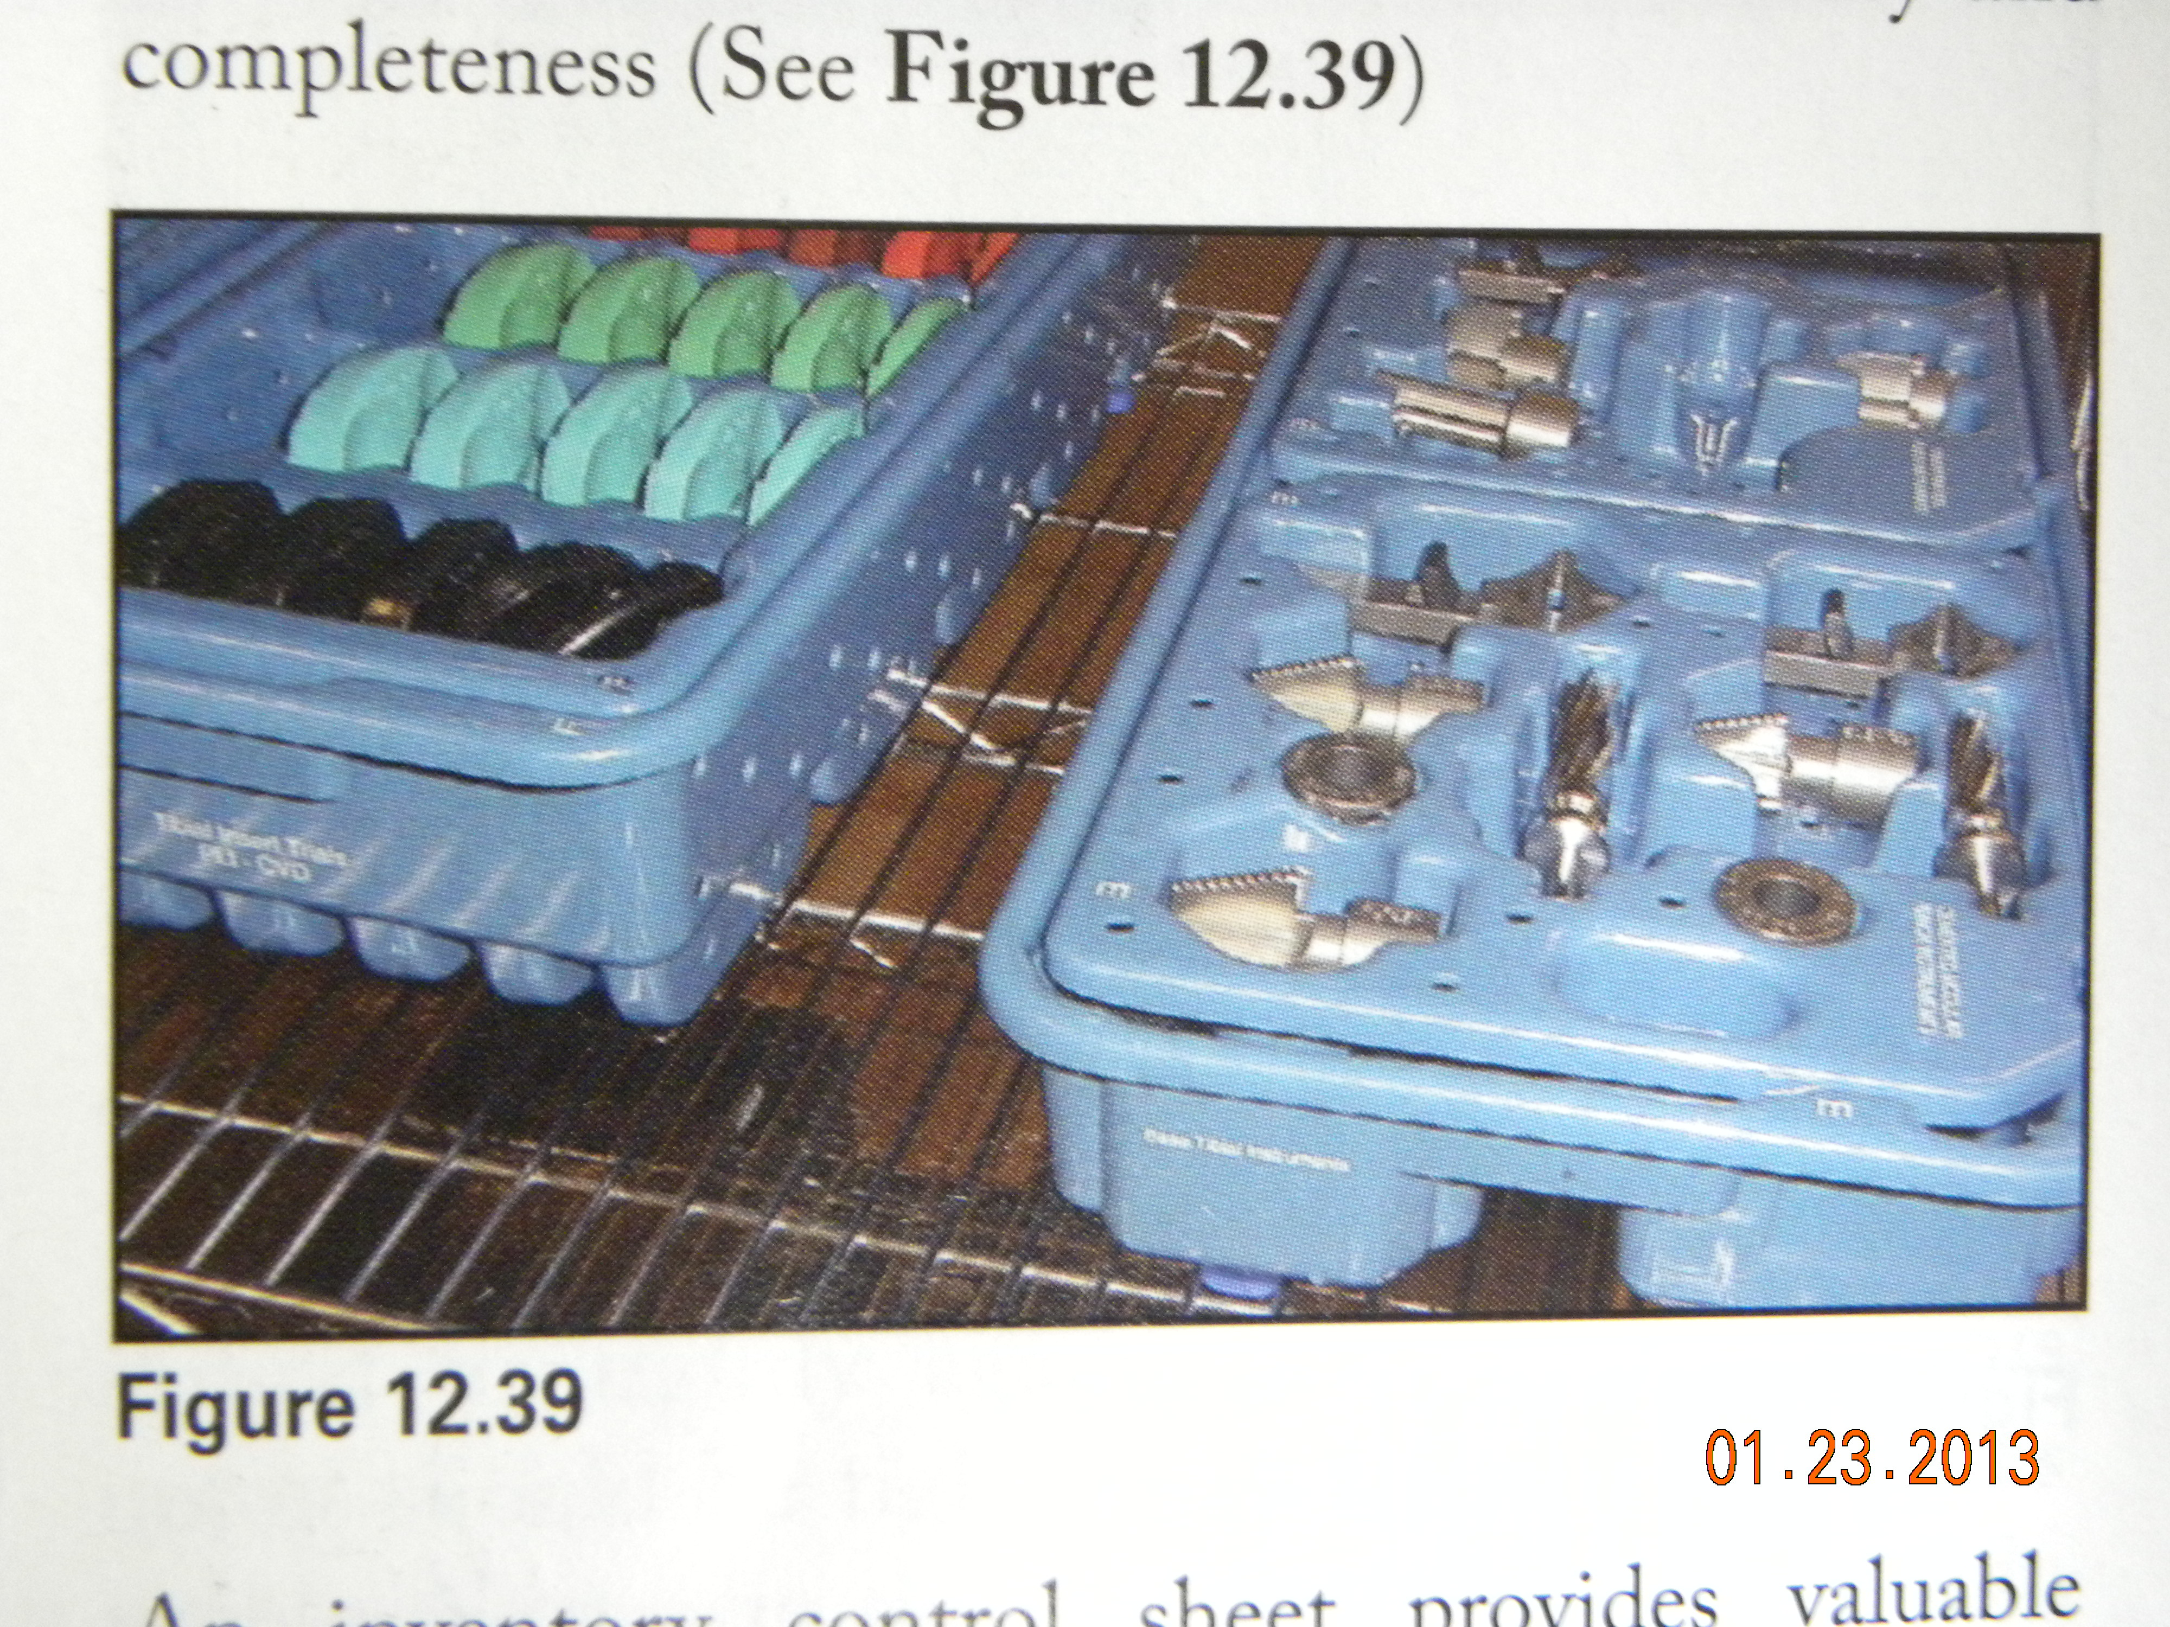
Loaner Instrumentation
  Delivered from instrument company / manufacturer
    May have many trays
  To hospital commonly used for:
    Orthopedic
    Neurologic

Slide 62
CS responsibilities
  Receive sets
    Shipped in for specific procedures
    Brought by vender sales representatives
    Must be inventoried and QA
      Correct items and complete number of items
      Check for damage
    Document:
      Date and time
      Signature of delivery person and person receiving
      Doctors name and patients last name
      Number of trays
      Number of implants
      Document inventory brought and QA

Slide 63
  Decontaminate
    Most critical step
    Consider them to be contaminated
    Follow EOM’s recommendations
  Inspect and Assemble
    Examine for bioburden
    Defects – report immediately if found
  Sterilize
    Chemical indicators should be in each layer of set
    Wrap per policy – use sterilization tape – not containers
    Time may include time to kill PRION – Cruetzfeldt-Jakob Disease (CJD)
      (European model)
    If there are implants – there must be a BIOLOGIC MONITOR

Slide 64
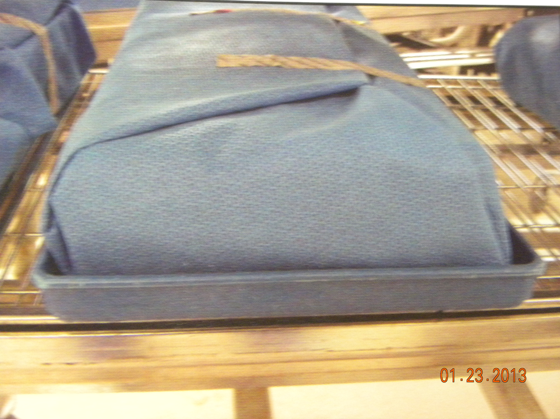
  Store
    Handling
      Stored away from traffic or cool ventilation
        Don’t want condensation to occur after sterilization
      Trays are heavy
      Wrappers can be damaged if not handled properly
        Handle as little as possible
        Don’t slide across a surface
        Lift and set on surface
        May use transport tray to
        prevent damage

Slide 65
  Decontaminate
    Must occur even if they are not sterilized
    Must be safe to handle
    Exit inventory is recommended to be sure sets are complete
    Stored until ready for pick up
  Return
    After procedure

