Slide 1
Sterile Packaging and Storage
Chapter 13 7th Ed.
Rosemary Thurston RN

Slide 2
Compare
Food packaging
  Protection
    Keep it ready for use
  Safe
    Can be compromised
    Will affect contents
  Tamper proof
    Seals on lids
    Seals under lids
  Considers use of item
    Ready to eat
    Ready to microwave
Sterile packaging
  Protection
    Keep it ready for use
  Safe
    Can be compromised
    Will affect contents
  Tamper-evident seals
    Tape
    seals
  Considers use of item
    Reusable items
    Disposable - SUD

Slide 3
Objectives of Packaging
Allow penetration of sterilant - Penetration
  Must also allow release of
    Sterilant
    Moisture
Maintain sterility until opened - Barrier
  Provide barrier to organisms
Can be opened aseptically – Aseptic opening
  Without contamination of item
Contents sterile at time of use

Slide 4
IS Class II Medical device by FDA
  Has potential risks if not good barrier
    Items used during surgery if not sterile
      Can cause infection that is life threatening
  Must
    Allow sterilization
    Protect item from contamination

Slide 5
Packaging Materials
Selecting
  Type of sterilization method
    Different materials required to different methods
  Item
    Kinds of packaging varies with item
  Check RESEARCH
    Many different materials and methods available
Must BE
  Approved by FDA
CS Employees
  Must understand how to package appropriately

Slide 6

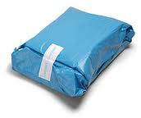
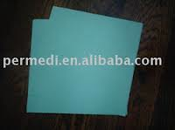
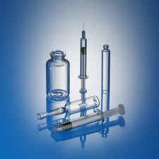
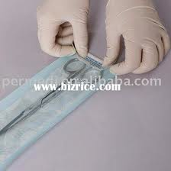
Packaging Materials

Slide 7
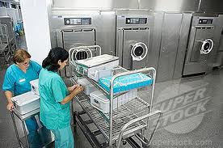
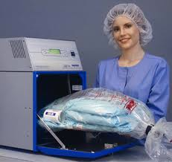
Selection by STERILIZATION METHOD
STEAM
  Withstand high temperatures
    250 – 275ºF
    Allow penetration
    Allow release to DRY
ETO - Ethylene Oxide
    Allow penetration
    Allow release - AERATION

Slide 8
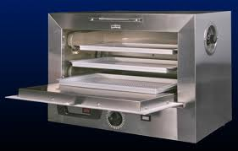

DRY HEAT
  Tolerate 2 – 3 hours at 320 – 400º F
    Without melting or burning
Gas PLASMA
  Tolerate deep vacuum
  Without
    Absorbing sterilant
    Interrupting the cycle
    Damaging contents

Slide 9
Reusable Fabric Materials
Muslin
  Loosely woven cotton fibers
    140 threads per square inch
    2 ply to achieve better barriers
      Sewn together around edges = 1 wrapper layer
  Need 2 layers for adequate BARRIER
Standard for Other WOVEN Fabrics
  PENETRATION of sterilant
  BARRIER

Slide 10
Other woven textiles are used
  Must compare barrier wise to the Muslin
    For sterilant penetration
  Requirements
    Laundered
      Limited number of laundering
    Inspected
      Holes or tears
    Delinted
    Repaired
      Heat sealed patches – concern about penetration of sterilant

Slide 11
Linen fabrics
  Held before sterilizing
    At room temperature - warm
    Relative humidity 35 – 70% - some moisture
  Prevents superheating
    Where steam’s temperature is higher than it should be
      Temp at 27psi should be 270ºF
      Steam at 27 psi that is at 300ºF becomes dry
    Need Moisture contact (wet steam) to sterilize

Slide 12
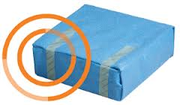
Linen pack limitations
  12” x 12” x 20” size
  Not more than 12 lbs (pounds)
  Maximum DENSITY
    Must not exceed 7.2 lbs (pounds) per cubic foot
    Reduces penetration of sterilant to all of contents
    Determined by:
      Weight (pounds)/ Volume (HxWxL in “) / 1,728 = Density
    Avoid – don’t compress contents

Slide 13
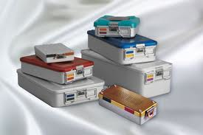
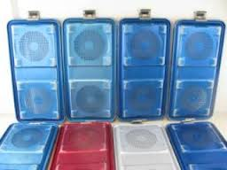
Rigid Containers
Rigid containers
  Materials
    Aluminum
    Stainless steel
    Plastic
  Have
    Lids – allow penetration
      Use filters for BARRIERS
    Inner basket
      Holds instruments
    Handles
      Ease of handling

Slide 14
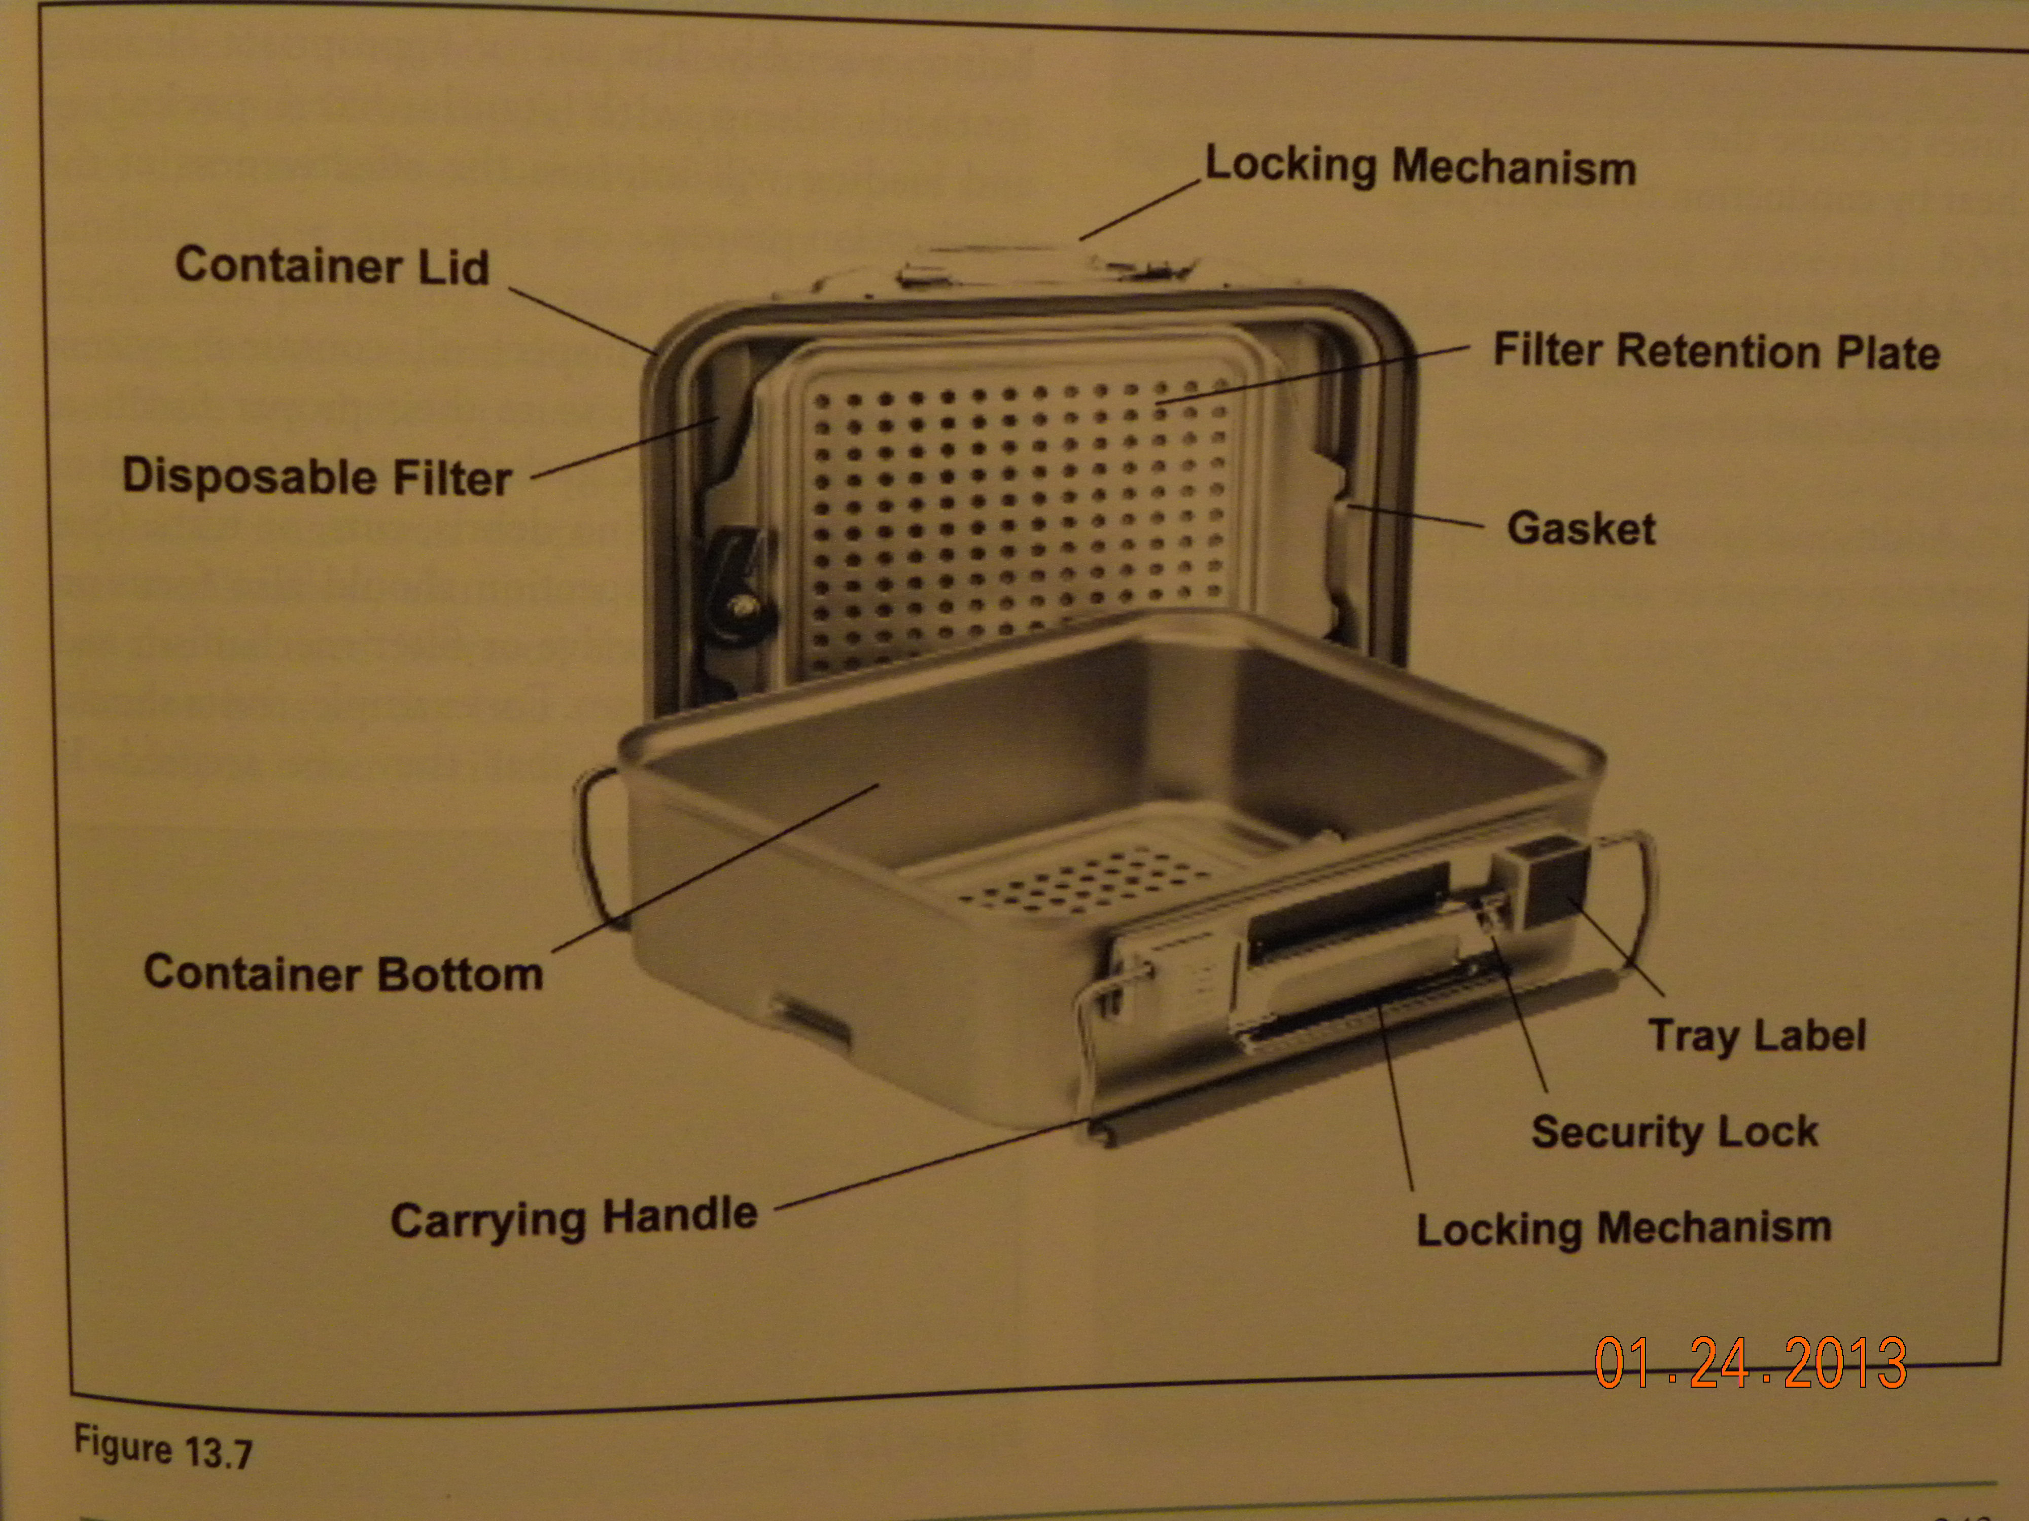
Components

Slide 15
Advantages
  Excellent BARRIER
  EASY to use
  Eliminate TORN WRAPPERS
  PROTECT instruments
    Processing
    Storage
    Transport

Slide 16
Disadvantages
  WEIGHT
    Empty can weight 8 – 9 lbs
      Plus weight of instruments
    Must use good body mechanics when lifting
      Ergonomics
  More DRYING TIME
    More metal = more condensation
    May leave “WET PACK”
      If wet when opening = can’t use

Slide 17
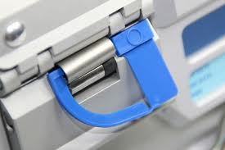
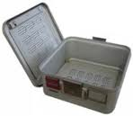
  Must be decontaminated after each use
  Latches can break
    Can’t use any more if not sealable
  Filter retention plates get loose
    No BARRIER – no use

Slide 18
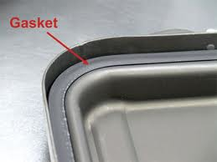
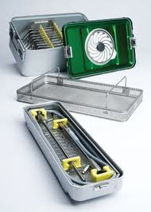
Cleaning / Inspecting
Release filter retention plate
  Remove filters
Follow OEM’s recommendation
  Decontamination procedures
  Detergents
Inspect
  Gasket
    Debris, cuts, tears
  Filter retention latching mechanism
    Secure fitting – no loss of barrier
Carry by their handles

Slide 19
Disposable Packaging Materials
Non-woven materials
  “Engineered fabrics”
    Disposable non-woven materials
      Coffee filters, teabags, vacuum cleaner bags, disposable diapers
  Must inspect before use
    Tears or holes
  Advantages
    Excellent BARRIER
    Can be DISCARDED

Slide 20
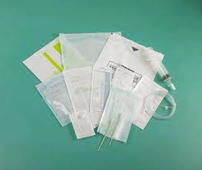
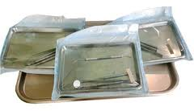
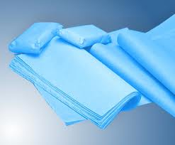
Types
  Paper
    Container cellulose
      Can’t be used in plasma sterilizers
      Plasma absorbs the sterilant
        Reduces penetration
  Polyolefin plastic
  Disposble nonwoven wraps

Slide 21
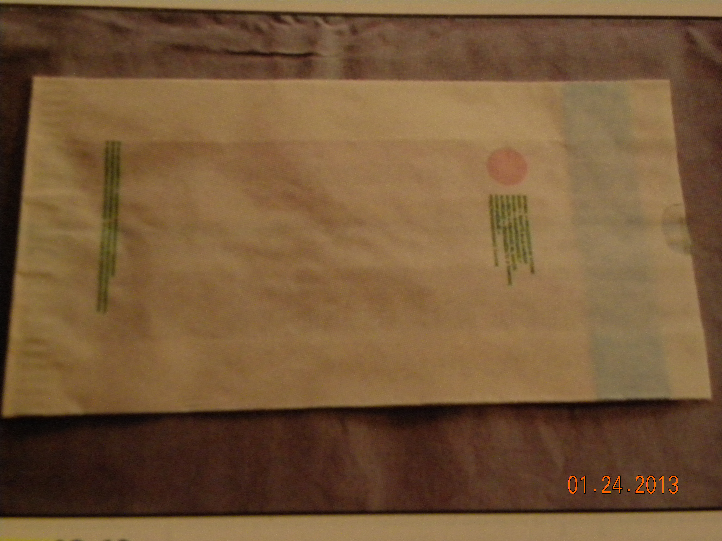
Paper
  Kraft type – medical grade – POUCH

Slide 22
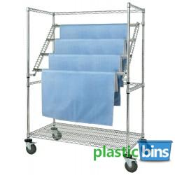
  Non-woven FLAT WRAP
    SMS – most popular
      “Spunbond-meltblown-spunbond”
        Pressure bonded synthetic material
    Disposable – single use
      Are recyclable
    Many sizes available
    Made in 2 ply with bonded edge

Slide 23
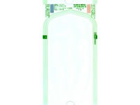
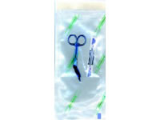
Peel packs
  Paper / Plastic
    Components
      Paper – allows sterilant through
      Plastic – see through
    Used with Steam sterilization and ETO
      Not with dry heat or Plasma
  Spunbond polyolefin / plastic - LOW TEMPERATURE
    Components
      Tyvek – no cellulose
    Can be used with Plasma sterilization
      Melt in Steam sterilization

Slide 24
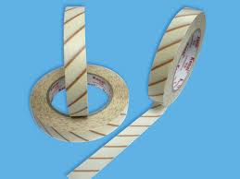
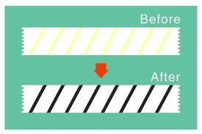
Closure methods
Tapes
  Don’t use anything:
    That can be taken off and reattached without evidence
    Will put holes in wrappers
    Other than Indicator Tape
  Indicator tape
    BEST PRACTICE – use on every package
      Withstands sterilization
      Changes color to indicate sterilization
      Help avoid mixing processed and
      unprocessed items

Slide 25

Rubber Band
  Use only if recommended by wrapper manufacturer
    Use proper size to fit snugly without wrinkles
    Must place label or indicator sticker
    in a way to reveal
    the band has been removed

Slide 26
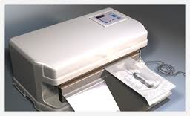
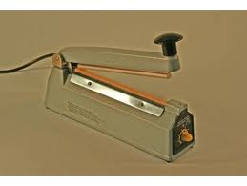
Heat Seals
  Paper / plastic and plastic / plastic
  Placed between jaws of heat sealer
    2 sides are fused together
    Follow OEM instructions
    Check for adequate seal

Slide 27
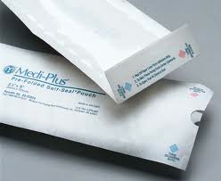
Self adhesive seals
  Paper/plastic and Polyolefin/plastic
  Strip is on end of pouch
    Remove paper strip for adhesive area
  Carefully fold it over on itself
Avoid compromising all seals
    GAPS
    WRINKLES
    CREASES

Slide 28
Sealing tape to secure pouch
  Fold bottom corners over onto plastic
  Fold bottom edge over folded corners
  Seal with tape overlapping edge of pouch by ¼”
    Tape must completely cover the open edge
    Must be securely attached to plastic

Slide 29
Preparing Pack
After assembling contents – WRAPPING
  Placed
    Separately
    As group
    In trays
    Basins
    Containers

Slide 30
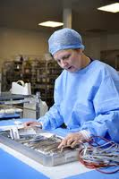
Instruments should be checked for:
  Cleanliness
  Corrosion
  Rust
  Pitting
  Burrs
  Nicks
  Cracks
  Chipped plated surface
  Stiffness

Slide 31
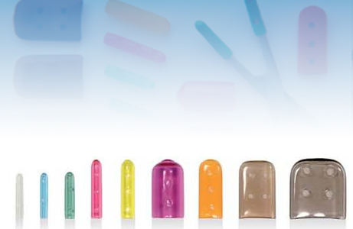
Instruments needing repair
  Taken out of service
    To be replaced or repaired
Protection
  Sharp points protected with
    Special holders
    Tip guards
    Foam sleeves
    Also protects packaging - pouch
  Must ensure sterilization - OEM

Slide 32
Instrument sets
  Groups in
    Sets
    Trays
    Kits
  Smaller for:
    Suturing
    Small procedures
      May include other items for the procedure
        Syringes
        Towels
        Needles
      Deisgned for use in patient care areas
        Include most items needed

Slide 33
Procedure trays/ packs
  Should be uniform
    If provider wants something additional
    Provide individual items
  Basic packs
    Instruments needed for many similar procedures
      Laparotomy instruments used for
        Abdominal incisions
        Pelvic incisions
    Other instruments grouped per specialty in a tray
      Ie. hysterectomy specific instruments

Slide 34
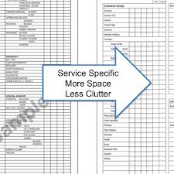
Instrument Tray Packing List (count sheet)
  Specific to tray being assembled
    Lists specific instruments, length and number
    Checked off as set is assembled
    Initial or sign sheet as person preparing

Slide 35
Count Sheet
Instrument List/Count Sheet - Standard Laparotomy Set
Instrument Name Quantity Set Assembly Initial Count First Count Final Count
Knife handle #3 2
Knife handle #3L 1
Knife handle #4 1
Knife handle #7 2
Dressing forceps 10" 1
DeBakey forceps 8" 2
DeBakey forceps 7" 2
Tissue forceps with teeth 5½" 2
Adson tissue forceps with teeth 4¾" 2
Yankauer suction cannula 1
Yankauer tip (in separate peel pouch) 1
Poole suction stylette 1
Poole suction cannula 1
Ruler 1
Backhaus perforating towel clamp 4
Edna nonperforating towel clamp 2
Mosquito curved 4
Kelly curved 8
Kelly straight 4
Babcock 6¼" 2
Allis 6" 2
Allis 7¼" 2
Kocher 5½" 2
Rochester Oschner 8" 2
Schnidt 7½" 4
Mixter 7¼" 2
Pean 7¼" 4
Foerster 9½" 2
Mayo-Hegar needle holder 5" 2
Mayo-Hegar needle holder 7" 2
Lister bandage scissors7¼" 1
Mayo scissors straight 5½" 1
Mayo scissors curved 5½" 1
Metzenbaum scissors 7" 1
Army-Navy retractor 2
Murphy/Volkmann retractor, 4-prong 2
Richardson retractor (multiple sizes) 3
Deaver retractor (multiple sizes) 3
Harrington retractor 1
Weitlaner retractor 6½" 2
Ribbon retractor (multiple sizes) 2
Bladder blade 1
Balfour abdominal retractor 1
Mini Zim clip 2
Adds:
Signature of individual preparing set: ________________________________________________________________________

Slide 36
Assembly
Tray liners – towel
  Used on bottom of tray to absorb condensation
  Provide cushioning
Require indicator inside
Don’t use peel pouches
  Can assure sterilization
    Concern re plastic blocking sterilant
  Paper pouches (all paper) can be used

Slide 37
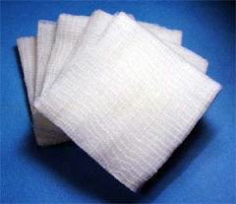

Never put free gauze sponges in instrument trays for the O.R.
  Sponges are counted – these would be extra
    Would not be accounted for
    Might end up in wound
Basin sets
  Arranged to allow moisture to drain
  during sterilization
    All items must face same direction
  Requires wicking materials around
    To avoid condensation / wetness

Slide 38
Wet Packs
  Moisture left in sterile package after drying
    Steam contacting metal cools temperature
      Leaves moisture / wetness behind
  Wicking materials help absorb moisture
    Materials dry during drying cycle
    No moisture is left behind
  When density is too great
    Will leave moisture after drying – wetness = WET PACK
    Basin set should not weight more than 7 lbs.
    WET PACK = CONTAMINATION

Slide 39
SET ASSEMBLY
  Instruments with finger rings
    Group together on
      Rack
      Tray pins
      Stringers
    Assures
      Instruments are in open position – open to sterilization
      Curves go in the same direction
      Follow instrument set list / count sheet
  Place heavy items on the bottom
    Never place heavy items on top of smaller items –
    AVOID DAMAGE

Slide 40
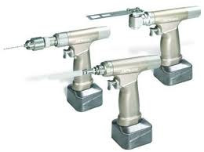
Power Instruments
  IF not purchased separately – disposable items can be placed in pack
    Blades
    Burrs
    Drills
  Parts are disassembled
  Place trigger handles in the safety position
  Turn power switches off
  Follow OEM recommendations

Slide 41
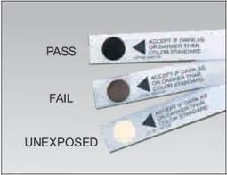
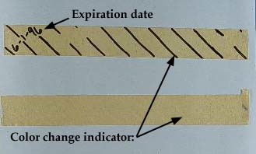
Basic Packaging Procedure
Check
  Name of device to be packaged
  Correct placement in package
  Sterilization method used
  Facility policy for type and placement of indicators

Slide 42
Peel pouches
  Can see item inside
  Come in :
    Precut sizes
    Long rolls for length desired
  May require tip protectors
    Protect tip of instrument
    Maintains integrity of surface of pouch

Slide 43
  Must have as much air expelled before sealing as possible
    Trapped air can expand with heat and break seal
    May not allow adequate penetration of sterilant
    May hinder drying
  Don’t overfill
    Can cause pouch to rupture
    Leave 1” around item up to the seal
      Can stress seal
      Will be difficult to open
    Too Large – can cause item to slip around in pouch

Slide 44
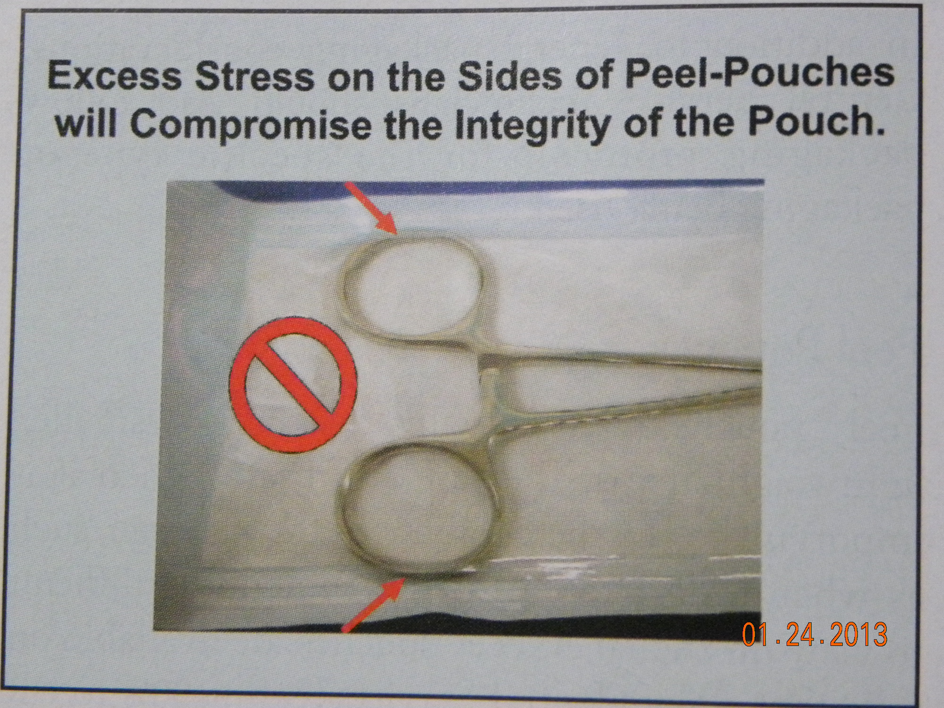

Slide 45
  After sterilization
    Observe for moisture
  Before storage
    Observe for moisture
  Writing on peel pouches
    Write on plastic side – felt tip marker
    Write on paper side outside of seal
    Prevents damage to paper BARRIER

Slide 46
Flat Wrapping Technique
Requires
  2 layers for BARRIER
  Uses old Muslin requirements for steam penetration
    Muslin was 2 layers per wrap and 2 wraps
Methods
  Sequential – one on top of the other
    Wrapped 2X
    Package within a package
    Each is wrapped the same way
  Simultaneous – 2 layers together
    Double layer wrapper is wrapped once

Slide 47
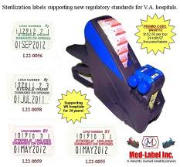
Techniques see p.256 -257
  Square fold
    Parallel fold or in-line fold
    Used for LARGE packages
  Envelope fold
    Used for SMALLER packages
    Looks like an envelope

Slide 48
Sizes
  Large enough to complete contain contents
    Don’t want excess – could inhibit penetration
Snug
  Not so tight to increase density
    Don’t want to impede penetration
Used as sterile field after opening
  Should extend 6” below edge of surface being covered

Slide 49
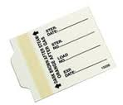
6 Towels RT
Package labeling
  Contents
  Your initials
  Lot control number
  Sterilizer ID
Other labeling
  Surgeon’s name if special item
  Assigned storage location – special unit?

Slide 50
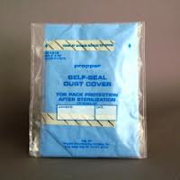
Sterility Maintenance Covers
Applied after sterilization
  Must be:
    Cool and dry
    Completely aerated
  Protect from:
    Dust
    Moisture
    Other contamination
  2 – 3 mils thick
  Sealed
    Heat seal or security tape
  “DUST COVER” marking

Slide 51
6 Towels RT
Why label?
  To know what content is
    CS and User
  Quality Assurance
    Tracking
      Find packages if needed
  Stock rotation
    Inventory control
Load 5
94 (day)
(April 4, 2013)

Slide 52
Information
  Clear and legible handwriting
  Can cause confusion
    Wrong package for the user
    Can delay treatment
    Misplacing items
  On
    Sterilization TAPE
    Pre-printed adhesive labels

Slide 53
Special Concerns
  Packages should held for 2 hours before sterilization:
    Room temperature 67-72ºF
    Relative humidity of 30 – 60%
  Prevents superheating
    Humidity will already be in packs
    Prevents DRY STEAM
  Weight
    ANSI / AAMI recommend between 16 – 25 lbs.

Slide 54
  Check all packages for damage and seal
    Before storage
    When dispensing
    Before opening
  Sterilization personnel
    Should wrap all packages sterilized in CS
    Have knowledge of items / wraps, etc.
    Conditions needed for sterilization

Slide 55
Sterility Maintenance
  Must remain sterile until opened
    Includes storage outside of Central Service
      Infection control
      Quality Assurance
      Personnel must be trained about requirements
  Affected by
    Activities of Staff
    Environment in CS
    Damage to packaging material

Slide 56





  Activities of staff
    Well lighted to see labels easily
    Easily accessible
      Away from heavy traffic
    People entering
      Hand hygiene and personal hygiene
        Frequently
      Proper attire
      Good health
      No artificial nails
      Short nails

Slide 57


Environment in CS
  Moisture and fluid / liquid contamination
    Must be DRY
    RELATIVE HUMIDITY LESS THAN 75%
      Too dry makes plastic brittle
      Too much
        Loosens seals
        Causes condensation
        Cause STRIKE THROUGH CONTAM.
        Hastens organism growth
    TEMPERATURE 64 – 75º F

Slide 58

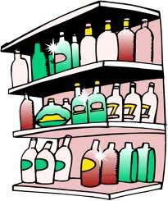
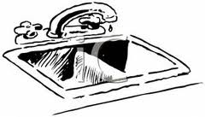
  Moisture and fluid contamination – Cont.
    KEEP PACKAGES 2” away from walls, windows
    PACKAGES 8 – 10” above floor
      Concern re. floor cleaning agents, spills
      Possible shoves and kicks
    PACKAGES 18” from sprinkler heads / ceiling
    Space on shelves to avoiding touching as much as possible
    No sterile storage near / under:
      Sinks
      Pipes
      Sewer lines
      Air conditioning drains

Slide 59
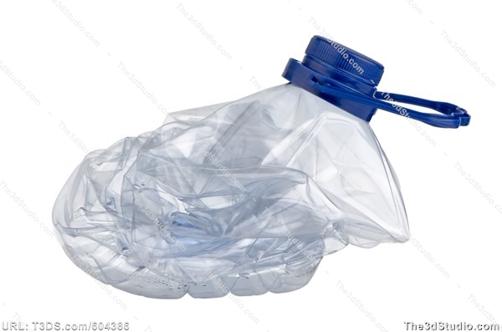
  Stored packages
    Not crushed or compressed
      Can force air out
      Can suck air / contamination in
    Not bent
    Not stacked inappropriately

Slide 60
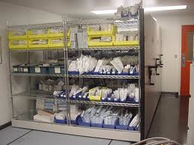

  Storage shelves
    Open shelves
      Shelves are not solid
        Prevents dust accumulation
      Less expensive
      Packages are more vulnerable
  Closed shelves
    Have doors to prevent contamination
    Protects more expensive/delicate items
      Open doors slowly to prevent rush of air / contamination

Slide 61
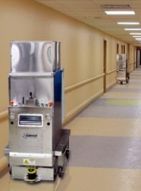
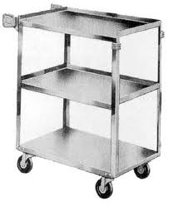
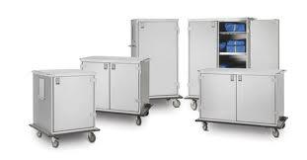
  Storage of items from outside vendors
    Outer shipping containers must be removed
    Transported in Clean Transport Container
      Closed
      Solid bottom shelf

Slide 62

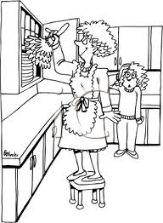
  Dirt, dust and debris
    Must be CLEAN
      Clean from STERILE to CLEAN to CONTAMINATION
      Routine cleaning with hospital approved germicidal
      Damp dust
    Sterile areas
      Removing sterile items
      Clean shelves
      Assure shelves are dry before placing sterile packages

Slide 63


  Damage to packaging material
    Abrasions
    Tears and Cuts
    Punctures
    Breakdown of barrier/packaging
    Broken seals

Slide 64
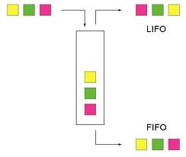
Sterile Stock
  Organized by the following:
    Name, function, or specialty
    Heavier on the bottom
  Stock rotation
    FIFO – First In First Out
      Assurances that items with expiration dates are used before they expire
      Less exposure / contamination
      May work back to front, left to right
        Using colored shelf divide – “use this first”

Slide 65
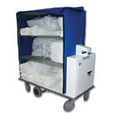
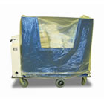
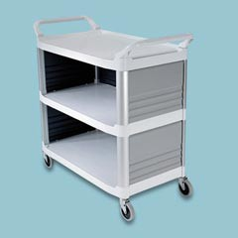
Transport considerations
  Done in covered or enclosed carts

Slide 66

Handling packages
  The more it is handled the greater chance of contamination
  Sterile items dropped – considered contaminated
    Even if no damage is apparent
  Lifting sterile pack
    Pick up with one hand
    Place other hand midway back and lift
      Don’t drag or push
      Causes friction / abrasion
    Shelf liners decrease drag

Slide 67



  Checking packages
    Sterilization indicator
    Expiration date
    Tears
    Abrasion
    Fuzzy “worn” areas
    Punctures
    Broken seal
    Dirty
    Stains or signs of moisture

Slide 68

  If the package is damaged in any way
    Consider CONTAMINATED
    If REUSABLE
      Remove and Reprocess
      LINEN MUST BE REWASHED
      SEND THROUGH DECOTAMINATION AGAIN
    If disposable – DISCARD
    SINGLE USE WRAP IS NEVER REUSED

