Slide 1
Point of Use PROCESSING
Chapter 14 7th Ed.
Rosemary Thurston RN

Slide 2

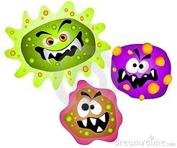
When
  Immediately before use
Where
  Close to patient care area
    Operating room sub sterile area
    Transported SHORT DISTANCE to care area
    WITHOUT STERILE WRAPPING
Concern
  Contamination before use

Slide 3
Why
  Speed – needed quickly
How
  Steam sterilization – FLASH STERILIZATION
  Oxidizing Chemicals
    Liquid sterilization -
Standards
  To be safe – must follow standards

Slide 4
Flash Sterilization
Definition
  Processing of sterilizing unwrapped instruments for immediate use
  When there is an immediate / emergency situation
Standards from
  AAMI
  AORN
  The JOINT COMISSION

Slide 5
AAMI
  Ensure proper cleaning, decontamination, inspection, placement in container
  Layout provides to direct delivery to POU
  Procedures for aseptic handling and safety during transport – must be followed
  Must be used immediately after sterilization
  Do not FLASH sterilization for IMPLANTS
    Complete DOCUMENTATION for BIOLOGICAL INDICATORS
    Complete Exception Form for PREMATURE RELEASE OF IMPLANTABLE DEVICES

Slide 6
AORN
  Only used in selected situations in a controlled manner
  Use should be minimized
  Only done when not enough time to process by preferred wrapped /container method
  Not used as a substitute for enough inventory
  Do not FLASH sterilization for IMPLANTS

Slide 7
AORN continued
  Only done if:
    Ok with OEM
    Devices and lumens are thoroughly cleaned
    Placement in container allows penetration
    Aseptic transfer to sterile field procedure in place
    Documentation / monitoring results maintained
      To allow tracking to individual patients

Slide 8
The JOINT COMMISSION
  Used only in unanticipated situations
  Not routine practice to turnover sets
  Plan in place
    To not require the same sets many times / day
    Sufficient time for regular processing
    Document what you do – follow your procedures
  Increase instrument inventory as needed
  Plan to improve / decrease flash sterilization
  Pay attention to frequency of flash sterilization
  Documentation to track instruments to patient

Slide 9
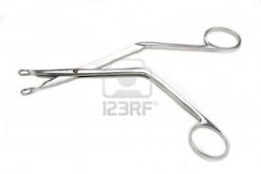
Original intention of Flash Sterilization
  To sterilize one instrument
    For dropped / contaminated instrument
  Not recommended for large trays because
    Need longer heat-up time
    Increase total cycle time
    Increases cooling time
    Full trays may need more exposure (kill) time
      For POROUS or COMPLEX instruments

Slide 10
Flash Sterilization Procedures
  Issues
    Not enough instrument inventory to meet day’s schedule
      Surgeons with back to back repeat procedures
    Not enough time for wrapped sterilization
    Lack of space in the OR for proper decontamination
      Unless it is a new facility
    Specialty instruments brought by surgeon –
      Must undergo decontam, sterilization IN THE FACILITY

Slide 11
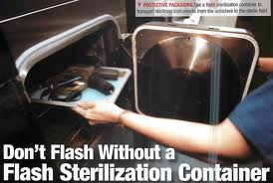
Flash Sterilization cycles
  Gravity
  Pre-vacuum
    Complex instruments
      Orthopedic
      Neurologic
      Power equipment – newer
  Express
    Single instrument
    Wrapped in single layer
Current known as: IMMEDIATE USE STEAM STERILIZATION

Slide 12
Flash Phases
Conditioning
  Steam enters
  Temperature increases
  Moisturizes organisms
  Penetrates packages
Exposure – to steriliant – Sterilization
  Kill time plus Safety time = 3, 4 or 10 minutes
Exhaust
  Filtered air enters
  Steam is removed
  Essentially 1 minute of dry time

Slide 13
Gravity Displacement
    Common Flash Sterilizers
    Can sterilize non-porous and porous items
Load
  Single instrument - 3 min. 270ºF
  Lumens
  Mixed materials
  Multiple instruments 10 min 270ºF
Pre Vacuum
  Mixed load 4 min 270ºF

Slide 14
Decontamination in OR
Process is the same where ever it is done
Environmental considerations
  Only for instrument decontam
  Surface materials should be the same as CS
    Walls, floors, etc
  Lighting
  Ventilation – 10 exchg /hour
  Negative air pressure
  Temp 60 – 65º
  Relative humidity 30 – 60%

Slide 15
Staff –
  CST
    Understands requirements
    Knows risks
  Transfer –
    Care with contaminated instruments
    Care with sterile instruments

Slide 16
Decontamination and Prep physically separated
  If not possible – separate areas for dirty/clean
    Label each area
  Flow is always “dirty” to “clean”
  Activities should not be done at the same time
  Air flow from CLEAN side to DIRTY side

Slide 17
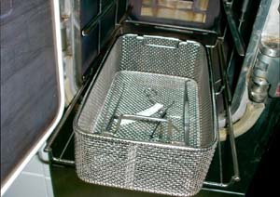
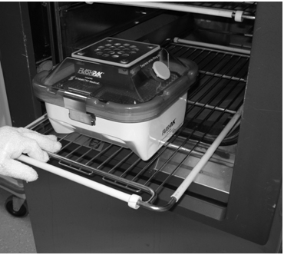
  Process
    Use of PPE
    Appropriate presoaks
    Thorough CLEANING
      Manual, ultrasonic, washer-disinfector
      Opened or disassembled
    Inspection
    Flush lumens before flash sterilization
    Trays used for sterilization
      Are perforated
    Containers for Flash
      Follow OEM recommendations
        May require longer sterilization times

Slide 18
Transport
Aseptic manner to transport
  Alert to potential contamination
    No unsterile obstacles in route
    No high aerosolization area (scrub sinks)
    Not by people without masks
  Covered
    In flash tray
    With sterile towel or metal tray
  To sterile field by CS personnel
    Only the item goes on the sterile field by scrub person
  To Field by Scrub Person
    Moves only in restricted areas
      Cleared of people / activities that could contaminate

Slide 19
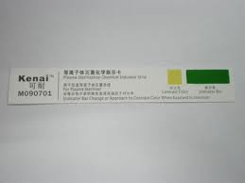
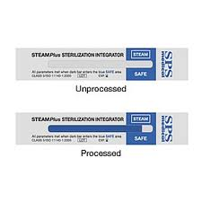
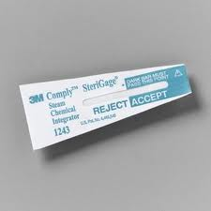
Quality Controls
Monitoring
  Chemical Indicators
    Indicate exposure to sterilization ONLY
    Every tray
    Every cycle
  Class 5 Integrators monitor:
    Indicate exposure to additional parameters
    Time
    Temperature
    Moisture

Slide 20

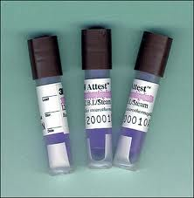
Biologic Monitoring - BI
  Contain bacterial SPORES specific to sterilization mode
    Geoabacillus Stearothermophilus
  Come from manufacturer as:
    In a Process Challenge Device
      Acts like a package and must be able to enter to kill spores
    In a self-contained vial (naked)

Slide 21
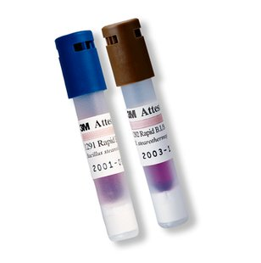
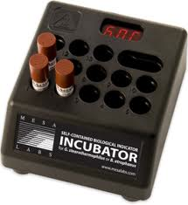
  Early-readout Enzyme-based BI
    Readout based on enzyme activity
    Floresence is read as positive or negative
  Must Incubate the BI’s after use
    122 – 140º F for
      Geobacillus Stearothermophilus
    For 1 – 3 hours
    Should be NEGATIVE
      NOT GROW
    Use “CONTROL”
      Spore not exposed to sterilization
      Should GROW = POSITIVE

Slide 22
Control BI
  When
    AAMI –
      Recommends weekly
      Prefers daily
      Must check each kind of cycle
      Every type of tray
        Tested separately with each cycle
  How
    In mesh bottom instrument tray
    Placed in lower half of sterilizer over drain
  Incubate with others
    Should grow = Positive

Slide 23
  Negative BI
    If negative – must be reported / documented
    Sterilizer taken out of service
    Items processed since last BI was run
      Must be retrieved – considered non-sterile
      Must be traceable to a patient
    Investigation
      Check by service rep of company
      Check chemical and mechanical monitors
      Do lab test for bacillus growth
      Notify Infection Control
      Retest after maintenance / repair

Slide 24

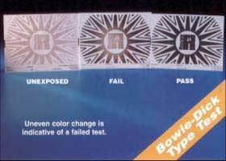
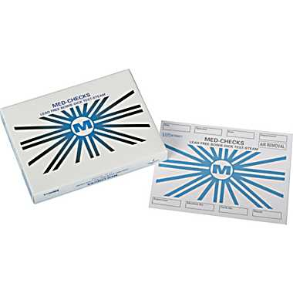

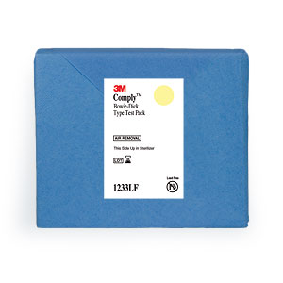
Residual Air Bowie-Dick
Required for Pre-Vacuum sterilizers
  Run each day before using
    After warm up cycle
  Checks for air removal system
    Detects air left in chamber – usually above the drain
  Commercial packs are available

Slide 25

  Use
    After warm up cycle
    Place in empty chamber on the bottom over drain
    Sterilize for 3.5 minutes at 273º F
      Never more than 4 minutes
    Read
      Coloration should be equal across the form
      Uneven coloring means failure
    Must be repaired

Slide 26
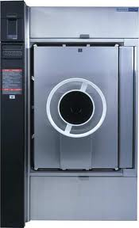
Cycle Monitoring
Physical Monitoring
  Mechanical or electronic
    Time
    Temperature
    Pressure
  Before, during, after
  Shown on displays / printouts
    Are legal documentation

Slide 27
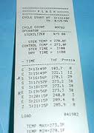
Monitoring
  Be sure last cycle was completed satisfactorily
  Select cycle for the item being sterilized
  More sure it is completed properly before removing items

Slide 28
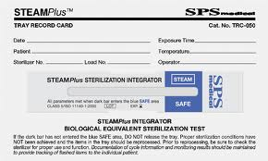
Documentation for Flash Sterilization
  Each cycle should include
    Patient’s Name
    Contents of load
    Type of cycle used
    Parameters
    Reason for flash
    Signature of staff
Documentation keep per Hospital policy

Slide 29
POU Processing for Heat-Sensitive Devices
Demand for less invasive procedures
Trend for MIS – Minimally Invasive Surgery
  Endoscopic procedures
    More complex, delicate and heat sensitive-devices
    Creates processing challenges
    May not have enough inventory
    May create “SHORT CUTS” to process quickly

Slide 30
Selecting heat sensitive processing
Depends on
  Resistance of organisms
  Intended use of the device
    Surgical or GI endoscopy
  Complexity of design in reprocessing
    Some can now be steam sterilized
  Compatibility of device with agents for cleaning / sterilizing
  Time required to reprocess
  Ease of use
  Safety – staff and patient
  Ability to monitor
  Cost

Slide 31
Low Temperature Sterilization
  ETO – ethylene oxide
    Long cycle times
  Gas Plasma
    Additional prep time required
    Must be thoroughly dry before packaging
Spaulding’s Classifications of devices
  Critical = into sterile areas = sterilization
  Semi-critical = on intact mucous membranes = high-level disinfection
  Non-critical = intact skin = intermediate / low-level disinfection

Slide 32
Options
Need for faster turnover times
  More use of high-level disinfection
    Spores would still need longer exposure times
    TIMES vary with TEMPERATURE and TYPE of Disinfectant
  Shift from Manual to Automated processing
    Removes ‘human’ factor
    Gives predictable outcomes
    Frees up staff

Slide 33
Priorities
  Safety of chemicals
    For all people involved
    For instruments
    For environment
  Efficacy of agent and process
    To kill spores / bacteria / other
    Ability to prevent biofilm in the processor
      Stick to solid surface – in and out of body
      Forms “slime” in aqueous solutions
      Resistant to detergents and antibiotics
  Efficiency of process

Slide 34
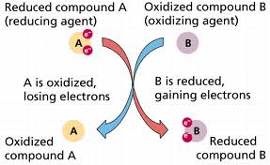
Oxidation Processes
Oxidation - Involves oxygen and electrons
B (oxidizing agt) removes electrons from A (reducing agt)
B adds electrons (reduced) and A looses electrons (is oxidized)

Slide 35
Oxidation
  Includes Peroxygen
    Contains additional atom of oxygen
    Bound to another oxygen
  Uses oxidative reactions to damage cell function
    Causes death of microorganism
Benefits – excellent:
  Cleaning
  Disinfecting
  Sterilizing
  Non-toxic
    Hydrogen peroxide = oxygen and water
        H₂O₂ = H₂O + O₂
    Is sterilant or high-level disinfectant

Slide 36
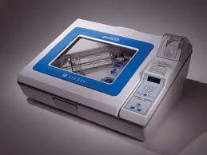
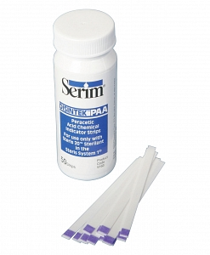
Peracetuc Acid – PA - Steris
  Biocide at low temps
  Is VINEGAR plus an extra OXYGEN atom
    Reacts with most cells – causes death
  Sterilizes FLEXIBLE SCOPES plus others
  Used for STERILIZATION or HIGH-LEVEL DISINFECTION depending on:
    Exposure time
    Formulation
    Labeled use
  Water soluble and free rinsing
  Active in presence of organic matter at low temp.
  STERILIZEs rather than high-level disinfection

Slide 37
Difference between PA and ETO
  ETO
    Used on wrapped items
    Very long process
  PA
    Unwrapped items
    Must be used now
    Shorter process

Slide 38
Ozone
  Used as sterilant and disinfectant
  Uses Oxygen, Water and Electricity
    Kills organisms by denaturation
    Environmentally friendly byproducts
  Harsh on some materials

Slide 39
Liquid Processing Systems
Special PA Processor – Steris
  Uses prepackaged cup of 35% peracetic acid
    Adds buffers to be neutral pH
    Adds corrosion inhibitors
    One cup for each cycle
  Containers for specific scopes
    Flexible
    Rigid
  Automated, monitored
    Push button operation
    Internal self-diagnostic system
    Printout for process monitoring

Slide 40

  Criteria for sterilization
    Proper concentration – premeasured
      Sterilant and buffers
    Dilution proper
    Temperature 122 – 133º F
    12 exposure time
    Fluid circulation constantly during cycle and rinse
    4 sterile water rinses (filtered tap water)

Slide 41
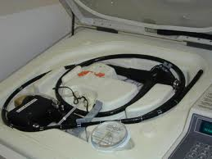
Using PA
  Scopes must be Leak tested, CLEAN and RINSED
  Interchangable trays for flexible and rigid scopes
    Should fit properly / easily
    Must be immersible
    Can withstand temps up to 133ºF
    Must contact all surfaces of device
    Channels must be connected to processor
    Must be OK with OEM
  Cup is placed
    to puncture bottom buffer
    Probe enters top to aspirate PA
  Push start button

Slide 42

Process monitoring
  PA system is continually monitored throughout the cycle
  Operator observation
    Check PA cup before insertion
      Compromised container / box
      Turned bright yellow
      Has strong vinegar smell
      Expiration date
      Bottom of cup is not hardened
  After insertion of probe
    Check tubing for integrity – kinks
  Check through window for solution flow
  Chemical indicator should be the right color

Slide 43
Parametric monitoring
  Verifies
    Concentration - 175
    Temperature – 122 – 133º F
    Time – 12 minutes
  Cancels if these are not met
  Checked by operator at end of cycle on printout

Slide 44

Chemical monitoring
  For MEC –minimum effective concentration
    Verifies concentration of agent
  Run with each load
Biological Monitoring
  Test challenge of Geobacillus Stearothermophilus
  Compared to control
Diagnostic cycle
  Run each day before using processor
    Electrical, mechanical, pneumatic and hydraulic systems
    Verifies integrity of sterile filter membrane
  No steriliant used for this cycle

Slide 45
Toxicity and Residues
  Safety risks were evaluated
    Concentrate caustic to skin and eyes
      Moderate if swallowed
    Dilution
      Not caustic to skin or orally
      It is nearly a neutral pH

