Slide 1
High Temperature Sterilization
Chapter 15 7th Ed.
Rosemary Thurston RN

Slide 2
High Temperature Sterilization
Definition
  Items are exposed to thermal energy from moist heat (steam) or dry heat
Advantages
  Effective in killing microorganisms
  Steam is the most frequently used
    Safe
    Effective
    Raliable
    Low cost

Slide 3
Preconditions
  Must be
    CLEAN
      Removes soil
    DECONTAMINATED
      Kills most microorganisms
    PROPERLY PREPARED
      Packing
      Wrapping or in container

Slide 4
Effectiveness factors
  Type of organisms
    Some more resistant than others
  Cleanliness
    Number of microorganisms (BIOBURDEN)
      More increases difficulty to sterilize
    Amount / type of soil
      May shield / protect microorganism
    Device protection for microorganisms
      Cracks, crevices, porous in designn

Slide 5
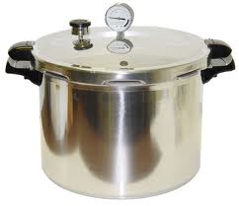
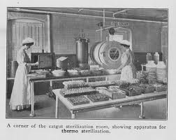
Steam sterilization – most commonly used
  Advantages
    Low cost
    Fast
    Fairly simple
    No residue / by-products
History
  Used to use boiling water
  Needed to increase temperature to kill resistant
    Steam under pressure

Slide 6
Heat Transmission
TYPE OF TRANSFER | DESCRIPTION | STERILIZATION METHOD
CONDUCTION Solids | Heat moves from one particle to another next to it by colliding – warmer gives to cooler | Dry Heat
CONVECTION Liquids / Gases | Heat moves from particle to particle and moves around sharing it’s warmth – circulates through liquid / gas disseminating it’s heat | Steam
RADIATION through space | Transfer through space to warm another part without warming the space – sun warms earth | Radiation

Slide 7
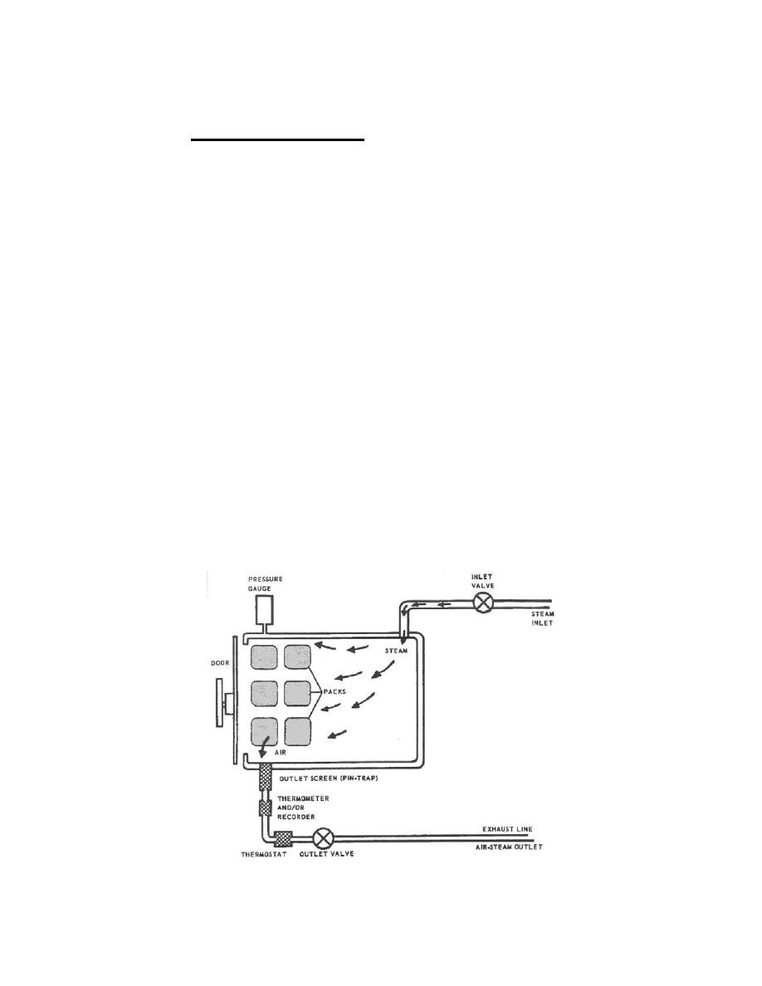
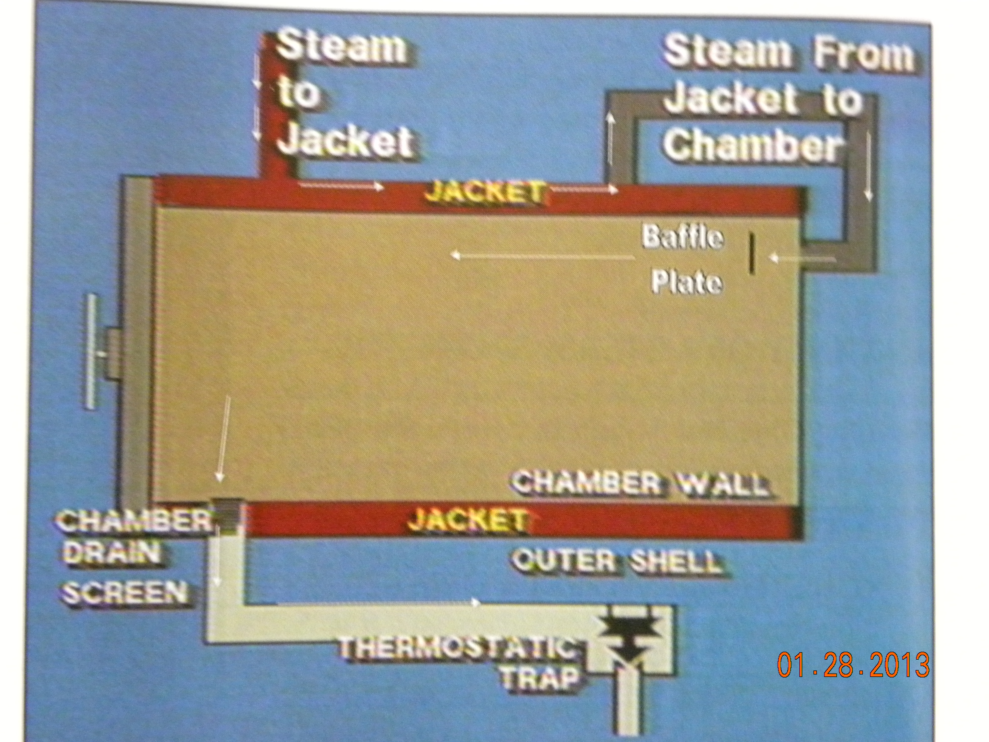
Steam sterilizer

Slide 9
Steam Sterilizer components
Jacket
  Steam enters jacket
    From main steam line in Hospital
      Will be HOT
    Decreases condensation when steam enters chamber
    Insulation on outside to prevent exterior condensation
      Protects YOU from Burns

Slide 10
Door p. 291
  Locks automatically when pressure starts
    Can be tightened
    Can’t be loosened
  Unlocked when pressure is down to “0”
Seal
  Prevents steam from leaking
  Keeps the pressure us

Slide 11
Chamber Drain
  Front or center location
    Must be cleaned daily
Thermostatic trap
  In drain line
    Coolest place in sterilizer
  Senses steam temperature
    When is it at the sterilizing temperature
    Controls flow of air /condensation

Slide 12
Gauges / Monitors / controls
  Provide visual / written record of sterilization conditions / parameters
  Printout
    Date and time
    Written record of activities in sterilizer
      Temperatures
      Exposure time
        Conditioning
        Sterilizing
        Evacuation
      Pressure

Slide 13
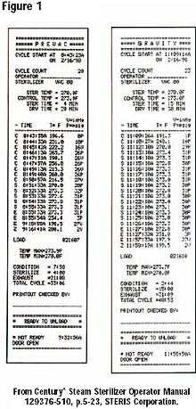
Steam Sterilizer
Printout
May have to Initial
printout to show it
met parameters.

Slide 14
Types of Steam sterilizers
Table top
  Used in clinics, offices
    Water is poured in to make steam
    Heated until it is steam
    Enters top
    Fills chamber
    Forces air out of bottom to temp sensor
    Valve closes
    Pressure builds
    At appropriate temp – valve closes – pressure builds
    At sterilizing temp – start cycle time
    Allow steam to evacuate
    Leave items to dry and cool before removing

Slide 15
Gravity AIR Displacement sterilizer
  Small to medium autoclaves
    Create steam in air
    Hot air rises
    Forces cooler air down - out of drain
    Air is removed during preconditioning
      Air is vacuumed and pressurized – pulses
  Have automatic controls
    Printouts
  Can be used for sterilizing liquids

Slide 16
Dynamic Air Removal Sterilizers
  Similar to Gravity Air Displacement units
  Vacuum pump / water ejector removes air during preconditioning
    During preconditioning phase
    Pulses vacuum and pressure
    Reduces total time
    Reduces possible air pockets
      MUST BE CHECKED WITH BOWIE-DICK DAILY
  Operate at higher temperature – 270 – 275ºF

Slide 17
Steam-Flush Pressure-Pulse Sterilizers
  (SFPP)
  Repeat sequence of
    Steam flush
    Pressure Pulse to remove air
      No vacuum is required
    Works similar to air removal systems
      Rapidly removes air
      Not susceptible to air leaks
        No need for Bowie-Dick

Slide 18
Special Purpose sterilizers
FLASH Sterilizer
  Used in operating rooms / substerile rooms, L&D and Special Procedures
    Used when there isn’t time for terminal sterilization

Slide 19
Instrument Washer –Sterilizer
  Used in Decontamination in CS
  May be used prior to cleaning
  Chamber flooded with cold water
    Prevents proteins setting
  Mechanical washing
    Water drained
  Rinses
  Sterilization cycle

Slide 20
Steam sterilization cycle Phases
Flash sterilization
  Sterilizing something that is not packaged
Terminal Sterilization
  Sterilizing something that is packaged
  Usually done in CS

Slide 21
Saturated Steam Sterilization cycles p.296
  Conditioning
    Door closed
    Steam enters
      Hit baffle plate to prevent wetting the load
    Air evacuates
      Through drain
  Exposure
    Pressure rises
    Temperature gets to sterilization temp
    Begins sterilization cycle / KILL time

Slide 22
  Exhaust
    Drain is opened
    Steam is removed
    Air is gradually entering
    Gets to ambient (room) temperature
  Drying
    Occurs with packaged items
    Uses heat of chamber / heated air;
    Timed to dry load
  End of cycle Signal
    Door is opened

Slide 23
Conditions for Steam sterilization
Contact
  Must have direct contact with all surfaces
  Failure may be due to:
    Not clean – prevents contact with surface
    Wrapped too tightly –
      Air trapped – can’t get out
      Steam can’t enter to touch surfaces
    Loads too crowded
      Must have adequate spacing to enable penetration to all

Slide 24
    Poorly positioned containers
      Basins – others that can hold liquids
      Positioned to allow water and air removal
    Clogged drain strainer
      Lint and tape can clog the drain
    Other mechanical malfunctions
      Defective steam traps
      Clogged exhaust line
      Qualified service rep must repair

Slide 25
2 & 3 Temperature and Time
  270 – 275ºF (132.2 – 134ºC)
  250º F (121º C)
    Requires a longer time for sterilization
  Higher temp = less time
  Lower Temp = more time

Slide 26
Moisture
  Saturated Steam
    Like a fog – holds moisture in suspension – no air spaces
    Moisture content should have relative humidity of 97 – 100%
    It is actually DRY SATURATED STEAM
  Temperature and Pressure
    The Higher the Temperature = the higher the Pressure
    The Lower the Temperature = the lower the Pressure
    P. 299

Slide 27
Superheat
  When the temperature exceeds the normal temperature at a certain pressure
    Ie. 300º F at 27 lb./square inch
    = superheated = DRY steam
    Normal would be 270º F at 27 lb./square inch

Slide 28
Preparing for Steam sterilization
Steam must contact all surfaces
  Must be clean first
  Air removal from all areas
    Perforated trays
      Distribute mass in tray evenly
    Proper positioning – basins
  Only non-linting material can be used
    Lint carries organisms and foreign body reactions can occur
  Stoppers / tubes removed from bottles
  No rubber on instruments

Slide 29
Basic procedures:
  Positioned to allow steam contact with all surfaces
  Instrument in OPEN position – use holders
  All parts disassembled
    Unless documented by EOM that sterilization can occur
  No rubber bands on instruments
  Broad flat surfaces must be placed on edge – to drain
  Heavy instruments on bottom – won ‘t damage others

Slide 30
  Lighter instruments positioned to protect tips
  Inspect for cleanliness
  Instruments must be dry
    Except for lumens – as dry as possible
  Complex instruments – follow EOM
  Protective Cases
    Must be prove effectiveness of sterilization
    Must evaluate drying of loaner trays
      Be sure you have instructions from manufacturer

Slide 31
Catheters, Tubing, Rubber and “Other”
  Rubber
    Not stable – factors that can reduce life
      Heat
      Light
      Direct contact with:
        Acids
        Solvents
        Petroleum
        Ether
        Hot metal

Slide 32
  Rubber products – follow OEM
    Catheters
    Tubing
    Drains
  Wood and Cork – can’t be sterilized
  Oils / powders – sterilize with dry heat only

Slide 33
Paper/Plastic pouches
  Small light-weight low profile items
    Individual instruments
  To double pack
    2 sequentially sized pouches
      One to fit into other’s sealed area
  Not to be used in instrument trays
    Doesn’t allow adequate steam contact and removal
    May end up “wet”

Slide 34
Textile packs
  Packaging should allow penetration and evacuation
  Consult EOM re density and sterilization parameters
  Linens must be clean and Preconditioned
  DO NOT REWRAP LINENS WITHOUT LAUNDERING
    CAN CAUSE SUPERHEATING

Slide 35
Basins and basin sets
  Nested basins should be smaller by 1”or more
  Should all face the same direction
  Linen should separate basins
    To absorb condensation
  Should not exceed 7 lbs.
  Should be positioned to allow drainage during sterilization35

Slide 36
Syringes / medicine glasses
  Glass syringes
    Barrel and plunger should be wrapped separately p.305
      Not gauze songes
      Use non-linting absorbent material
Lumens
  Moistened with distilled water
    Displaces air more easily
    Becomes steam and forces air out
  Consult OEM

Slide 37
  Any other items to be included with trays
    Make sure to consult OEM
Tray liners
  Help absorb condensation
  Dispenses moisture over greater surface
  More efficient drying
  MUST NOT IMPEDE AIR REMOVAL OR STEAM PENETRATION

Slide 38
Loading
  Allow air circulation
  Allow steam circulation and penetration
  Allow evacuation
  Allow drainage of condensation
  Group similar things together
    Have the same requirements for sterilization
  Cart shelf liners – non-linting like all other fabric
  Items that can hold water should be positioned so it will drain out – ie. basins

Slide 39
Basic Procedure
  Allow for steam circulation
    Steam will not force it’s way in
  Use absorbent shelf cover on sterilizer cart shelf p.306
    Absorbs moisture – prevents dripping
  Solid containers – non perforated
    Should be set on side
  Leave visible space between packs
    Allows circulation of steam and drying

Slide 40
  Hard goods should be on the bottom
    Prevents condensation dripping on softer goods – wet
  No touching chamber walls
  Basin sets on edge
    Allows drainage
  Textile packs
    Flat sides should be perpendicular to shelf
    Should be on edge

Slide 41
  Peel pouches – paper/plastic
    On edge – using bucket or rack
    Paper to plastic for air / steam circulation
  Separate textiles and hard good loads
  Other than lumens – all items in package should be dry
    Wet in = wet out
  Instrument sets with perforated bottoms
    Sit flat on shelf

Slide 42
Unloading
  At end of cycle – door is opened
  Packages are warm – may have vapor
    Touching can cause Strike through contamination
    Barrier is maintained only if dry
  Check for liquids
    Droplets can mean moisture in load
    Check each item carefully
    Don’t TOUCH

Slide 43
  Wet items = contamination
  Crack the door –
    10 minutes for pre-vac
    20 – 25 minutes for gravity
  Unload once items are cool - 30 – 60 minutes
    Don’t touch until cool
    No dust covers until cool
    Cool-down in traffic free area – no cool air currents
  Handle packages as little as possible

Slide 44
Wet Packs
  When dampness, droplets or puddles are in/on package after steam sterilization p.308
  WET PACK = CONTAMINATION
    Can’t be used
    Must be REPROCESSED and REPACKAGED

Slide 45
Causes of WET Packs
  Loading cart incorrectly
    Metal above condenses
    Condensation through steam lines
  Inside item
    Meal positioned to allow water to pool or trap steam
    Too dense – overloaded
    Lacking absorbent materials
    Too tightly wrapped
    Device may need extended drying time – see OEM

Slide 46
  Internal Moisture
    Plastic trays may require increased drying time
  Document wet packs
    Packs should be returned immediately for examination
      Must identify root cause
        Specific device
        Specific person
  External Moisture
    Noticed on removal from sterilizer
    Don’t check for moisture until after cooling
      May vaporize during cooling

Slide 47
Assembling instrument sets
  Trays
    Must have perforations or mesh bottom
    Adequate size to evenly distribute the metal mass
  Line with lint-free absorbent surgical towel or other
    Moisture dries more easily than droplets
    Some foams may hold condensation
    Don’t use with rigid containers unless recommended by OEM

Slide 48
  Instruments
    Open
    Evenly distributed in tray
  Wrapping sets
    Wrapper
    Absorbent material – for condensation
    Then instrument tray
    Can place a towel on top of set
      Can help prevent torn wrappers

Slide 49
Cleaning / maintaining sterilizers
  Follow OEM recommendations
  Cool chamber first
    Wear protective gloves
  Check
    Chamber drain – particles p.310
      Screen strainer – remove and clean daily
      Use abrasive brush and mild detergent

Slide 50
    Chamber
      Use specific mop and mild detergent – no abrasives
        Turn off steam
        Allow to cool
        Wear protective gloves
    Door gasket
      Inspect for damage
      Wipe clean daily
    Carriage, cart, loading baskets
      Clean with mild detergent
      Check for rough areas
      Check wheels/rollers for free moving function

Slide 51
    Drain
      Follow OEM recommendation / instructions
      Must allow free movement of air and steam
    Recording devices
      Paper charts
      Printer paper

Slide 52
Dry heat sterilization
What
  To penetrate some materials not permeable to steam
    Oils, petroleum jelly
    Powders
    Closed containers
Rate of microbiological destruction determined by
  Temperature
  Time
  Uniformity of heating
  Permeability of material
  Amount of bioburden

Slide 53
Use
  When saturated steam can’t do the job
    Can’t penetrate – water can’t penetrate
  Glassware
    Withstands higher heat for a short time
  Not with fabric or rubber
Heat transfer
  CONDUCTION – from particle to particle
    Heats entire item, not just surface
  TIME – no moisture – takes longer to kill organisms

Slide 54
Advantages
  Can sterilize powders and oils
  Doesn’t erode glass surface
  Not corrosive / rust metals / sharps
  Reaches all surfaces – on items that can’t be disassembled

Slide 55
Disadvantages
  Difficult to control in narrow limits
  Penetrates slowly / unevenly
  Requires long exposure times
  High heats damage some items
  Limited packaging materials for wraps
  Not suitable for fabrics / rubber

Slide 56
Types of dry heat sterilizers
  Hot air convection
    Gravity Convection Sterilizers
      Heated air rises and displaces cooler air
      Causes inconsistent temperatures
      Difficult to monitor temperatures at level of item
    Mechanical Convection Sterilizers
      Has a blower to force heated air throughout chamber
      More uniform temperatures
      More efficient

Slide 57
Dry Heat Procedures
  Follow OEM recommendations
    Temp, timing, loading, etc.
  Temperature
    Most common is 320ºF
  Time
    For 2 hours
  Time and temperature relationship
    Hotter the TEMPERATUR = shorter TIME
    The lower the TEMPERATURE = longer TIME
  Must allow air to circulate freely when loaded

Slide 58
Oils and Powders
  Quantity is limited to single use
    Oil depth not more than ¼”
    Powder depth is also limited
  Impregnated gauze strips
    Gauze placed in stainless steel contained
    Covered with petroleum jelly or other oil
    Depth not to exceed ½”

Slide 59
  Glass syringes –
    Can sterilize assembled
  Needles
    Can have stylet in place
  Instruments
    Must be dry
  When loading
    Standardize loads – same things at same time
    Spaces between for good circulation

Slide 60
Packaging materials
  Heat resistant glass
  Stainless steel trays / pans with lids
  Cotton muslin if not over 400º
  Aluminum foil
  Nylon films
  Other as specified by OEM

Slide 61

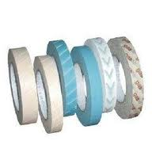
Sterilization quality control
Need to PROVE sterility
  Must monitor conditions
Control measures
  Process indicators -
    Proper exposure to process
      Visual evidence of the process – change color
      Sensitive to Heat of sterilization
      Can detect: air leaks, wet steam, cool temp, packaging problems, pack density
    Internal – used inside – Chemical Indicators
    External – outside – Indicator Tape

Slide 62
Use
  Chemical Indicators
    Placed in tray in area least accessible to steam
    If there is a question about the process
      Color is not good or consistent
      DO NOT USE ITEM / SET

Slide 63
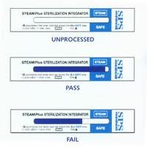
  CHEMICAL INTEGRATORS
    Heat sensitive paint along a strip
    Gradually changes color over time
Sterilization Load Control Numbers
  Label items with Load control number
    Sterilizer number - 2
    Load of the day - 5
    Date Sterilized - 94
      94th day of Julian calendar
      Or April 4, 2012
2 Load 5
94 (day)
(April 4, 2012)

Slide 64
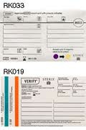
Load control number
  Helps trace packages if there is a problem
    Positive indicator
    Positive biologic indicator, etc
Sterilization cycle information
  Date, time, load number (lot #)
  Specific items sterilized
    Number of each / department
      Towel pack 10 OR
      Basin sets 6 L&D
  Time and temperature
  BI results and Bowie-Dick

Slide 65
If a recall occurs
  Load information tells you how many of specific items
  Load control number enables you to find each item from list
Documentation
  Compiled manually in a log or envelopes
  Compiled in a computer program

Slide 66
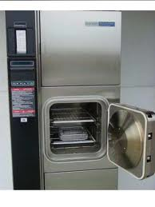
Physical Monitoring
  Time
  Temperature
  Pressure
  Displays
  Digital printouts
  Gauges
Can tell you if there is
a problem

Slide 67
After sterilization, check recording chart for proper:
  Date / time
  Sterilizer / load
  Review at the end of the cycle that parameters are met
  Initial

Slide 68
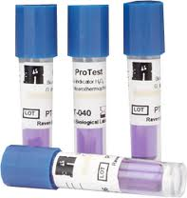
Biologic indicators
Used to challenge the sterilization process
  PROVE STERILITY
  Measure lethality of sterilizing agent
Are:
  Spores on a carrier
    Self contained with incubation media
    Geobacillus Stearothermophilus
    Dry heat is Bacillus Atrophaeus

Slide 69
Use:
  Placed in load to be sterilized
    Preferably daily – must weekly
    Placed with EVERY IMPLANT
  After sterilization
    Placed in INCUBATOR to grow
    CONTROL (unexposed) is also placed to grow
      Should be from the same LOT # as BI used

Slide 70
  After incubation period check and record:
    Check for growth of sterilized BI
      Should be negative – not grow
    Check for growth of CONTROL
      Should be Positive – should grow
  If BI’s from the same lot are used during the day
    Only one CONTROL is needed for that day

Slide 71
Test Pack – PCD – Process Challenge Device
  BI placed in the middle of 16 folded towels
  Chemical indicators placed beside it
  No wrapper
  Should weigh 3 lbs.
Run in fully loaded chamber
  In difficult area – over the drain on bottom shelf

Slide 72
Process Devices
  Implants
    EVERY IMPLANT should have a PCD run with it
    Implant should be quarantined (not used) until the BI comes back negative
  Should be used for:
    Table top steam sterilizers
    Dry Heat Sterilizers
    Choose most difficult package to sterilize for placement

Slide 73
  Protocols for Positive PCD test
    Report to supervisor immediately
    Report to include:
      Time and date of cycle
      Description of sterilizer and load
        Using load control number
      Results of physical and chemical monitoring
      Other appropriate information
    Possible RECALL of all processed items since last negative BI test

Slide 74
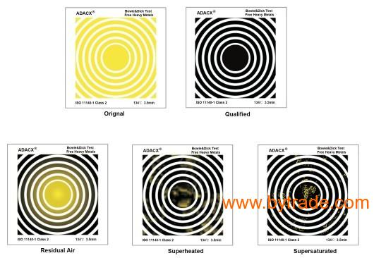
Bowie Dick test - evaluates air removal in dynamic air removal sterilizers

Slide 75
Validation
  Uses a documented procedure by manufacturer
    to check testing results of the process of sterilization
    To be able to consistently produce a sterile product
Verification
  By healthcare facility
  To confirm that Validation applies to them
    Documentation of:
      Obtaining, recording and interpreting it’s test results (BI, etc.)
      Test packs for items being sterilized

Slide 76
Special high temperature concerns
D-Values = Sterilization Time
  All microbes are not killed at the same ttime
    Certain % are killed in a certain time
    Time to kill 90% of organisms
      Ie. Of 1000 organisms, 900 died in 1 minute
      Leaves 100 organisms, 90 die in another minute
      Leaves 10 organisms, 1 dies in another minute
    Geobacillus Stearothermophilus D-Value to kill 90% is:
      about 2 minutes at 250º
      About 20 seconds at 275º

Slide 77
Cruetzfeldt-Jakob Disease – CJD
  Caused by a PRION
    Very small protein – smaller than a virus
    VERY VIRULENT
  Incubation period
    after infection with organism may be 30 years
  Disease
    Neurologic disease that is fatal
    Brain degenerates – encephalopathy
  Rare –1 person in 1 million die annually

Slide 78
  CJD concerns:
    Infected persons (may not know)
    Who have eye, brain, spinal surgery
    May contaminate instruments
  Organisms found in
    Dura Mater Covering over brain, spinal cord and eye
    CerebroSpinal Fluid - CSF
    Spleen, lymph nodes
    Kidney
    Liver
    And possibly others

Slide 79
  When suspected
    Must notify all persons involved with patient
    Instruments used for brain biopsies
      Disposable
      Quarantined until biopsy is reviewed
    Procedure for instruments
      Disinfect surfaces with sodium hydroxide
        Surfaces Wet for one hour
        Rinse x3 with water
      Keep moist until cleaned / decontaminated
        Minimizes drying on object

Slide 80
    Devices that can be cleaned of tissue
      Sterilize
        275 -278 F - 18 min Prevac / or for porous load
        270 F - 1 hour Gravity
        250 F - 4.5 hours in Gravity
    Devices difficult / impossible to clean
      incinerate
    Recall devices if risks were found out later
      Use Tracking system to recall devices used on high risk patients

Slide 81
    Environmental surfaces (non-critical)
      Clean with detergent
      Spot clean with 5,000ppm sodium hypochlorite
        1:10 solution of bleach
    Tag equipment for special reprocessing
    Try to avoid using power equipment
      Difficult to clean in normal circumstances
    Cleaning lower risk tissues
      Clean as per usual protocol

Slide 82
Sterile Solutions
Parenteral
  Will be injected
    IV
    Other
External
  Irrigation
  Topical application
  Surgical use
  Oral use
  Inhalation use

Slide 83
Aqueous
  Water based for other solutes
  In-hospital preparation is discouraged
Water
  Hydrologic cycle
    Earth water evaporates
    Becomes vapor in clouds
    Rains becomes moisture in air
    Absorbed by plants
    Collected in rivers - ocean

Slide 84
  Pollution has occurred
  Must be aware of quality of water used
    Microorganisms can survive in water
    Minerals
  Distilled water is
    free of microorganisms
    May collect organisms when cooling

